Slide 1
Estimating the Societal Benefits of Reducing PM25 and Precursor Emissions via Hemispheric Adjoint Analysis
Yasar Burak Oztaner, Shunliu Zhao, Amir Hakami (Carleton University); Rohit Mathur, Barron Henderson (US. EPA)

Slide 2
INTRODUCTION
PM_{2.5} human exposure which is directly related with mortality is a major global health concern.
The latest Global Burden of Disease (GBD, 2022) assessment indicates that outdoor fine particulate matter causes over 4 million premature deaths annually.
In this study, we present backward/adjoint analysis to provide location-specific source attribution of the long-term mortality and Benefit-per-ton (BPTs) from exposure to fine particulate matter pollution in the Northern Hemisphere.

Slide 3
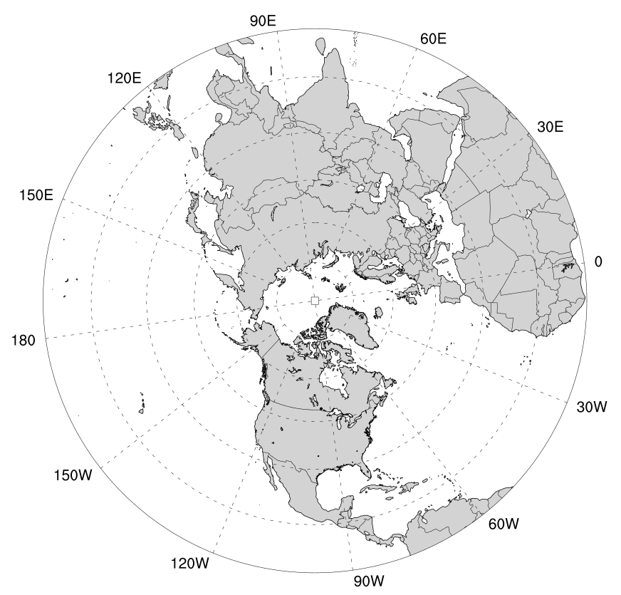
Methodology
 | Northern Hemisphere | USA
Study Period | 2016 (Full year) (2 weeks of backward spin-up period)
Meteorology | GFS initialization / WRF v3.8.1
Emissions | The 2016 Hemispheric Emission modelling platform.
Spatial Resolution | 108km - Polar Stereographic Projection (187 x 187)
CTM | CMAQ v5.0 and its ADJOINT
Objective function (CRF) | Global Exposure Mortality Model (GEMM) (Burnett et al., 2018)

Slide 4
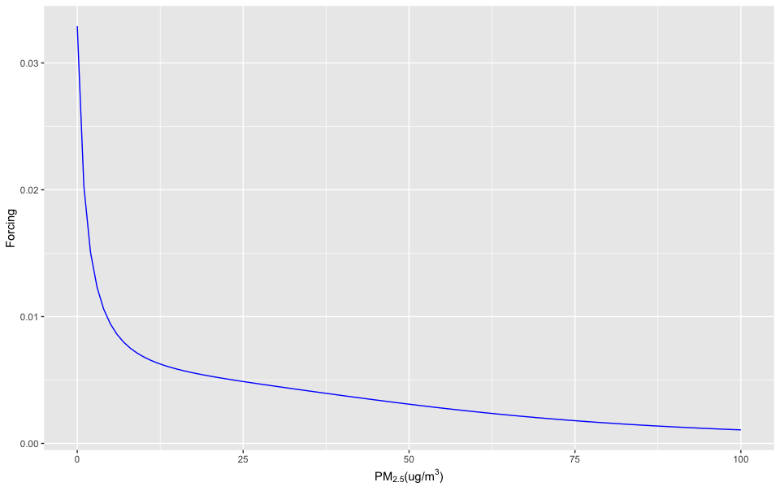
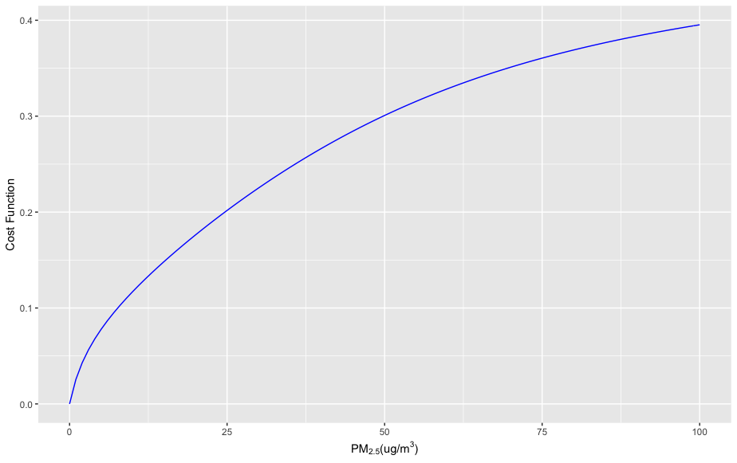
Mortality as the Adjoint Objective Function
FORCINGS
An adjoint application requires definition of an objective (or cost) function:
GEMM (Burnett et al., 2018)
We use the parameters for NCD (Non-Communicable Disease) + LRI (Lower Respiratory Infections) causes of mortality. It is defined for the population above 25 years (25+).
It has a threshold (where PM_{2.5} > 2.4 µg/m³).
Country-specific Baseline Mortality Rates (BMRs) are obtained from IHME (2021, http://ghdx.healthdata.org/gbd-results-tool) for the year of 2016.
COST FUNCTION
GEMM

Slide 5
Population
World Population database:
The Gridded Population of the World (Demographic Characteristics at 1 km resolution). It is aggregated to the domain (108 km spatial resolution).
It consists of human population by age groups (we only used 25+ age groups).
Value of Statistical Life (VSL)
Country-specific V_{SL} calculated based on unit value transfer approach to monetize the health benefits (OECD, 2012, 2014). They are adjusted by GDP per capita ($Y_{c,PPP2005}$), Consumer Price Index ($\%∆P),$income elasticity ($b$) and income growth rate ($\%∆Y$). Values are obtained from World Bank.
${VSL}_{c,2016}={VSL}_{OECD,2005}×{\left(\frac{Y_{c,2005}}{Y_{OECD,2005}}\right)}^{b}×{\left(1+\%∆P+\%∆Y\right)}^{b}$
Multiphase of adjoint CMAQ
Gas-phase chemical mechanism is updated to CB05TU.
The species NTR is revised (7 species added, removed single NTR) in gas-phase chemistry in forward and backward model (as in Mathur et al., 2017).
The wet scavenging constants and dry deposition velocities of NTR species are mapped to HNO3 (as in Mathur et al., 2017).

Slide 6
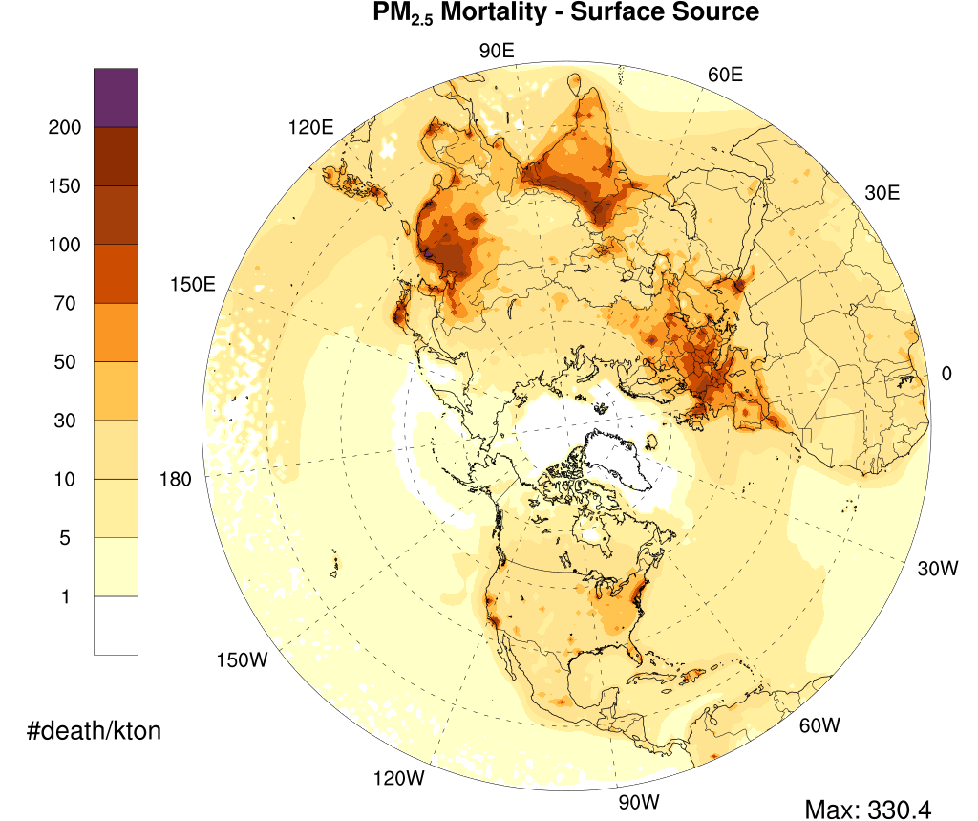
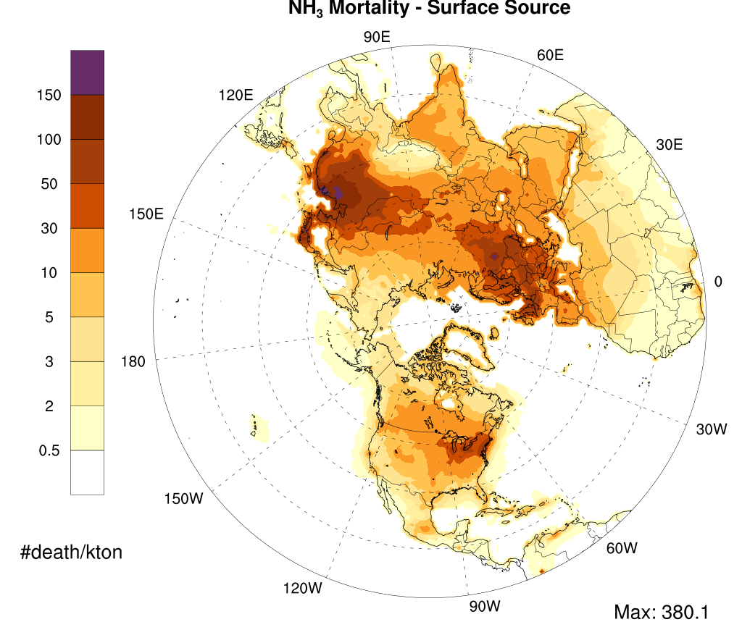
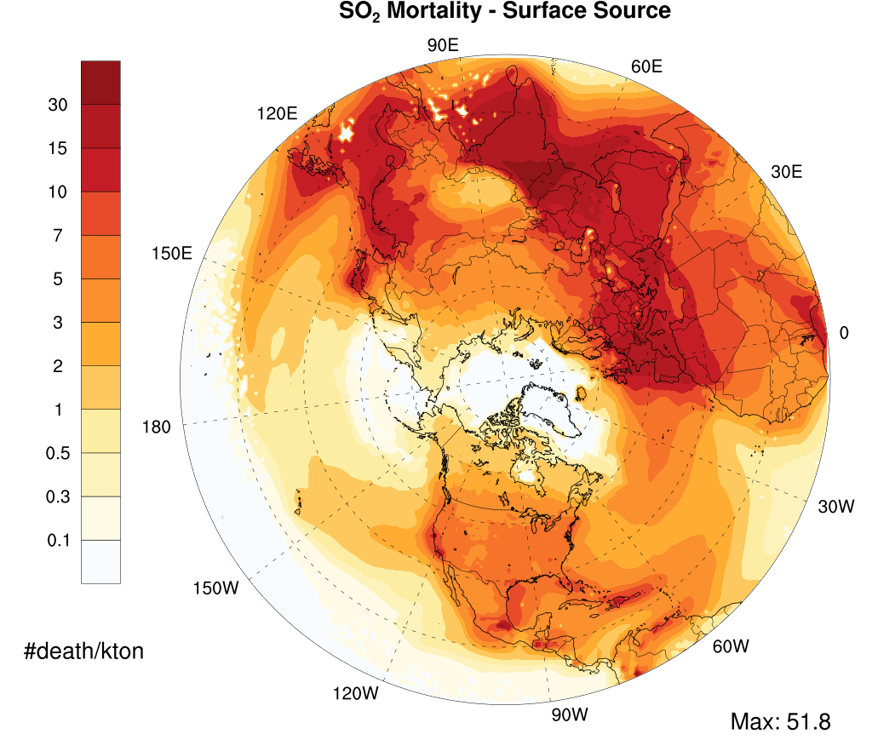
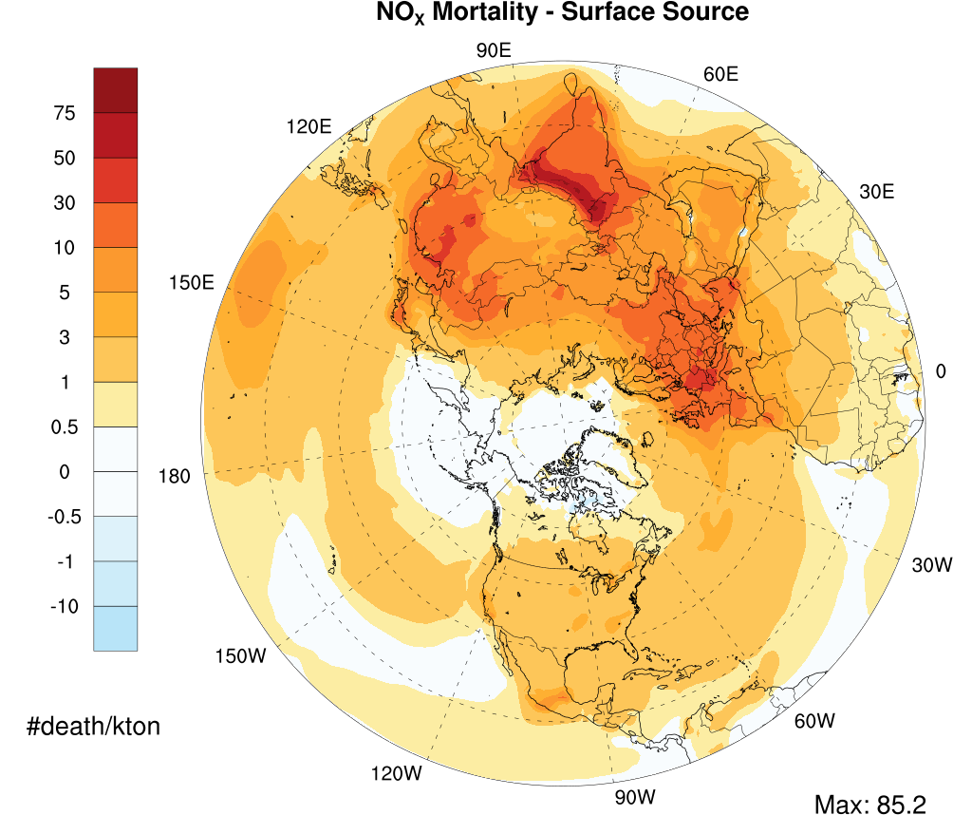
RESULTS: MORTALITY SENSITIVITIES – Northern Hemisphere [Surface sources]

Slide 7
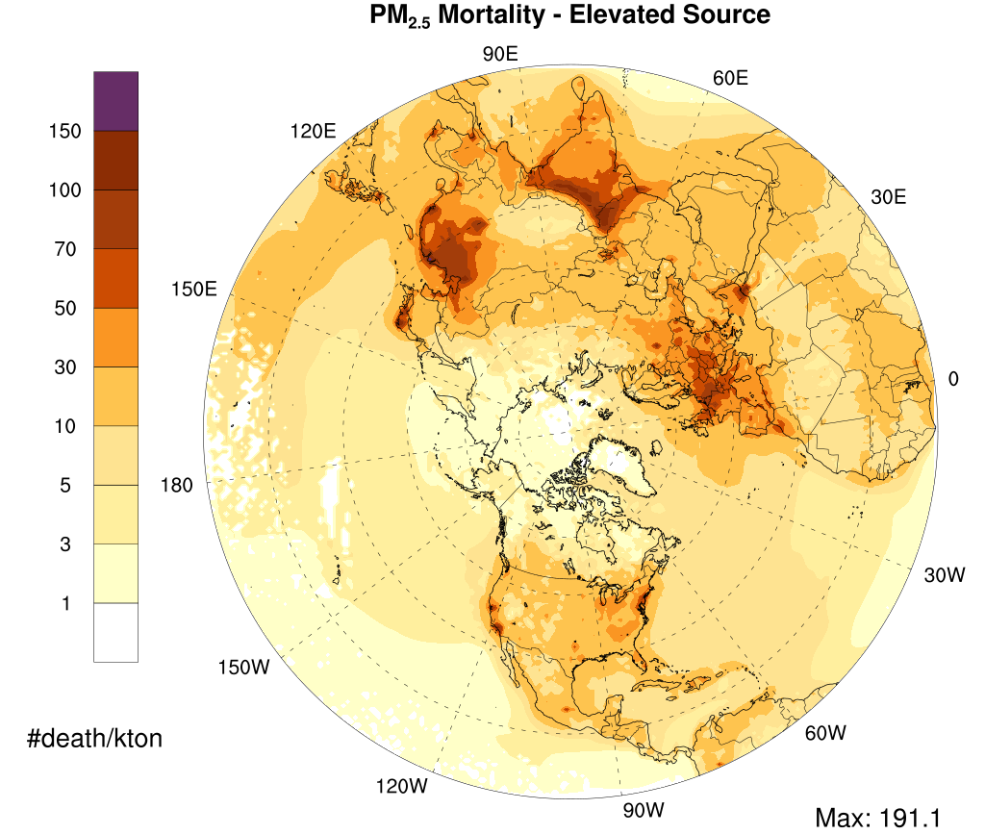
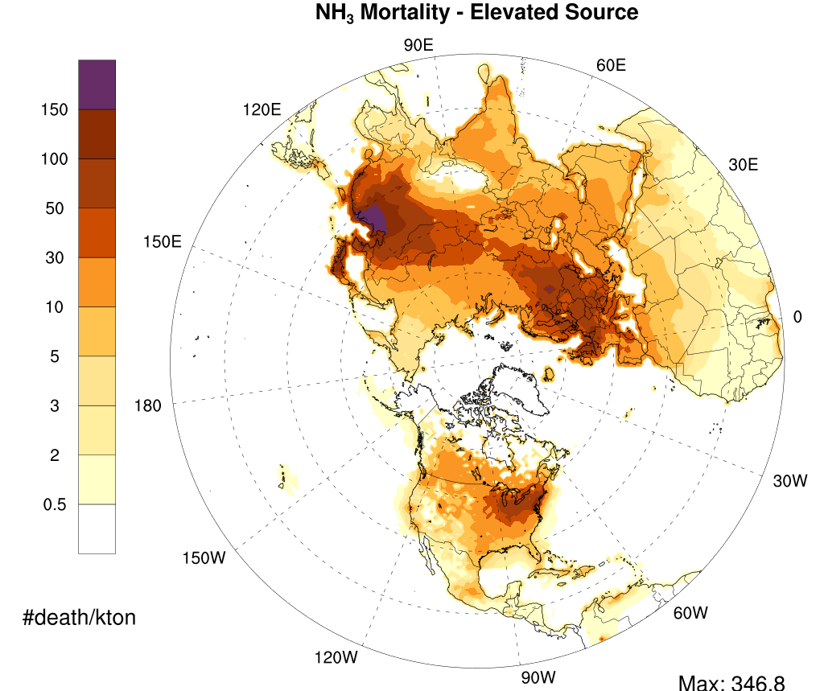
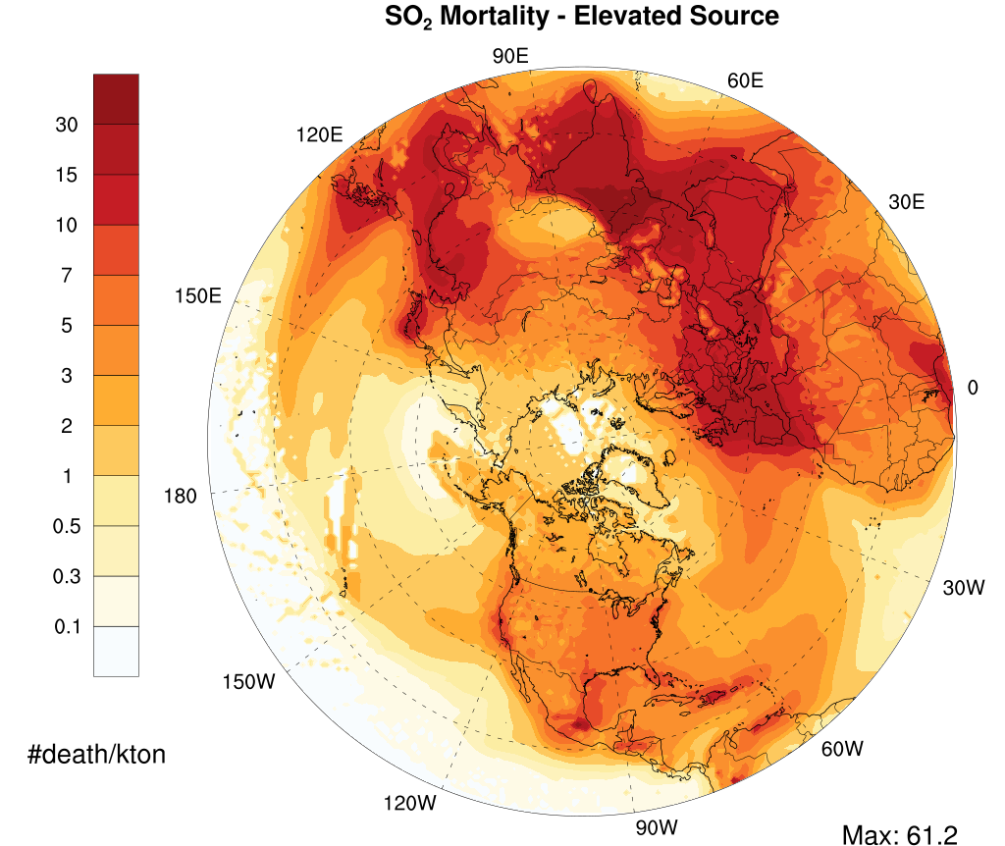
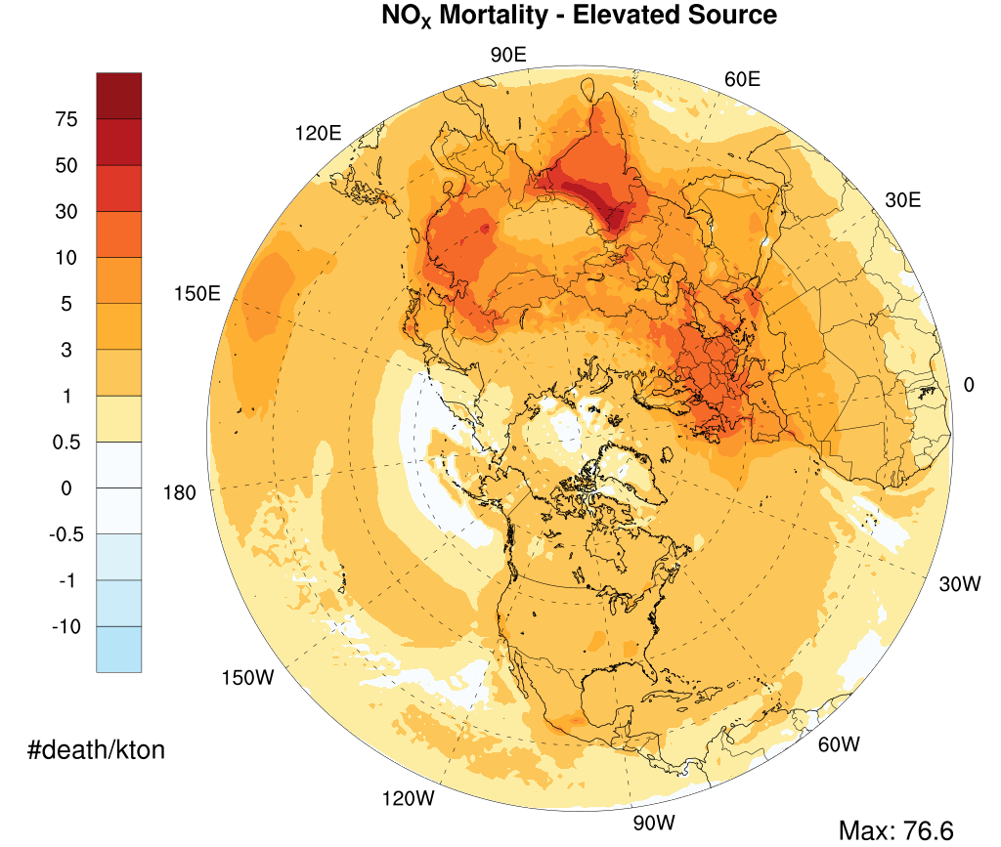
RESULTS: MORTALITY SENSITIVITIES – Northern Hemisphere [ELEVATED sources]

Slide 8
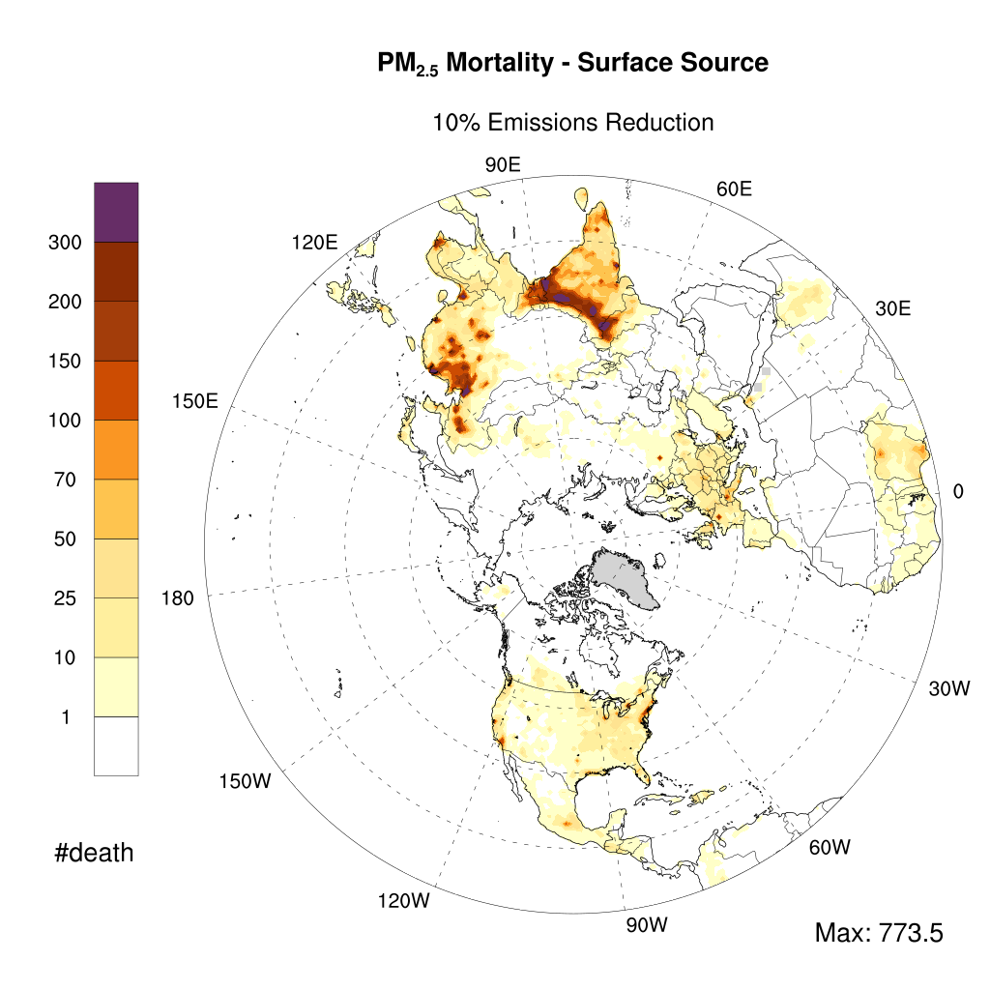
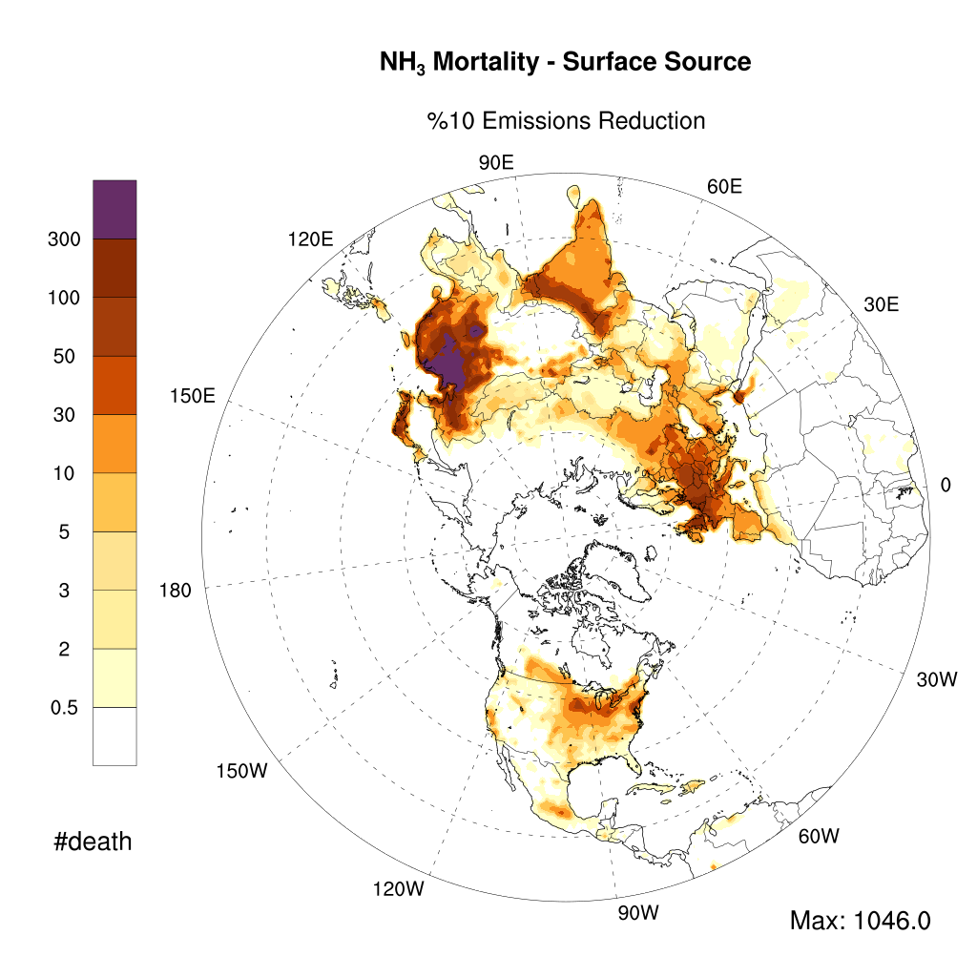
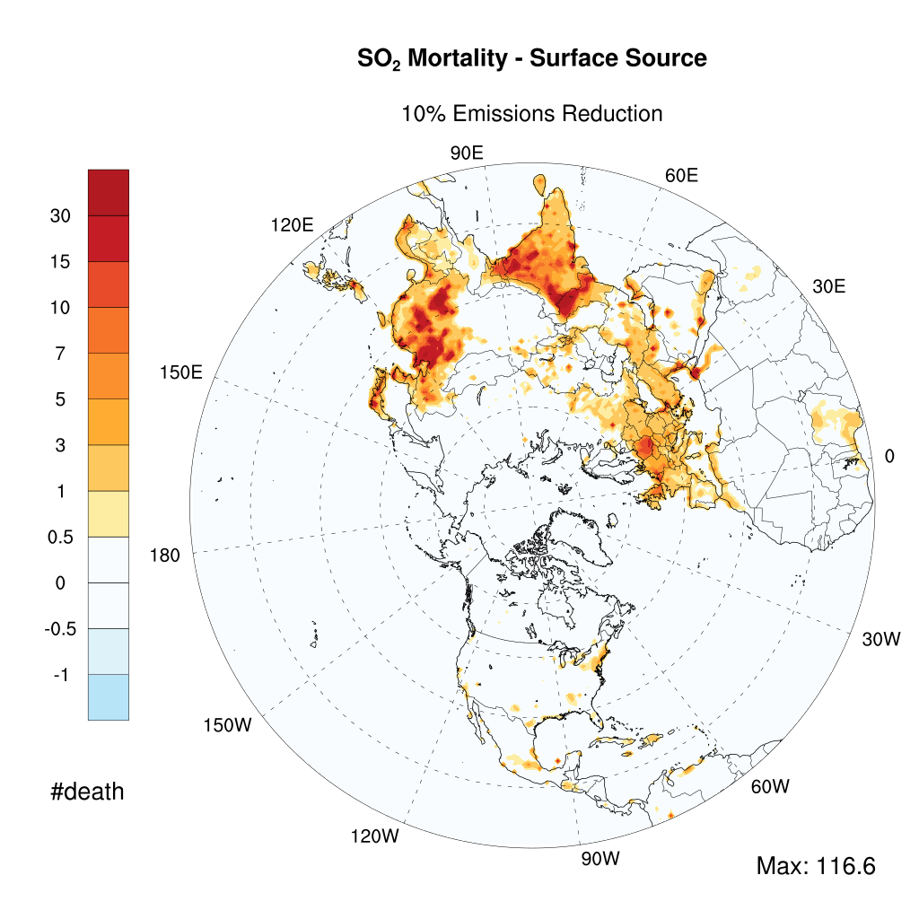
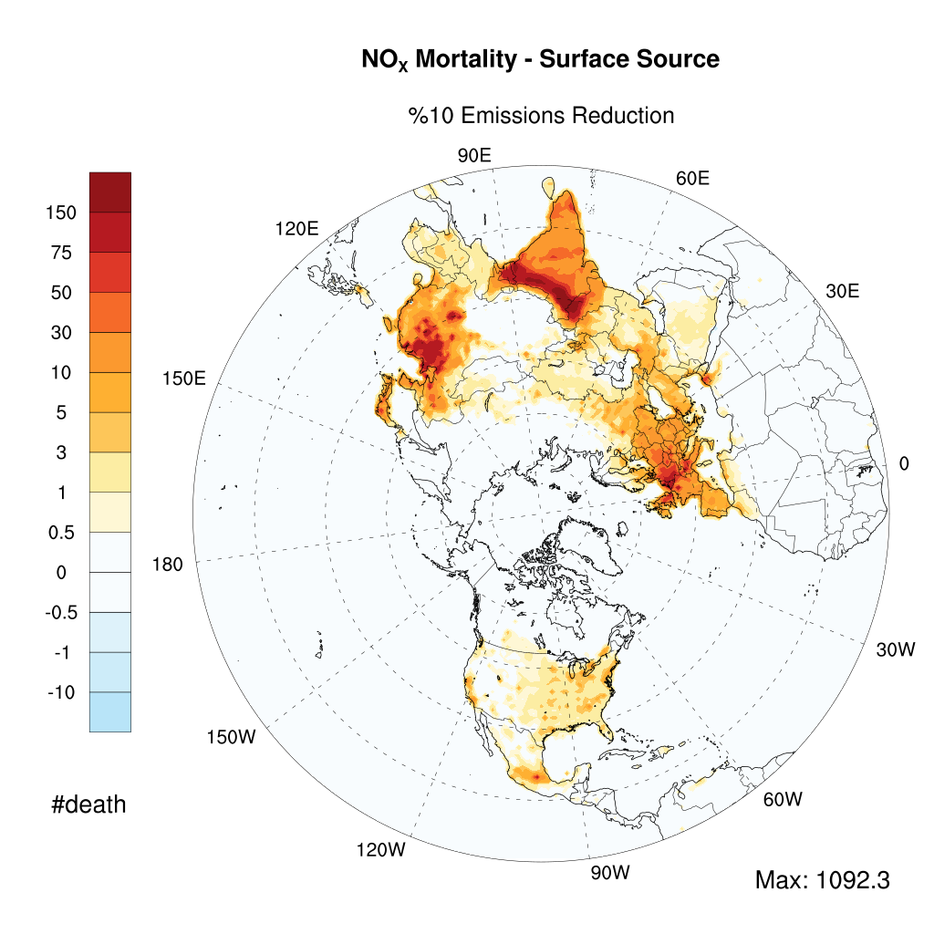
AVOIDED DEATH in 10% emission reduction (All Surface Emissions)

Slide 9
AVOIDED DEATH 10% Emissions Reduction (Pollutant-specific contributions- All sectors)
Region/Pollutant | PM_{2.5} |  | NO_{X} |  | NH₃ |  | SO₂
 | _{Surface} | _{Elevated} | _{Surface} | _{Elevated} | _{Surface} | _{Elevated} | _{Surface} | _{Elevated}
India | 37,385 | 16,536 | 20,533 | 10,298 | 11,210 | 392 | 2,817 | 24,234
China | 27,447 | 28,205 | 13,340 | 11,045 | 81,650 | 3,953 | 4,242 | 13,828
Rest of Asia | 20,461 | 18,728 | 9,889 | 5,656 | 12,238 | 807 | 3,722 | 21,134
Europe | 8,646 | 7,104 | 9,529 | 6,147 | 20,410 | 1,749 | 1,486 | 8,284
North America | 10,814 | 5,024 | 1,513 | 824 | 6,134 | 705 | 213 | 1,807
Central America & Caribbean | 1,996 | 1,805 | 565 | 309 | 557 | 70 | 147 | 1,363
Northern Africa | 537 | 278 | 605 | 343 | 985 | 40 | 294 | 1,443
Sub-Saharan Africa | 7,728 | 1,707 | 287 | 254 | 332 | 88 | 254 | 238
Total | 115,014 | 79,387 | 56,261 | 34,877 | 133,516 | 7,803 | 13,174 | 72,329

Slide 10
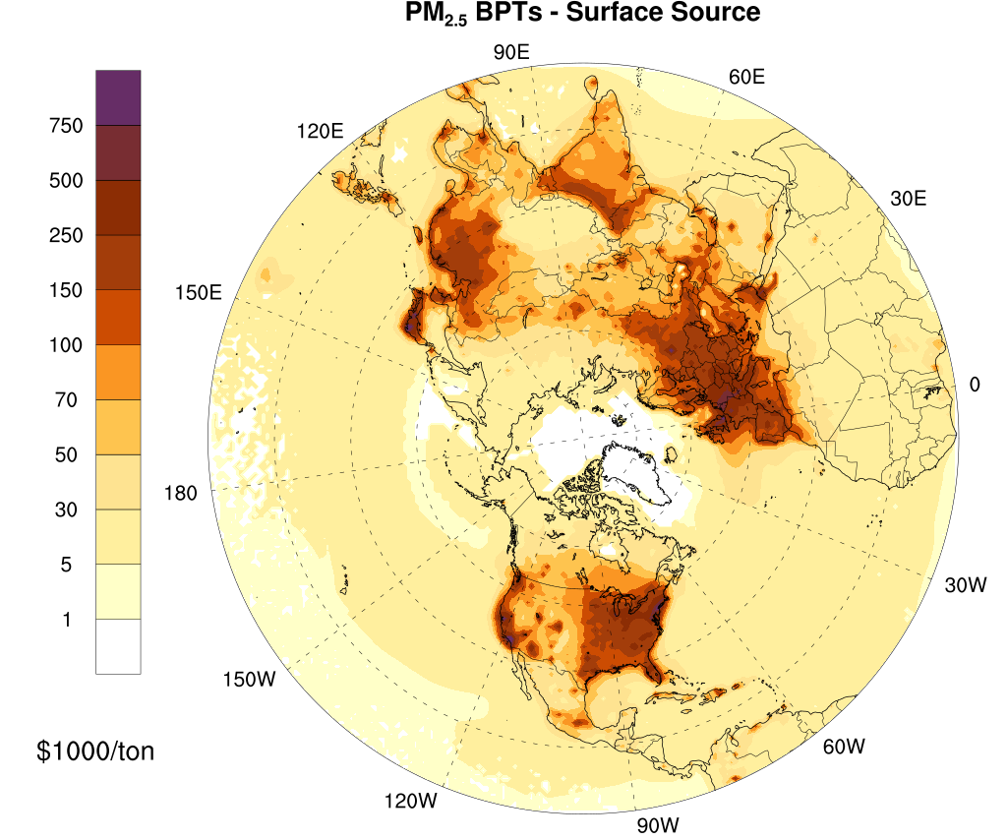
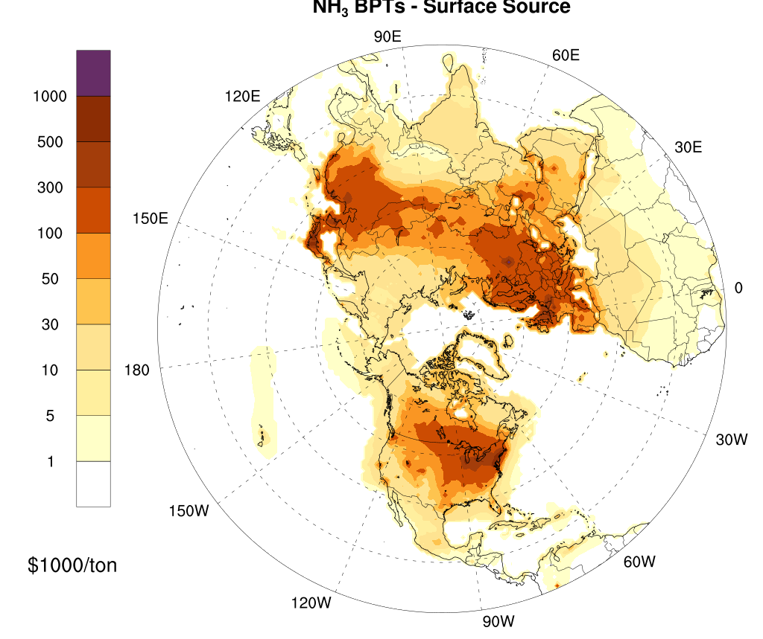
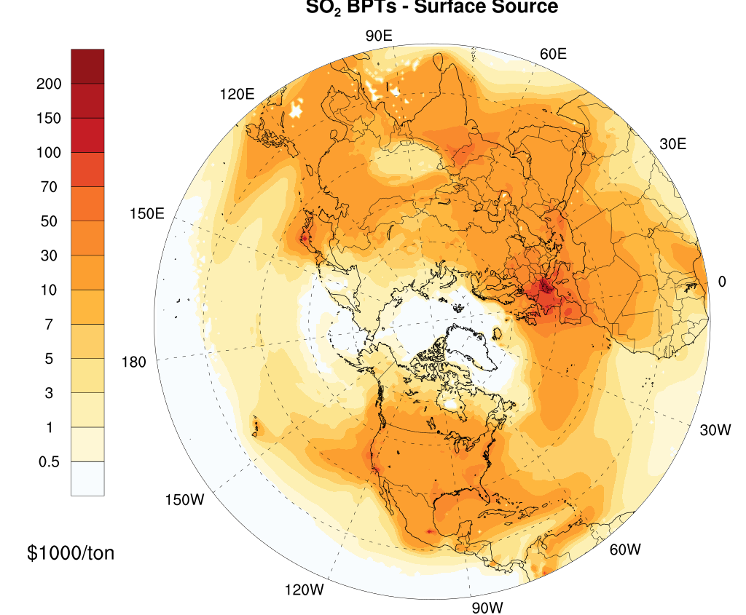
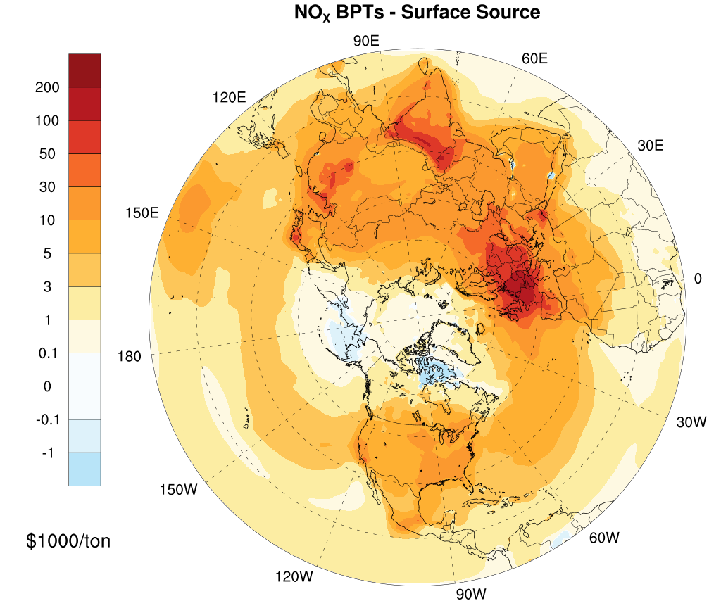
RESULTS: BPTs– Northern Hemisphere [Surface sources]

Slide 11
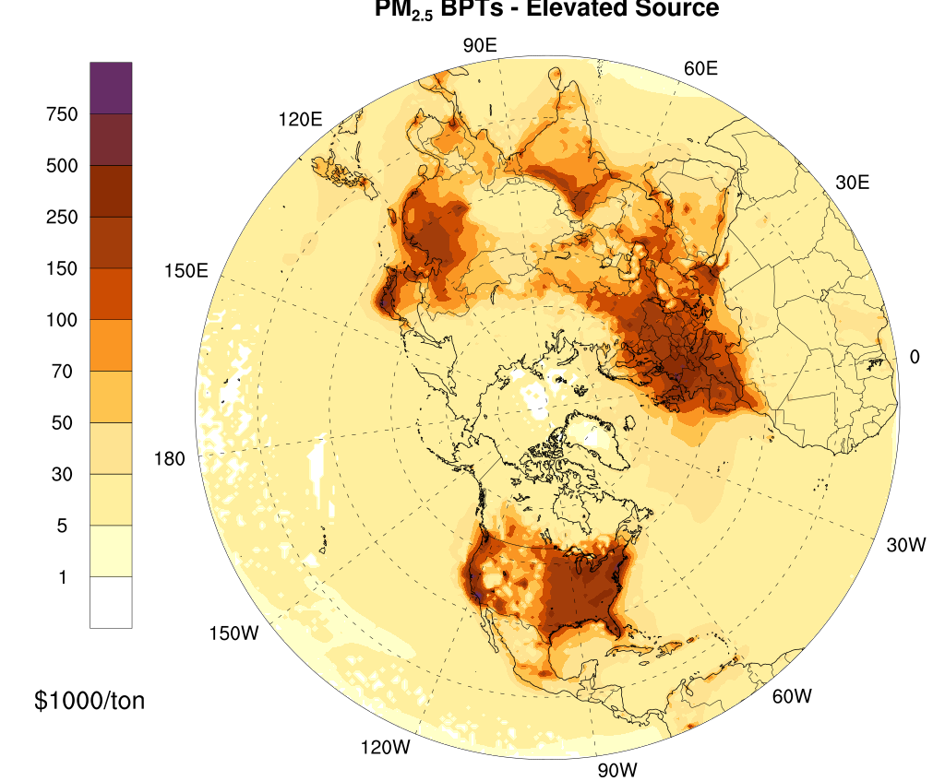
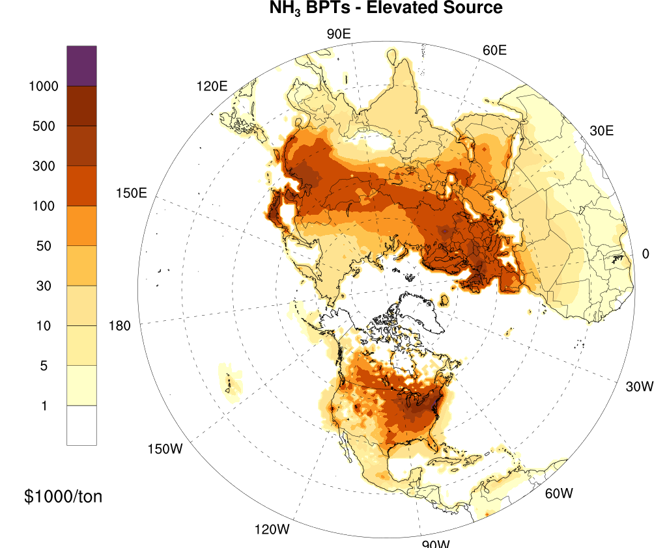
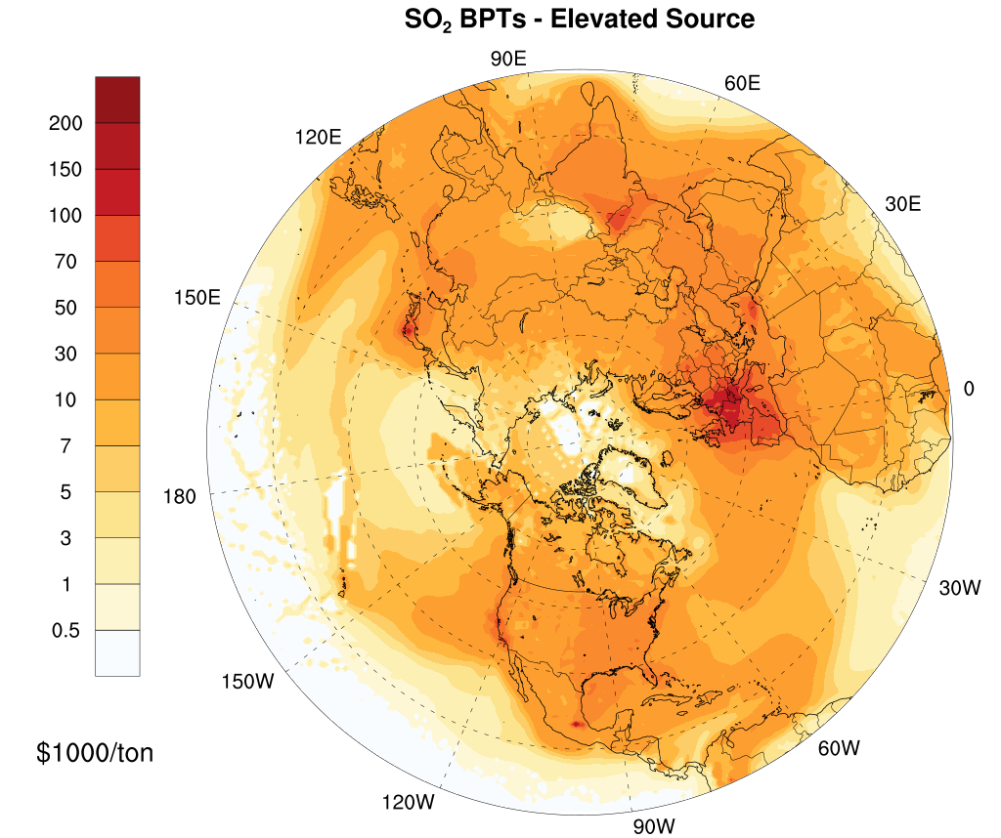
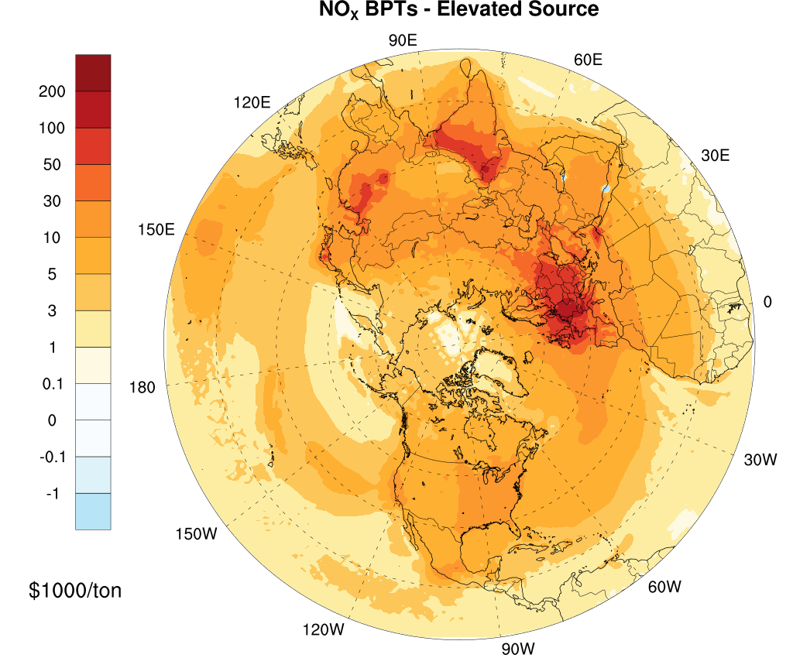
RESULTS: BPTs– Northern Hemisphere [ELEVATED sources]

Slide 12
TOTAL DAMAGES ($ Million) 10% Emissions Reduction (Pollutant-specific contributions- All sectors)
Region/Pollutant | PM_{2.5} |  | NO_{X} |  | NH₃ |  | SO₂
 | _{Surface} | _{Elevated} | _{Surface} | _{Elevated} | _{Surface} | _{Elevated} | _{Surface} | _{Elevated}
India | 49,552 | 26,828 | 27,390 | 15,309 | 14,490 | 654 | 3,383 | 36,997
China | 49,372 | 63,375 | 18,995 | 21,872 | 163,548 | 8,924 | 6,831 | 32,629
Rest of Asia | 33,253 | 41,346 | 17,108 | 12,523 | 35,508 | 2,771 | 6,327 | 52,004
Europe | 32,088 | 27,828 | 37,030 | 26,579 | 83,307 | 6,876 | 4,666 | 33,144
North America | 66,834 | 35,207 | 7,007 | 4,392 | 45,562 | 5,702 | 1,060 | 11,831
Central America & Caribbean | 4,828 | 6,144 | 1,427 | 979 | 1,499 | 241 | 357 | 4,854
Northern Africa | 1,196 | 762 | 1,448 | 1,028 | 2,569 | 120 | 618 | 4,113
Sub-Saharan Africa | 7,900 | 2,672 | 347 | 487 | 329 | 115 | 244 | 328
Total | 245,022 | 204,162 | 110,752 | 83,168 | 346,812 | 25,402 | 23,485 | 175,901

Slide 13
CONCLUSION
China (~184k) and India(~124k) show 60% of total mortality in the case of 10% emission reduction in all emissions (surface+elevated).
Total damages and total avoided death for 10% emissions reduction in PM precursor emissions are substantially larger than primary PM.
30% of total damage in China (~366 Billion USD₂₀₁₆) and %15 in India (~175 $ Billion USD₂₀₁₆).
512,000 total death is counted in the case of 10% emission reduction from all sources over the Northern Hemisphere.
In 10% reduction in surface emissions, total damage calculated to be ~726 $ Billion (USD₂₀₁₆). Total damage due to elevated sources estimated to be 489 Billion (USD₂₀₁₆).

Slide 14
THANK YOU
REFEFERNCES:
Global Burden of Disease Collaborative Network. Global Burden of Disease Study 2019 (GBD 2022) Reference Life Table. Seattle, United States: Institute for Health Metrics and Evaluation (IHME), 2022.
Burnett et al (2018). Global Estimates of Mortality Associated with Long Term Exposure to Outdoor Fine Particulate Matter, PNAS, Vol. 115, no. 38, pp.9592-9597.
OECD. (2012). Mortality Risk Valuation in Environment, Health and Transport Policies. Paris: OECD Publishing.
OECD. (2014). The Cost of Air Pollution: Health Impacts of Road Transport. OECD Publishing.
Mathur, R., Xing, J., Sarwar, G., Hogrefe, C., Pleim, J., Pouliot, G., . . . Young, J. (2017). Extending the Comunity Multiscale Air Quality (CMAQ) modeling system to hemispheric scales: overview of process considerations and initial applications. Atmospheric Chemistry and Physics, 17, 12449-12474.
Institute for Health Metrics and Evaluation (IHME) (2015). GBD Tool. Seattle, WA: IHME, University of Washington, 2015. Available from http://ghdx.healthdata.org/gbd-results-tool. (Accessed July 2, 2021)

