Slide 1

The views expressed in this presentation are those of the authors
and do not necessarily reflect the views or policies of the U.S. EPA.
Anthropogenic Secondary Organic Aerosol and Ozone from Asphalt-Related Emissions
Karl Seltzer,¹ Venkatesh Rao,¹ Havala Pye,² Ben Murphy,² Bryan Place,³ Peeyush Khare,^{4,5} Drew Gentner,⁴ Christine Allen,⁶ David Cooley,⁷ Rich Mason,¹ Marc Houyoux¹
¹Office of Air and Radiation, US Environmental Protection Agency, ²Office of Research and Development, US Environmental Protection Agency, ³ORISE Fellow at the US Environmental Protection Agency, ⁴Department of Chemical and Environmental Engineering, Yale University, ⁵Laboratory of Atmospheric Chemistry, Paul Scherrer Institute, ⁶General Dynamics Information Technology, ⁷Abt Associates
United States Environmental Protection Agency
Office of Air and Radiation
October 18, 2022
Presentation to: CMAS Conference

Slide 2
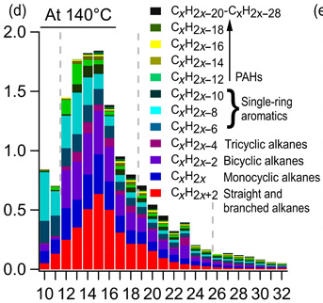
Asphalt Usage Results in Emissions
~20 Tg of liquid asphalt is consumed in the US annually.
In paving applications, liquid asphalt is generally applied at ambient temperatures or hot/warm.
    To lower viscosity when applied in ambient conditions, additives (e.g., naphtha, kerosene, diesel, water-based solvents) are introduced.
    When applied at elevated temperature, no additives are introduced; historically, assumed there were no emissions.
  Emissions occur at the time of application and during an “in-use” phase, with “in-use” representing the diffusive period following application.
Hot-Mix Asphalt Emissions
Khare et al., Science Advances 2020

Slide 3
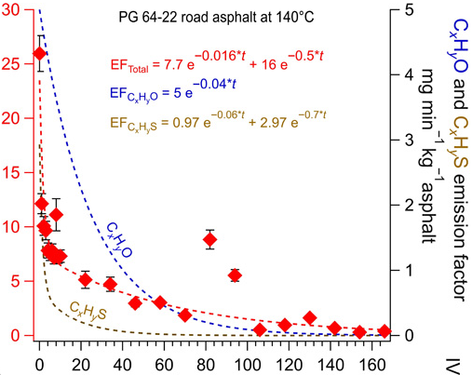
Estimating Asphalt-Related Emissions
2017 National Emissions Inventory (NEI) included:
  Ambient temperature paving applications based on 2008 usage:
      Cutback (55.6 Gg).
      Emulsified (102.0 Gg).
  Asphalt roofing application (1.1 Gg, select states).
Updates in this work:
  Updated to 2018 usage statistics.
  Added hot/warm-mix emissions.
    Application and in-use phase magnitude and speciation based on Khare et al. (2020).
  Expanded roofing asphalt estimates to entire nation.
Khare et al., Science Advances 2020

Slide 4
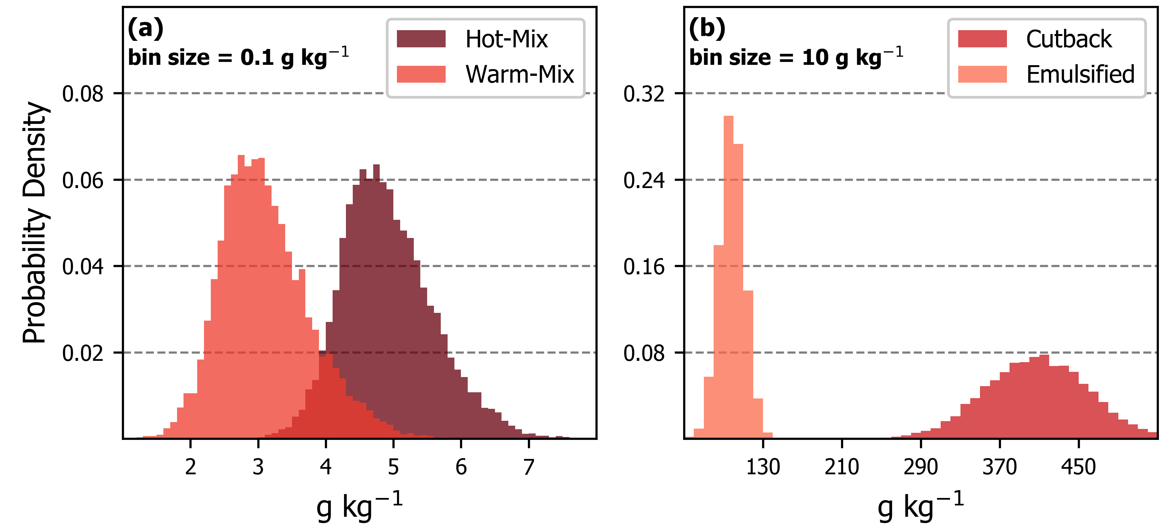
Uncertainty of Emission Factors and Usage
Uncertain parameters tested through Monte Carlo analysis:
  Duration of application.
  Timescale for long-term diffusion of emissions.
  Base emission factors for cutback/emulsified processes.
  Product usage (± 25% for all processes).
  Hot- and warm-mix usage split (assume ± 25%).
Predicted Emission Factors
Units in g of emissions per kg of liquid asphalt applied

Slide 5
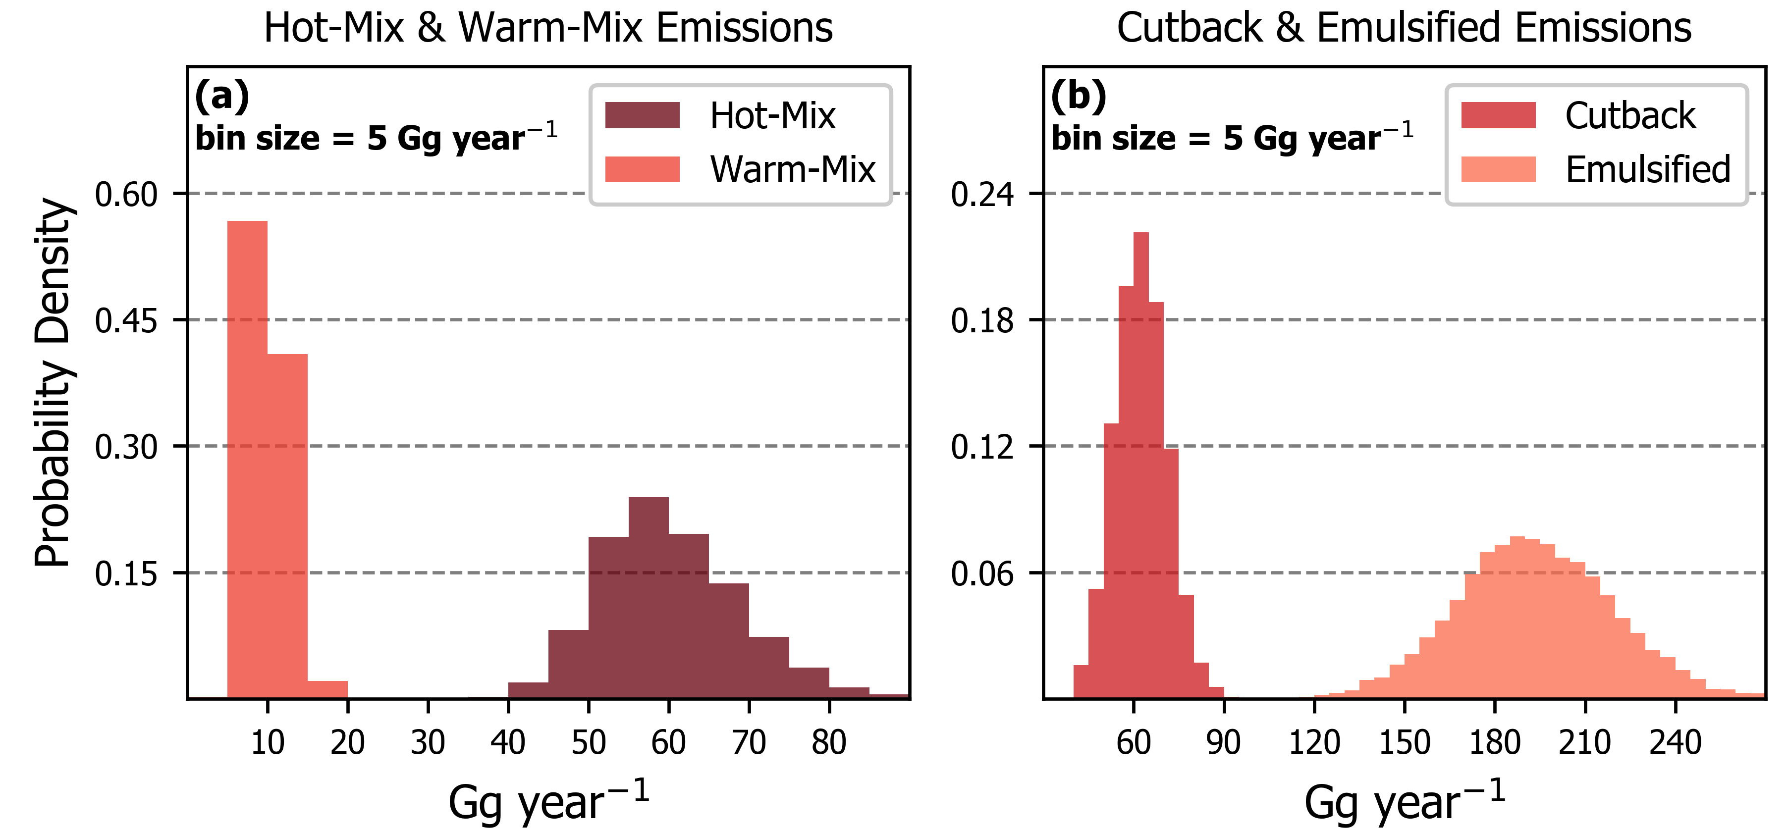
Updated Asphalt-Related Emissions
Application | Usage [Tg] | Emissions [Gg]
Hot-Mix | ~12.2 | ~60 (95% CI: 45 – 79)
Warm-Mix | ~3.2 | ~10 (95% CI: 6 – 15)
Emulsified | ~1.9 | ~193 (95% CI: 143 – 245)
Cutback | ~0.15 | ~62 (95% CI: 46 – 80)
Roofing | ~2.9 | ~54 (95% CI: 28 – 93)
Emissions from all paving processes predominately occur during application.
Emissions from roofing asphalt predominately occur during in-use phase.
Total emissions (380 Gg) estimated to be higher than 2017 NEI (159 Gg).

Slide 6
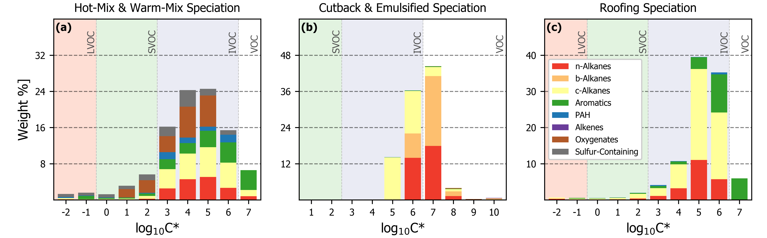
Speciation of Asphalt-Related Emissions
Speciation of hot-, warm-mix, and roofing asphalt emissions feature significant fraction of emissions are S/IVOCs, which are efficient SOA precursors.
Additives for cutback and emulsified asphalt paving depend on desired cure rate: can include gasoline, naphtha, kerosene, and diesel; a medium cure rate was assumed here (kerosene).

Slide 7

Estimating Ambient Impacts
Full-year (2018) simulation using CMAQv5.4 at 12-km resolution:
  CRACMMv1.0 chemical mechanism (Pye et al. in prep, https://github.com/USEPA/CRACMM).
  Non-asphalt anthropogenic emissions and meteorology from U.S. EPA’s Air QUAlity TimE Series Project (Foley et al., in prep.; www.epa.gov/cmaq/EQUATES).
Updated asphalt-related emissions for 2018:
  Paving usage (including cutback/emulsified) allocated to the state-level using regional hot- and warm-mix usage statistics.
  Non-paving usage allocated to the state-level using construction expenditure statistics.
www.epa.gov/cmaq

Slide 8
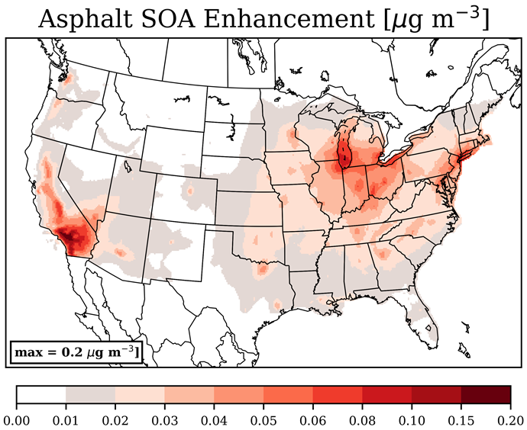
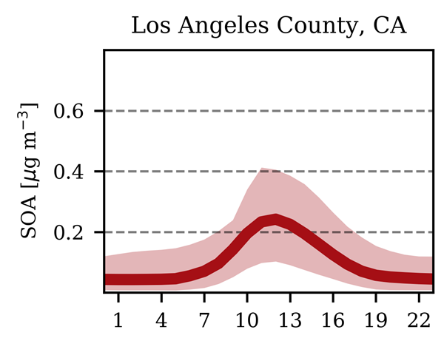

Asphalt Enhancements of Summer SOA
Summertime, 24-hour averages:
Southern California: 0.08-0.17 µg m⁻³
New York City: 0.07-0.09 µg m⁻³
Population weighted average enhancement at each hour of the day (line) and the hourly enhancement for 95% of all days (shading).

Slide 9
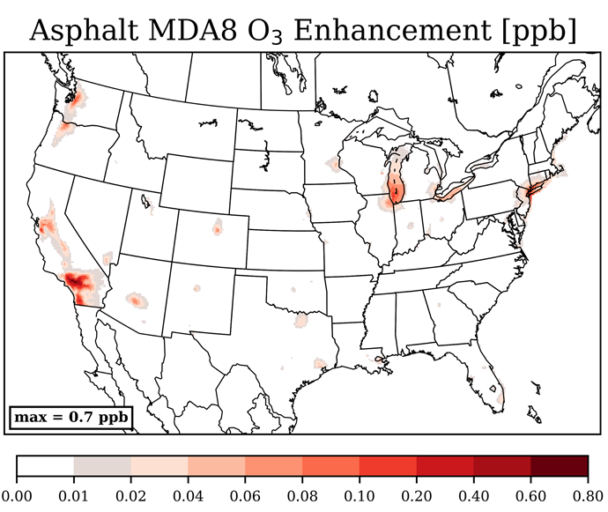
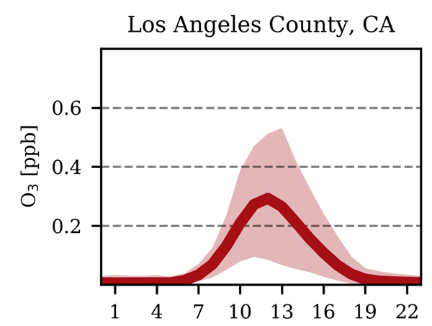
Asphalt Enhancements of Summer MDA8 Ozone
Summertime, MDA8 averages:
Southern California: 0.14-0.51 ppb
New York City: 0.11-0.19 ppb
Population weighted average enhancement at each hour of the day (line) and the hourly enhancement for 95% of all days (shading).

Slide 10
Conclusions
Asphalt paving emissions across all types of application are estimated to result in ~380 Gg (95% CI: 317 Gg – 447 Gg) of reactive organic carbon emissions.
Hot-mix, warm-mix, and roofing asphalt (previously neglected) contribute ~33% of the total emissions.
Emissions result in up to 0.17 µg m⁻³ of SOA in Southern California summer.
Modest ozone impacts of up to 0.5 ppb MDA8 O₃ also occur in summer California.
Asphalt-related contributions to SOA and MDA8 O₃ could be further amplified due to temperature feedbacks (not considered) on hot, sunny days.

Slide 11
Contact:
seltzer.karl@epa.gov

