Slide 1
Simulations of IEPOX Chemistry Using Laboratory Results and F0AM-CMAQ Model with ISORROPIA and AIOMFAC Thermodynamic Model Integration
IEPOX Based SOA Formation Using Updated Kinetics and Thermodynamics
Jaime R. Green
Coauthors
Yuzhi Chen, Jason D. Surratt, and William Vizuete

Slide 2
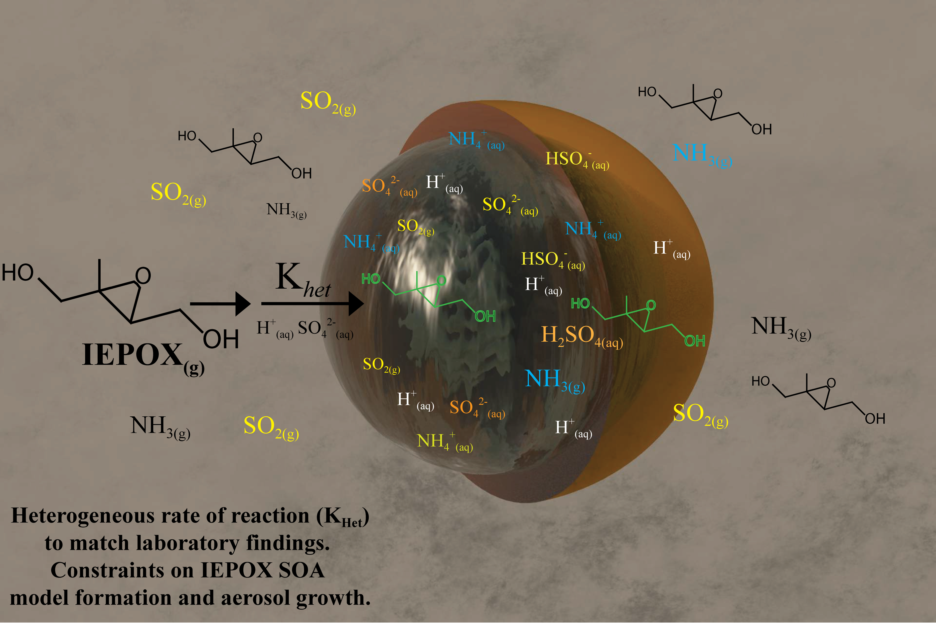
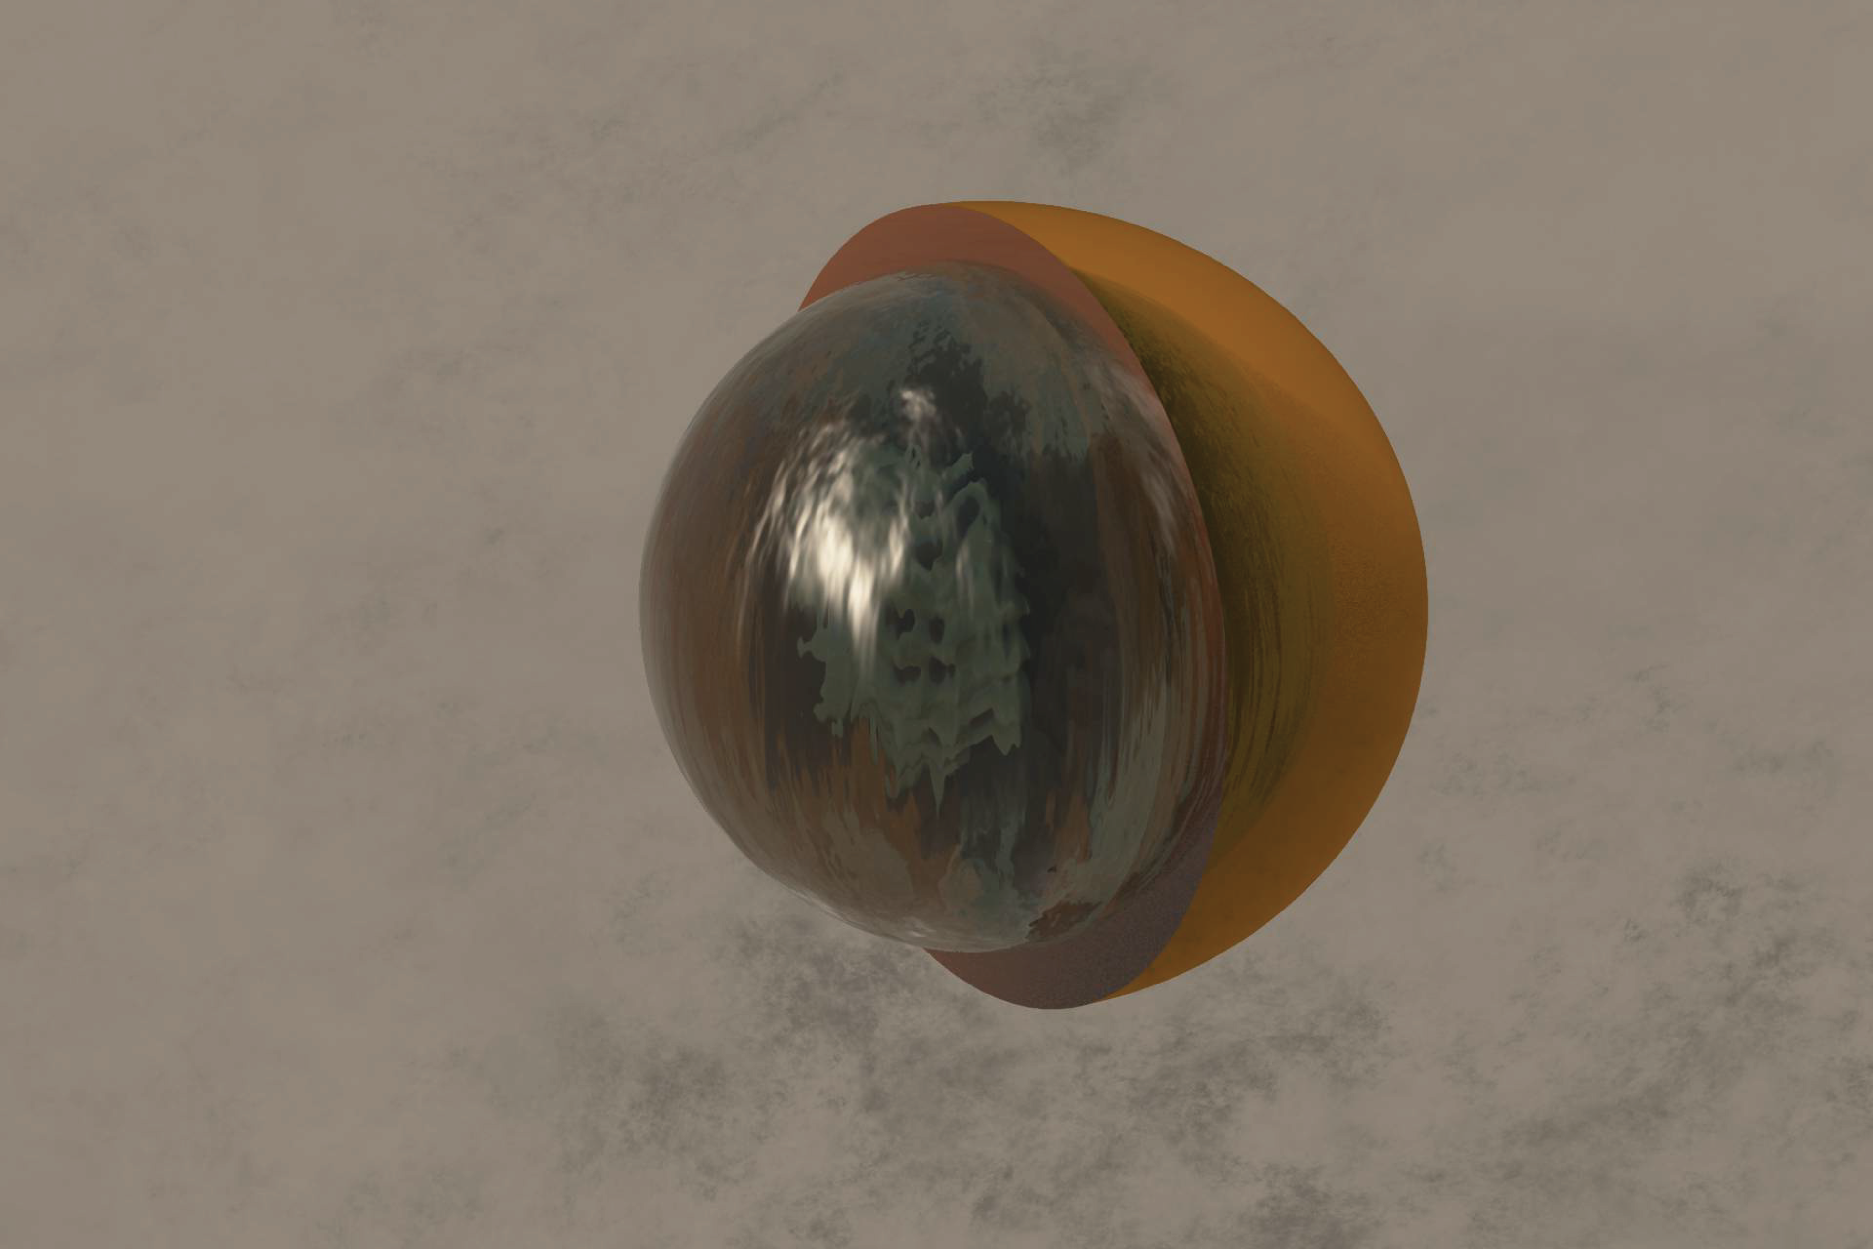
Tetrol
DimerOS
Dimer
Methyltetrols
MethyltetrolOS
Organosufates also
Contribute to
acidic activity
Notes:
Here’s a computer generated image of an aerosol particle formed in the chamber experiments at UNC.
They are not necessarily spherical in shape, and are formed as IEPOX comes in contact with the ammonium sulfate aerosols.
The rate at which IEPOX uptaken into the aerosol is determined by gamma uptake coefficent which is determined by the acidity of the aerosol, available surface area at the same time we have sulfate ammonium Ions and organic components contributing to the acidity of the aerosol and the physical properties during aging.
Several products are formed within the liquid layer on the aerosol and on the surface of the particle. Such as tetrols, methytetrols, Methyltetrol OS, Oligomers, Dimers and Dimer OS. All of which undergoes phase separation as the aerosol ages, forming a organic layer around the wet aqueous layer around the aerosol core.

Slide 3
Observed and experimental effects
Heterogeneous aerosol-phase uptake of IEPOX
  Affected by phase state
    Physical Size feedback
    Organic separation via organic layer
  Affected by aerosol-phase activities organic/ inorganic
    Acidic feedback

Slide 4
Assumptions in current CMAQ model
Assumptions in relation to both inorganic and organic acid reactivity
  Near Constant aerosol-phase acidity
    Affected by inorganic aerosol species
  Near Constant uptake coefficient 𝛾_{IEPOX}
    homogenous mixture
    No separation from aqueous species
  IEPOX SOA aging not well represented

Slide 5
Inorganic and Organic Acid Reactivity
Reaction Probability or reactive uptake coefficient (𝛾_{IEPOX}) – model relevant parameter
k_{het} = 𝛾_{IEPOX} S_{a}ω/4
Aerosol Phase
Dissertation: Characterizing the Effects of Aerosol Sulfate, Phase State and Aging on Atmospheric Secondary Organic Aerosol Formation from Isoprene Epoxydiols , Chen, Yuzhi, 2021, ISBN 9798516059315
Riva, M., Environmental science & technology, 53(15), 8682-8694.
Notes:
First lets go over some of the details on the observational experiments used to determine what parts of CMAQ 5.3.2 need to be updated. The IEPOX chamber experiments used ammonium sulfate seed particles to measure the uptake.
IEPOX aerosol reactive uptake coefficient (𝛾IEPOX ) was obtained from flow tube measurements, ω (cm/s) is the mean molecular speed of IEPOX vapours, Sa is the wet surface area concentration(cm²/cm.³). Khet really is a relative rate measuring all of the reactions of the hydrolysis of IEPOX, in in the new parameterization from Yuzhi Chen Khet also includes the products of IEPOX contribution to the activity of H+, which in turn drives more reactions forwards, but not necessarily just IEPOX in the aerosol. The dimerization of several products and the loss of volatiles formed occur, increasing the viscosity of the aerosol along with the other organic components.
Remember that for the Current CMAQ model there are several assumptions , aerosol acidity in relation to the inorganic species only. Constant uptake coefficient gamma IEPOX, and IEPOX SOA chemical aging are not well represented in relation to the organic species. This acidity can be modified by the organic components and result in different reactions that can suppress further reactive uptake of IEPOX
Observations have shown the heterogeneous aerosol uptake of IEPOX is affected by the physical Size feedback. Organic layer properties, phase separation, and acidic organic/inorganic feedback in the chemical system.

Slide 6
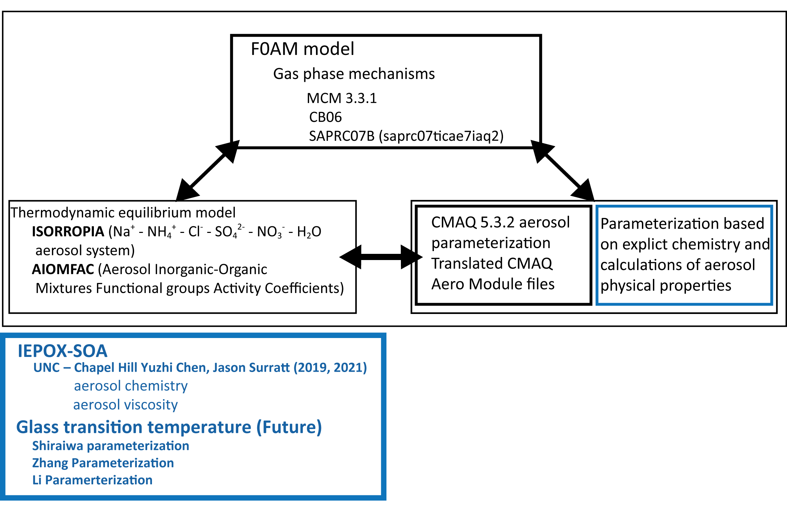
F0AM 4.2.2 0D box model , Thermodynamic Models,
CMAQ aerosol mechanism
Notes:
Our workflow into development of a set of parameters to input into the CMAQ 5.3.2 involves the use of the F0AM model for gas phase mechanisms, and any multiphase mechanisms that need to be added.
The thermodynamic models provide information on the acidity on the mixture, ISORROPIA for inorganic, and AIOMFAC for acidity based on the functional groups .

Slide 7
Experimental Parameters
For all experiments: An initial concentration of 3 ppbv IEPOX Addition of 1162 µg/m³ (240 ppbv) of IEPOX at a rate of 14.51 µg/m³ /min (3 ppbv/min) for 80 minutes
Exp 1: Low sulfur case
(NH₄)₂SO₄ 130 µg/m³
Relative humidity : 51%
Exp 2: High sulfur case
(NH₄)₂SO₄ 600 µg/m³
Relative humidity : 49%
Total duration of aerosol residence time 8 Hours for 0D box models
Notes:
Low sulfur case about 24 ppbv of Ammonium Sulfate
High sulfur case about 110 ppbv of Ammonium Sulfate
Not representative of the number of particles per cubic meter at pm 2.5

Slide 8
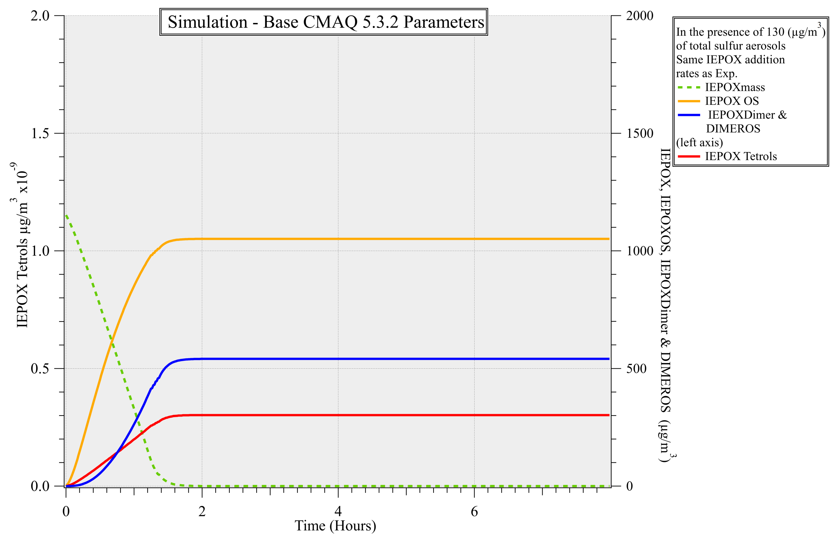

Slide 9
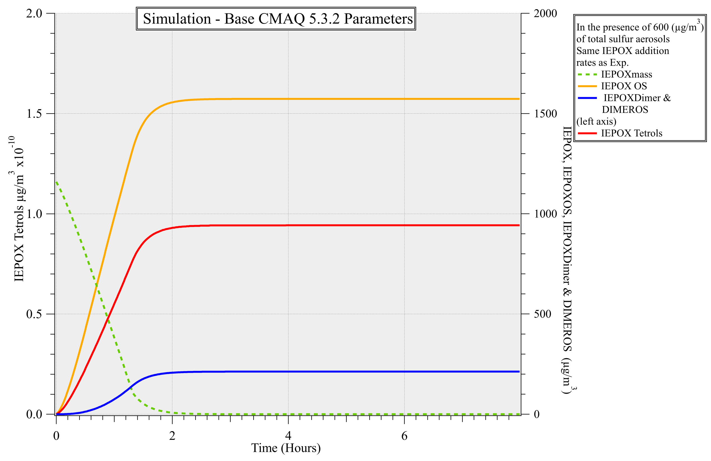

Slide 10
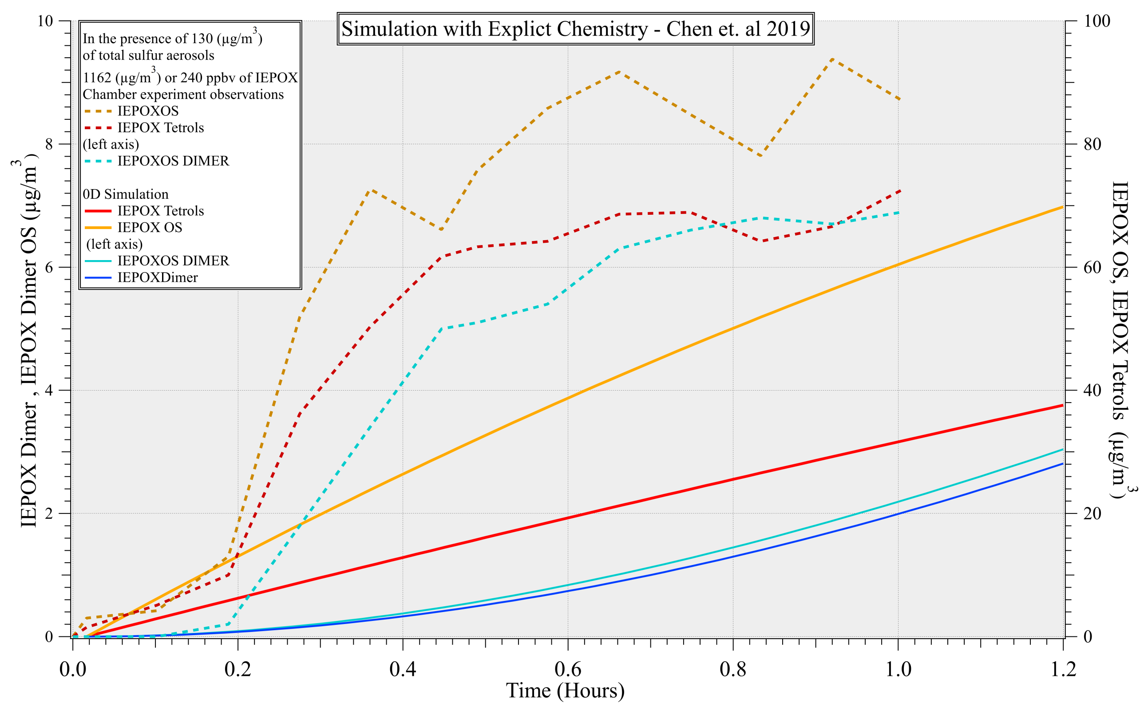
Notes:
OD simulation using Yuzhi Chen parameters Underestimated for the overall reaction time by ~50%

Slide 11
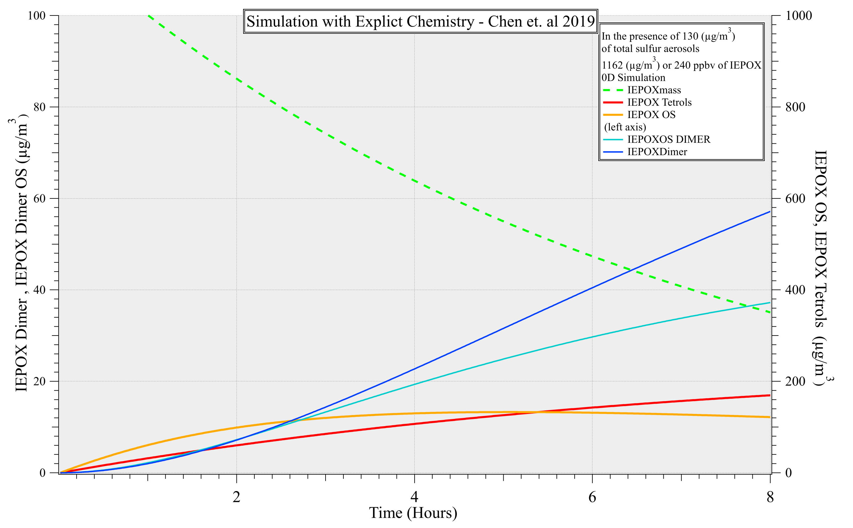
Notes:
Using the set of parameters given by our collaborators we executed

Slide 12
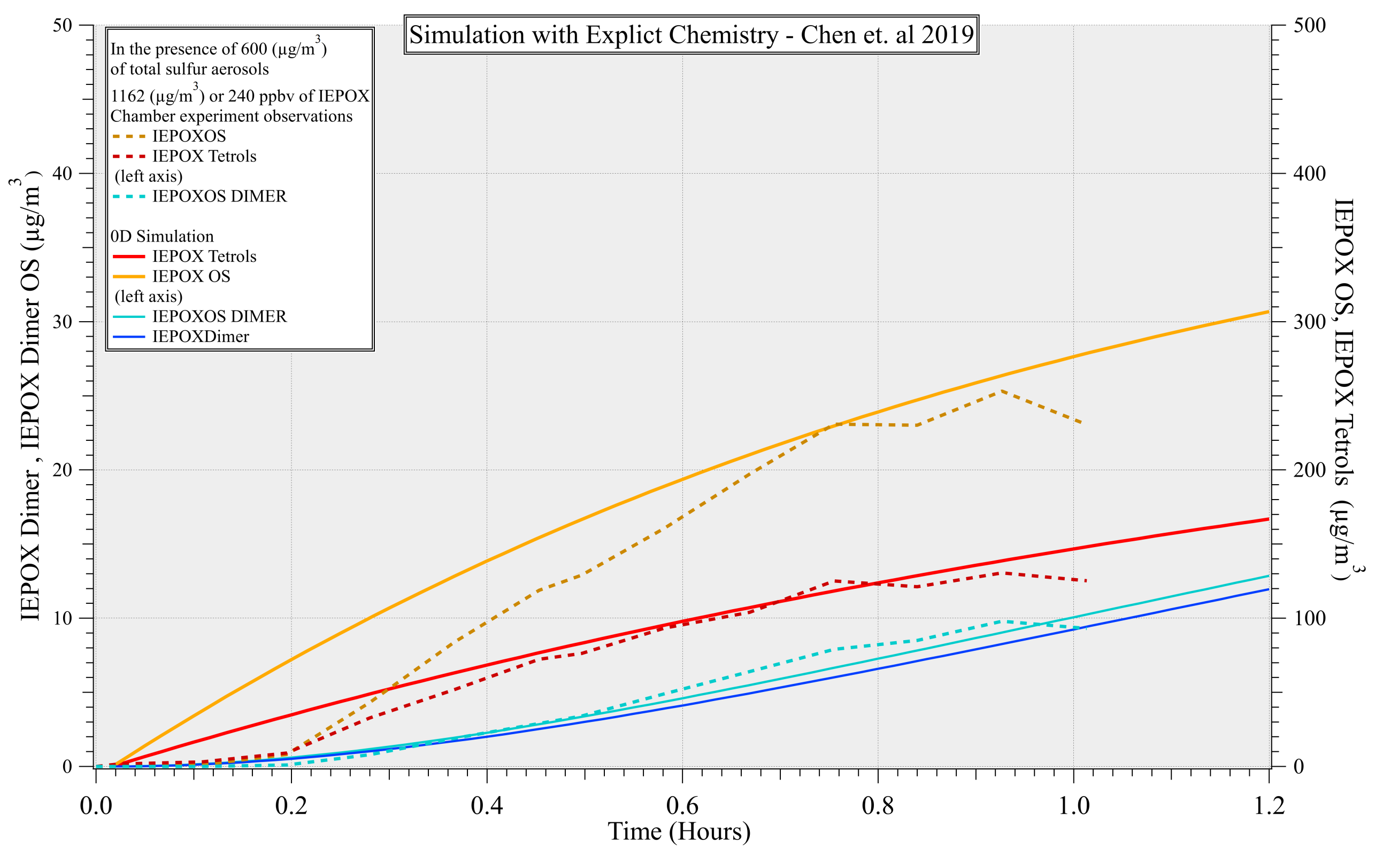
Notes:
Overestimated for the first 40 minutes of reaction time

Slide 13
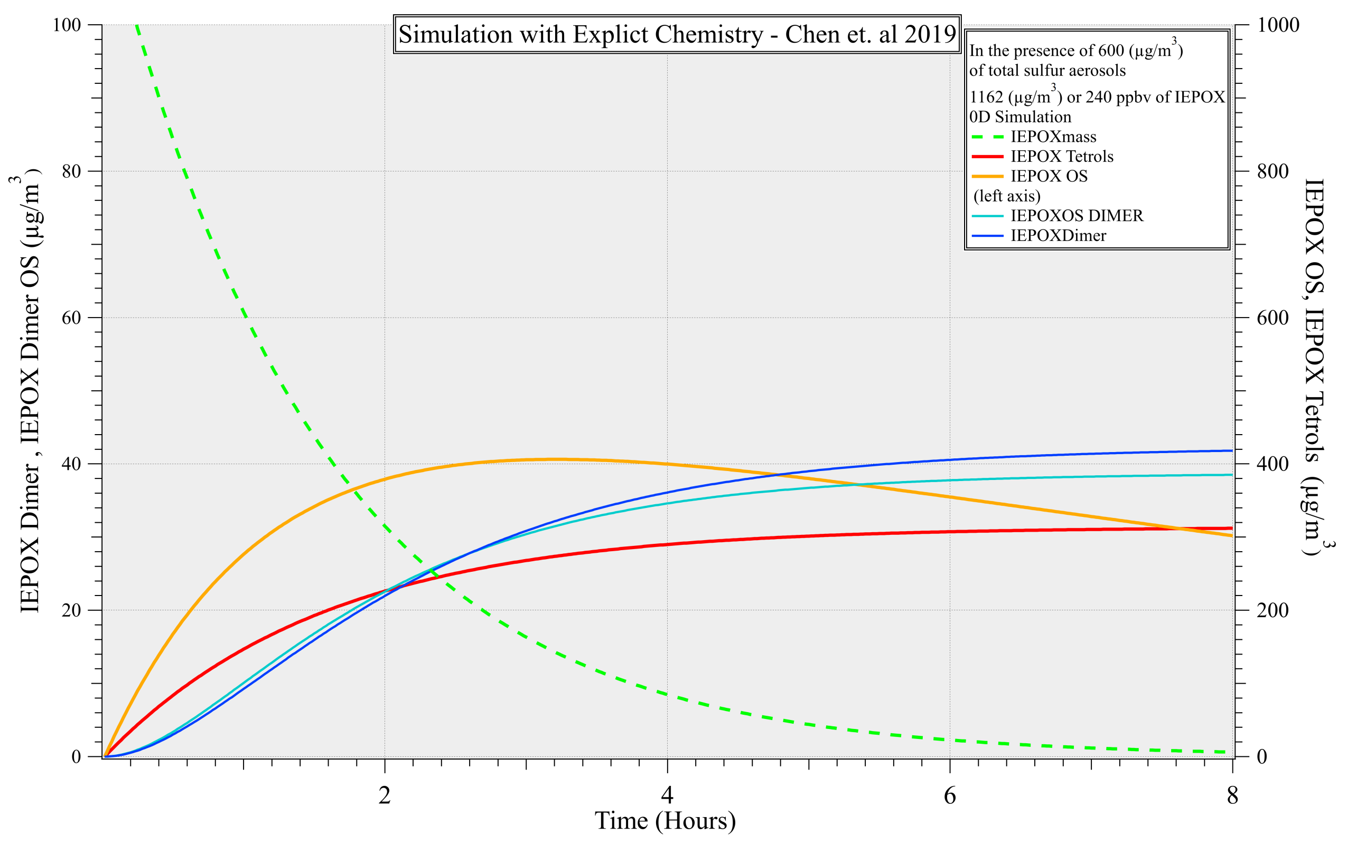

Slide 14
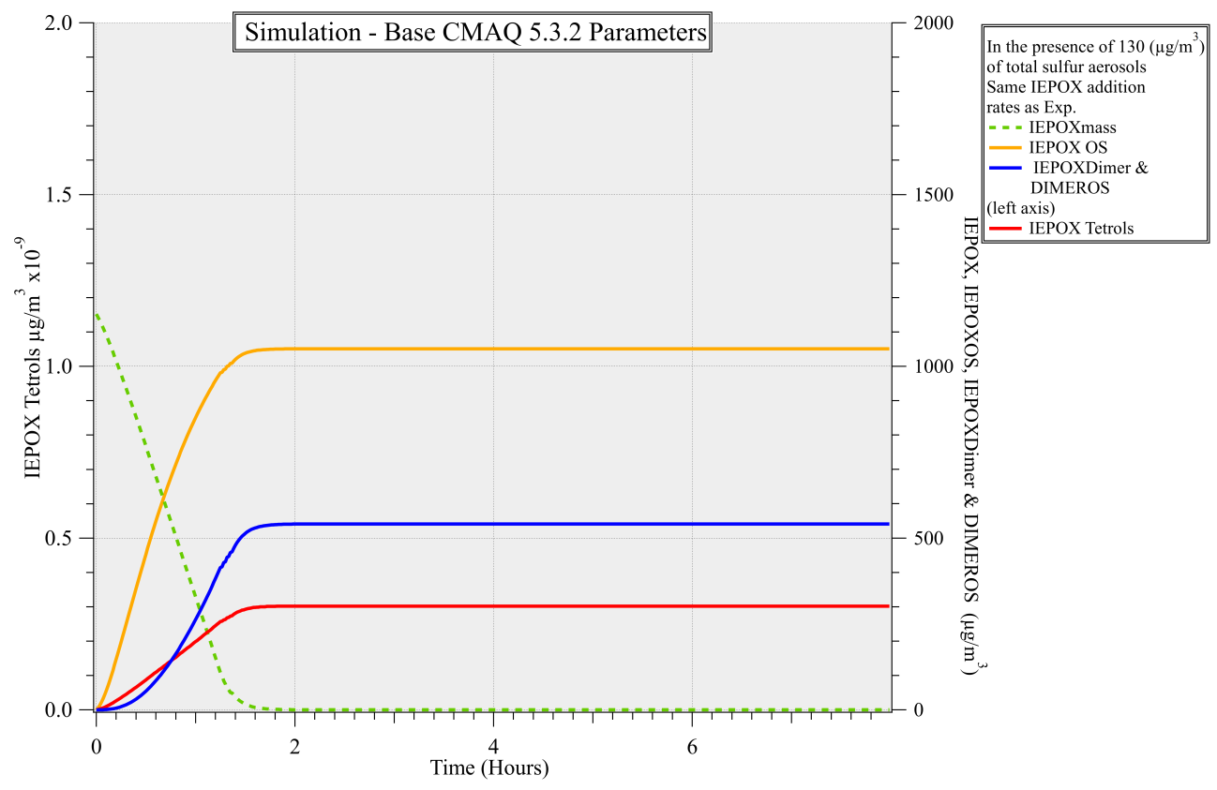
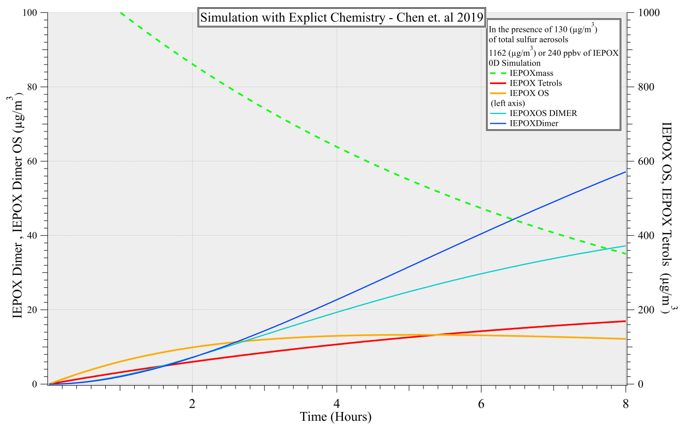
Comparison with Low Sulfur: 130 (µg/m³)

Slide 15


Comparison with High Sulfur 600 (µg/m³)

Slide 16
Key Points
Several Chemical Model Feed Backs affect representation of IEPOX SOA
  H+ activity, organic acid activity
  Viscosity , (T_{g}) Glass transition temperature
    May result organic separation via unreactive layer
  Internal aerosol organic chemistry (SOA aging)
    Continued organic species formation with lowered IEPOX uptake

Slide 17
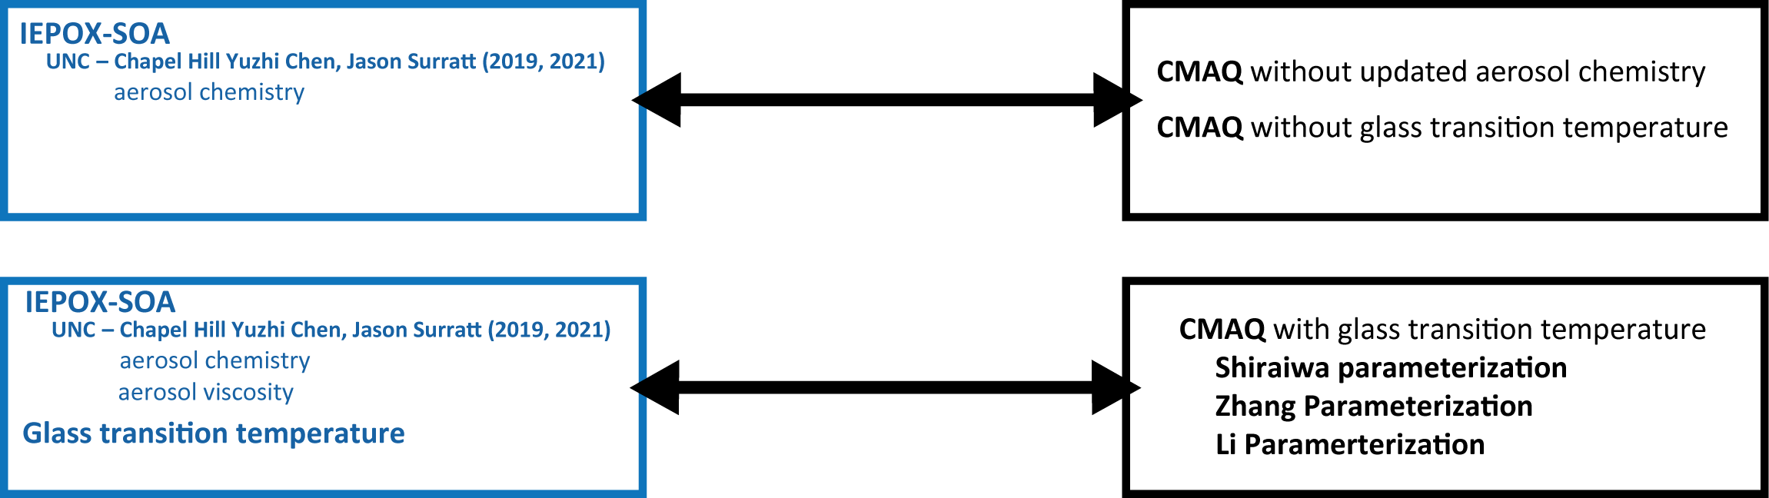
Current
Future Work
CMAQ/MATLAB development of internal SOA chemical mechanisms
    Aerosol mechanisms need to be added implicitly to mirror observations
    More accurate representation of aging effects and aerosol viscosity on other multiphase chemical species
    Addition of AIOMFAC (Aerosol Inorganic-Organic Mixtures Functional groups Activity Coefficients) to represent acid activity of organic components
0D box model runs to develop aerosol CMAQ parameterization with updated IEPOX chemical mechanisms.
    Using glass transition parameterization
    Include physical chemical interactions based on shell morphology

Slide 18
Thank You.
Coauthors
Yuzhi Chen, Jason D. Surratt, and William Vizuete
Members of William Vizuete Research Group
This work was funded by: NSF AGS-2037697

Slide 19
Zhang, Y., Joint impacts of acidity and viscosity on the formation of secondary organic aerosol from isoprene epoxydiols (IEPOX) in phase separated particles, ACS Earth and Space Chemistry, 3(12), 2646-2658.
Riva, M.(2019), Increasing isoprene epoxydiol-to-inorganic sulfate aerosol ratio results in extensive conversion of inorganic sulfate to organosulfur forms: implications for aerosol physicochemical properties, Environmental science & technology, 53(15), 8682-8694.
Dissertation: Characterizing the Effects of Aerosol Sulfate, Phase State and Aging on Atmospheric Secondary Organic Aerosol Formation from Isoprene Epoxydiols , Chen, Yuzhi, 2021, ISBN 9798516059315

