Slide 1
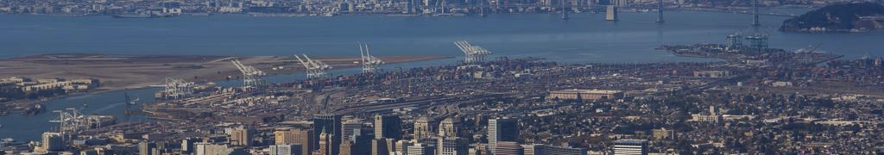

Incorporating Model-based Equity Analyses into Air Quality Planning and Environmental Justice Programs in the San Francisco Bay Area
Stephen Reid, David Holstius, Bonyoung Koo, Yuanyuan Fang, Yiqin Jia, James Cordova, Song Bai, Saffet Tanrikulu, Phil Martien
Bay Area Air Quality Management District, 375 Beale Street, San Francisco, CA
The 21st Annual CMAS Conference
October 18, 2022

Slide 2
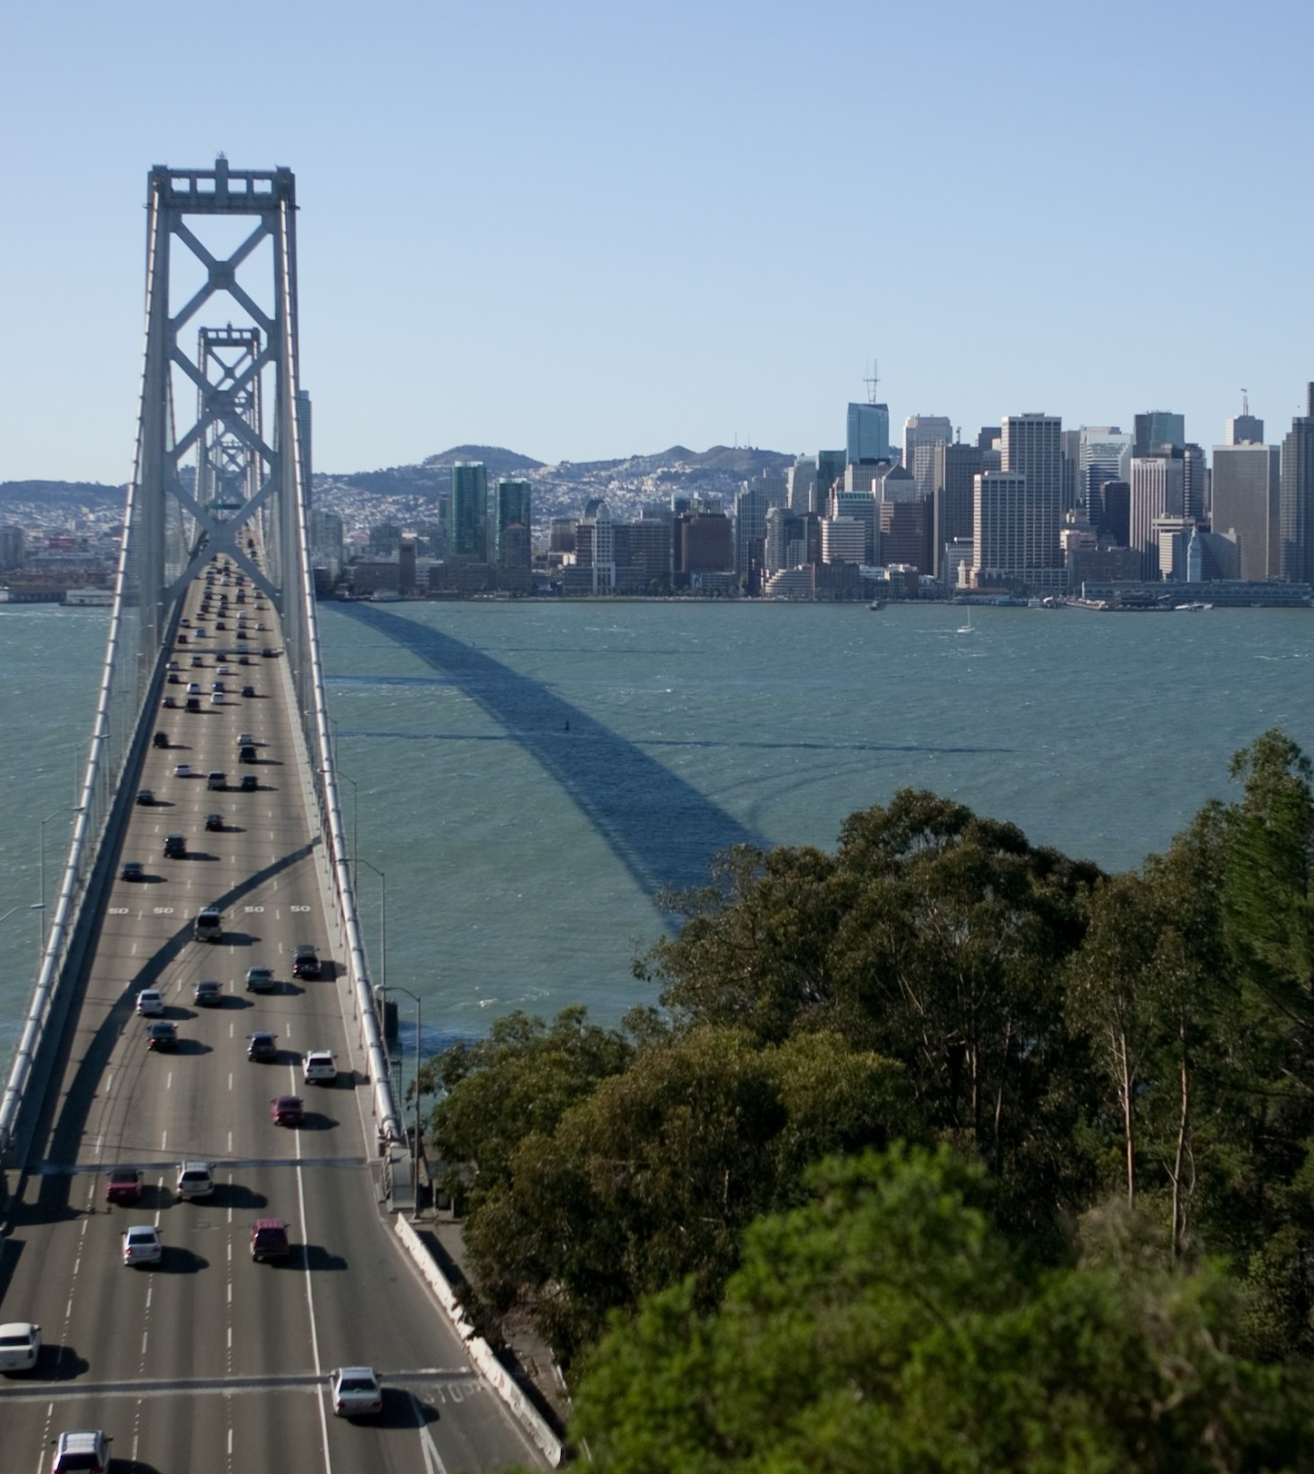
Presentation Outline
Background
About BAAQMD
Community Air Risk Evaluation (CARE) Program
Environmental Justice Initiatives
Land Use Planning: Senate Bill (SB) 1000
Community Air Protection: Assembly Bill (AB) 617
Equity Analyses for Rulemaking
Ongoing and Future Work

Slide 3
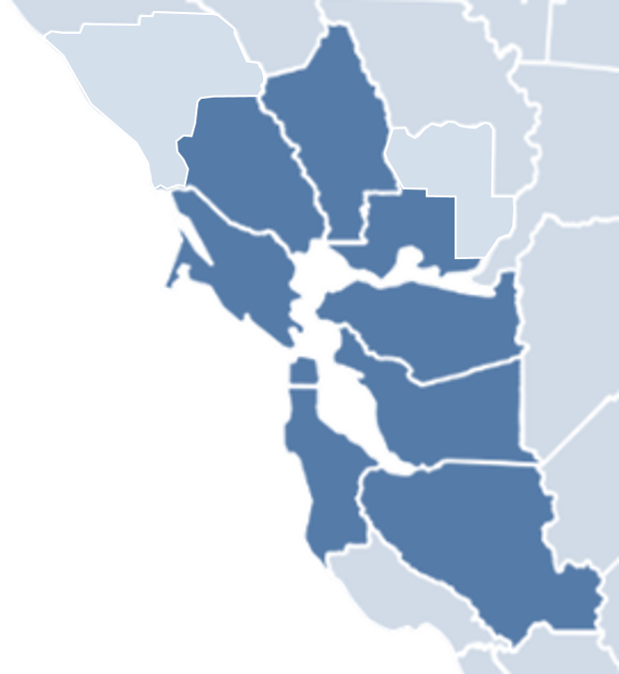
About BAAQMD
Napa
Regulates stationary sources of air pollution in the 9-county San Francisco Bay Area
Our modeling section performs meteorological, photochemical and air dispersion modeling to support District programs
Resources include 2 Linux clusters:
- Each cluster has 12 compute nodes
- Each node has 2 Xeon 2.4GHz 10-core processors (20 cores per cluster)
Sonoma
Solano
Marin
Contra Costa
SF
Alameda
San Mateo
Santa Clara

Slide 4
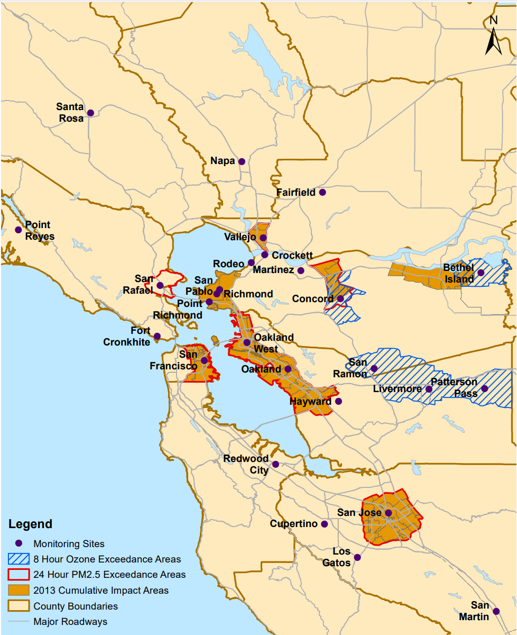
The CARE Program
Served as forerunner to the District’s current EJ efforts
Initiated in 2004 to identify areas with high levels of air pollution and populations most vulnerable to air pollution’s health impacts
Technical efforts included regional air toxics modeling with CAMx
7 cumulative impact areas identified based on local air toxics emissions levels, modeled cancer risk from air toxics exposure, and household income levels

Slide 5
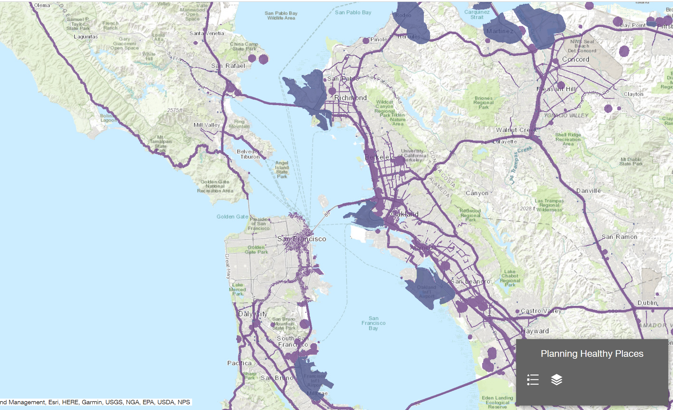
Planning for Environmental Justice: SB 1000 (1)
Cities and counties with disadvantaged communities required to incorporate EJ policies into their General Plans
Air pollution exposure is one of 7 issues that must be addressed by local policies
The District’s Planning Healthy Places initiative developed tools and guidance to support identification of EJ areas
Technical work included modeling of freeways, major surface streets, and rail lines with the Rcaline dispersion model

Slide 6

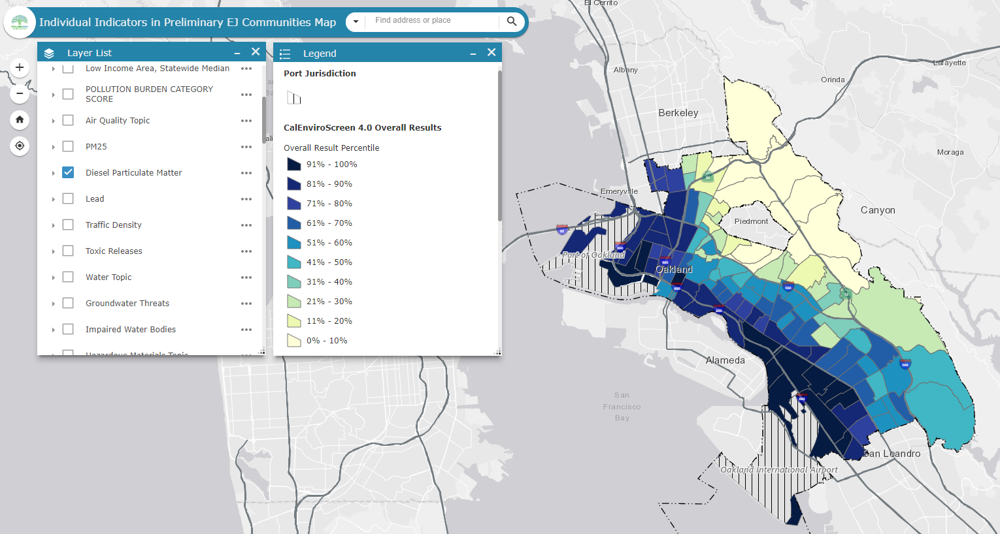
Planning for Environmental Justice: SB 1000 (2)
The Air District is also providing technical support to individual municipalities for their latest General Plan Updates (GPU)
For example, Oakland is developing an initial EJ Element for its 2045 GPU
The District provided Oakland planners with results from our 2018 regional CMAQ simulations
Annual average PM_{2.5} and diesel particulate matter (DPM) concentrations were incorporated into an online mapping tool

Slide 7
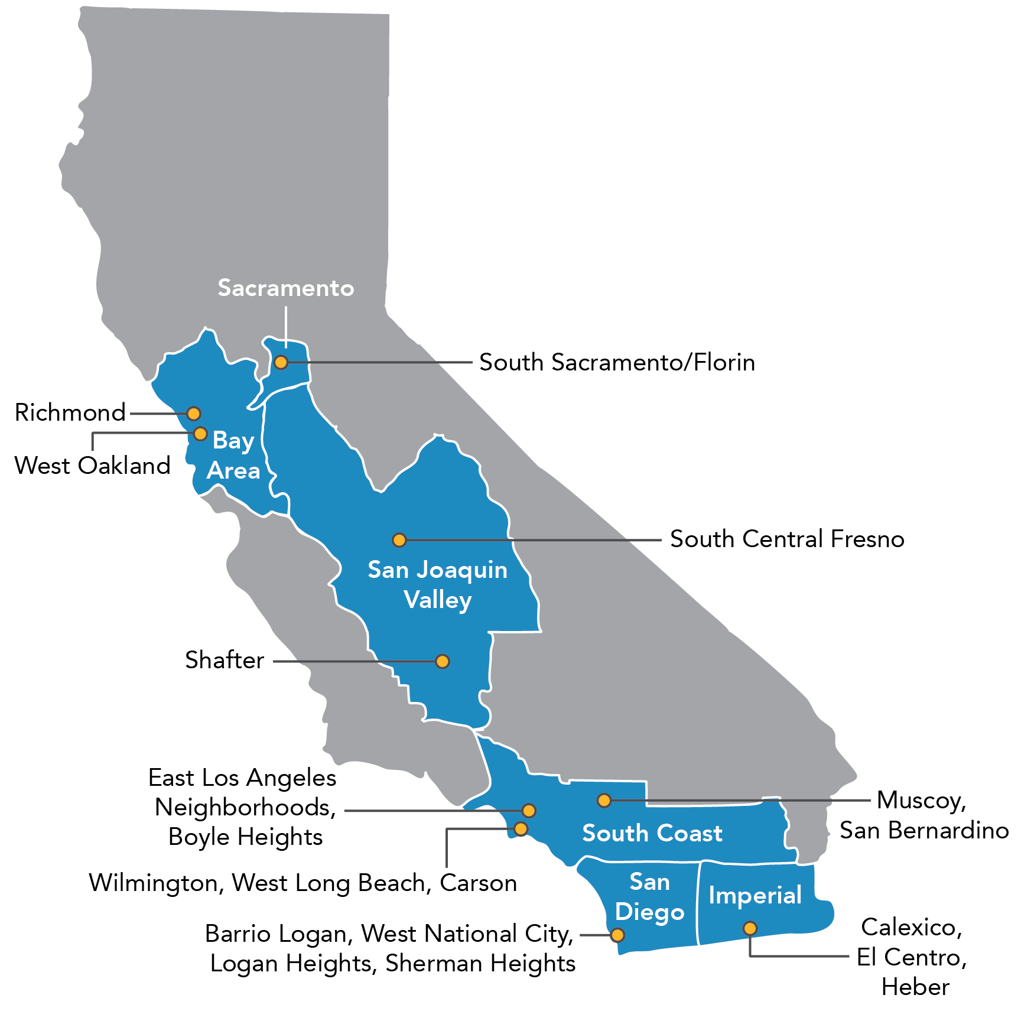
AB 617 Background
2017 companion legislation to Cap & Trade (AB 398) reauthorization
Addresses environmental justice concerns about local disparities in air quality
Requires local air districts to partner with community groups and develop emission reduction plans
10 initial AB 617 communities identified, including 2 in the Bay Area (West Oakland and Richmond-North Richmond-San Pablo)

Slide 8
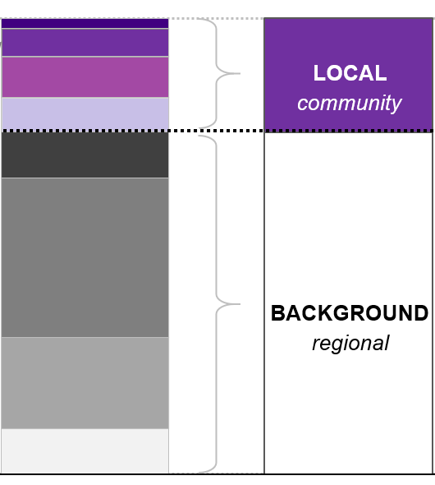
AB 617 Technical Assessments
May include air quality monitoring
Emissions inventory development for criteria pollutants and air toxics required
Hybrid modeling approach used in Bay Area:
- CMAQ was run at 1-km grid resolution to estimate background PM_{2.5} and air toxics concentrations
- AERMOD was run for significant emission sources within each community
- Combined CMAQ+AERMOD results provide total pollutant concentrations
- AERMOD results used for source apportionment analyses to inform local emission reduction strategies
AERMOD
Local Emission Sources
CMAQ
Regional sources outside the community
8

Slide 9
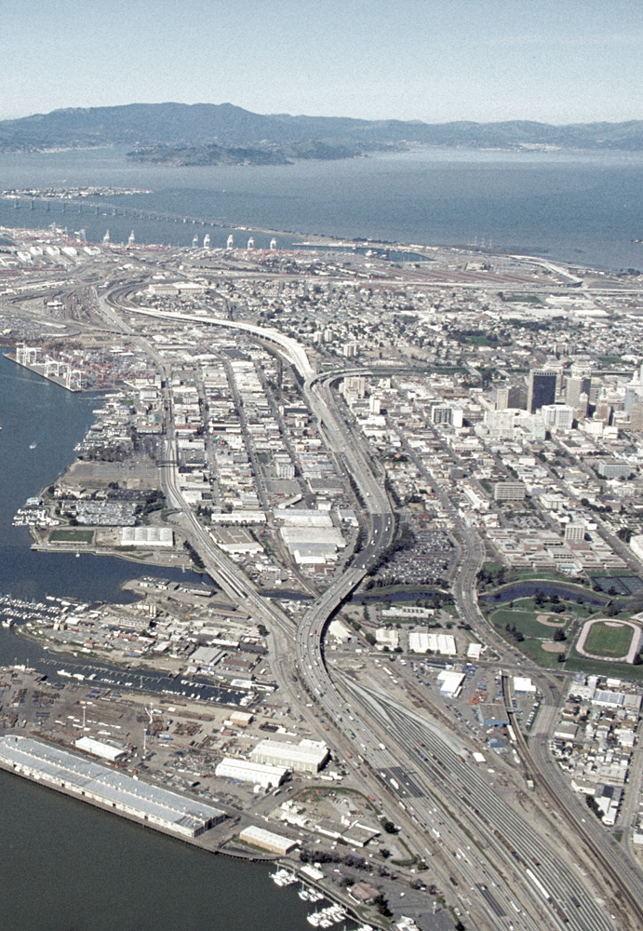

West Oakland AB 617 Community
In 2019, the District partnered with the West Oakland Environmental Indicators Project (WOEIP) to develop a community action plan
The District conducted a technical assessment to support strategy development for the plan
Hybrid modeling results for West Oakland were presented at the 2019 CMAS Conference
West Oakland

Slide 10
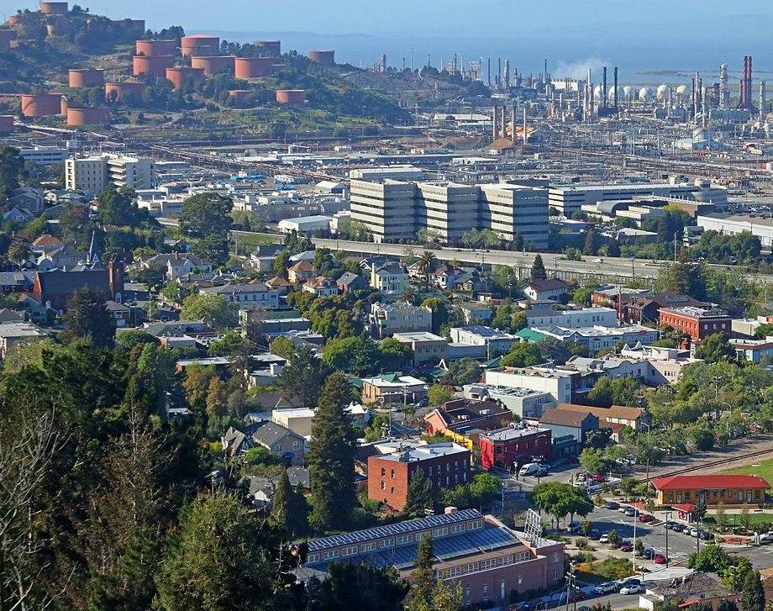
Richmond-North Richmond-San Pablo
AB 617 Community
This community in western Contra Costa County has major pollution sources and the population experiences a disproportionately high health burden
Industrial sources include a petroleum refinery, a chemical plant, a landfill, a coal and petroleum coke terminal, and wastewater treatment plants
Mobile sources include high volume freeways (I-80, I-580), truck activity at distribution facilities, seaport operations, and railyards
Notes:
Michelle

Slide 11
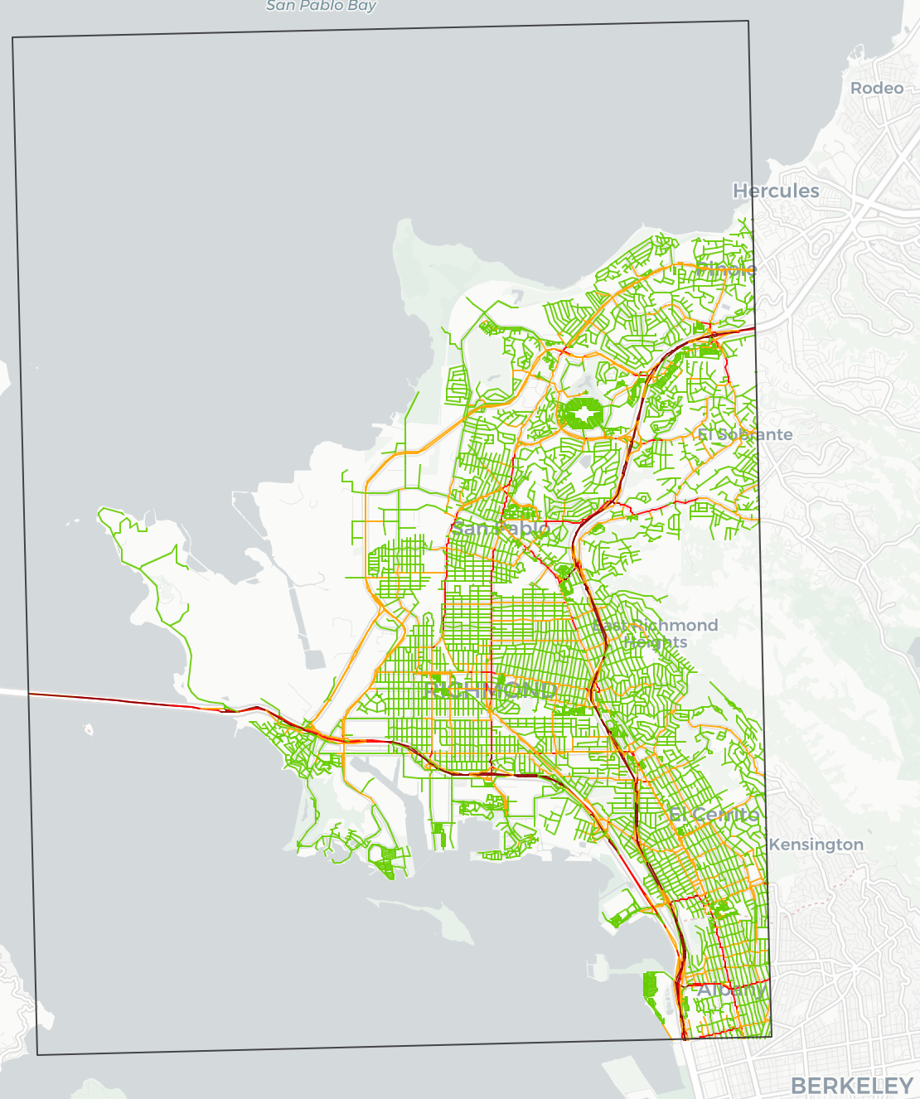
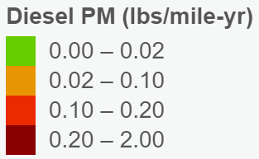
R-NR-SP Technical Assessment (1)
Detailed emissions inventory includes:
- Link-level estimates for on-road mobile sources
- Process-level estimates for 300+ permitted facilities
AERMOD modeling of individual sources to enable source attribution analyses
Modeling results combined with health risk values and population data to evaluate exposures
Technical findings shared with an Ad Hoc Committee of community members
11

Slide 12
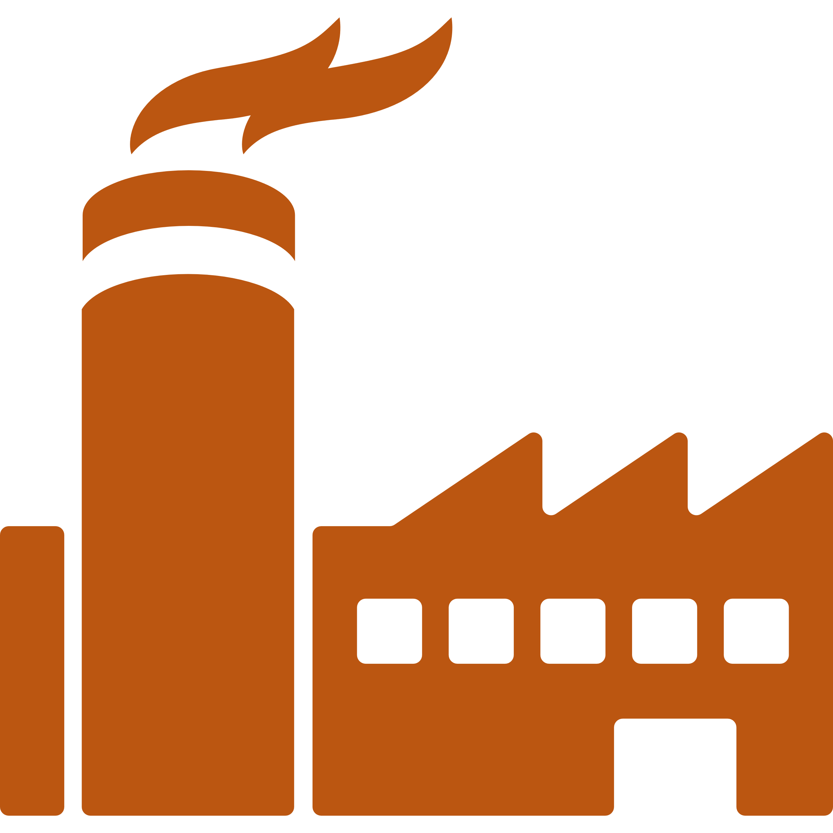




R-NR-SP Technical Assessment (2)
Source apportionment analyses focused on areas of concern identified by the community:
Fuel refining, support facilities, storage, and distribution
Vehicles and trucks, streets and freeways, and logistics
Industrial and commercial sources near communities
Marine and rail sources
12

Slide 13
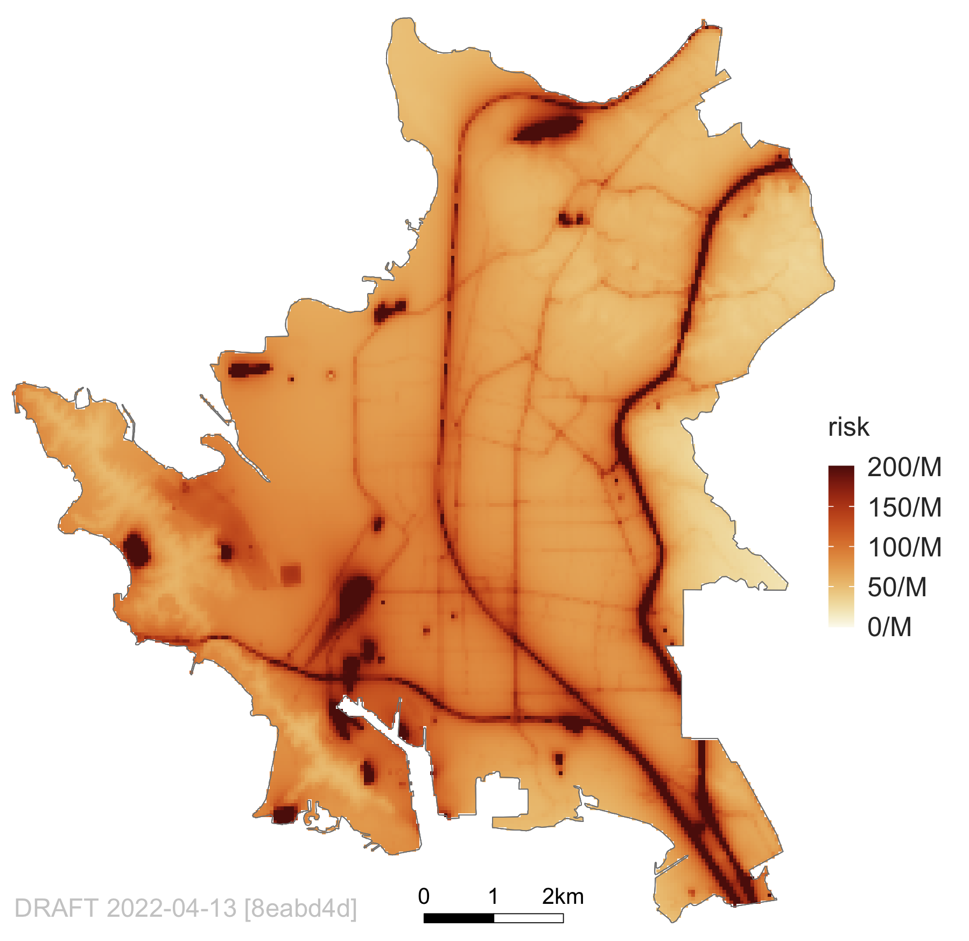
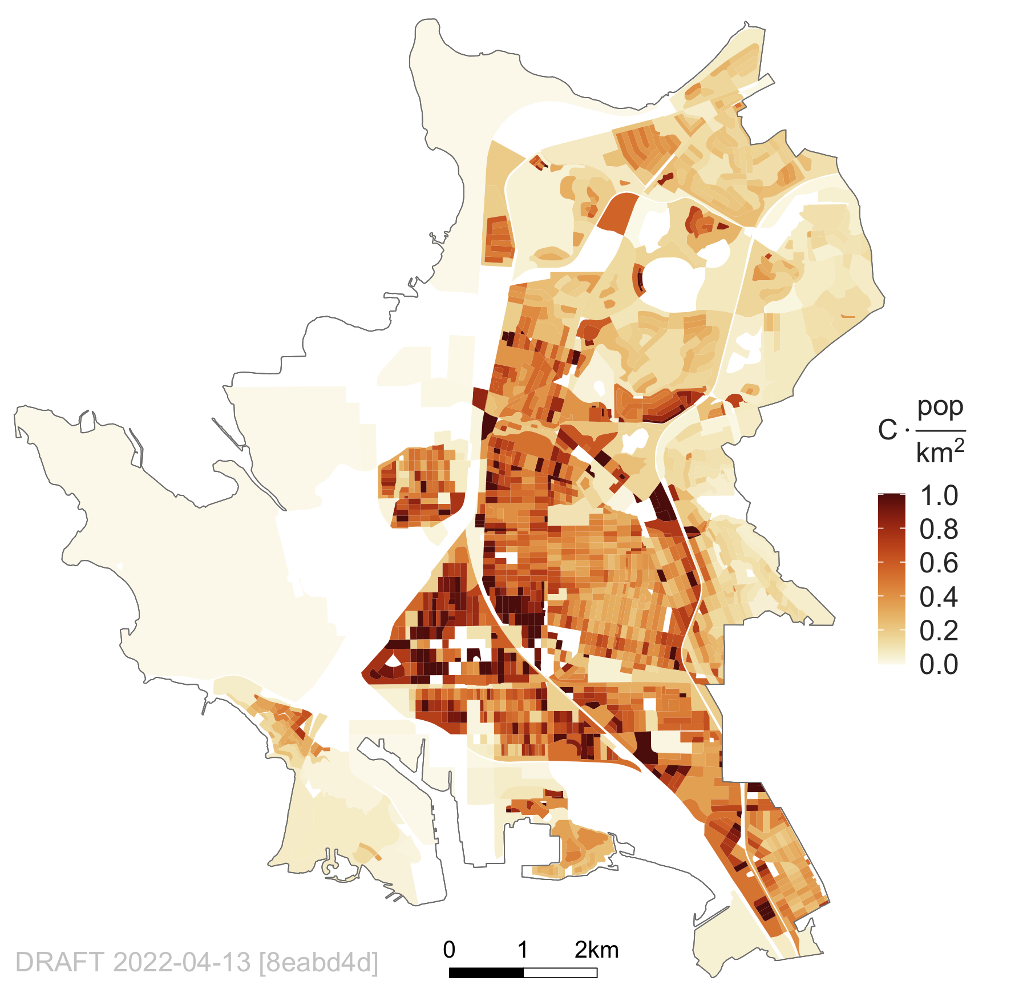
R-NR-SP Modeling Results (1)
Average Residential Cancer Risk (per million)
Cancer Risk Map
Exposure Map
36%
13

Slide 14
R-NR-SP Modeling Results (2)
Source Contributions to Average Residential PM_{2.5} Exposures
(stacked bar total = 1.06 µg/m³)
Source Contributions to Average Residential Chronic Hazard Index
(stacked bar total = 0.11)
Source Contributions to
Average Residential Cancer Risk
(stacked bar total = 84.3 per million)
14
14

Slide 15
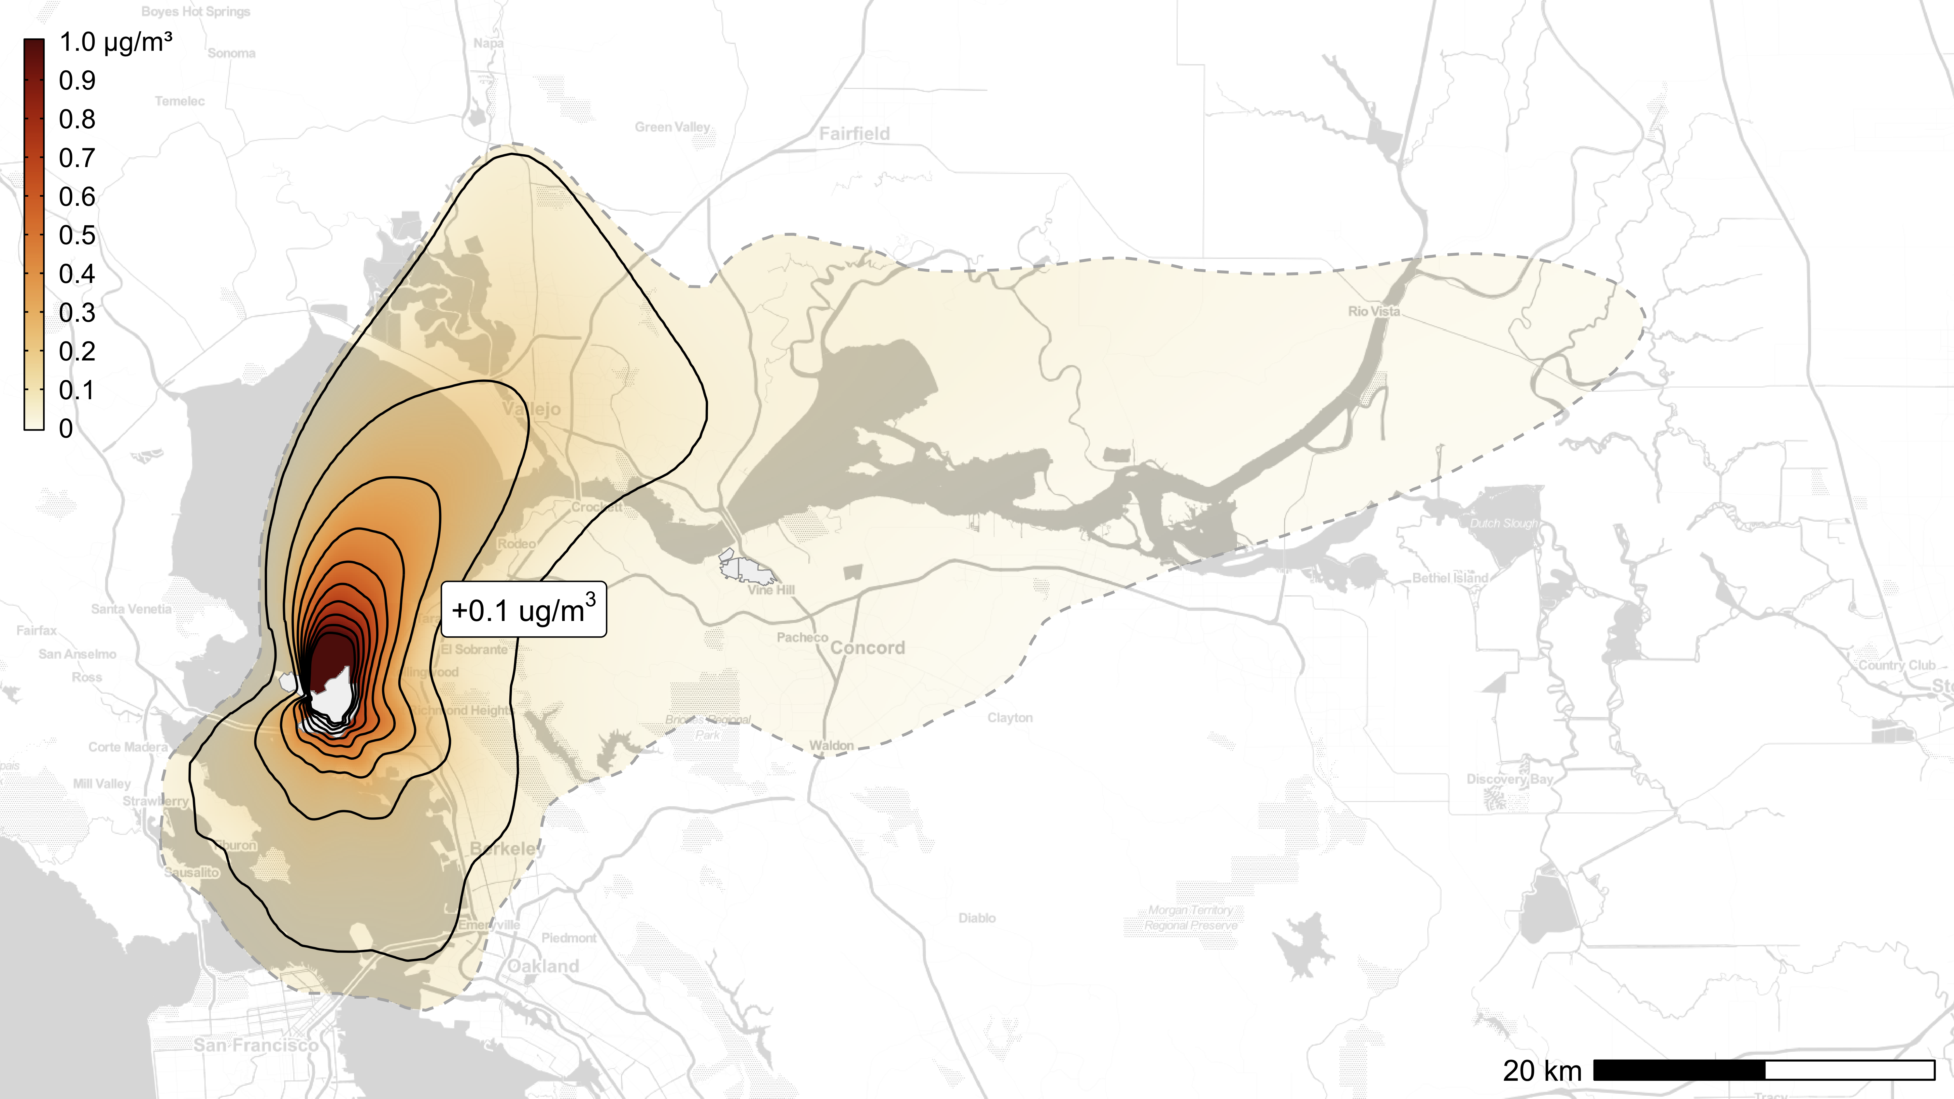
Equity Analyses for Rulemaking (1)
The District has begun incorporating model-based equity analyses into rulemaking efforts
For example, a rule controlling PM_{2.5} emissions from refinery fluidized catalytic cracking units (FCCU) was just amended
Refinery PM_{2.5} emissions were modeled using CALPUFF and resulting pollutant concentrations were combined with Census data to evaluate exposures for different population groups
Solid contours correspond to modeled contributions of +1.0, +0.9, … +0.1 µg/m³
15

Slide 16
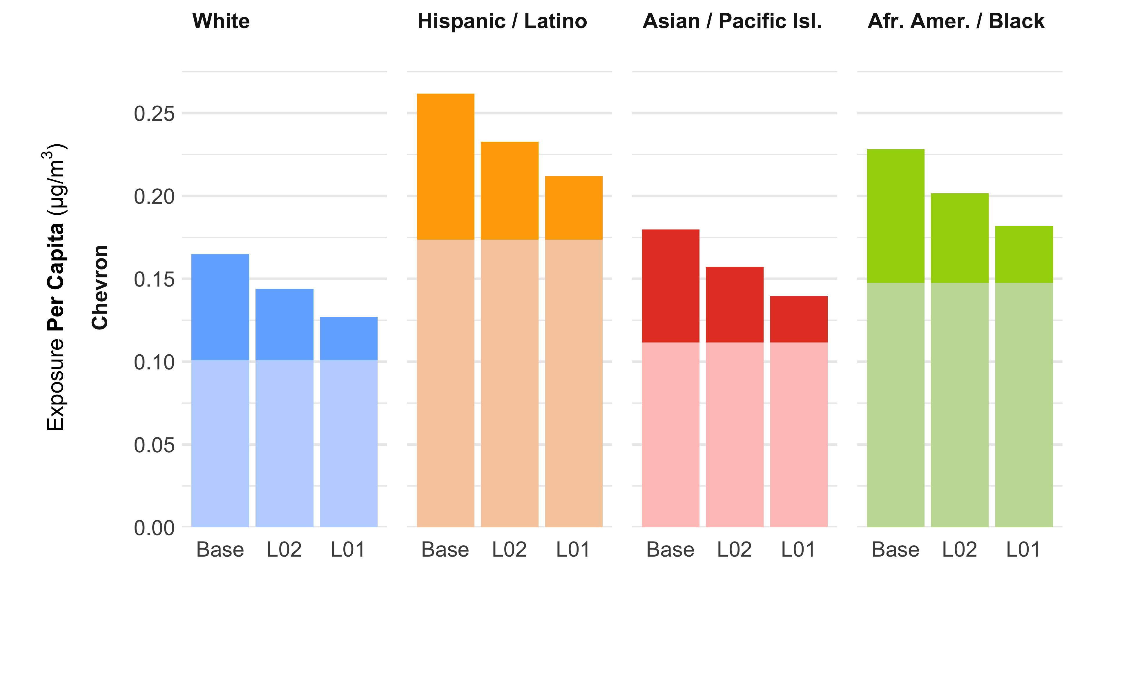
Equity Analyses for Rulemaking (2)
Disparities in Per Capita Exposure
Base case emissions and two control scenarios modeled
On average, Hispanic/Latino and African American/Black residents are exposed to more PM_{2.5} from the refinery
Sources other than the FCCU drive these disparities
Disparities remain significant across all modeled scenarios
FCCU impacts shown in darker colors
Bar heights = total impacts (FCCU + Non-FCCU)
16

Slide 17
Ongoing and Future Work
Conducting CMAQ model to support rulemaking efforts related to natural gas appliances and residential wood combustion
Using recent dispersion modeling results for roadways and rail lines to update screening tools used by the District’s Planning Division
Supporting the R-NR-SP Community Steering Committee as they develop emission reduction strategies for their plan
Launching technical assessments for new AB 617 communities (e.g., East Oakland and the Bayview-Hunters Point community in SF)
Working with Univ. of Wash. to use a reduced form model (InMAP) to evaluate the impact of policy interventions on PM_{2.5} exposures
17

