Slide 1

The Burden of Lightning NO_{x} Emissions over the Contiguous United States and the Northern Hemisphere Derived Using Observational and Climatological Approaches
Daiwen Kang, J. Mike Madden, Christian Hogrefe, Golam Sarwar, Rohit Mathur, and Barron H. Henderson
21st Annual CMAS Conference, Chapel Hill, North Carolina
October 17-19, 2022
Office of Research and Development
Center for Environmental Measurement & Modeling

Slide 2
Outline
Brief description of ground-based lightning detection networks
Comparison of detected lightning flashes from different networks
Scaling of lightning data from network with low lightning detection efficiency
Spatial and temporal lightning NO_{x} (LNO_{x}) emissions over the Contiguous United States (CONUS) and the relative burden to total NO_{x} emissions
Hemispheric distributions of LNO_{x} emissions

Slide 3
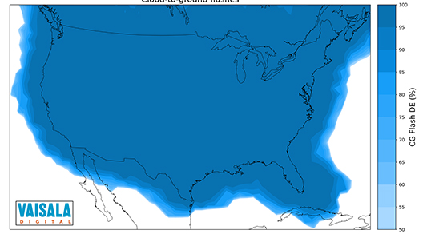
Overview of Lightning Detection Networks
The National Lightning Detection Network (NLDN):
Started in the early 1980s, it focused on the Contiguous United States (later joined by Canadian lightning network), is the most accurate lightning detection network. and often is considered as the “ground truth” for lightning observations.
  Wideband sensors that operate from approximately 400 Hz–400 kHz radio wave detection
  Detection Efficiency (DE): >95% (over CONUS US)
  Location Accuracy (LA): 50 m (over CONUS US)
Cloud to Ground Flashes

Slide 4
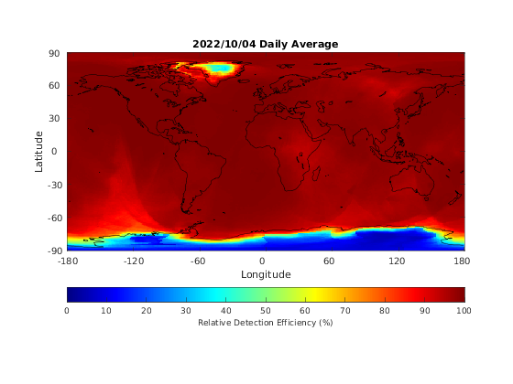
Overview of Lightning Detection Networks
The World Wide Lightning Location Network (WWLLN):
  Ground-based global lightning detection network was started in the early 2000s and has ~70 sensors.
  Very Low Frequency (VLF, 3-30kHz) radio wave detection (VLF waves propagate through the ionosphere with relatively low attenuation, enabling the detection of these radio atmospherics at great distances between 6000 to 12000 km from the lightning discharge).
  DE: 60-80% for CGs (> 40 kAmp), 10-11% for all strokes. The spatially uniform relative DE is achieved in most regions with deMap correction derived using the average stroke energy distribution (doi:10.1029/2012RS005049).
  LA: 4-5 km

Slide 5
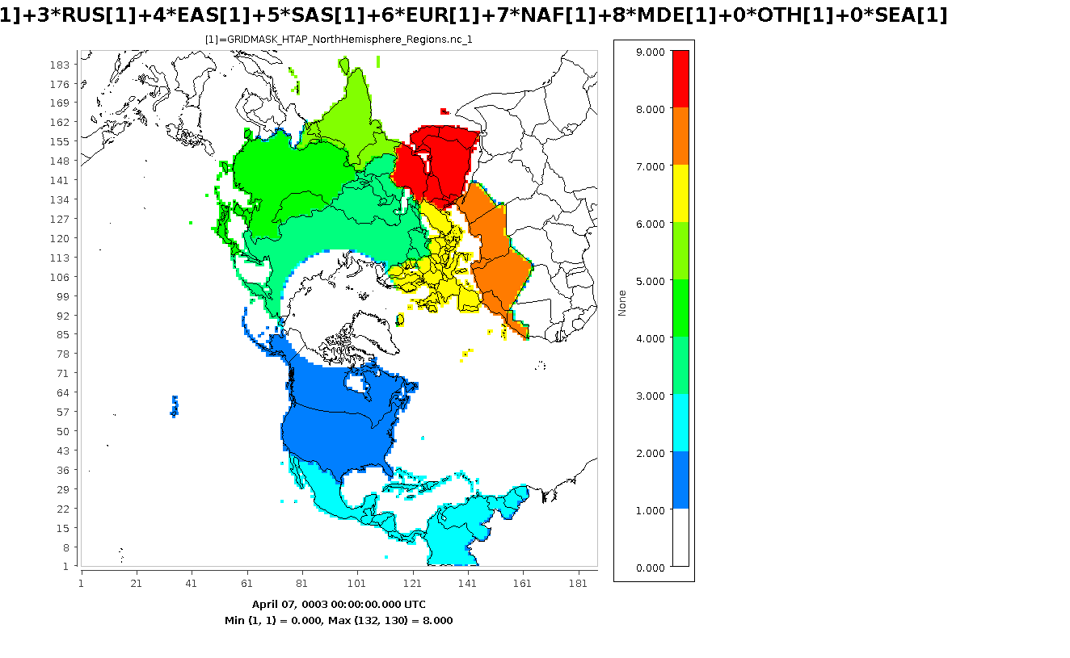
Analysis Regions in the CONUS and Hemispheric Modeling Domain
MDE
NAF
EUR
SAS
EAS
RUS
CAM
NAM
NE: Northeast, SE: Southeast, OVC: Ohio Valley Central, UM: Upper Midwest, WNC: West North Central, SW: Southwest, NW: Northwest, and the other geographic regions: South and West.
Emission Cases:
NLDN, WWLLN, WWLLNs (scaled WWLLN dataset, to be introduced later), and GEIA (Global Emissions InitiAtive) climatological dataset that provides the same daily LNO_{x} emissions (hourly varying) for each month.
OTH
NAM: North America, CAM: Central America, RUS: Russia, EAS: East Asia, SAS: South Asia, EUR: Europe, NAF: North Africa, MDE: Middle East, and OTH: The rest of the geographic domain.
Notes:
u

Slide 6

Lightning Flash Density over CONUS: NLDN vs WWLLN in 2016
NLDN
WWLLN
50
46
42
38
34
30
26
Lightning Flash Rate (flashes/km²·hr x 10⁻³)
July
3.6
3.2
2.8
2.4
2.0
1.6
1.2
0.8
0.4
-115 -105 -95 -85 -75
-115 -105 -95 -85 -75
50
46
42
38
34
30
26
September
-115 -105 -95 -85 -75
-115 -105 -95 -85 -75

Slide 7
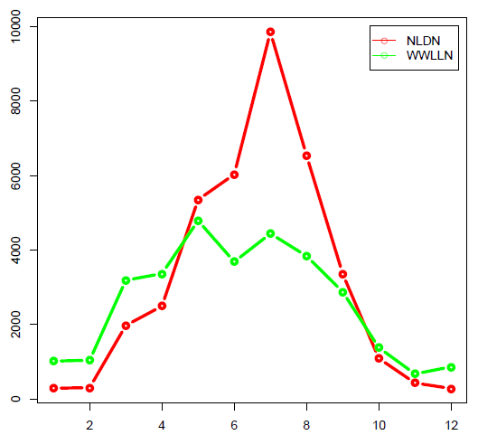
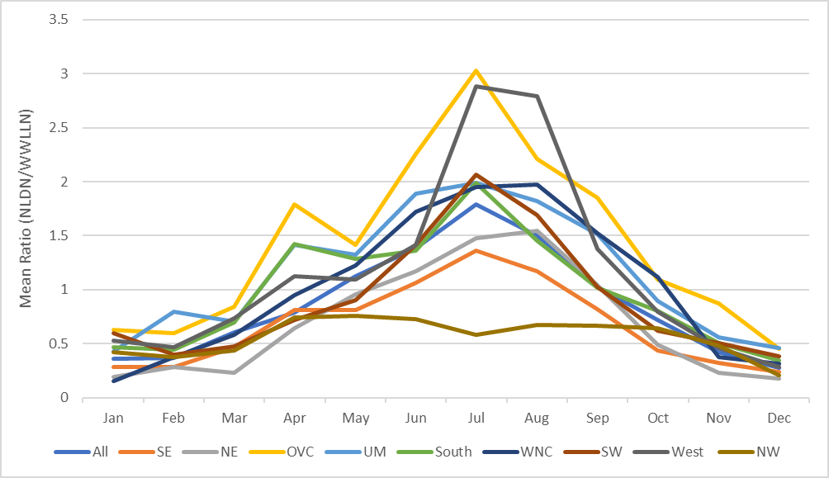
Lightning Flashes over CONUS: NLDN vs WWLLN
Lightning Flashes (^{x}1000)
10,000
2016
2017
2018
8,000
Total lightning flashes by month over CONUS
6,000
4,000
2,000
0
2 4 6 8 10 12
2 4 6 8 10 12
2 4 6 8 10 12
Ratio of NLDN/WWLLN monthly means considering data for 2016 – 2018. Ratios are shown for each region as well as aggregated for land vs. ocean cells in the domain
Month of the Year
3.5
3.5
Mean Ratio (NLDN/WWLLN)
3.0
3.0
2.5
2.5
2.0
2.0
1.5
1.5
1.0
1.0
0.5
0.5
0
0
Jan Feb Mar Apr May Jun Jul Aug Sep Oct Nov Dec

Slide 8
Monthly NLDN/WWLLN Lightning Flash Ratio over Land & Ocean
These monthly-varying land ratios are applied uniformly across all CONUS/hemispheric land cells
The ocean ratios < 1 are caused by lower NLDN detection efficiency when lightning strikes are away from the monitors over land, and therefore WWLLNs and WWLLN are identical over ocean cells
Month | Land | Ocean
January | 0.76 | 0.37
February | 0.70 | 0.35
March | 0.85 | 0.52
April | 1.04 | 0.52
May | 1.57 | 0.75
June | 2.21 | 0.82
July | 2.99 | 0.96
August | 2.64 | 0.86
September | 1.92 | 0.73
October | 1.16 | 0.54
November | 0.86 | 0.35
December | 0.50 | 0.29
1.0

Slide 9
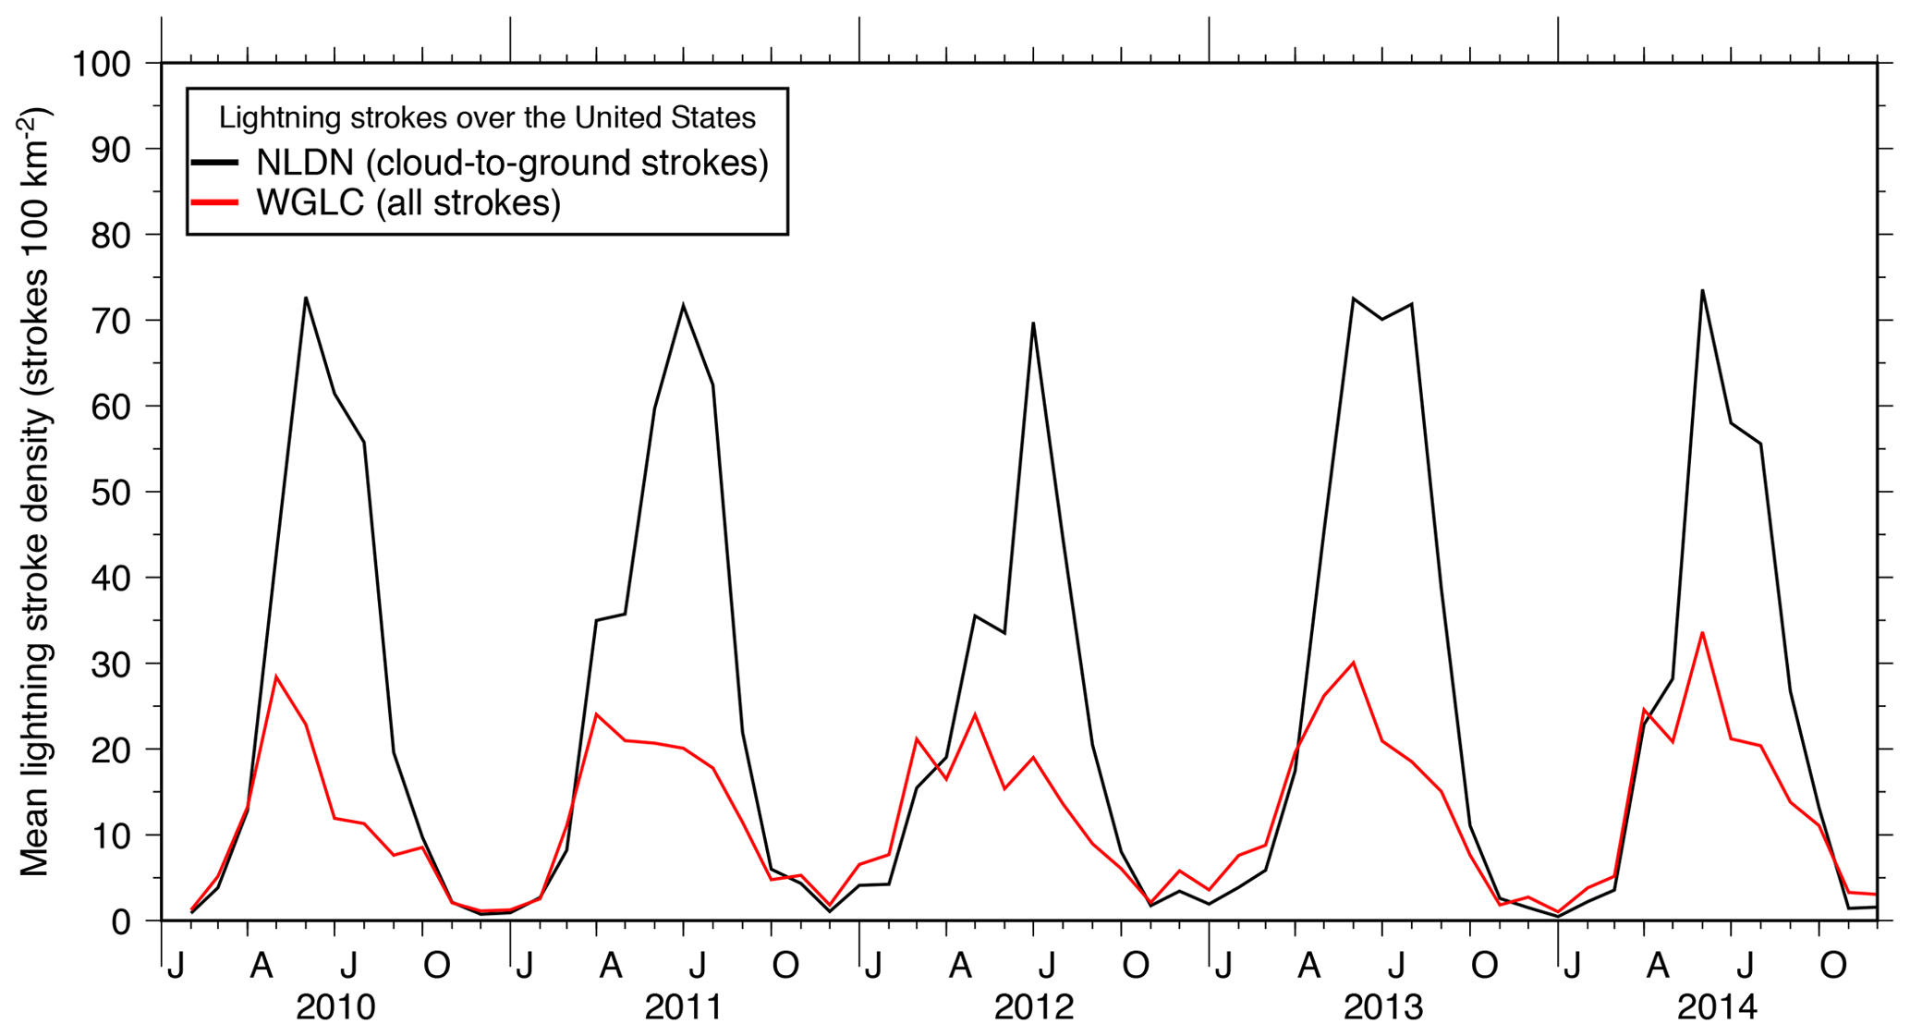
Lightning Flash Density over CONUS: NLDN vs WWLLN
Courtesy of Kaplan and Lau (2021), https://doi.org/10.5194/essd-13-3219-2021
Peak summertime lightning density in WGLC (WWLLN Global Lightning Climatology) is about 40 % of the amount reported by NLDN

Slide 10
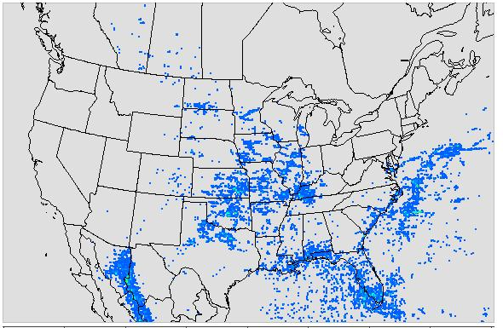
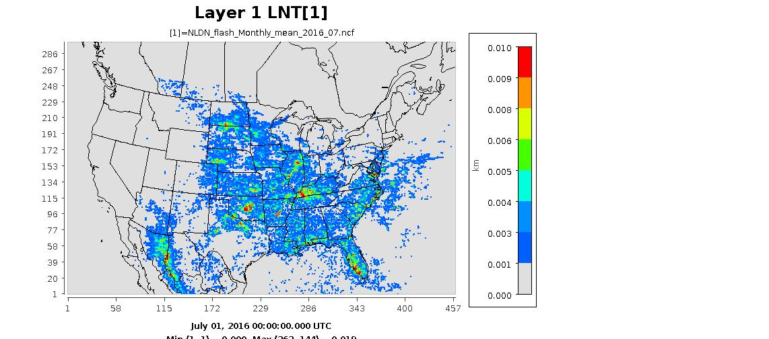
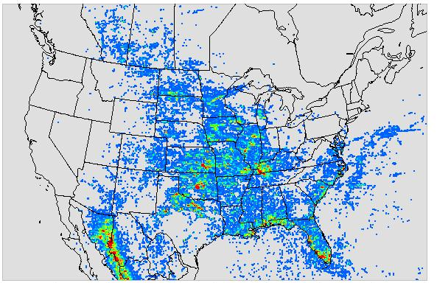
Spatial Distribution of Lightning Flash Rate in July 2016
WWLLN
NLDN
More lightning flashes were observed by NLDN than by WWLLN over land, but the differences were quite small over ocean.
The scaled WWLLN (WWLLNs) flashes are comparable with NLDN flashes both in magnitude and spatial distribution.
WWLLNs
flashes/km²hr

Slide 11
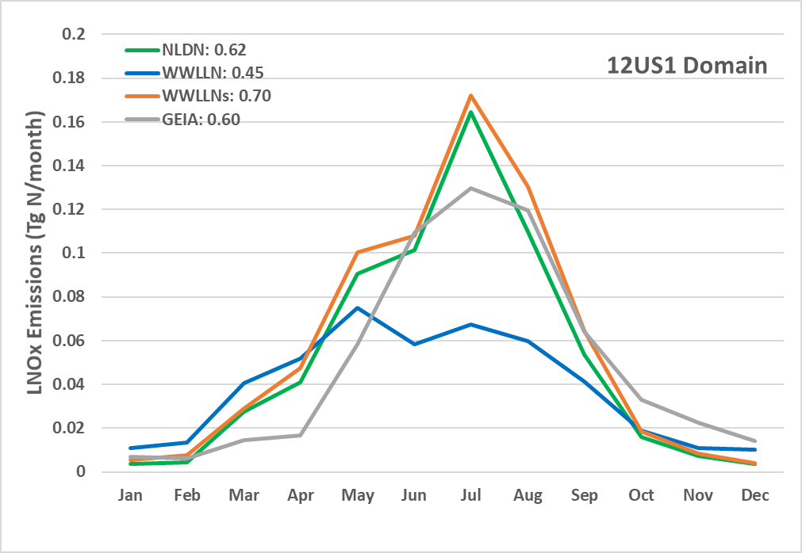
Monthly Total LNO_{x} Emissions over CONUS in 2016
Domain-wide total annual LNO_{x} emissions are in the range of 0.45 to 0.70 Tg N (compare to the global estimate of 2 – 8 Tg N in literature)
Collectively over the domain, the NLDN, WWLLNs, and GEIA emissions are comparable to each other during warm months. The unscaled WWLLN emissions are lower than all the other cases by more than 25%.
The LNO_{x} production rate for NLDN and WWLLNs: 350 moles/flash
(0.47)
(0.28)
(0.48)
(0.34)
The values after the legend symbols are the annual total LNO_{x} (Tg N) over the domain and the values in the parentheses are the corresponding annual total LNO_{x} over the CONUS land grid cells.

Slide 12
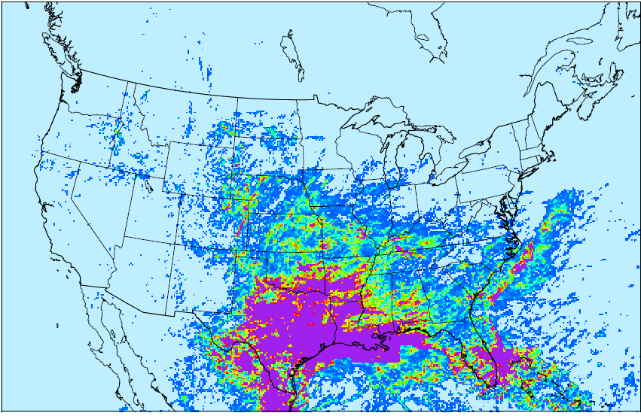
Spatial Distribution of Seasonal Total LNO_{x} Emissions in 2016
NLDN
WWLLN
WWLLNs
GEIA
6.3
LNO_{x} Emissions (Tons N)
5.6
Spring (MAM)
4.9
4.2
3.5
2.8
2.1
1.4
0.7
18
16
14
Summer (JJA)
12
10
8
6
4
2

Slide 13
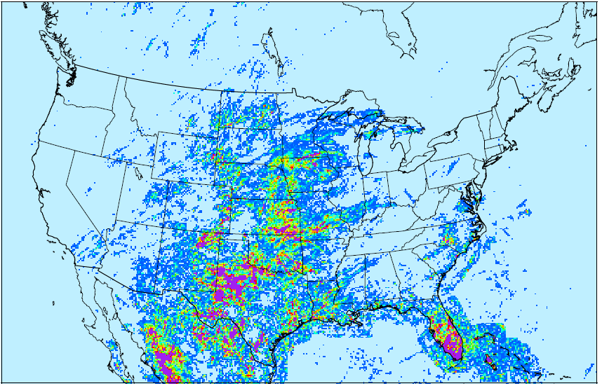
Spatial Distribution of Seasonal Total LNO_{x} Emissions in 2016
NLDN
WWLLN
WWLLNs
GEIA
6.3
LNO_{x} Emissions (Tons N)
5.6
Autumn (SON)
4.9
4.2
3.5
2.8
2.1
1.4
0.7
1.8
1.6
1.4
Winter (DJF)
1.2
1.0
0.8
0.6
0.4
0.2

Slide 14
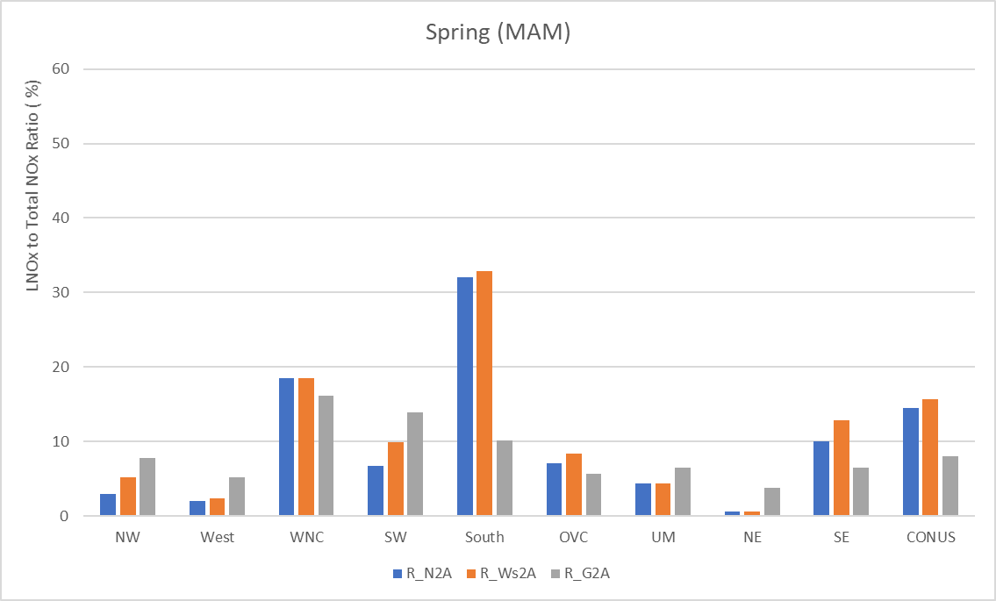
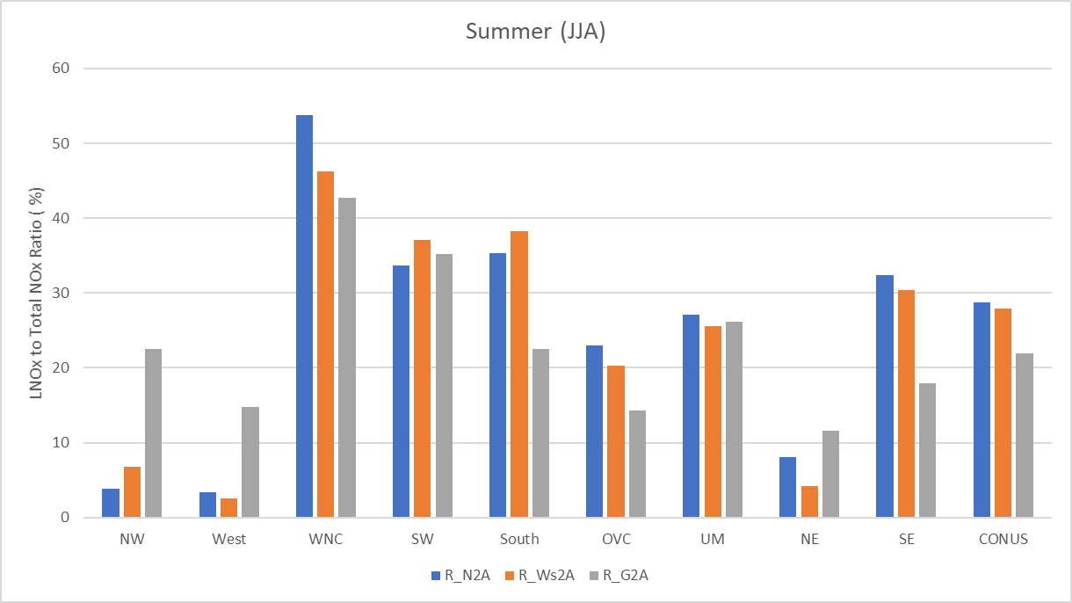
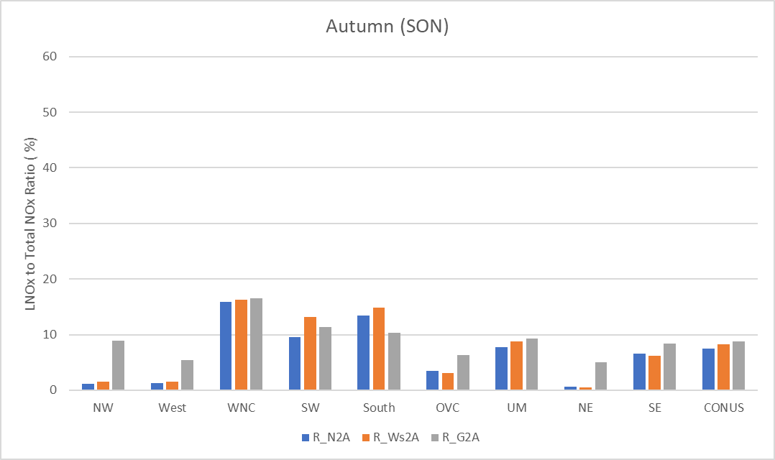
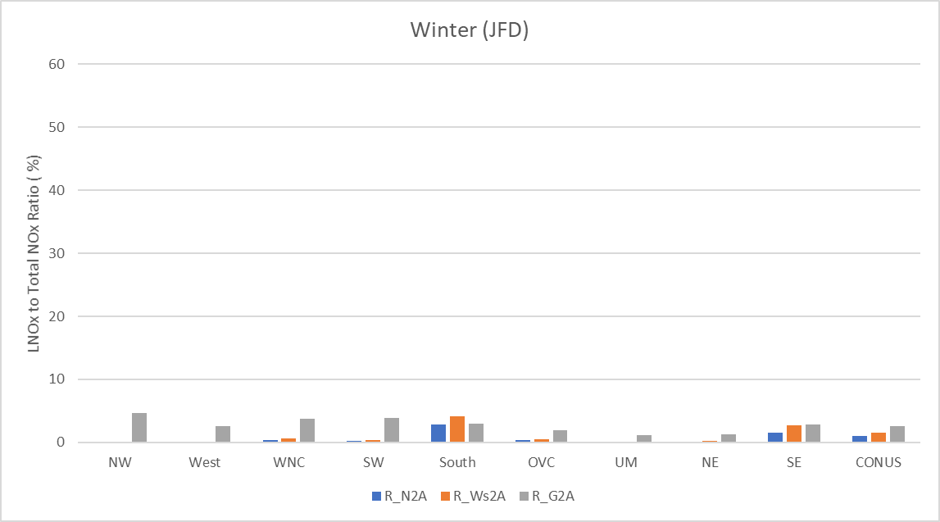
Seasonal LNO_{x} to Total NO_{x} Ratios in the U.S. Climate Regions in 2016
Spring (MAM)
Summer (JJA)
The LNO_{x} to total NO_{x} (TNO_{x}: total anthropogenic NO_{x} + LNO_{x}) ratio displays significant seasonal and geographic variations.
The ratio’s seasonal variation is common to all the LNOx emissions cases.
LNOx to TNOx Ratio (%)
60
LNOx to TNOx Ratio (%)
60
50
50
40
40
30
30
20
20
10
10
0
0
Autumn (SON)
Winter (JFD)
LNOx to TNOx Ratio (%)
60
LNOx to TNOx Ratio (%)
60
50
50
40
40
30
30
20
20
10
10
0
0
R_N2A: Ratio of NLDN LNO_{x} to ANO_{x}, R_Ws2A: Ratio of WWLLNs LNO_{x} to ANO_{x}, R_G2A: Ratio of GEIA LNO_{x} to ANO_{x}

Slide 15
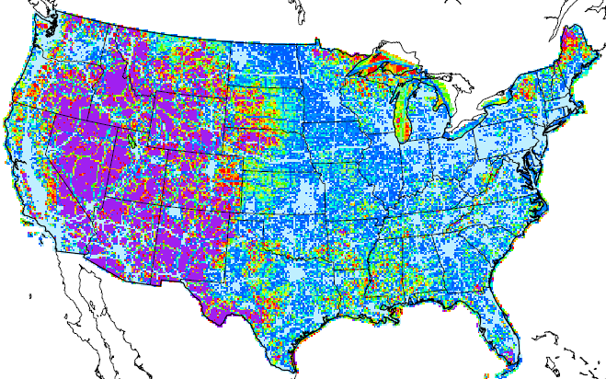
Spatial Distribution of Seasonal LNO_{x} to Total NO_{x} Ratio in 2016
Spring
Summer
Autumn
Winter
NLDN
LNO_{x} to TNO_{x} (%)
90
80
WWLLNs
70
60
50
40
30
20
GEIA
10

Slide 16
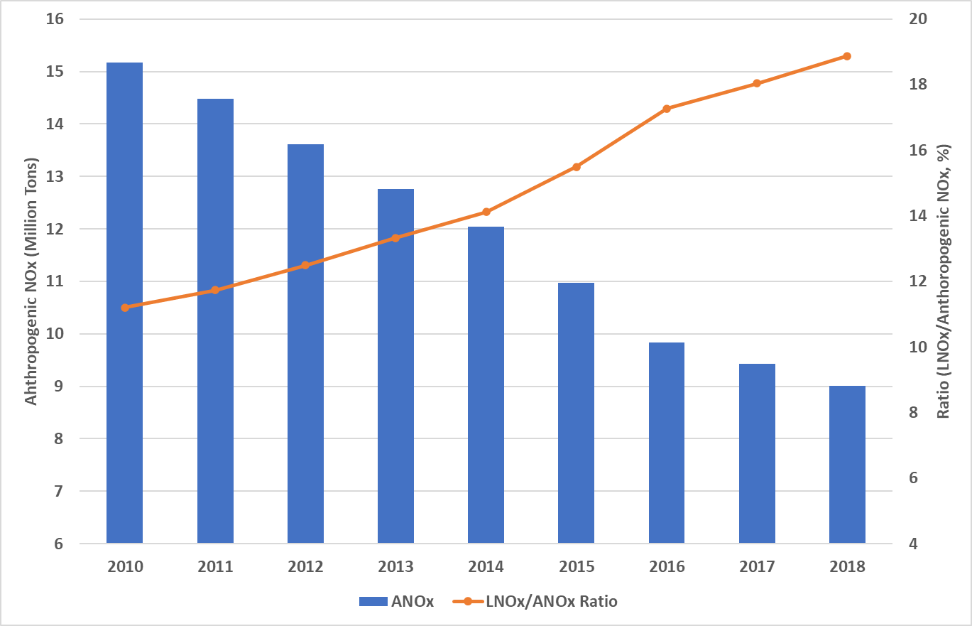
The Trend of Annual ANO_{x} and the LNO_{x}/ANO_{x} Ratio over the CONUS from 2010-2018
The annual total anthropogenic NO_{x} (ANO_{x}) emissions from 2010 to 2018 (extracted from the EQUATES* project) decreased by ~ 5%/year.
The ratio of LNO_{x}/ANO_{x} increased from 11 to 19% from 2010 to 2018 based on the 2016 LNO_{x} level (NLDN) over the CONUS.
*EPA’s Air QUAlity TimE Series Project (https://www.epa.gov/cmaq/equates)

Slide 17
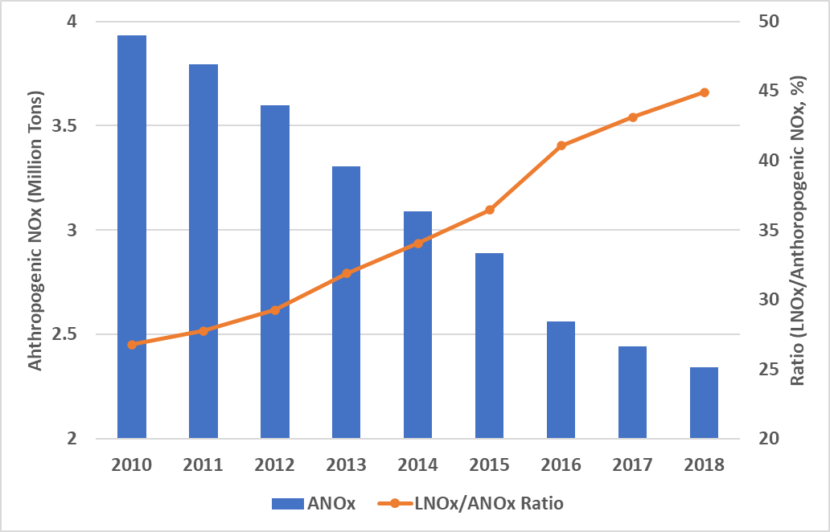
The Trend of Summer-month (JJA) ANO_{x} and the LNO_{x}/ANO_{x} Ratio over the CONUS from 2010-2018
The total anthropogenic NO_{x} (ANO_{x}) emissions during summer months from 2010 to 2018 (extracted from the EQUATES* project) decreased by ~ 5%/year.
The ratio of LNO_{x}/ANO_{x} during summer increased from 27 to 45% from 2010 to 2018 based on the 2016 LNO_{x} level (NLDN) over the CONUS.
*EPA’s Air QUAlity TimE Series Project (https://www.epa.gov/cmaq/equates)
Notes:
Over 60% of the annual lightning NOx emissions over the CONUS is from the summer months (JJA).

Slide 18
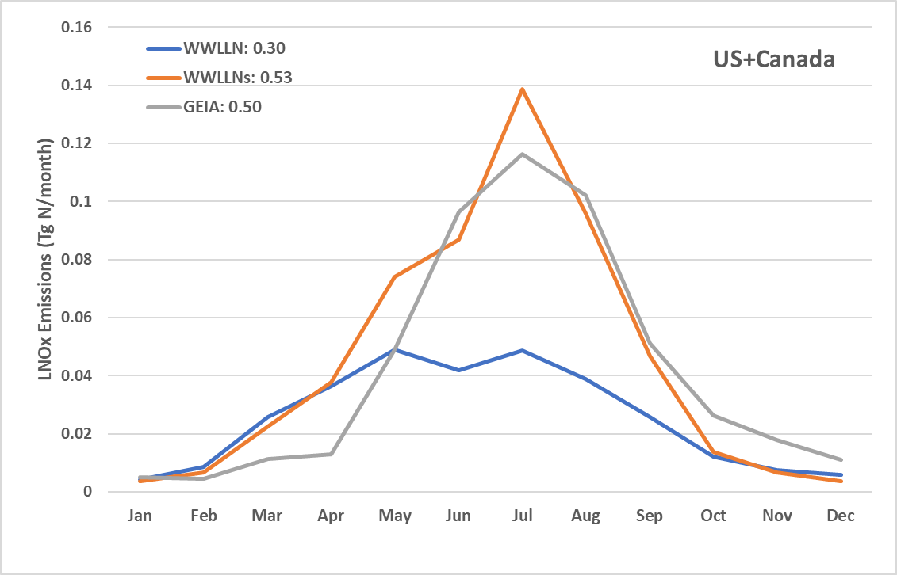
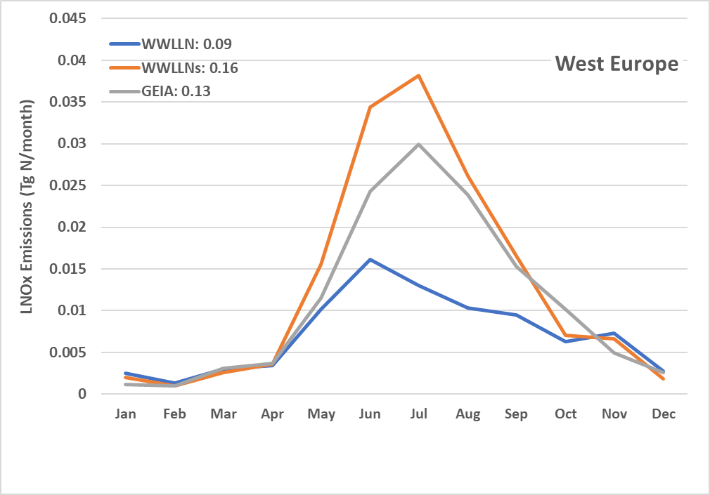
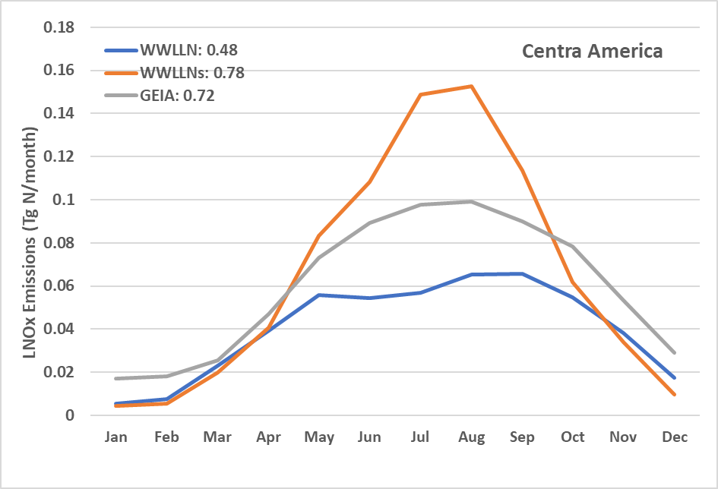
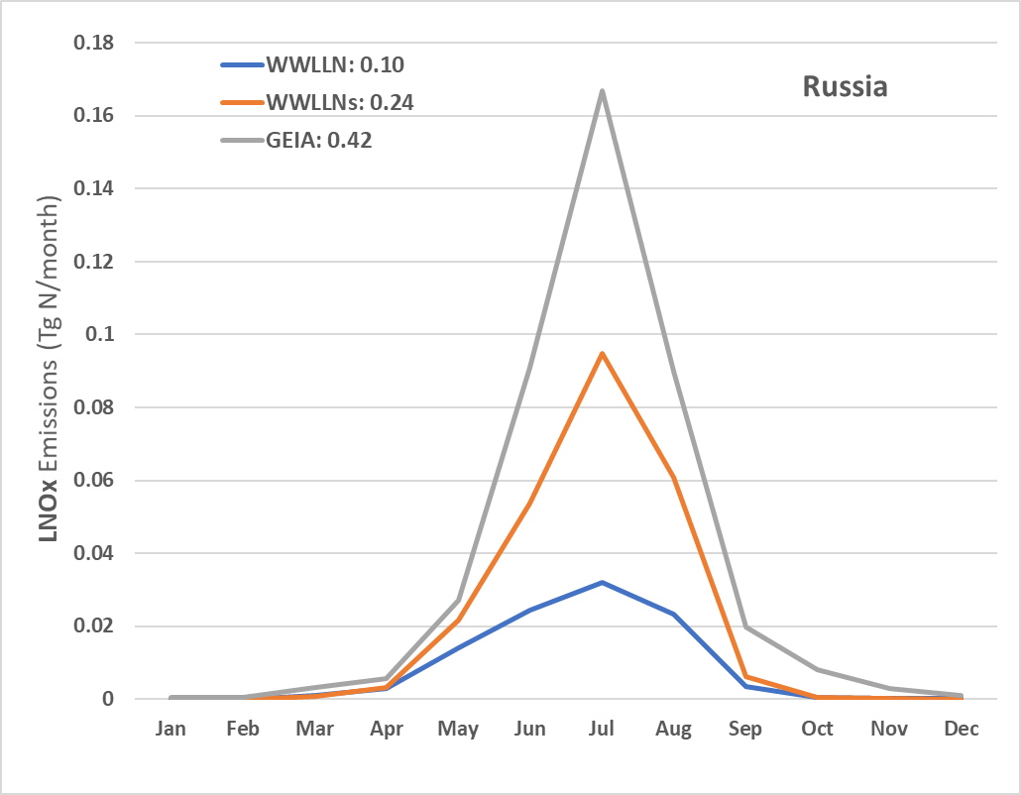
Monthly Total LNO_{x} Emissions in Hemispheric Regions in 2016
The total LNO_{x} emissions from WWLLNs are comparable (within 50%) to the climatological LNO_{x} emissions from GEIA in North America, Central America, West Europe, and Russia.
Similar seasonal variation trends are displayed by all the emissions cases.
North America
West Europe
Central America
Russia

Slide 19
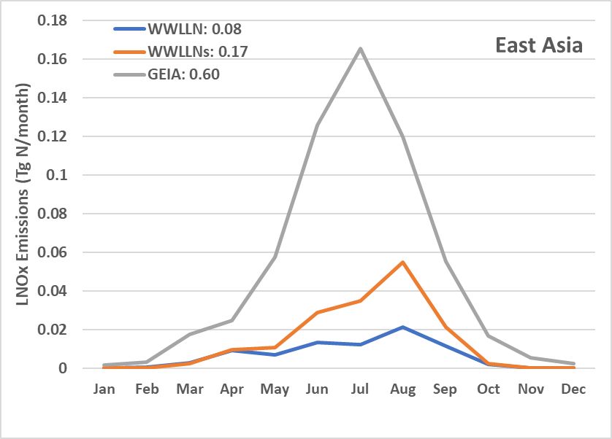
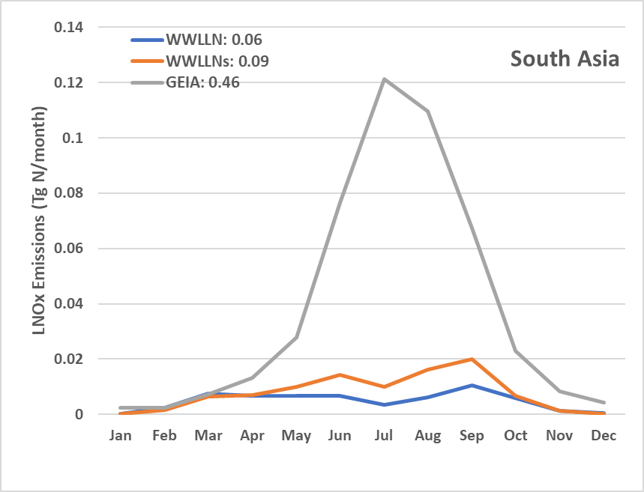
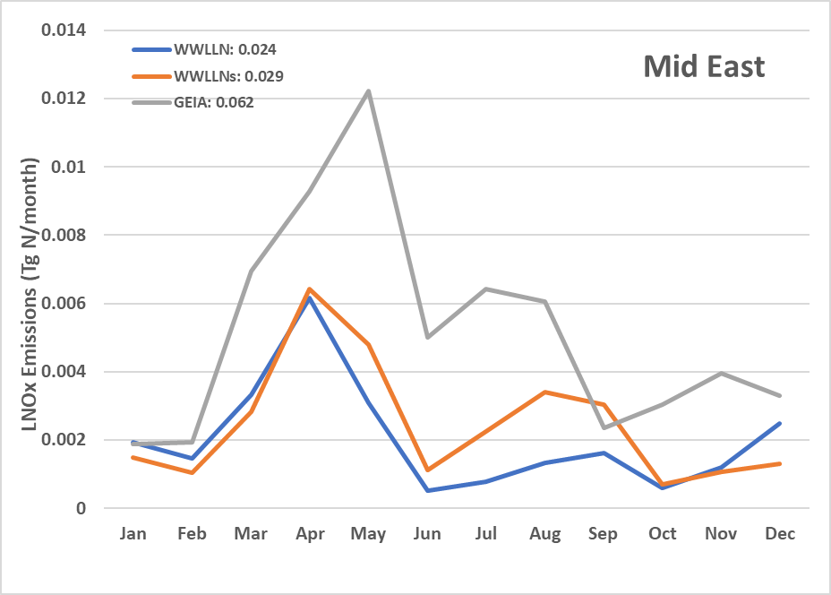
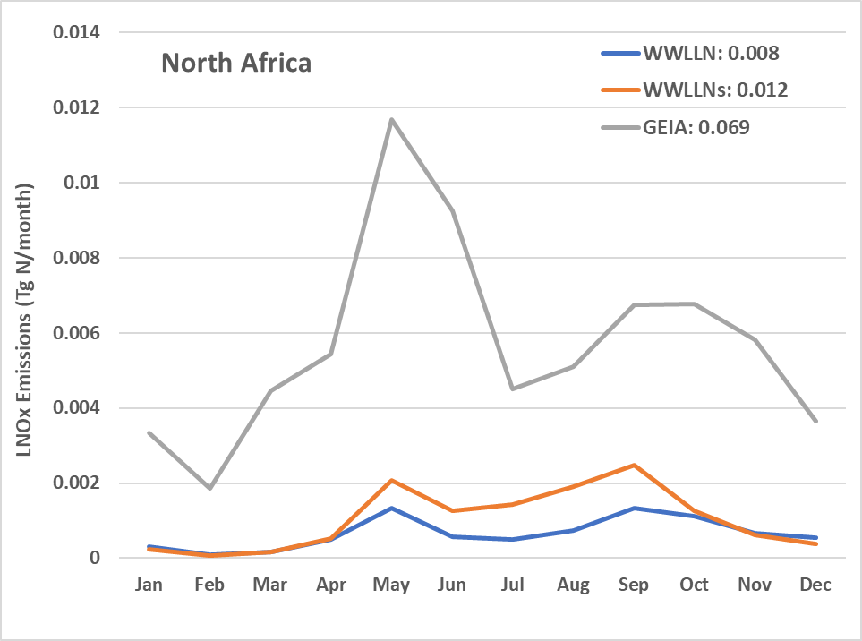
Monthly Total LNO_{x} Emissions in Hemispheric Regions in 2016
For annual total LNO_{x} emissions, GEIA’s estimates are 3 to 10 times larger than those from WWLLNs in East and South Asia, Middle East, and North Africa.
The seasonal variation trend from GEIA is different from WWLLN and WWLLNs.

Slide 20
Summary
The lightning flash data from WWLLN, a network with low lightning detection efficiency, is scaled using lightning flash data from NLDN in time and space for lightning NO_{x} production
There are clear differences in the magnitude and distribution of LNO_{x} emissions across CONUS and the Northern Hemisphere with different emission configurations.
WWLLNs generally produces similar LNO_{x} emissions to NLDN in time and space over the CONUS.
LNO_{x} composes an increasingly significant fraction of total NO_{x} emissions over the years; for some regions, it dominates the total NO_{x} emissions budget during summer months.
Compared to WWLLNs, the monthly climatological GEIA LNO_{x} emissions are unrealistically large for parts of Asia and Central Africa but are more comparable (within 50% for total annual values) in other regions such as North and Central America, West Europe, and Russia.

Slide 21
Disclaimer
References
  Kang, D.; Hogrefe, C.; Sarwar, G.; East, J.D.; Madden, J.M.; Mathur, R.; Henderson, B.H.: Assessing the Impact of Lightning NOx Emissions in CMAQ Using Lightning Flash Data from WWLLN over the Contiguous United States. Atmosphere 2022, 13, 1248. https://doi.org/10.3390/atmos13081248.
  Kang, D., Heath, N., Gilliam, R., Spero, T., and Pleim, J.: Lightning Assimilation in the Weather Research and Forecasting (WRF) Model Version 4.1.1: Technique Updates and Assessment of the Applications from Regional to Hemispheric Scales, EGUsphere [preprint], https://doi.org/10.5194/egusphere-2022-348, 2022.
  Kaplan, J.O.; Lau, K.H.-K. The WGLC global gridded lightning climatology and time series. Earth Syst. Sci. Data 2021, 13, 3219–3237, https://essd.copernicus.org/articles/13/3219/2021.
The views expressed in this presentation are those of the authors and do not necessarily reflect the views or policies of the U.S. EPA

