Slide 1
Development and Evaluation of an Advanced Ozone Dry Deposition Model
Kiran Alapaty¹
Jesse Bash¹
Bin Cheng²
Sarav Arunachalam²
J. William Munger³
1. Center for Environmental Measurement and Modeling, Office of Research and Development,
U.S. Environmental Protection Agency, RTP, NC
2. Institute for the Environment, The University of North Carolina at Chapel Hill, Chapel Hill, NC
3. Harvard School of Engineering and Applied Sciences, Cambridge, MA
21st Annual CMAS Conference
October 17-19, 2022
Office of Research and Development
Center for Environmental Measurement and Modeling
Notes:
I thank each of my coauthors for their valuable contributions to this research - without which this work would not exist. Each of them had specific contributions – like pieces in a puzzle.

Slide 2
Background…
Dry deposition velocity for gases, estimated as:
Dry deposition of pollutants:
can impact ecosystems via nutrient supply
has biases that can cause uncertainty in human exposure estimates
Notes:
Over 3 decades many resistance formulations came out depending up on the needs of models and level of sophistication needed. This branching has resulted in differing outcome from models.

Slide 3
Introduction
Some issues with dry deposition modeling…
(1) Several PBL stability functions used in models are causing differences, in part, among different models (e.g., Liu et al. 2006).
(2) Turbulence strength
(a) is under-represented in some of the resistances’ formulations (e.g., Wesely 1989; Nemitz et al., 2001); and
(b) in current models do not capture the turbulent transport accurately in the estimation of O₃ fluxes (e.g., Clifton et al. 2020)
(3) No existing methods take advantage of three-dimensional (3-D) turbulence velocity variances in estimating dry deposition.
(4) impacts of dew and particle deposition on leaves are absent in many models
Notes:
Some issues are…

Slide 4
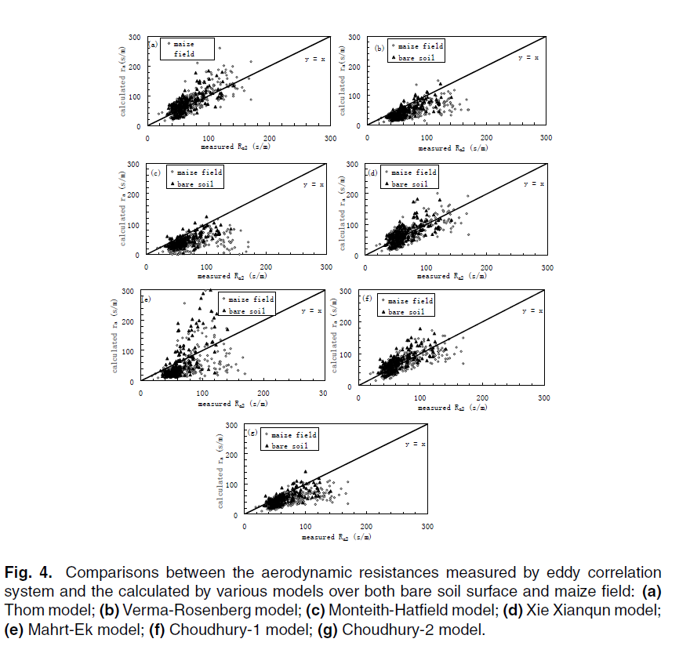
Current Status…
Issues with Ra - aerodynamic resistance - estimation
1). Several PBL stability functions used in models are causing differences, in part, among different models
Liu, Mao, and Lu (2006) evaluated SEVEN different
Aerodynamic Resistance formulations with measurements. The usage of different stability functions contributed to different R_{a} estimations
Modeled Aerodynamic Resistance (s/m)
Measured aerodynamic resistance (s/m)
Notes:
Some schemes are under or over predicting measured Ra, causing the differences among the model estimations, this is because they use different stability functions. For this reason, we want to avoid usage of stability functions.

Slide 5
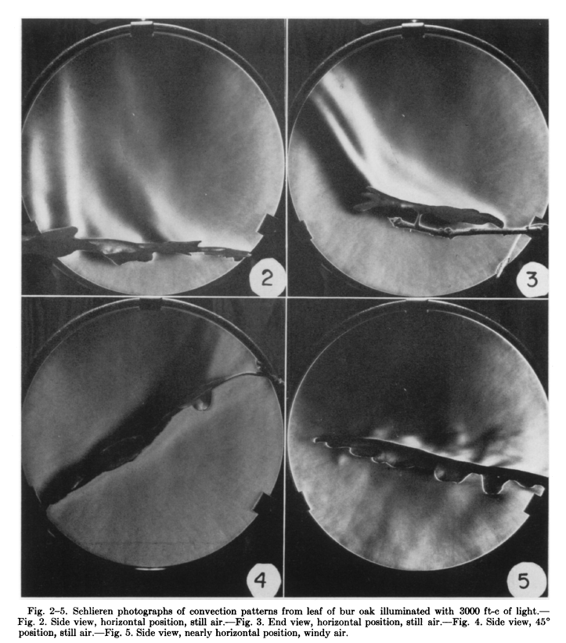
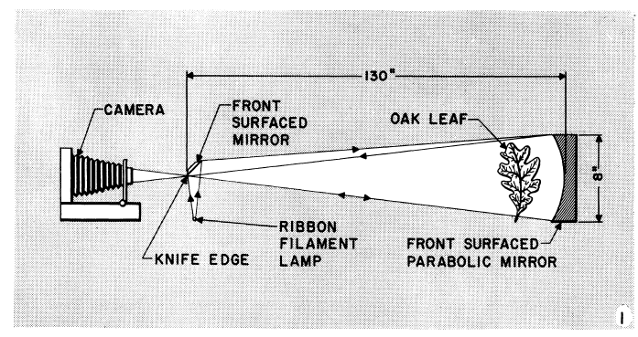
Current Status…
2). Turbulence strength is under-represented in R_{b} In all formulations. All schemes use neutral PBL conditions.
Leaf convection phenomena from lab studies: For turbulent conditions, such as daytime with surface heating, the literature indicates the presence of convective plumes at the leaf scale under still and windy air conditions
This is because plants are subjected to heat load or thermal stress.
Convection phenomena from plants in calm and windy air was observationally studied firstly by Gates and Benedict (1962).
Other leaf-scale studies:
Wigley and Clark (1974)
Brenner and Jarvis (1995)
Wesely et al. (1985) used convection
factor in R_{b}
Notes:
This figure shows that convective plumes originating from the leaf surface causing surface turbulence. Thus, Rb resistance need to have proper representation of turbulence magnitudes. Second cartoon shows impacts of forced convection. Thus, turbulence effects caused by both free convection and forced convection needs to be included in the Rb

Slide 6
Impacts of aerosols/particles on Stoma → Rs, stomatal resistance
Notes:
Explore the usage of e* in many formulations as it fits

Slide 7
What we want to do… (AKA objectives)
(1) We want to eliminate explicit usage of stability functions in various resistance formulations, for example: ( in use for half a century)
$$R_{a}=\frac{1}{{ku}_{∗}}\left( ln\left[\frac{z_{r}}{z_{0}}\right]− Ψ_{H}\right)$$
$$R_{a}=\frac{1}{???}ln\left[\frac{z_{r}}{z_{0}}\right]$$
so that only one equation can be used for all stability conditions in PBL in all models promoting uniformity across all models.
It can be achieved via introduction of 3-D velocity scale, $e_{∗}$
(2) Improve turbulence strength representation in other resistance formulations via using $e_{∗}$
→ Proposing new/revised resistance formulations
Notes:
Explore the usage of e* in many formulations as it fits

Slide 8
Methodology: 3-D Turbulence Velocity Scale
Friction velocity ($u_{∗}$) is used in almost all gas & particle deposition formulations
For neutral Conditions:
Unstable & Stable Conditions:
$$u_{∗}=\frac{k u\left(z\right) }{ln\left[\frac{z−z_{d}}{z_{0}}\right]}$$
$$u_{∗}=\frac{k u\left(z\right) }{ln\left[\frac{z−z_{d}}{z_{0}}\right]− ψ_{m}\left[\frac{z}{L}\right]+ψ_{m}\left[\frac{z_{0}}{L}\right]}$$
Turbulence Kinetic Energy (TKE) at the surface:
$TKE= \overline{e^{′2}}= \frac{1}{2} (\overline{u^{′2}}+\overline{v^{′2}}$ $+$ $\overline{w^{′2}})$
Using Variance of Velocity Fluctuations (σ ² ):
$TKE=\overline{e^{′2}}$ = $\frac{1}{2}\left(σ_{u}^{2}+σ_{v}^{2}+σ_{w}^{2}\right)$
We introduce the 3-D Turbulence Velocity Scale, $e_{∗}$
$e_{∗}= \sqrt{\overline{e^{′2}}}$ $=\sqrt{\frac{1 }{2}\left(σ_{u}^{2}+σ_{v}^{2}+σ_{w}^{2}\right)}$
Turbulence Velocity Scale can be written as
Notes:
One formulation for all PBL conditions is much needed to promote generalization

Slide 9
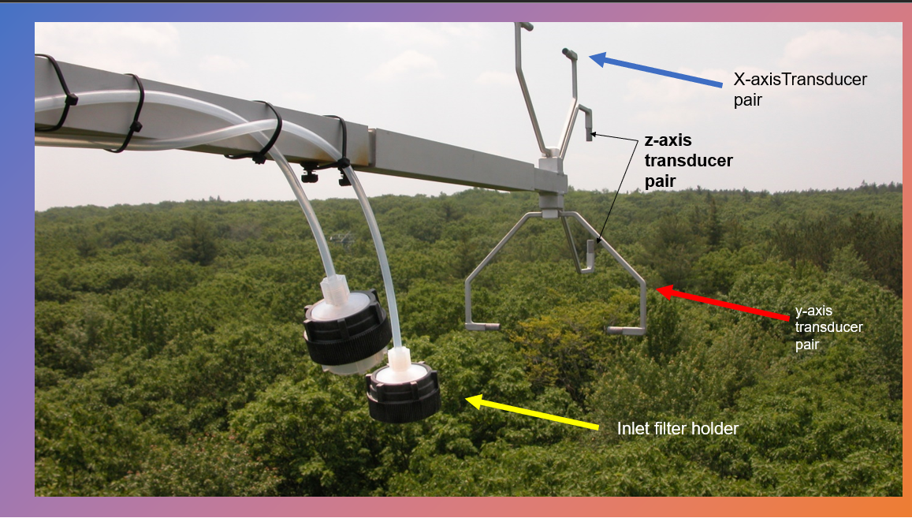
Harvard Forest 3-D Sonic Anemometer
The 3-D sonic anemometer measures 3-D velocity variances.
We call $e_{∗}$ as the 3-D turbulence velocity scale
The anemometer also measures friction velocity that naturally includes impacts of vertical heat flux on momentum fluxes and thus no stability functions are needed when using in models
$σ_{u}^{2 },σ_{v}^{2 }$, and $σ_{w}^{2 }$
Blue arrow is the x-axis transducer pair - measures wind in x-axis
Red arrow is the y-axis transducer pair measures wind in y-axis
Black arrow is the z-axis transducer pair (vertical wind)
yellow arrow is an inlet filter holder for sampling O₃ and CO₂
Since $e_{∗}$ includes 3-D turbulence, how can we use it in PBL research? So, far
no one has used it! We are the 1st !!
Notes:
Sonic anemometer can measure turbulence velocity estar as well as friction velocity ustar.
View of forest canopy in the direction upwind of the Harvard Forest Flux tower. The ATI sonic anemometer and inlets for O3 and CO2 samples are shown in the foreground. The ATI sonic anemometer has an orthogonal array of transducers that transmit and receive sound pulses. Wind velocities are computed from difference in transit times for pulses in opposite directions. Air temperature is calculated from the speed of sound determined by the mean transit time for the vertically oriented transducer pair. Wind velocities and temperature are reported at 10 Hz. The fluxes of CO2, H2O, O3, and heat are computed from the covariance between vertical wind velocity and concentration over 30-minute intervals.

Slide 10
Closure Problem – how to estimate $e_{∗}$
Since we have only one 3-D sonic anemometer site data for the US, we need a methodology to estimate it for every site where surface measurements are available or for use in a gridded model.
Alapaty and Alapaty (2001) used it for a PBL scheme; He & Alapaty (2018) coupled cloud processes with PBL process and proposed & evaluated $e_{∗}$using the Multi-Scale Kain-Fritsch (MSKF) scheme. In those studies, $e_{∗}$was estimated as:
But $e_{∗}$was never evaluated against measurements

Slide 11
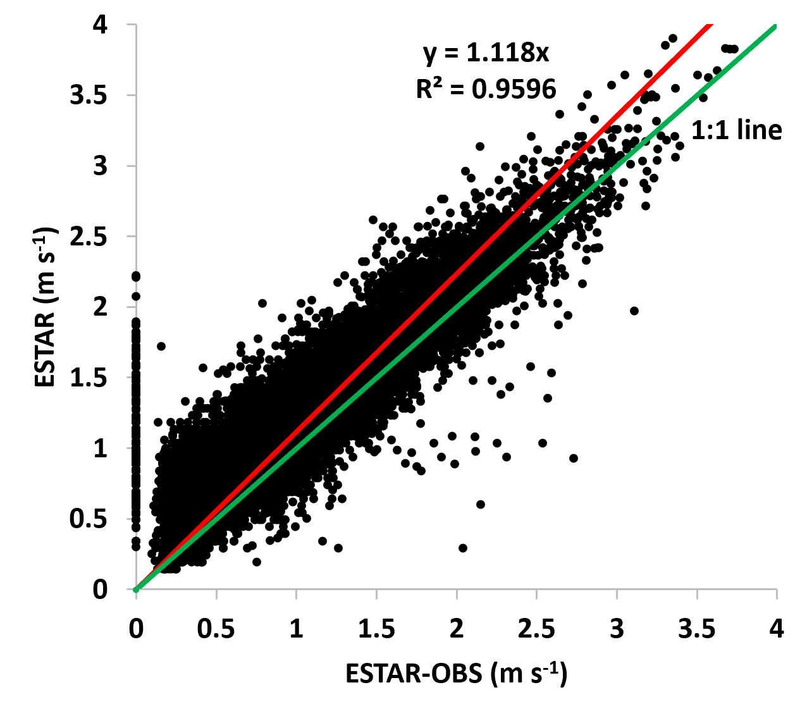
Validation of e* Estimation Using 3-D Sonic Anemometer Micrometeorological variance Data (1991-2000)
The $e_{∗}$ and $e_{∗}$_{obs} have excellent correlation, validates the parameterized $e_{∗}$ estimation at decadal timescale & its utility representing 3-D turbulence.
Parameterized $e_{∗}$
Measured $e_{∗}$ ${ ( e}_{∗}obs$ )
Notes:
Replace k*ESTAR with k.ESTAR

Slide 12
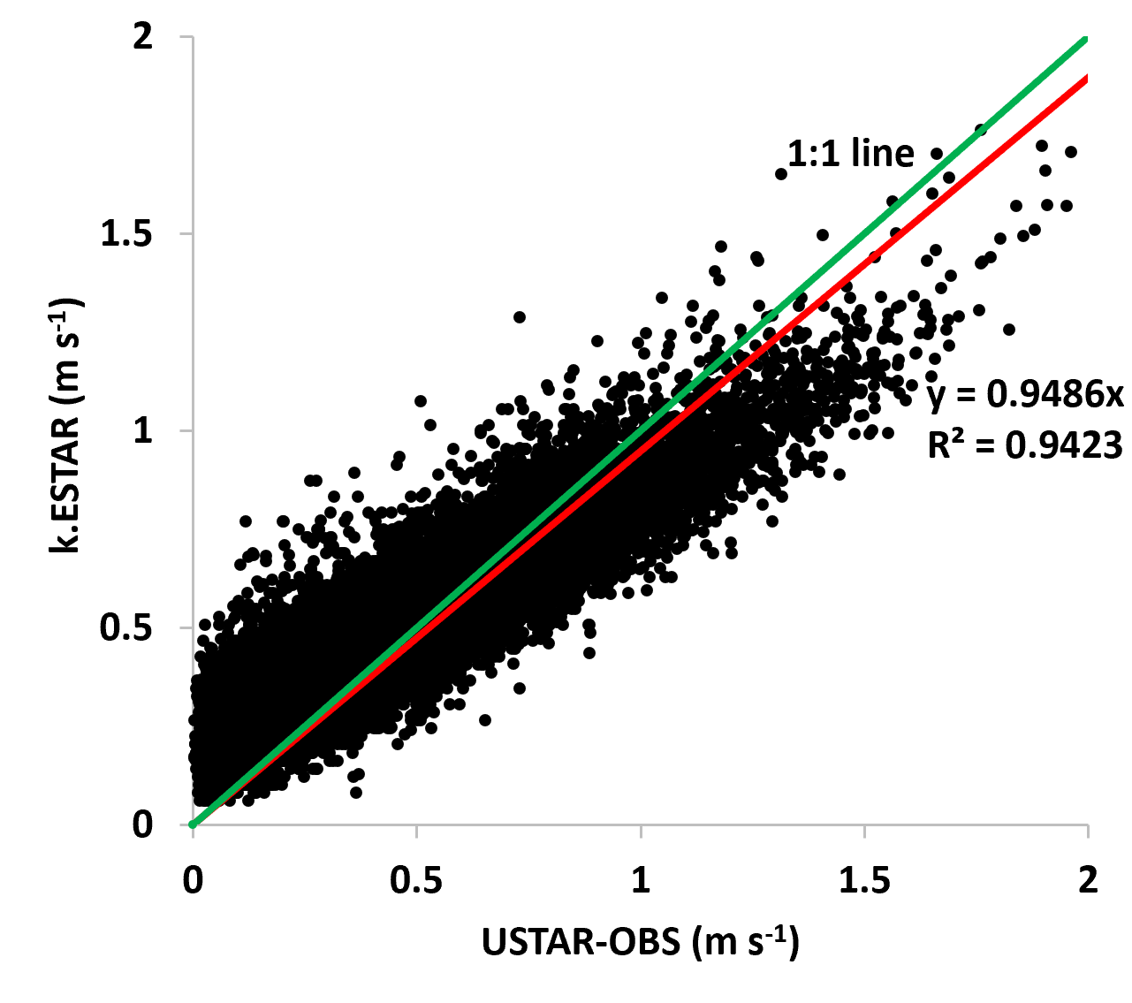
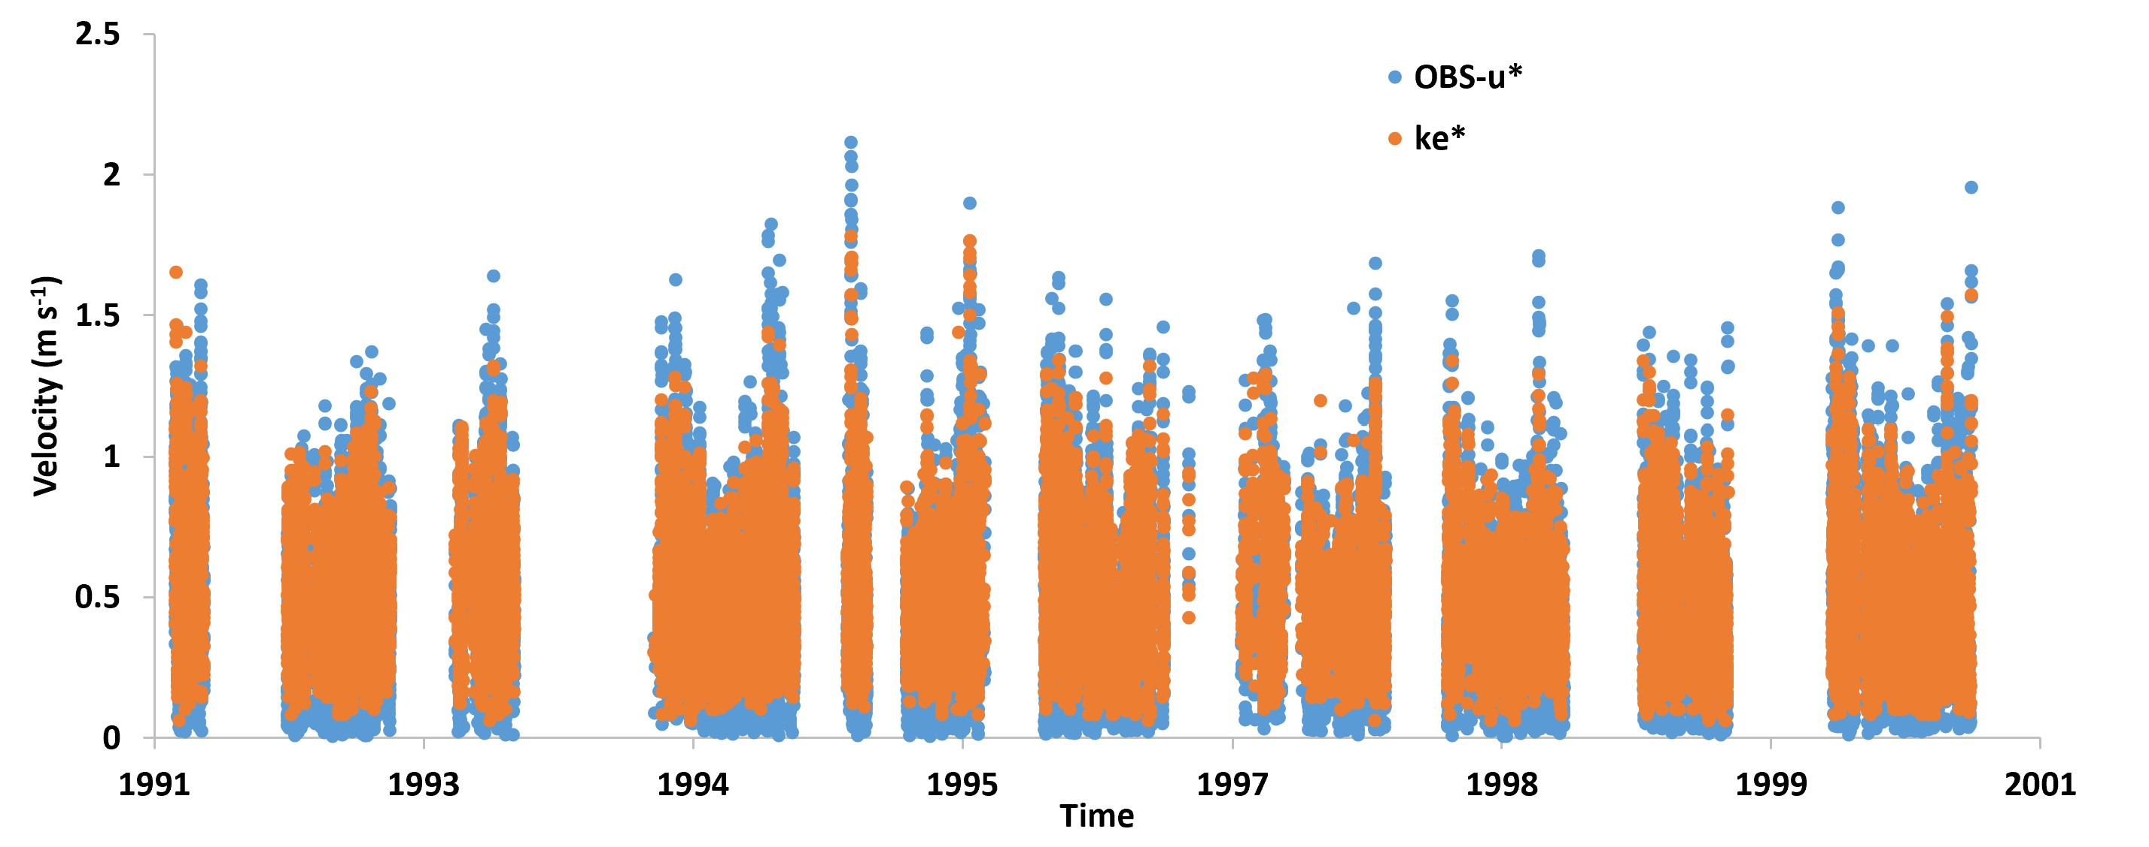
Hypothesis: $u_{∗c}$ ≈ ${k e}_{∗}$ and evaluation
Since $e_{∗}$ contains normal stresses while $u_{∗c}$ contains shear stresses, we have to scale $e_{∗}$ before we can use it for deposition modeling.
1991-2000
The von Karman constant (k) provided a good scaling for $e_{∗}$ to replace the measured friction velocity, $u_{∗c}$ .
Thus, $u_{∗c}$ ≈ ${k e}_{∗}$
Sonic anemometer measured friction velocity $u_{∗c}$ can be approximated as the product of $e_{∗}$ and von Karman constant, k.
Notes:
In this research, we prove that…
Replace k*ESTAR with k.ESTAR

Slide 13
Resistance Formulations
New aerodynamic resistance (R_{a}) for different stability regimes in PBL
$$R_{a}= \frac{U}{k^{2}e_{∗}^{2}} =\frac{1}{k^{2}e_{∗}} ln\left[\frac{z−z_{d}}{z_{0}}\right]$$
Revised leaf boundary layer resistance (R_{blf}) & soil boundary layer resistance (R_{bsoil})
$$R_{blf}=\frac{v {(l_{leaf} {ke}_{∗}/(v {LAI}^{2}))}^{1/3}}{D{ke}_{∗}}$$
$$R_{bsoil}=\frac{\frac{v}{D} − log\left\{\frac{10 D}{k \exp\left(−LAI∗0.5\right) {ke}_{∗}}\right\}}{k \exp\left(−LAI∗0.5\right) {ke}_{∗}}$$
New in-canopy aerodynamic resistance (R_{inc})
$$R_{inc}= R_{a}\left(e^{0.5 LAI}−1\right)= \frac{U}{{k^{2}e}_{∗}^{2}} \left(e^{0.5 LAI}−1\right)$$
where U is surface wind speed, k is the von Karman constant (0.41), z₀ is roughness length, z is the measurement height, z_{d} is zero-plane displacement height, ν is kinematic viscosity of air, $l$_{leaf} is characteristic leaf width specified as 0.0314 m, LAI is leaf area index, and D is diffusivity of gases.
Notes:
New resistance formulations are proposed by replacing measured friction velocity with the product of von Karman constant and turbulence velocity. In the new equations, all the red colored parameters are new.
Original Rblf, Rbsoil, Rinc formulations are designed for neutral conditions, but we are introducing ESTAR to represent all the conditions in the PBL.

Slide 14
Resistance formulations…
New cuticle resistance (R_{cut}) for dry and wet regimes
$R_{cutd}=\frac{R_{cd0}}{I_{t} \left(e^{RH}\right) {\left(L_{AI}\right)}^{0.25} }$ (dry)
$R_{cutw}=\frac{R_{cw0}}{I_{t} {\left(L_{AI}\right)}^{0.85} }$ (wet)
$$I_{t}= \frac{e_{∗}}{U}$$
Revised stomatal resistance (R_{s}): impacts of PM_{2.5} blocking stoma
$$g_{smax }=g_{smax} G_{pm25}$$
where G_{pm25} is the factor (0.8 which is equal to 20% reduction) we specify when PM_{2.5} deposition exists else it assumes a value of unity. The proposed is conceptually analogous to a decrease in g_{smax} under drought stress conditions (Running, 1976; Cavender-Bares et al., 2007; Zeppel et al.,2011).
Revised photosynthetically active radiation (PAR): Impacts of dew formation and PM_{2.5} on PAR
$$P_{AR}={P_{AR} P}_{dew+pm25}$$
In our study, impacts of PM_{2.5} deposition and dew formation on the photosynthesis is approximated via reduction in photosynthetically active radiation (PAR). For dew conditions RH > 70%) a reduction of 10% in PAR is used since dew formation is predominant only in the upper parts of the canopy. For PM_{2.5} deposition effects on the reduction in photosynthesis (e.g., González et al. 2014), an additional 10% reduction of PAR is introduced for use in polluted sites.
Notes:
New Rcut formulation is similar to Zhang’s formulation but avoids direct dependence on u*. Thus in the new formulation Rcut feels the degrees of variation of turbulence magnitude . Impacts of PM2.5 on stoma closure and PAR is explored via simple methodology. In the future dynamic equations can be introduced in lieu of universal constants. Dew formuation effects on PAR are also roughly included (which is only predominant on upper parts of canopy)

Slide 15
Single-point O₃ Dry Deposition Model: STAGE
We used the Surface Tiled Aerosol and Gas Exchange (STAGE) deposition model as it is parameterized in the CMAQ v5.3 release (Appel et al., 2020)
Jesse Bash , John Walker, Zhiyong Wu, and Colleen Baublitz have developed a single-point version of the STAGE Model available in CMAQ
Configured as a standalone R code
Numerical simulations (1991-2000)
Base formulations referred to as STAGE
New formulations referred to as TKE-STAGE
Long-term measurements at Harvard Forest (HF)
O₃ flux
Notes:
Jesse Bash and John Walker have developed single-point version of the STAGE Model.

Slide 16
Conductances estimation
Summer month
$$\frac{1}{R_{a}}$$
$$\frac{1}{R_{inc}}$$
Winter
month
Notes:
Based on literature review, both the base and estar cases predicted aerodynamic conductance well within the measured values.
Also, the gaps in the data indicates either missing inputs or bad inputs.

Slide 17
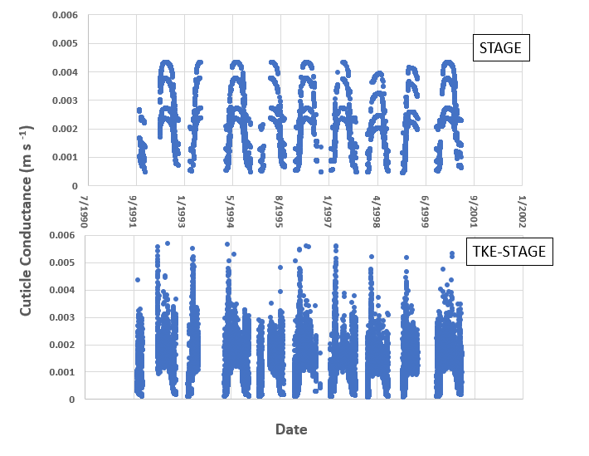
Cuticle conductances
Notes:
Since the STAGE Rcut is inversely proportional to LAI, changes in LAI are reflected via “layered” values. In the new formulation, as mentioned earlier impacts of intensity of turbulence modulated the variability. Both have similar magnitudes. We need some observations, especially long term, to further evaluate these formulations.

Slide 18
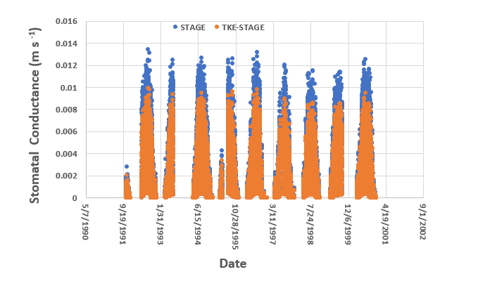
Stomatal Conductance
Notes:
As expected, impacts of particle blockage and dew formation effects result in reduced stomatal conductance (increased resistance) that will have reduced ozone fluxes

Slide 19
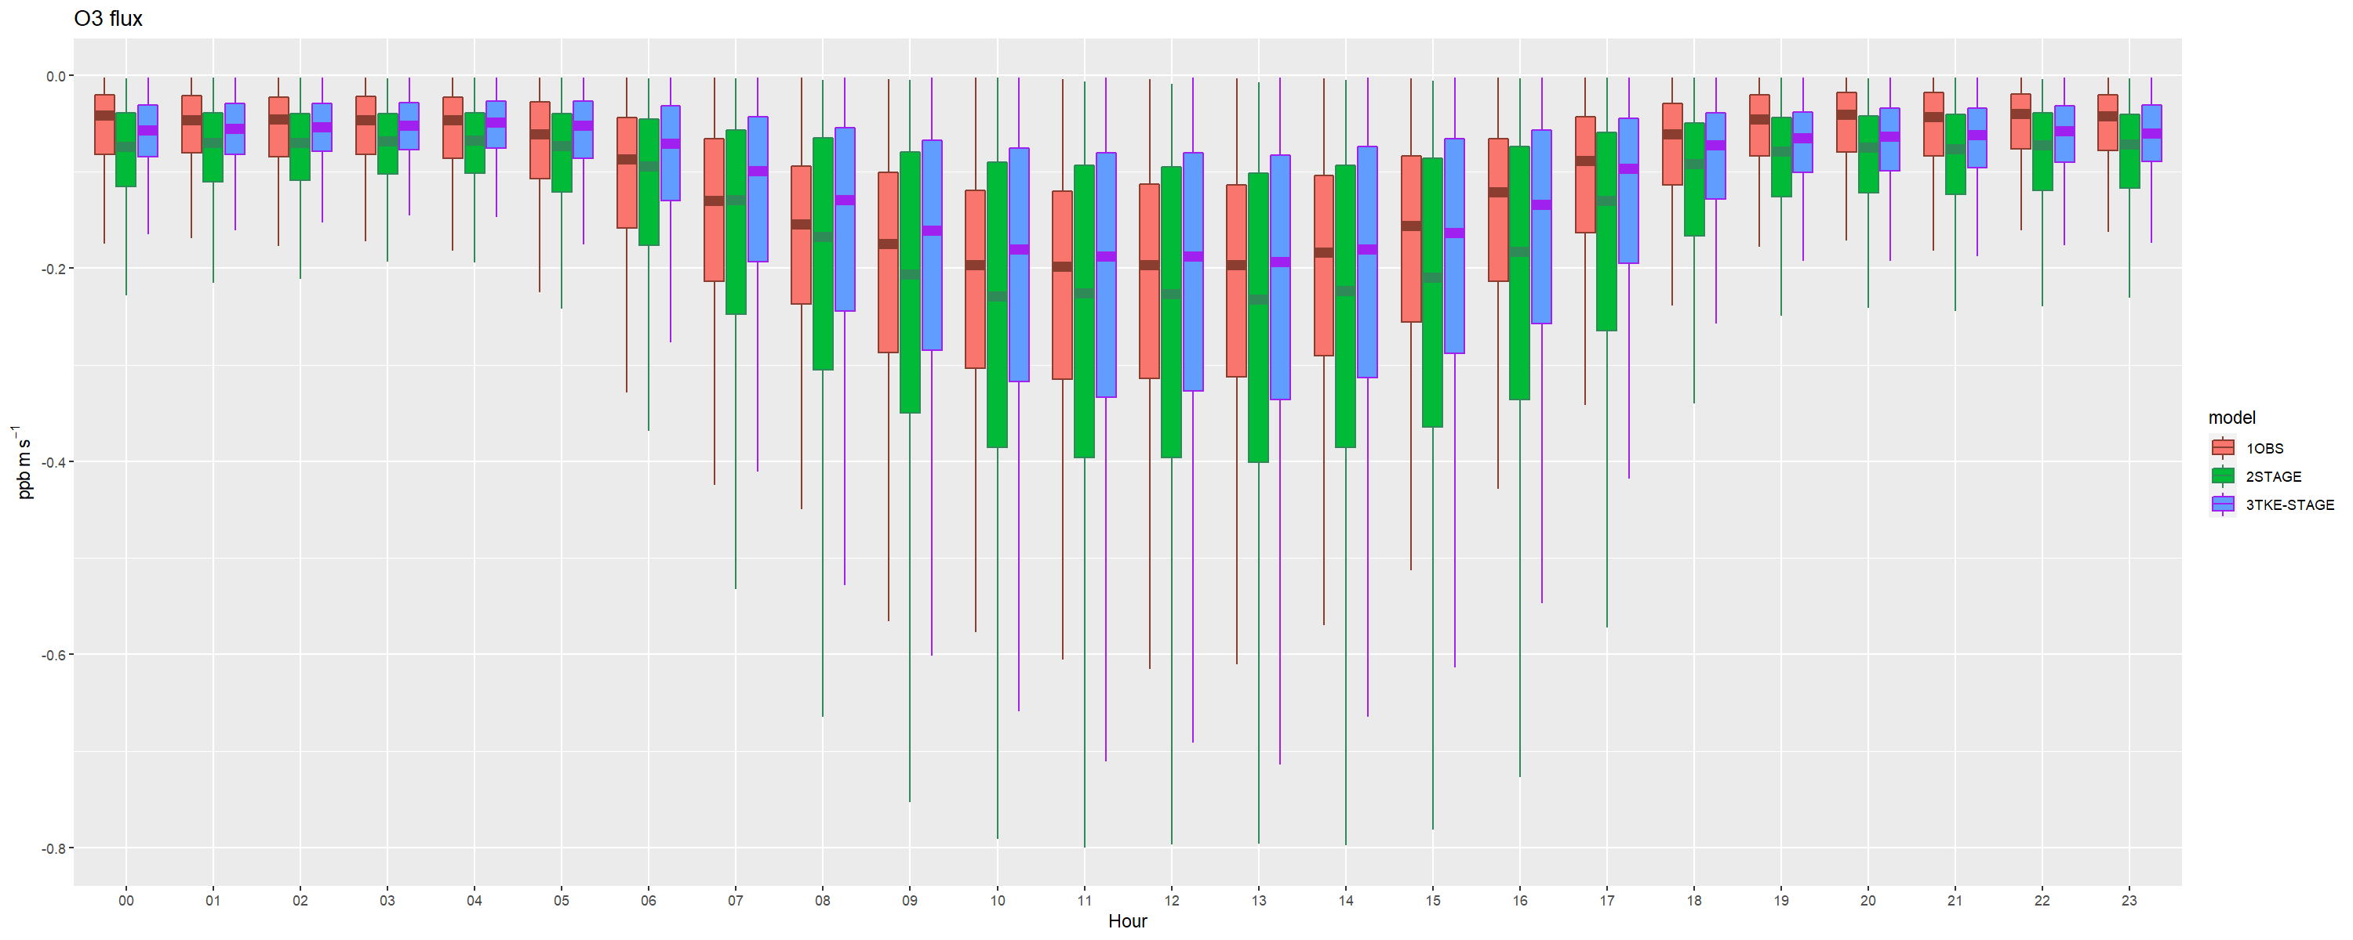
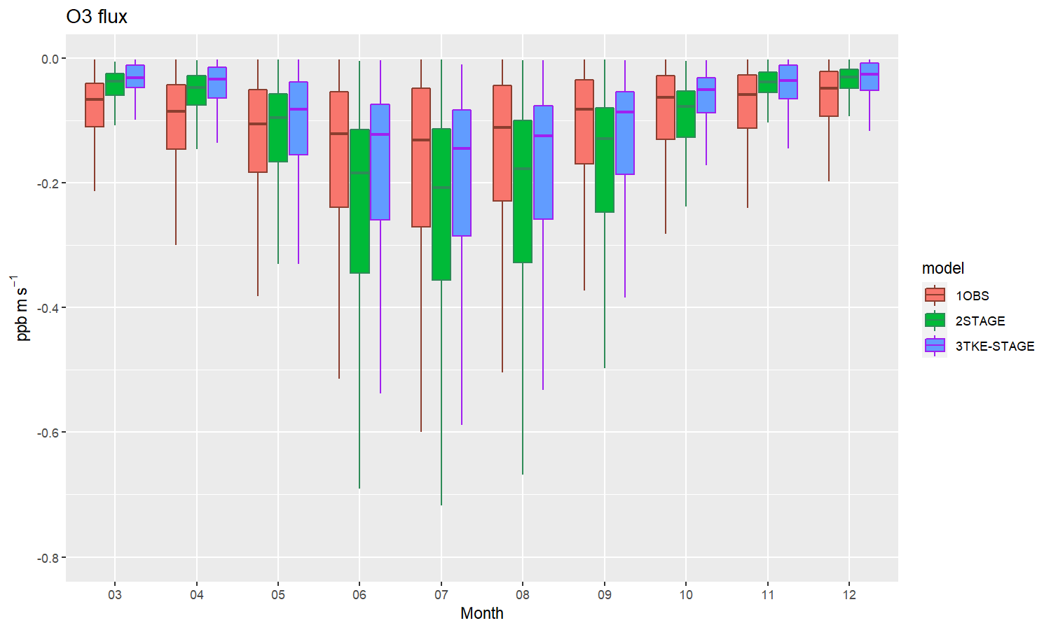
O₃ Diurnal and Seasonal Fluxes Simulations
Diurnal Variation: O₃ fluxes by STAGE are always greater than TKE-STAGE; Both cases overestimated maximum values of fluxes during daytime.
Seasonal Variation: STAGE estimated higher fluxes during warmer months. Both methods estimated lower fluxes during cooler months.

Slide 20
SUMMARY
The proposed 3-D turbulence velocity scale has R² of about 0.96 when compared to that measured by the 3-D sonic anemometer, providing a solid foundation for the use of $e_{∗}$ in dry deposition modeling.
We hypothesized and verified that measured friction velocity can be replaced by the product of von Karman constant and the 3-D turbulence velocity scale.
Thus, k$e_{∗}$can be considered as pseudo 3-D sonic anemometer friction velocity.
We have introduced :
a new and generalized R_{a} formulation
turbulence strength effects into R_{blf}, R_{inc}, R_{bsoil} , and , R_{cut}
a new cuticle formulation that has more degrees of freedom
effects of stomatal blocking and dew formation on stomatal resistance
These new/revised resistance formulations work very well in simulating surface O₃ fluxes when compared to existing formulations at a decadal time scale.
These results encourage us to further test the new equations in the CMAQ.

Slide 21
Thank You!
Questions/Comments?
Disclaimer: The views expressed in this presentation are those of the authors and do not necessarily reflect the views or policies of the U.S. EPA.

Slide 22
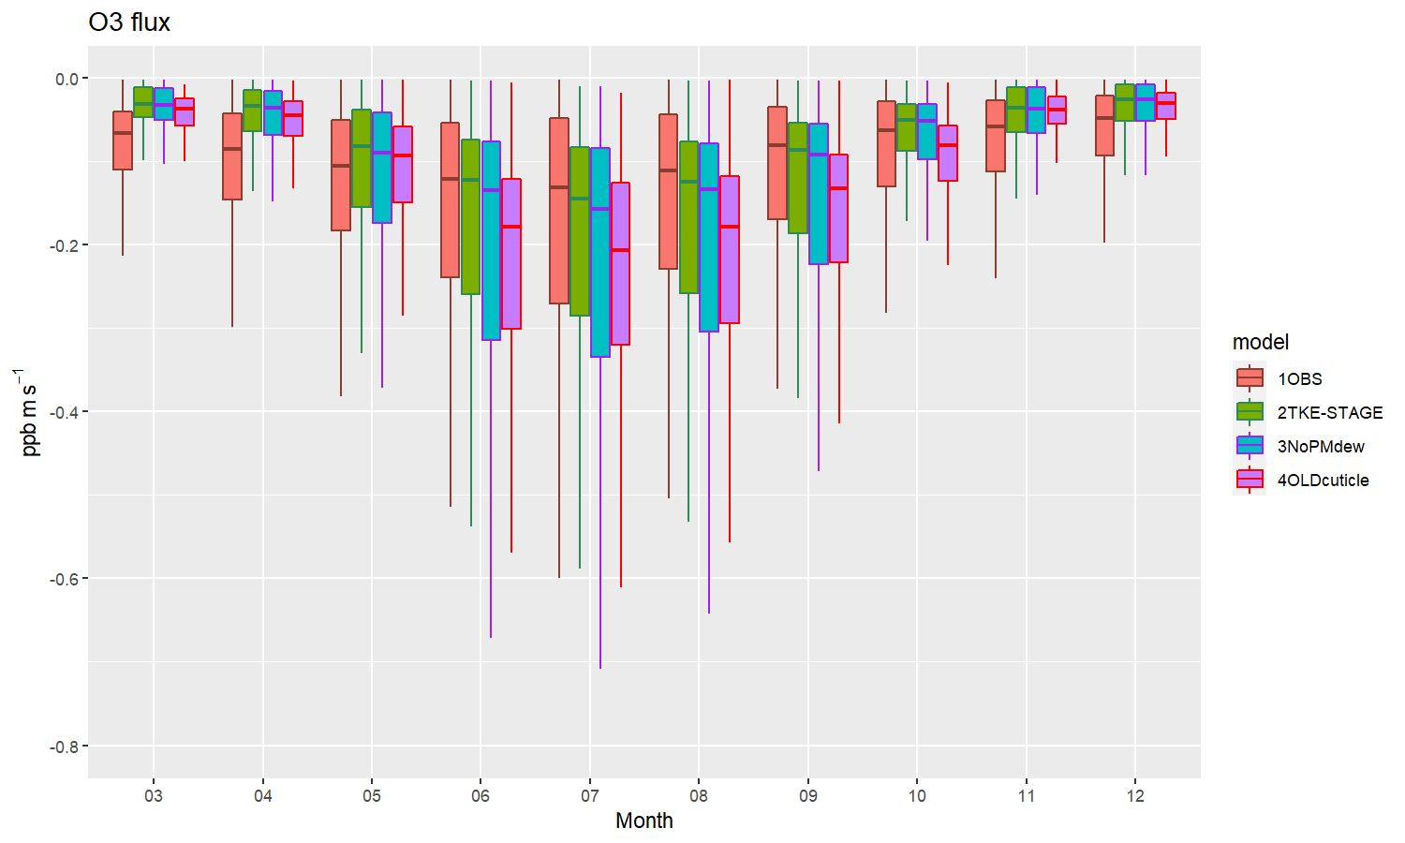
Sensitivity Studies
Notes:
During cooler months, all cases largely underpredict fluxes. During warmer months when PM and dew effects are ignored, then bias in fluxes has increased (blue boxes) as compared to that included those effects (green boxes). When original cuticle resistance formulation was used, it also resulted in small increased bias in fluxes (purple boxes) in warmer months only.

Slide 23
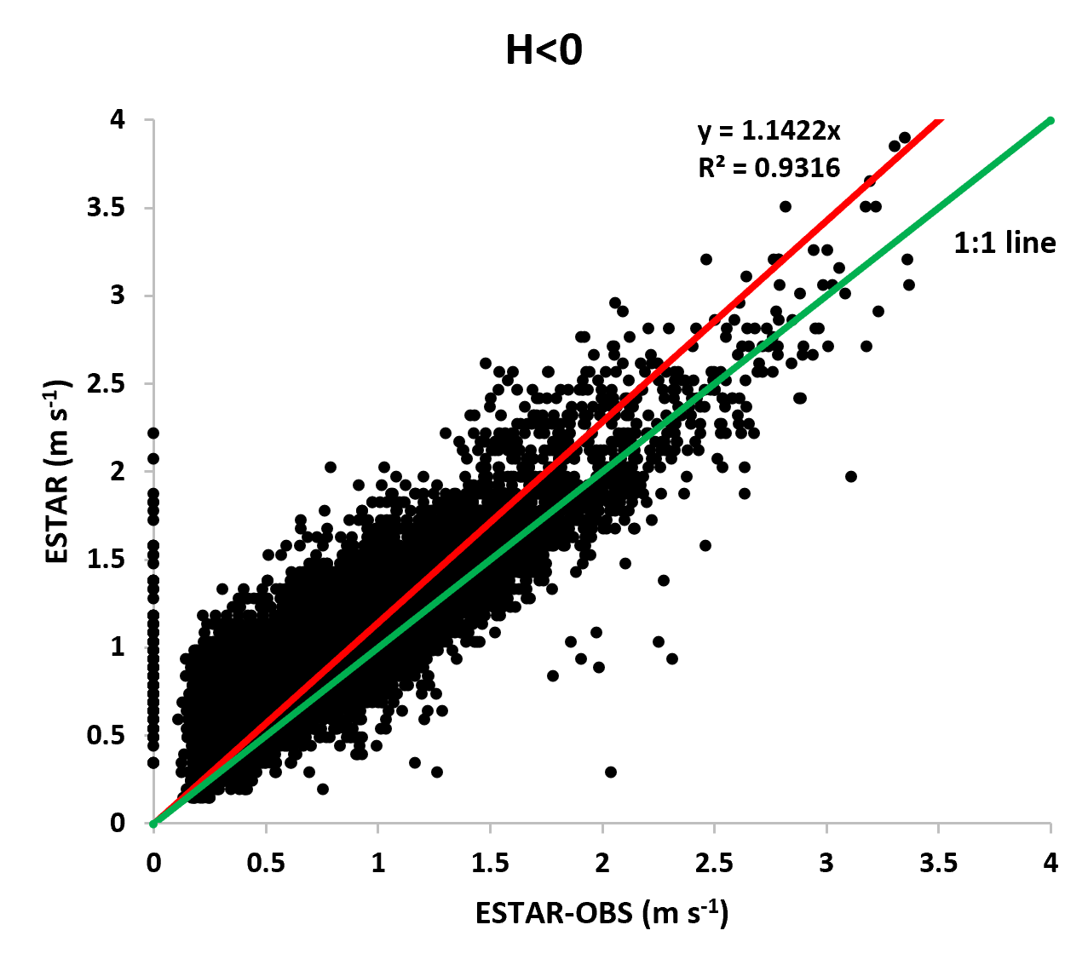
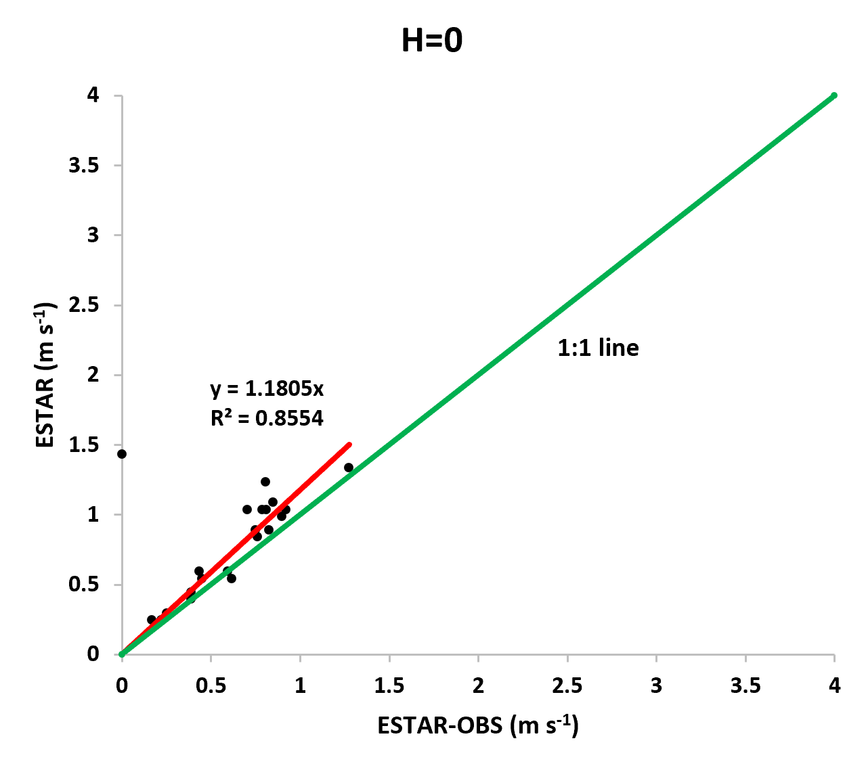
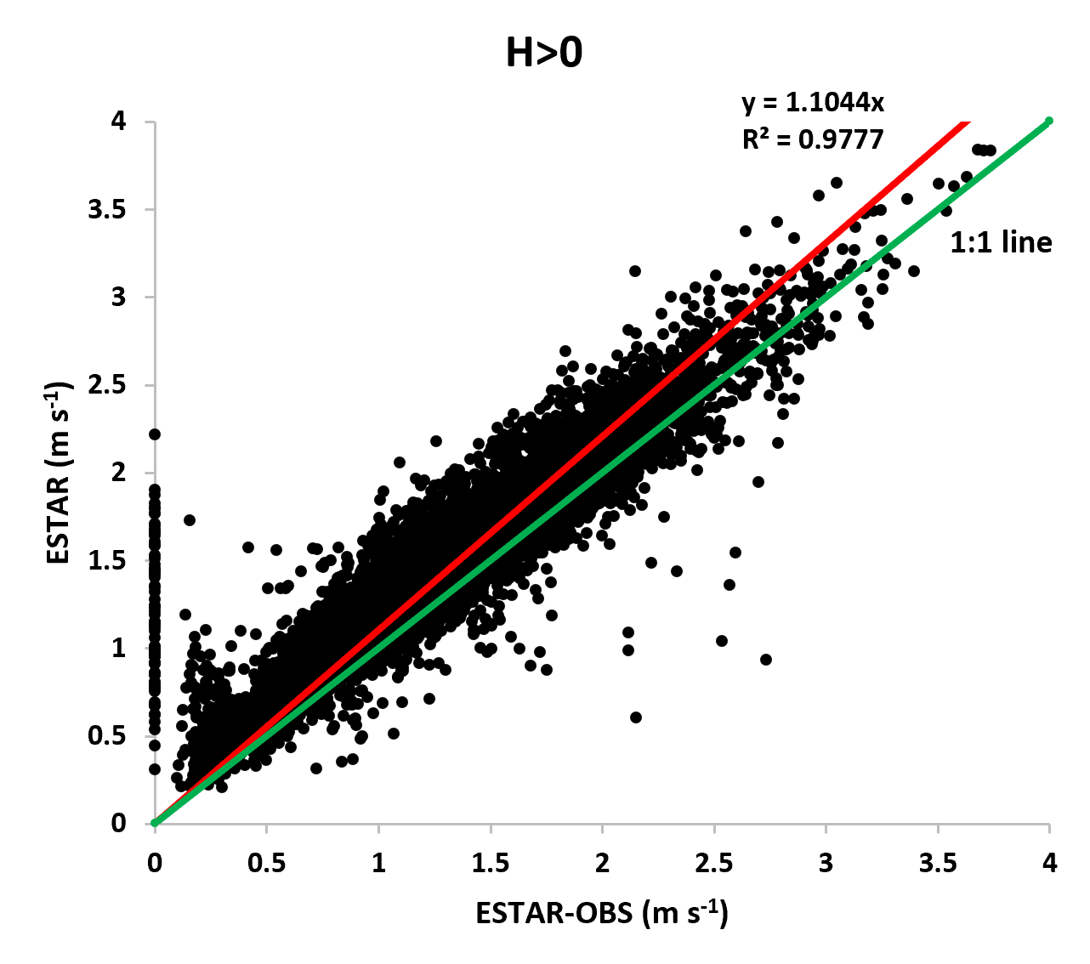
Parameterized Velocity Scale vs Measured Velocity Scale for different PBL stability regimes

Slide 24
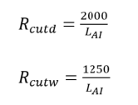
STAGE orig formulations for Cuticle Resistance

