Slide 1


US coal power plant emissions changes and inequities since 1999
Lucas Henneman
Munshi Md Rasel, Christine Choirat, Susan Anenberg, Corwin Zigler
CMAS
October 2022
lhennem@gmu.edu
@lucas_henneman

Slide 2
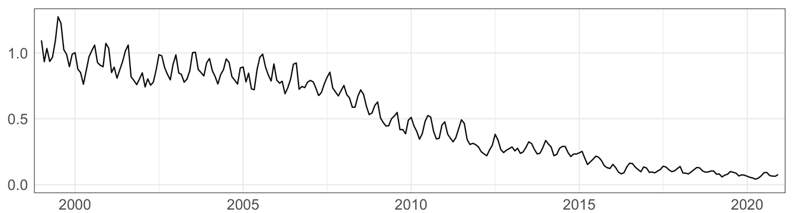
Why coal power plants?
SO₂ emissions, 10⁶ tons
How did emissions reductions influence air pollution exposure & equity?

Slide 3
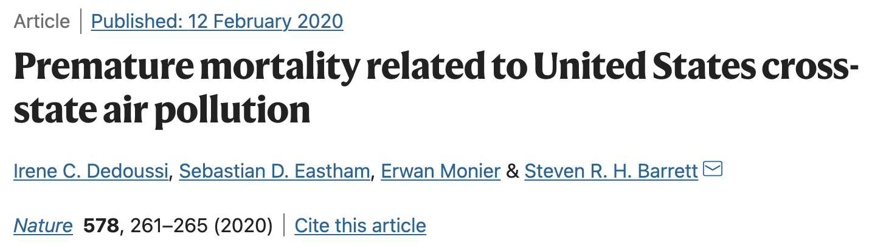
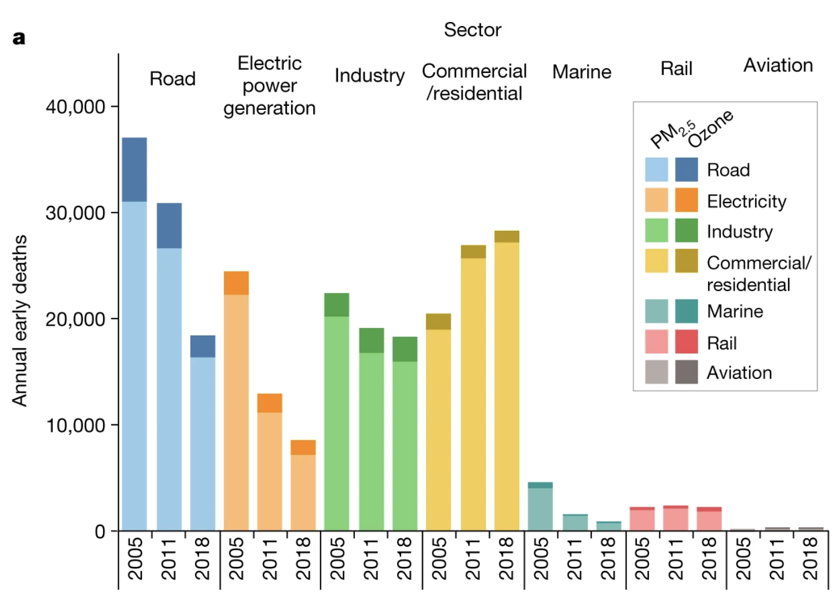
Why coal power plants?
(Historically) major contributor to air quality and health burden
Regulations and economics have led to large emissions reductions

Slide 4
United States coal power plants
https://www.flickr.com/photos/wigwam/2630349031
Data from EPA Air Markets Program Data
~ 350 coal power facilities
~ 1,200 units
Concentrated in eastern United States
25 largest facilities
Notes:
John E Amos pp in W Virginia
Update map?

Slide 5
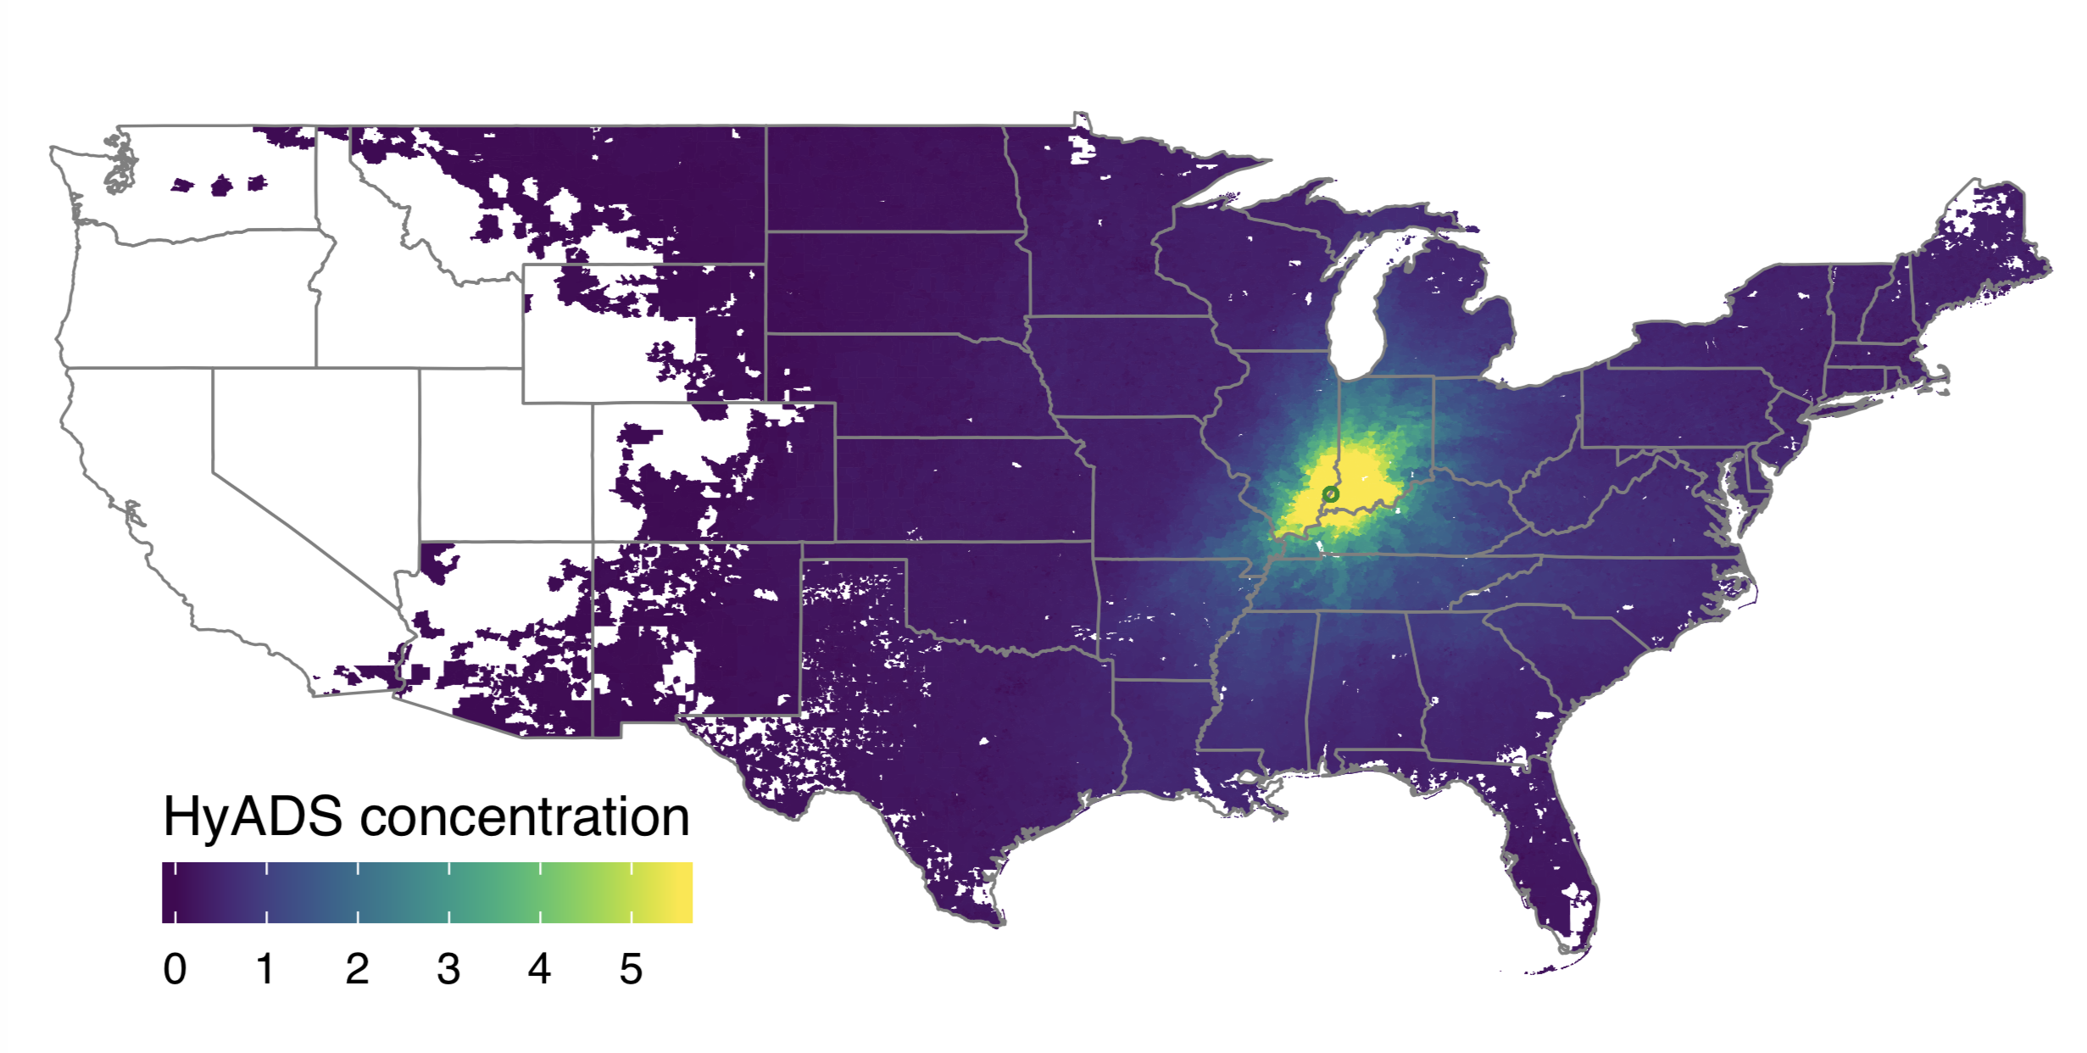
Exposure from individual power plant emissions - HyADS
Facility 6113, Unit 1
HYSPLIT transport and dispersion model
  Track 100 parcels from each stack
  Parcels tracked for 7 days
  Omit near-source impacts
  Parcels not resuspended
Repeat at 6-hour intervals daily
Aggregate parcel locations to grid
Weight by monthly SO₂ emissions
Accessible through disperseR R package www.github.com/lhenneman/disperseR

Slide 6
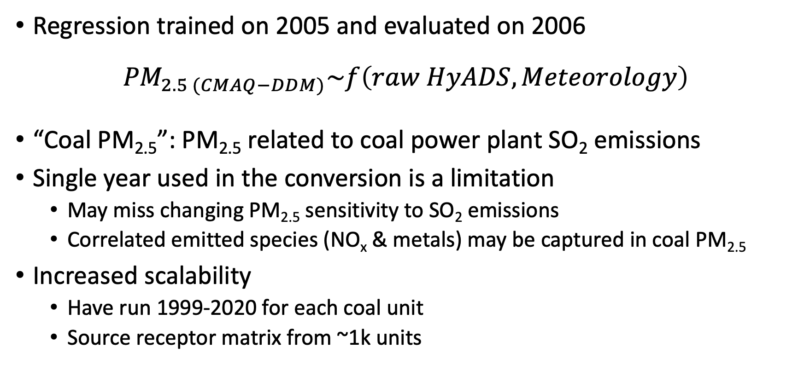
Regression model converts raw output to coal PM_{2.5}
Regression trained on 2005 and evaluated on 2006
$${PM}_{2.5 (CMAQ−DDM)}\sim f\left(raw HyADS, Meteorology\right)$$
“Coal PM_{2.5}”: PM_{2.5} related to coal power plant SO₂ emissions
Single year used in the conversion is a limitation
  May miss changing PM_{2.5} sensitivity to SO₂ emissions
  Correlated emitted species (NO_{x} & metals) may be captured in coal PM_{2.5}
Increased scalability
  Have run 1999-2020 for each coal unit
  Source receptor matrix from ~1k units

Slide 7
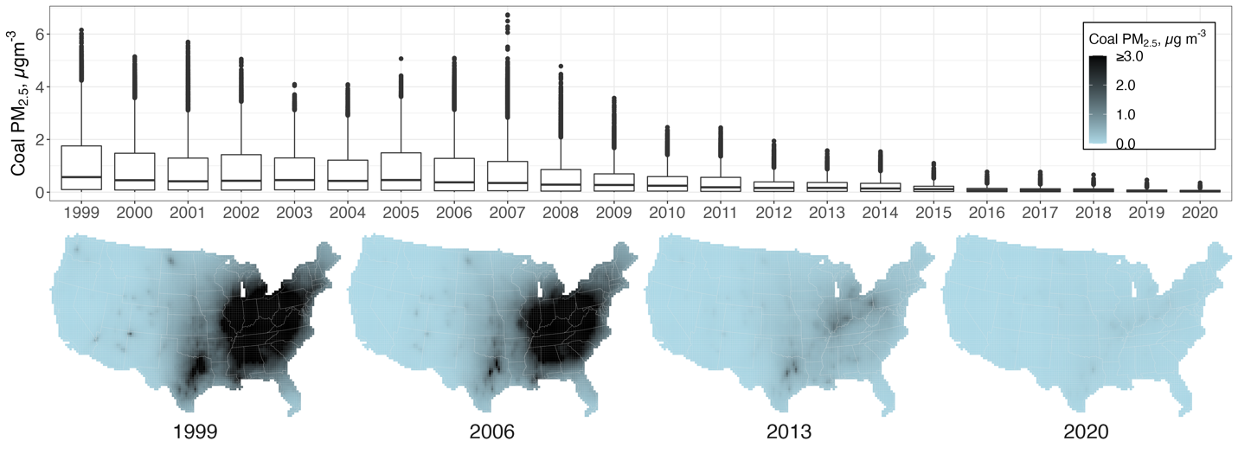
Coal PM_{2.5} decreased substantially since 1999

Slide 8
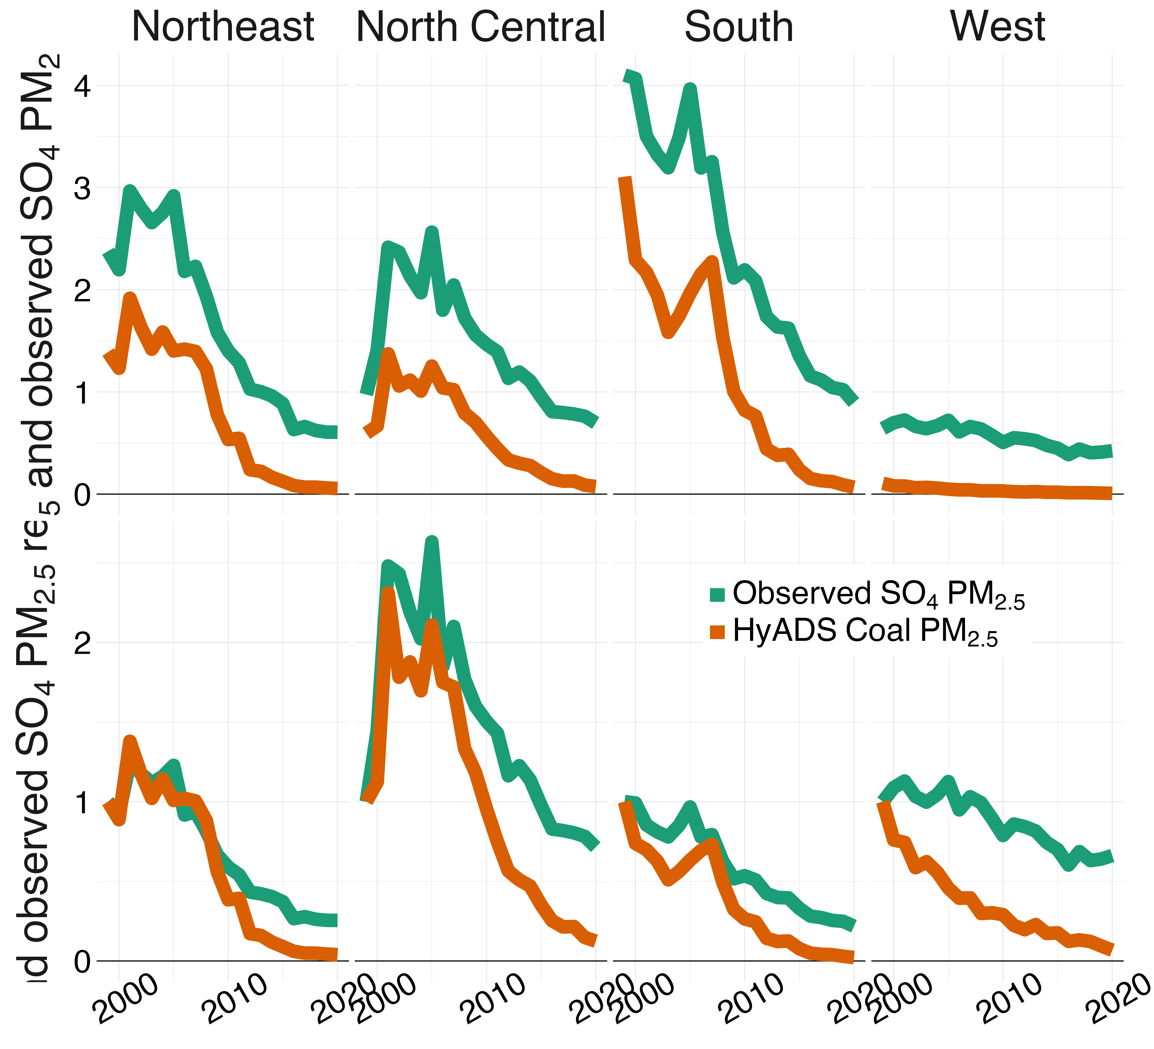

Coal PM_{2.5} is related (not equivalent) to sulfate
Coal EGUs contributions to national SO₂:
  >65% before 2015
  <50% after 2018
Coal PM_{2.5} ~1 µg m⁻³ less than observed sulfate
Coal PM_{2.5} decreases faster than sulfate after 2010
  Changing PM_{2.5} sensitivity to coal?
  Reduced emissions near 0?
Concentration, µg m⁻³
Relative to 1999

Slide 9
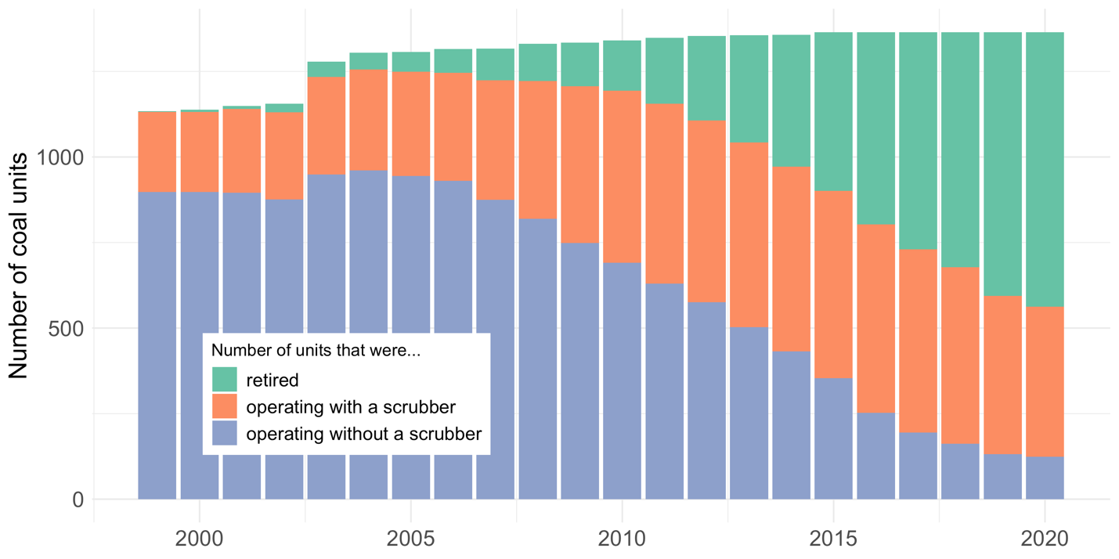
Utilities have modified and retired coal EGUs
Number of coal EGUs
2006-2011
scrubber installations
after 2012
retirements

Slide 10
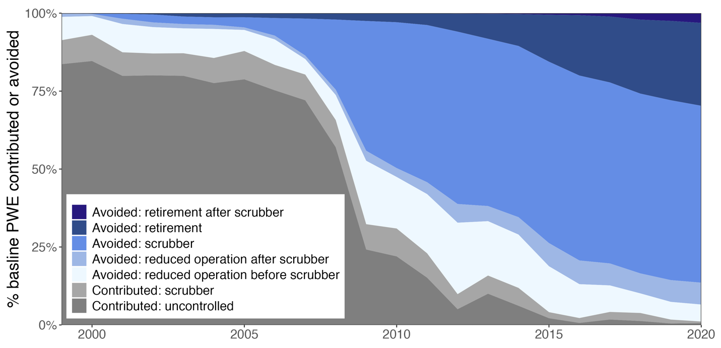

Scrubbers and retirements led to coal PM_{2.5} exposure reductions in different periods
% baseline population-weighted exposure
Exposure contributed
No scrubber
With scrubber
Exposure avoided
Retirement before/after scrubber
scrubber
Reduced operation before/after scrubber
Estimated using difference between PWE before & after interventions

Slide 11
Scrubbers and retirements led to coal PM_{2.5} exposure reductions in different periods
% baseline population-weighted exposure
2006-2011
scrubber installations
2008-2012
reduced operations
after 2012
retirements

Slide 12
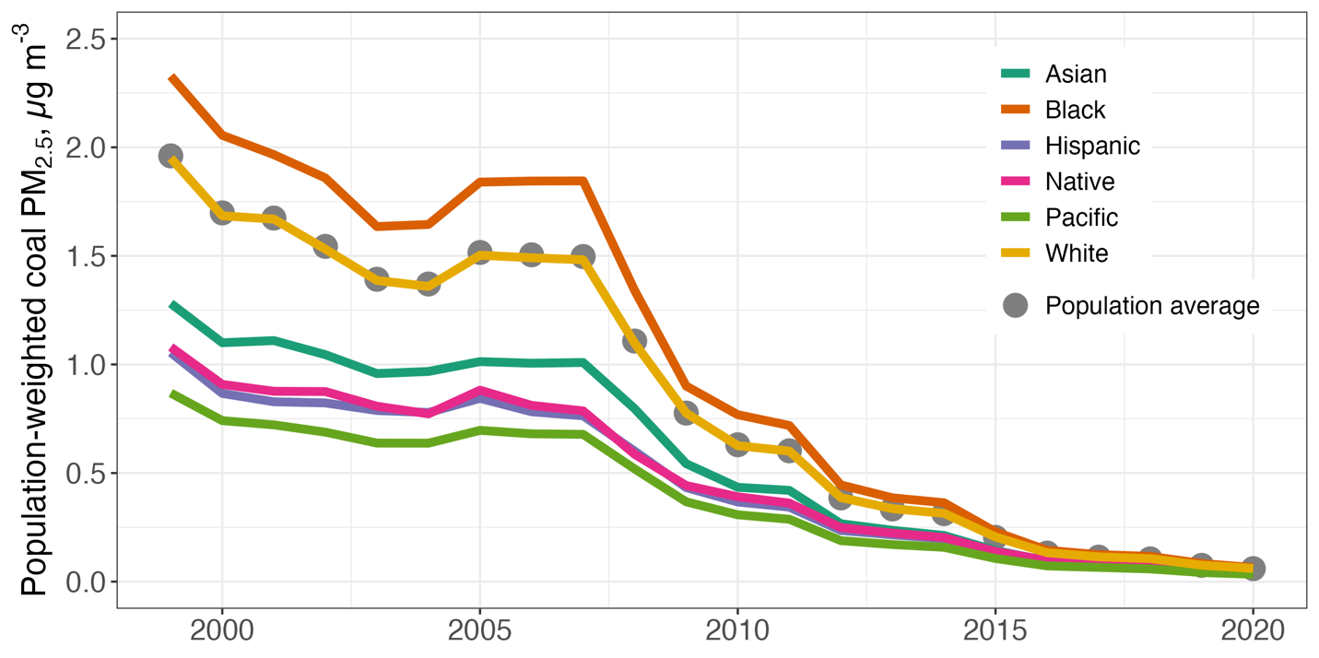
Nationwide population-weighted exposure declined
Population-weighted coal PM_{2.5}, µg m⁻³
County population: US Census
  Coarse resolution, but coal PM_{2.5} is regional
  Racial categories include Hispanic & non-Hispanic
  Hispanic incorporates White & non-White
Black population exposure higher than national average
Asian: Asian population alone
Black: Black or African American population alone
Hispanic: population of Hispanic origin (any race)
Native: American Indian and Alaska Native population alone
Pacific Native Hawaiian and Other Pacific Islander
population alone
White: White alone

Slide 13
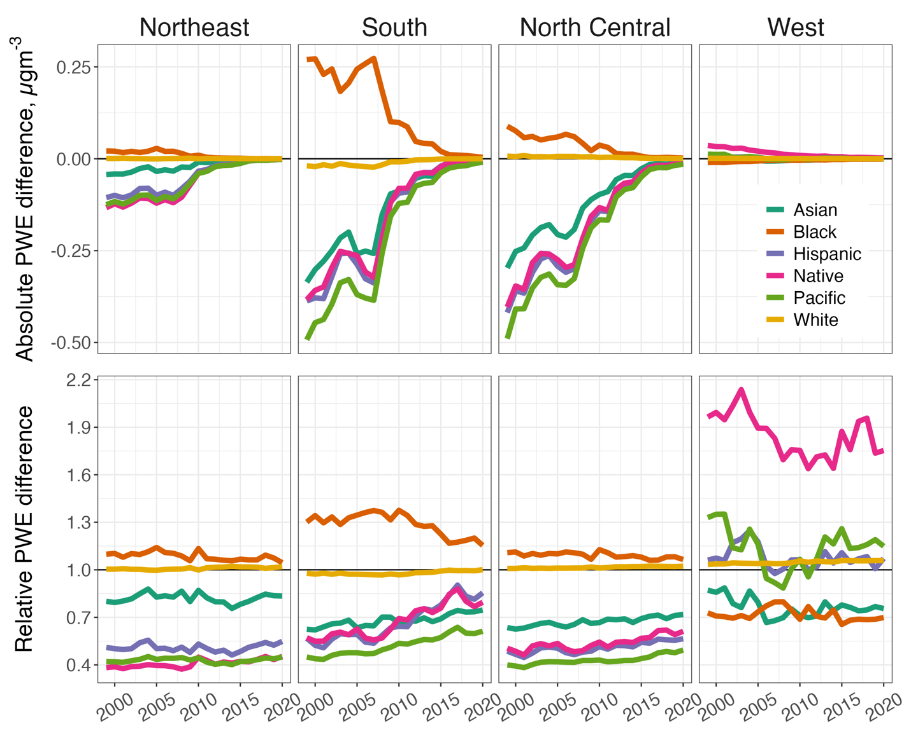
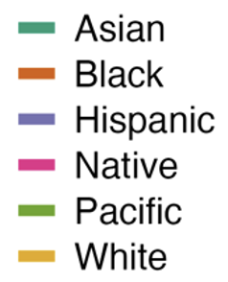
Two metrics explore exposure disparities
Absolute exposure difference (µg m^{‑3})
  Inequitable exposure in South Black population
  Inequity reductions across period
Relative exposure difference
  Black population consistently exposed at higher levels
  Little inequity reductions over time
  Native American population exposed to higher levels in West (absolute differences small)

Slide 14
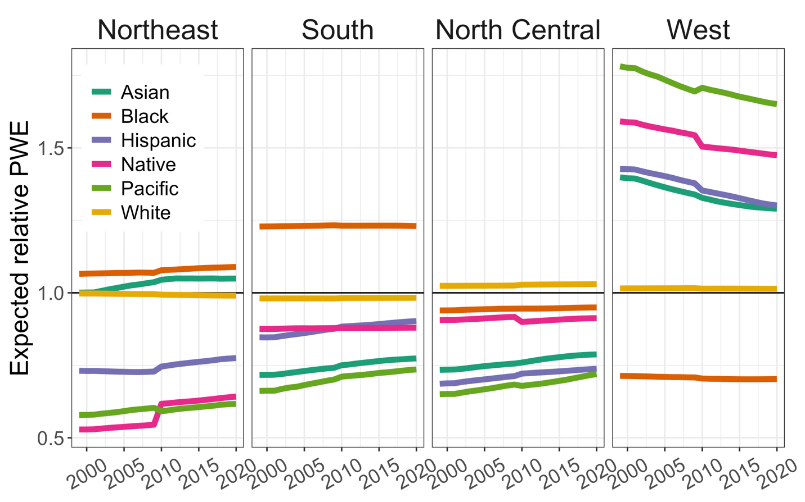
Issue: power plants located near the populations they serve
Expected Inequity
Potential inequities from population distributions
Our solution: normalize by “expected inequity”
  EGU assumed at centroid of each 36 km grid cell
  Inverse-distance weighted exposure
Accounts for:
  Population demographics
  Population changes

Slide 15
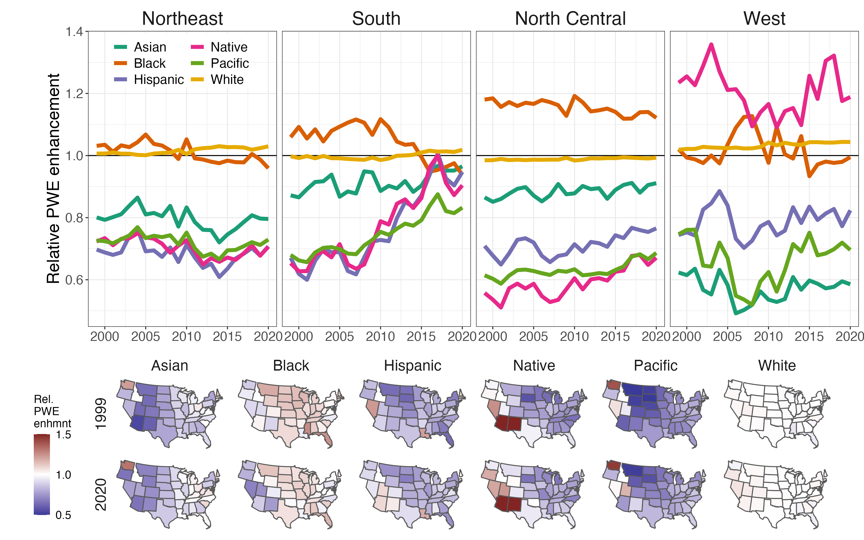
New exposure metric: relative exposure enhancement

Slide 16
Facilities in some states contribute inequitable exposure
Black population inequitably exposed by facilities in most states
Facilities in Western states contribute exposure inequities to Asian, Hispanic, Native, and Pacific populations (exposure low in West)

Slide 17
Conclusions
Decreasing exposure to PM_{2.5} from coal power plant SO₂ emissions since 1999
Exposure inequities persist even:
  As emissions have been reduced from the entire source sector
  After accounting for regional demographics
Coal contributions to ambient PM_{2.5} is small in recent years

Slide 18
Thank you
Lucas Henneman
Munshi Md Rasel, Christine Choirat, Susan Anenberg, Corwin Zigler
CMAS
October 2022
lhennem@gmu.edu
@lucas_henneman
Notes:
21:20 (need to cut)

