Slide 1
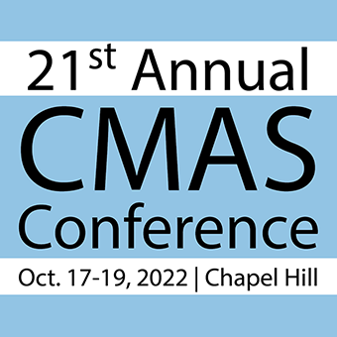
State of the
Center for Community Modeling and Analyses System (CMAS)
> 2 Decades of Serving the Community
Sarav Arunachalam
Director, CMAS Center
21st Annual CMAS Conference
October 17 – 19, 2022

Slide 2
The CMAS Center at UNC https://www.cmascenter.org/
Established in 2001, the U.S. EPA’s CMAS Center has been hosted at UNC since 2003, which works with the agency to lead the international, open-source, community-based air quality modeling and analysis software used to develop policies and analyze air quality impacts
Objectives
  Serve as bridge between segments of the AQ modeling community
  Foster growth of developer and user communities
  Serve as hub for modeling education and training
Functions
  Model Research and Development
  User Support
  Applications and Training
  Outreach

Slide 3
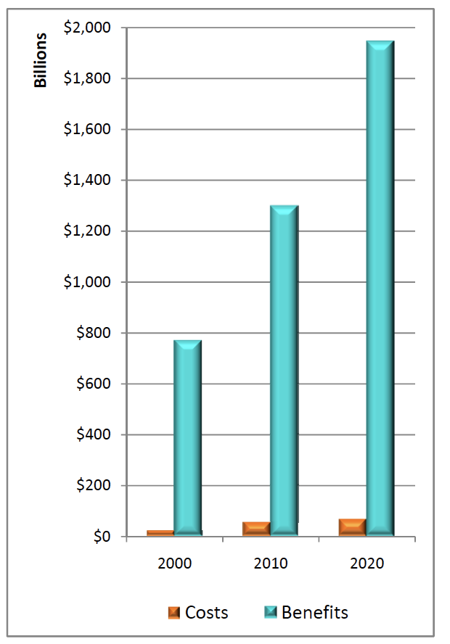
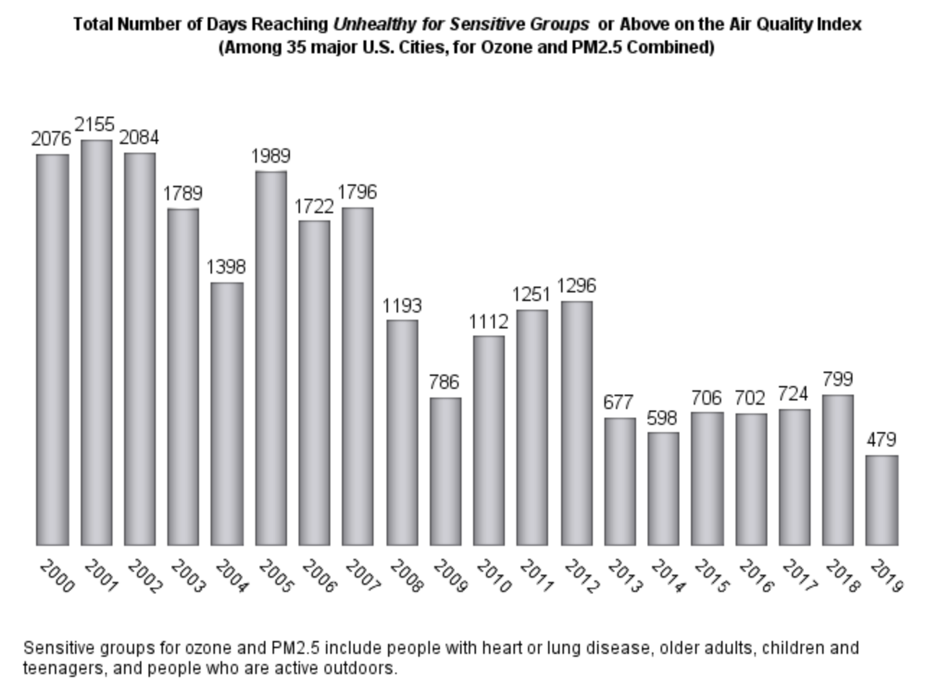
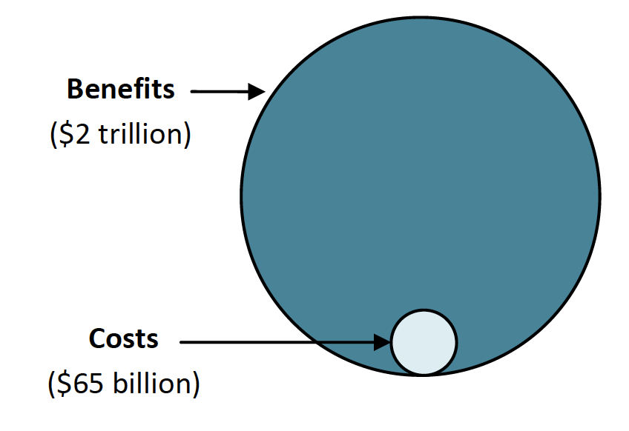
Costs and Benefits of the Clean Air Act Amendments of 1990
CAAA benefits exceed costs by a factor of more than 30 to one
Tools Supported by CMAS are central to this analytical framework
Drastic reduction in all criteria pollutants, and in number of unhealthy days
Source: U.S. EPA, 2011. The Benefits and Costs of the Clean Air Act, 1990 to 2020

Slide 4
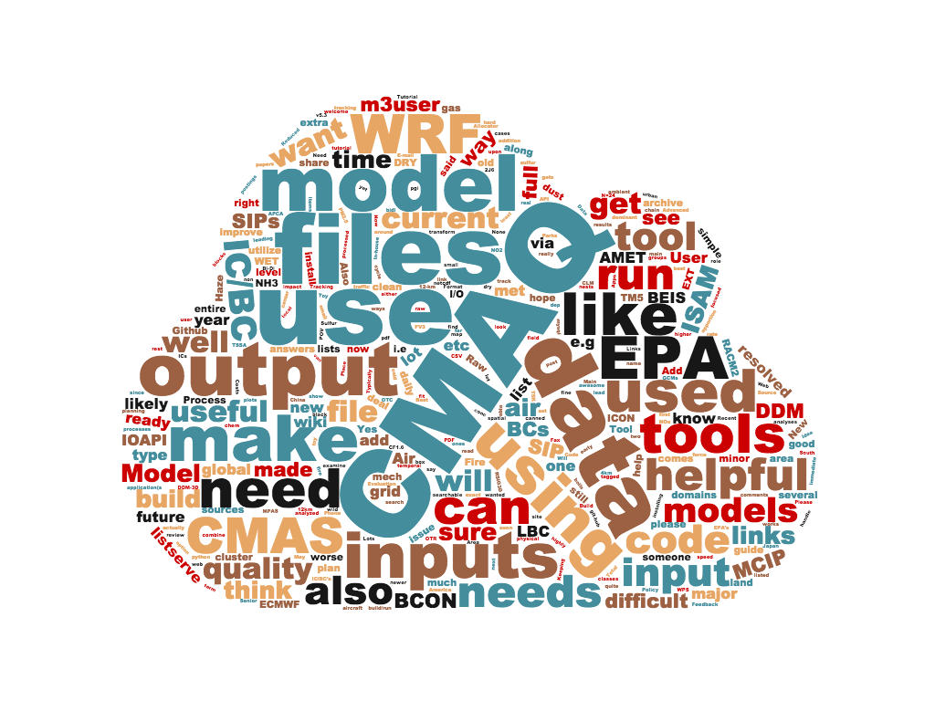
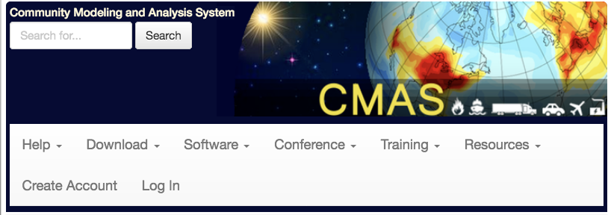
Tool Suite @ CMAS Center
21st year of operation, serving > 10,000 users globally
See https://www.cmascenter.org
to download these tools

Slide 5

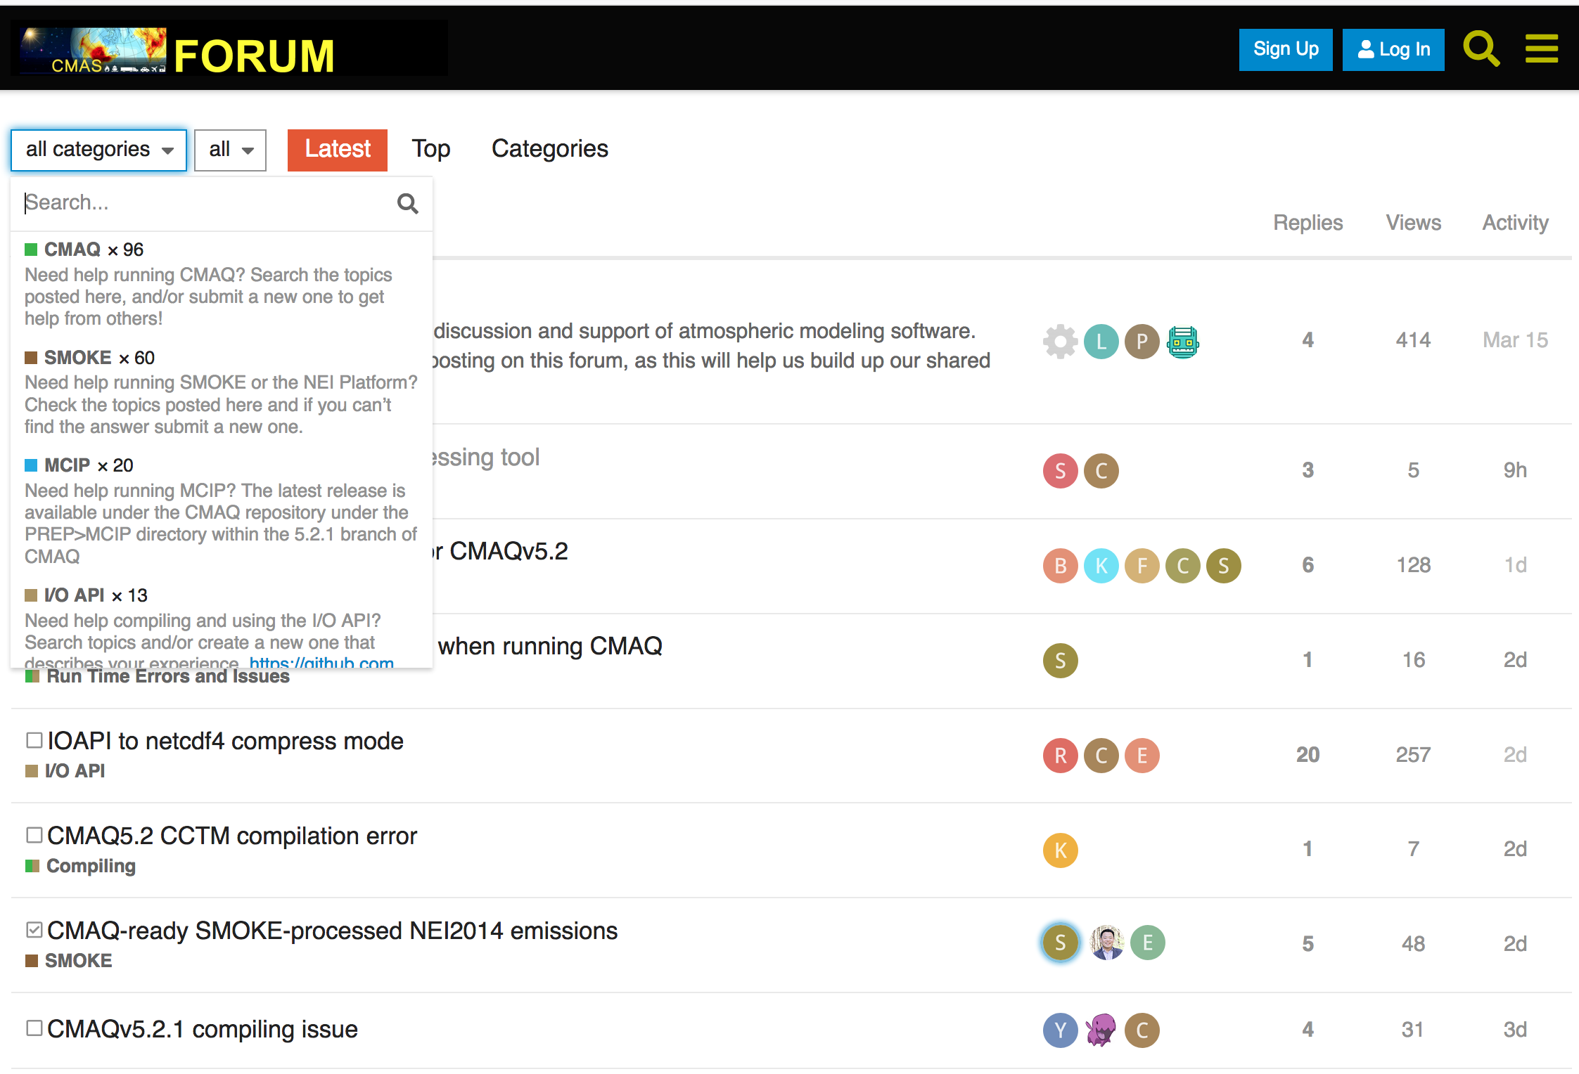
CMAS Discourse Forum http://forum.cmascenter.org
USER SUPPORT
About ~50 queries from user community each month on various CMAS products

Slide 6




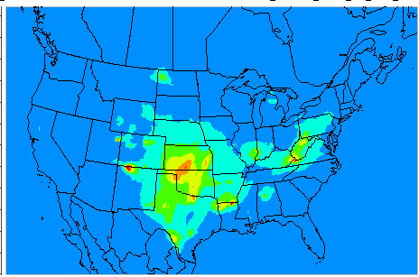

CMAS Data Warehouse
USER SUPPORT
Emissions (NEI)
Reporting
Met (WRF/MCIP)
AQ (CMAQ)
Modeling
Data Warehouse on Google Drive / AWS
Observations
Visualization
~79 TB and Growing
Cloud computing using AWS and Microsoft Azure

Slide 7
CMAS Data Warehouse
- both for and from the community
USER SUPPORT
Current datasets available for CMAS community
  Assortment of various CMAQ inputs and outputs
    From 2002 – 2016
    NEI-based modeling platform
    MCIP outputs
    CMAQ Northern Hemispheric outputs
    CMAQ Continental US outputs
  EPA’s Air QUAlity TimE Series Project (EQUATES)*
    2002 – 2017 Met, Emis and AQ Datasets @ 12-km x 12-km
    Northern Hemisphere and ConUS
  1-month ConUS data from 2016 on AWS Open Data Program
    See registry at: https://registry.opendata.aws/ and https://go.unc.edu/i9WQr
Interactive Forms interface to share datasets from researchers to others
As of 2020 on Google Drive
Added in 2021/2022
On Google Drive
New for 2022
* See Foley et al, CMAS 2021 and various new publications coming out

Slide 8
CMAQ on the Cloud
USER SUPPORT
Significant progress in running CMAQ v5.3 on Cloud
  Extensive testing on AWS and Azure
  Using both native builds and containers
  Single node vs. Multiple nodes (ParallelCluster and CycleCloud)
  See Efstathiou and Adams et al in Cloud Computing Session (Wed 1:10 – 2:50 pm)
Two detailed tutorials
  Best practices for running CMAQ on a Cloud (AWS and Azure)
  Access datasets from AWS S3 bucket while on compute nodes
  See Tutorial Demos by Adams and Efstathiou in Cloud Computing Session
  (Wed 3:20 – 4:30 pm)

Slide 9
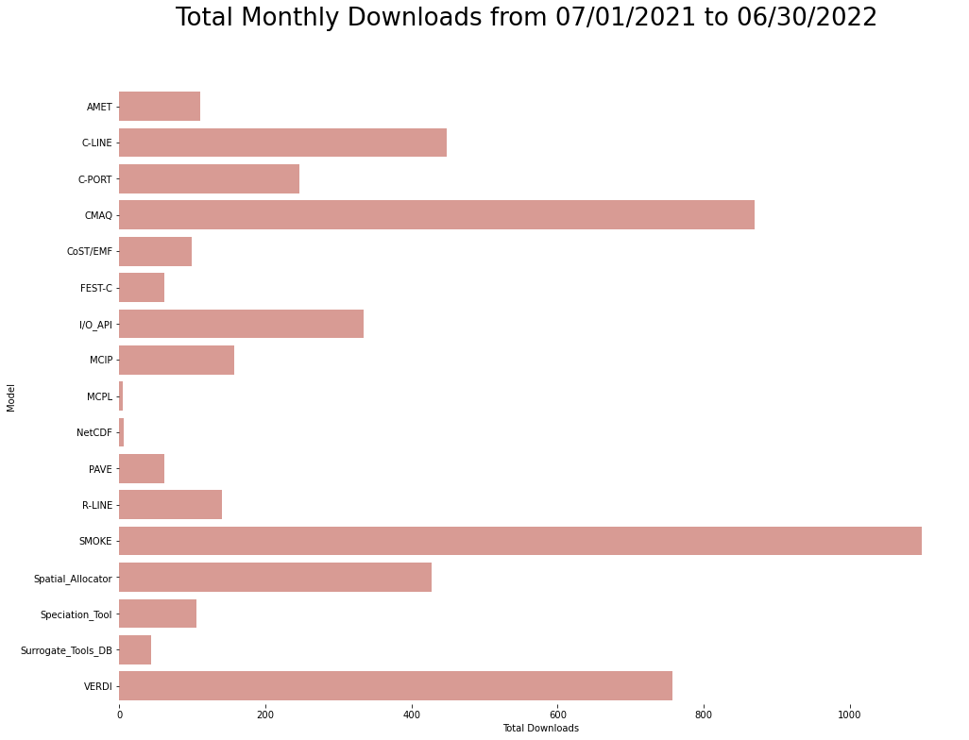
Model Downloads
USER SUPPORT
Model Releases during 2021 - 2022
CMAQ v5.3.3, v5.4^{a*}
FEST-C v1.4.1
Surrogate Tools DB v1.2, 1.3
Speciation Tool v5.1
SMOKE v4.9
CoST / EMF v3.7
VERDI 2.1, 2.1.4^{b*}
AMET v1.5^{c}
  See Posters by ªSidi et al, ^{b}Kang et al, ^{c}Morton et al
* Just released on Friday October 14, 2022

Slide 10
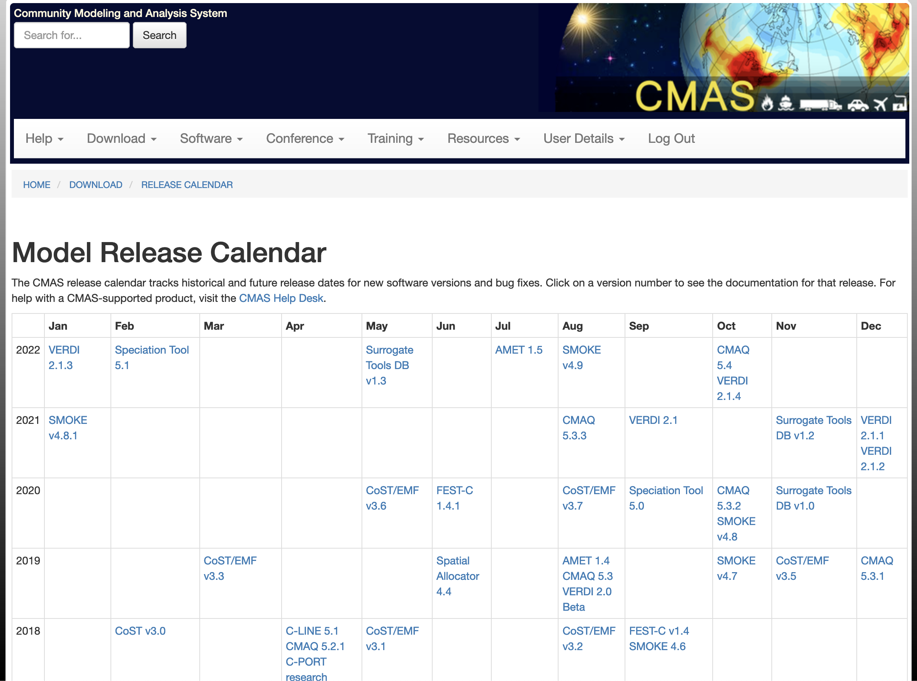
Software Release Calendar
USER SUPPORT

Slide 11
Training – both Onsite and Offsite
APPLICATIONS AND TRAINING
Transitioned completely to online training
  Lecture and Hands-on components using AWS EC2 instances
  Twice a year, Spring and Fall 2022*
Conducted international training sessions
  Brazil, Bulgaria, Canada, China, Colombia, Greece, Hong Kong, India, Mexico, S. Korea
Special trainings
  Python for Air Quality Research and Applications
  Model Interpretive Analyses
* SMOKE Training October 11 – 14, 2022
CMAQ Training October 25 – 28, 2022

Slide 12
Collaboration and Information Sharing
OUTREACH
CMAS Conferences
  Annually at Chapel Hill, NC during October
  Asia
    CMAS – Asia Pacific Conference (Beijing, China in May 2018)
    CMAS – Asia Pacific Conference (Japan in July 2023)*
  South America
    4th CMAS South America Conference (Belo Horizonte in July 2019)
    5th CMAS South America Conference (Sao Paolo in August 2023)*
Webinars
  Webinar series on special topics or new releases
CMAS Visiting Scientist Program
  Brazil, China, Hong Kong, Korea, Portugal
Special Issues with Peer-reviewed Journal Articles
  Atmos. Environ., (2004), J. Applied Meteorol. (2005),
  Environ. Fluid Mech. (2007), J. Air and Waste Mgmt. Assoc. (2020)
* Stay tuned for detailed announcements

Slide 13
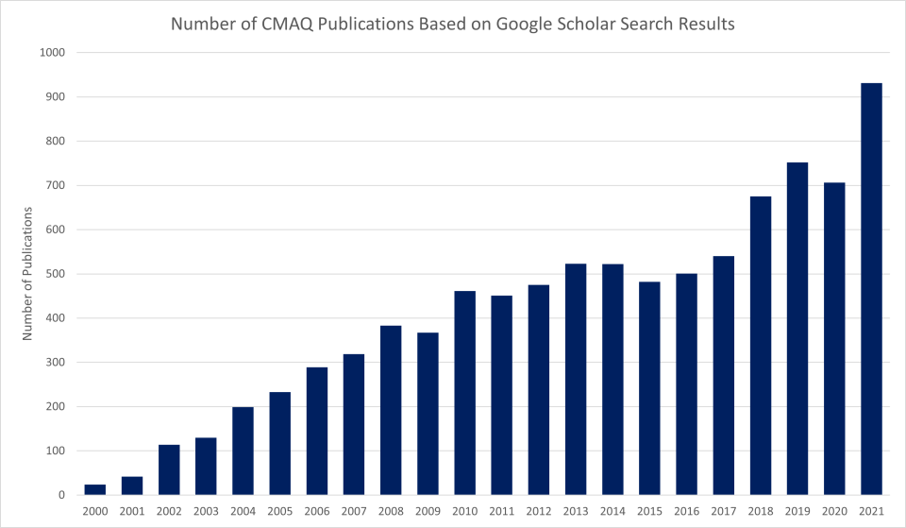
Growth in CMAQ Publications
OUTREACH
Source: U.S. EPA

Slide 14
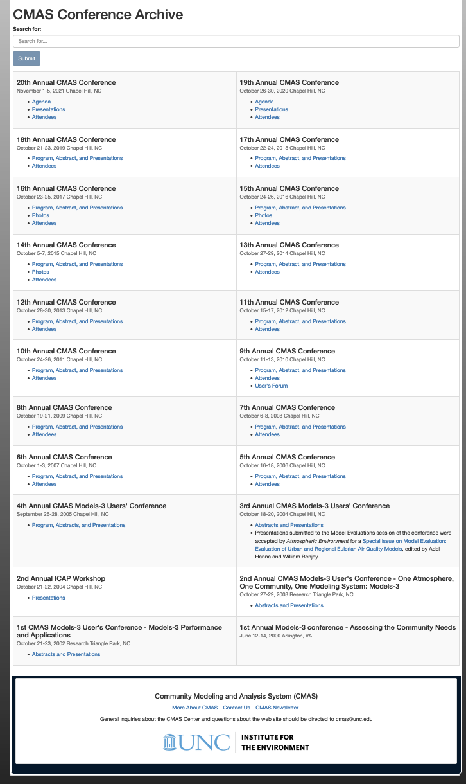
Looking back …
CMAS Conference History
OUTREACH

Slide 15
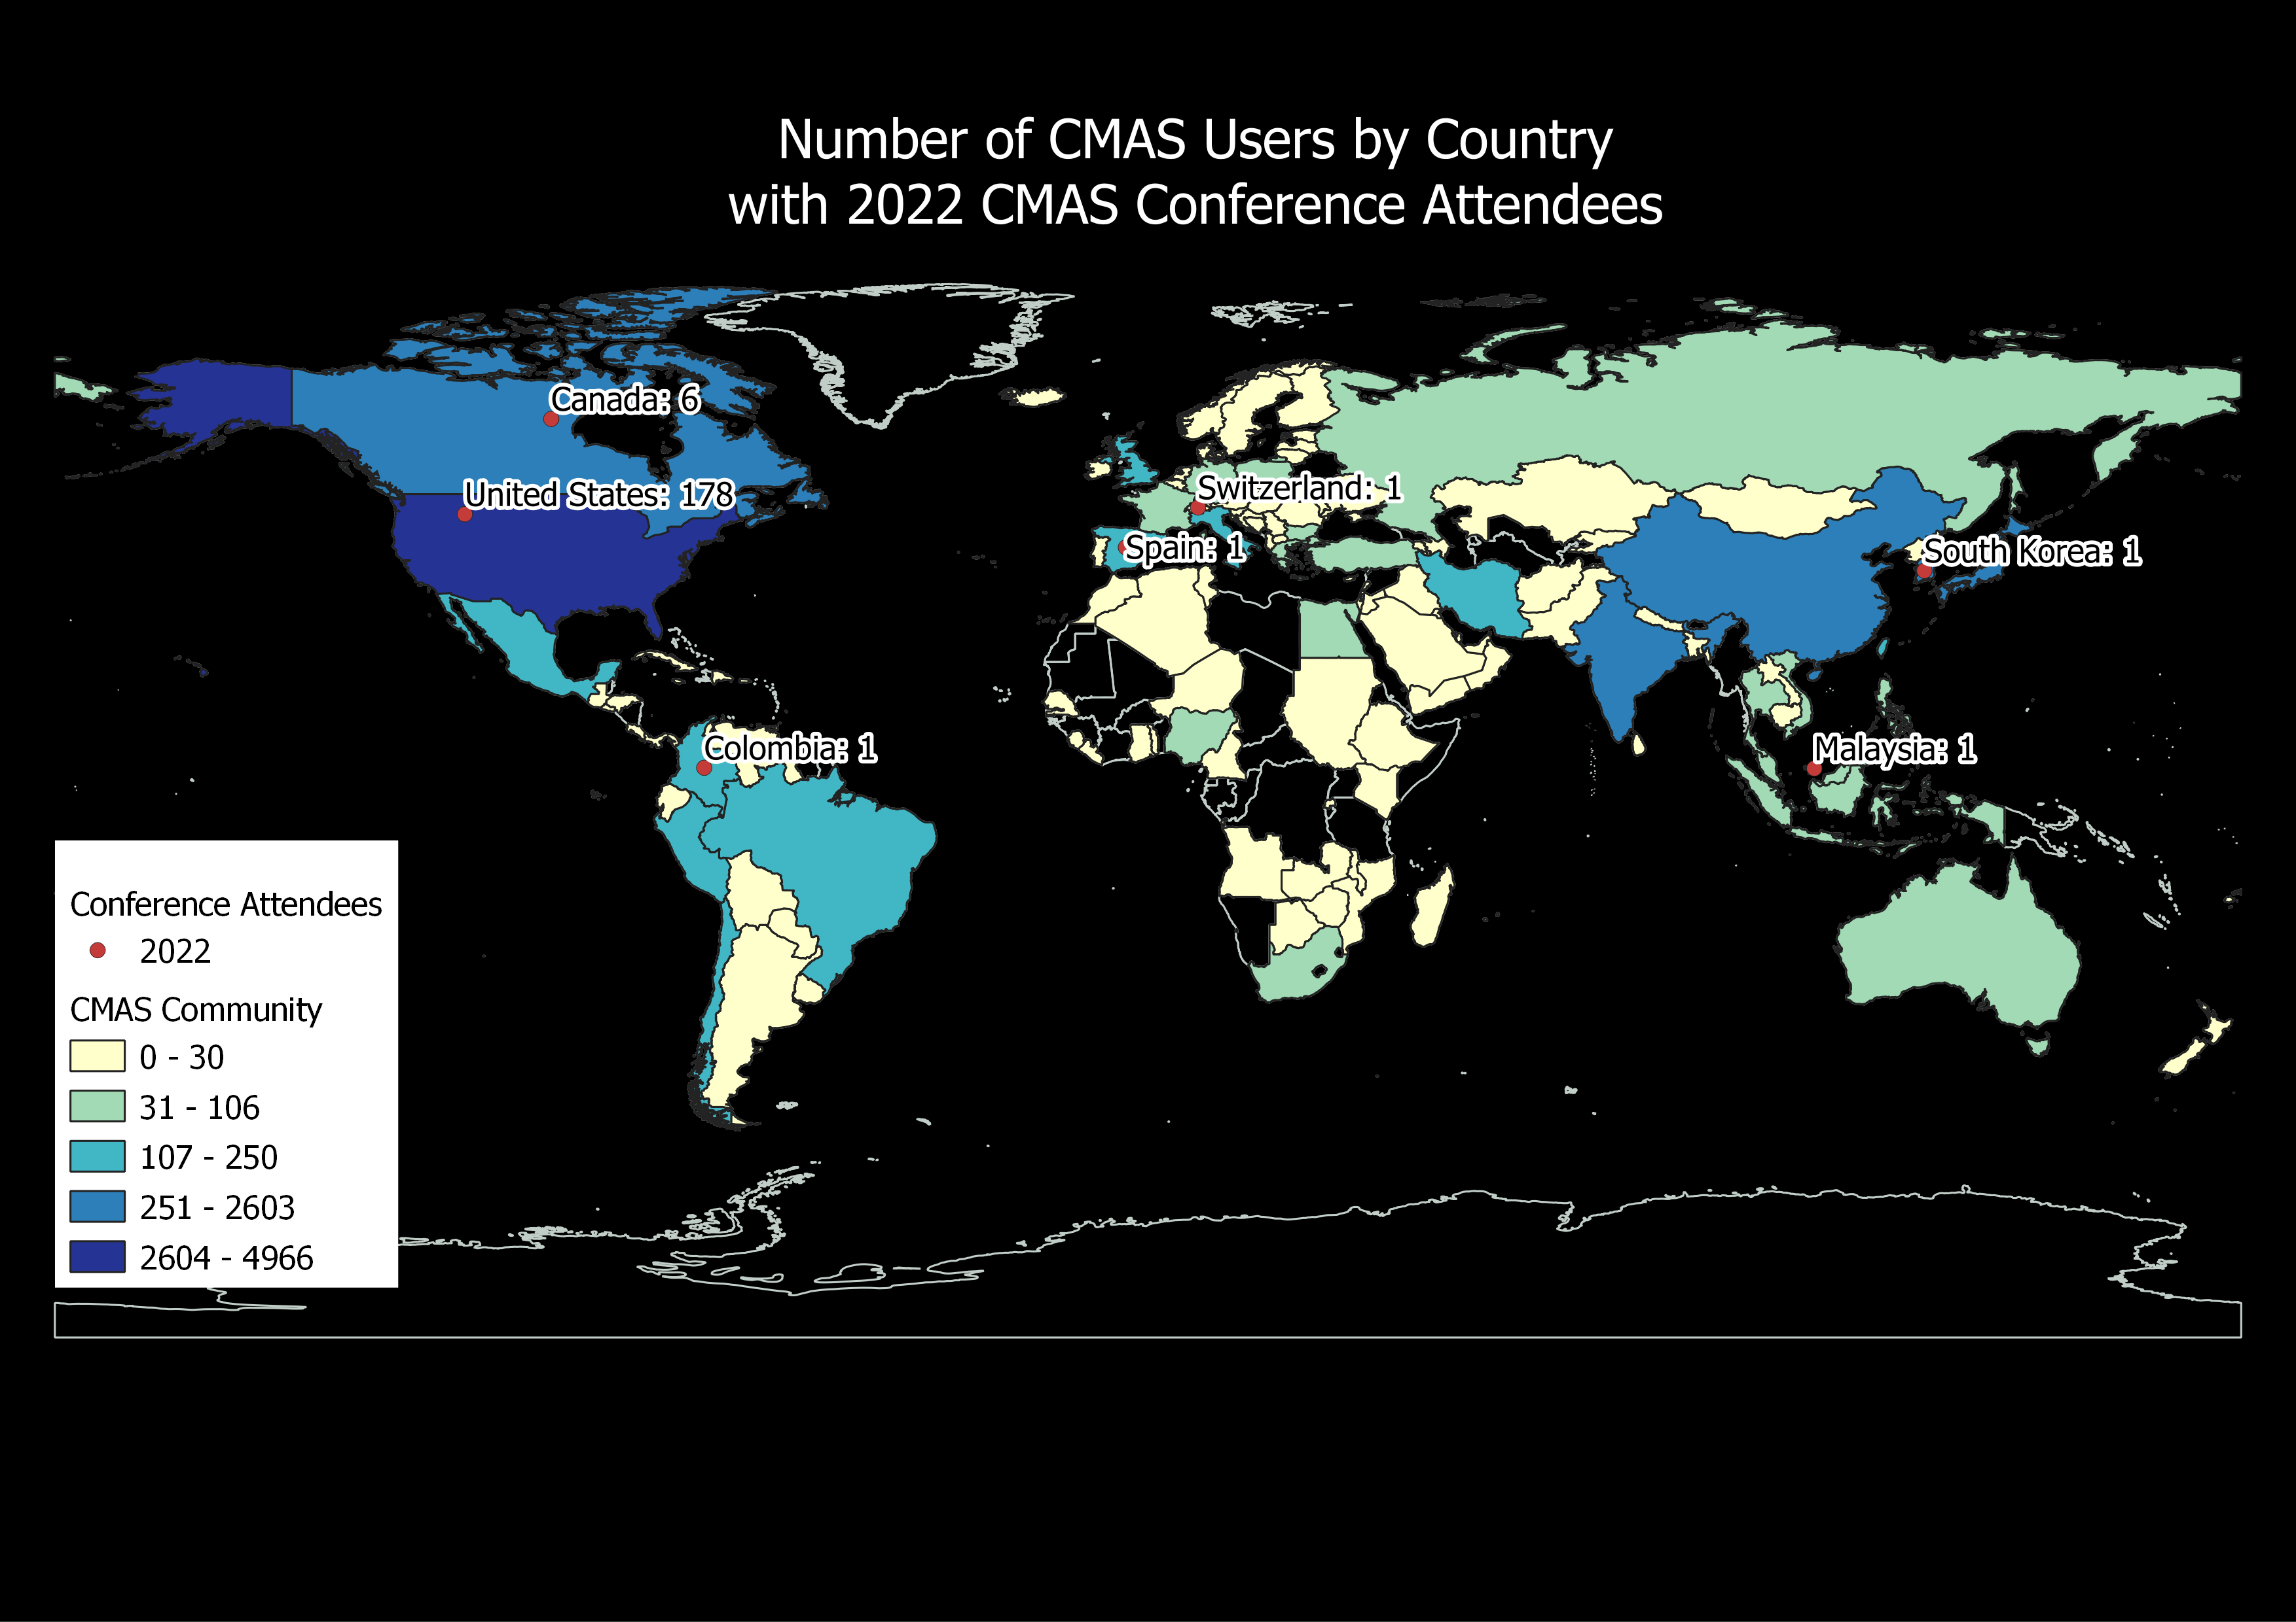
CMAS Global Footprint
OUTREACH and USER SUPPORT

Slide 16
CMAS Center Team
@ UNC
External Advisory Committee (EAC)
Director and Outreach
  Sarav Arunachalam
Research and Applications
  Sarav Arunachalam
Training and Conference
  Brian Naess, Liz Adams
  Catherine Seppanen
  Christos Efstathiou
  Erin Valentine
User Support and Documentation
  Liz Adams
  Christos Efstathiou
  Catherine Seppanen
Communications and Events
  Brian Naess, Emily Williams
Technical Editing
  Erin Valentine
Arastoo Pour Biazar (Univ Alabama)
Tyler Fox (US EPA)
Amir Hakami (Carleton Univ)
Prakash Karamchandani (Ramboll)
Byeong-Uk Kim (GA EPD)
Naresh Kumar (EPRI)
Rebecca Matichuk (US EPA)
Mike Moran (Env Canada)*
Talad Odman (Ga Tech)
Roger Timmis (Env Agency, UK)
Taciana Toledo (UFMG, Brazil)
Neil Wheeler (Science-One)
Yang Zhang (NCSU)
* Recenlty retired

Slide 17
Acknowledgements
CMAS Community
CMAS EAC Members
U.S. EPA
Kristen Foley, U.S. EPA ORD
  CMAS Center Program Officer
Conference Team
  Erin Valentine, Brian Naess, UNC-IE
  Sessions Chairs from the CMAS Community, and
  UNC-ESE Student Volunteers

Slide 18


