Slide 1
Prescribed Fire Emissions and their Impacts on Air Quality in southeastern United States (US)
Kamal J. Maji¹, Zongrun Li¹, Yongtao Hu¹, Armistead G. Russell¹
Jennifer Stowell², Chad Milando², Patrick Kinney², Gregory A. Wellenius²,
Ambarish Vaidyanathan^{1, 3}, and M. Talat Odman¹
¹ School of Civil and Environmental Engineering, Georgia Tech, Atlanta, GA
² School of Public Health, Boston University, Boston, MA
³ Centers for Disease Control and Prevention, Atlanta, GA
Research described herein is conducted under contract to the Health Effects Institute (HEI), an organization jointly funded by the United States Environmental Protection Agency (EPA) (Assistance Award No. CR-83998101) and certain motor vehicle and engine manufacturers. The contents of this article do not necessarily reflect the views of HEI, or its sponsors, nor do they necessarily reflect the views and policies of the EPA or motor vehicle and engine manufacturers.
October 18, 2022
Notes:
This research is sponsored by the Health Effects Institute

Slide 2
Outline
Project overview
Methodology to detect prescribed fire
Prescribed fire in southeastern US
Air quality modeling and fire impacts
Conclusions

Slide 3
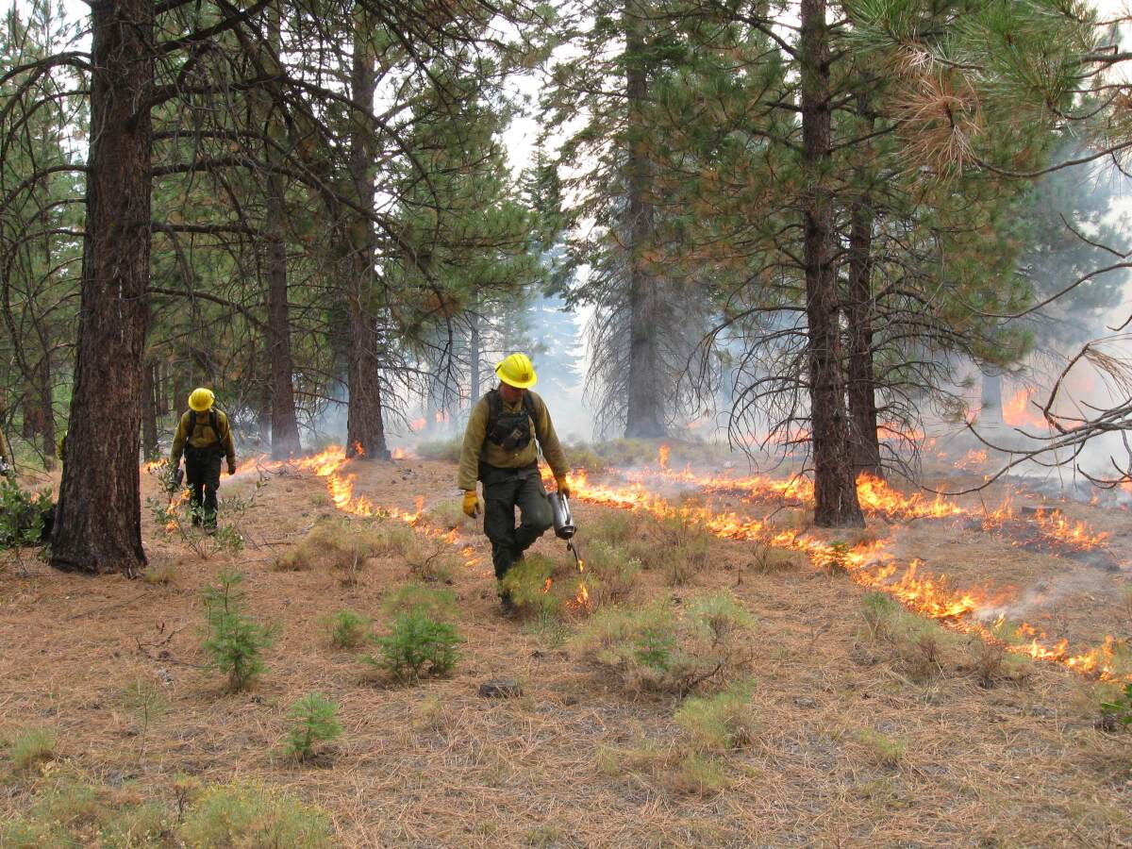
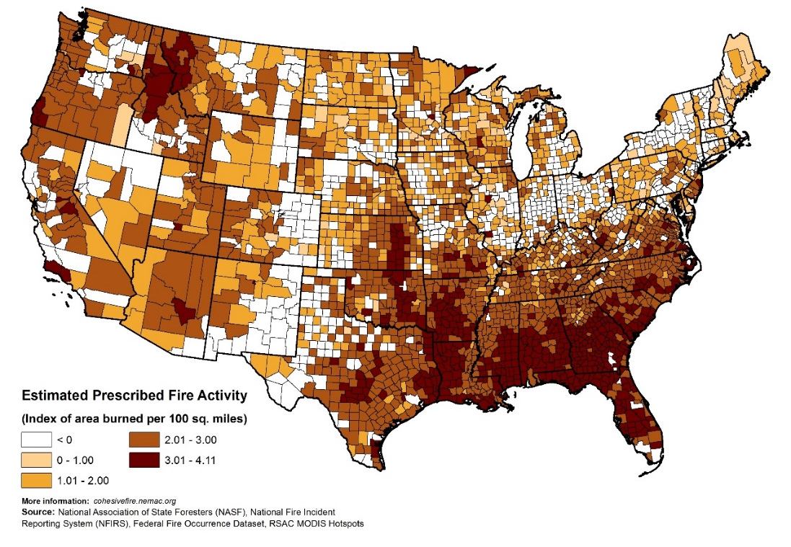
Prescribed fire: Large source of PM_{2.5} emissions in the southeastern US
Prescribed burns decrease the buildup of flammable vegetation and subsequent fuel for wildfires, mitigating the spread and intensity of wildfires.
Prescribed fire improves native vegetation and wildlife habitat, controls insects and disease.
Source: LA times, 2021
2014 NEI attributes 24% of all PM_{2.5} emissions in the southeastern US to prescribed fire, which also contributes to ozone formation.

Slide 4
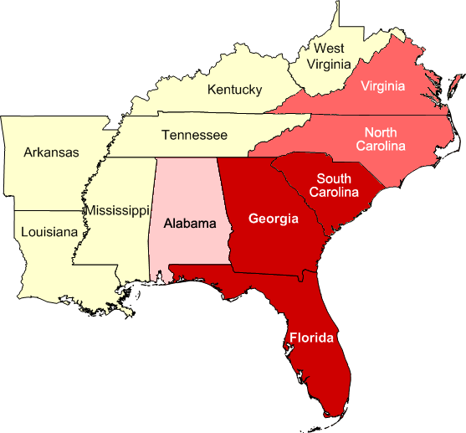
Hypotheses and Objective
Hypotheses
Hypothesis 1: Prescribed burning contributes to a large proportion of daily PM_{2.5} and ozone concentrations in the southeastern US.
Hypothesis 2: Exposure to air pollution from prescribed burns is associated with a higher risk of emergency department (ED) visits for respiratory and cardiovascular disease.
Overarching objective
Estimate the air quality impacts associated with prescribed burning and related exposure to both PM_{2.5} and O₃ levels in the southeastern US.
Quantify the effects of PM_{2.5} and O₃ attributable to prescribed burns on rates of ED visits in a large population of insured individuals residing across the southeastern US.

Slide 5
Tasks
Acquired the prescribed fire permit data for FL, GA, and SC for the years 2016–2020
Also obtained satellite-based fire emissions data for the 2016–2020 period from the Fire Inventory from National Center for Atmospheric Research (FINN)
The data consist of location, date/time and acreage of the burns
Remove Agricultural fire based on land cover database (NLCD)
Compared and adjusted the burned areas of FINN based on the permit records
Remove wildfire based on the durations
(We assume all fires which last more than one day are wildfires.)
Run the BlueSky emission framework with FINN adjusted burned area
Prescribed Fire
Run CMAQ
Fire
Without Fire

Slide 6
Why FINN?
The fire radiative power (FRP) -based method bypasses the parameter burned area, thereby in the context of our research objective, we cannot compare or adjust the satellite burned area with permit burn area.
In addition, FRP-based emissions are prone to satellite misidentifying land cover and having significant uncertainties in fuel loadings and combustion completeness.
BlueSky framework was developed by the USDA Forest Service, is more comprehensive with lab/field-based measurements of fire emissions in different land cover and incorporates fuel moistures under different weather conditions.
For BlueSky framework, burn area is the primary input to estimate burn emission from prescribed burn. FINN adjusted burned area can be used as input to BlueSky.
Other reasons why FINN was preferred in this study:
Wiedinmyer et al. (2011) showed that the FINN emissions agree well with other emission inventories.
Reddington et al. (2016) reported that smallest bias between the model and PM_{2.5} and AOD observations was found using FINN emissions.

Slide 7
Matching prescribed burning records in FINN with permits
Since we expect FINN estimated burned area to be directly related to permit burn area, a linear regression is conducted.
Statewide matching between FINN and permits in FL, SC and GA.
Statewide matching shows a relatively strong correlation (R² > 0.50) after applying linear regression model.
FINN underestimates burned area in Florida while overestimates in Georgia and South Carolina.
FINN underestimates burned area when daily total burned area is small. This can be explained by the limitations of satellite products in detecting small fires.
Notes:
Each point is the daily statewide total burned area.

Slide 8
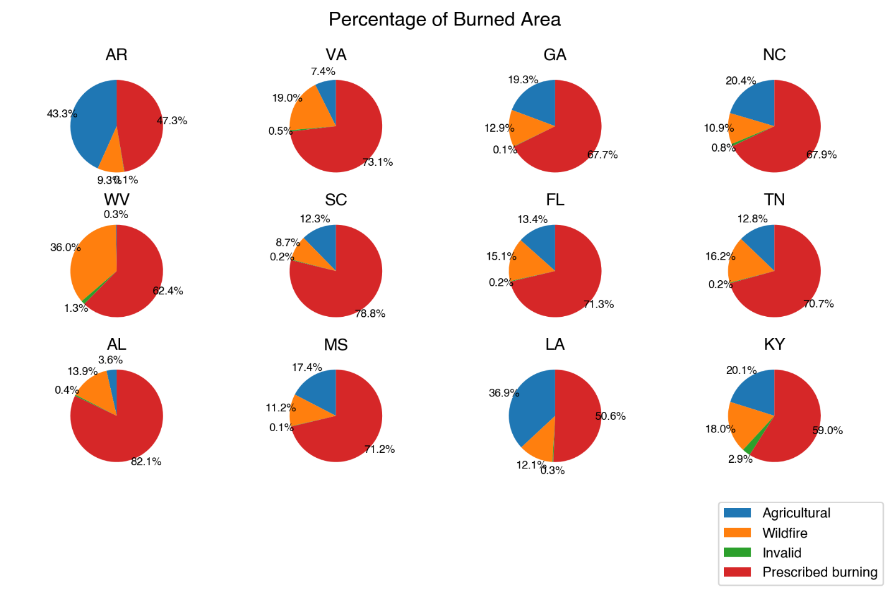
Burn types in FINN and permits
The percentage of records number and burned area are estimated for each southeastern state based on permits.
Half of FL permit records are associated with agricultural burning but prescribed burning accounts for 79.4% of burned area.
From FINN, prescribed burning is the main burn type in southeastern US except in Arkansas and Louisiana where agricultural is the main type of burning.
West Virginia and Virginia have the largest portion of wildfires, relative to all wildland fires, among southeastern states.
Permit record
FINN data

Slide 9
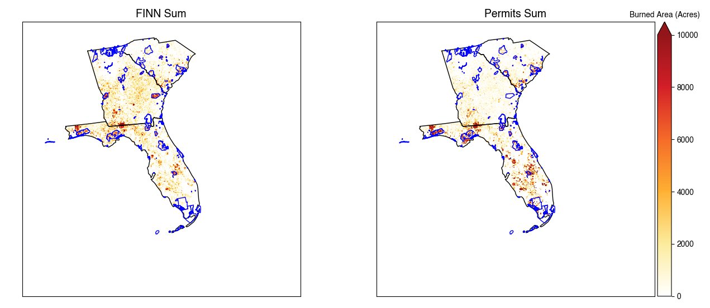
Matching prescribed burning records in FINN with permits
Total grid-based burned area from FINN and permit. Blue line is the boundary of federal land.
State Name | BlueSky (with permit burned area) | BlueSky (with FINN burned area) | BlueSky (with adjusted FINN burned area) | FINN
GA | 125521 | 221407 | 146129 | 11263
FL | 243534 | 198409 | 130950 | 88463
SC | 54533 | 79173 | 52254 | 63798
PM_{2.5} emissions (tons/yr) in 2017 from prescribed burning in three southeastern states.

Slide 10
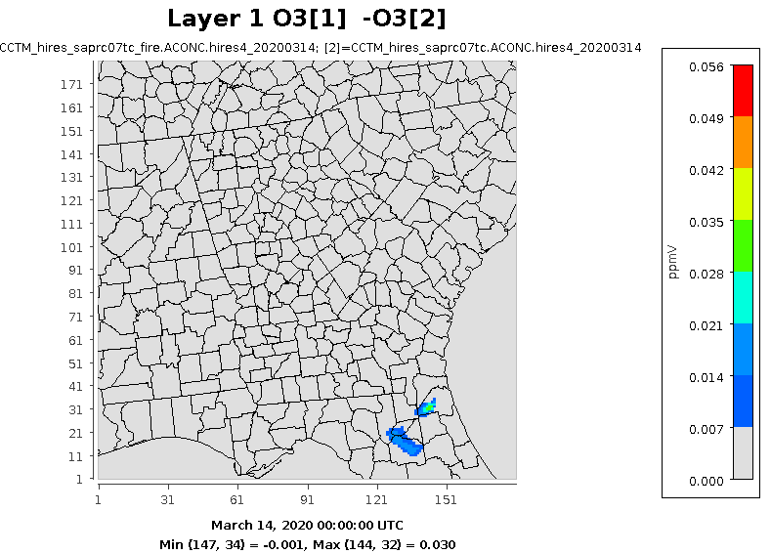
Air quality modeling using CMAQ: March 14, 2020
O₃ from prescribed fire
O₃-concentration field with fire
O₃-concentration field without fire
O₃-concentration field due to fire
Notes:
This is the day with highest number of prescribed fires

Slide 11
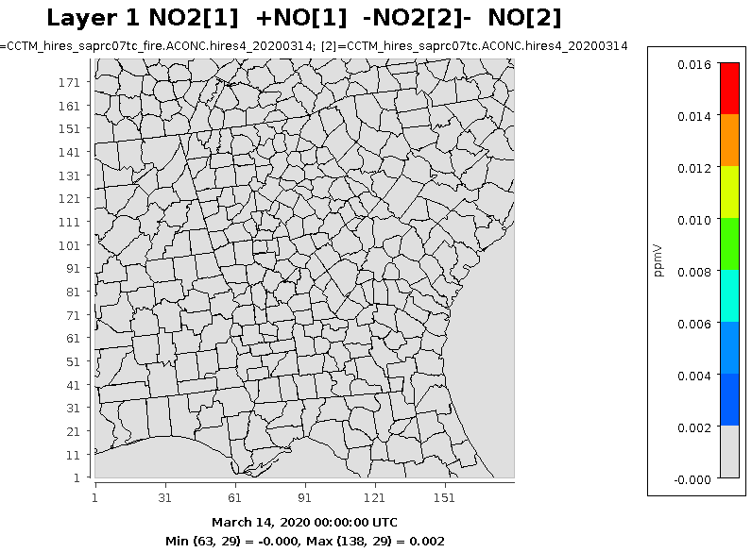
NO_{x} from prescribed fire
NO_{x}-concentration field with fire
NO_{x}-concentration field without fire
NO_{x}-concentration field due to fire

Slide 12
Prescribed NO_{x} vs O₃
Tallahassee
Crestview
Notes:
Tallahassee and Crestview are cities with large anthropogenic NOx emissions. Prescribed fire NOx emissions are relatively small.

Slide 13
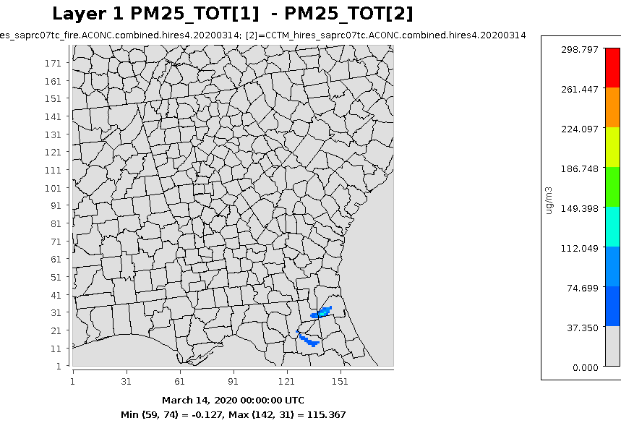
PM_{2.5} from prescribed fire
PM_{2.5-}concentration field with fire
PM_{2.5-}concentration field without fire
PM_{2.5-}concentration due to fire

Slide 14
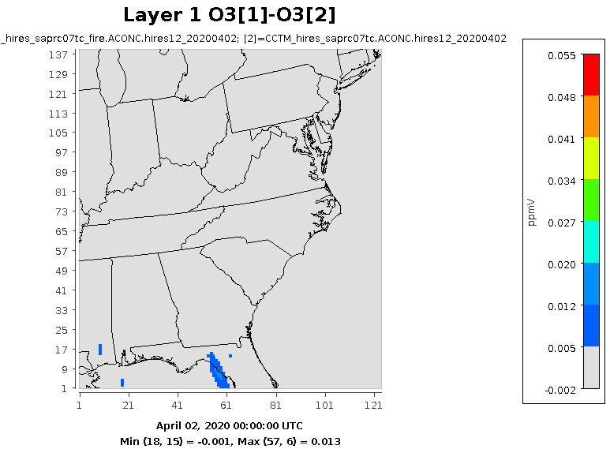
Air quality modeling using CMAQ: April 2, 2020
O₃ from prescribed fire: 12 state 12km-grid
O₃-concentration field with fire
O₃-concentration field without fire
O₃-concentration due to fire
Notes:
This is a typical burn day in the southeastern US.

Slide 15
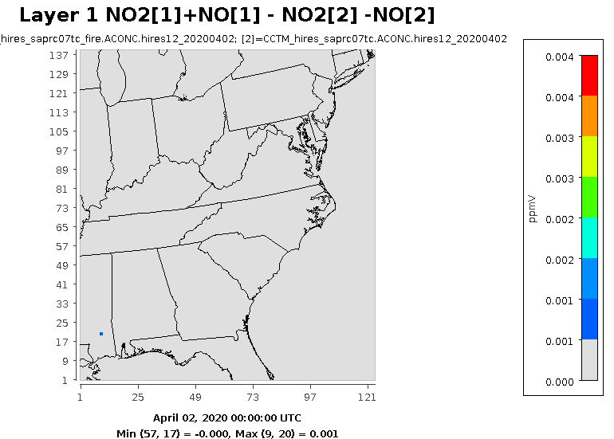
NO_{x}-from prescribed fire: 12 state 12km-grid
NO_{x}-concentration field with fire
NO_{x}-concentration field without fire
NO_{x}-concentration due to fire

Slide 16
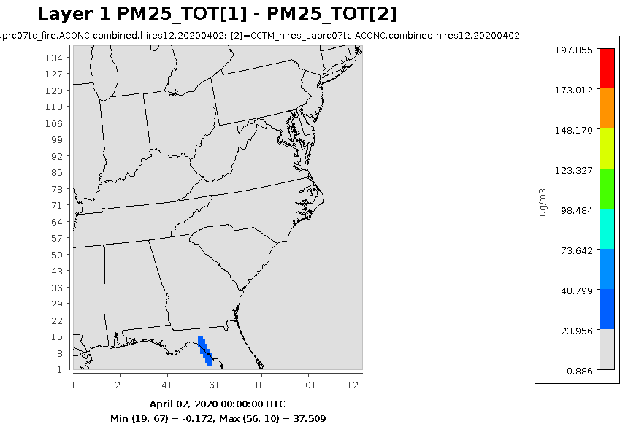
PM_{2.5}-from prescribed fire: 12 state 12km-grid
PM_{2.5}-concentration field with fire
PM_{2.5}-concentration field without fire
PM_{2.5}-concentration due to fire

Slide 17
Prescribed PM_{2.5} & O₃
Tallahassee

Slide 18
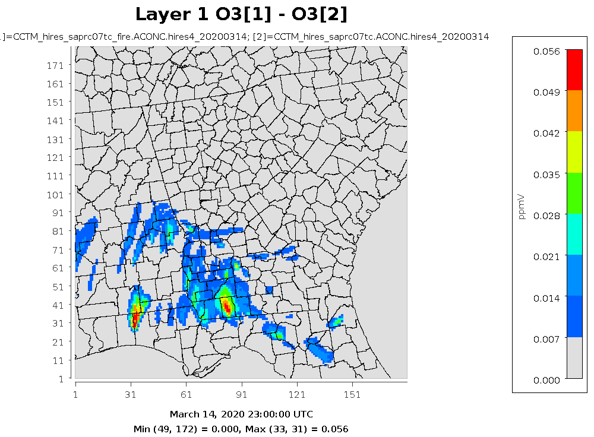
Next Step: Use of fire impact modeling data
Epidemiological study
Quantitative health risk study
Crop production

Slide 19
Conclusions:
FINN overestimates the size of small fires, but this can be mitigated by calibrating its burned area based on acreage reported in prescribed burn permits.
More permit data in other state may overall improve the correlation between permit burn area and FINN based on the permit records.
Prescribed burn increase O₃ and PM_{2.5} pollution in southeastern US.
Tallahassee effect much more due to prescribed burn.

Slide 20
Thank you! Questions?
email: kmaji3@gatech.edu

Slide 21
Identify Wildfire
FINN data includes all fires detected by MODIS and VIIRS satellites. Therefore, matching FINN data with permit data requires removing wildfires from FINN.
Large wildfires can last multiple days, we assume the fires which have more than one day duration are wildfires.
The duration of fires can be calculated by temporally tracking each fire in FINN. In other words, if FINN detects fires occurring in a specific region for consecutive days, the algorithm will mark all fires in that region during those days as wildfires.
Since large wildfires can also spread over long distances in one day, FINN may identify a wildfire as several fires. This segmentation problem could lead to underestimation of the size of wildfires if we just track the wildfires temporally.
A spatial clustering algorithm is also applied to cluster concurrent FINN fire records that are close to each other. In this spatial and temporal clustering algorithm, we use 1000 m as the spatial distance and 800 m as the temporal distance for clustering the different FINN records into a wildfire based on a sensitivity analysis.

Slide 22
Emission comparison between FINN and BlueSky
Particulate matter and CO are highly correlated (R² > 0.90).
PM_{2.5} and PM₁₀ from FINN are 74%, 96% of BlueSky.
CO from FINN is 16% higher than BlueSky.
Comparison between FINN and BlueSky estimated daily total prescribed burning emissions in southeastern U.S. Black line is 1:1 line and red line is regression line. Uncertainty of linear regression parameters is estimated by 0.95 confidence interval

Slide 23
Comparison between FINN and BlueSky estimated prescribed burning emissions under 4km CMAQ grid definition. Black line is 1:1 line and red line is regression line. Uncertainty of linear regression parameters is estimated by 0.95 confidence interval

