Slide 1

Application of Ozone Source Apportionment using CMAQ-ISAM during Long Island Sound Tropospheric Ozone Study (LISTOS)
Qian Shu, K.R. Baker, S.L. Napelenok, J. Szykman, L. Valin, T. Plessel
CMAS Conference
October 22, 2019
Disclaimer: this work does not necessarily represent the views or policies of the US EPA.
US EPA Office of Research and Development
Center for Environmental Measurement & Modeling
Notes:
Good afternoon, in this morning we already saw two interested talks about ozone apportionment application from global scale from barron Henderson and pradeepa vennam, today I will put this topic down to nationwide and local scale. First, I will thank all my co-authors for their great contributions in this project. And of course, this work only represents points of view from authors and does not necessarily represent the views or policies of the US EPA.

Slide 2
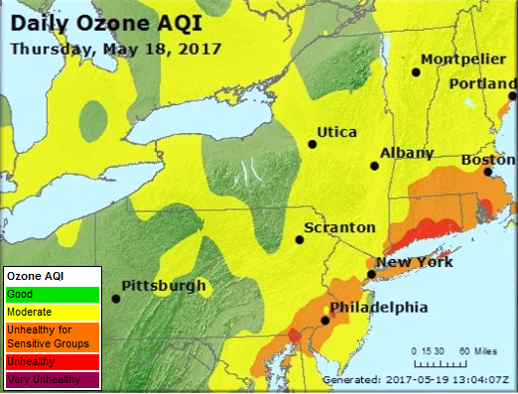
Motivation
the New York City (NYC) metropolitan area (comprised of portions of New Jersey, New York, and Connecticut in and around NYC) continues to persistently violate both past and recently revised federal health-based air quality standards for ground-level ozone.
It directly influences over 20 million people living in this area and millions of people living downwind indirectly.
https://www.nescaum.org/documents/listos
shu.qian@epa.gov
Notes:
So here is our motivation, the new York metropolitan area has been suffered high ozone pollution over decades. Considering there are over millions of people living in this area and its downwind area, people’s health and well beings are directly influenced in this area.

Slide 3
Long Island Sound Tropospheric Ozone study
LISTOS was launched by NESCAUM to investigate the evolving nature of ozone formation and transport in the NYC region and downwind.
Key points: to understand the sources and temporal emission profiles of the ozone precursors nitrogen oxides (NOx) and volatile organic compounds (VOCs).
Resources: satellite, aircraft, balloon (ozone sondes), marine, and ground-based data, mobile data, air quality modeling.
https://www.nescaum.org/documents/listos
shu.qian@epa.gov

Slide 4
Long Island Sound Tropospheric Ozone study
LISTOS was launched by NESCAUM to investigate the evolving nature of ozone formation and transport in the NYC region and downwind.
Key points: to understand the sources and temporal emission profiles of the ozone precursors nitrogen oxides (NOx) and volatile organic compounds (VOCs).
Resources: satellite, aircraft, balloon (ozone sondes), marine, and ground-based data, mobile data, air quality modeling.
What can we do from air quality modeling perspective?
https://www.nescaum.org/documents/listos
shu.qian@epa.gov

Slide 5
Long Island Sound Tropospheric Ozone study
LISTOS was launched by NESCAUM to investigate the evolving nature of ozone formation and transport in the NYC region and downwind.
Key points: to understand the sources and temporal emission profiles of the ozone precursors nitrogen oxides (NOx) and volatile organic compounds (VOCs).
Resources: satellite, aircraft, balloon (ozone sondes), marine, and ground-based data, mobile data, air quality modeling.
Simulate LISTOS episodes using CMAQ and do model-observation paired evaluation
Source apportionment method using CMAQ-ISAM.
https://www.nescaum.org/documents/listos
shu.qian@epa.gov

Slide 6
Integrated Source Apportionment Method
CMAQ-ISAM
CMAQ-ISAM provides source tracking information simultaneously with the concentrations/depositions outputs.
CMAQ-ISAM has been released previously in parallel to the base CMAQ release since version 5.0.2.
For the current version (5.3), the source apportionment model is built into the base CMAQ.
The current release ISAM implementation also addresses the main issue of the previous releases – slow run times.
  New ISAM gas chemistry module, new ISAM cloud treatment, new ISAM aerosol wrapper
shu.qian@epa.gov
Notes:
The major tool we are going to use for this project is CMAQ-ISAM, which is a integrated source apportionment method implemented in CMAQ model. There was a poster yesterday from sergey napelenok introducing updates of CMAQ-ISAM in CMAQ version 5.3. Today I will just quickly look through it.

Slide 7
Current ISAM Capability
CMAQ-ISAM is based around tracking species classes from user-specified sources.
Currently available Tag Classes are:
  SULFATE: ASO4I/J, SO2, SULF
  NITRATE: ANO3I/J, HNO3, HNO3, NO, NO2, NO3, HONO, N2O5, other mechanism-dependent species
  AMMONIUM: ANH4I/J, NH3
  EC: AECI/J
  OC: APOCI, APOCJ, APNCOMI/J
  VOC: mechanism-dependent species participating in ozone chemistry
  PM25_IONS*: ACLI/J, ANAI/J, AMGJ, AKJ, ACAJ, AFEJ, AALJ, ASIJ, ATIJ, AMNJ, AOTHRI/J
  CO
  OZONE*: O3, all NITRATE species + all VOC species
The goal is complete, mechanism-specific species coverage
*Expect a patch in the near future to improve the PM25_IONS and the OZONE Tag Classes
shu.qian@epa.gov
Notes:
Here shows currently available tag classes that we can track in CMAQ-ISAM.

Slide 8
Current ISAM Capability (2)
Each CMAQ-ISAM simulation can track any number and any combination of Tag Classes.
The user must also specify which Emissions Streams and geographical regions (if any) are of interest .
  Every simulation will also automatically track initial conditions (ICON) and boundary conditions (BCON) for the Tag Class species.
Emissions Streams that are not specified by the user for tracking will be aggregated and tracked as OTHR.
It is possible to track any combination of Emissions Streams including the ones calculated inline (BIOG, LTNG, SEASPRAY, WBDUST).
Finally, it is possible to track the impact of stratospheric ozone through the potential vorticity calculations (PVO3).
shu.qian@epa.gov

Slide 9
CMAQ Simulation
CMAQ v5.3 beta was used to conduct annual simulation for 2018.
12km CONUS annual simulation with CMAQ-base
Need 5TB hardware storage
~1 week duration with 512 nodes
12km CONUS annual simulation with CMAQ-ISAM
Need ~9TB hardware storage only for extracted CONC_SA* files, (52 variables = 13 sectors (10 tags + ICON, BCON, OTHR) * 4 species (NO, NO2, FORM, O3))
~3 weeks duration with 512 nodes (brute force: ~9 weeks)
shu.qian@epa.gov
Notes:
Here for CMAQ-ISAM, we track 10 tags, including other three default tags, ICON, BCON and OTHR for four interested species, NO, NO2, FORM and O3. With newly updates, current CMAQ-ISAM is pretty faster than previous version, also 3 times as faster as brute force method.

Slide 10
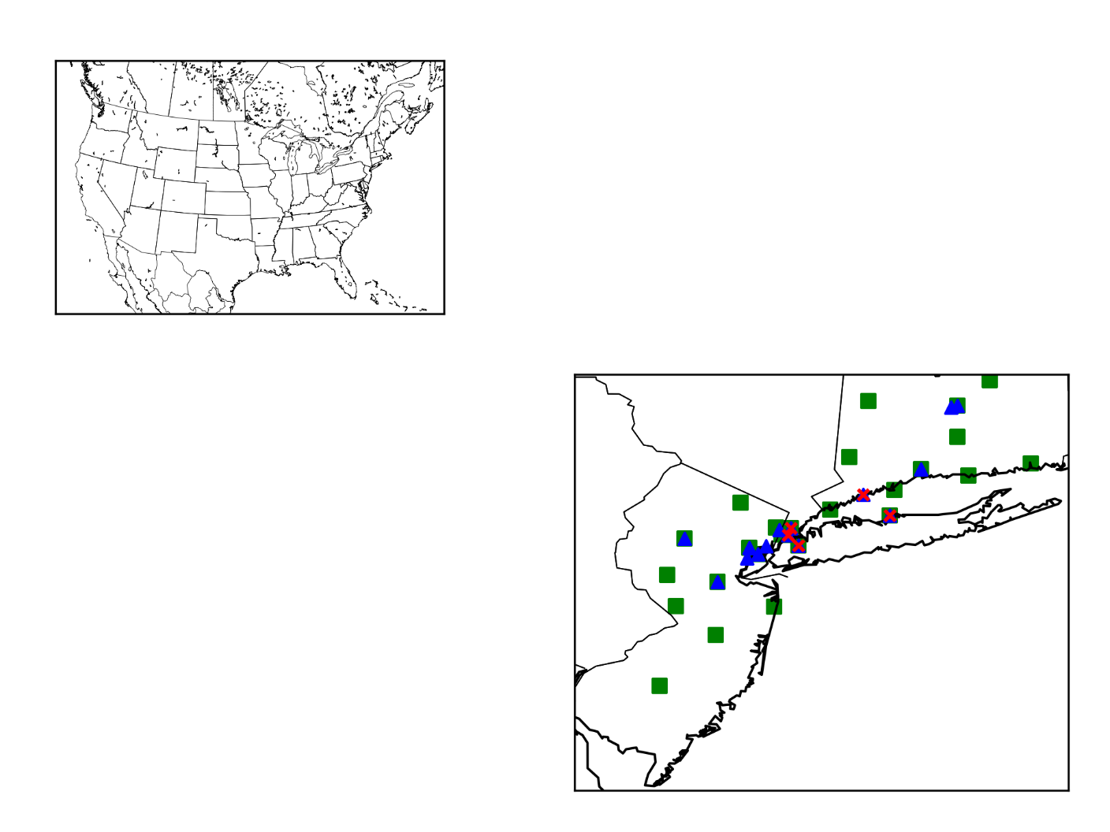
Model evaluation for 12km CMAQ simulation
Observation resources: satellite, aircraft, balloon (ozone sondes), marine, and ground-based data, mobile data.
TROPOMI satellite sensor to compare modeled Total Column HCHO and NO2 by season including LISTOS episodes.
Ground sites to compare modeled surface concentration of targeted species (HCHO, NO2, O3) during LISTOS episodes: measurements are daily averaged at each site marked on the map from 06/01/2018 to 09/30/2018.
12km CONUS
12km LISTOS
field campaign
HCHO
NO2
O3
https://www-air.larc.nasa.gov/missions/listos/index.html
shu.qian@epa.gov
Notes:
We first looked at model performance from nationwide to LISTOS area. There are bunch of observations resources from … to …. And for this project, we first look at TROPOMI satellite over 12km CONUS including LISTOS area. With available TROPOMI data, we really focused on HCHO and NO2. Rather than look at different layers concentration from surface to aloft, we look at total column HCHO and NO2 by postprocessing CMAQ model output in compatible with TROPOMI satellite data. We also compared model surface concentrations of HCHO, NO2 and O3 with available ground sites measurements during LISTOS. And marks on the map are available sites locations.

Slide 11
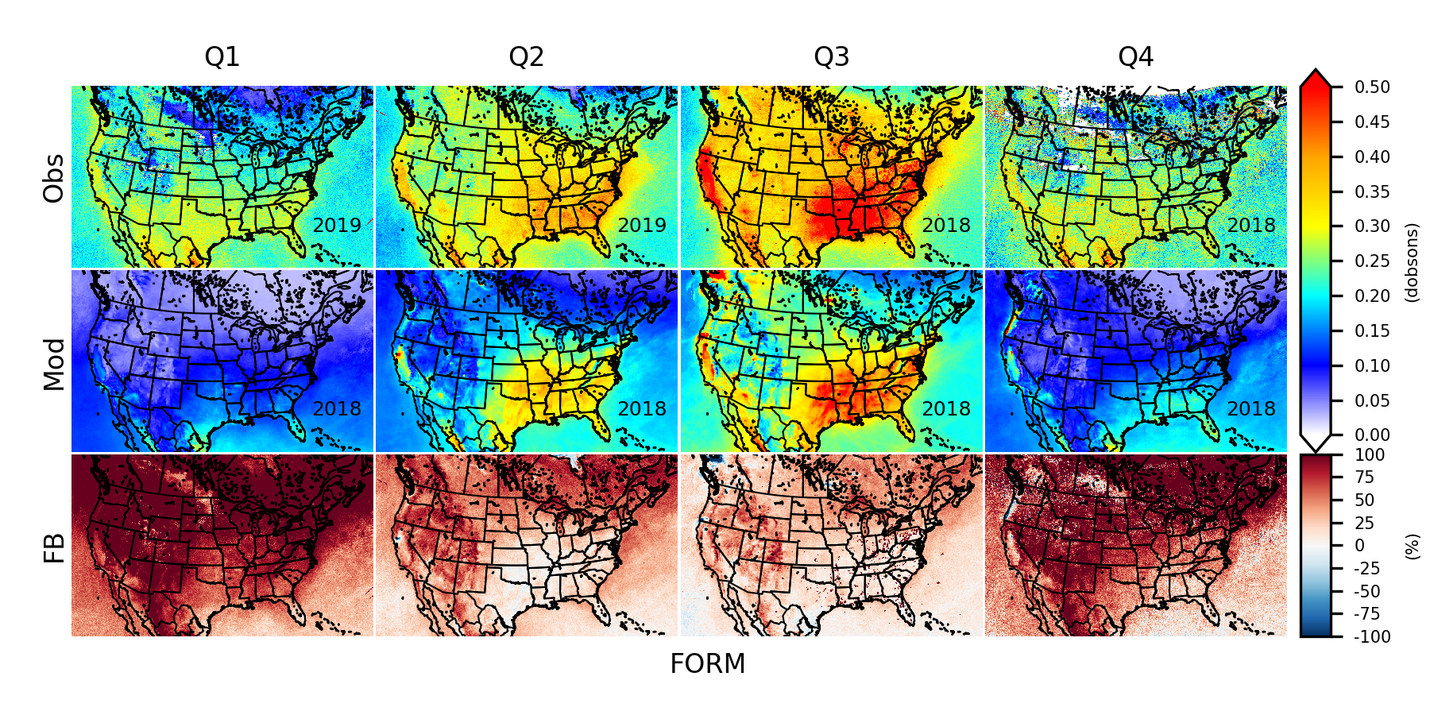
TROPOMI vs Modeled Column
Seasonal average total column HCHO
Q1: Jan-Mar
Q2: Apr-Jun
Q3: Jul-Sep
Q4: Oct-Dec
12x12 km grid for CONUS
shu.qian@epa.gov
Notes:
The figure shows spatial seasonal average total column HCHO. Top row is TROPOMI observations, mid row is modeled results, and bottom row is spatial fractional biases. We can directly see CMAQ column and TROPOMI both show similar spatial and temporal signatures. CMAQ underestimates total column HCHO, especially in Q1 and Q4. If we take US into two parts, west US and east US, which west US has more natural areas and east US has more urban and sub-urban areas, CMAQ performance is better in east urban area than west natural area. Needs to be notified, currently we do not have TROPOMI 2018 data for Q1 and Q2, so we use 2019 instead.

Slide 12
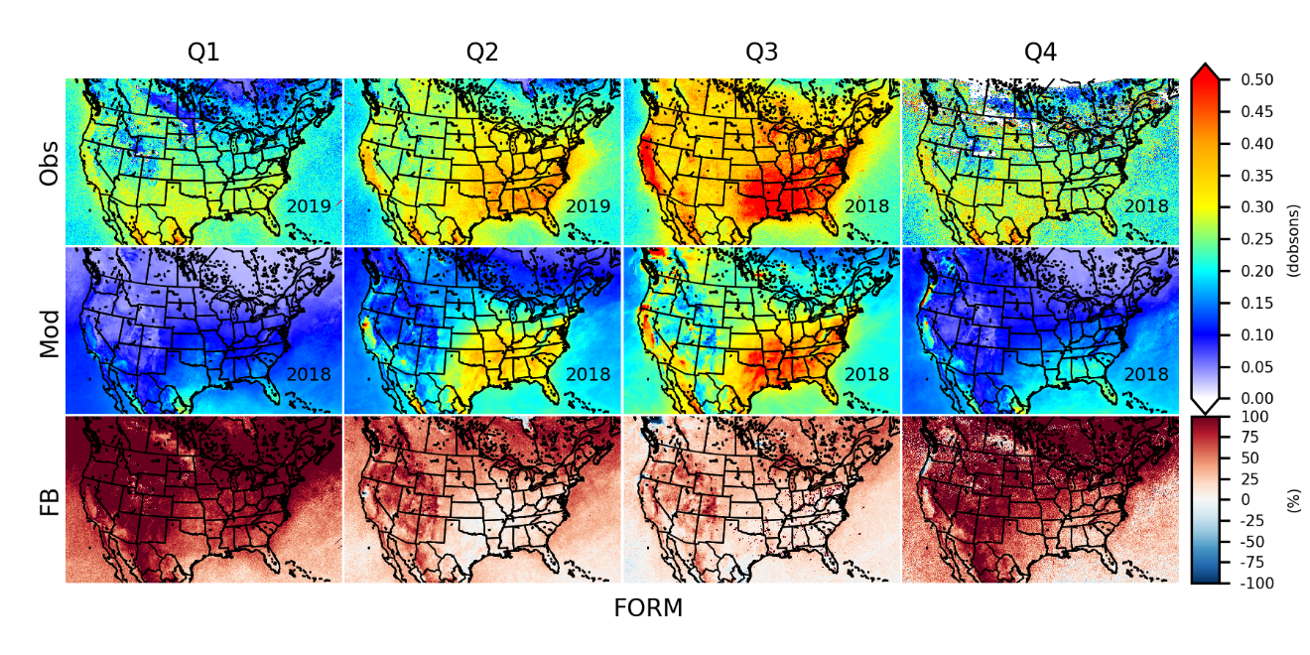
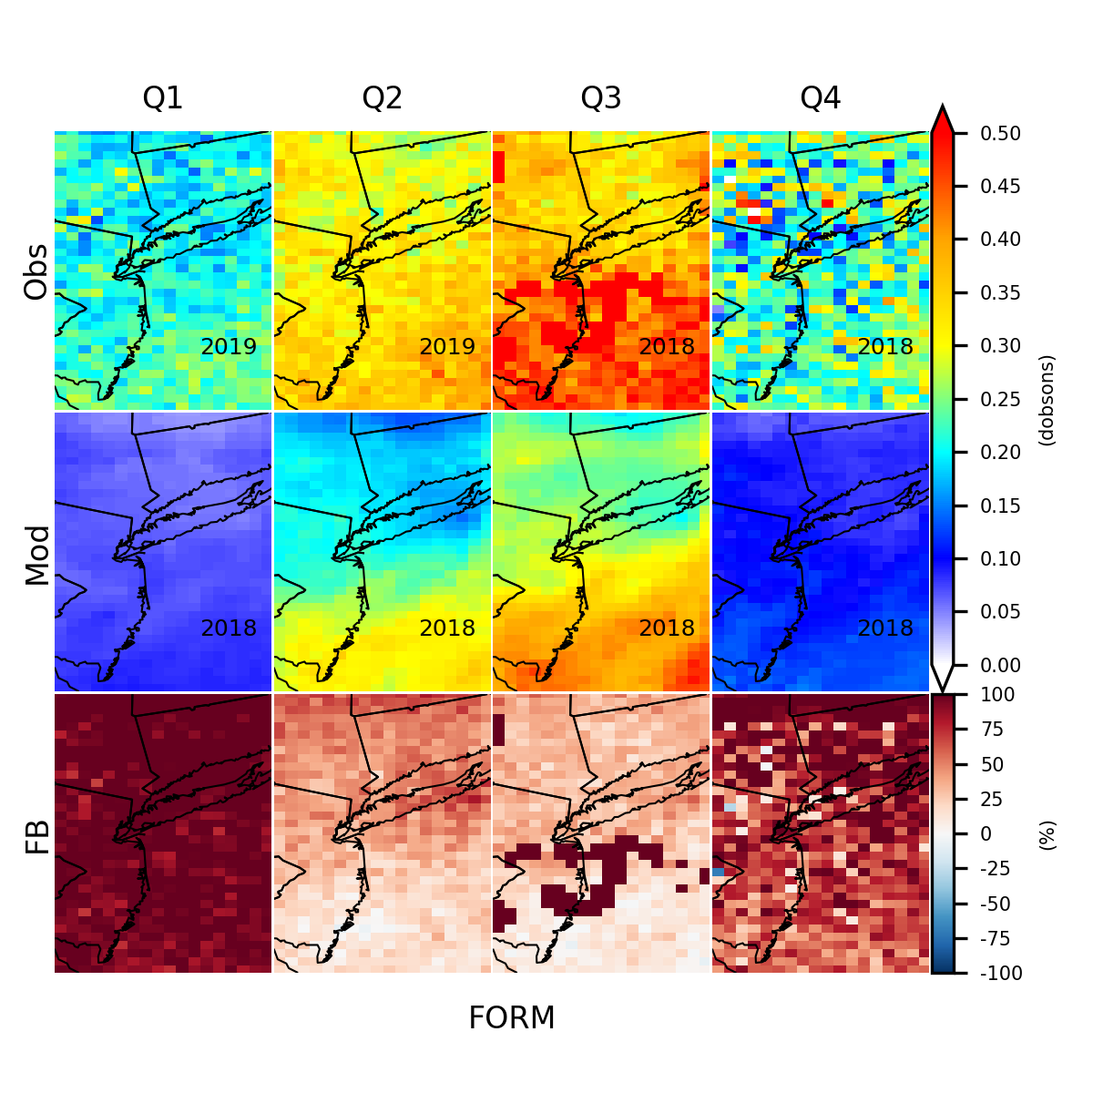
TROPOMI vs Modeled Column
Seasonal average total column HCHO
12x12 km grid for CONUS
CMAQ column and TROPOMI both show similar spatial and temporal signatures.
CMAQ underestimates total column HCHO, especially in Q1 and Q4.
12x12 km grid for LISTOS area
shu.qian@epa.gov
Notes:
We can also zoom in into LISTOS area, we can see similar results in LISTOS area in 12x12 grid resolutions.

Slide 13
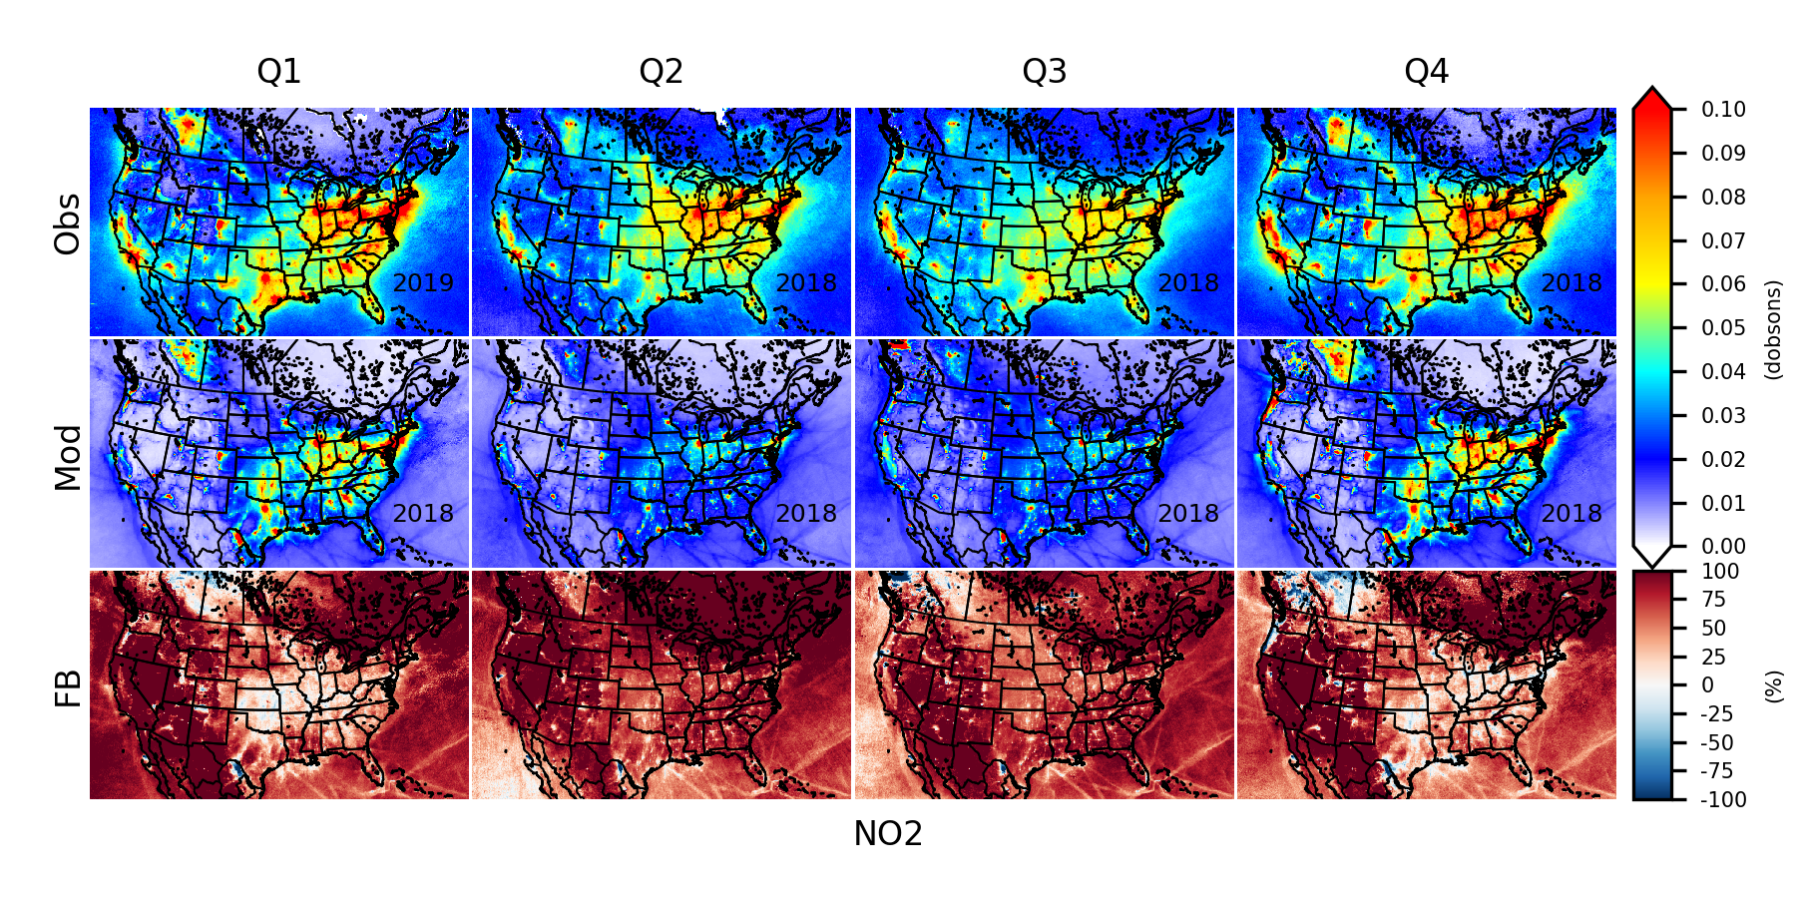
TROPOMI vs Modeled Column
Seasonal average total column NO2
Q1: Jan-Mar
Q2: Apr-Jun
Q3: Jul-Sep
Q4: Oct-Dec
12x12 km grid for CONUS
shu.qian@epa.gov
Notes:
For NO2, we saw converse situation while CMAQ predicts total column NO2 better in Q1 and Q4 while worse in Q2 and Q3. our model underestimates NO2 over summer.

Slide 14
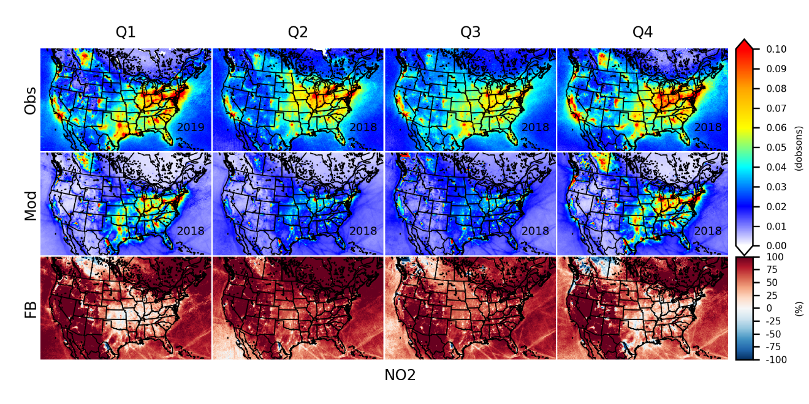
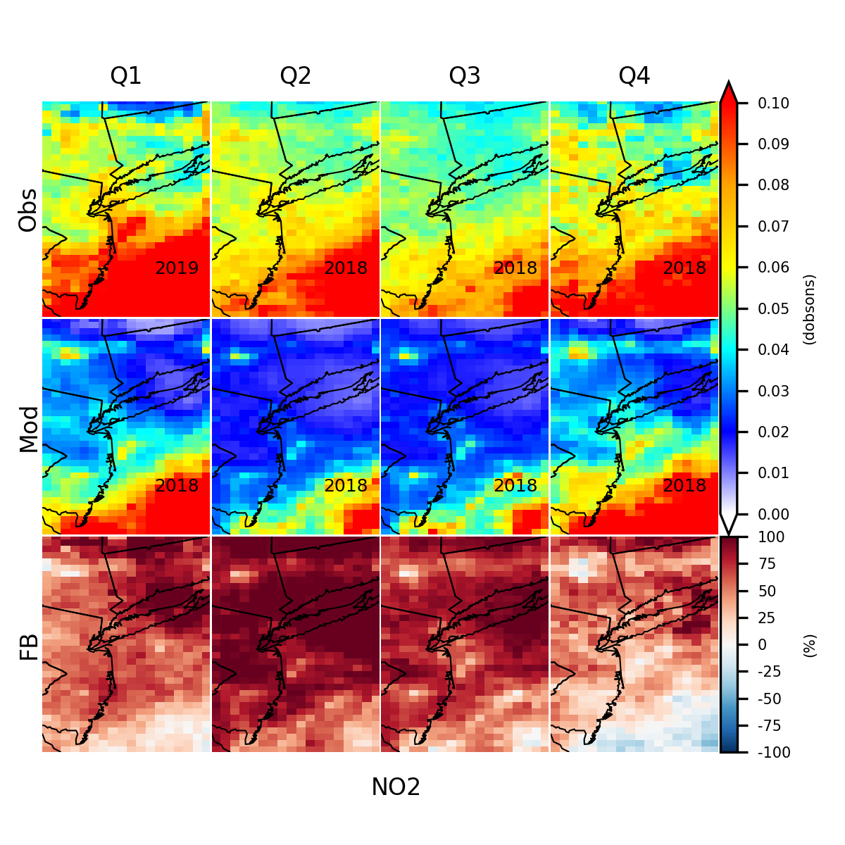
TROPOMI vs Modeled Column
Seasonal average total column NO2
12x12 km grid for CONUS
CMAQ column and TROPOMI both show similar spatial and temporal signatures.
Conversely, CMAQ predicts total column NO2 better in Q1 and Q4 while worse in Q2 and Q3.
12x12 km grid for LISTOS area
shu.qian@epa.gov

Slide 15
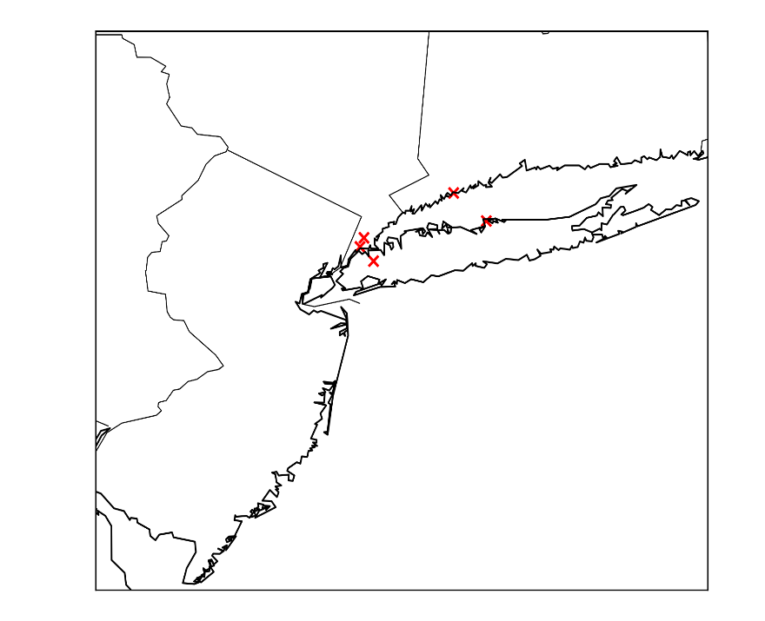
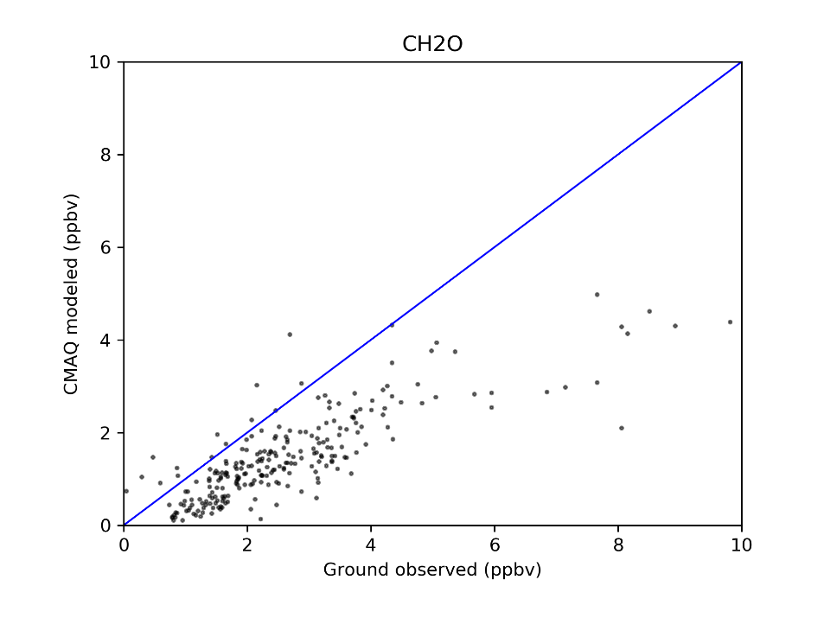
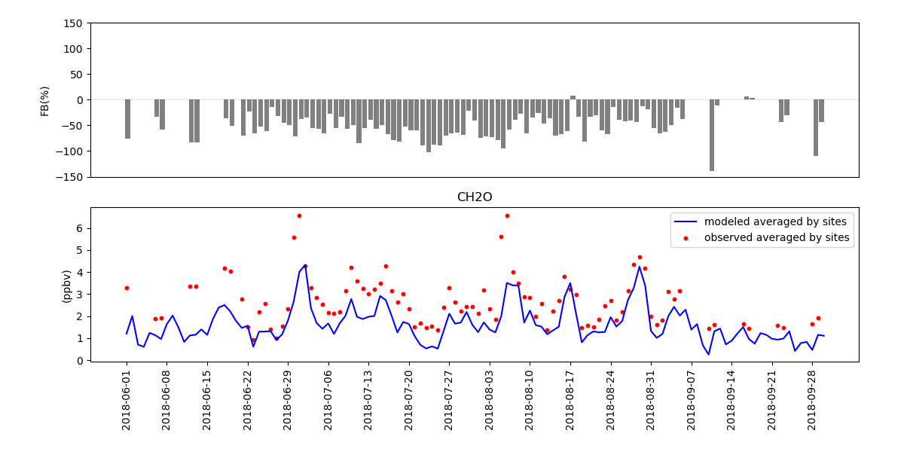
LISTOS ground measurements vs Modeled surface at paired sites
a
b
HCHO
Available sites
Scatter plots of observations vs models
Daily mean fractional biases over time
Daily averaged concentration by sites over time
CMAQ underestimates surface HCHO concentration during LISTOS episodes.
c
d
shu.qian@epa.gov

Slide 16
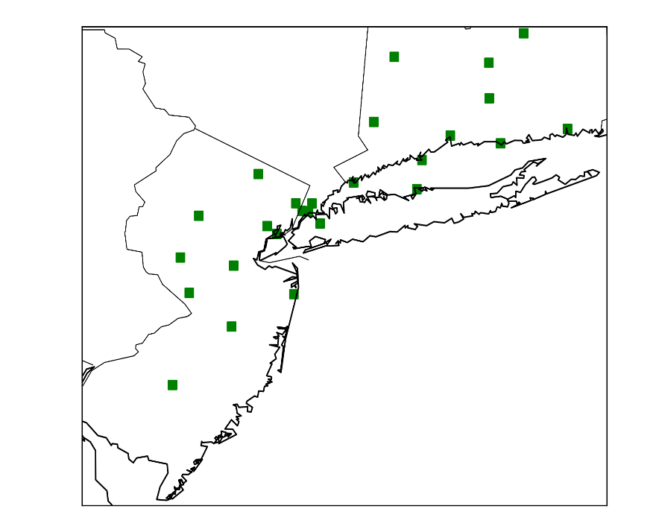
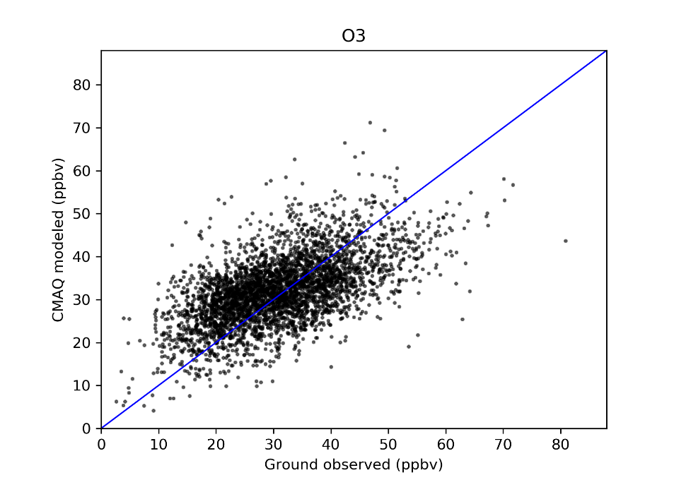
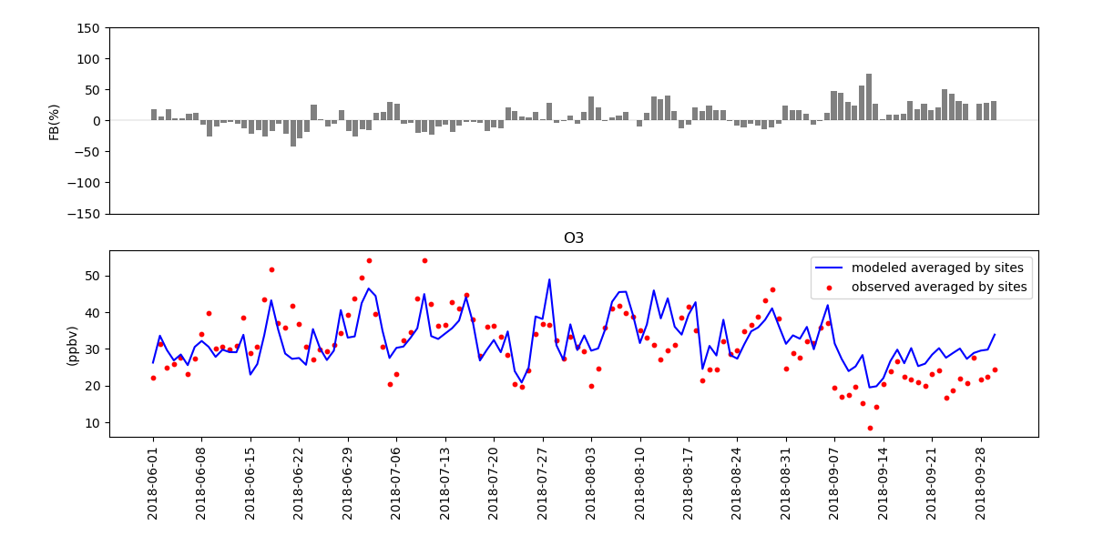
LISTOS ground measurements vs Modeled surface at paired sites
a
b
O3
Available sites
Scatter plots of observations vs models
Daily mean fractional biases over time
Daily averaged concentration by sites over time
CMAQ predicts surface O3 very well during LISTOS.
Daily mean fractional biases at all sites are between -50% and 50% at most of days during LISTOS.
c
d
shu.qian@epa.gov

Slide 17
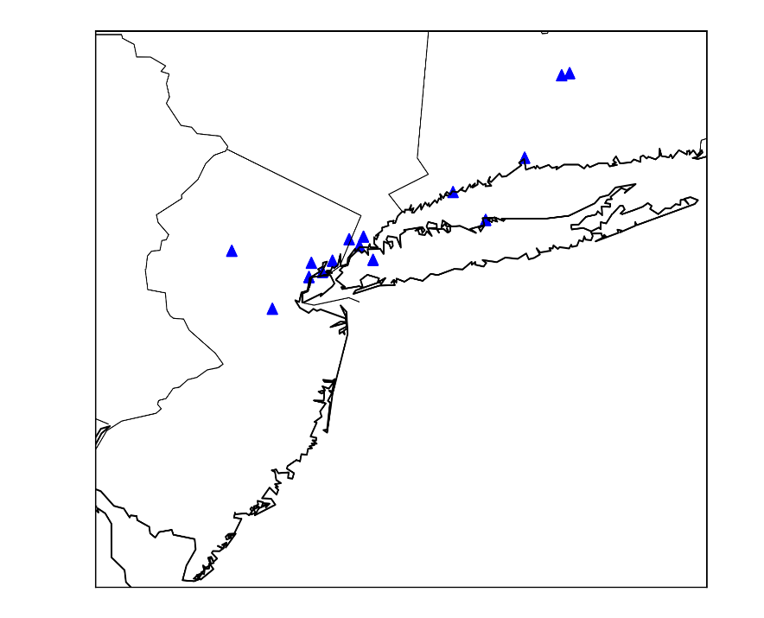
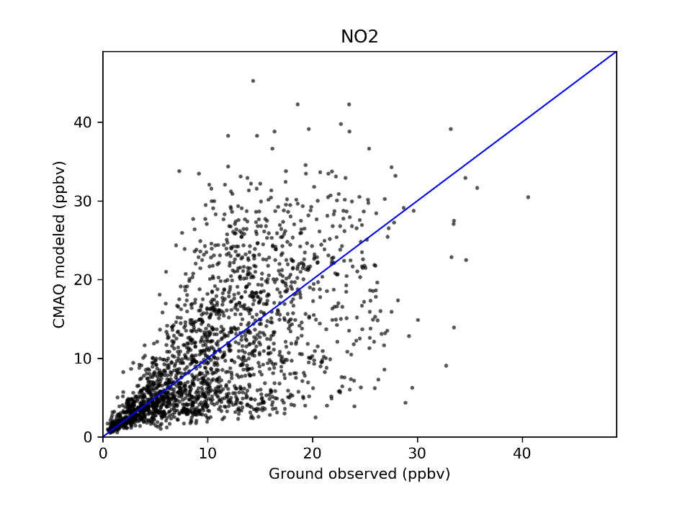
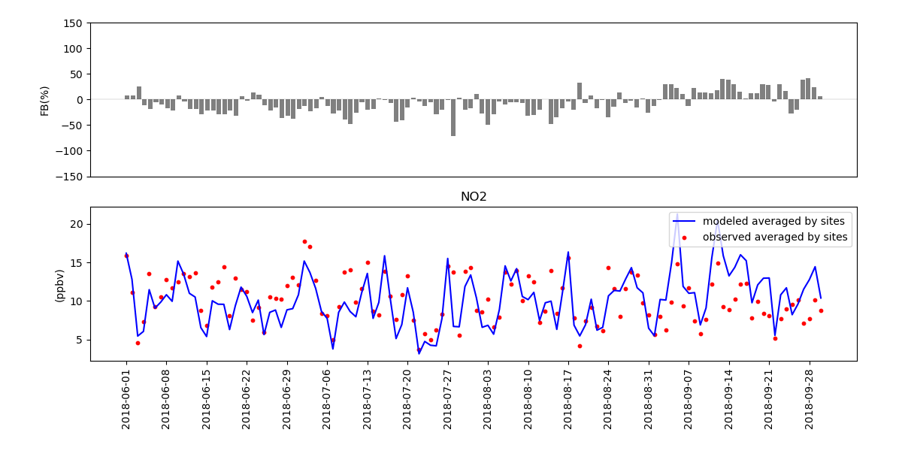
LISTOS ground measurements vs Modeled surface at paired sites
a
b
NO2
Available sites
Scatter plots of observations vs models
Daily mean fractional biases over time
Daily averaged concentration by sites over time
CMAQ underestimates surface NO2 at most of days during LISTOS.
c
d
shu.qian@epa.gov

Slide 18

Sector contributions
Sector definition
RAIL
EGU
NONEGU
CMV (commercial marine vessels)
OILGAS
FIRE
AREA
BIO (biogenic)
NONROAD
ONROAD
ICON (initial condition)
BCON (boundary condition)
OTHR (All – above sectors)
shu.qian@epa.gov
Notes:
Previous model evaluation results show that our model can fairly predict O3, NO2 and HCHO. Even if there still exists obvious biases compared to observation, but CMAQ v5.3 absolutely can show similar temporal and spatial signatures as TROPOMI satellite, which provides us this confidence to look at source apportionment results. In CMAQ-ISAM, we tracked ten tags from different emissions files from EGU emissions to onroad emissions, also including three default tags, ICON, BCON and others. OTHRS here represents the rest of sources. Then we calculated sector fractions to see how they contribute to model concentrations.

Slide 19
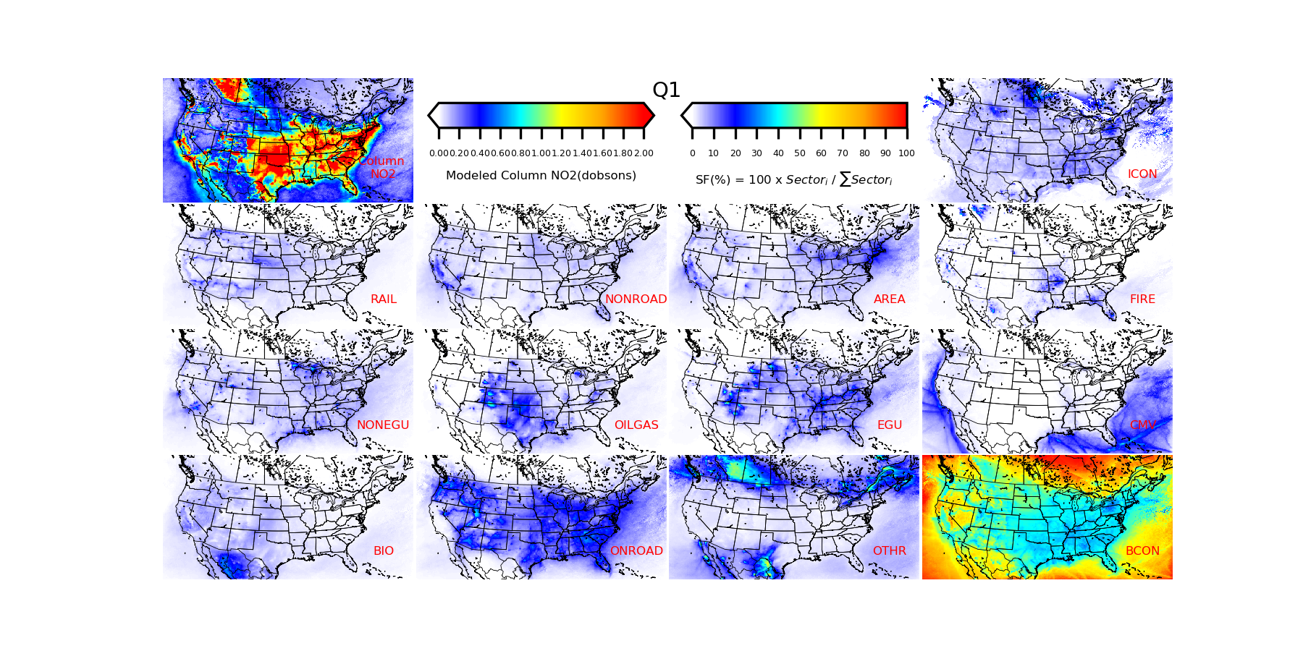
Seasonal summarized sector contributions for NO2 in Q1 (Jan-Mar)
12x12 km grid for CONUS
shu.qian@epa.gov
Notes:
We had annual contributions but due to some issues, we have to rerun the whole year. In this case, I can’t show you all seasons results today. But we do have the first three months data as test case. As you can see, the top left figure is seasonal summarized total column NO2 while other plots show spatial Q1 summarized sector fractions for different sectors defined in previous slides. I want to highlight here is in OTHR part, we saw this large contributions out of US, which can be identified as sources from Canada and Mexico. Major sources over ocean around US comes from CMV and BCON, which indicates global sources from other regions.

Slide 20
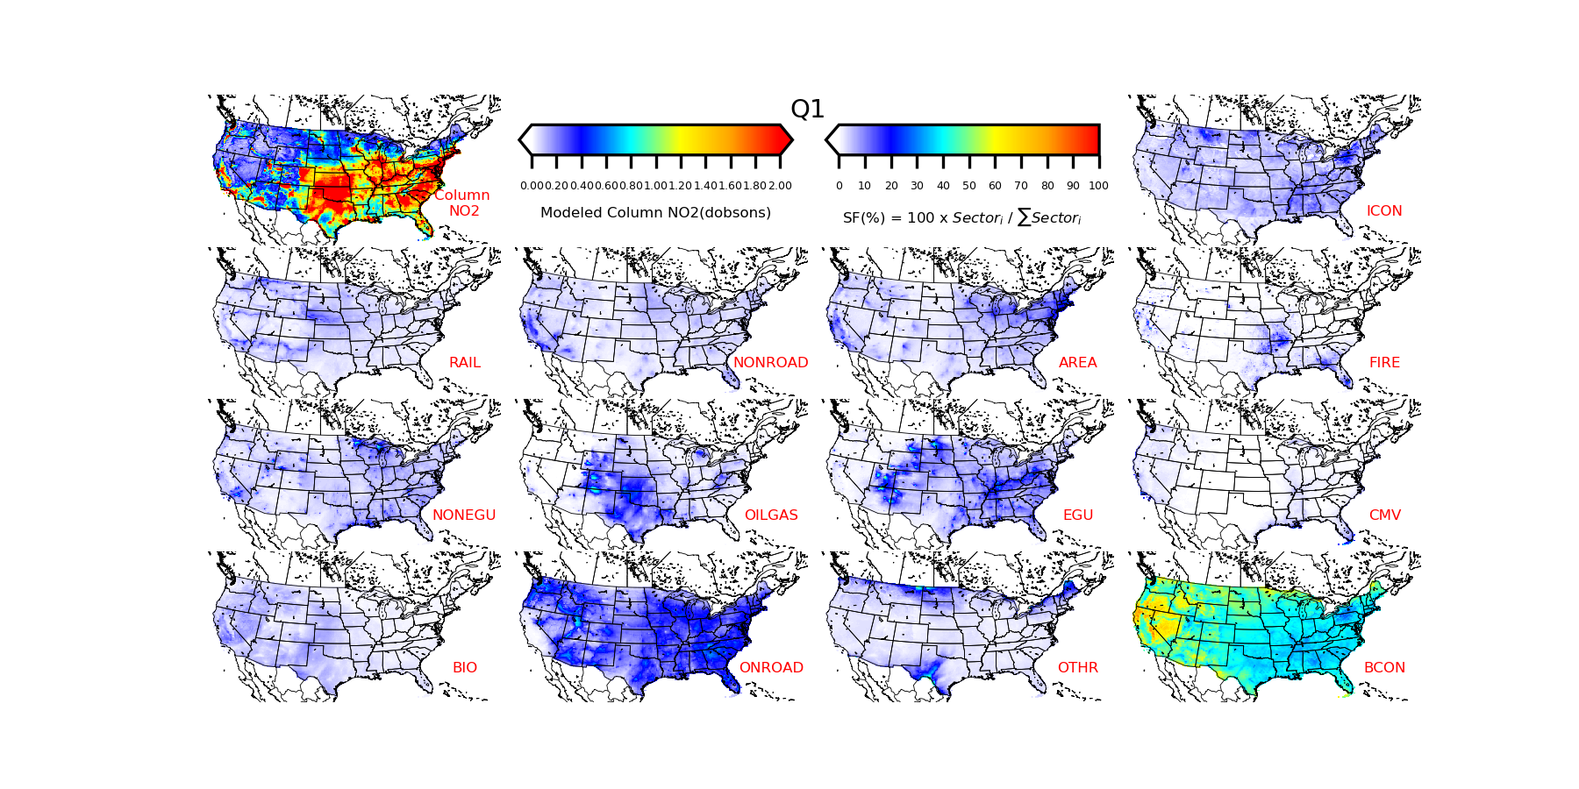
Seasonal summarized sector contributions for NO2 in Q1 (Jan-Mar)
12x12 km grid for CONUS excluding OCEAN, Canada and Mexico
shu.qian@epa.gov
Notes:
We mask out contributions in around ocean, Mexico and Canada and solely look at US. From previous simulation, it at least takes three months to get rid of ICON contributions. So here we can still see sources contributions from ICON. BCON takes up the majority of contributions. OILGAS concentrated in mid US where lots of oil and gas industrial activities happen. ONRAOD is the second large contributions over US rather than BCON. And we also noticed that AREA sector contributes a lot in northeastern US, which including LISTOS area than other US.

Slide 21
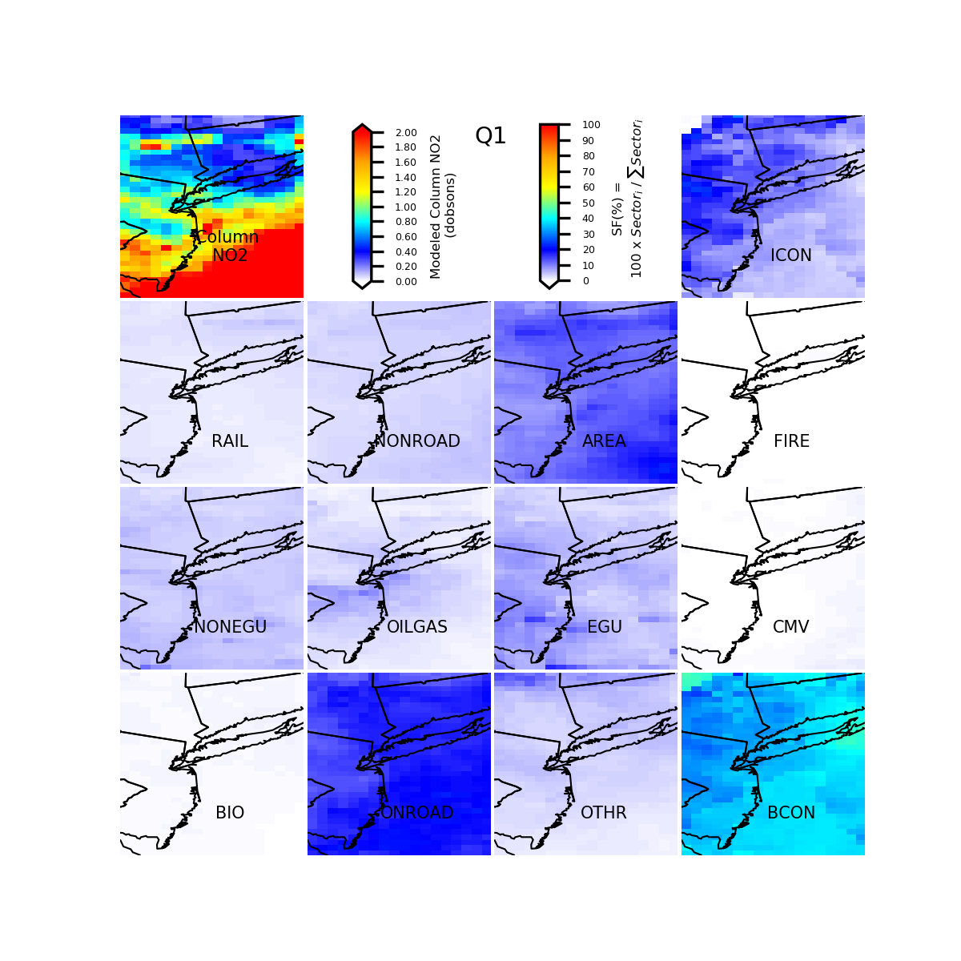
Seasonal summarized sector contributions for NO2 in Q1 (Jan-Mar)
12x12 km grid for CONUS excluding OCEAN, Canada and Mexico
12x12 km grid for LISTOS area
shu.qian@epa.gov
Notes:
So then we zoom in into LISTOS area. Except sectors I highlight in red, contributions from other sectors are under 5%.

Slide 22
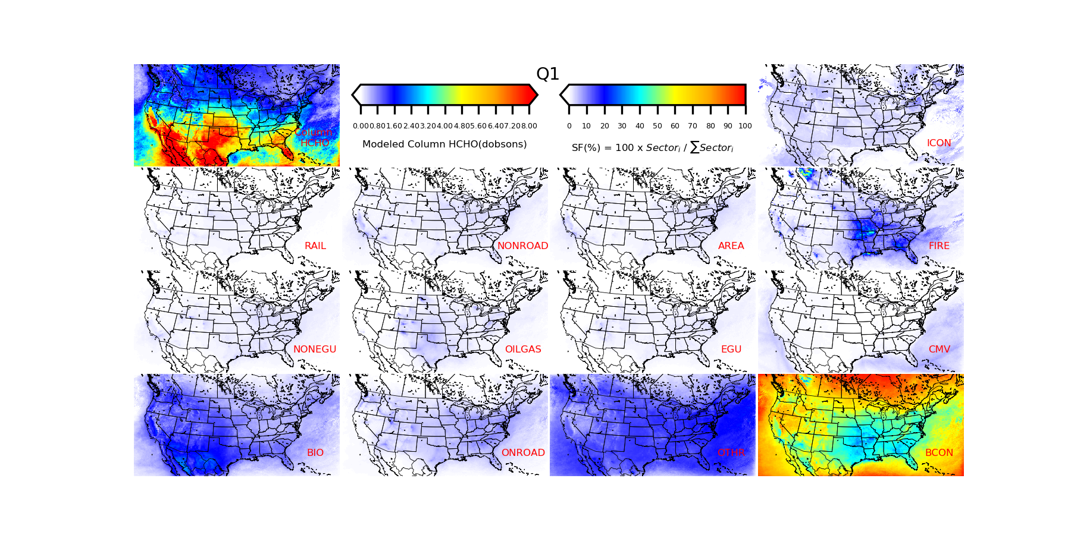
Seasonal summarized sector contributions for HCHO in Q1 (Jan-Mar)
12x12 km grid for CONUS
shu.qian@epa.gov
Notes:
Similar plots for HCHO. We mask out other area and focus on US.

Slide 23
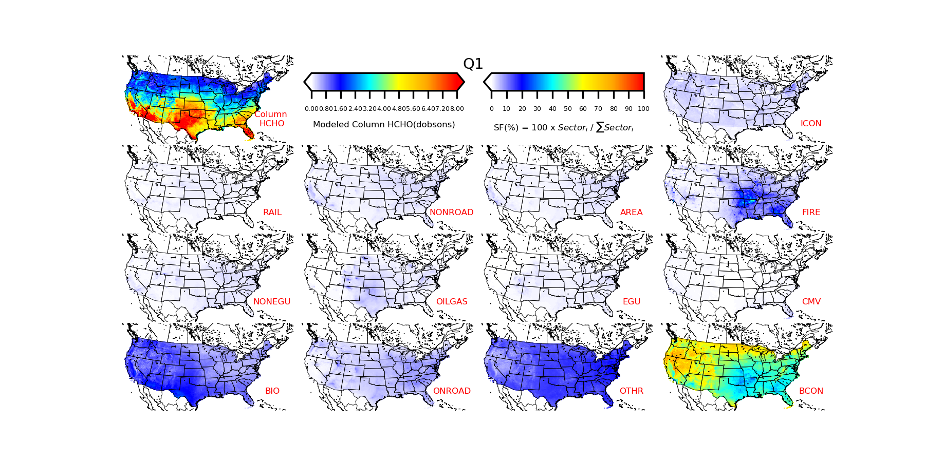
Seasonal summarized sector contributions for HCHO in Q1 (Jan-Mar)
12x12 km grid for CONUS excluding OCEAN, Canada and Mexico
shu.qian@epa.gov
Notes:
HCHO comes from bios, bcon, fires. There are also a large part contribution from OTHR, which we can’t track at current stage. If we borrow concept from Barron’s talk, we think there are lots of uncontrollable sources for HCHO that needs to be classified.

Slide 24
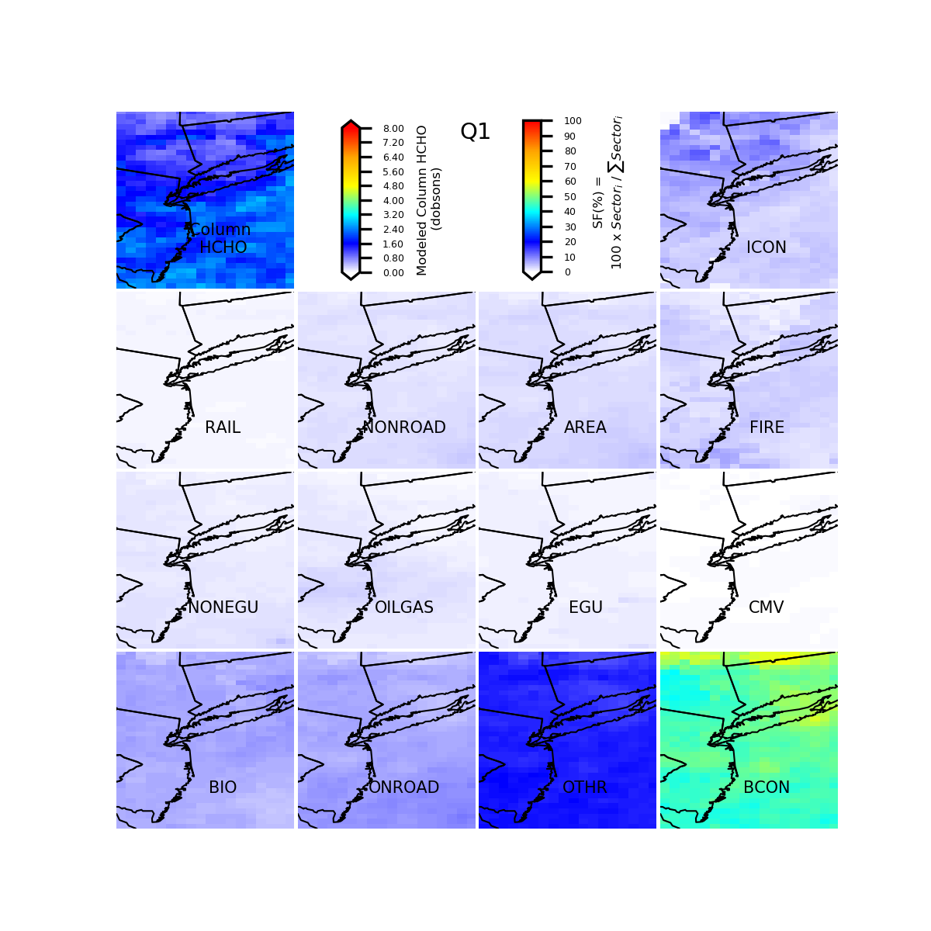
Seasonal summarized sector contributions for HCHO in Q1 (Jan-Mar)
12x12 km grid for CONUS excluding OCEAN, Canada and Mexico
12x12 km grid for LISTOS area
shu.qian@epa.gov
Notes:
Zoom into LISTOS area, fires and bios influences reduced. Biogenic sources are mainly located in southwest and west US.

Slide 25
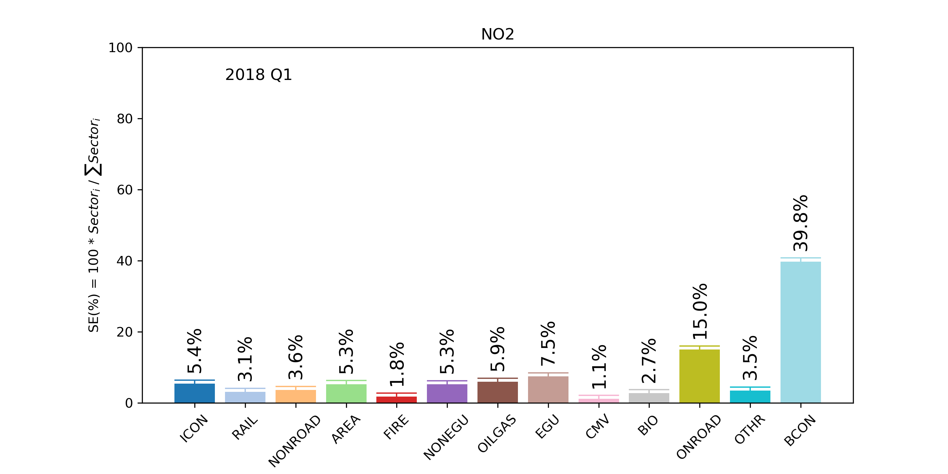
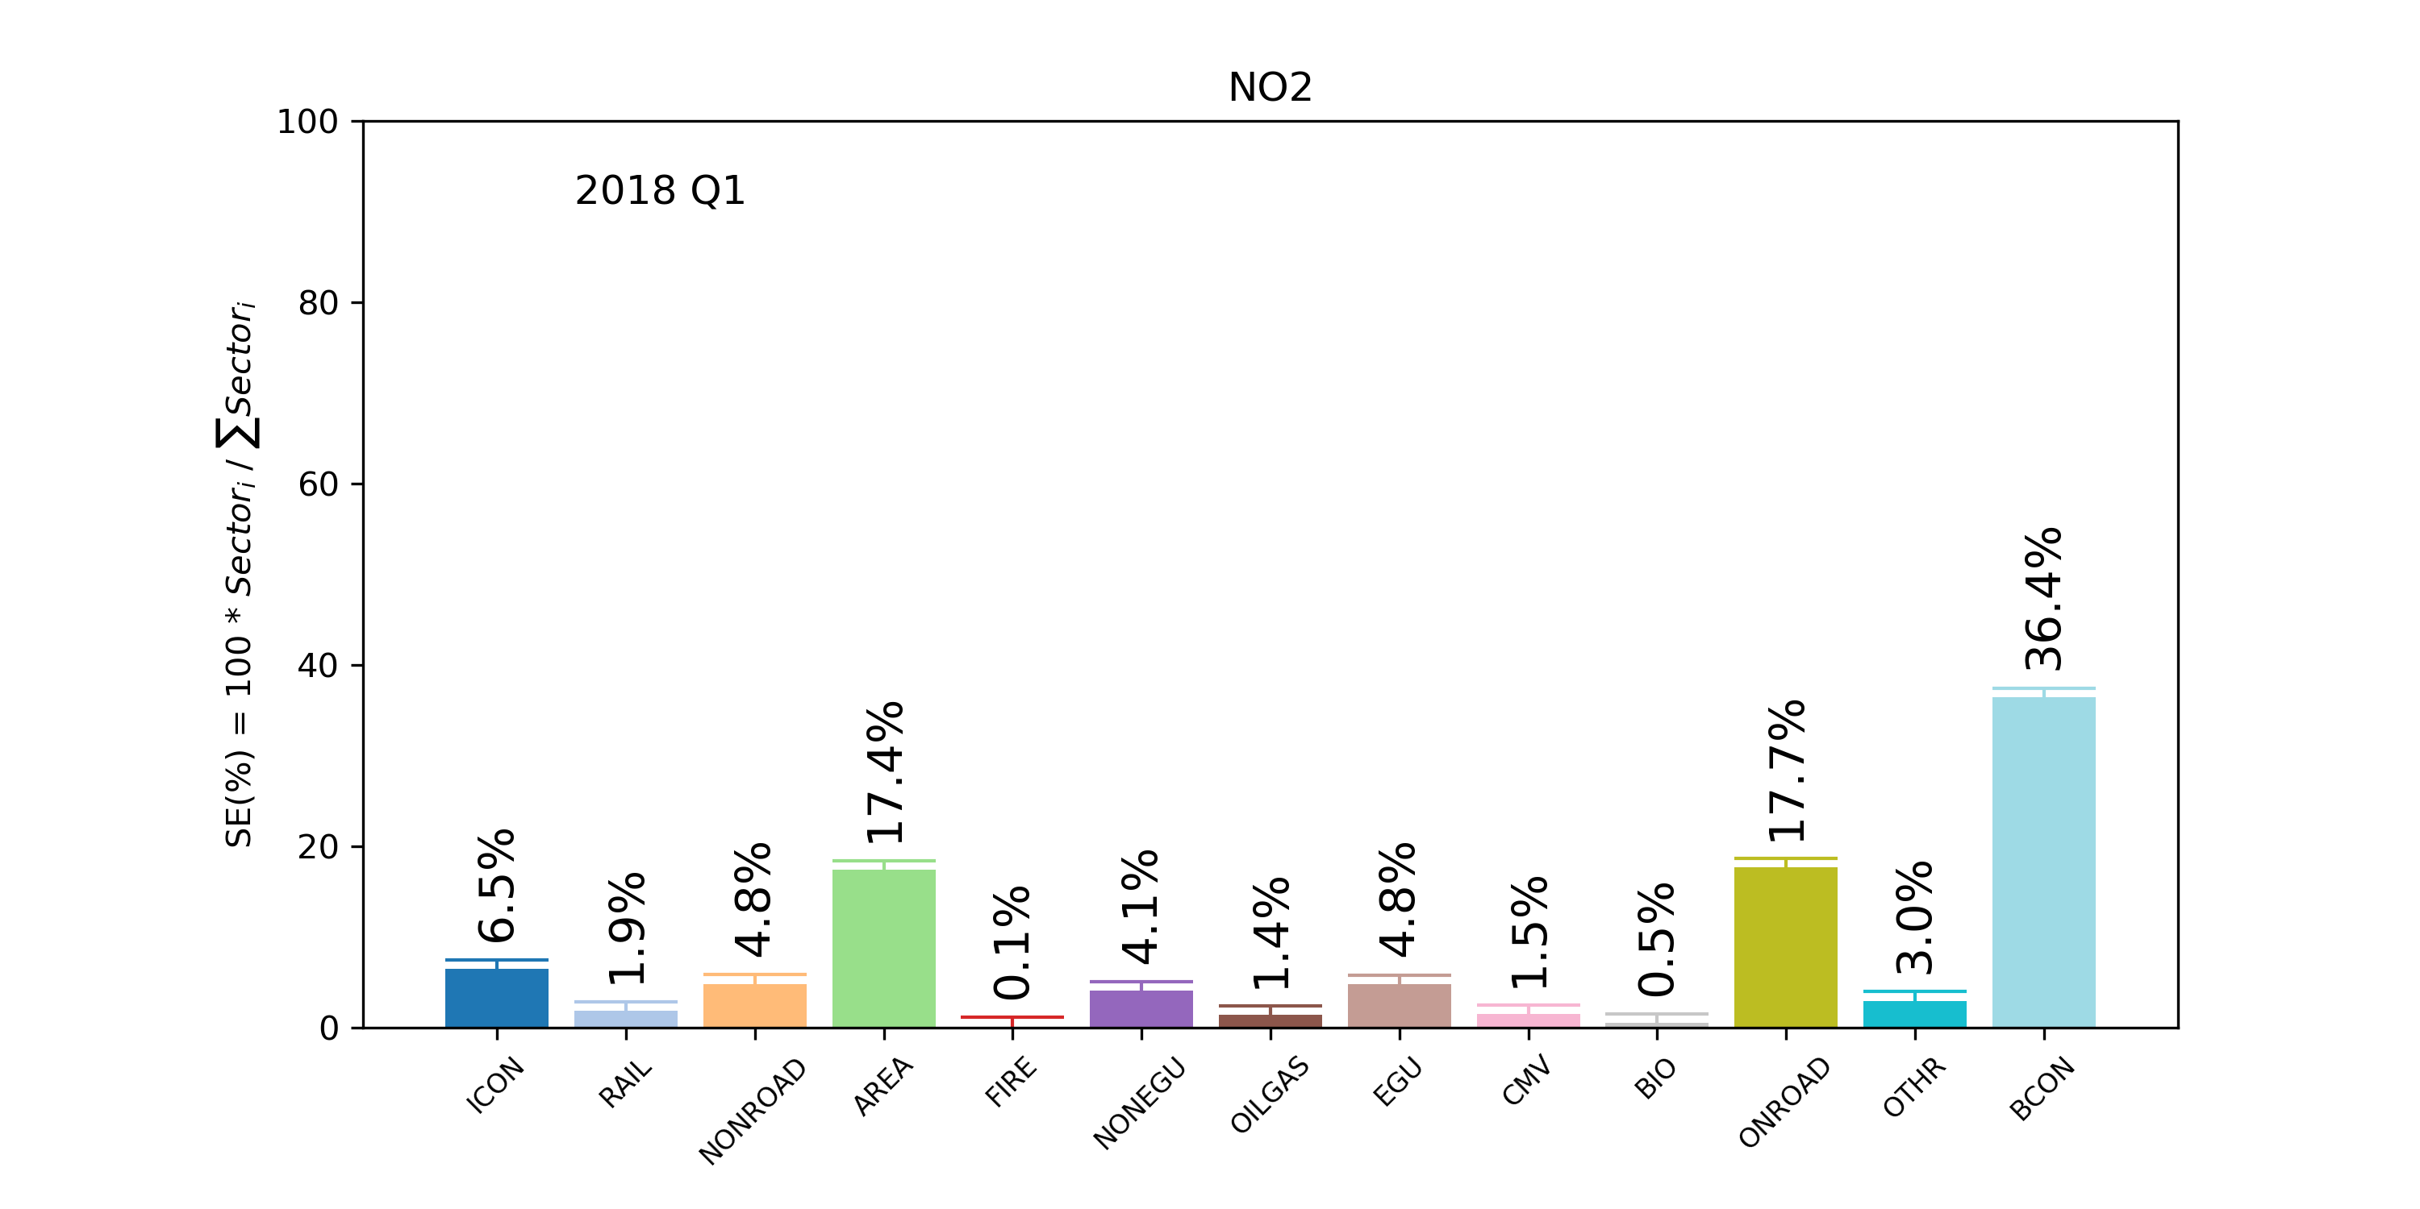
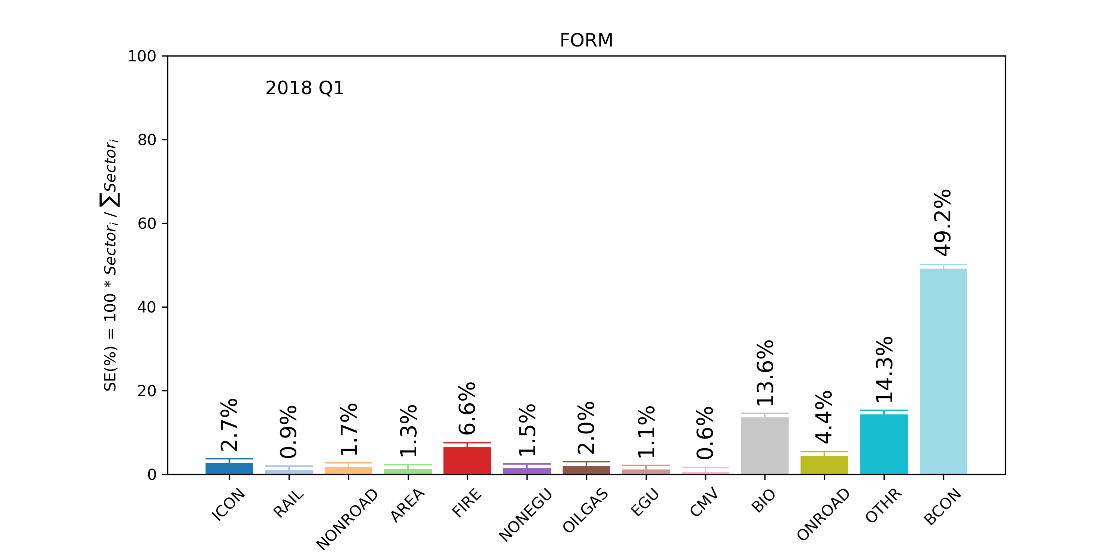
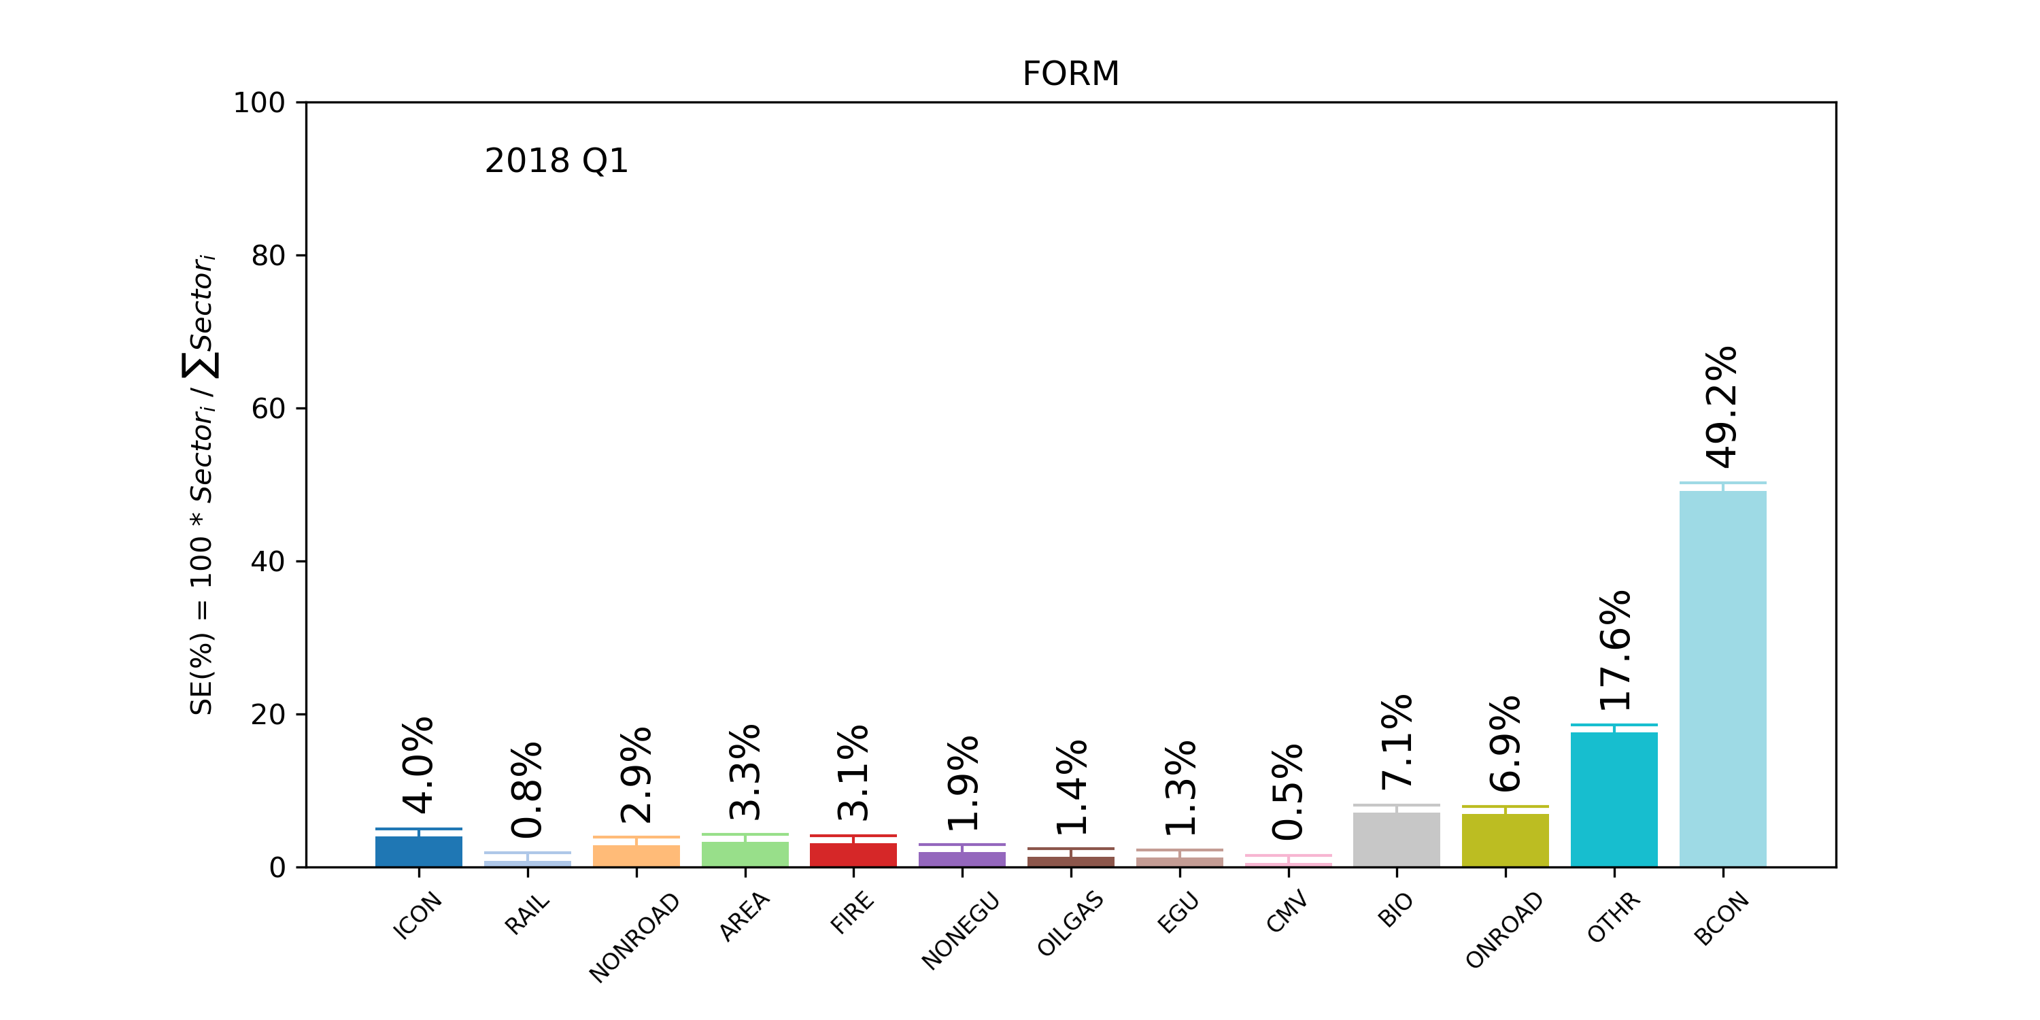
Seasonal summarized sector contributions for Q1 (Jan-Mar)
12x12 km grid for CONUS
12x12 km grid for LISTOS area
NO2
HCHO
shu.qian@epa.gov
Notes:
Then, we summarized sector fractions over the entire US and LISTOS area as bulk bars. For NO2, As one of major precursors of O3, most of NO2 sources are from BCON (39.8%) while the second part is ONROAD emissions (15.0%) nationwide. In LISTOS area, AREA sector increases and dominates source contributions with BCON and ONROAD. HCHO, is mainly from BCON, BIOGENICS, FIRES and OTHER (which we can’t track directly at current stage) nationwide. In LISTOS area, contributions from fires and biogenics reduce compared to nationwide.

Slide 26
Take-home-message
CMAQ simulation is conducted for LISTOS research using new version CMAQ (v5.3 beta).
CMAQ persistently underestimates HCHO and needs to be improved.
CMAQ-ISAM is applied to answer questions about O3 source contributions from nationwide to local area.
Based on Q1 results (Jan-Mar)
As one of major precursors of O3, most of NO2 sources are from BCON (39.8%) while the second part is ONROAD emissions (15.0%) nationwide. In LISTOS area, AREA sector increases and dominates source contributions with BCON and ONROAD.
HCHO, as a constraint on VOC emissions and chemistry, is mainly from BCON, BIOGENICS, FIRES and OTHER (which we can’t track directly at current stage) nationwide.

Slide 27

Thank you!
Questions?

