Slide 1
Comparison of PM2.5 measured in urban North Carolina settings using a low-cost optical particle counter and Federal Equivalent Methods
Brian Magi
Associate Professor of Atmospheric Sciences
UNC Charlotte (Charlotte, North Carolina)
Calvin Cupini
Citizen Science Program Manager
Clean Air Carolina (Charlotte, North Carolina)
Presentation at CMAS Conference
23 October 2019

Slide 2
Collaborations and input from
Mecklenburg County AQ (Charlotte, North Carolina)
Forsyth County AQ (Winston-Salem, North Carolina)
EPA National Exposure Research Lab
EPA National Health and Environmental Effects Lab
Students at UNC Charlotte

Slide 3
Showing ~50 of the nearly 100 low-cost monitors in North Carolina
North Carolina has ~20 PM2.5 regulatory monitors total
Greensboro
Raleigh-Durham
Winston-Salem
PM2.5 ($μg/m^{3}$) reported by low-cost monitors
Charlotte
Notes:
Snapshot at 0830 Eastern, 13 October 2019

Slide 4
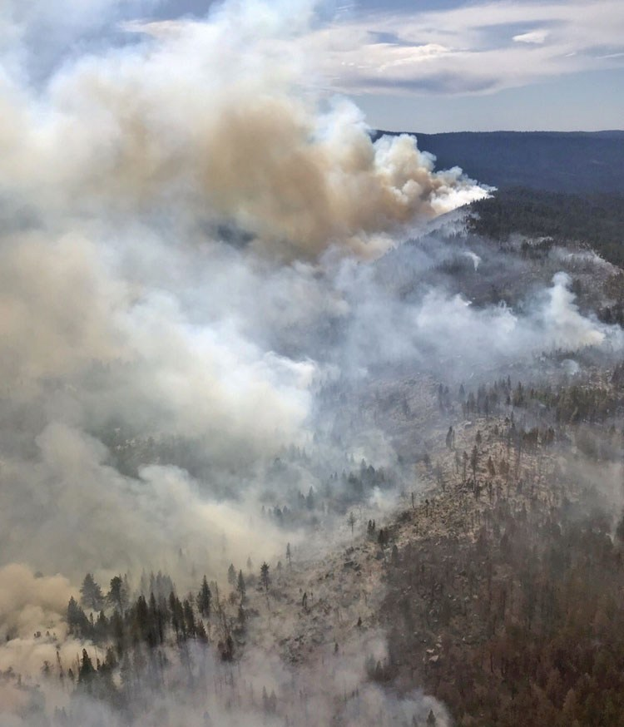
Notes:
Snapshot at 0830 Eastern, 13 October 2019 during Caples Escaped Rx Fire south of Lake Tahoe https://wildfiretoday.com/2019/10/12/caples-fire-spreads-to-the-south/ and image from https://wildfiretoday.com/2019/10/11/prescribed-fire-escapes-on-eldorado-national-forest/

Slide 5
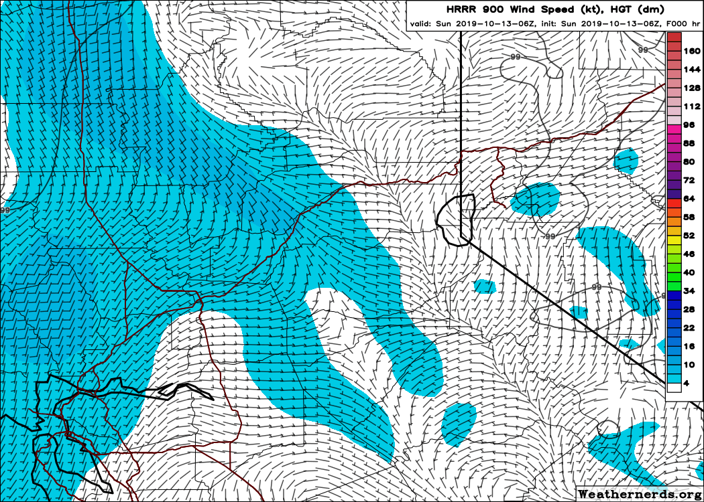
Notes:
2.5 million in Sacramento Metro, 5 million in SF Metro

Slide 6
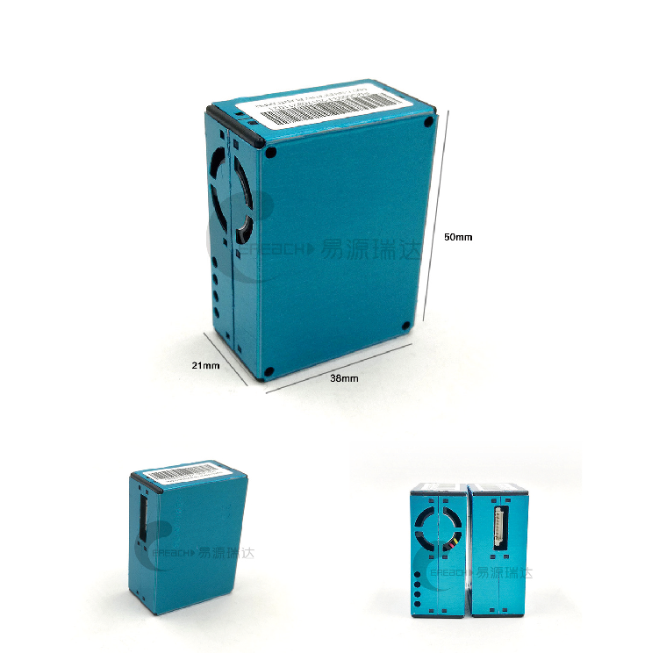
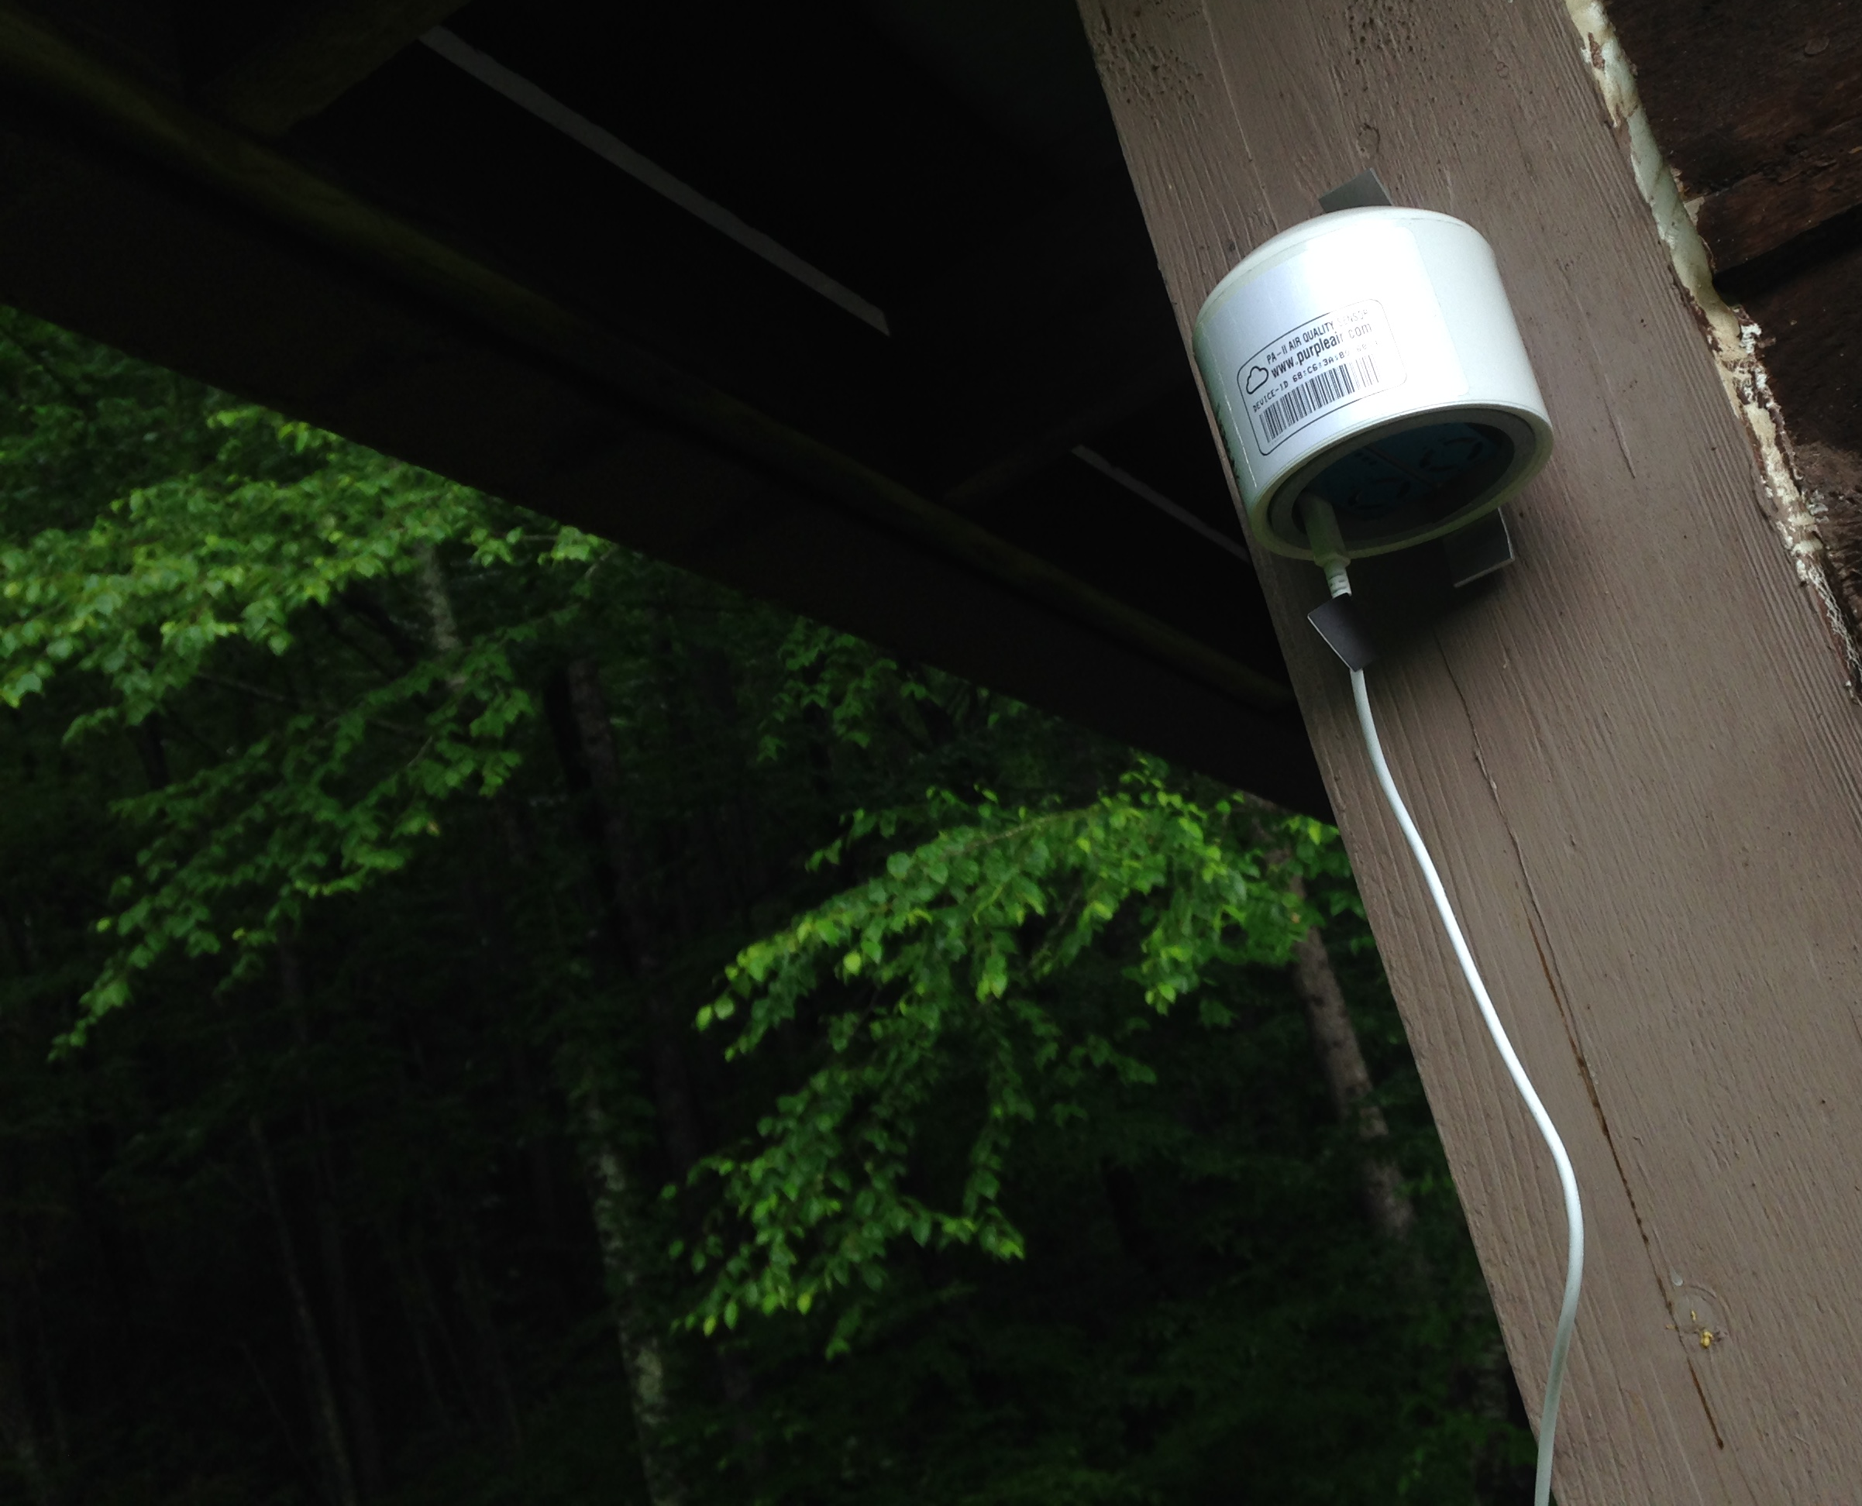
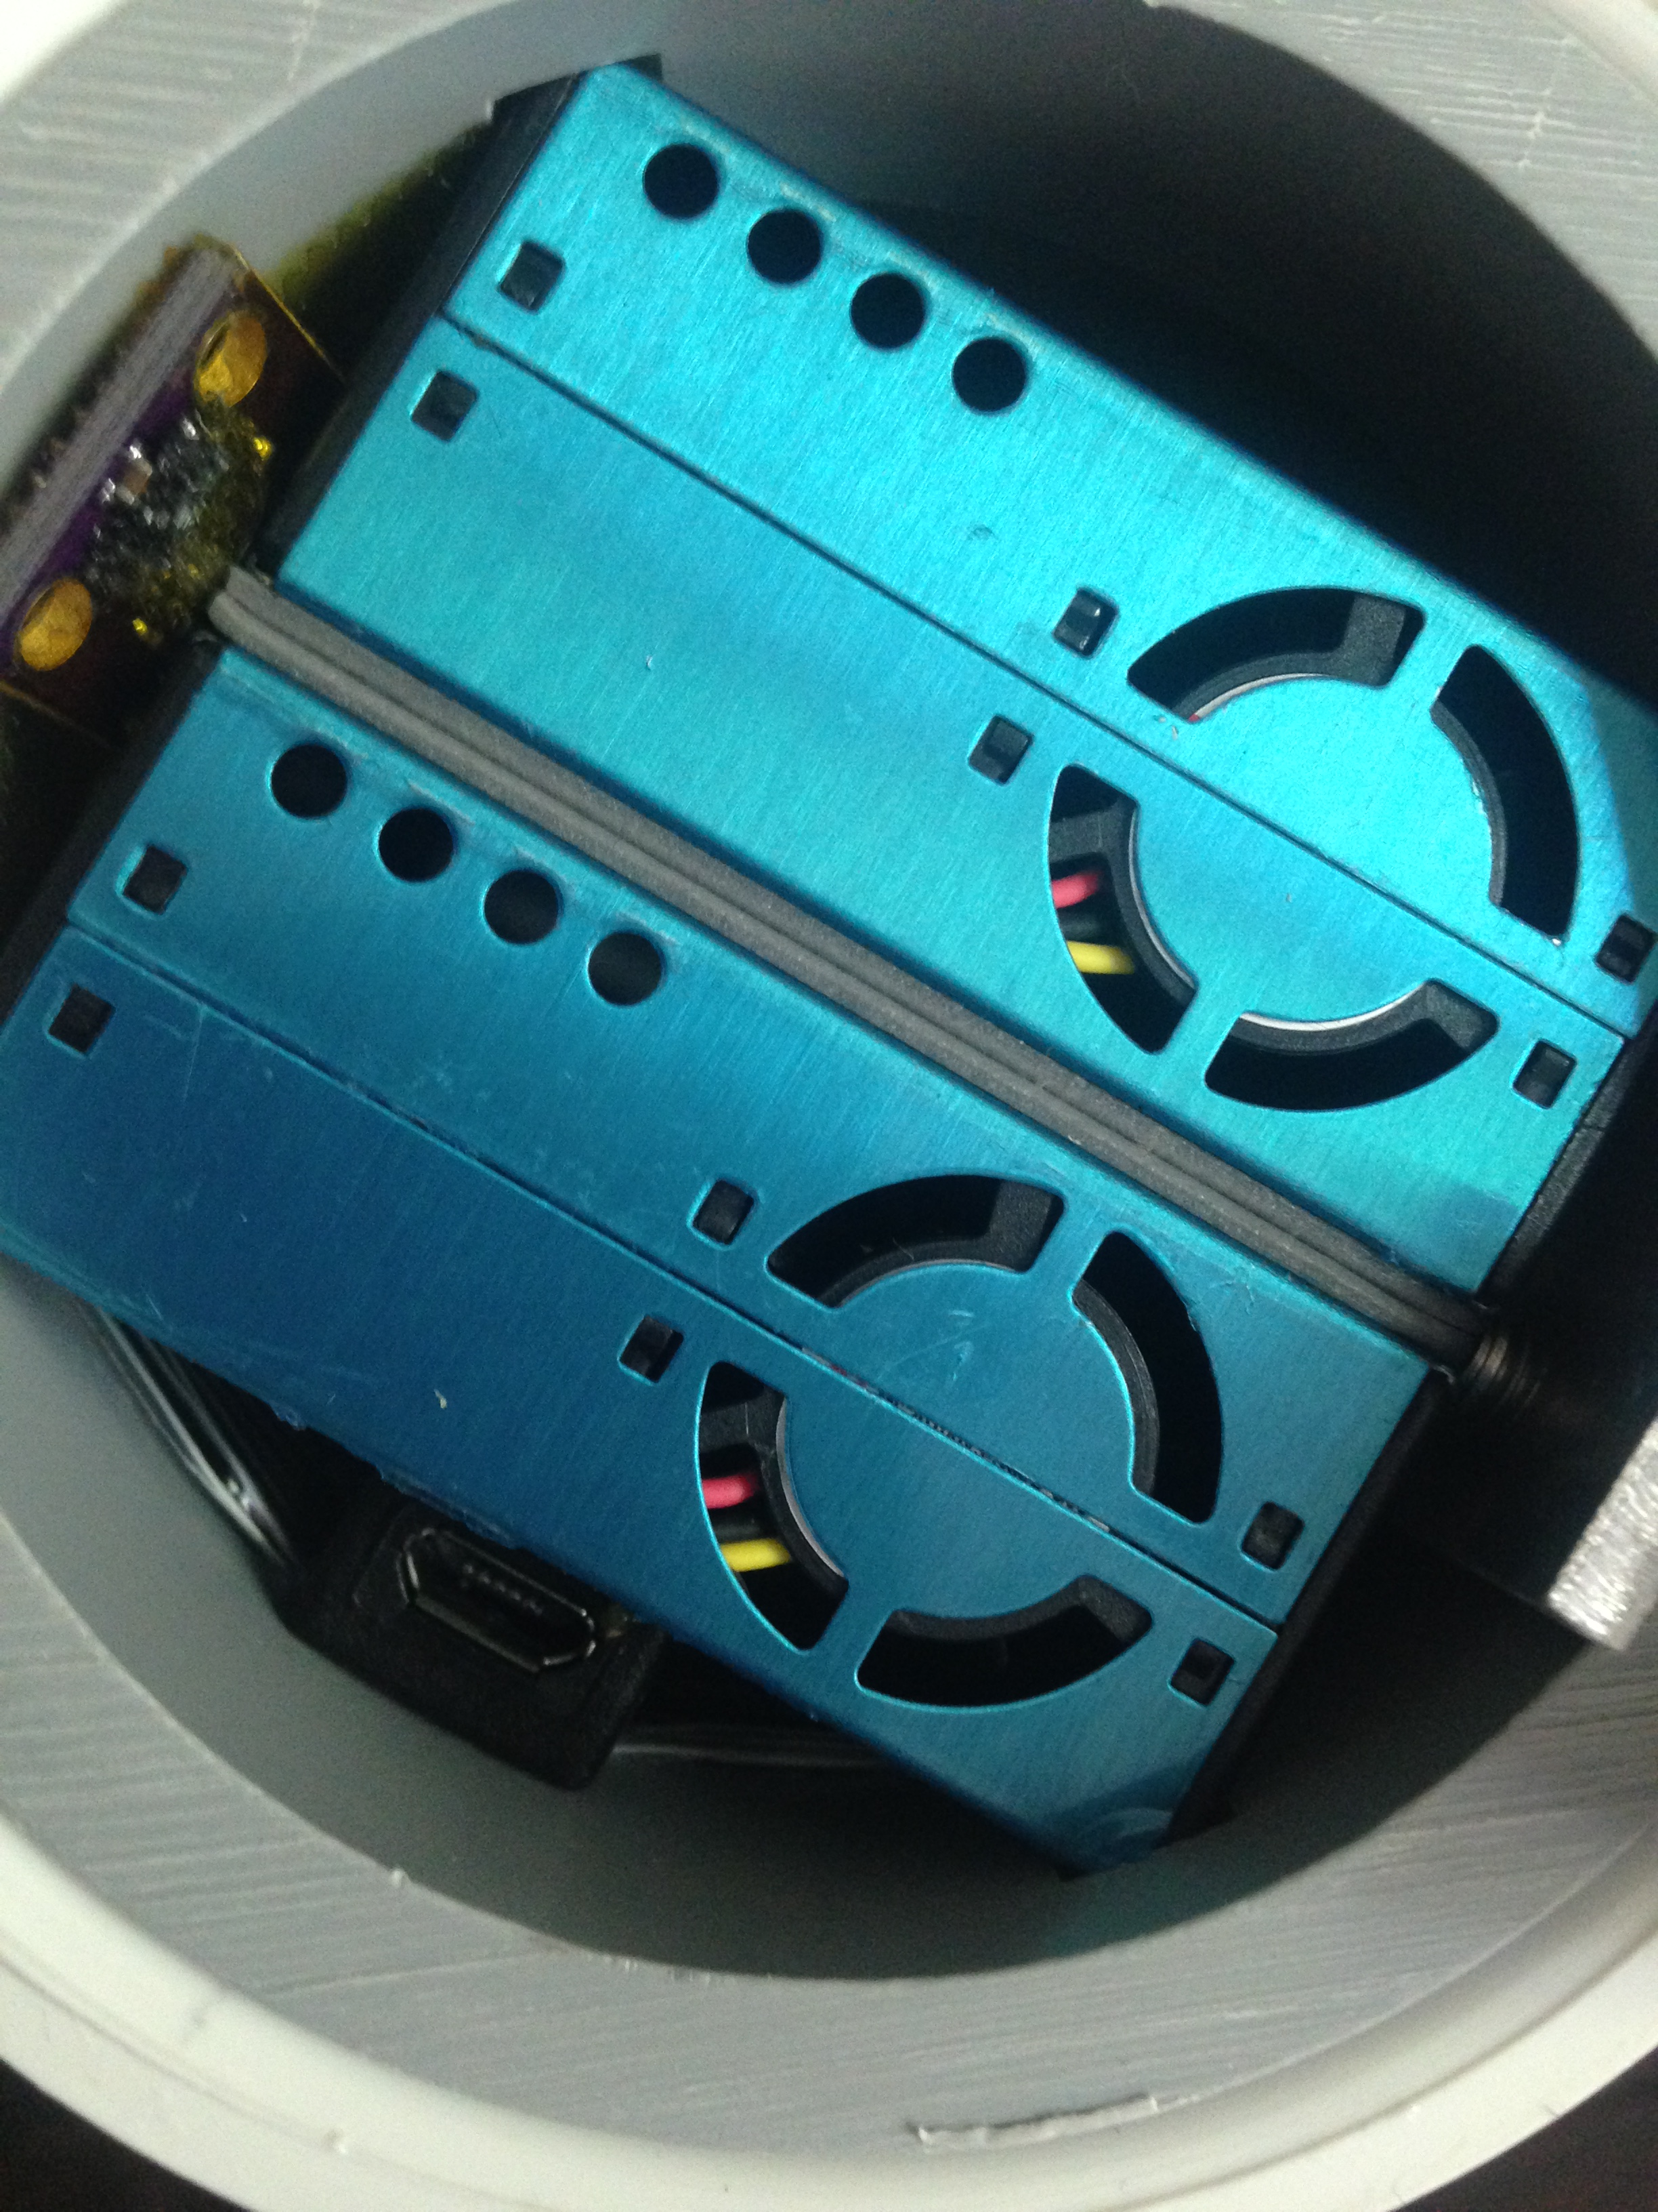
Purple Air PA-II sensor package
Measures number concentration using 2 Plantower PMS5003 sensors. Reports number and mass concentrations.
Also measures temperature and relative humidity
Good description at https://www.aqmd.gov/aq-spec/product/purpleair-pa-ii but also at Zamora et al 2019 Environmental Science & Technology https://doi.org/10.1021/acs.est.8b05174
Notes:
Describe what we learn from the data, rather than how we learning from the data

Slide 7
Data Objectives
What is the quality of the data from Purple Air PA-II Plantower sensors?
How long does a PA-II report consistent data?
CMAS Question
How can we make this data useful to modelers?

Slide 8
CMAS
Co-location study sites

Slide 9
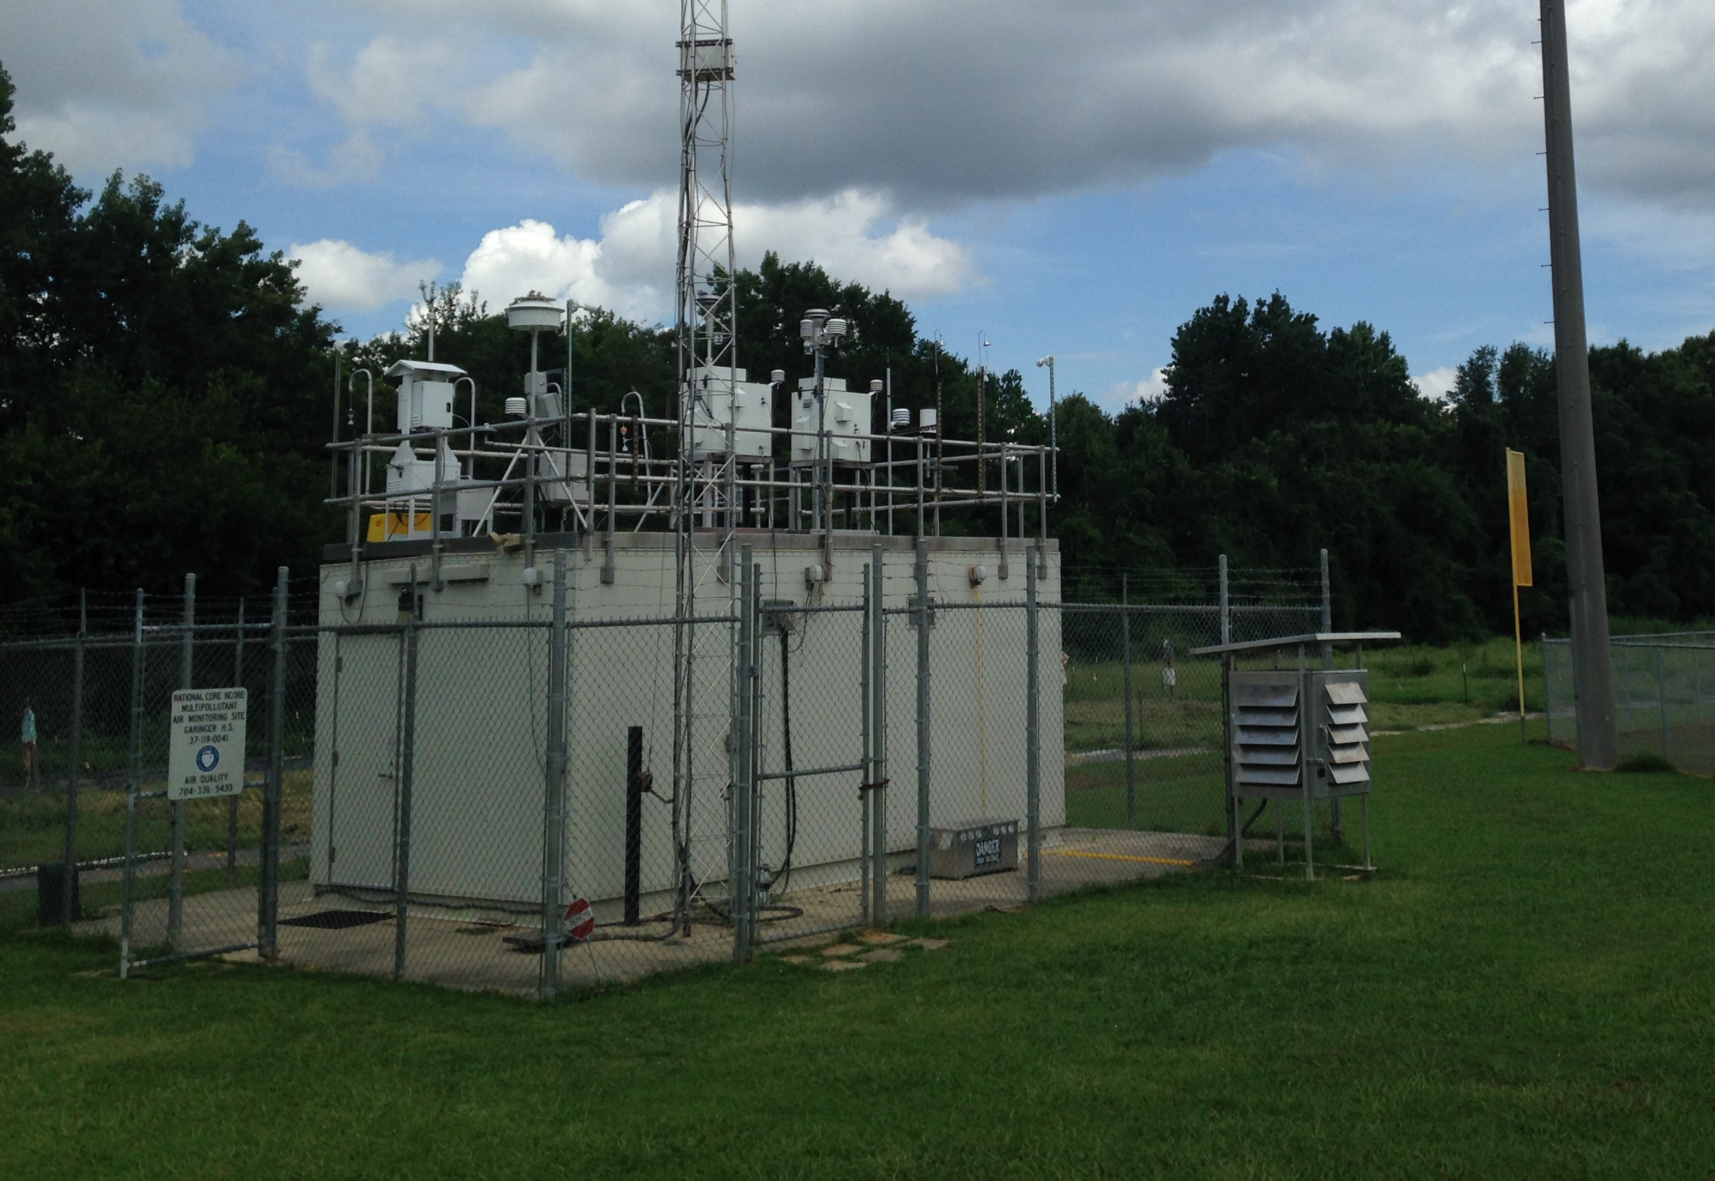
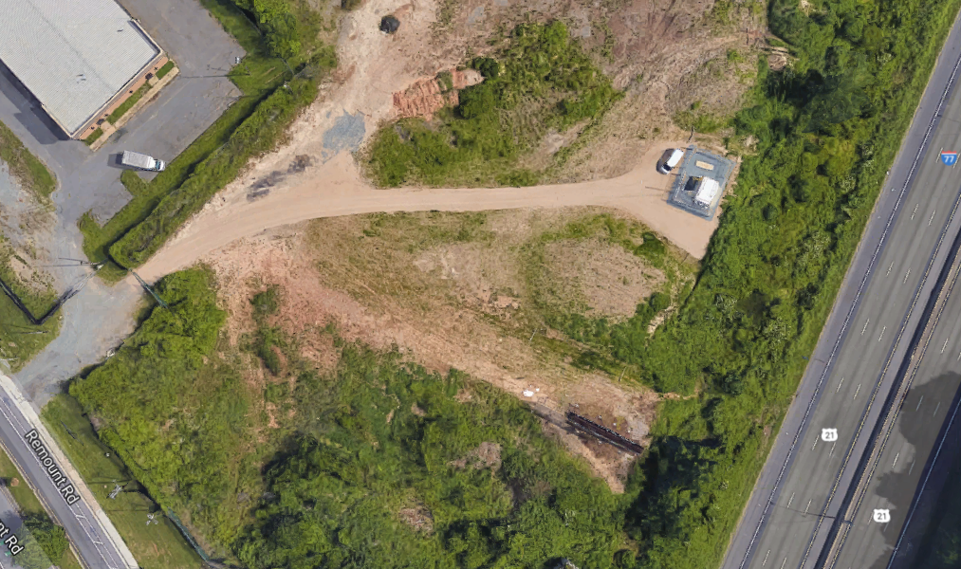
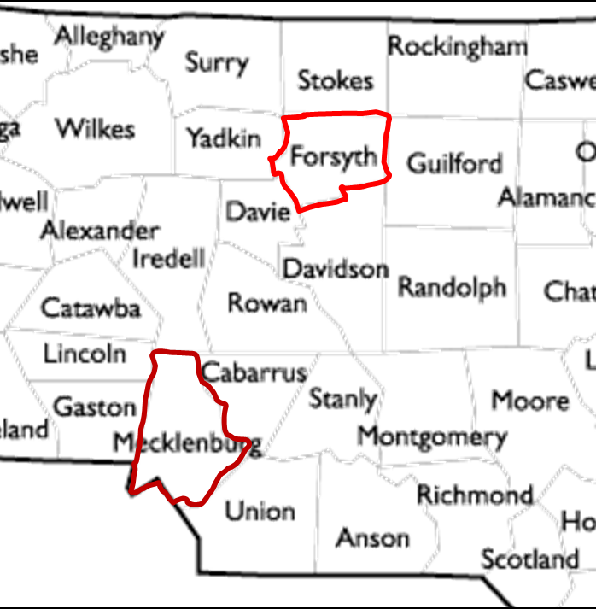
Co-location
PA-II and FEM T640X
Since March 2018
Co-location
PA-II and FEM BAM 1020
Since June 2019
Co-location
PA-II and FEM BAM 1022
Since March 2017
Notes:
Double collocation at Garinger HS = 4 sensors, at Remount = 3 (one is kaput), and single at Hatties Ave = 2 for a total of 9 data streams extending over months to as much as 2.5 years (Remount)

Slide 10
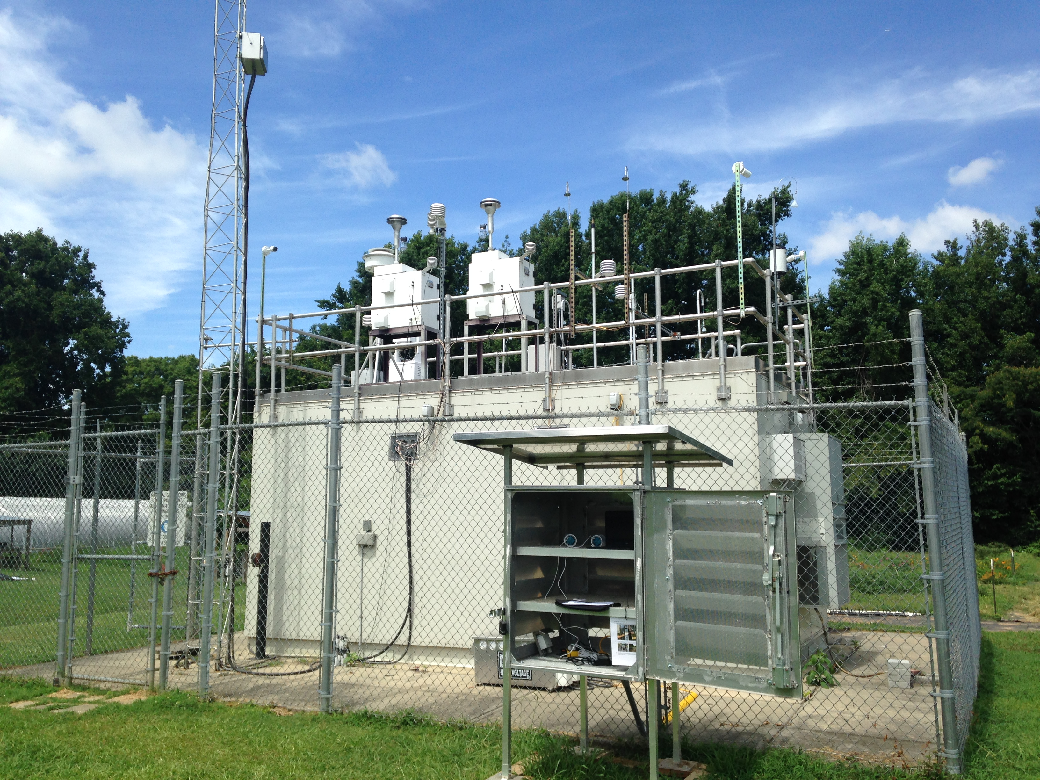
Field Work in North Carolina

Slide 11
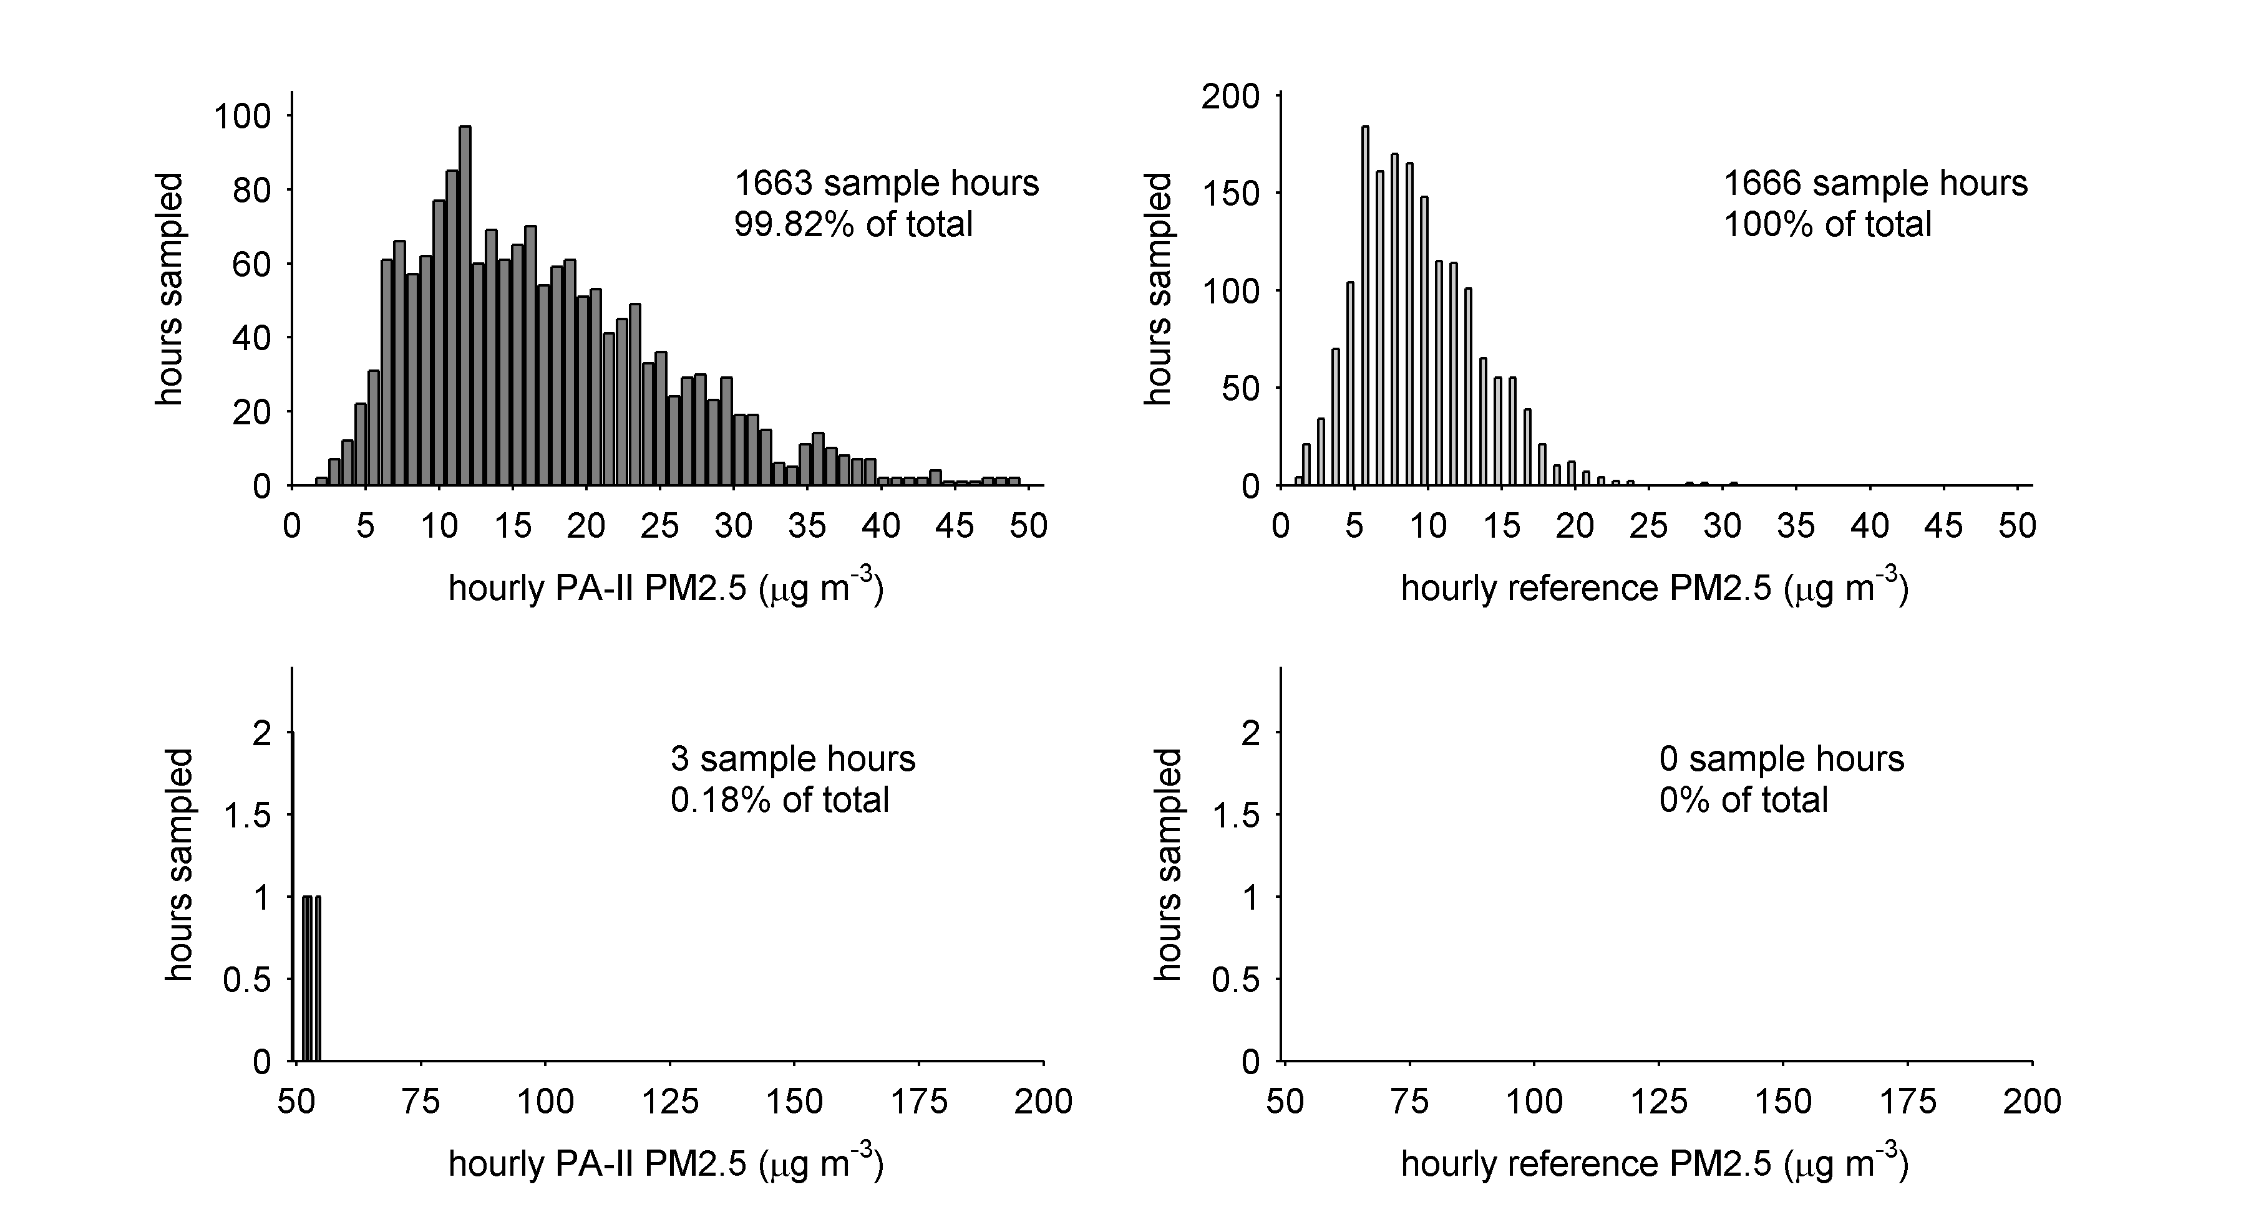
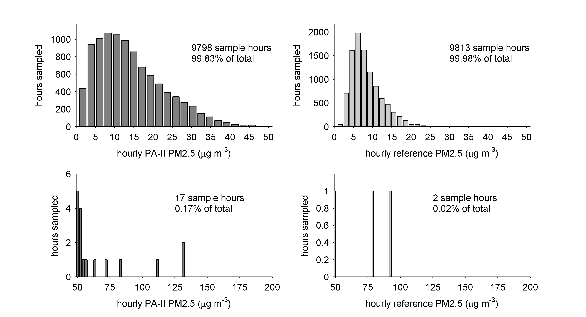
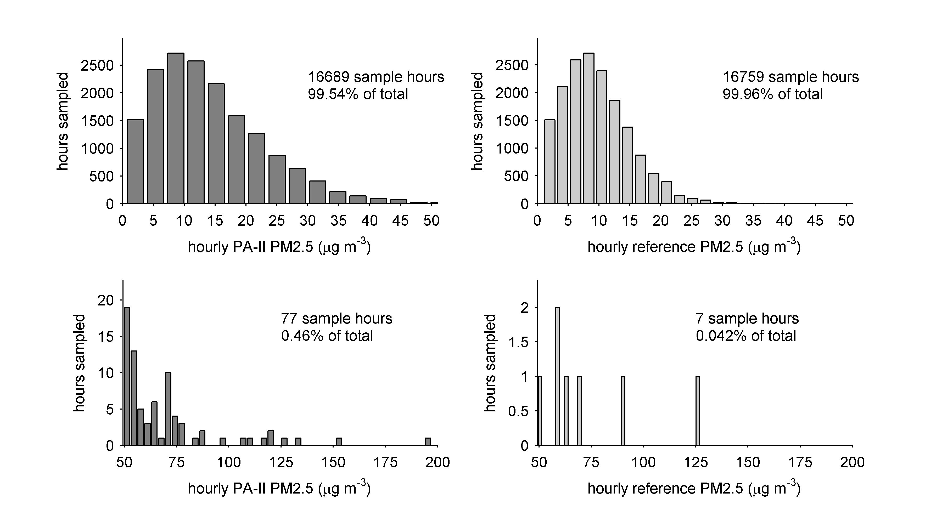
Histograms of quality controlled hourly-averaged PM2.5 reported at 3 sites
Notes:
This is only one of the two sensors (A vs B) and does not show Remount2

Slide 12
Quality control and data processing
Collect raw sub-hourly data
QC Step 1 (non-physical reporting)
QC Step 2 (repeating artifact)
Hourly average the sub-hourly
Discard values less than limit of detection
Discard values greater than limit of sampling
Use remaining “uncorrected” PA-II data as input to a linear regression
$\sim 5\%$of raw data discarded
$\sim 20\%$of remaining data discarded
Notes:
Example of Filters 5 and 6 using the data in this discussion (5/19/2019)
18,000+ hours or 760 days of samples before filtering.
14,000+ hours or 600 days of samples after filtering = 22% of the data is discarded.

Slide 13
Correction of PA-II PM2.5 data using a linear regression
$$PM{2.5}_{PAII}=a_{0}+a_{1}PM{2.5}_{ref}+a_{2}RH+a_{3}T$$
$$PM{2.5}_{PAII}=b_{0}+b_{1}PM{2.5}_{ref}$$
RH correction
T correction
bias correction
bias correction

Slide 14
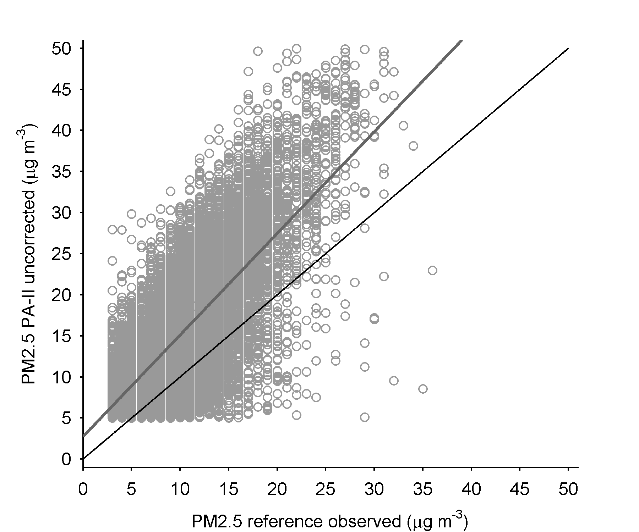
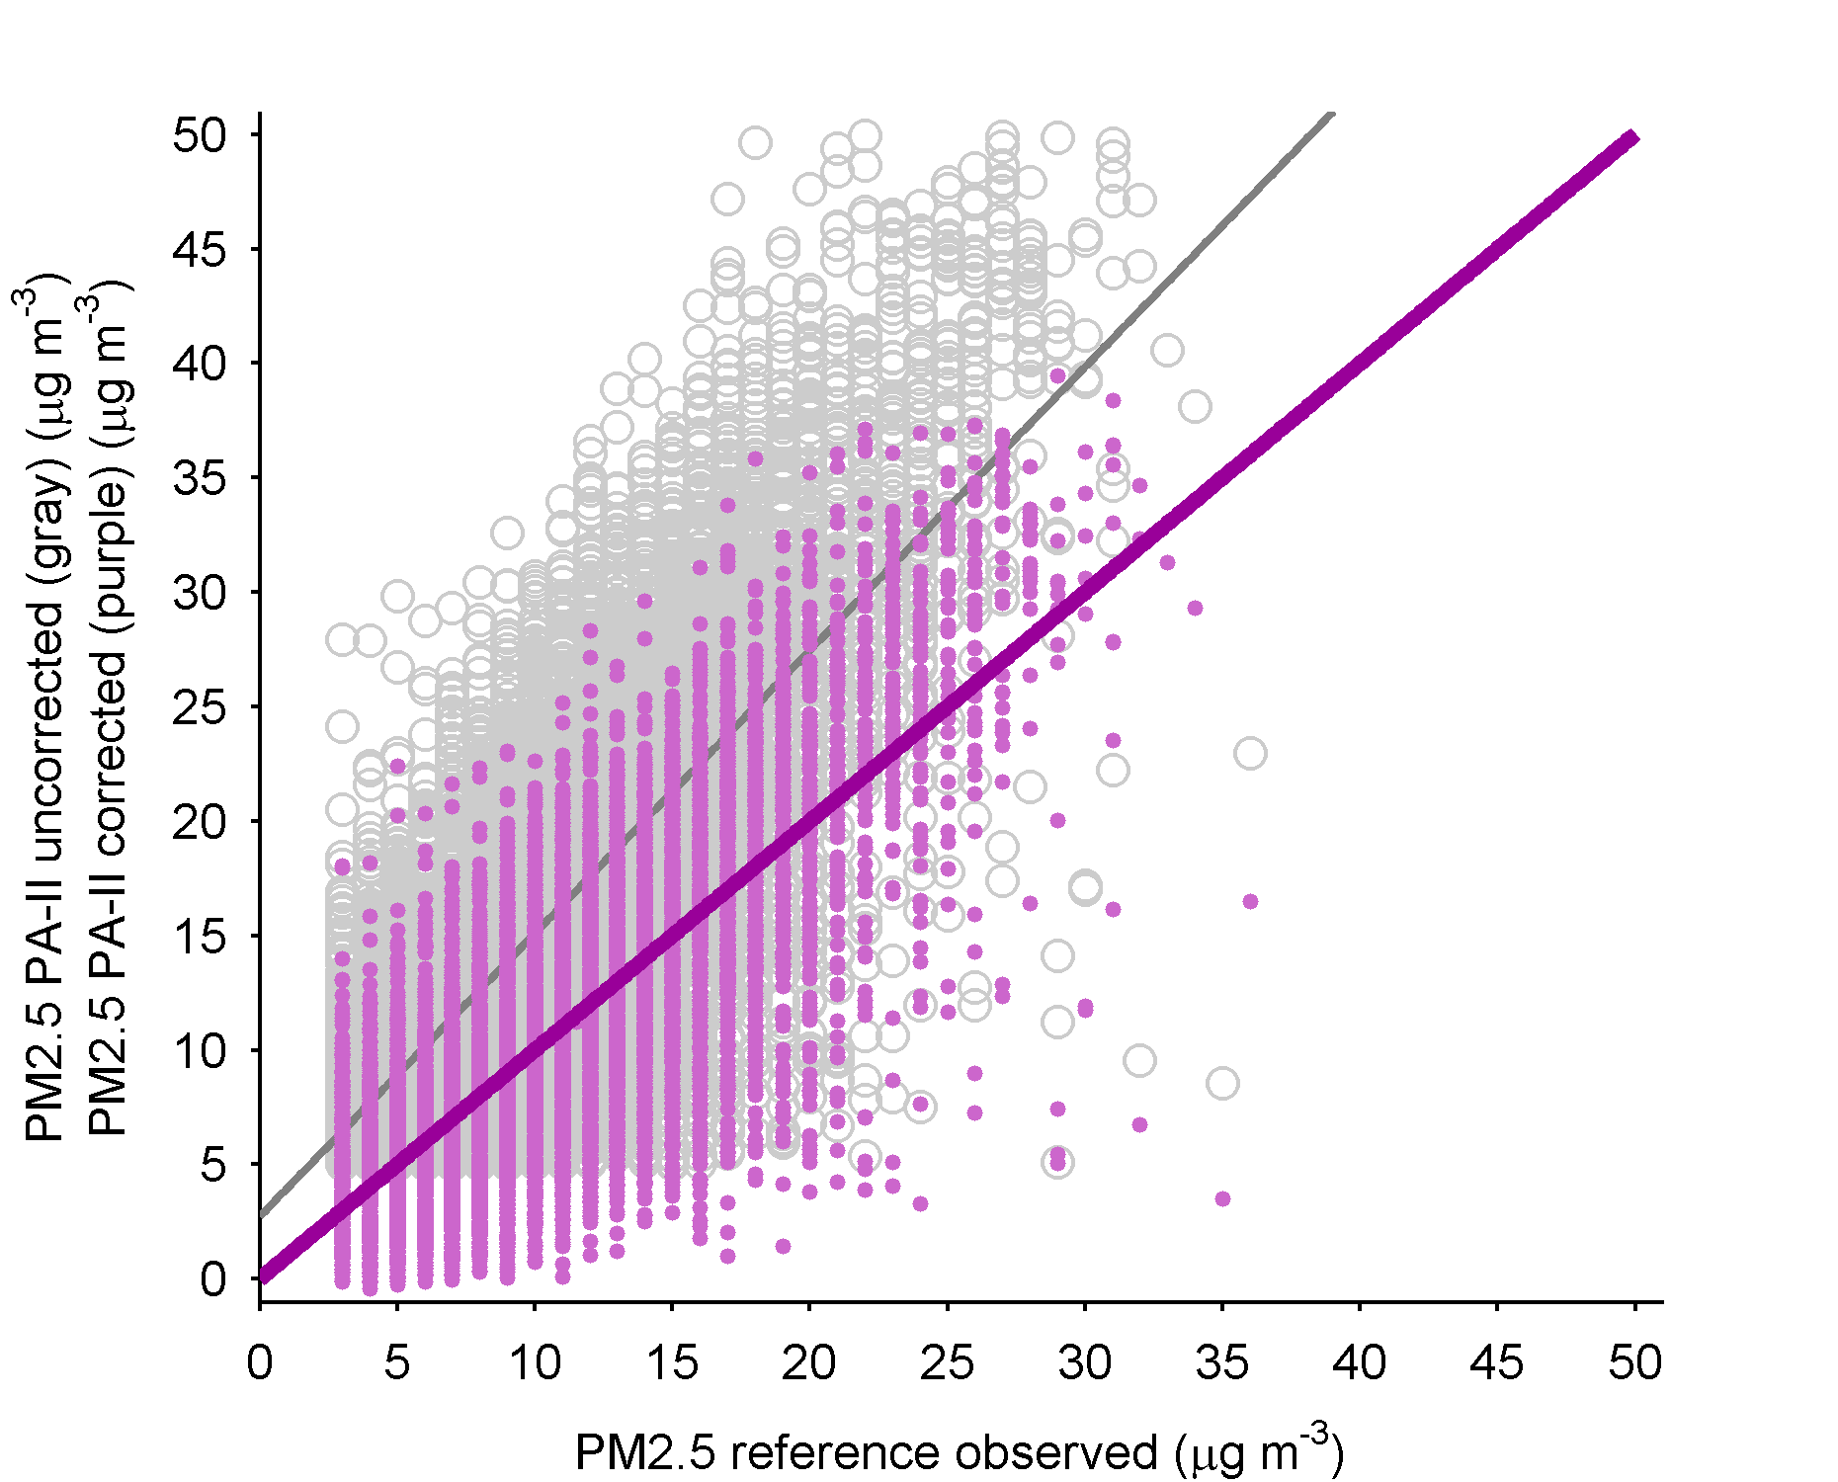
Charlotte co-location (17701 hours = 737 days)
RMS uncorrected $9.0 μg/m^{3}$
Bias uncorrected $6.5 μg/m^{3}$
RMS corrected for bias $4.5 μg/m^{3}$
RMS corrected for bias+RH
$4.1 μg/m^{3}$
MLR $PM{2.5}_{PAII}=a_{0}+a_{1}PM{2.5}_{ref}+a_{2}RH+a_{3}T$
With $a_{0}=−30.2$, $a_{1}=1.25$, $a_{2}=0.11$, $a_{3}=0.09$
Notes:
Bias correction $1.24$, RH correction $0.105$

Slide 15
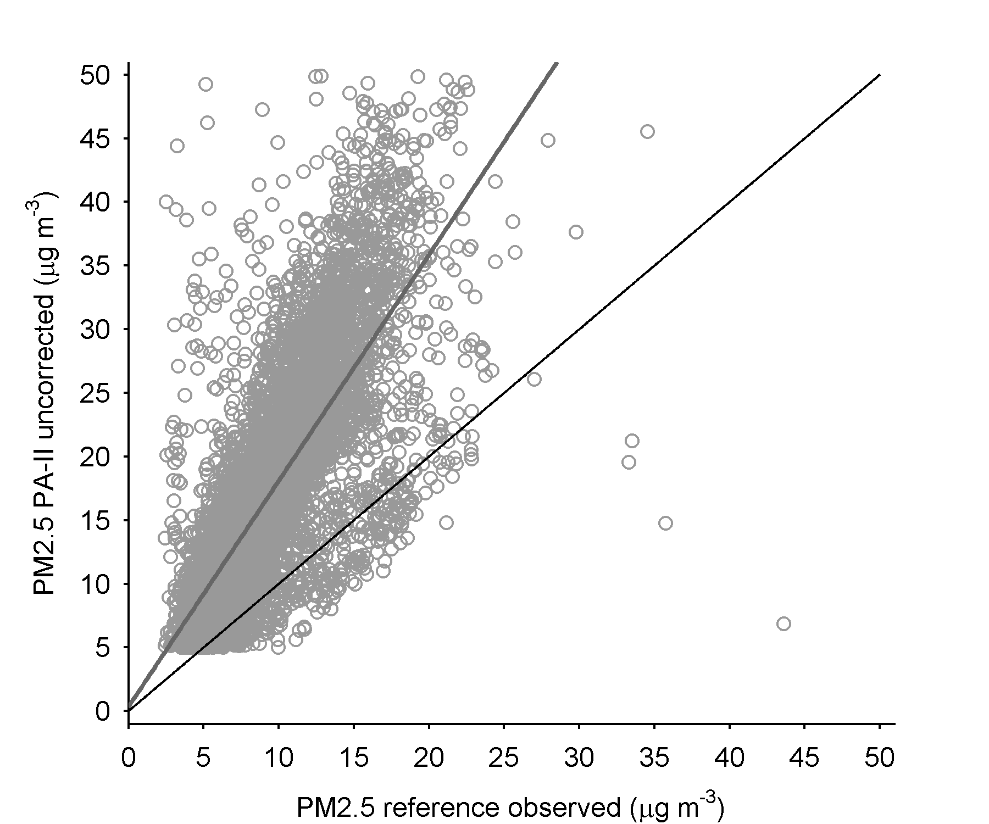
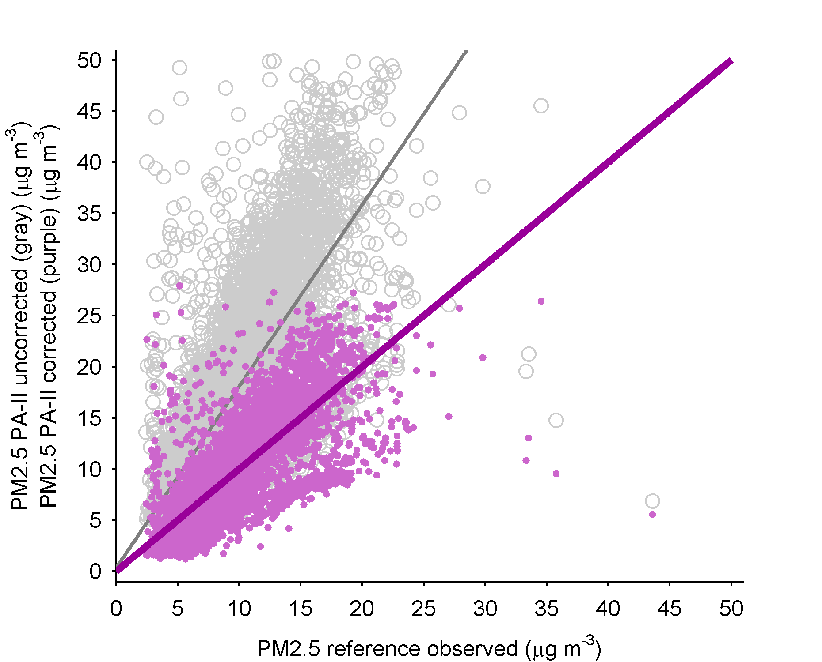
Winston-Salem co-location (8432 hours = 355 days)
RMS uncorrected $9.6 μg/m^{3}$
Bias uncorrected $7.3 μg/m^{3}$
RMS corrected for bias $3.1 μg/m^{3}$
RMS corrected for bias+RH
$2.9 μg/m^{3}$
MLR $PM{2.5}_{PAII}=a_{0}+a_{1}PM{2.5}_{ref}+a_{2}RH+a_{3}T$
With $a_{0}=−30.2$, $a_{1}=1.25$, $a_{2}=0.11$, $a_{3}=0.09$
Notes:
1.84, 0.111

Slide 16
Comparison of all FEM co-location hourly-averaged results
Site Sensor A | N (hours) | Bias before ($μg/m^{3}$) | RMS before ($μg/m^{3}$) | RMS after ($μg/m^{3}$)
Remount1 | 13964 | 5.3 | 7.8 | 4.2
Remount2 | 2892 | 9.8 | 12 | 4.5
Forsyth | 8432 | 7.3 | 9.6 | 2.9
Garinger1 | 1593 | 8.1 | 10 | 3.1
Garinger2 | 1435 | 7.1 | 9.5 | 3.2
Site Sensor B | N (hours) | Bias before ($μg/m^{3}$) | RMS before ($μg/m^{3}$) | RMS after ($μg/m^{3}$)
Remount1 | 17701 | 6.5 | 9 | 4.1
Remount2 | 2882 | 8.2 | 11 | 3.9
Forsyth | 8312 | 6.8 | 8.9 | 2.6
Garinger1 | 1611 | 7.8 | 9.9 | 3.1
Garinger2 | 1446 | 7.8 | 9.9 | 3.2
Average bias $7.5±1.2 μg/m^{3}$
Average RMS before $9.8±1.2 μg/m^{3}$
Average RMS after $3.5±0.6 μg/m^{3}$

Slide 17
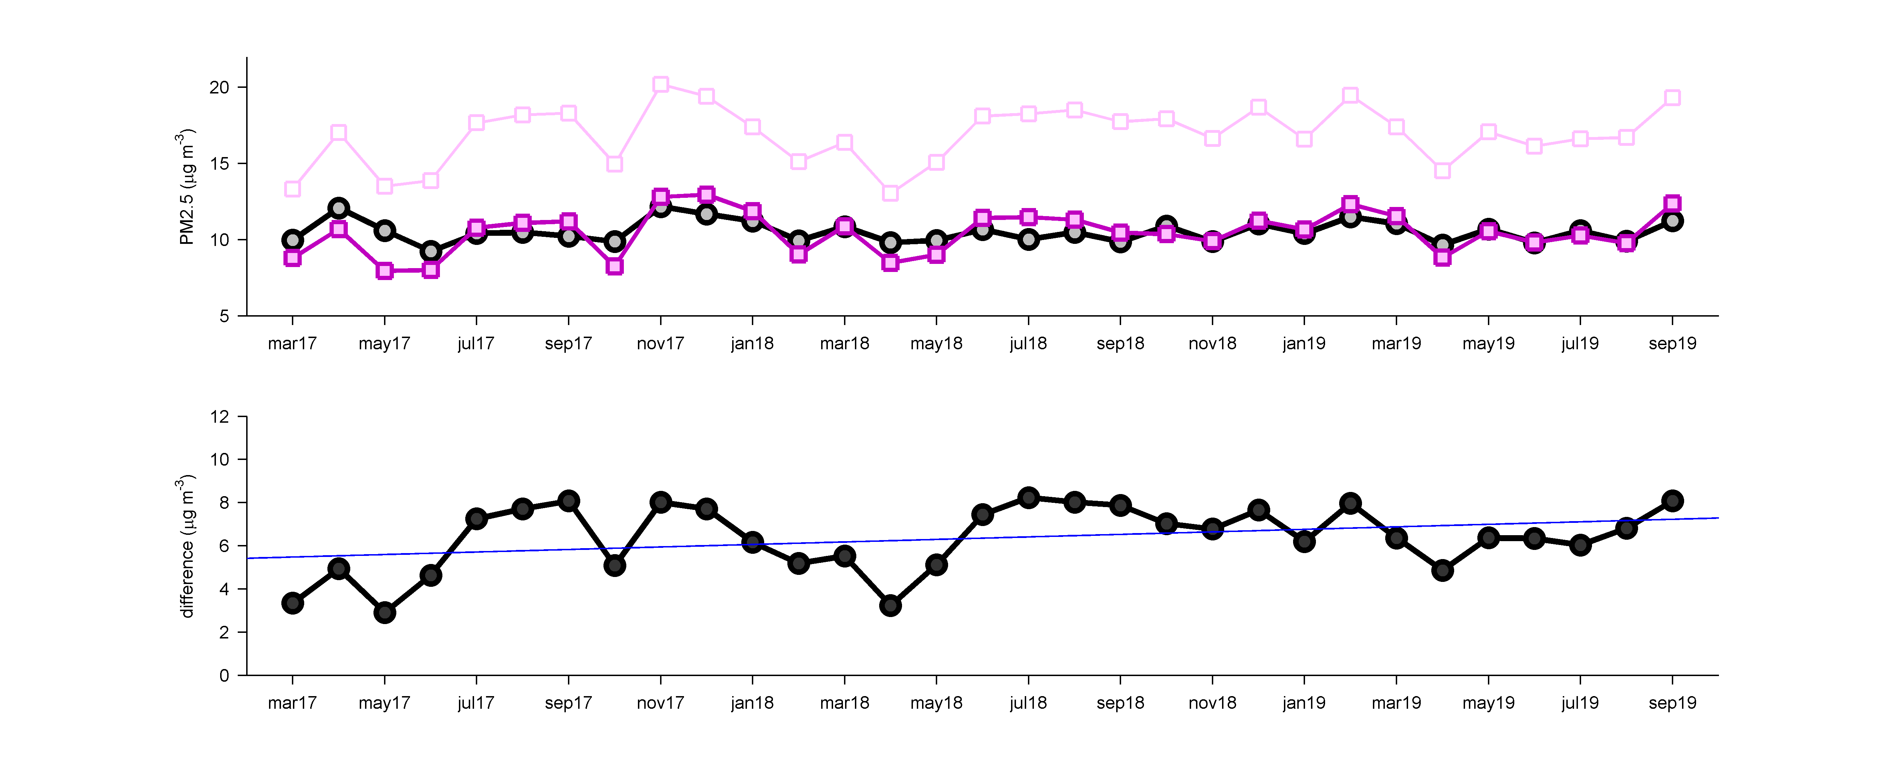
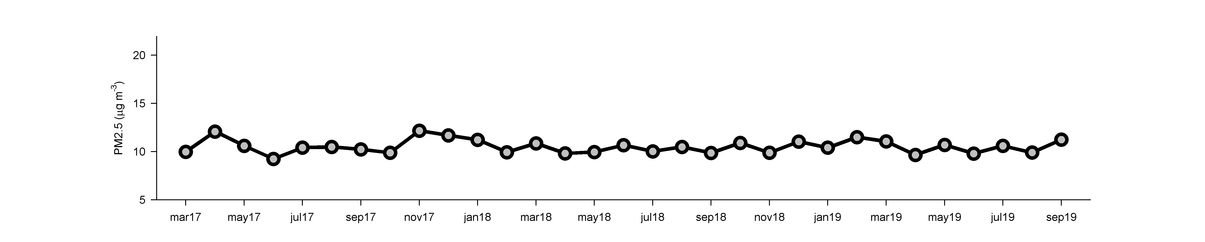
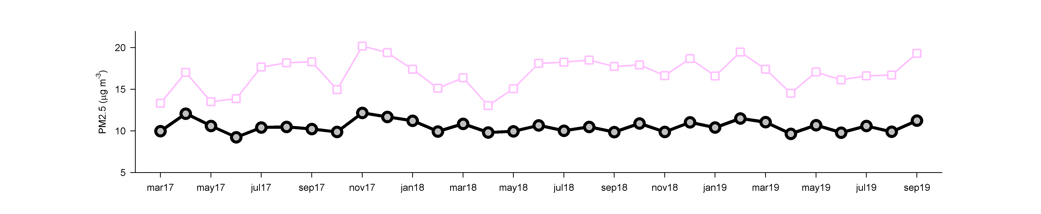
20
15
10
5
Jul
2017
Jan
2018
Jul
2018
Jan
2019
Jul
2019
Apply the FEM correction to the PA-II data from Charlotte, NC
Black shows monthly-averaged PM2.5 from BAM1022 (FEM)
Lighter purple is uncorrected PA-II PM2.5 (RMS $6.5 μg/m^{3}$)
Darker purple is the corrected PA-II PM2.5 (RMS $0.97 μg/m^{3}$)

Slide 18
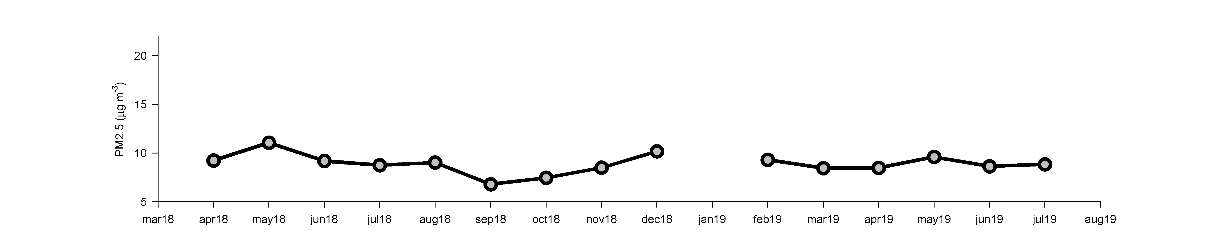
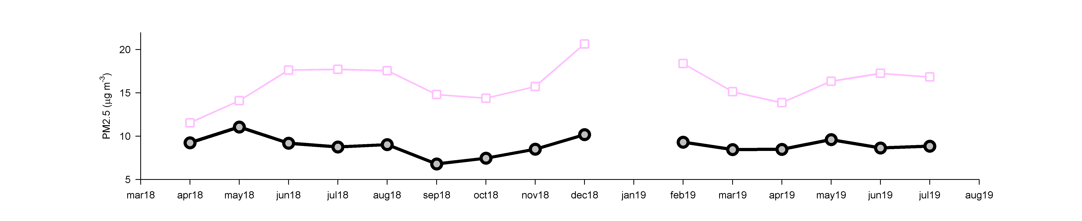
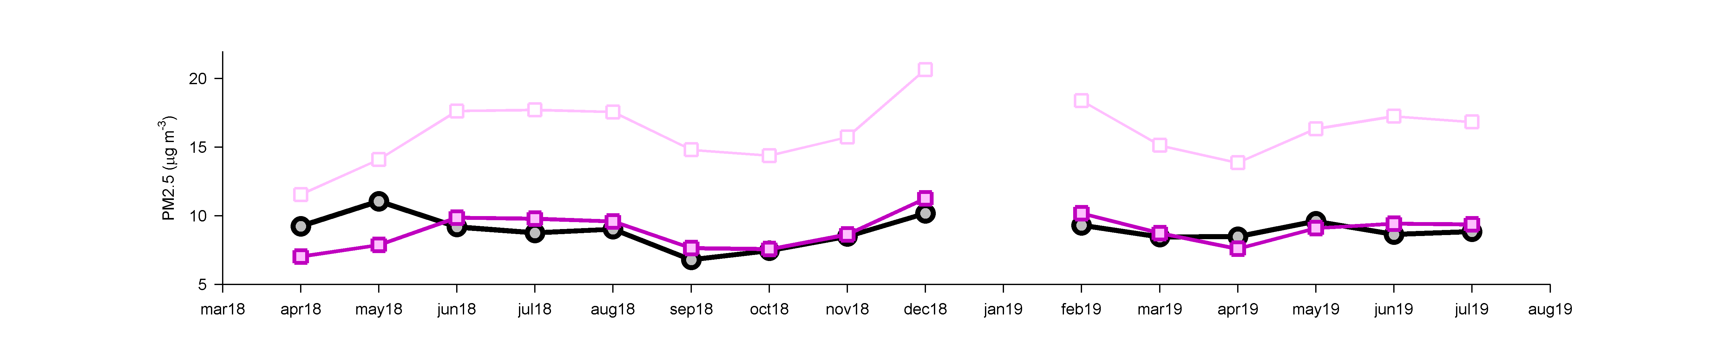
20
15
10
5
Apr
2018
Jul
2018
Oct
2018
Jan
2019
Apr
2019
Jul
2019
Apply the FEM correction to the PA-II data from Winston-Salem, NC
Black shows monthly-averaged PM2.5 from T640X (FEM)
Lighter purple is uncorrected PA-II PM2.5 (RMS $7.5 μg/m^{3}$)
Darker purple is the corrected PA-II PM2.5 (RMS $1.2 μg/m^{3}$)

Slide 19
Correction from Sensor B
Correction using Forsyth sensor
Relative humidity (%)
Relative humidity (%)
Uncorrected input PM2.5
Uncorrected input PM2.5
Sensor B vs. Sensor A
Sensitivity of correction to sensor site
Cool colors mean stronger correction
Cool colors mean stronger correction
Relative humidity (%)
Relative humidity (%)
Uncorrected input PM2.5
Uncorrected input PM2.5

Slide 20
Stability of Plantower sensors in PA-II for 15-31 months of sampling
12
8
4
0
Jul
2017
Jan
2018
Jul
2018
Jan
2019
Jul
2019
12
8
4
0
Apr
2018
Jul
2018
Oct
2018
Jan
2019
Apr
2019
Jul
2019
Charts show monthly averaged uncorrected PA-II minus FEM
Slight positive trends relative to FEM reference data
$0.72−1.1 μg/m^{3}$ increase in bias per year
Notes:
Forsyth A (15) 0.15+0.12 (two glitch months in Apr-May 2018), Remount A (25) 0.07+0.04, Forsyth B (15) 0.09+0.12, Remount B (31) 0.06+0.03

Slide 21
Future efforts
Continued expansion of Clean Air Carolina AirKeepers program in North Carolina
Case studies at higher PM2.5 concentrations
Large-scale synthesis of daily and hourly data
Health and exposure studies
Land-use regression towards a gridded data product
Note: Some of this work is published in our Aerosol Science and Technology paper

