Slide 1
Estimation of nose-level NO₂ in the Houston-Galveston area using airborne remote sensing data from DISCOVER-AQ and output from a 4-km resolution simulation with CMAQ
Dale J. Allen¹, Lok N. Lamsal^{2,3}, Melanie B. Follette-Cook^{2,3}, Kenneth E. Pickering¹, William H. Swartz⁴, and Scott J. Janz²
¹University of Maryland, College Park, MD
²NASA Goddard Space Flight Center, Greenbelt, MD
³Goddard Earth Sciences Technology and Research (GESTAR), Columbia, MD
⁴Johns Hopkins University Applied Physics Laboratory, Laurel, MD

Slide 2
Why we are interested in inferring nose-level NO₂ from space
NO₂ is criteria pollutant
Exposure to high-levels of NO₂
(~20 ppbv in Naess et al. study) increases chances of dying from heart or lung diseases
O₃ is an air pollutant and GHG
NO_{x} is an O₃ precursor
[Naess et al., 2007; American Jl. of Epidemiology]
[Dodge, 1977]

Slide 3
Why we are interested in inferring nose-level NO₂ from space?
NO₂ is excellent marker of combustion-related pollutants
NO₂ columns are dominated by PBL
Thus NO₂ columns provide more info on nose-level concentrations than do columns from other trace gases
Correlations
between
PM_{2.5} (NO₂)
and combustion
related
pollutants
Normalized
vertical
profiles of
trace gases
[30-50N,
125-70W)
for 2004
from
GEOS-Chem
R. Burnett et al. (2004)
R. Martin et al. (2008)

Slide 4
Why we are interested in inferring nose-level NO₂ from space
Surface measurements of NO₂, especially true NO₂, are relatively sparse
Remotely sensed columns for a set of days are available from aircraft in DISCOVER-AQ and other field campaigns
and soon hourly columns will be available from TEMPO

Slide 5
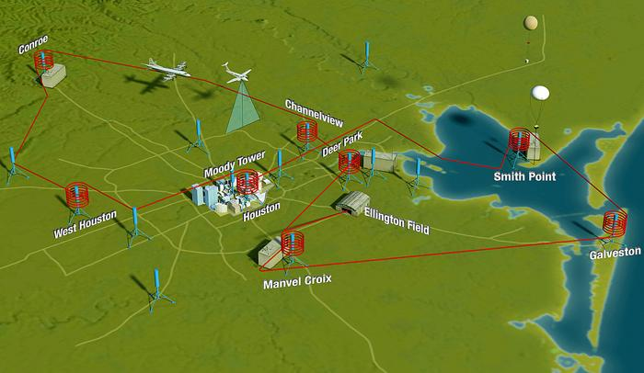
DISCOVER-AQ: NASA Earth Venture mission
designed to determine the extent to which column observations
can be used to diagnose surface air quality
Nominal Flight Plan over Houston-Galveston during DISCOVER-AQ TX campaign (Sep 2013)

Slide 6
Daily 1-Hour Max Ozone (ppbv) – All Stations
September 1st – 30th
bay, sea breezes
following cold front
#8
#9
#1
#4
#5
#6
clouds, heavy
rains, marine air
#3
#7
#2
Relatively clean 3 flight days
Moderate pollution 4
Strongly polluted 2

Slide 7
Nose-level NO₂ is inferred using NO₂ vertical columns derived from NASA Geo-CAPE Airborne Simulator (GCAS) and surface-layer tropospheric column relationship from CMAQ
Differential SCD is converted to an absolute SCD by subtracting off NO₂ SCD from PANDORA instrument at a “clean” reference location.
AMFs assume Lambertian surfaces, use surface reflectivity information from MODIS, and NO₂ profile information from CMAQ.
GCAS measures differential slant column density (SCD) at 250 x 250 m resolution using
UV/VIS spectrometer
(Kowalewski and Janz, 2014)
Absolute SCD is converted to vertical column density (VCD) by dividing by an air mass factor (AMF) computed with VLIDORT (Lamsal et al., 2017).
GCAS instrument being serviced at Warner Robins AFB
during GOES-R Validation Campaign

Slide 8
GCAS NO₂ columns over D-AQ Texas Region on September 25
9 AM LT 1 PM LT 3 PM LT

Slide 9
GCAS NO₂ columns over D-AQ Texas Region on September 26
9 AM LT 1 PM LT 3 PM LT

Slide 10
CMAQ is run off-line using MCIP-processed meteorological fields from WRF
WRFv3.8.1 |  |  | CMAQv5.2
Resolution | 36, 12, & 4 km |  | Resolution | 36, 12, & 4 km
Time Period | Aug 17 – Oct 2, 2013 |  | Time Period | Aug 19 – Oct 1, 2013
BC & IC | NAM |  | BC & IC | MOZART
Nudging | grid_fdda=1,1,1 grid_sfdda=1,1,1 Obs_nudge=1,1,1 |  | Mechanism | cb6r3_ae6_aq (No halogen chemistry)
Longwave radiation Shortwave radiation | RRTM Goddard |  | Emissions | Ramboll ENVIRON and TCEQ
Surface layer physics | Pleim-Xu |  | Point Source Emissions | CEMS2013 2013 Oil & Gas
Cumulus Physics | KF (all domains) |  | Area | TCEQ 2012 SIP base (projected to 2013)
Other | Daily varying SST Soil Moisture & Temperature passed between 3 day segments |  | Other Emissions | MEGAN, FINNv1, Lightning (Y), Dust (Y)

Slide 11
Inferred nose-level NO₂ (S) is f(GCAS NO₂ column) and S / $Ω$from CMAQ Refined estimate utilizes sub-grid scale (PBL) variability from GCAS
Initial (Intuitive) Estimate Refined estimate includes sub-grid scale GCAS info
$$S=\frac{S_{M}}{Ω_{M}}Ω S=(μ+\left(μ−1\right)\frac{Ω_{M}^{F}}{Ω_{M}^{B}})\frac{S_{M}}{Ω_{M}}\overline{Ω}$$
$$S≡Inferred surface concentration SM≡Modeled \left(CMAQ\right)surface concentration$$
$$Ω≡\text{Observed}\text{ (}\text{GCAS}\text{) }\text{VCD}. ΩM≡\text{Modeled}\text{ (}\text{CMAQ}\text{) }\text{VCD}$$
$Ω_{M}^{F}$ $≡\text{CMAQ} \text{free} \text{troposphere} \text{VCD} { Ω}_{M}^{B}$ $≡\text{CMAQ} \text{PBL} \text{VCD}$
$$μ≡\frac{Ω}{\overline{Ω}}\text{(}\text{Ratio} \text{of} \text{local} \text{250 }\text{x}\text{ 250 }\text{m} \text{GCAS} \text{column}\left(Ω\right)\text{to} \text{column} \text{averaged} \text{over}\text{ 4−}\text{km} \text{radius}\text{ (}\overline{Ω}\text{)}$$
Texas D-AQ deployment provided data needed to apply this approach and evaluate its performance.

Slide 12
Sep 24-26 time series showing biases between CMAQ- and-HSRL PBL heights
Water Land
CMAQ PBL Height minus
NASA Langley
High Spectral Resolution Lidar (HSRL) PBL Height
Biases in modeled PBL heights can lead to biases in modeled- and inferred
NO₂ concentrations.
Modeled biases were minimal during the morning; however, the modeled afternoon PBL height over water had a low-bias of up to 2 km

Slide 13
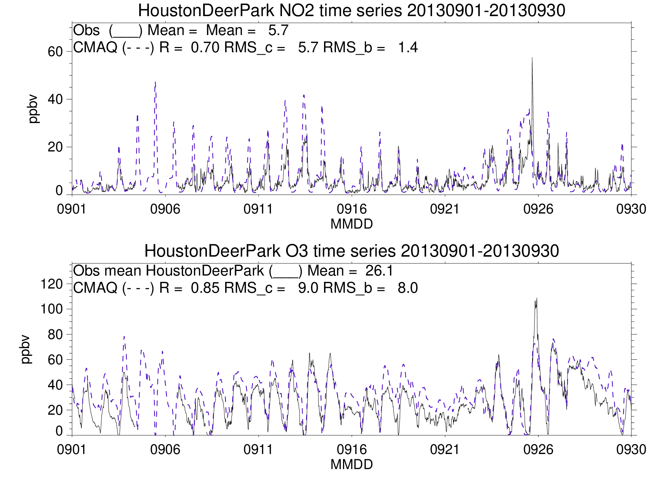
Sep24-26 AQ poor

Slide 14
25 September

Slide 15
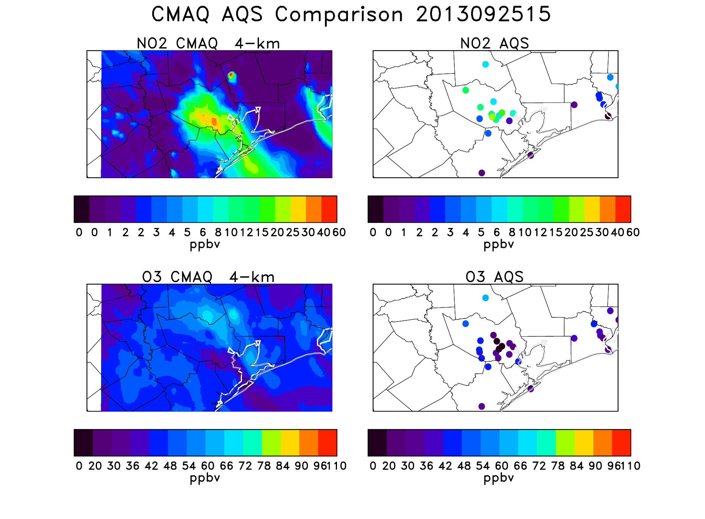
(10 AM)

Slide 16
Sea breeze
develops
between
17 and 20 UT
(12-15 CDT)

Slide 21
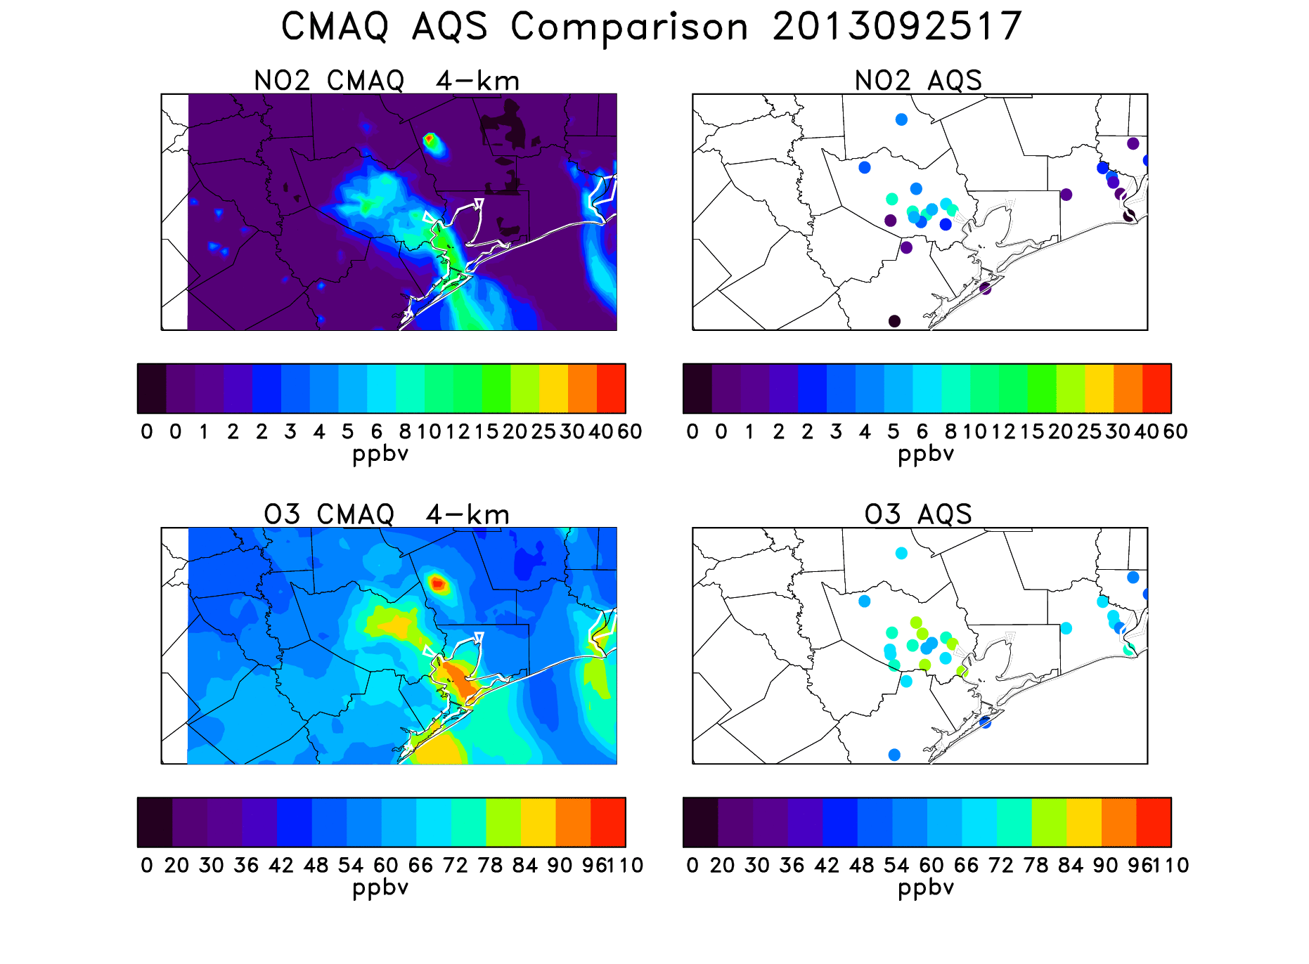
Pollution front
advances
inland with
sea breeze
17-20 UT
(12-15 CDT)

Slide 23
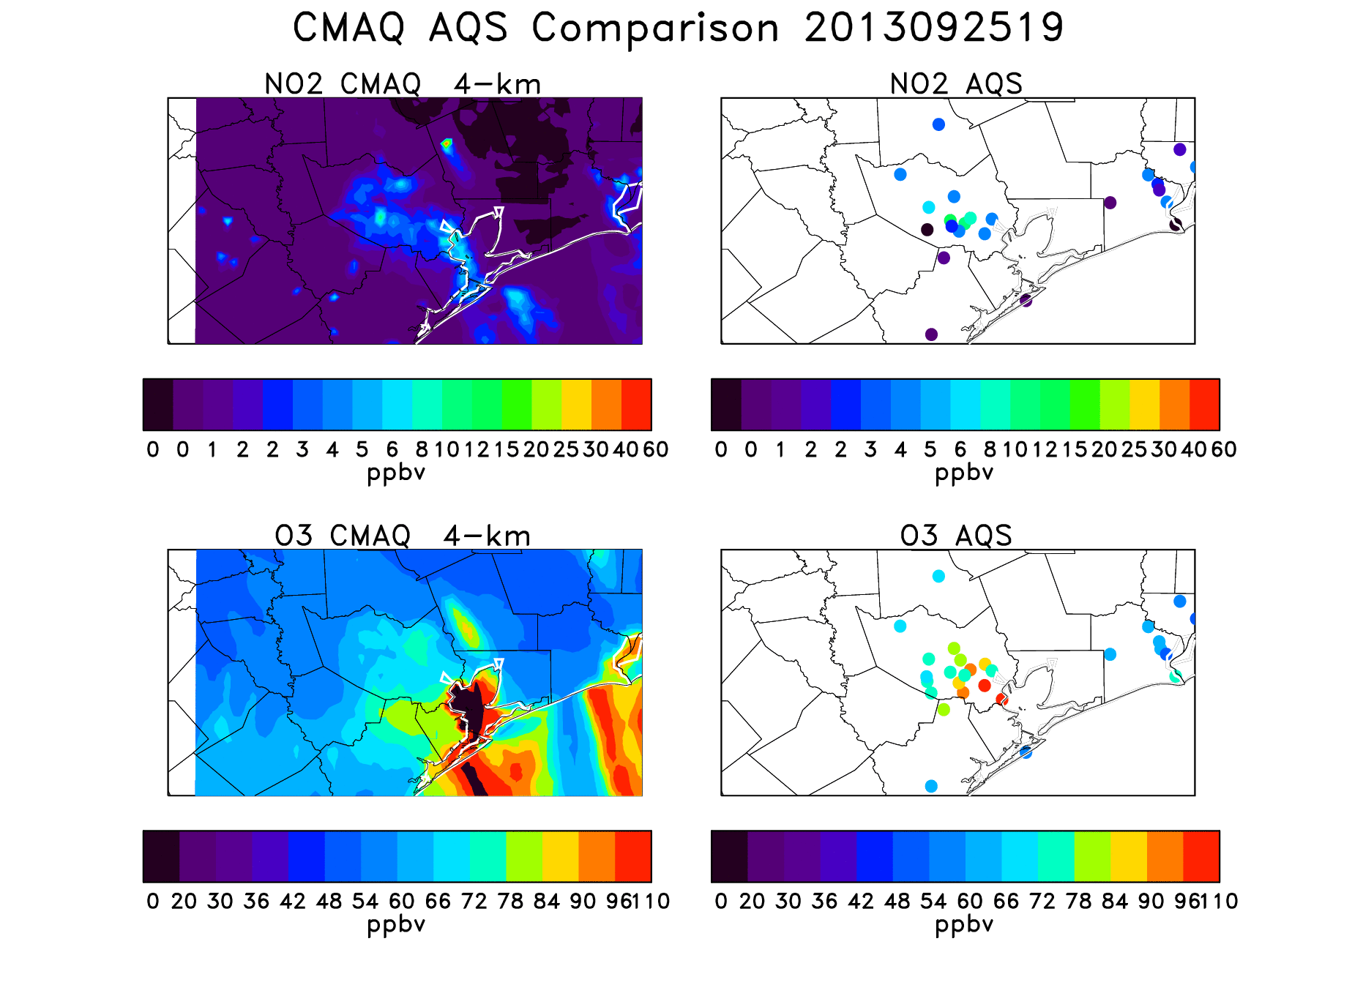

Slide 24
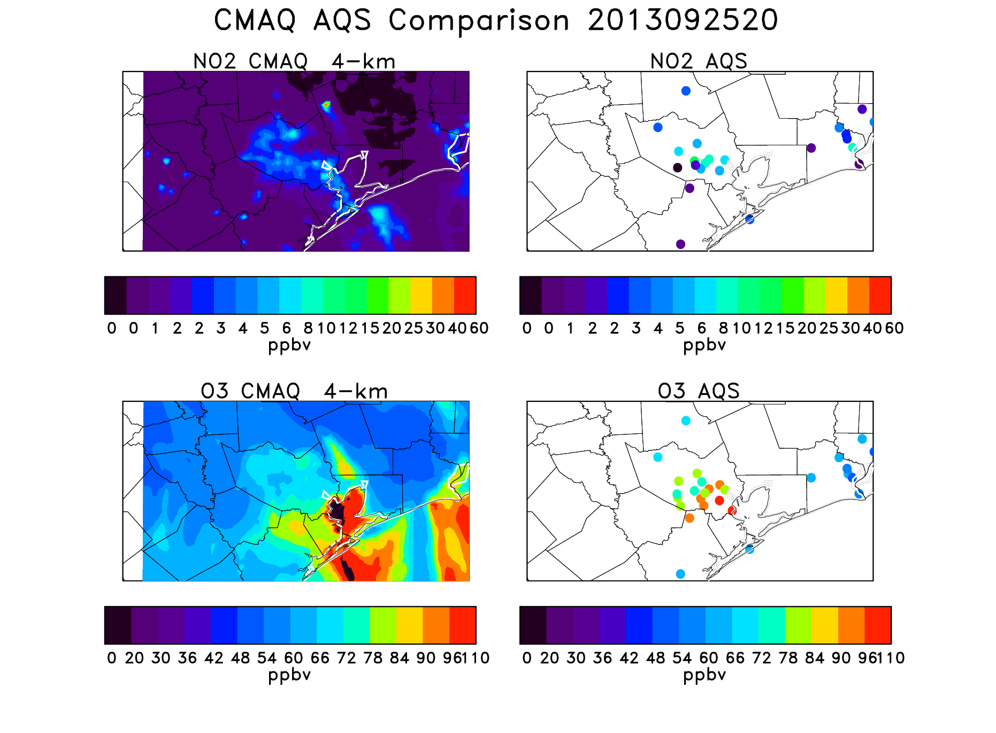

Slide 25
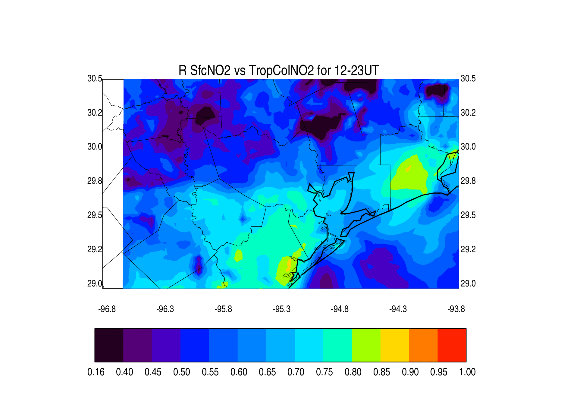
Correlation between modeled nose-level and column NO₂ for 12-23 UT

Slide 26
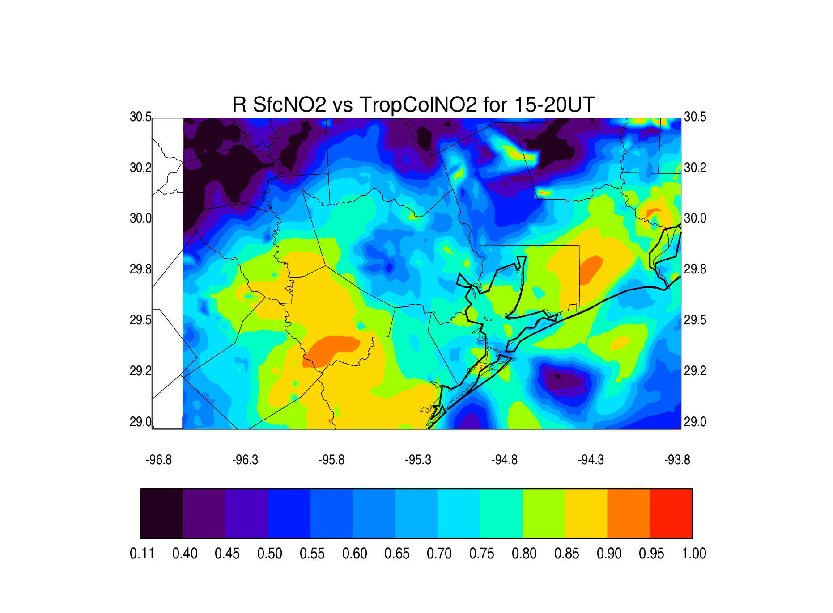
Correlation between modeled nose-level and column NO₂ for 15-20 UT
Correlations
are higher
during mid-day period when PBL heights are large

Slide 27
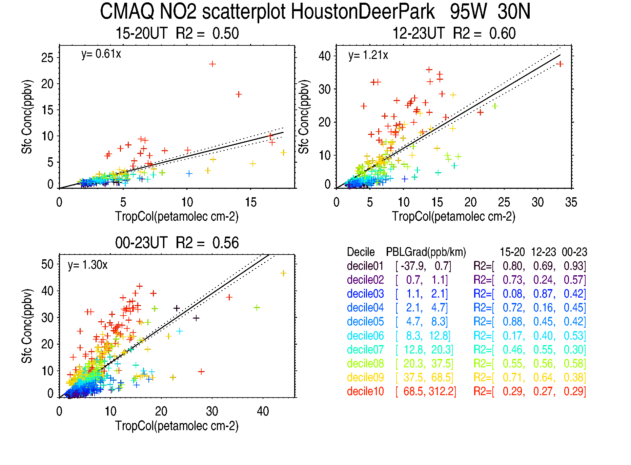
Urban (Polluted Site)
Well mixed
Poorly mixed

Slide 28
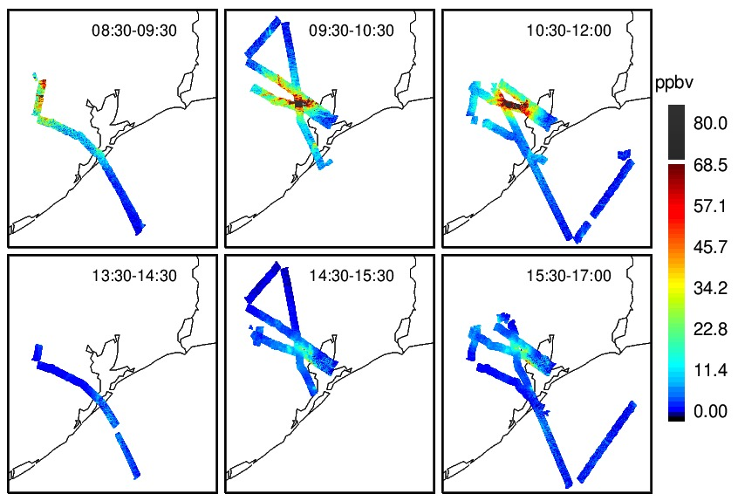
GCAS-Inferred Nose-level NO₂ as a f(LT) on 25 September

Slide 29
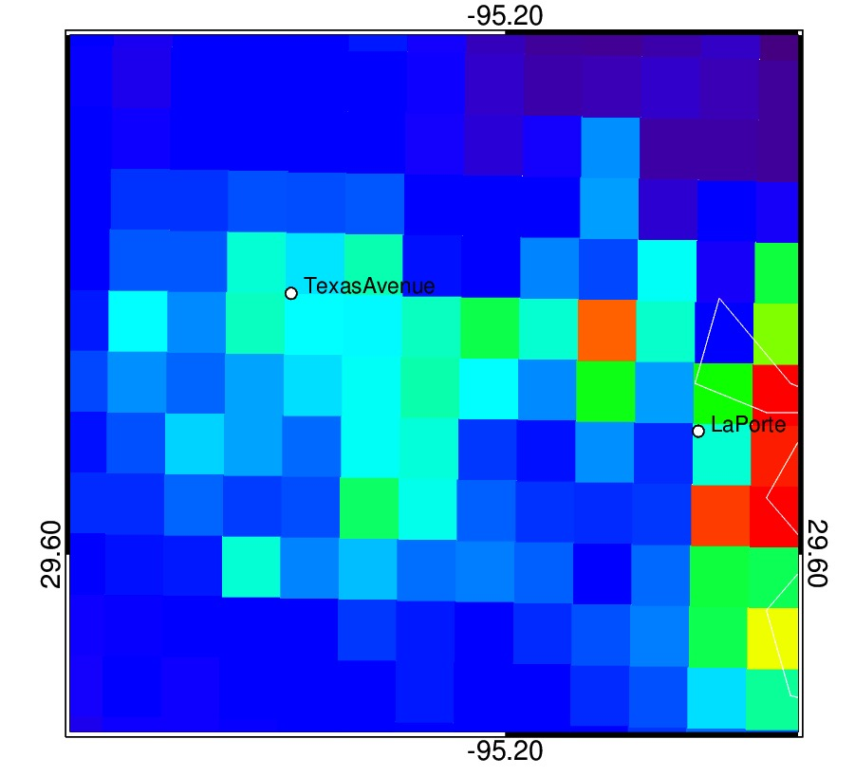
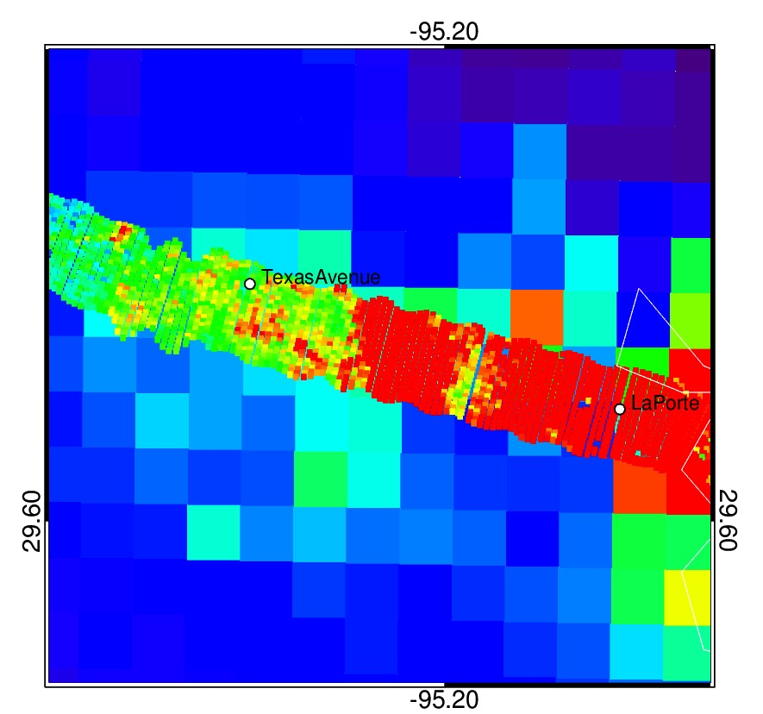
September 25
1440 LT 4 x 4 km CMAQ NO₂ 250 x 250 m GCAS-Inferred NO₂
Notes:
TX – 20130925
CMAQ 14:40 CDT
Red box in left map shows zoom region
GCAS overflight, same scale
(cf. time series plot for this day, slide 12)

Slide 30
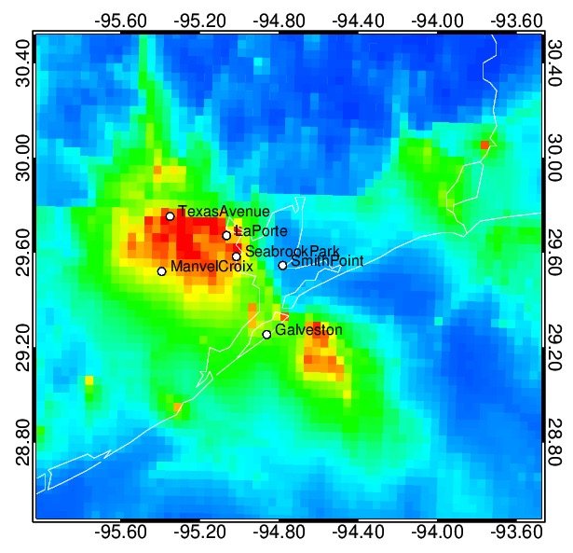
Summary statistics at true NO₂ sites for all 9 flight days
Station | Median GCAS/GB | GCAS–GB Correlation | Location
La Porte | 1.30 | 0.80 | Polluted
Manvel Croix | 0.76 | 0.75 | Polluted
Texas Avenue | 0.75 | 0.78 | Polluted
Seabrook Park | 1.70 | 0.43 | Coastal
Smith Point | 0.49 | 0.49 | Coastal
Galveston | 1.34 | 0.02 | Marine
CMAQ Mean surface NO₂ during
Period of airborne remote sensing for
September 25

Slide 31
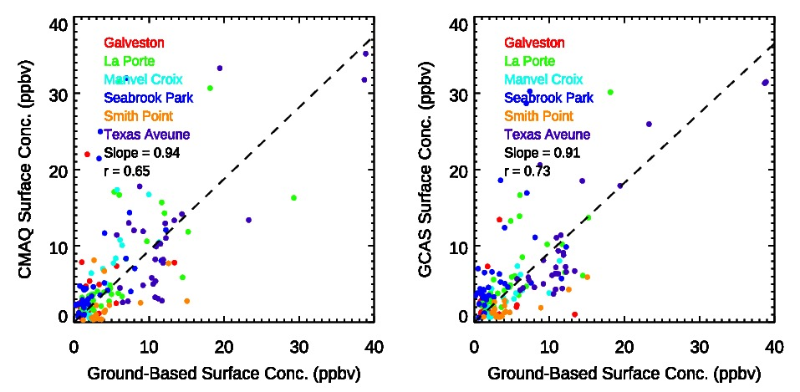
Scatterplots for all overpasses comparing ground-based NO₂ measurements (x-axis) with CMAQ NO₂ (y-axis) Inferred GCAS-based NO₂ (y-axis)
Notes:
Same slope and r for both, coincidentally.

Slide 32
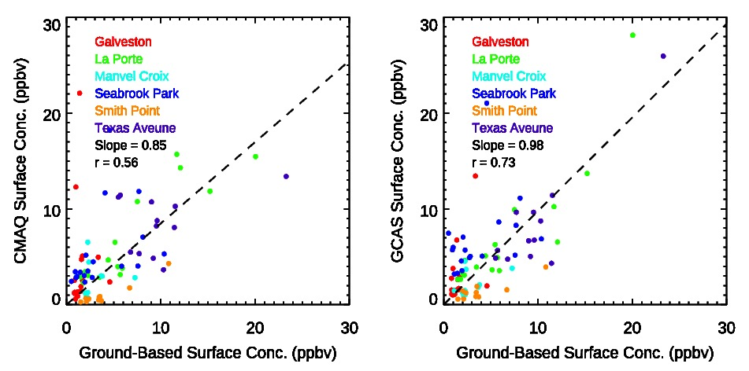
15-20 UT Scatterplots comparing ground-based NO₂ measurements (x-axis) with CMAQ NO₂ (y-axis) Inferred GCAS-based NO₂ (y-axis)
Inferred GCAS/CMAQ NO₂ agrees better with obs than CMAQ NO₂, esp during mid-day

Slide 33
Conclusions
GCAS provides high-resolution info (250 x 250 m) on spatial distribution of NO₂ over Houston-Galveston Bay area during D-AQ campaign
CMAQ captures inland advance of pollutants associated with bay/sea breeze
Nose-level NO₂ over Houston-Galveston Bay area has been inferred using GCAS and surface to column relationship from CMAQ
Inferred NO₂ concentrations are biased high when PBL is poorly mixed. This information can be used to refine surface estimates
Correlations between inferred and measured surface concentrations are highest at polluted sites and during mid-day hours

