Slide 1
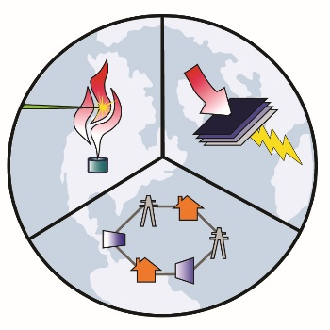
Quantifying the Air Quality and Human Health Benefits of GHG Mitigation Pathways in California
Michael Mac Kinnonª, Shupeng Zhu^{a,b}, Brendan Shafferª, Owen Yangª, Donald Dabdub^{a,b}, G.S. Samuelsenª
ª Advanced Power and Energy Program
^{b} Computational Environmental Sciences Lab
University of California, Irvine

Slide 2
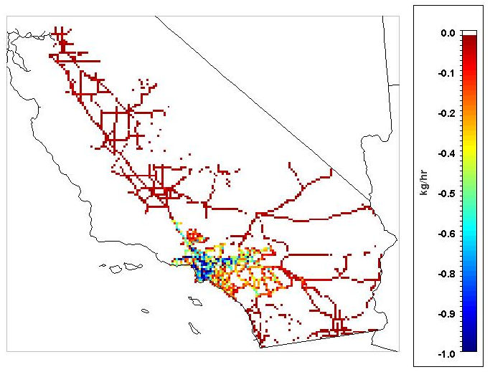
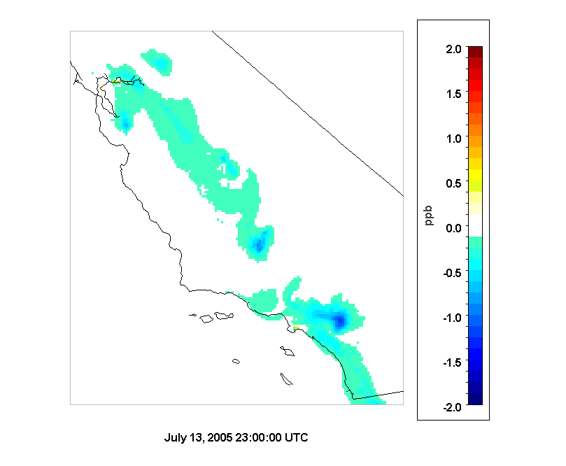
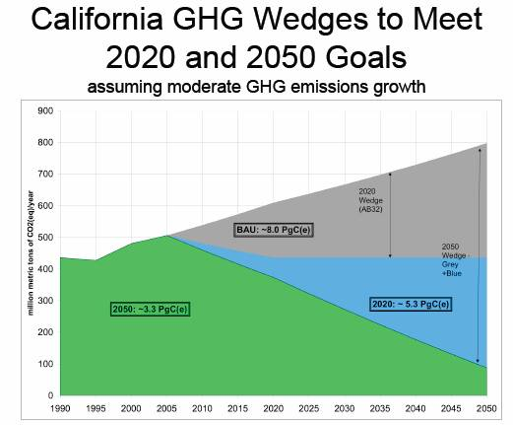
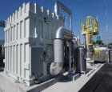
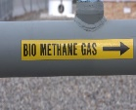
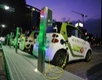
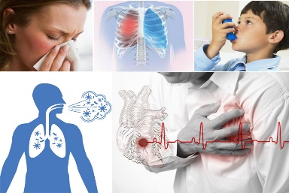
AQ Assessment Methodology
Assess impacts on emissions, air quality, and human health from low carbon mitigation scenarios from the PATHWAYS model (E3)
Provide insight into the air quality co-benefits of technological shifts within cases
Pathways Scenarios
Resolve Emissions (SMOKE 4.0)
Simulate Air Quality
(CMAQ 5.2
SAPRC 07)
80% below 1990
Health Impact Assessment
(BenMAP 1.4)
~15 different scenarios considered
Scenarios not designed from an AQ impact perspective, i.e., targeting criteria pollutant emission reductions
Notes:
E3=Energy + Environmental Economics What is pathway model? PATHWAYS model helps clients plan for and achieve economy-wide decarbonization. It identifies GHG reduction measures from transportation, buildings, industry, electricity, and other sectors, and captures interactions among measures to create a detailed picture of emissions reductions and costs through 2050.

Slide 3
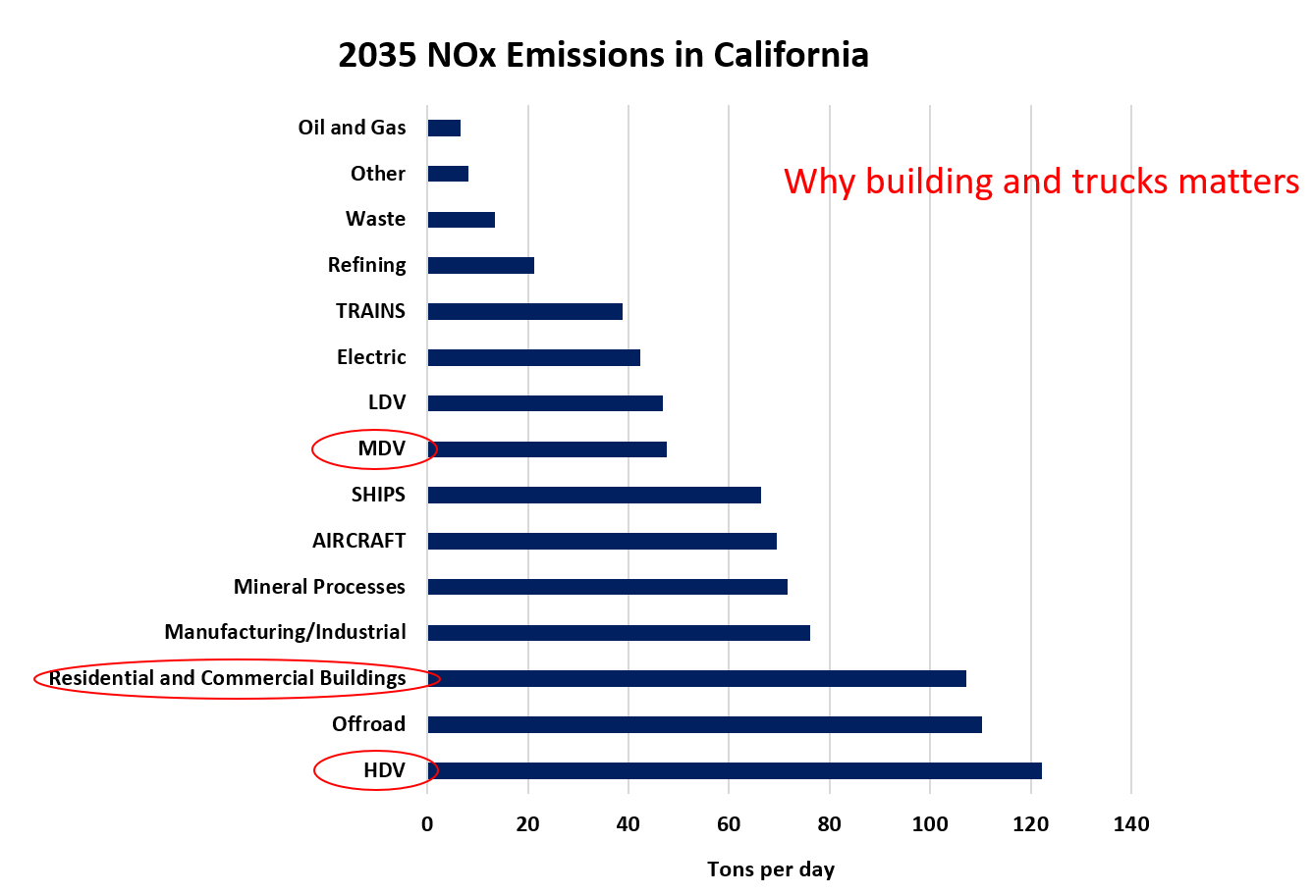
California 2035 NOx
Source: CARB CEPAM 2016 SIP

Slide 4
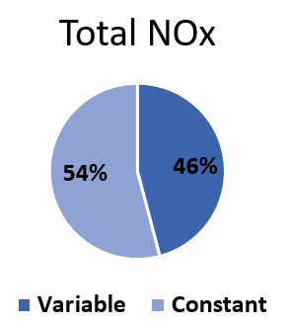
Scenario Development
Scenarios encompass shifts in energy consumption, technologies and fuels from Current Policy Reference Scenario
All assume measures in LDV, Off-road, Rail, Aircraft, Ships, Refining, Industry, etc. (Constant)
Three scenarios presented here have differences in:
MDV and HDV, Residential and Commercial Buildings, Electricity Generation
*Includes the use of battery electric and low NO_{x} CNG

Slide 5
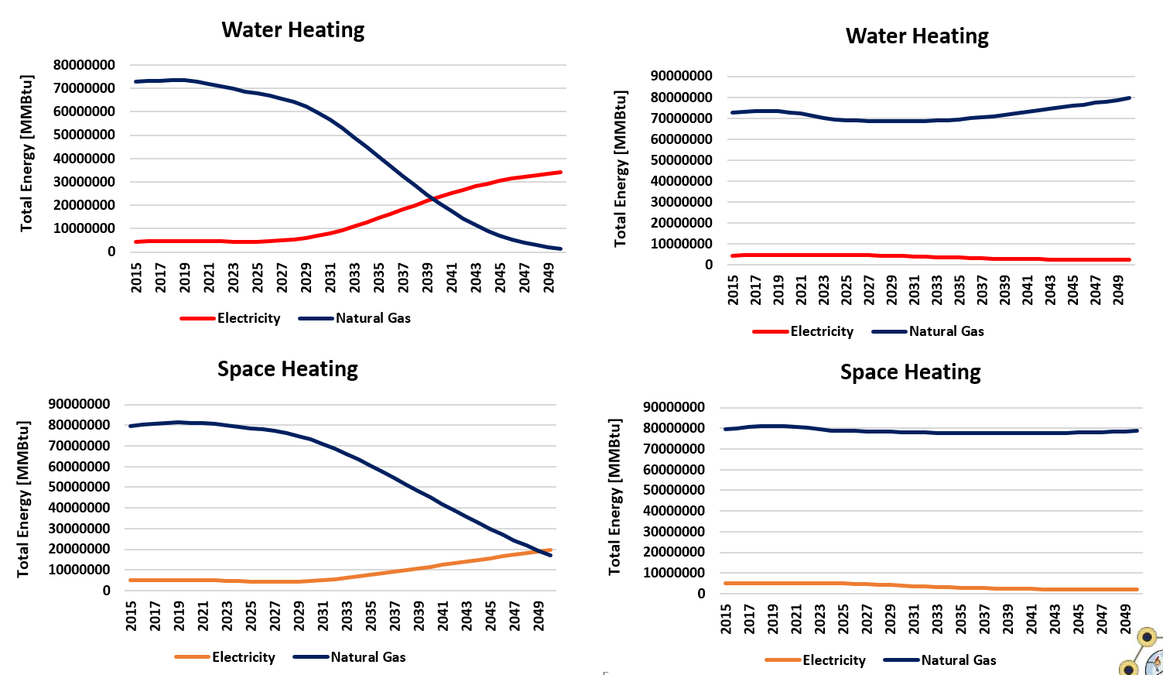
Commercial Energy Consumption (Pathway Model)
High Building Electrification
No Building Electrification

Slide 6
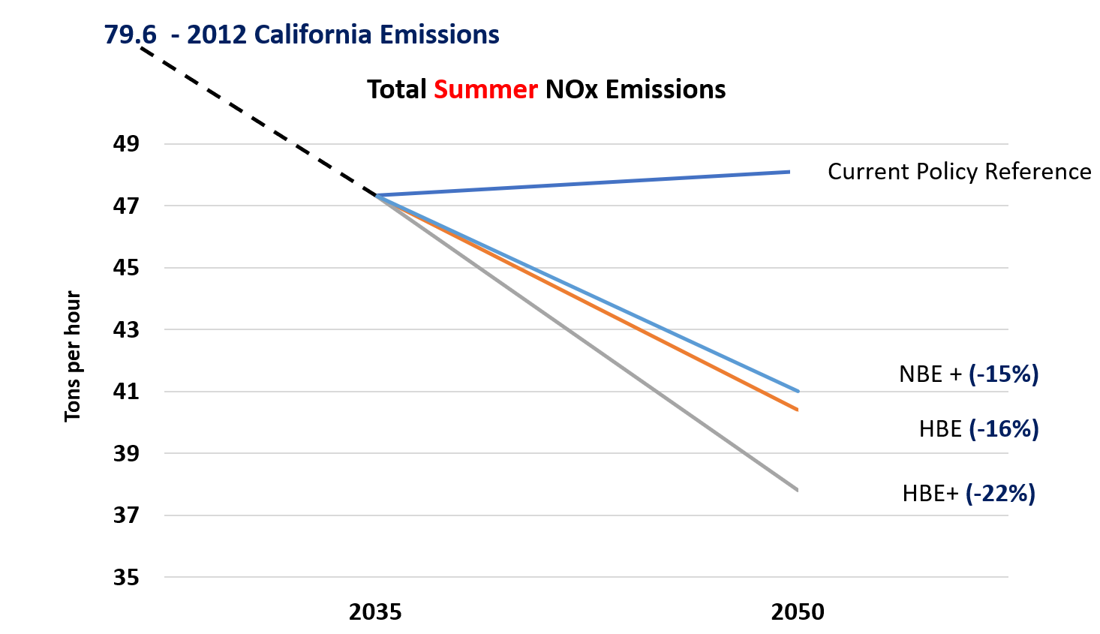
Emissions Projection Results
**Scale does not start at 0**

Slide 7
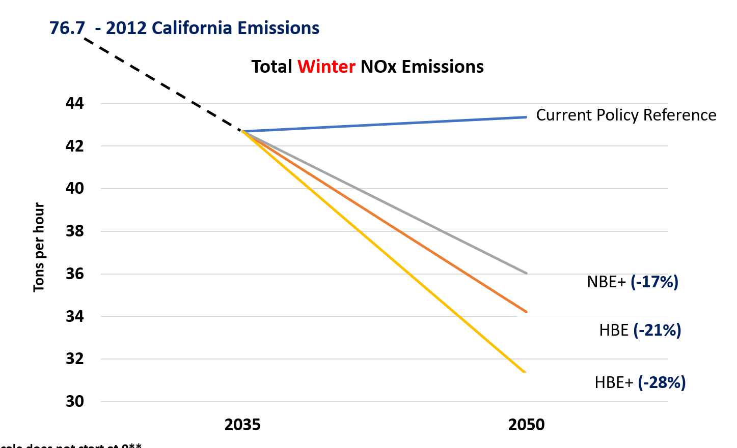
Emissions Projection Results
**Scale does not start at 0**

Slide 8
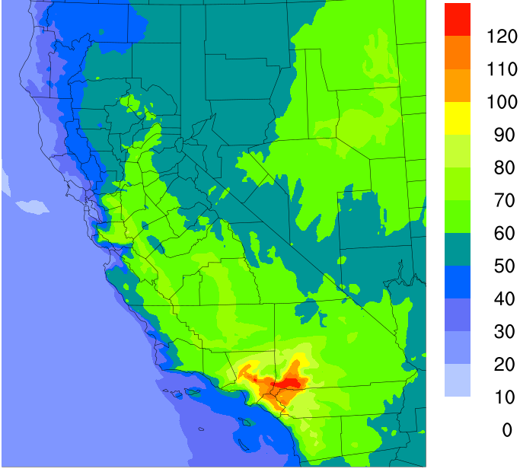
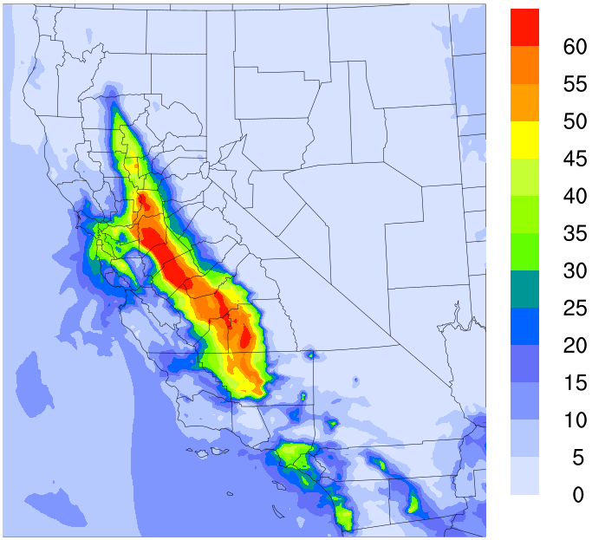
AQ for Current Policy Reference Scenario
Serves as baseline for comparison with alternative cases in 2050
Particular concerns for summer ozone in SoCAB and winter PM_{2.5} in Central Valley
Peak Summer MD8H Ozone: 137.7 ppb
Peak Winter 24-h PM_{2.5}: 74.2 µg/m³

Slide 9
AQ Impacts: HBE+ VS. Current Policy
Significant improvements in key locations (high population + base line levels) from CPR reference scenario in 2050
Ozone benefits in SoCAB and Central Valley, PM_{2.5} in Central Valley
Δ Peak Summer MD8H Ozone : -25.1 ppb
Δ Peak Winter 24-hr PM_{2.5}: - 13.3 µg/m³

Slide 10
AQ impacts of the Electrification of Buildings
Largest impacts correlated with locations of urban population centers
Difference between the HBE+ and NBE+ scenarios (13% vs. 88%)
Secondary PM_{2.5} reductions in Central Valley/Bay Area from NO_{x} reductions
Δ Peak Summer MD8H Ozone : -6.9 ppb
Δ Peak Winter 24-hr PM_{2.5}: - 4.93 µg/m³

Slide 11
AQ impacts of the Electrification of Trucks
Benefits to ozone widespread throughout the State, peak in SoCAB
Should be noted this is in the context of significant MDV/HDV reductions for all cases (53% vs. 86%)
Difference between the HBE+ and HBE scenarios
Δ Peak Summer MD8H Ozone : -5.6 ppb
Δ Peak Winter 24-hr PM_{2.5}: - 3.0 µg/m³

Slide 12
Value of Health Savings: Summer Episode
Health savings of 202 to 261 million $ for the modeled episode
Impacts of MDV/HDV NO_{x} mitigation on ozone and PM_{2.5} in the South Coast Air Basin
Impacts of building NO_{x} reductions in the South Coast Air Basin
*Mean values estimated from the BenMAP-CE Model
High Building Electrification
No Building Electrification
High Building Electrification w/ Trucks

Slide 13
Value of Health Savings: Winter Episode
Health savings of 166 to 249 million $ for the modeled episode
Impacts on secondary PM_{2.5} in the Bay Area/Central Valley from NO_{x} reductions from NG appliances have a major impact
Impacts from trucks achieve health savings from the same mechanism
*Mean values estimated from the BenMAP-CE Model
High Building Electrification
No Building Electrification
High Building Electrification w/ Trucks

Slide 14
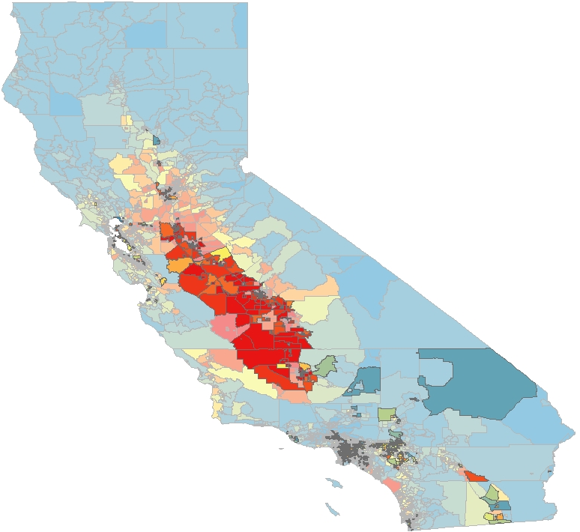
Benefits for disadvantage communities
Health Savings for the HBE+ Scenario in winter allocated to census tracts in California
In winter 39% of the total health savings goes to disadvantage communities (25% of total population), in summer the number is 31%.
$/Census Tract
Disadvantaged communities from CalEnviroScreen 3.0 are highlighted
Disadvantaged communities:
Poverty
High unemployment
Air and Water pollution
Presence of hazardous wastes
High incidence of asthma and heart disease.

Slide 15
Conclusions
Technological strategies to reach 2050 carbon goals attain notable co-benefits to air quality and human health
Impacts vary by season, source, and region
Reductions from MDV/HDV attain important benefits
Widespread benefits to ozone and secondary PM_{2.5} in summer from NO_{x} reductions
Building electrification has important impacts in densely populated urban areas
Impacts on secondary PM_{2.5} in winter from NO_{x} reductions from NG appliances
Disadvantage communities could benefit above average with both high building electrification and truck electrification.

Slide 16
Thank you!
Next Steps
Integrate and assess the potential impacts of bio-refineries
Results presented here do not account for emission impacts of renewable fuel production
Develop and assess scenario considering potential emission impacts from hydrogen/NG blending
End-use impacts could be positive or negative

Slide 17
Back Up Slides

Slide 18
Task 4 – Emissions Projection Methodology
Emissions projection based on CARB 2035 emissions projected to 2050 via Pathways Output
Projection of 2012 to 2050 yielded unrealistic concentrations
CEPAM 2016 is ARB projected emissions to 2035 accounting for current policy
ARB Projection (CEPAM Tool)
Pathways Output for 2012 to 2050
Pathways Output for 2035 to 2050
Baseline Emissions
CARB 2012
Baseline Emissions
CARB 2035
Baseline and Alternative Case Emissions
E3 FONG 2050

Slide 19
AQ impacts of Buildings and Trucks
Impacts on Summer PM_{2.5}
Difference between the HBE with Truck Measures and NBE scenarios
Secondary PM_{2.5} reductions in Central Valley/Bay Area from NO_{x} reductions
Buildings
Trucks
-0.74 ug/m³ ppb peak difference in SoCAB
-1.2 ug/m³ peak difference in SJV

Slide 20
South Coast Air Basin 2035 NOx
Source: CARB CEPAM 2016 SIP

Slide 21
Task 4 –AQ Results
Summer MD8H
Average difference: -2.7 ppb to -3.41 ppb
Peak difference: -13 ppb to -18 ppb
Summer 24-h PM_{2.5}
Average difference: -0.89 ug/m³ to -1.37 ug/m³
Peak difference: -2.0 ug/m³ to -2.91 ug/m³
Winter 24-h PM_{2.5}
Average difference: -4.01 ug/m³ to -6.03 ug/m³
Peak difference: -8.41 ug/m³ to -12.72 ug/m³

Slide 22
Task 4 – Emissions Projection Results
Total NOx is reduced by 15-25%
-16%
-15%
-22%
-25%
Current Policy Reference
High Building Electrification
No Building Electrification with SNG
High Building Electrification with Truck
No Building Electrification with Industry and Truck

Slide 23
Task 4 – Downscaling
Differences between cases driven by MDV, HDV and industry
Electricity sector emissions contribute to a lesser degree
Constant Across Cases | Differences Between Cases
On-road Vehicles LDV, Bus | On-road Vehicles MDV, HDV
Off-road Equipment | Residential and Commercial Buildings
OGV, Harbor Craft | Industrial Sector (non-petroleum)
Rail | Electricity Sector
Aircraft | Bio refineries
Petroleum Refineries

Slide 24
Pathways Downscaling
Downscale Pathways model results to an ARB criteria pollutant emission inventory in 2050
Energy consumption from various combinations of conventional and alternative fuels used to determine emission changes
Current Policy Reference
High Building Electrification
No Building Electrification w/ SNG
High Building Electrification w/ Truck Measures
No Building Electrification w/ Industry and Truck Measures

Slide 25
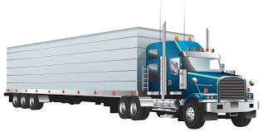
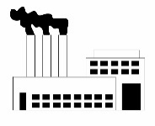
Scenario Development
Differences between cases driven by MDV, HDV and industry
Electricity sector emissions contribute to a lesser degree
*Representative, commercial NG other sources

