Slide 1
Overview of Long Island Sound Tropospheric Ozone Study (LISTOS)
LISTOS Science Team
Presented by Luke Valin
October 23, 2019

Slide 2
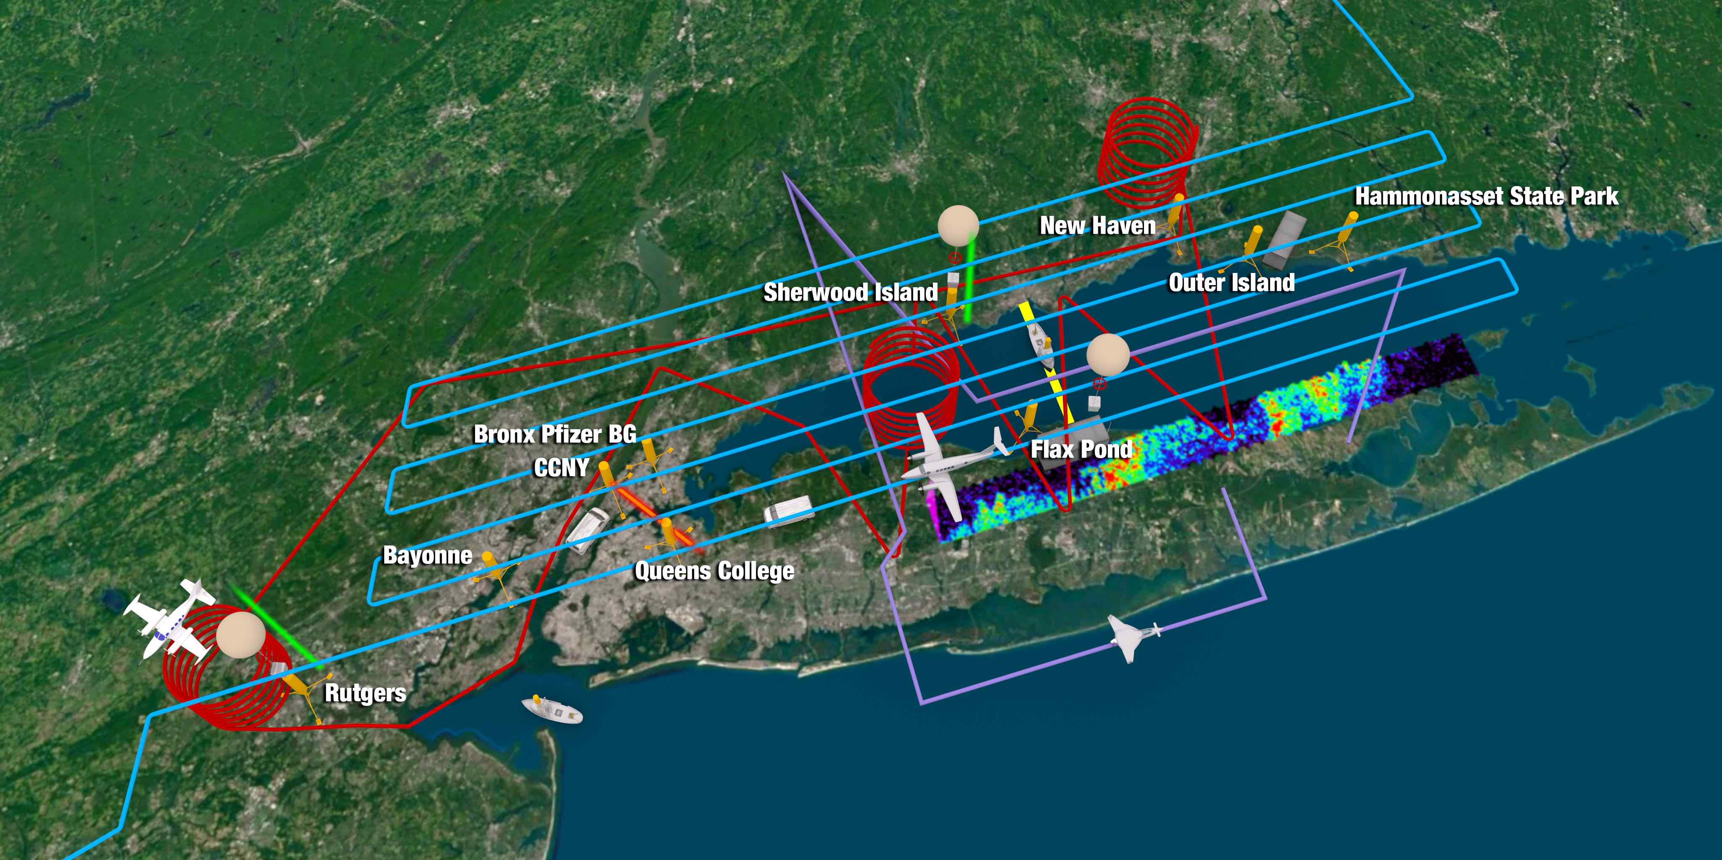
LISTOS overview
LISTOS included a combination of coordinated field research activities with support from existing and enhanced ongoing monitoring activities.
The overarching goal is to inform models and decision makers with sound measurements and scientific insights regarding ozone sources and transport.
Graphic courtesy of NASA LaRC

Slide 3
2018 LISTOS Participants & Activities
1.State AQI forecasters predicting ozone episodes to launch activities
2.NOAA-ESRL oxygenated/consumer product VOC mobile van measurements in NYC during March and July
3.Univ. Maryland Cessna 2018
4.Maine DEP and NYS DEC labs VOC canister analysis
5.NASA GeoTASO 20-30 high altitude flights; ozonesondes at Rutgers, NJ
6.EPA Pandoras Long Island Sound (LIS) coastline, Rutgers PAMS, NYC; ozonesondes& continuous HCHO at Westport, CT
7.CCNY boat-based air pollution measurements in LIS
8.CCNY aerosol LIDAR in northern Manhattan
9.Stony Brook Univ. oxygenated VOC measurements at Flax Pond PAMS site (Long Island north shore)
10.Stony Brook Univ. aircraft fine resolution wind field measurements over LIS
11.Univ. at Albany O3, NOx, VOC mobile measurements across Long Island south to north shore transects
12.Univ. at Albany ozonesondes from Long Island
13.NASA ozone LIDARs upwind at Rutgers Univ., NJ, and downwind on CT’s LIS shoreline
14.CT DEEP ozone monitor on LIS ferry between Bridgeport, CT and Port Jefferson, NY
15.PAMS VOC measurements at Rutgers, NJ & the Bronx, with new NYS DEC PAMS site at Flax Pond, Long Island
16. CT DEEP, NJ DEP, NYS DEC delivery of 1-minute continuous monitoring data from all sites requested
17. NYS DEC hosted EPA for formaldehyde intercomparison study (3 commercial units, 2 research, 1 TO-11A)
18.Yale Univ. Coastal Field Station –VOCs on CT coast
*Bold-face represent activities relevant to PAMS EMP ongoing monitoring plans
Sponsors and in-kind contributions: NYSERDA, NESCAUM, CT DEEP, NJ DEP, NYS DEC, US F&W, NOAA, NASA, EPA

Slide 4
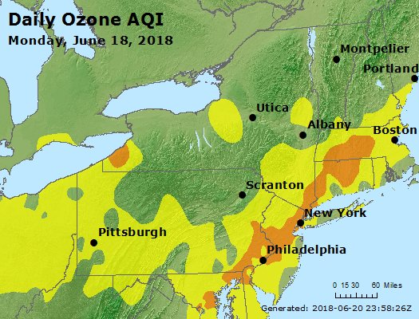
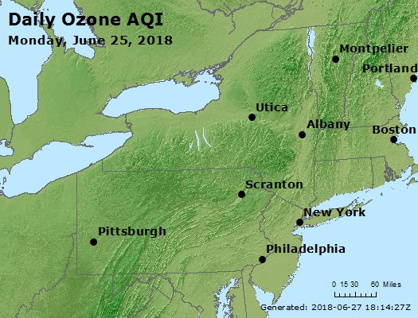
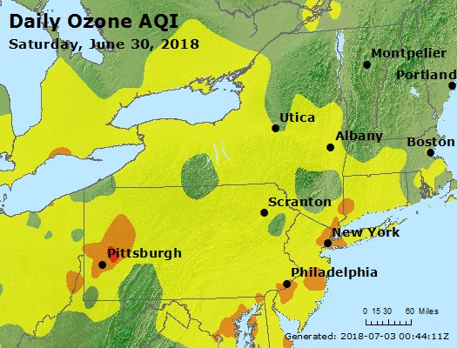
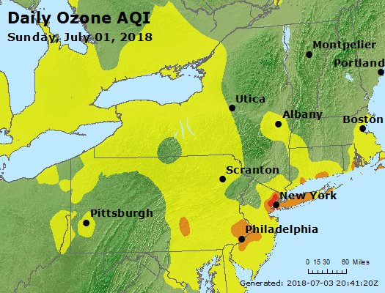
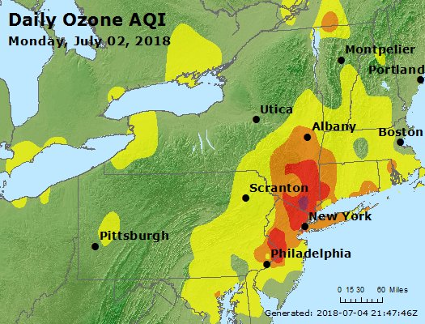
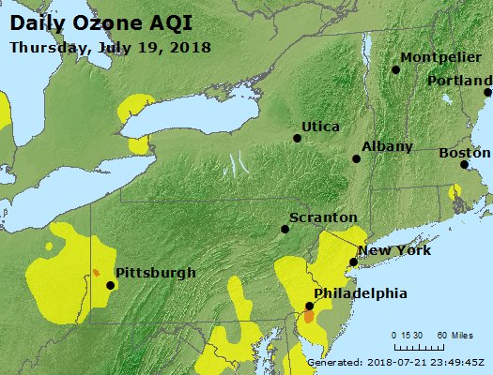
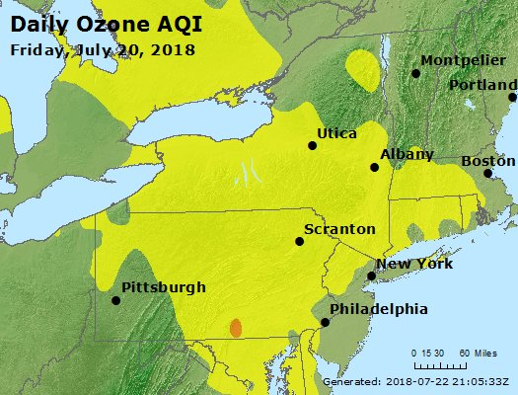
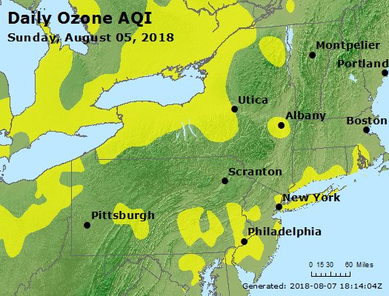
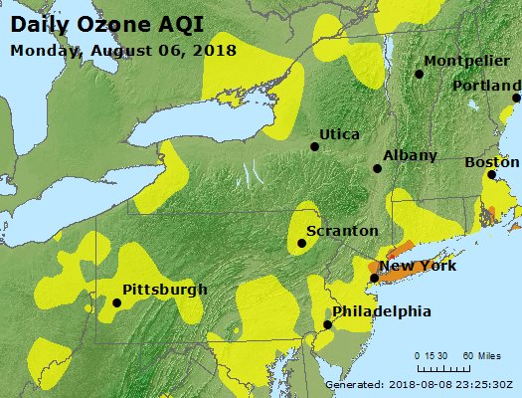
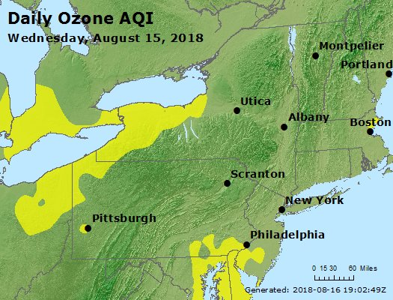
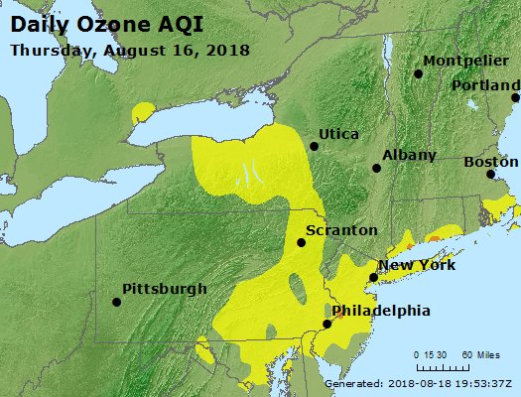
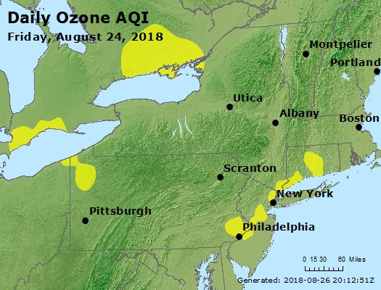
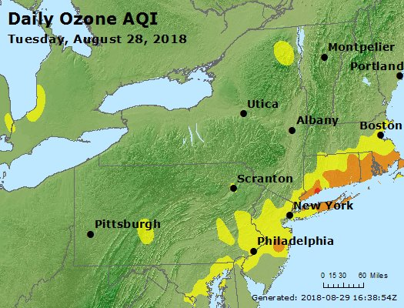
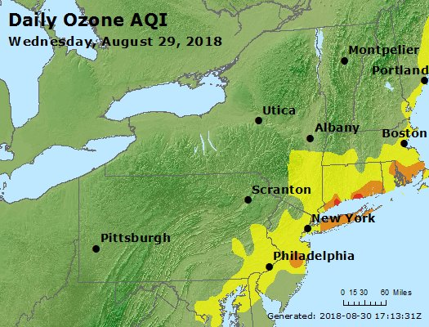
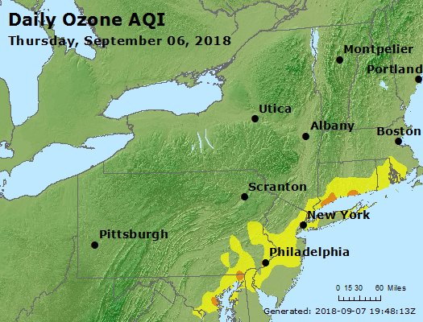


LISTOS sampled a variety of meteorology and day-of-week variations

Slide 5
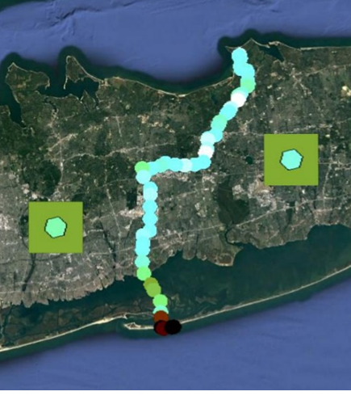
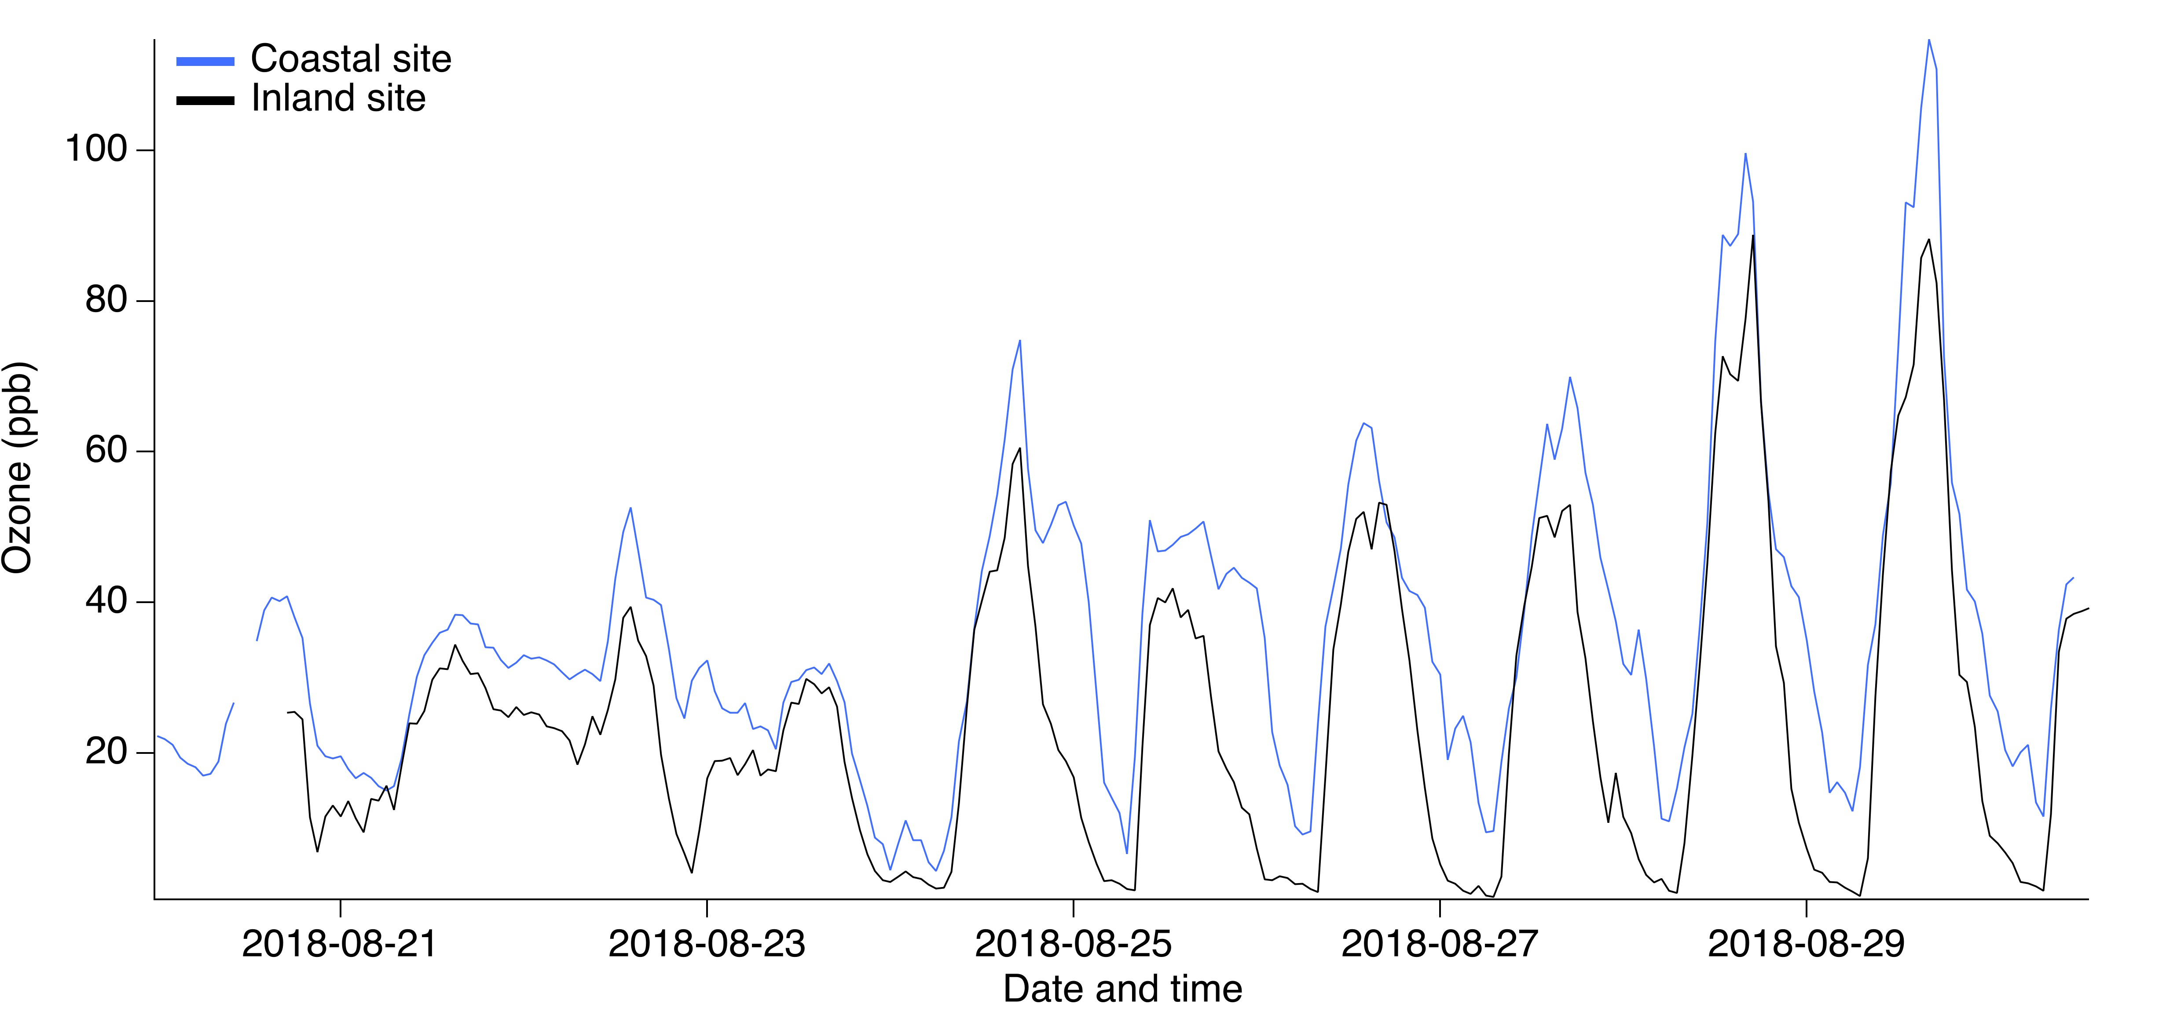
Steep ozone gradients (vertical and horizontal) near coastlines present a challenge for regulatory modeling
On 30 June, SUNY-Albany mobile vehicle observed a 50 ppb ozone gradient between interior and coastal setting
There are routinely large O₃ gradients between Yale Coastal site and forested site 5 km inland
50 ppb
110 ppb
Data courtesy of: Yale (Gentner) and SUNY-Albany (Schwab)
Sponsors: NESCAUM, NYSERDA, Yale

Slide 6
Slide and LIDAR data:
T. Berkoff (LaRC),
J. Sullivan(GSFC)

Slide 7
Surface ozone in East US decreases on Sundays and has decreased over last two decades

Slide 8
I95-corridor surface ozone (95th %) is linearly correlated with observed NO2 columns over same time periods (magenta)

Slide 9
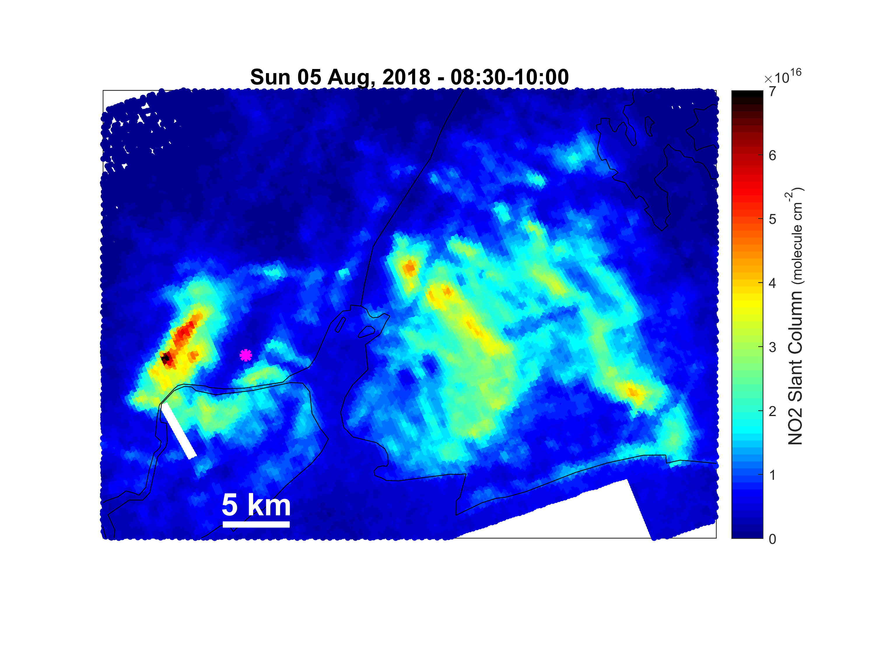
Understand NOx emission patterns at finer spatial detail
Ports, railyards, highways
Winds were rather slow on the morning of Sunday August 5
The meteorology and timing isolate certain sources (e.g., Newark airport, lack of port emissions)
Newark Airport
Data courtesy of Laura Judd, Jay Al-Saadi (NASA LaRC) and Scott Janz (NASA GSFC)

Slide 10
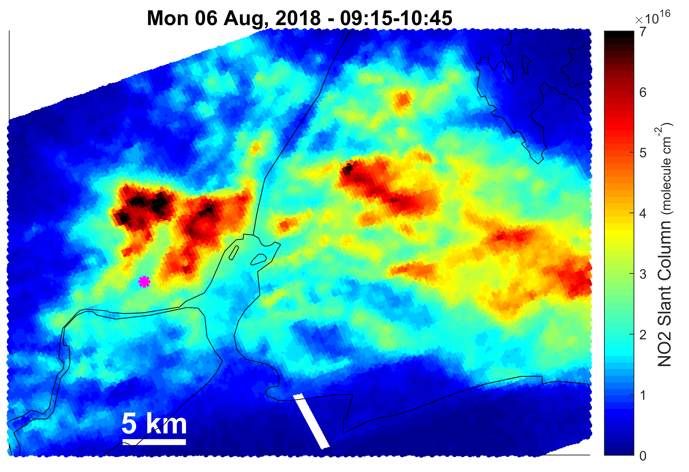
Understand NOx emission patterns at finer spatial detail
Ports, railyards, highways
Newark Airport
Data courtesy of Laura Judd, Jay Al-Saadi (NASA LaRC) and Scott Janz (NASA GSFC)

Slide 11
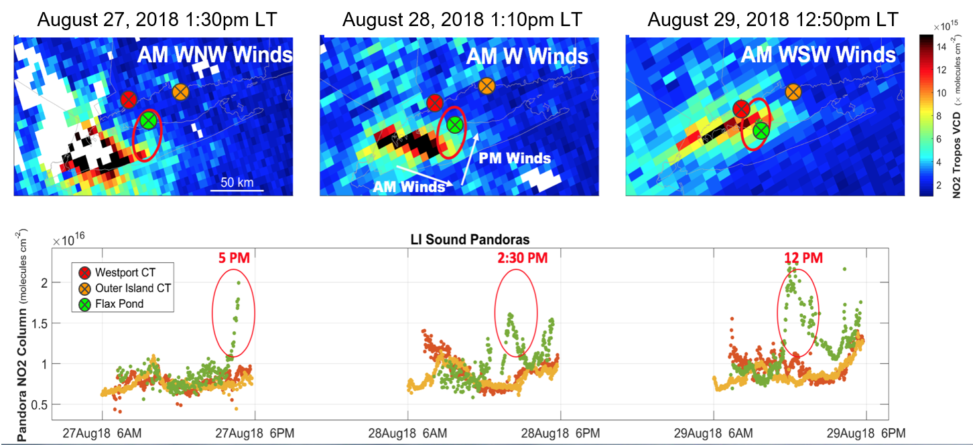
Better understand NOx transport at urban to regional scales
ESA Copernicus TROPOMI NO2 tropospheric column

Slide 12
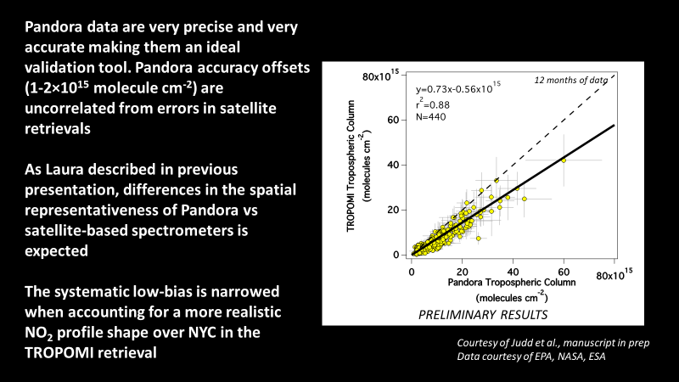
Pandora spectrometers and validation of TROPOMI NO₂ products

Slide 13
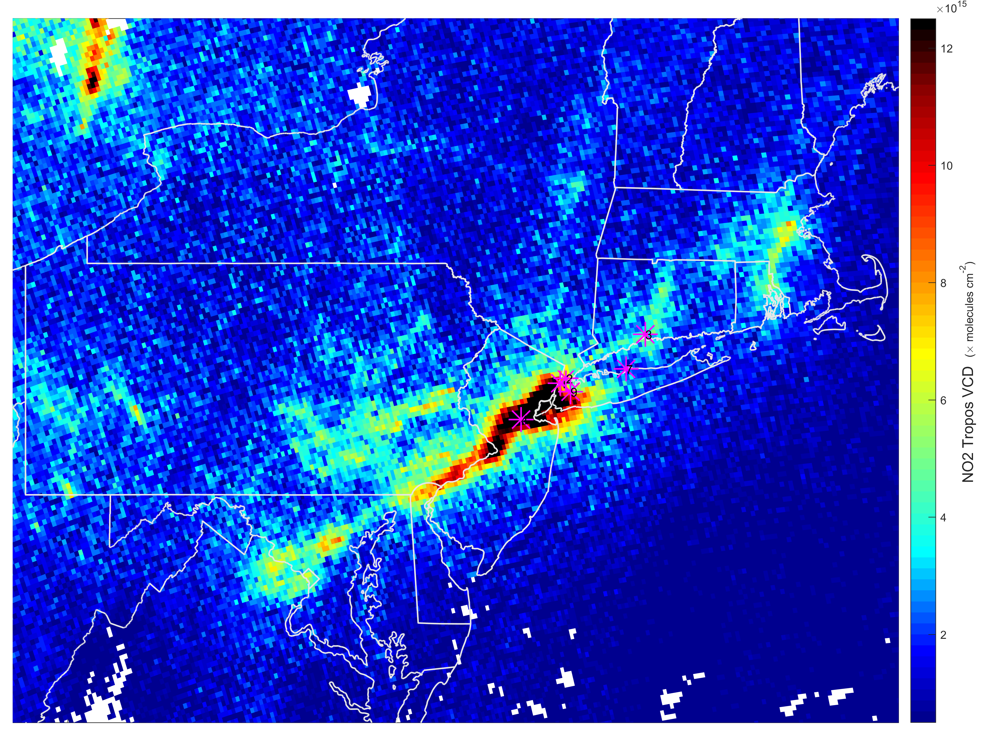
Detailed validation information will add confidence for use of TROPOMI data in AQ modeling applications
ESA Copernicus Sentinel 5P TROPOMI
NO2 Tropospheric Column
September 19, 2019

Slide 14
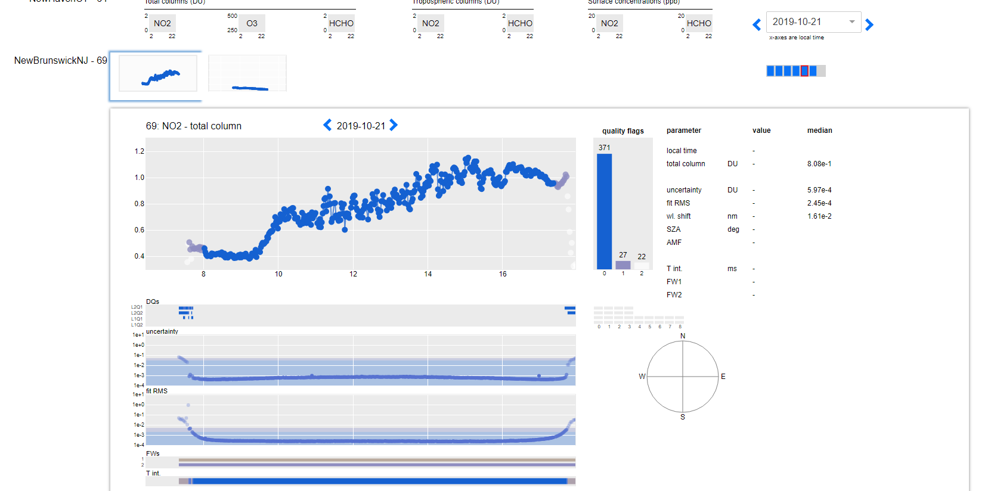
Pandonia Global Network is working towards real-time delivery of QA/QC’d data from ~100+ sites globally in upcoming years
Rutgers site
EPA/NASA Pandor NO2 Column
Monday 21 October
Data processing courtesy of ESA Luftblick and NASA GSFC

Slide 15
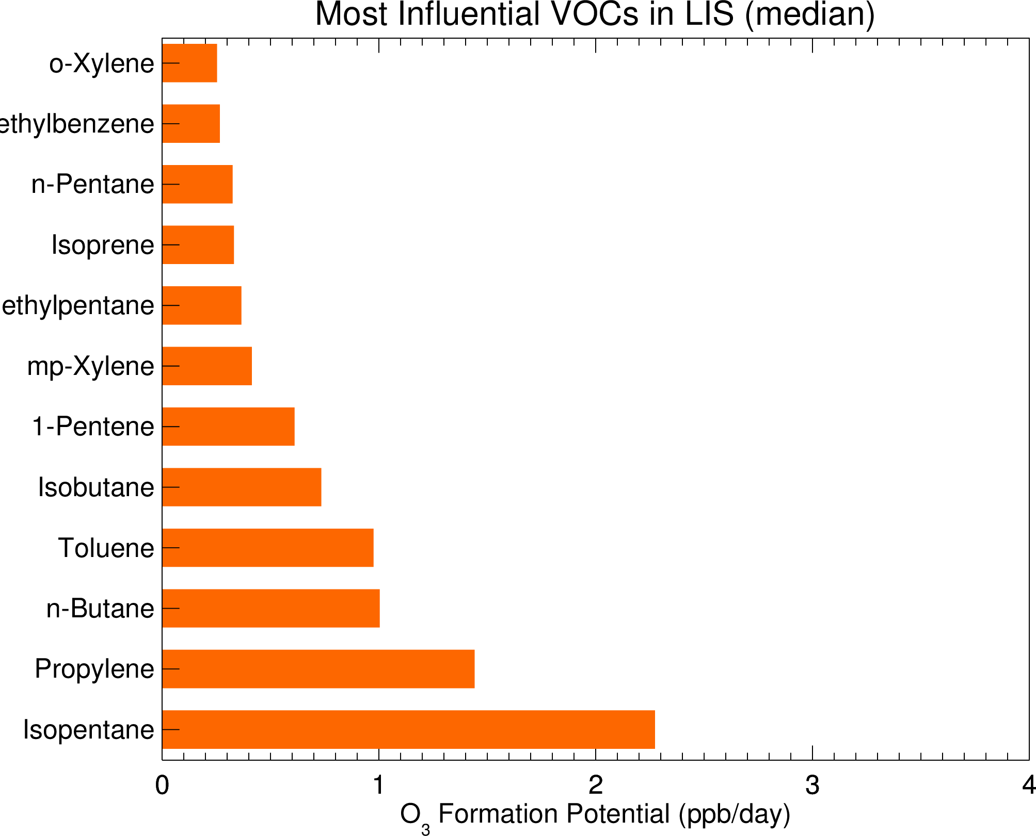
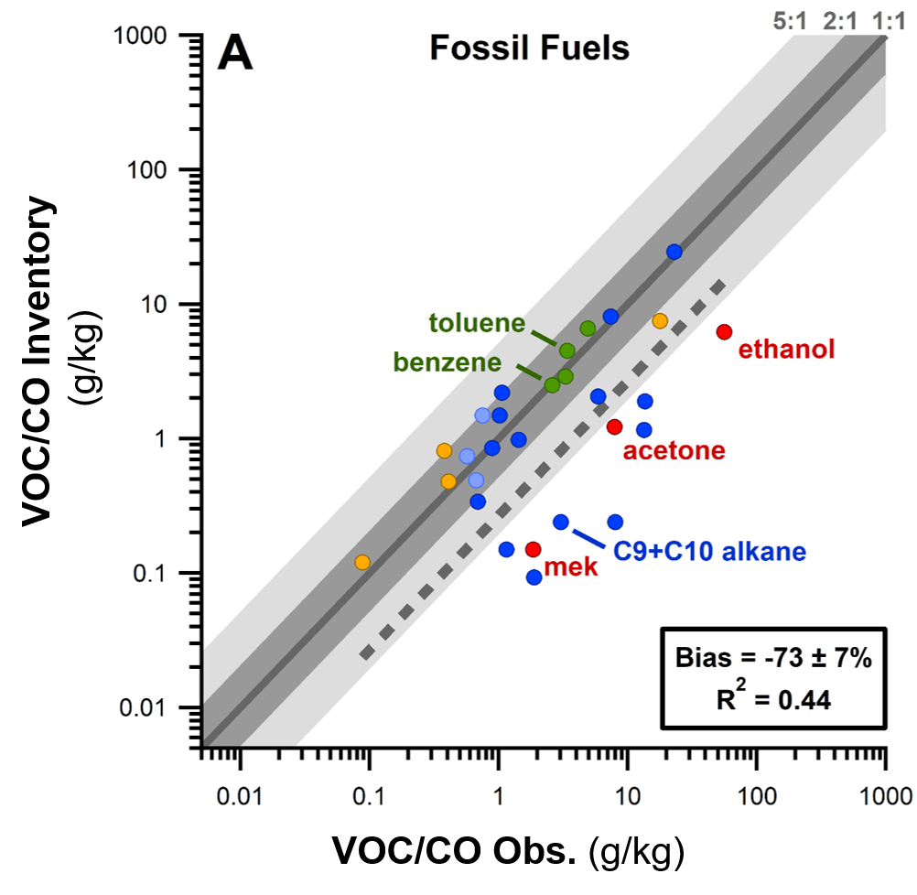
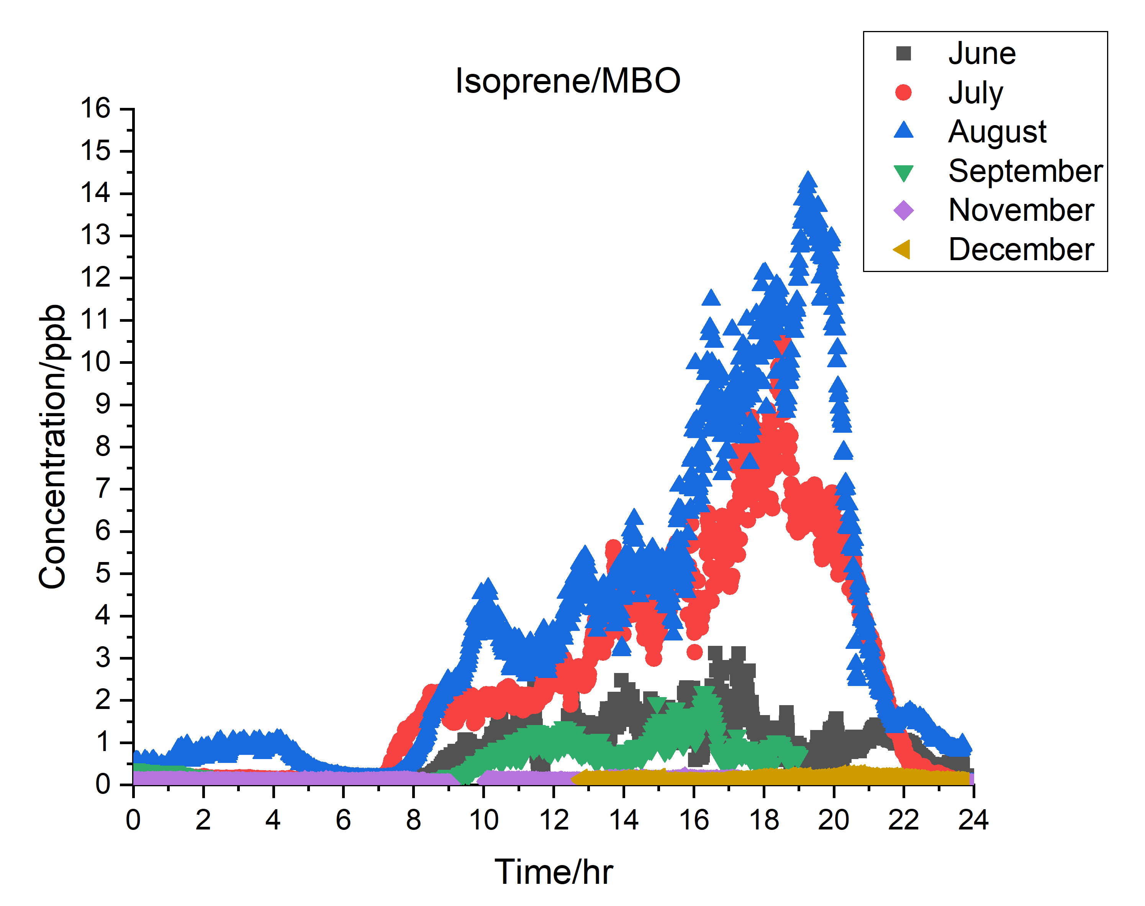
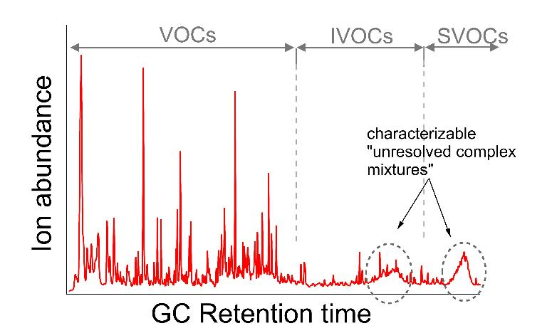
Identify data gaps in knowledge of VOC emissions
Anthro VOC are largest contributor to O3 formation
Ring et al., in prep
UMD/Maine DEP
A large fraction of anthro VOC from consumer products (not fuel)
McDonald et al., 2018
NOAA CMD
“Some of the largest isoprene/MBO concentrations we’ve observed”
Data preliminary
Flax Pond, N. Shore LI
SUNY-Stony Brook
← NYC air: a soup of VOC, Yale Group
Sheu et al., J. Chrom. A, 2018; Khare et al., J. Chrom. A, 2019, Ditto et al. Chem. Comm. 2018
The variety of VOC compounds and sources, and the short lifetime of important compounds, like isoprene, make it challenging to quantify regionally
Data Courtesy: UMD/Maine DEP, SUNY-Stony Brook, Yale ($ - NESCAUM); NOAA

Slide 16
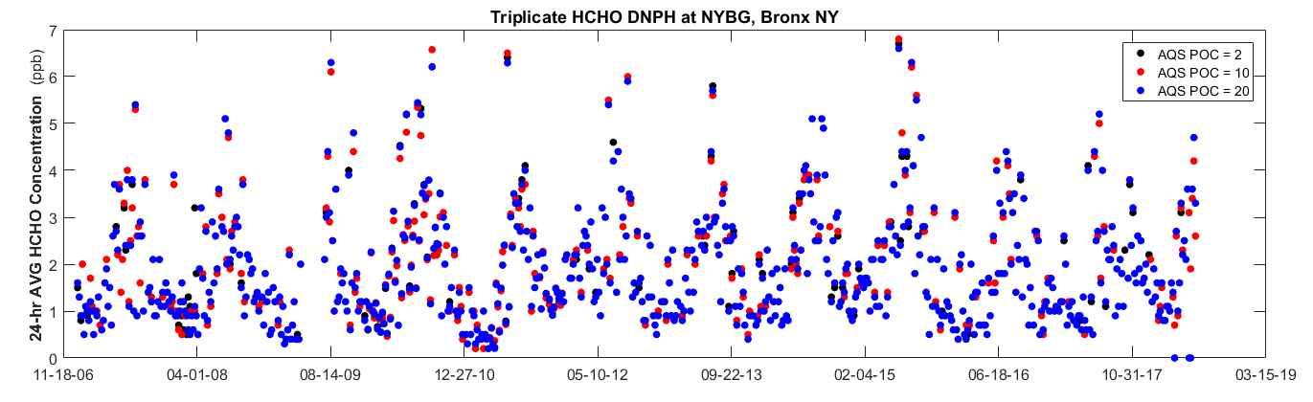
Decline in anthropogenic VOC emissions (not shown) is not associated with any trend in formaldehyde
Despite large emission reductions of many anthropogenic VOC, there is no obvious trend of formaldehyde, a predominantly secondary pollutant formed via VOC oxidation
NYBG – Bronx 24-H DNPH Formaldehyde
5.5 ppb
2007
2018
Data courtesy of NYS DEC

Slide 17
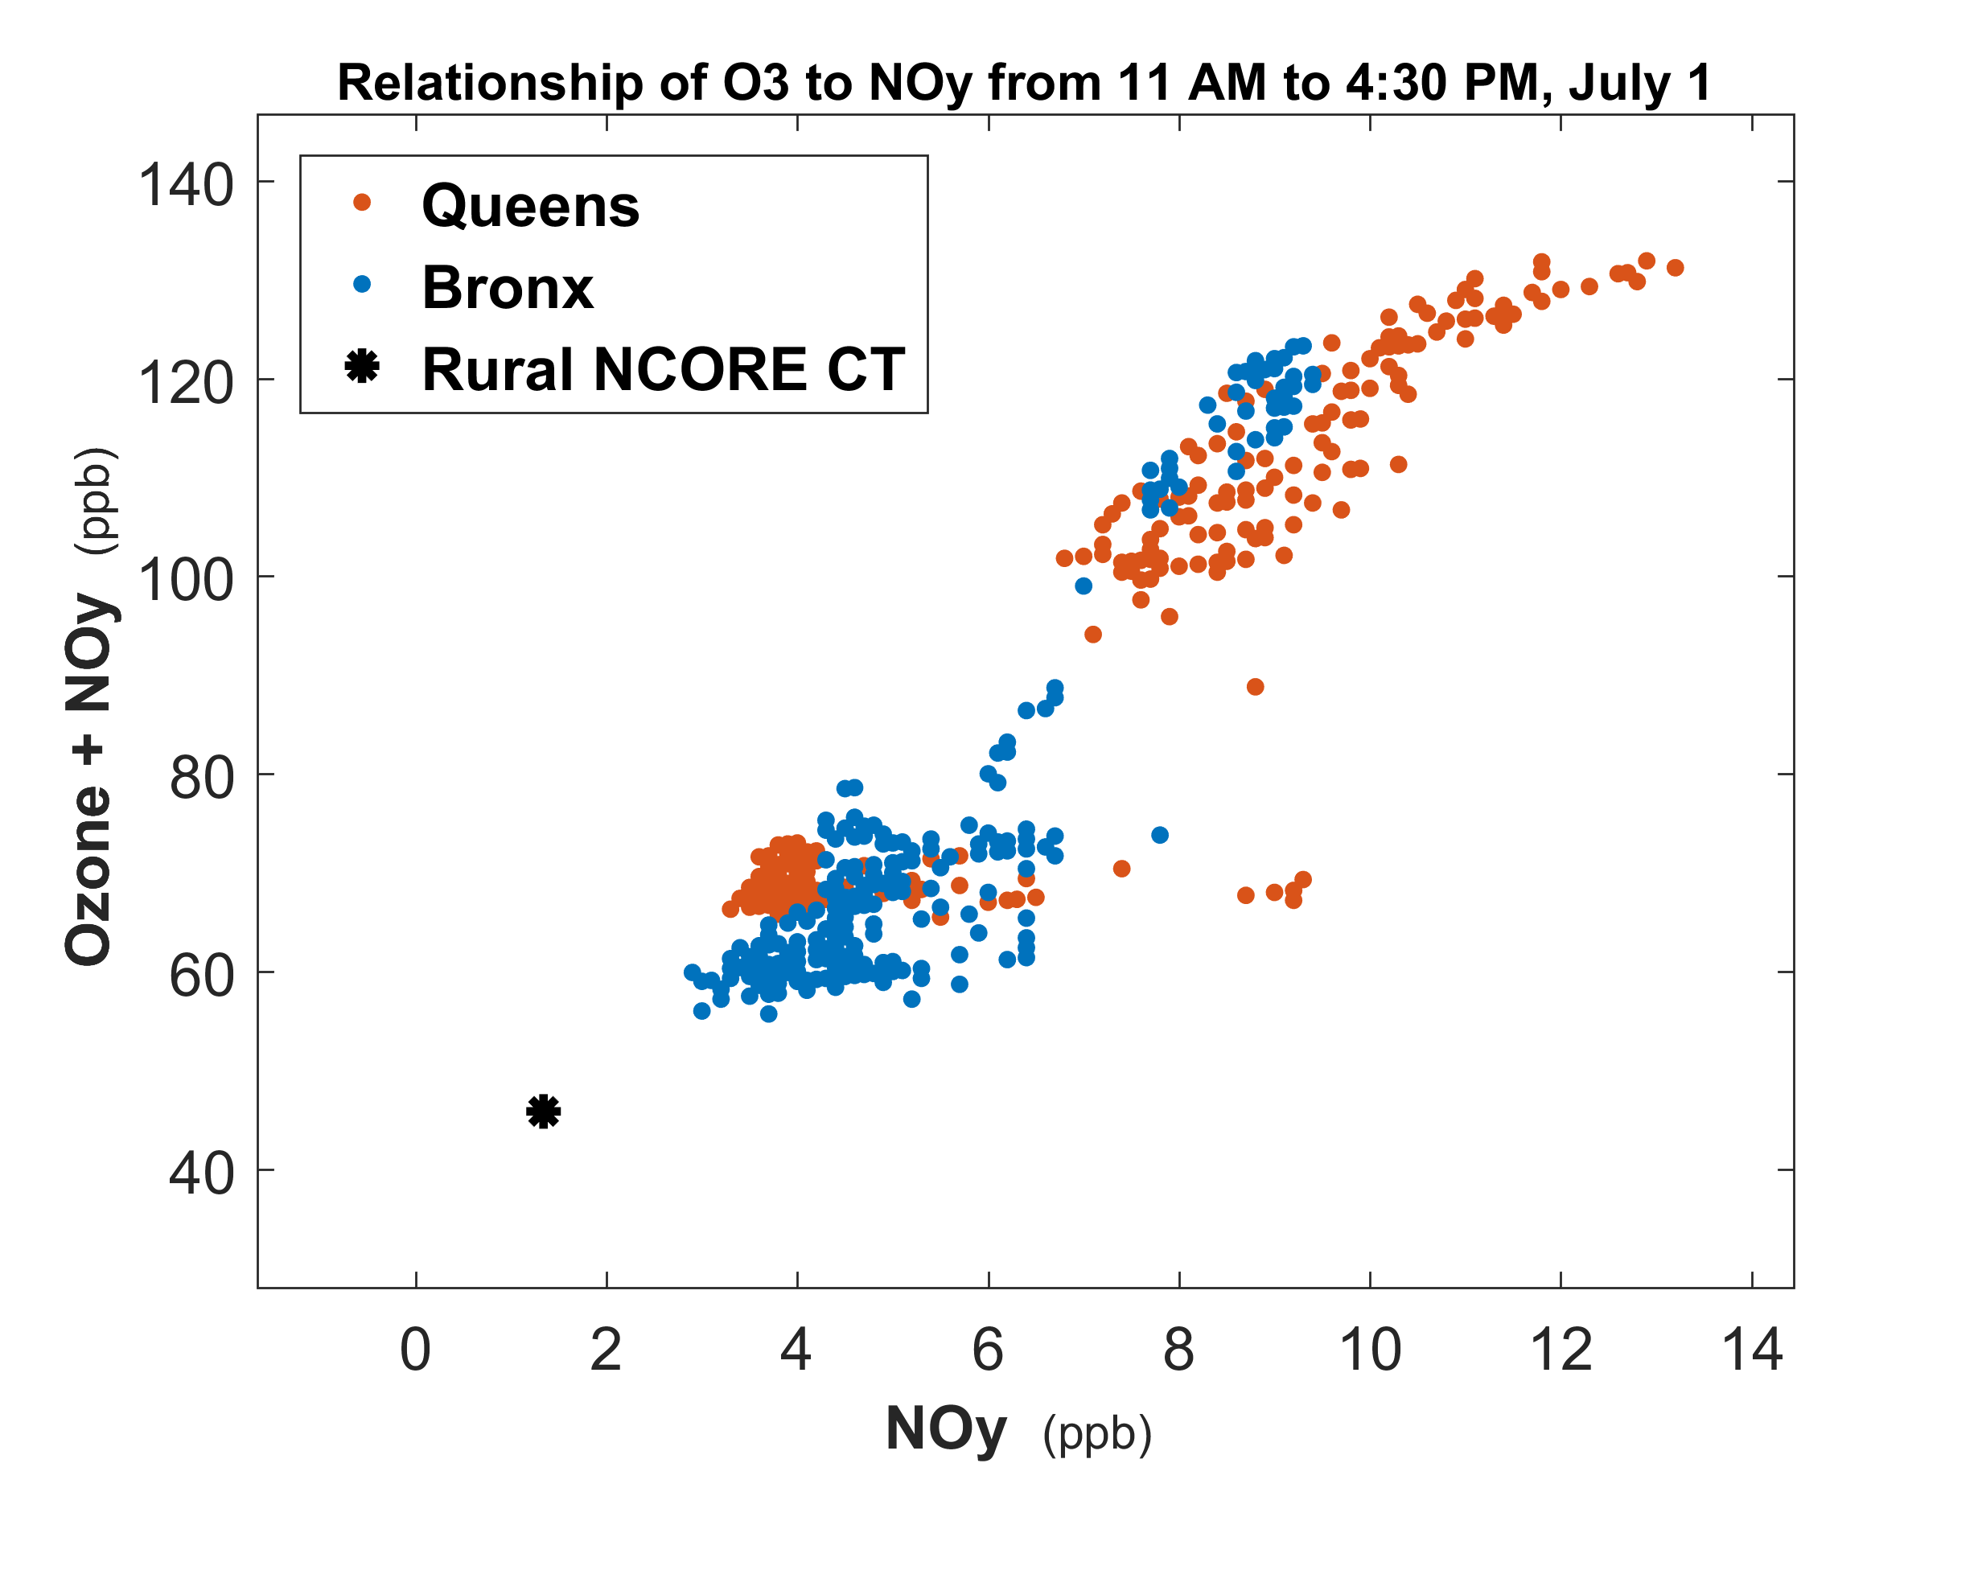
Routine archival of one-minute time resolution regulatory measurements helps reveal important relationships
To understand ozone variability, we must understand the distribution of nitrogen oxides
In this example, 1-minute data from the Queens, NY NCore site were useful for distinguishing freshly-emitted NO_{y} from aged NO_{y}, and for quantifying ozone production.
Aged emissions
Fresh emissions
Data courtesy of NYS DEC and CT DEEP

Slide 18
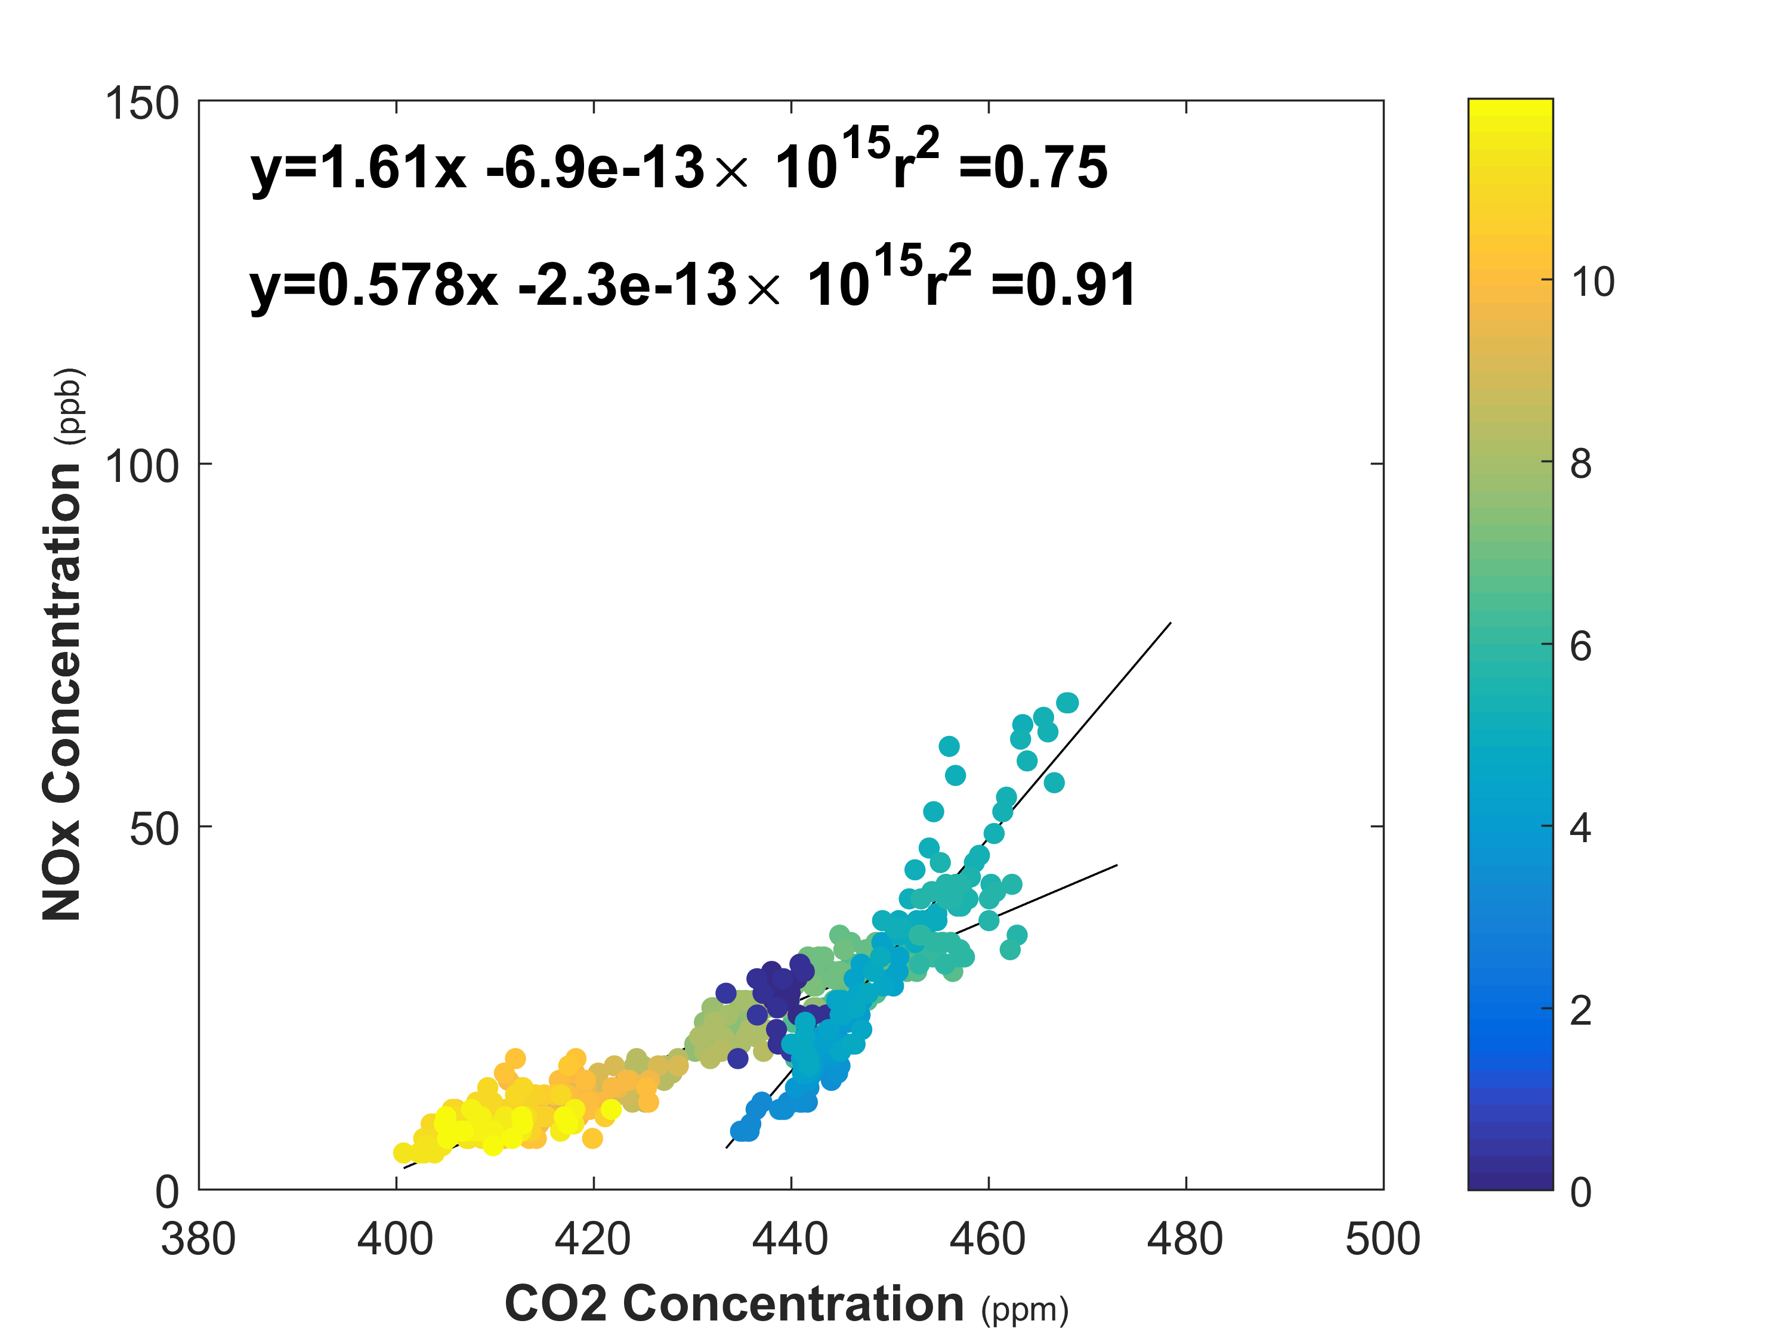





CO₂: An Important Measurement in unraveling Combustion Emission Source Signals
Near-road site GW Bridge, Fort Lee, NJ
Sunday Morning April 22, 2018
Six BEACO2N nodes integrated into NYC DEC and NJ DEP sites to provide high time resolution, high precision CO₂ measurement to complement existing FRM/FEM measurements. Continue to work with LISTOS participants to expand measurements to large domain
Hour of Day

Slide 19
LMOS LISTOS and OWLETS:
Converge on modeling best practices?
 | UW-Madison (LMOS) WRF-Chem and CMAQ 12 km, 4 km, 1.3km | U Iowa (LMOS) WRF-Chem, 4km, z=53, z_{<1km}=11 | EPA ORD (LISTOS) WRF/CMAQ 12 km, 4 km, 1.3km
Soil T and M | Compare ACM2/PX and YSU/NOAH Hi-res NASA SpORT analysis | Better met with NOAH LSM than 5-layer thermal diffusion | Nudge PX LSM with URMA (2km)
Sea Surface T | Testing GLSEA vs. GDAS |  | GHSST
Met Initialization |  | HRRRv2 from UoU archive improves cold bias and lake breeze timing
Anthro. Emissions |  | 5× anthro VOC improves O₃ episode Base NOx = 0.72× NEI2011 (0.22, 0.5) | 2018 MOVES specific to counties in NJ/NY/CT. Otherwise 2016 platform projected forward
Biogenic VOC | Testing NASA SPoRT-LIS analysis, | Using state-of-art LAI/PFT/LU inputs BEIS vs MEGAN | In-line BEISv3.61 Perhaps test revised BEIS or MEGAN
Photolysis | Use GOES-16 to bias correct cloud optical depth and height | Sensitivity test: clouds
Other Comments | See Huang et al., 2017; https://www.geosci-model-dev.net/10/3085/2017/ See McNider et al., 2018, https://journals.ametsoc.org/doi/full/10.1175/JAMC-D-17-0355.1
 | Initial model analysis and findings for LMOS studies: https://www.ladco.org/wp-content/uploads/Research/LMOS2017/LMOS_LADCO_report_revision_apr2019_final.pdf

Slide 20
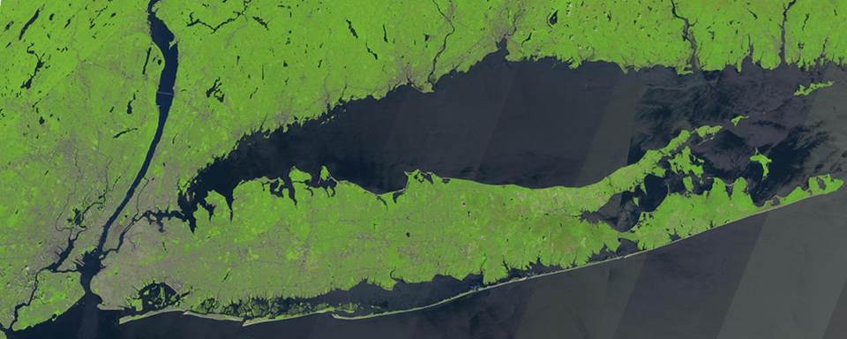
Acknowledgements
LISTOS Science Team
http://www.nescaum.org/documents/listos
Funding: NYSERDA, NESCAUM, CT DEEP, NJ DEP, NYS DEC, US F&W, NOAA, NASA, EPA ORD A-E
Disclaimer: This work does not necessarily reflect the views or official policy of the EPA. Any mention of tradenames does not connote endorsement.

Slide 21
LMOS LISTOS and OWLETS:
Converge on modeling best practices?
Common challenges:
Resolving (or parameterizing) convergence, clouds, PBL structure and timing (Note: John Mak 3D wind data, NYS MESONET)
Nighttime low-level jets appear to be potentially important in East US (NYS MESONET)
Regulatory considerations: Emissions, Emissions, Emissions
Processing model emissions specific to a year is very challenging but is critical, given rapidly changing NOx emissions and responsible sources
MOVES model results are quite sensitive to input parameters. The national defaults may not be representative of location-specific emissions
2017 Tier 3 Motor Vehicle Emission and Fuel Standards program begins
Balance of biogenic VOC emissions (and oxidation products) vs anthropogenic VOC

Slide 22
Courtesy: T. Berkoff, J. Sullivan

Slide 23
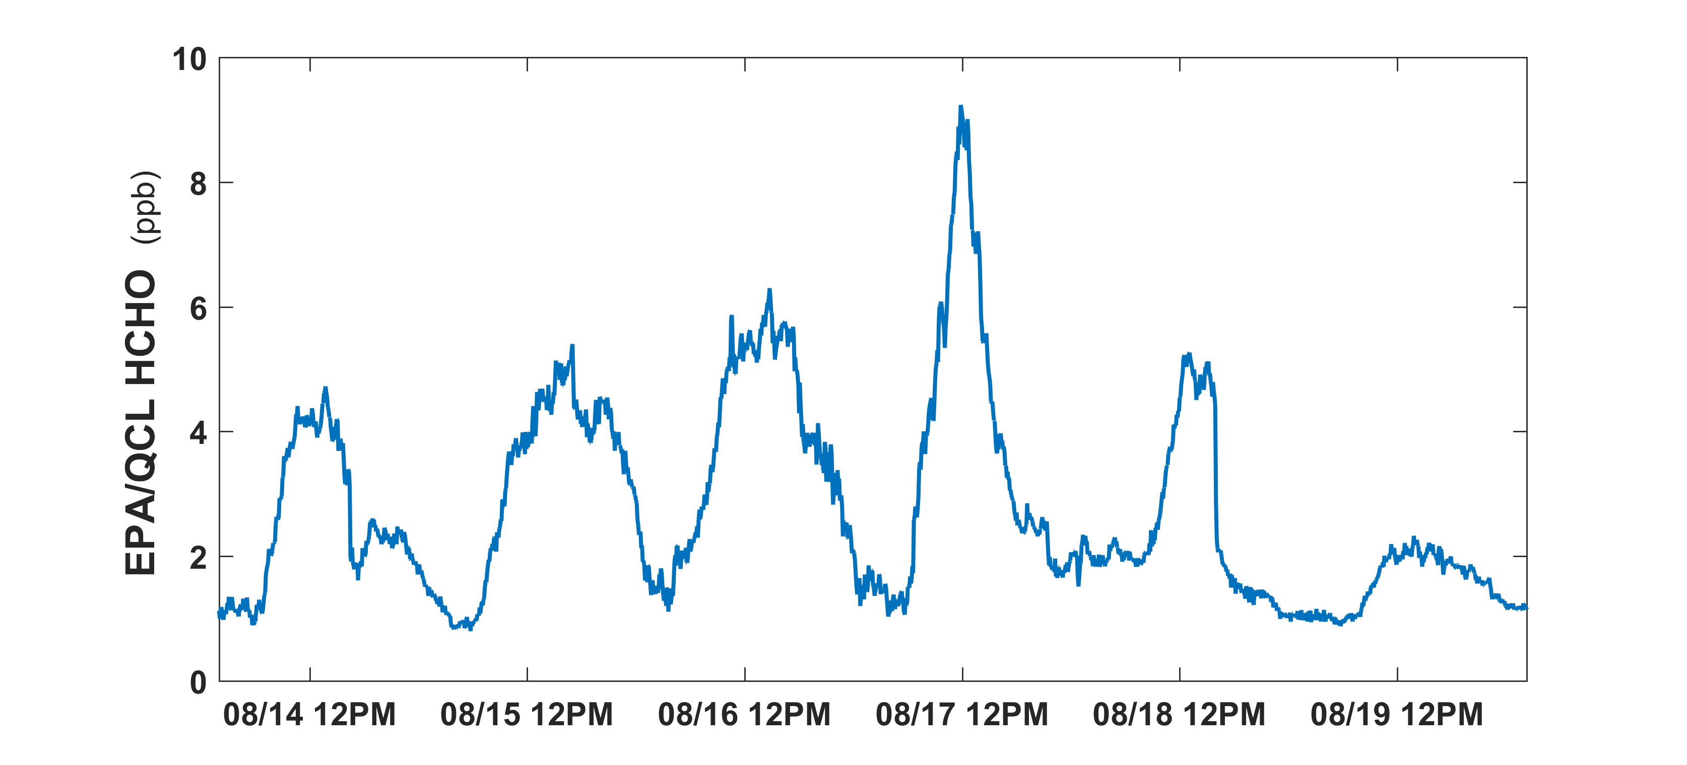
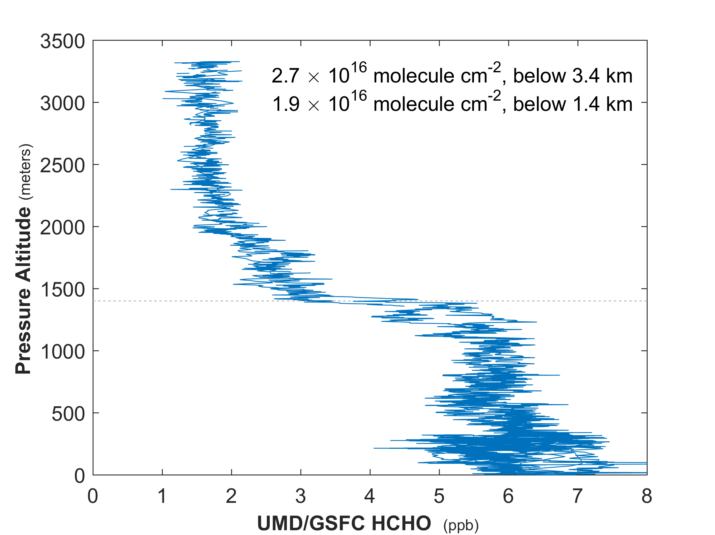
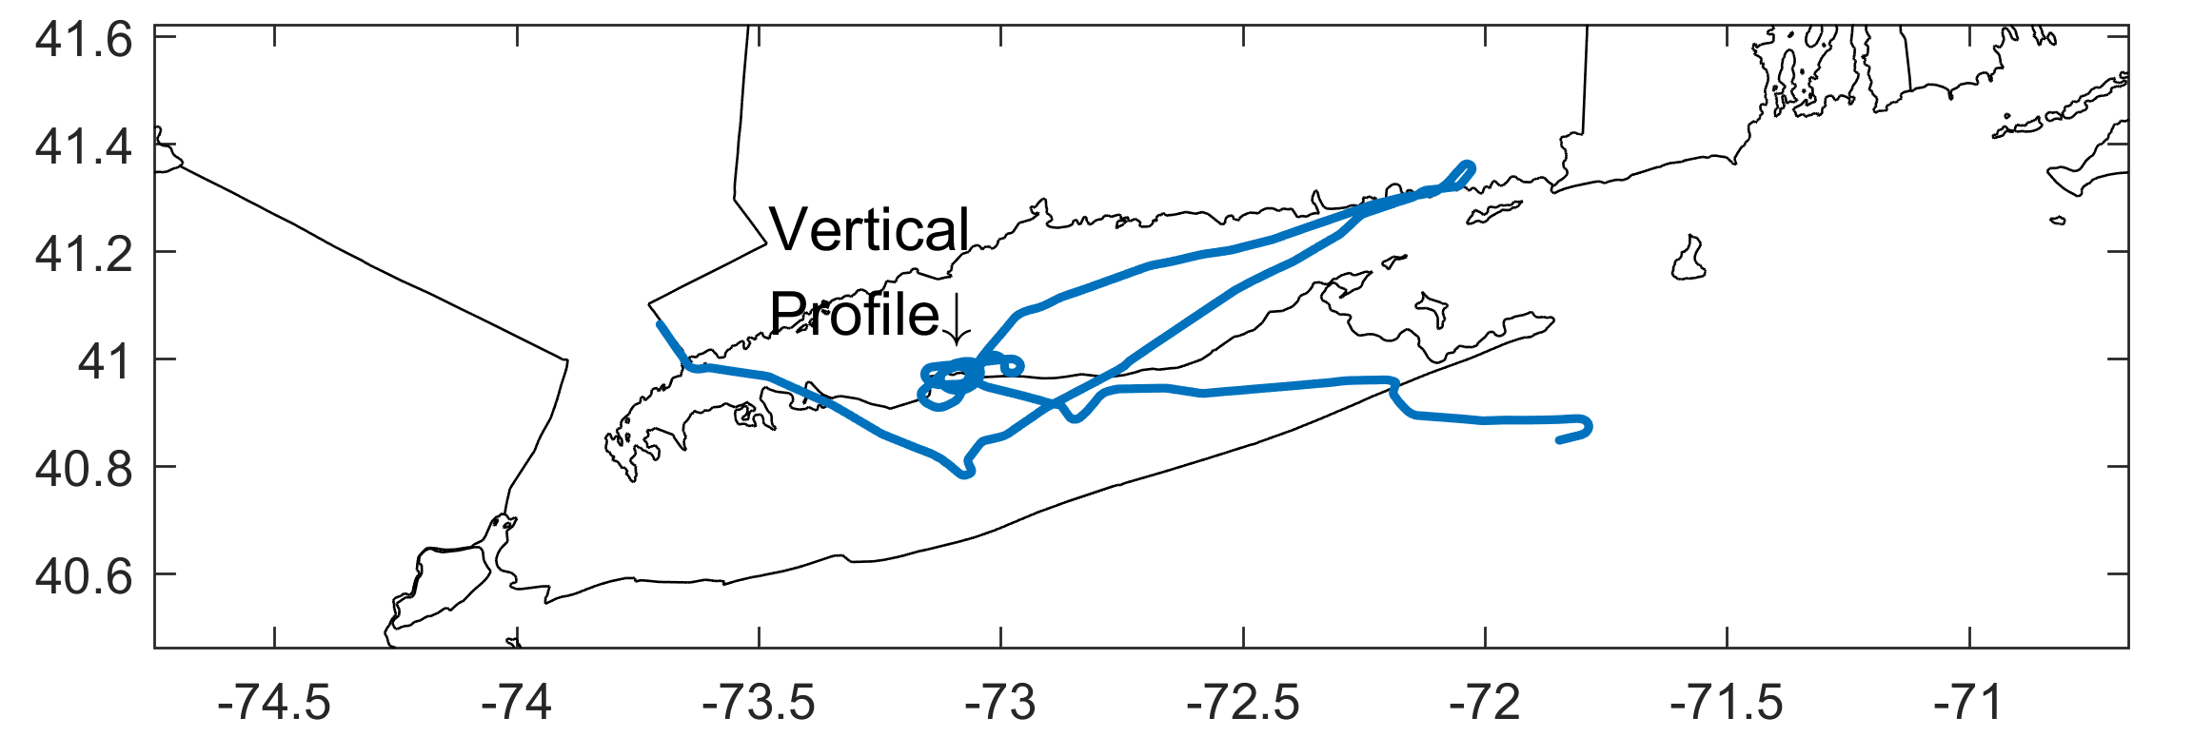
On a hot day, formaldehyde concentrations are large nearly everywhere
Westport CT coastal monitor HCHO Time Series
5.5 ppb
UMD/GSFC Formaldehyde, 2-4:30 PM, 16 August 2018
Afternoon formaldehyde is between 5 ppb and 7 ppb nearly everywhere in the afternoon boundary layer on 8/16. The same is true on 8/15 (not shown in flight data)
EPA data: Andrew Whitehill
UMD/GSFC data: NESCAUM; R. Dickerson, X. Ren, T. Hanisco, J. St. Clair, G. Wolfe

Slide 24
Key Monitoring Need: Formaldehyde provides information on VOC and OH
In a full CTM, the mid-day boundary layer concentration (or column) of formaldehyde can be approximated by two parameters: OH production and reactivity-weighted total VOC concentration
Valin et al., 2016.

