Slide 1

Traffic-Related PM_{2.5} and NO₂ Health Risk Assessment in the United States
A Fine-Scale Hybrid Modeling Approach
Alejandro Valencia^{1,} Marc Serre^{1,} Dongmei Yang ^{2,} Sarav Arunachalam ^{1,2}
¹University of North Carolina at Chapel Hill – Environmental Sciences and Engineering Dept.
²University of North Carolina at Chapel Hill – Institute for the Environment – Center for Environmental Modeling and Policy Development
Notes:
Date and Where

Slide 2
Background
TRAP concentrations are highest near roads and dramatically decrease to background levels within 150m from roads. ¹
In United States, around 19% of the population resides in the vicinity of a heavily trafficked road. ²
Traffic related air pollutants (TRAPs) have been associated with a range of adverse health effects.
¹ Barzyk et al., 2009; Hagler et al., 2009
² Rowangould, 2013
Notes:
California, up to 40% of the population live close to TRAPs

Slide 3
Previous
Traffic Related PM_{2.5} Premature Mortality Studies
36% ﻿of U.S. premature mortality is associated to traffic related PM_{2.5} ¹
U.S. traffic related PM_{2.5} causes between 29,000 and 53,000 premature deaths per year²
  Top largest contributor to premature mortality
¹ Lelieveld et al., 2015
² Caiazzo et al., 2013; Fann et al., 2013
Notes:
Impact of on-road PM_{2.5}:
Coarse resolution CTMs were used in these study. And this is a problem beacuse

Slide 4
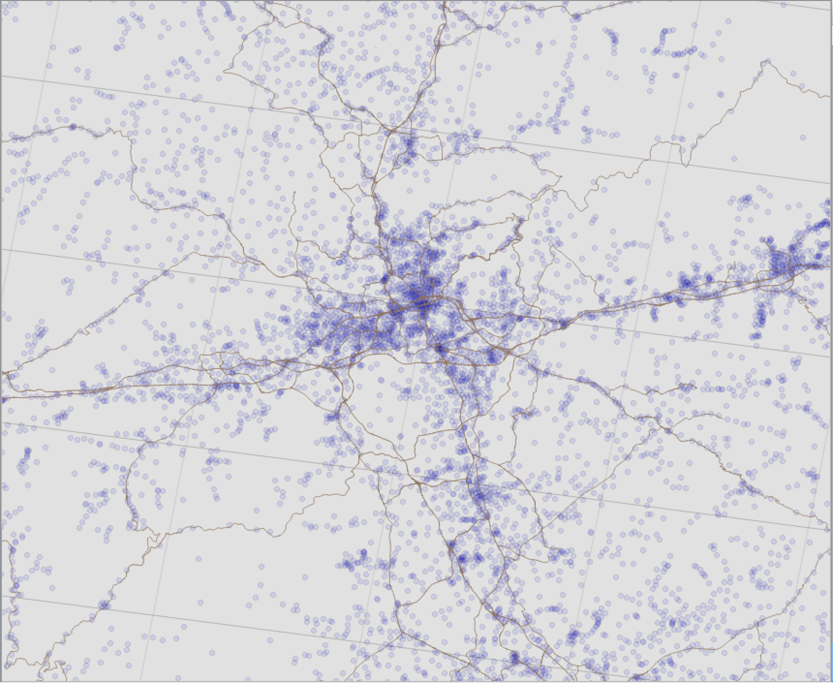
Motivation
Chemical transport models (CTMs) lack the spatial gradients necessary to assess the relationship between TRAP population exposure and health.
Land use regression (LUR) models ignore chemical/transport processes that can better quantify road source contributions.
A hybrid modeling approach in Central North Carolina estimated 24% more on-road PM_{2.5}-related premature mortality than only a CTM.¹
12km
¹ Chang et al., 2017
Notes:
Census block is the smallest geographic unit in the US

Slide 5
Objectives
Estimate mortality due to traffic-related emissions at fine scales in the U.S.
  Use dispersion modeling to estimate primary PM_{2.5} at Census-block scales
  Combine CMAQ at 12 x 12-km resolution to estimate both secondary PM_{2.5} and background sources
  Apply Bayesian Maximum Entropy (BME) Methods to correct model bias
Compare with prior studies that used only coarse resolution grid-based modeling

Slide 6
Study design flowchart
CMAQ
Concentrations at 12km Grid Resolution
Hybrid
Concentrations at Census Block
Resolution
Health Impact Function (HIF)
Grid-Based Mortality
Census Block-Based Mortality
HIF

Slide 7

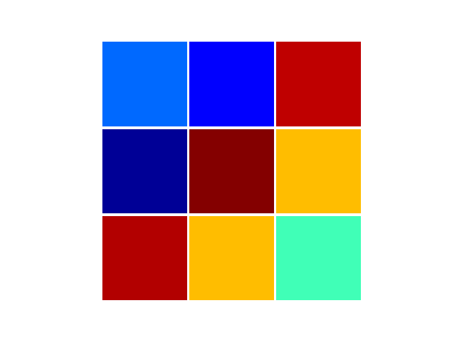


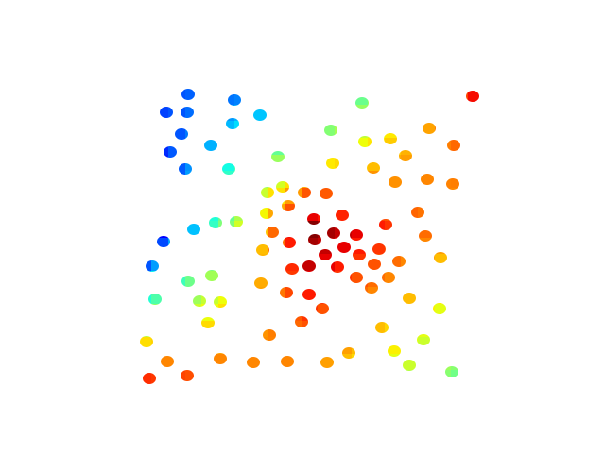
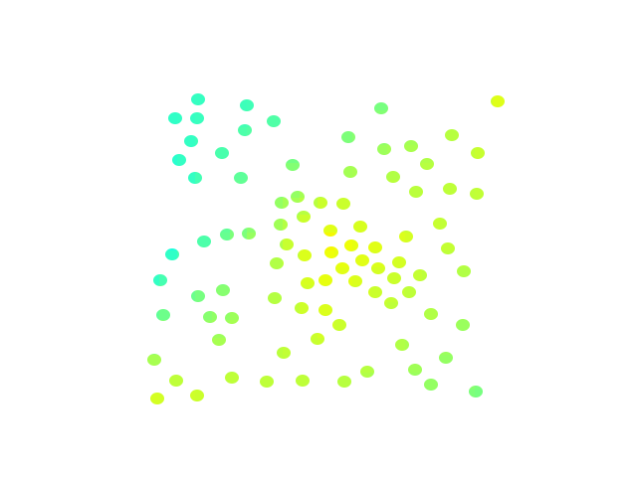
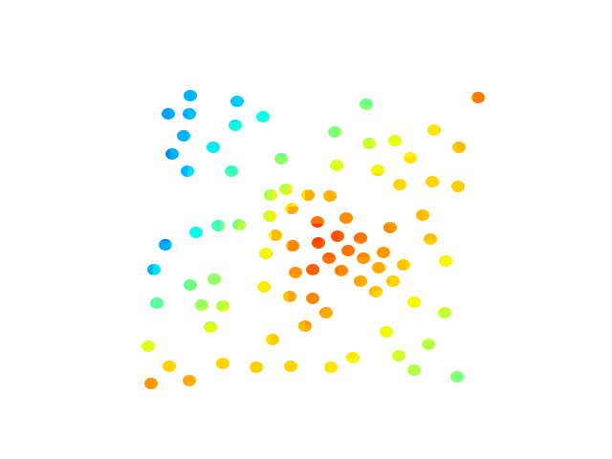

CMAQ-RLINE
Hybrid
RLINE
Major Roads
CMAQ
All Emissions
CMAQ without
Major Roads
RLINE
Major Roads
Average
-
=
Removes the need to run multiple CTMs to obtain background emissions
Includes chemistry formation or loss from local sources that CTMs cannot simulate if emissions were zeroed out
=
RLINE
Major Roads
+
CMAQ-RLINE Hybrid
Interpolated
CMAQ w/o Major Roads
Concentration
Low
High
Notes:
Explain RLINE and CMAQ
Different from Chang because it requires only one CMAQ run
Used by Lefebvre, 2011 Scheffe, 2016 and Bates, 2018

Slide 8


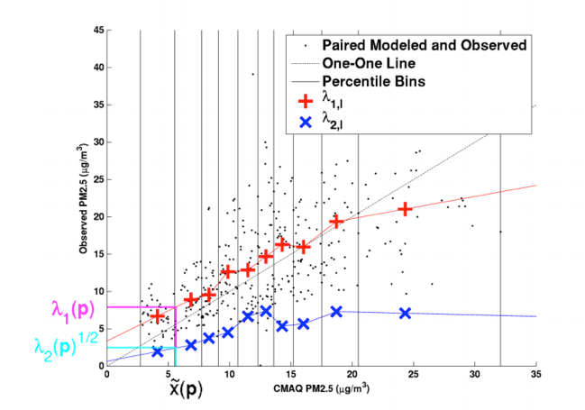

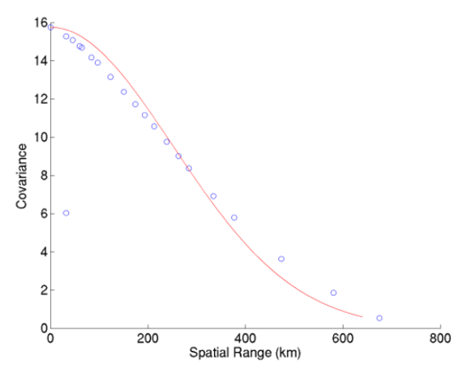

Bayesian Maximum Entropy (BME) Biased Corrected Hybrid
Run Hybrid at AQS measurement locations
Constant Air quality Model Performance (CAMP)
  Performs a model performance analysis that accounts for the non-linearity and non-homoscedastic behavior of model performance with respect to the modeled value 𝑥̃_{𝑘}.
  Models the mean 𝜆₁ (𝑥̃_{𝑘}; 𝒟) and variance 𝜆₂ (𝑥̃_{𝑘}; 𝒟) of the observed value $\hat{X}$
$x_{obs} =z_{obs}−{go}_{(obs)}$
    where $go=CAMP corrected hybrid model$
BME kriging → ${\hat{x}}_{k}^{BME}$
  Covariance model: C_{x}(𝑟,𝜏) for PM_{2.5} across the US
$z_{k}$= ${\hat{x}}_{k}^{BME}+go_{(k)}$
Reyes et al., 2017
Notes:
### Work in progress
Different from Chang
The experimental covariance and covariance models for the posterior mean estimates for kriging
The CAMP method does not investigate how λ₁ (x˜_{k}; 𝒟) and λ₂ (x˜_{k}; 𝒟) change across the domain 𝒟.
Plot (j) shows the RAMP analysis of an arbitrary CMAQ grid location on 07/01/2001 for daily PM2.5. The black dots are all the paired modeled and observed daily PM2.5 concentrations within a space/time region ℛ(𝒑) consisting of the 3 closest stations to the CMAQ grid location of interest within 180 days of 07/01/2001, with modeled data on the independent axis and observed data on the dependent axis. The vertical black lines identify the 10 bins used to stratify all the paired data in which each bin contains one decile of all the paired points. The dotted black line is the one-to-one line between the modeled and observed data. The red + marker in each bin denotes 𝜆1,𝑙(𝑥̃𝑙 , ℛ(𝒑)), the average of paired observed values within the 𝑙-th decile bin. The blue x marker in each bin denotes the square root of 𝜆2,𝑙(𝑥̃𝑙 ; ℛ(𝒑)), the standard deviation of paired observed values within that bin. As shown in the figure, the + and x markers are linearly interpolated to obtain the 𝜆1(𝒑) and √𝜆2(𝒑) values, respectively, corresponding to the CMAQ modeled data 𝑥̃(𝒑) within ℛ(𝒑).

Slide 9
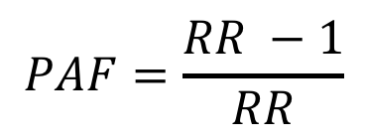


Health Impact Function (HIF)
Relative Risk (RR)
Integrated exposure-response (IER)¹
Population Attributable Factor (PAF)
Mortality (Mort)
Chronic obstructive pulmonary disease (COPD), Lung Cancer (LC), Stroke, Ischemic heart disease (IHD)
𝛾₀: baseline mortality rate
pop: population
$$RR_{IER}=1+α \left\{1−exp\left[−γ{\left(C−C_{0}\right)}^{δ}\right]\right\}$$
C: annual average ambient PM_{2.5}
C₀: PM_{2.5} threshold concentration (below which no additional risk is assumed)
$$PAF=\frac{RR −1}{RR}$$
$$ΔMort= γ_{0}∙PAF∙{pop}_{i}$$
¹Burnett et al., 2014
Notes:
Alpha gamma delta
extensively used by recent studies, Liu et al. (2017), Silva et al. (2016a, b), Wang et al. (2017), and the World Health Organization (2016), Zhang et al. (2018).
The baseline mortalities for IHD, COPD, stroke, and lung cancer were collected from the CDC-WONDER database, where county-level age-stratified baseline mortality for 2016 is available.⁽³⁾

Slide 10
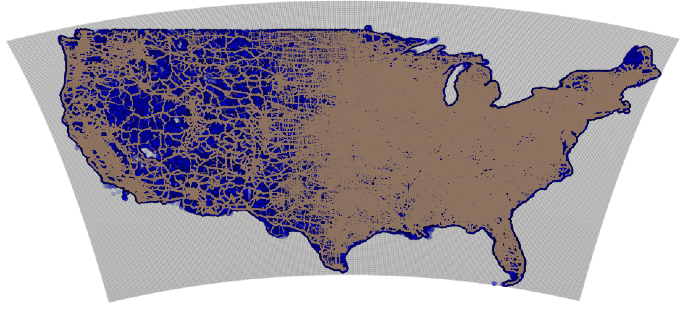
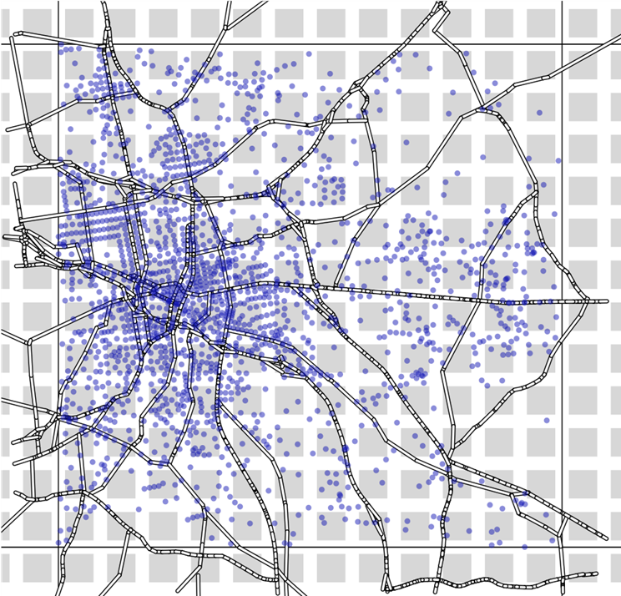
Modeling Domain
Study period: 2016
Each hybrid run is divided into
  CMAQ run
    12x12km CMAQ grid
  RLINE run
    Major road segments with emission
    Census Blocks Centroid (CBC) Receptors
    1x1km RLINE Grid of Receptors
    Hourly Met at each CMAQ Grid
Hybrid Stats
  ~55,500 Hybrid calculations
    Only grid cells that contain both major roads and CBC
    ~2 weeks with 800 processors for one pollutant
~7.5 million major road sources
~11 million census blocks
~130,000 CMAQ grid cells
Notes:
Different from Chang not MetARE

Slide 11
Inputs
CMAQv5.2.1
Meteorology
2016 MCIPv4.3 (Meteorology-Chemistry Interface Processor) from WRF﻿v3.8
Emissions
2016v7.2 (beta) Platform
Chemical Mechanism
CB6R3_AE6_AQ
RLINEv1.2
Meteorology
2016 ﻿Mesoscale Model Interface Program (MMIF) extracted from ﻿WRFv3.8 grid cells
Emissions
2016v7.2 (beta) Platform
Emission Factors, Fleet mix, and Temporal allocation
Highway Performance Monitoring System (HPMS) 2016
Census Blocks Centroid Locations
Annual Average Daily Traffic (AADT )
Health Impact Function (HIF)
2016 County-based Baseline Mortality (CDC-WONDER)
For COPD, LC, Stroke, and IHD
Population at Census Blocks
Constant Air quality Model Performance (CAMP) with BME
2016 hourly AQS Observations
Notes:
Using Meteorology from MMIF at each grid cell.
Weather Research and Forecasting Model (WRF). continental U.S. at a 12km resolution with 35 vertical layers.
Census Block Population needs to be projected to 2016

Slide 12
Annual PM_{2.5} Results - Durham, NC
CMAQ
CMAQ
Interpolated
Hybrid
Allocated CMAQ gridded concentrations to each Census Block Centroid (~1900)
Used bilinear interpolation to allocate each Census Block Centroid
Hybrid estimates peaks that are ignored in CMAQ

Slide 13
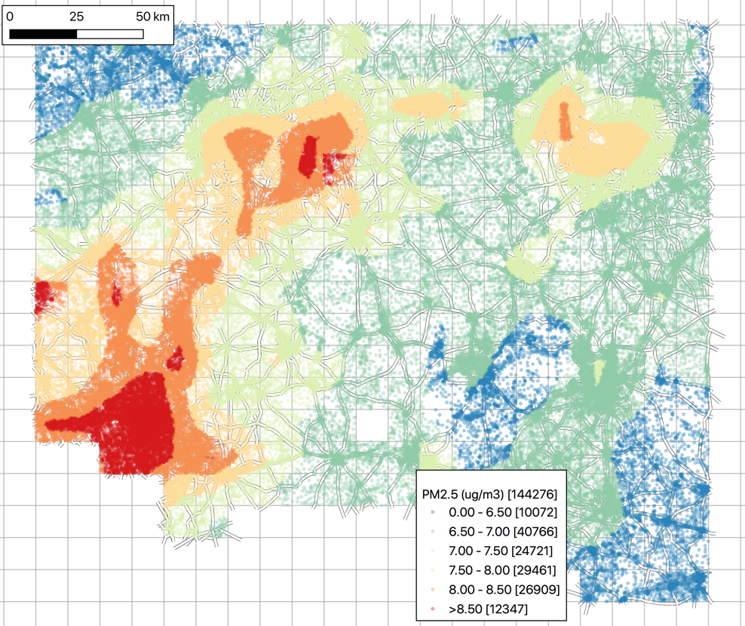
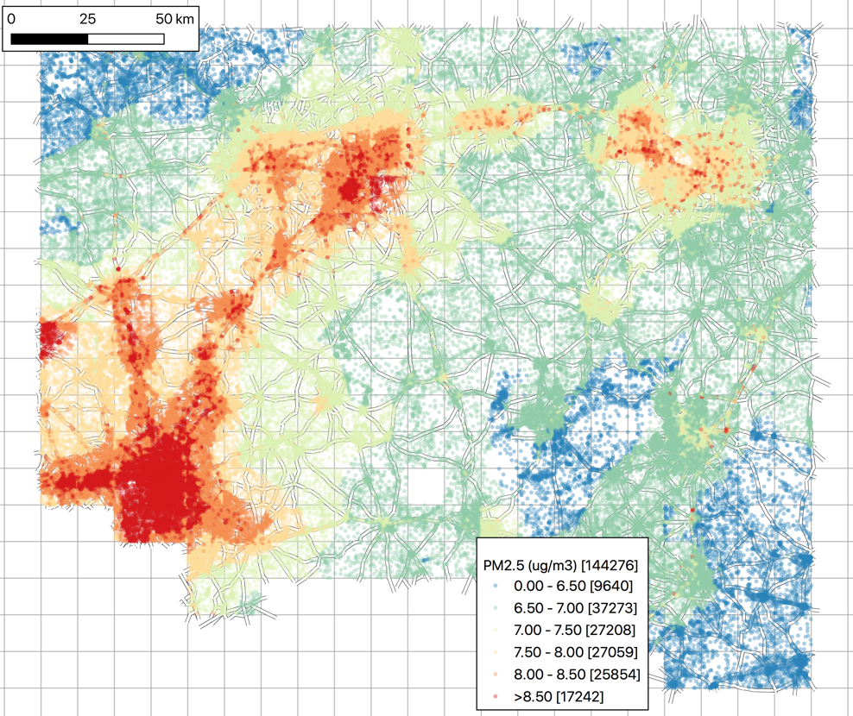
Annual PM_{2.5} Results - Central North Carolina
CMAQ
Interpolated
Hybrid
~150,000 census blocks centroids in 320 grid cells
Hybrid shows better distribution of high and low concentrations

Slide 14
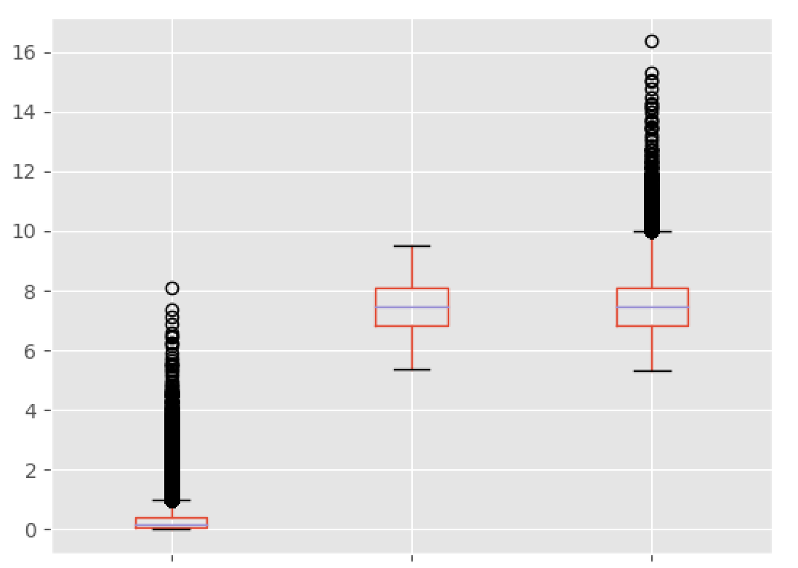
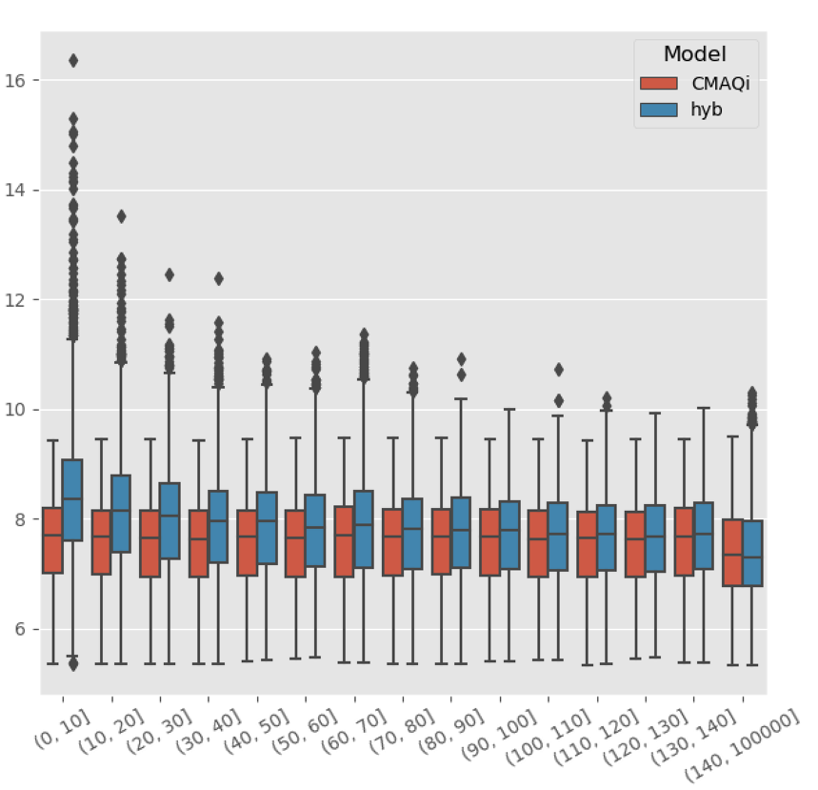
Annual PM_{2.5} Results - Central North Carolina
■ CMAQ Interpolated
■ Hybrid
PM_{2.5} (μg/m³)
PM_{2.5} (μg/m³)
RLINE CMAQ Hybrid
Interpolated
Distance From Road (m)
RLINE adds concentration spikes to Hybrid with marginal changes to the CMAQ distribution
Hybrid shows a marked decrease as CBCs are farther away from road

Slide 15

Discussion
Successfully implemented the Hybrid approach
Hybrid improves on our previous approach
  Requires only 1 CMAQ run
  Includes secondary from local sources by not using a zero out run
  Uses actual hourly meteorology
Hybrid model captures PM_{2.5} fine resolution spatial gradient

Slide 16

Future Work
Expand analysis nationwide
Apply bias adjustment to CMAQ and RLINE before hybrid
Calculate mortality
Evaluate against other exposure-response functions
Compare mortality against CMAQ using Berrocal et al. downscaler
Add NO₂ Analysis

Slide 17
Acknowledgment
UNC
  Calvin Arter
  Brian Naess
  Catherine Seppanen
Sonoma Technology
  Shih Ying Chang (Changsy)
U.S. EPA
  Allison Eyth
  Chris Misenis
  James Thurman
  David Heist
  Vlad Isakov
  Michael Breen
This work was supported by the National Center for Advancing Translational Sciences, National Institutes of Health [grant number OT3TR002020].
The U.S. EPA, through its Office of Research and Development, also partially funded and collaborated in the research described here under Contract EP-W-16-014 to the University of North Carolina at Chapel Hill.

Slide 18
References
Barzyk TM, George BJ, Vette AF, Williams RW, Croghan CW, Stevens CD. 2009. Development of a distance-to-roadway proximity metric to compare near-road pollutant levels to a central site monitor. Atmos Environ 43:787–797; doi:10.1016/j.atmosenv.2008.11.002.
Berrocal, V.J., Gelfand, A.E. and Holland, D.M., 2012. Space‐time data fusion under error in computer model output: an application to modeling air quality. Biometrics, 68(3), pp.837-848
Burnett RT, Pope CA, Ezzati M, Olives C, Lim SS, Mehta S et al. An integrated risk function for estimating the global burden of disease attributable to ambient fine particulate matter exposure. Environ Health Perspect 2014; 122: 397–403.
Caiazzo, F., Ashok, A., Waitz, I.A., Yim, S.H.L., Barrett, S.R.H., 2013. Air pollution and early deaths in the United States. Part I: Quantifying the impact of major sectors in 2005. Atmos. Environ. 79, 198–208. doi:10.1016/j.atmosenv.2013.05.081
Chang SY, Vizuete W, Serre M, Vennam LP, Omary M, Isakov V, et al. 2017. Finely Resolved On-Road PM2.5and Estimated Premature Mortality in Central North Carolina. Risk Anal 37:2420–2434; doi:10.1111/risa.12775.
Fann, N., Lamson, A.D., Anenberg, S.C., Wesson, K., Risley, D., Hubbell, B.J., 2012. Estimating the national public health burden associated with exposure to ambient PM2.5 and ozone. Risk Anal. 32, 81–95. doi:10.1111/j.1539-6924.2011.01630.x
Hagler GSW, Baldauf RW, Thoma ED, Long TR, Snow RF, Kinsey JS, et al. 2009. Ultrafine particles near a major roadway in Raleigh, North Carolina: Downwind attenuation and correlation with traffic-related pollutants. Atmos Environ 43:1229–1234; doi:10.1016/j.atmosenv.2008.11.024.
Lefebvre W, Vercauteren J, Schrooten L, Janssen S, Degraeuwe B, Maenhaut W, et al. 2011. Validation of the MIMOSA-AURORA-IFDM model chain for policy support: Modeling concentrations of elemental carbon in Flanders. Atmos Environ 45:6705–6713; doi:10.1016/j.atmosenv.2011.08.033.
Lelieveld J, Evans JS, Fnais M, Giannadaki D, Pozzer A. 2015. The contribution of outdoor air pollution sources to premature mortality on a global scale. Nature 525:367–371; doi:10.1038/nature15371.
Reyes, J. M., Xu, Y., Vizuete, W., & Serre, M. L. (2017). Regionalized PM2.5 Community Multiscale Air Quality model performance evaluation across a continuous spatiotemporal domain. Atmospheric environment (Oxford, England : 1994), 148, 258–265. doi:10.1016/j.atmosenv.2016.10.048
Rowangould, G.M., 2013. A census of the US near-roadway population: Public health and environmental justice considerations. Transp. Res. Part D Transp. Environ. 25, 59–67. doi:10.1016/j.trd.2013.08.003

Slide 19

Extra Slides

Slide 20
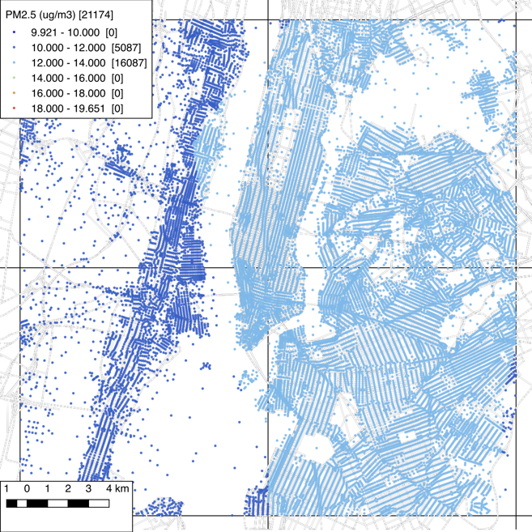
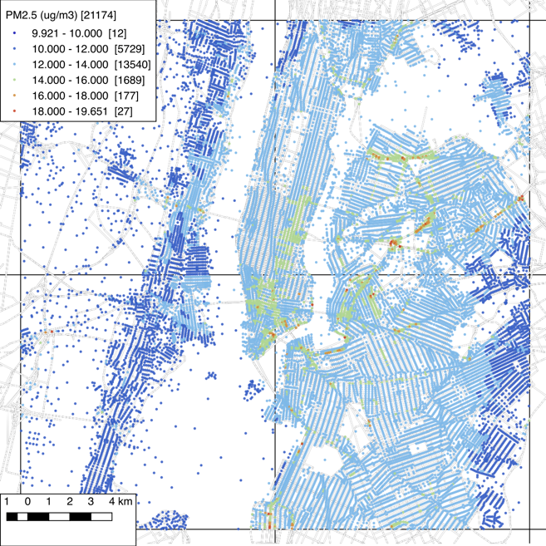
Annual PM_{2.5} Results - New York City
CMAQ
Interpolated
Hybrid
20,000 census block centroids in 4 CMAQ grid cells
Hybrid shows better distribution of high and low concentrations
Notes:
Change to CNC

Slide 21
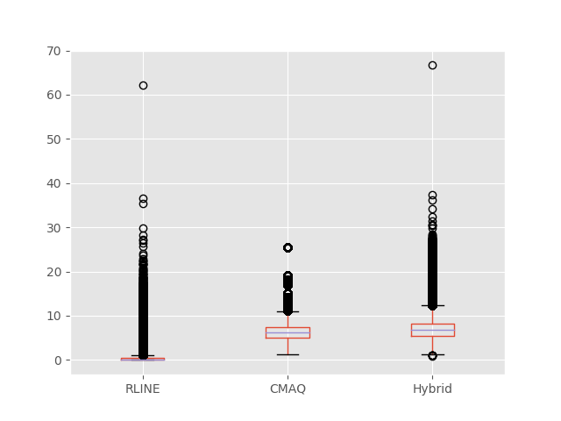
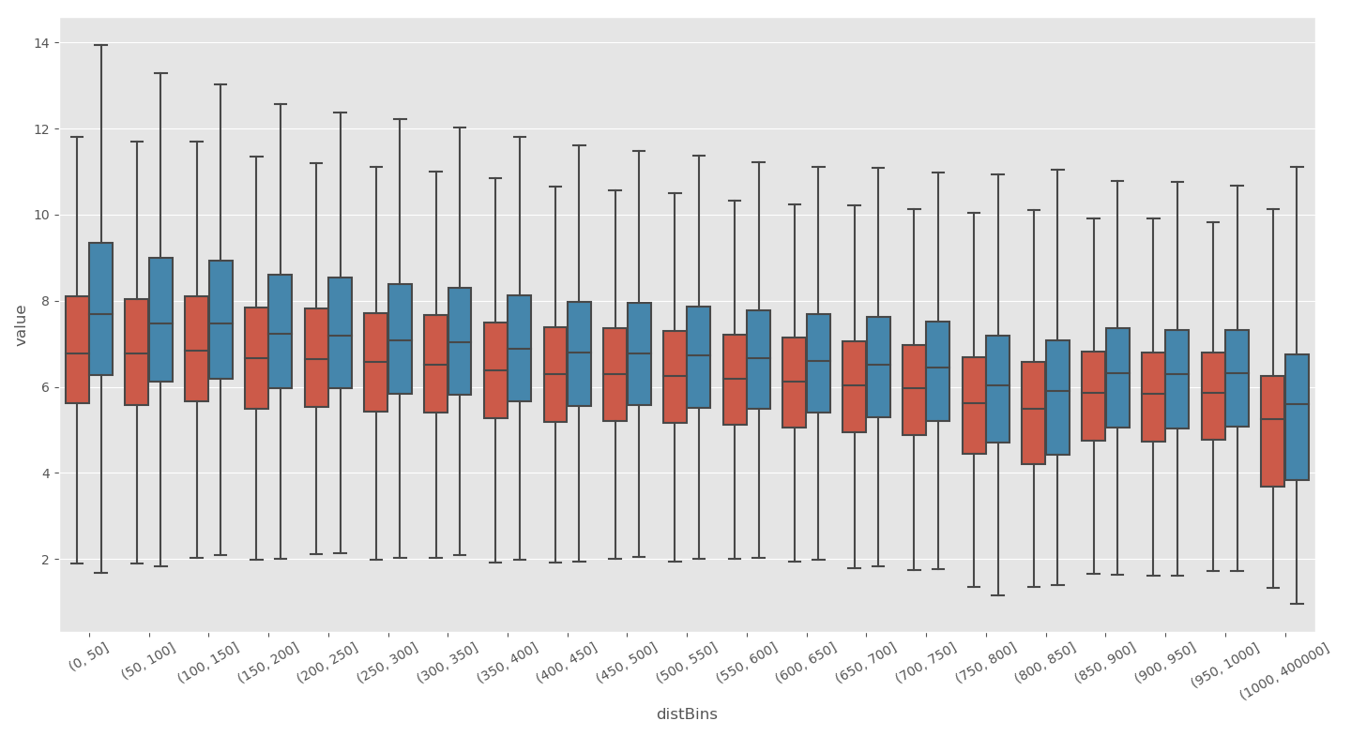
Annual National PM_{2.5} Results
Hybrid shows a marked decrease as CBCs are farther away from road
■ CMAQ Interpolated
■ Hybrid
PM_{2.5} (μg/m³)
PM_{2.5} (μg/m³)
RLINE CMAQ Hybrid
Interpolated
RLINE adds concentration spikes to Hybrid with marginal changes to the CMAQ distribution
Distance From Road (m)

