Slide 1

An efficient way in quantifying the nonlinear response of air pollution to emission changes using the indicator-based response surface model
Jia Xing¹, Shuxiao Wang¹, James T. Kelly², Carey Jang², Yun Zhu³, Dian Ding¹, Zhaoxin Dong¹, Song Liu¹, Jiming Hao¹
¹ School of Environment, Tsinghua University, Beijing, China
² Office of Air Quality Planning & Standards, US EPA, RTP, NC, USA
³ South China University of Technology, Guangzhou, China
2019 CMAS annual meeting, Oct 21st, Chapel Hill, NC
Notes:
1
两控区
2019/10/13
大气处
1

Slide 2



IAMs need fast prediction of air quality response to pollution
Challenge of Air Pollution Control
An integrated assessment model system (ABaCAS)
Complex emissions of sectors
SMAT
RSM
ABaCAS
CoST
BenMAP
Complex atmospheric processes
Notes:
Integrated Assessment Modeling 综合评估建模

Slide 3
RSM: real-time estimate of air quality responses
Response Surface Model (RSM)
——a meta-model built upon multi-“Brute Force” model simulations, to explore the response relationship between emission changes and air quality responses
Ambient Concentration
Sensitivity (e.g., DDM)
“real atmosphere”
RSM
Source Apportionment (e.g., ISAM)
0
1
Emission ratio
base
Notes:
decoupled direct methods 直接差分法
源分配 Integrated Source Apportionment Method 集成源分配方法

Slide 4
Overview of the RSM evolution
Air pollution
Air pollution
Air pollution
pollution 1
pollution 1
pollution 2
pollution 2
Chemistry
Transport
Indirect
A pathway to reduce the number of cases required in RSM
Full range responses to multiregional sources
Multiple pollutant responses to multiregional sources with well-solved indirect effects
A series polynomial functions to explicitly represent the nonlinear response
Specific scenarios
Full range responses
Emission C
Emission C
POA
Emission
Emission
NO_{x}
NH₃
Emission B
Emission B
SO₂
VOC
Emission A
Emission A
CTM
RSM
ERSMv1.0
ERSMv2.0
pf-RSM
Xing et al., ACP, 2011
Zhao et al., GMD, 2015
Xing et al., ES&T, 2017
Xing et al., ACP, 2018
Wang et al., ES&T, 2011
Zhao et al., ACP, 2017
Notes:
ERSM extended response surface modeling
Modeling studies with chemistry–transport models (CTMs) have been conducted to investigate the responses of O3 and PM2:5 to emission perturbation through sensitivity analyses, such as decoupled direct methods (DDMs) and high-order DDMs (Hakami et al., 2003; Cohan et al., 2005), and source apportionment technology such as ozone source apportionment technology (Dunker et al., 2002), particulate matter source apportioning technology (Wagstrom et al., 2008) and the integrated source apportionment method (Kwok et al., 2013, 2015).

Slide 5
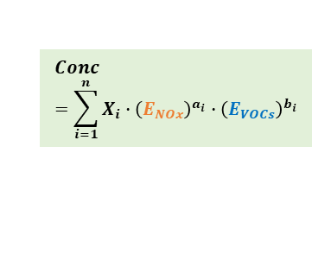
Design of RSM with polynomial functions (pf-RSM)
Original training samples
Ozone response
the prior knowledge was characterized as a series polynomial functions
Fewer samples->high efficiency (60% reduction in the sample number)
Easier investigation on the nonlinearity (e.g., peak value, derivative)
Regression-based
RSM (Traditional)
regression
VOC
VOC
NO_{x}
NO_{x}
Fewer samples
Prior knowledge
fitting
Fitting-based RSM
(pf-RSM)
VOC
$$Conc=\sum_{i=1}^{n}{X_{i}∙{\left(E_{NOx}\right)}^{a_{i}}∙{\left(E_{VOCs}\right)}^{b_{i}}}$$
VOC
NO_{x}
NO_{x}
(Xing J. et al. ACP, 2018)

Slide 6
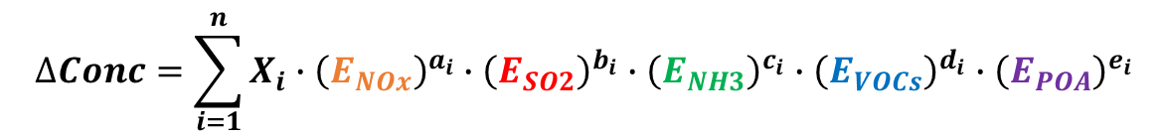
Design of RSM with polynomial functions
$$∆Conc=\sum_{i=1}^{n}{X_{i}∙{\left(E_{NOx}\right)}^{a_{i}}∙{\left(E_{SO2}\right)}^{b_{i}}∙{\left(E_{NH3}\right)}^{c_{i}}∙{\left(E_{VOCs}\right)}^{d_{i}}∙{\left(E_{POA}\right)}^{e_{i}}}$$
15 coefficients of polynomial terms can be derived from 20~40 samples
O₃
PM_{2.5}
1st
1st
2nd
1st
POA
3rd
1st
VOC
NO_{x}
1st
2nd
4th
SO₂
NH₃
2nd
3rd
5th
3rd
Linear behavior for SO₂ and POA
High order for NOx and VOC

Slide 7
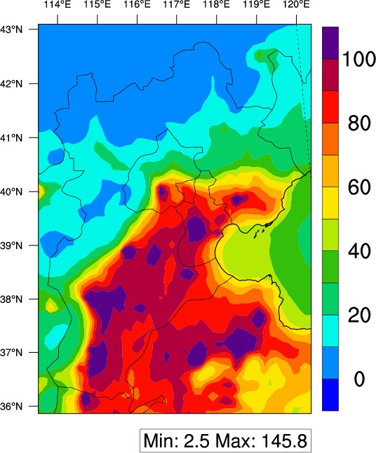
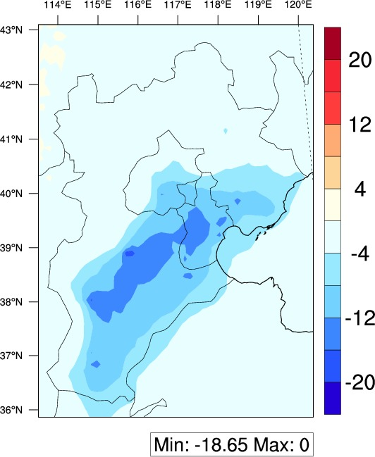
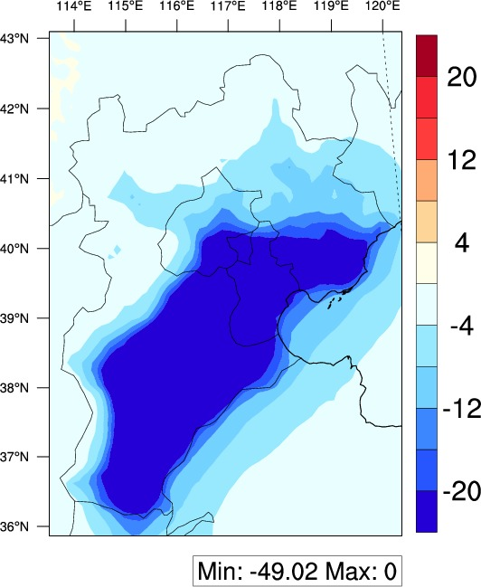


Validation of pf-RSM prediction
Baseline
ΔCase1 (moderate control)
ΔCase2 (strict control)
PM_{2.5} (monthly averages in January 2014, unit: µg m⁻³)
CMAQ
pf-RSM
E_{NOx}, E_{SO2}, E_{NH3}, E_{VOCs} and E_{POA}
case1 : -49%, -45%, -20%, -64%, -20%
case2 : -76%, -79%, -81%, -83%, -73%

Slide 8
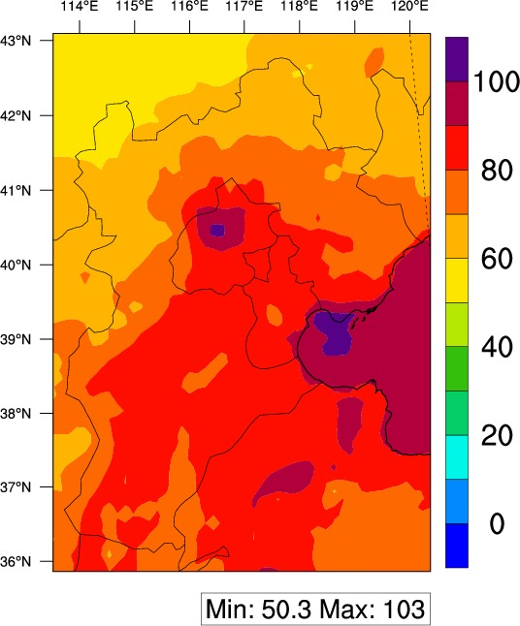
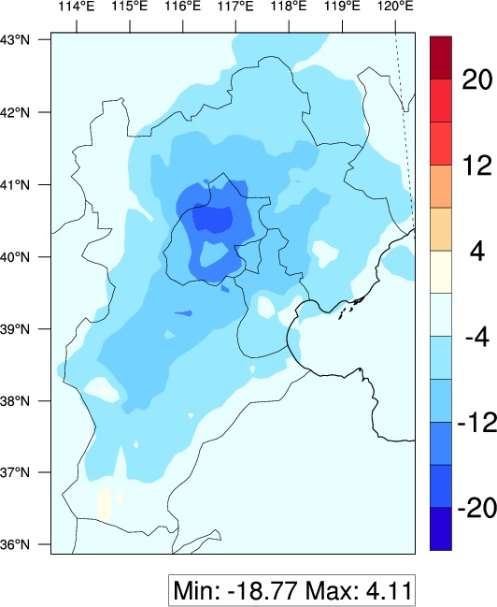
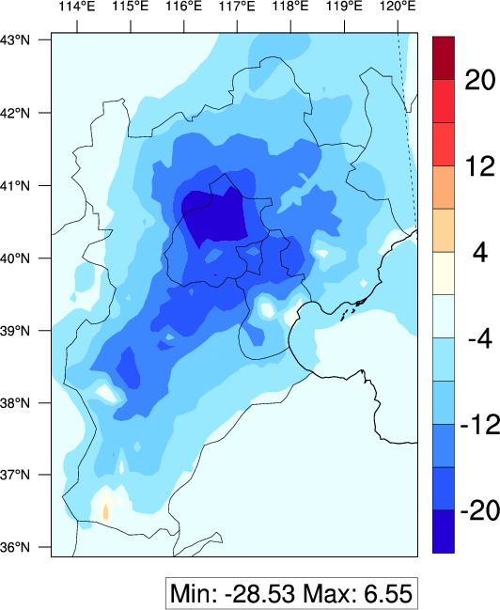

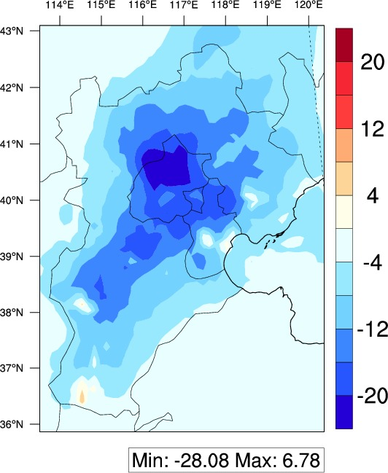
Validation of pf-RSM prediction
Baseline
ΔCase1 (moderate control)
ΔCase2 (strict control)
O₃ (monthly averages of daily 1-hour maxima in July 2014, unit: ppb)
CMAQ
pf-RSM
E_{NOx}, E_{SO2}, E_{NH3}, E_{VOCs} and E_{POA}
case1 : -49%, -45%, -20%, -64%, -20%
case2 : -76%, -79%, -81%, -83%, -73%

Slide 9



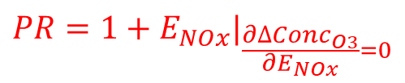
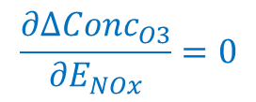
Definition of Peak Ratio (PR)
2-D isopleths of O₃ sensitivity to NO_{x} and VOC emission changes
$$\frac{∂∆{Conc}_{O3}}{∂E_{NOx}}=0$$
1.2
1.0
0.8
0.6
0.4
0.2
0.0
PR <1: VOC-limited PR>1: NO_{x}-limited
NOx-limited
95.00
90.00
85.00
80.00
75.00
70.00
65.00
60.00
55.00
$${1+E}_{VOC}$$
VOC-limited
PR can be directly calculated from the polynomial function
0.0 0.2 0.4 0.6 0.8 1.0 1.2
$$PR={1+E}_{NOx}|_{\frac{∂∆{Conc}_{O3}}{∂E_{NOx}}=0}$$
$${1+E}_{NOx}$$

Slide 10
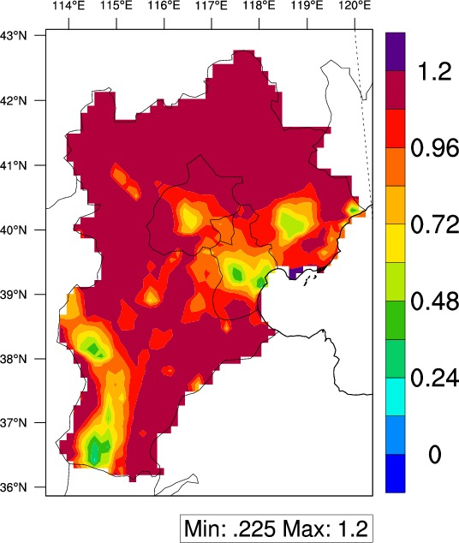
Peak Ratio (PR) in the Beijing-Tianjin-Hebei region
PR map
2014/7
 | Jan | Jul
Beijing | 0.11 | 0.76
Tianjin | 0.1 | 0.45
HebeiN | 0.19 | >1.2
HebeiE | 0.15 | 0.74
HebeiS | 0.13 | 0.59
Smaller PRs (0.4–0.8) were evident in urban areas where NO_{x} emissions are saturated, resulting in a strong VOC-limited condition

Slide 11



Definition of suggested VOC/NOx ratio
2-D isopleths of O₃ sensitivity to NO_{x} and VOC emission changes
1.2
1.0
0.8
0.6
0.4
0.2
0.0
$$VNr={E_{VOC}}/{E_{NOx}}$$
VNr quantifies how much simultaneous control of VOC is required to avoid increasing O₃ from the NO_{x} controls
95.00
90.00
85.00
80.00
75.00
70.00
65.00
60.00
55.00
$${1+E}_{VOC}$$
0.0 0.2 0.4 0.6 0.8 1.0 1.2
$${1+E}_{NOx}$$

Slide 12
Suggested VOC/NOx ratio to avoid increasing O3
PR map
2014/7
 | Jan | Jul
Beijing | 3.8 | 0.6
Tianjin | 3.5 | 1.2
HebeiN | 2.5 | -
HebeiE | 2.8 | 0.5
HebeiS | 3 | 1.1
To avoid increasing O₃ during the transition from VOC-limited to NOx-limited condition, a simultaneous VOC reduction by 0.5-1.2 times as the rate of NO_{x} reduction is recommended

Slide 13
observable response indicator
Traditional indicator can provide a quick estimate of chemical regime, but has limited policy implication
H₂O₂/HNO₃
O₃/NO_{x}
HCHO/NO_{y}
Baseline case
Observable indicators
New indicator
RSM
Comparison
Observable Response
O₃-Peak Ratio(PR):
the NO_{x} emissions that produce maximum O₃ concentrations under baseline VOC emissions
linkage
PR<1
PR>1
Controlled cases
Response indicators
PR
Response indicator can provide a quantitate estimate of chemical regime, but requires multiple simulations
Xing et al., ACP Discussion, 2019
Notes:
With the RSM development, we also designed the observable response indicators. The idea of indicator analysis has been widely used in identifying the O3 and PM chemistry. The traditional indicators, such as the ratio of H2O2 to HNO3 can provide a quick estimate of O3 chemical regime. But it has limited policy implication, since it can only tell us if current situation belongs to VOC- or NOx- limited regime.
In our previous RSM study, we designed the response indicator Peak Ratio to quantify the O3 chemistry. The PR value can not only identify the NOx- or VOC- limited regime, but also imply how much the NOx control is needed to overcome the VOC-limited regime and change to NOx-limited. However, the original response indicator is built based on RSM model, which requires multiple simulations and not as quickly as observable indicator which can be easily calculated from the base case. The observable response indicators is designed to address such issue.

Slide 14
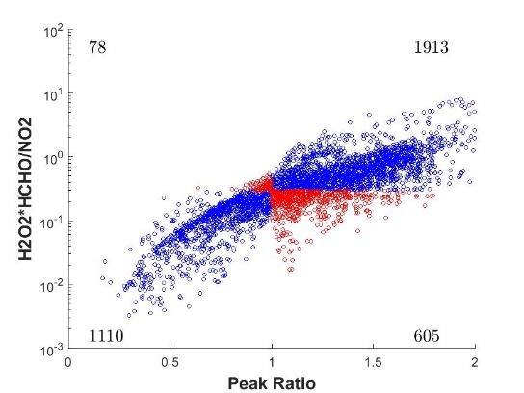
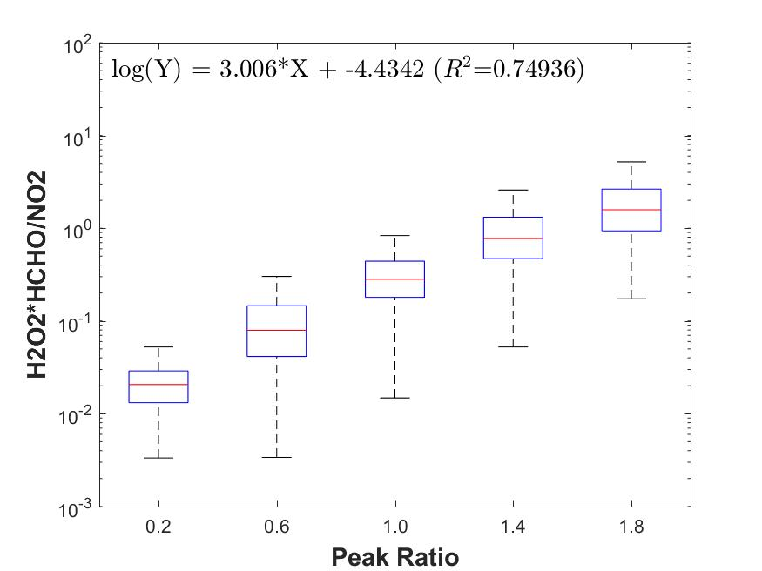
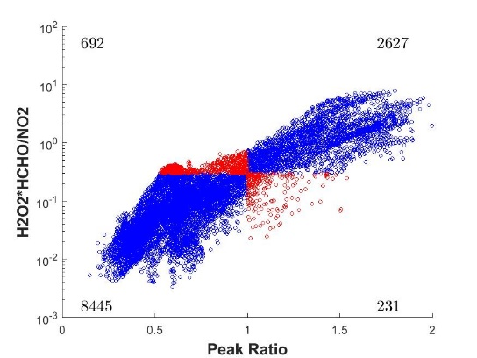
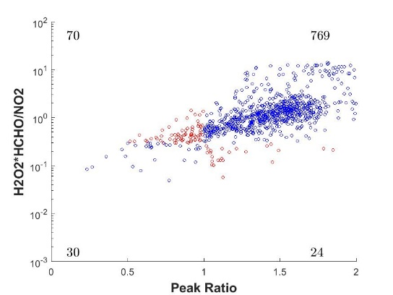
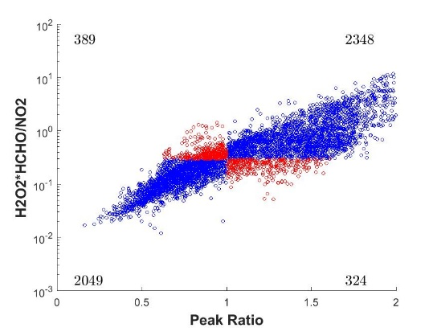
observable response indicators-O₃
Success rate of [H₂O₂]*[HCHO]/[NO₂] in predicting O₃ chemistry
Quantify the relation bewteen [H₂O₂]*[HCHO]/[NO₂] and PR
Jan
92.3%
Apr
81.6%
Jul
Oct
89.5%
86.0%
log-linear combinations of baseline H₂O₂, HCHO, and NO₂ could provide an approximate PR
The blue dots represent the grids where O₃ chemistry is successfully predicted by the observable indicator; the red dots is not
the new O₃-chemistry indicator exhibited high success rates
Notes:
The we compared all the original observable indicator with PR, and we found almost all observable indicator exhibits strong correlations with PR. Particularly for the new O₃-chemistry indicator that we defined, [H2O2]*[HCHO]/[NO2] has the highest success rates in predicting O3 chemistry and also the strongest correlations with PR. Such results suggest that we actually can use log-linear combinations of baseline H₂O₂, HCHO, and NO₂ to estimate PR. Then we don’t need to run multiple CMAQ simulations, just use the baseline concentration to get an approximate PR.

Slide 15
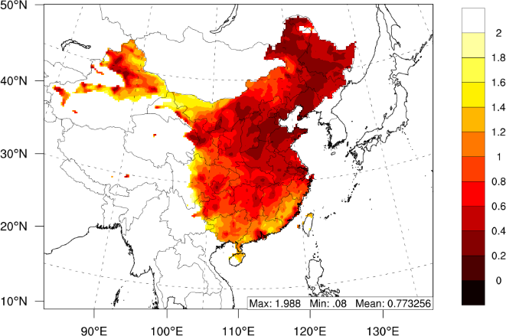
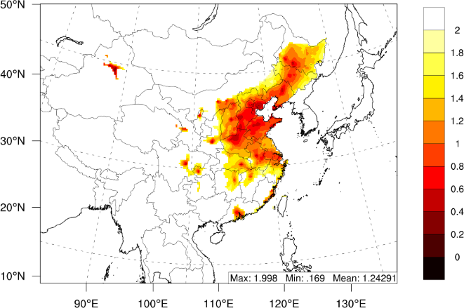
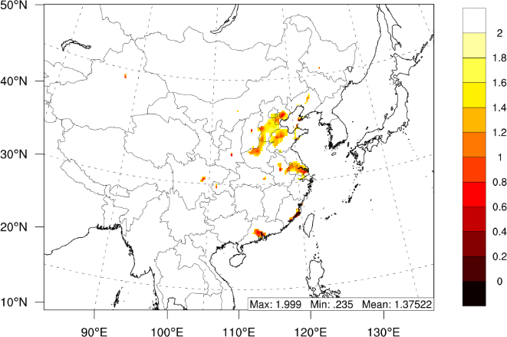
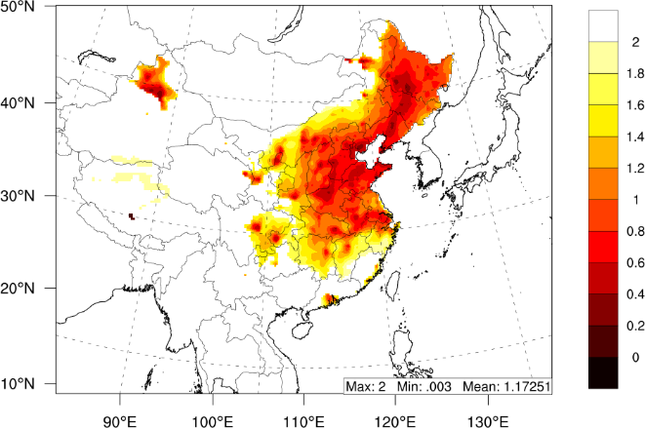
Use PR to identify the O₃ Chemistry in China
Spatial distribution of O₃ Chemistry (Peak Ratio)
Jan
Apr
Jul
Oct
Strong spatial and temporal variation of O₃ chemistry in China
VOC-limited regime is more common (PR < 1) in January, implying the importance of simultaneous VOC control in winter
Most of urban area in east China is located in VOC-limited regime, due to high NOx emission intensity
Notes:
With the response indicator, we studied on the O3 chemistry in China, the Spatial distribution of PR in four different months suggest Strong spatial and temporal variation of O3 chemistry in China. VOC-limited regime is more common (PR < 1) in January, implying the importance of simultaneous VOC control in winter. Most of urban area in east China is located in VOC-limited regime, due to high NOx emission intensity

Slide 16
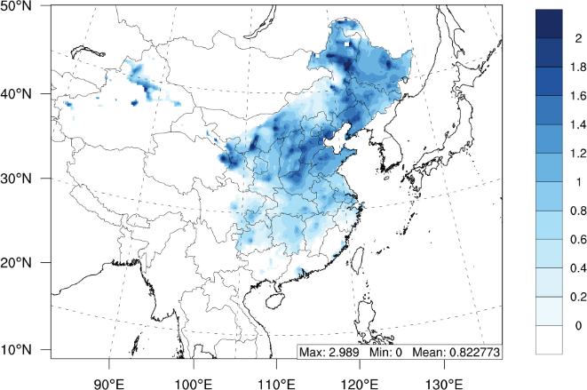
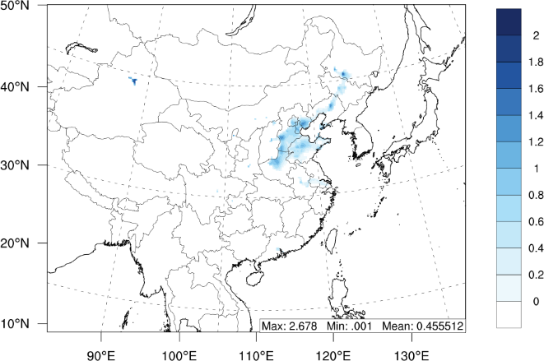
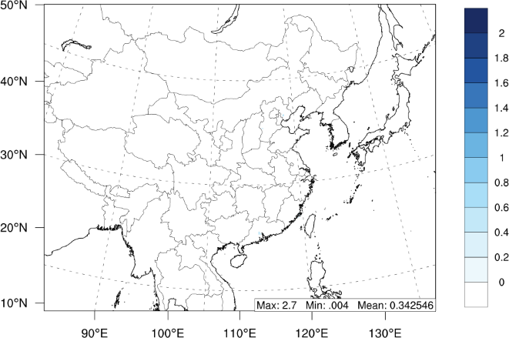
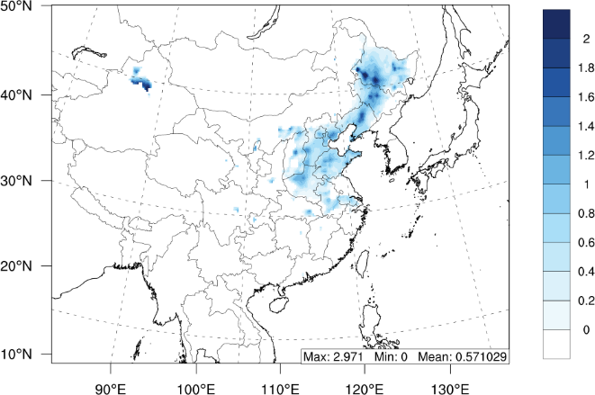
policy implication from indicator: VOC-to-NOx ratio
Spatial distribution of VOC-to-NOx ratio (suggested VOC/NOx to avoid increased O₃)
Comparison of the annual-averaged PR with VOC-to-NOx ratio in each province
Jan
Apr
Jul
Oct
VOC-to-NOx ratio was negatively correlated with the PR
Notes:
If the current O3 chemistry is VOC-limited, there may have potential enhancement of O3 from NOx controls. To avoid such increase O3, simultaneous VOC control is necessary. Here we defined an indicator called VNr (suggested VOC/NOx to avoid increased O3) to provide such information. Clearly, Under stronger VOC-limited regime, the VNr will be larger, due to more VOC control is needed, as shown in the right Figure, VNr was negatively correlated with the PR. In northern China, PR exhibits smallest values, thus the VNr will be largest.

Slide 17
New direction: i-RSM with Machine Learning
Air pollution
Air pollution
Air pollution
pollution 1
pollution 1
How to further reduce the number of cases required in RSM?
pollution 2
pollution 2
Chemistry
Transport
Indirect
Full range responses to multiregional sources
Multiple pollutant responses to multiregional sources with well-solved indirect effects
A series polynomial functions to explicitly represent the nonlinear response
Specific scenarios
Full range responses
Emission C
Emission C
POA
Emission
Emission
NO_{x}
NH₃
Emission B
Emission B
SO₂
VOC
Emission A
Emission A
CTM
RSM
ERSMv1.0
ERSMv2.0
pf-RSM
i-RSM
Xing et al., ACP, 2011
Zhao et al., GMD, 2015
Xing et al., ES&T, 2017
Xing et al., ACP, 2018
Wang et al., ES&T, 2011
Zhao et al., ACP, 2017

Slide 18
Development of indicator-based RSM
Xing et al., in prep

Slide 19
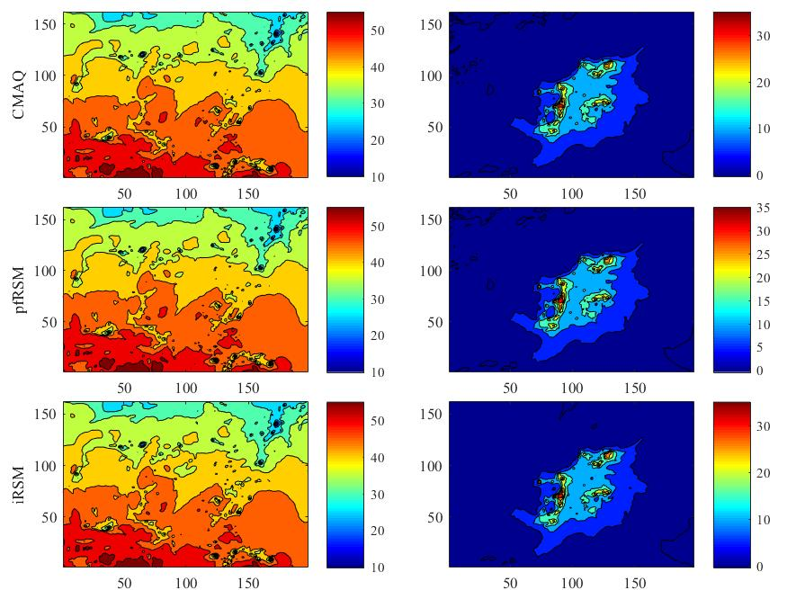
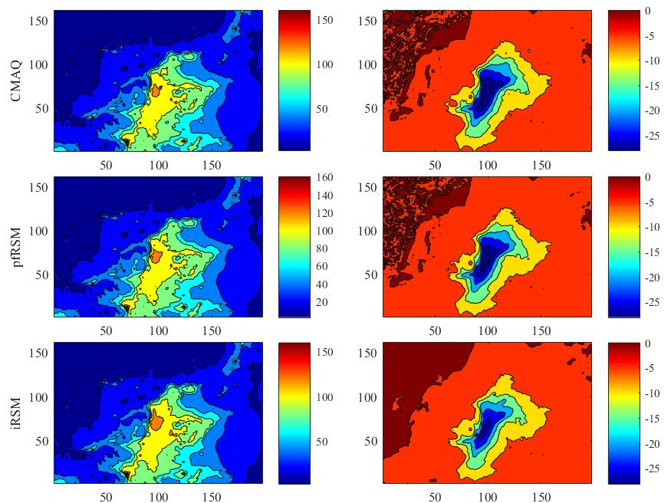
Preliminary results of i-RSM
i-RSM can further reduce the case number from 40 to 2!
PM_{2.5}
Conc
ΔConc
Conc
ΔConc
O₃
CMAQ
pf-RSM
i-RSM
can quickly update the response functions with any changes of baseline meteorology and emissions

Slide 20


Thank you very much!
Jia Xing
Associate Professor
School of Environment, Room 229
Tsinghua University, Beijing, China, 10084
Email: xingjia@tsinghua.edu.cn

