Slide 1


18th Annual CMAS Conference
The impact of the direct effect of aerosols on meteorology and air quality using aerosol optical depth assimilation during the KORUS-AQ Campaign
Jia Jung¹, Amir H. Souri², David C. Wong³, Sojin Lee¹, Wonbae Jeon⁴, Jhoon Kim⁵, Yunsoo Choi^{1*}
(1) Department of Earth and Atmospheric Sciences, University of Houston, Houston, Texas, US, (2) Harvard-Smithsonian center for Astrophysics, Cambridge, MA, US, (3) U.S. Environmental Protection Agency, Research Triangle Park, NC, US, (4) Institute of Environmental Studies, Pusan National University, Busan, South Korea, (5) Department of Atmospheric Sciences, Yonsei University, Seoul, South Korea
Notes:
Acknowlege co-authors, thanks to Dr. Wong, published in JGR

Slide 2
Elevated Aerosol Concentrations in East Asia
East Asia often undergoes elevated aerosol concentrations originating from a wide spectrum of sources (e.g. dust, biomass burning, anthropogenic emissions).
Aerosols modify the radiation budget by the direct and indirect effects of aerosols. Meteorological changes such as solar radiation, air temperature, PBLH and wind speed by aerosol may affect air quality.
For many years, numerous efforts have been devoted to assimilating observations into three-dimensional chemical transport model (CTM) to improve the simulation of aerosol concentration.

Slide 3
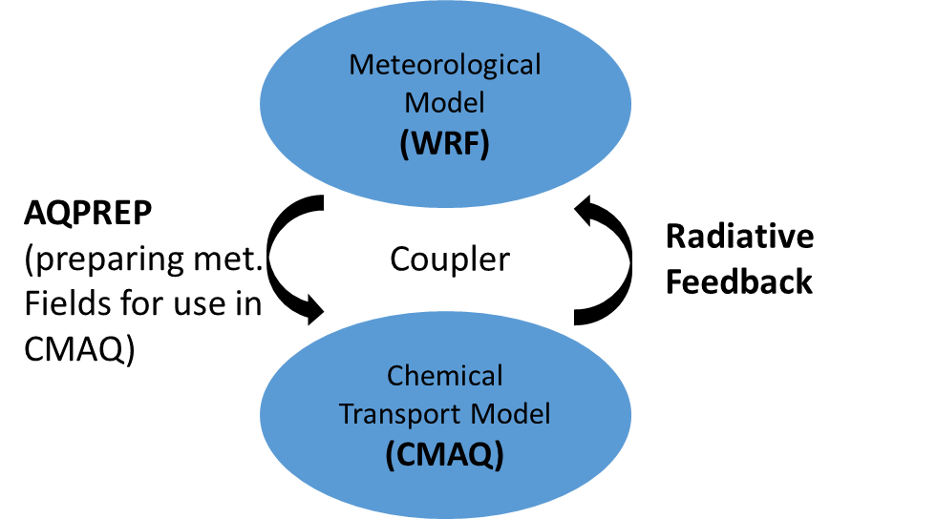
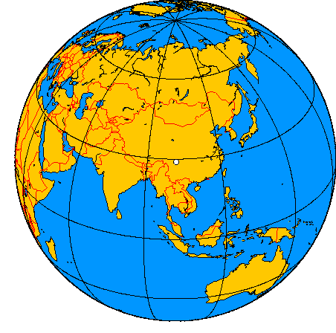
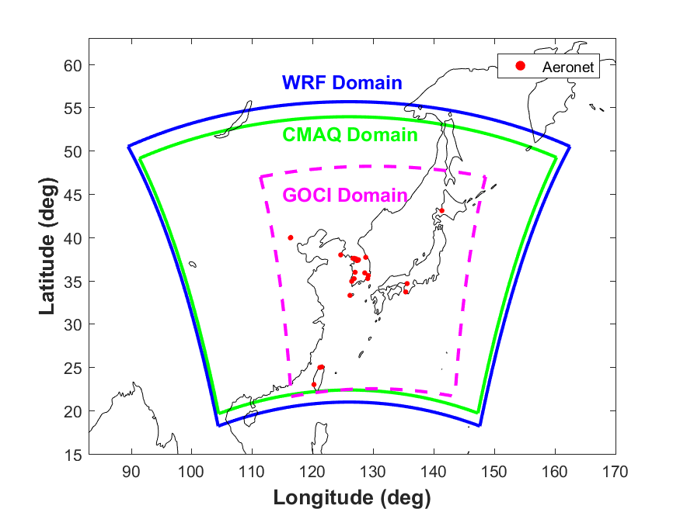
WRF-CMAQ two-way
In this study, we used a data assimilation method to incorporate the Geostationary Ocean Color Imager (GOCI) AOD into the WRF-CMAQ two-way model that address direct aerosol radiative forcing and its effect on both meteorology and air quality during the KORUS-AQ campaign.
The WRF-CMAQ two-way coupled model addresses the feedback between the chemistry and the meteorology [Wong et al., 2012].
  WRF v3.8 for meteorology and CMAQ v5.2 for chemistry
We ran the simulation between April 10 and June 19, 2016 (the KORUS-AQ campaign), and spent 22 days in April for model spin-up
Notes:
Why we did it An International Cooperative Air Quality Field Study in Korea from May to June in 2016Satellite, ground measurements, flight

Slide 4
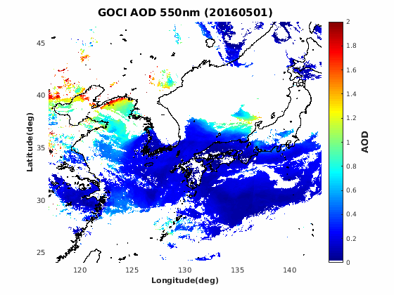
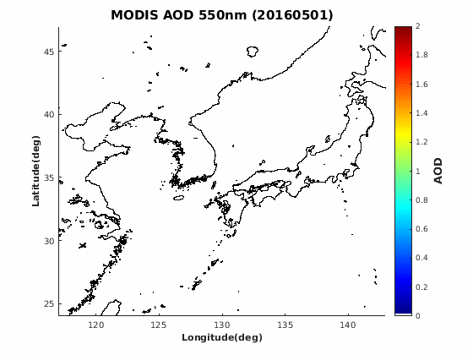
OI assimilation with GOCI AOD
The GOCI L1B data provide daylight spectral images 8 times per a day (9:30 to 16:30 LST) over East Asia in eight spectral channels.
We acquired AOD data at 550 nm at a 6 km spatial resolution from the improved GOCI Yonsei aerosol retrieval (YAER) algorithm version 2 (V2) [Choi et al., 2016].
We assimilated MODIS AOD only outside of the GOCI domain to enlarge the coverage of the AOD data within the domain of this study and minimize the difference inside and outside of the GOCI domain.
Notes:
We focused on May 2016. And, we used WRF version 3.7 to make meteorological input data for CTM.We used FNL data for the initial and boundary condition, thus We used the optimal grid analysis nudging.

Slide 5
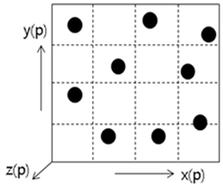
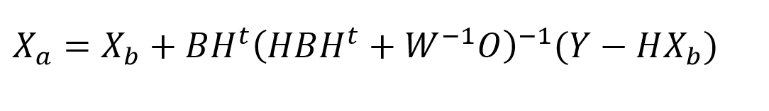
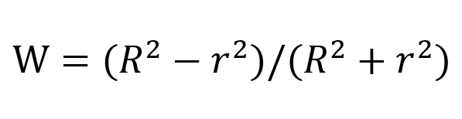
OI assimilation with GOCI AOD
OI data assimilation
  We update the initial condition in the CTM using OI method suggested by Tang et al.(2006). It modifies grid cells near observations.
  Cressman function is added in order to incorporate a number of observations inversely proportional to the distance within a influence radius.
z
  * X_{a} : the modified value, X_{b} : priori initial conditions, B : the covariance matrices for the priori values, O: the covariance matrices for the observational value, H: the observational operator
  * Cressman function
  R : 60 km, r:the Euclidian distance between the observation and model grid cell
Notes:
The priori variables are modified substantially near observations and remain unchanged in grid where observations are sparse or absent. We added Cressman function which is W here, in order to incorporate observations within a influence radius inversely proportional to the distance.

Slide 6
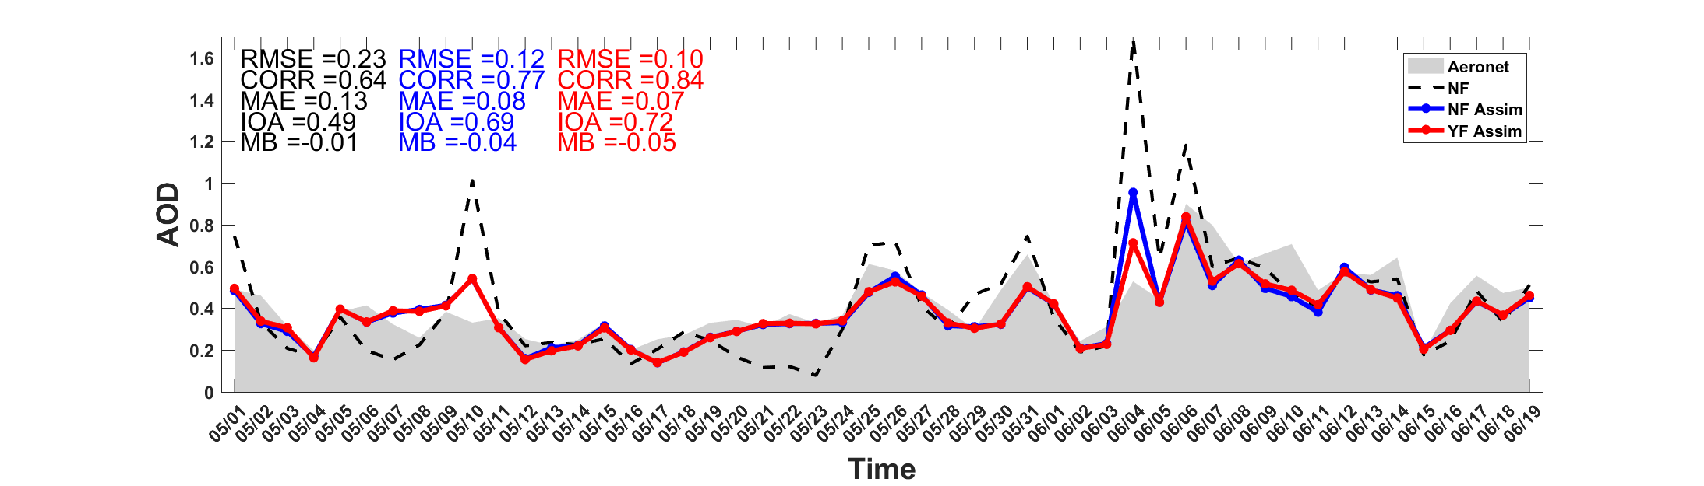
Results – the impact of the satellite AOD assimilation and the aerosol feedback on the AOD
Experiments | Aerosol Feedback | AOD Assimilation
NF | off | Off
NF Assim | off | On
YF Assim | on | On
Notes:
the time series of the 24-hour average simulated AOD from the three experiments and compare them to AERONET observations. NF without either assimilation or aerosol feedback could capture the general trend of AOD/some biases./The results of NF Assim tended to yield more accurate AOD values than NF after incorporating the satellite observations

Slide 7
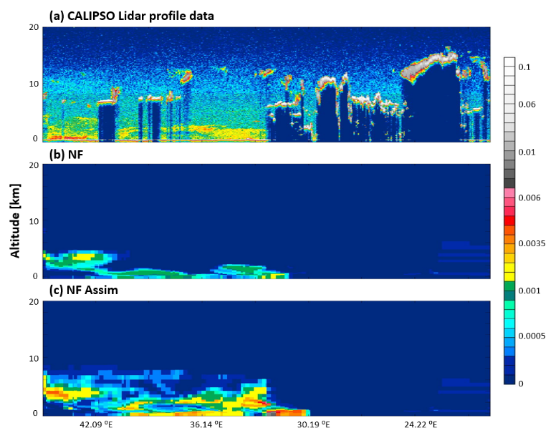
Results – the impact of the satellite AOD assimilation and the aerosol feedback on the AOD
Comparing to CALIPSO Lidar L1B profile data
Notes:
The benefits of AOD assimilation were reflected in the comparison of back-scattering coefficients from CALIPSO Lidar L1B profile data at 533 nm and the corresponding simulated coefficients (NF and NF Assim) at 550 nm on May 22 when NF produced a severe underestimation (Figure 3). Compared to CALIPSO data (Figure 3 (a)), NF (Figure 3 (b)) was able to simulate a plume observed at an altitude of 3-4 km, but the magnitude and the values over the surface were significantly underestimated. With the GOCI AOD assimilation, the results of NF Assim (Figure 3 (c)) showed well-adjusted values in magnitude. Aerosol plumes appearing at 3 km, around 34-40⁰E, and aerosol flumes in the upper atmosphere were more realistically captured.

Slide 8
Results – the impact of the satellite AOD assimilation and the aerosol feedback on the AOD
Experiments | Aerosol Feedback | AOD Assimilation
NF | off | Off
NF Assim | off | On
YF Assim | on | On
Notes:
The results of YF Assim, shown in Figure 2, indicate that the direct effect of aerosols can improve AOD. The direct effect of aerosols both increased and decreased AOD. More specifically, on June 4, the AOD value (0.95) of NF Assim had greatly improved compared to observation (0.53) than that of NF (1.70), but it was still overestimated. Encouragingly, YF Assim with the direct effect of aerosols reduced the AOD value by 25%.

Slide 9
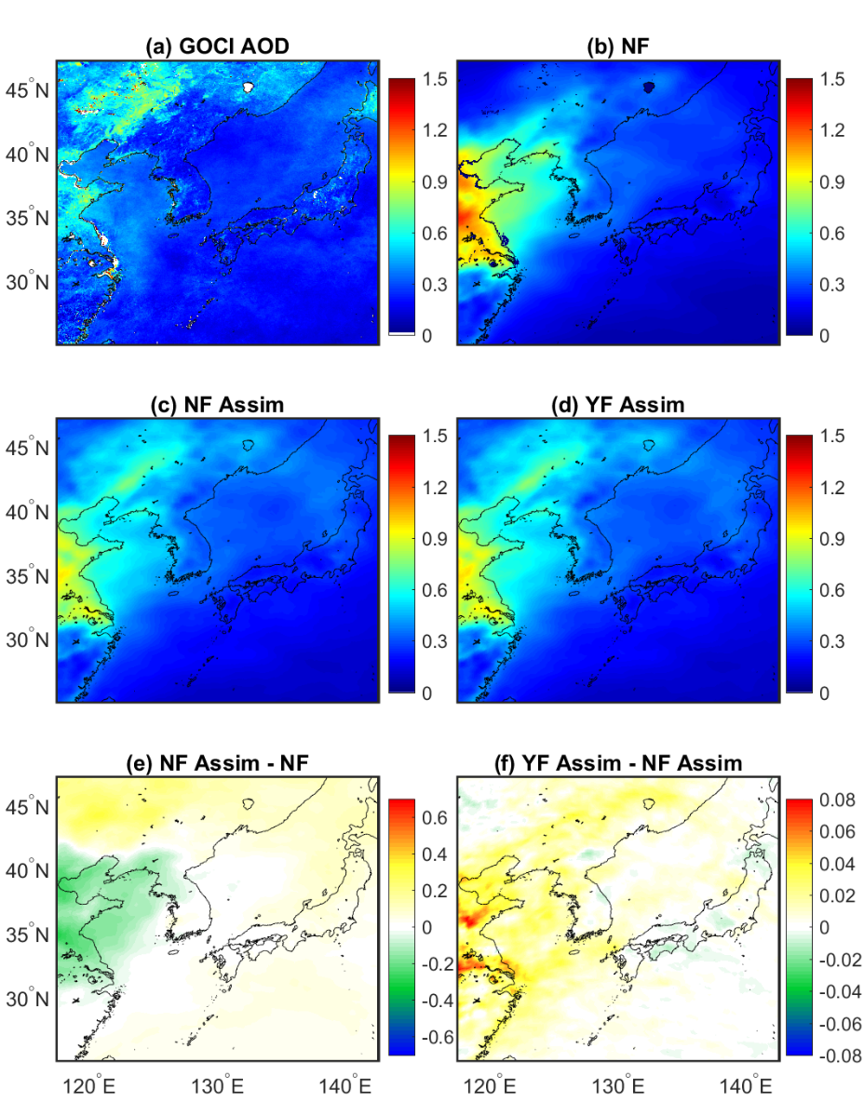
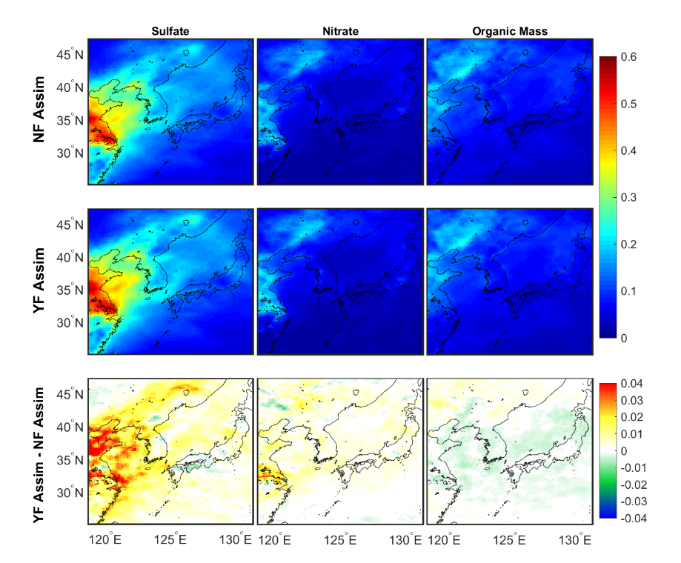
Results – the impact of the satellite AOD assimilation and the aerosol feedback on the AOD
  Major particulate speciated AOD - sulfate, nitrate and organic mass
GOCI AOD assimilation is helpful to adjust aerosol concentrations.
Aerosol feedback increases total AOD and increase in sulfate/nitrate-derived AOD.
Notes:
the contour maps of the averaged GOCI AOD and simulated AOD/the effects of the GOCI AOD assimilation/the direct effect of aerosols/A comparison between the simulated AOD from the NF experiments and the GOCI AOD data suggests that the NF significantly overestimates aerosol concentrations/decreased AOD values up to 0.32/enhancement were 0.15This conflicting tendency might be associated with the diverse physical and chemical processes involved in their formation and loss. High enhancement of the AOD (in sulfate and nitrate) to the direct effect of aerosols also occurred in the highly polluted area of eastern China, suggesting that the impact of the direct effect of aerosols depends on the air quality associated with feedback impact on meteorology

Slide 10
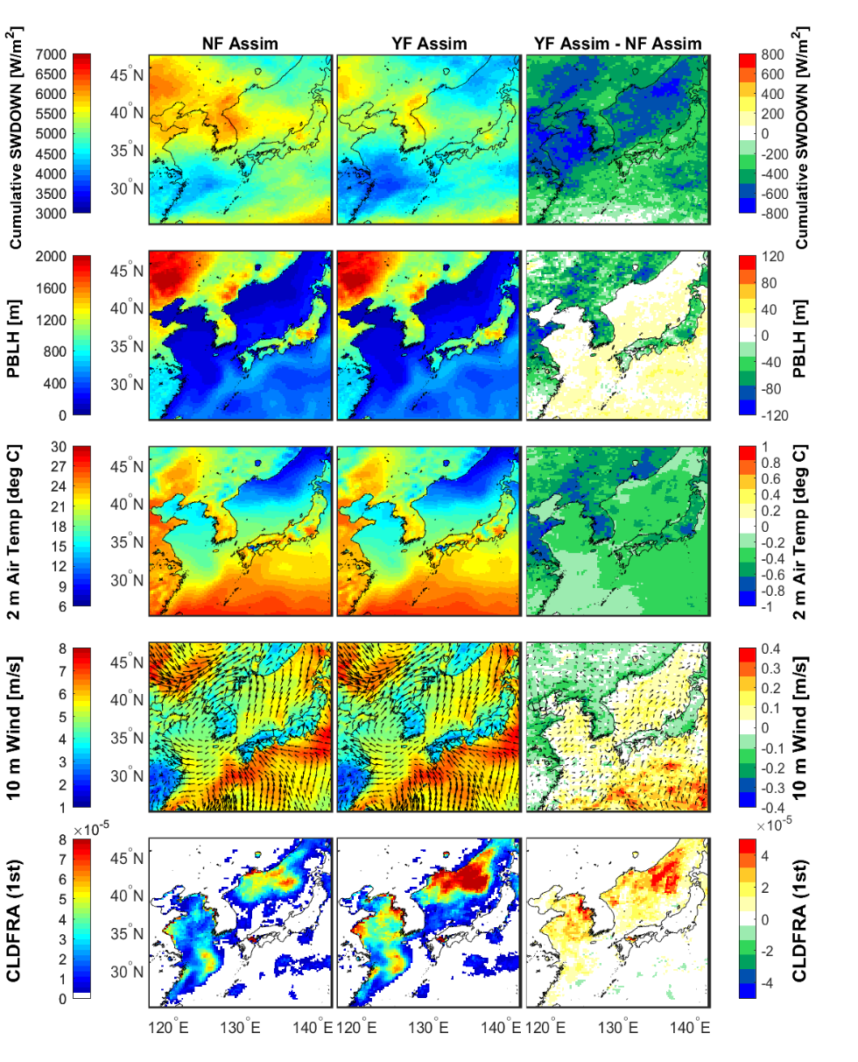
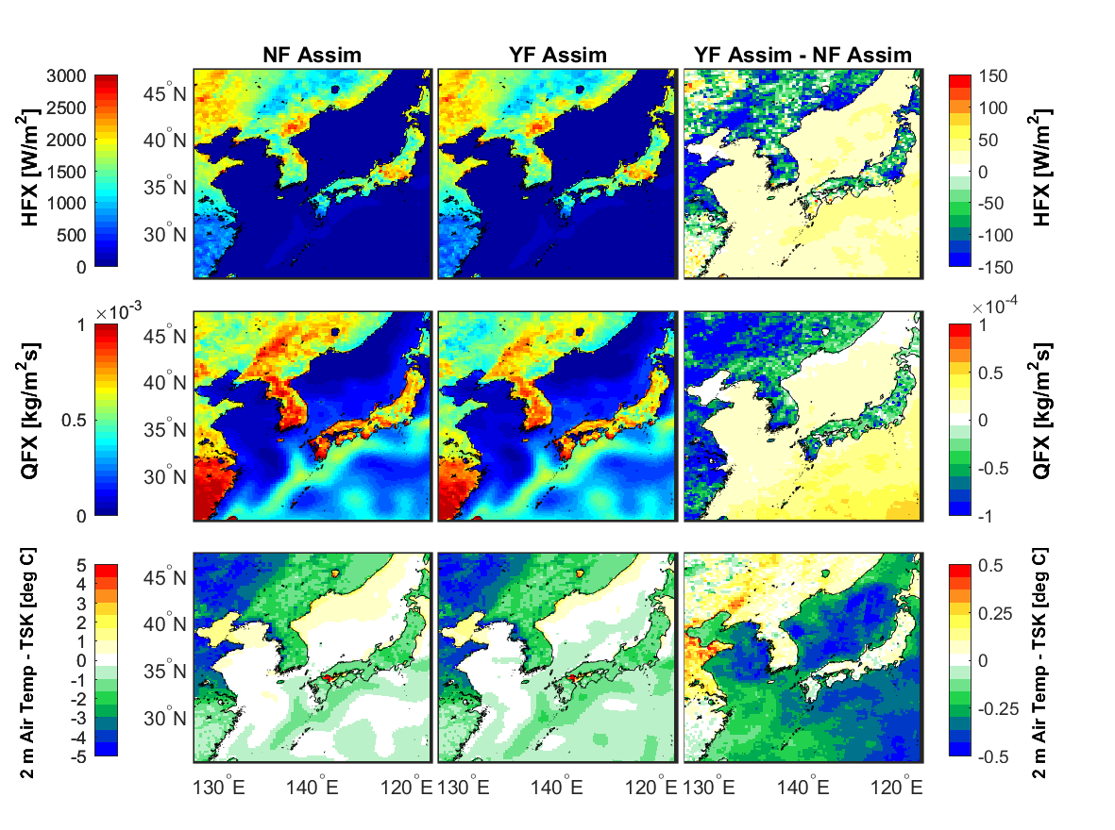
Results – the impact of aerosol feedback on meteorology
The thermal inertia of land and the ocean can result in diverse responses of the PBLH to aerosol feedback

Slide 11
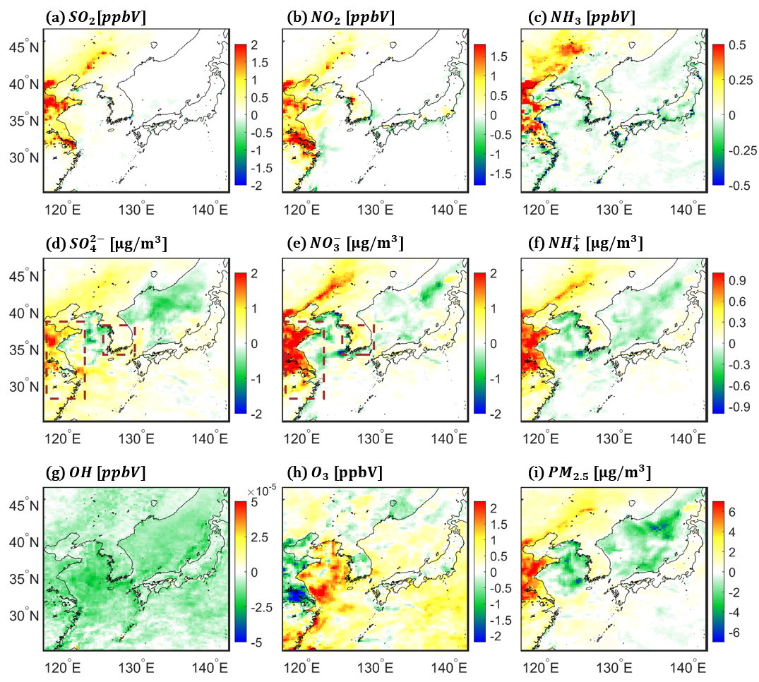
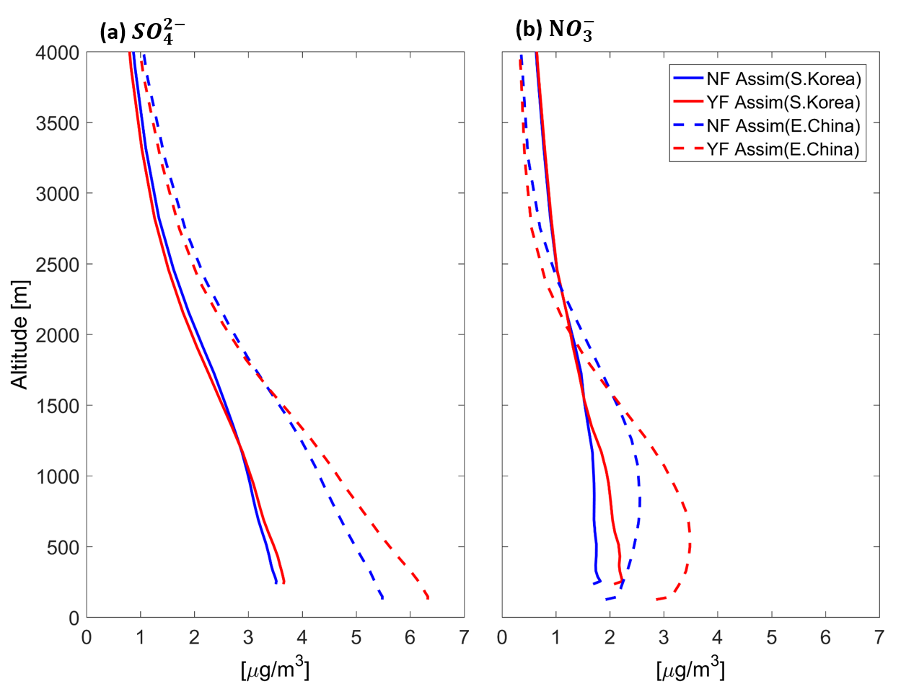
Results – the impact of aerosol feedback on air quality
This surface enhancement was observed in the vertical distributions of sulfate and nitrate concentrations. Interestingly, the change in nitrate concentrations near the surface was greater than that in sulfate concentrations mainly the results of its favorable formation at lower temperatures.

Slide 12
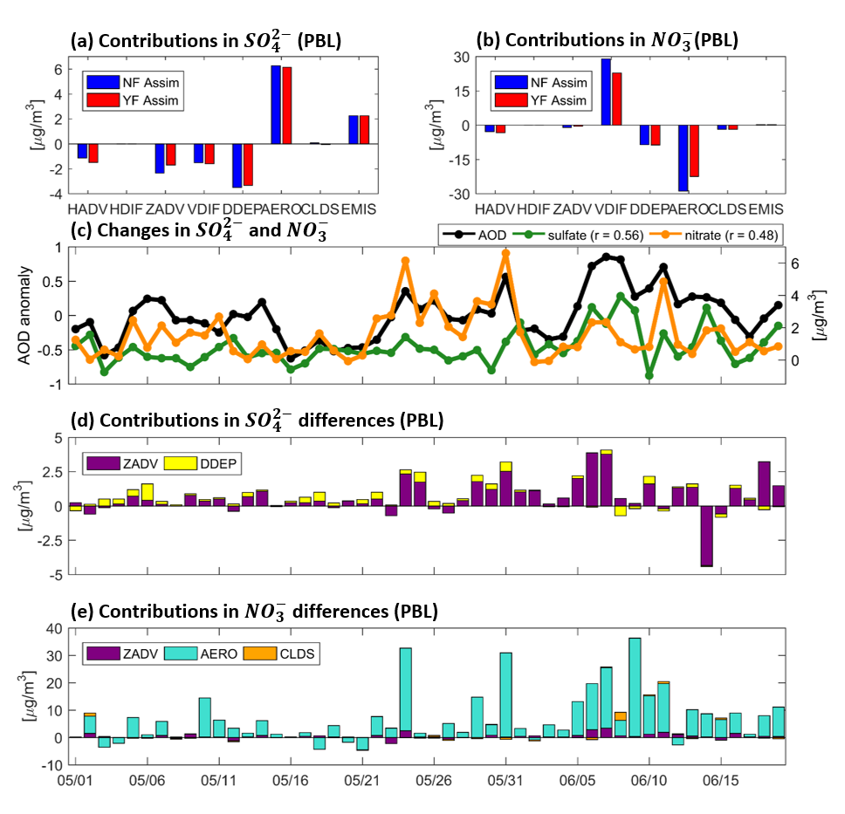
Results – the impact of aerosol feedback on air quality

Slide 13
Conclusion
GOCI AOD assimilation is crucial to produce reasonable aerosol concentrations. It allows to have accurate direct aerosol forcing effects on meteorology and air quality.
In response to aerosol direct impact, the concentrations of surface air pollutants were modified over land not only because of stabilization of the atmosphere with a lower PBLH and less ventilation but also because of the reduced amount of solar radiation.
This study found that aerosols in the atmosphere increase surface aerosol concentrations through changing the meteorology.
Without a concerted effort to reduce aerosol concentrations (e.g., emission control), this situation, under a stable atmosphere, will persist with considerably enhanced feedback. Thus, a rigorous study that examines the effects of aerosol forcing on climate change would be a worthy direction of research.
Notes:
To rap up,

Slide 14

Thank you!

