Slide 1




Initial Development of a NOAA Emissions and eXchange Unified System (NEXUS)
Patrick Campbell, Barry Baker, Rick Saylor, Daniel Tong, Youhua Tang, Pius Lee, Stuart McKeen, Gregory Frost, and Christoph Keller
18th Annual CMAS Conference
October 22, 2019

Slide 2

Motivation
Unified Forecast System (UFS) → Aerosols and Atmospheric Composition (AAC) models.
Emissions of gases and aerosols → critical components of AAC models.
Needs→ Adaptable system to provide AAC models with emissions inputs.
Needs→ Surface-atmosphere exchange interface with different model components.
Air Resources Laboratory (ARL) is playing a significant role in the UFS development.
Notes:
The Unified Forecast System (UFS) is a community-based, coupled Earth system modeling system. It is designed to provide numerical guidance for applications in the forecast suite of NOAA's National Centers for Environmental Prediction (NCEP).
Also, emissions are a laborious, time-consuming process when applying across different scales, projections, gas chemistry, etc.

Slide 3
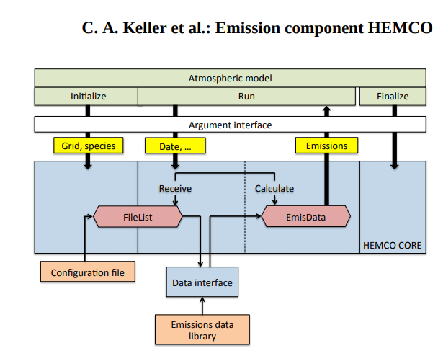
Harvard-NASA Emissions Component - HEMCO
HEMCO is currently used within the GEOS-Chem model.
HEMCO computes emissions from different sources, regions, and species for use in atmospheric models.
HEMCO is fully compliant with the Earth System Modeling Framework (ESMF) environment.
HEMCO can run both online and offline.
Keller, C. A., Long, M. S., Yantosca, R. M., Da Silva, A. M., Pawson, S., and Jacob, D. J.: HEMCO v1.0: a versatile, ESMF-compliant component for calculating emissions in atmospheric models, Geosci. Model Dev., 7, 1409-1417, https://doi.org/10.5194/gmd-7-1409-2014, 2014.
Notes:
HEMCO is currently used within the GEOS-Chem model. It is a stand-alone software component for computing emissions in global-scale atmospheric models.. Emissions that depend on dynamic source types and local environmental variables such as wind speed or surface temperature are calculated in separate HEMCO extensions.
HEMCO is based on ESMF and a highly modularized data container objects as FORTRAN derived types, where all objects and variables need to undergo initialization, run commands, and finalization, which cleans up code.
HEMCO is fully compliant with the Earth System Modeling Framework (ESMF) environment. It is highly portable and can be deployed in a new model environment with only few adjustments at the top-level interface. So far, HEMCO has been implemented in the NASA Goddard Earth Observing System (GEOS-5) Earth system model (ESM) and in the GEOS-Chem chemical transport model (CTM).

Slide 4
What does HEMCO do already?
Aerosols
ESMF compliant
Handles different datasets
Self-described data (NetCDF)
Offline and online ready
Couple to different models
Mass conservative remapping
Simple/flexible emissions scaling
Historical
&
Future Projections
(IPCC, RCP)
Anthropogenic
&
Biofuel
Biomass Burning
Halogens
HEMCO
HEMCO Extensions
(Dust, Sea-Salt Biogenic, etc.)
Natural Sources
Anthropogenic
Aircraft
&
Ship
Non-Emission Data
(Satellite O₃, LAI, Albedo, etc.)
Notes:
HEMCO determines emissions from different sources, regions, and species on a user-defined grid and can combine, overlay, and update a set of data inventories and scale factors. New emission inventories at any spatial and temporal resolution are readily added to HEMCO and can be accessed by the user without any preprocessing of the data files or modification of the source code
Able to run online and offline driven by different datasets and models (not just 3D weather models but land models and ocean model coupling as well.
Includes inline emission extensions such as dust, DMS, biogenics, etc.
Includes multiple platforms (e.g., satellite, aircraft, etc.) easily and efficiently.
Mass conservative remapping.
Applies simple, flexible scaling factors such as:
Temporal emission variations including diurnal, seasonal, or interannual variability.
Regional masks that restrict the applicability of the base inventory to a given region.
Species-specific scale factors including splitting lumped organic compound emissions.

Slide 5
Initial NEXUS Development at NOAA
Adapt HEMCO for the NOAA Emissions and eXchange Unified System (NEXUS).
Demonstrate capabilities of HEMCO with global and regional emission inventories.
Offline couple HEMCO and demonstrative tests with NOAA’s global AAC models.
Implementation and tests of a new NOAA/ARL dust parameterization in HEMCO.

Slide 6
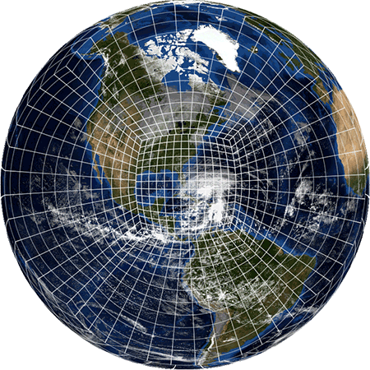
GFS physics, including sub-grid scale tracer transport
Other more advanced physics options are available through Common Community Physics Package (CCPP)
FV-3
Coupled chemistry suites
ESMF-NUOPC coupled WRF-Chem-based
suite for global model
ESMF-NUOPC coupled CMAQ suite for regional model
Simplified sulfur chemistry.
More sophisticated aerosol modules including secondary organic aerosols (SOA)
Operational CMAQ EPA modules in progress (CB6, AERO)
GOCART
GOCART RACM
RACM
SOA
Global Ensemble Forecast System (GEFS) - Aerosols w/GOCART
Notes:
As you may or may not know at NOAA the global forecast model is based on FV3: GFDL’s Finite-Volume Cubed-Sphere Dynamical Core. Coupled to WRF-Chem based suite for global and CMAQ suite for regional. Will discuss NUOPC framework layers under ESMF layter. The main point here is to emphasize that all of WRF-Chem chemistry suites are available, although the operational system (GEFS-Aerosols) only uses GOCART. And that a CMAQ chemistry module will be available shortly.
National Unified Operational Prediction Capability (NUOPC)

Slide 7
HEMCO Tests with GEFS-Aerosols/GOCART
GEFS-Aerosols/GOCART v088-Beta, C384 Grid (~25 km resolution)
Warm-start, 1-month, July 2019 Simulation (10-days spin-up removed)
Run | Global Emissions | Regional Emissions
PREP-Chem Sources (Base) | CEDS 2014 - SO₂, OC, BC HTAP 2010 - Unspeciated PM_{2.5} | None
HEMCO (Sens1) | Same as in Base | None
HEMCO (Sens2) | CEDS 2014 - SO₂ (Shipping), OC, BC HTAP 2010 - Unspeciated PM_{2.5} OMI-HTAP 2017 - SO₂ (Liu et al., 2018) | 2016 EPA p;Modeling Platform for Contiguous U.S. (CONUS) – SO₂, OC, BC
Reproducibility: HEMCO Sens1 run is nearly equal (< +/- 5%) to PREP-Chem Sources Base run.
Notes:
Sens2 Run = Sens 1 Run + Blended Regional 2016 NEI-Beta in North America and updated 2017 OMI-HTAP SO2 global emissions (Liu et al., 2018). CEDS 2014 SO2 used for shipping.
A new global anthropogenic SO2 emission inventory for the last decade: a mosaic of satellite-derived and bottom-up emissions Fei Liu1,2 , Sungyeon Choi2,3 , Can Li2,4 , Vitali E. Fioletov5 , Chris A. McLinden5 , Joanna Joiner2 , Nickolay A. Krotkov2 , Huisheng Bian2,6 , Greet Janssens-Maenhout7 , Anton S. Darmenov2 , and Arlindo M. da Silva2

Slide 8
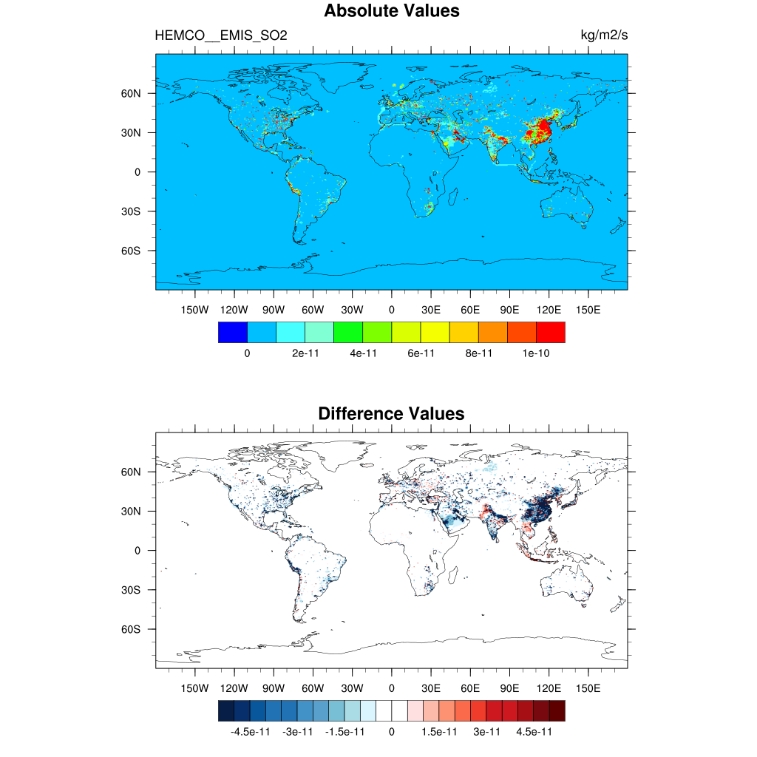
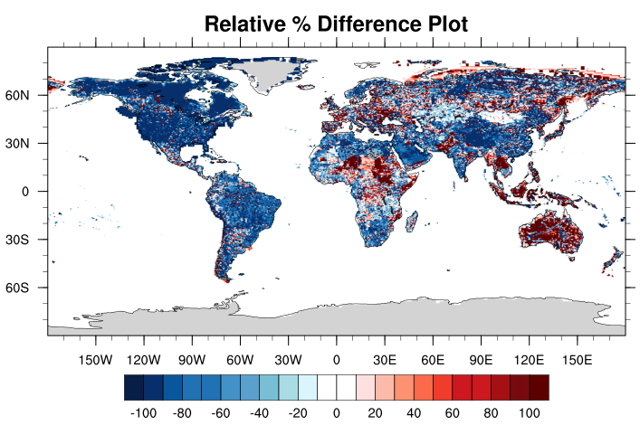
SO₂ Emissions Differences (Sens2 - Sens1)
Sens2-Sens1
Sens1
Sens2-Sens1
Notes:
Large decreases in SO2 emissions in U.S. due to 2016 emissions modeling platform and elsewhere due to OMI-HTAP 2017 platform.

Slide 9
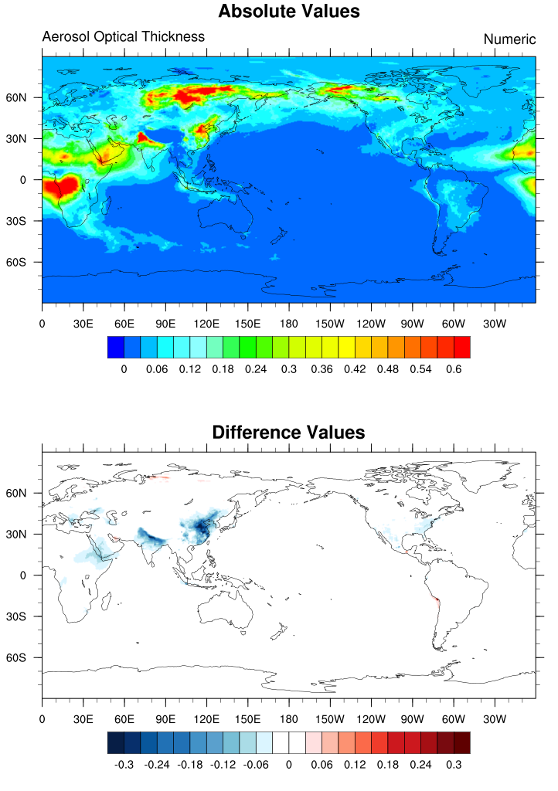
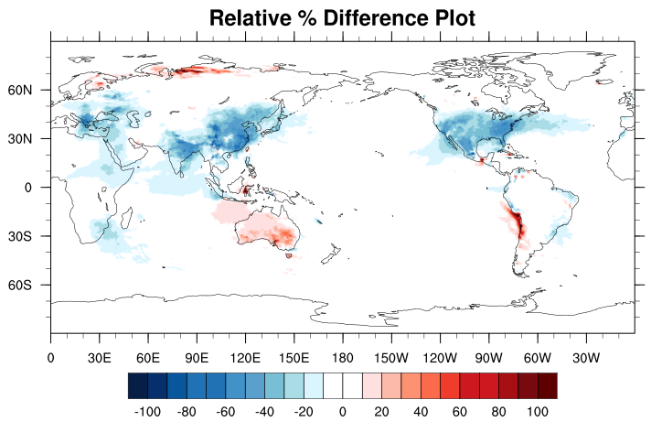
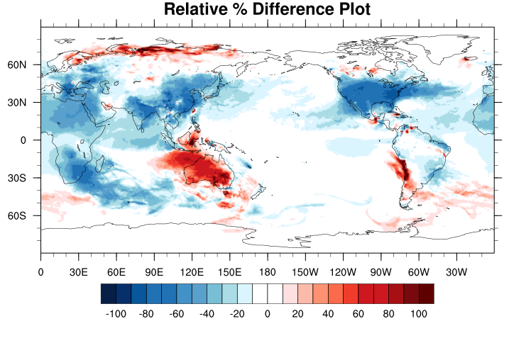
HEMCO Tests with GEFS-Aerosols/GOCART
Total AOT: Sens1
Total AOT: Sens2-Sens1 Relative
Total AOT: Sens2-Sens1 Absolute
Sulfate AOT: Sens2-Sens1 Relative
Notes:
Appreciable changes in total AOT, with largest contributions from sulfate AOT due to SO2 emission changes.

Slide 10
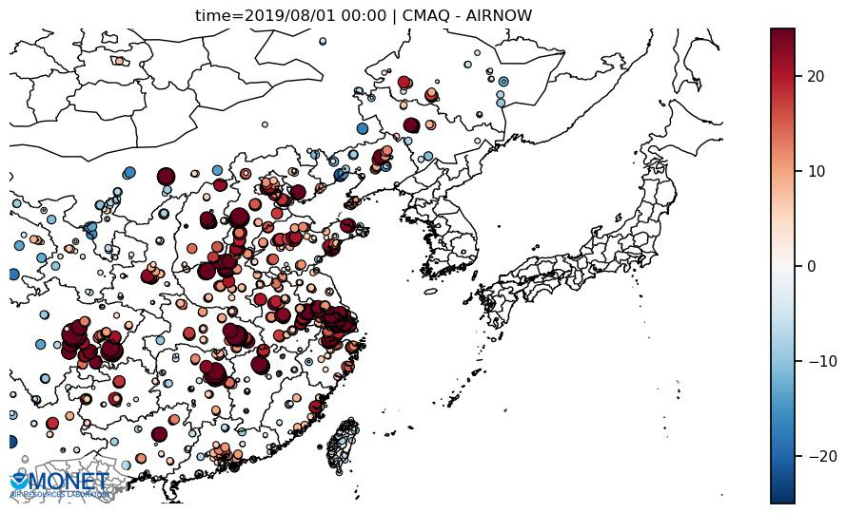
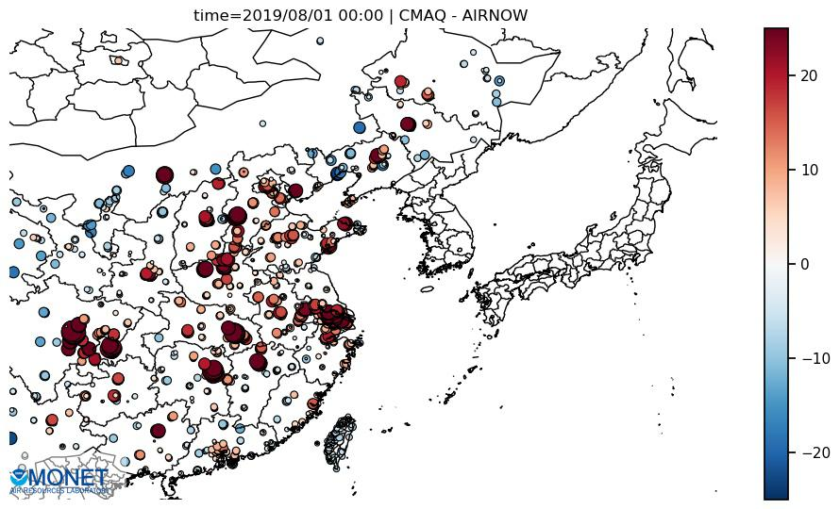
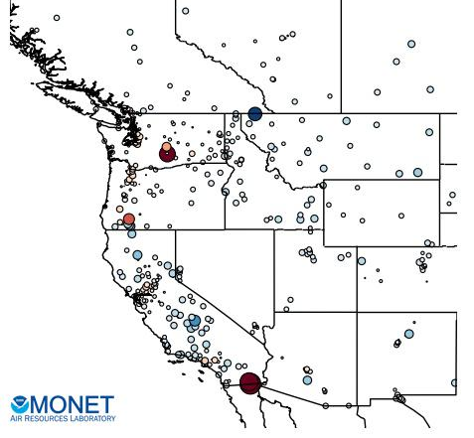
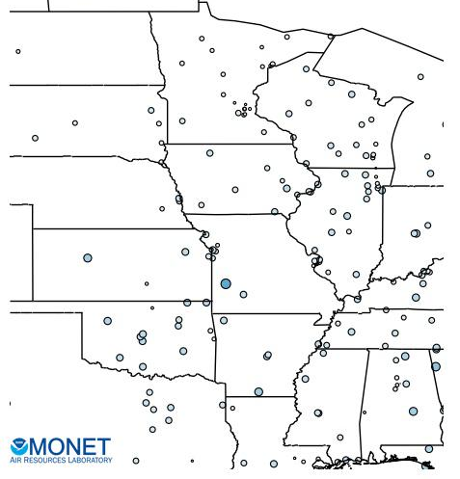
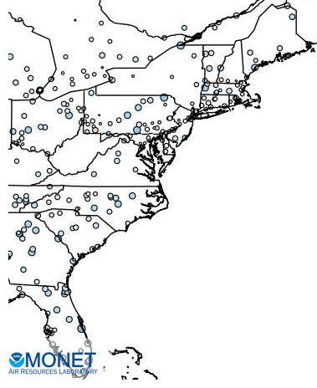


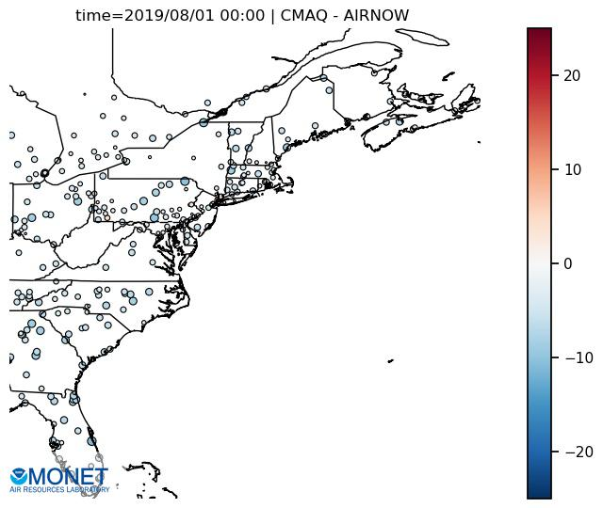
Open-AQ Surface PM_{2.5} Bias and Statistics: July 2019
Sens1 Mean PM_{2.5} Bias (μg m⁻³)
Sens2 Mean PM_{2.5} Bias (μg m⁻³)
Reduces
Bias/Error
EAS
EAS
NMB= +41% | NME= 72% | IOA= 0.59
NMB= +28% | NME= 66% | IOA= 0.60
Similar
WNA
CNA
ENA
WNA
CNA
ENA
NMB= -22% | NME= 76% | IOA= 0.18
NMB= -49% | NME= 60% | IOA= 0.53
NMB= -37% | NME= 57% | IOA= 0.51
NMB= -26% | NME= 78% | IOA= 0.18
NMB= -53% | NME= 62% | IOA= 0.52
NMB= -43% | NME= 60% | IOA= 0.50
Notes:
Global OPEN-AQ evaluation by world Giorgi regions.

Slide 11
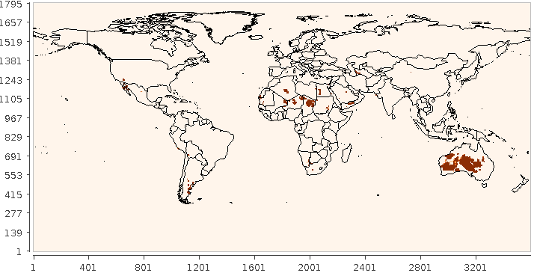
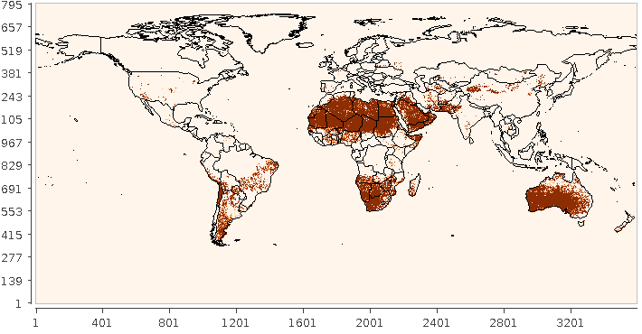
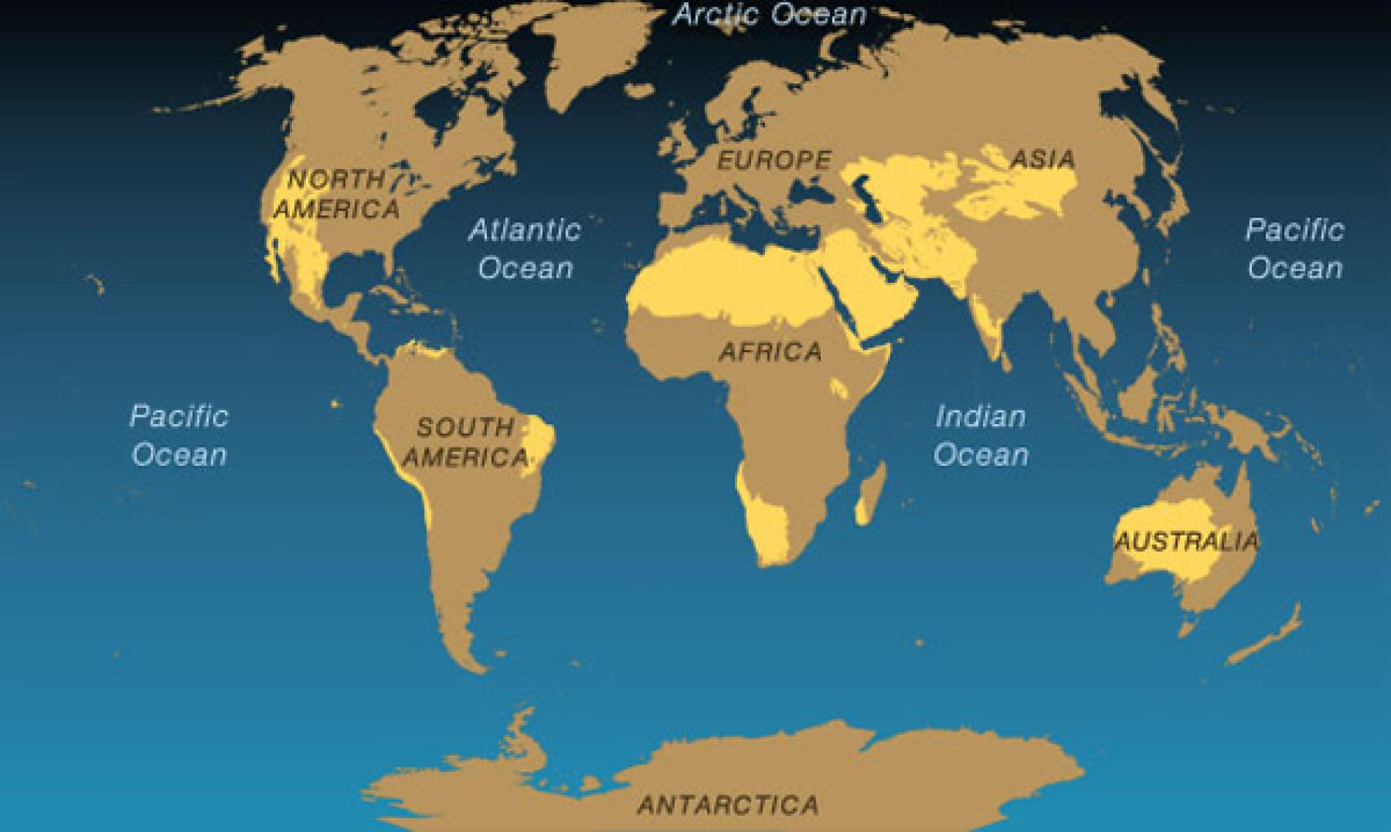
HEMCO with the FENGSHA Dust Model
January 2019 dust simulation in HEMCO with 0.5° MERRA2 analysis
DEAD Model & 2.5° SSM
FENGSHA Model & 0.1° B-S SSM
Default Run: DEAD model with 2.5° SSM
The FENGSHA model with new 0.1° B-S SSM leads to more dust sources and higher spatial inhomogeneity compared to DEAD.
Brown = Total
Monthly Dust Flux
See NOAA/ARL colleagues Drs. Daniel Tong and Barry Baker for more details on the FENGSHA dust model and Baker-Shepanski (B-S) Sediment Supply Map (SSM).
World Deserts
Source: National Geographic
Notes:
Our work with moving to NEXUS using HEMCO is to provide such SSM maps and dust predictions on all scales and projections (Global FV3 or regional CMAQ).
Dust Entrainment and Deposition Model (DEAD).

Slide 12
A Roadmap to NEXUS
HEMCO-based emissions and evaluate over an extended period.
Create emissions for FV3-SAR (stand-alone regional)-CMAQ.
Implement new NOAA wildfire emissions as extension/ensemble.
Blended Global Biomass Burning Emissions Product (GBBEPx)
Implement ensemble gas/aerosol dry deposition extensions.
Implement biogeochemical/agroecosystem model extensions.
Environmental Policy Integrated Climate (EPIC) model
Daily time-step CENTURY biogeochemical (DAYCENT) model
Further develop NEXUS emissions and interface with other models.
Notes:
Over the next two years, the majority of effort in NEXUS development will be adapting HEMCO to create emissions for the FV3-SAR (stand-alone regional) and replacing the CMAQ-NAM NAQFC with FV3-SAR-CMAQ. Also, definitely mention EPIC but make sure to mention that it's a longer-term goal (for which there is no current funding). Can we take the agroecosystem extensions to global-scale with available data?
Global Biomass Burning Emissions Product eXtended (GBBEPx) (based on QFED and extended to VIIRS products)
Pros: The fire radiation power (FRP) based emission can be well constrained, depending on the tuning factors.
Cons: can only provide one snapshot per day based on polar orbiting satellites.
The QFED emissions are based on the fire radiative power (top-down) approach and draw on the cloud correction method developed in the Global Fire Assimilation System (GFAS). Location and fire radiative power of fires are obtained from the Moderate Resolution Imaging Spectroradiometer (MODIS) Level 2 fire products (MOD14 and MYD14) and the MODIS Geolocation products (MOD03 and MYD03). QFED strengths are high spatial and temporal resolutions and near-real time availability. Daily mean emissions are available at 0.3125 times 0.25 degrees and in recent versions also at 0.1 times 0.1 degrees. QFED provides emissions of black carbon, organic carbon, sulfur dioxide, carbon monoxide, carbon dioxide, PM2.5, ammonia, nitrogen oxides, methyl ethyl ketone, propylene, ethane, propane, n- and i-butane, acetaldehyde, formaldehyde, acetone and methane. Two QFED product systems are maintained by the NASA Global Modeling and Assimilation Office (GMAO): one that produces near real-time daily emissions used operationally in the GEOS-5 Data Assimilation System, and one that produces an extended historical dataset with daily emissions from March 2000 to the present. The historical dataset also provides monthly mean and monthly climatological emissions.
Agroecosystems are defined as "a biological and natural resource system managed by humans for the primary purpose of producing food as well as other socially valuable nonfood goods and environmental services."
DayCent is a terrestrial ecosystem model designed to simulate fluxes of C and N among the atmosphere, vegetation, and soil (Del Grosso et al., 2001, Parton et al., 1998). DayCent is the daily time-step version of the Century model (Parton et al., 1994).
In the short-term plans, NEXUS is able to quickly provide updated anthropogenic global and regional emission inventories for the global AAC models, which affects model predictions and performance. Furthermore, it provides a mass-conserving ESMF regridding that improves on the current method of interpolation between resolutions.
In the long-term plans, advanced development of NEXUS science proposes the following at this time: Possible higher temporal resolution for emissions (e.g,. daily, hourly); Satellite-based emissions data assimilation - rapid emission refresh (NOx, dust, wildfires); NUOPC cap for direct coupling and enhanced surface-atmosphere exchange capabilities; Improved consistency between dry deposition and LSM component under NUOPC; Sub-grid LU tiling and deposition; Ensemble of dry deposition (gaseous and particles) models; Nutrient and heavy metals loading; In-canopy effects (physics and chemistry); MEGAN or biologically-based BVOC emissions; Marine emissions (DMS, MSA, isoprene, organic aerosols, sea salt, etc.); Lighting NOx emissions, etc.
A significant advantage of NEXUS over current system is that it would be developed to be able to test such advances both offline and online, which allows for faster development, testing/evaluation, and publication/dissemination of results. NEXUS also plans to provide regional NAQFC-equivalent emissions for SARFV3-CMAQ, which could reduce the overall time/effort significantly compared to the current regional emissions workflow.

Slide 13
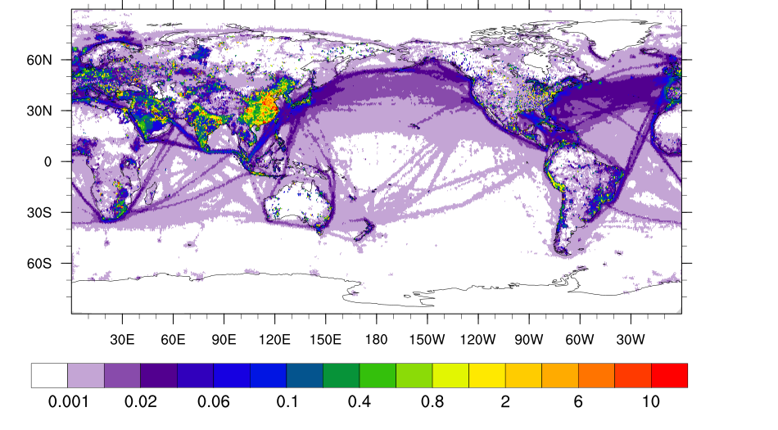
NEXUS for the Model for Prediction Across Scales
SO₂ Emissions for MPAS 46-12 km Mesh
CEDS 2014
(kg m² s⁻¹)*10⁻¹⁰

Slide 14
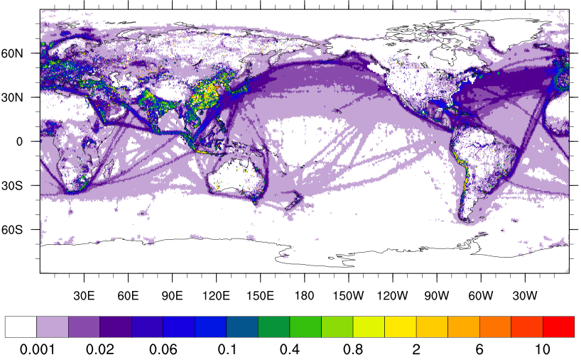
NEXUS for the Model for Prediction Across Scales
SO₂ Emissions for MPAS 46-12 km Mesh
CEDS 2014 (ship) + OMI-HTAP 2017 + 2016 Modeling Platform (U.S.)
(kg m² s⁻¹)*10⁻¹⁰

Slide 15
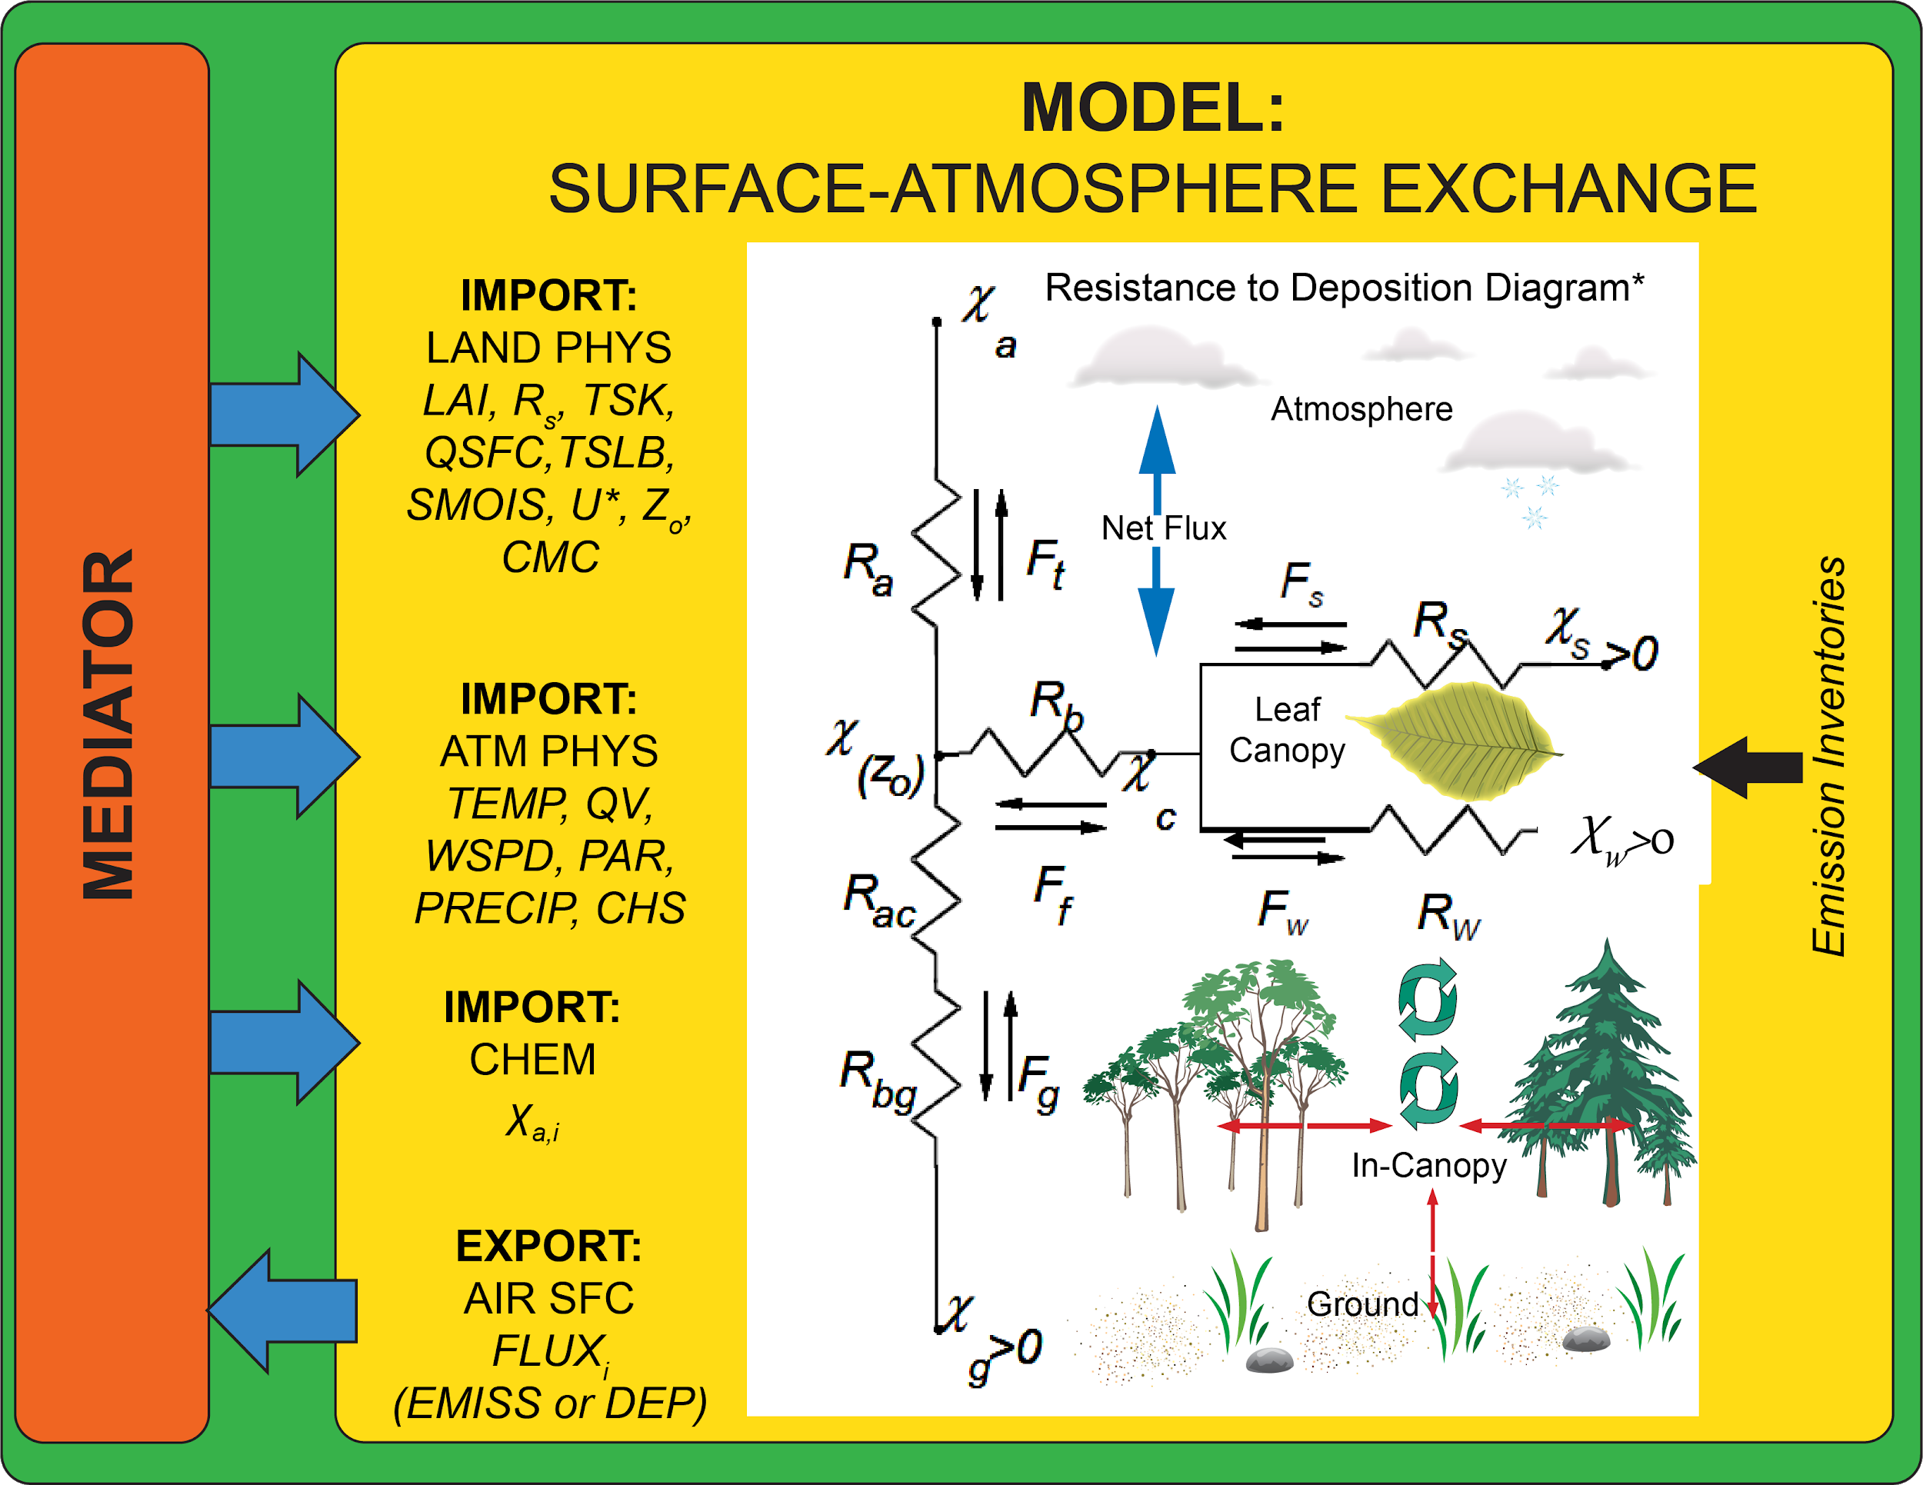
The Future of NEXUS
Coupled surface-atmosphere
exchange with NUOPC
Interface with other
earth system components
(land, ocean, chem, etc).
National Unified Operational Prediction Capability
(NUOPC)
Green = Driver
Orange = Mediator
Blue = Connector
Yellow = Model
Notes:
Further develop NEXUS to handle all surface-atmosphere exchange processes through NUOPC-ESMF framework. Explicitly mention the goal of making emissions/deposition consistent with surface exchange physics in the LSM. Also want to move from just a big-leaf or two layer vegetation canopy, to parameterize in-canopy processes, e.g., Rick Saylors in-canopy access model for ammonia, or even full chemistry down the road.
Download
The NUOPC Layer is bundled with the ESMF distribution.
Features
The NUOPC Layer implements a component based software architecture with the following key features:
Four basic building blocks.
There are four basic kinds of components:
Driver - Provides a harness for Models, Mediators, and Connectors, coordinating their initialization and driving them during the application time loop.
Mediator - Used for custom coupling code (flux calculations, averaging, etc.) between multiple Models.
Connector - Connects pairs of components, e.g. Model to/from Model, or Model to/from Mediator, and executes simple transforms (Regrid or Redist).
Model - Typically implements a specific physical domain, e.g. atmosphere, ocean.

Slide 16
Preliminary Summary and Collaboration
HEMCO is being adapted and developed at NOAA/ARL for NEXUS.
Tests of updated emissions show impacts on GEFS-Aerosols/GOCART.
FENGSHA dust extension and source map in HEMCO have major impacts.
Promise for NEXUS to replace current emission modeling system at NOAA.
NOAA/ARL - NEXUS
GEFS-Aerosols
Short-term Implementation
NASA/Harvard - HEMCO
GEOS-Chem
Collaboration
Other Orgs & Models
(EPA, NCAR)
Collaboration
Long-term Collaborative Science
Notes:
Provide science back to NASA/Harvard such as advanced agroecosystem/biogeochemistry/and air-sfc exchange fluxes on the global scale. This makes perfect sense as NOAA and NASA are engaged in unifying our global aerosols and atmospheric composition modeling and forecasting.
Working with other agencies such as EPA: Flexible emissions of MPAS-CMAQ development, overlapping wildland fire emission development between EPA and NOAA ARL, use NEXUS as a community-based tool for flexible incorporation of emission inventories, emission scale factors, etc. This was something mentioned by Jeff Vukovich and George Pouliot. Future climate/weather prediction index for wildland fires.

