Slide 1

A Retrieval Closure Study to Determine the Best Metrics for Evaluating the CMAQ Model with CrIS NH₃ Retrievals
M. J. Alvarado¹, K. Cady-Pereira¹, J. Mascio¹, C. R. Lonsdale¹, and M. Shephard²
¹Atmospheric and Environmental Research (AER)
²Environment and Climate Change Canada
Acknowledgements: NASA Applied Science
Grant #80NSSC19K0190
18th Annual CMAS Conference
October 23rd, 2019

Slide 2
Ammonia (NH₃) is a PM_{2.5} precursor and reactive N species
NH₃ + HNO₃⬅➔NH₄NO₃
2 NH₃ + H₂SO₄➔(NH₄)₂SO₄
Increase incidence of cardiovascular and respiratory diseases
Increase number of CCN
NH₃ is also one of the most important reactive nitrogen species
  Leads to soil acidification, water eutrophication (e.g. algal blooms)
  Ammonia is the least well understood part of the nitrogen cycle
SO₂, NO_{x} emissions decreasing due to controls, but NH₃ increasing!

Slide 3

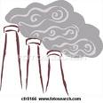


NH₃ sources are not well known
Automobiles (catalytic converters)
Large urban centers
  50% of NH₃ in LA area (Nowak et al., GRL, 2012)
Biomass burning
Industry
Fertilizer
Coal Mining
Power generation
Bi-directional
Flux
AGRICULTURE
Animal waste (temperature dependent)
Fertilizer application

Slide 4
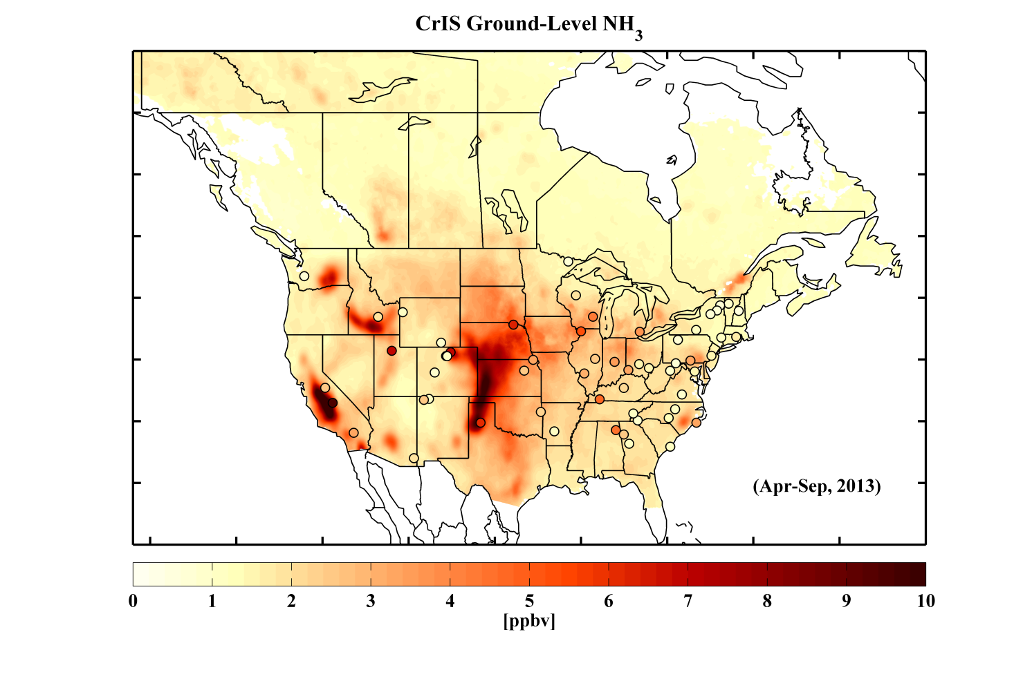
CrIS can identify NH₃ sources
CrIS Satellite NH₃ warm season (Apr. – Sept., 2013) average surface map, with corresponding AMoN surface network measurements overlaid.
AMoN Surf. Site
Notes:
AMoN: Ammonia Monitoring Network (surface observations in the USA)
NAPS: National Air Pollution Surveillance Program (NAPS) (Canada)

Slide 5
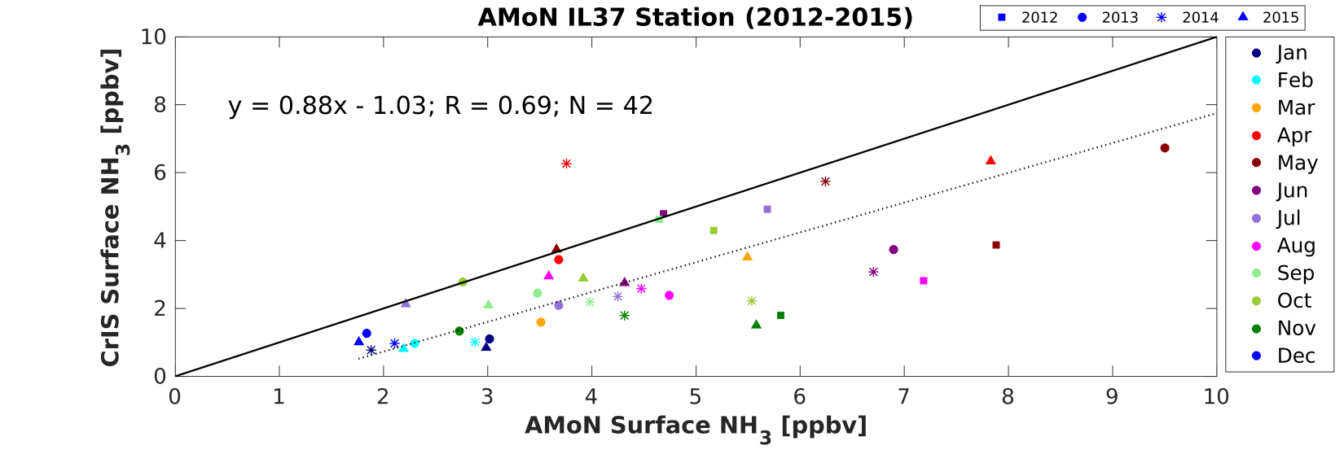
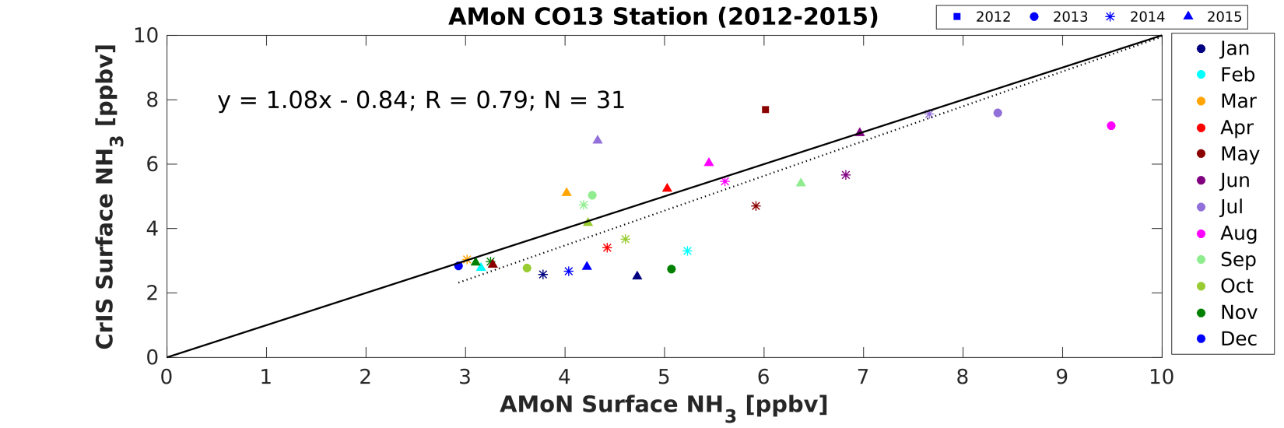
CrIS Satellite Ammonia Monitoring and Evaluation
Multi-year monthly comparisons of CrIS surface NH₃ with AMoN obs.
Initial assessment shows that the satellite and AMoN surface observations agree well despite sampling differences
Stockton, Illinois
Fort Collins, Colorado
Notes:
AMoN: Ammonia Monitoring Network (surface observations in the USA)
NAPS: National Air Pollution Surveillance Program (NAPS) (Canada)

Slide 6
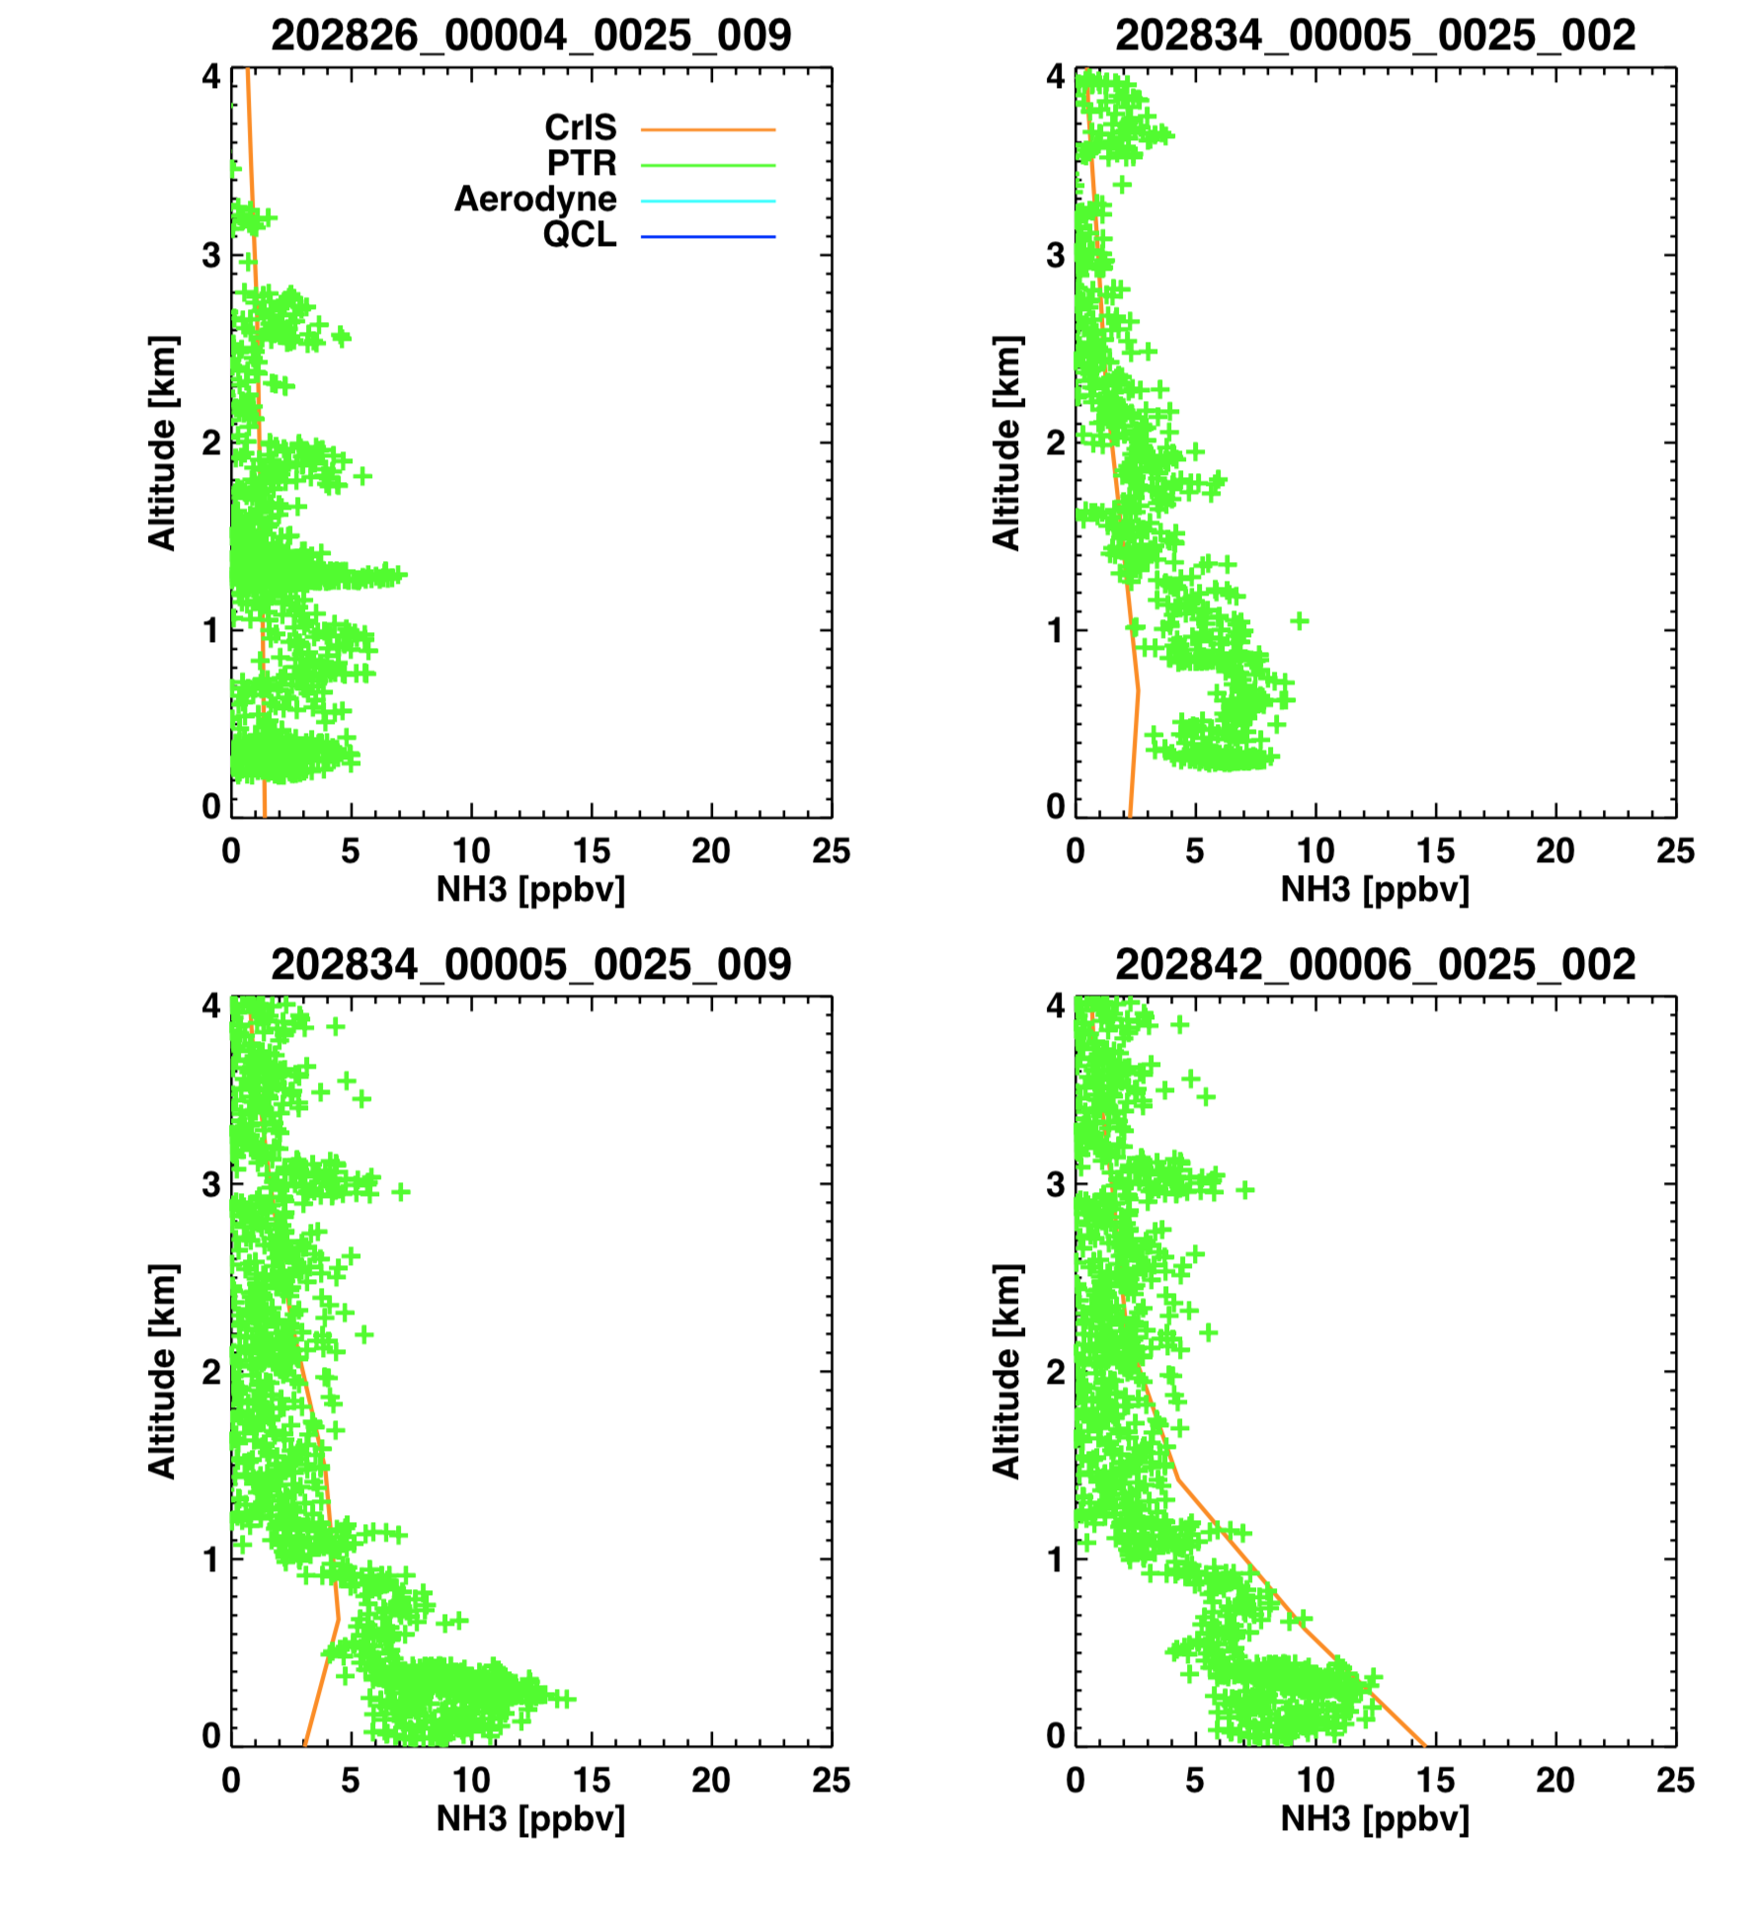
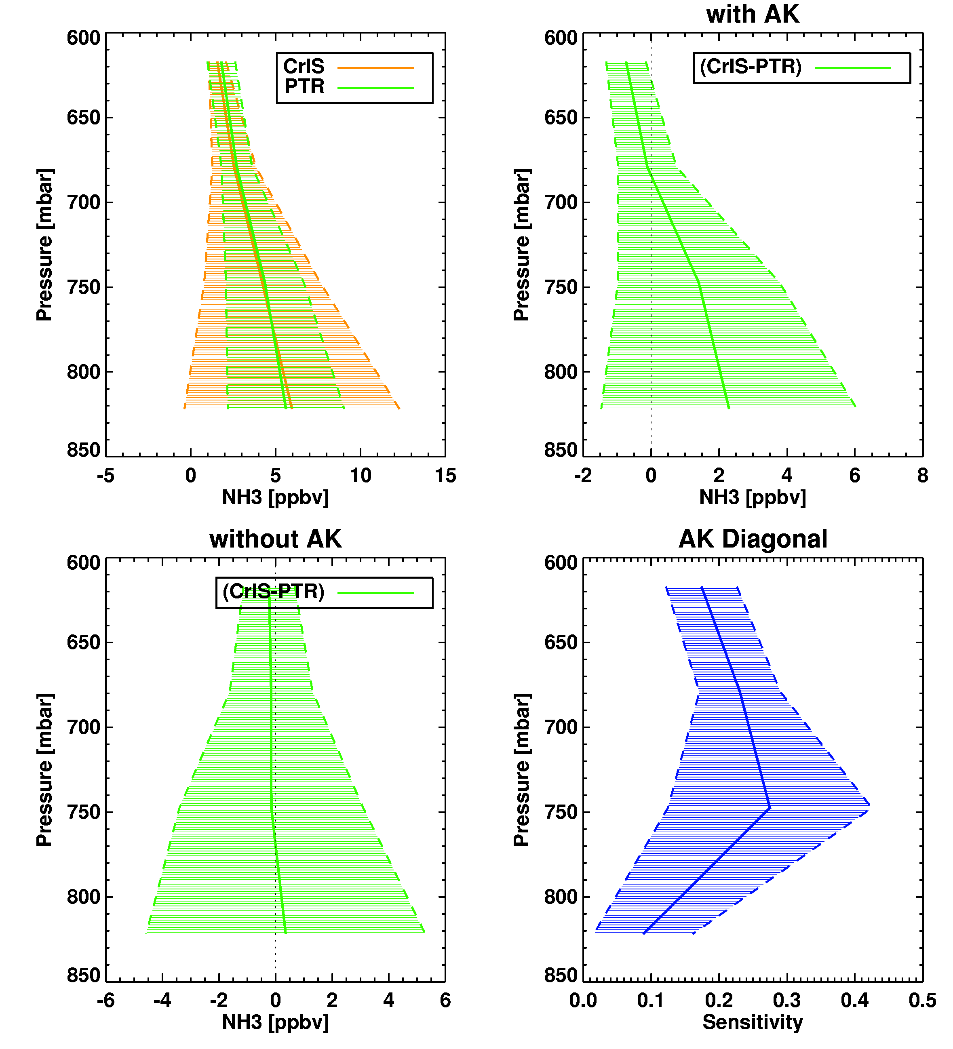
Validation in DAQ Colorado: CrIS vs PTR
Jul 17, 2014
Jul/Aug 2014
Aircraft measurements often start higher up
Few inversion cases
CrIS is unbiased in direct comparisons
Bias when operator is applied may be due to non-optimal choice of a priori

Slide 7
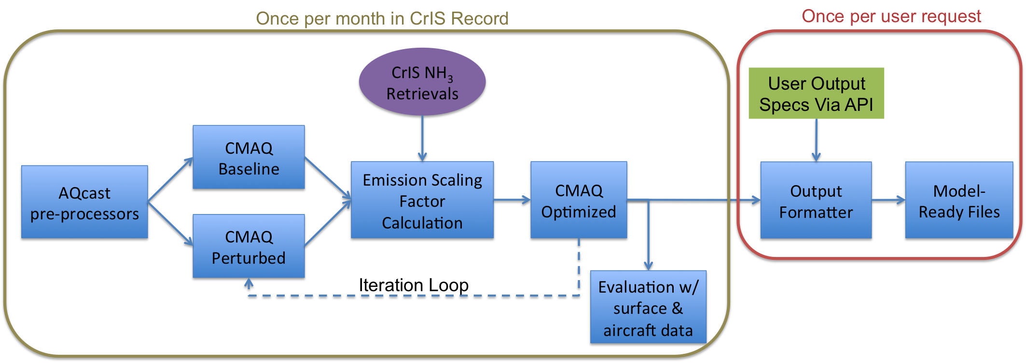
Technical Approach For This Project
Schematic of the AQcast processing set up for this project on the Amazon cloud. The steps on the left outline include monthly iterations of the CrIS data record. The steps on the right outline each user output request.

Slide 8
AQcast CMAQ System for Continental US
Met Inputs
Global CTMs
Emission Inventory
Reanalysis Data
Real-Time
Forecasts
NCAR
Forecasts
NEI
nCast WRF
Other Inputs and Preprocessors
EPA Emission Modeling Platform
ICON/BCON
OMI O₃
EPA Modeling Platform Scripts
WRF
MCIP
NormBEIS
SMOKE
FEST-C
Lightning
CTM
CMAQ
Air Quality Analyses
Sensitivity Studies
Air Quality Forecasts

Slide 9
AQcast Production Architecture

Slide 10
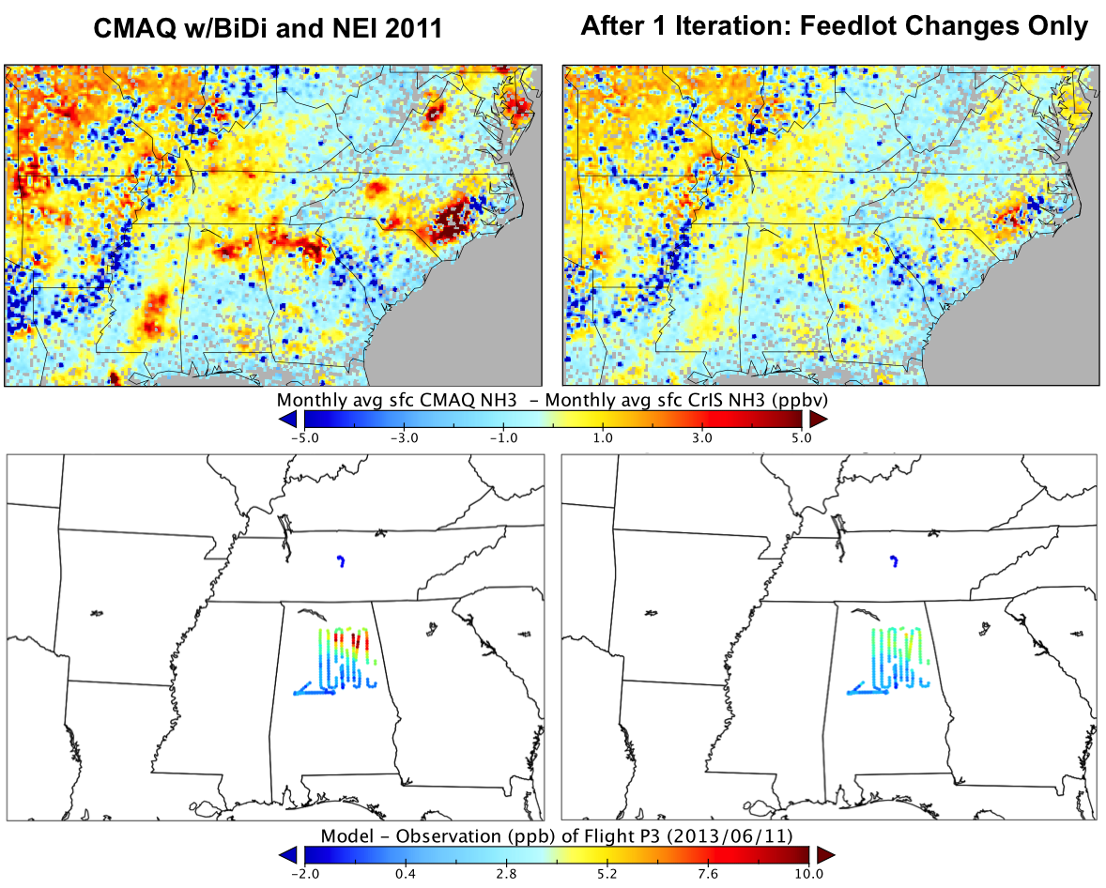
Proof-of-Concept Inversion Method
Finite-difference mass balance (Lamsal et al., GRL, 2011).
Requires two model runs per iteration to estimate sensitivity to emissions.
Calculate emission scaling factors and apply to next iteration.

Slide 11
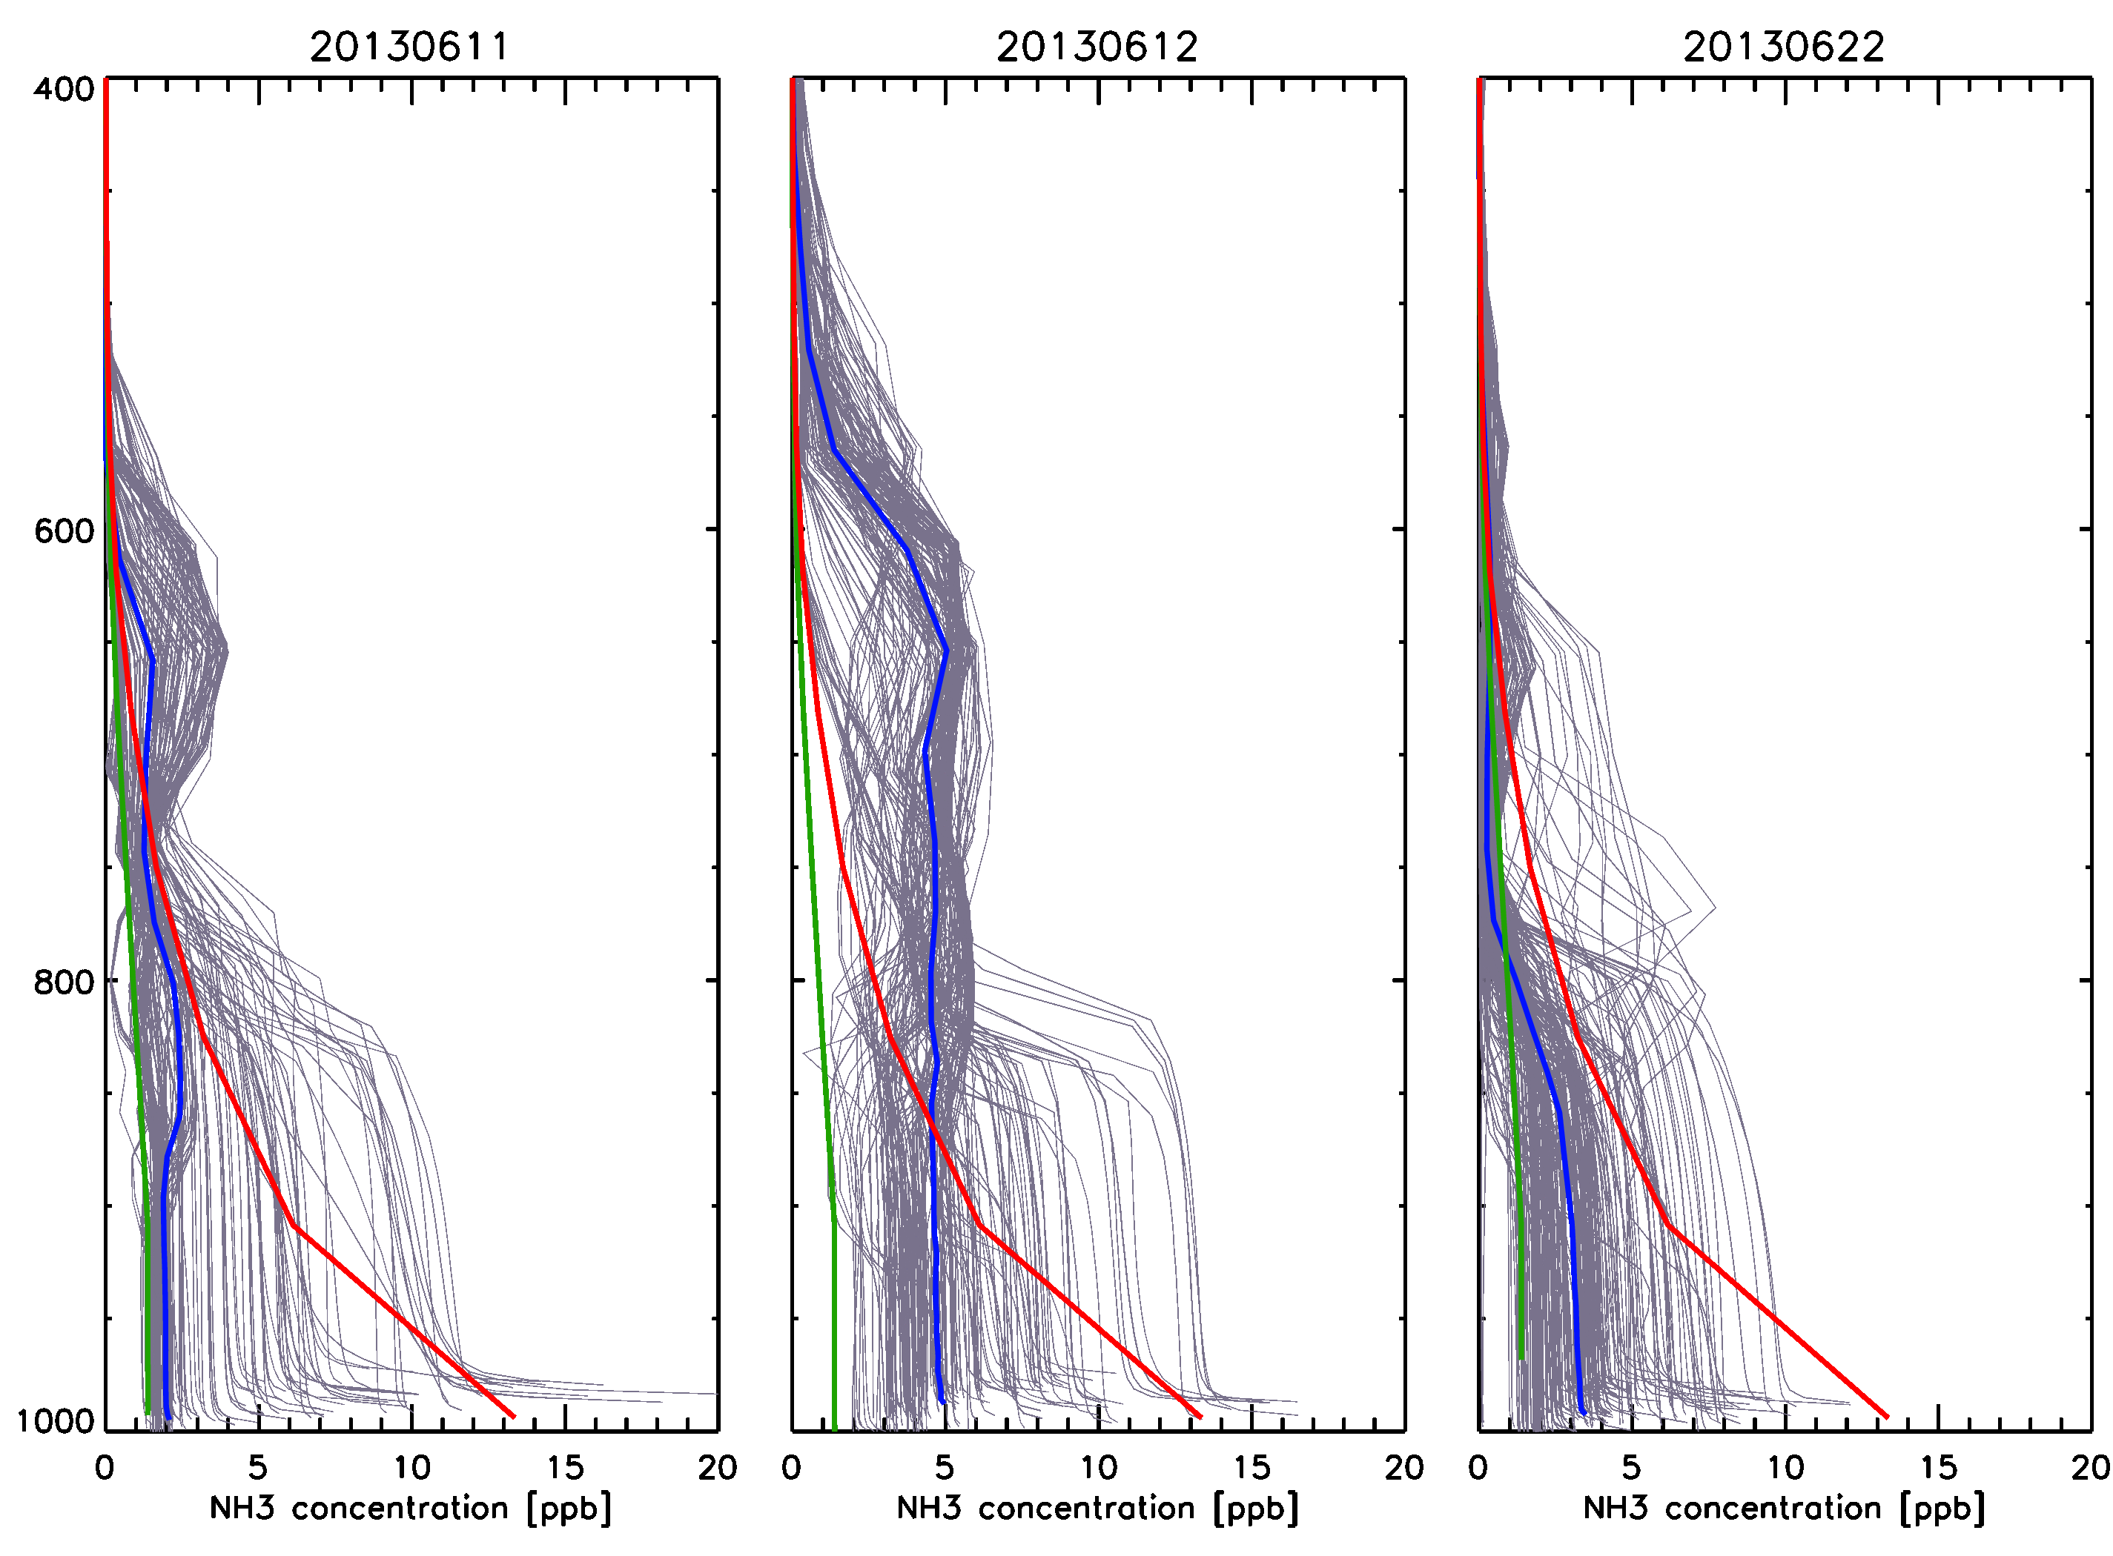
How best to evaluate CMAQ with CrIS?
Selected ~850 CMAQ NH₃ profiles from SENEX period/region
The average CMAQ resembles the CrIS moderate a priori profile
But individual CMAQ profiles have very different shapes from the CrIS polluted and moderate a priori profiles
  Well mixed BL
  Elevated amounts above BL
Key Question: What is the best metric for comparing CrIS and CMAQ?

Slide 12
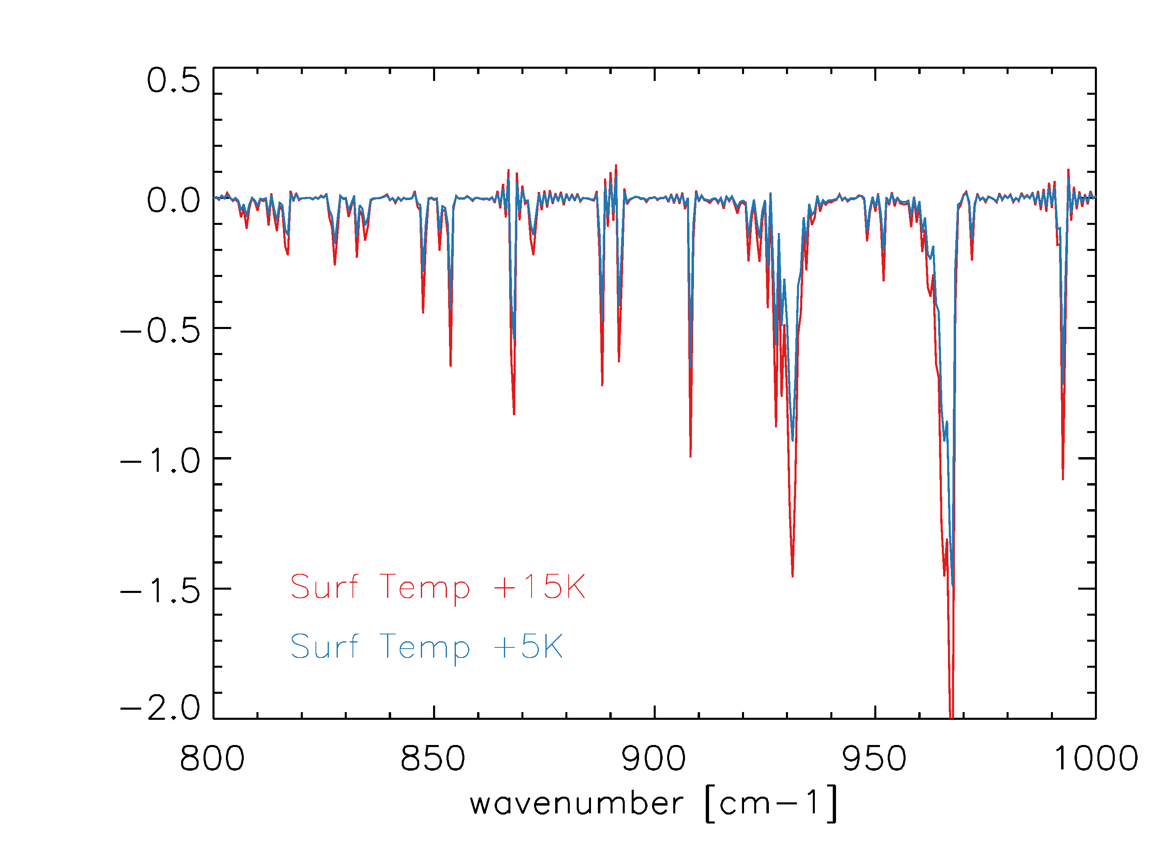
Simulated CrIS retrievals
Used the CMAQ profiles as input to our forward model (OSS) and added typical CrIS noise to the output radiances
Ran the simulations with and without NH₃ to determine NH₃ signal
Since the NH₃ signal is very dependent on the thermal contrast (TCON) ran sets of simulations with different TCON values: 15K and 5K
Selected TCON values are high but not unusual over many source regions
NH₃ on - off
BT Diff [K]

Slide 13
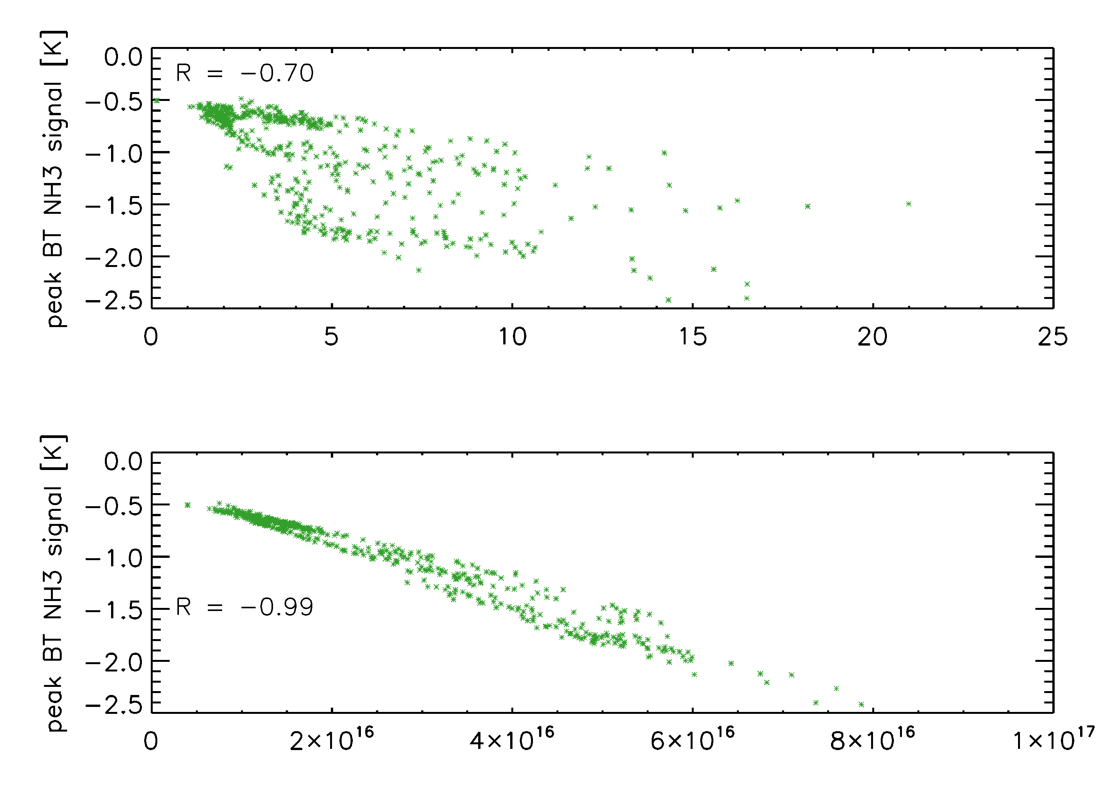
NH₃ Signal Drivers
CMAQ Surface NH₃
Since NH₃ is concentrated in the boundary layer, surface NH₃ is a strong driver of the NH₃ signal
Kharol et al. (2019) have shown similar correlation between AMoN and CrIS surface data
Peak BT Diff [K]
ppbv
CMAQ Total Column NH₃
In this simulation total column and the NH₃ signal are almost perfectly correlated
Could total column be the most robust retrieval metric?
molec/cm2

Slide 14
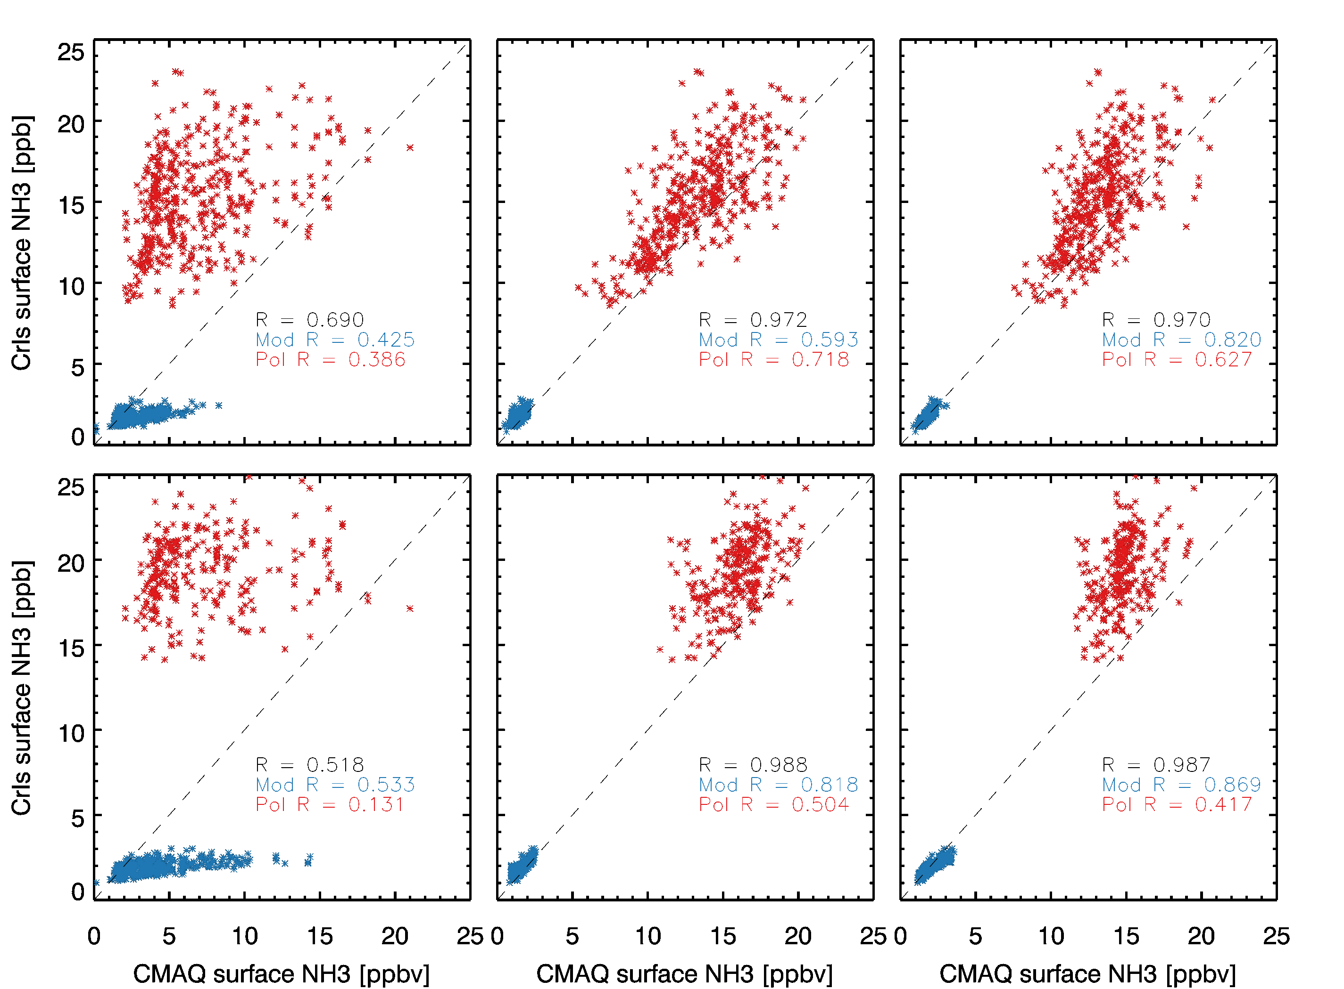
Surface NH₃: Retrieved vs CMAQ
Straight comparisons (no AK)
CrIS biased high for polluted and low for moderate
Applying the operator improves correlation and reduce bias
Retrieval is performing as well as possible
CMAQ no AK
CMAQ+AK log
CMAQ +AK linear
TCON: 15K
Similar results for weaker signal, but:
Selection of a priori has larger impact on the spread of the retrieved surface amounts
TCON: 5K

Slide 15
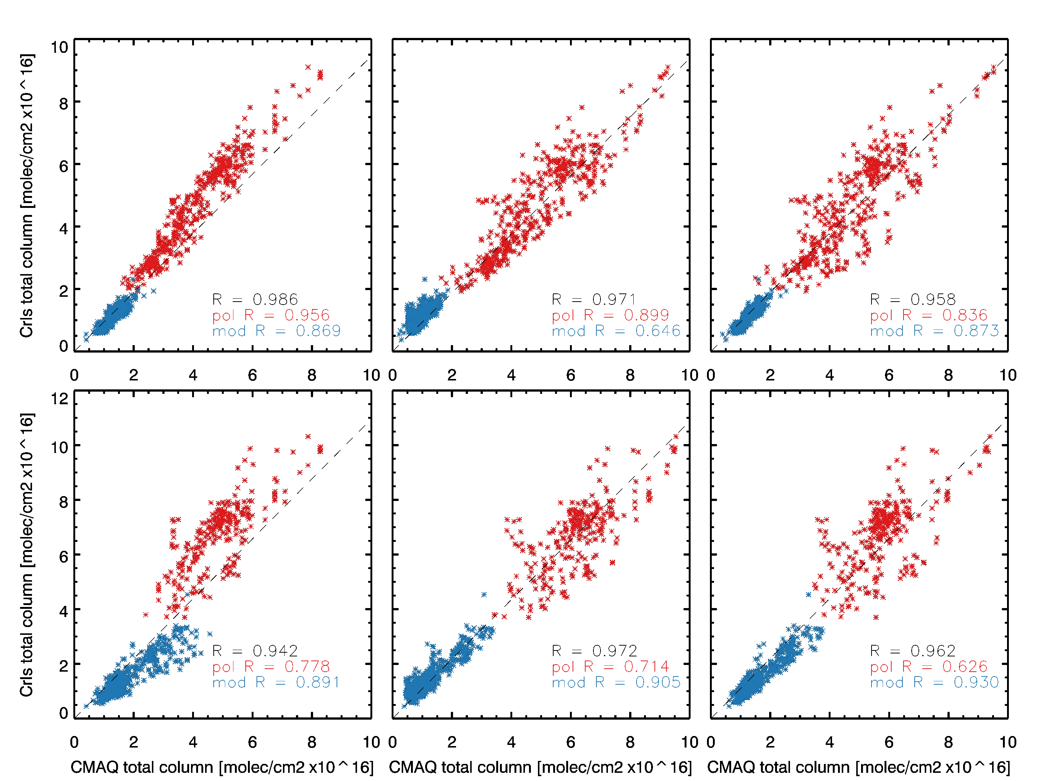
Retrieved Total Column: CrIS vs CMAQ
CMAQ no AK
CMAQ+AK log
CMAQ +AK linear
Correlations
Very high and better than surface correlations
Smooth transition between a priori choices
Applying the AK also has little impact
TCON: 15K
Correlations
Higher and better than surface correlations
But a priori selection does create a gap
TCON: 5K

Slide 16
Summary
We performed a model-retrieval closure study to determine the best metrics to use in the CMAQ inverse modeling, concluding that the total column of NH₃ from CrIS should be compared with the total column from CMAQ after an observation operator with a linear averaging kernel (instead of a log AK) is applied.
The current set up for our NASA Applied Science project includes:
  WRF, SMOKE, EPA Emission Platform, and CMAQ along with its pre-processors
  A North American WRF/CMAQ domain
  Using AWS batch which saves the infrastructure as software and allows you to create identical machines and easily maintain them
This work will provide improved emission inventories of NH₃ to air quality (AQ) forecasters, AQ managers, and other stakeholders.

Slide 17
Additional Slides

Slide 18
NASA Applied Science Project
Expanded North American Domain
WRF version 3.8.1 with the YonSie University (YSU, Hong et al., 2006) non-local turbulent PBL scheme and the Noah land surface scheme (Chen and Dudhia, 2001) were used. Initial and boundary conditions for WRF were provided by the North American Regional Reanalysis (NARR, Mesinger et al., 2006),

Slide 19
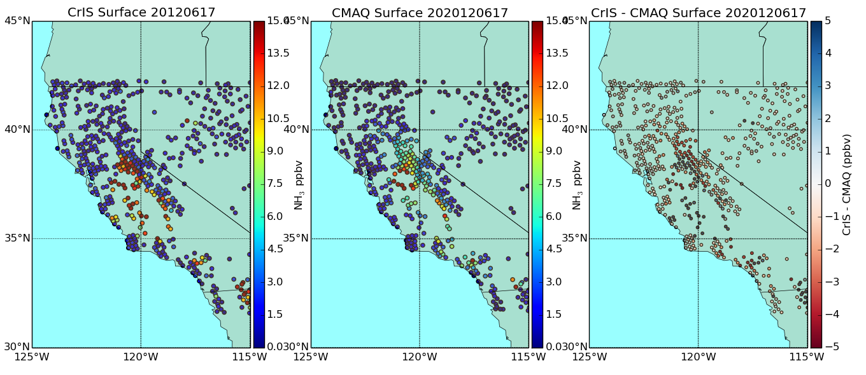
Using Satellites to Investigate NH₃ in California
TES NH₃ transects over Bakersfield in CalNex suggested a x2 underestimate in afternoon due to diurnal cycle errors (Lonsdale et al., ACP, 2017)
2012 CrIS NH₃ is consistent with CalNex TES results.

Slide 20
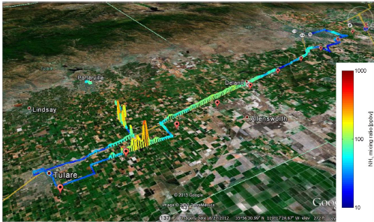
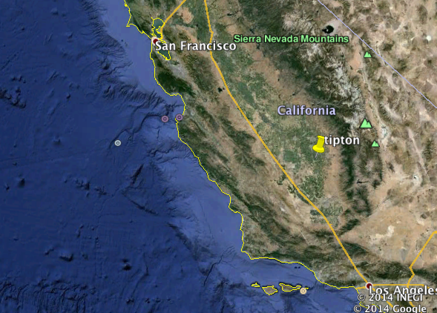
Monitoring NH₃ is difficult
NH₃ is highly reactive
➔ highly variable in space and time
NH₃ from an Open path Quantum Cascade Laser (QCL) on a moving platform in the San Joaquin Valley during DISCOVER-AQ 2013.
Miller et al., AMT 2013

Slide 21
Cross-track Infrared Sounder (CrIS)
CrIS can monitor global NH₃ with high spatial coverage from 2011 and over the next decade or more
 | TES | CrIS
Satellite | AURA | NPP and JPSS-1
Available Data | July 2004 - Jan. 2019 | October 2011-present
Resolution | 0.06 cm⁻¹ | 0.625 cm⁻¹
Footprint | 5x8 km rectangle | 14 km diameter circle
Repeat cycle | Once every 16 days | Daily
Equatorial crossing | 1:30 am and 1:30 pm | 1:30 am and 1:30 pm
Noise in NH₃ window | 0.09 – 0.12 K | 0.03 – 0.06 K

Slide 22
Project Goal
To use CrIS NH₃ retrievals to provide improved emission inventories of NH₃ to air quality (AQ) forecasters, AQ managers, and other stakeholders.
  Integrate the NASA CrIS NH₃ retrieved product and our CMAQ-based inversion methodology into a prototype application system on the Amazon cloud (ARL 4)
  Develop model-ready updated NH₃ emission files for CMAQ, CAMx, and GEM- MACH and beta-test them in the end-user applications (ARL 5)
  Demonstrate that the prototype application improves the simulation of NH₃ and inorganic PM_{2.5} in end-user modeling and leads to better decision making (ARL 6)
  Fully integrate the prototype application into end-user decision-making (ARL 7)
Project Objectives

Slide 23
Application Work Flow
nCast WRF + MCIP
Container
Spatial Allocator Tool
Modeling work flow currently includes:
  North American met configuration
  AMET evaluation
  Spatial allocator shapefiles
  Multiple emission configuration options
  Pre-processor configuration
  Multiple CCTM configuration options
AMET
Original Emissions
Updated Emissions
Report and Review
Pre-processors
CMAQ
CAMx Emissions
GEM-Mach Emissions

Slide 24
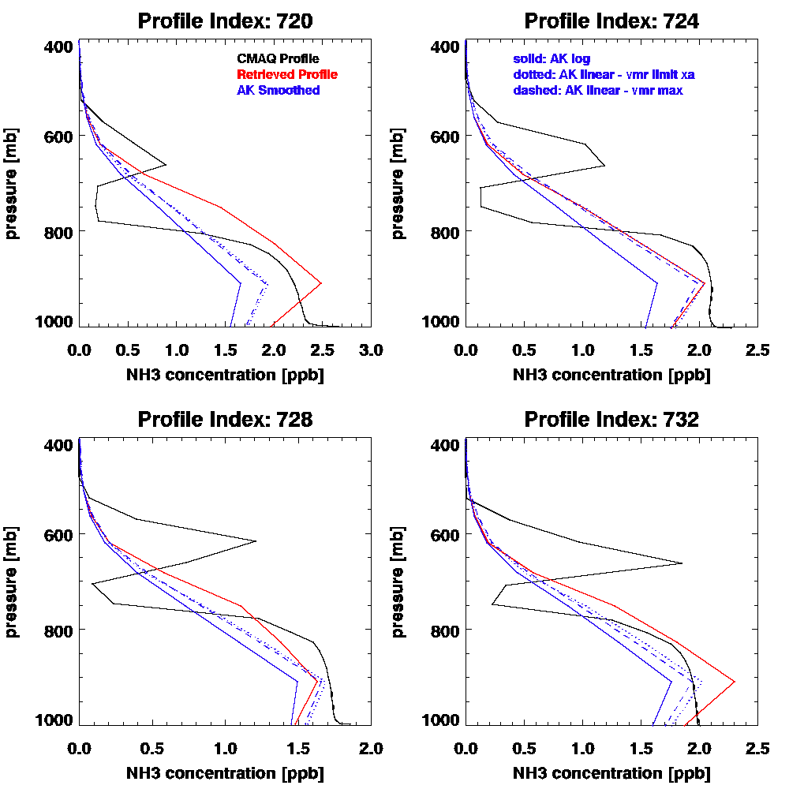
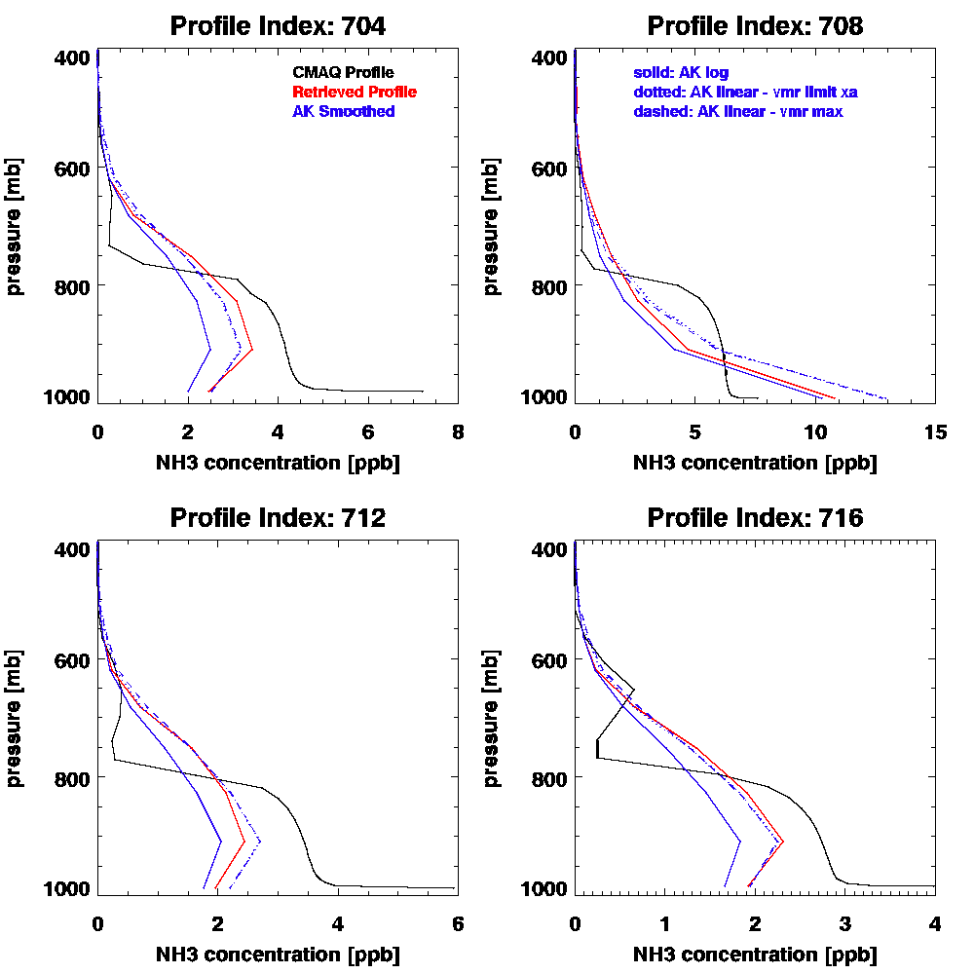
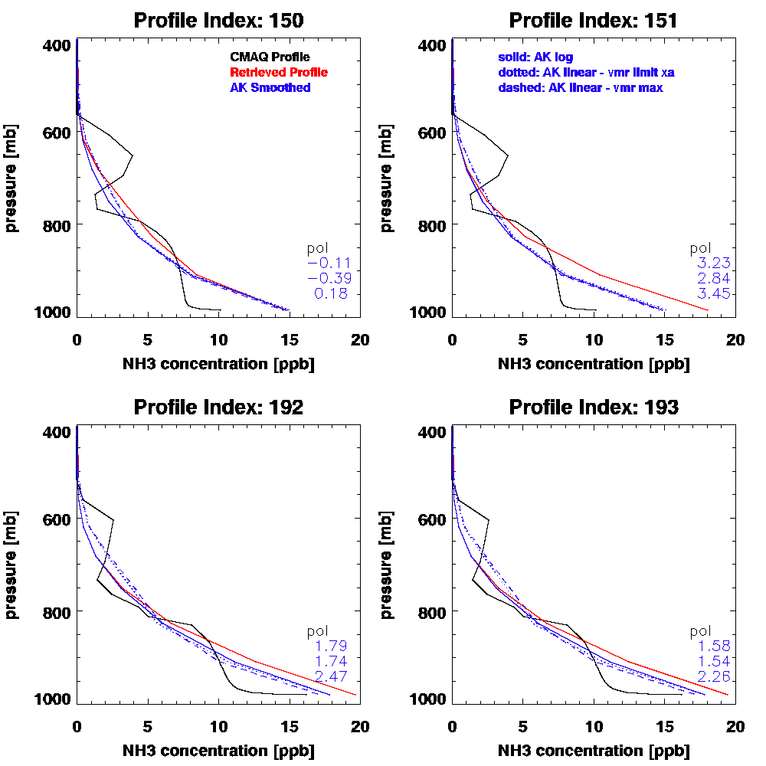
Simulated Retrievals - examples
Moderate
Polluted
Notes:
Comme

Slide 25
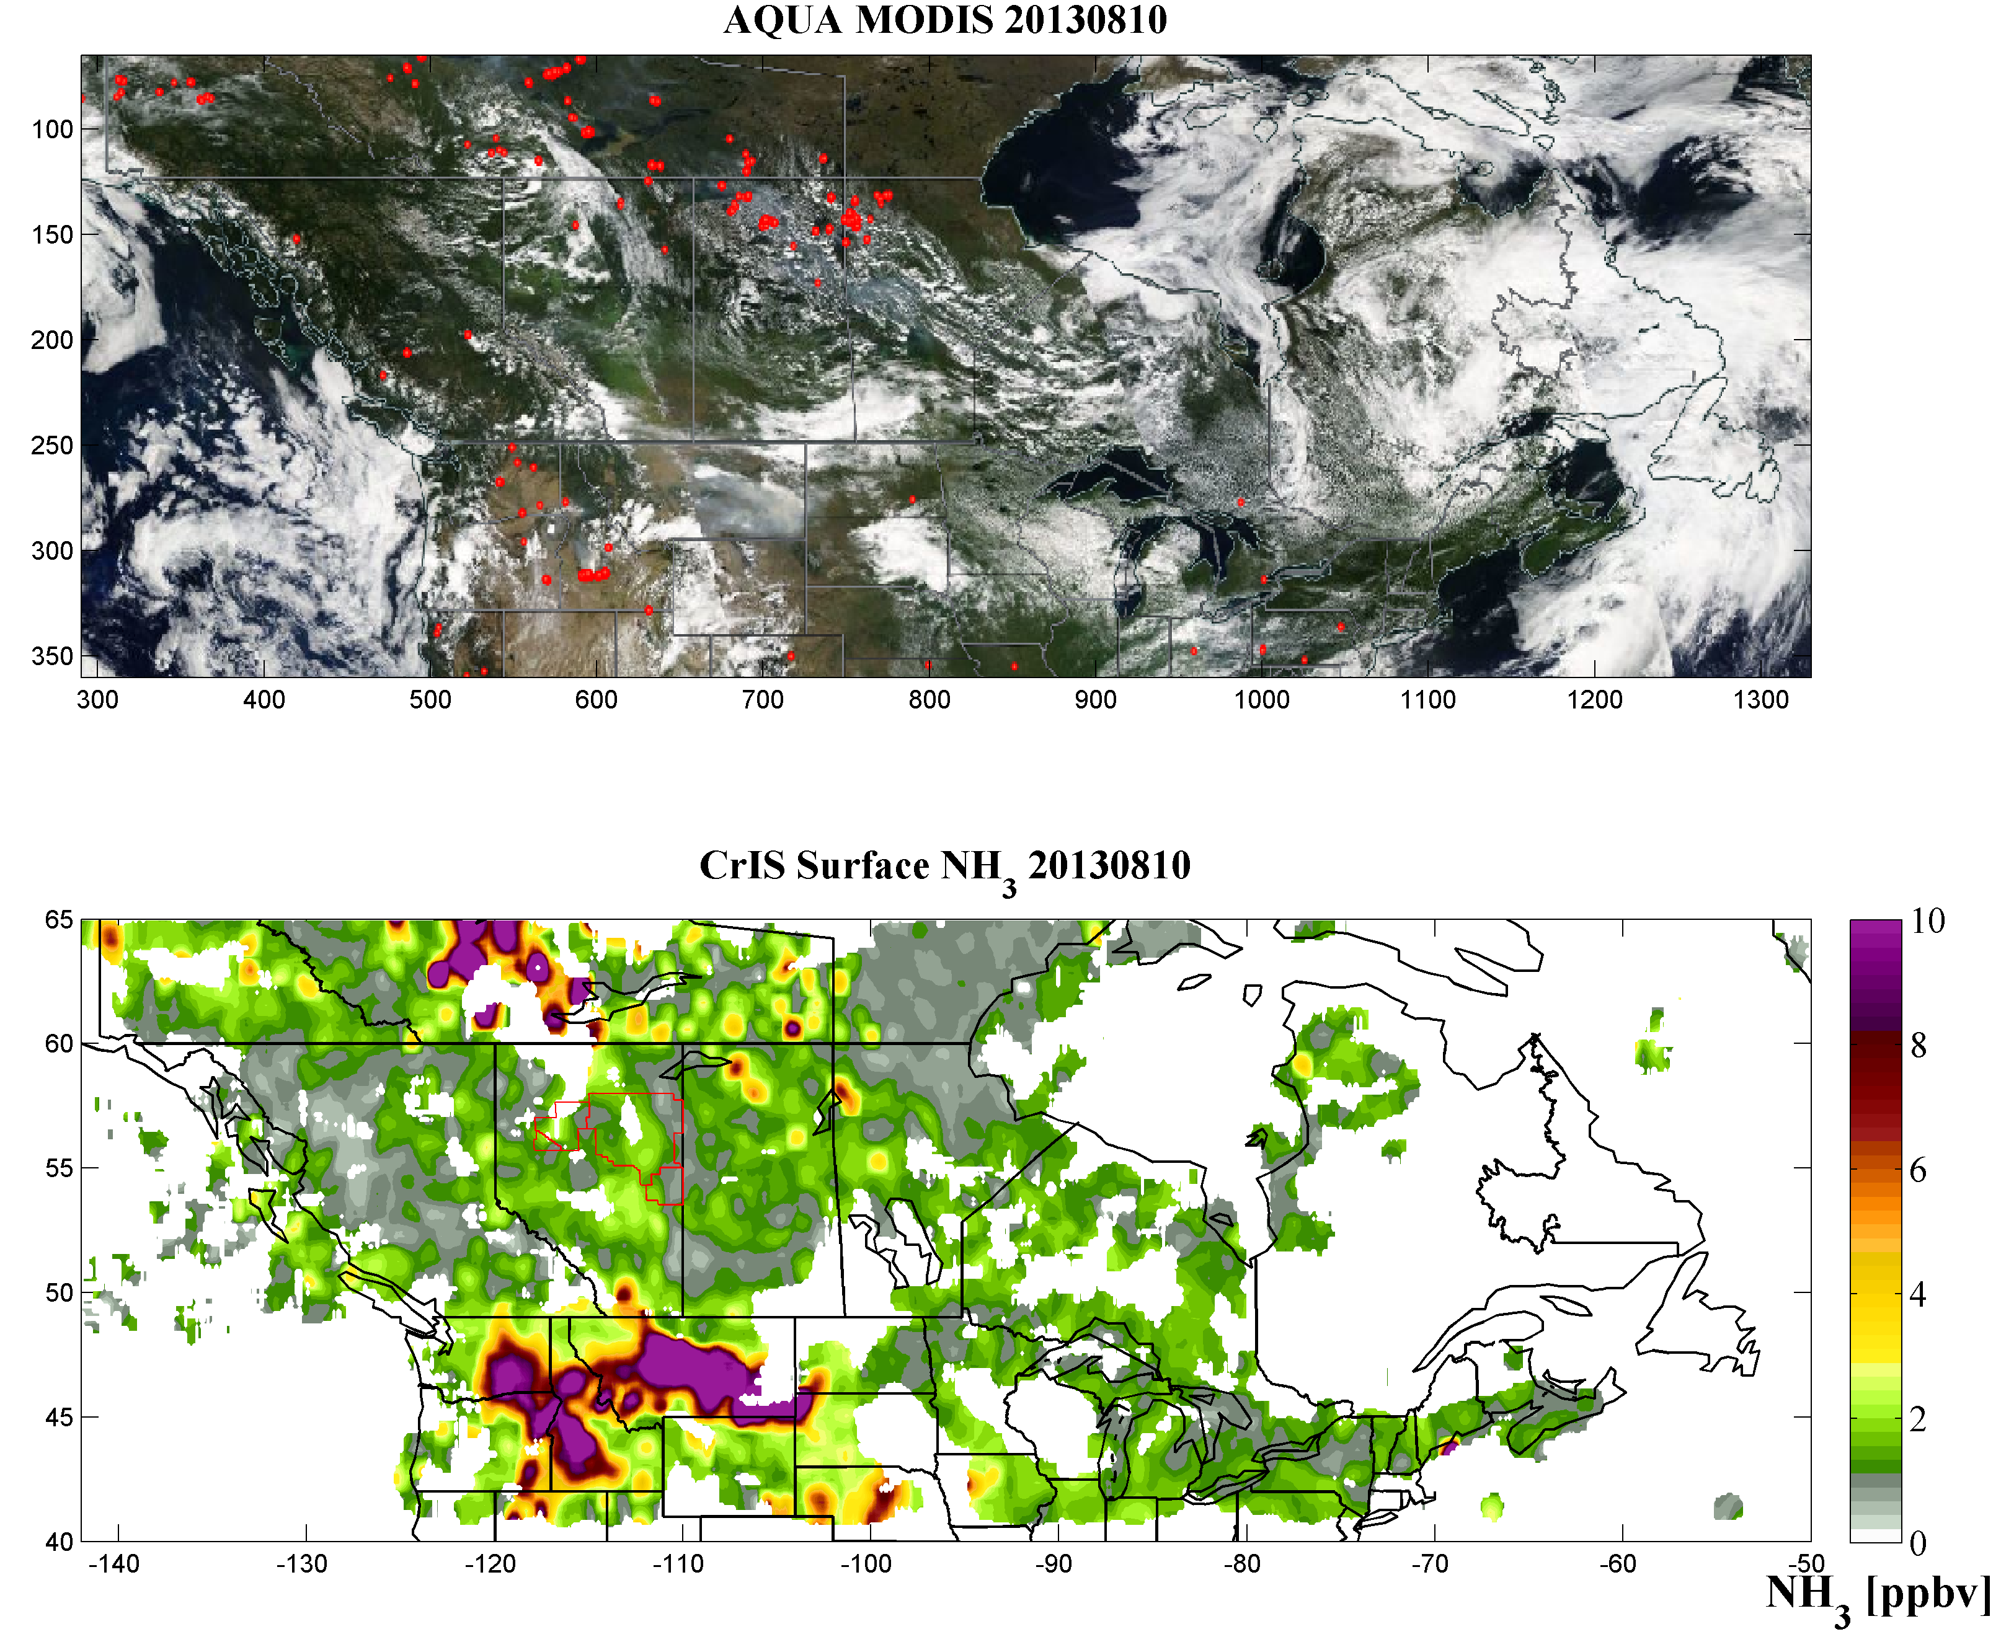
CrIS NH₃: Example of Daily Spatial Variability of Surface NH₃ over North America on August 10, 2013
MODIS
Infrared:
Fire Detection
(red)
Visible:
Cloud (White)
Smoke (blue/gray)
CrIS
Infrared NH₃

Slide 26
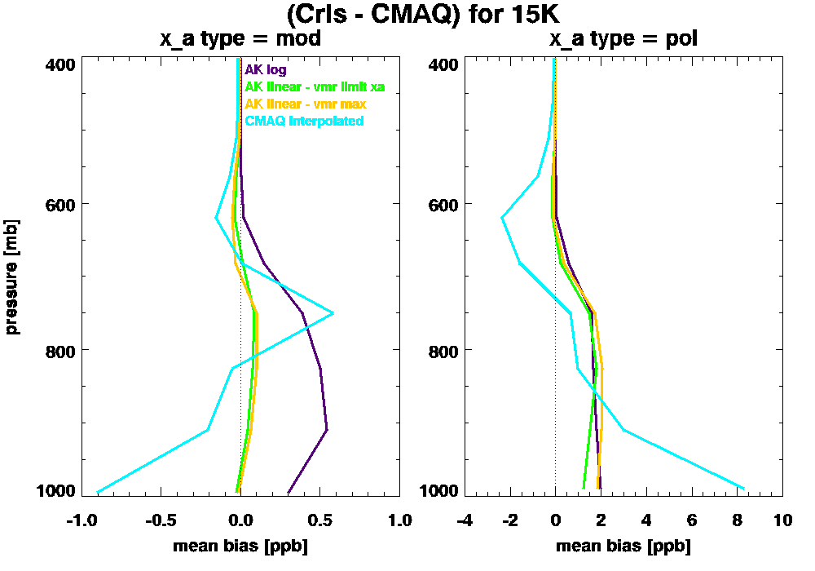

Linear AKs Have Less Bias for Moderately Polluted Cases
Mean Bias for +15K
Mean Bias for +5K
CMAQ No AK CMAQ AK linear – vmr limit xa
CMAQ AK log CMAQ AK linear – vmr max

