Slide 1
CAMQ-AI: A computationally efficient deep learning model to improve CMAQ performance over the United States
By: Ebrahim Eslami
Alqamah Sayeed, Dr. Yunsoo Choi*, Yannic Lops
Department of Earth and Atmospheric Sciences
University of Houston, TX
* Corresponding author
October 2019

Slide 2
Overview
Computation time
Simplified process
Limited measurements
Accuracy
Input uncertainty
Generalized model
Model Uncertainty
1

Slide 3
Overview
Input uncertainty
Simplified process
Limited measurements
Aggregating many variables
Continuous observation feedback
Spatial and temporal generalization
Machine Learning
2

Slide 4
Deep Learning
Introduction
Dendrites
(receiver)
Terminals
(output)
Cell body
(Processor)
Axon
(Connector)
Artificial Intelligence
Machine Learning
Neural Network
Deep Neural Network
Deep Convolutional Neural Network
Regressive
Deep Convolutional Neural Network
3

Slide 5
Methodology: CMAQ-AI
Physical System: Atmosphere
CMAQ-AI
Observed Data: Point-based data
WRF + CMAQ
AI
AI-powered Air Quality Prediction
Numerical Model: Model estimation (e.g., vertical wind field, precursors); parametric values (e.g., PBL); atmospheric chemistry
Computer Simulation:
Fine-resolution 3D spatial grid; continuous timesteps, chemical mechanism
Weather Parameters (WRF)
AI: Deep CNN
Actual Concentration of Pollutant
(O₃ Observation Network)
Chemistry Parameters (CMAQ)
DNN modeling time period (for continental U.S. – 1215 AQS stations):
Training process: 2011 – 2013 (April – October)
Next day prediction: 2014 (April – October)
4

Slide 6
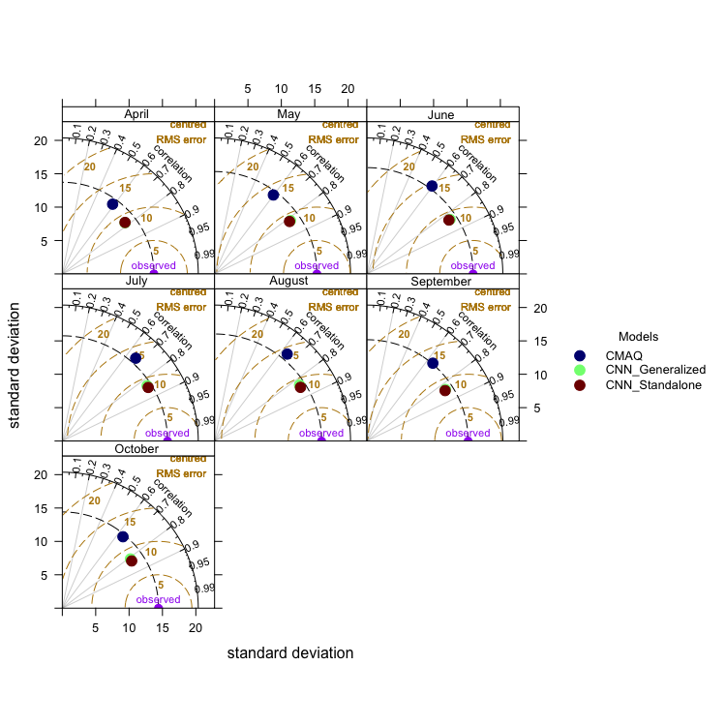
Results:
Generalization
CNN_Generalized:
One model predicts all stations
CNN_Stanalone:
Each station has specific model
5

Slide 7
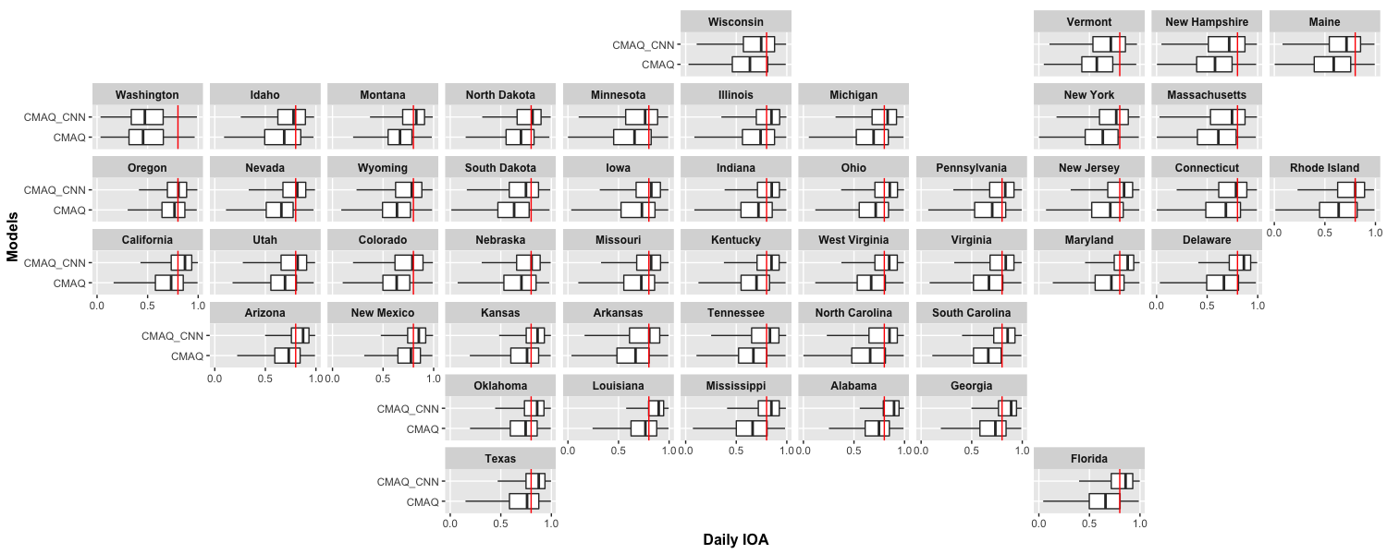
Results: IOA
IOA: Index of Agreement
Lowest scale = 0.0
Highest scale = 1.0
6

Slide 8
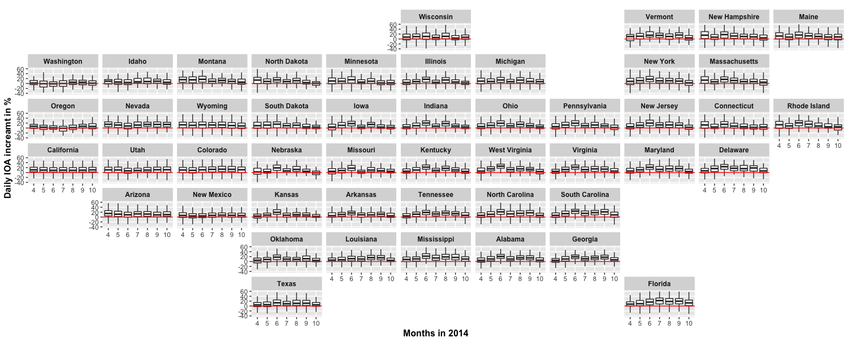
Methodology
7

Slide 9
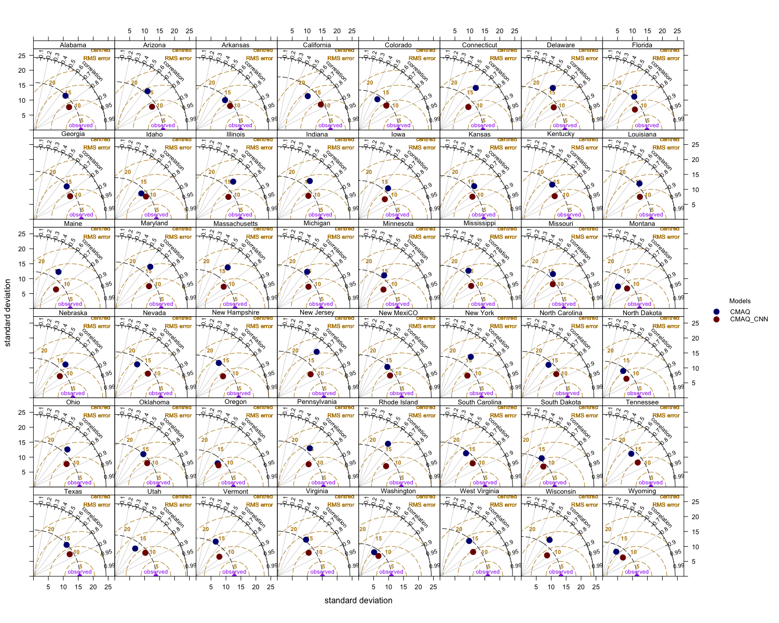
8
18

Slide 10
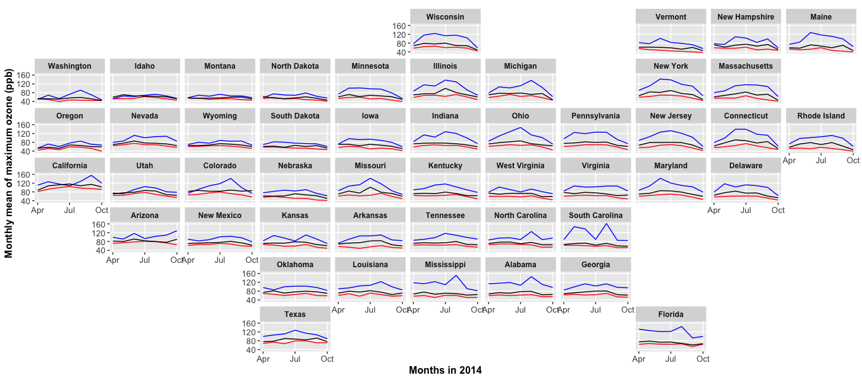
Results: Max ozone
9

Slide 11
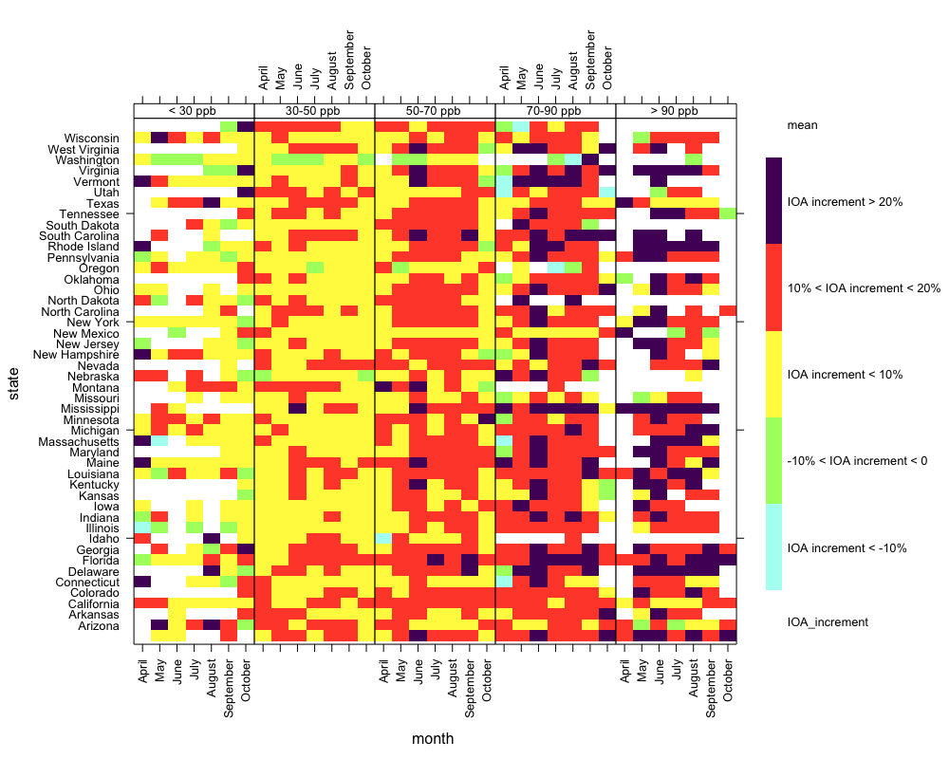
Results:
Dependencies
10

Slide 12
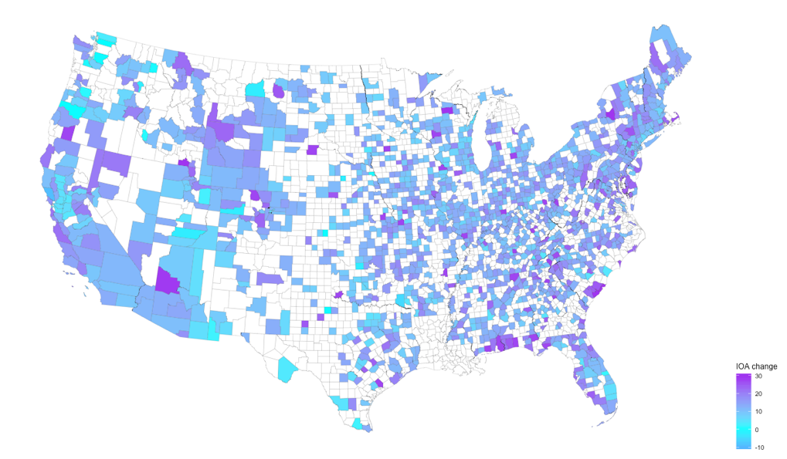
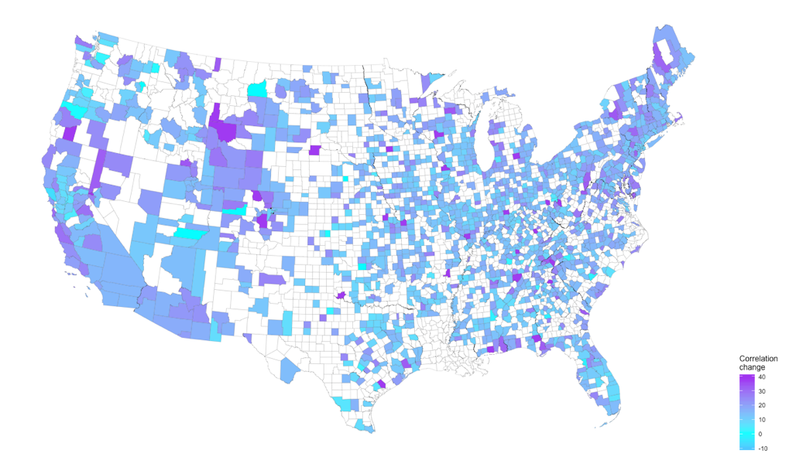
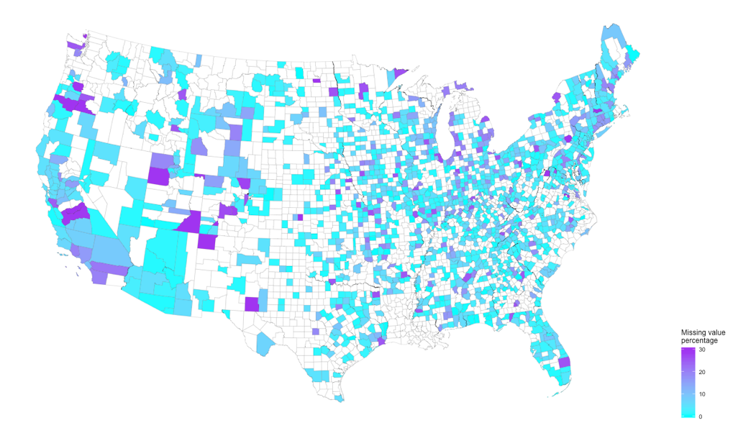
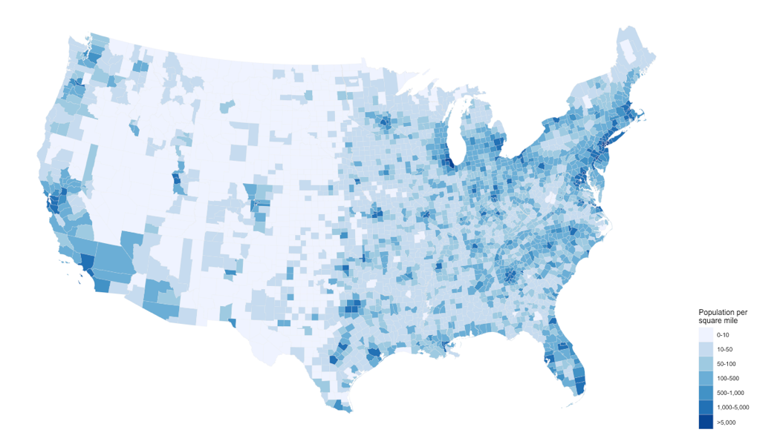
11

Slide 13
Results:
NaN Percentage
NaN %
9
12

Slide 14
Results
$$y+x=1$$
Perfect Prediction
$$y+x=0.91$$
13

Slide 15
Summary
The CMAQ-AI is a generalize and robust post-processing model.
The CMAQ-AI model significantly improved the performance of the CMAQ model in term of both accuracy (IOA) and bias (maximum daily ozone).
Yearly IOA improved around 0.13 on average and up to 0.30 across the United States by using CMAQ-AI model.
The CMAQ-AI model shows significant improvement on post-processing high overprediction of ozone peaks by CMAQ.
14

Slide 16
Thank
you
for
your
attention

