Slide 1
Expansion of a Size Distribution Profile Library for Particulate Matter (PM) Emissions Processing from Three to 32 Source Categories
Junhua Zhang and Michael D. Moran
Air Quality Research Division, Environment and Climate Change Canada,
4905 Dufferin Street, Toronto, ON, M3H 5T4, Canada
junhua.zhang@canada.ca
Elisa Boutzis
IT/Net-Ottawa Inc., 150 Elgin Street, Suite 1800, Ottawa, ON K2P 2P8, Canada
18th Annual CMAS Conference 21-23 Oct. 2019 Chapel Hill, NC, USA

Slide 2
outline
Current PM Size Disaggregation and Chemical Speciation for the Canadian Air Quality Model GEM-MACH
Compilation of the New PM Size Distribution Profile Library
Creation of Combined SMOKE-ready PM Speciation and Size Disaggregation Profiles
Impacts on Processed PM Emissions
Summary and Conclusions

Slide 3
CURRENT PM Size Disaggregation and Chemical Speciation for GEM-MACH (1)
GEM-MACH: Global Environmental Multiscale – Modelling Air-quality and Chemistry, ECCC’s air quality model
In-line chemical transport model with two sectional (i.e., size bin) configurations to represent the PM size distribution
Two-bin: PM_{2.5} (fine bin) and PMC (coarse bin, equal to PM₁₀ - PM_{2.5})
12-bin: PM_{2.5} (Bins 1 - 8), PMC (Bins 9,10), and >PM₁₀ (Bins11,12)
Bin 1 | Bin 2 | Bin 3 | Bin 4 | Bin 5 | Bin 6 | Bin 7 | Bin 8 | Bin 9 | Bin 10
0.01-0.02 | 0.02-0.04 | 0.04-0.08 | 0.08-0.16 | 0.16-0.32 | 0.32-0.64 | 0.64-1.28 | 1.28-2.56 | 2.56-5.12 | 5.12-10.24

Slide 4
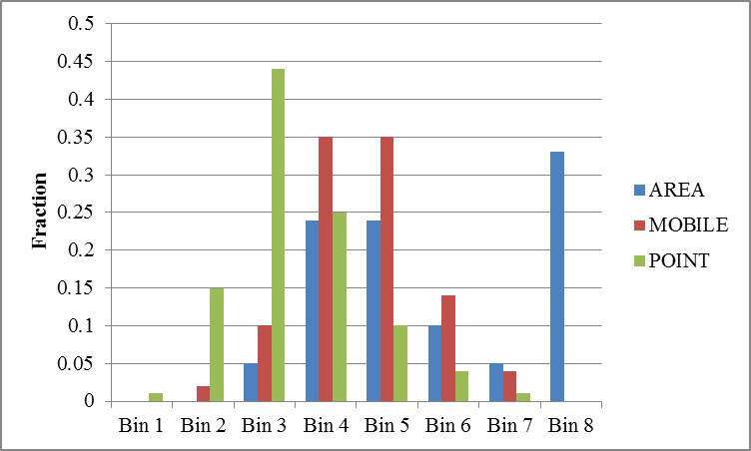
CURRENT PM Size Disaggregation and Chemical Speciation for GEM-MACH (2)
For the12-bin version, three generic PM size distribution profiles are currently applied for three broad source types: area, mobile, and point
Fractional distribution of the eight PM_{2.5} size bins for the 12-bin version of GEM-MACH for three broad types of emissions sources
Based on 10 source-type-specific particle size distributions discussed in Eldering and Cass (1996)
Eldering, A., and G.R. Cass. 1996. J. Geophys. Res. 101: 19343-19369

Slide 5
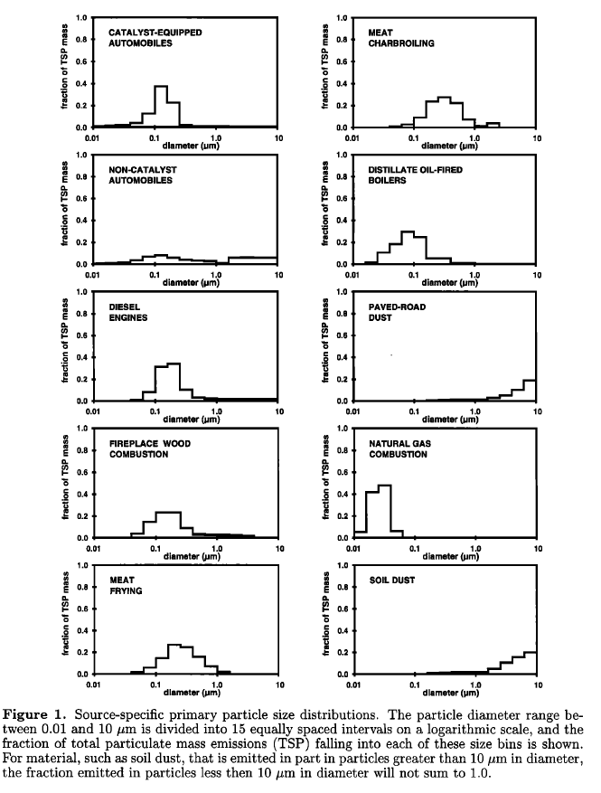
Current PM Size Disaggregation and Chemical Speciation for GEM-MACH (3)
Current PM_{2.5} Size Distributions for 3 Broad
Source Types
(Eldering and Cass, 1996)
“AREA” size distribution is used for all area sources, e.g., PM emissions from wood combustion are treated the same as road dust!

Slide 6
Current PM Size Disaggregation and Chemical Speciation for GEM-MACH (4)
PM chemical speciation is based on PM speciation profiles obtained from the EPA SPECIATE database
91 PM speciation profiles are used for splitting PM emissions into six model PM chemical components:
    Sulfate (SU), Nitrate (NI), Ammonium (AM), Elemental Carbon (EC), Organic Matter (OM), and Crustal Material (CM = PM - SU - NI - AM – EC - OM)
PM size disaggregation is assumed to be independent of PM chemical speciation
Notes:
e.g. dust from unpaved roads in a facility whose emissions are reported in the point source inventory will use size distribution for point source, whereas area source size distribution will be used for regular unpaved road dust

Slide 7
Compilation of the NEW PM Size
Distribution Profile Library (1)
Ultimate goal is to create a size disaggregation profile for each of the 91 PM speciation profiles
100+ publications were reviewed for PM size distribution data
PM size distribution profiles representing 32 of the 91 PM speciation profiles were identified from 95 publications
Graphical digitizing software (Engauge Digitizer and WebPlot Digitizer) was used to transform PM size distribution plot images from paper versions to .CSV files
Units transformations were required from various types of measurement data to the model representation as mass size distribution in Stokes diameter

Slide 8
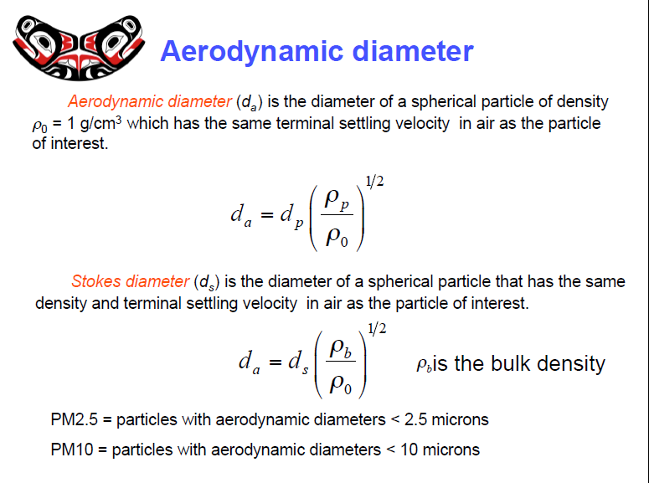
Compilation of the NEW PM Size
Distribution Profile Library (2)
Different measurement methods give different diameter types, commonly aerodynamic diameter and electrical mobility diameter, but model uses Stokes diameter
https://courses.washington.edu/envh431/files/3.aerosol.pdf

Slide 9
Compilation of the NEW PM Size
Distribution Profile Library (3)
Measurements of PM size distribution may be number, volume, or mass but model requires mass distribution
Particle density is needed for various conversions
Density of model PM species (g cm⁻³):
Average weighted particle density for each PM speciation profile was calculated based on the relative fractions of 6 model PM chemical components, e.g., Agricultural Burning
SU | NI | AM | EC | OM | CM
1.769 | 1.725 | 1.7543 | 1.5 | 1.3 | 2.65
PM Species | Density | Fraction | Weighted Density
SU | 1.769 | 0.016456 | 0.029111
NI | 1.725 | 0.0035 | 0.006038
AM | 1.7543 | 0.018 | 0.031577
EC | 1.5 | 0.109 | 0.1635
PC | 1.3 | 0.65994 | 0.857922
CM | 2.65 | 0.193104 | 0.511726
Average Weighted Density |  |  | 1.599873

Slide 10
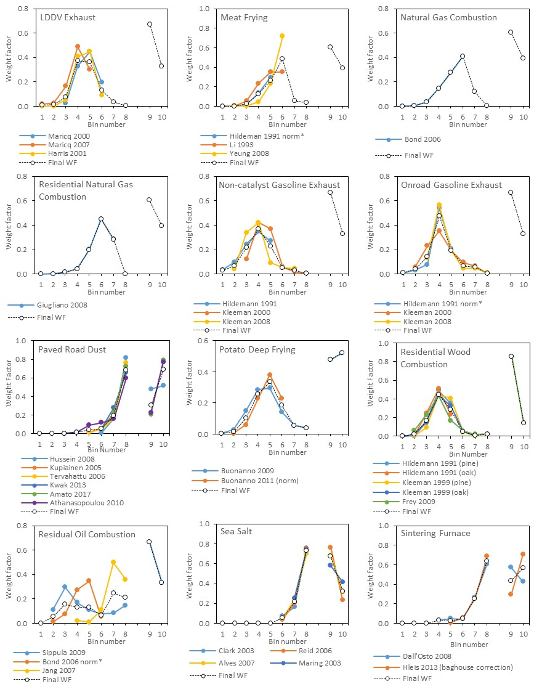
Compilation of the NEW PM Size
Distribution Profile Library (4)
Measurements from various studies (solid lines) for the same type of emissions were normalized and averaged to get a mean size disaggregation profile (dashed lines)
Notes:
If there is no measurement for some bins, split factors from other literature examples for the same source (or a similar source) were used for those bins. In one case (distillate oil combustion) it was necessary to perform extrapolation to get the fractions for those bins.

Slide 11
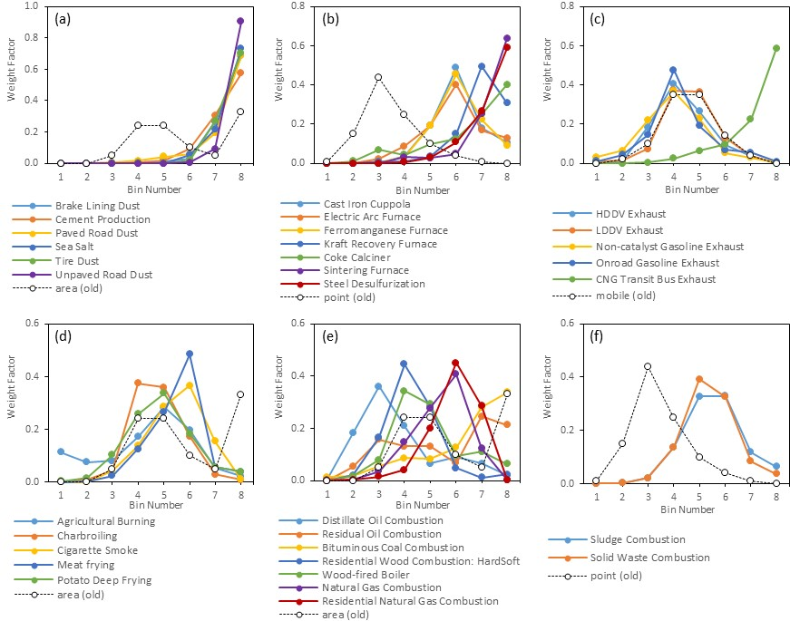
Compilation of the NEW PM Size
Distribution Profile Library (5)
32 new PM_{2.5} size distribution profiles (solid lines) versus 3 current generic profiles (dotted lines)

Slide 12
Compilation of the NEW PM Size
Distribution Profile Library (6)
Remaining 59 PM speciation profiles for which no PM size distribution profiles were found in literature are grouped by process type, e.g., size distribution profile for Unpaved Road Dust is used for 14 other PM speciation profiles
P_NUMBER | PM_PROFILE_NAME
92088 | Unpaved Road Dust - Simplified
92020 | Construction Dust - Simplified
92073 | Sand & Gravel - Simplified
92074 | Sandblast - Simplified
92045 | Limestone Dust - Simplified
92047 | Mineral Products - Avg - Simplified
92022 | Crustal Material - Simplified
92010 | Brick Grinding and Screening - Simplified
92093 | Wood Product Sanding - Simplified
92094 | Wood Product Sawing - Simplified
92030 | Food & Ag - Handling - Simplified
92001 | Agricultural Soil - Simplified
92023 | Dairy Soil - Simplified
92038 | Industrial Soil - Simplified
92007 | Auto Body Shredding - Simplified

Slide 13
Creation of combined SMOKE-ready PM Speciation and Size Disaggregation profiles (1)
Creation of PM speciation-profile-specific SMOKE-ready size distribution profiles
AM
AM1, AM2, ……, AM7, AM8
CM
CM1, CM2, ……, CM7, CM8
Speciation Profile
EC
EC1, EC2, ……, EC7, EC8
PM2.5
NI
NI1, NI2, ……, NI7, NI8
OM
OM1, OM2, ……, OM7, OM8
SU
SU1, SU2, ……, SU7, SU8
Size Distribution Profile

Slide 14
Creation of combined SMOKE-ready PM Speciation and Size Disaggregation profiles (2)
SMOKE-ready PM speciation/size distribution profiles, e.g., Agriculture Burning
Profile | Poll | Species | Split Factor | Divisor | Mass Fraction
92000 | PM2_5 | EAM1 | 0.002056787 | 1 | 0.002056787
92000 | PM2_5 | EAM2 | 0.001368361 | 1 | 0.001368361
92000 | PM2_5 | EAM3 | 0.001468646 | 1 | 0.001468646
92000 | PM2_5 | EAM4 | 0.003084393 | 1 | 0.003084393
92000 | PM2_5 | EAM5 | 0.005097205 | 1 | 0.005097205
92000 | PM2_5 | EAM6 | 0.003552803 | 1 | 0.003552803
92000 | PM2_5 | EAM7 | 0.000962329 | 1 | 0.000962329
92000 | PM2_5 | EAM8 | 0.000409477 | 1 | 0.000409477
92000 | PM2_5 | ECM1 | 0.022065211 | 1 | 0.022065211
92000 | PM2_5 | ECM2 | 0.014679774 | 1 | 0.014679774
92000 | PM2_5 | ECM3 | 0.015755632 | 1 | 0.015755632
92000 | PM2_5 | ECM4 | 0.033089366 | 1 | 0.033089366
92000 | PM2_5 | ECM5 | 0.054682812 | 1 | 0.054682812
92000 | PM2_5 | ECM6 | 0.038114469 | 1 | 0.038114469
92000 | PM2_5 | ECM7 | 0.010323866 | 1 | 0.010323866
92000 | PM2_5 | ECM8 | 0.004392869 | 1 | 0.004392869
92000 | PM2_5 | ……. | ……. | ……. | …….

Slide 15
Impacts on Processed PM Emissions (1)
Comparisons of model-ready size-disaggregated PM_{2.5} emissions for some merged sectors (dashed=old, solid=new)

Slide 16
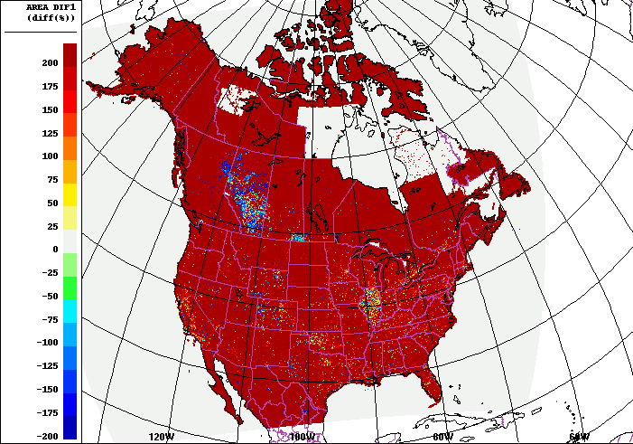
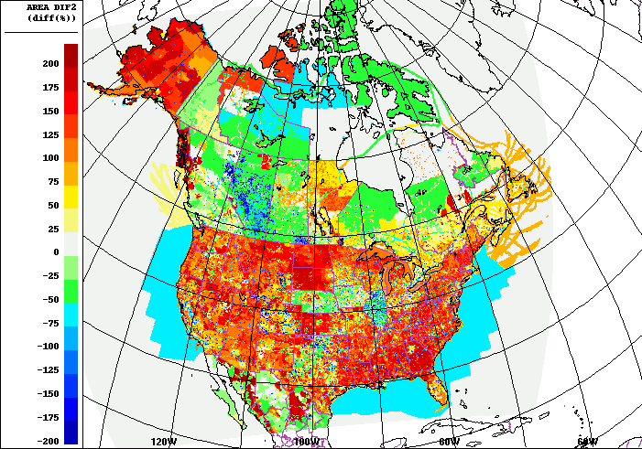
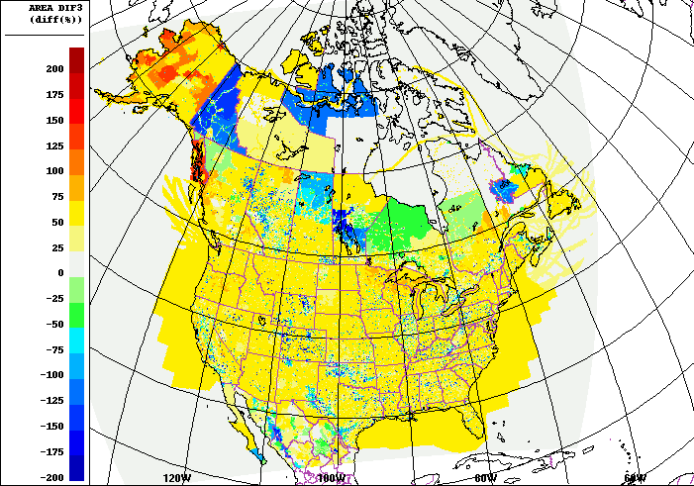
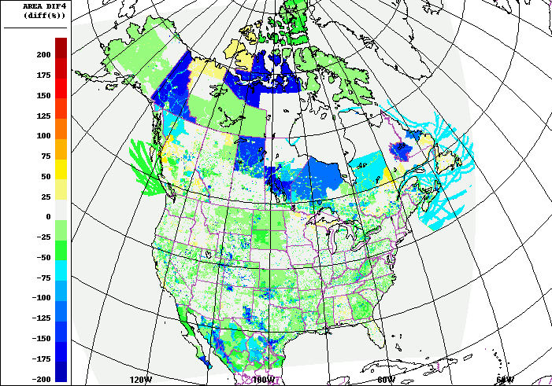
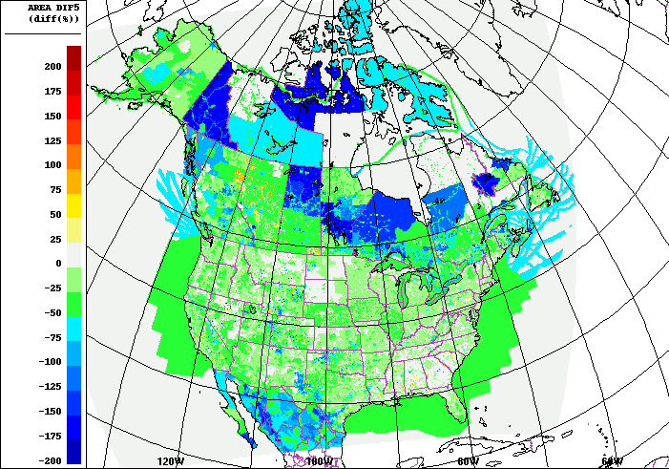
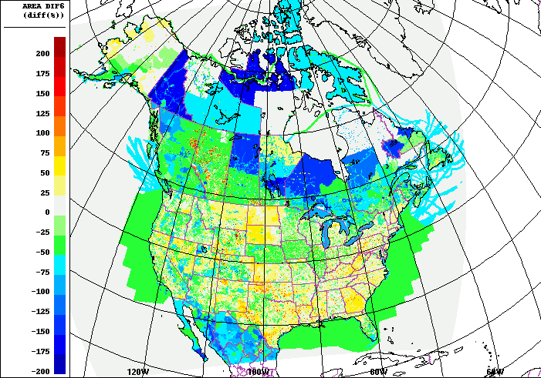
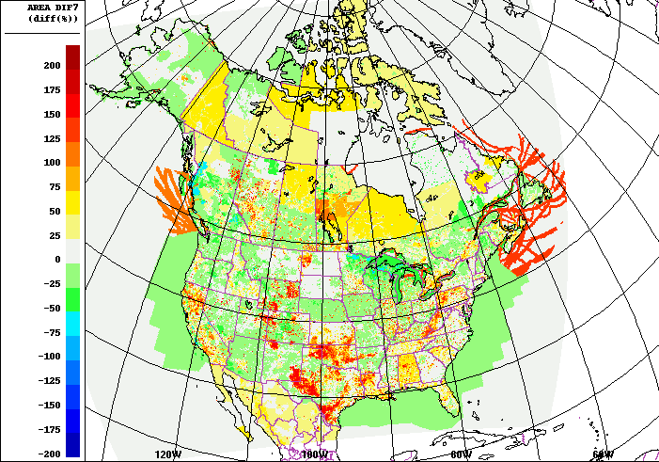
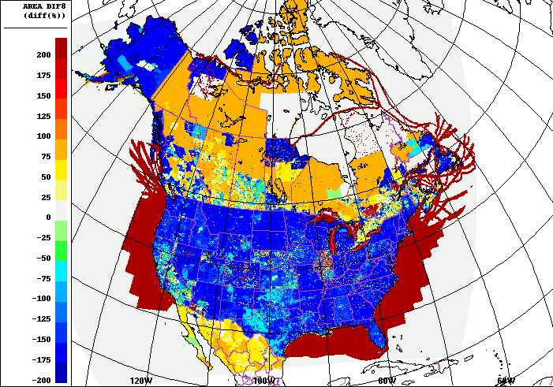
Impacts on Processed PM Emissions (2)
Percentage difference upon change to new speciation profiles for area source PM_{2.5}
1
2
Old size distribution for area source does not have emissions for Bin 1 (0.01-0.02 um)
3
4
5
6
7
8

Slide 17
Summary and conclusions (1)
Current PM size distribution profiles used for generating size-disaggregated PM emissions for GEM-MACH are limited to only three broad sources, which is not representative enough
Current size-disaggregation of PM emissions is independent of chemical process (PM speciation) which is inappropriate for many types of emissions
32 new PM-speciation-dependent size distribution profiles were created based on review of more than 100 size distribution profiles from the literature

Slide 18
Summary and conclusions (2)
Discrepancy between emissions/observations units and in model units for physical/chemical processes
Aerodynamic: some emissions; observations
Electrical mobility: some emissions
Stokes: model physical & chemical processes
Significant differences were observed between the size-disaggregated model-ready emissions processed using the old and new size distribution profiles
Impacts on GEM-MACH performance for prediction of size-resolved PM concentration will be tested in the near future
Publication in preparation

Slide 19
Thank You

