Slide 1
Urban-Scale Source Attribution of Greenhouse Gases Using an Air Quality Model
Mike Moran¹, Stephanie Pugliese Domenikos², Craig Stroud¹, Junhua Zhang¹, Felix Vogel³, Shuzhan Ren¹, Qiong Zheng¹, Doug Worthy³, and Jennifer Murphy⁴
¹ Air Quality Research Division, Environment and Climate Change Canada (ECCC),
Toronto, Ontario, Canada
² Dept. of Science and Technology Studies, York University, Toronto, Ontario, Canada
³ Climate Research Division, ECCC, Toronto, Ontario, Canada
⁴ Dept. of Chemistry, University of Toronto, Toronto, Ontario, Canada
18th CMAS Conference 21-23 October 2019 Chapel Hill, North Carolina

Slide 2
Talk objective
To show how a regional AQ model has been applied at high spatial resolution over an urban area for source attribution of two greenhouse gases:
CO₂ (completed)
CH₄ (ongoing)

Slide 3
CO₂ and δ¹³CO₂
(carbon dioxide and its stable carbon isotopic composition)

Slide 4
CO₂ Project background
This modelling project contributed to a recent University of Toronto Ph.D. dissertation by Stephanie Pugliese Domenikos to analyze and interpret continuous mixing ratio and isotope measurements from the ECCC network of CO₂ monitors in the Greater Toronto Area and south-central Ontario

Slide 5
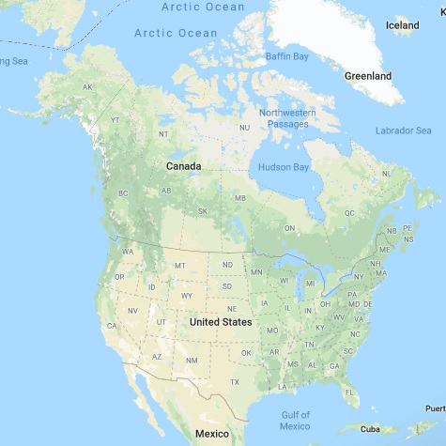
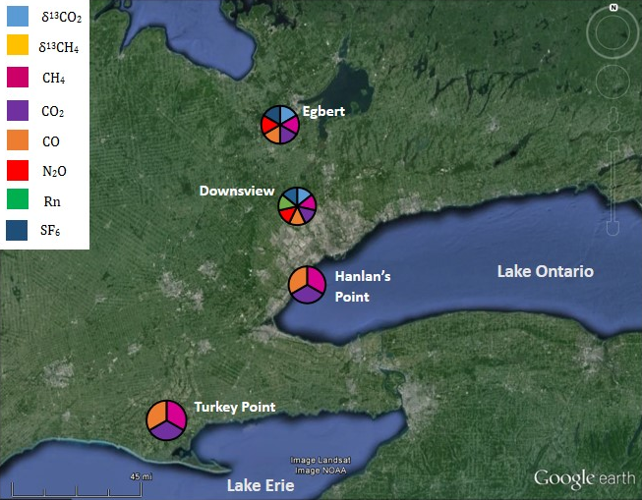
ECCC greenhouse gas monitoring network in south-central Ontario
~ 85 km

Slide 6
Why use an AQ Model in a climate-focused study?
Eulerian air quality models simulate the emission, transport, transformation, and removal of air pollutants such as SO₂ and NO_{x} but also longer-lived species such as low-reactivity VOCs and CO
Such simulations require the AQ model to be provided with detailed information about pollutant emissions and meteorological conditions
An AQ model should be able to simulate atmospheric concentrations of long-lived greenhouse gases (GHGs) such as CO₂ and methane (CH₄) if their emissions can be described in similar detail, including source type and spatial and temporal distribution
CO is also considered to be an indirect GHG (CO₂ and O₃ precursor) as well as an air pollutant

Slide 7
Necessary modelling ingredients:
1. Detailed CO₂ Emissions Inventory
Considered 7 source sectors for Ontario: residential natural gas (NG); commercial NG; other point; other area; on-road; non-marine off-road; and marine
Obtained source-sector-specific provincial CO₂ emissions from the 2010 Canadian National Inventory Report (NIR)
Obtained source-sector-specific provincial CO emissions from the 2010 Canadian national Air Pollutant Emissions Inventory (APEI) except for residential and commercial NG
Calculated sector-average CO₂:CO ratios for Ontario
Anthropogenic CO₂ emissions outside of Ontario were obtained from the Fossil Fuel Data Assimilation System v2 inventory (FFDAS, 2010)
Biogenic CO₂ fluxes were obtained from C-TESSEL (land surface component of the ECMWF forecast system)

Slide 8
Necessary modelling ingredients:
2. spatial and temporal allocation
Allocation of anthropogenic CO emissions for Ontario was used as a proxy for allocation of CO₂ emissions ‒ sources are similar
SMOKE emissions processing system was used for spatial allocation (to a 2.5-km regional grid centred over Toronto) and temporal allocation (hourly) of CO emissions for 7 sectors for 3 winter months (Jan.-March)
Sector-average CO₂:CO ratios were used to convert model-ready CO emissions into CO₂ emissions for 5 sectors; residential and commercial NG emissions were allocated directly using residential-dwelling and commercial-fuel surrogates: the resulting CO₂ emissions for Ontario are called the Southern Ontario CO₂ Emissions (SOCE) inventory
FFDAS v2 CO₂ emissions were available hourly on a 0.1° x 0.1° grid
C-TESSEL CO₂ fluxes were available every 3 hours on a 15-km grid (Jan.-Feb.) or 9-km grid (March)

Slide 9
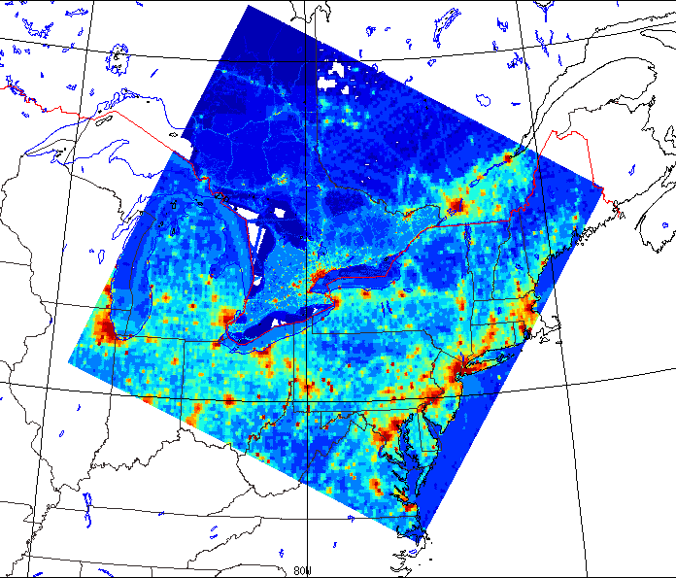
CO Emissions on 2.5-km gem-mach grid

Slide 10
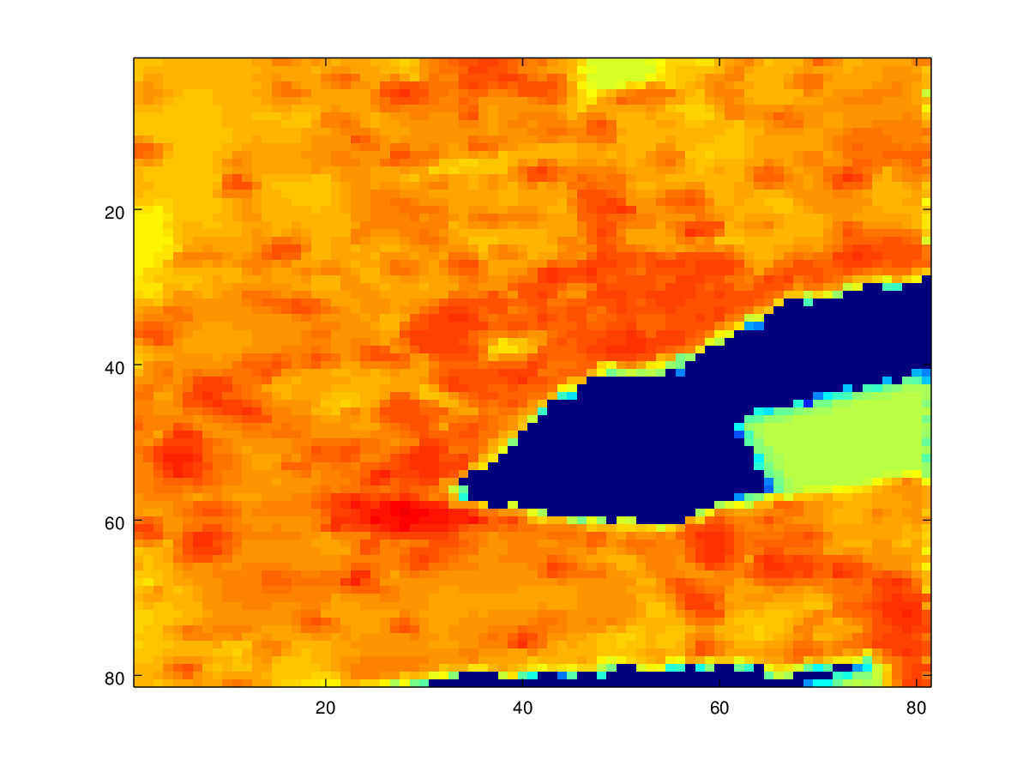
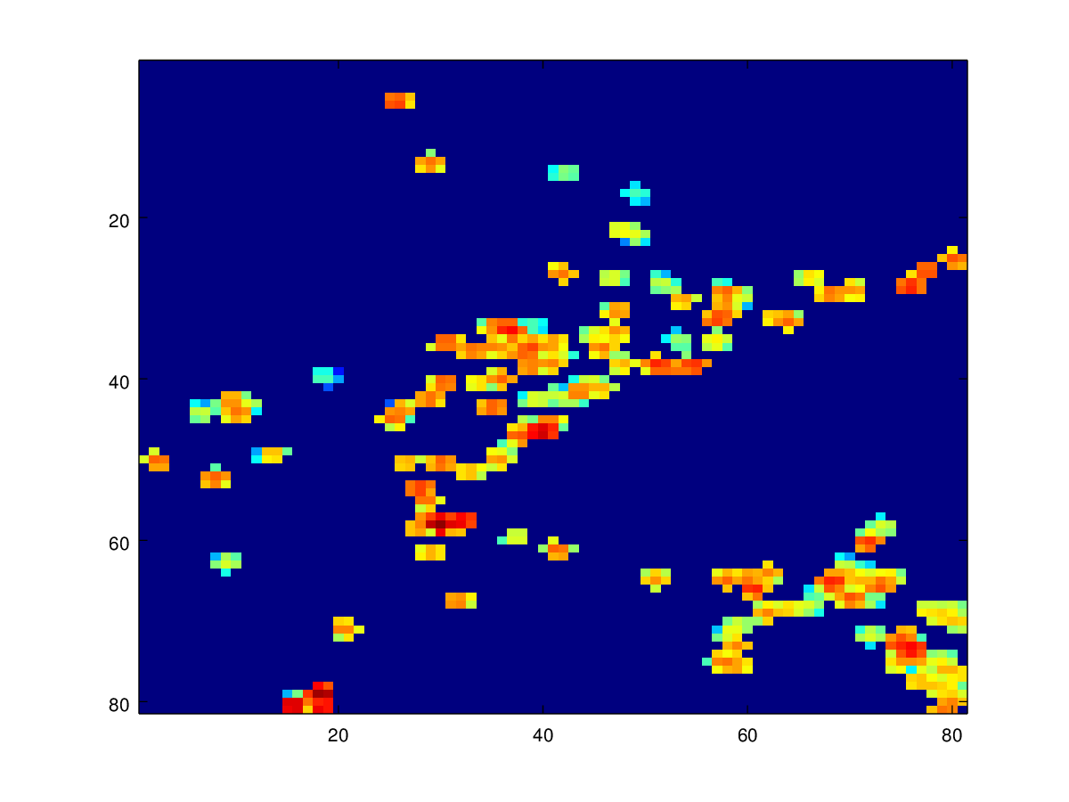
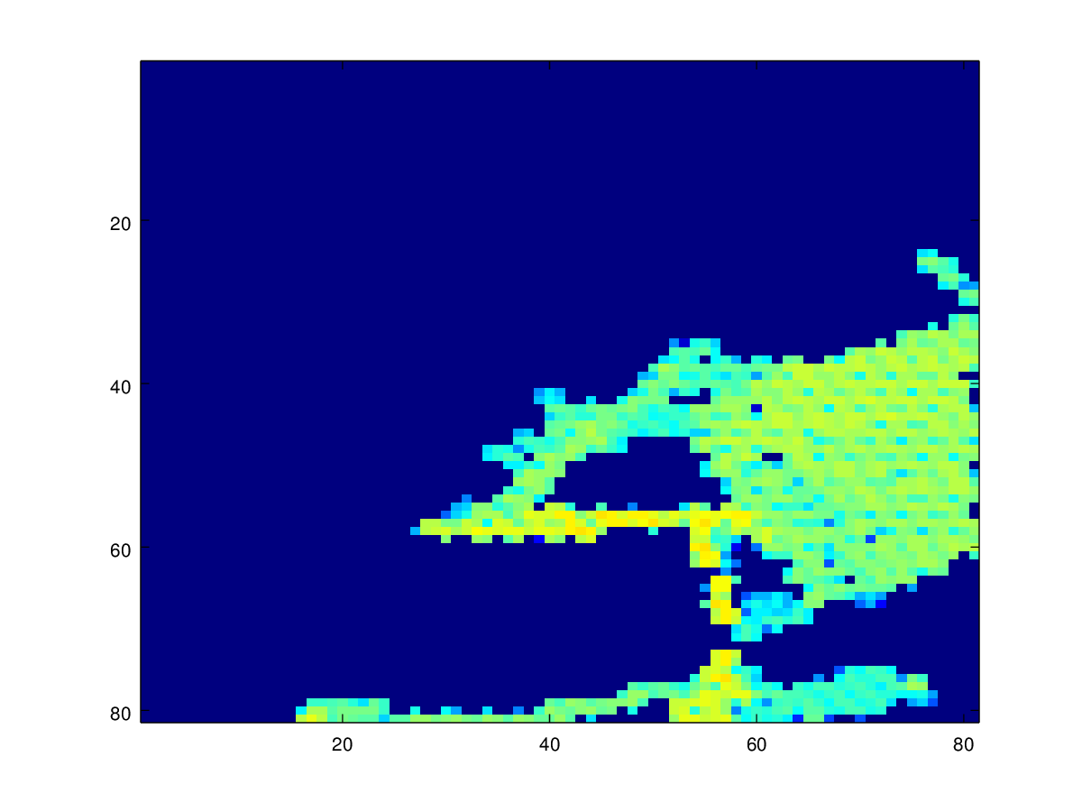
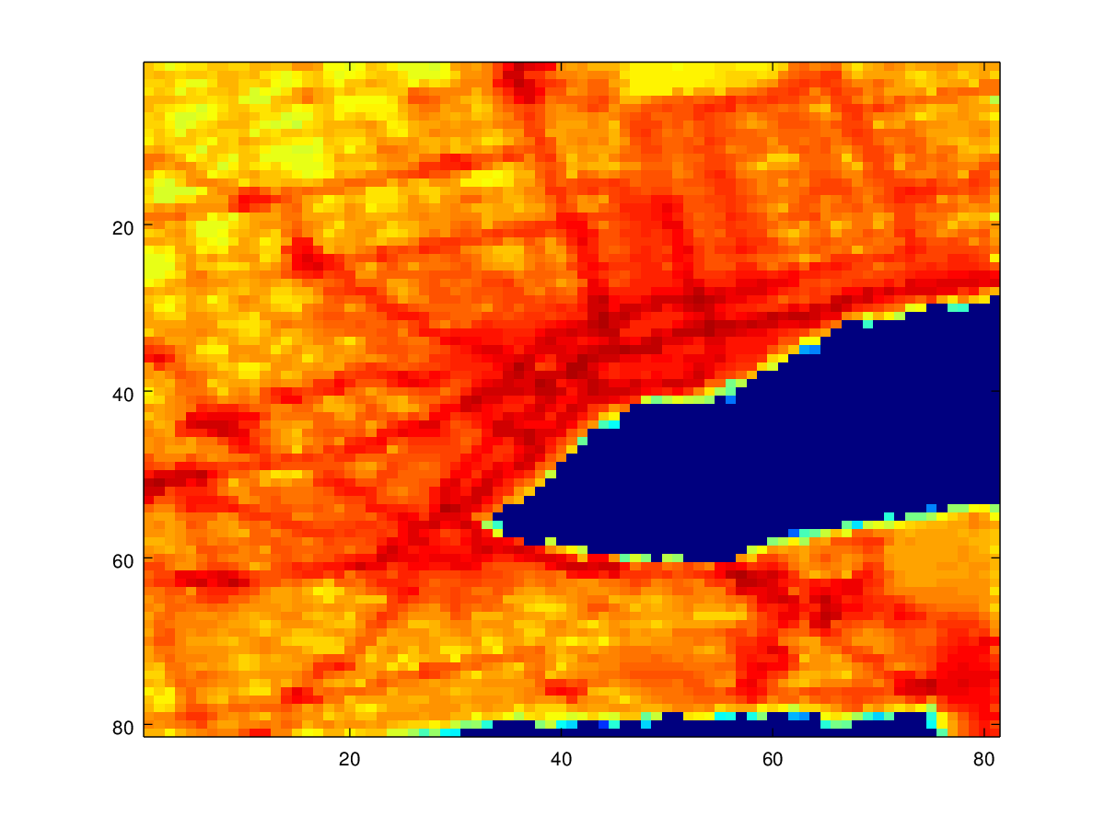
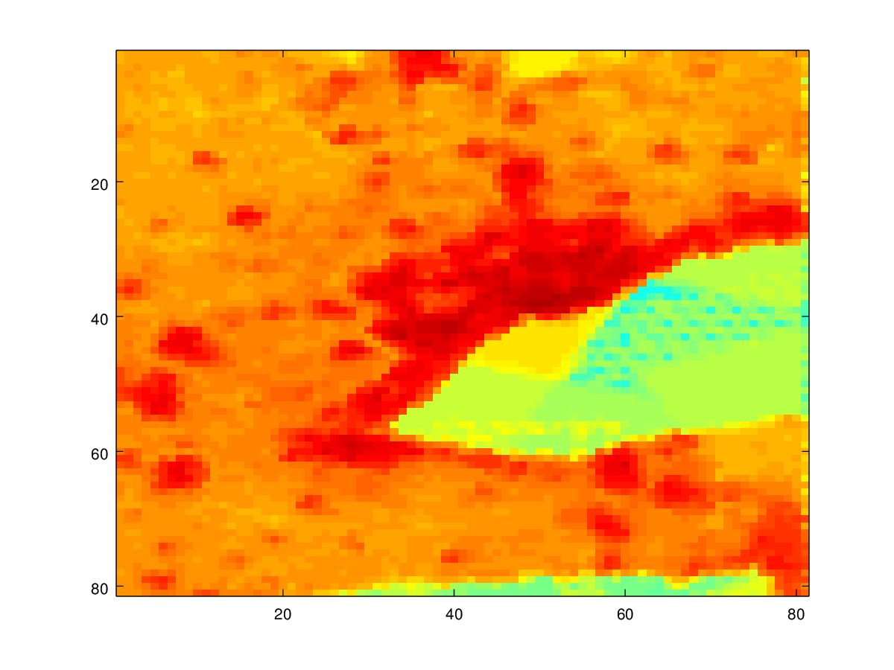
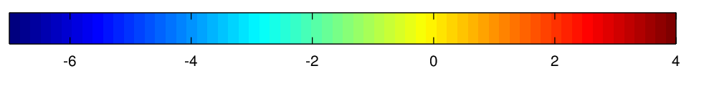
Sector-specific CO emissions over South-central Ontario
Area
CO₂:CO = 294 kt/kt
Point
CO₂:CO = 354 kt/kt
Marine
CO₂:CO = 844 kt/kt
Area
Point
Marine
On-road
CO₂:CO = 29 kt/kt
Off-road
CO₂:CO = 10 kt/kt
On-road
Off-road
CO (log(ton))
Notes:
Say what each sector is

Slide 11
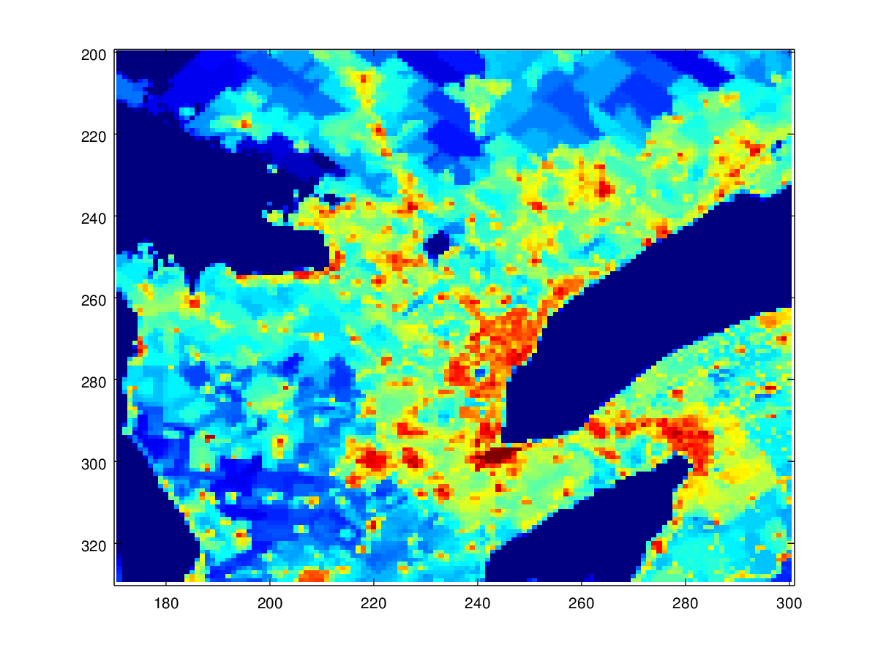
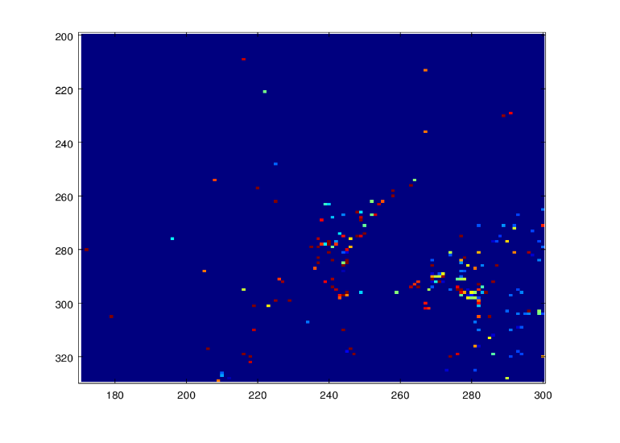
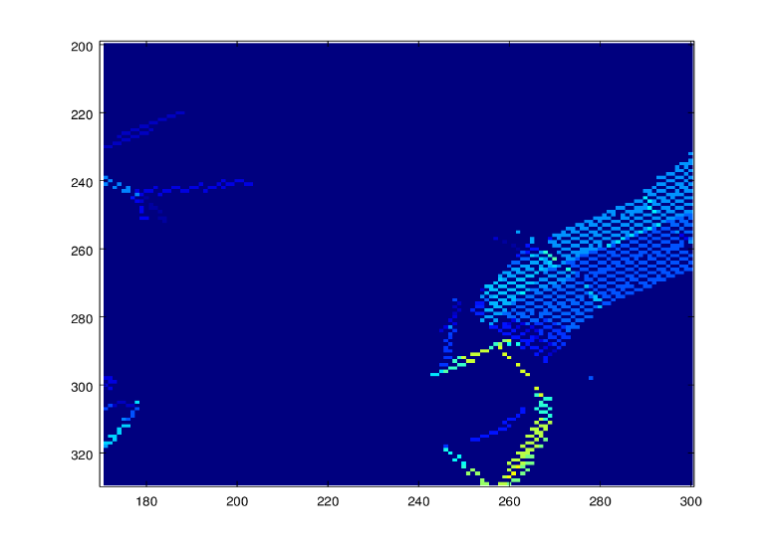
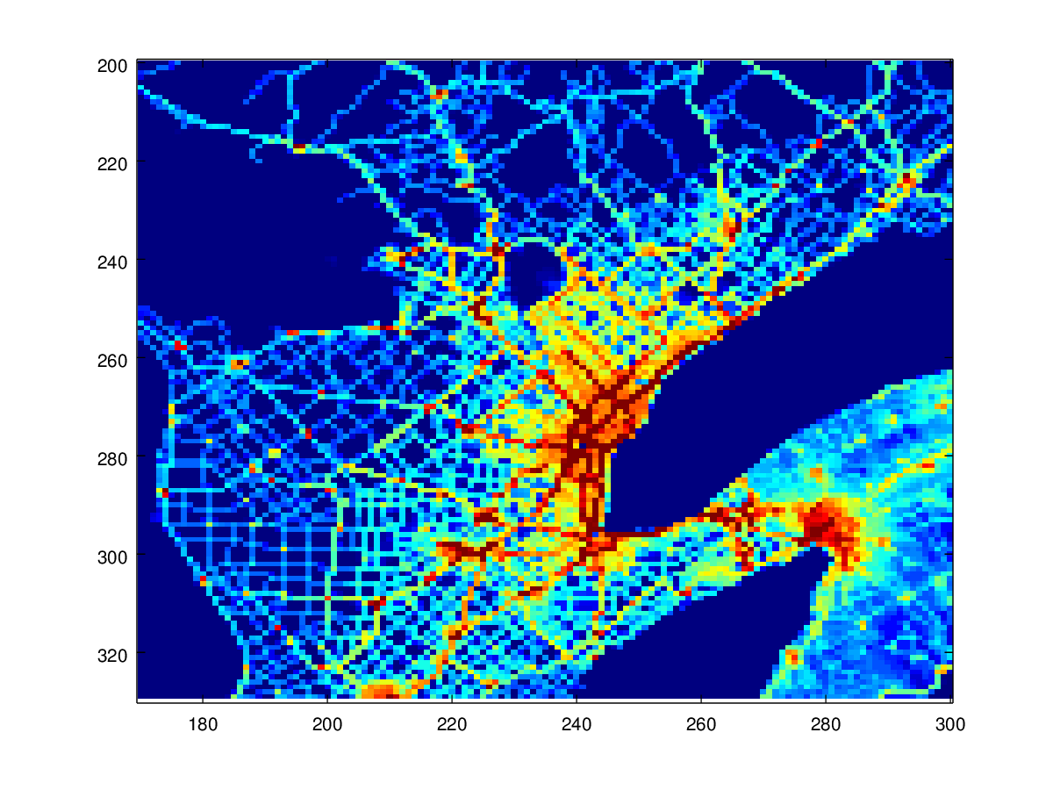
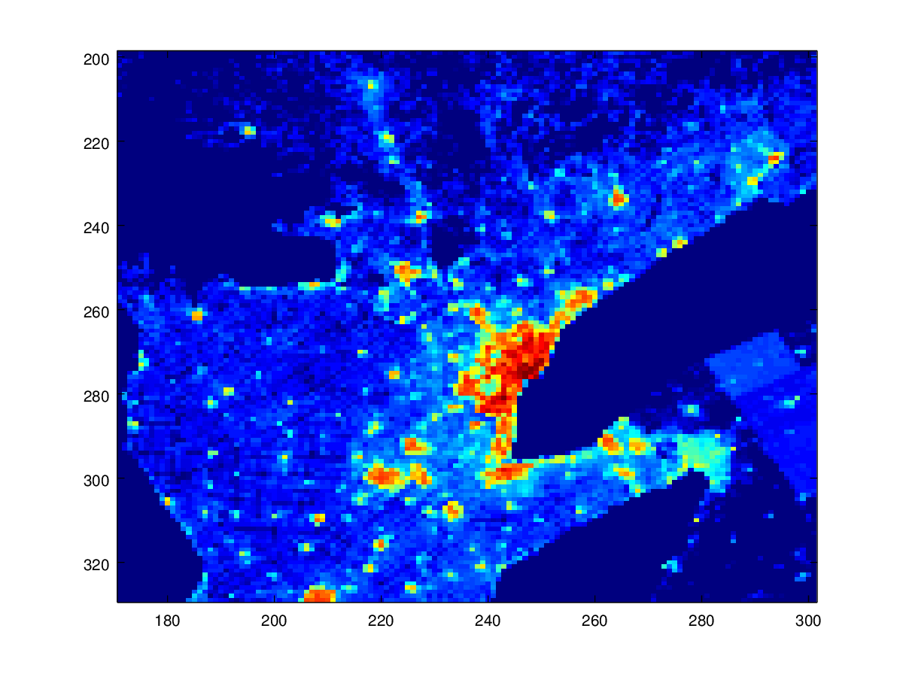
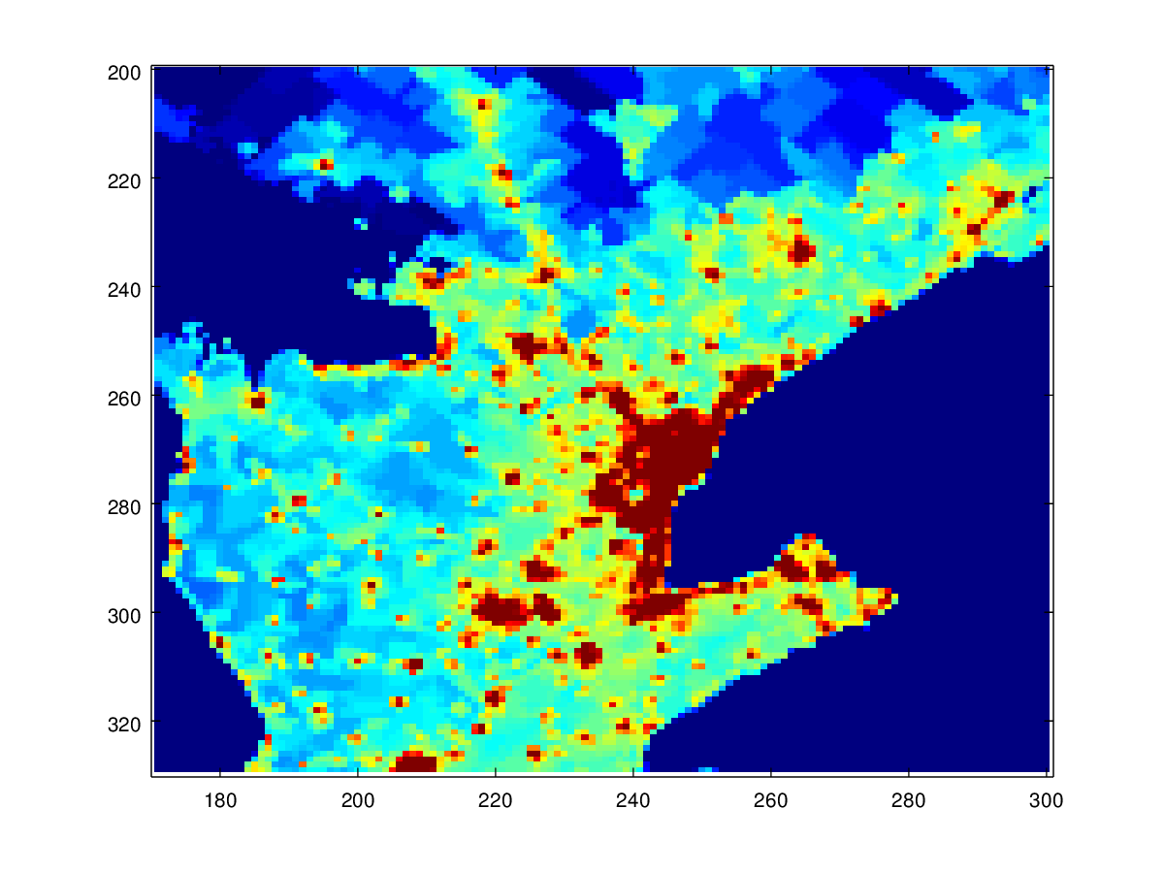
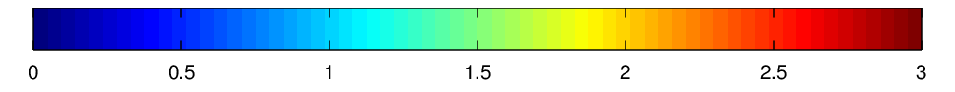
Sector-specific CO₂ emissions over South-central Ontario from SOCE
Area
Point
Marine
Lake Ontario
Lake Ontario
Lake Ontario
On-road
Off-road
Residential/Commercial NG
Lake Ontario
Lake Ontario
Lake Ontario
1 10 100 1000
g CO₂/second/grid cell

Slide 12
Necessary modelling ingredientS:
3. set of “tagged” tracer fields
A special version of the GEM-MACH in-line AQ model was constructed with an additional set of “tagged” inert-tracer mixing-ratio fields to track GHG emissions from specific source sectors and geographic regions
A total of 11 tagged CO₂ emissions fields were considered: 9 source sectors, 3 source regions (ON, QC, US), plus boundary contribution
The sum of these 11 tagged CO₂ mixing-ratio fields yields the total CO₂ mixing-ratio field, and the ratio of a tagged CO₂ mixing-ratio field to the total CO₂ mixing-ratio field at a receptor provides an estimate of the relative contribution of that source sector-region at that place and time
GEM-MACH was run with model-ready tagged CO₂ emissions on 2.5-km grid with 62 vertical levels for Jan.-March 2016 period, 24-hour simulations, 60-sec time step, hourly outputs

Slide 13
Data flow for gem-mach simulation
SOCE Inventory
(Ontario CO₂ emissions)
GEM Meteorology
Modelled CO₂
FFDAS Inventory
(Quebec and USA CO₂ emissions)
$$GEM−MACH$$
Chemistry Transport Model
MACC II boundary conditions
(CO₂ emissions outside of PanAM domain)
C-TESSEL
(Net Ecosystem Exchange of CO₂)
Simulation Period: Jan. – March 2016

Slide 14
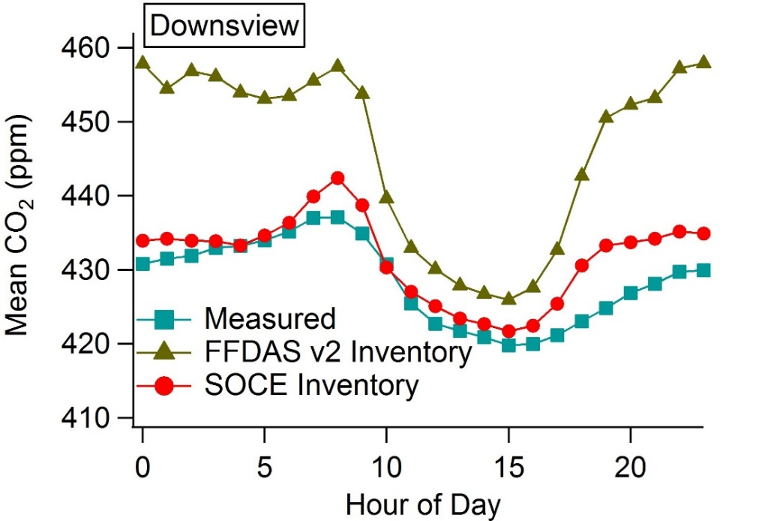
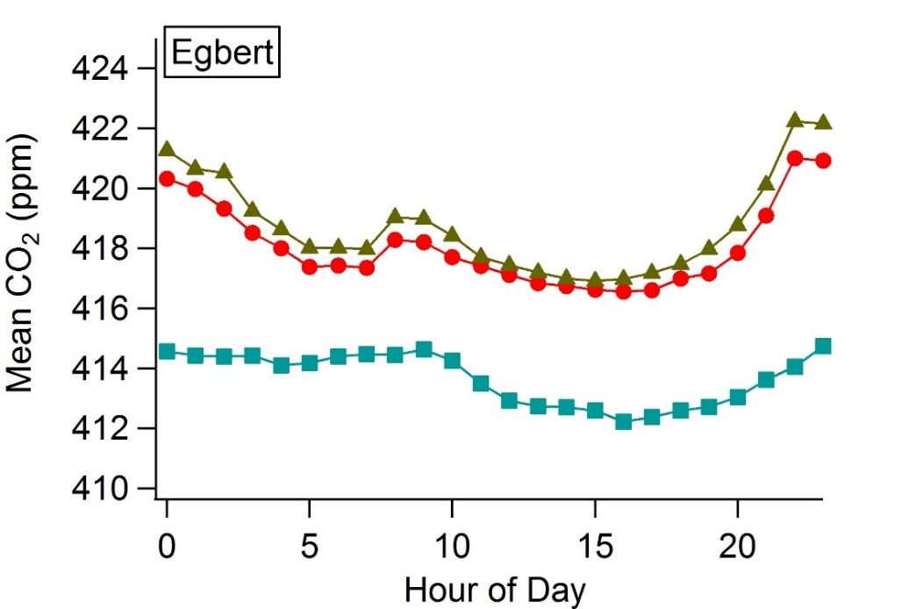
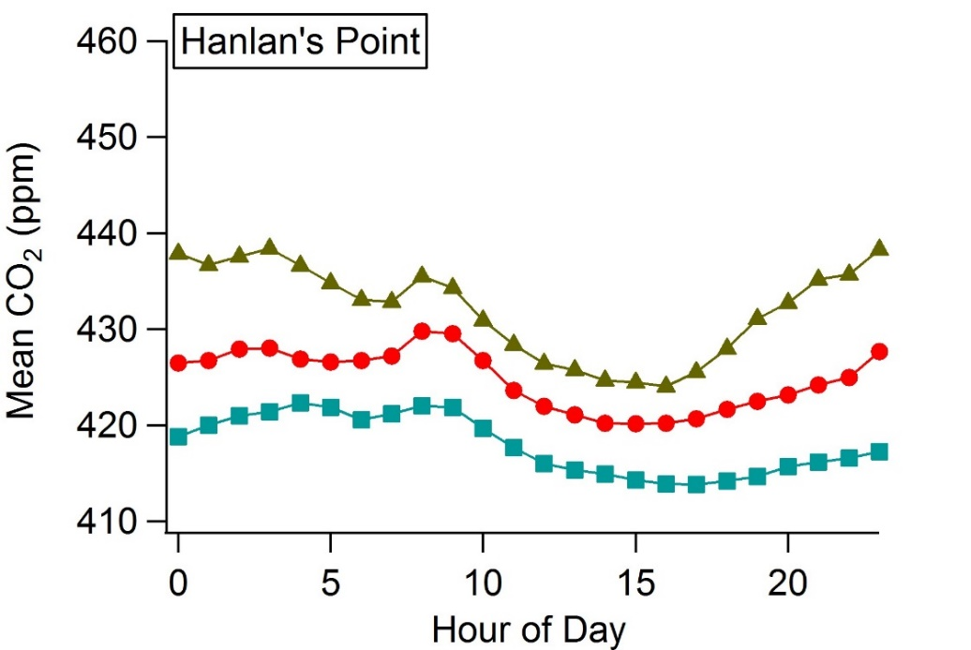
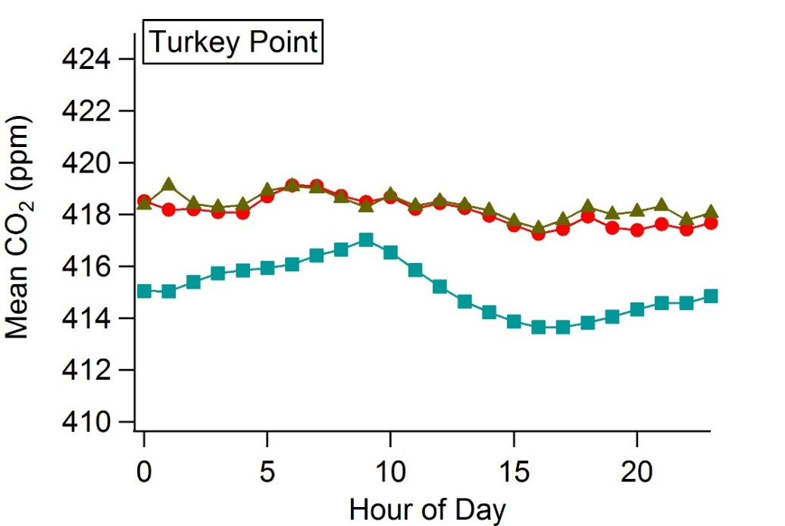
Evaluation of predicted diurnal variation

Slide 15
Sectoral contributions to CO₂ enhancement by day of week at Downsview (Jan. 2016)

Slide 16
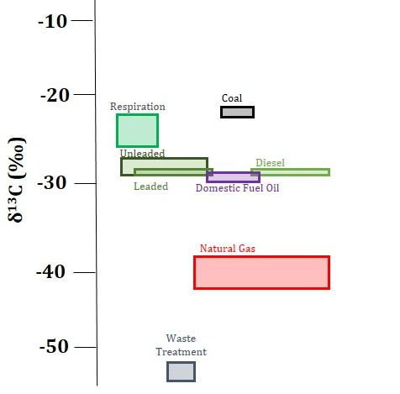
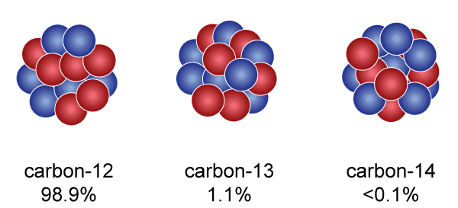
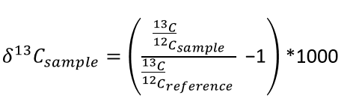

Using weighted δ¹³CO₂ source signatures to predict ambient δ¹³CO₂ signature
C_{t} = C₁ + C₂ + C₃ +… + C_{i}
$$δ^{13}{C }_{t}∙C_{t}= \sum_{i}{δ^{13}C_{i}∙C_{i}}$$

Slide 17
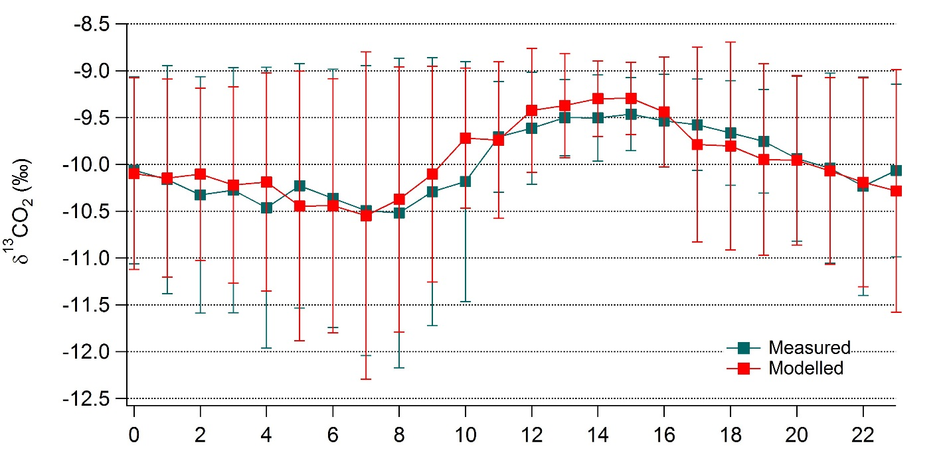
Modelled vs. Measured Mean δ¹³CO₂ Diurnal Profile at downsview (3 months)
*Error bars show standard deviation; figure is from Pugliese Domenikos et al. (2019)

Slide 18
CH₄
_{(methane)}

Slide 19
CH₄ Project background
This project builds on and extends the approach of the CO₂ source attribution project
Continuous CH₄ fixed-site network measurements and high-resolution mobile CH₄ survey measurements by car and bicycle are available for Toronto region
Toronto GHG testbed is Canadian contribution to the UN IG3IS (Integrated Global Greenhouse Gas Information System) program

Slide 20
Necessary modelling ingredients:
1. detailed ch₄ Emissions inventory
Considered 8 anthropogenic source sectors for Canada: NG storage/transmission/distribution; NG power generation; other industrial; non-industrial; landfills; ruminants; other agriculture; mobile
2015 source-sector-specific provincial CH₄ emissions were obtained from 2 sources supplemented by a third:
  2018 Canadian National Inventory Report (NIR)
  facility reports to Canadian GHG Reporting Program (GHGRP)
  2015 Canadian VOC emissions (Zhang et al., 2016)
Gridded monthly anthropogenic CH₄ emissions for U.S. for 2012 were obtained from Harvard study (Maasakkers et al., 2016)
CH₄ wetland emissions from ECCC CTEM model (Arora et al., 2018)
CH₄ wildfire emissions from the ECCC FireWork model (Chen et al., 2019)
CH₄ boundary values from ECCC EC-CAS-regional model

Slide 21
Necessary modelling ingredients:
2. spatial and temporal allocation
New spatial information for Ontario from special data sets, including:
  Natural gas consumption data by postal code
  Data base of small landfill sites
Default spatial allocation is standard set of Canadian spatial surrogates used for VOC allocation; temporal allocation is hourly
U.S. anthropogenic CH₄ emissions are monthly on a 0.1° x 0.1° grid
Wetland CH₄ emissions are monthly on a 2.81° x 2.81° grid
Wildfire CH₄ emissions are hourly point emissions

Slide 22
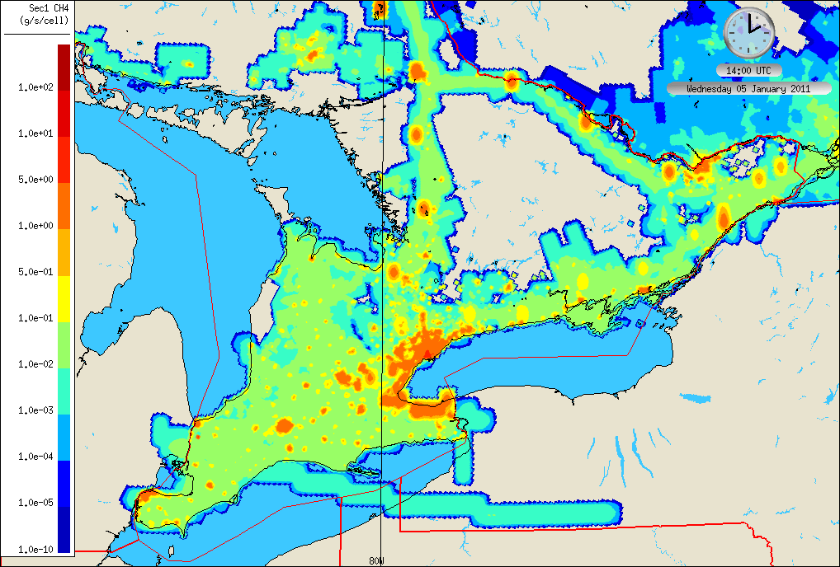
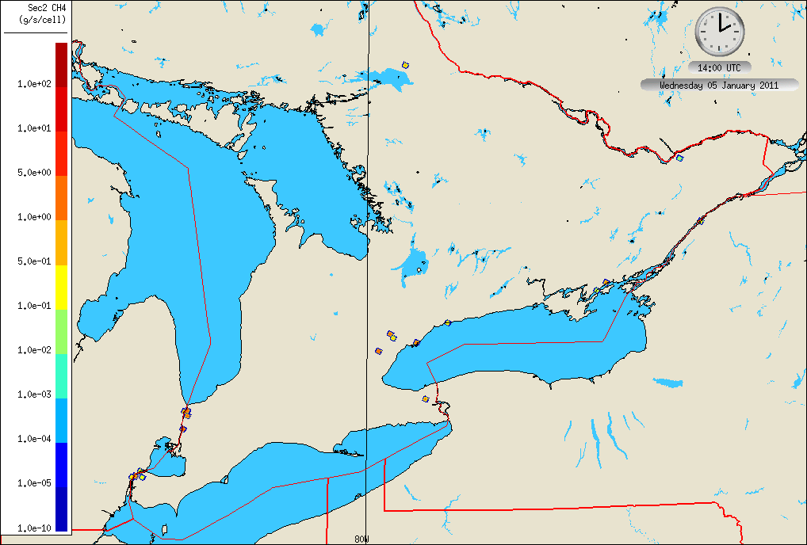
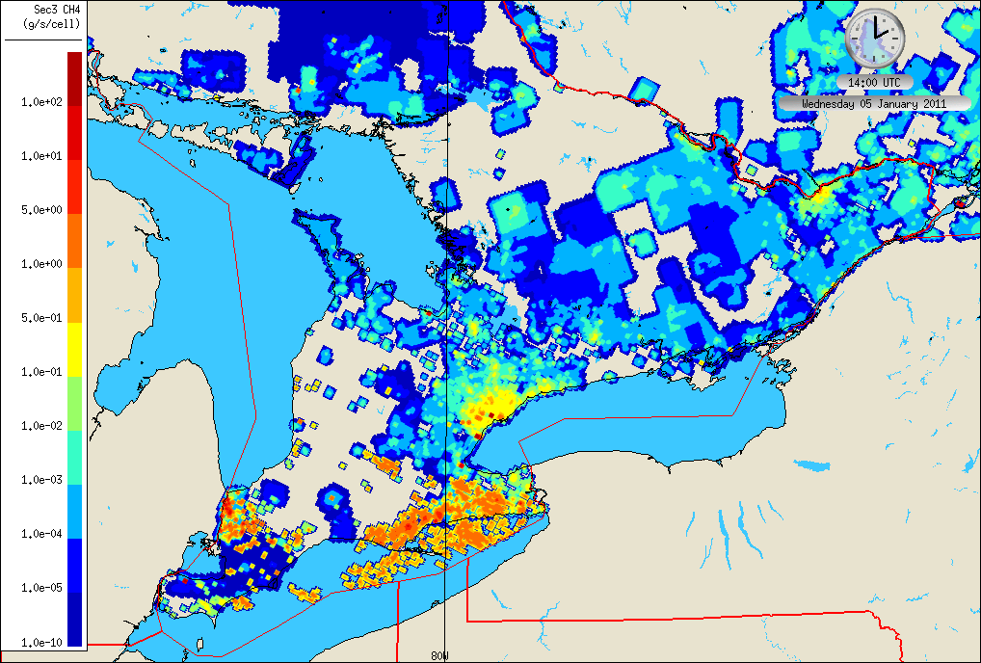
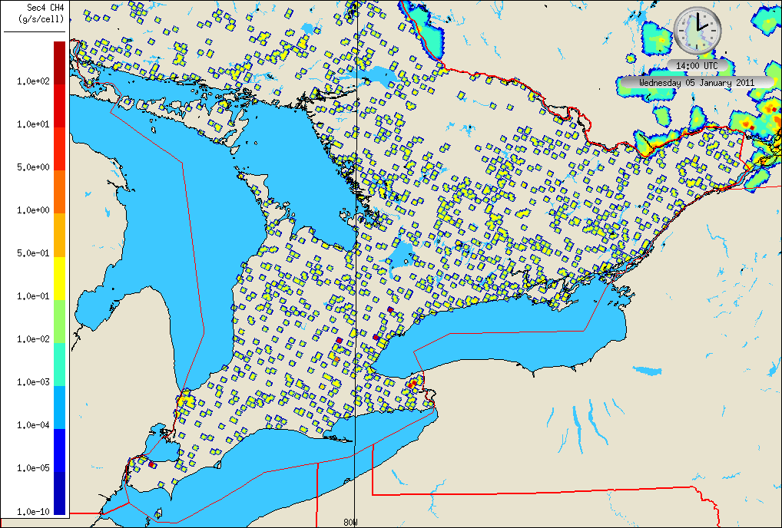
Methane Emissions for Sectors 1 to 4 – Southern Ontario
Sector 1 – Natural Gas Storage, Transmission, Distribution
Sector 2 – Natural Gas EPG
Sector 3 – Industrial Sources
Sector 4 – Landfills
Notes:
SPI layout name: SouthernON

Slide 23
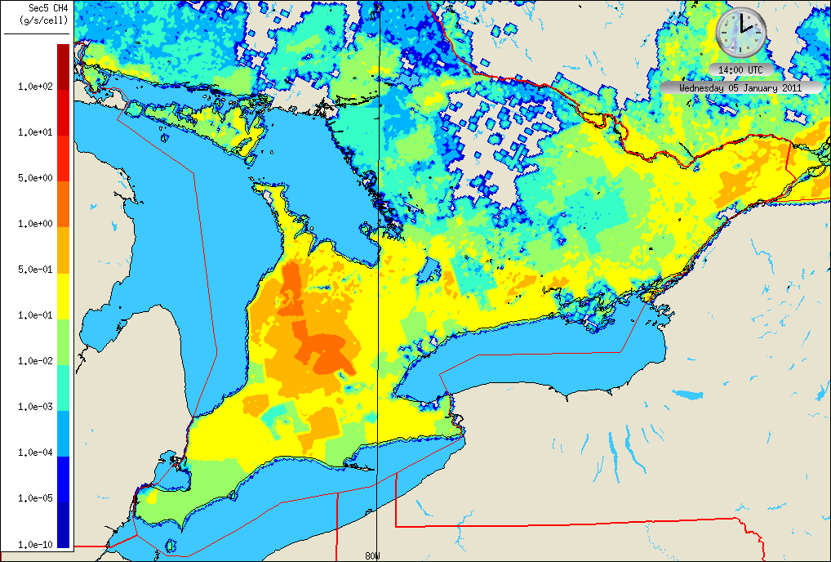
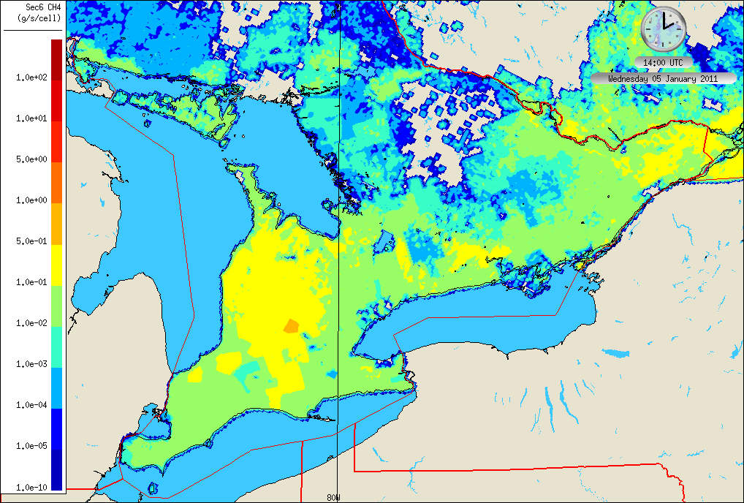
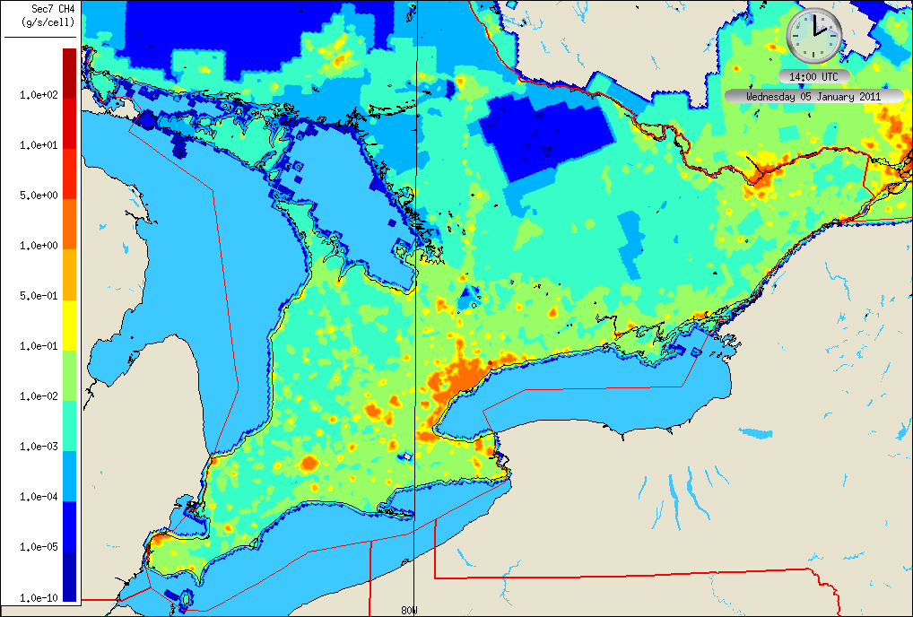
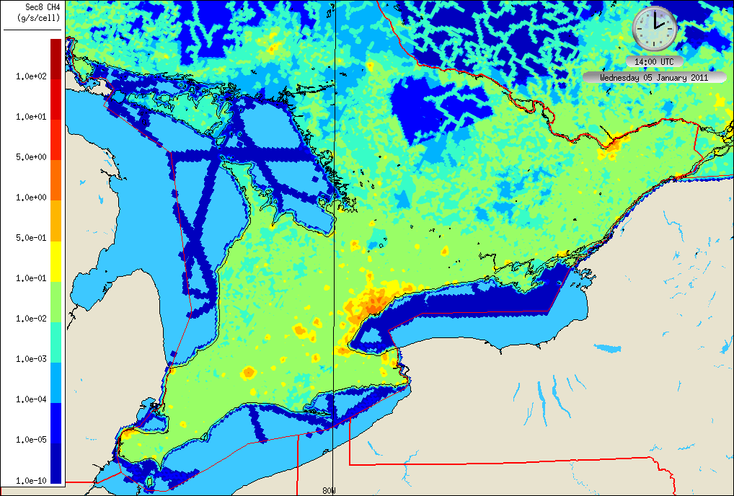
Methane Emissions for Sectors 5 to 8 – Southern Ontario
Sector 5 - Ruminants
Sector 6 - Agriculture
Sector 7 – Non-Industrial Sources
Sector 8 – Mobile Sources
Notes:
SPI layout name: SouthernON

Slide 24
Necessary modelling ingredientS:
3. set of “tagged” tracer fields
A total of 136 tagged CH₄ emissions fields were considered based on:
  11 source sectors (8 anthropogenic, wetlands, wildfires, boundary)
  13 geographic regions (10 ON + QC, NY, PA, rest of US)
  2 times of day: daytime (12-24 UTC); nighttime (0-12 UTC)
Shapefile masks were used to select emissions by geographic region
GEM-MACH was run with model-ready tagged CH₄ emissions on 2.5-km grid centred on Toronto with 62 vertical levels for January 2016 period, 24-hour simulations, 60-sec time step, hourly outputs

Slide 25
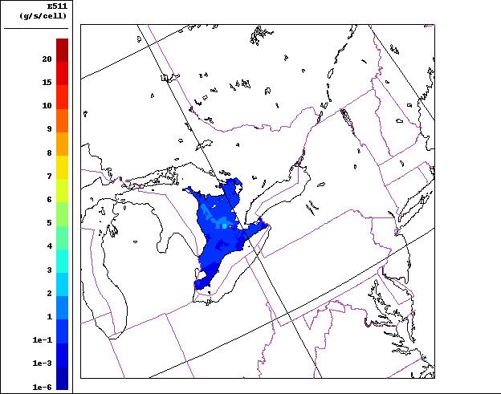
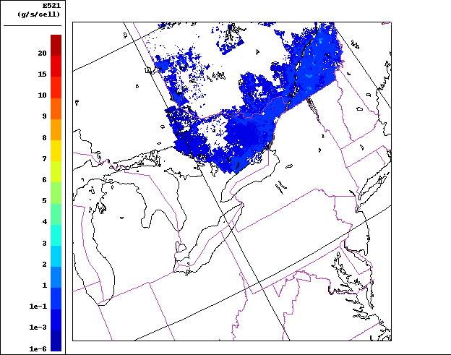
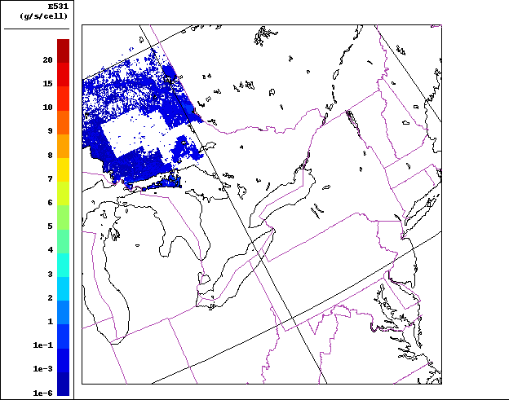
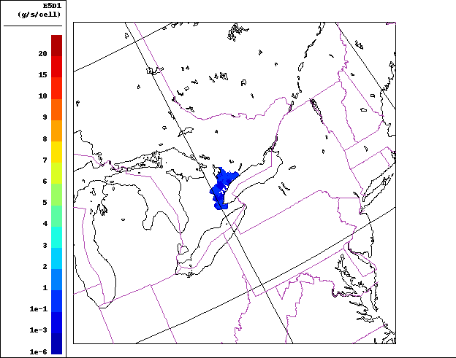
Sample tagged emissions: ruminants, daytime
SW Ontario
SE Ontario + Quebec
37_2011_Jan_Thursday_PanAm2_5_IG3IS.fst_20Z_E511
38_2011_Jan_Thursday_PanAm2_5_IG3IS.fst_20Z_E521
Greater Toronto-
Hamilton Area
NW Ontario
39_2011_Jan_Thursday_PanAm2_5_IG3IS.fst_20Z_E531
40_2011_Jan_Thursday_PanAm2_5_IG3IS.fst_20Z_E5D1

Slide 26
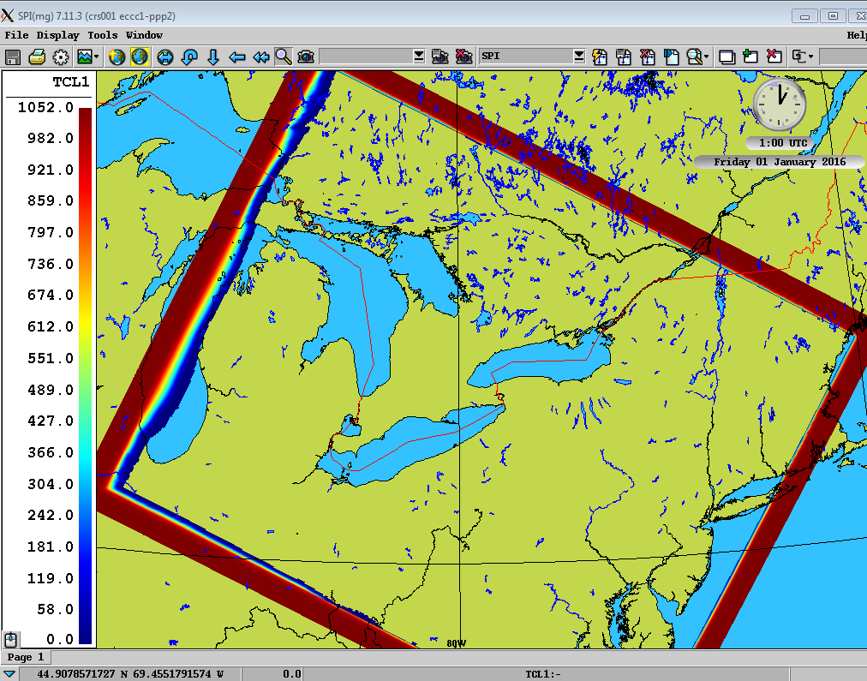
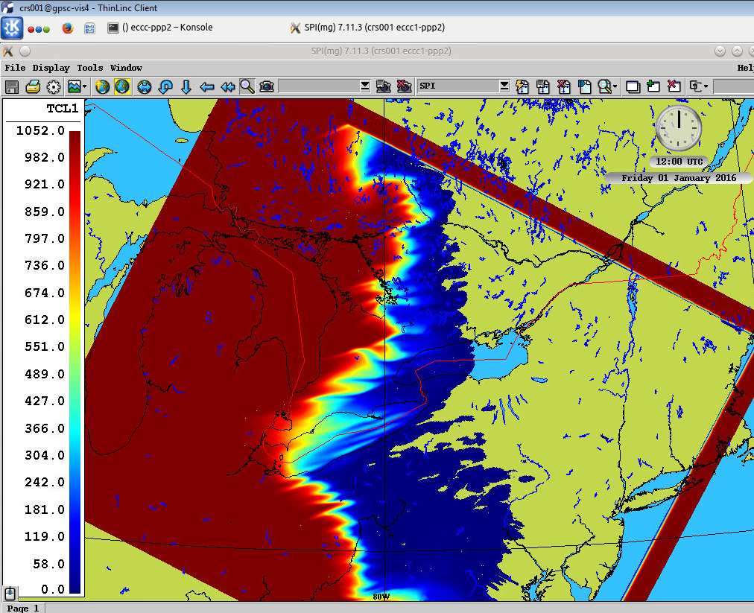
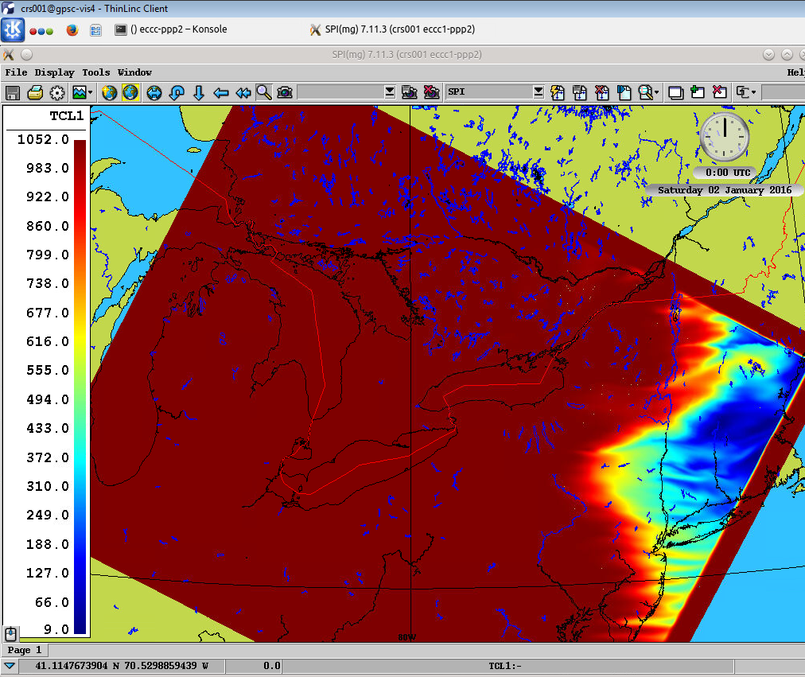
TCL1, boundary Tracer
Nighttime release, ug/kg
After 1 hour
After 12 hours
After 24 hours

Slide 27
Summary and conclusions (1)
Both GHG source attribution studies required the development of a special regional GHG emission inventory; this inventory was then processed by the SMOKE emissions processing system to build a set of tagged emissions fields from specific source sectors, source regions, and times of day
Both studies employed a high-resolution (2.5-km) regional grid centred over Toronto and a special version of the GEM-MACH in-line AQ model with an additional set of “tagged” inert GHG mixing-ratio fields
For the CO₂ source attribution project, 11 tagged CO₂ emissions fields for 9 source sectors and 3 source regions were used while the CH₄ source attribution project is considering 136 tagged CH₄ emissions fields for 11 source sectors, 13 geographic regions, and 2 times of day

Slide 28
Summary and conclusions (2)
Complicating factors for modelling include the importance of vegetation fluxes for CO₂ and wetland emissions for CH₄; wintertime simulations minimize the impact of both of these factors
Area sources (including natural gas combustion) were found to be the dominant local sources of CO₂ in the Toronto area in late evening and early morning while on-road sources were dominant at midday
Model predictions of stable carbon isotope composition δ¹³CO₂ compared reasonably well against measurements
The comparison of model-predicted mixing ratios with measured values can also provide a check on the accuracy of the emissions inventory, including individual point sources (e.g., landfills)

Slide 29
Thank you for your attention
Pugliese, S.C., J.G. Murphy, F. Vogel, and D. Worthy, 2016. Characterization of the δ¹³C signatures of anthropogenic CO₂ emissions in the Greater Toronto Area, Canada. Applied Geochemistry, 83, 171-180, https://doi.org/10.1016/j.apgeochem.2016.11.003.
Pugliese, S.C., J.G. Murphy, F.R. Vogel, M.D. Moran, J. Zhang, Q. Zheng, C.A. Stroud, S. Ren, D. Worthy, and G. Broquet, 2018. High-resolution quantification of atmospheric CO₂ mixing ratios in the Greater Toronto Area, Canada. Atmos. Phys. Chem., 18, 3387-3401, https://doi.org/10.5194/acp-18-3387-2018.
Pugliese Domenikos, S.C., F.R. Vogel, J.G. Murphy, M.D. Moran, C.A. Stroud, S. Ren, J. Zhang, Q. Zheng, D. Worthy, L. Huang, and G. Broquet, 2019. Towards understanding the variability in source contribution of CO₂ using high-resolution simulations of atmospheric δ¹³CO₂ signatures in the Greater Toronto Area, Canada. Atmos. Environ., 214, 116877, https://doi.org/10.1016/j.atmosenv.2019.116877.
SOCE inventory: https://dataverse.scholarsportal.info/dataset.xhtml?persistentId=doi:10.5683/SP/GOQGHD
Zhang, J., M.D. Moran, Q. Zheng, and S. Smyth, 2016. Canadian anthropogenic methane and ethane emissions: A regional air quality modeling perspective. 15th CMAS Conference, 24-26 Oct., Chapel Hill, NC [see https://www.cmascenter.org/conference//2016/slides/zhang_canadian_anthropogenic_2016.pdf]

Slide 30
Here is the naming convention for emissions:
EXYZ
X = source type (Note: emissions for source 9 and A are set to zero for Jan. No emissions for C because it is not a emissions source)
1=natural gas storage, transmission, distribution (9x2 species, e.g. T141 stands for methane from this natural gas source from Toronto region in daytime, 9 Ontario regions, 2 times)
2=natural gas power generation (9x2 species)
3=other industrial sources (9x2 species)
4=landfill waste (9x2 species)
5=ruminants (4x2 species, all GHTA together so only 4 Ontario regions, e.g. T5D1)
6=agricultural (4x2 species)
7=non-industrial area sources (9x2 species)
8=all mobile sources (4x2 species)
9=natural wetland (only summer, but I will create memory space) (4x2 species)
A=natural forest fire (only summer, but I will create memory space) (4x2 species)
B=all US anthropogenic source types added together, gridded emissions (only TBA1, TBA2, TBB1, TBB2, TBC1 and TBC2)
C=lateral boundary contribution, flux from global model at domain edge (only TCL1, tracer lateral boundary)
Y = emission regions (Note: No emissions for L because it is not a emissions source)
1=SW Ontario
2=SE Ontario + Quebec
3=NW Ontario
4=Toronto region
5=York region
6=Halton
7=Durham
8=Peel
9=Hamilton
A=New York state
B=Pennsylvania state
C=other US states
D=all GTHA in one category (4+5+6+7+8+9, only for certain source types that are not urban related)
L=lateral boundary contribution, flux from global model
Z = emission time period (Jan, EST for PanAm 2.5km grid)
1=daytime (7am to 6pm (12Z to 24Z ))
2=nighttime (7 pm to 6am (00z to 12Z))

