Slide 1
Impact of renoxification on air quality over Northern Hemisphere
Golam Sarwar¹, Daiwen Kang¹, Wyat Appel¹, Christian Hogrefe¹, Barron Henderson², Rohit Mathur¹
¹Office of Research and Development
USEPA, RTP, NC, US
²Office of Air and Radiation
USEPA, RTP, NC, US
18th Annual Community Modeling and Analysis System Conference
Chapel Hill, North Carolina, October 21 - 23, 2019
Notes:
(1) While “arial” is used in this example, other fonts may be used. Please strive for consistency in font type and size.
(2) While a blue background is shown here, other colors noted on the EPA/ORD intranet site may be used.
(3) A picture may be added if desired.
--- The goal is to promote our CED “brand” and maintain some degree of consistency among CED presentations.

Slide 2
Disclaimer: The views expressed in this presentation are those of the authors and do not necessarily reflect the views or policies of the U.S. EPA.
Notes:
Disclaimer may be placed elsewhere in the presentation (such as the title slide or the “final” slide); however, it should be clearly legible.

Slide 3
Background
  Ye et al. (2016) conducted a research campaign over the North Atlantic Ocean
    Measured up to ~10 pptv of daytime HONO over marine environment
    Performed box model calculations and concluded that the current known chemistry cannot explain high measured HONO over marine environment
    Proposed that rapid recycling of HONO and NO_{x} occur in clean marine boundary layer via particulate nitrate (ANO₃) photolysis (j_{ANO3})
    Reported j_{ANO3} ≈ 200 x j_{HNO3}
  Ye et al. (2017) conducted additional chamber experiments of aerosol filter samples collected near surface as well as from aircrafts and reported that
    photolysis of ANO₃ produces HONO and NO₂
    j_{ANO3} decreases with higher ANO₃ and proposed an empirical equation for noontime value for j_{ANO3}
    j_{ANO3} is ~100 times faster than j_{HNO3} in clean atmosphere and several times faster than j_{HNO3} in polluted atmosphere

Slide 4
Background (cont.)
  Reed et al. (2017) examined “renoxification” in marine boundary layer
    Analyzed long-term (two years) NO_{x} measurements in a marine environment (Cape Verde) and reported that peak values occur around noon
    HONO concentrations also peaked during the daytime at Cape Verde
    Model with known chemistry cannot explain elevated NO_{x} and HONO levels
    Model with added ANO₃ photolysis enhances NO_{x} and reproduces observed HONO

Slide 5
ANO₃ photolysis in CMAQ
  Similar to most models, CMAQ does not include photolysis of ANO₃
  Here, we added the photolysis of fine-mode ANO₃ in CMAQ
    ANO₃ = 0.67 × HONO + 0.33 × NO₂
    J_ANO3 (HR) = Scaling Factor x J_HNO3 (HR)
      Scaling Factor = J_ANO3_YE2017 (12LST) / J(HNO3, 12LST)
      J_ANO3_YE2017 (12LST) is calculated using the Ye at el. (2017) equation and is a function of ANO₃. Calculated rates decrease with increasing values of ANO₃
      J(HNO3, 12LST) is CMAQ predicted tropical summer mean value

Slide 6
Model, meteorology, and emissions
Chemical Transport Model - hemispheric CMAQv5.3_beta
  Simulation duration – full year, 2016
  Three simulations were completed
  Base: CB6r3m mechanism
  JSEA: Base + photolysis of ANO₃ over seawater grid-cells
  JALL: Base + photolysis of ANO₃ over all grid-cells
  Differences in results are attributed to the photolysis of ANO₃
Meteorology
  Weather Research and Forecasting (WRFv3.8) Model
  Standard USEPA WRF run configuration
Emissions - used model-ready emissions of Vukovich et al. (2018)

Slide 7
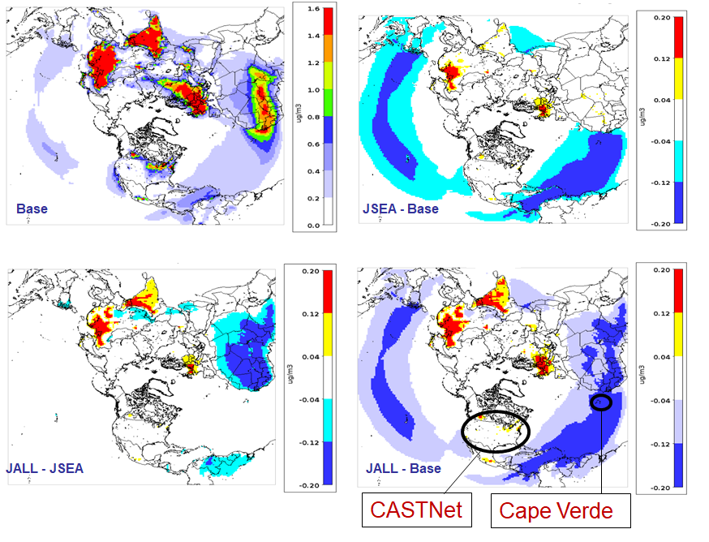
Impact of ANO₃ photolysis on ANO₃
Base model predicts higher ANO₃ values over land and lower values over seawater
JSEA decreases ANO₃ over seawater but increases over some land areas
JALL has mixed impacts. It increases ANO₃ over some land areas and decreases over other areas
Overall, the photolysis of ANO₃ decreases ANO₃ over seawater and has mixed impacts over land areas

Slide 8
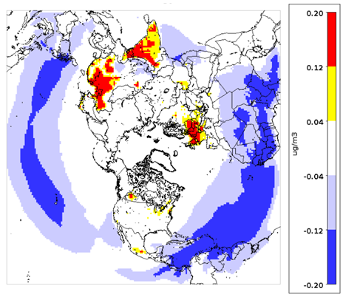
Reaction chain impacting ANO₃
In the JSEA case, ANO₃ increases over land due to the following process chain:
  ANO₃ photolysis increases NO₂ and HONO over sea water which produces OH upon photolysis
  Both lead to increased O₃ over sea water
  O₃ transported to land reacts with NO₂ to eventually increase night-time HNO₃
  Increased HNO₃ then leads to higher ANO₃ over NH₃-rich land regions
In the JALL case, additional OH from HONO increases daytime HNO₃ production, further increasing ANO₃ over some land regions
JALL - Base
ANO₃ over seawater decreases due to its photolysis

Slide 9
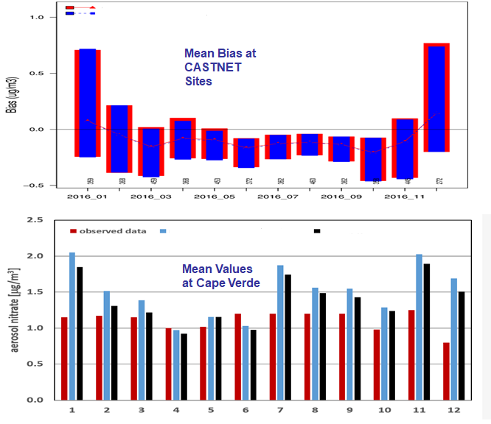
Comparison with observed ANO₃
Model predictions (Base and JALL) compare well with CASTNET data. No discernible change in model performance & seasonal bias characteristics at CASTNET sites
Models (Base and JSEA) over-predict at Cape Verde. JALL predictions are similar to JSEA (not shown). The over estimation is reduced with ANO₃ photolysis but has implication on HONO prediction for November as shown later
Cape Verde data: Fomba et al., 2014
JALL
BASE
Base
JSEA

Slide 10
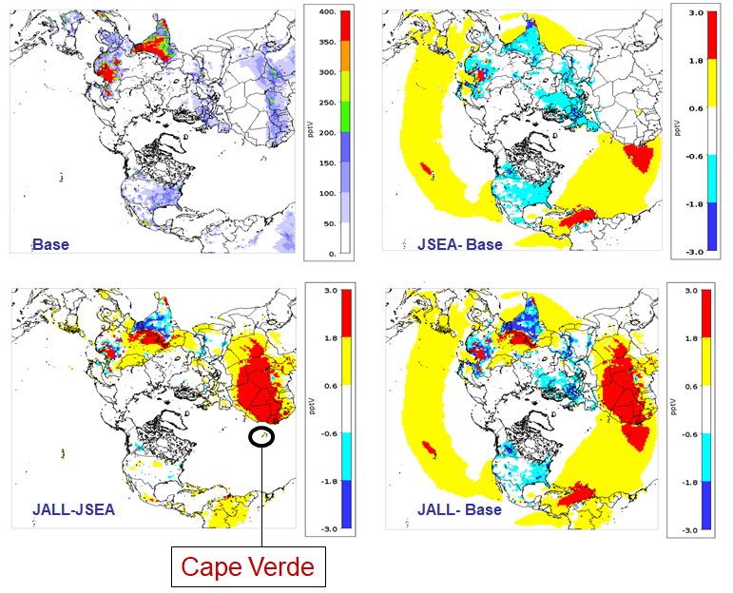
Impact of ANO₃ photolysis on HONO
Base model predicts higher HONO over land and lower values over seawater
JSEA increases HONO over seawater due to photolysis of ANO₃ but decreases over land due to lower night-time NO₂
JALL has mixed impacts on HONO over land. Photolysis of ANO₃ directly increases HONO but lowers NO₂ over some areas which then decreases HONO production. Net impact is determined by the relative importance of these changes

Slide 11
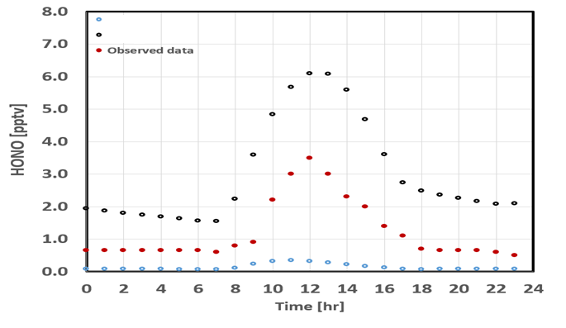
Comparison with observed HONO at Cape Verde
Base
JALL
Base model under-predicts HONO compared to observed data
JALL increases HONO but over-predicts compared to observed data primarily due to higher ANO₃ levels in the model. Increased HONO enhances OH and affects model results
JSEA and JALL predictions are similar (not shown)
Cape Verde data: Reed et al., 2017

Slide 12
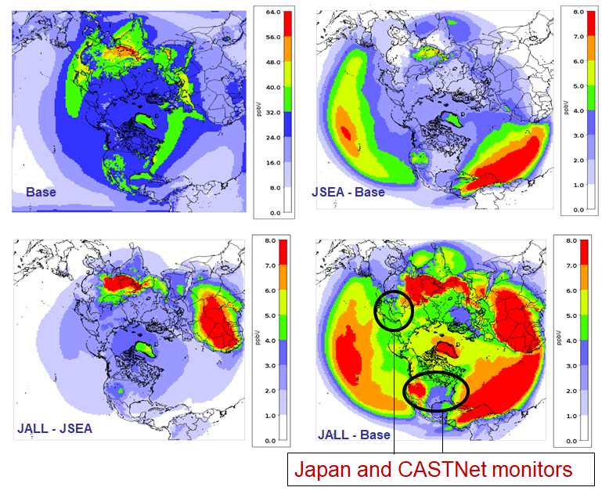
Impact of ANO₃ photolysis on O₃
Base model predicts higher O₃ over land and lower levels over seawater
JSEA increases NO₂ and HONO over seawater. HONO produces OH via photolysis. Both increase O₃ over seawater which is then transported to land areas
Compared to JSEA, JALL increases more O₃ over land than over seawater
Overall, the photolysis of ANO₃ increases O₃ levels over seawater and land due to the formation of HONO and NO₂ from ANO₃ photolysis
Notes:
Japan and CASTNet monitors

Slide 13
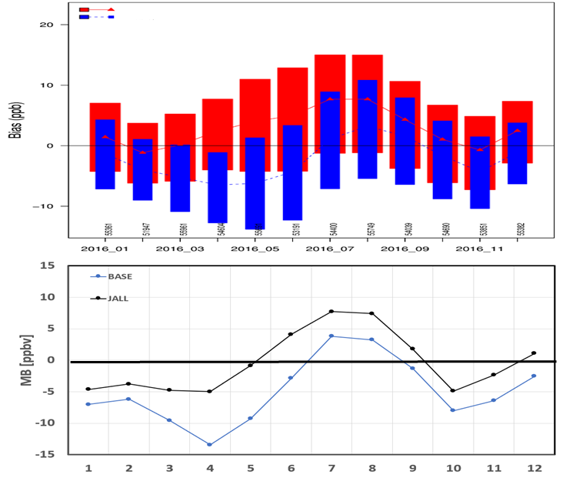
Comparison with surface observed O₃
JALL
CASTNet
BASE
Increase in O₃ reduces negative bias in cooler months but exacerbates positive bias in warmer months both at CASTNET and JAPAN sites
Data from 9 remote/rural monitoring sites are included for JAPAN (www.eanet.asia)
Japan

Slide 14
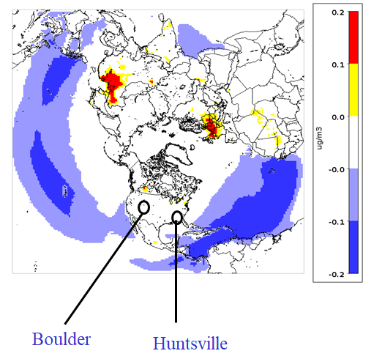
Ozonesonde sites

Slide 15
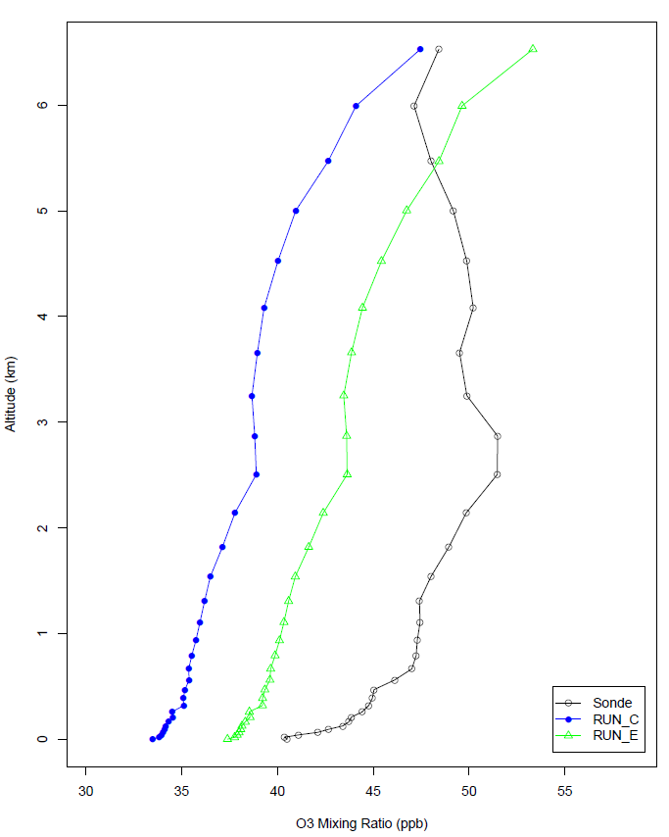
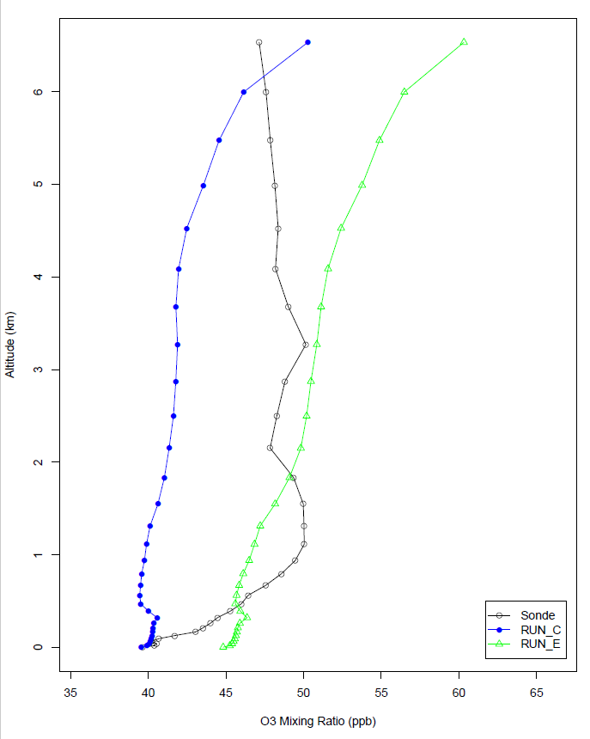
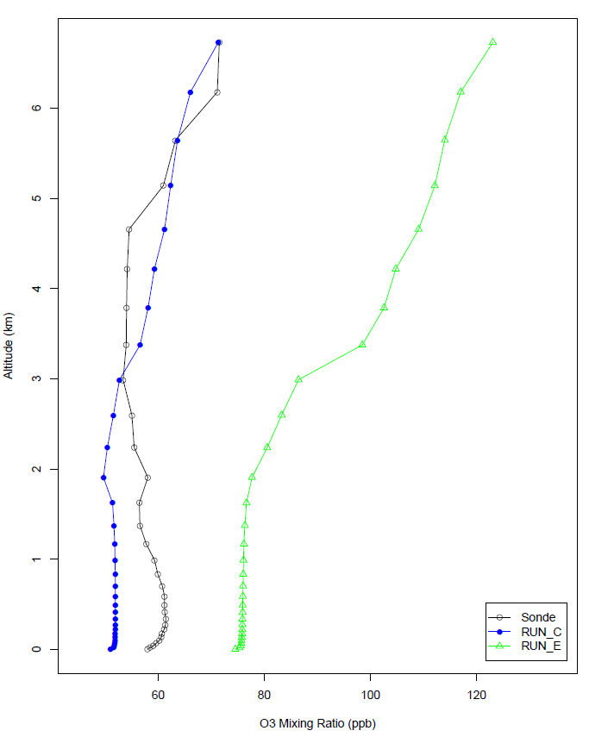
Comparison with ozonesonde data at Boulder
Base model predictions are low-biased in cooler months
Adding ANO₃ photolysis improves the comparison in cooler months but creates a high bias in warmer month
Performance is similar to that at surface sites
January
February
May

Slide 16
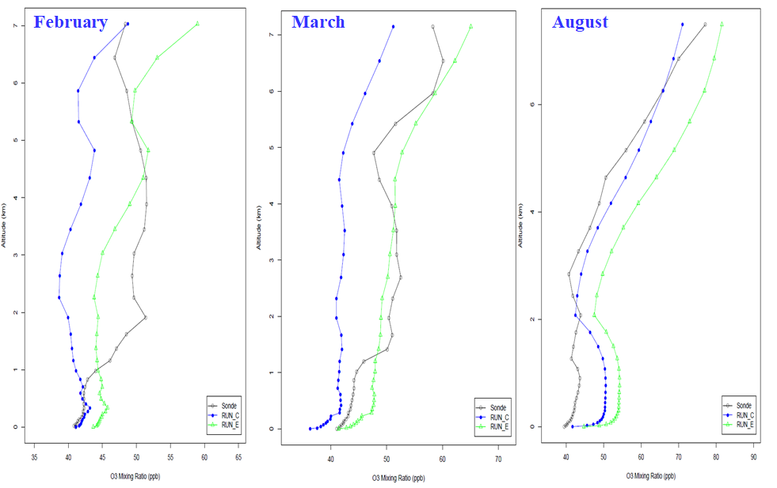
Comparison with ozonesonde data at Hunstville
Base model predictions are generally low-biased in cooler months
Adding ANO₃ photolysis reduces low-bias in cooler months and creates a high bias in warmer months
Performance is similar to that at surface sites

Slide 17
Summary
  Photolysis of ANO₃ decreases ANO₃ over large areas but also increases over some land areas due to enhanced day- and night-time HNO₃ production
  Photolysis of ANO₃ increases HONO over large areas but decreases over some land areas due to lower NO₂
  Photolysis of ANO₃ increases O₃ over all areas due to formation of HONO and NO₂
    Reduces mean bias in cooler months but increases mean bias in warmer months over the US and Japan
    Improves the comparison with ozonesonde data in cooler months but deteriorates the comparison in warmer months

Slide 18
Future plan
  Here, we used the photolysis rates suggested by Ye et al. (2017)
      Rate calculated by the Ye et al. equation depends on the atmospheric ANO₃ level
      When ANO₃ level is low (~0.2 μg/m³ ), calculated value of j_{ANO3} ≈ 130 x j_{HNO3}
      When ANO₃ level is moderate (~2.0 μg/m³ ), calculated value of j_{ANO3} ≈ 16 x j_{HNO3}
  Romer et al. (2018) recently provided constraints on the photolysis rates of ANO₃
    They analyzed data collected over the Yellow sea during KORUS-AQ study in 2016
    They reported that j_{ANO3} ≈ 1-30 x j_{HNO3}
    Our j_{ANO3} values for polluted conditions are similar to those of Romer et al., 2018
    However, our j_{ANO3} for clean conditions are higher than Romer et al. (2018) values
    We plan to conduct additional simulations by adjusting the photolysis rates of ANO₃

