Slide 1
Dynamical downscaling of a global chemistry-climate model to study the influence of climate change on mid-21st century PM_{2.5} and O₃ distributions in the Continental US
Surendra B. Kunwar¹, Jared H. Bowden², George Milly³, Michael Previdi³, Arlene M. Fiore³, J. Jason West¹
¹Department of Environmental Sciences and Engineering, University of North Carolina at Chapel Hill; ²Department of Applied Ecology, North Carolina State University;
³Lamont-Doherty Earth Observatory, Columbia University
18th CMAS Conference
Wednesday October 23rd, 2019

Slide 2
Climate Change Impacts on Air Quality: Pathways
Meteorology influences air quality (PM_{2.5} and O₃) in many ways:
Δ CLIMATE
Δ FUTURE AIR QUALITY
Δ ANTHROPOGENIC EMISSIONS
Δ NATURAL EMISSIONS
Δ METEOROLOGY
Δ AIR CHEMISTRY
Δ Land Use/Cover
Adapted: Jacob & Winner, 2009

Slide 3
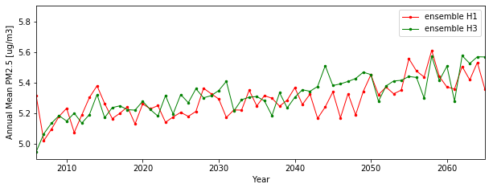
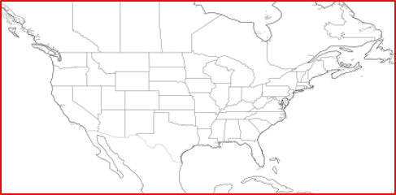
Climate Variability vs Climate Change
Internal Variability (noise) can confound Climate Change (signal)
PM_{2.5} variability+change shown by two GFDL ensemble members
≠
NATURAL CLIMATE VARIABILITY = fluctuation around a steady mean
CLIMATE CHANGE (SIGNAL) = long term change of mean
+
NATURAL FORCING = caused by solar activity, volcanoes
INTERNAL VARIABILITY (NOISE) = internally arising due to chaotic nature of climate system
Area used in averaging PM​

Slide 4
Past Studies of Climate Change on US PM_{2.5} and O₃
Findings:
        synoptic meteorology is key driver of PM_{2.5} and O₃
        inconsistency in climate impact on air quality:
        complexity of PM_{2.5} components like
        limited number of future years averaged
        single realization of one climate model
 | [O₃] results | [PM_{2.5}] results
↑ Direction | Consistently +ve | Inconsistent sign
↑ Magnitude | 1-10 ppb (polluted regions) | Between -1 and +1 µgm⁻³
Crustal Elements |  |  | Bulk Organic Carbon |  | Secondary Inorganic Ions |  |  | Anthropogenic (Industrial) Tracers
Si | Ca | Al | OC | EC | NH₄⁺ | SO₄²⁻ | NO₃⁻ | Fe | Zn | Pb
from Kundu & Stone, 2015 study
Attributes:
Source: Fiore et al, 2015; Jacob & Winner, 2009; Dawson et al, 2015; and references therein; Garcia-Menendez et al, 2017; Nolte et al, 2018

Slide 5




Objectives of Our Study
Overall objectives (Columbia University + UNC): Use a large ensemble of the global models NCAR CESM and GFDL CM3 to
  define probability distributions of PM_{2.5} and O₃ air quality in different US regions till mid-21st century
  characterize the role of climate variability and change on PM_{2.5} and O₃ distributions in US regions
Objectives of UNC team: Use finer scale regional meteorology and air quality models to
  dynamically downscale selected years from global simulations to the continental US at fine resolution (12km)
  describe the frequency of high PM_{2.5} in sub regions of the CONUS using probability distributions of global models
  estimate the health burdens of future PM_{2.5} changes due to air quality in probabilistic terms

Slide 6

Major Steps of Our Study
Global Chemistry-Climate Model
Global Chemistry-Climate Model
GFDL CM3 model, with RCP8.5 global change scenario and PM_{2.5} and O₃ precursor emissions kept constant at 2005 levels, provides meteorology and air quality globally at 2.5⁰ × 2⁰ longitude-latitude and 6hr resolutions.
Year Selection
Perform EOF analysis to select years for downscaling knowing where each CONUS region falls in the full distribution
Dynamical
Downscaling
Use WRF (Weather Research and Forecasting) model to simulate regional climate and variability at 12km horizontal resolution for selected years.
Air Quality
Downscaling
Use CMAQ (Community Multi-scale Air Quality) model to resolve air quality at 12km resolution over the CONUS with RCP8.5 emissions processed in SMOKE.
Analysis
Construct probability distributions for each grid cell from the CMAQ downscaling and the probability distributions from the GFDL and NCAR ensembles

Slide 7
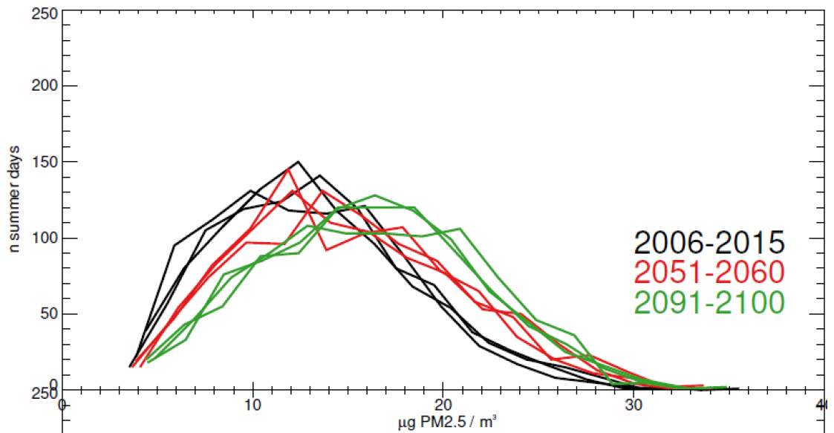
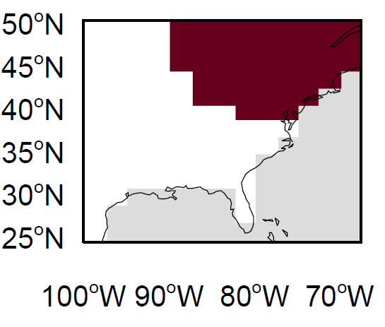
Selection of Years for Downscaling based on EOF Analysis of GFDL Output
Our intention is to select years from GFDL chemistry-climate global model that represent upper quartile and median PM_{2.5} levels in each US region
Method of Year Selection
Histograms of summer daily mean PM_{2.5} of 3 ensemble members of GFDL CM3 to (i) better characterize internal variability, and
(ii) show the shift in PM_{2.5} distribution due to climate change
Daily mean PM_{2.5} from GFDL-CM3
Courtesy: G. Milly & A. Fiore
EOF analysis of GFDL
Identify US regions that vary PM_{2.5} coherently
Year Selection for Downscaling
Identify upper-quartile and median annual PM_{2.5} years in each US region

Slide 8
Reconstructing Fine Scale PM_{2.5} Probability Distribution
We would like to construct fine resolution future PM_{2.5} probability distribution based on global model ensembles (NCAR CESM and GFDL CM3) at each grid cell
Such probability distribution of mean annual PM_{2.5} can be reconstructed
for individual grid cell or for a subregion of CONUS, and
for present and for future (with no emissions change)
The difference between present and future distributions isolates the impact of climate change

Slide 9
WRF/CMAQ Simulations Planned
Scenario | Time | Meteorology | GFDL IC/BCs | Anthrop. Emissions | # Realizations
RCP8.5m_2005e_PRES | 2006-2020 | 2005 RCP8.5 | RCP8.5_WMGG | 2014 NEI | 4
RCP8.5m_2005e_FUT | 2050-2065 | 2050 RCP8.5 | RCP8.5_WMGG | 2014 NEI | 4
RCP8.5m_2050e_FUT | 2050-2065 | 2050 RCP8.5 | RCP8.5 | 2050 RCP8.5 | TBD
2005m_2050e_FUT | 2050-2065 | 2005 RCP8.5 | RCP8.5 | 2050 RCP8.5 | TBD
* Land Use/Cover remains constant for all WRF/CMAQ simulations
* GFDL RCP8.5_WMGG fixes aerosol, ozone precursors emissions at 2005 level while GFDL RCP8.5 is full RCP8.5
* Additional CMAQ simulations may be undertaken for focused sensitivity analysis of Biogenic SOA in Southeastern US
RCP8.5m_2005e_FUT - RCP8.5m_2005e_PRES = effect of only climate change on future PM_{2.5} and O₃
RCP8.5m_2050e_FUT - RCP8.5m_2005e_PRES = effect of climate change and emissions on future PM_{2.5} and O₃
RCP8.5m_2050e_FUT - 2005m_2050e_FUT = effect of climate change on future PM_{2.5} and O₃ under future emissions condition

Slide 10
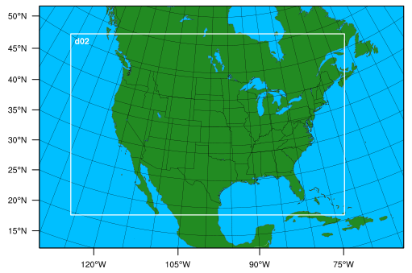
Current Progress: WRF Simulations and Options
8 selected GFDL years (RCP8.5 met. and 2005 emissions) downscaled in WRF:
  Present years: 2006/07 H1, 2010/11 H5, 2014/15 H1, 2018/19 H3
  Future years: 2054/55 H3, 2054/55 H5, 2058/59 H1, 2058/59 H5
Physics Options used in WRFv3.9.1.1 simulations
Domains used in Simulations
Parameter | Physics options used in WRF simulation
mp_physics = 6 | WSM 6-class graupel scheme microphysics
ra_lw_physics = 4 | RRTMG radiative transfer scheme used for longwave radiation
ra_sw_physics = 4 | RRTMG radiative transfer scheme used for shortwave radiation
sf_surface_physics = 2 | Unified Noah land-surface model
cu_physics = 1 | Kain-Fritsch (new Eta) scheme for cumulus parameterization
num_land_cat = 40 | 40 land categories of NLCD2006 used
num_soil_cat = 16 | 16 soil categories of soil data
12km domain
36km domain
* Spectral nudging is applied to moisture for better precipitation results (Spero et al, 2018)

Slide 11
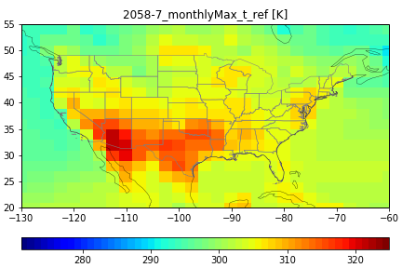
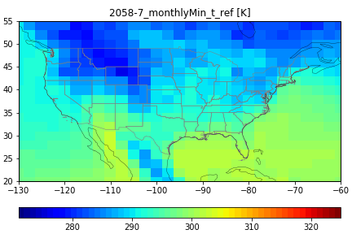
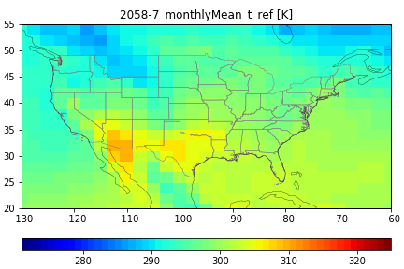
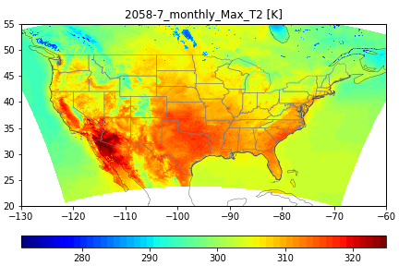
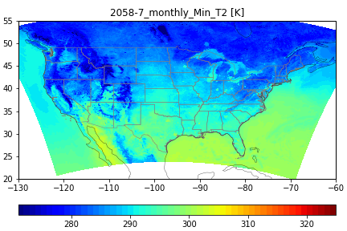
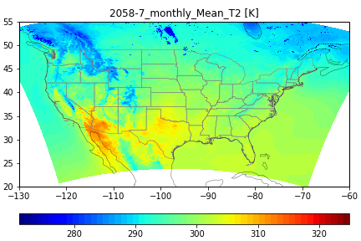
Comparing GFDL & WRF July 2058 (H1) T2 [K] Statistics
Features of WRF simulations with GFDL BCs:
  Proper representation of general temperature patterns shown by GFDL
  Addition of fine scale details in the WRF simulation
 | T2 July 2058(H1) Maximum | T2 July 2058(H1) Minimum | T2 July 2058(H1) Mean
GFDL 2058 H1
WRF 12km

Slide 12
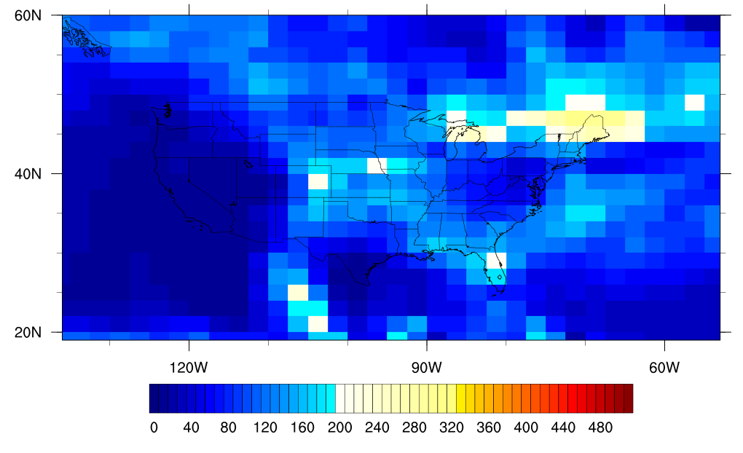
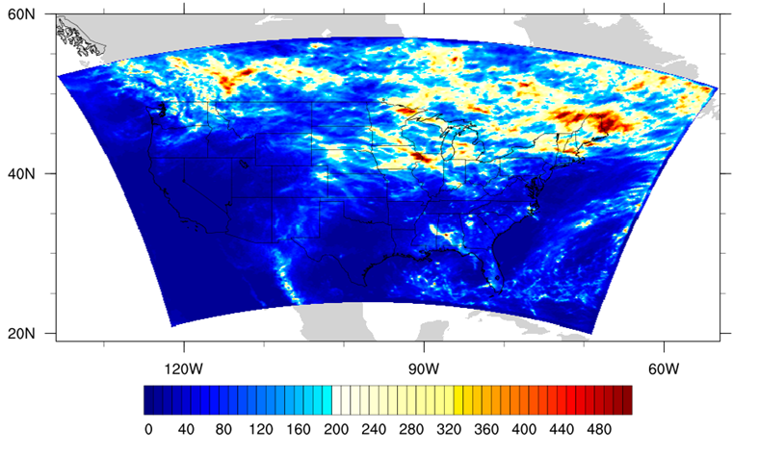
Comparing GFDL & WRF July 2058 (H1) Precipitation Total [mm]
WRF simulations with GFDL BCs also
  properly represent the general precipitation pattern shown by GFDL
  add fine scale details
GFDL 2058 H1
WRF 12km

Slide 13
Current and Upcoming Tasks
Completed Tasks:
  Achieved full-year downscaling of meteorology in WRF for the selected ‘present’ and ‘future’ years
Current Tasks:
  Tested CMAQv5.2.1 for 1 week of Jan 2014
  In the process of testing CMAQv5.3 for a full year at 36km
Future Tasks:
  Finalize emissions for future (2050-2065) RCP8.5 scenario
  Process RCP8.5 emissions in SMOKE
  Perform CMAQv5.3 simulations of selected years

Slide 14
Expected Outcomes
Map fine scale probability distributions of PM_{2.5} and O₃ in US regions to identify climate change impacts on PM_{2.5} and O₃ distinct from the range of natural climate variability in 2050.
Make improved air quality projections for the individual US regions, and highlight the importance of climate change for future air quality.
Deduce implications of changes in PM_{2.5} and O₃ for air quality planning, and probabilistic health impact assessment

Slide 15
References
Jacob, D. J., & Winner, D. A. (2009). Effect of climate change on air quality. Atmospheric environment, 43(1), 51-63.Deser, C., R. Knutti, S. Solomon, and A. S. Phillips (2012a), Communication of the role of natural variability in future North American climate, Nature Clim. Change, 2(12), 888-888.
Fiore, A. M., Naik, V., & Leibensperger, E. M. (2015). Air quality and climate connections. Journal of the Air & Waste Management Association, 65(6), 645-685.
Nolte, C. G., Spero, T. L., Bowden, J. H., Mallard, M. S., & Dolwick, P. D. (2018). The potential effects of climate change on air quality across the conterminous US at 2030 under three Representative Concentration Pathways. Atmospheric chemistry and physics, 18(20), 15471-15489.
Kundu, S., & Stone, E. A. (2014). Composition and sources of fine particulate matter across urban and rural sites in the Midwestern United States. Environmental Science: Processes & Impacts, 16(6), 1360-1370.
Dawson, J. P., Bloomer, B. J., Winner, D. A., & Weaver, C. P. (2014). Understanding the meteorological drivers of US particulate matter concentrations in a changing climate. Bulletin of the American Meteorological Society, 95(4), 521-532.
Garcia‐Menendez, F., Monier, E., & Selin, N. E. (2017). The role of natural variability in projections of climate change impacts on US ozone pollution. Geophysical Research Letters, 44(6), 2911-2921.

Slide 16
Thank You!
Advisor
Mentors
Collaborators
PhD Committee
CHAQ Lab
Department of ESE, UNC-Chapel Hill
CMAS Center

Slide 17
Questions

