Slide 1
Application of Data Fusion for Improved Background Ozone Estimates
Nash Skipper, Talat Odman, Yongtao Hu, Petros Vasilakos, Armistead (Ted) Russell
School of Civil and Environmental Engineering, Georgia Institute of Technology, Atlanta, Georgia, USA
18th Annual CMAS Conference
October 2019
Chapel Hill, North Carolina

Slide 2
Ozone in the United States
US ozone air quality standard set to 70 ppb in 2015
Background ozone (BGO) may take up a significant portion of the standard
  BGO – the hypothetical ozone concentration that would be observed with no anthropogenic emissions
    US BGO – Ozone concentration with no US anthropogenic emissions
    Of interest for regulatory purposes (see Draft Ozone ISA)
As anthropogenic emissions are reduced and as air quality standards are (potentially) strengthened, accurate BGO estimates will become increasingly important to informing ozone control strategies

Slide 3
Background Ozone
Different types depending on the purpose
  Global background, North American background, US background, etc.
US BGO originates from non-controllable ozone sources such as stratosphere-troposphere exchange, wildfires, biogenic sources, and non-domestic pollution
US BGO typically estimated as 30-40 ppb, but may exceed 70 ppb in certain locations on some days
  Seasonally and geographically varying
Cannot be observed → use chemical transport models to estimate
Different CTMs provide different estimates, and models have biases → uncertainty
  Uncertainty of ±10 ppb for seasonal mean BGO; higher for individual days (Jaffe et al. 2018)

Slide 4
Objective
Integrate modeled and observed ozone concentrations to develop improved estimates of background ozone
Run regional scale CTM (CMAQ) for base case (includes all emissions) and background case (zero US anthropogenic emissions) for 2017 at 36 km resolution
Use two estimates of boundary conditions for each case
  CMAQ default profile (static) BCs
  Dynamic BCs from Hemispheric CMAQ simulation
Separate base case ozone into background and US anthropogenic components
Apportion model error for each component using regression with observed ozone
Use results of regression to adjust modeled BGO to improve estimates

Slide 5
Approach
Adjusted O₃
Boundary Conditions
Base Case
Chemical Transport Model
(CMAQ)
HCMAQ BCs
Background
Static BCs
Regression Model
Emissions
Base Case O₃
Background O₃
Natural Sources
US Anthropogenic Sources
International Sources
Observed O₃
Formed (US Anthropogenic) O₃
= Base Case O₃ – Background O₃

Slide 6
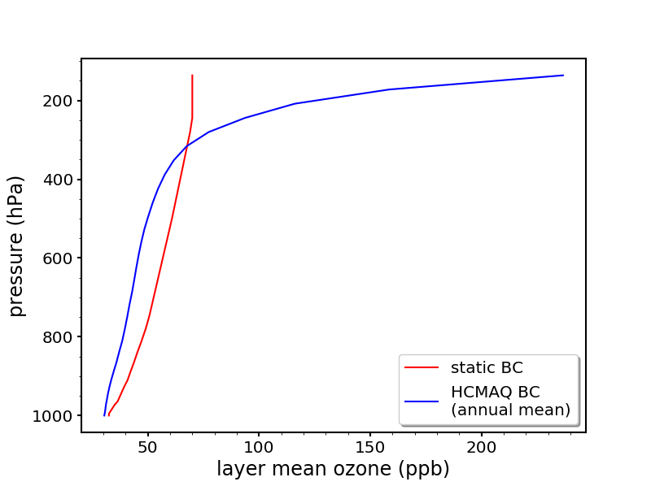
Boundary Conditions
More ozone at lower layers with static BC
  Still within about 10 ppb of one another
More ozone in upper layers with HCMAQ BC
  More accurate compared to ozone sonde data

Slide 7
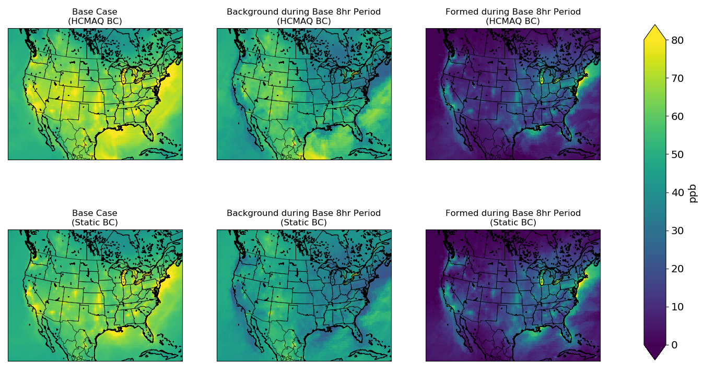
Model Results
HCMAQ case results in greater concentrations for base and background for the highest ozone days
  Formed is fairly consistent
Ozone formed represents the enhancement of ozone above the background concentration due to US anthropogenic emissions
Mean of 10 highest MDA8 ozone concentrations
Mean of same 10 days as Base Case
Formed = Base - Background

Slide 8
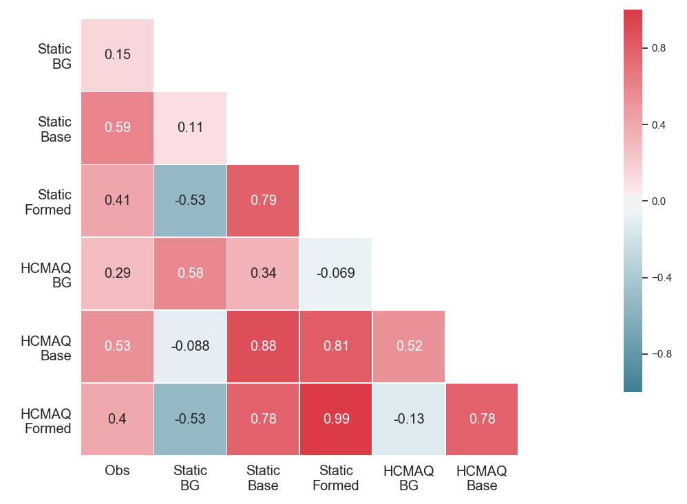
Correlation of Ozone Components
O₃ formed shows high agreement between the two BC cases (r=0.99)
BG O₃ and O₃ formed are negatively correlated
  O₃ formed = base O₃ – BG O₃
  Correlation is stronger for Static BC
HCMAQ BG has stronger correlation with observations
Notes:
Correlation coefficients

Slide 9
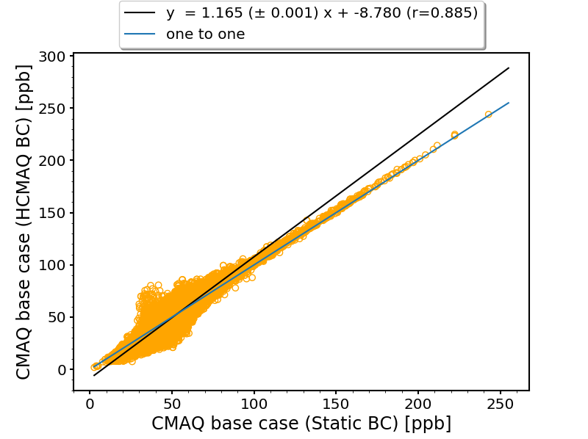
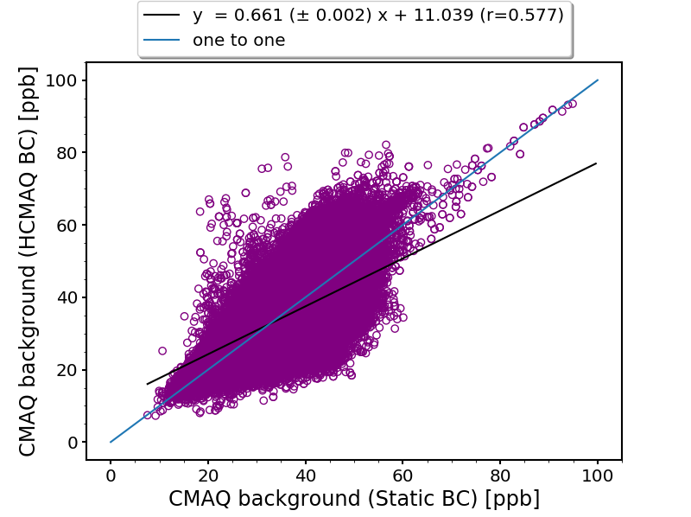
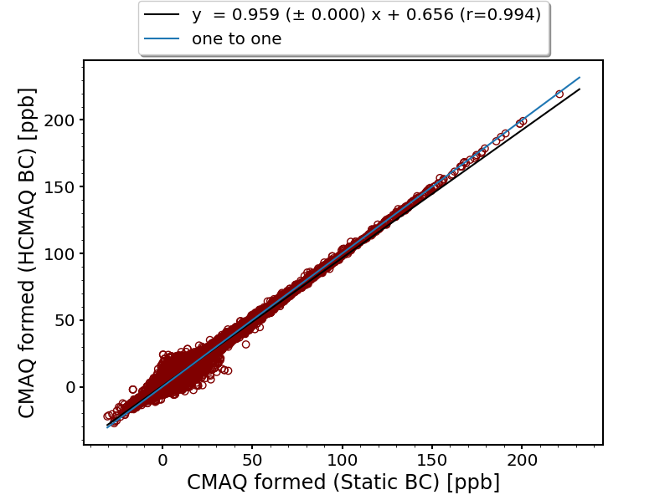
Boundary Condition Effects
Plots show the comparison only at observation locations (N=379120)
Ozone formed is mostly consistent between the two BC cases
Most of the difference in the base cases is due to the background contribution

Slide 10
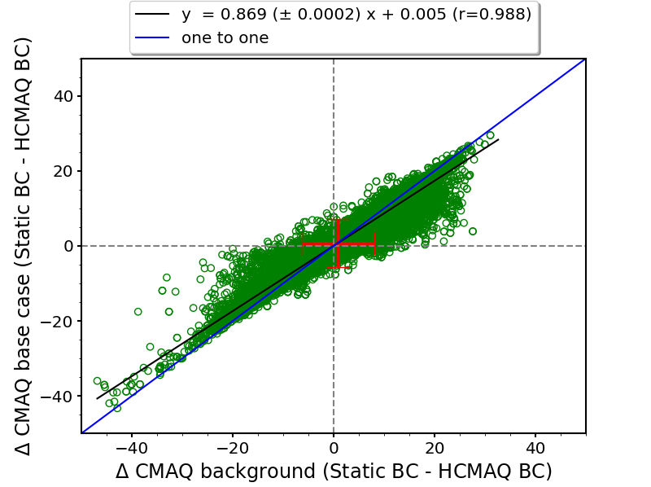
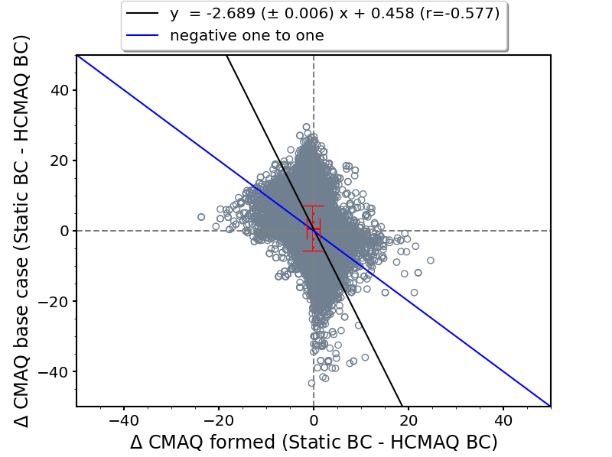
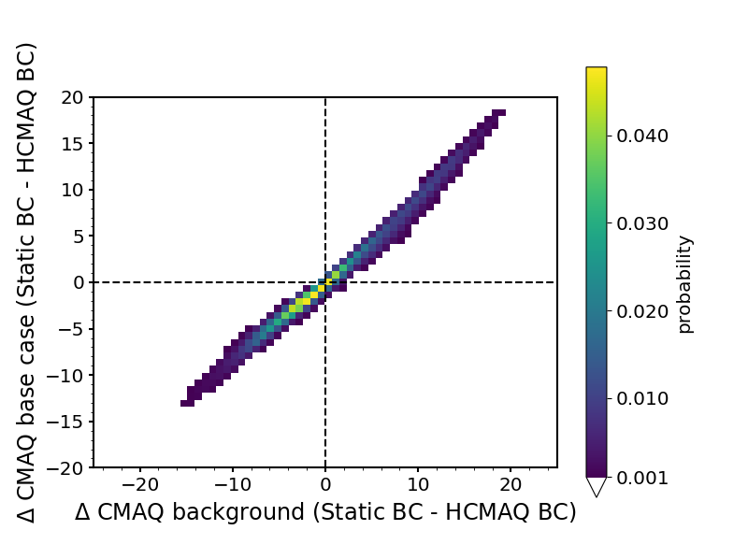
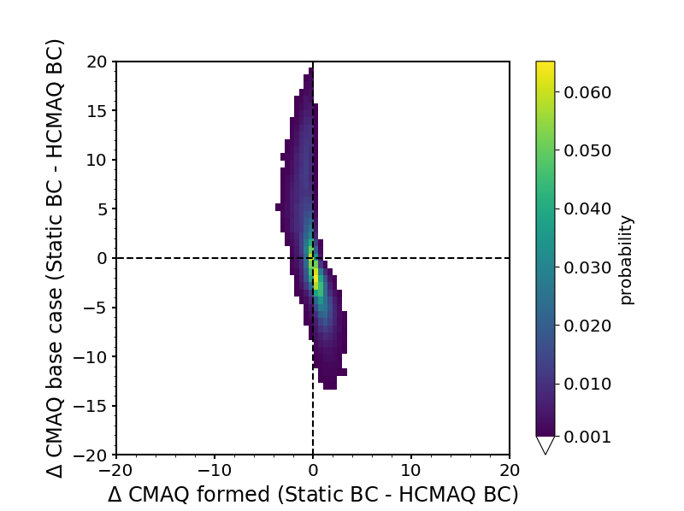
Background and Formed Ozone
Difference in base case and difference in background case have a highly linear relationship
Difference in formed has a much weaker relationship with the difference in the base case
  Difference in formed is usually near zero
Notes:
Red bar indicates one standard deviation from the mean.

Slide 11
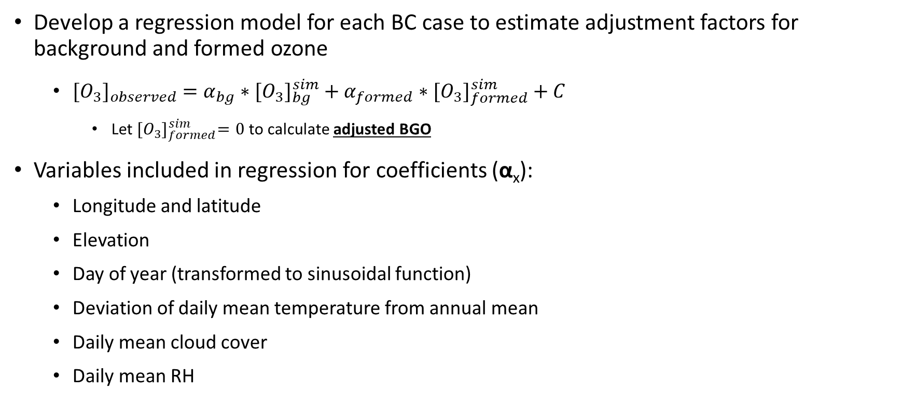
Ozone Regression Model
Develop a regression model for each BC case to estimate adjustment factors for background and formed ozone
  ${[O_{3}]}_{observed} ={α_{bg}∗[O_{3}]}_{bg}^{sim}+{α_{formed}∗[O_{3}]}_{formed}^{sim}+C$
    Let ${[O_{3}]}_{formed}^{sim}=0$ to calculate adjusted BGO
Variables included in regression for coefficients (α_{x}):
  Longitude and latitude
  Elevation
  Day of year (transformed to sinusoidal function)
  Deviation of daily mean temperature from annual mean
  Daily mean cloud cover
  Daily mean RH

Slide 12
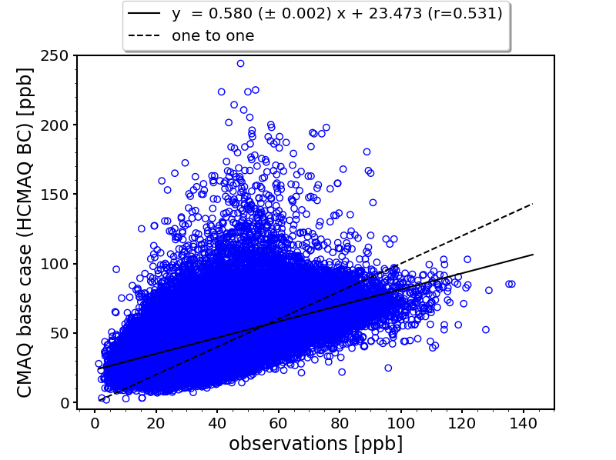
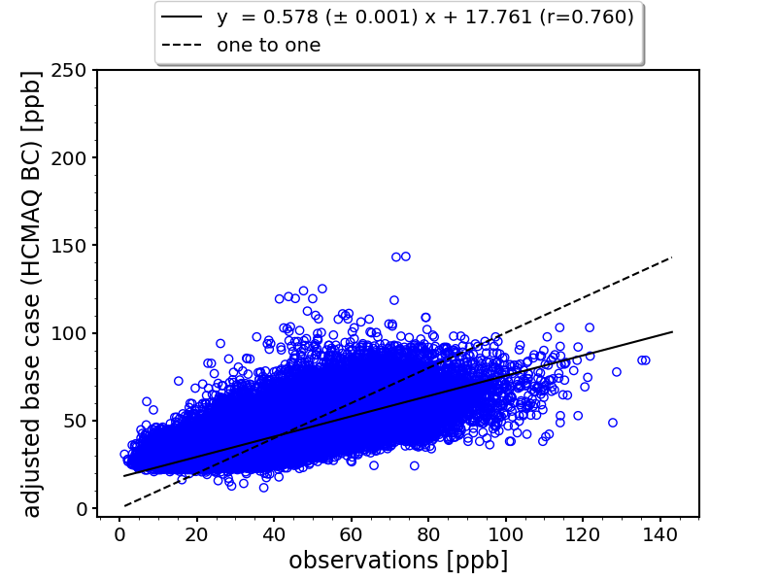
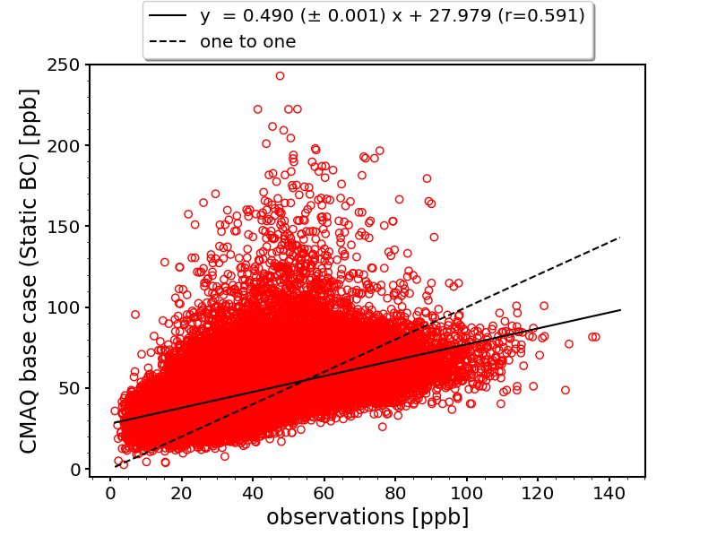
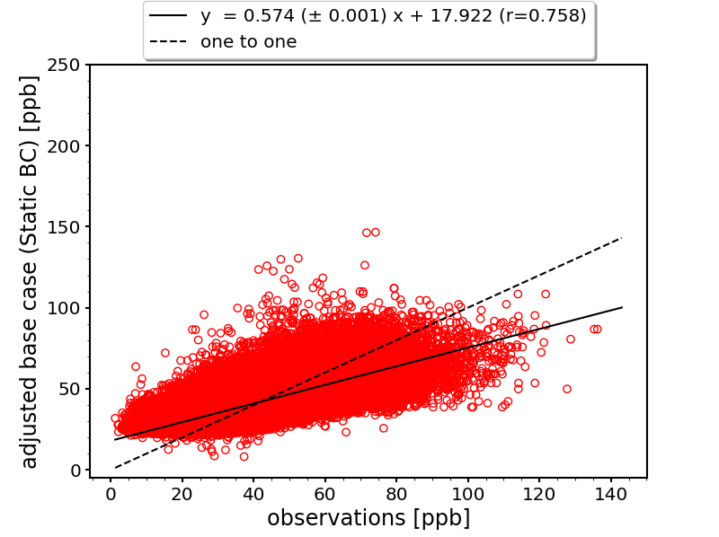
Adjusted Base Case Ozone
CMAQ
Adjusted
Performance is improved compared to original CMAQ results
Fewer extreme high ozone outliers after adjusting
Improved performance → decreased uncertainty in background ozone prediction

Slide 13
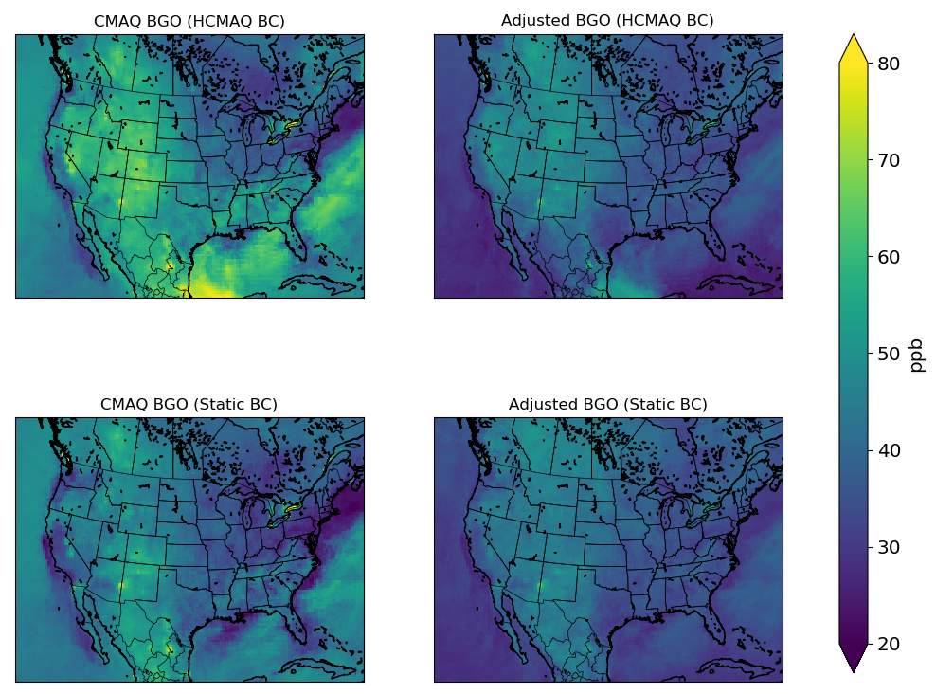
Adjusted Background Ozone
Improved agreement after applying adjustment factor
  CMAQ: R² = 0.20
  Adjusted: R² = 0.70
Information from the model is still retained after adjusting
  Fire impacts from HCMAQ southern boundary conditions
  Higher concentrations in western US with HCMAQ BC
Mean of 10 highest MDA8 ozone days from Base Case

Slide 14
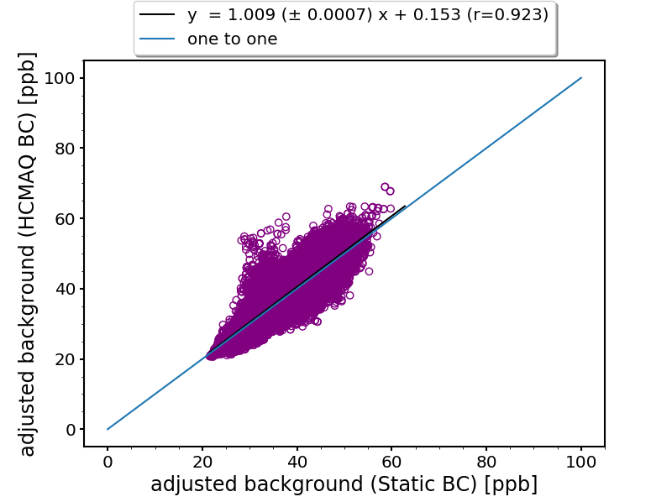
Regression Model Comparison – Background
Original CMAQ
Adjusted
Agreement of BGO estimates is greatly improved when adjustment factor is applied
Less variability in background ozone between BC cases → decreased uncertainty in background ozone prediction
Notes:
Scatter plot shows comparison only at observation locations.

Slide 15
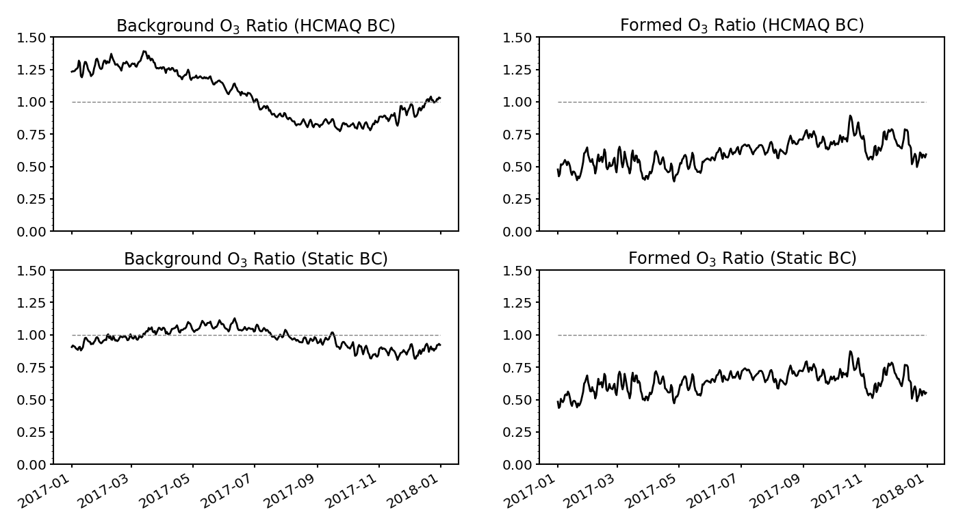
Ozone Adjustment Ratios
Adjustment to O₃ formed is consistent for the two cases
Adjustment to BGO shows more differences
  More seasonal variation in HCMAQ case
O₃ ratio = adjusted O₃ / simulated O₃

Slide 16
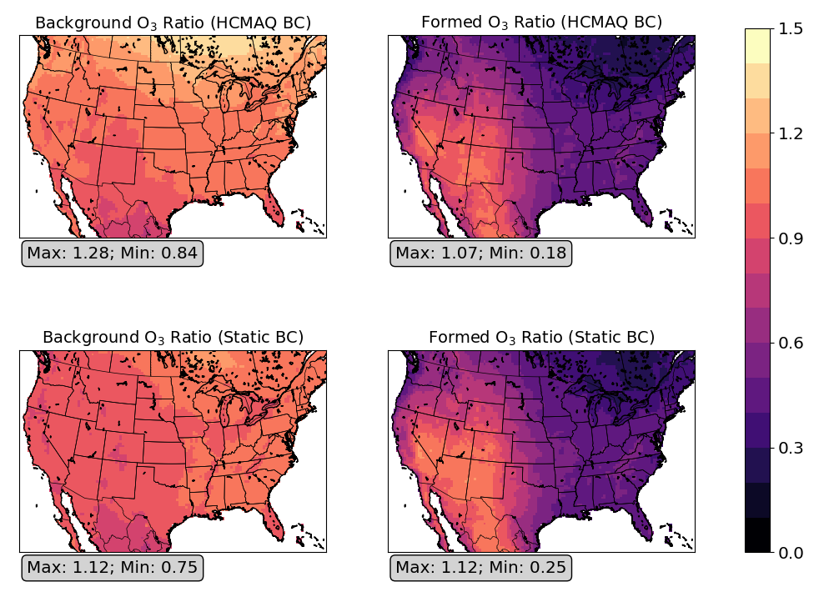
Ozone Adjustment Ratios – Annual Mean
Adjustment to O₃ formed has a clear pattern
  High in the mountain west and southwest
  Low in the east
Adjustment to BGO has less spatial variation
Notes:
Max/min refers to the maximum and minimum in US grid cells.

Slide 17
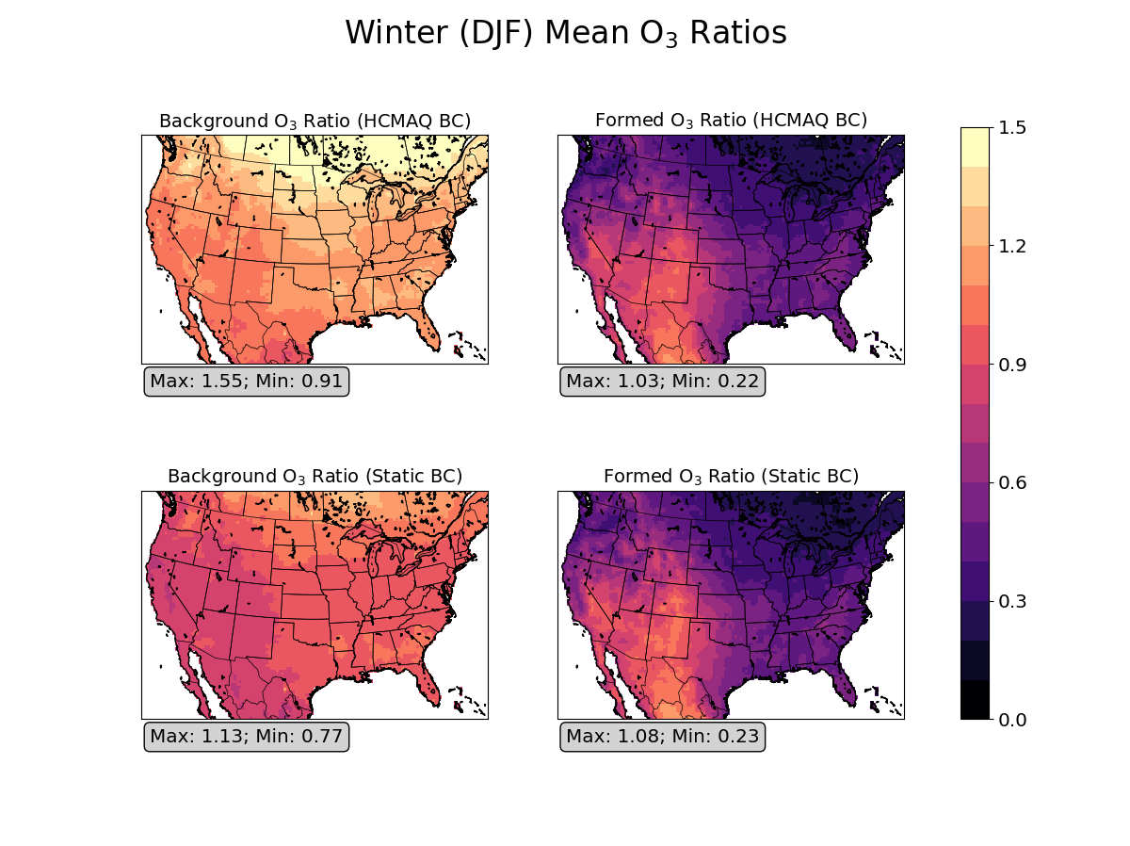
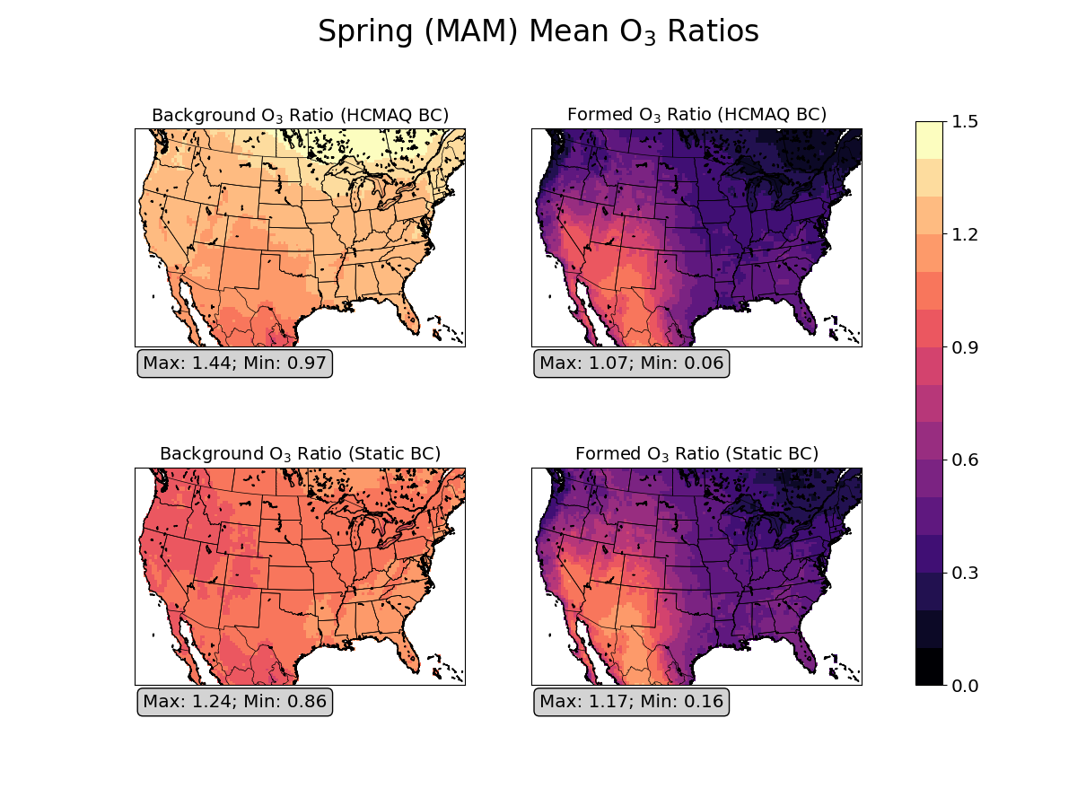
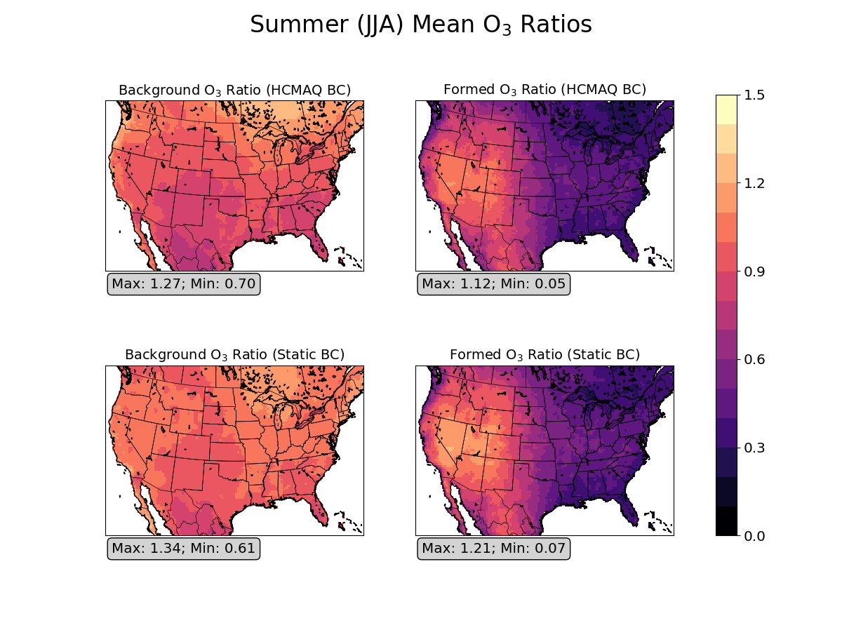
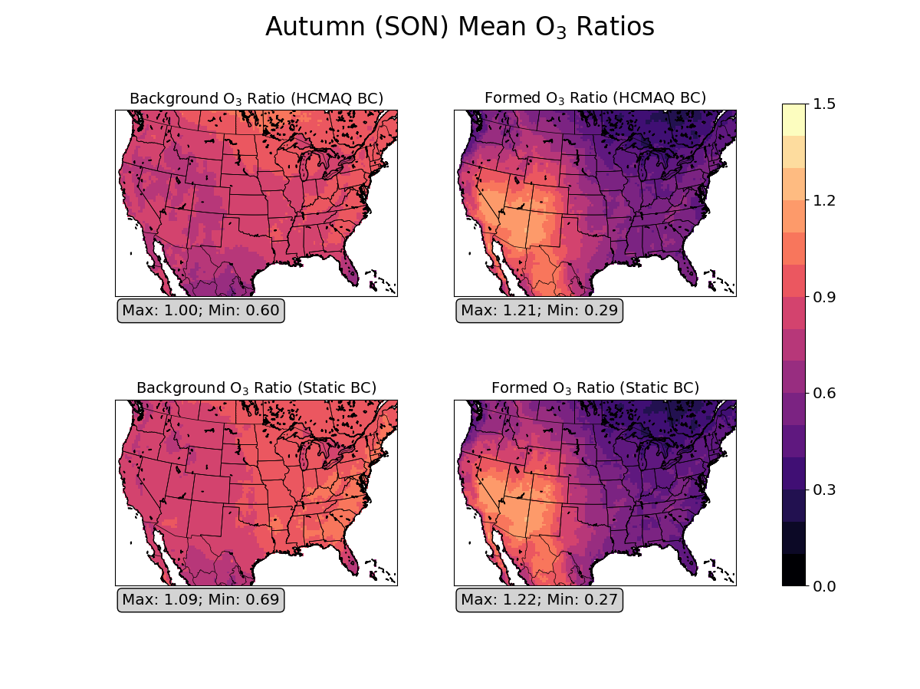
BGO adjustment is higher in Winter and Spring
Spatial pattern of O₃ formed adjustment is consistent across seasons

Slide 18
Summary and Conclusions
Application of the adjustment factors resulted in improved agreement of background ozone estimates with different boundary conditions
  At observation sites, BGO correlation is improved from 0.58 to 0.92
  Across the entire model domain, BGO correlation is improved from 0.63 to 0.90
Adjustment of BGO follows a seasonal trend – higher in Winter/Spring
Adjustment of O₃ formed shows a spatial pattern – higher in Southwest/Mountain West
Ozone adjustments resulted in decreased uncertainty in background ozone prediction due to:
  Improved performance in the base case
  Increased agreement of background ozone estimates

Slide 19



Acknowledgements
Thanks to US EPA for providing Hemispheric CMAQ boundary conditions.

Slide 20
Extra Slides

Slide 21
Ozone Regression Model
ΔT = deviation from annual mean temperature
X = |longitude|/180
Y = |latitude|/90
Z = elevation in km
ω = 2π/365
d = day of year
CLD = cloud fraction (0-1)
RH = relative humidity (0-1)
Formulation of the model
  [O₃] = [O₃]_{bg}*(α_{bg,0} + α_{bg,ΔT} ΔT + α_{bg,X} X + α_{bg,Y} Y + α_{bg,Z} Z + α_{bg,sin} sin(ωd) + α_{bg,cos} cos(ωd) + α_{bg,CLD} CLD + α_{bg,RH} RH)
  + [O₃]_{formed}*(α_{f,0} + α_{f, ΔT} ΔT + α_{f,X} X + α_{f,Y} Y + α_{f,Z} Z + α_{f,sin} sin(ωd) + α_{f,cos} cos(ωd) + α_{f,CLD} CLD + α_{f,RH} RH)
  + C
Let [O₃]_{formed} = 0 to calculate adjusted BGO
  Since [O₃]_{formed} represents the enhancement of ozone above the background level, it is neglected when calculating the adjusted BGO based on the regression model

Slide 22
Regression Model Results
AQS + CASTNET monitors
CASTNET monitors only
Term | HCMAQ BC |  | Static BC
 | α_{bg} | α_{formed} | α_{bg} | α_{formed}
constant (α₀) | 0.4572 | 0.6633 | 0.4020 | 0.6974
α_{ΔT} | 0.0055 | 0.0410 | 0.0129 | 0.0845
α_{X} | -0.0007 | 0.0135 | -0.0119 | 0.0337
α_{Y} | 0.0387 | -0.0383 | 0.0198 | -0.0294
α_{Z} | 0.0058 | 0.0663 | 0.0139 | 0.0711
α_{sin} | 0.1334 | -0.0621 | 0.0775 | -0.0112
α_{cos} | -0.0082 | 0.0610 | -0.0313 | 0.0792
α_{CLD} | -0.0238 | -0.5301 | -0.0195 | -0.5391
α_{RH} | -0.0357 | -0.1456 | -0.0346 | -0.1445
Intercept | 19.1322 |  | 19.8428
R² | 0.58 |  | 0.57
Term | HCMAQ BC |  | Static BC
 | α_{bg} | α_{formed} | α_{bg} | α_{formed}
constant (α₀) | 0.4180 | 0.5769 | 0.3769 | 0.6283
α_{ΔT} | -0.0160 | 0.0848 | -0.0181 | 0.1495
α_{X} | -0.0028 | 0.0336 | -0.0187 | 0.0708
α_{Y} | 0.0181 | -0.0078 | 0.0063 | -0.0030
α_{Z} | 0.0457 | -0.0071 | 0.0537 | -0.0066
α_{sin} | 0.1319 | -0.0571 | 0.0688 | 0.0048
α_{cos} | -0.0250 | 0.0966 | -0.0580 | 0.1386
α_{CLD} | -0.0497 | -0.1949 | -0.0369 | -0.2535
α_{RH} | -0.0095 | -0.2575 | -0.0164 | -0.2423
Intercept | 22.2098 |  | 22.2458
R² | 0.64 |  | 0.64
p > 0.05
Regression variables normalized to zero mean and unit variance

