Slide 1

Air Quality and Human Health Impacts of Prescribed Fire: Links to PM2.5 and Asthma in Georgia, USA
Ran Huang, Yongtao Hu, Armistead Russell, James Mulholland, and Talat Odman
The 18th Annual CMAS Conference Chapel Hill, North Carolina
October 21, 2019

Slide 2
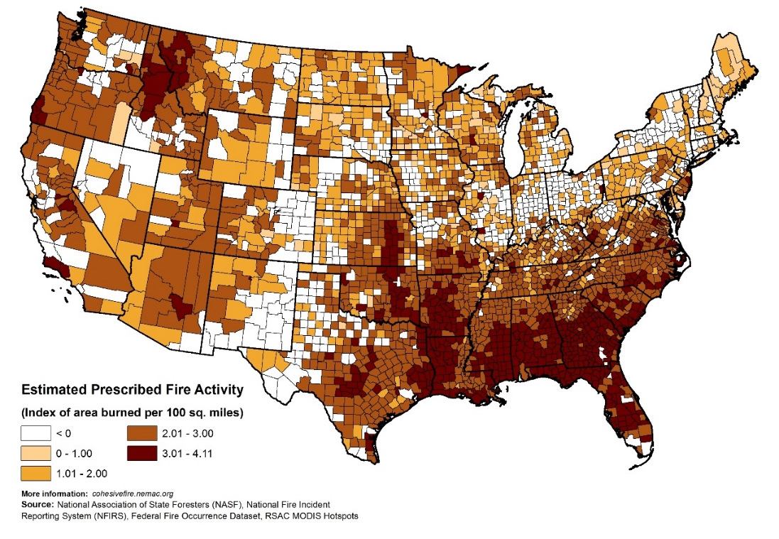
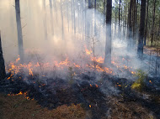
Prescribed fire is the largest source of PM_{2.5} emissions in the southeastern U.S.
Prescribed fire improves native vegetation and wildlife habitat, controls insects and disease, and reduces wildfire risk.
Georgia
2014 National Emissions Inventory (NEI) attributes 27% of all PM_{2.5} emissions in the southeastern U.S. to prescribed fire (250 Gg / year).
Notes:
Prescribed fire is a large source of PM2.5, especially in the Southeast, which is the most active prescribed fire region in the nation.

Slide 3
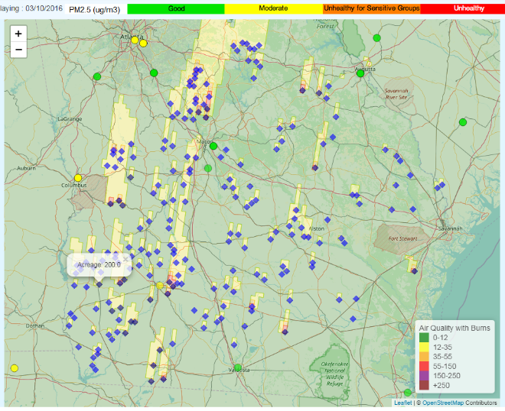
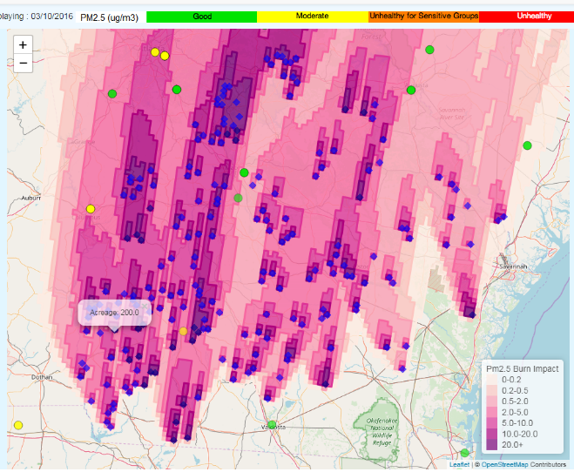
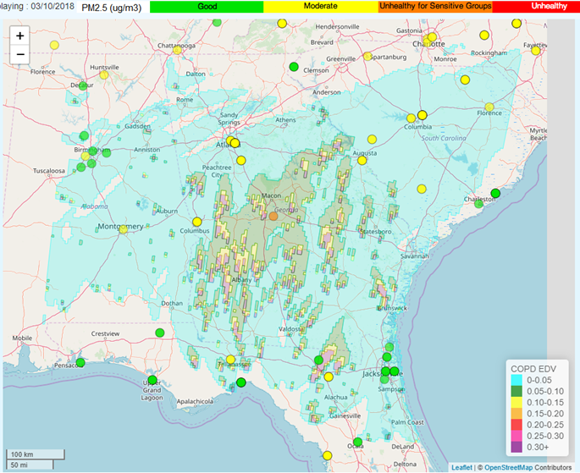
HiRes-X: Operational forecasting of prescribed fire impacts for air quality and health management
Daily forecasts of prescribed-fire related air quality impacts to state agencies for prescribed burn and air quality management
https://forecast.ce.gatech.edu
Prescribed-fire related exposures to CDC and its partners for public health tracking and source-specific epidemiological assessments
https://sipc.ce.gatech.edu/SIPFIS/map/
PM_{2.5} Forecast
Burn Impact Forecast
Health Impact Forecast
Odman, M. T., et al. (2018) Atmosphere, doi:10.3390/atmos9060220
Hu, Y., et al. (2019) IJERPH, doi:10.3390/ijerph16111981
Notes:
We have developed HiRes-X to forecast the impacts of prescribed fires. HiRes-X is operational: it provides daily forecasts of air quality, and prescribed fire impacts on air quality and health.
WRF-CMAQ models

Slide 4
Components of HiRes-X forecasting system
Weather Research and Forecasting (WRF) model for weather forecast
Prescribed burn activity forecast (number, location, size of burns) based on weather forecast and historic fire patterns
BlueSky framework for prescribed fire emissions (fuel loads, fuel consumption, emission factors, plume rise)
National Emissions Inventory (NEI) and Sparse Matrix Operator Kernel Emissions (SMOKE) model for other emissions
Community Multiscale Air Quality (CMAQ) model for air quality forecast
Decoupled Direct Method (DDM) for prescribed fire impact forecast

Slide 5
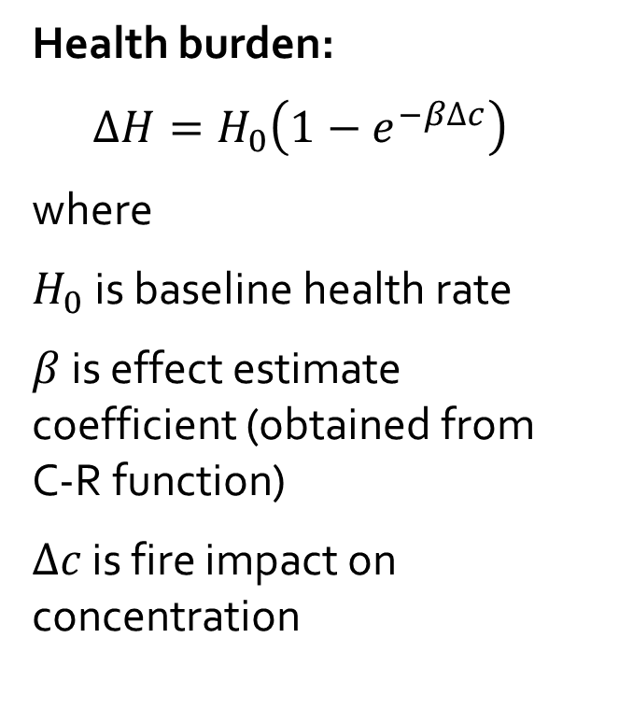
HiRes-X estimates health impacts based on smoke exposure epidemiological studies
C-R function
Response
PM_{2.5} concentrations
β = 0.008 for asthma ER visits
β = 0.006 for asthma hospitalizations
Alman, B. L., et al., Environ. Health (2016), DOI: 10.1186/s12940-016-0146-8
Notes:
HiRes-X estimates the burden on a certain health outcome such as the asthma related ER visits or hospitalizations using concentration-response functions derived in smoke exposure epidemiological studies.

Slide 6
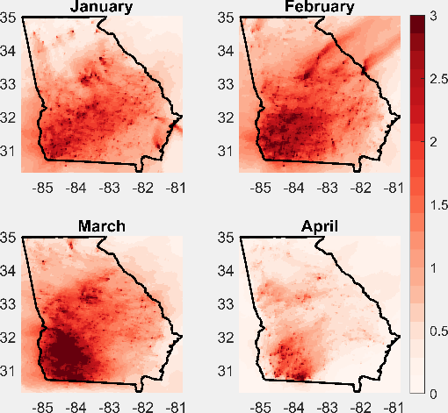
HiRes-X can also be used for retrospective analysis with actual fire data
Huang, R., et al. (2019) IJERPH, doi:10.3390/ijerph16132312
Estimated asthma-related ER visits due to Rx fire by county in Georgia from 2015 to 2018 for the first four months of the year.
2015 Rx fire impact on PM_{2.5} (µg/m³)
Notes:
HiRes-X can also be used with actual fire data in retrospective analyses: For example we used it to generate fire-related PM2.5 exposure fields from 2015 to 2018 in Georgia. Then, we estimated the numbers of excess asthma-related ER visits.
We used national asthma-related ER visit rate in 2013 (626 per 100,000 person) as the annual asthma-related ER visit rate in Georgia and converted to a daily rate by constructing weights based on observed daily ER visits due to asthma during 2013.
While PM2.5 is highest in southwest Georgia, population density is low there. Therefore there are more asthma related ER visits in metro Atlanta.
The estimated asthma-related ER visits due to Rx burning in Atlanta MSA has an average of about 66 during the reporting years, which is ~0.6% of all asthma-related ER visits (11,372) in Atlanta MSA in 2013.

Slide 7
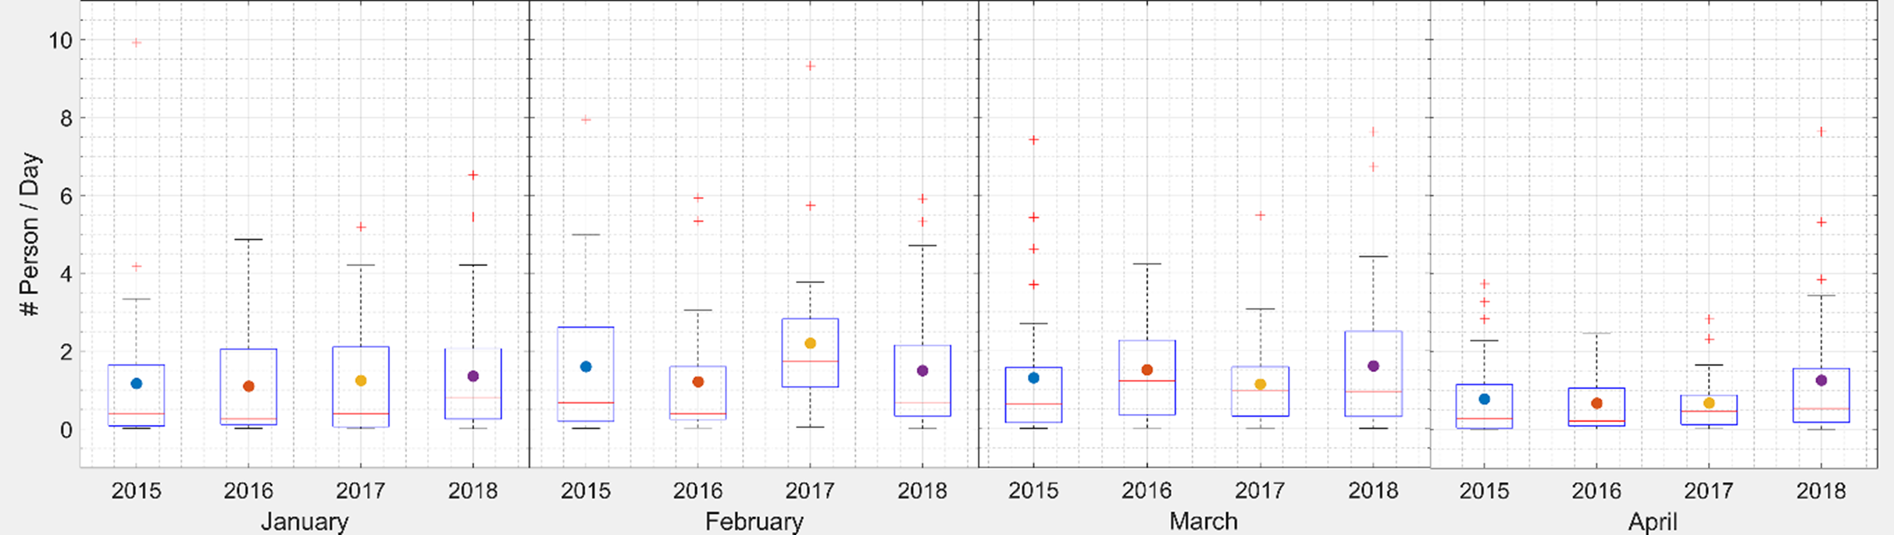
Estimated asthma-related ER visits in Georgia due to prescribed burning
 | January | February | March | April | Total
2015 | 36 | 45 | 41 | 23 | 145
2016 | 34 | 35 | 47 | 20 | 136
2017 | 39 | 62 | 35 | 20 | 156
2018 | 42 | 42 | 50 | 38 | 171
Notes:
February and March have larger health impact than January.
February 2017 has a larger health impact compared to other years, probably due to larger emissions related to the drought that year.
April 2018 also has a larger health impact with more burned areas compared to previous years, likely due to an extended burn season.
February 2017 has the largest estimated health impacts across the reporting years with 62 ER visits due to asthma, a rate of 6.4 per 1,000,000 people.
~145 asthma-related ER visits are estimated due to Rx burning, a rate of 15 per 1,000,000 people, during the first four months of 2015. This number increases by 18% in 2018.
The uncertainties were derived assuming 50% uncertainty in $β$ and 40% uncertainty in $∆PM$.

Slide 8
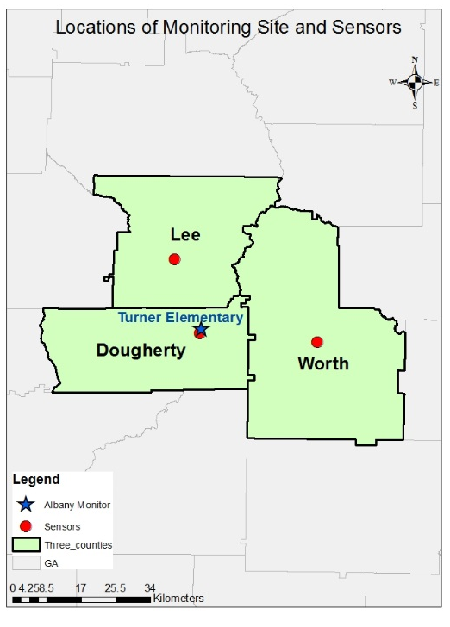
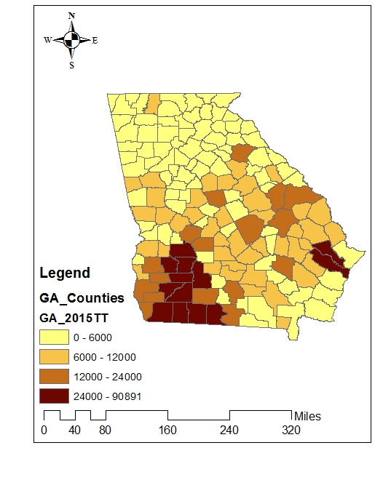
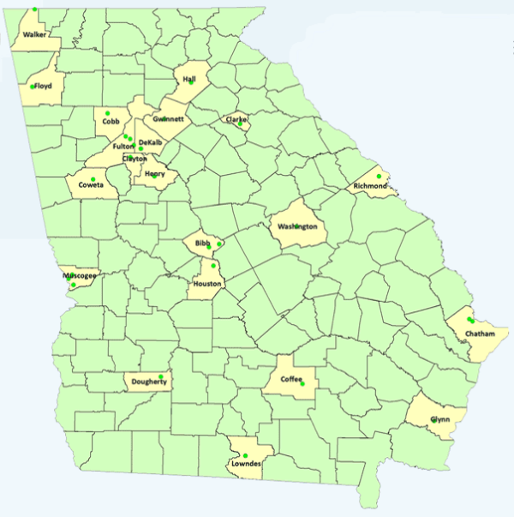
Low-cost sensors deployed at smoke impacted areas of Southwest GA
Burned area
(2015 permit data)
PM_{2.5} Monitoring Sites in GA
Counties shaded in yellow
have PM_{2.5} monitoring sites
GA EPD site at Turner Elementary, Albany, GA
(13095007)
BAM
Notes:
While the prescribed burned area and smoke exposure are largest in southwest Georgia, there is only one PM2.5 monitor there. We deployed 4 low-cost sensors: one collocated with the monitor and 3 at county high schools.
BAM replaced with a Teledyne T640 as of the end of February 2019.

Slide 9
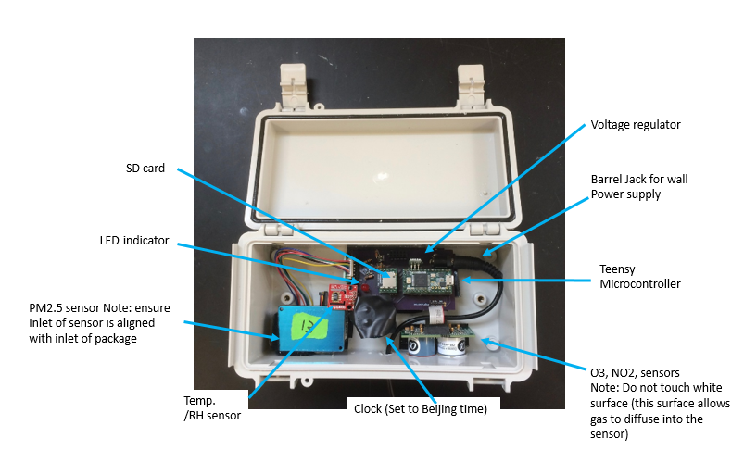
The low-cost PM sensor is
Plantower PMS 3003
Plantower PMS 3003
PM sensor costs $17. Box total cost is ~$300.
The Plantower PMS 3003 sensor uses an optical method to measure PM₁, PM_{2.5} and PM₁₀.
It converts particle number concentration, based on laser scattering principle.
The sensor performance was better when ambient PM_{2.5} was higher
Zheng, T., et al. (2018) Atmos. Meas. Tech., DOI: 10.5194/amt-11-4823-2018
Notes:
The low-cost PM sensor we used is Plantower PMS 3003. Here’s the box we deployed. Zheng has evaluated the sensor and shows that it has better performance in higher concentrated area while fire impact usually cases high PM2.5 concentration level.

Slide 10
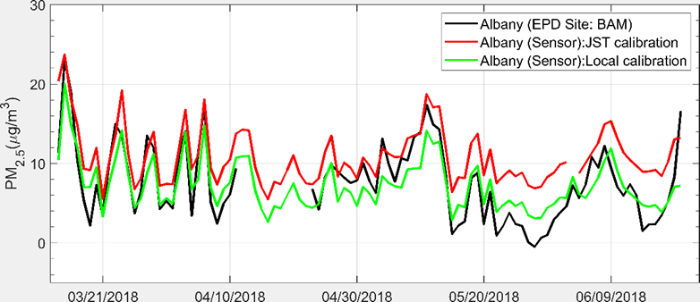
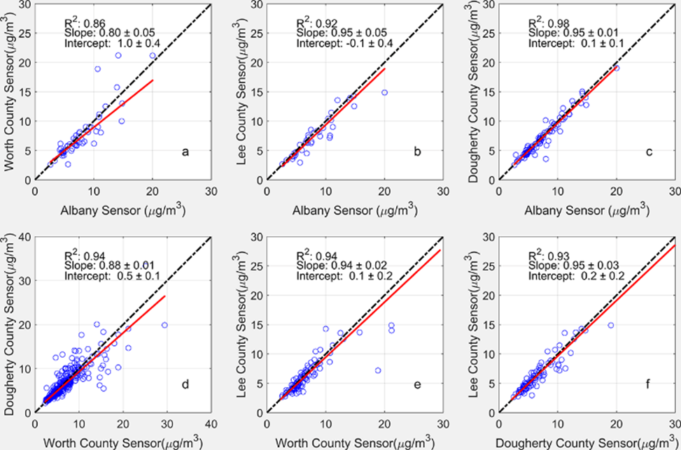
Calibrated sensor data show spatial variation in prescribed fire impacts on PM_{2.5}
Daily PM_{2.5} concentrations from low-cost sensor using different calibration methods and BAM at GA EPD site in Albany (March 14–June 20, 2018)
Orthogonal regression of daily PM_{2.5} concentrations between low-cost sensors (vs. sensor at Albany EPD site)
Notes:
The correlation between the sensors and the monitor was largest at the nearest high school and smallest for the most distant high school. Also, the correlations between two sensors decreased with distance. These show the level of spatial variation in PM2.5 due to prescribed fires.

Slide 11
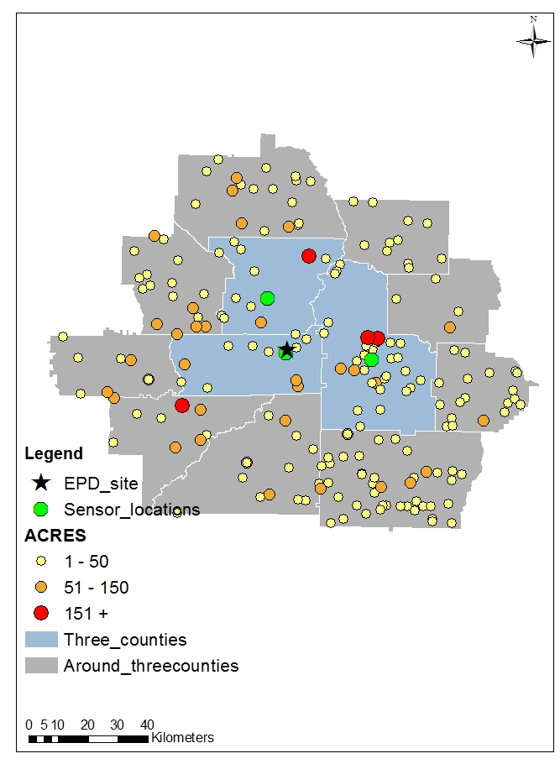
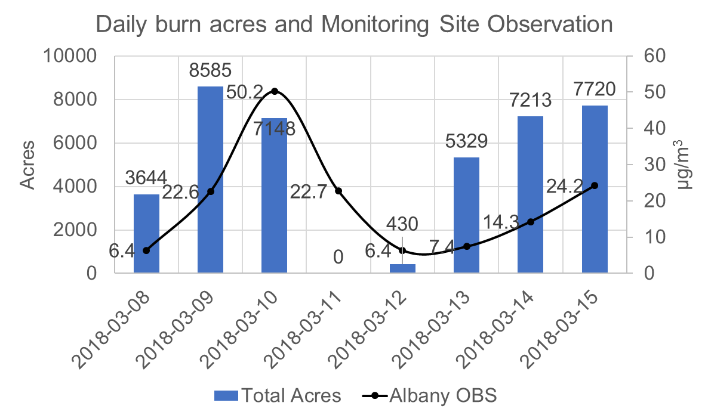
A PM_{2.5} exceedance was detected by Albany EPD monitor on March 10, 2018
Albany EPD Daily PM_{2.5}: 50.2 µg/m³
Permits
Number: 247
Total Acres: 7148
Simulation period: March 8–15, 2018
Models: WRFv3.6, CMAQv 5.0.2, DDM
Fire emissions: BlueSky, all fires start at 11 am (EST), and last 3 hours
11
Southerly winds
Notes:
I want to show you two case studies. First, on March 10, daily average PM2.5 recorded in Albany was 50 micrograms. This was an active fire day with southerly winds. Red, orange and yellow dots mark the large medium and small sized fires. Green dots mark the monitors. We simulated this event with HiRes-X

Slide 12
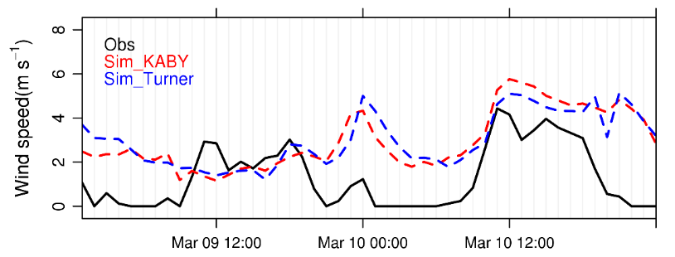
Evaluation of simulated PM_{2.5} and fire impact at Albany EPD site: March 09–10
March 9th:
  Peak concentration level captured, but timing missed in the simulation. This may be due to fire start/end times.
March 10th:
  Nighttime concentrations underestimated in the simulation. This is due to a systematic bias in WRF that overestimates nighttime wind speed.
  Peak missed in the simulation.
Notes:
The simulation did not reproduce the exceedance because nighttime PM2.5 concentrations were underestimated. This is due to a systematic bias that overestimates nighttime wind speeds. Also an early morning peak that was probably due to a nearby local burn was not picked up by the simulation.
Problem with the peak on March 9: May be due to start (11 am) and duration (3 hours) of the fires in the simulation. There are permits approved to start in the afternoon and end at night
Problem with the exceedance on March 10: Observed wind speed from observation (KABY: Southwest Georgia Regional Airport) is 0 from 00:00 to 07: 00 and 19:00 to 23:55 EST on Mar. 10th,; however WRF simulation shows higher wind speed.
The peak at 10:00 am may be caused by a new fire starting early and located close to the monitoring site. However, it’s hard to tell which fire it is.

Slide 13
4-km grid-resolution simulations cannot capture the spatial variation of fire impact
Albany
EPD site
Dougherty County HS
Notes:
The simulation did not resolve the PM2.5 spatial variation detected by the low-cost sensors. While two sensors measured very different concentrations the simulation showed similar concentrations.

Slide 14
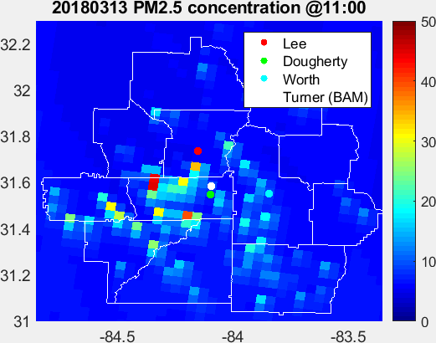
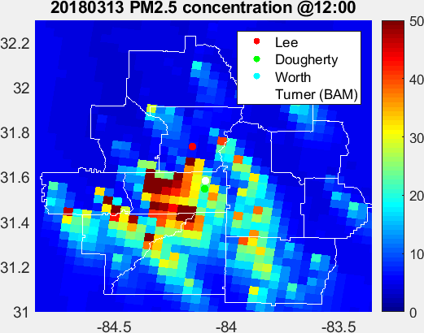
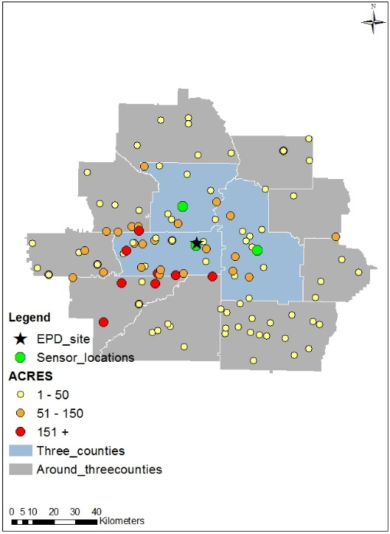
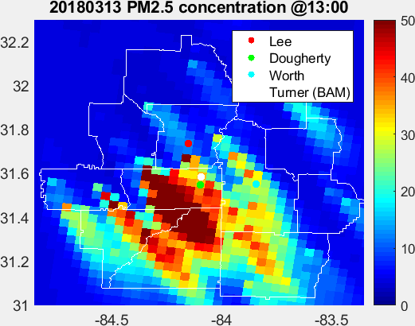
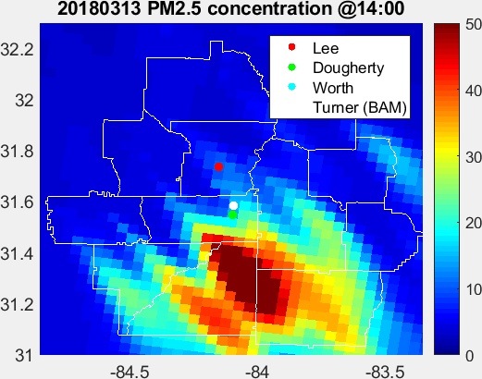
March 13
Permits
Number: 118
Total Acres: 5329
Northwesterly winds
Notes:
The second case is March 13.
Under northwesterly winds the plumes moved in the southeast direction. The Worth County sensor picked up the impact of these medium and small fires, as shown by this peak.
Large fires to the west and southwest missed the EPD monitor and the Dougherty County sensor where the observations are both flat at low concentration.
The impact of these large fires remained undetected.

Slide 15
Fusion of low-cost sensor data improves simulated PM_{2.5} fields
Albany (BAM)
DCHS
WCHS
Albany
Sim.
DCHS
DF
WCHS
DW
Notes:
Fusion of the low-cost sensor data improved simulated PM2.5 fields, even when the data for the sensor being evaluated were withheld.
At all three locations including observations from low-cost sensors improved the accuracy of PM2.5 fields.
It decreased the underestimation of simulated fire impacts during the night. The missing peaks also have been restored.

Slide 16
Conclusions
Due to the shortage of monitoring sites in Southwestern Georgia, the severe impact of prescribed fires on local air quality and public health may be missed.
PM_{2.5} concentrations in Southwestern Georgia are not homogeneous; the spatial variation cannot be captured with 4-km resolution model simulations.
Finer resolution together with better knowledge of start and end times of the burns could improve the simulations. However, the uncertainties in wind speed and direction would still limit the accuracy.
Low-cost sensors could be used to detect prescribed fire impacts and provide spatial and temporal information missed by the simulations.
Notes:
In conclusion: 1) there is a lack of monitoring sites in smoke impacted areas. 2) The spatial and temporal variation of PM2.5 in prescribed fire smoke impacted areas is large. 3) READ #3 and #4

Slide 17





Acknowledgements
Dan Chan (GaFC)
Jim Boylan (GaDNR)
Rish Vaidyanathan (CDC)
Scott Goodrick (USFS)
Susan O’Neill (USFS)
Fernando Garcia-Menendez (NCSU)
Yufei Zou (UW)
Notes:
Let me start by acknowledging our sponsors and our collaborators.

Slide 18
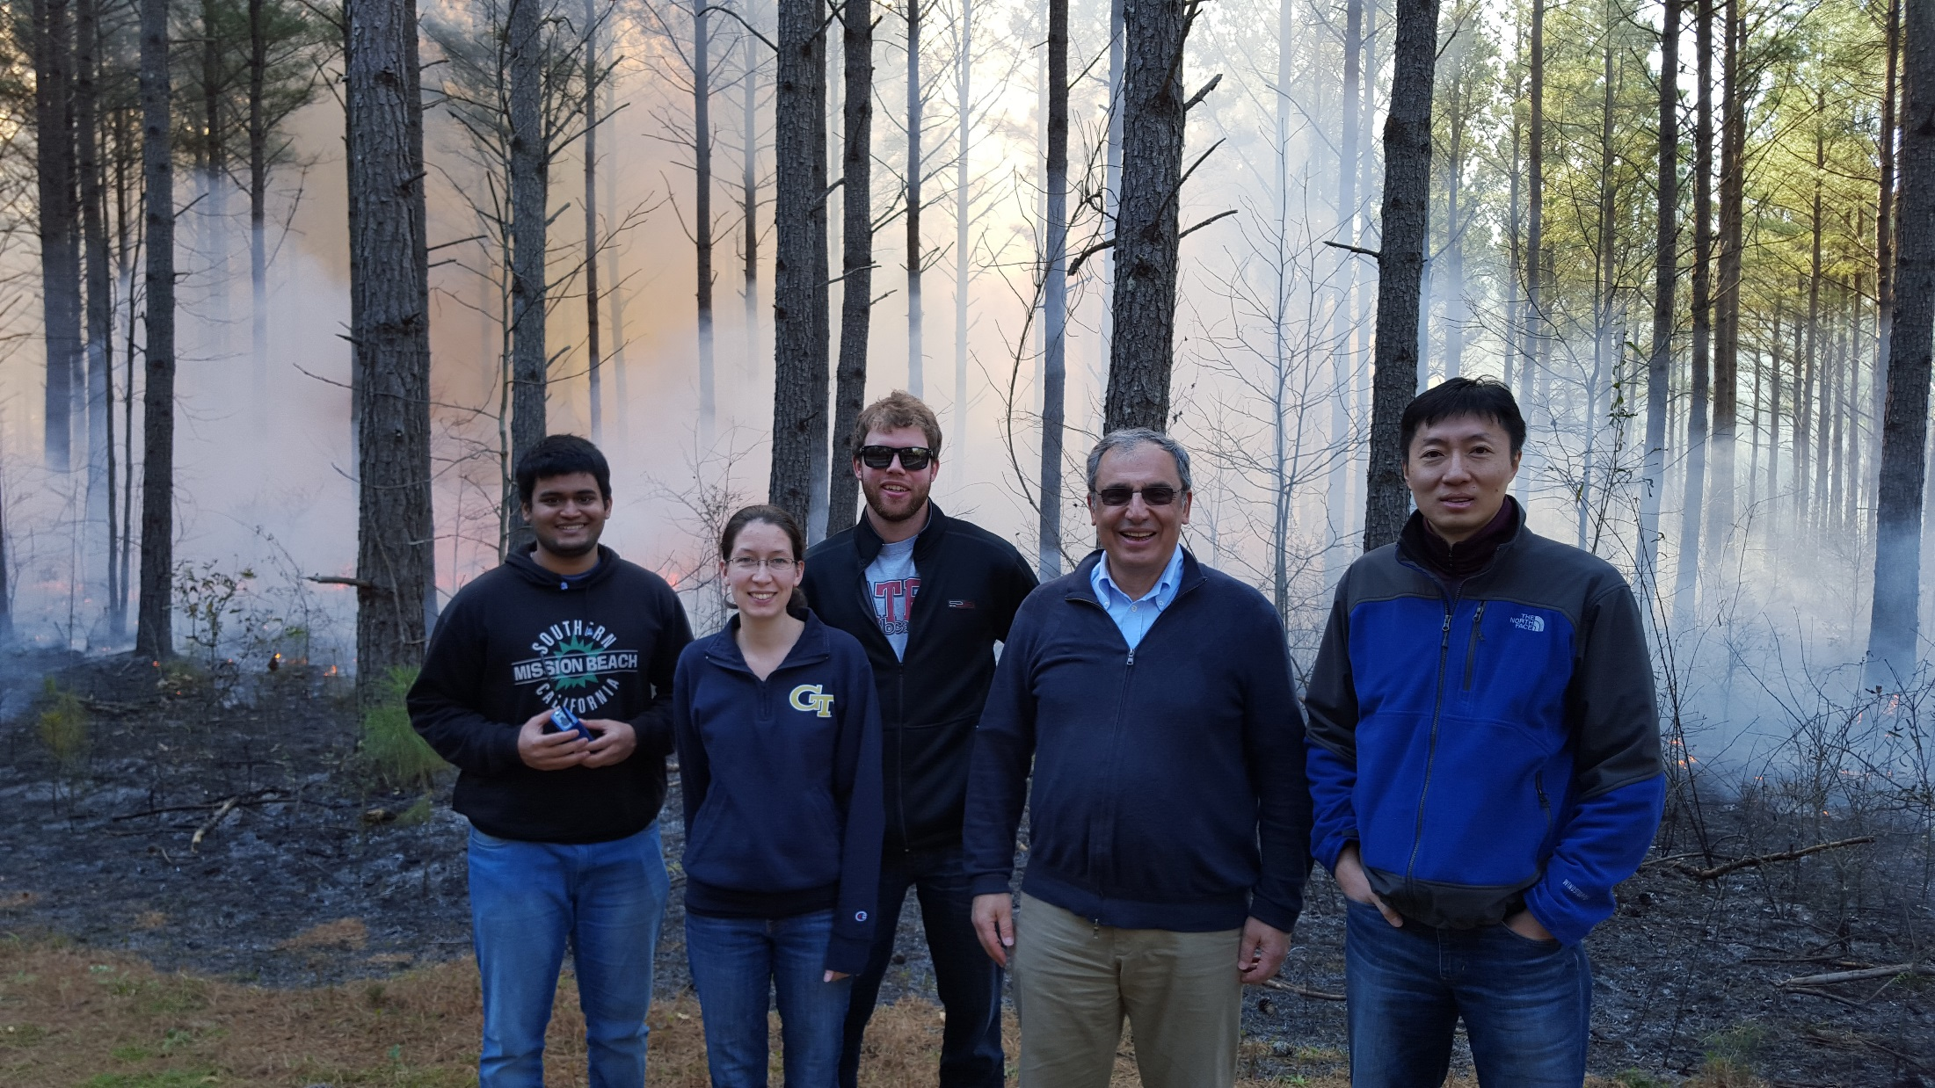
Questions?
odman@gatech.edu

Slide 19
Method to identify days when prescribed fire may have acute health impacts.
Red dots represent days with high observed PM2.5 concentrations (95th percentile) due to prescribed fire impacts.
Future epidemiological studies could focus on these days to find the relationship between short-term high-level PM2.5 exposures due to prescribed fire and health impacts over a series of single-day lags.

Slide 20
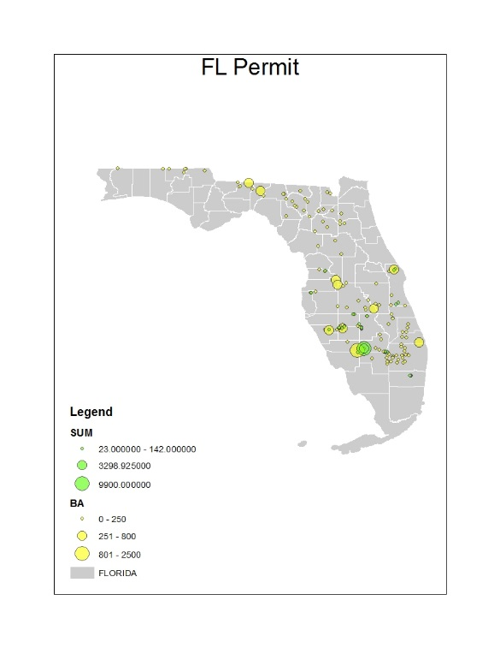
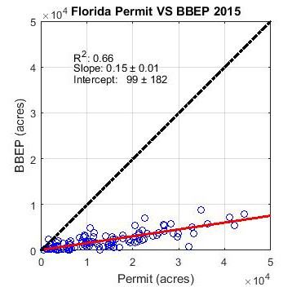
Earth observations in prescribed fire impact forecasting
Fire detection
Fuel loads
Emissions
Plume heights
Smoke dispersion
Huang, R., et al. (2018) J. Geophys. Res., DOI: 10.1029/2017JD028217

Slide 21
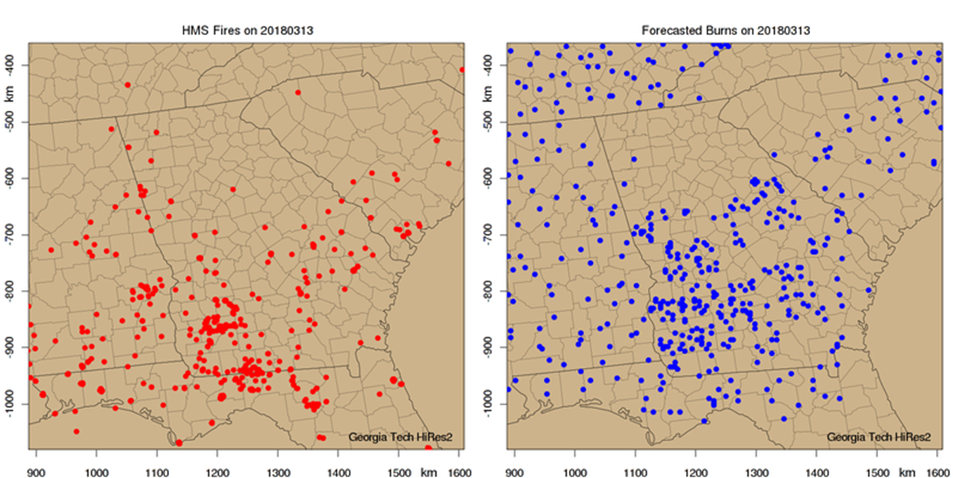
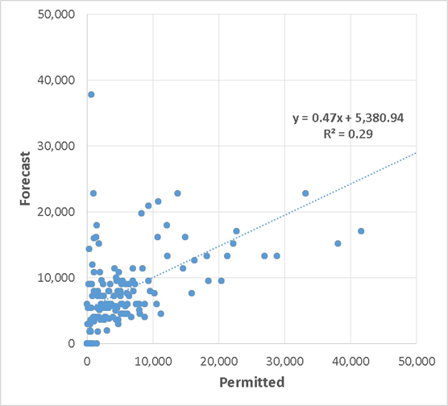
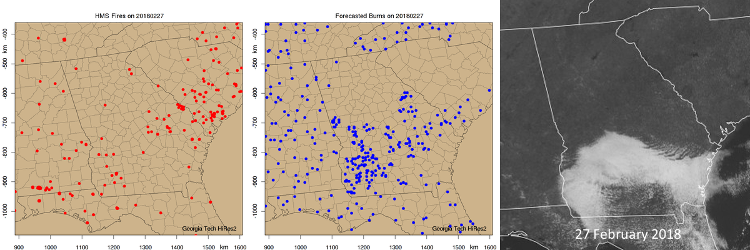
Prescribed fire activity forecast is based on weather forecast and historic fire patterns
2010-2016 burn permit data in Georgia (GA)
2015-2016 Biomass Burning Emissions Product data elsewhere
County-specific Classification and Regression Trees in GA
Meteorological burn/no-burn criteria in other states
HMS Fire Detections
HiRes-X Burn Forecast
Forecast vs. Permitted
Burn Areas
Notes:
HiRes-X forecasts tomorrow’s fire activity based on historic information from burn permit databases or satellite fire detection products. Satellite products are also used for the evaluation of the activity forecast.
NOAA’s Hazard Mapping System (HMS) Fire and Smoke Analysis is a product blended from GOES-E, GOES-W, MODIS, and AVHRR satellites.

Slide 22
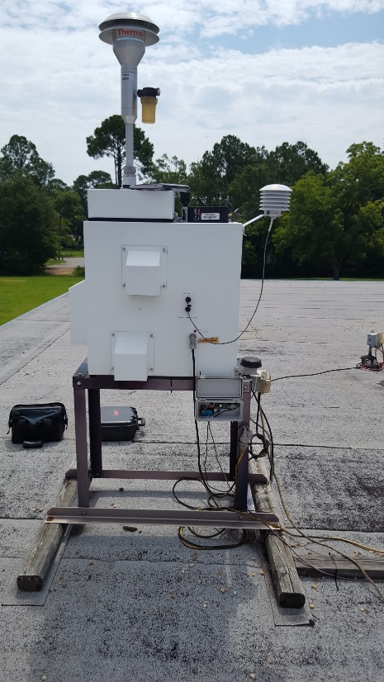

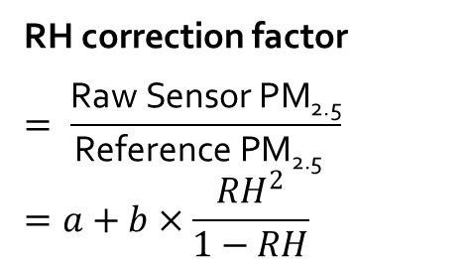
Low-cost PM Sensor Calibration:
Remote vs. Local
Remote
RH correction calibration
Local
Linear regression calibration
RH correction factor
$$= \frac{\text{R}\text{aw} \text{Sensor} \text{PM}\text{2.5}}{\text{R}\text{eference} \text{PM}\text{2.5} }$$
$$=a+b×\frac{{RH}^{2}}{1−RH}$$
$$Calibrated data$$
$$=0.36 RawData+1.98$$
BAM: Smart heater controls RH to the setpoint of 35%
Sensor vs. BAM PM_{2.5} at EPD’s Albany site (hourly,
March 14–June 20, 2018)
RH data: Southwest Georgia Regional Airport (Distance: 13 km)
22
Notes:
We tried two different calibrations: 1) Remote calibration against a tapered element oscillating microbalance in Atlanta prior to and after deployment at southwest Georgia, which requires an RH correction. 2) Local calibration against the beta attenuation monitor in Albany.
When using those low-cost sensors, calibration of raw data is important. Usually, people used the RH correction calibration, to have the RH correction factor. However, for our case, there’s no obvious correlation between the RH and referenced pm2.5, so we decide to use the linear regression calibration. Here’s the equation that was applied to all sensors’ raw data to have the following results.

Slide 23
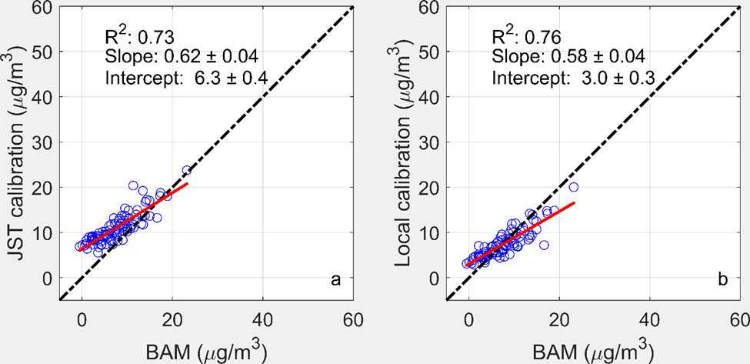
Local calibration performed better than remote calibration with RH correction
Daily PM_{2.5} concentrations from low-cost sensor using different calibration methods and BAM at GA EPD site in Albany (March 14–June 20, 2018)
EST
Remote calibration
Local calibration
Comparison of the daily PM_{2.5} concentrations from collocated
low-cost sensor with those from
BAM at GA EPD site in Albany
(March 14–June 20, 2018)
Notes:
We preferred the local calibration because it yielded better agreement between the sensor and the local monitor.

