Slide 1
EPA's eGRID Database
Jonathan Dorn, Marissa Hoer, David Cooley
Abt Associates, 5001 S. Miami Blvd, Durham, NC
Travis Johnson
U.S. EPA, 1200 Pennsylvania Ave, Washington, DC
18th Annual CMAS Conference
Chapel Hill, North Carolina
October 21 – October 23, 2019

Slide 2
Abstract
Electricity generation is the dominant industrial source of air pollutant emissions in the United States today. Whenever you switch on an electrical appliance, chances are you are contributing to air pollution and greenhouse gas emissions. By documenting the environmental attributes of electric power generation, the Emissions & Generation Resource Integrated Database (eGRID) can help consumers, policy analysts and researchers to better understand the relationship between electricity and the environment. eGRID integrates many different federal data sources on power plants and power companies, including, but not limited to data sources from: EPA, the Energy Information Administration (EIA), and the North American Electric Reliability Corporation (NERC). Emissions data from EPA are carefully integrated with generation data from EIA to produce emission rates in pounds per megawatt-hour (lb/MWh), which allows direct comparison of the environmental attributes of electricity generation. eGRID is used by EPA, other government agencies, nongovernmental organizations, and private industry to quantify the release of emissions (i.e., SO₂, NO_{x}, CO₂, CH₄, N₂O, and PM_{2.5}) to the air and subsequently directly assess the impacts of air pollutants on natural resources. eGRID provides a convenient source of data for states implementing policies such as emissions disclosure, output-based emissions standards, and renewable portfolio standards.
EPA is slated to release eGRID2018 by the end of 2019. This presentation: 1) discusses the procedures for developing eGRID and the recent improvements, such as the addition of PM_{2.5} emissions rates, found in eGRID2018; 2) provides an overview of the current emission rates by region and state in the United States; and 3) discusses proposed additions and improvements for future editions of eGRID.

Slide 3
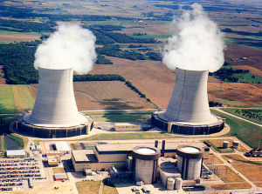


What is eGRID?
eGRID = Emissions & Generation Resource Integrated Database
A globally recognized source of emissions data for the electric power generated in the United States (www.epa.gov/egrid)
Contains a comprehensive inventory of emissions-related data for the U.S electric power industry (e.g., emissions, net generation, heat input, etc.)
Based on available plant-specific data for all U.S. electricity generating plants that provide power to the electric grid and report data to the U.S. government

Slide 4
What is eGRID? (continued)
Links electricity generation, air emissions and resource mix for virtually all U.S. power plants
  50 States and DC (not Puerto Rico or other U.S. Territories),
  Data years: 2016, 2014, 2012, 2010, 2009, 2007, 2005, 2004, & 1996-2000
  GHG Emissions: CO₂ (all years), CH₄ and N₂O (2005 forward)
  Other Air Pollution: NO_{X} and SO₂ (all years), Hg (1998-2000, 2004, 2005)
  Fuel use, and net generation
  Emissions rate data (total, non-baseload, fossil)
State & U.S. import-export data (including grid gross loss factors)
Technical Support Document contains full documentation

Slide 5
eGRID Data Sources
eGRID is developed using data from the EIA and the EPA, including:
EIA Forms 860, 861, and 923
  Includes data at the plant, generator, and boiler level on plant name, location, nameplate capacity, heat input, fuel use, and net electricity generation
EPA Part 75 Data
  Includes data at the unit level on GHG and criteria pollutant emissions, heat input, and gross electricity generation
  EPA GHG emission factors
    For plants that do not report emissions to EPA, eGRID uses emission factors from the EPA GHG reporting rule to estimate GHG emissions based on heat input data from EIA

Slide 6
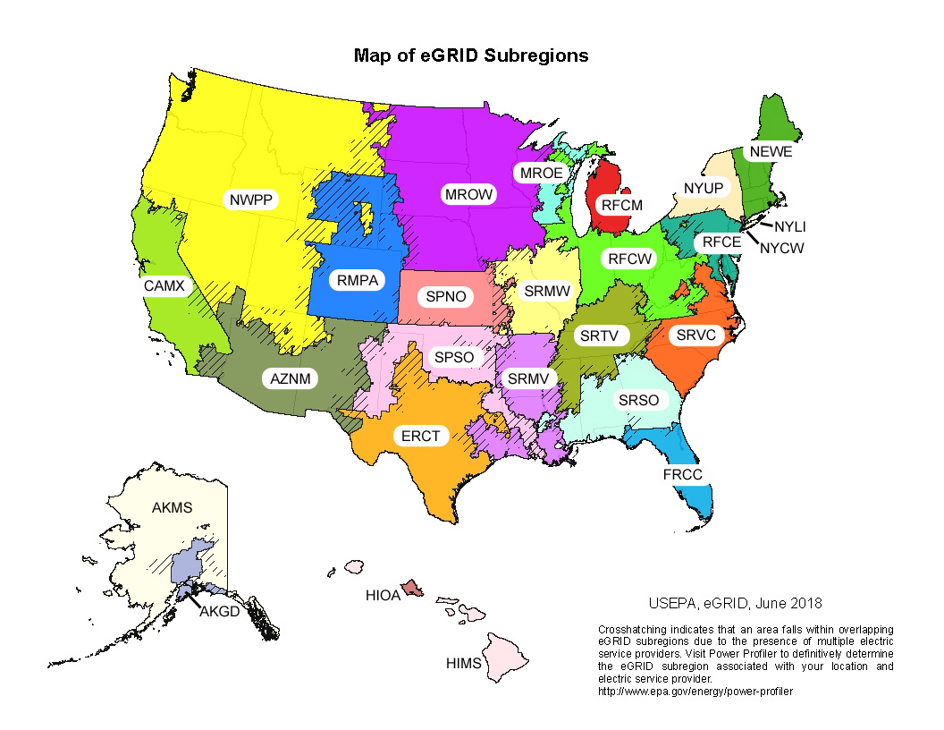
eGRID Data Levels
eGRID provides data at multiple levels:
  Unit
  Plant
  State
  Balancing Authority
  eGRID Subregion
  NERC Region
  US

Slide 7
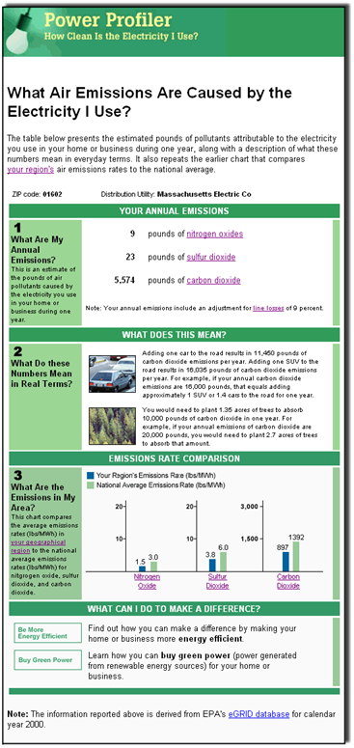
eGRID Uses
Convenient source of data for states implementing policies such as emissions disclosure, output-based emissions standards, and renewable portfolio standards
Allows air regulators to monitor changes in power plant air emissions
Used by EPA tools and programs such as Power Profiler, the Personal GHG Emissions Calculator, and the GHG Emissions for Electric and Plug-in Hybrid Electric Vehicles Calculator

Slide 8
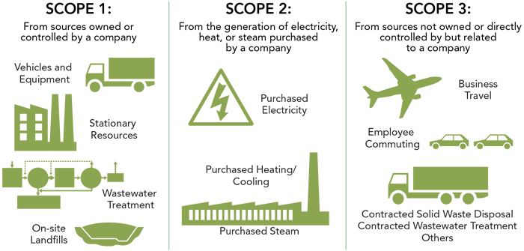
eGRID Uses – Carbon Footprinting
Line loss emissions

Slide 9

eGRID 2018 – Preliminary CO₂ Rates
CO₂ emissions rates (lbs./MWh)
by eGRID Subregion

Slide 10

PM_{2.5} Overview
PM_{2.5} results in significant negative health impacts
Causal link between PM_{2.5} and premature mortality, respiratory effects, and cardiovascular effects
Potentially linked to 55,000 deaths per year in the United States

Slide 11
PM_{2.5} Emissions from Power Generation
Power Sector Generation and Emissions of Select Criteria Air Pollutants and Mercury in 2011
(~180,000 tons PM_{2.5})

Slide 12
Adding PM_{2.5} to eGRID
eGRID uses data reported to EPA from Continuous Emissions Monitors (CEMS) pursuant to 40 CFR Part 75
Electric Generating Units (EGUs) generally do not report PM_{2.5} emissions from CEMS
Used PM_{2.5} data from EPA’s National Emissions Inventory

Slide 13
Adding PM_{2.5} to eGRID
4-step process for adding PM_{2.5} emissions to eGRID (13,231 units in total)
  Direct unit-level match between eGRID and NEI (4,040 units)
  Average emissions factors by fuel type, unit firing type, and prime mover (570 units)
  Average emissions factors by fuel type and prime mover (2,922 units)
  Emissions factors from EPA’s AP-42 (5,699 units)

Slide 14
Results
PM_{2.5} emissions rates (lbs./MWh) by eGRID Subregion

Slide 15
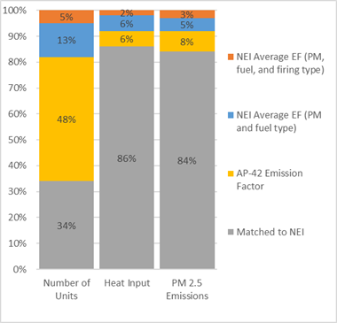
Results

Slide 16
Conclusions
eGRID2018, scheduled for release later this year, is being updated to include PM_{2.5} emissions
PM_{2.5} emissions are a significant source of health impacts and premature death in the United States.
Understanding PM_{2.5} emissions rates for electricity generating units will provide for a better understanding of how a change in electricity generation impacts emissions and ultimately ambient air quality and human health effects
White paper detailing the methodology of adding PM_{2.5} emissions to eGRID will be released later this year
eGRID website is also being updated and will include interactive data exploration and visualization

Slide 17
Jonathan Dorn
Senior Associate jonathan_dorn@abtassoc.com
+1 919-294-7763

