Slide 1
Impacts of a National Survey on the Development of the Residential Wood Combustion Component of the National Emissions Inventory
Rich Mason, U.S. Environmental Protection Agency
David Cooley, Abt Associates
18th Annual CMAS Conference
October 22, 2019

Slide 2
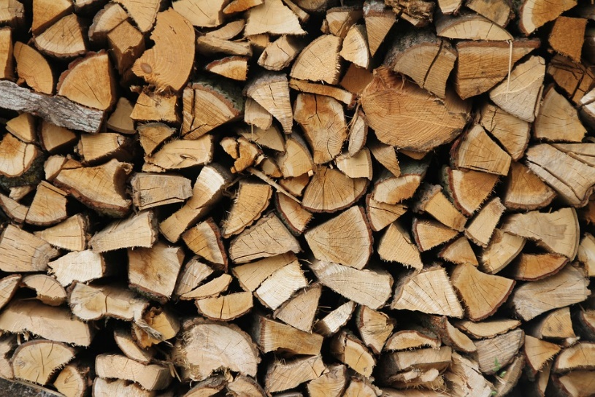
Residential Wood Combustion in the NEI
Residential Wood Combustion (RWC) is a significant source of air pollution
  Approx. 6% of all primary particulate matter =< 2.5 microns in diameter (PM_{2.5}) emissions in 2014
Emissions estimation method uses survey data to estimate:
  Fraction of homes in each county that use wood-burning appliances
  Average amount of wood burned in each appliance
2014 NEI used data from Energy Information Administration’s (EIA) Residential Energy Consumption Survey (RECS)

Slide 3
NEI Nonpoint Development Process: New!
Previously composed of State/Local/Tribal (SLT) reporting agency data with EPA (default) data “gap-filling”
For the 2017 NEI, SLT reporting agencies may:
  Continue to submit emissions -takes precedence over any other estimates (6 States, 2 Locals, 6 Tribes)
  Accept/supplement with EPA default estimates
  Submit input activity data to refine EPA estimates (3 states)
New “Wagon Wheel” tool, Nonpoint Survey, and Input Template structure facilitates the new process

Slide 4
The Residential Wood Combustion (RWC) Tool
Access Tool first released in December 2012 for the 2011 NEI
Latest version allows users to submit:
  County-level occupied homes, appliance fractions, burn rates, wood density factors, control factors
  County-level distribution of woodstoves to uncertified vs certified catalytic & non-catalytic devices –to override Census Region defaults
  County-level distribution of central heaters to 1 of 5 device types: indoor pellet boilers, indoor pellet furnaces, indoor cordwood boilers, indoor cordwood furnaces, outdoor cordwood boilers –to override national defaults
  Emission Factors by appliance type (SCC)

Slide 5
New RWC Tool Features and Adjustments
Uses 2,984 survey responses to compute statistical regression approach for appliance fractions and burn rates based on the following predictor variables:
  Number of heating Degree days (HDD) in 2017 climate zone
  2017 population density from U.S. Census Bureau
  Urban/rural zip code from U.S. Census Bureau
  Percentage of county-level forest cover from Biogenic Emissions Land Database v4.1
  County-level fraction of homes that use natural gas as primary heat in 2017 from American Community Survey
  Type of home: single family detached or attached, multifamily, mobile home)
Normalized state consumption to EIA State Energy Data System (SEDS), applied to all RWC appliances
Sigmoid curve equation applied to central heaters and outdoor recreational equipment in dense urban areas –to zero where housing density approaches 1,000 homes/mi²

Slide 6
2017 National Survey: Background
2017 NEI will use data from a national survey supported by the Commission for Environmental Cooperation (CEC) and Northeast States for Coordinated Air Use Management (NESCAUM)
Surveyed 21 states throughout the U.S.
Mailed letters and follow-up post cards; survey conducted by web
Stratified: more surveys sent to areas likely to burn wood
State | # of Responses | # of Surveys Sent | Response Rate (%)
AR | 68 | 2,992 | 2.27
CO | 90 | 2,625 | 3.43
CT | 140 | 4,310 | 3.25
GA | 91 | 4,976 | 1.83
ID | 42 | 1,737 | 2.42
LA | 33 | 2,113 | 1.56
ME | 223 | 5,184 | 4.30
MA | 215 | 6,781 | 3.17
MI | 237 | 7,418 | 3.19
MO | 113 | 5,083 | 2.22
NH | 150 | 3,529 | 4.25
NJ | 46 | 2,216 | 2.08
NY | 240 | 7,738 | 3.10
NC | 183 | 7,011 | 2.61
OH | 170 | 7,117 | 2.39
PA | 301 | 8,640 | 3.48
RI | 34 | 1,118 | 3.04
UT | 37 | 1,007 | 3.67
VT | 126 | 2,538 | 4.96
WA | 181 | 5,006 | 3.62
WI | 264 | 5,363 | 4.92
TOTAL | 2,984 | 94,502 | 3.16

Slide 7
2017 National Survey
Survey asked:
  Whether respondent used a particular type of wood-burning appliance
  How much wood they burn (cordwood, pellets, or wax logs)
  When and how often they burn
  Appliance age, model #
  Demographic data
Appliances included:
Conventional Fireplaces
Fireplace inserts
Woodstoves
Wood-fired furnaces
Wood-fired boilers
Pellet stoves
Outdoor recreational equipment (e.g. fire pits)

Slide 8
Survey (Weighted) Results - Summary
Percentage of wood-burning households that use each appliance
Percentage of households that burn wood

Slide 9
Survey Results – Primary Use
Primary use of wood-burning appliances

Slide 10
Survey Results – Cords Burned
Average Cords Burned Per Appliance

Slide 11
Appliance Fractions & Burn rates by County Type

Slide 12
Survey Results – Natural Gas Access

Slide 13
Survey Results – Type of Dwelling
Percent of Households Using Each Appliance by Type of Dwelling

Slide 14
Survey Results – Heating Degree Days
Average Cords Burned Per Year by Heating Degree Day Bins
Warmest
Coldest

Slide 15
EPA Default Comparisons: Draft Results
New (2017) vs Existing (2014) RWC Tool Estimates
For this analysis, defined counties as Urban, Suburban and Rural based on # of occupied housing units / square mile:
  Urban: > 1,000
  Suburban: 500 – 1,000
  Rural: < 500
Caveat: Does not reflect (3) SLT-submitted inputs

Slide 16
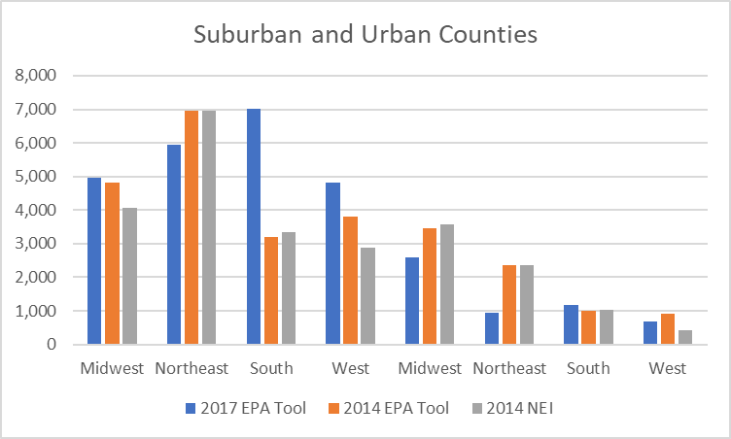
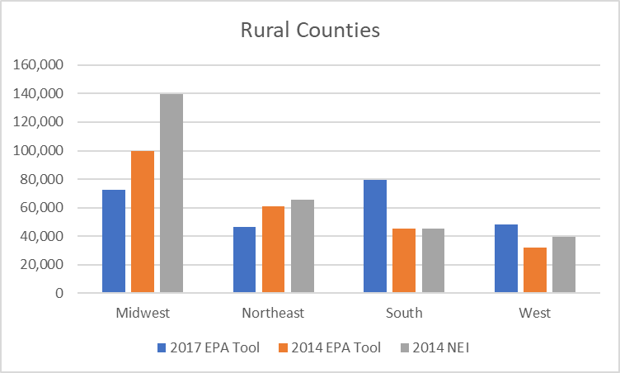
PM2.5 Total RWC Emissions by Census Region
Notes:
2017 default is ~275K vs 265K for 2014 tool (not NEI2014=315K)

Slide 17
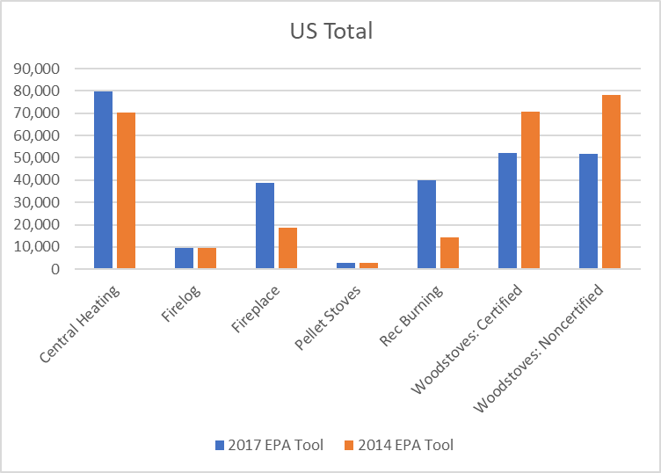
PM2.5 Estimates by Appliance Type: New vs Old Tool

Slide 18
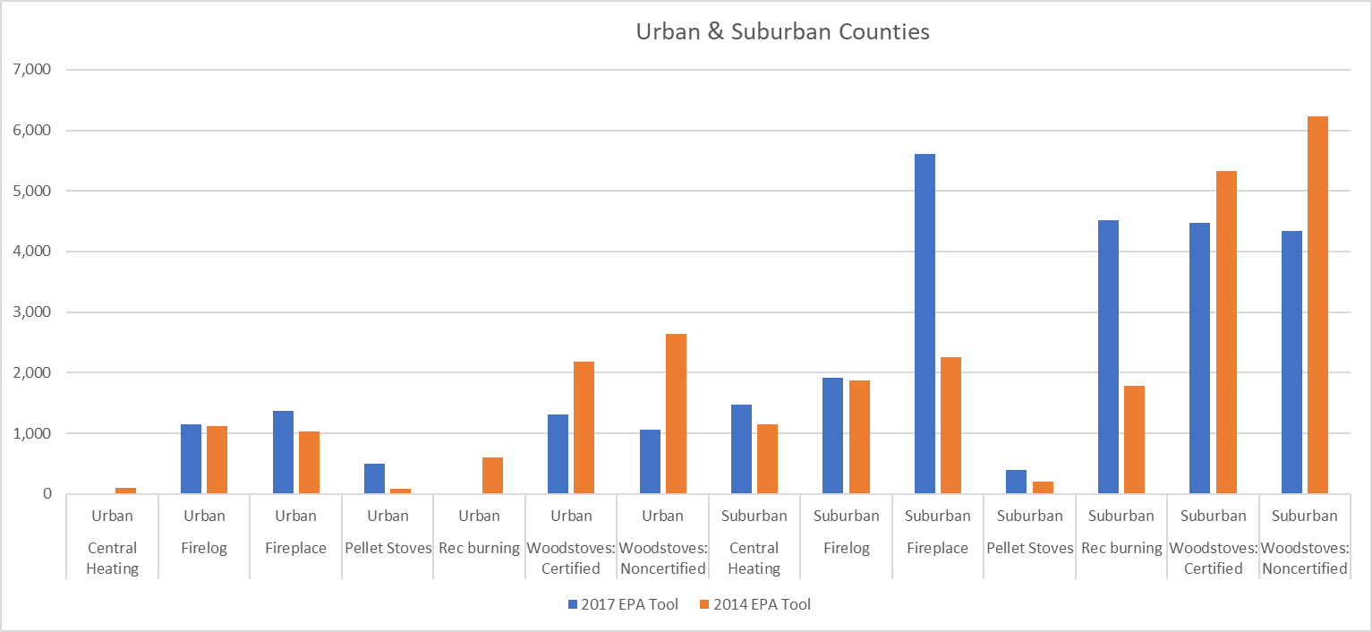
National RWC PM2.5 Emissions for Non-rural Counties

Slide 19
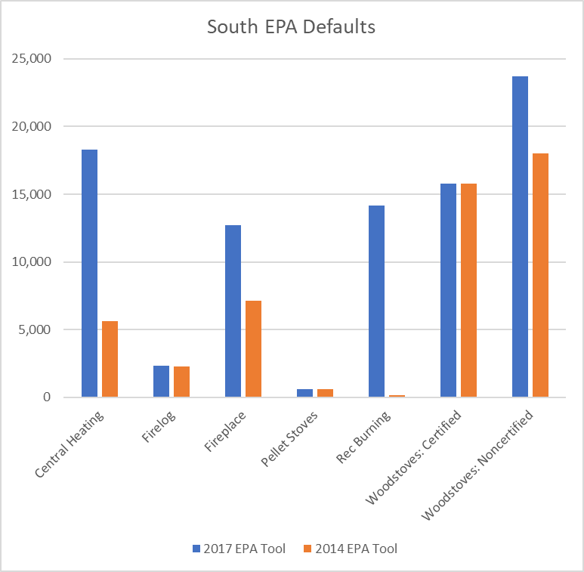
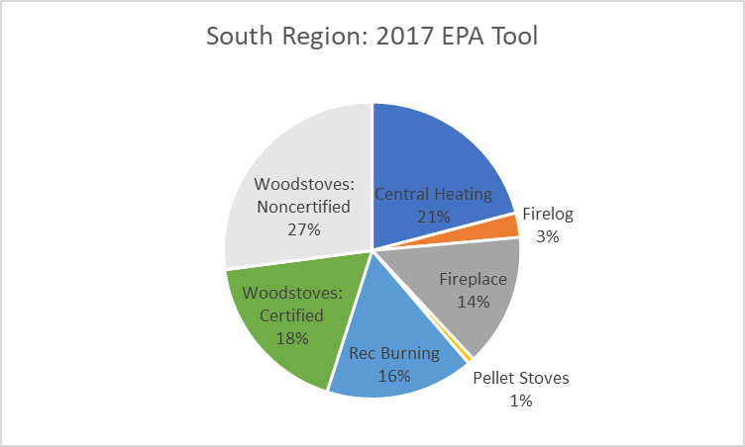
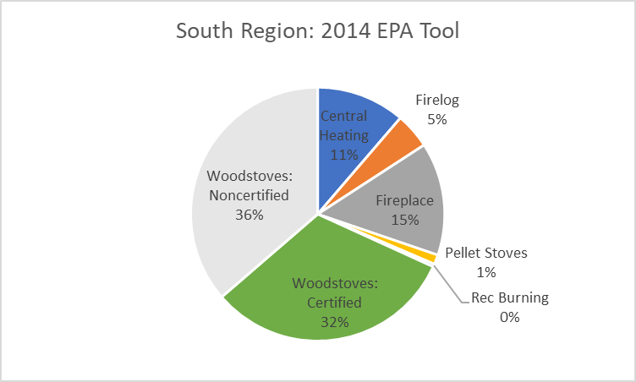
South Region: More Outdoor Recreational Burning & Central Heating

Slide 20
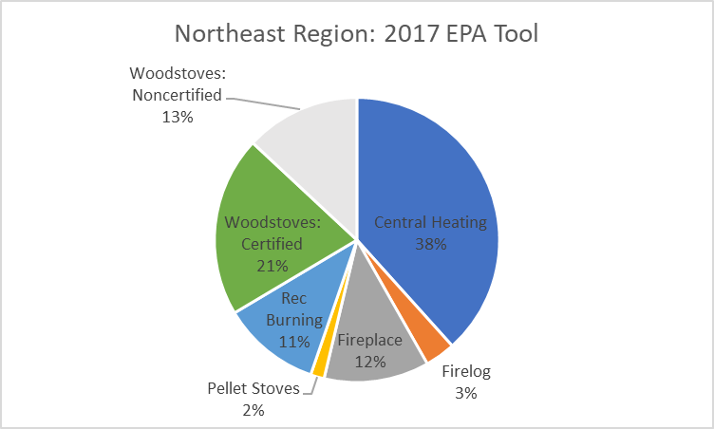
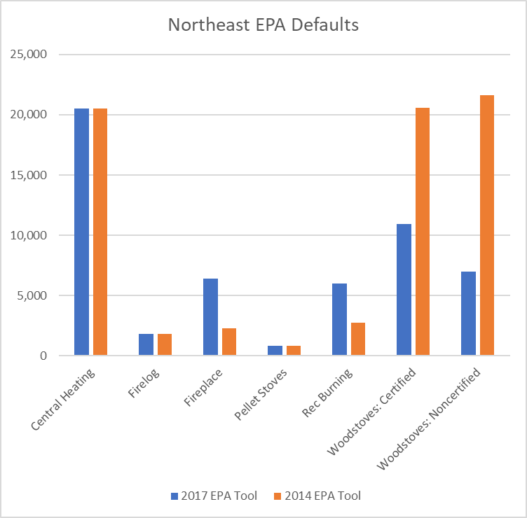
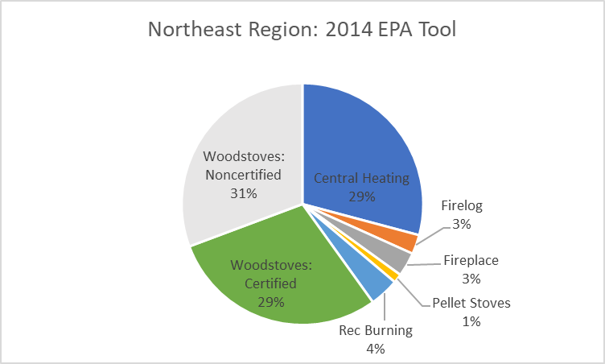
Northeast Region: More Rec-burning & fireplaces, less woodstoves

Slide 21
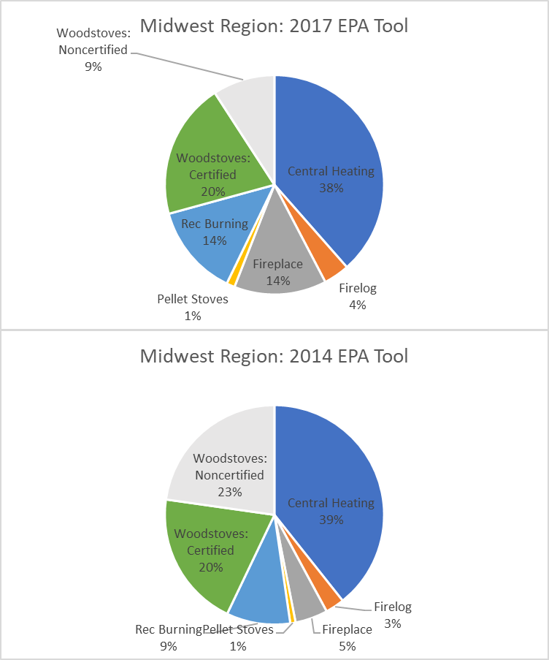
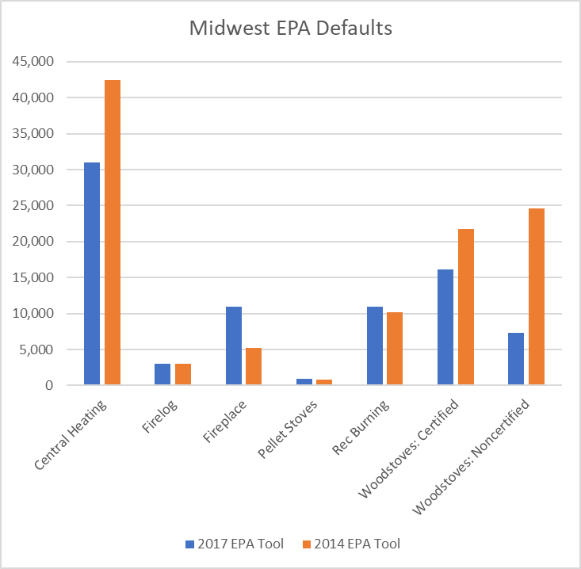
Midwest Region: Large Reductions Woodstoves & Central Heating

Slide 22
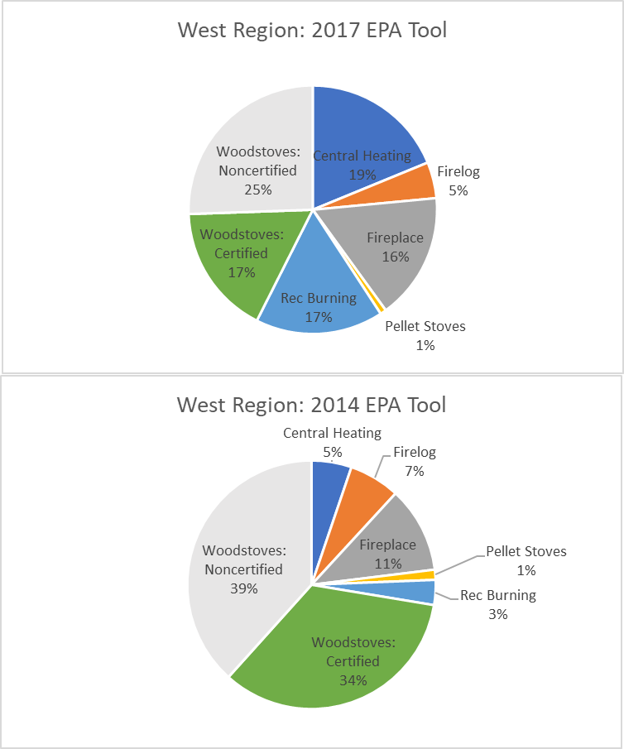
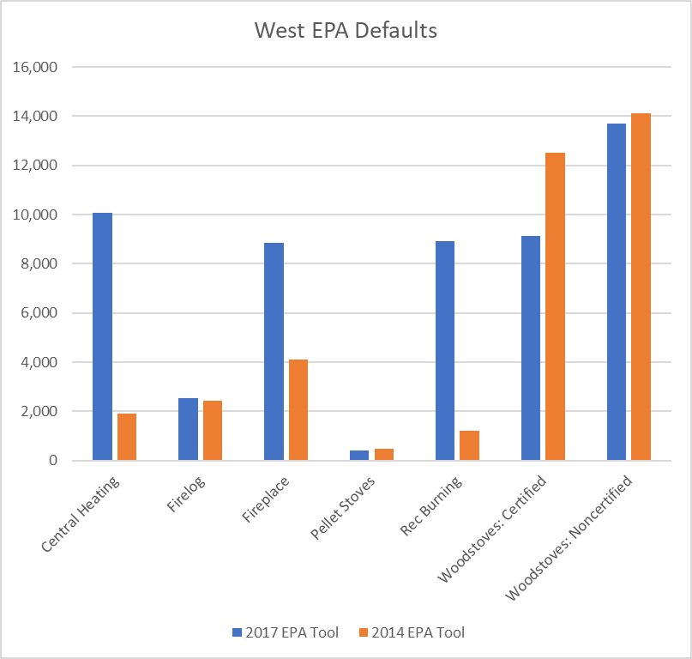
West Region: Fewer Woodstoves, more Central Heating, Fireplaces & Rec-burning

Slide 23
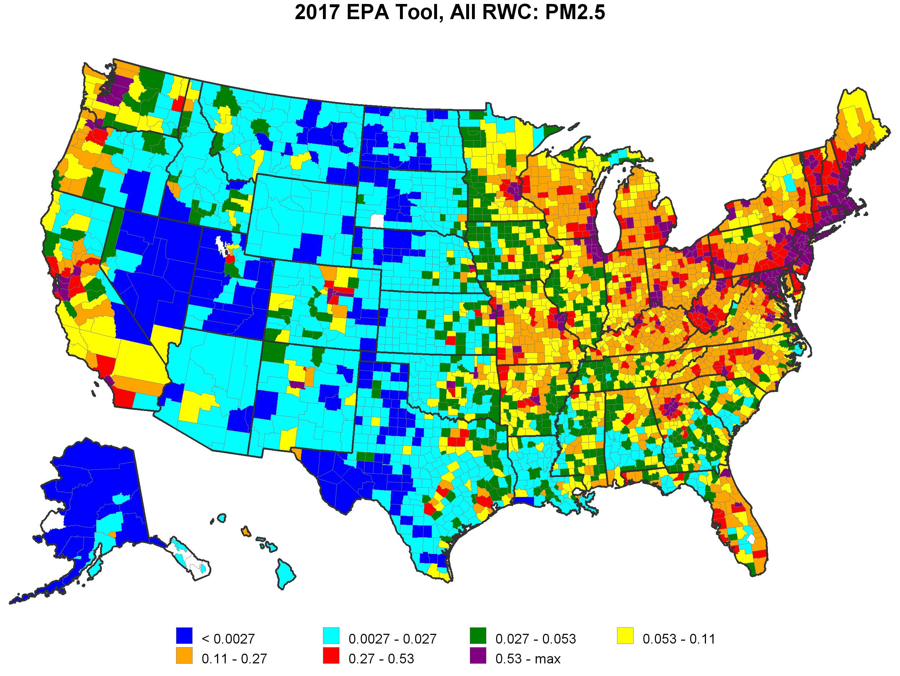
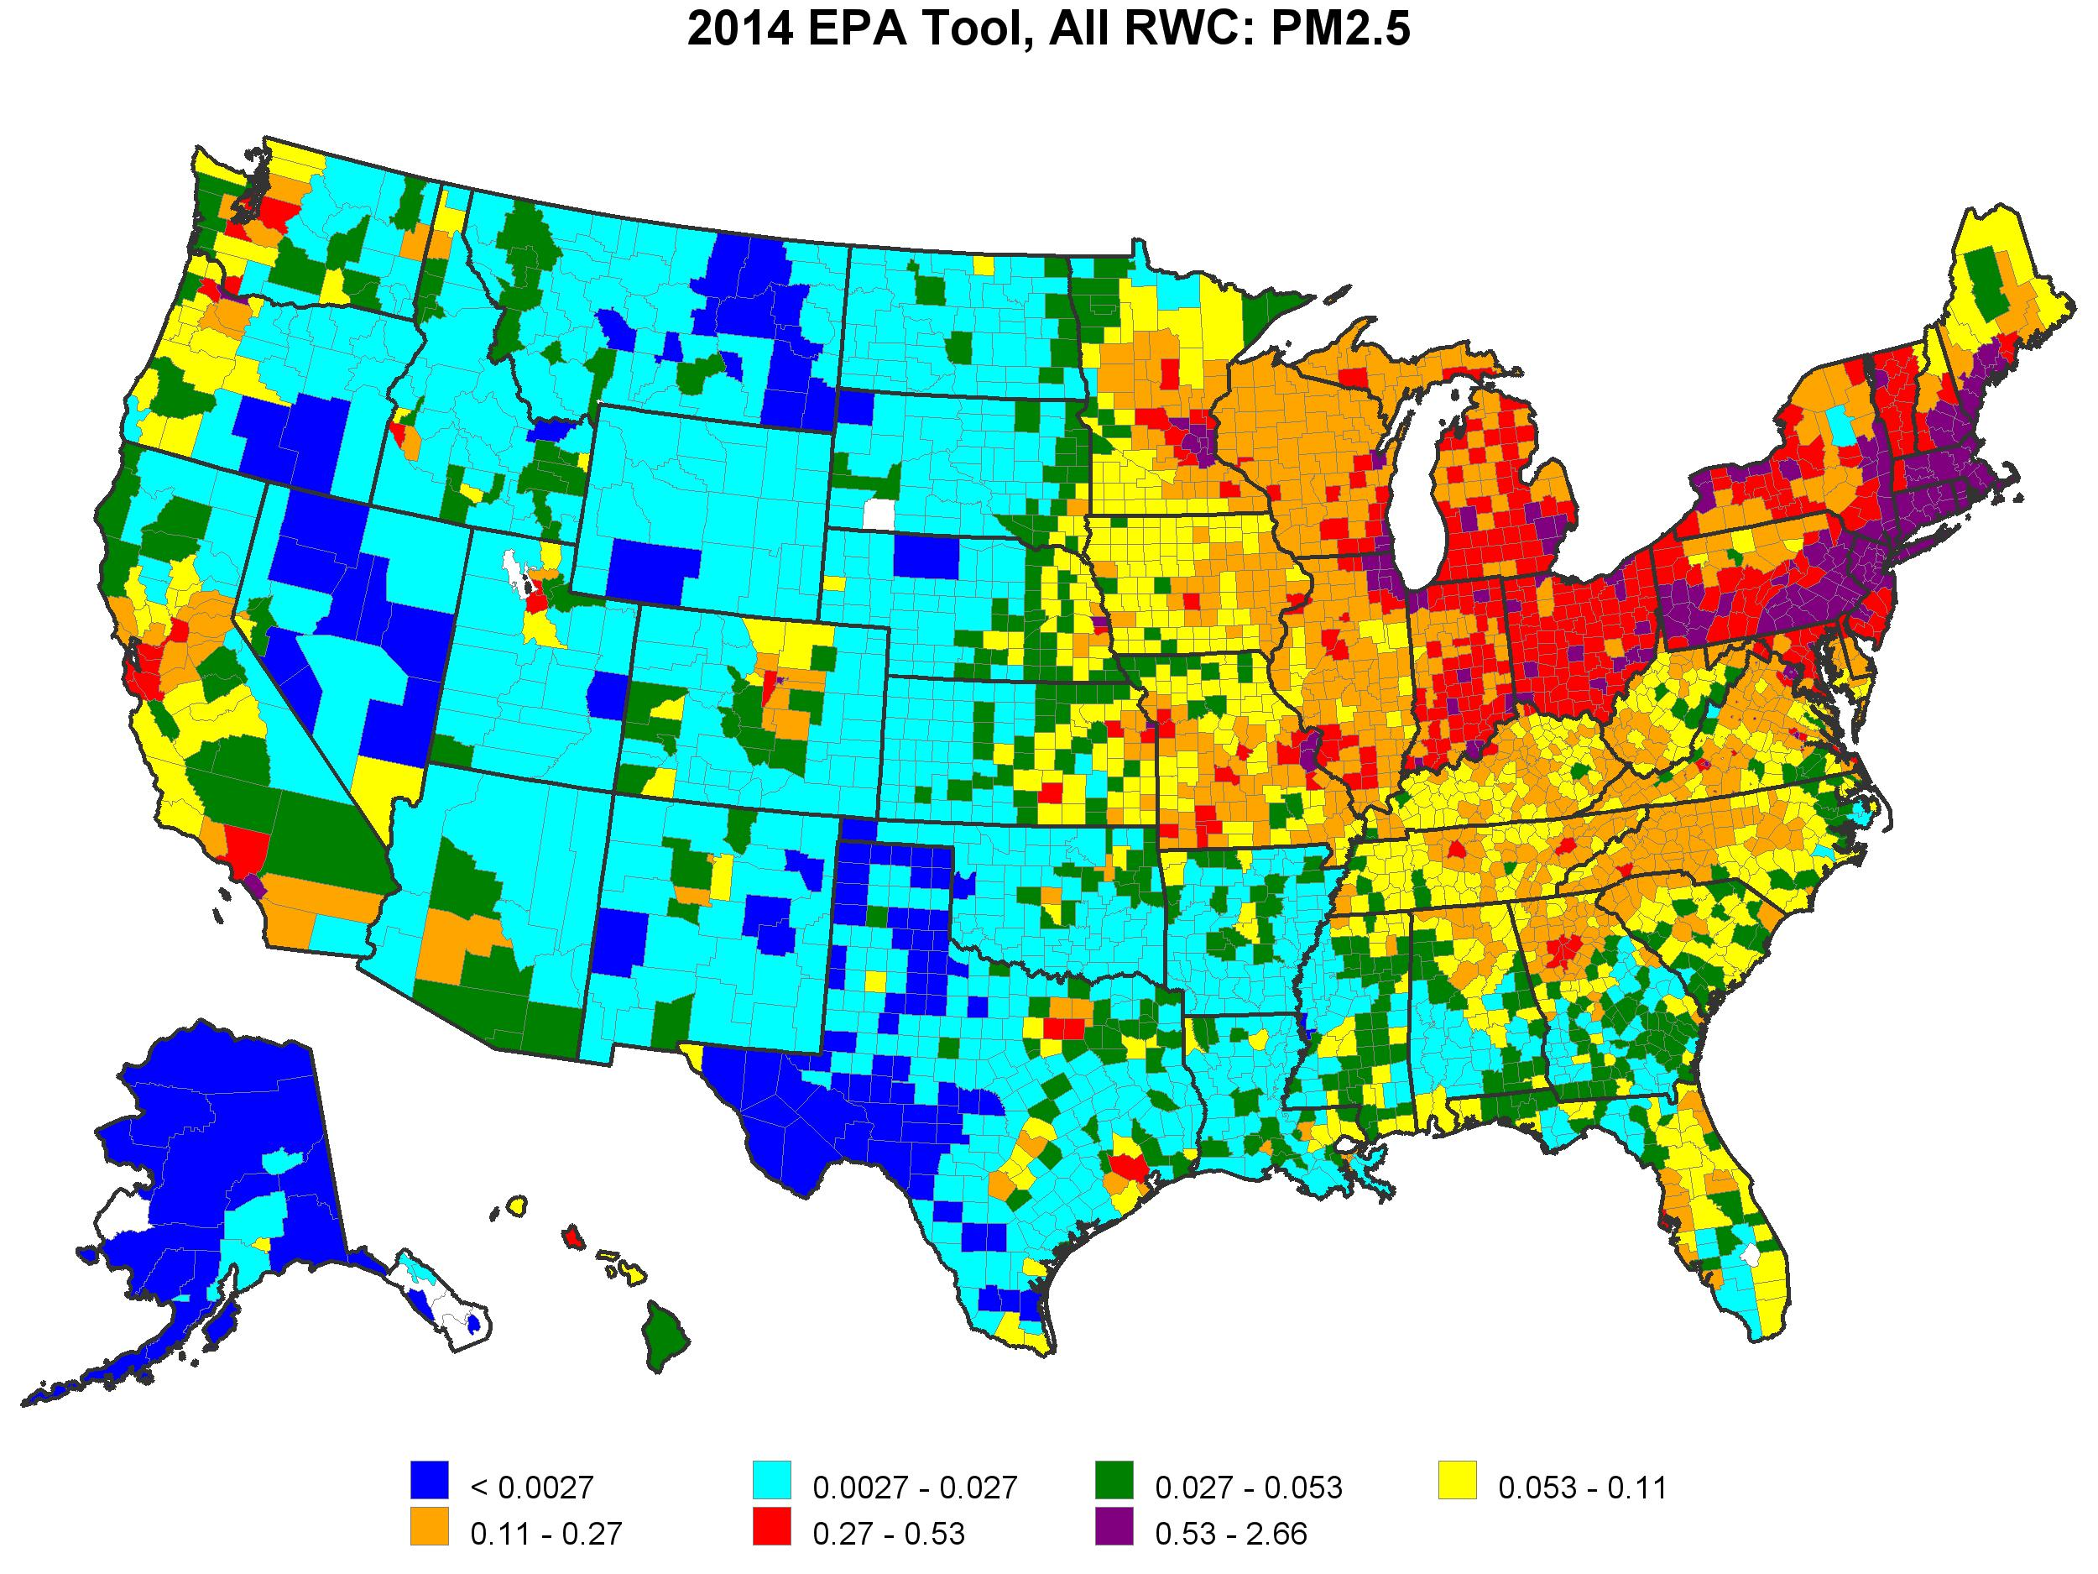
2017 (left) & 2014 (right) EPA Tool
Total RWC PM2.5 (tons/sq. mile)

Slide 24
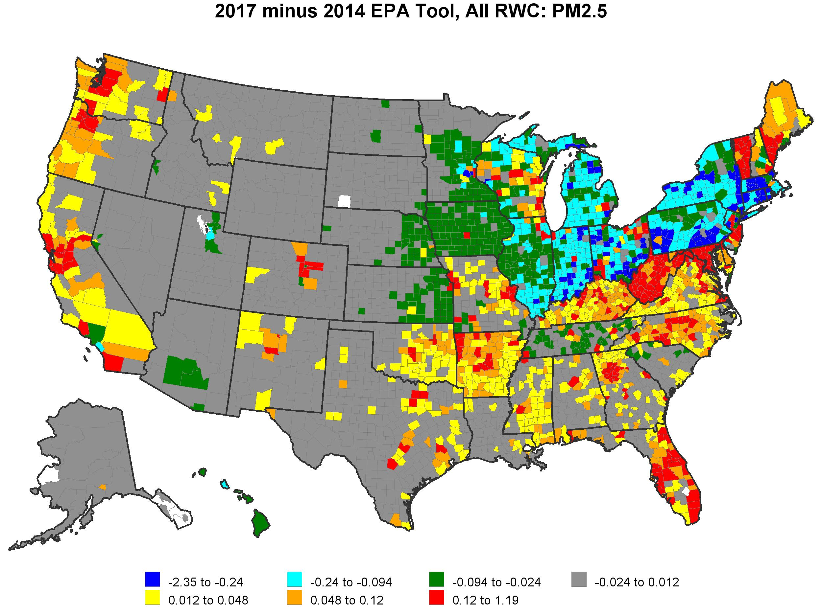
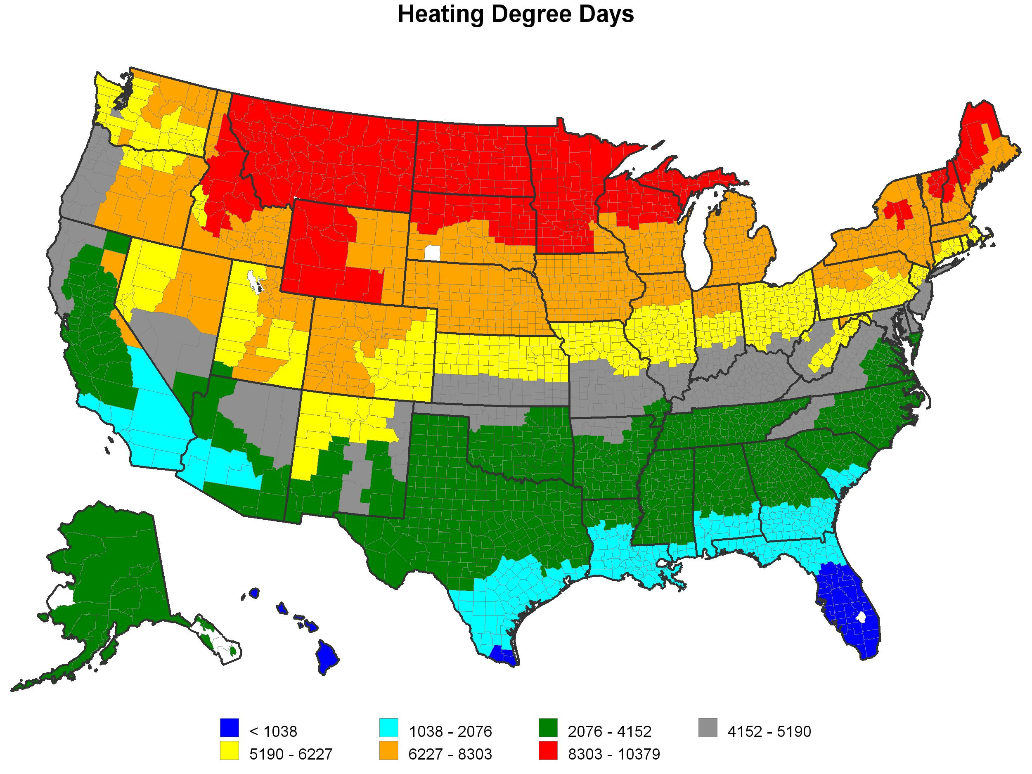
2017 – 2014 EPA Tool, Total RWC PM2.5 (tons/sq. mile)

Slide 25
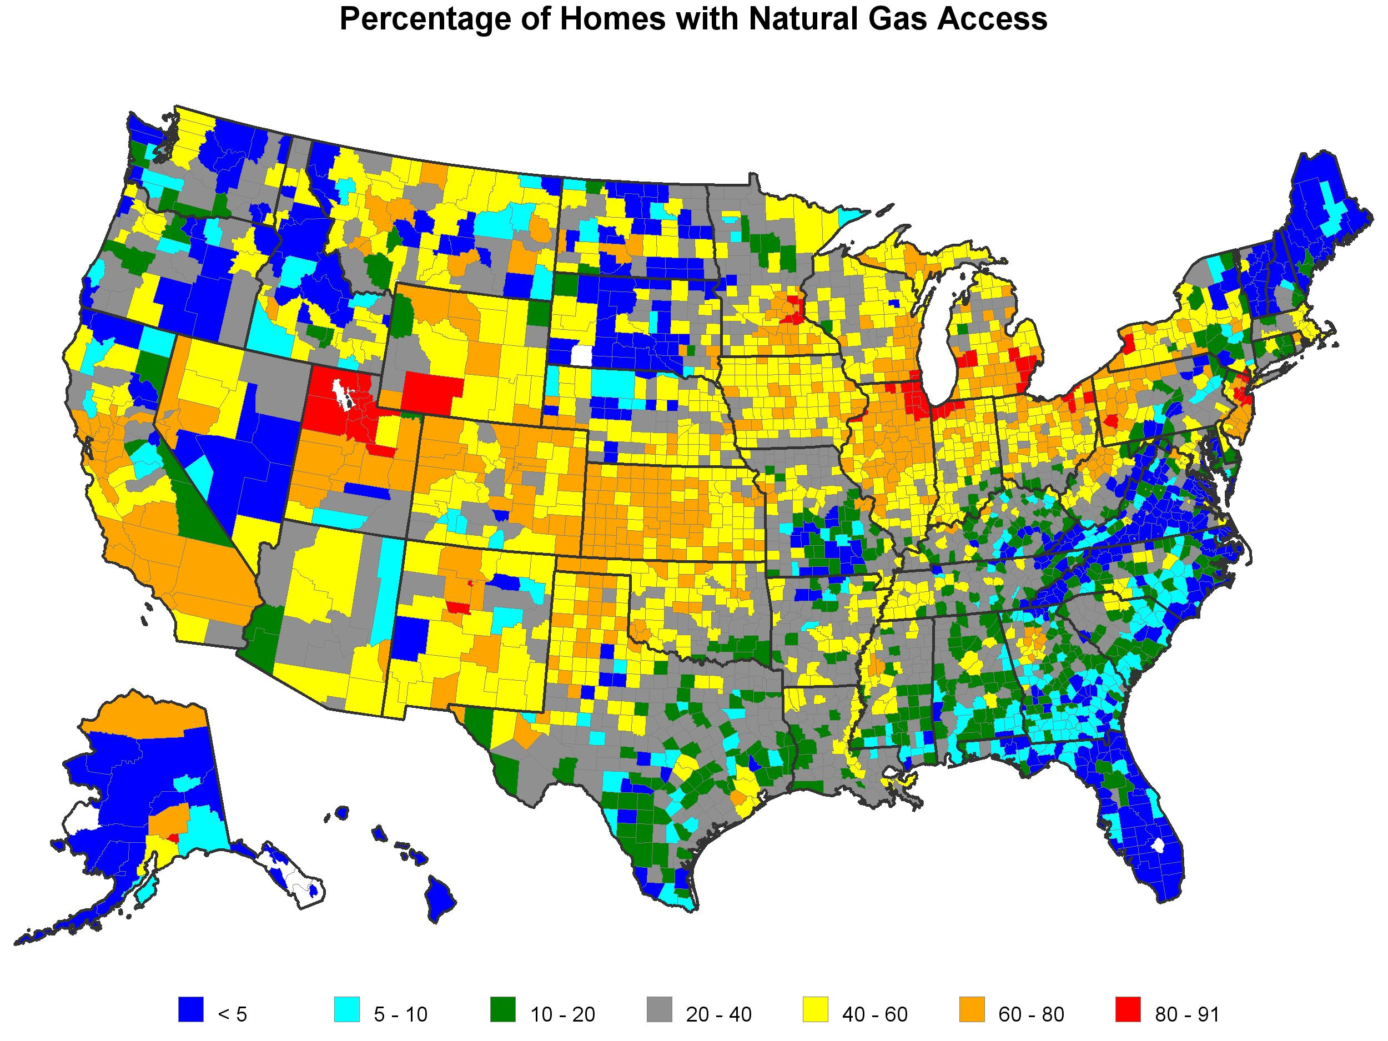
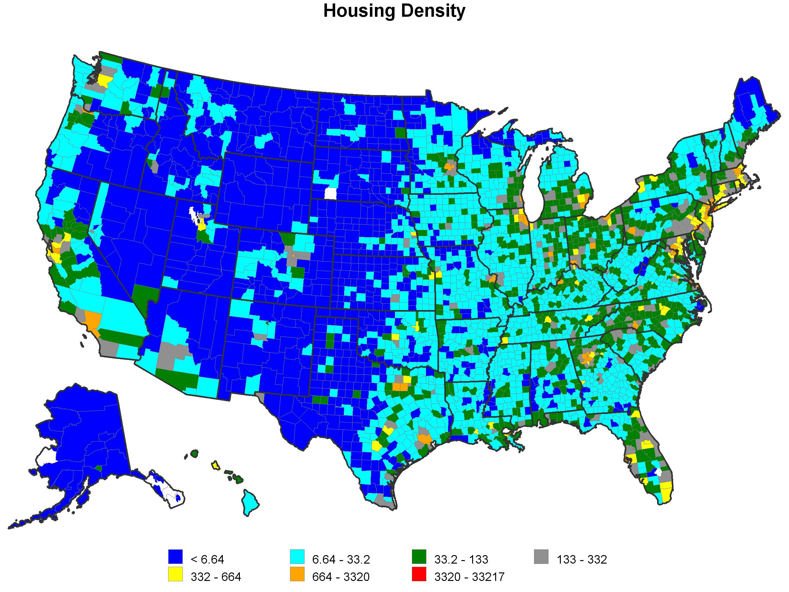
% Homes w/ Natural Gas Access (left), Occupied Housing density (right)

Slide 26
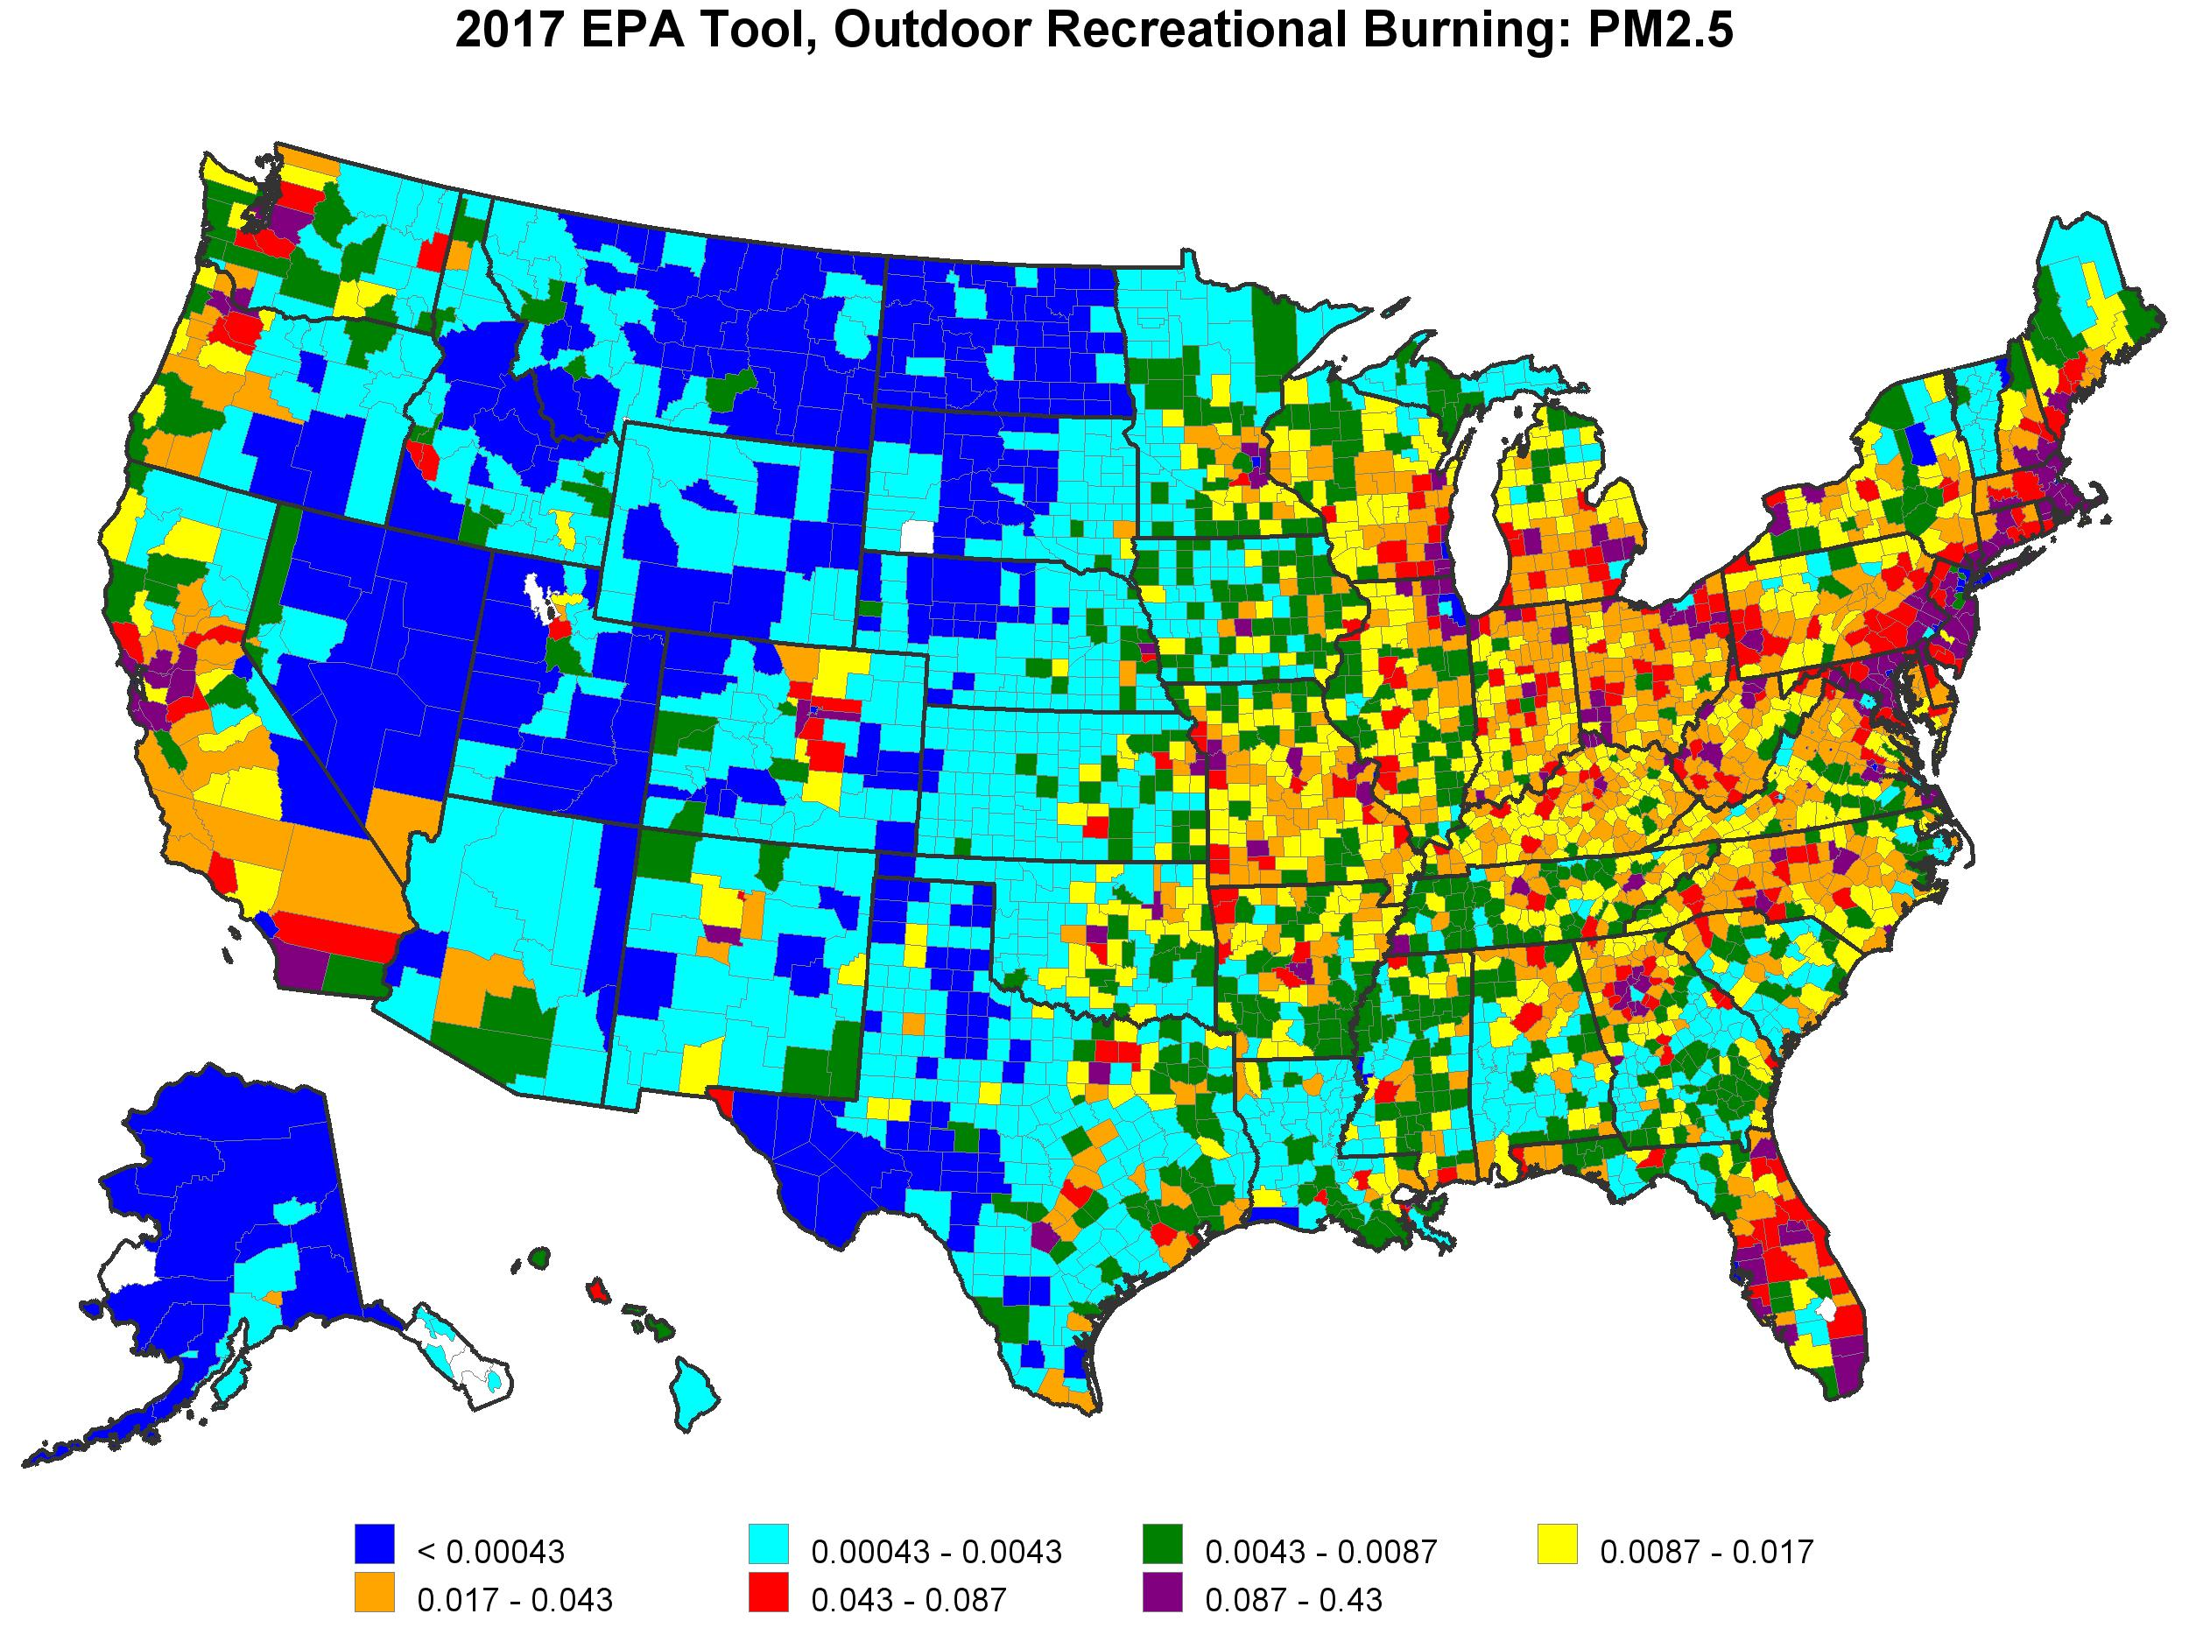
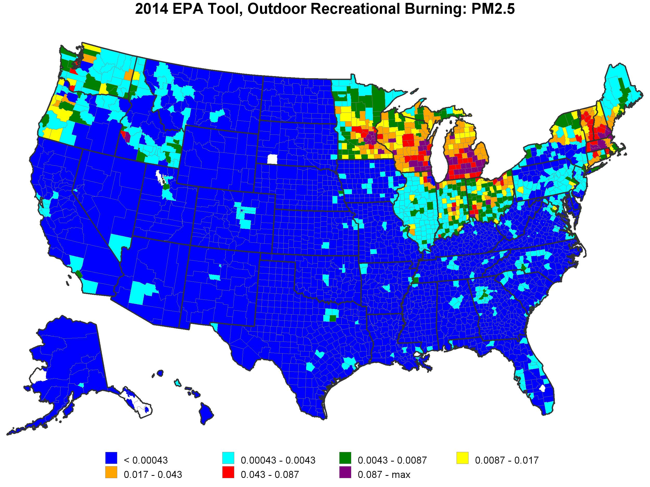
2017 (left) & 2014 (right) EPA Tool RWC Outdoor Recreational Burning PM2.5 (tons/sq. mile)

Slide 27
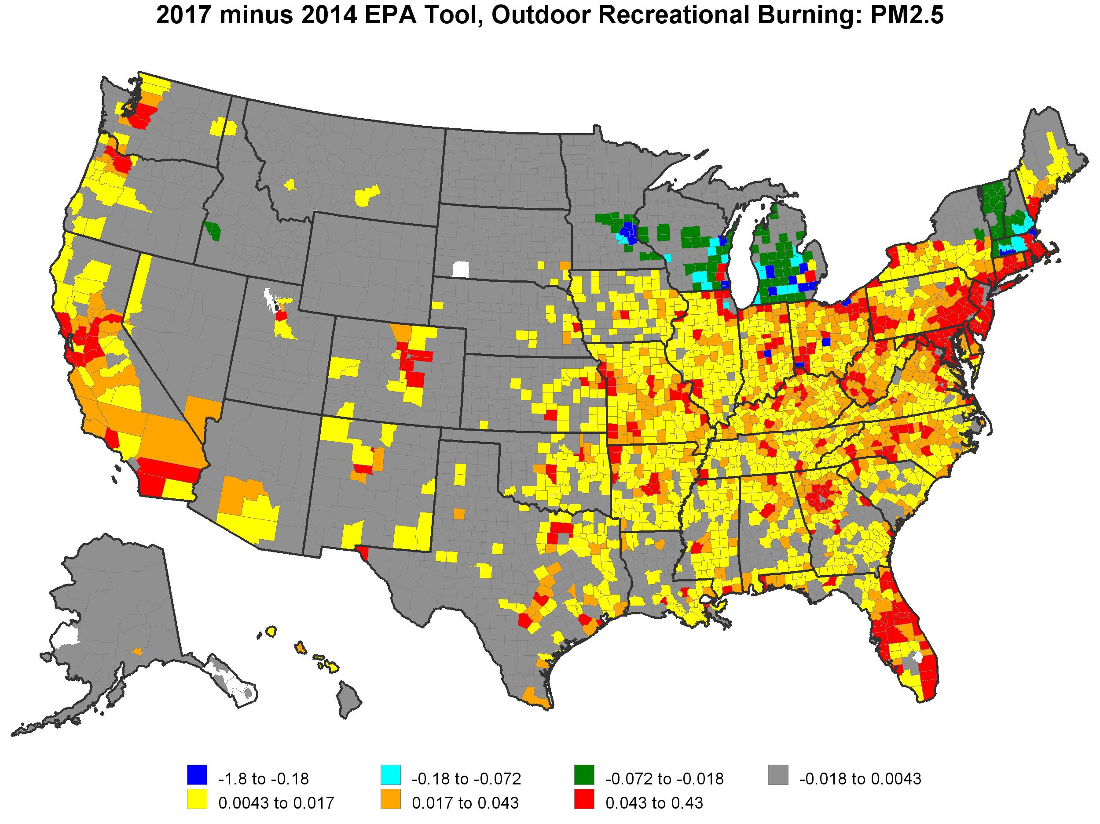
2017 – 2014 EPA Tool, RWC Outdoor Recreational Burning PM2.5 (tons/sq. mile)

Slide 28
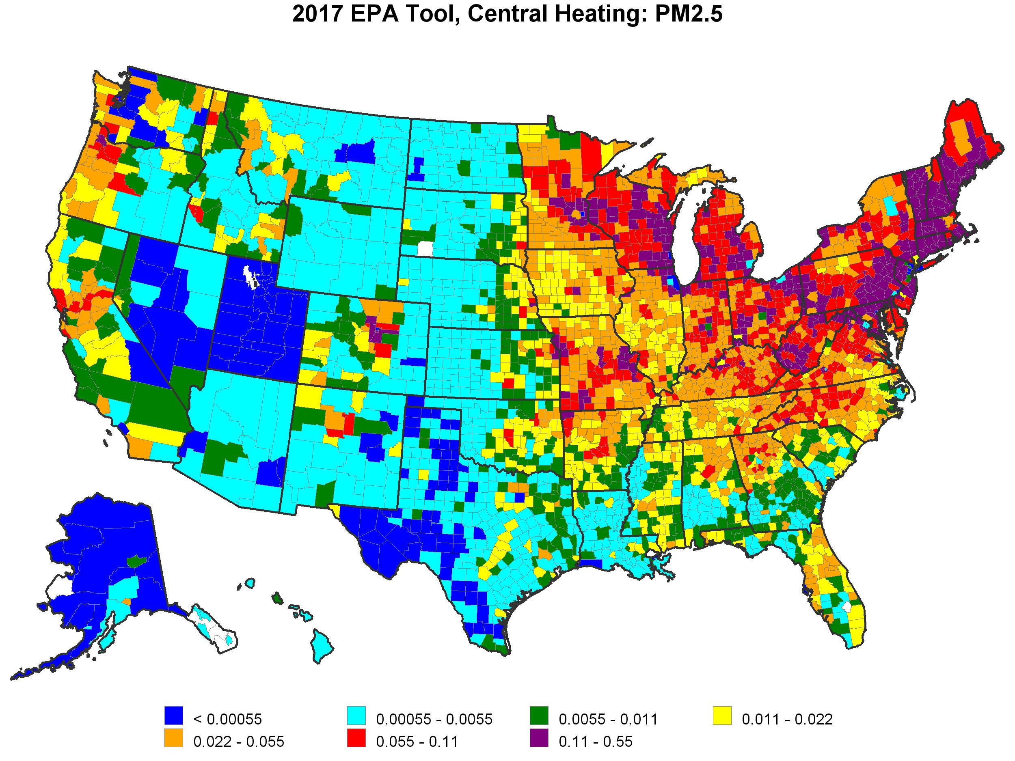
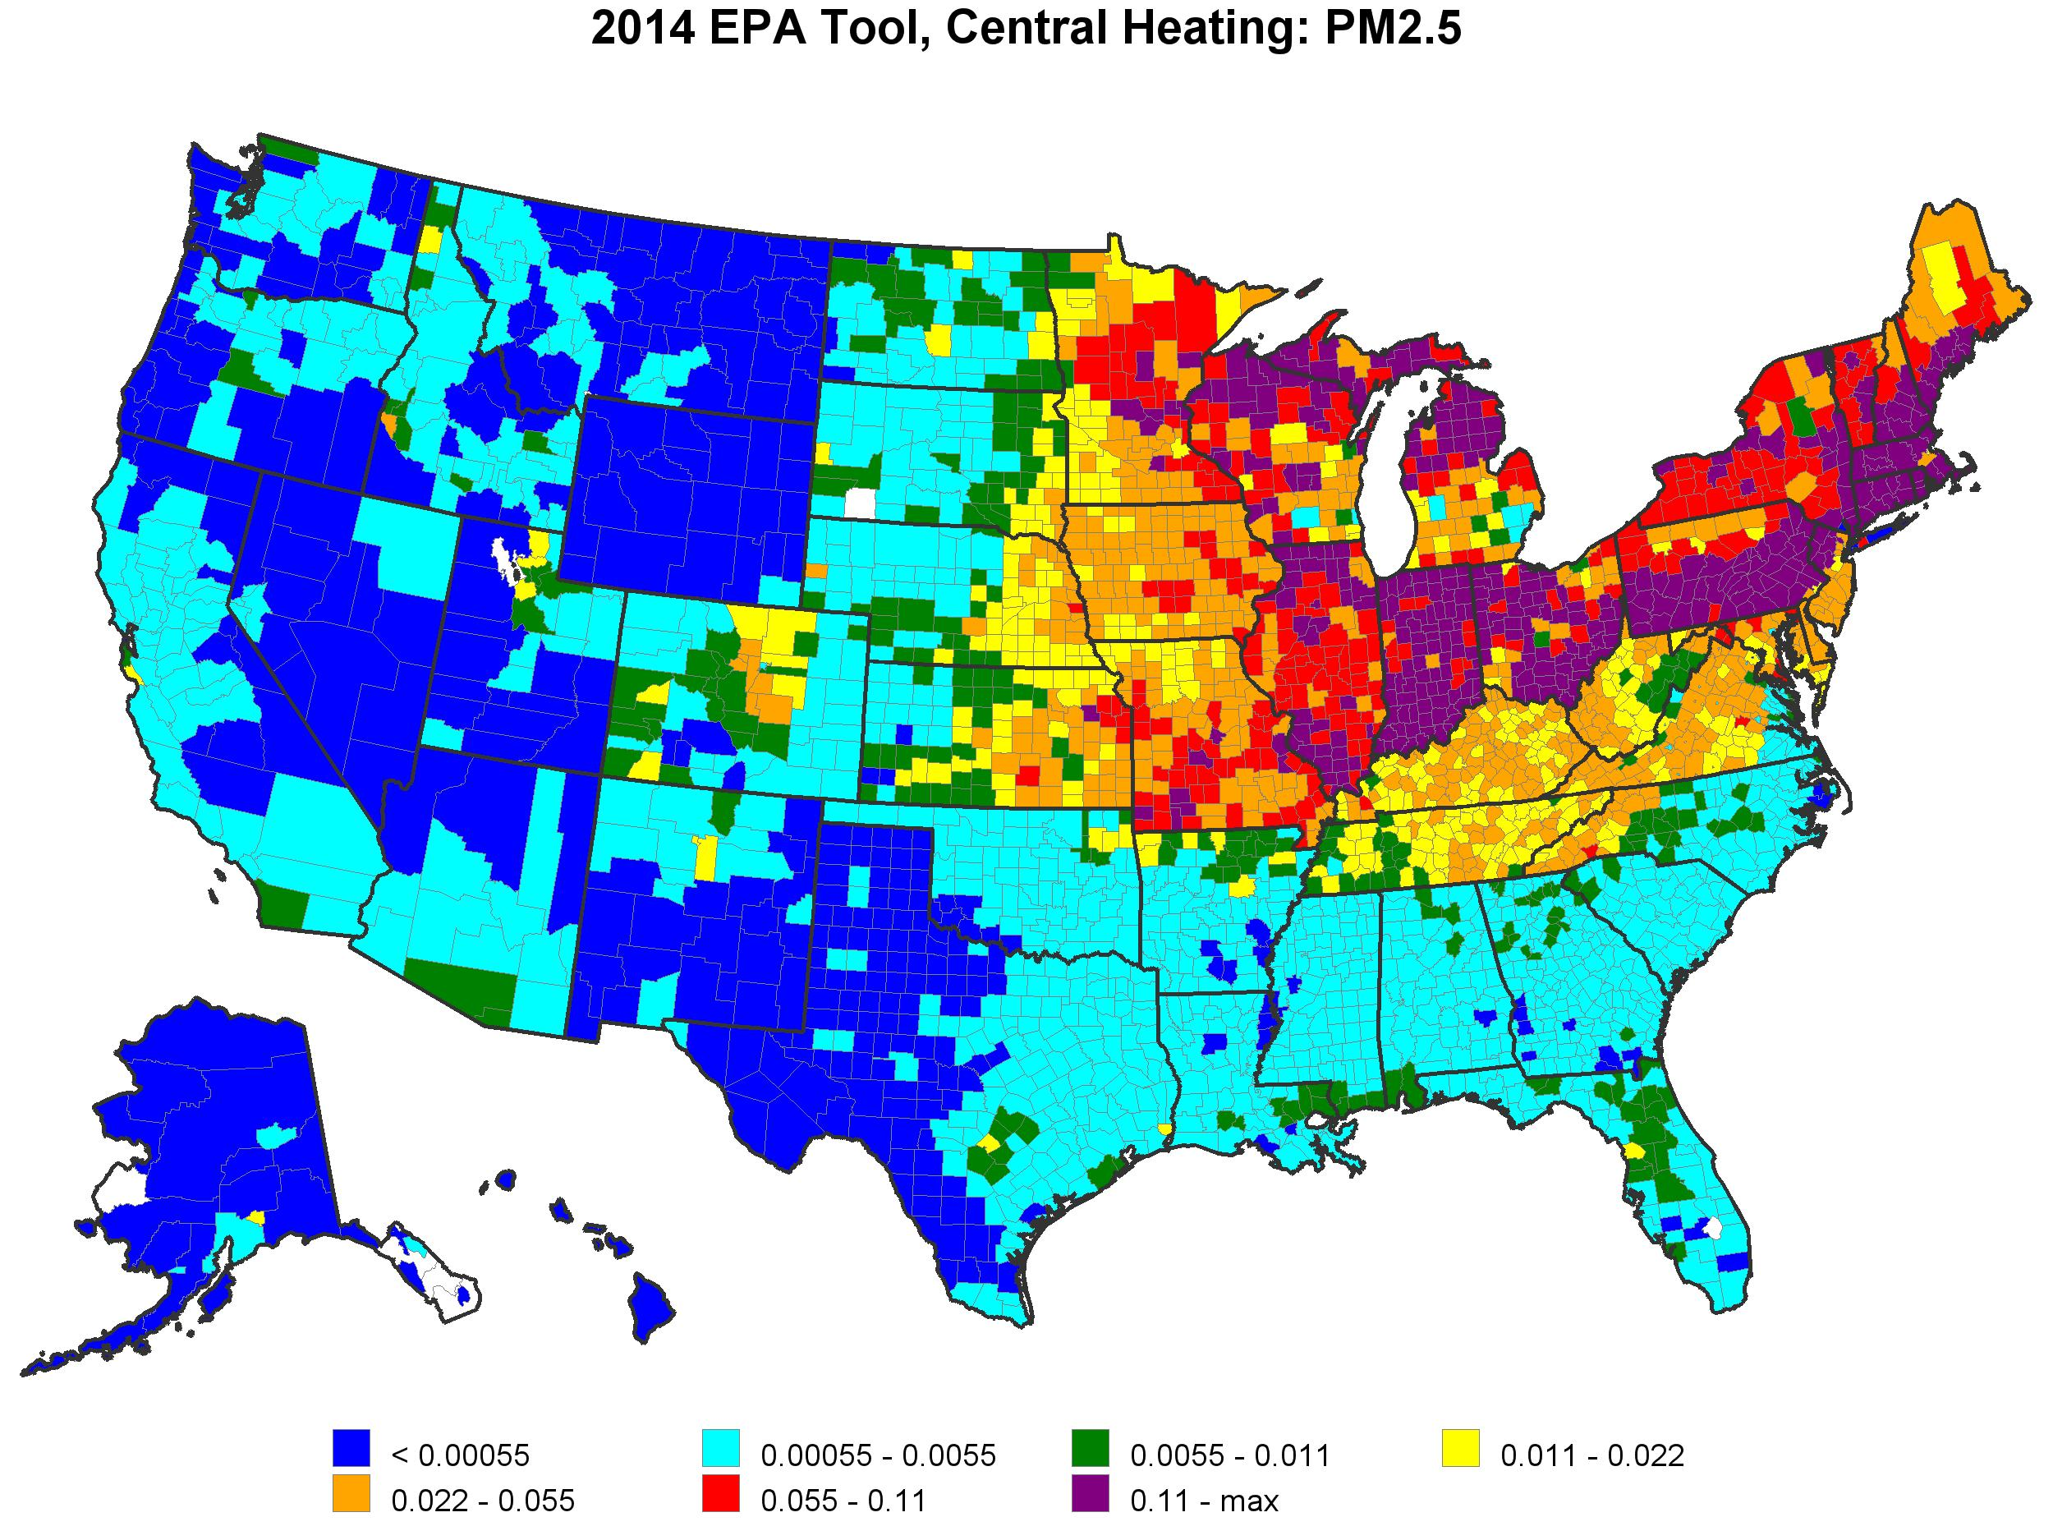
2017 (left) & 2014 (right) EPA Tool
RWC Central Heating PM2.5 (tons/sq. mile)

Slide 29
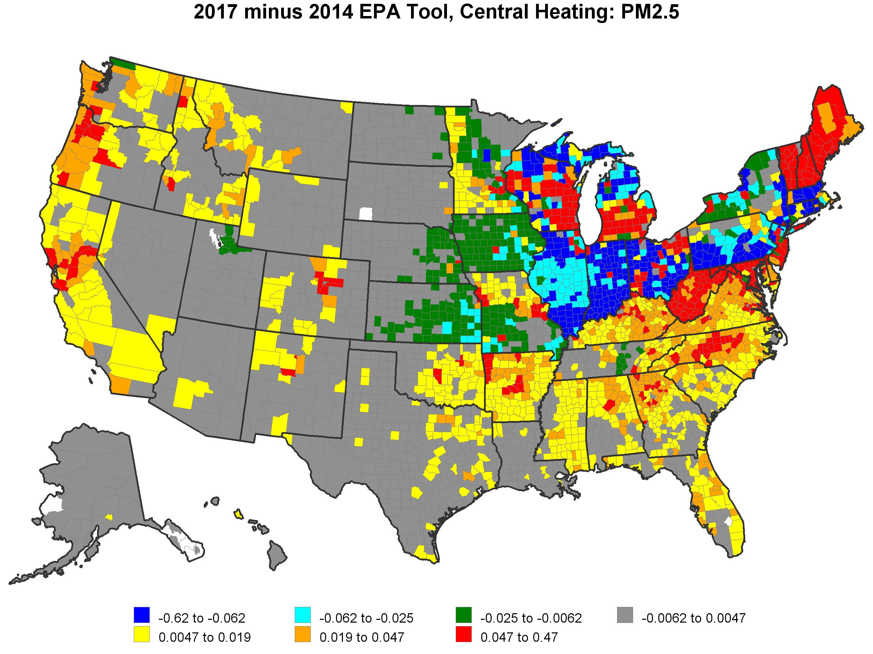
2017 – 2014 EPA Tool, RWC Central Heating PM2.5
(tons/sq. mile)

Slide 30
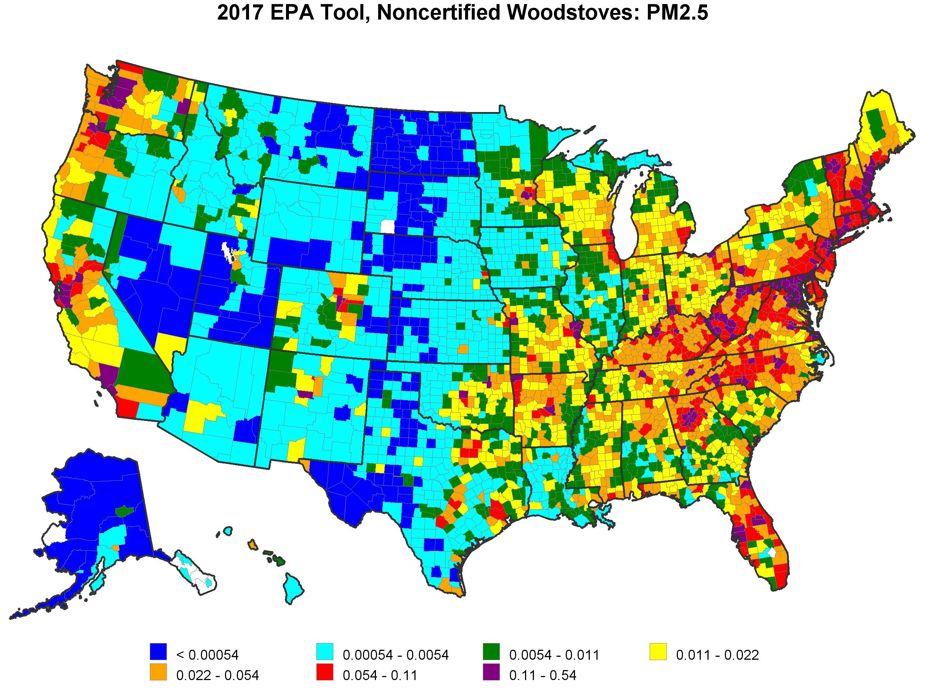
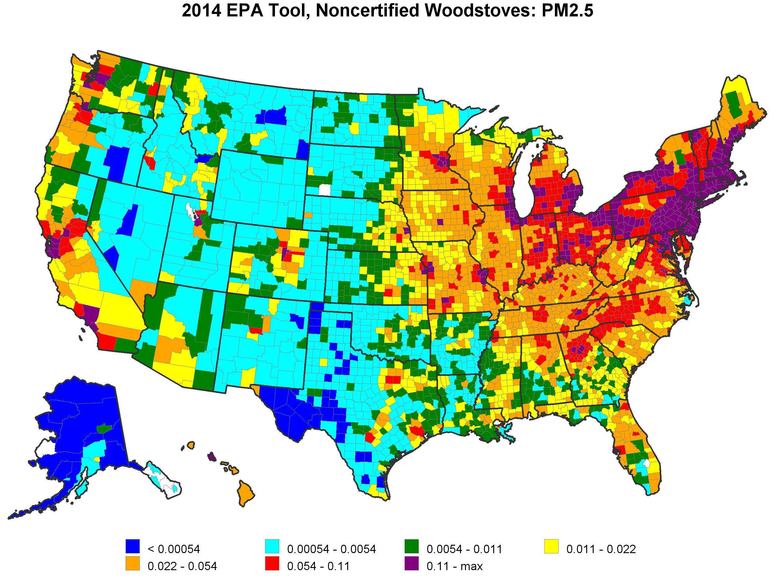
2017 (left) & 2014 (right) EPA Tool RWC Noncertified Woodstoves PM2.5 (tons/sq. mile)

Slide 31
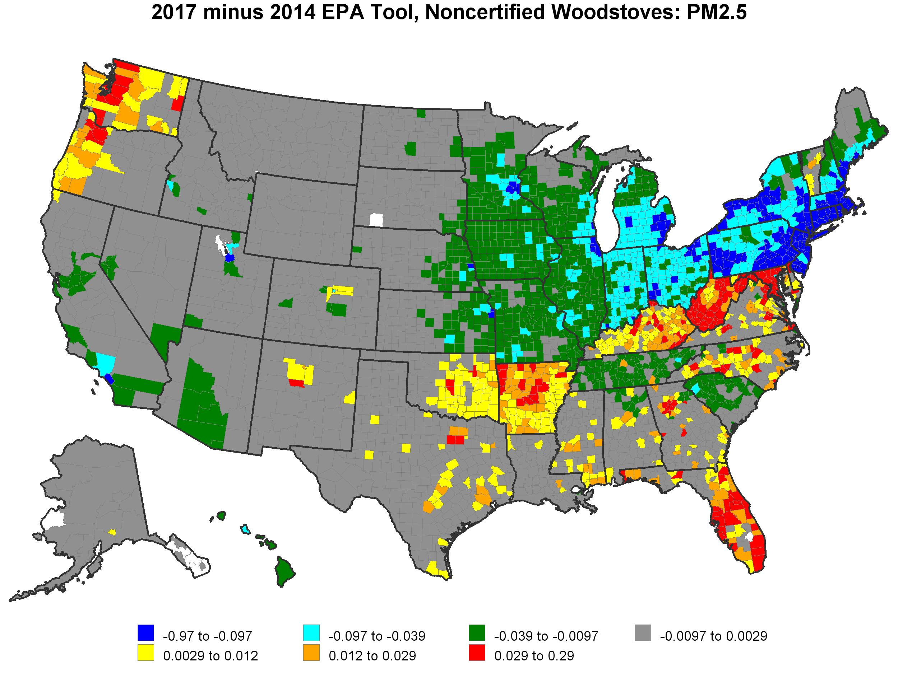
2017 – 2014 EPA Tool, RWC Noncertified Woodstoves PM2.5 (tons/sq. mile)

Slide 32
Summary
The survey represents the most comprehensive national assessment of wood-burning activity in the United States to date
The most common wood-burning appliances—fireplaces and outdoor recreational equipment—have the lowest burn rates
There are notable differences in urban, suburban, and rural burning, with wood-burning activity generally being more common in rural areas and areas with little natural gas access
Results compared reasonably well to other state and local surveys
While DEFAULT overall national RWC totals are similar, spatial distribution and appliance allocations changed considerably
  Final RWC NEI estimates, with SLT inputs and emissions will differ –release date 4/30/2020

Slide 33
Questions?
Appendix slides follow

Slide 34
Survey Results – Comparison to Other Surveys
Percentage of Households Using Each Appliance Type:
Comparison of Multiple Survey Results

Slide 35
Survey Results – Comparison to Other Surveys
Average Cords Burned per Appliance Type: Comparison of Multiple Survey Results

