Slide 1
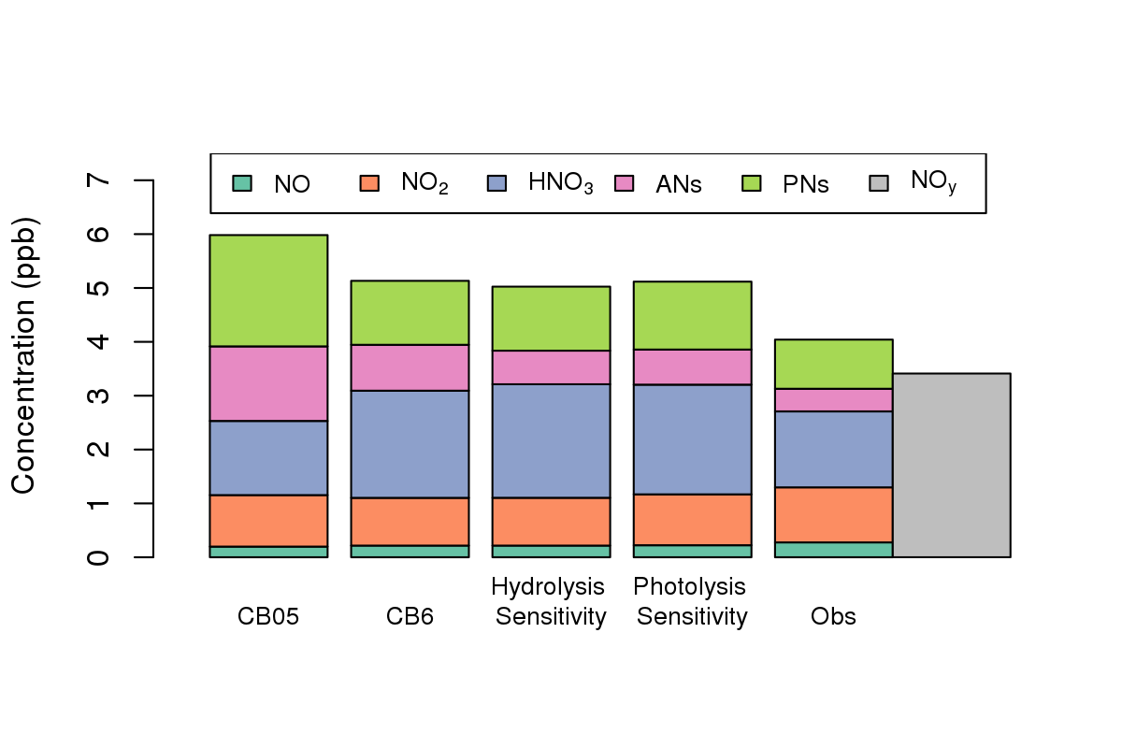
Evaluation of CMAQ Estimated NO_{x} from 2002 - 2016
Kristen M. Foley, Heather Simon, Claudia Toro, Kirk Baker, Wyat Appel, Barron Henderson, Alison Eyth, Deborah Luecken
Diurnal Profile of NO_{x} Bias for Summer 2011
NO_{x} Bias by Region/Season/Year
Observed and Modeled NO_{y} Species
Office of Research and Development
Center for Environmental Measurement & Modeling | Atmospheric & Environmental Systems Modeling Division
October 22, 2019
Notes:
Abstract: In recent years, many published studies comparing ambient NO_{X} and NO_{Y} concentrations to modeled or inventory values found a high bias on the order of 1.4 - 2 times observed levels. Some researchers proposed reducing mobile-source NOx emissions by 30-70% in their modeling applications. Many of these applications were based on evaluation of summer 2011 modeling to leverage the latest 2011 National Emissions Inventory and various summer field campaigns such as the 2011 DISCOVER-AQ Baltimore. Here, model estimates of NO_{X} from 2002 through 2016 from the Community Multiscale Air Quality (CMAQ) model were compared to routine surface network measurements to identify differences in NO_{X} bias across years, seasons, time of day, and regions of the country. Evaluation against NO_{X} observations across the U.S. show that the high summertime bias has significantly decreased across this period with decreasing ambient NO_{X} levels and improvements in the emissions inventories and the CMAQ system over time. Wintertime NO_{X} is found to be underestimated in many regions of the country in this set of simulations. Aircraft measurements taken as part of the 2011 DISCOVER-AQ Baltimore field campaign were compared to model estimates to further explore how emissions, model formulation (e.g., chemistry), and measurement uncertainty contribute to predictive skill. In-depth analysis using 2011 field measurements showed that the model bias in NO_{X} and NO_{z} components was sensitive to choices about pairing of model and measured values with disparate spatial and temporal resolution and to the chemical mechanism used. Estimates of daytime NO_{Y} normalized mean bias in the boundary layer aloft could vary from 76% to 28% depending solely on choice of model chemistry and measurement method.

Slide 2
Evaluation of NO_{x} and NO_{y} Emissions and Modeling
Evaluation of EPA’s 2011 emissions and air quality modeling identified high summertime bias in NO_{x} and NO_{y}
2016 and 2017 CMAS presentations identified multiple sources of positive bias
EPA workgroup has continued to investigate persistent bias
Diurnal Profile of NOx Bias in CMAQv5.0.2
May – August 2011
All AQS Sites
Motivation: What is causing a high bias in modeled values of NO_{x} and NO_{y} and what improvements are needed in our emissions inventories and/or air quality models to reduce these biases?
NO_{x} bias attributed to:
Emissions + Mixing + Chemistry + Obs Uncertainty
Hour of the Day (LST)
Notes:
EPA’s 2011 NEI and associated 2011 emissions modeling platform have been widely applied for scientific and regulatory analyses.
2011 emissions and air quality modeling have also been extensively evaluated against ground based, aircraft and satellite data.
Many research publications identified a positive bias in summertime modeled NOx and NOy and presented evidence that mobile source emissions could be a significant contributor to the bias.
These evaluations took many forms. Figure shows CMAQ evaluation that shows how summertime NOx bias changes across the day with peaks in the morning and evening corresponding to low PBL heights.
A cross agency workgroup was formed in EPA in 2016 to investigate this high bias and explore what improvements are needed in our emissions inventories and air quality models.
Workgroup members gave CMAS presentations in 2016 and 2017 that identified multiple sources of NOx bias, including mobile source emissions but also mixing layer height and chemistry parameterizations and uncertainty in observations.
This presentation is an update on some, certainly not all, of the evaluation work that has continued at EPA since those last CMAS presentations.

Slide 3
In this presentation…
Diagnostic evaluation of CMAQ estimated NO_{y} species using 2011 model sensitivities with CB05 and CB6 chemical mechanisms [aloft, midday]
Dynamic evaluation of model estimated NO_{x} at AQS sites using 2002-2016 time series of CMAQ simulations [surface, morning transition]
What’s not in this talk:
  Several additional diagnostic CMAQ sensitivities
  Evaluation and updates of mobile source emissions using real-world measurements and recent vehicle/transportation datasets
Notes:
Today’s talk: diagnostic evaluation of CMAQ estimated NOy using two different versions of the CB condensed chemical mechanism which are commonly used in regulatory modeling.
Evaluation of 2002 through 2016 CMAQ simulations are used to explore how the model bias has changed with more recent emissions platforms and updates to CMAQ.
The first evaluation is based on measurements aloft at midday, while the second focuses on surface observations during morning hours when mixing layer heights are still relatively low.
This is not a comprehensive update on everything the workgroup has investigated.
There are several additional CMAQ sensitivities that were conducted to rule out specific hypotheses about the model bias that I will not have time to cover.
EPA’s Office of Transportation and Air Quality have made many updates to the MOVES since the 2010b version that was used in the 2011 emissions platform based on evaluation against new mobile measurements.
Look for a more comprehensive summary of the work coming out of this workgroup in the coming year in the form of a manuscript and possibly an additional white paper.
-------------------------------------------------------
New mobile measurements are a mix of near-road data, dynamometer testing from I&M programs, and on-road PEMS data
Additional diagnostic CMAQ sensitivities: EGU and nonroad temporal profiles, diurnal profiles for heavy duty vehicles

Slide 4
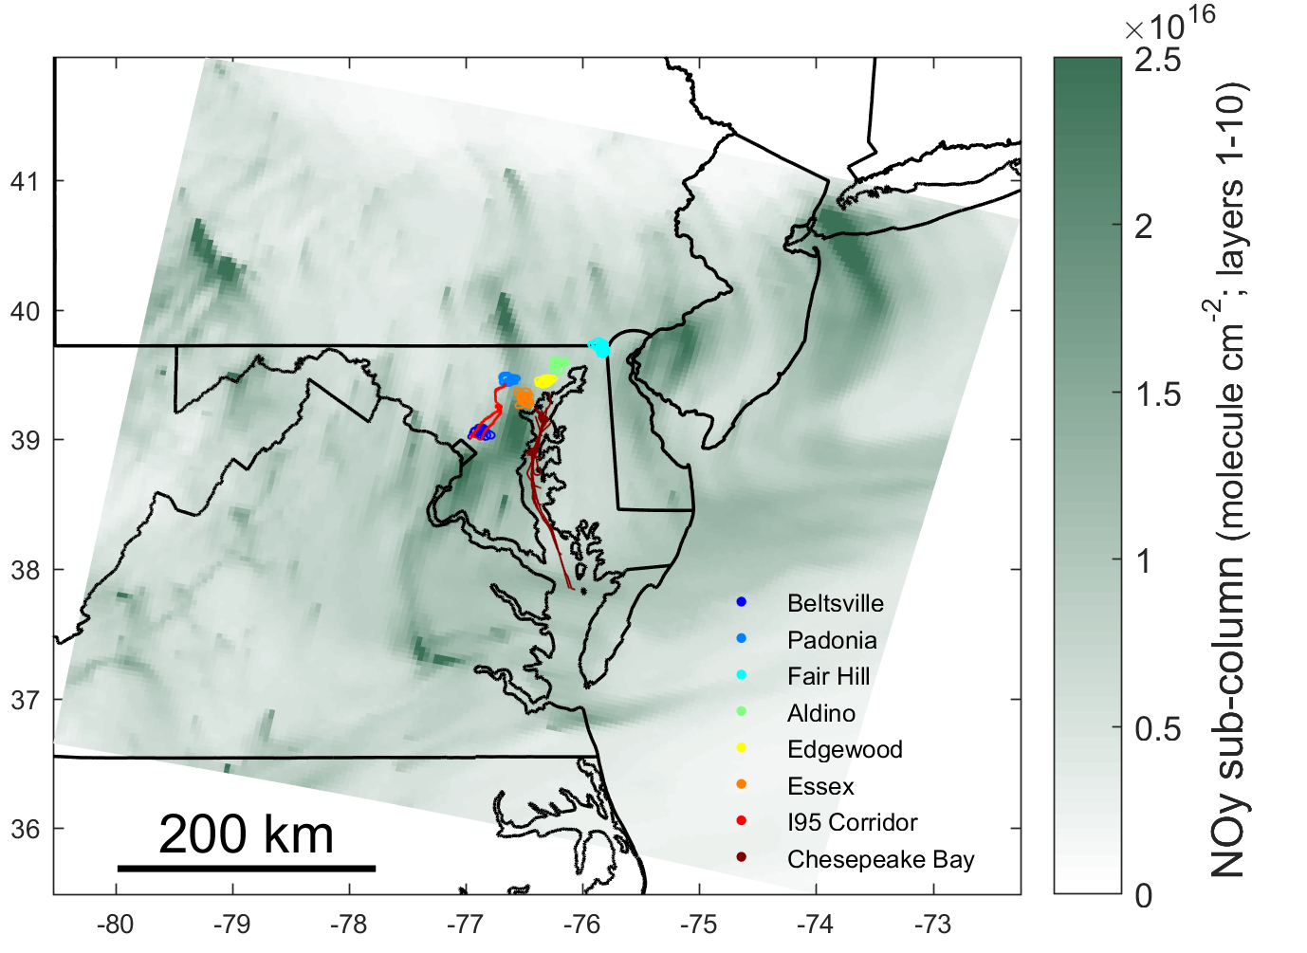
Evaluation of NO_{y} Species with Different Mechanisms
Hypothesis: Model mechanisms may not properly characterize individual organic nitrogen species, resulting in an underestimate of deposition and decay
Utilized NASA P-3B aircraft data from the July 2011 DISCOVER-AQ Baltimore Field Campaign
  NO, NO₂ and NO_{y}: NCAR four-channel chemiluminescence (CL)
  Alkyl Nitrates (ANs), Peroxy Nitrates (PNs), HNO₃: Thermal dissociation coupled with laser-induced fluorescence (TD-LIF) instrument
Notes:
From a CMAQ development point of view, one hypothesis that Deborah and Heather investigated is how well model chemical mechanisms characterize individual organic nitrogen species.
Along those lines: could the NOx and NOy bias be due to an underestimate of deposition and decay.
They utilized the July 2011 Discover AQ field campaign which had aircraft measurements of total NOy as well as individual measurements of NO, NO2, Alkly Nitrates, Peroxy Nitrates and Nitric Acid
----------------------------------------------------------
TD made second NO2 measurement as well

Slide 5
Comparison of NO_{y} Species
(all boundary layer measurements on all flight days)
CB05 vs CB6: CB6 includes two additional AN species with hydrolysis pathway to terminate NO_{x}
CB6 Hydrolysis Sensitivity: Decreased hydrolysis lifetime of AN species NTR2 from 6 to 2 hrs
CB6 Photolysis Sensitivity: introduce NTR2 photolysis reaction with NO₂ products
Observed NO_{y}: Summing observed NO_{x} and NO_{z} species is not equivalent to NCAR NO_{y} measurement
35%
23%
NO_{y} species from
CL & TD-LIF
24%
25%
17%
12%
13%
23%
NO_{y} from CL
23%
10%
39%
42%
40%
35%
23%
16%
17%
18%
18%
25%
NO_{x} = NO + NO₂
NO_{y} = NO + NO₂ + Nitric Acid (HNO₃) + Alkyl Nitrates (ANs) + Peroxy Nitrates (PNs)
Notes:
The evaluation includes model simulations using CB05 and CB6.
Two CB6 sensitivities were conducted aimed at changing the atmospheric lifetime of NOy by increasing deposition and decay
Modeled NOy species (CMAQv5.2) were then compared to aircraft observations averaged across all boundary layer measurements on all flight days for July 2011.
An important thing to note is that the sum of the measured NOy species was greater than the NOy measurement from the CL instrument.
Measurement uncertainty can impact how we quantify and interpret model bias.

Slide 6
Comparison of NO_{y} Species
(all boundary layer measurements on all flight days)
NO_{x} performance: Fairly good performance in all simulations.
CB05 vs CB6: CB6 has better agreement with observations for ANs and PNs but increase in HNO₃ leads to overprediction.
Additional mechanism updates: Most efficient chemical mechanism changes for reducing total NO_{y} would shift to shorter lifetime species (HNO₃). →Any additional shifts towards HNO₃ will further exacerbate HNO₃ overprediction
35%
23%
24%
25%
23%
17%
12%
13%
23%
10%
39%
42%
40%
35%
23%
16%
17%
18%
18%
25%
Notes:
The evaluation shows that NO and NO2 estimates aloft during midday hours are fairly consistent with observations in terms of magnitude.
CB6 has better agreement with observations for Alkyl Nitrates and Peroxy Nitrates but the overprediction in nitric acid is increased in both sensitivities.
This shows that assumptions in our condensed chemical mechanisms can make substantial changes in the atmospheric lifetime of NOy by shifting to shorter lifetime species.
However, chemistry alone cannot remove the positive bias because additional shifts toward nitric acid will only increase our overprediction for that species. We know that other model processes – mixing, emissions – must also be addressed.

Slide 7
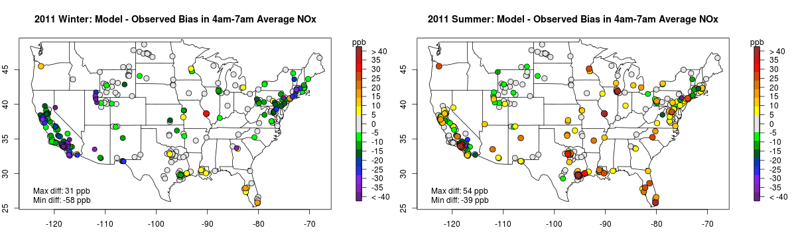
Evaluation of Model Estimated NO_{x} from 2002-2016
Hypothesis: Model bias is due to some unique feature of 2011 NEI and/or summer
Summer 2011, 4am-7am Average NO_{x} Bias [CMAQv5.0.2 – Observed]
Many previous NO_{x} and NO_{y} evaluations focused on simulations that utilized the 2011 National Emissions Inventory and Emissions Modeling Platform
Many evaluations also focused on summer months
Notes:
Our diagnostic evaluation, like many previous studies, focused on modeling of 2011 summertime conditions.
We saw there was not much bias in NOx aloft during midday hours, but here we see summertime NOx at the surface in 2011 is overestimated across much of the country.
We now turn to an evaluation of NOx estimates against AQS observations from 2002 to 2006 to investigate whether this bias is present for other modeling years and in in winter months.

Slide 8
Evaluation Against Hourly AQS NO_{x} Measurements
Focused on 4am to 7am hourly measurements
  Corresponds to the peak of the NO_{x} bias at most sites
  Captures the window when mobile emissions are increasing and mixing layer height is still relatively low
  Minimizes the interference of other reactive nitrogen species in the NO_{x} measurement that occurs during warmer mid-day hours (Dickerson et al., 2019)
CMAQ simulations are a “convenience sample”
  2002-2012: CMAQv5.0.2
  2013: CMAQv5.1
  2014-2015: CMAQv5.2
  2016: CMAQv5.2.1 and CMAQv5.3

Slide 9
Evaluation Against Hourly AQS NO_{x} Measurements
Focused on 4am to 7am hourly measurements
  Corresponds to the peak of the NO_{x} bias at most sites
  Captures the window when mobile emissions are increasing and mixing layer height is still relatively low
  Minimizes the interference of other reactive nitrogen species in the NO_{x} measurement that occurs during warmer mid-day hours (Dickerson et al., 2019)
CMAQ simulations are a “convenience sample”
  2002-2012: CMAQv5.0.2
  2013: CMAQv5.1
  2014-2015: CMAQv5.2
  2016: CMAQv5.2.1 and CMAQv5.3
Con: When looking at model bias over time, improvements in emissions and air quality modeling are confounded with decreasing observed NO_{x}

Slide 10
Evaluation Against Hourly AQS NO_{x} Measurements
Focused on 4am to 7am hourly measurements
  Corresponds to the peak of the NO_{x} bias at most sites
  Captures the window when mobile emissions are increasing and mixing layer height is still relatively low
  Minimizes the interference of other reactive nitrogen species in the NO_{x} measurement that occurs during warmer mid-day hours (Dickerson et al., 2019)
CMAQ simulations are a “convenience sample”
  2002-2012: CMAQv5.0.2
  2013: CMAQv5.1
  2014-2015: CMAQv5.2
  2016: CMAQv5.2.1 and CMAQv5.3
Pro: Model time series compares “state of the science” 2011 results with current “state of the science”

Slide 11
Diurnal Profiles of Summer NO_{x}: Obs and Bias
Diurnal Profile of Observed Summer NOx (ppb)
Averaged across all sites
Diurnal Profile of Bias in Summer NOx (ppb)
Averaged across all sites
2002
Switch to CMAQ v5.1
2011
CMAQv5.3
2016
Switch to 2014 Emissions Platform
Step change decrease in bias in 2013 reflects significant improvements in CMAQv5.1 in the characterization of mixing in morning and evening transition hours.
2014 improvement reflects switch to 2014 platform data (e.g., improved age distributions for representative counties for onroad emissions).
Notes:
These are diurnal profiles of observed NOX and model bias. For each hour of the day in summer months the values are averaged across all sites in the US.
Each colored line represents data from a different year.
Diurnal profile of observed NOx and model bias shows peaks in morning hours and evening transition hours.
Steady decrease in observed NOx and in model bias from 2002 to 2016.
Decreasing model bias reflects more than just decreasing observed NO_{x}.
Step change decrease in bias in 2013 reflects significant improvements in CMAQv5.1 in the characterization of mixing in morning and evening transition hours.
2014 improvement reflects switch to 2014 platform data (e.g., improved age distributions for representative counties for onroad emissions).

Slide 12
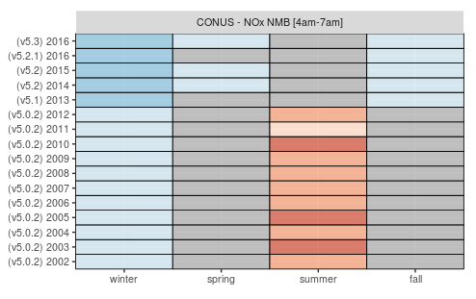
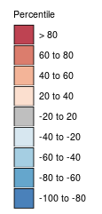
Status report on NOx bias: Where have we been and where are we now
Normalized Mean Bias of morning NOx across all sites for each season in 2002 – 2016
  2002 – 2012: 35-66% NMB
  2013 – 2016: 7-15% NMB
7%
11%
11%
10%
15%
41%
35%
66%
43%
50%
43%
54%
62%
55%
65%
52%
Notes:
Here is we use a Kelly Plot of normalized mean bias to provide a summary across all years and all seasons. This removes the impact of the decreasing NOx observations.
In summer months we see values range from 35-66% for the first 11 years of the time series.
The bias dramatically drops to 15% in 2013 with the switch to CMAQv5.1 and then to 10% with the introduction of the 2014 NEI.
We also see a consistent winter low bias that has actually worsened slightly with more recent years.

Slide 13
AQS Sites Grouped by NOAA Climate Regions
Notes:
We can break these down regionally as well by dividing the AQS sites into these 8 subregions based on NOAA climate regions.

Slide 14
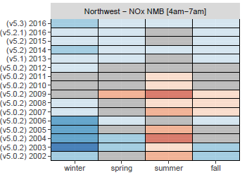
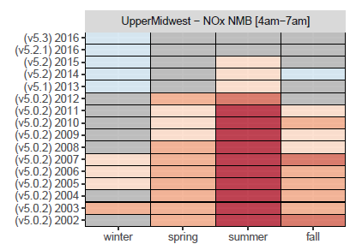
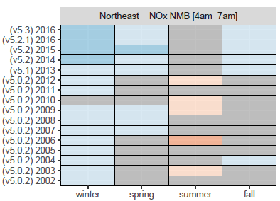
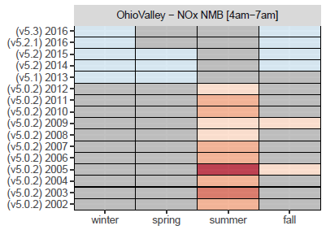
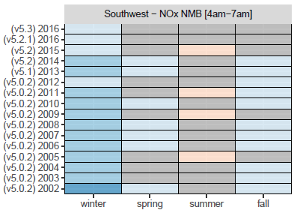
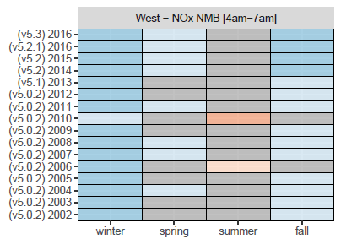
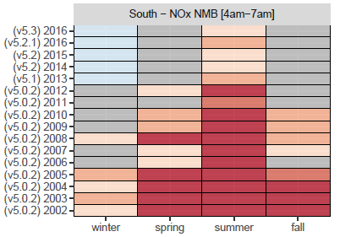
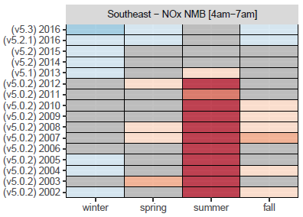
4am-7am NO_{x} NMB (%) by Region/Season/Year
Northwest
Upper Midwest
Northeast
Ohio Valley
Southwest
West
South
Southeast
Notes:
The summertime bias was most pronounced in the South and up through the Ohio Valley and Upper Midwest.
The upper midwest and south also had substantial bias in spring and fall months. These two regions continue to have some summer overestimation even in the most recent years of modeling.
We also see a winter underestimation is mainly in the western regions an Northeast but with some underestimation appearing in all regions in the 2016 modeling.

Slide 15
Diurnal Profiles of Winter NO_{x}: Obs and Bias
Diurnal Profile of Observed Winter NOx (ppb)
Averaged across all sites
Diurnal Profile of Bias in Winter NOx (ppb)
Averaged across all sites
Switch to CMAQ v5.1
2011
CMAQv5.3
2002
NO_{x} is often biased low in morning hours in winter months.
Decreasing wintertime observed NO_{x} did not decrease bias in morning hours.
Notes:
Looking more closely at the winter bias, we see the model tends to be biased low in morning hours. That low bias is not improving over time.
This low winter bias was reported was reported in Wyat’s publication on the evaluation of CMAQv5.1.
It was observed in evaluation of the WINTER aircraft campaign, 2 papers in JGR-Atmospheres (L. Jaegle et al JGR-Atmos 2018; O.E. Salmon et al. JGR-Atmos 2018).

Slide 16
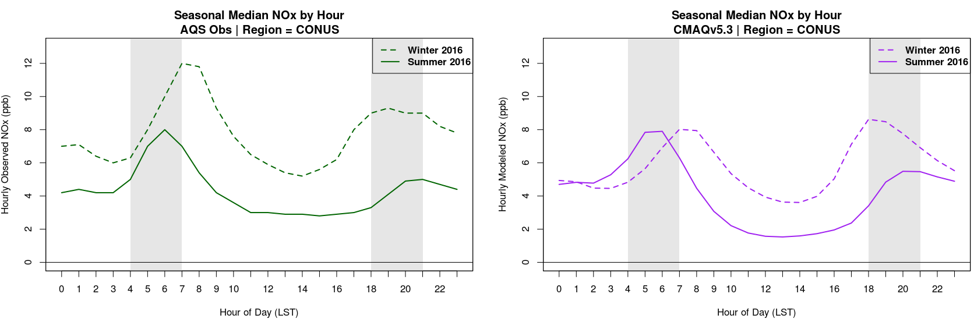
Status Report on Seasonal Pattern in NO_{x} Bias
2016 Diurnal Profile of Observed Summer and Winter NOx (ppb)
Averaged across all sites
2016 Diurnal Profile of CMAQv5.3 Summer and Winter NOx (ppb)
Averaged across all sites
Seasonal change =
Emissions (magnitude and temporal profile) +
Diurnal variation in mixing layer height
Observed increase in morning NO_{x} from summer to winter.
This seasonal pattern is not seen in the modeled NO_{x}, even in the latest 2016 CMAQv5.3 simulation.
Notes:
Exploring the summer to winter change in NOx: An incorrect seasonal pattern in NOx was reported previously in the evaluation of 2011 modeling and it persists in the 2016 estimates using CMAQv5.3.
The left hand plot shows the observed diurnal profile in winter as a dashed line and the summer profile as a solid line. We see a shift in the morning peak due to change in daylight hours and an increase from summer to winter.
The model profiles on the right show the model is missing this increase in the winter in early morning hours.
Modeled mobile emissions tend to decrease from summer to winter, but the changes depends a lot by location. For example in NYC mobile NOx decreases across all hours of the day in winter due to a decrease in nonroad emissions. In Houston the decrease in mobile NOx in winter is during midday hours due to decreasing running emissions.
At the same time the growth of the mixing layer from early to mid morning changes from summer to winter. Again this seasonal change depends on the location. Early morning mixing heights often increase in in winter due to increased winds. Starting around 8am winter mixing heights tend to be much lower than in summer due to lower temperatures and more stable conditions (less convective activity).
Here we see how difficult it is to use air quality modeling output to diagnose errors in the magnitude of emissions in one sector. The temporal profiles of the emissions and the timing of the growth of the mixing layer can either mask or exacerbate errors in either process.
------------------------------------------------------------------------------------------------
Brian McDonald’s presentation at Sept 2019 AQUARIUS workshop in UT
Used TROPOMI satellite data to evaluate NO2 columns from WRF-Chem (March 2019).
Suggested mobile emissions may be low in winter. Recommended future winter campaigns combining satellite, roadside measurements and air craft measurements of urban VOC sources
https://atmos.utah.edu/aquarius/presentations/24_mcdonald.pdf
------------------------------------------------------------------------------------------------

Slide 17
Status report on NO_{x} bias: Where have we been and where are we now
Punchline
Summer NO_{x} bias for modeling using CMAQv5.1+ and emissions inventories for 2014+ is much lower than what was reported based on 2011 emissions and modeling.
Improvements reflect both lower observed NO_{X} across the country AND improvements in emissions and air quality modeling.
Cause for the incorrect seasonal pattern in modeled NO_{x} is still unclear.

Slide 18
Discussion and Next Steps
Sensitivity to AQS observational uncertainty: Evaluation of 2002-2016 model results was repeated comparing modeled NO_{y} to observed NO_{x}. Positive bias increased but spatial and temporal patterns in the bias were unchanged.
Updates in MOVES and SMOKE-MOVES: Many updates in the current 2016 modeling platform and future versions of MOVES will have further updates to address NO_{x} related evaluation.
New ceilometers at PAMS sites: Ceilometer measurements allow for further evaluation of modeled mixing layer heights during transition hours.
New CMAQv5.3 time series coming in 2021: 2002 - 2017 CMAQv5.3 simulations using WRFv4.1.1, boundary conditions from Hemispheric CMAQ and mobile emissions from latest MOVES release.

Slide 19

Questions?
Contact: foley.kristen@epa.gov
www.epa.gov/cmaq
Disclaimer: The views expressed in this presentation are those of the authors and do not necessarily represent the views or policies of the U.S. Environmental Protection Agency.

Slide 20
YEAR | NEI VERSION (EMISSIONS PLATFORM) | MOBILE EMISSIONS | MET MODEL | AQ MODEL
2002 | 2002 NEI v3 (2002af) | 2002 MOVES 2010b | WRFv3.4 | CMAQv5.0.2
2003 | 2002 NEI v3 (2003af) | Interpolated 2002, 2005 MOVES output | WRFv3.4 | CMAQv5.0.2
2004 | 2005 NEI v3 (2005ct_04) | Interpolated 2002, 2005 MOVES output | WRFv3.4 | CMAQv5.0.2
2005 | 2005 NEI v3 (2005ct_04) | 2005 MOVES 2010b | WRFv3.4 | CMAQv5.0.2
2006 | 2008 NEI v3 (2007ed_06) | 2005 MOVES eftables, 2006 activity data and met | WRFv3.4 | CMAQv5.0.2
2007 | 2008 NEI v3 (2007rh) | 2007 MOVES 2010b | WRFv3.4 | CMAQv5.0.2
2008 | 2008 NEI v3 (2008ab) | 2008 MOVES 2010b | WRFv3.4 | CMAQv5.0.2
2009 | 2008 NEI v3 (2009ef) | 2009 MOVES 2010b | WRFv3.4 | CMAQv5.0.2
2010 | 2008 NEI v3 (2007ed_10) | 2009 eftables, 2010 activity data and met | WRFv3.4 | CMAQv5.0.2
2011 | 2011 NEI v1 (2011ed) | 2011 MOVES 2010b | WRFv3.4 | CMAQv5.0.2
2012 | 2011 NEI v2 (2011ed_12) | MOVES2014a | WRFv3.4 | CMAQv5.0.2
2013 | 2011 NEIv2 (2013ej) | MOVES2014a | WRFv3.7.1 | CMAQv5.1
2014 | 2014 NEI v1 (2014fb) | MOVES2014a | WRFv3.8.1 | CMAQv5.2
2015 | 2014 NEI v2 (2015fd) | MOVEs2014a | WRFv3.8 | CMAQv5.2
2016 | 2016 alpha platform (2016fe) | MOVES2014a | WRFv3.8 | CMAQv5.2.1
2016 | 2016 beta platform (2016ff) | MOVES2014b | WRFv3.8 | CMAQv5.3

Slide 21
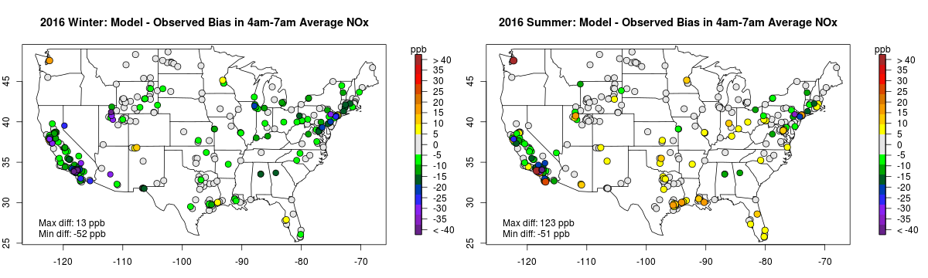
Status Report on Summer NO_{x} Mean Bias
Summer 2011, 4am-7am Average NO_{x} Bias
[CMAQv5.0.2 – Observed]
Summer 2016, 4am-7am Average NO_{x} Bias
[CMAQv5.3 – Observed]
NO_{x} summertime bias in 2016 using CMAQv5.3 and 2016beta emissions is much lower than 2011 bias using CMAQv5.0.2 and 2011 platform emissions.
Improvements reflect both lower observed NO_{X} across the country AND improvements in emissions and air quality modeling.

Slide 22
Status Report on Winter NO_{x} Mean Bias
Winter 2011, 4am-7am Average NO_{x} Bias
[CMAQv5.0.2 – Observed]
Winter 2016, 4am-7am Average NO_{x} Bias
[CMAQv5.3 – Observed]

Slide 23
# Sites used in NMB Calculation (4am-7am)

Slide 24
NOx obs vs NOx model (repeat of slide 17)

Slide 25
NOx obs vs NOy model

Slide 26
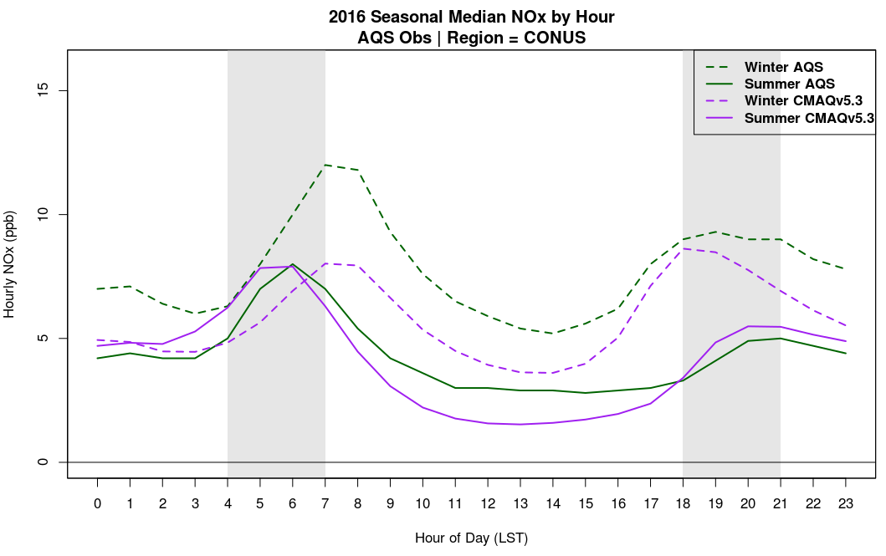
Diurnal Profile of 2016 Winter and Summer NO_{x} (ppb)
Averaged across all sites

Slide 27
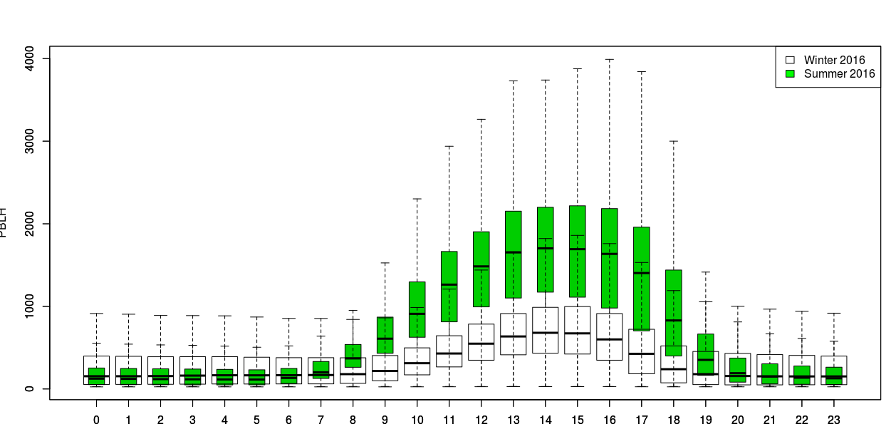
Modeled PBL Heights in January and July 2016 at all AQS Sites

Slide 28
