Slide 1
Comparing
Projected and Modeled
Health Benefits of Alternative Energy Futures
Kristen E Brown, PhD
CMAS conference
October 21, 2019

Slide 2
Objectives
Energy use produces a lot of emissions so we want to:
Calculate benefits of emissions reductions
Analyze potential future outcomes
Determine which calculation method is best suited for 2045 analysis
Notes:
Energy more broad than just electricity

Slide 3
Energy Futures
Modeled four future energy scenarios
  No Fee -- Business as Usual
  HIP -- Fees targeting criteria pollutants
  GHG -- Fees targeting GHGs
  Combo -- Fees targeting criteria pollutants and GHGs
Results for 2045 are analyzed

Slide 4
Emissions in 2045 in Each Scenario
Notes:
This specific policy led to more change in electricity & industry, which you’ll see in AQ changes

Slide 5
Expectations
Health Benefits
Emissions Changes
Marginal Damages
Tons in MARKAL
$/ton from Fann et al. (2012)
Notes:
So we could stop here, or…

Slide 6
Calculating Health Benefits
Damage Scaled
Health Benefits
Emissions Changes
Marginal Damages
Health Benefits
Modeled
Concentration Changes
Health Impact Function
CMAQ
BenMAP

Slide 7
CMAQ simulation
CMAQ v5.2
Anthropogenic emissions: 2011 NEI v2
12 km resolution
Year-long simulation
2011 meteorology from WRF
Notes:
For CMAS, it would be useful to provide some details on CMAQ simulation (e.g. version, resolution, base case, etc)

Slide 8
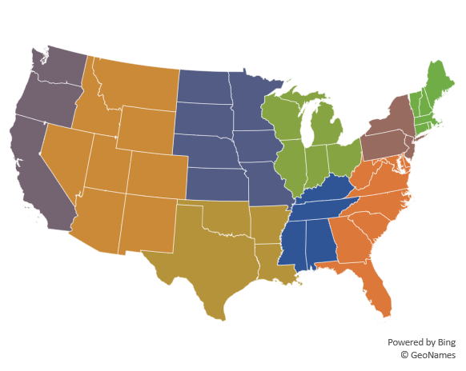
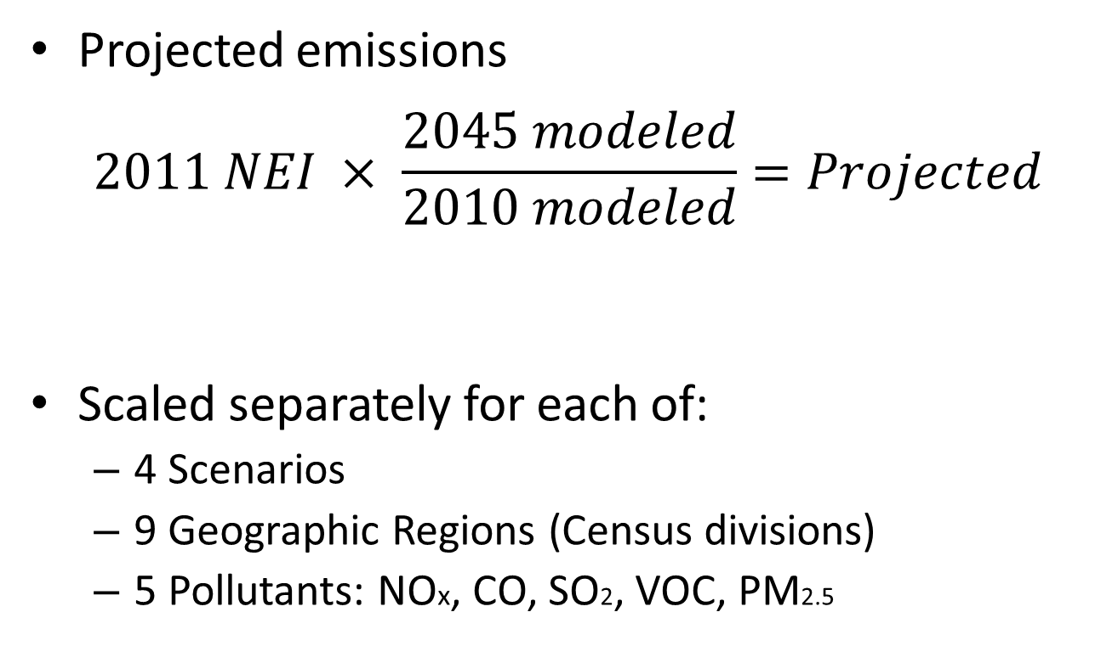
Emissions Scaling
Projected emissions
$$2011 NEI × \frac{2045 modeled}{2010 modeled}=Projected$$
Scaled separately for each of:
  4 Scenarios
  9 Geographic Regions (Census divisions)
  5 Pollutants: NOx, CO, SO2, VOC, PM2.5
Notes:
Is all grow-in-place, scale categories: elc: coal, NG, other; TRN mode; indust

Slide 9
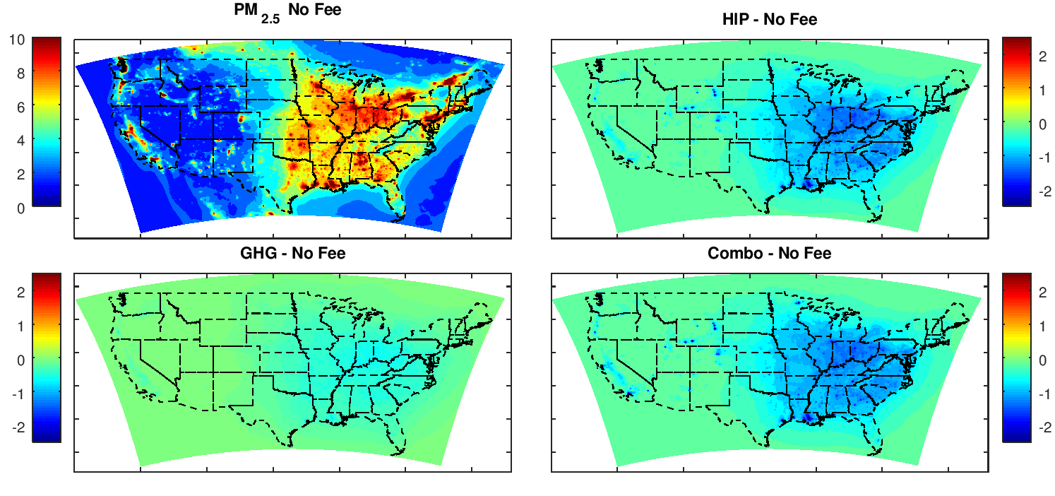
PM2.5 concentrations (µg/m³) in 2045
No Fee
HIP - No Fee
10
5
0
2
0
-2
GHG - No Fee
Combo - No Fee
Notes:
Ug/m3

Slide 10
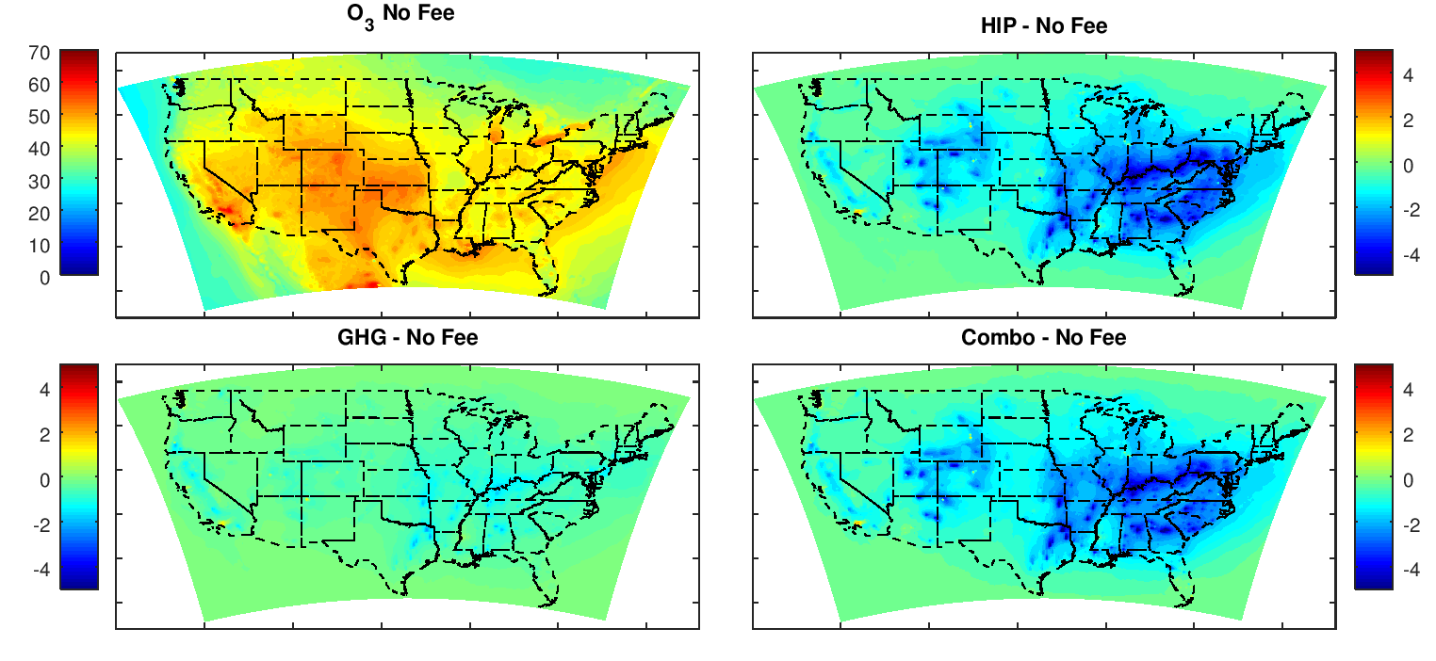
O3 concentrations (ppb) in 2045
No Fee
HIP - No Fee
70
35
0
4
0
-4
GHG - No Fee
Combo - No Fee
Season avg. MDA8 [ppb]
Notes:
Season avg MDA8 ppb
Does increase in some cities

Slide 11
Comparison of Health Benefits

Slide 12
Differences in Benefit Calculations
Damage Scaled
Modeling
Assumes marginal changes
Captures changing population over time
Captures regional variation

Slide 13
Cost Benefit Analysis
Notes:
GHG damages are already projected to the future and don’t care about location

Slide 14
Future needs
Better characterization of upstream emissions locations
We can’t capture this
Notes:
Similarly, locations of scaled emissions can be improved

Slide 15
Conclusions
Models are useful tools for evaluating health impacts of large emission changes
Consider population changes when evaluating future health effects
Evaluating health impacts is improved with knowledge of the location of affected emissions
Brown.Kristen@EPA.gov
Disclaimer: The views expressed in this presentation are those of the author and do not necessarily reflect the views or policies of the U.S. Environmental Protection Agency.
Notes:
These are strong statements. I suggest to soften the language, something like “Models are useful tools for evaluating health impacts of large emission changes”, or “Modeling is critical …”

