Slide 1
NOAA’s National Air Quality Forecast Capability operational and experimental updates
Dorothy Koch¹, Ivanka Stajner², Jeff McQueen^{2,} Pius Lee³, Jianping Huang^{2,5},
Ho-Chun Huang^{2,5}, Li Pan^{2,5}, Youhua Tang^{3,6}, Daniel Tong^{3,6}, Patrick Campbell^{3,6}, Ariel Stein³, James Wilczak⁴, Irina Djalalova^{4,8}, Dave Allured^{4,8}, Phil Dickerson⁷, Jose Tirado^{1,9}
(1) NOAA NWS/STI
(2) NOAA NWS/NCEP
(3) NOAA ARL
(4) NOAA ESRL
(5) IMSG
(6) Cooperative Institute for Satellite Earth System Studies (CISESS)
(7) EPA
(8) CIRES, University of Colorado
(9) ERG
with contributions from the entire NAQFC Implementation Team
CMAS Conference, Chapel Hill, NC October, 2019

Slide 2
NAQFC related presentations
Implementation of new satellite-based source maps in the FENGSHA dust module and initial application with the CMAQ-based NAQFC system, Daniel Tong (next speaker).
Development of a Fast Fire Emission Processor and Its application with HMS-Bluesky and GBBEPx Inventories, Youhua Tang (Tue, Oct 22, 10:40 AM - 11:00 AM, Dogwood Room).
Evaluation of GFS-driven CMAQ predictions of PM2.5 and O3 at NOAA, Jianping Huang (poster session, Tue, Oct 22, 05:00 PM - 07:45 PM, Main Atrium).

Slide 3
NWS context
The Office of Science and Technology Integration (OSTI) Modeling Division (about $29M/yr)
Includes:
NGGPS (Next Generation Global Prediction System)
HFIP (Hurricane Forecast Improvement Program)
“Weeks 3-4”
Air Quality
COASTAL Act
We are moving towards “unification”, reducing the number of model component versions, for example using the FV3 dynamical core for all atmospheric applications, including AQ
We are collaborating closely with the Research office (OAR) and community, to bring “Research to Operations” and vice versa.
The Unified Forecast System (UFS) is becoming a central effort, started from our office, now also supported by OAR/OWAQ, and we are planning to extend the collaboration to other NOAA Offices and beyond: http://ufscommunity.org
The UFS has 8 “applications”, including air quality, and an atmospheric chemistry working group
Most of our air quality development work will now be supported under the UFS project, and we are in the project and proposal development stage now.

Slide 4
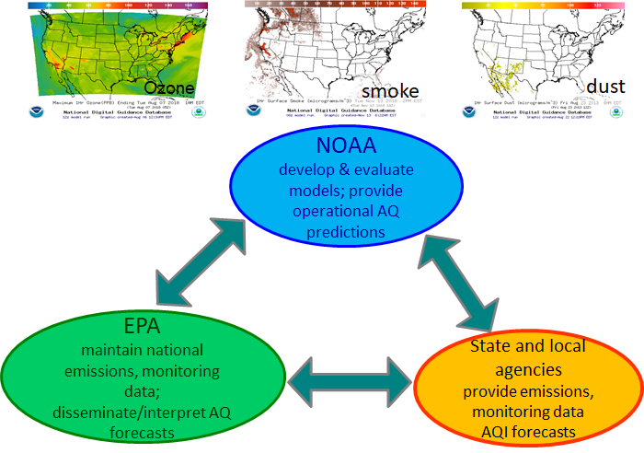
National Air Quality Forecast Capability
We improve the basis of air quality alerts and provide air quality information to people at risk to further NWS mission of protecting life and property and the enhancement of the national economy.
National Air Quality Forecast Capability (NAQFC) develops and implements operational air quality forecast guidance for the United States.
Current operational Prediction Capabilities are:
Ozone nationwide
Smoke nationwide
Dust over CONUS
Fine particulate matter (PM2.5) nationwide
These capabilities rely on a strategic partnership with the Environmental Protection Agency (EPA) and state and local air quality forecasters.

Slide 5
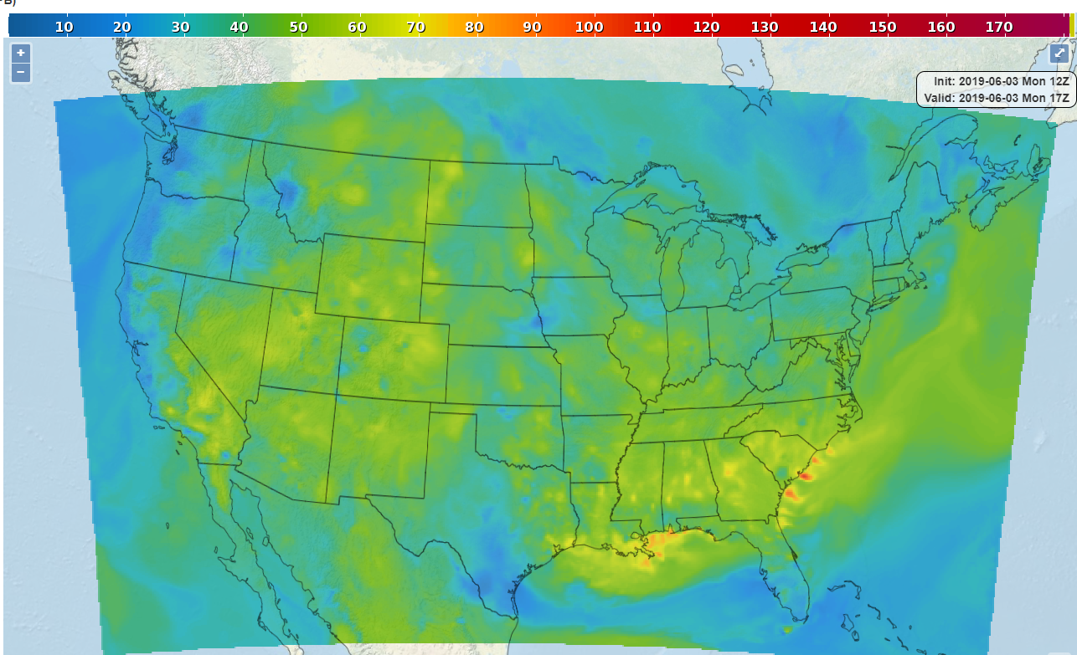
Our products are available @
Realtime images @ airquality.weather.gov and as GRIB files from ftp://tgftp.nws.noaa.gov/SL.us008001/ST.opnl/DF.gr2/DC.ndgd/GT.aq/AR.conus/
In GIS format @ https://idpgis.ncep.noaa.gov/arcgis/rest/services/NWS_Forecasts_Guidance_Warnings
Historical database available from the National Digital Guidance Database@
https://www.ncdc.noaa.gov/data-access/model-data/model-datasets/national-digital-guidance-database-ndgd

Slide 6
Operational centers Forecast performance analysis
NAQFC/CMAQ has the best performance based on several metrics against other operational centers models, ECCC (Regional AQ Deterministic Prediction system) Canada and ECMWF (CAMS-IFS)
NAQFC/CMAQ has best overall Factor of 2 fraction (FAC2) scores for O3 and PM2.5.
For ozone in the summertime, NAQFC/CMAQ has the best correlations.
NAQFC/CMAQ has best (closest to 0) Mean Fractional Bias for daily max O3 and PM2.5
NAQFC/CMAQ has best overall performance (AQPI) for summertime daily max O3
NAQFC/CMAQ has best overall performance (AQPI) for daily max PM2.5
All comparison statistics based on CMAQ raw output

Slide 7
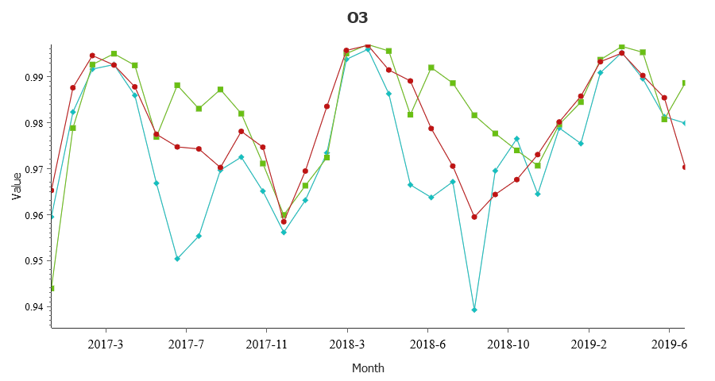
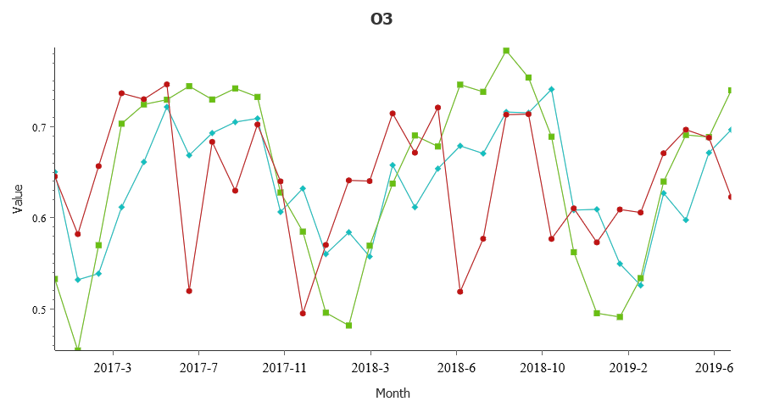
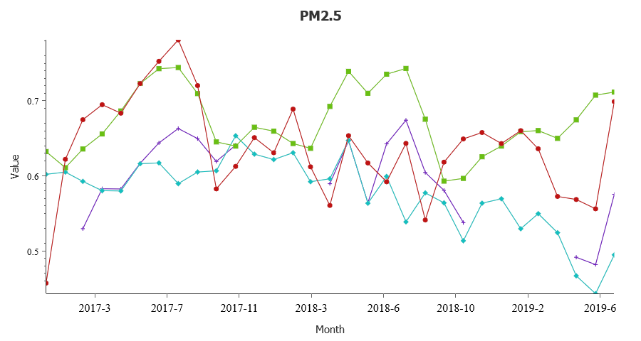
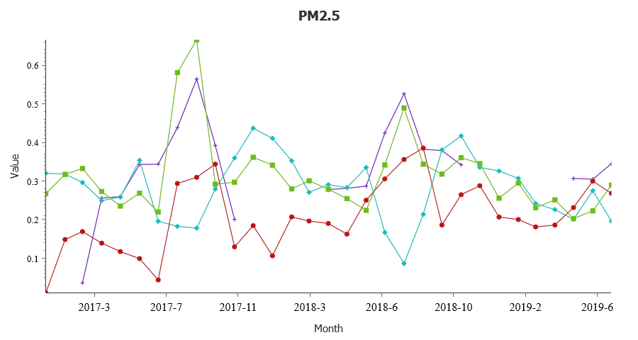
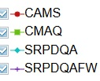
Time Series of O₃and PM_{2.5} Mean Monthly Values for Factor-of-2 and Correlation: 2017/01–2019/07, Continental Domain
FAC2
R
O₃
PM_{2.5}
Moran, et al
Statistics are calculated using daily MAX observed and forecasted concentrations
Notes:
* NAQFC has best overall FAC2 scores for O3 and PM2.5
* RAQDPS has better FAC2 scores for NO2 than IFS in winter, lower in summer
* R scores for O3 are comparable overall; NAQFC performs better in summer, RAQDPS in winter
* CAMS-IFS has consistently lower R scores for NO2 than RAQDPS and has several "drops“ in summer 2017 and summer 2018
* R scores are lower for PM2.5 for all models compared to O3 and there is considerable "jockeying" between models over the 2+ year period
* In August 2018 the R score for FireWork had a large increase vs. the large decrease for RAQDPS: only difference in 2 systems is inclusion of wildfire emissions in FireWork; as shown in next slide, there was a large increase in wildfire activity in western Canada between July 2018 and August 2018

Slide 8
Operational updates implemented last December
Updated fine particulate matter (PM2.5) bias correction system to use:
Consistent model predictions for training of the unified KFAN bias correction system
Increased number of observation sites for model bias correction to over 900 monitors
Improvements to forecast extreme events by adding the difference between the current raw model forecast and historical analogs’ mean to the KFAN bias-corrected predictions
New ozone bias correction with the same unified codes and configuration
Uses ozone, wind direction, wind speed, temperature, solar radiation, NOx, NOy and PBL height as parameters to identify analogs
airquality.weather.gov display bias corrected ozone instead of raw ozone
Updated anthropogenic emissions (NEI2014v2)
Update Alaska and Hawaii domain CMAQ code to the same version used for CONUS:
CB05 gas-phase and aero6 aerosol chemistry (155 species)
Improved heterogeneous, aqueous, winter-time reactions
Improved SOA and coarse mode PM

Slide 9
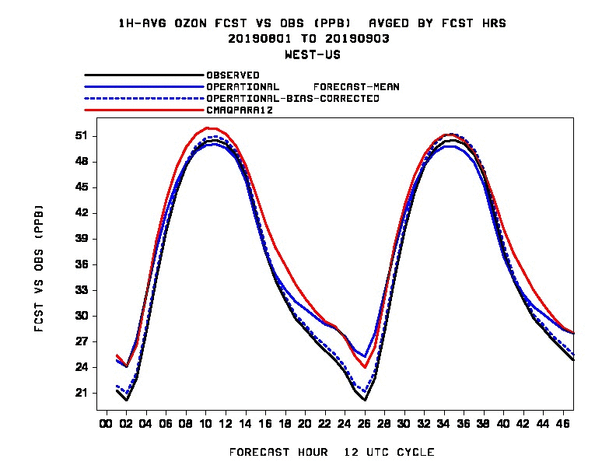
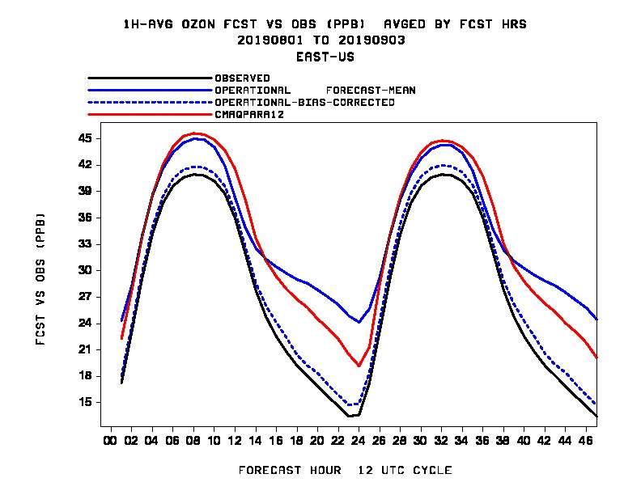
Performance of Ozone predictions: Observed Vs predicted 1 hr averaged Diurnal variability, August 2019

Slide 10
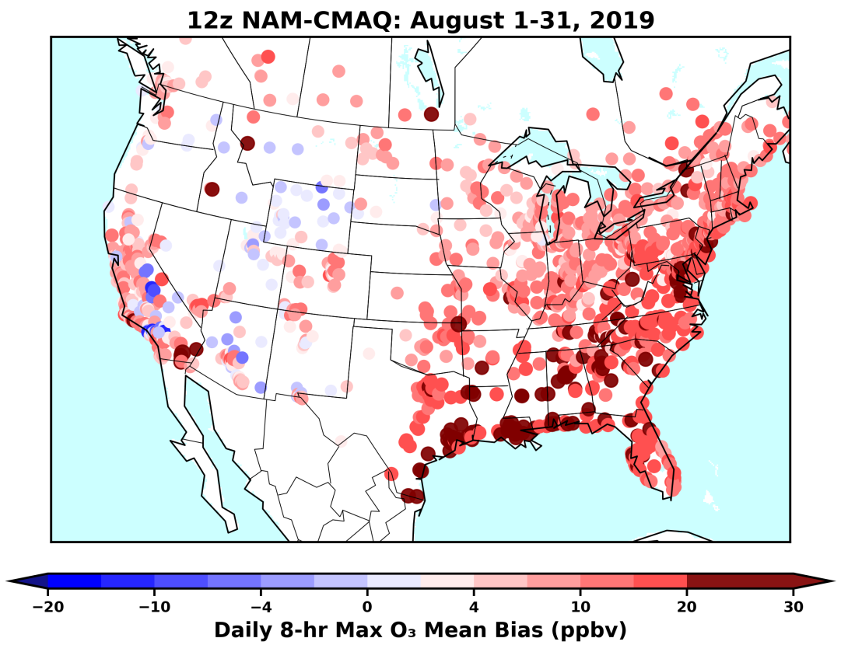
Performance of Ozone predictions: Daily 8 hr max mean bias, August 2019

Slide 11
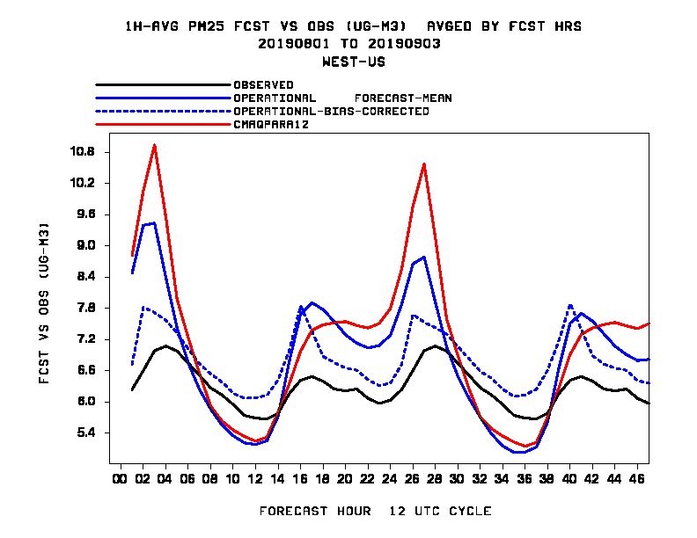
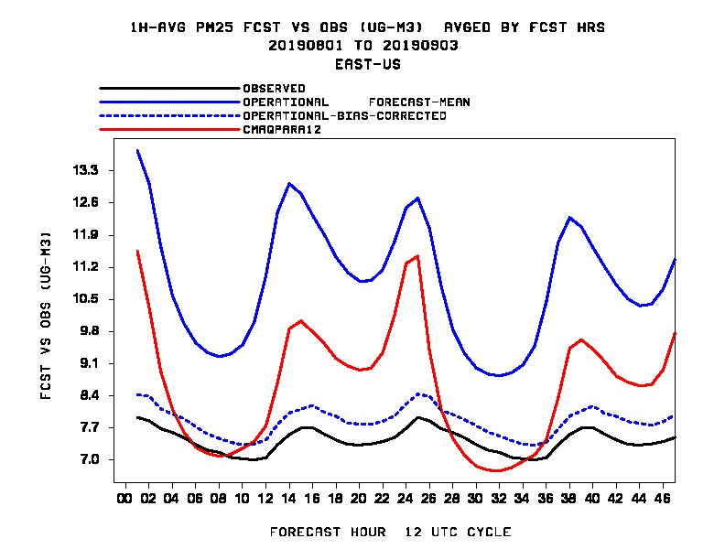
Performance of PM predictions: Observed Vs predicted 1 hr averaged Diurnal variability, August 2019

Slide 12
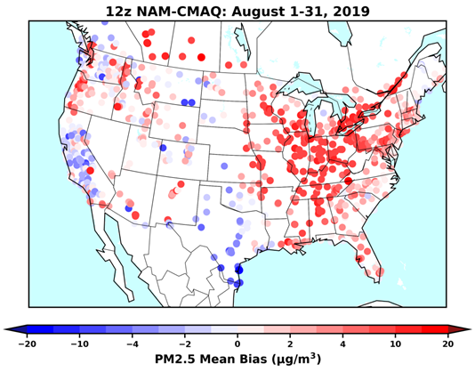
Performance of PM predictions: 1 hr daily max PM2.5 August 2019 Monthly Average Bias

Slide 13
NAQFC Future updates and work in progress
Couple and drive CMAQ with FV3GFS, NOAA’s Next Generation Global Prediction System.
Extend the range of CMAQ predictions from 48 hours to 72 hours
Including the KFAN/Bias corrected products
Updates to fire emission scheme (Global Biomass Burning Emissions Product eXtended (GBBEPx)
Use of GEFS-Aerosols for lateral boundary conditions
Develop new probabilistic forecast product for ozone and PM2.5
Working on initiating display of operational PM 2.5 products on NWS websites and ozone bias correction on GIS web services

Slide 14
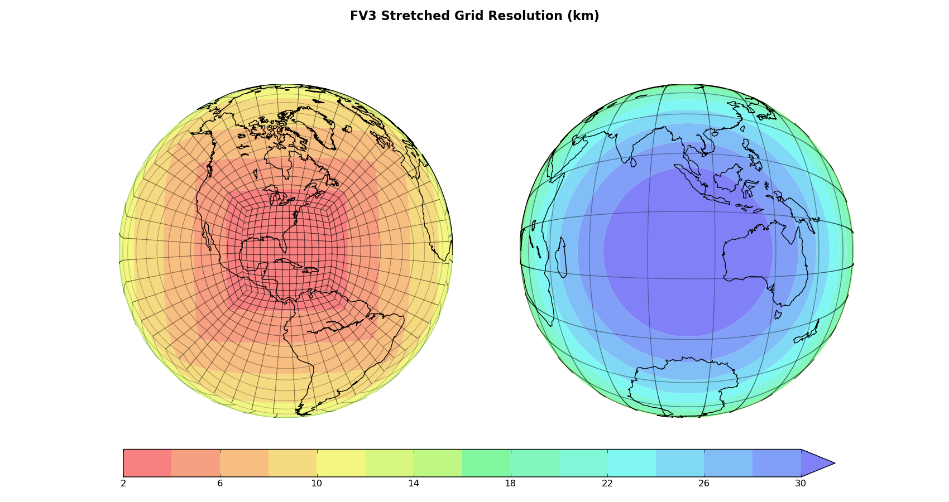
Transitioning to FV3GFS-CMAQ
The new dynamic core, Finite-Volume on a Cubed-Sphere (FV3)
NOAA next generation global prediction system
Allows for higher resolution and extension of weather forecast through 14 days
Implemented last June
noaa.gov

Slide 15
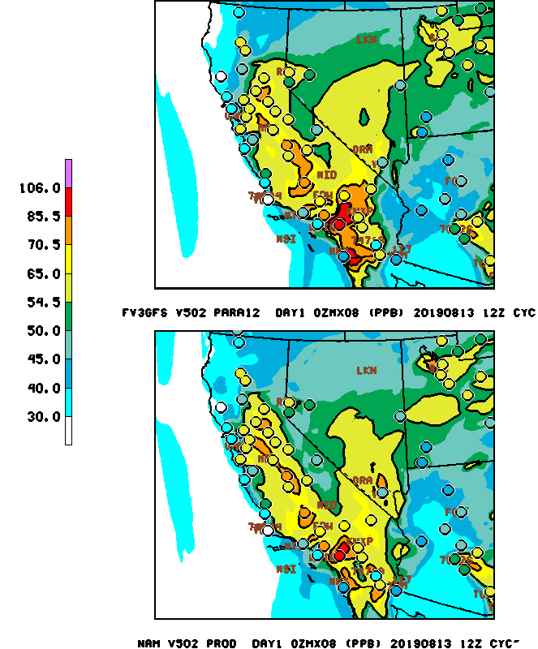
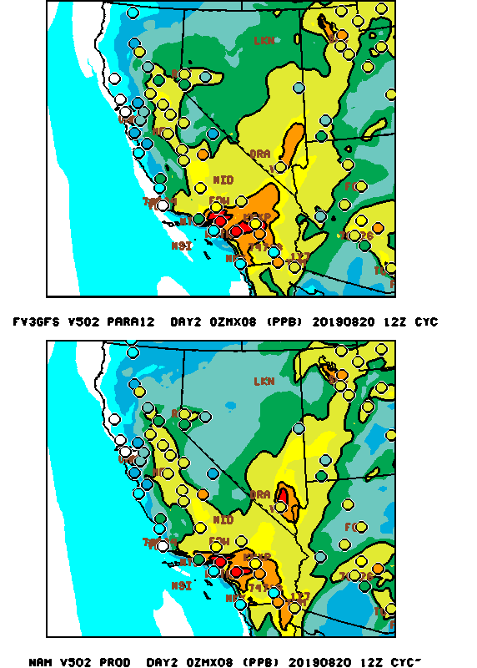
CMAQ Ozone driven by FV3GFS 13 km
FV3 and operational predictions are similar

Slide 16
8 hr daily max Ozone (day 1) August 2019 Monthly Average Bias
NAM driven
FV3GFS driven
Both models over predict Ozone, for FV3-CMAQ in SE and Mid-Atlantic slightly larger over prediction
Jianping Huang, EMC
Benjamin Yang, PSU
Notes:
over prediction but for FV3 in SE and Mid-atlantic slightly larger overprediction

Slide 17
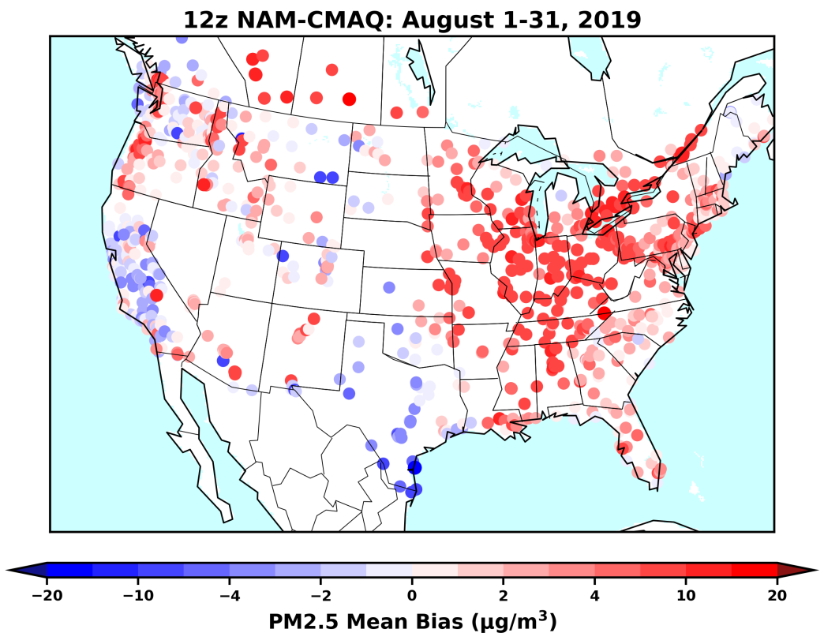
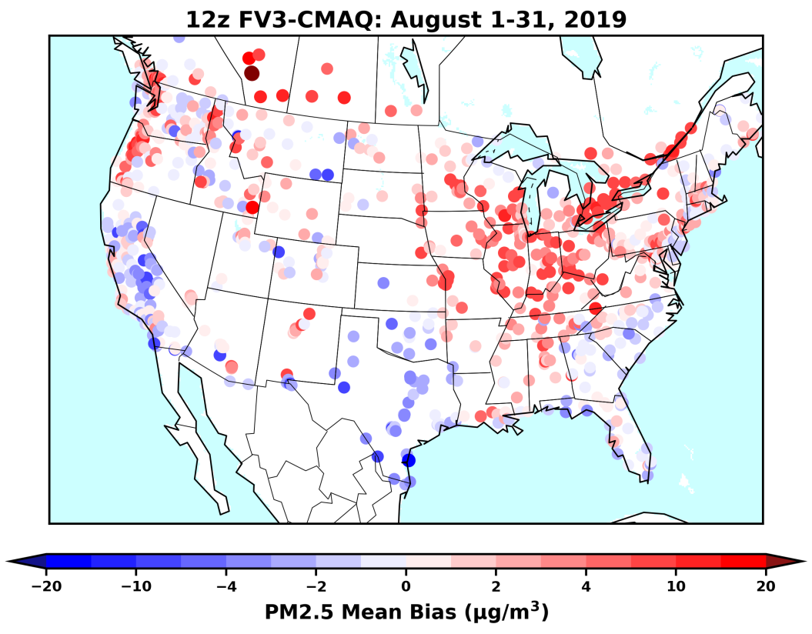
1 hr daily max PM2.5 August 2019 Monthly Average Bias
Both models over predict PM over north
FV3-CMAQ: under prediction over south
Jianping Huang, EMC
Benjamin Yang, PSU

Slide 18
Global Biomass Burning Emissions Product eXtended (GBBEPx)
Currently also testing a new fire emissions scheme with FV3GFS-CMAQ
GBBEPx calculates biomass burning emissions from wildfires using the Fire Radiative Power (FRP) derived from satellites.
Uses observations from MODIS, VIIRS and Geostationary satellites like GOES
Developed by NOAA, NESDIS and scientist from NASA and South Dakota State University
Currently testing 2 configurations in near real time and a retrospective run from last year’s Camp fire event in California
We also participated in this year multiagency Fire Influence on Regional to Global Environments and Air Quality (FIREX-AQ) field campaign and will be using the data to evaluate our system

Slide 19
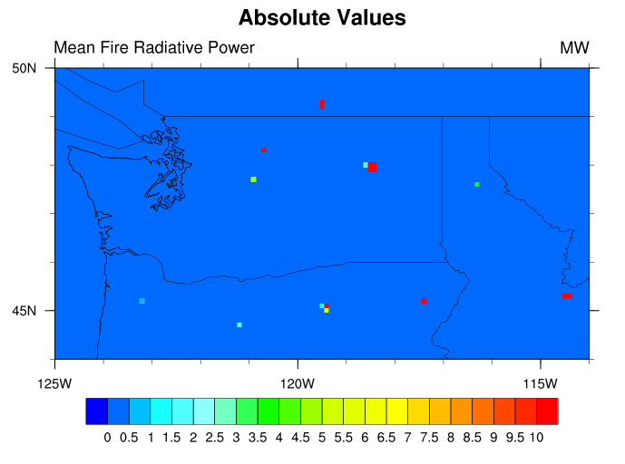
Case study
GBBEPx Mean Fire Radiative Power
Williams Flat Fire
August 7, 2019
Williams Flat Fire
August 7, 2019
Image credit: NASA
Suomi NPP satellite natural-color image using the VIIRS (Visible Infrared Imaging Radiometer Suite)

Slide 20
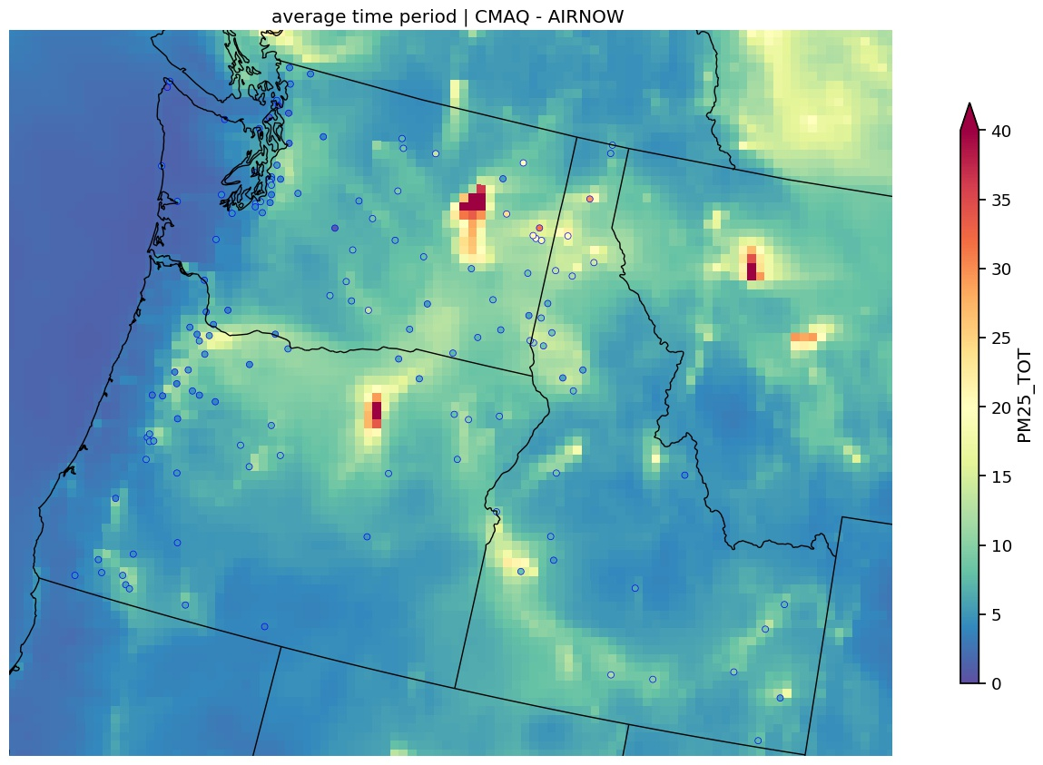
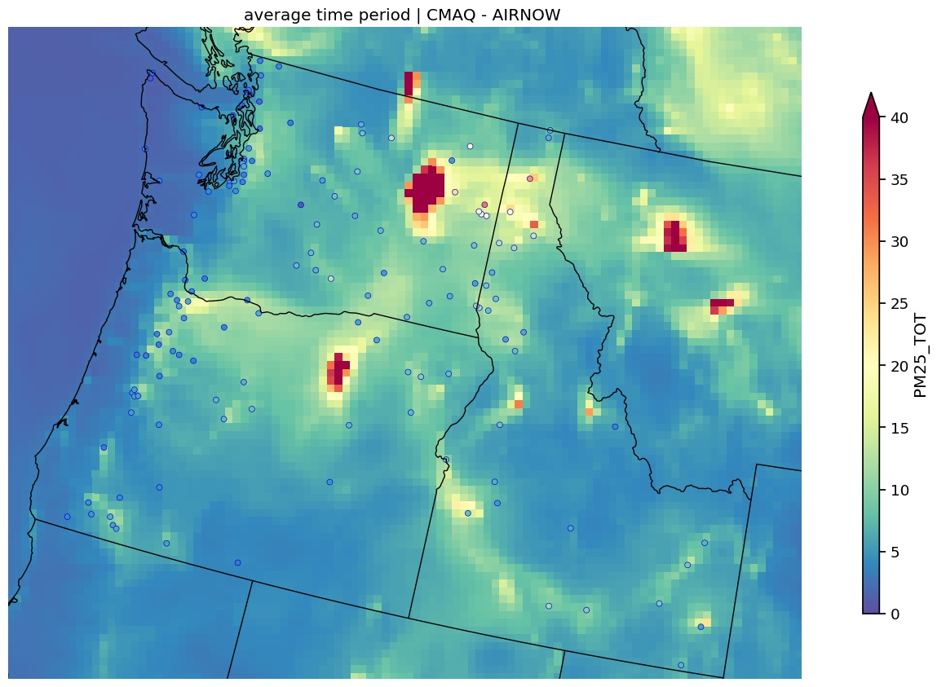
CMAQ-AIRNOW PM_{2.5} Evaluation - Region 10
Exp#2
Exp#4
Average of 24-hr forecasts for 2019-08-06_13 to 2019-08-08_12
ARL AQ team, Experimental product

Slide 21
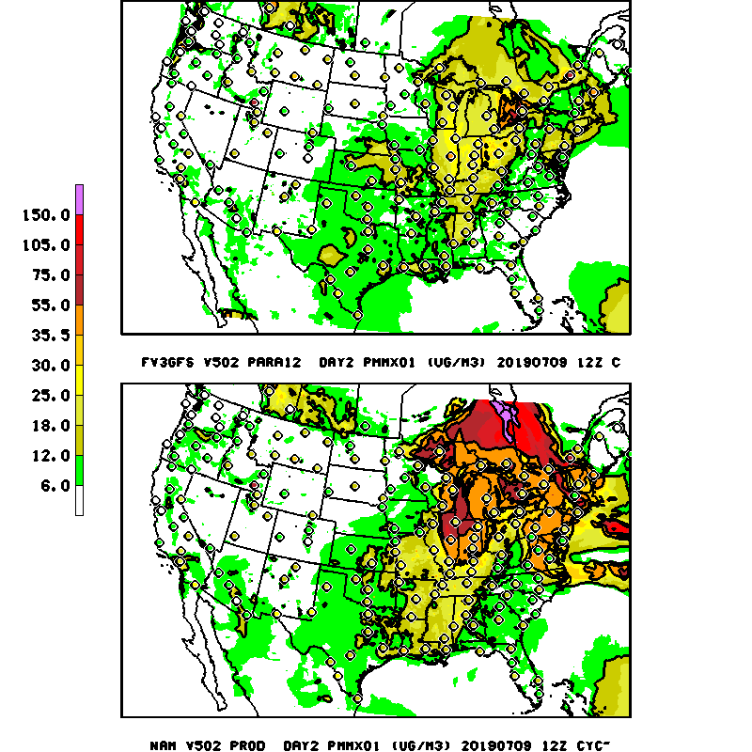
NAM vs FV3 fire cases
- Para12 GBx run performs best especially during fire events - FV3 runs under predict over SE away from fires

Slide 22
Probabilistic forecast
In collaboration with partners from NOAA Earth System Research Laboratory probabilistic forecast for Ozone and PM2.5 is being developed
The probabilities are calculated from a climatology first guess of previous CMAQ predictions and computed analogs from AirNOW observation sites around the nation.
The following are examples for Ozone > 50 ppbv and Ozone > 70 ppbv respectively

Slide 23
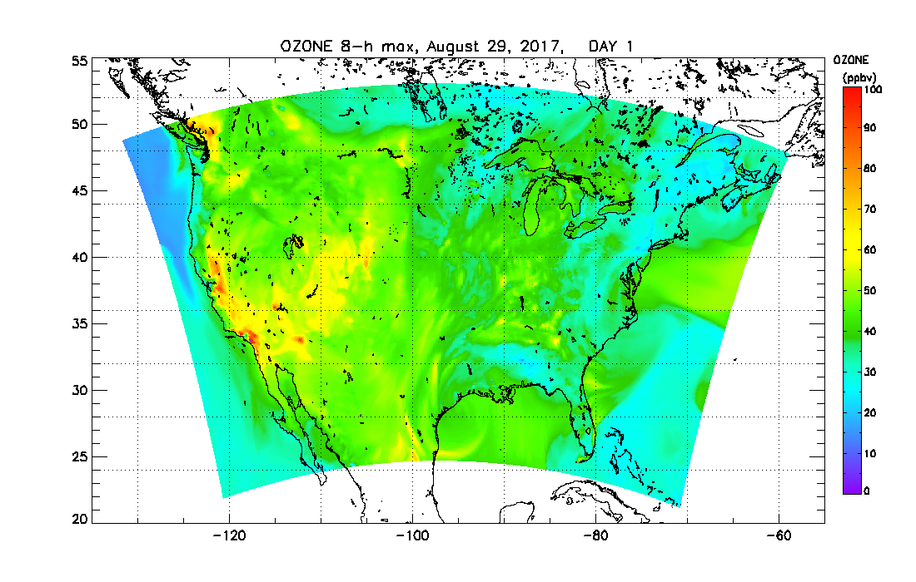
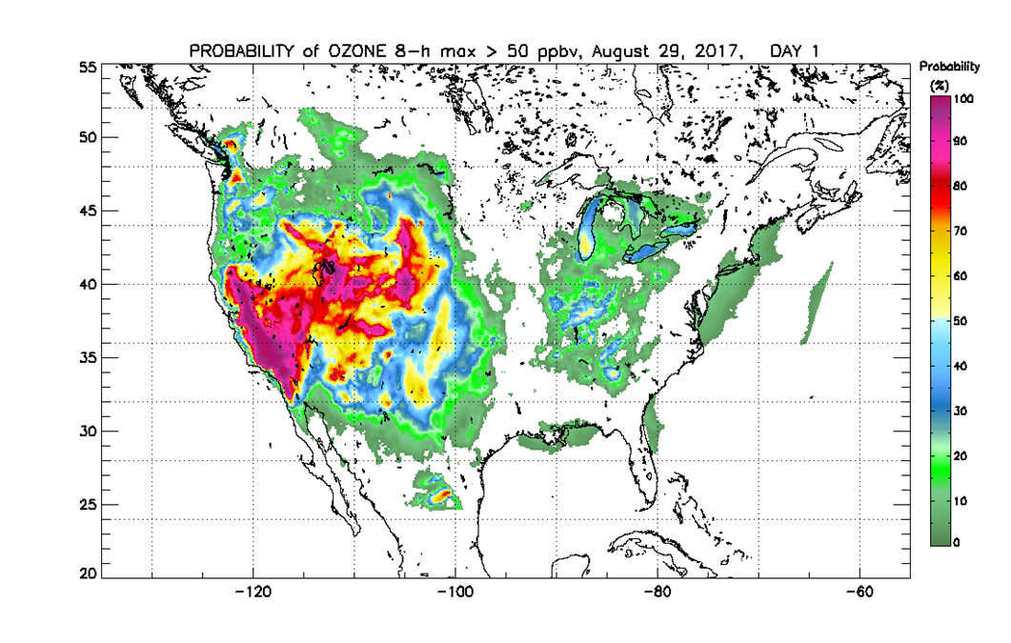
Ozone > 50 ppbv
CMAQ guidance
AirNow stations
Probability
James Wilczak & Irina Djalalova, ESRL
Experimental product

Slide 24
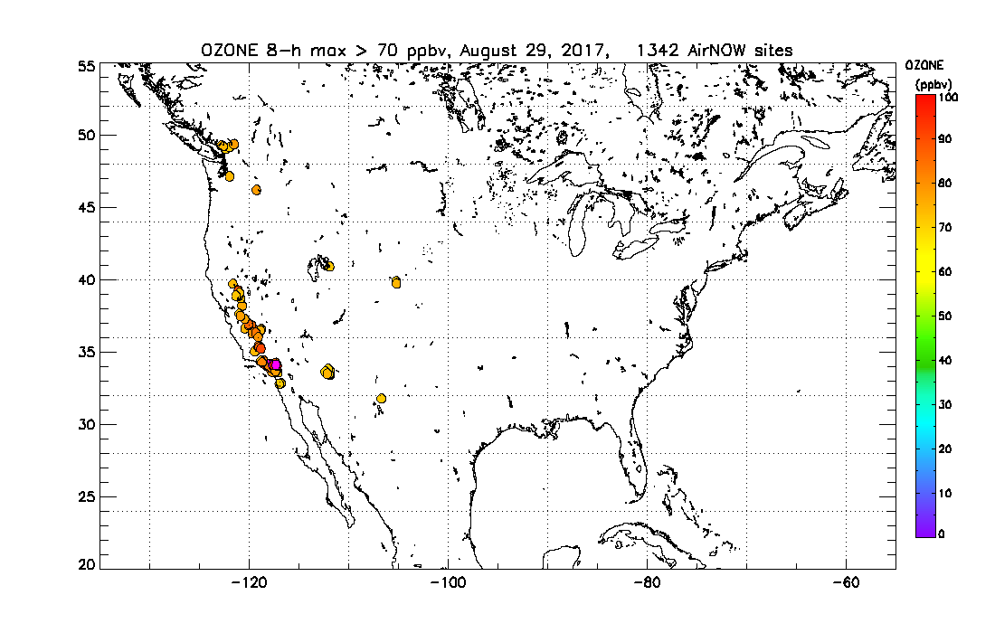
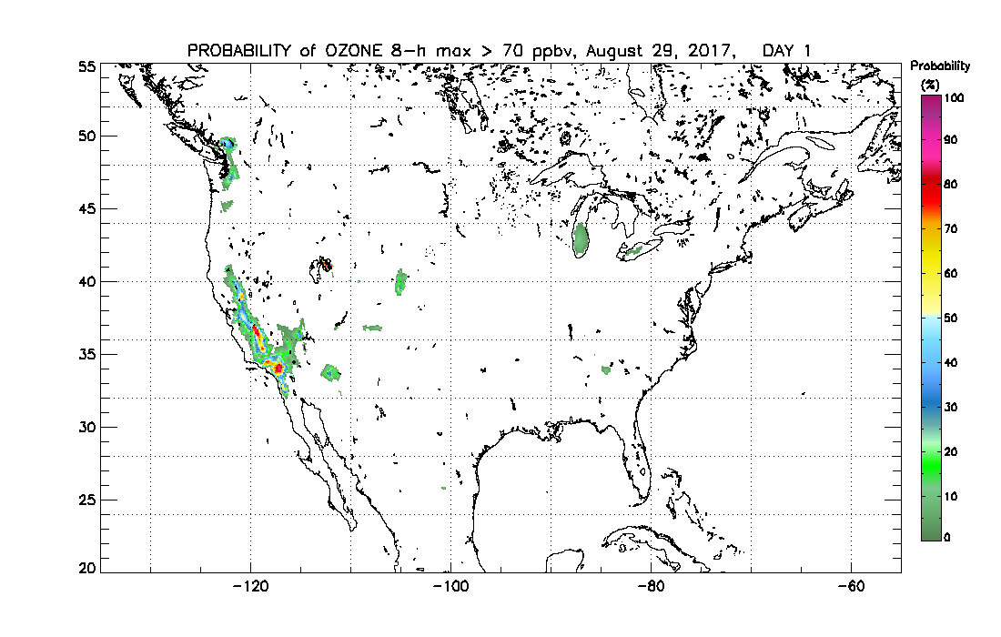
Ozone > 70 ppbv
AirNow stations
CMAQ guidance
probability
James Wilczak & Irina Djalalova, ESRL
Experimental product

Slide 25
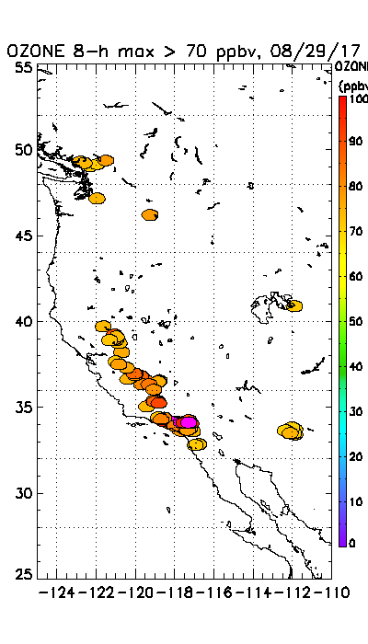
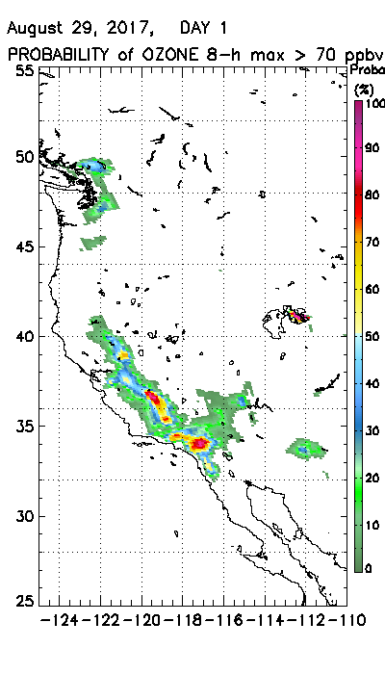

Slide 26
Summary
We provide real time hourly predictions of ozone, particulate matter, smoke and dust to the nation
Our work relies on a strategic partnership with the Environmental Protection Agency (EPA) and state and local air quality forecasters.
Our products are freely available online (airquality.weather.gov, others)
December 18 implementation:
New bias-corrected ozone predictions
Updated fine particulate matter (PM2.5) bias correction
Updated anthropogenic emissions from NEI2014v2
Updated Alaska and Hawaii domain CMAQ code to the same version used for CONUS
Work in progress:
Future improvements will include coupling of CMAQ with FV3GFS, extension to 72 hour predictions and new fire emissions processing

Slide 27
Thank you for your attention
Questions? Contact me @ jose.tirado-delgado@noaa.gov

Slide 28
Acknowledgments: AQF implementation team members
Special thanks to new and previous NOAA and EPA team members who contributed to the system development
NOAA/NWS/STI Dorothy Koch STI modeling program lead
NWS/OD Cynthia Jones Data Communications
NWS/OSTI/MDL David Miller, Dave Ruth Dev. Verification, NDGD Product Development
NWS/STI Jose Tirado-Delgado Program Support
NESDIS/NCDC Alan Hall Product Archiving
NWS/NCEP
Ivanka Stajner, Jeff McQueen, Jianping Huang, Ho-Chun Huang AQF model interface development, testing, & integration
Jun Wang, Li Pan, *Sarah Lu Global dust aerosol and feedback testing
*Brad Ferrier, *Eric Rogers, NAM coordination
*Hui-Ya Chuang, Perry Shafran, Boi Voung
Geoff Manikin Smoke and dust product testing and integration
Rebecca Cosgrove, Steven Earle, Chris Magee NCO transition and systems testing
Mike Bodner, Andrew Orrison HPC coordination and AQF webdrawer
ESRL/PSD
Jim Wilczak, Irina, Djalalova, Dave Allerud, bias correction development
NOAA/OAR/ARL
Pius Lee, Daniel Tong, Youhua Tang CMAQ development, adaptation of AQ simulations for AQF
Barry Baker, Patrick Campbell
Ariel Stein HYSPLIT adaptations
NESDIS/STAR Shobha Kondragunta Smoke and dust verification product development
NESDIS/OSDPD Liqun Ma Production of smoke and dust verification products
EPA/OAQPS partners:
Chet Wayland, Phil Dickerson, Brad Johns, John White AIRNow development, coordination with NAQFC
* Guest Contributors

