Slide 1
Development of a Fast Fire Emission Processor and Its application with HMS-Bluesky and GBBEPx Inventories
Youhua Tang^{1,2}, Daniel Tong^{1,2,3}, Pius Lee¹, Barry Baker^{1,2}, Patrick Campbell^{1,3}, Jeff McQueen⁴, Ho-Chun Huang^{4,5}, Li Pan^{4,5}, Jianping Huang^{4,5} , Jose Tirado^{6,7}, Shobha Kondragunta⁸, Xiaoyang Zhang⁹, and Ivanka Stajner⁴
1. NOAA Air Resources Laboratory, 5830 University Research Court, College Park, MD.
2. Cooperative Institute for Climate and Satellites, University of Maryland, College Park, MD.
3. Center for Spatial Information Science and Systems, George Mason University, Fairfax, VA.
4. NOAA National Centers for Environmental Prediction (NCEP), College Park, MD
5. I.M. Systems Group Inc., Rockville, MD
6. NOAA NWS/STI
7. Eastern Research Group, Inc (ERG)
8. NOAA NESDIS/STAR
9. South Dakota State University, Brookings, SD

Slide 2
WildFire Emission in current Operational NAQFC
USFS Bluesky
NOAA Hazard Mapping System (HMS)
Fire Emission Raw Inventory
Fire Emission Processor
Fire emission mapping to model grid
Calculate plume rise
Apply temporal profile
Apply speciation profile
Meteorological Inputs
Issues of this processor
Slow (take about 10 to 15 minutes for CONUS domain)
Take too many disk spaces
Codes/scripts not easy to manage or change
3-D Anthropogenic Emissions
Merge 3-D fire and anthropogenic emissions
NAQFC CMAQ run

Slide 3
Our solution to this process
Re-write a new processor to supply CMAQ PT emission for inline plume rise
All-in-one process which can one-step finish Smkinven, Temporal, Elevpoint, Spcmat …..
Have tunable namelist controlling the daily/diurnal profile for wildfire, prescribe/agriculture burning, and heat flux, respectically.
Have tunable parameters controlling species mapping
New fire emission processor
Fire Emission Raw Inventory
NAQFC CMAQ run
Anthropogenic Emissions
Meteorological inputs

Slide 4
Issues Related to Fire Emission Inventories
HMS-Bluesky
Bottom-up approach: Based on HMS provided fire locations, Bluesky calculates the fire emissions according to fuel loading database etc.
Pros: Need relatively few inputs, mainly just fire locations.
Cons: highly sensitive to these inputs without further constrains.
Global Biomass Burning Emissions Product eXtended (GBBEPx) (based on QFED and extended to VIIRS products)
Pros: The fire radiation power (FRP) based emission can be well constrained, depending on the tuning factors.
Cons: can only provide one snapshot per day based on polar orbiting satellites.

Slide 5
Biomass Burning Emissions from MODIS Fire Detections
-- Quick Fire Emission Dataset (QFED)
QFED:
MODIS FRP for various biome types (tropical forest, extratropical forest, savanna, and grassland)
Combustion factors obtained by comparing with Global Fire Emissions Database (GFED) product
Fire emissions are calculated from FRP flux and combustion factors
Fire emissions are tuned using scaling factors that are calculated by comparing GFS-GOCART-modeled AOD (fire emissions as input) with MODIS observed AOD.
Finally, QFED product at 0.25x0.3125 degree is merged from Terra and Aqua daily fire emissions of BC, OC, SO₂, CO, CO₂, PM2.5
Darmenov, A., and da Silva, A. 2013, The Quick Fire Emissions Dataset (QFED) - Documentation of versions 2.1, 2.2 and 2.4, In M. J. Suarez (Editor), Technical Report Series on Global Modeling and Data Assimilation, Volume 32.

Slide 7
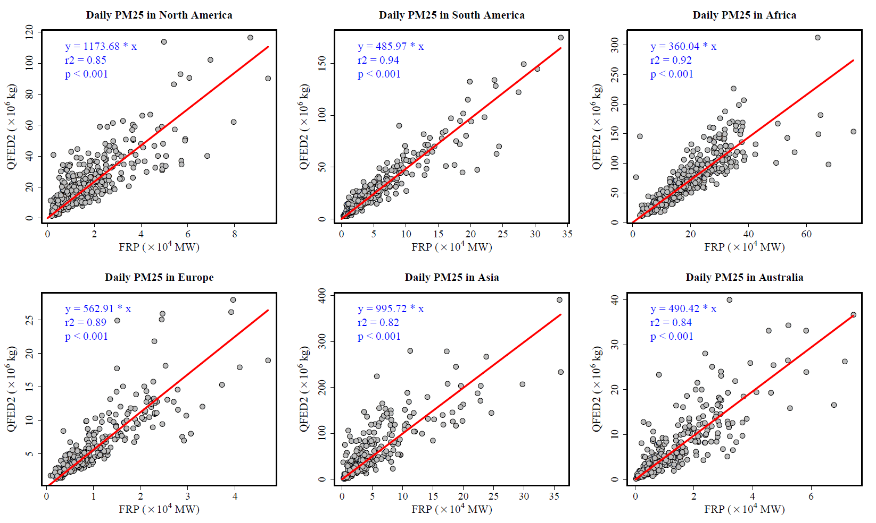
Correlation Model between VIIRS 750m FRP and Fire Emissions from QFED (April 2016 - March 2017)

Slide 8
Emissions Coefficients (kg.MJ⁻¹) for Fire Emissions Estimation from VIIRS FRP Flux
 | CO2 | CO | PM2.5 | OC | BC | SO2
NA | 61350 | 3278 | 1174 | 802 | 61.5 | 86.9
SA | 53189.4 | 2551 | 486 | 298 | 37.4 | 31.7
AF | 43197.3 | 2017 | 360 | 219 | 28.9 | 23.2
EU | 69339.4 | 2925 | 563 | 367 | 42.1 | 38.6
AS | 46529.3 | 2657 | 996 | 677 | 51.2 | 73.7
AU | 71027 | 2958 | 490 | 311 | 40.7 | 32.4
NA—North America; SA—South America; AF—Africa; EU—Europe; AS—Asia; AU--Australia

Slide 9
Other Issues Related to Implementing the GBBEPx Emission in CMAQ
Plume Rise: CMAQ uses Briggs scheme to calculate plume rise, which needs heat flux and burned area.
GBBEPx provides the FRP, which can be used to estimate the heat flux. We have a tunable ratio for converting FRP to heat flux (Frankman, D., et al. "Measurements of convective and radiative heating in wildland fires." International Journal of Wildland Fire 22.2 (2013): 157-167.))
Burning area: currently we applied a fixed ratio: 10% of gridded area
Fire duration: Duration is determined by the forest fraction (Deciduous Broadleaf Forest+ Deciduous Needleleaf Forest + Evergreen broadleaf Forest+ Evergreen Needleleaf Forest + Mixed Forest). We only process the grid with the forest fraction > 0.4
Daily Variation Ratio: 1 for day one, 0.25 for day two and after.
Diurnal Variation: SMOKE wildfire diurnal profiles
Speciation: SMOKE wildfire speciation profiles

Slide 10
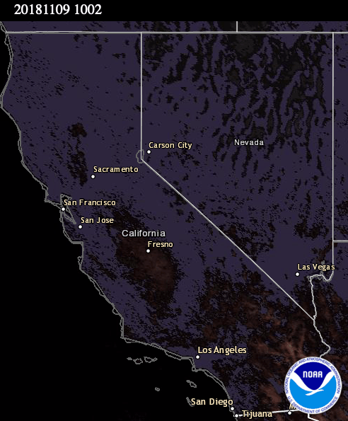
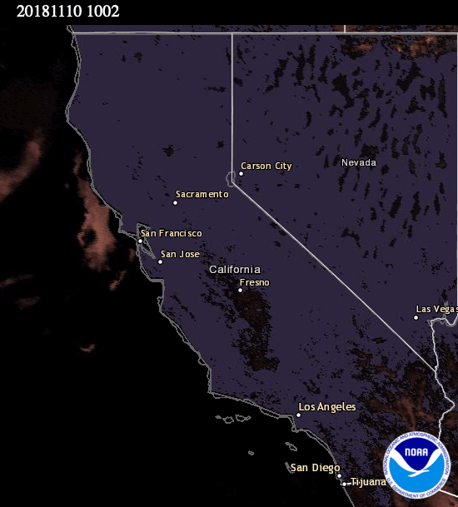
GOES-R Fire Observations
Nov 9, 2018
Nov 10, 2018
(Source: NOAA AerosolWatch)

Slide 11
Fire Detection from Polar Orbiting Satellite
MODIS-Terra
MODIS-Aqua
VIIRS-SNPP
10:30AM
1:30PM
1:30PM

Slide 12
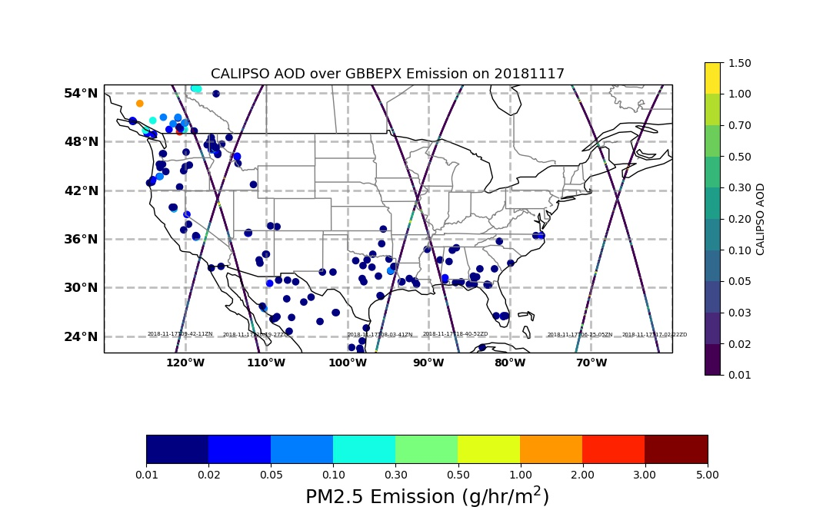
Verify the Plume Rise using CALIPSO Lidar data: a case of 2018 California Fire

Slide 13
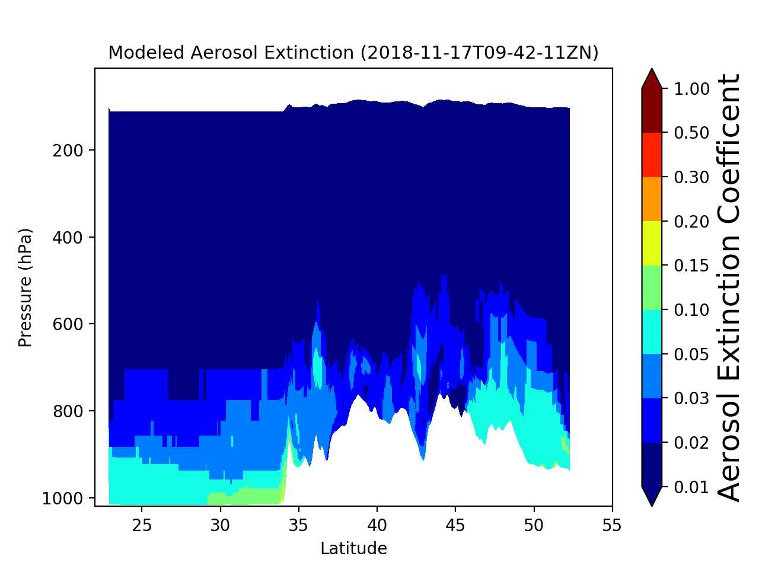
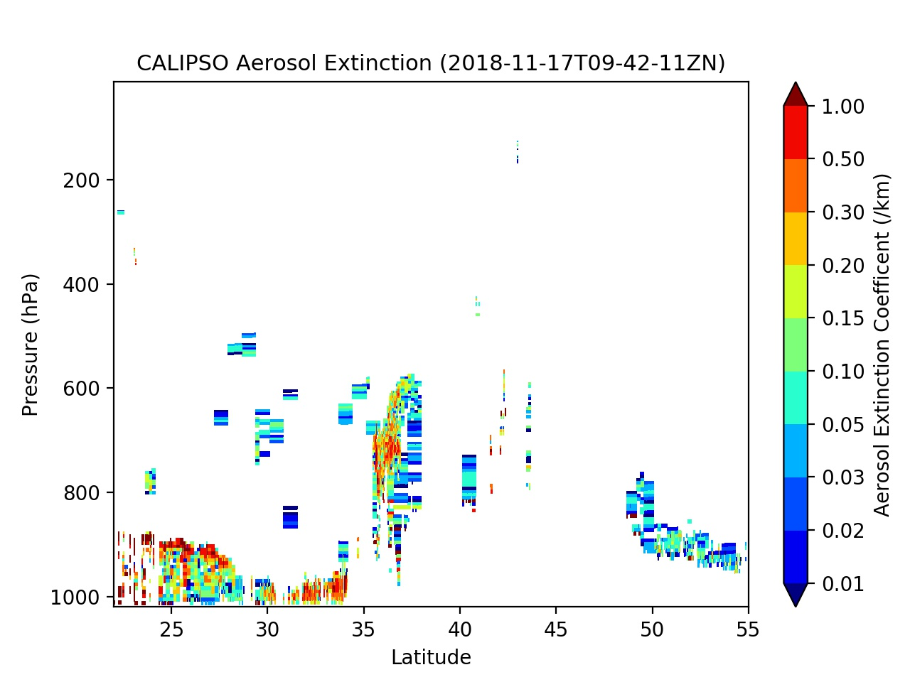
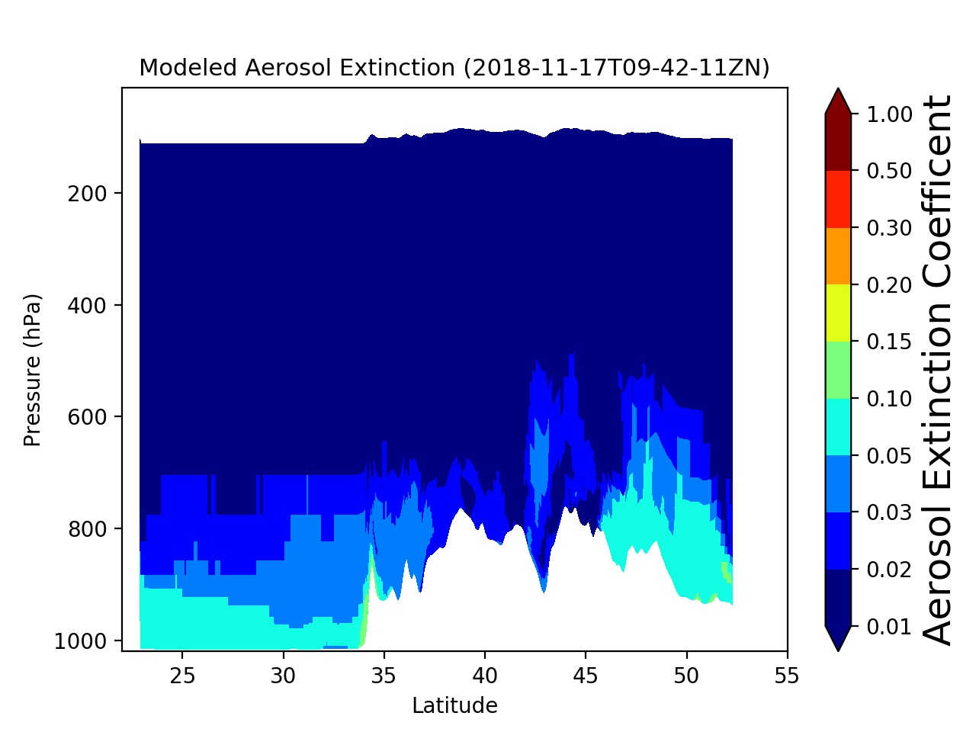
Fire case
The fire case shows the risen plumes and near-surface increment
Nofire case has the aerosols capped within the PBL
Fire case with 0.5 Heat Flux
Nofire case
Calipso aerosol extinction @532nm is converted from that @1064nm
assuming Ångström component is 2 for fire plumes (Moritz Haarig et al., Atmos. Chem. Phys., 18, 11847-11861, 2018)

Slide 14
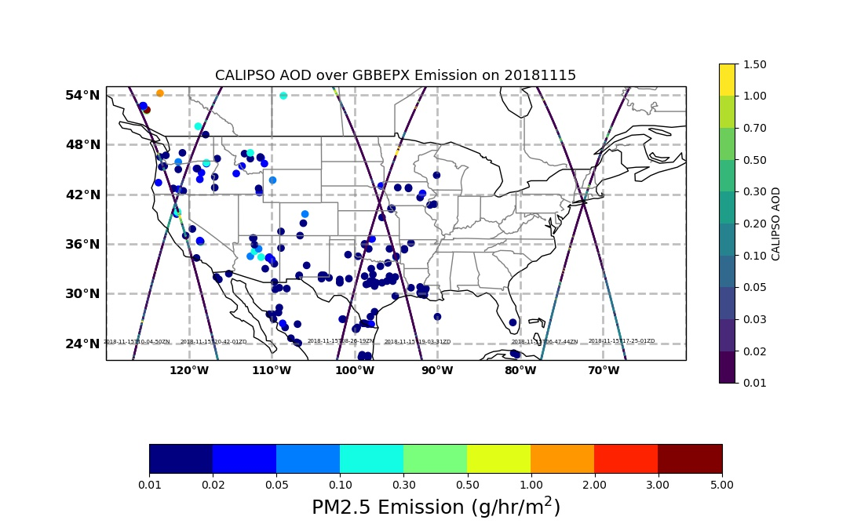
Verify the Plume Rise using CALIPSO Lidar data: a case of California Fire on 11/15/2018

Slide 15
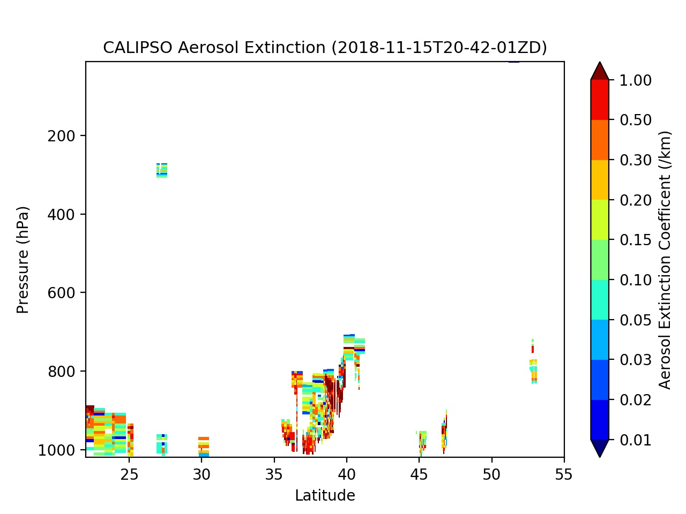
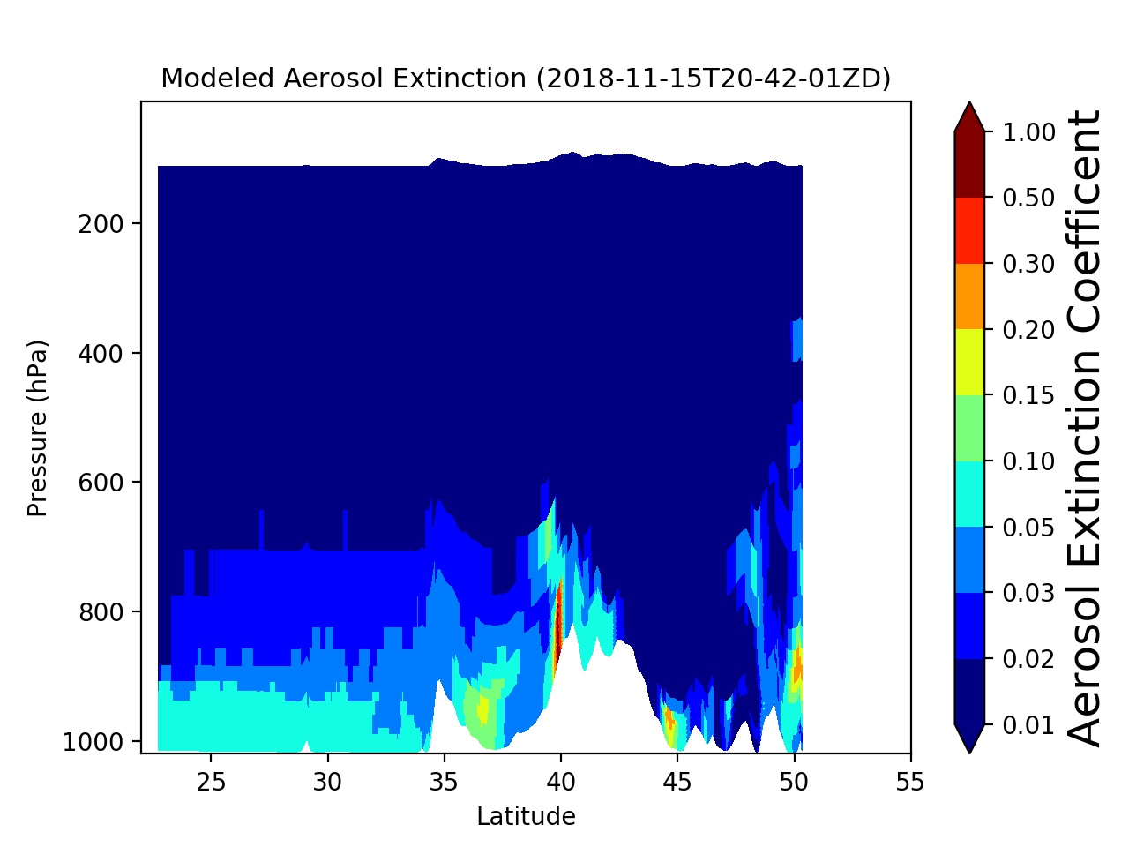
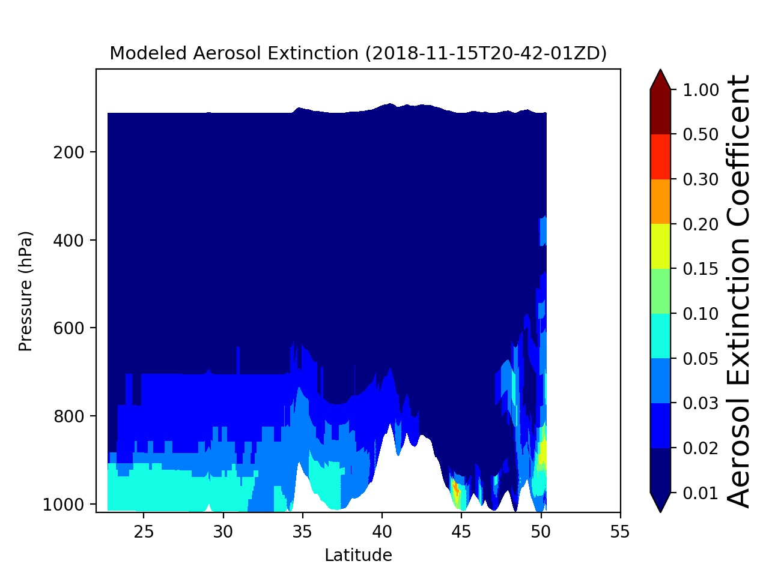
Fire case
Nofire case
Fire case with 0.5 Heat Flux

Slide 16
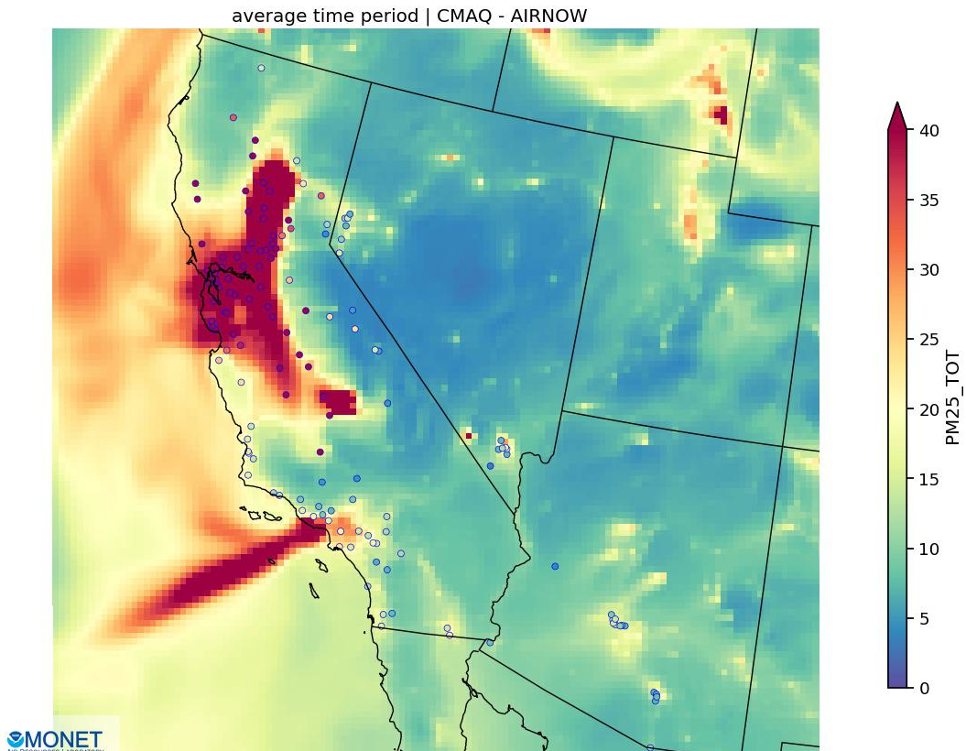
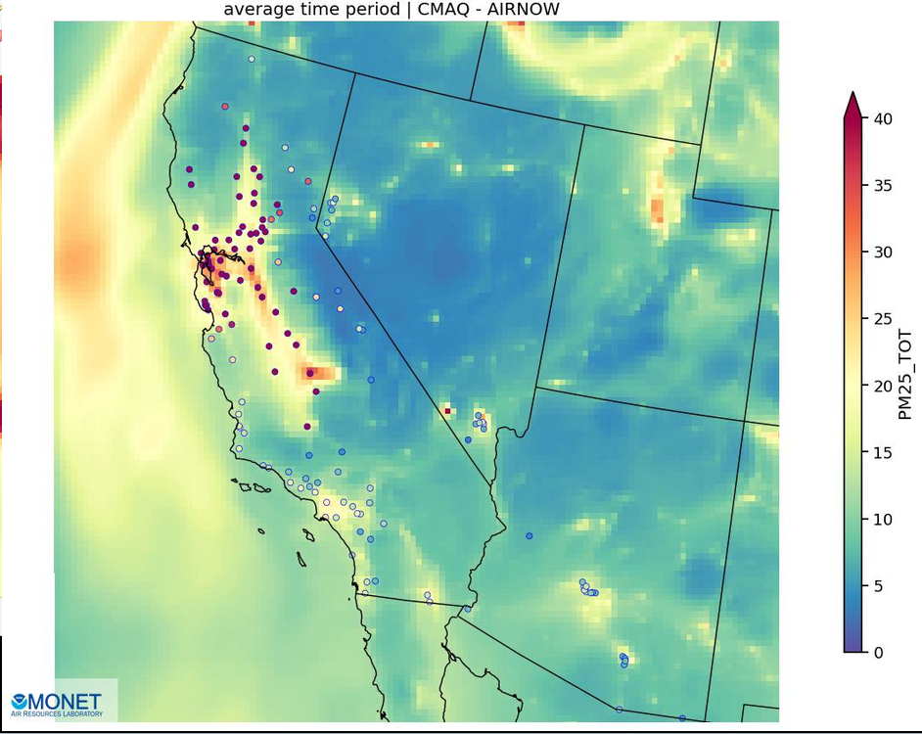
GBBEPx VS. nofire simulation results averaged for Nov 8-26 (R9 DAY1 statistics)
Notes:
These plots are PM2.5 concentrations averaged over the 19 days simulated with corresponding obs overlaid --- significant improvement

Slide 18
The fire duration treatment did not degrade the later-day performance

Slide 19
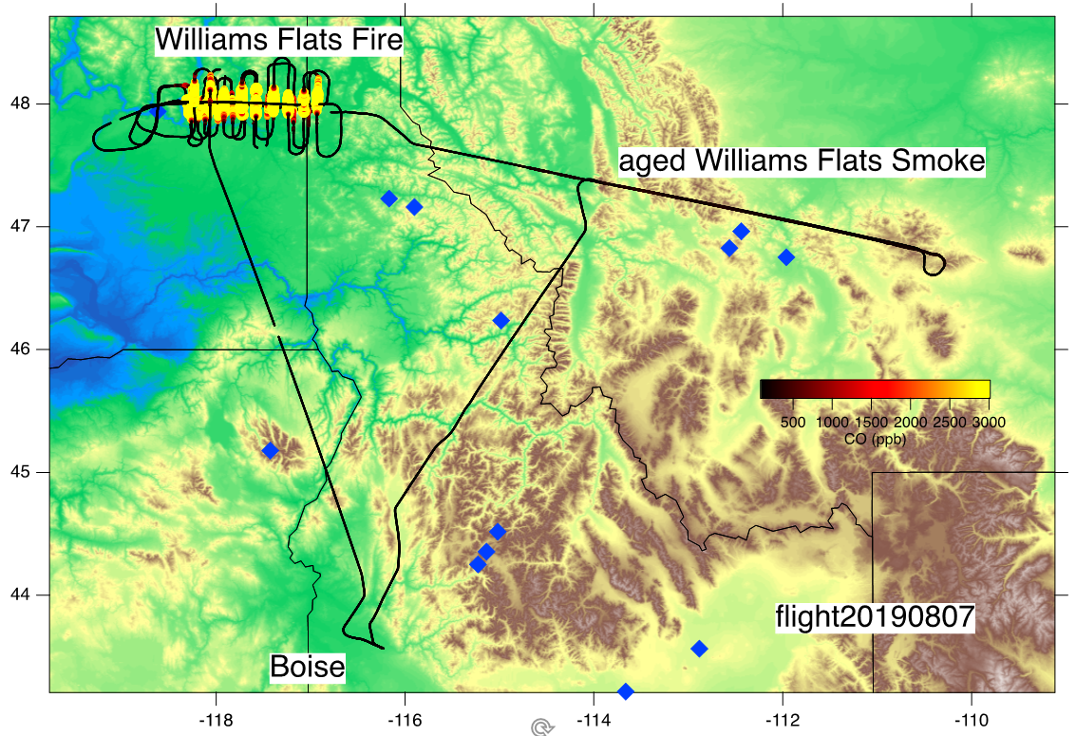
FireX-AQ 2019 Science Flight #8: DC8 Flight Legs and CO
Notes:
Mission Science Report:
FIREX-AQ flight20190807
Objective: aged and fresh smoke from Williams Flats Fire
After a flight leg over Cascade Reservoir, to enable a MASTER calibration, we headed in the direction of the Snow Creek Fire to find and sample the one-day old smoke from the Williams Flats Fire, which was seen on GOES in the same area. We never sampled the Snow Creek Fire.
Aged smoke from the Williams Flats Fire was forecast by all models and clearly visible in the satellite pictures. When approaching station, a widespread smoke plume in the boundary layer was clearly visible as predicted. We lined up along the axis of the plume traveling east for a remote sensing overpass and decided that 12kft was a good altitude to stay in the smoke. We returned on the same line west at 12kft and stayed in the aged smoke for about 45 minutes on our way to the Williams Flats Fire.
Fresh smoke from the Williams Flats Fire was the focus of the rest of the mission. We approached the plume from the downwind side and started with a high remote sensing overpass at 24kft and determined that the plume was very thick and decided the best altitudes were between 12-16kft. We started the pattern at 12kft with an upwind pass and lawn mowing in a very thick, wide and intense plume. The smoke plume was at higher altitudes further away from the fire and therefore the seventh and eight transects were at 13kft and the ninth and tenth at 14 kft. The later transects were also spaced wider so we could reach the end of the plume without spending too much time. After that first pattern we climbed to 27kft to get a remote sensing overpass over the highest part of the plume and also over parts of the pyroCu. The second pattern was done at a higher altitude at 16kft to determine, if the light attenuation and therefore the chemistry was different higher up in the plume. This second pattern had one upwind and 9 in plume downwind transects and went as far as the chimney of Idaho all at 16kft. Throughout this pattern even at the furthest downwind transects the mixing ratios of inert tracers such as CO did not decrease, even though chemistry was clearly observed by increases of secondary species, including formaldehyde. After the end of this pattern we did another remote sensing overpass at 27kft.
After that we just had enough time to do two more close in passes through the smoke to check, if the emissions had changed during the past 1.5 hours. After that the DC-8 returned to base.

Slide 20
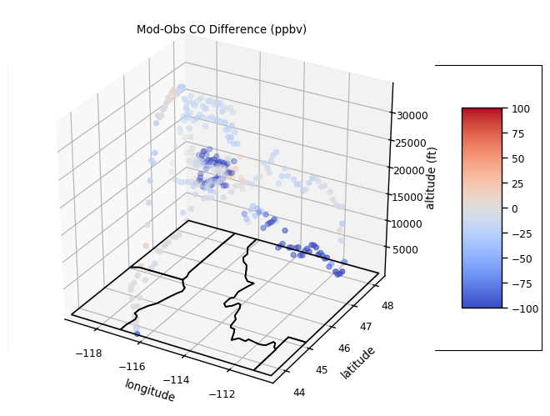
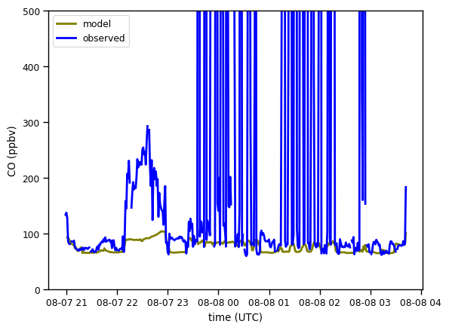
Comparisons of Model and DC8 Observed CO
Diskin, Glenn S.
NASA Langley Research Center
DACOM: Diode laser spectrometer measurements of CO, CH4
NASA FIREX-AQ Mission 2019
ASSOCIATED_DATA: DC-8 Nav data
INSTRUMENT_INFO: Diode Laser Spectrometer measurements of CO and CH4
Notes:
Plots are 4D interpolation, in x,y,z,t. In a sense they are model comparisons following the position of the aircraft in space and time.
Model is currently Experiment #2, using GBBEPx-NGAC-VIIRS NLBC.

Slide 21
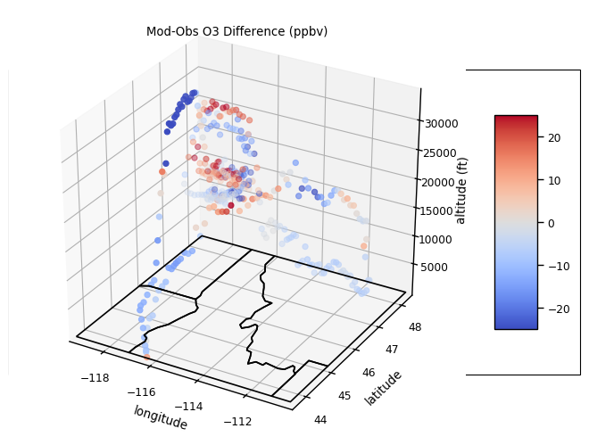
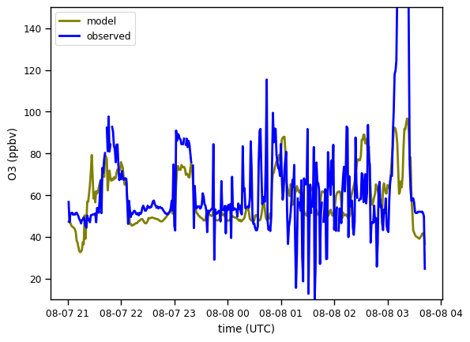
Comparisons of Model and DC8 Observed O₃
Tom Ryerson, Ilann Bourgeois and Jeff Peischl
NOAA ESRL Chemical Sciences Division
NOyO3: O3 measurement
ASSOCIATED_DATA: DC-8 Nav data
INSTRUMENT_INFO: Nitric-oxide-induced chemiluminescence for ozone
Notes:
Plots are 4D interpolation, in x,y,z,t. In a sense they are model comparisons following the position of the aircraft in space and time.
Model is currently Experiment #2, using GBBEPx-NGAC-VIIRS NLBC.

Slide 22
Summary
We developed a fire emission processor which can quickly convert the fire inventories (Bluesky and GBBEPx) to CMAQ ready-to-input PT files.
It is a little bit challenging to verify the fire emissions. Besides the emission inventory (time, location, and emission strength), there are issues about FRP-derived heat flux, plume rise, fire duration, and its temporal variation. The other settings of the model, including resolution and meteorology, could also affect the results.
The existing scheme for GBBEPx shows the overall reasonable performance, though it still needs further tuning.

