Slide 1
“What to expect from the 18th CMAS Conference”
B.H. Baek, Institute for the Environment

Slide 2
New Conference Event Manager!
By “Zoho Backstage”
Ability to bookmark your interested presentations on the agenda after signing in
Create your own agenda with notification
Follow announcements from the organizers during the Conference
Mobile App (“Zoho Backstage”) or Mobile Web Browser (https://cmas.zohobackstage.com)
Add bio and photo!
Connect with other attendees

Slide 3
Job and Career Fair!
When: 3:30 p.m. on Wednesday, October 23
Where: Main Atrium
Two Job posting bulletin boards by the registration desk
Day 1 – 3: Check out the list of openings before the Job Fair!
Day 3: Job and Career Fair
A section will be provided for company representatives
Companies include:
UNC-Chapel Hill, Sonoma Technology Inc., Abt Associates, Blowfish, University of Central Florida, GDIT, Tsinghua University, The Hong Kong University of Science and Technology, and more

Slide 4
Research-Discussion Tables
When: 5-7p.m. Poster/Reception on Tuesday, October 22
Where: Main Atrium
Six cocktail tables with research subjects
Each table with research subject-experts
Research Subjects are:
Model Development
Exposure and Health Modeling Studies
Emissions Inventories, Models and Processes
Regulatory and SIP Applications
Air Quality, Climate and Energy
Remote Sensing Technology

Slide 5
Poster Lightening Talks
When: Monday and Tuesday, October 21 and 22
Where: Grumman
Day 1: 3:30 – 4:00 p.m. (30 minutes)
Day 2: 4:15 – 5:00 p.m. (45 minutes)
All poster presenters will have a chance to show their work
Come close to the Grumman podium
Limited to 1 minute
Submit one slide ASAP if you desire to share

Slide 6
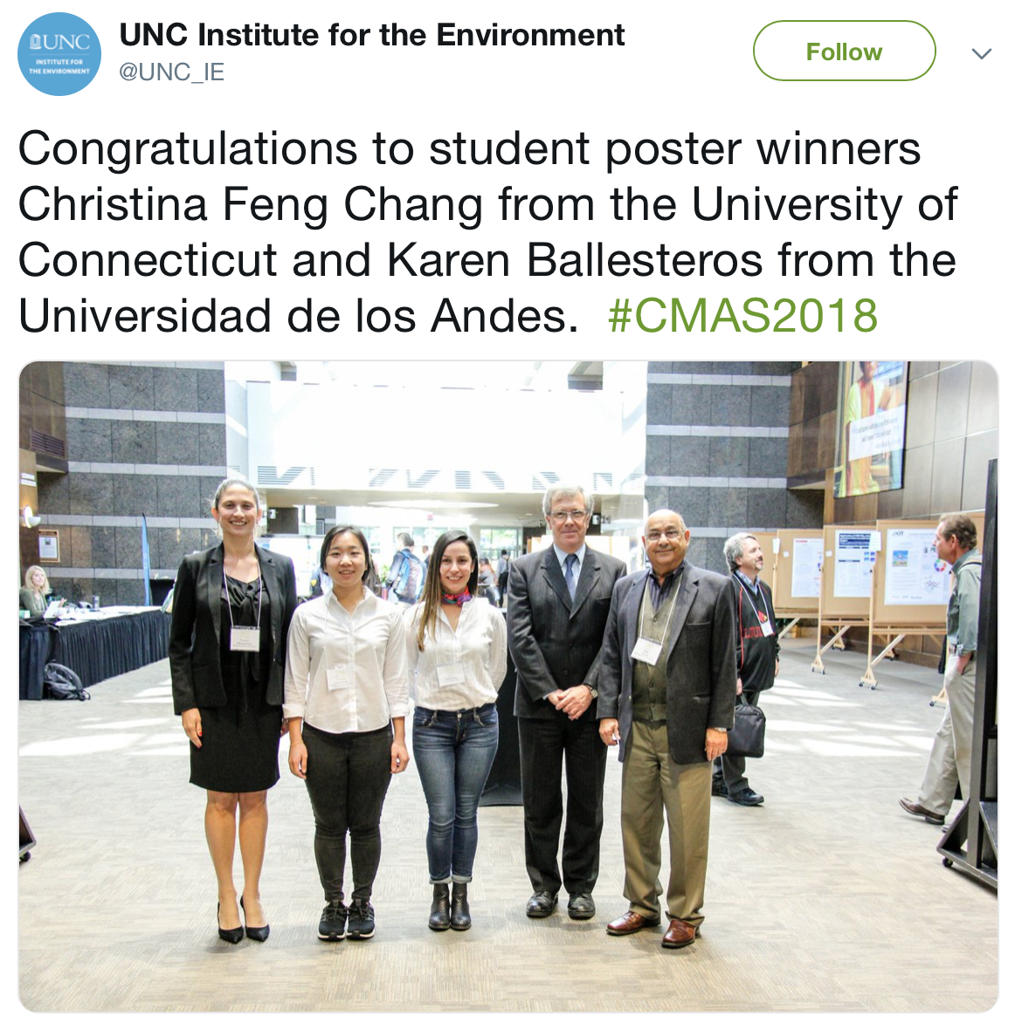
Student Poster Presentation Awards
When: Wednesday, October 23
Where: Main Atrium
Student Poster presenters will give 5 minutes presentations to the CMAS Eternal Advisory Committee (EAC) members
The EAC member will have Q&A with student presenters
Winners will be announced on Day 3
Two student winners have a chance at winning an iPad 7th Generation (128GB)

