Slide 1
Impact of using detailed-level marine emissions on Canadian Air Quality
Environment and Climate Change Canada (ECCC)
Air Quality Policy-Issue Response Section (REQA)
Rabab Mashayekhi
Mourad Sassi
Calin Zaganescu
Radenko Pavlovic
Integrated Transportation Policy Section
Navin Sundar

Slide 2
Motivations
13% of total NOX emissions in Canada are from Commercial Marine Vessels.
Improve SMOKE inputs for Canadian marine emissions:
Emissions inventory files
Spatial and temporal allocations files
Evaluate the impact of point sources marine emissions on air quality.

Slide 3
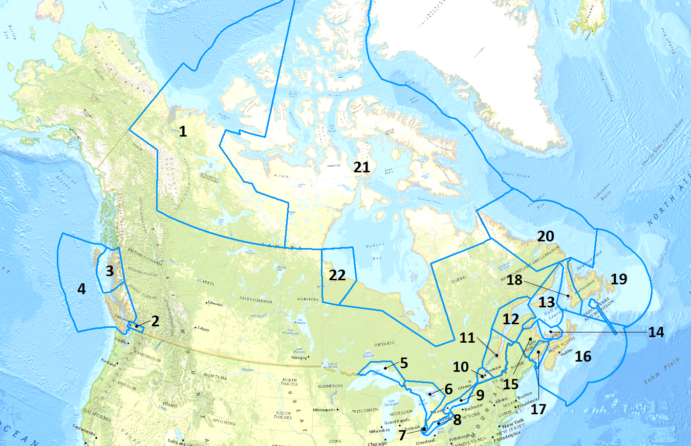
Canada’s Marine Emissions Inventory Tool (MEIT 2015)
Developed by Transportation section of ECCC.
Bottom-up, activity-based inventory.
All marine vessels operating in Canadian waters. (15 ship classes; 69 sub-class)
High temporal, spatial resolution (1-km gridded, linked-based).
Allocated in 22 MEIT regions.

Slide 4
SMOKE-Ready Inventory
1-km aggregated to 3-km.
69 ship types aggregated to 15 ship classes.
Mapped in SCCs (ship class, fuel type and operating mode).
Link-based hourly data aggregated to monthly emissions.
Assigned stack parameters (height: 20m, diameter: 1m, velocity: 20m/s, temperature:275C).
Two types of inventory files (point and area).
15 surrogates generated for each ship class (using annual fuel consumptions)

Slide 5
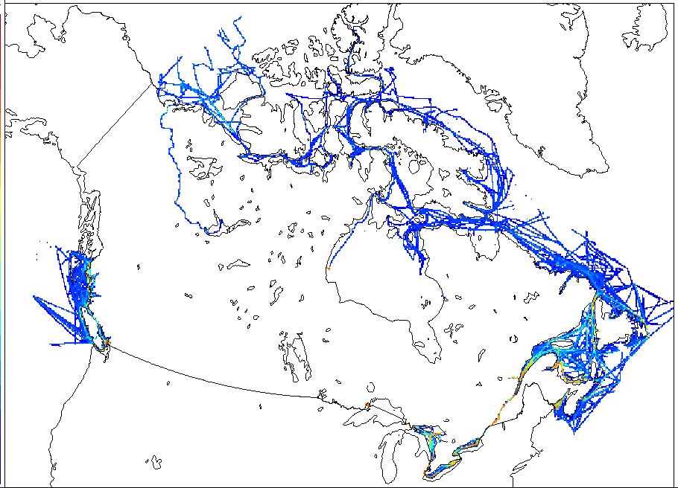
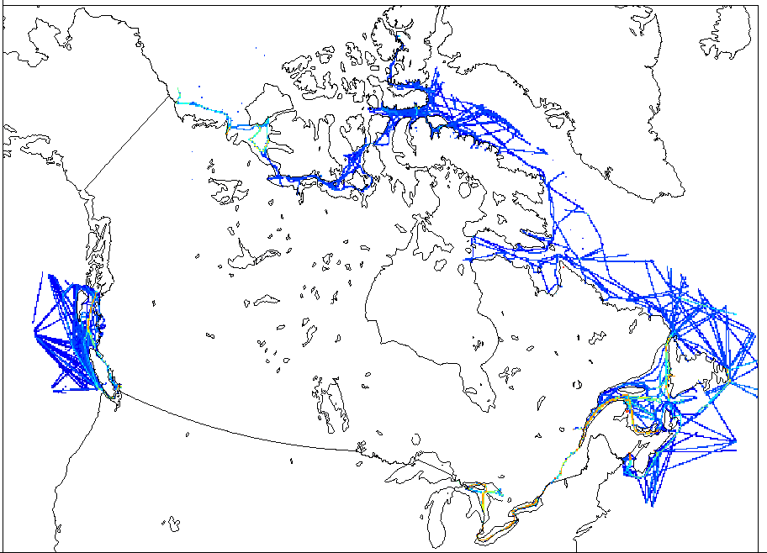
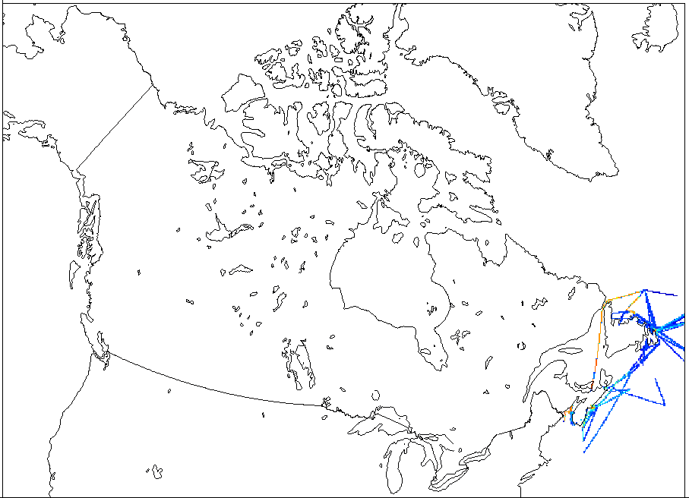
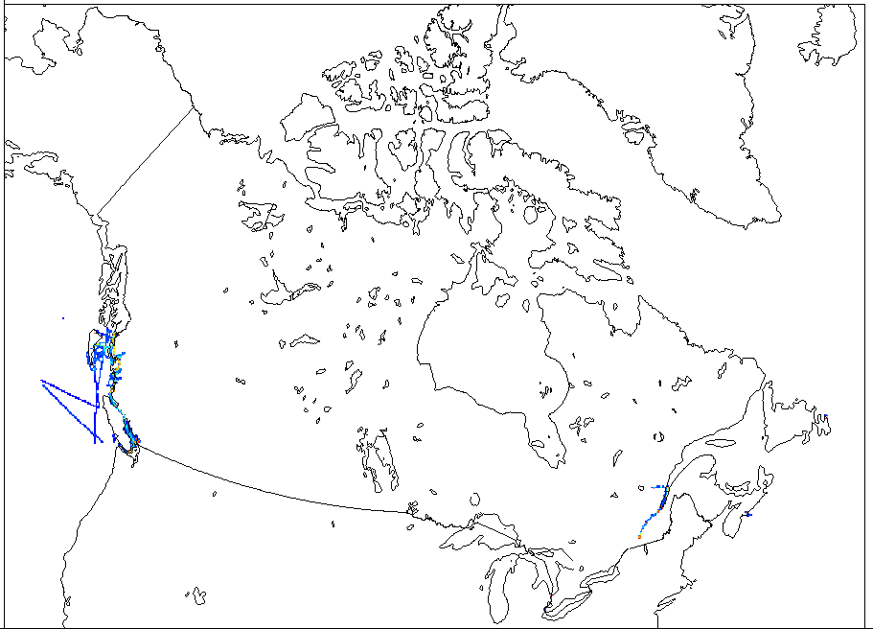
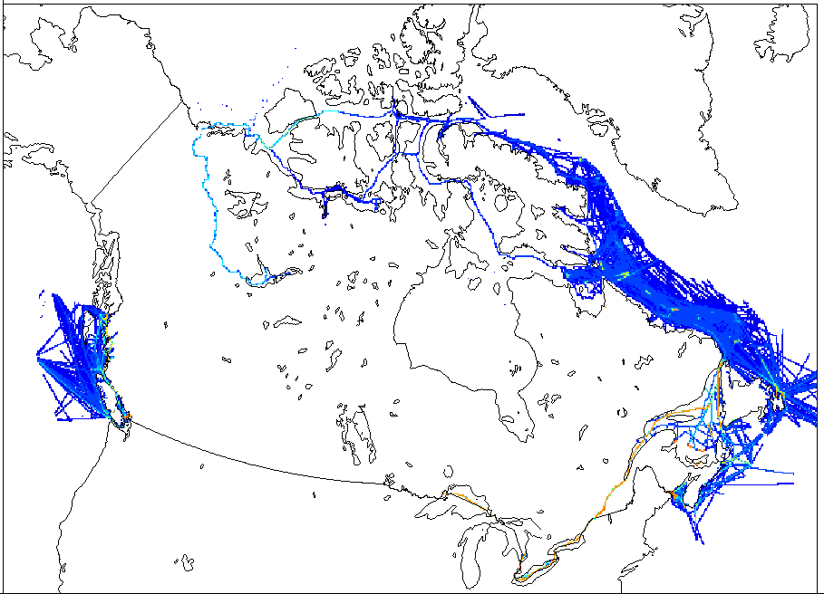
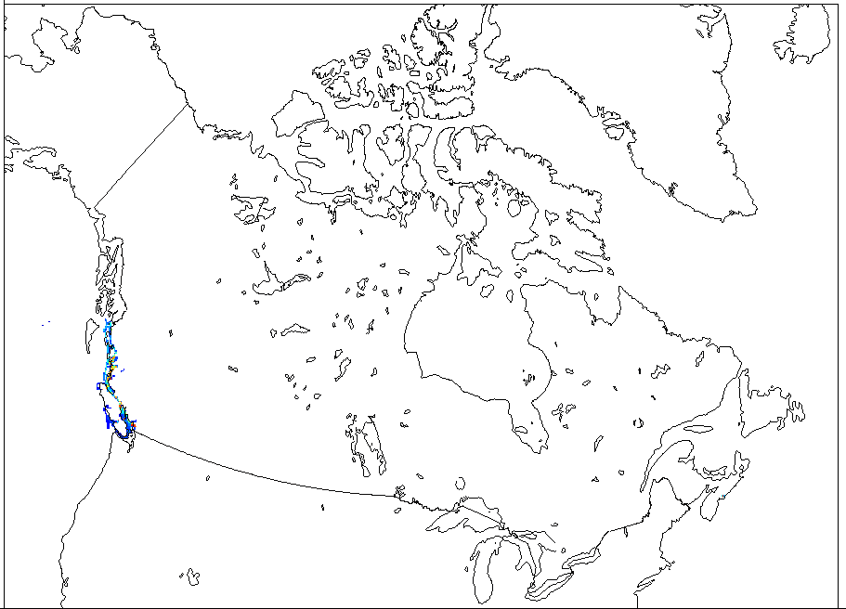
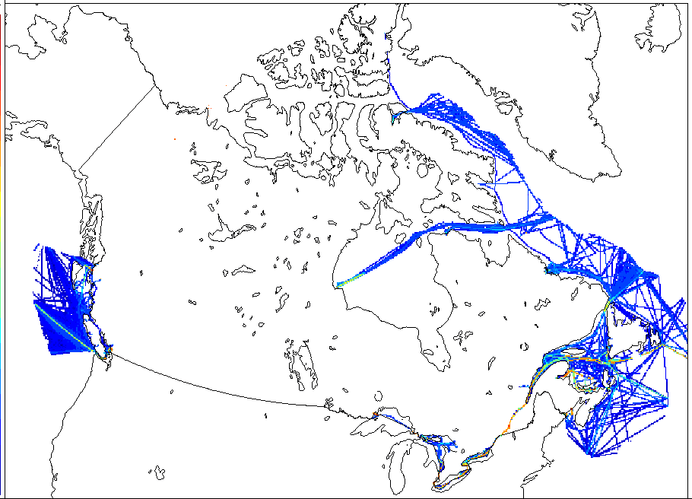
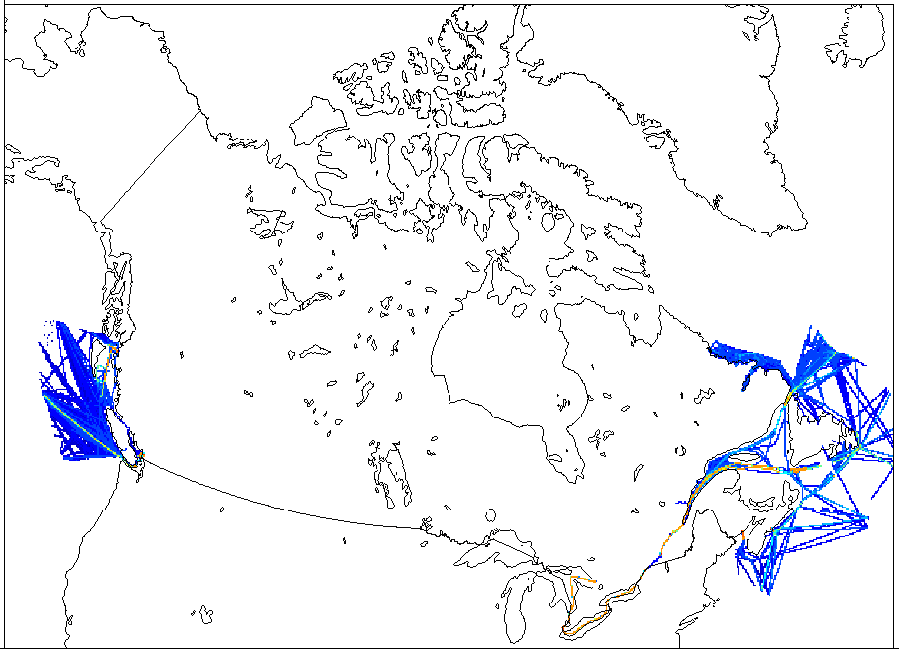
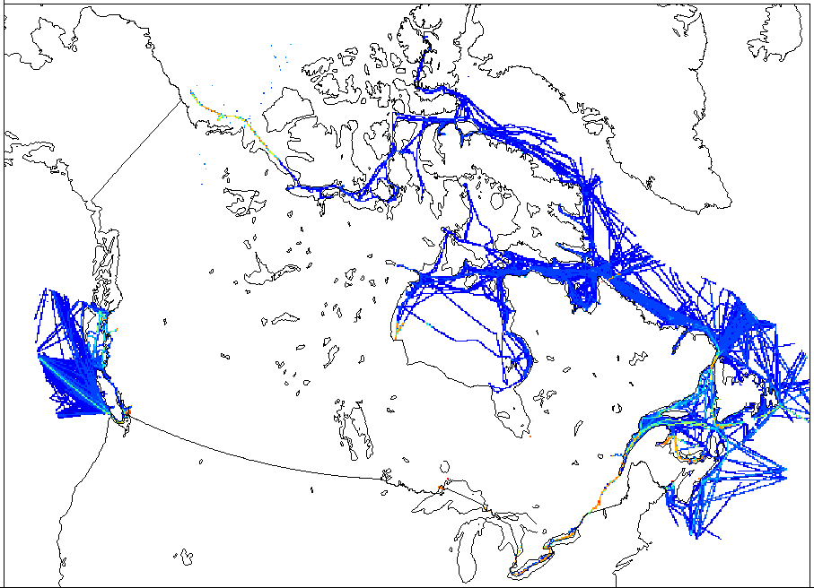
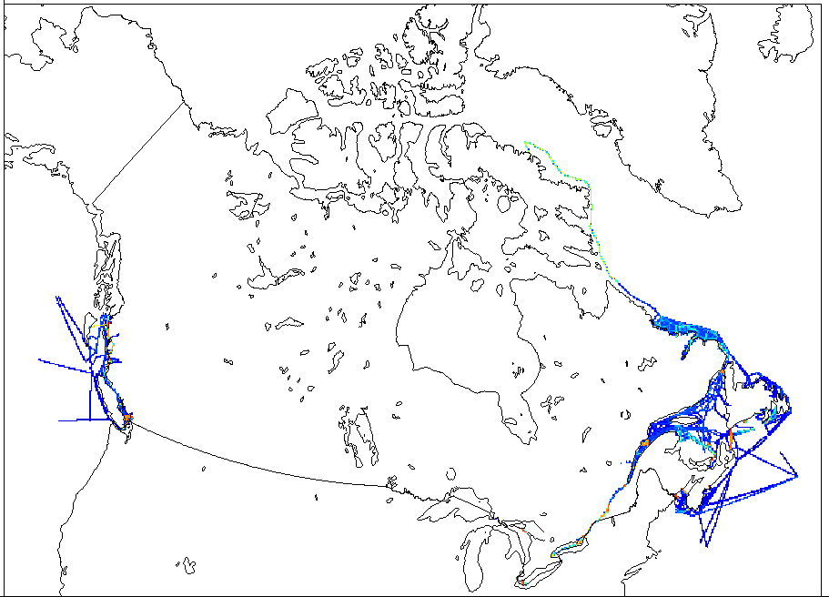
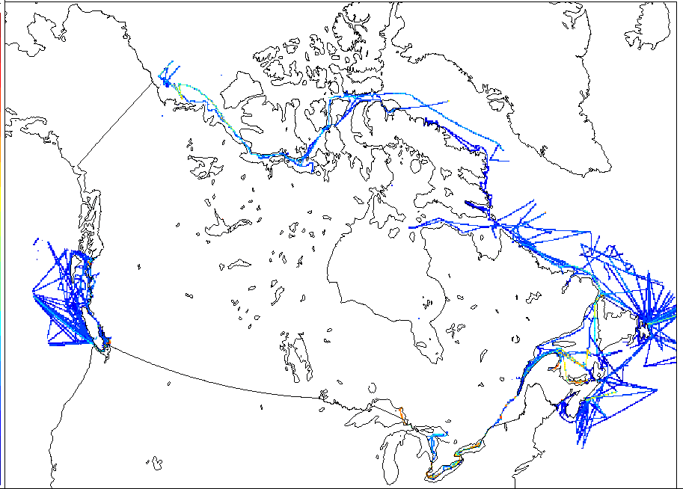
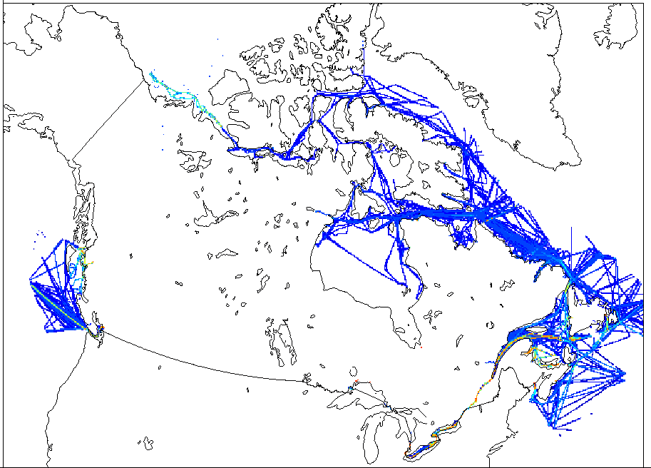
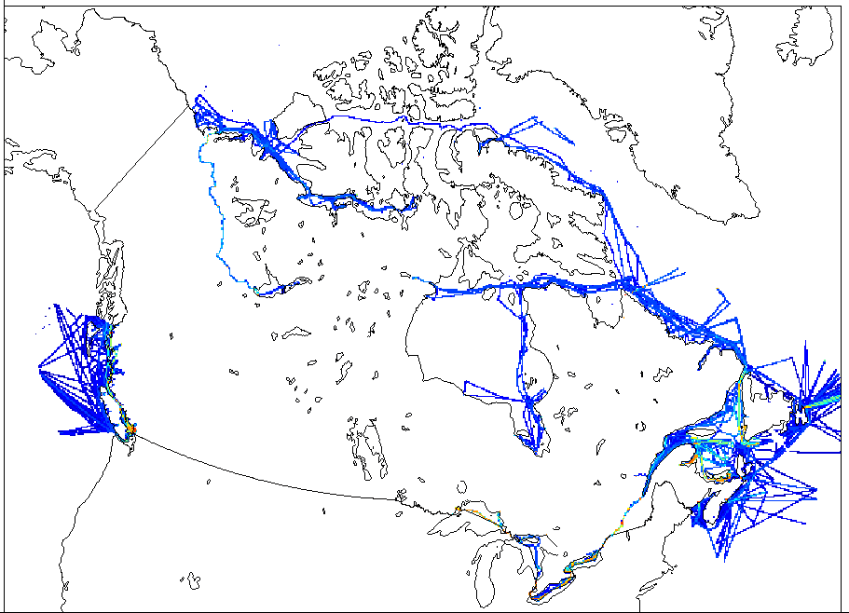
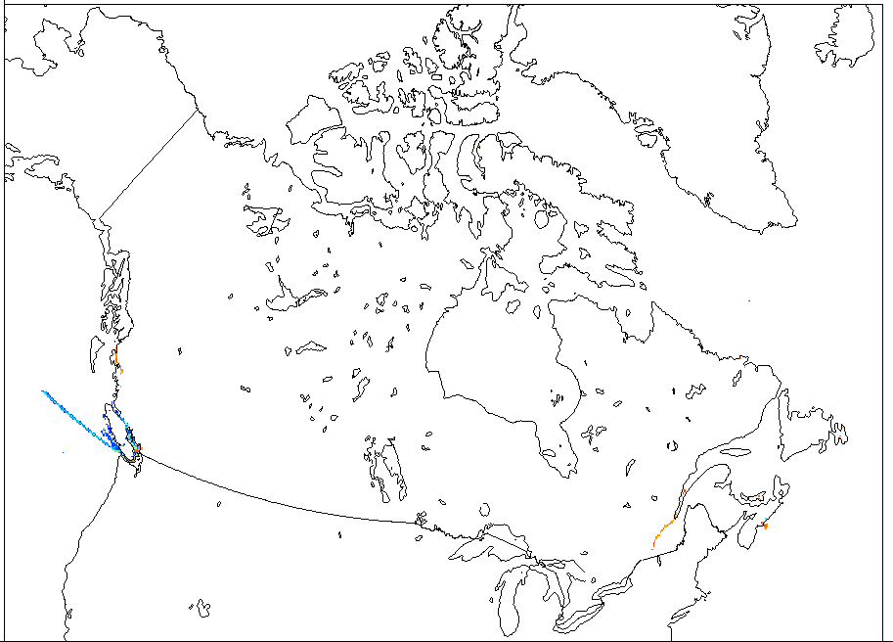
Ship-class based Surrogates
Barge
Coast Guard
Cruise
DFO Fishing
Excursion passenger
Fishing
INNAV Test Vessels
Merchant Bulk
Merchant Container
Merchant Other
Merchant Passenger
Special Purpose
Tanker
Tug
War

Slide 6
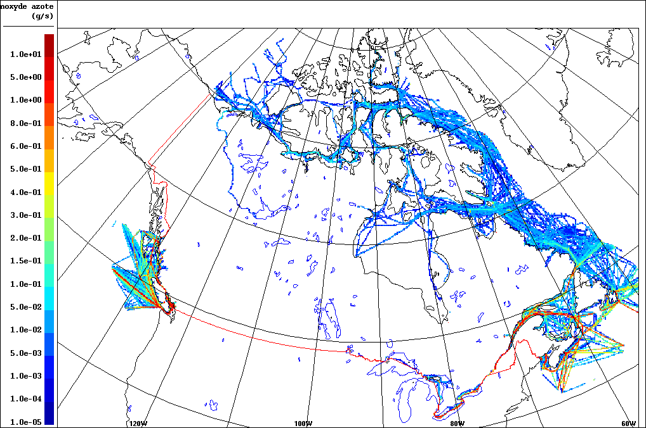
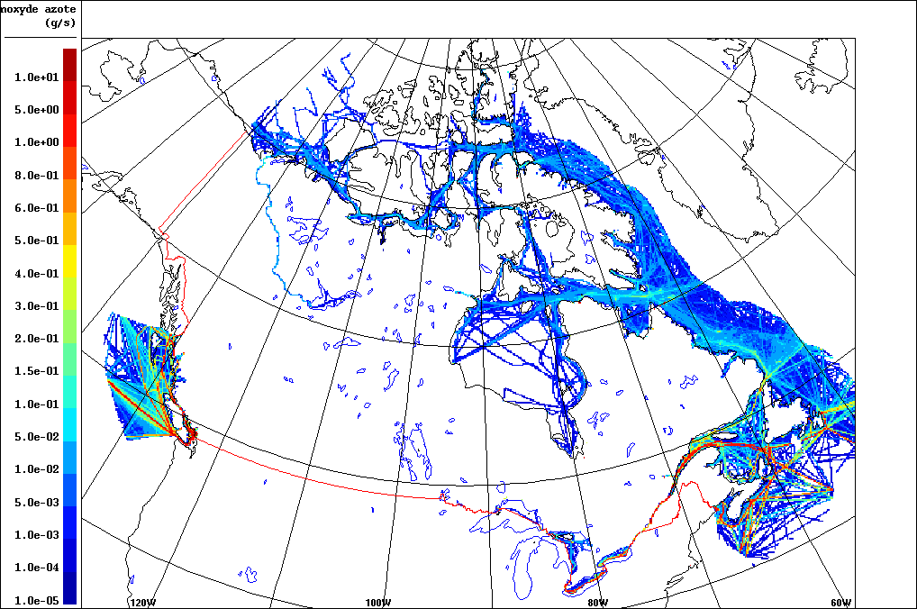
AQ-Model Ready Emissions (NO; g/s)
September 4 at 14 UTC
Point source
Area source

Slide 7
GEM-MACH simulation Global Environmental Multi-scale Modeling Air Quality and Chemistry
ECCC’s operational regional air quality model.
In-line Chemistry Transport Model.
10-km grids, 80 vertical levels up to 0.1hPa.
Other anthropogenic emissions (2015 Canadian APEI; 2017 USA projected from NEI 2011, Mexico 2008)
Summer episode (June to September 2017).

Slide 8
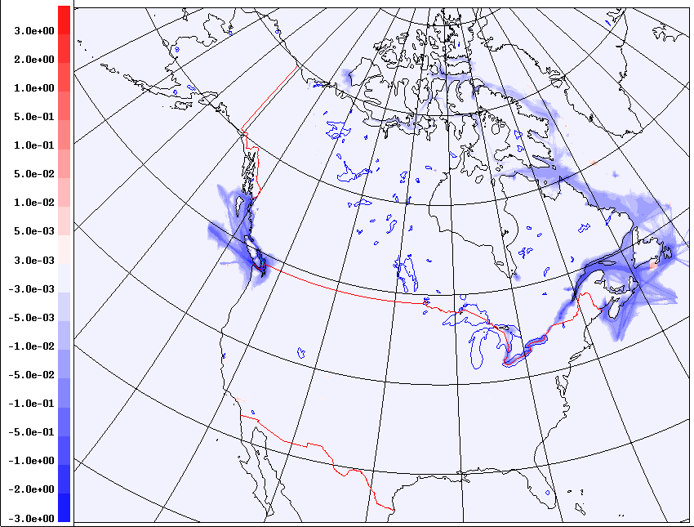
2017 Summertime Average NO2 (ppb)
treating marine emissions as point sources reduces the surface NO2 concentration (up to 15%)
Point - Area

Slide 9
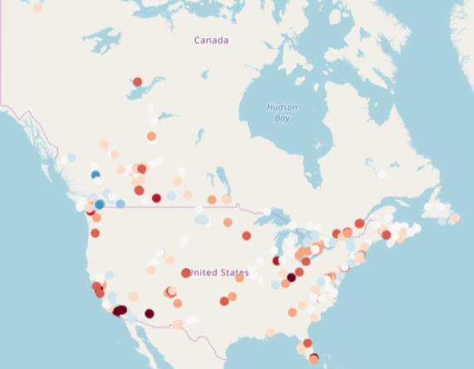
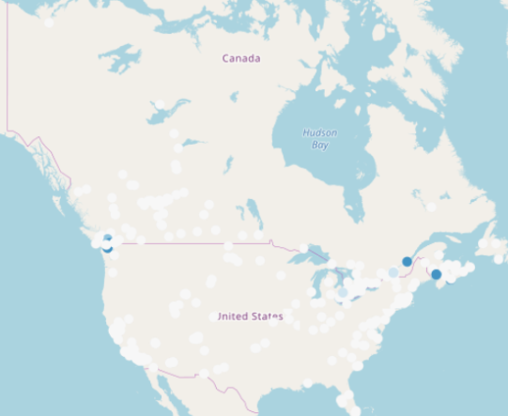
Mean bias; NO2
Point - Area
Point - Area

Slide 10
Mean bias; NO2
Point - Area
Point - Area

Slide 11
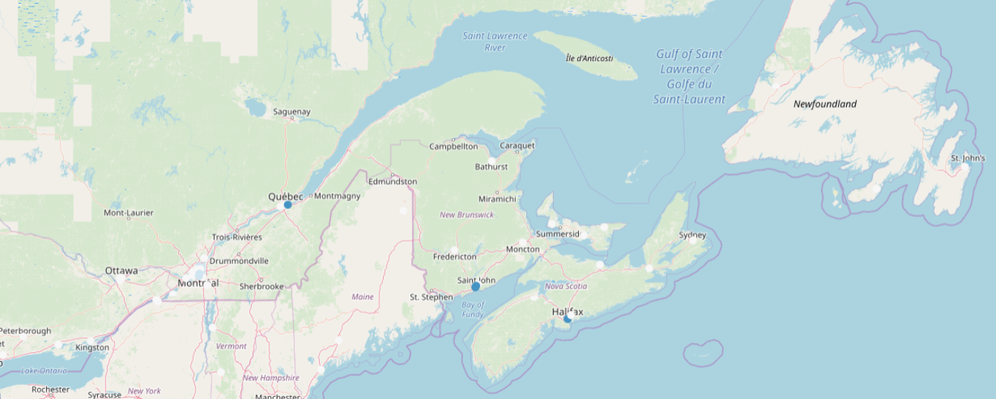
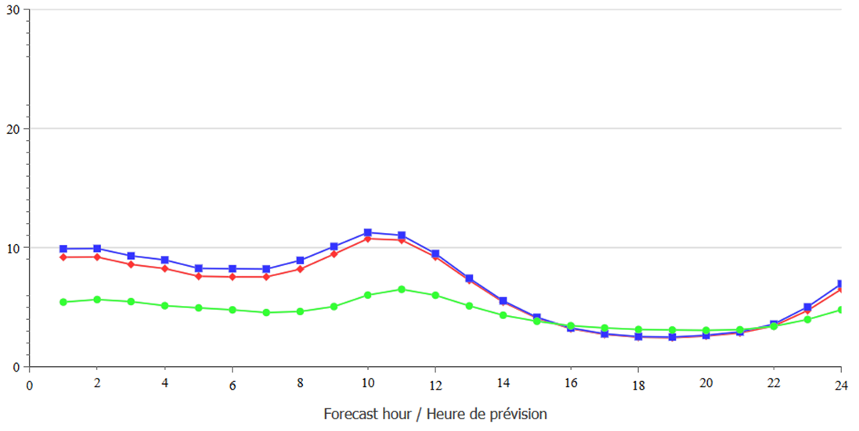
East Canada
Observation
Marine as point
Marine as area
Per-hour average NO2 (ppb)

Slide 12
East Canada
Observation
Marine as point
Marine as area
Per-hour average NO2 (ppb)

Slide 13
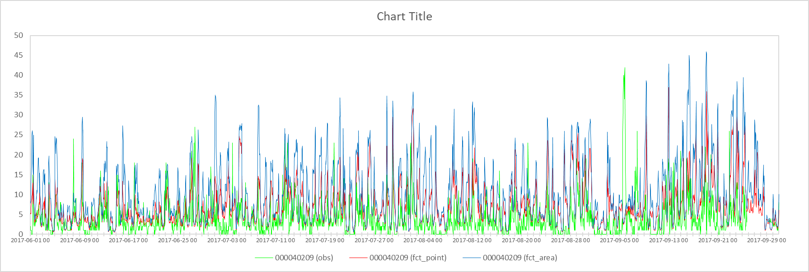
East Canada; NO2 (ppm)
Observation
Marine as point
Marine as area
Quebec
St. John
Halifax

Slide 14
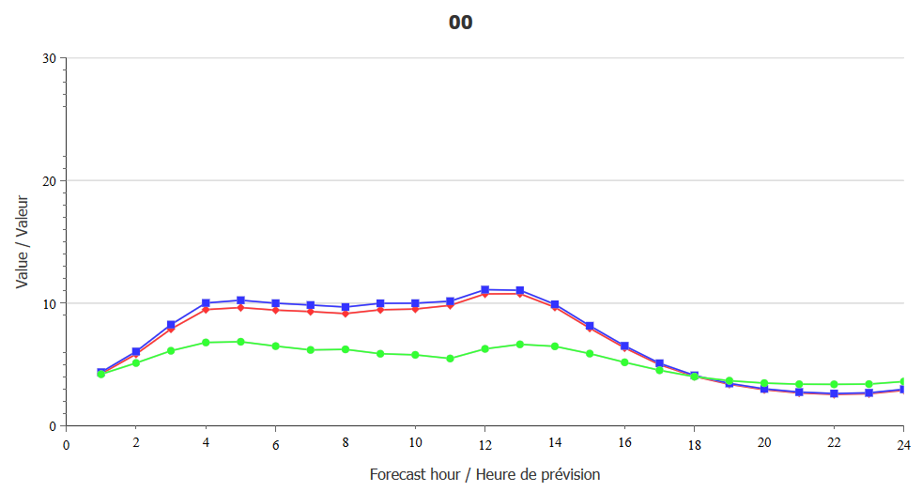
West Canada
Per-hour average NO2 (ppb)
Observation
Marine as point
Marine as area

Slide 15
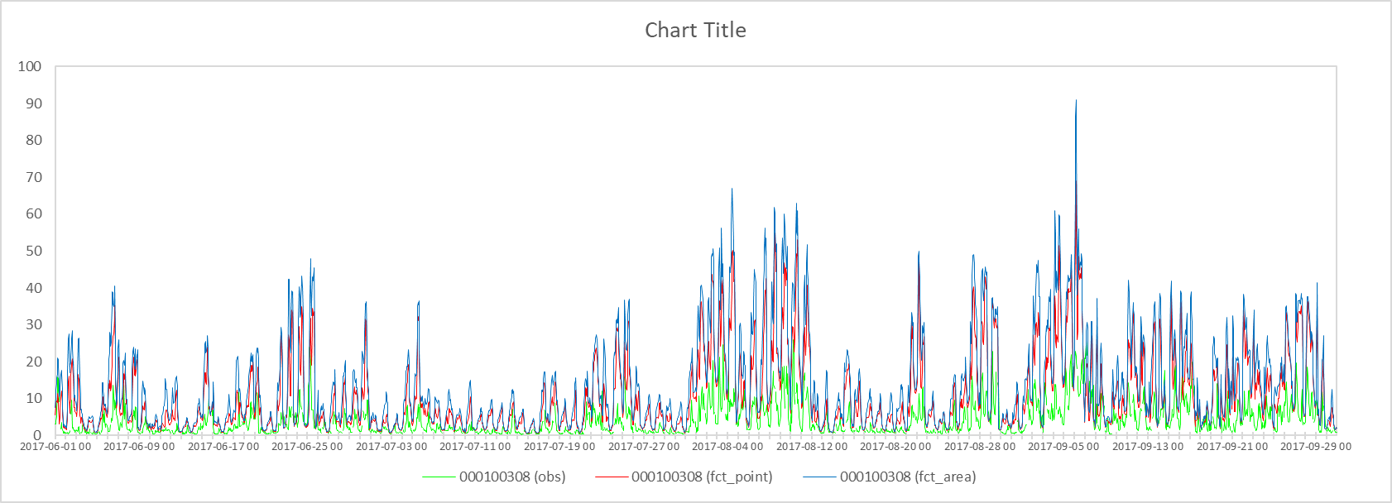
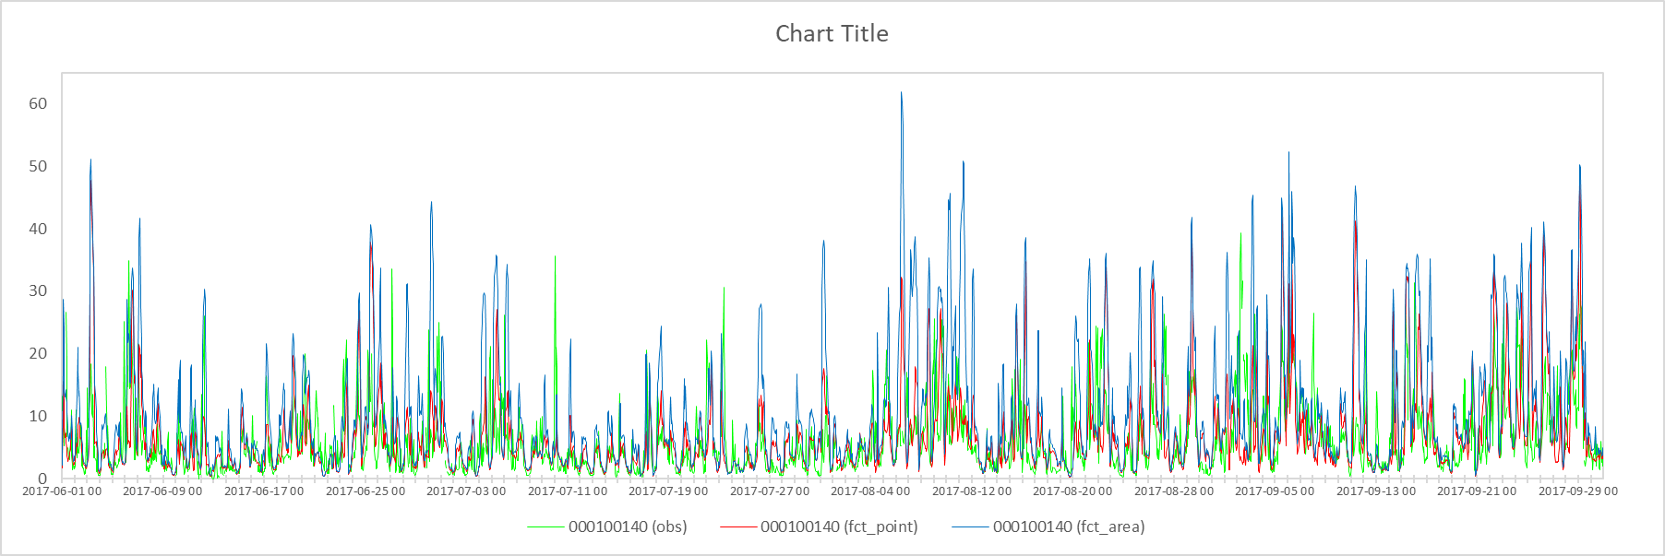
West Canada
Observation
Marine as point
Marine as area
Victoria
Vancouver

Slide 16
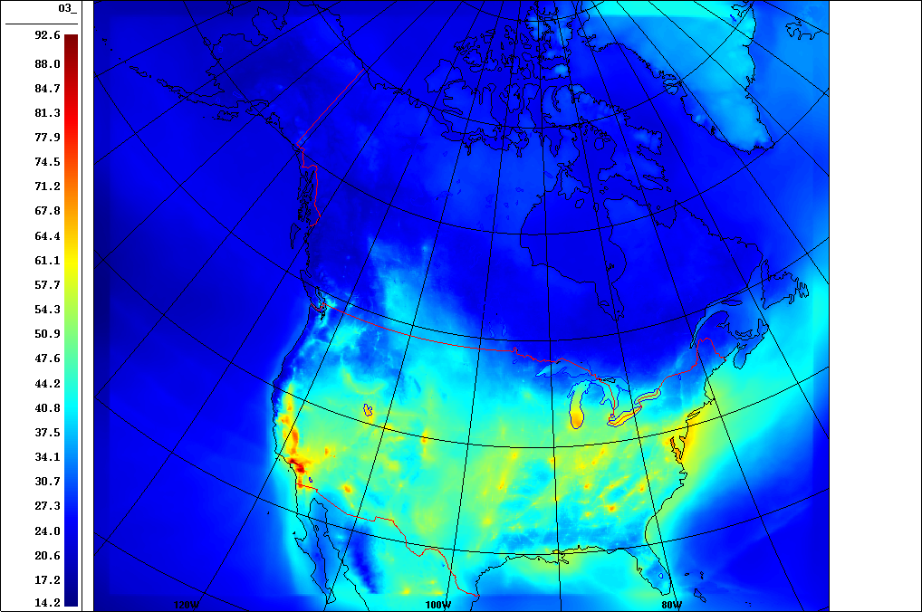
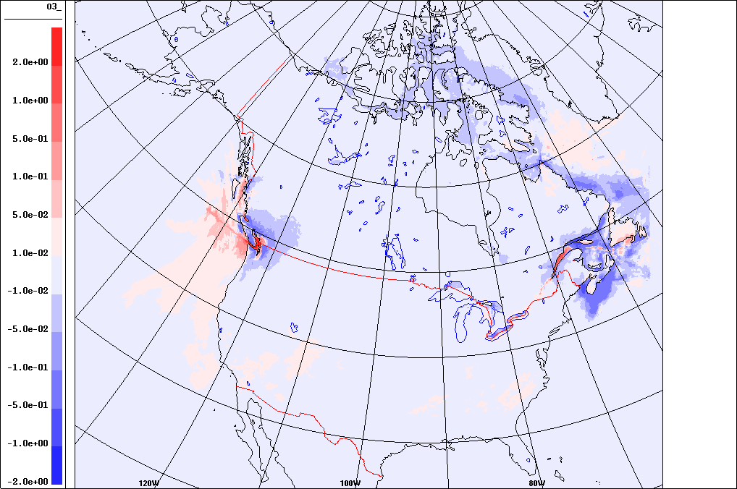
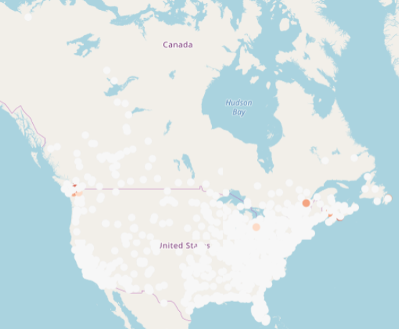
2017 Summertime 8-h Average O3 (ppb)
Point - Area

Slide 17
2017 Summertime 8-h Average O3 (ppb)
Point - Area

Slide 18
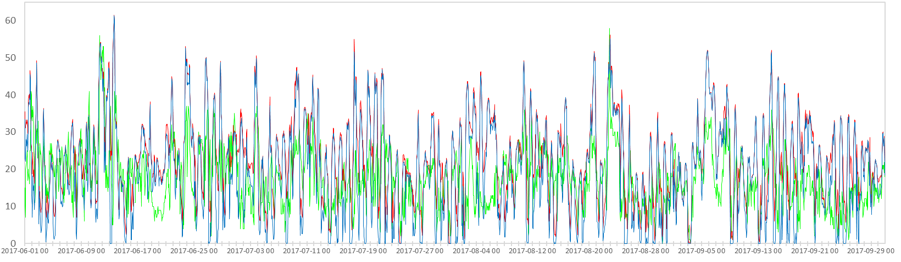
2017 Summertime 8-h Average O3 (ppb)
Point - Area

Slide 19
Hourly Score Statistics
Mean Bias | Canada |  | East-Canada |  | West-Canada
 | Point run | Area run | Point run | Area run | Point run | Area run
NO2 | 1.756 | 2.081 | 1.867 | 2.242 | 1.649 | 1.926
O3 | -1.479 | -1.731 | -0.330 | -0.560 | -3.249 | -3.534
RMSE | Canada |  | East-Canada |  | West-Canada
 | Point run | Area run | Point run | Area run | Point run | Area run
NO2 | 6.900 | 7.341 | 6.406 | 6.926 | 7.346 | 7.720
O3 | 10.646 | 10.695 | 10.101 | 10.182 | 11.457 | 11.44

Slide 20
conclusion
Upgrading emission platform using MEIT 2015 is an improvement in marine emissions processing.
There is an overall improvement in NO2 and O3 by processing marine emissions as point sources.

Slide 21
THANK YOU

