Slide 1
Evaluating Updated Tools for the Estimation of Wildland Fire Emissions:
Bluesky Pipeline and R-SmartFire3
18th Annual CMAS 2019 Conference
Chapel Hill NC October 21-23, 2019
James Beidler – GDIT
George Pouliot – U.S. EPA, ORD

Slide 2
Overview
SmartFire3
Technical description
Comparison to SmartFire 2
Test case results
BlueSky Pipeline
Technical description
Comparison to BlueSky Framework
Test case results
Notes:
- Basic structure of this presentation is to first look at what BlueSky Pipeline is and then compare it to the version of BlueSky framework that is currently is use for fire emissions production.
- The presentation will alsocover an R-based version of SmartFire, labeled SmartFire3 and how that compares to SmartFire 2.
* As a reminder of how wildland fire emissions are created for the NEI we can look at the flowchart in the appendix

Slide 3
Existing NEI Wildland Fire Emissions Estimation Method
Location
Fuels
(FCCS v3; LF v1.4)
Consumption
(Consume v4)
Emission
Factors
(FEPS v2)
Dates
Emissions
Type
Size
Bluesky Framework v3.5.0
SmartFire 2
Notes:
The existing NEI wildland fire emissions estimation method uses SF2 to reconcile attributes of various types of wildland fire activity. The sources of this activity vary in quality, formatting, strengths, and weaknesses. The reconciliation process can be thought of as taking the best attributes of each source dataset to create a single activity dataset.
For example, a highly spatial resolved activity dataset in the form of a polygon shapefile, set as the GeoMAC, gets more weighting in terms of size and location than a ground report giving a street address and estimated size. However, the ground report may provide more accurate start and end dates for a fire. So the output activity once reconciled will use the size and location from GeoMAC and the dates from the ground report.
Once the activity is reconciled it is passed into the bluesky framework, a series of processors for calculating emissions from activity. Fuelbeds are identified based on the single given location of the daily fire activity. Consumption is then calculated based on the fuel bed attributes, in particular the fuel loading. Emission factors are then applied to the consumption by phase to get daily emissions releases by location.

Slide 4
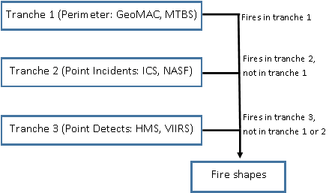
R-SmartFire 3
R-SmartFire 3 tranche processing
R-based implementation of the SmartFire system
Developed by SmartFire 2 designer (Raffuse)
Open source and available on github
Changes in methods make the software package smaller/less enterprise focused
Tranches (layers) vs weightings
RSF3: https://github.com/raffscallion/RSF3
Notes:
RSF3 is an R-based implementation of the SmartFire system, which was Java and postgis.
Follow up to SF2 developed as an open source project on github.
Changes in methodologies where input datasets are merged and given property priority (through reconciliation) in tranches (layers or slices) rather than SF2 reconciliation weightings.
Figure 1 shows the processing tree to illustrate how these tranches work

Slide 5
R-SmartFire3 vs SmartFire2
R-SmartFire3 Advantages
Very fast compared to SmartFire2
Spatial subsetting and filtering
Runs on typical HPC environments and easy to install
Open and expansible source code
Flexibility in inputs
R-SmartFire3 Disadvantages
Lacks clean interface
Requires lots of memory
No fire growth or type assignments
Methodology not completely consistent with SmartFire2
Does not reconcile fires with best attributes
Notes:
The key advantage to RSF3 is that it is very fast compared to SF2. SF2 can take days to import datasets, sort through errors, and reconcile fires where RSF3 can take mere hours.
RSF3 is also easy to install – no complicated tomcat and postgres configurations – and it runs on atmos.
Some nice features not available in SF2 are spatial filtering using a shapefile so that RSF3 can be run for a single state or region. The input definitions are also much more flexible.
On the disadvantages side RSF3 lacks a clean interface with SF2 having dashboards, searchable fire databases, and form-based configuration.
RSF3 also requires a lot of memory for these operations. I could not get a complete CONUS run done because I was running out of memory, so I ended up subsetting and testing with certain states.
There is also no fire growth (everything is a single event rather than daily chunks) and no type assignments for remote detects (this can be easily replicated, though, states have been questioning the use of climatological type assignments – a new method may be needed at some point).

Slide 6
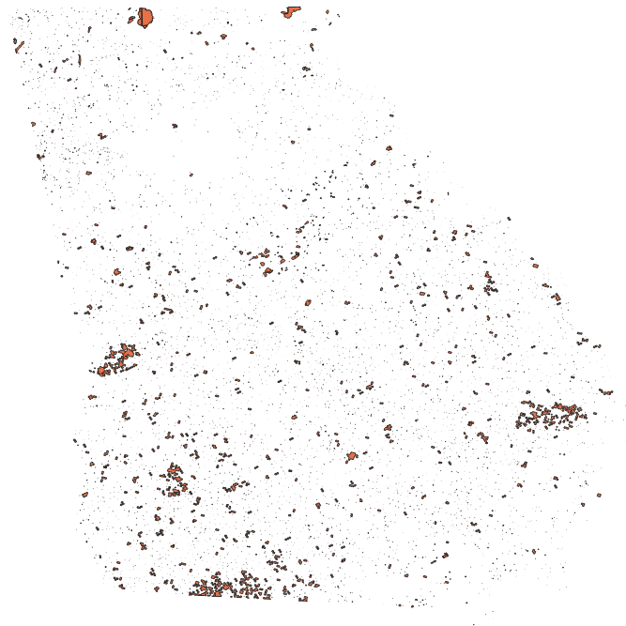
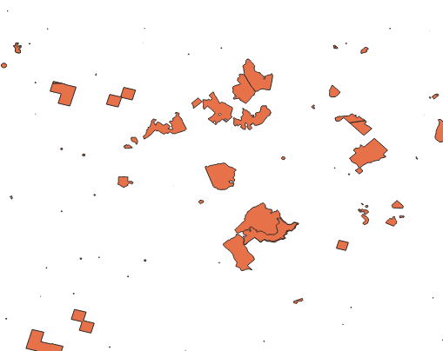
R-SmartFire 3 2016 Test Runs
R-SmartFire3 2016 GA activity results zoomed
R-SmartFire3 2016 GA activity results
Notes:
Because I ran out of memory for a CONUS run I ran two states using 2016beta inputs (HMS, GeoMAC, NASF, FACTS, MTBS), GA and WA.
These states were selected for the different types of fires in the area: GA is mostly smaller RX fires and WA has larger WF. WA also has large tracts of federal lands where fires in GA are typically taking place in smaller corridors in between towns and farms.
Fig 1 on the left shows the total results of merging all of the tranches of data for GA. Up top you can see some of the larger perimeters. Speckled throughout are the smaller detects and activity.
On the right in Fig 2 is a zoomed in region where satellite detects are shown as rectangular clumps (rather than circular) and perimeters are more jagged.

Slide 7
R-SmartFire 3 2016 Test Runs
Table 5. R-SmartFire 3 2016 WA tabular results
FIPS | County | Fire Name | Fire ID | Data Source | Fire Type | Fire Start | Fire End | Area
53007 | Chelan | WINTON SPOT | T2_1_000158_5300712888 | ICS | WF | 6/16/2016 | 6/16/2016 | 0.1
53007 | Chelan | Morical | T2_2_3894250927591.0 | NASF | WF | 5/19/2016 | 5/20/2016 | 0.5
53007 | Chelan | Bloodgood | T2_2_6094251228212.0 | NASF | WF | 5/22/2016 | 5/23/2016 | 0.01
53007 | Chelan | Lily Road | T2_2_4894251428582.0 | NASF | WF | 5/24/2016 | 5/25/2016 | 0.01
53007 | Chelan | Lily #2 | T2_2_3254257142664.0 | NASF | WF | 7/20/2016 | 7/21/2016 | 0.1
53007 | Chelan | Oklahoma | T2_2_7944257343283.0 | NASF | WF | 7/22/2016 | 7/23/2016 | 0.1
53007 | Chelan | unknown | 1192 | HMS | WF | 10/27/2016 | 10/27/2016 | 526.5259391
Table 6. 2016 GA SmartFire2 vs R-SmartFire 3 Activity
Fire Type | SF2 Area (Acres) | RSF3 Area (Acres) | Diff | % Diff
RX | 656,350 | 589,522 | -66,828 | -10%
WF | 63,838 | 119,038 | 55,200 | 86%
Total | 720,188 | 708,560 | -11,628 | -2%
Table 7. 2016 WA SmartFire2 vs R-SmartFire 3 Activity
Fire Type | SF2 Area (Acres) | RSF3 Area (Acres) | Diff | % Diff
RX | 105,782 | 17,990 | -87,792 | -83%
WF | 341,800 | 525,830 | 184,030 | 54%
Total | 447,582 | 543,820 | 96,238 | 22%
Notes:
Table 6 shows detects from different tranches. The dates and area for merged fires come from the highest ranked dataset in the highest tranche.
Table 7 has the total annual acres burned results for GA. The RX and WF are different, which is almost certainly because I applied a blanket assignment of RX for all HMS detects, whereas SF2 uses month. The total numbers are pretty close. Both methods underestimate the RX fires by a large amount according to NIFC.
Table 8 has the total annual acres burned results for WA. I applied a blanket assignment of WF for all HMS detects here so I do expect an RX underprediction. The WF acres, however, are much larger and the total is larger by over 20%. NIFC shows ~294k acres for WF, so both methods overpredict according to NIFC.

Slide 8
BlueSky Pipeline
Common platform/framework that links biomass combustion related modules
Designed to process activity in conjunction with SmartFire
Shares modules with FERA Fire Tools (FFT)¹ and the legacy BlueSky Framework
Fuel Characteristics Classification System (FCCS) v2 fuelbed identification and loading
Consume² v5.0 fuel consumption
Fire Emission Production Simulator (FEPS)³ v2
¹FERA FFT: https://www.fs.fed.us/pnw/fera/fft/
²Consume: https://www.fs.fed.us/pnw/fera/fft/consumemodule.shtml
³FEPS: https://www.fs.fed.us/pnw/fera/feps/
Notes:
BlueSky Pipeline is a software framework for calculating emissions from fire activity data. It has other features, such as smoke dispersion modeling that we typically do not use.
- The modules in BSP are the same as in FFT and BSF, with updated versions.

Slide 9
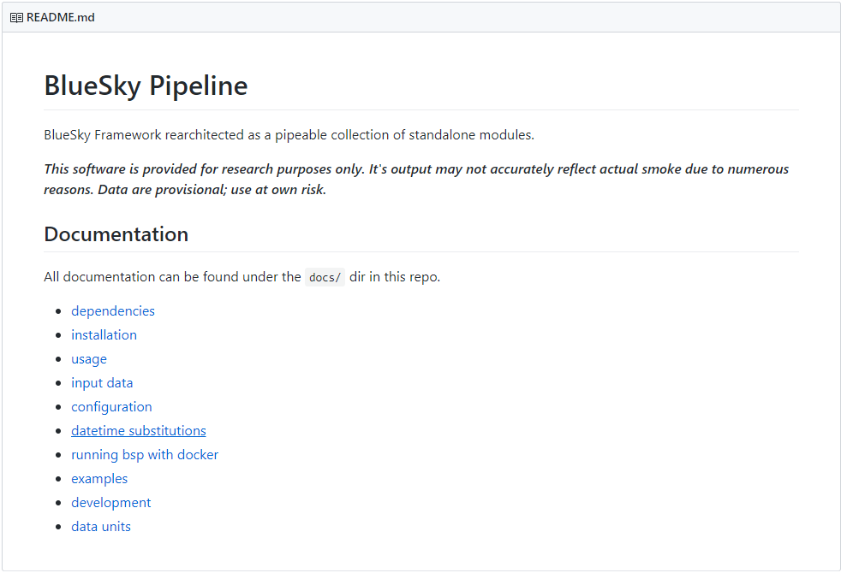
BlueSky Pipeline
BSF Github: https://github.com/pnwairfire/bluesky
Notes:
BSP is open source and hosted on github. Unlike the iteration of BSF that is used for EPA processing, BSP is in active development.
Individual modules are also hosted on github by airfire
Complete documentation is available for processing. Example cases and config scripts are available on the github.
Can still follow NEI method (Appendix A)

Slide 10
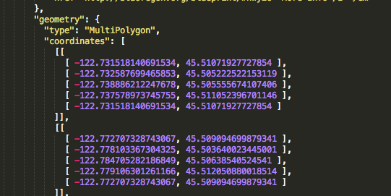
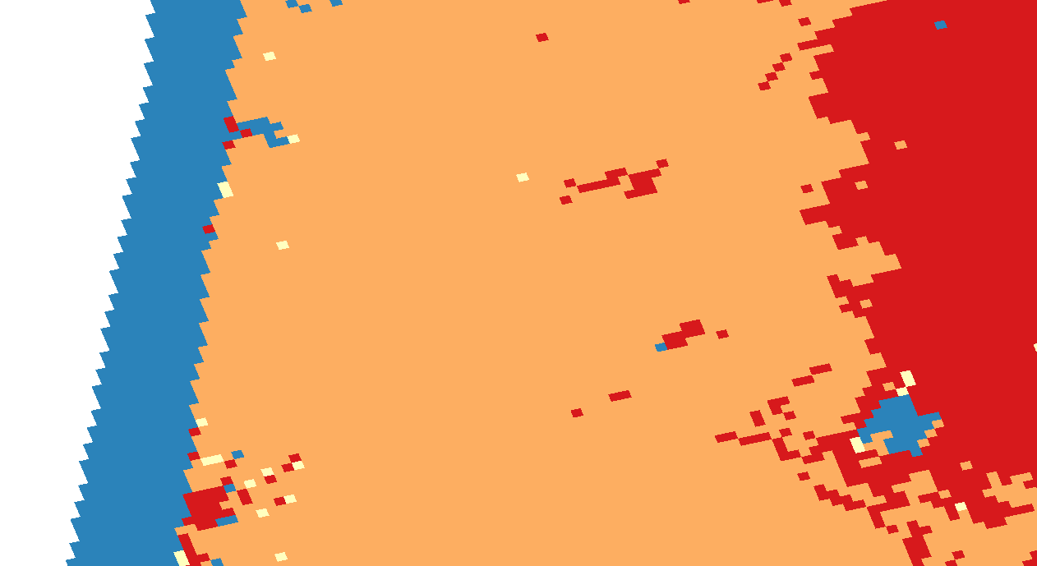
Key BlueSky Pipeline Enhancements
Pipeline design
Easy module swapping and analysis
Input from Geo-JSON
Fuelbed resampling
Notes:
BSP brings many enhancements over previous BSF iterations:
The pipeline design allows for redirection of input and output into modules and other software. You can also start at any place in the stream. If you already have loading or emissions factors for a fire that can be manually entered and that module step skipped.
Each stop in the pipeline can be examined for further analysis and issues
geo JSON is a formatted standard for geospatial data. The image on the lower right shows the hierarchy for defining a multipolygon shape.
Why is this an enhancement?
It allows fires with perimeter data to be directly exported into the BS processing stream with their true shape retained. When overlaid onto other geospatial data, such as fuelbeds this allows for a more complete picture of what the fire is doing.
A very major enhancement is this acknowledgement that not all fires burn a homogenous fuel bed. BSP can identify and retain multiple fuelbeds per fire to pass along to the consumption model. Not only that it can ignore certain types (urban or water) and resample on the fly into a nearby fuel bed type. This has implications for consumption and emissions.
Other interesting enhancements include filtering by state/county/country or bounding box, whitelisting of output emissions, and filtering by fire size
Many other enhancements that may not be directly useful to the purposes of this group such as updates to the dispersion models and automated output distribution

Slide 11
BlueSky Pipeline vs BlueSky Framework
BlueSky Pipeline Advantages
Fuelbed identification more complete
Updated version of Consume
Open source and active development
Flexible to handle special runs
Outputs from each module are retained
BlueSky Pipeline Disadvantages
Installation complicated from github
json format not as familiar as CSV
Requires pre-processing of dates and county FIPS from SmartFire 2
At times can be a web of modules
Slower processing
Notes:
The advantages are familiar from previous slides and have been discussed to a degree.
One to point out is that Consume is at the center of fire emissions processing and there have been many fixes since the version that we are using, so this is important to highlight.
On the disadvantages I found the installation to be a bit complicated when installing from github, although this would be much easier for someone with root access. A docker image is also available if that can be setup properly on atmos.
- Json can be tedious to read from a text editor and isn’t as instantly recognizable like a CSV.
Misc changes match later SF2 Later versions of SF2 had fixes for the timezone which aren’t available in our version, but need to be handled before BSP processing. It also doesn’t add FIPS like BSF does, so I had to do that on my own, which is ultimately just as well because I always went back and corrected the counties from BSF runs.
- The whole system can seem complicated at times. Chasing an error may mean digging through multiple layers of modules and handlers. If you know the structure and python it isn’t too terrible, but there is that learning curve.
BSP does process slower than BSF but that is likely due to the higher number of fuelbeds that it has to process per fire.

Slide 12
BlueSky Pipeline 2016 National Run
Figure 1. 2016 total PM25
2016 beta Collaborative Platform activity used for CONUS runs of BSF and BSP
LANDFIRE v1.4 fuel beds used for both BSF and BSP runs
~400k ton PM2.5 decrease from BSF to BSP across CONUS
Largest wildland fires saw 50-90% decreases in fuel consumption from BSF to BSP
Table 1. 2016 large fire comparison
Fire | BSF Consumption (tons) | BSP Consumption (tons) | BSF PM2.5 (tons) | BSP PM2.5 (tons)
350 Complex | 29,872,561 | 3,060,864 | 37,328 | 25,218
Pioneer Fire | 10,703,183 | 2,052,387 | 52,592 | 26,857
Gap Fire | 2,381,723 | 546,879 | 12,284 | 7,050
Soberanes Fire | 2,351,746 | 903,091 | 15,053 | 11,031
Beaver Creek Fire | 2,295,523 | 328,458 | 11,004 | 3,958
Rail Fire | 2,073,226 | 620,085 | 19,841 | 8,344
Range 12 Fire | 1,761,322 | 237,024 | 3,125 | 1,949
Notes:
Comparison was done between BSF and BSP where activity and fuelbed information was kept constant.
BSP was run using the 2016beta SF2 output activity. Both the fuelbed information (LF1.4) and loading were the same between the two runs.
The inputs are the same so this comparison should generally reflect the changes in processing methodologies between BSF and BSP.
Fig 1 shows the total CONUS PM25 from the two runs across all fire types. There is a notable decrease in PM25 emissions from BSP.
The same decrease in PM25 is shown for the large fires. Two things to note in table 1 is the marked reduction in consumption and the varying decreases in PM2.5 between fires.

Slide 13
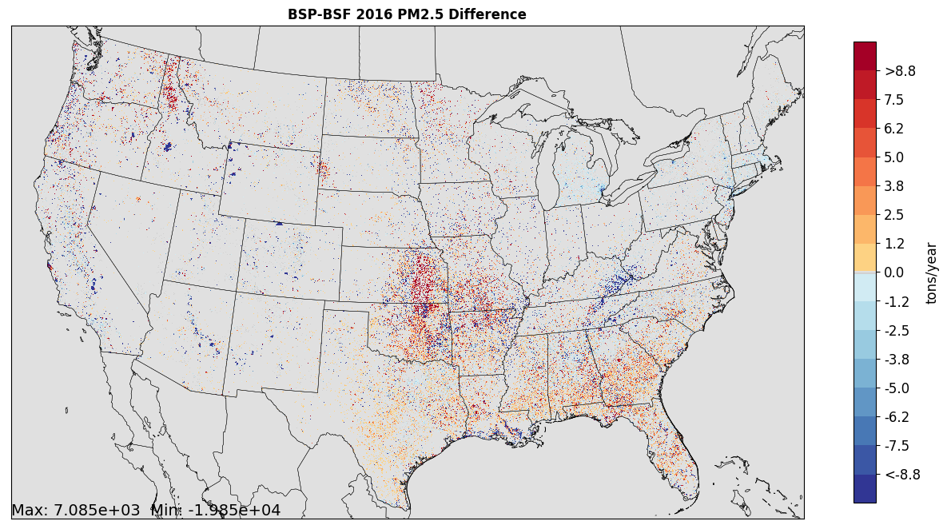
Bluesky Pipeline 2016 CONUS PM2.5
2016 total PM25 BSP minus BSF difference
Notes:
Spatial difference on a 4 km CONUS grid of Bluesky Pipeline run minus the legacy Bluesky Framework run
Grid cells where BSP emits more PM are in red, grid cells where there was a decrease versus BSF are in blue
Largest PM2.5 decreases occurring with large fires in western US (ID, CA, NV, WY, CO) and in KY.
Large increases over Flint Hills Kansas can be ignored due to removal of region for replacement with state data in official BSF 2016beta run.
Large increases in northern Idaho and modest increases throughout the Southeast could be related to differences in consumption for RX burns.

Slide 14
BlueSky Pipeline 2016 National Run
Table 2. High duff content fuel beds
Fuel bed | BSF Area (acres) | BSP Area (acres) | BSF Consumption (tons) | BSP Consumption (tons) | BSF PM25 (tons) | BSP PM25 (tons) | Area % Diff | PM25 % Diff | Total Duff Loading (tpa)
Pond pine/little gallberry-fetterbush shrubland | 20,680 | 20,936 | 867,583 | 271,434 | 9,621 | 3,292 | 1% | -192% | 152
Smooth cordgrass-black needlerush grassland | 111,894 | 121,047 | 7,452,260 | 1,488,796 | 56,087 | 18,446 | 8% | -204% | 90
Redwood-tanoak forest | 6,375 | 7,681 | 1,009,141 | 391,353 | 11,122 | 5,588 | 20% | -99% | 70
Western hemlock-Douglas-fir-Sitka spruce forest | 4,976 | 7,130 | 639,275 | 293,813 | 5,543 | 4,031 | 43% | -37% | 43
Table 3. Low duff content fuel beds
Fuel bed | BSF Area (acres) | BSP Area (acres) | BSF Consumption (tons) | BSP Consumption (tons) | BSF PM25 (tons) | BSP PM25 (tons) | Area % Diff | PM25 % Diff | Total Duff Loading (tpa)
Bluestem-Indian grass-switchgrass grassland | 651,256 | 729,184 | 32,422,303 | 5,385,879 | 43,962 | 45,055 | 12% | 2% | 0
Fallow field - growing season | 58,066 | 76,506 | 23,656 | 204,997 | 180 | 1,901 | 32% | 91% | 0
Pasture, hay, or alfalfa field - grazed or harvested | 132,400 | 158,053 | 591,402 | 810,683 | 4,196 | 7,175 | 19% | 42% | 0
Pasture, hay, or alfalfa field - ungrazed or unharvested | 830,228 | 1,024,738 | 7,057,743 | 6,911,973 | 38,044 | 62,867 | 23% | 39% | 0
Notes:
The handling of duff consumption has always been suspect in the version of BSF that is currently in use. Older documentation for BSF notes a process to tamp down duff consumption in prescribed fires.
As a starting place to help explain differences I looked at changes in emissions for fuel beds that had at least 1000 acres burned (so we weren’t looking at small values) and increased in the area burn between the two runs so that decreases in PM25 would not be immediately attributable to a decrease in acresburned.
- Table 4 shows fuel beds with a lot of duff loading. These are mostly mature forests, except for the cordgrass. The first record shows that the area burned was essentially the same between the two runs, but the PM25 emitted drops by nearly 200%.
Table 5 shows fuel beds with no duff loading. These are all grasses. Each one of these beds saw increases in PM25.
- This is an area that needs further study such as comparison to field values. I also didn’t differentiate RX vs WF, which can play a role in consumption and emissions.

Slide 15
BlueSky Pipeline 2016 National Run
Table 4. Soberanes fuelbed and consumption comparison
Month | State | Date | FIPS | Fire Name | Fire Type | FCCS Number | Vegetation | Total Consumption BSF (tons) | Total Consumption BSP (tons) | Area BSF (acres) | Area BSP (acres) | PM25 BSF (tons) | PM25 BSP (tons)
7 | CA | 20160726 | 06053 | Soberanes Fire | WF | 47 | Redwood-tanoak forest | 321617 | 146189 | 2607 | 2596 | 4,614.37 | 2,080.01
7 | CA | 20160725 | 06053 | Soberanes Fire | WF | 47 | Redwood-tanoak forest | 18378 | 98624 | 149 | 2300 | 263.68 | 1,404.72
7 | CA | 20160728 | 06053 | Soberanes Fire | WF | 36 | California live oak-blue oak woodland | 203333 | 34147 | 5214 | 5193 | 412.10 | 353.28
7 | CA | 20160727 | 06053 | Soberanes Fire | WF | 47 | Redwood-tanoak forest | 110269 | 24667 | 447 | 445 | 791.04 | 355.53
7 | CA | 20160731 | 06053 | Soberanes Fire | WF | 36 | California live oak-blue oak woodland | 19171 | 20316 | 819 | 1113 | 64.76 | 269.85
7 | CA | 20160729 | 06053 | Soberanes Fire | WF | 36 | California live oak-blue oak woodland | 31952 | 17771 | 819 | 2300 | 64.76 | 208.29
CMAQ model runs using 2016 beta BSF emissions showed exceptionally large PM concentrations around Soberanes fire around Monterey, CA
PM particularly high from Redwood-tanoak fuel bed (3rd highest duff fuel bed)
BSP fuel bed resampling adds more identified land cover to single fires
Where acres burned is the same, fuel consumption cut in half in BSP
Notes:
Digging further into table 4 is an overview of the top burning days by fuel bed for the Soberanes fire. The first record shows approximately the same area of Redwood-tanoak burned between the two runs, with a >50% decrease in both consumption and PM25. The third record shows the same area of California live oak burned with a large consumption reduction, but nearly identical PM25. So there are some pretty big differences in CONSUME for how certain fuel beds are being handled.

Slide 16
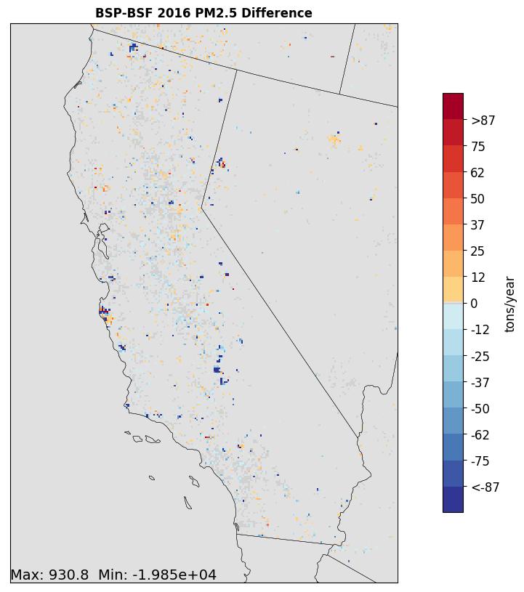
Bluesky Pipeline 2016 California PM2.5
Figure 3. 2016 total PM25 BSP minus BSF difference
Notes:
Marked decreases in PM2.5 around Soberanes due to fuel consumption. Some grid cells increased as fuel beds were resampled.

Slide 17
Impressions and Next Steps
BlueSky Pipeline
Mature, well-supported open source product that could readily be applied for emissions modeling
Nagging question: Results are different for certain fuel beds – which method is more accurate?
CMAQ sensitivity using BSP emissions
Comparison against alternative emissions datasets
R-SmartFire3
Very “beta”, but provides a good foundation for future development
May be useful for quick runs (non-NEI years, smaller projects) or for screening
Potential improved integration with new remotely sensed data
This presentation has been reviewed and approved in accordance with U.S. Environmental Protection Agency policy
Notes:
BSP could be put in use now. This is just the newer version of BSF with changes in the software framework. It captures 5 years of scientific improvements in crucial modules like CONSUME. But, I think it is important to know which method is doing a better job at predicting consumption and/or PM. In the end that’s really the concern.
Need to understand which method is more realistic
RSF3 isn’t really ready for primetime as much as I want to be able to move away from SF2. I think that with improvements and further development it could be at some point, though. I do see it as a useful option for doing quicker runs or for research (non-regulatory) purposes. I also think that it has the potential to better integrate new RS data. There is already an example input for VIIRS I-band available and others could be made.

