Slide 1


Quantifying Economic Damages from Crop Productivity Loss Due to Ozone Precursor Emissions via Hemispheric Adjoint Analysis
Yasar Burak Oztaner*, Shunliu Zhao, Amir Hakami (Carleton University); Rohit Mathur (EPA); the CMAQ-Adjoint Development Team
18th Annual CMAS Conference
Oct. 21 -23 | Chapel Hill

Slide 2
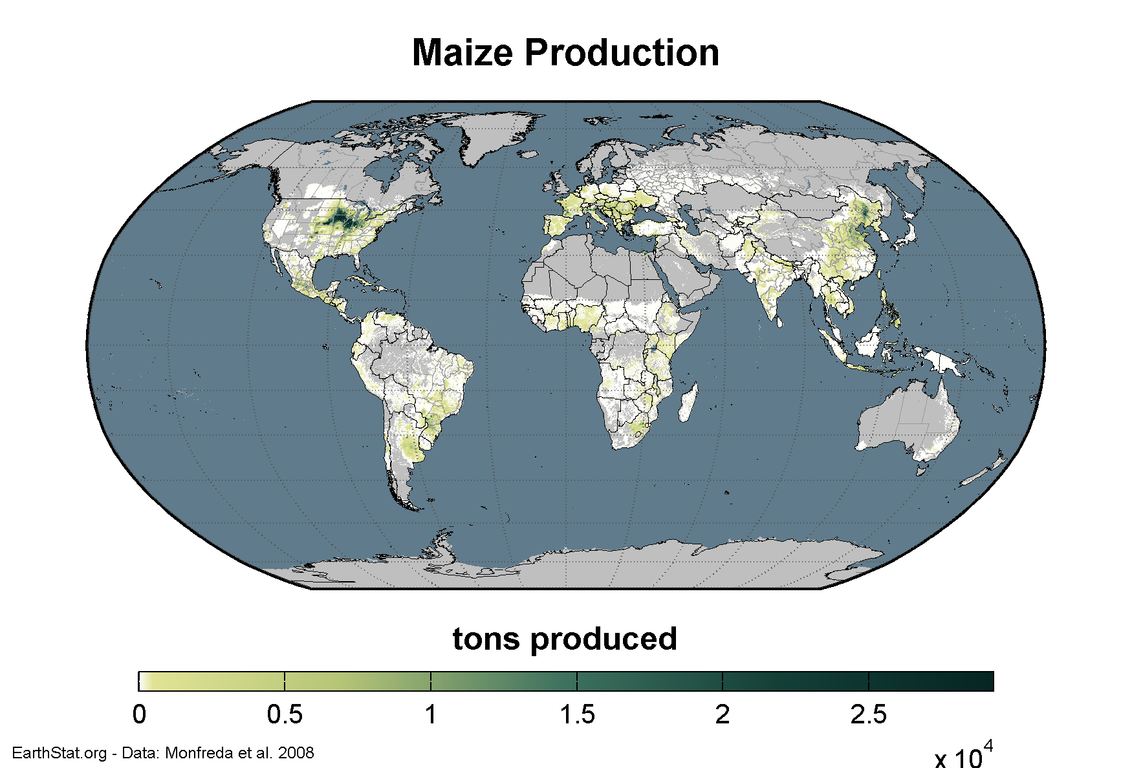
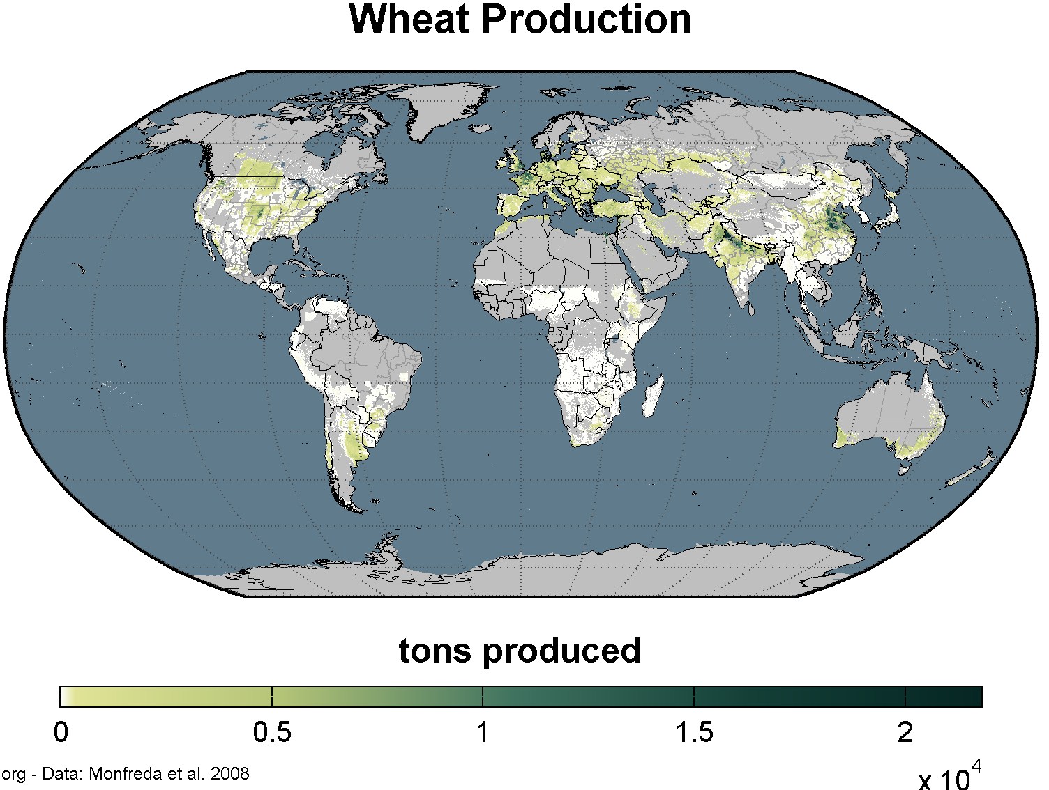
Introduction
Wheat production in the world constitutes 26% (756 Mt) of the world’s grain production(24% in the Northern Hemisphere -- 713 Mt). (FAO,2019, http://faostat.fao.org/ ).
Maize production in the world constitutes 35% (1029 Mt) of the world’s grain production(30% in the Northern Hemisphere -- 893 Mt). (FAO,2019, http://faostat.fao.org/ ).
Gross Agricultural Production value according to FAO:
  Wheat → 185 $US Billion
  Maize → 239 $US Billion
18th Annual CMAS Conference
October 2019
Notes:
Wheat production in 2010 is 26% of the world’s grain production. It is 35% in Maize production.
Wheat and Maize production constitutes 61% (in total) of world’s grain production and Northern Hemisphere has 54% of this production in total.
Maize production concentrated in some countries while Wheat production is more wide-spread.
Gross production value according to FAO for wheat is 185 Billion USD and for maize 239 Billion USD.

Slide 3
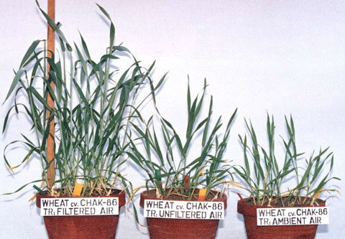
Motivation
Wheat Biomass Loss
Elevated O₃ concentrations have the following impacts on plant life functions:
  Reduce photosynthesis rate
Decrease transpiration and gas exchange
  Damage substomatal apoplast
  Destroy cell membranes and walls
Ozone
Sinha et .al (2015)(Photographer: Abdul Wahid, Pakistan)
18th Annual CMAS Conference
October 2019
Notes:
The motivation of our study start here. Elevated O3 conc. Has some impacts on plant life. …. Biomass loss means less production. Here’s an example of the biomass loss. With increasing Ozone, and wheat biomass loss.

Slide 4
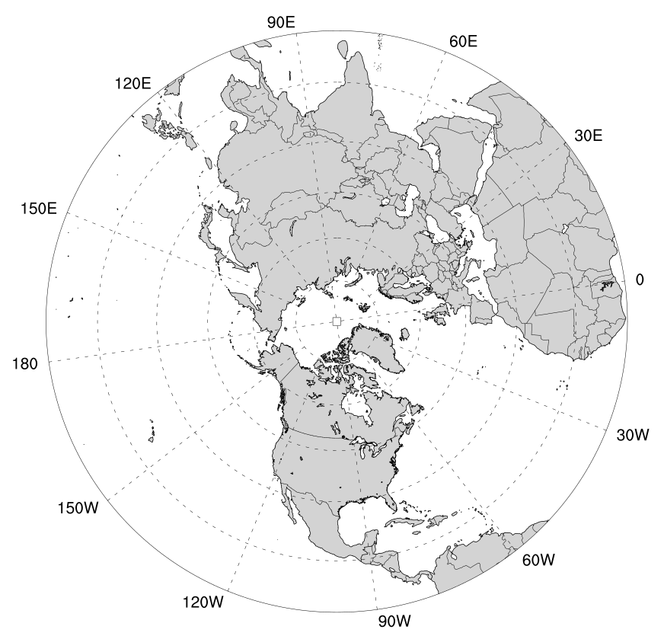
Methodology
Study Period | June 8 – July 24, 2010 (first and last weeks are for Forward and Backward ramp-up periods)
Meteorology | WRF v3.8.1
Emissions | EDGAR/HTAP2
Resolution | 108km - Polar Stereographic Projection
CTM | CMAQ v5.0 and its ADJOINT
Objective function | AOT40* (Northern H. and Europe) W126** (Northern H and North America)
To asses risk to vegetation from ozone exposure:
AOT40* : Accumulated exposure over a threshold of 40 ppbv
W126** : Sum of hourly ozone concentrations (weighted by a sigmoidal weighting function
18th Annual CMAS Conference
October 2019
Notes:
Here’s the methodolgy we applied in the study. 6 consecutive weeks in the middle of ozone season is the study period. First week has been chosen as the forward spin-up period and the last week of this period is used to be ramp-up period for backward. We used WRF to create meteorological fields and SMOKEv4 with Edgar/Htap emission inventory to create model ready emissions. The plot is shwoing the modeling domain which is polar stereographic projection with the 108km spatial resolution. CMAQ v5.0 and its adjoint is used for two different ozone exposure metric which are accepted by EPA and EEA. AOT40 is used for northern hemisphere and europe (it is the vegetation regulatory index.). Same for the W126 method for NH and

Slide 5
Ozone Exposure Indices
The AOT40 sums over a threshold of 40 ppb for the daylight time (08:00-19.59h) during growing season (European Environmental Agency, 1999).
Weighting Functions Used to calculate AOT40, W126 Exposure Index
The W126 sums daylight-time (08:00-19.59h) hourly ozone concentrations-sigmoidal weight function (EPA, Federal Register, 2008).
18th Annual CMAS Conference
October 2019
Notes:
AOT40 sums Ozone concentrations over a threshold of 40 ppb for the daylight time. It is defined by European Environmental Agency.
W126 sums only daylight time hourly concentrations with sigmoidal weighting function and it is EPA’s secondary regulator index.
In the figure, W126 weighting is increasing with ozone concentration while AOT40 does not apply till 40 ppb.

Slide 6
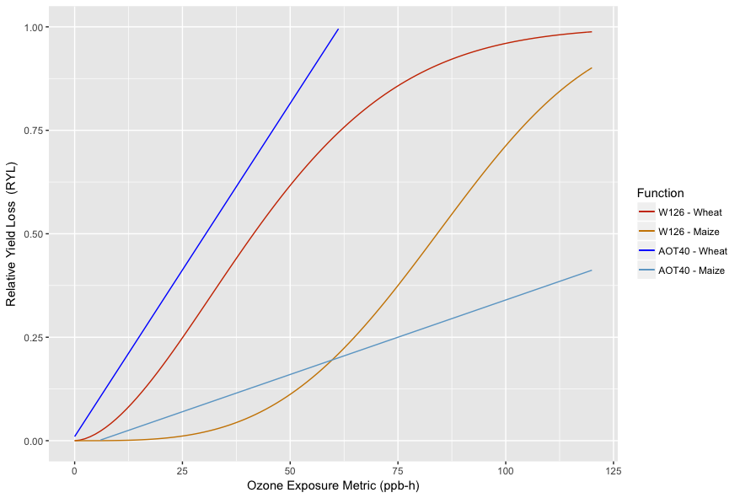
O3 Exposure-yield response equations
18th Annual CMAS Conference
October 2019
Notes:
Relative yield function associated with each exposure metrics are shown here for each crop type. AOT40 functions were publish in Mills et al in 2007. For W126, we used the Wang and Mauzerall paper’s parameters. We plotted the Relative yield loss functions with exposure metric applied to the over all study period. AOT40 and W126 for wheat show comparable values up to 60 ppb. We do see a large difference in Maize AOT40 and W126 function actually. Up to 60 ppb, AOT40 shows larger Relative loss. Later W126 gets larger values with the increase of exposure metric. We are going to see this difference in the results.

Slide 7
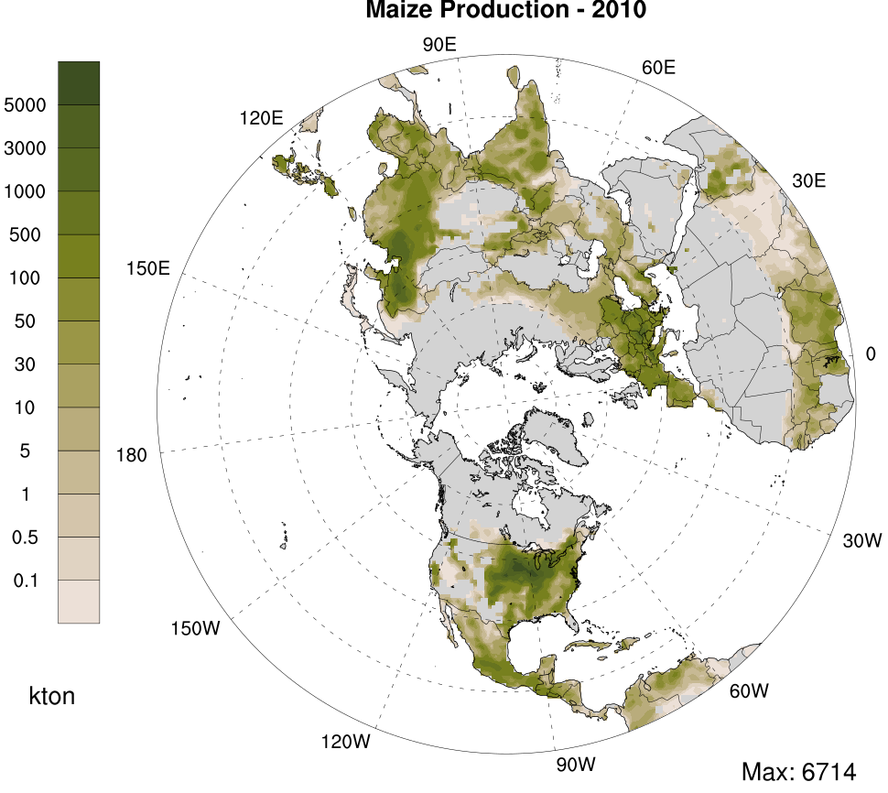
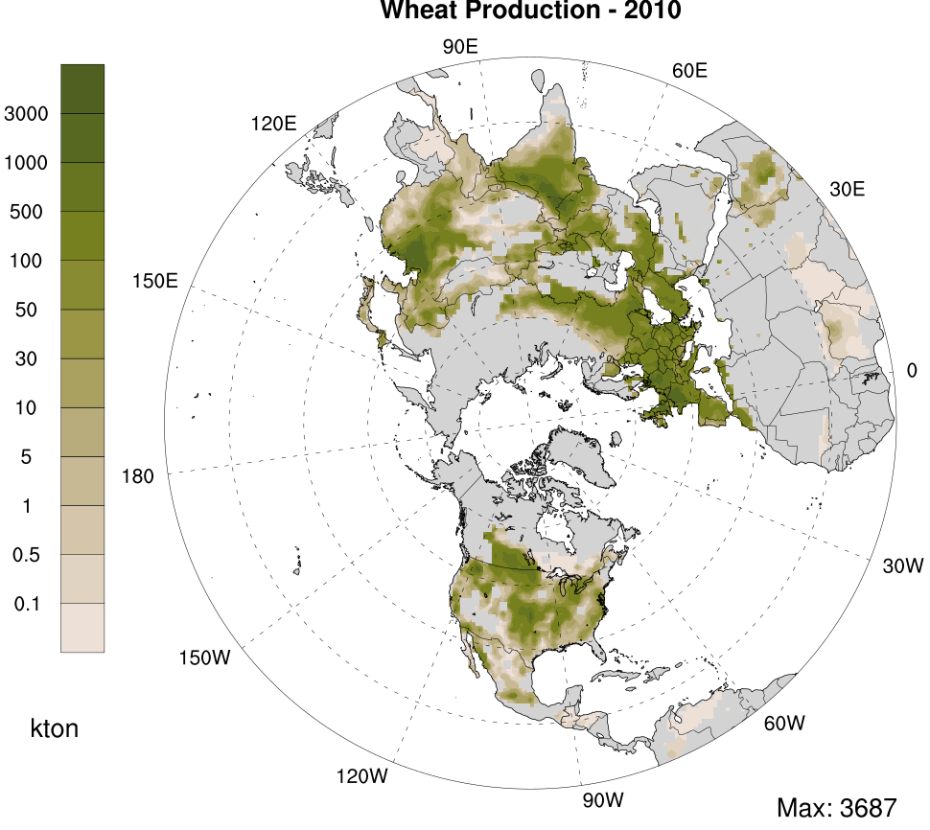
Distribution of Wheat and Maize Production
Gridded wheat/maize production data were retrieved from Monfreda et al. (2008, http://www.earthstat.org). The dataset were for the year of 2000 with 10 km spatial resolution.
We used these gridded data for spatial distribution of FAO country-specific total productions of the year 2010.
We aggregated them to the Polar Stereographic domain(108 km).
Notes:
Same as the text.

Slide 8
ECONOMIC VALUATION OF CROP PRODUCTION LOSS
$$\frac{∆\$}{∆Emissions}=\frac{∆\$}{∆CropProductionLoss}×\frac{∆CropProduction Loss}{∆Concentration}×\frac{∆Concentrations}{∆Emissions}$$
Economics*
Exposure-Yield Response
Air quality modeling
*Economics term in the equation is retrieved from FAO Database (Annual Producer Price**, $/ton for the year of 2010). – Average producer Price for wheat: 204 $/ton and for maize: 280 $/ton
**Producer Price is defined as prices paid at the farm-gate.
18th Annual CMAS Conference
October 2019
Notes:
We made the economical evaluation based on the formula shown here. Air quality modeling part done with CMAQ-ADJ. Exposure yield response function are from the literature. And the economics term is retrived from FAO databased as the annual producer price. Which is defined as price at the farm-gate. The average producer price for wheat 204 $/ton and 280 $/ton for maize.

Slide 9
Adjoint sensitivity analysis: where influences come from
Inputs/emissions
Crop Production Loss
18th Annual CMAS Conference
October 2019

Slide 10
RESULTS FOR Northern Hemisphere

Slide 11
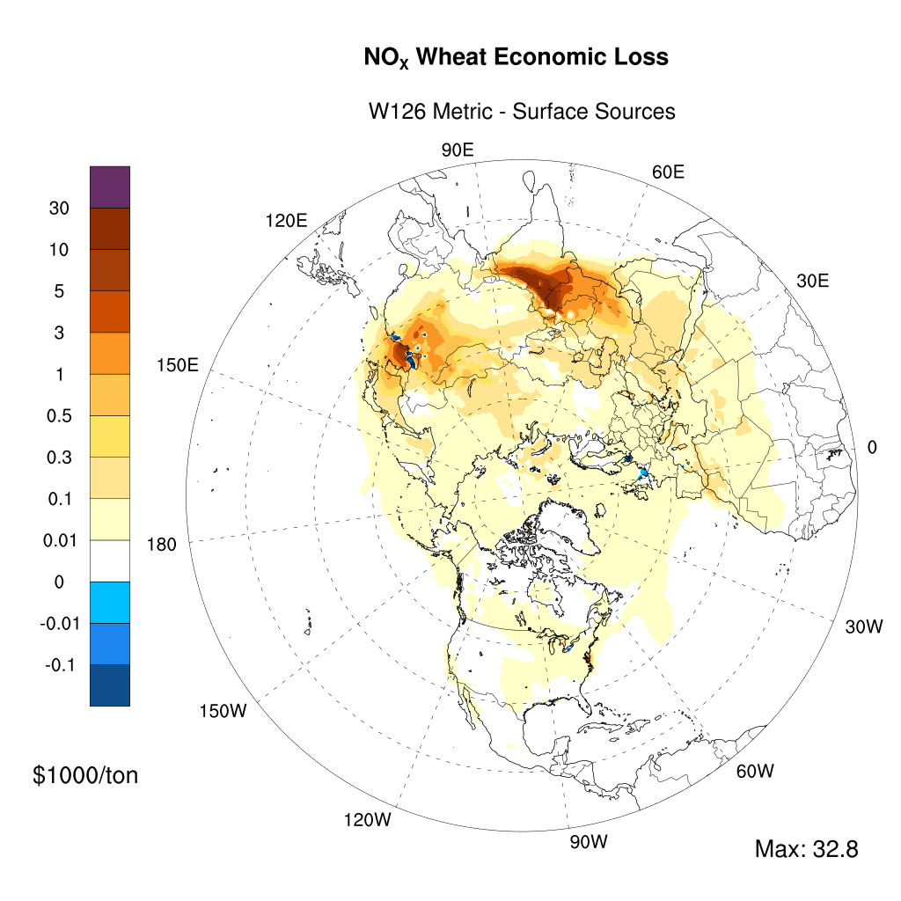
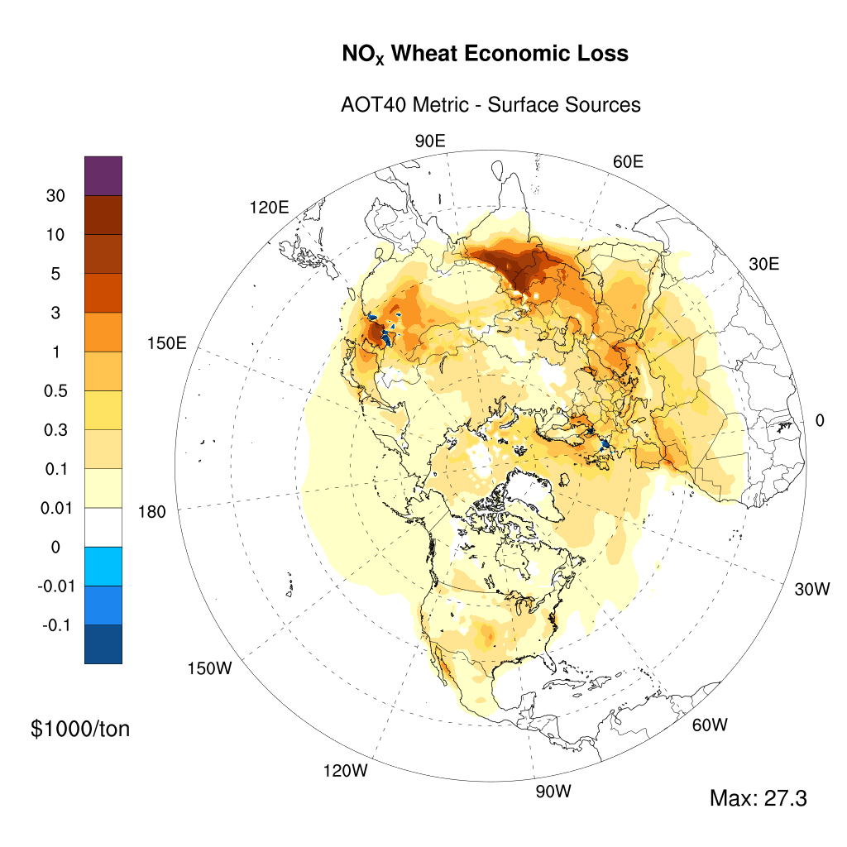
RESULTS for Wheat

Slide 12
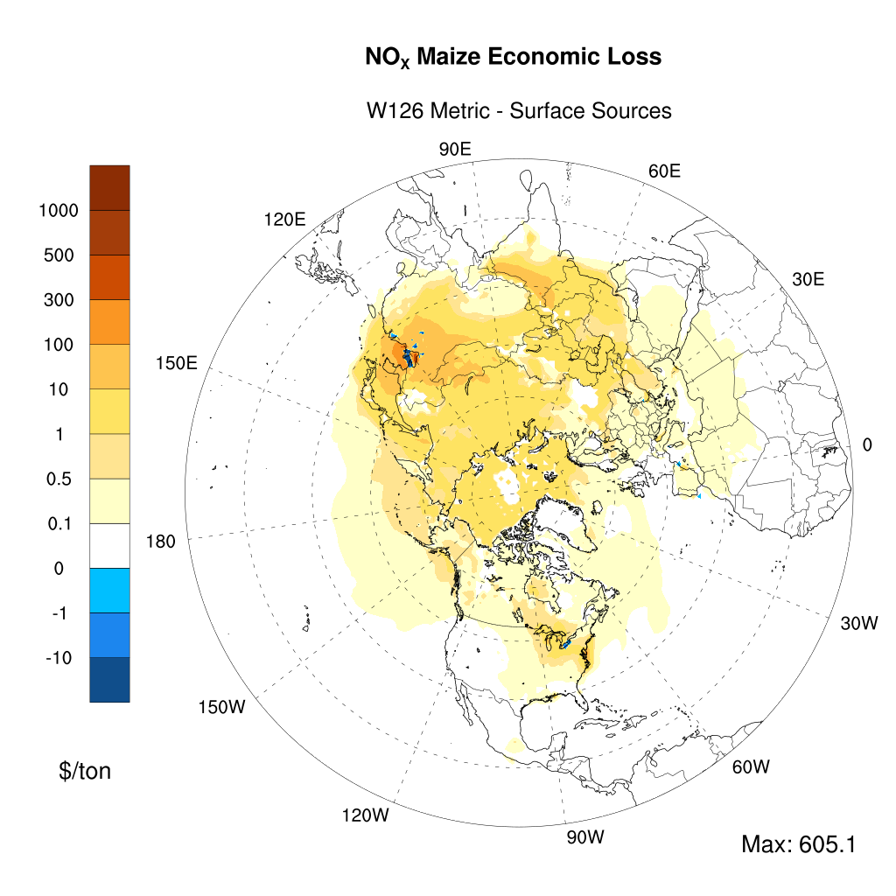
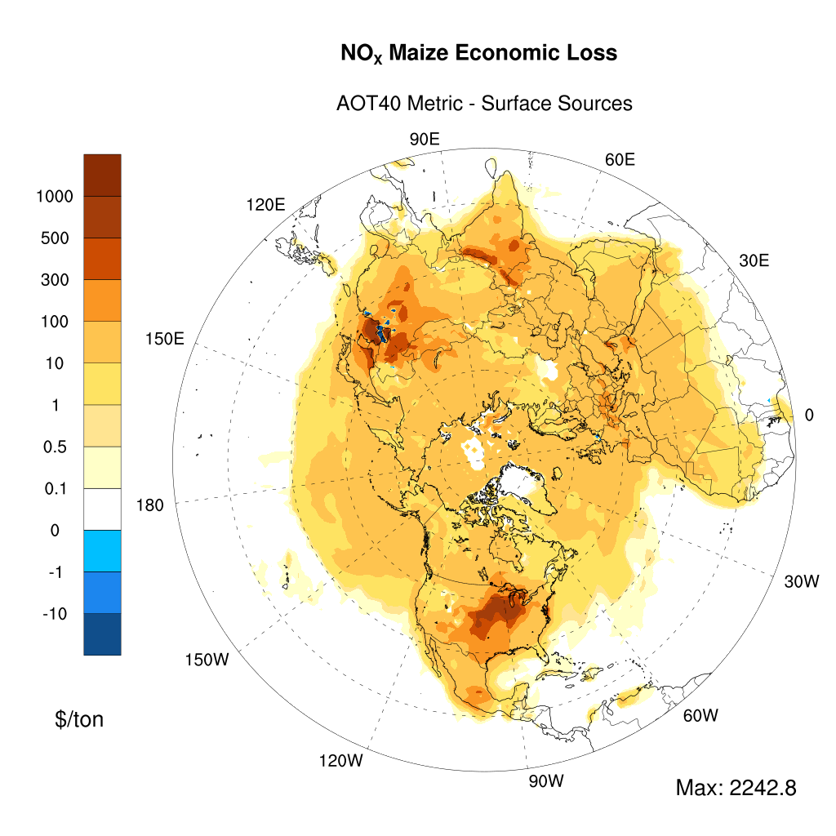
RESULTS : Maize

Slide 13
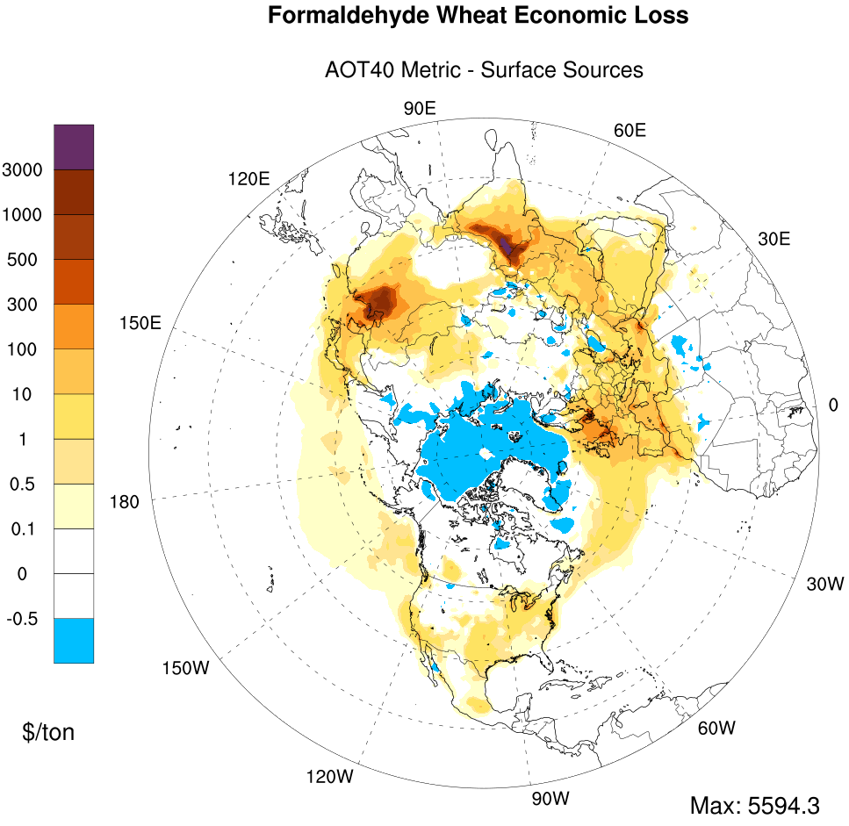
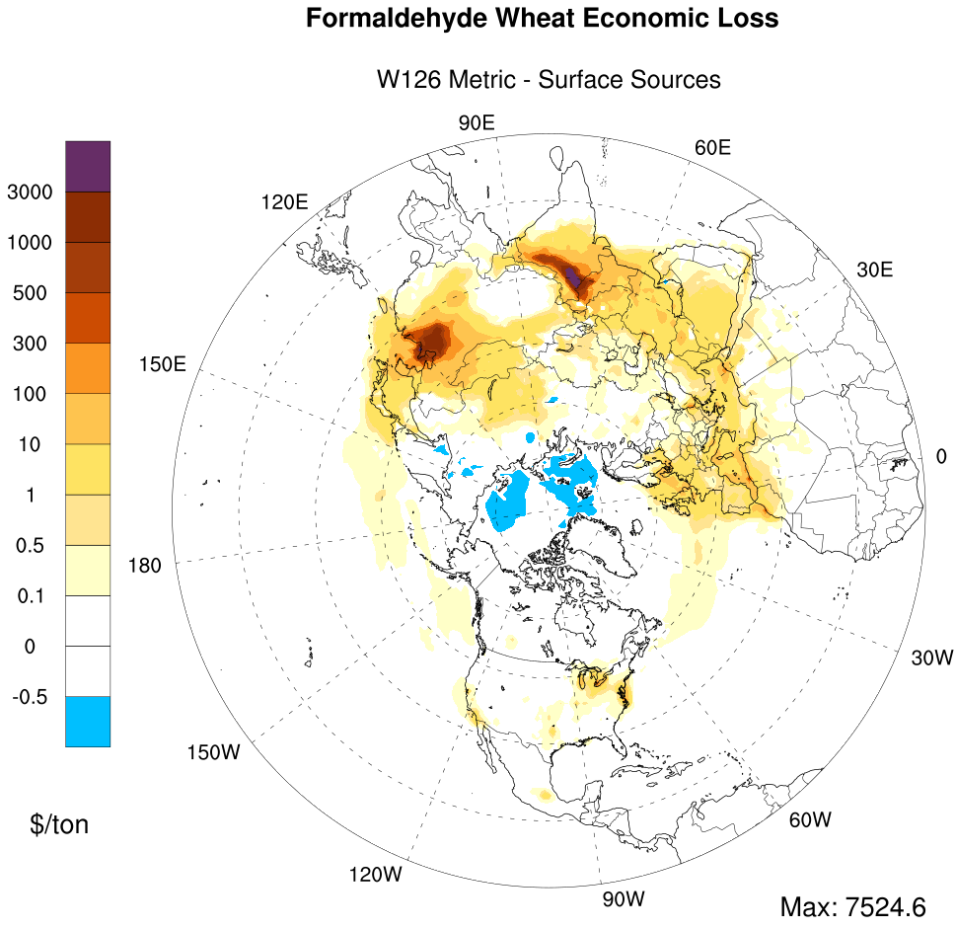
18th Annual CMAS Conference
October 2019
Notes:
As an example of VOCs, formaldehyde is shown here for two metrics and surface source. We have some negative sensitivities over all VOCs, so that s why I show you here only one species in VOCs. In over all, the most contribution is because of NOX emission.
Something that we r looking into.

Slide 14
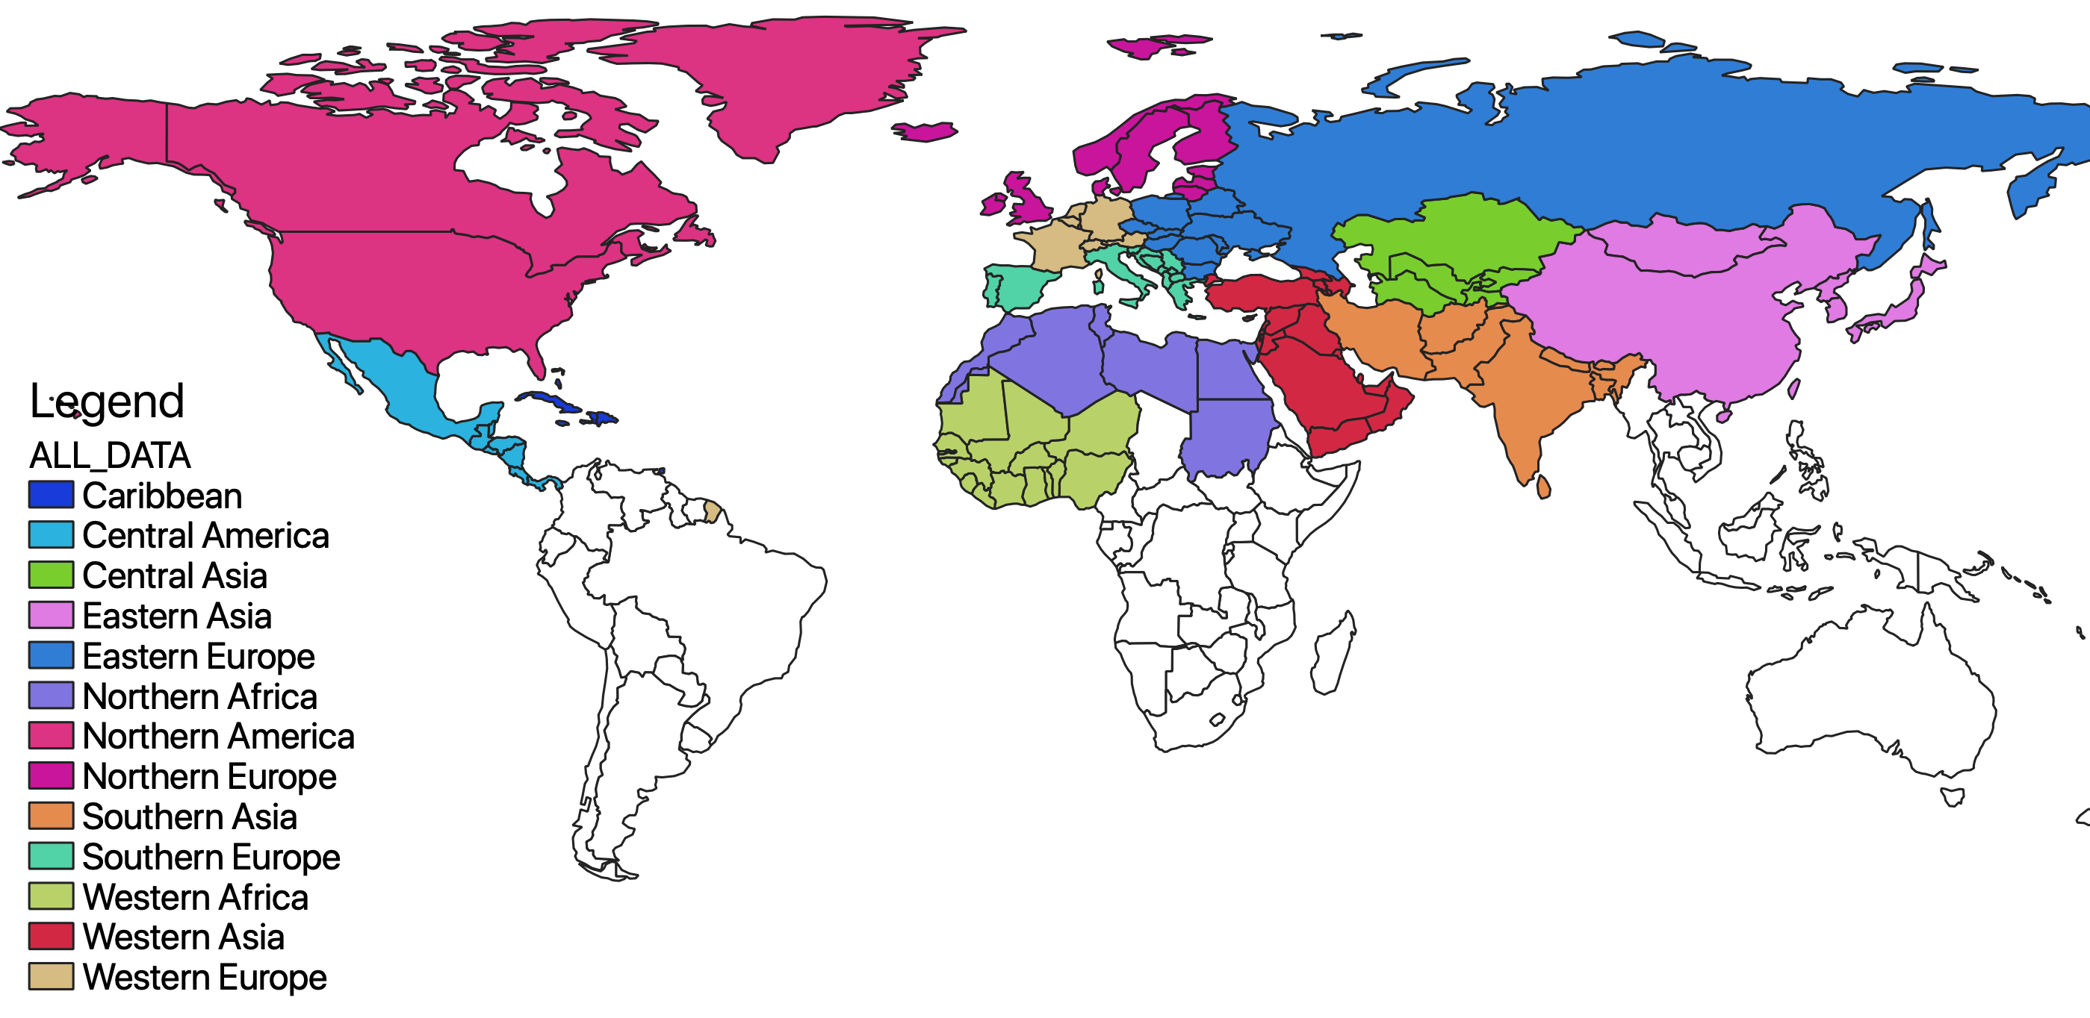
Regional Total Crop Economic Loss (NO_{X}, TRANSPORTATION)
 | Maize (Million USD) |  | Wheat (Million USD)
Regions | AOT40 | W126 | AOT40 | W126
Caribbean | 0.02 | 0.01 | 0.02 | 0.01
Central America | 85 | 0.2 | 51 | 4
Central Asia | 4 | 0.3 | 72 | 25
Eastern Asia | 828 | 107 | 4,527 | 4,397
Eastern Europe | 60 | 2 | 378 | 71
Northern Africa | 29 | 0.2 | 330 | 578
Northern America | 857 | 4 | 618 | 95
Northern Europe | 17 | 0.2 | 296 | 18
Southern Asia | 382 | 37 | 16,488 | 16,330
Southern Europe | 90 | 0.3 | 590 | 72
Western Africa | 0.3 | 0.00 | 0.39 | 0.10
Western Asia | 28 | 0.4 | 709 | 158
Western Europe | 79 | 0.2 | 584 | 38
Northern Hemisphere | 2,459 | 152 | 24,643 | 21,786
18th Annual CMAS Conference
October 2019

Slide 15
Regional Total Crop Economic Loss (NO_{X}, ENERGY)
Regions | Maize (Million USD) |  | Wheat (Million USD)
 | AOT40 | W126 | AOT40 | W126
Caribbean | 0.03 | 0.00 | 0.04 | 0.01
Central America | 25 | 0.02 | 22 | 2
Central Asia | 7 | 1 | 63 | 24
Eastern Asia | 899 | 114 | 4,646 | 4,651
Eastern Europe | 58 | 4 | 344 | 109
Northern Africa | 22 | 0.08 | 233 | 42
Northern America | 464 | 2 | 274 | 41
Northern Europe | 7 | 0.04 | 95 | 6
Southern Asia | 127 | 11 | 4,262 | 4,087
Southern Europe | 31 | 0.1 | 184 | 21
Western Africa | 0.1 | 0.00 | 0.3 | 0.1
Western Asia | 27 | 0.4 | 658 | 144
Western Europe | 13 | 0.1 | 118 | 8
Northern Hemisphere | 1,680 | 133 | 10,899 | 9,135
18th Annual CMAS Conference
October 2019

Slide 16
RESULTS FOR North America

Slide 17
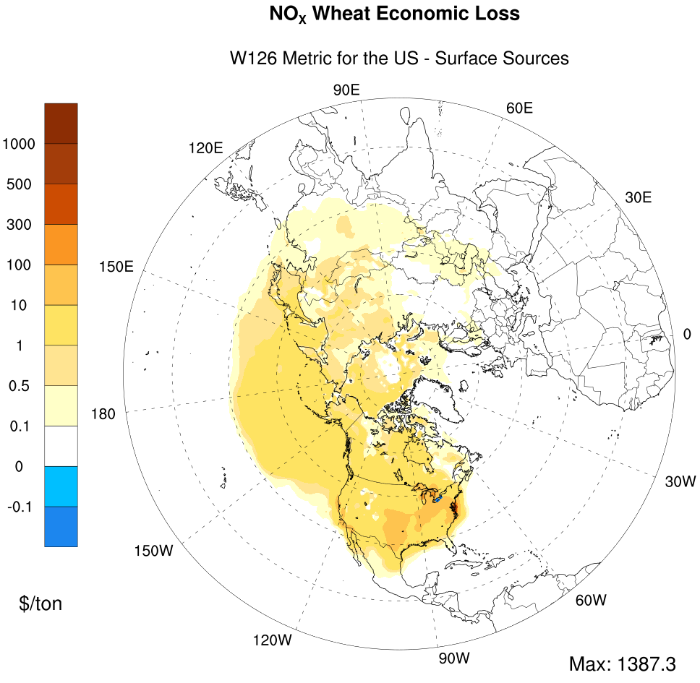
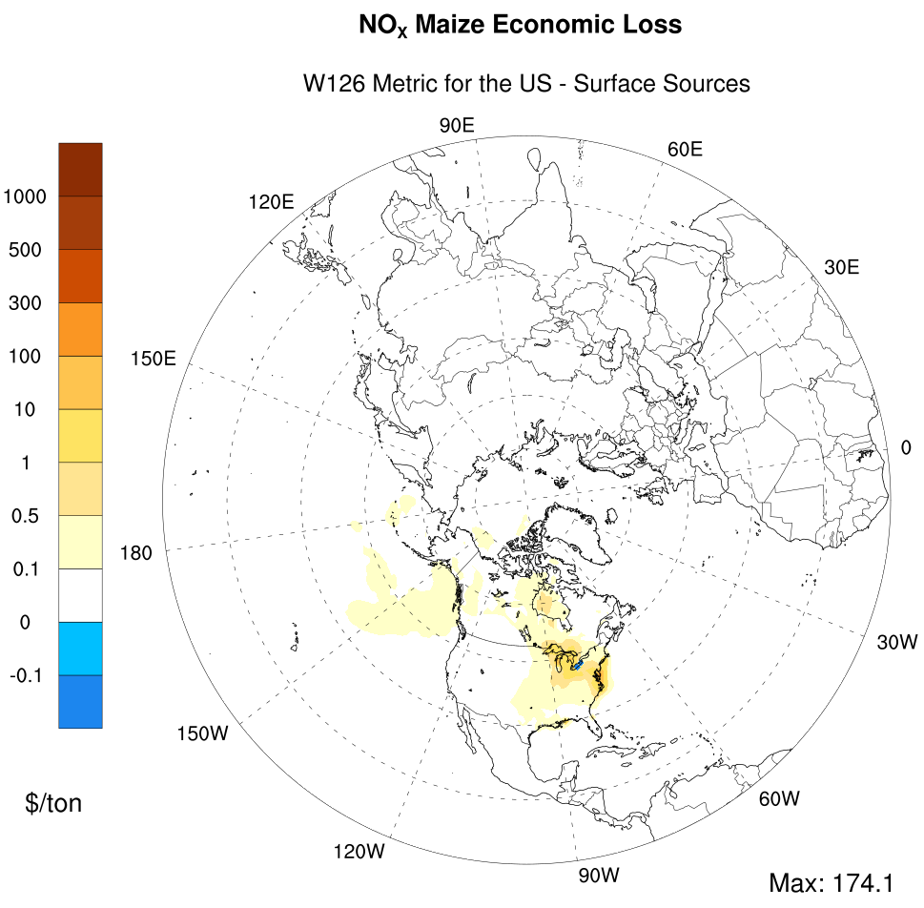
RESULTS FOR W126 CR function

Slide 18
Total Crop Economic Loss in North America (NO_{X}, Source-Specific)
Region/Source | Transportation (Million USD) |  | Energy (Million USD) |  | All Sources (Million USD)
 | Maize | Wheat | Maize | Wheat | Maize | Wheat
Asia | 0.3 | 4 | 0.1 | 2 | 0.6 | 8
Europe | 0.2 | 1 | 0.1 | 0.5 | 0.4 | 2
North America | 3 | 62 | 1.5 | 28 | 12 | 193
Other Regions | 0.2 | 0.7 | 0.01 | 0.5 | 0.3 | 2

Slide 19
RESULTS FOR Europe

Slide 20
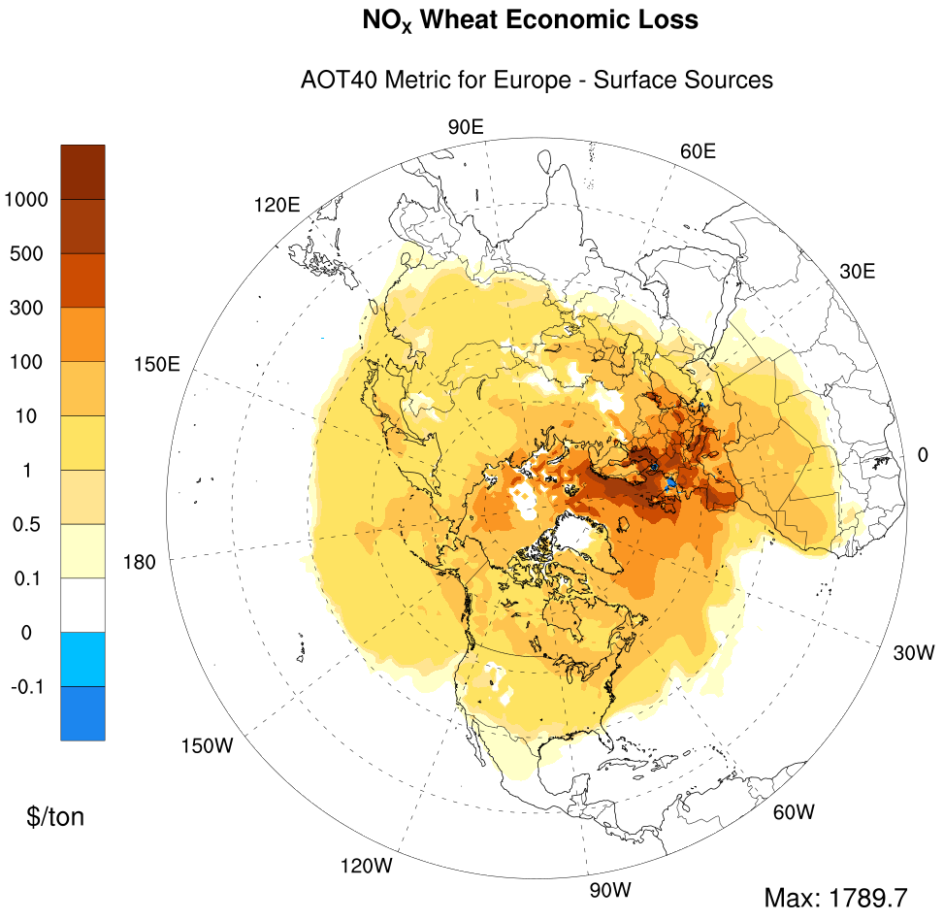
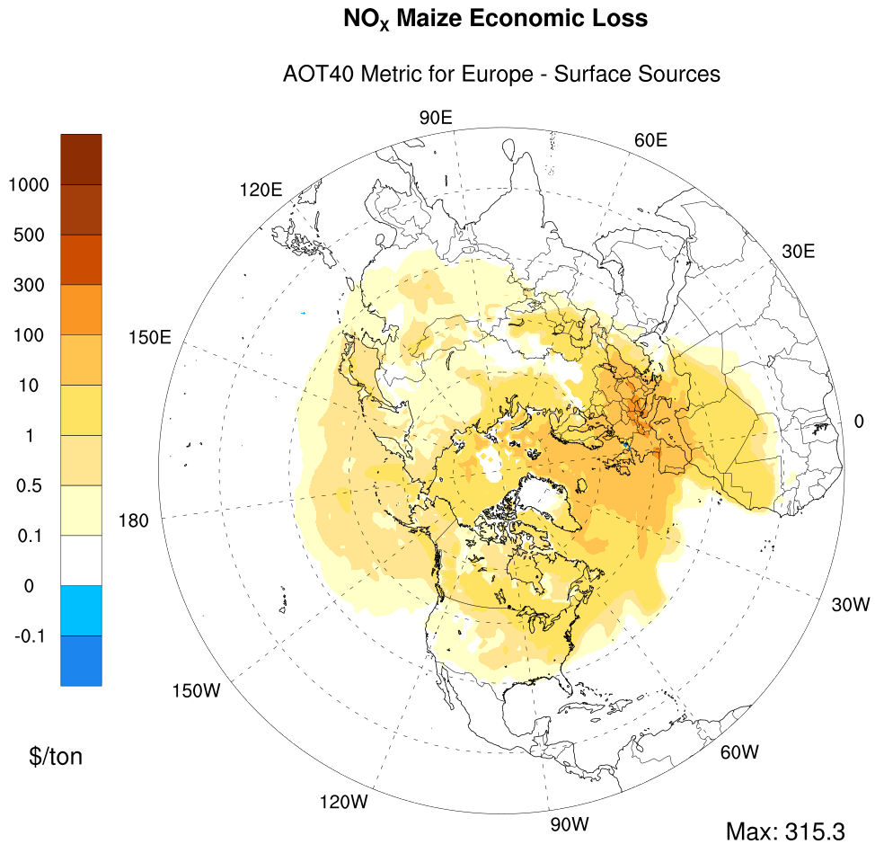
RESULTS FOR AOT40 CR function

Slide 21
Total Crop Economic Loss in Europe (NO_{X}, Source-Specific)
Region/Source | Transportation (Million USD) |  | Energy (Million USD) |  | All Sources (Million USD)
 | Maize | Wheat | Maize | Wheat | Maize | Wheat
Asia | 3 | 22 | 3 | 19 | 10 | 70
Europe | 205 | 1409 | 66 | 474 | 423 | 2874
North America | 6 | 45 | 2 | 16 | 13 | 99
Other Regions | 4 | 21 | 3 | 17 | 11 | 62

Slide 22
Summary – All sources
 | Maize (Billion USD) | Wheat (Billion USD)
Northern Hemisphere | 0.5 – 7.1 | 50.7 – 60.4
India | 0.07 – 0.7 | 21.7 – 24.6
China | 0.4– 2.8 | 14.6 - 14.7
North America | 0.02 – 2.3 | 0.3 – 1.5
Europe | 0.01 – 0.6 | 0.6 - 4
Notes:
Instead of reporting a number for each crop type, I show you the range of crop economic loss with lower bound and higher bound for each region. China and North America as the biggest producer of maize has larger economic loss, Around 5 billion USD. Larger economic loss for wheat seemed to be appear in India and China (Almost the half).

Slide 23
O3 Exposure-yield response equations
18th Annual CMAS Conference
October 2019
Notes:
The difference in Maize and Wheat economic loss again can be explained with the yield response function. Most of the Ozone exposure metric values are lower than 50, in a couple of cases above 50 ppb. So this is one another reason why AOT40 is larger than W126 for maize.

Slide 24
CONCLUSION
Crop economic loss from transportation sources is estimated to be 0.2 – 2.5 Billion USD for maize, while it is 21.7 – 24.6 Billion USD for wheat. For energy sources, economic loss is valued 0.1-1.7 Billion USD for maize and 9.1 – 10.9 Billion USD for wheat.
India and China show larger damage than North America and Europe in the Northern Hemisphere.
USA case study (W126 metric used) shows that Asian contribution is larger than European contribution. Most of the economic loss is projected due to North American sources (193 million USD for Wheat, 12 million USD for maize).
Europe case study (AOT40 metric used) shows that North American emissions have more economic loss contribution to Europe than emissions from other non-European regions
VOC sensitivities are smaller than NOX sensitivities in both crops and metrics.
Selection of exposure-yield function has a significant role in projecting the economic loss/benefit.
18th Annual CMAS Conference
October 2019

Slide 25
Acknowledgements
Funding from the Health Effects Institute, Natural Science and Engineering Research Council of Canada, Health Canada
Computational resources from Compute Canada

Slide 26

Thank you!

Slide 27
REFERENCES
Food and Agriculture Organization of the United Nations (FAO), (2019). FAOSTAT Database, Available from http://faostat.fao.org/ (Accessed July 3, 2019).
Sinha et .al (2015). Assessment of crop yield losses in Punjab and Haryana using two years of continuous in-situ ozone measurements, International Workshop on Atmospheric Chemistry and Agricultural Meteorology, Pune, India, November, 2015.
EEA (1999). Environmental assessment Report No. 2, Environment in the European Union at the turn of the century, European Environ- ment Agency, Copenhagen, pp.446.
USEPA (1996). Air quality criteria for ozone and other photochemical oxidants, Vol.II. EPA-600/p-93/00bf, US Environmental Protection Agency, National Center For Environmental Assessment, NC, USA (Tech. Rep.)
Mills, G., Buse, A., Gimeno, B., Bermejo, V., Holland, M., Emberson, L., and Pleijel, H. (2007) A synthesis of AOT40-based response functions and critical levels of ozone for agricultural and horticultural crops, Atmos. Environ., 41, 2630–2643.
Wang, X. P. and Mauzerall, D. L. (2004). Characterizing distributions of surface ozone and its impact on grain production in China, Japan and South Korea: 1990 and 2020, Atmos. Environ., 38, 4383– 4402.
Monfreda, C., N. Ramankutty, and J. A. Foley (2008), Farming the planet: 2. Geographic distribution of crop areas, yields, physiological types, and net primary production in the year 2000, Global Biogeochem. Cycles, 22, GB1022, doi:10.1029/2007GB002947.

Slide 28
EXTRA SLIDES

Slide 29
AOT40 vs W126
Ozone exposure indices
Relative Yield Loss

Slide 30
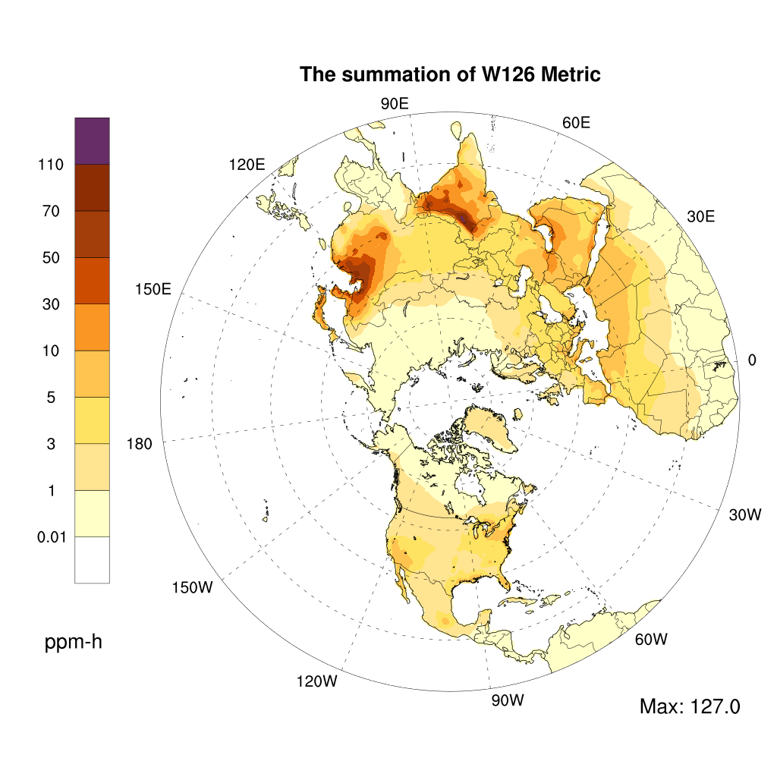
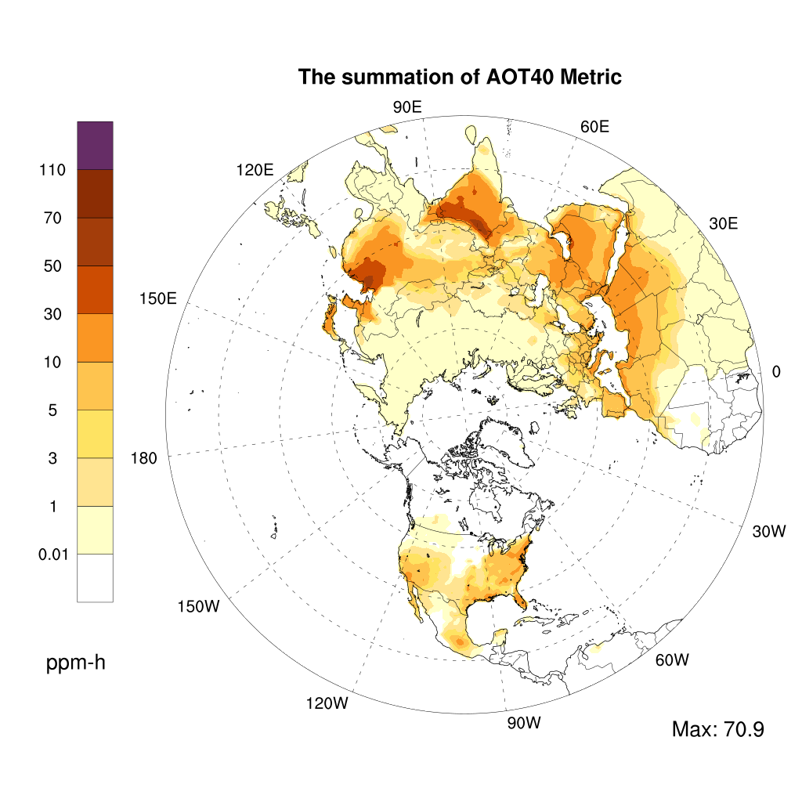
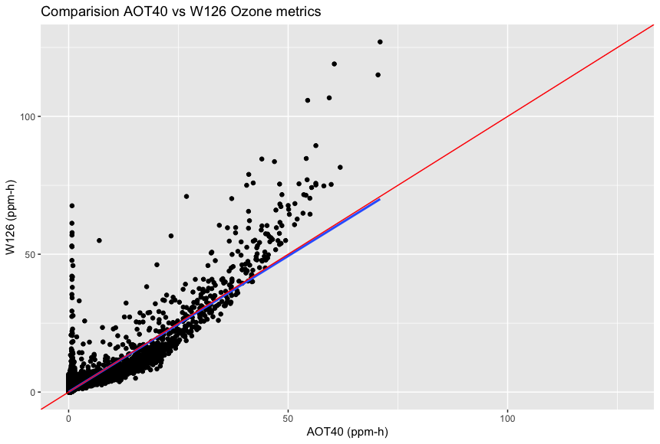
Ozone metrics

Slide 31
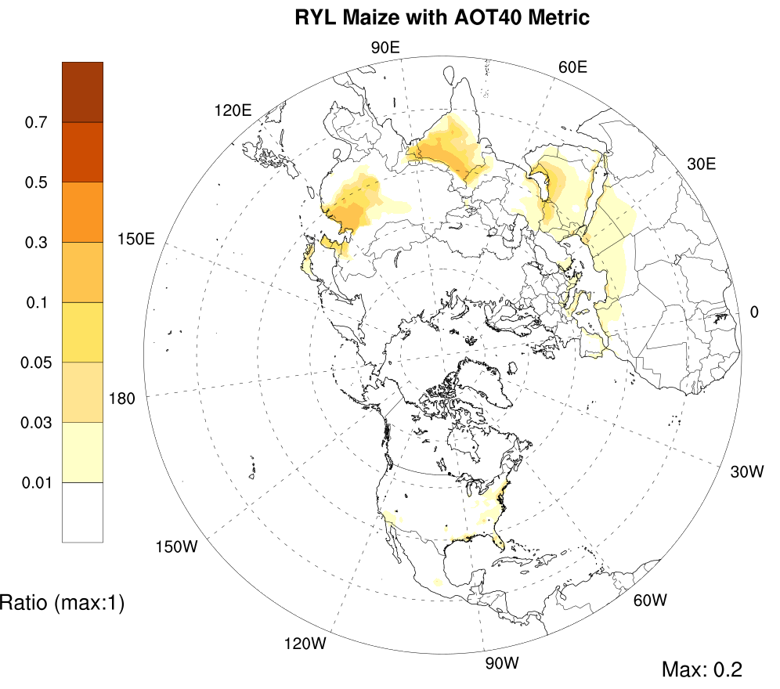
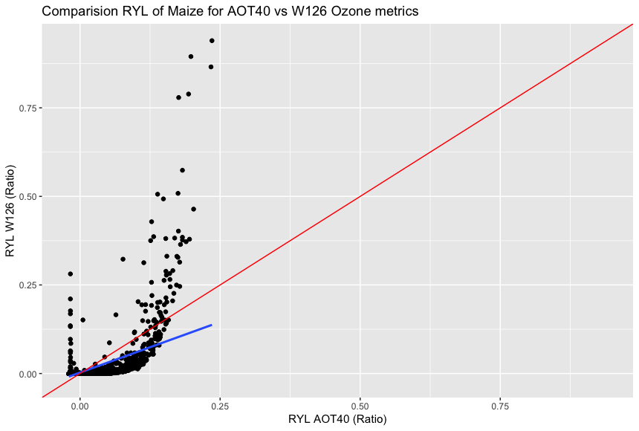
RYL for Maize (AOT40 vs W126)

Slide 32
O3 Exposure-yield response equations
18th Annual CMAS Conference
October 2019

Slide 33
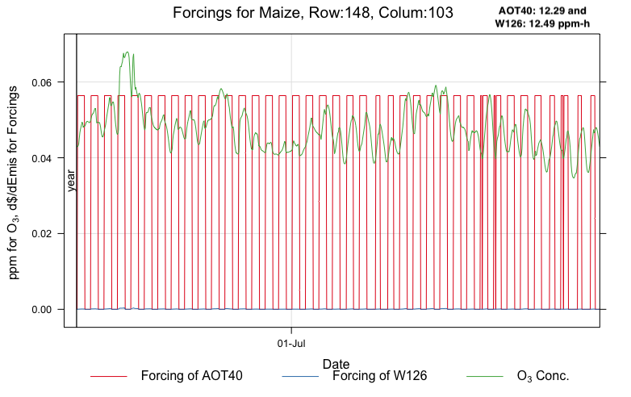
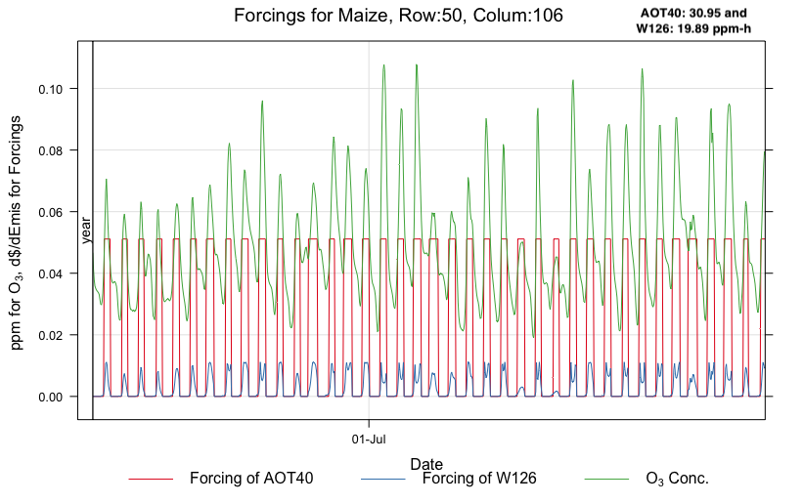
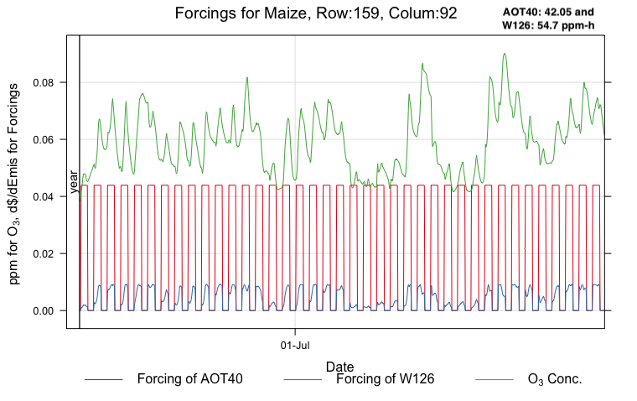
Time series plots (3 locations)

Slide 34
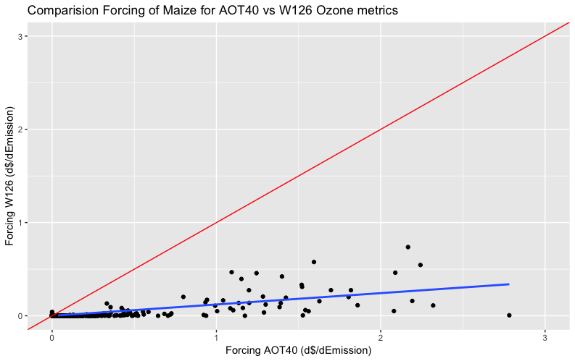
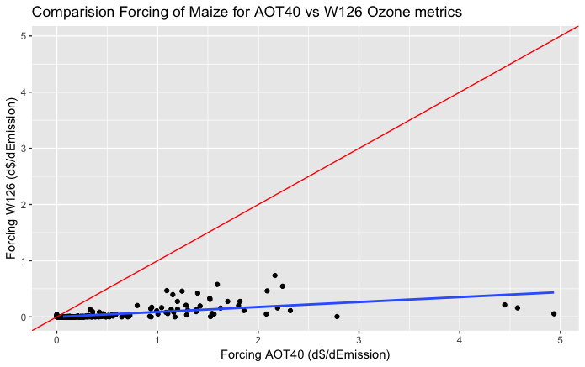
Scatter Plot of Forcings AOT40 vs W126 (maize)

