Slide 1
Assessing the Impacts of Emissions from Oil and Gas Extraction on Urban Ozone and Associated Health Risks
Congmeng Lyu, Shannon L. Capps, Daven K. Henze,
Amir Hakami, Shunliu Zhao, Rene Nsanzineza, Jana B. Milford
CMAS Conference 2019

Slide 2
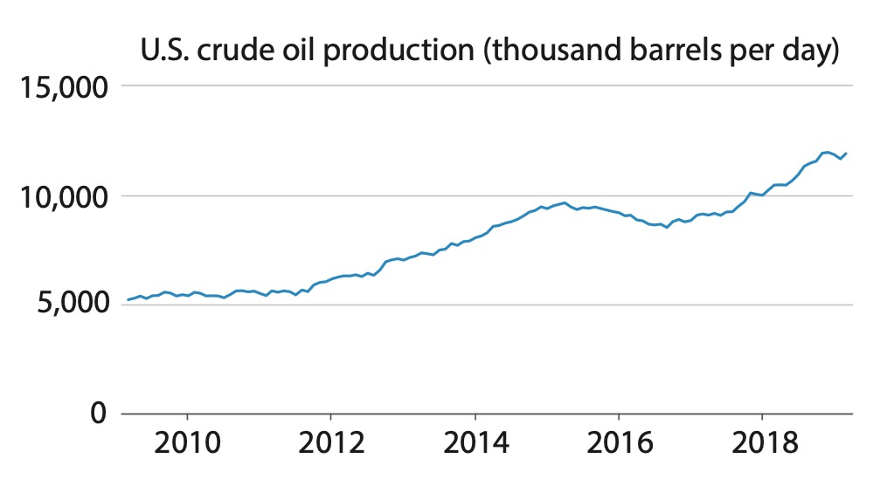
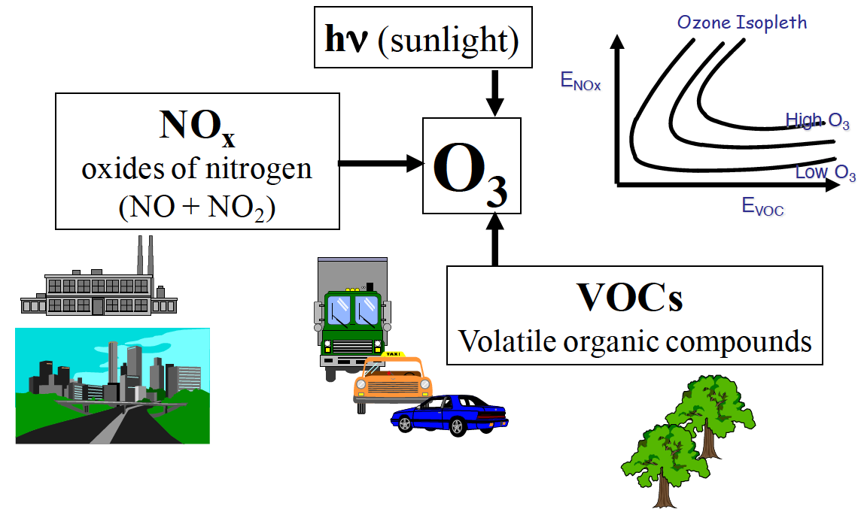
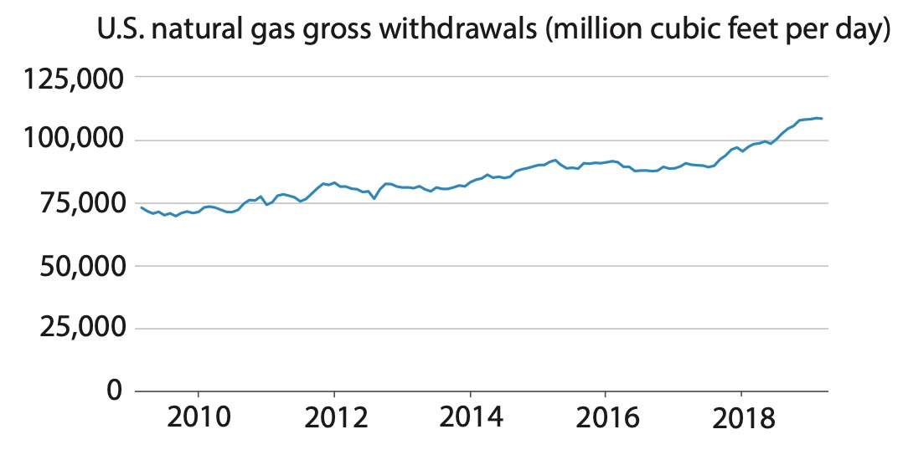
Motivation: trend of oil and natural gas (O&NG) production
Ozone formation. Source: Ted Russell, Georgia Tech
Source: U.S. Energy Information Administration
Notes:
Text too small, enlarged
Slide numbers, added, make sure not covering it.

Slide 3
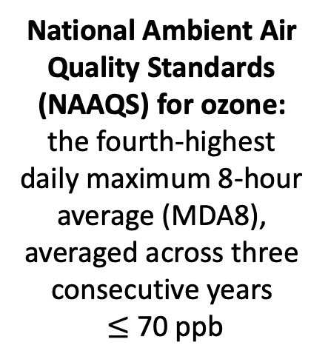
Motivation: MDA8 exceedances
National Ambient Air Quality Standards (NAAQS) for ozone:
the fourth-highest
daily maximum 8-hour average (MDA8),
averaged across three consecutive years
$≤$ 70 ppb
Source: U.S. EPA
Notes:
Have to find a way to explain why we choose Denver CSA only
Best it is marginal, almost passed, so they want to have emission controls that attain the standard.

Slide 4
Motivation: MDA8 exceedances
Question 1:
How much MDA8 exceedance in the Denver CSA may be attributed to emissions from O&NG production in Colorado, Utah, and Wyoming?
Denver Combined Statistical Area (CSA)
Notes:
Label larger
Colors

Slide 5
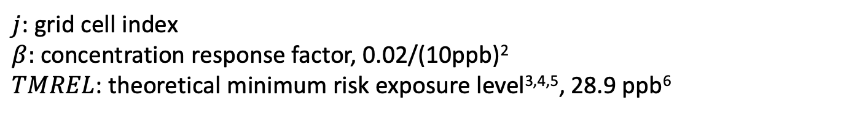
Motivation: health effects of ground-level ozone
M: Estimated ozone-related mortality
M₀: Baseline mortality
C: Annual mean of MDA8 ozone, 2007
$j$: grid cell index
$β:$ concentration response factor, 0.02/(10ppb)²
$TMREL$: theoretical minimum risk exposure level^{3,4,5}, 28.9 ppb⁶
¹Jerrett et al., 2009; ²Turner et al., 2016; ³Lim et al., 2014; ⁴Cohen et al., 2017; ⁵Liang et al., 2018; ⁶Malley et al., 2017.
Notes:
Label larger
Colors

Slide 6
Motivation: health effects of ground-level ozone
Question 2:
How many ozone-related premature mortalities in the Denver CSA may be attributed to emissions from O&NG production in Colorado, Utah, and Wyoming?
M: Estimated ozone-related mortality
Notes:
1:30

Slide 7
Motivation: previous VOC source apportionment work
Measurement campaign:
Ozone Precursor Study conducted by Colorado Department of Public Health & Environment (CDPHE) Air Pollution Control Division.
Flasks analyzed for 79 non-methane organic compounds.
3-hr samples acquired from 6 a.m. to 9 a.m. M.S.T.
Source apportionment:
Positive Matrix Factorization (PMF)
Notes:
But, oil and gas production is not the only source of ozone precursor emissions. Understanding the relative contributions from different sources are important.
Because transportation and photochemical reactions are relatively weak in the early morning. That means these observations can well represent local emissions.

Slide 8
PMF source apportionment
Speciation profiles as percent of species in each PMF factor with variability⁷.
⁷Capps et al., in review
Notes:
O&NG from Platteville are larger
Traffic and urban from Denver are larger

Slide 9
Q1’ & Q2’
How much MDA8 exceedance (Q1’) and
how many ozone-related premature mortalities (Q2’)
in the Denver CSA may be attributed to each of the PMF factors?
Notes:
Conclusions are answers to these questions

Slide 10
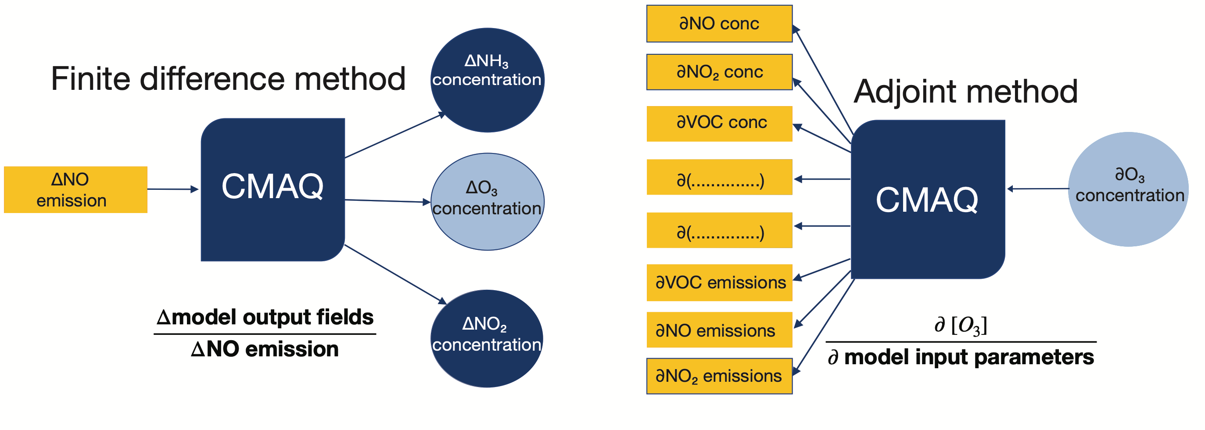
Method: CMAQ-adjoint sensitivity analysis
Notes:
To answer these questions

Slide 11
Method: CMAQ-adjoint sensitivity analysis

Slide 12
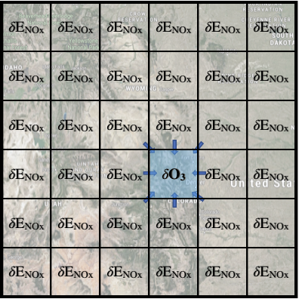
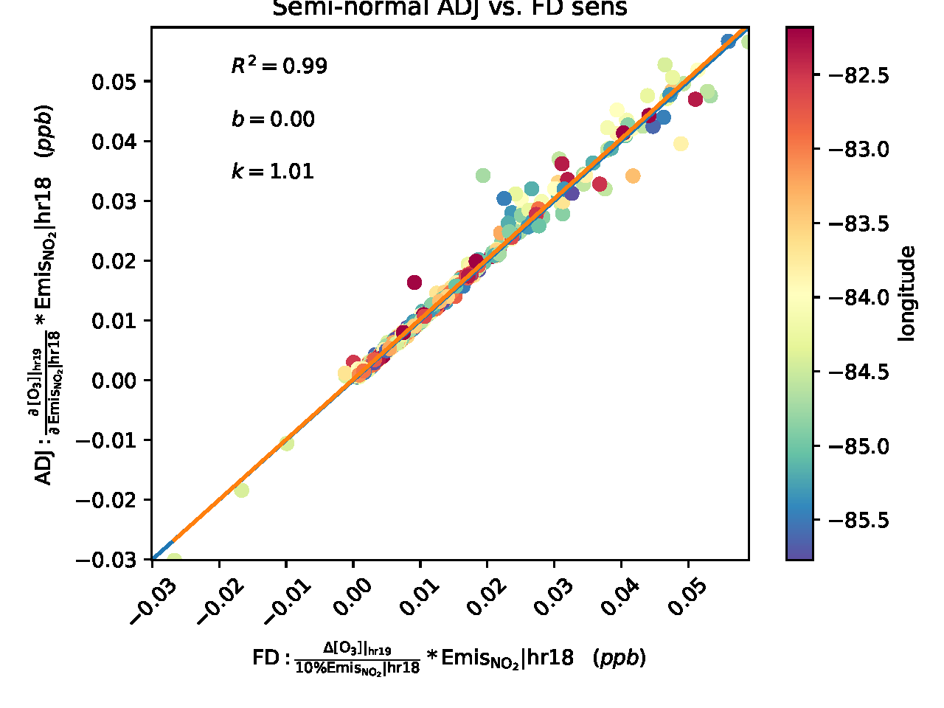
Method: CMAQ-adjoint sensitivity analysis
CMAQ-adjoint evaluation

Slide 13
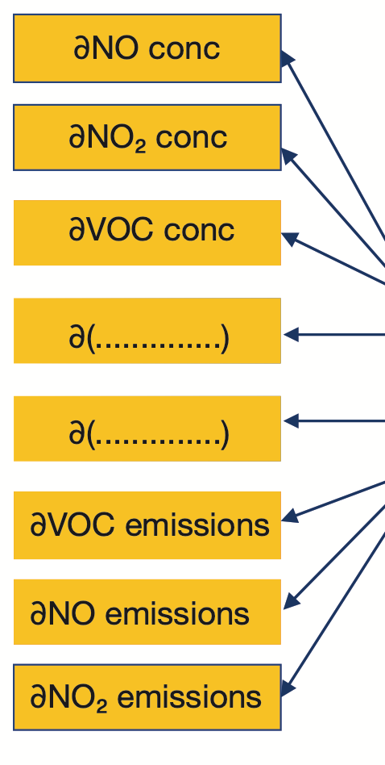
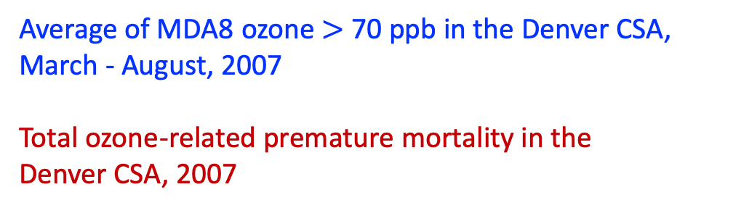




Method: cost function & adjoint forcing function
Adjoint forcing function
$Adjoint sensitivity= \frac{∂Cost Function}{∂ Model inputs}$ = $\frac{∂[O3]}{∂ Model inputs}$ $∗\frac{∂Cost Function}{∂[O3]}$
$$∂ Model inputs$$
Backward model run
$$∂Cost Function$$
$∂\overline{MDA8}:$
Average of MDA8 ozone $>$ 70 ppb in the Denver CSA, March - August, 2007
Total ozone-related premature mortality in the
Denver CSA, 2007
$∂Mort:$
Notes:
Maybe some visually easy way to explain this page
Add count of exceedances days in Denver CSA in backup slides

Slide 14
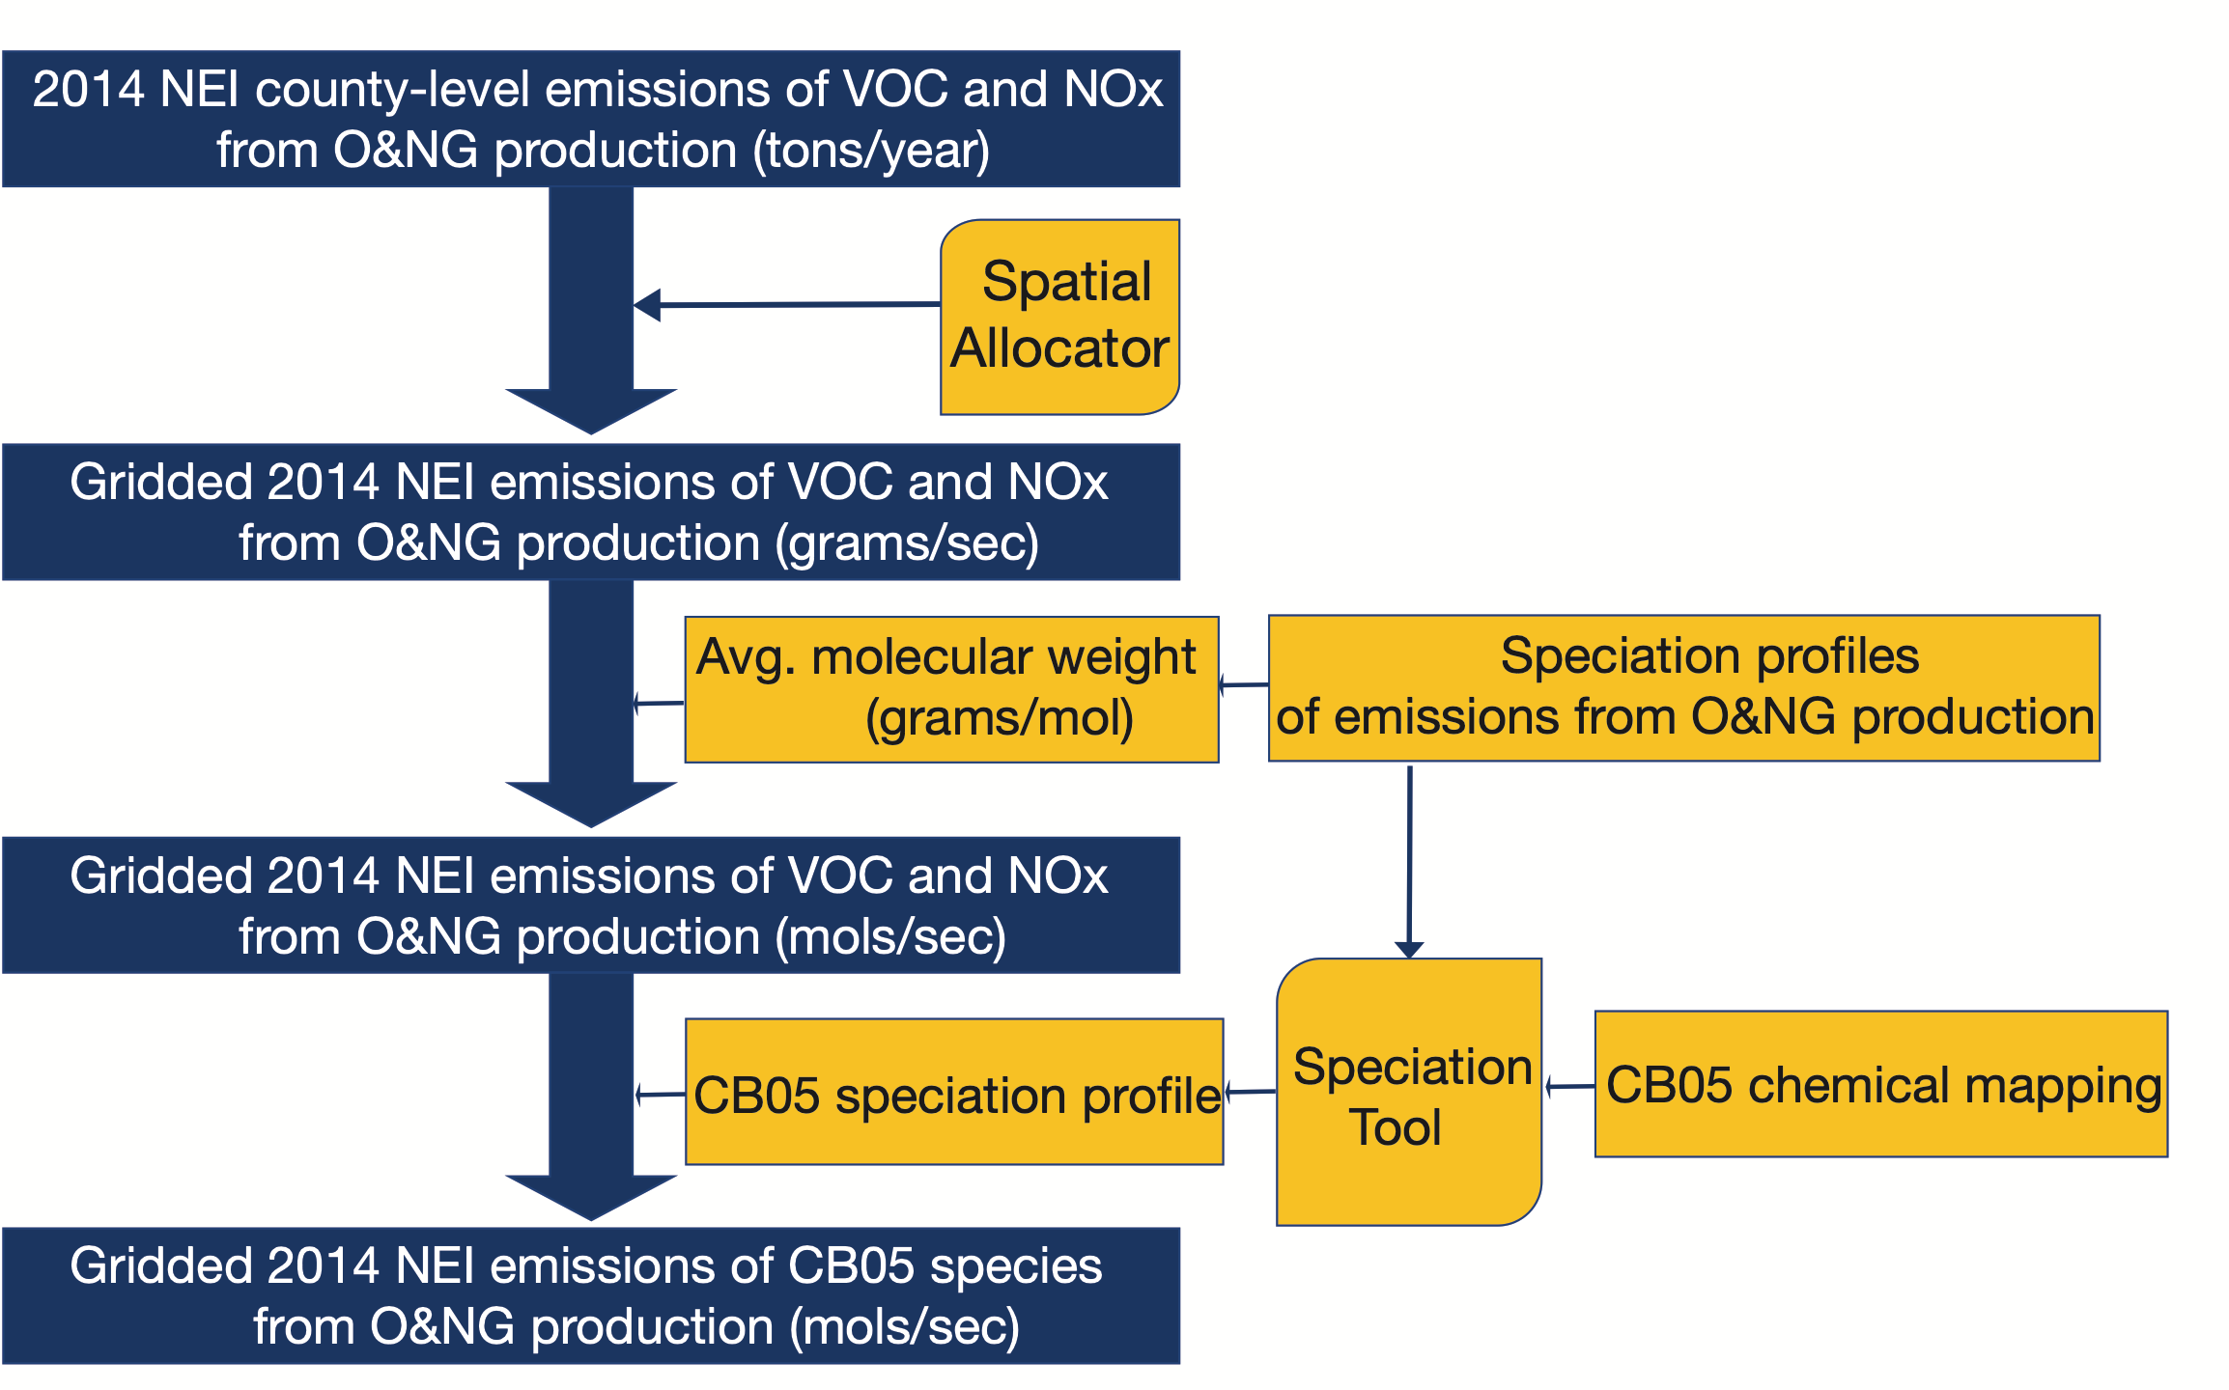
Method: emissions data
O&NG emissions
Non-O&NG emissions
2008 National Emissions Inventory (NEI) Version 2
Motor Vehicle Emission Simulator (MOVES) Version 2010b
Combine with Sparse Matrix Operator Kernel Emissions (SMOKE)

Slide 15
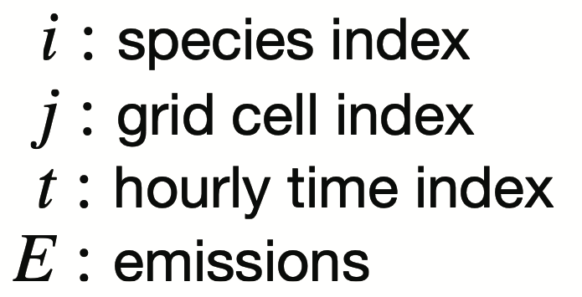
Results: emissions
Spatial allocated O&NG emissions
Speciation profile of modeled VOC emissions from O&NG production (%)
Notes:
Avoid tables at all cost, Pie charts, did
Show one part at a time, did

Slide 16
Results: emissions
Speciation profile of modeled VOC emissions from O&NG production (%)
Spatial allocated O&NG emissions
Notes:
Avoid tables at all cost, Pie charts
Show one part at a time

Slide 17
Results: emissions
Speciation profile of modeled VOC emissions from O&NG production (%)
Spatial allocated O&NG emissions
Spatial allocated other emissions
Notes:
Avoid tables at all cost, Pie charts
Show one part at a time

Slide 18
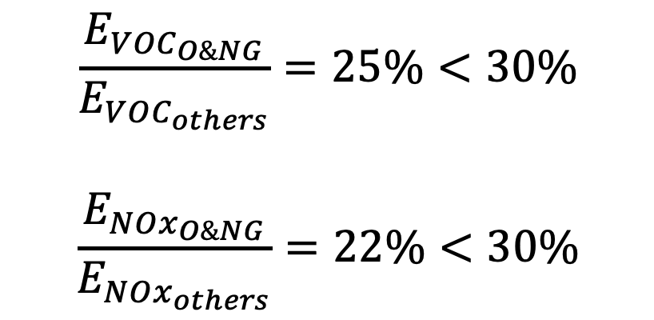
Results: emissions
$$\frac{E_{{VOC}_{O\&NG}}}{E_{{VOC}_{others}}}=25\%<30\%$$
$$\frac{E_{{NOx}_{O\&NG}}}{E_{{NOx}_{others}}}=22\%<30\%$$
Notes:
Why the adjoint approach works?
Within 30% change in emissions.

Slide 19
Results: contributions to MDA8 exceedance from O&NG emissions
$i:$species index $j:$grid cell index $t:$hourly time index $E:$emissions
Notes:
Increase scientific notation size in AI, maybe big enough give an example of data
Add stacked bar charts, emissions and MDA8 contributions

Slide 20
Results: contributions to MDA8 exceedance from O&NG emissions
Notes:
Eventhough

Slide 21
Results: contributions to premature mortality from O&NG emissions
Notes:
Add stacked bar charts, emissions and MDA8 contributions, mortality contributions

Slide 22
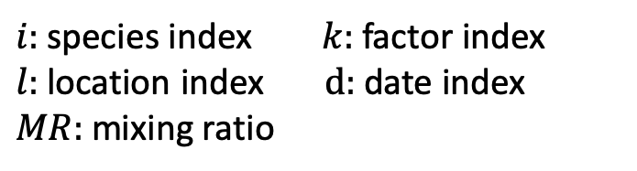
Results: contributions to MDA8 exceedance from each PMF factors
$i:$species index $k:$ factor index $l:$location index $d:$ date index $MR:$ mixing ratio
Adjoint-weighted PMF contributions from Denver and Platteville monitoring sites
Apparent increase from
2013 -2015
Notes:
Highlight the novelty of PMF + adjoint
Hourglass
how these are calculated

Slide 23
Results: contributions to MDA8 exceedance from each PMF factors
Apparent increase across the three years
Traffic and urban contribute most from Denver
O&NG contribute most from Platteville
Notes:
Add bullet points

Slide 24
Results: contributions to premature mortality from each PMF factors
$i:$species index $k:$ factor index $l:$location index $d:$ date index $MR:$ mixing ratio
Adjoint-weighted PMF contributions from Denver and Platteville monitoring sites
No clear trend from
2013-2015

Slide 25
Results: contributions to premature mortality from each PMF factors
No clear trend across the three years
Traffic and urban contribute most from Denver
O&NG contribute most from Platteville

Slide 26
Conclusion
Emissions from O&NG activities in CO, UT, and WY are estimated to contribute to
0.4 ppb MDA8 exceedance/(grid cell * day) and
6 ozone-related premature deaths/year in Denver CSA.
Controlling NOx emissions from O&NG activities is more effective than controlling VOC emissions.
The contributions to MDA8 exceedance from PMF factors summed together seem to increase over time.
The contributions to premature mortality from PMF factors summed together do not show a clear trend over time.
Notes:
1-3 to questions, done
Key point,

Slide 27
Acknowledgements
CMAQ adjoint development team
Kirk Baker, Rob Pinder, EPA OAQPS: modeling platform
Colorado Department of Public Health & Environment (CDPHE)
Air Pollution Control Division
Notes:
Do we add coauthors’ acknowledgement here?

Slide 28
Backup: contributions to MDA8 exceedances from emissions
from 2014 NEI O&NG Emissions
from equivalent amount of other emissions
Notes:
Add the same info for other emissions

Slide 29
Backup: contributions to premature mortality from emissions
from 2014 NEI O&NG Emissions
from equivalent amount of other emissions

Slide 30
Backup: contributions to premature mortality from O&NG emissions
$i:$species index. $j:$grid cell index. $t:$hourly time index. $E:$emissions
Notes:
Add stacked bar charts, emissions and MDA8 contributions, mortality contributions

Slide 31
Average nonattainment days in each month
Months | Days
Jan | 0
Feb | 1
Mar | 3
Apr | 3
May | 5
Jun | 6
Jul | 7
Aug | 3
Sep | 1
Oct | 0
Nov | 0
Dec | 0

