Slide 1
CAMx Ozone Source Apportionment Application over the Northern Hemisphere
Flux measurement at CA-Ca3 FLUXNET site
Photo by A. Christen, UBC Geography
Greg Yarwood, Chris Emery, Pradeepa Vennam ( Ramboll )
Jim Smith (TCEQ)
pvennam@ramboll.com
2019 CMAS- 18th Annual conference
October 21 - 23, 2019, Chapel Hill, NC

Slide 2
Acknowledgments and Disclaimer
Portions of this work were supported by contract from the State of Texas through the Texas Commission on Environmental Quality (TCEQ)
US EPA provided extensive model input data and supported the new boundary concentration interface
The content, findings, opinions and conclusions are the work of the author(s) and do not necessarily represent findings, opinions or conclusions of the TCEQ

Slide 3
Objectives
Improve the characterization of “background” ozone within regional (continental) air quality simulations
Apportion ozone in hemispheric scale simulations
Transfer the hemispheric ozone source apportionment to a nested domain via boundary concentrations (BCs)
Hemispheric domain
Regional domain

Slide 4
Current Modeling Practice
Perform global model (GEOS-Chem, WACCM, CAM-chem, Hemispheric-CMAQ)
Derive ozone apportionment by brute force emission perturbations
  e.g. ZROW: zero-out rest of world anthropogenic emissions
  Zero-out is time consuming
  Zero-out has technical limitations for non-linear ozone chemistry

Slide 5
Ozone Apportionment (OSAT) in Hemispheric CAMx (H-CAMx)
Model Chemistry
CAMx includes tagged-species ozone apportionment (OSAT)
Update CAMx to work at hemispheric scale (H-CAMx)
Connect OSAT in H-CAMx to OSAT in the regional model
  More efficient and consistent
  Enable better resolution of transported contributions to background ozone

Slide 6
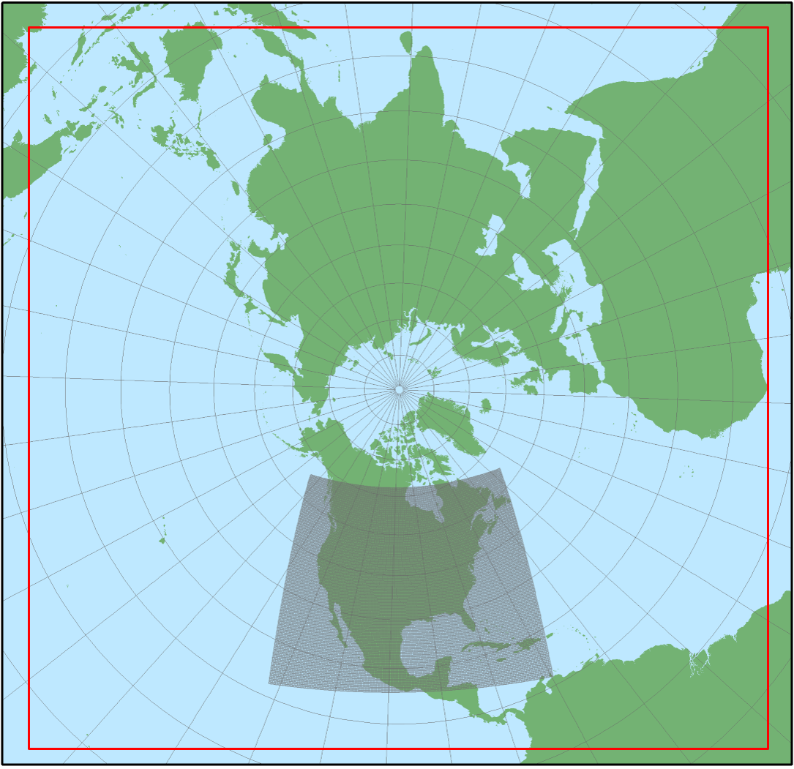
H-CAMx Setup
Build upon hemispheric CMAQ input database
  Thanks to US EPA
108 km grid in polar stereographic coordinates
WRF for 2016
Emissions from EPA
  EDGAR-HTAP, US, Canada, Mexico, China, biogenic, wildfire, lightning
Differences from EPA
  Oceanic, windblown dust emissions
  BCs from GEOS-chem
CAMx improvements
  Diagnose the tropopause and replace stratospheric ozone using top BC (from GEOS-chem)
  OSAT I/O improvements
Run time per single day (24 cores)
  H-CAMx without OSAT – 22 mins
  H-CAMx with OSAT – 35 mins

Slide 7
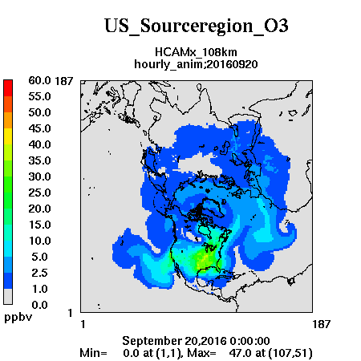
Ozone from US emission (anthro and non-anthro)
1.5 month OSAT test
Showing example from September 20-25, 2016
Expected transport to Europe
  Including Arctic regions
Also transport into Pacific
108 km resolution over-produces ozone in Midwest
  Should expect similar bias for other regions
  Finer grid resolution is very feasible

Slide 8
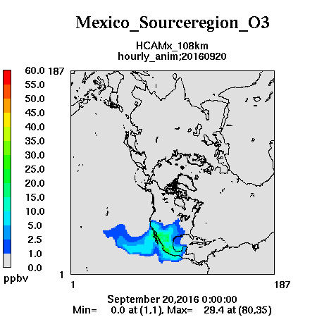
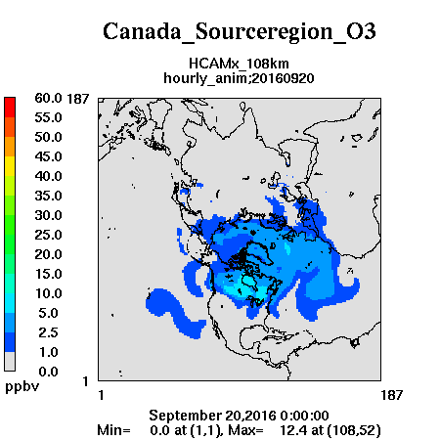
Ozone from Canada and Mexico emission
Mexico
Canada

Slide 9
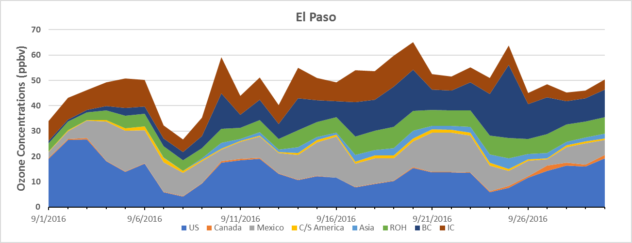
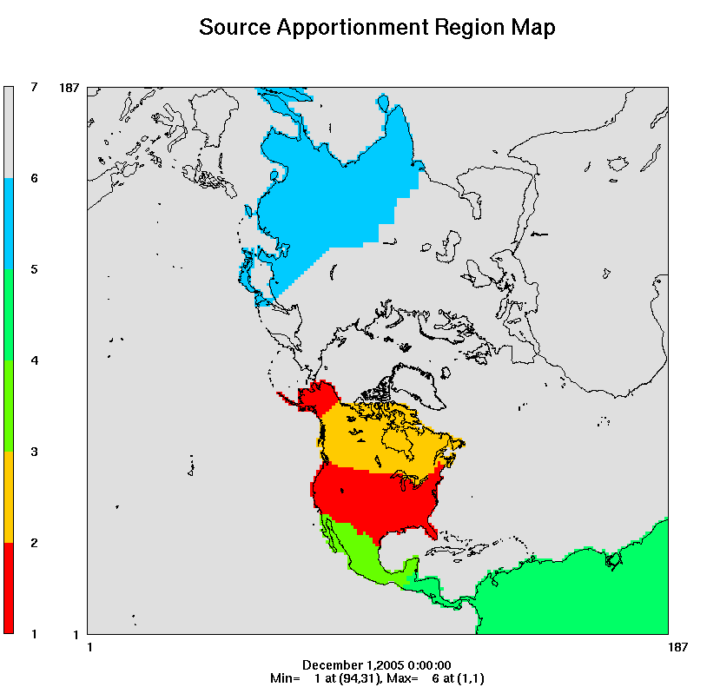
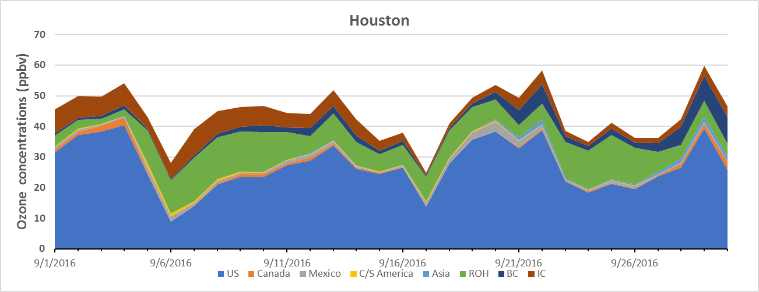
Ozone source apportionment from H-CAMx
El Paso, Texas
7 OSAT Source Regions
El Paso
IC
BC
Other
back-ground
Houston
Mexico
Asia
US
Houston, Texas
Different source contributions to background ozone in Houston (coastal) and El Paso (mountains)
Next step: run regional CAMx using apportioned ozone BCs from H-CAMx
back-ground
US
September, 2016

Slide 10
Creating Apportioned BC inputs for OSAT/PSAT
A new pre-processor creates OSAT BC input files
Option 1: H-CAMx with OSAT
run HCAMx with SAT
extract BCs
run regional CAMx with OSAT
Option 2: Not using H-CAMx
run global model
run global model again
extract BCs
reconcile several BC files
translate to OSAT
run regional CAMx with OSAT

Slide 11
New in CAMx v7
Science
Bi-directional NH₃ within Zhang dry-deposition scheme with landuse-dependent compensation point
Terpene SOA yields now include ELVOC and are NOx-dependent (tendency to reduce SOA)
Sulfate from dimethyl sulfide (DMS) emitted by OCEANIC pre-processor
Optional explicit elemental species: Fe, Mg, Mn, Ca, K, Al, Si, Ti (one or many, and included in PSAT)
Probing Tool
OSAT/PSAT: 3-D output and BC/IC input updates
DDM: very large number of sensitivities enabled (“64-bit” update)
CSA: new probing tool for Chemical Sensitivity Analysis
Model I/O and NetCDF
Multiple emission files (avoid merging)
Mixture of NetCDF and binary files allowed
3-D gridded emission input (recommend using compressed NetCDF4)

Slide 12
Next Steps
Develop and evaluate the use of satellite data products to derive lateral IC/BC
  Reduce H-CAMx reliance on global models
  Ozone from NASA AIRS/OMI product, CO from MOPITT products
  Climatology methane and default small value for other compounds (NOy, VOC, PM)
Expand the H-CAMx to entire year of 2016
  Extend the model performance evaluation
  Compare with GEOS-Chem and EPA’s H-CMAQ
Run alternative simulations of WRF
  To support CAMx cloud-in-grid (CiG) convective sub-model and test H-CAMx sensitivity to improved vertical resolution

