Slide 1
Impacts of Fleet Automation and Electrification on 2050 Air Quality in the United States
18th CMAS Conference
October 23rd 2019
9.10am
Abiola S Lawal, Jooyong Lee, Huizhong Shen, Ph.D., Yilin Chen, Abigail Bruning,
Kara M. Kockelman, Ph.D., P.E., Armistead G. Russell, Ph.D.

Slide 2
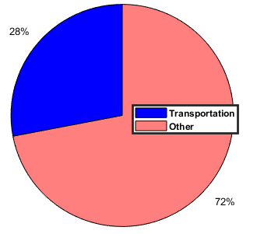
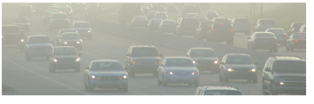
Background
The transportation sector is a significant component of the US economy.
Source: Energy Information Administration (2018)

Slide 3
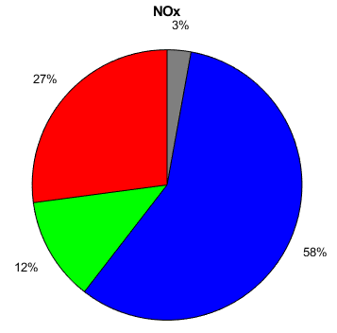
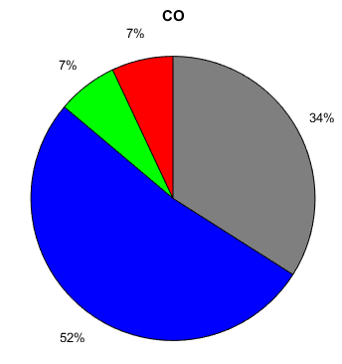
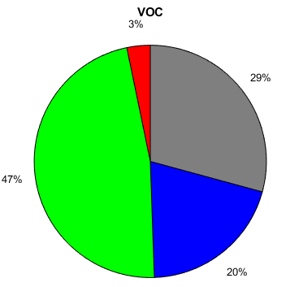
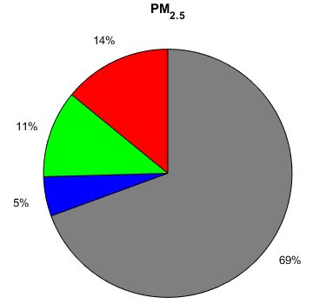
US Emission Profiles
Passenger cars contribute a large portion of emissions in transportation
Source: 2018 US EPA Emissions trends

Slide 4
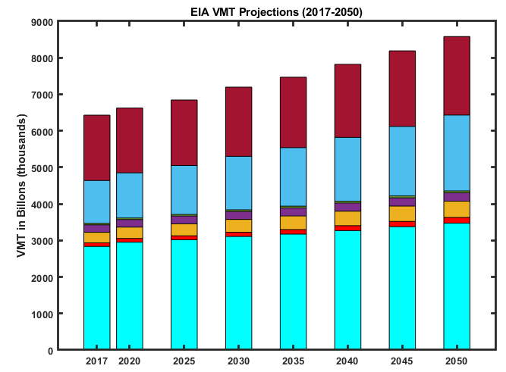
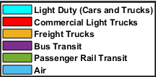
US Driving Trends
According to the US Energy Information Administration (EIA), vehicle miles traveled (VMT), along with population projections are expected to increase in the future.
Currently, passenger cars make up the bulk of vehicle miles traveled.

Slide 5
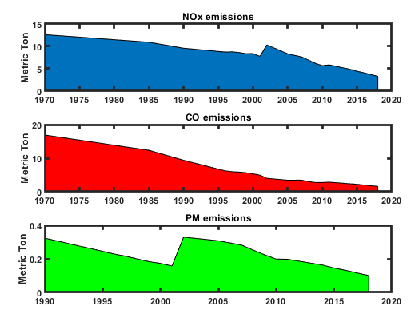
Impact of Environmental Regulations
Despite an increase in the number of vehicles and increased VMTs, regulations over the past few decades have helped to improve air quality in the US.
Since the passage of the Clean Air Act (CAA) and further amendments, the following have occurred
Passenger cars are over 80% cleaner than they were in the 60s
Fuels are cleaner
Improved air quality in urban cities
Technological advancements
Source: US EPA
Transportation Emission Reductions
74% Reduction in NOx
90% Reduction in CO
70% Reduction in PM_{2.5}

Slide 6
Impact of Environmental Regulations
Pollutant | 2011 | 2050
Volatile Organic Compounds | 0.11 g/mile | 0.0057 g/mile
Carbon Monoxide | 3.97 g/mile | 0.92 g/mile
Nitrous Oxides | 0.48 g/mile | 0.02 g/mile
PM_{2.5} | 0.01 g/mile | 0.002 g/mile
Obtained using EPAs Motor Vehicle Emissions Simulator (2014)
Takes into account the Corporate Average Fuel Economy (CAFE) standards enacted by the last administration.
Passenger cars are becoming quite ‘clean’.

Slide 7
Future Scenarios
The current trajectory with emissions show a continued decrease, despite increased VMTs.
Passenger cars are slowly switching to electric engines from fuel powered cars (gasoline/diesel).
With electric cars, it comes the ability to have automation which can impact driving habits.

Slide 8
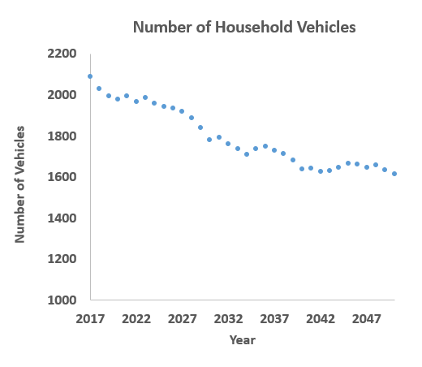
Survey Data Results Household
Statistical models projections of future vehicle ownership and driving habits from survey questionnaire
Conducted by University Texas at Austin
Temporal span: 2017 to 2050
Sample size (n ~1420) that reflects national make up.
Passenger Cars was the focus
Power train make up of vehicle fleet adjusted.
Quarles, N. et al (2020). America’s Fleet Evolution in an Automated Future (Under review for presentation and publication in TRB/TRR 2020). Transportation Research Board 2020.

Slide 9
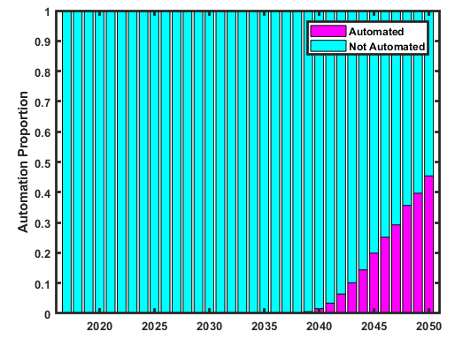
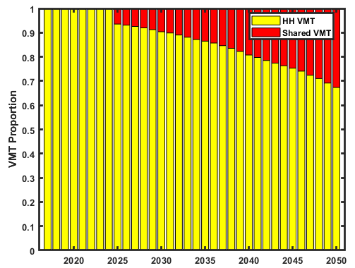
Survey Data Results Household
Automation Mode
Automated 2. Not Automated
Driving Mode
Personal vehicle within households
Ride Sharing (e.g. Uber)
Vehicle automation up to 40%
VMT proportion from shared ride services is about 30%.

Slide 10
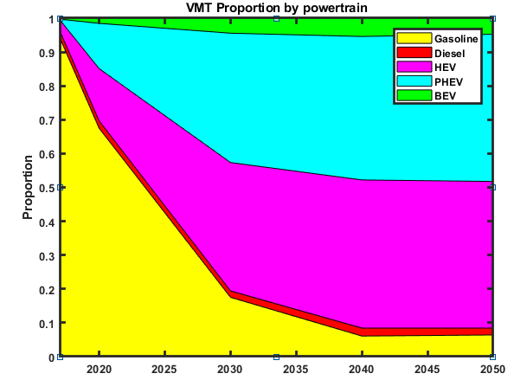
Survey Data Results Household
Electrification options of passenger car fleet
Battery (BEVs)
Plug in Hybrid Electric Vehicles (PHEVs)
Hybrid Electric Vehicles (HEVs).
VMTs largely from a combination of electric vehicles

Slide 11
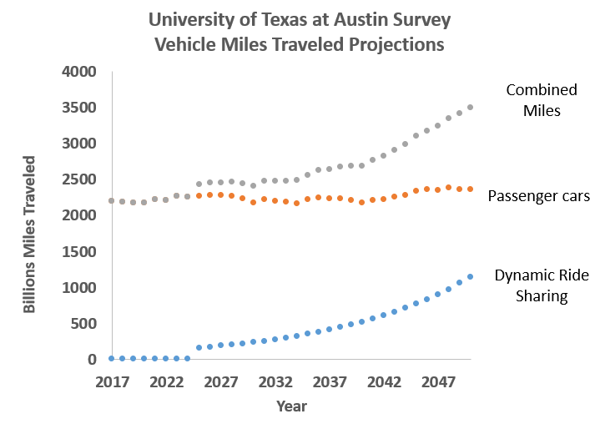
Effect of Automation on Vehicle Miles in 2050
An increase in vehicles miles traveled due to
Self driving feature
Increase in shared fleets usages such as uber, automated fleets

Slide 12
Questions
What impact will the combination of the following have on air quality in 2050?
Increased VMTs
Automation
Electric vehicles
Will changes in air quality from electrification of passenger car fleet, be substantial, when compared with cleaner gasoline powered cars by 2050?

Slide 13
MOVES-SMOKE-WRF-CMAQ
MOVES - Motor Vehicle Emissions Simulator (2014b)
Used to estimate mobile emissions
SMOKE-2011 NEI platform
2011 National Emissions Inventory (NEI) was used as base case and to scale future emissions.
Sparse Matrix Operator Kerner Emissions (SMOKE) modeling system
Meteorology
Community Earth System Model Version 1 (CESM1)
Global model developed by the National Center for Atmospheric Research (NCAR)
Weather Research Forecasting (WRF) Model v3.8.1
Used to downscale the global model
Air Quality Modeling
The Community Multiscale Air Quality (CMAQ) system
CMAQv 5.0.2

Slide 14
FRAME WORK
Survey of Car Owners
Project adoption of autonomous vehicles
Scale up from Survey
2011 NEI
SMOKE/Platform
Use 2050 projected emissions for other sectors and MOVES output to modify emission inventory
CMAQ
Simulate dispersion and generation of secondary pollutants (ozone, SOA, etc.)
Concentration Profile
Resulting car fleet power train make up
MOVES
Generate emissions for simulated vehicle population and VMT
Statista Projection Tables for populations and households
July 2010/2050
Use 2050 predicted meteorology.
VMT
Predicted Car
Demographic
Emission Rates
Emission Report
CMAQ Output
Notes:
SOA = secondary organic aerosol

Slide 15
Input into MOVES Mobile Emissions Scale up 2010 - 2050
Annual, Monthly, Daily, and hourly VMT distribution (2011 NEI)
Fleet Age Distribution (Fleet Turnover)
UT-Austin Survey Passenger Cars
MOVES default for others
VMT Road Type distribution (2011 NEI)
Fuel data (MOVES default)
VMT Speed Distribution (MOVES default)
Fleet Power Train Makeup
UT-Austin Survey Passenger Cars
MOVES default for others

Slide 16
Emissions Other Sectors
2050 emissions for other sectors were estimated using the National Energy Modeling System operated at Georgia Tech (GT-NEMS) forecast model which assesses energy distribution, with demand in combination with technology changes and regulations.
Electricity Power Generation Power Units
Area Source and Non Point (residential, commercial and industrial sectors)
Biogenic emissions: Biogenic Emissions Inventory System (BEIS) version 3.61
Details of the methods can be found in Shen et al. (One Earth, in press).

Slide 17
Scenario runs
Simulation Case | 1 | 2 | 3
Scenario Year | 2010 | 2050 | 2050
Season (month) | July | July | July
Base Case to compare | NA | 1 | 1/2
Future Energy policy (REP) | N/A | REP | REP
Emissions | 2011 NEI | 2050 Projected | 2050 Projected
Marginal Energy Adjusted for EV Charging on the grid | NA | N/A | No
Meteorology Climate: Representative Concentration Pathway | 2050 4.5 | 2050 4.5 | 2050 4.5
Biogenic emission file | BEIS 2050 | BEIS 2050 | BEIS 2050
Electrification Scenario | None | None | Fleet Electrification

Slide 18
Results

Slide 19
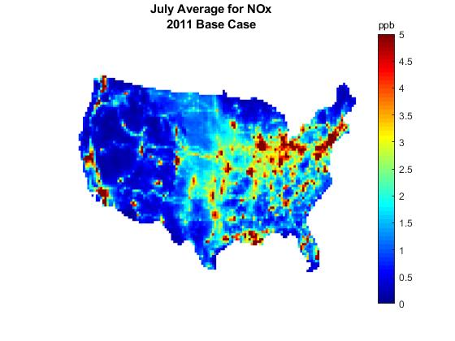
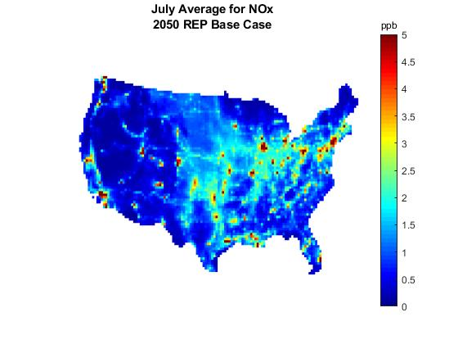
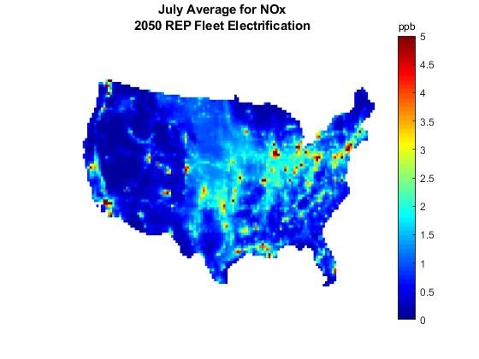
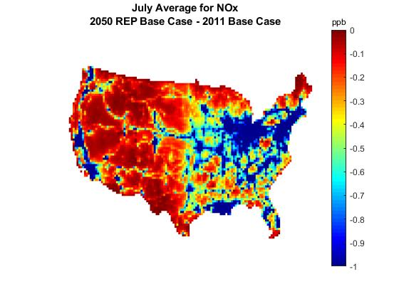
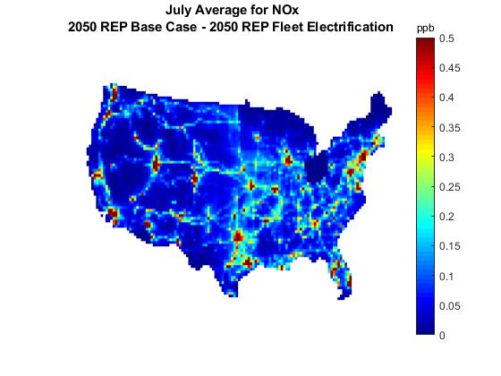
NO_{X} (July Monthly Avg)
Pollutant (ppb) | 2010 Base Scenario (ppb) | 2050 Base Scenario (ppb) |  | 2050 Electric Scenario (ppb)
NOx
NOx Difference 2050 Base Fleet – (two scenarios)
Notable changes seen in NO_{x} spatial concentration profiles between 2010 and 2050 scenario runs. Largely in the eastern region. 2050 Base Fleet vs 2050 Electric Fleet: Decreases (0.2 – 0.5 ppb) largely on road networks. But less spatial scatter than 2050/2011, indicating impact of electrification. 2050 (Base Fleet and Fleet Changes) vs 2010 Base Fleet Decreases as high as 1 ppb and higher (i.e. 3ppb) Mainly on the east coast

Slide 20
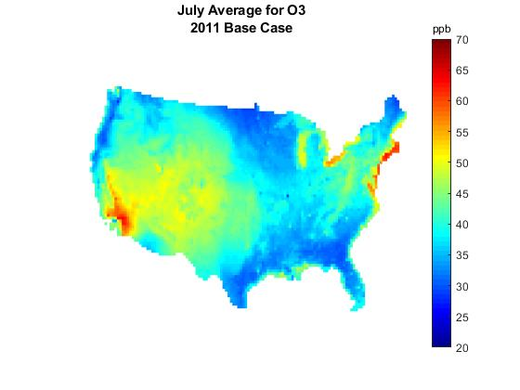
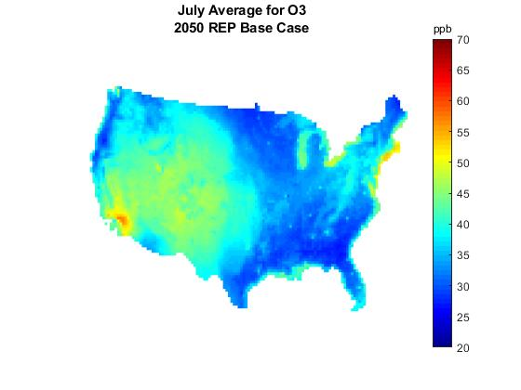
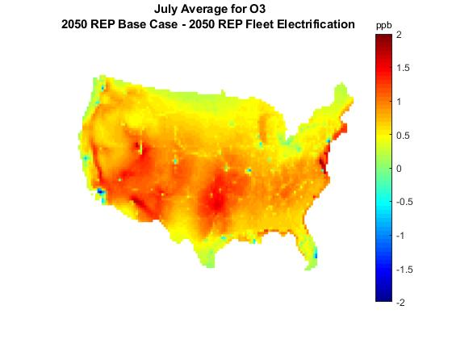
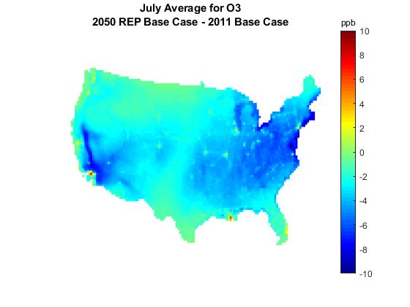
O₃ (Monthly Avg)
Pollutant (ppb) | 2010 Base Fleet (ppb) | 2050 Base Fleet (ppb) |  | 2050 Electric Fleet (ppb)
O₃
O₃ Difference 2050 Base Fleet – (two scenarios)
Noticeable changes in O₃ spatial concentration profiles between 2010 and 2050 scenarios observed over the entire US. 2050 Base Fleet vs 2050 Electric Fleet: Decreases between 1-1.5 ppb in ozone concentrations 2050 (Base and Fleet Changes) vs 2010: Decreases as high as 10 ppb.

Slide 21
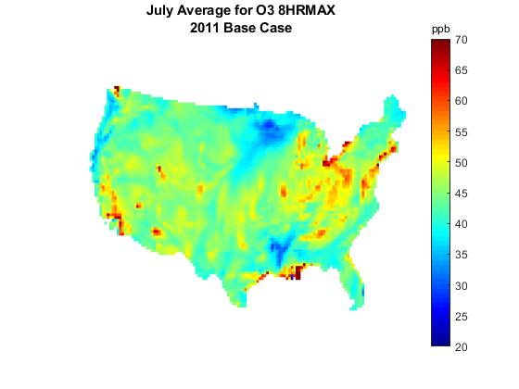
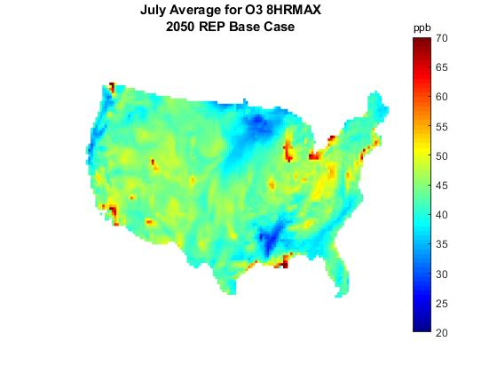
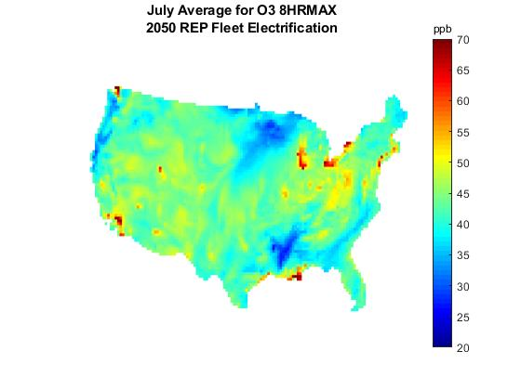
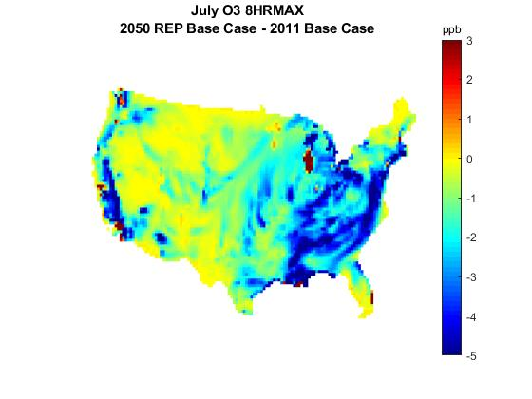
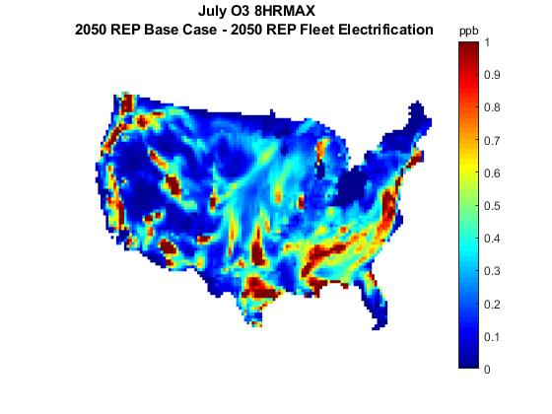
8hr Max O₃ (Monthly Avg)
Pollutant (ppb) | 2010 Base Fleet | 2050 Base Fleet |  | 2050 Electric Fleet
8hr Max O₃
8hr Max O₃ Difference 2050 Base Fleet – (two scenarios)
Changes in 8hr daily maximum O₃ spatial concentration profiles between 2010 and 2050 scenarios were noticeable along the east and west coast regions of the US 2050 vs 2050 Fleet changes: Differences were as high as 0.9 ppb seen all over US. 2050 (Base and Fleet Changes) vs 2010: Noticeable decreases along eastern and west coast regions

Slide 22
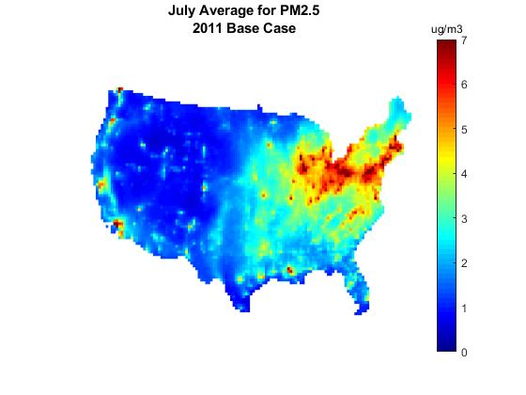
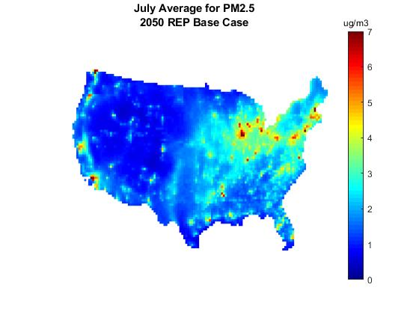
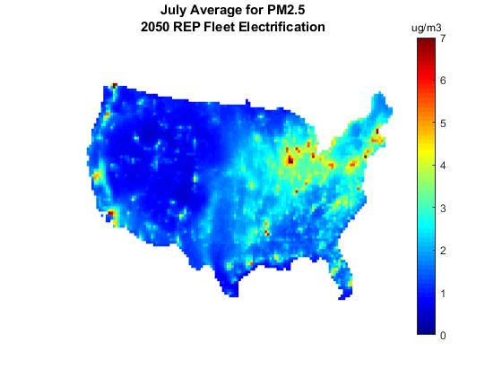
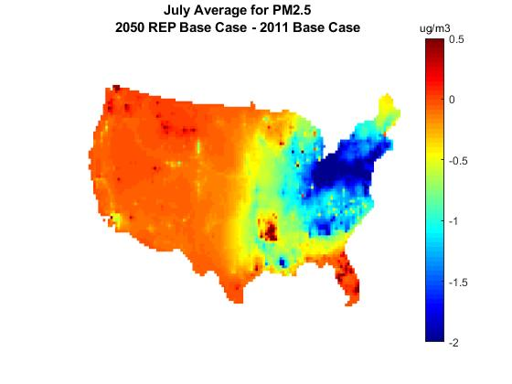
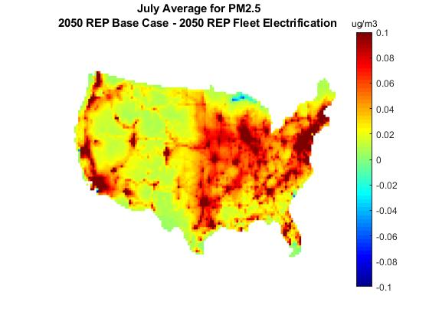
PM_{2.5} (Monthly Avg)
Pollutant (ug/m3) | 2010 Base Fleet | 2050 Base Fleet |  | 2050 Electric Fleet
PM_{2.5}
PM_{2.5} Difference 2050 Base Fleet – (two scenarios)
2050 vs 2050 Fleet changes: Very small differences. Differences match road network 2050 (Base and Fleet Changes) vs 2010 Most of the change is in the North eastern coast

Slide 23
Conclusions
Electric cars have some advantages over future gasoline vehicles.
Seeing those benefits in particulate matter are harder unlike other species.
Small changes in PM_{2.5} maybe due to underestimation of SOA formation.
But there are clear benefits in regard to ozone although regional characteristics might obscure some benefits (i.e. SE vs NE).
Moving to Zero Emission Vehicles (ZEV) is where we might see the largest benefit of all

Slide 24
Thanks
Email: alawal7@gatech.edu

