Slide 1
Mutual comparison of source sensitivities and apportionments obtained by BFM, DDM, and ISAM on PM_{2.5} and ozone concentrations over Japan
Satoru Chatani¹, Hikari Shimadera²,
Syuichi Itahashi³, and Kazuyo Yamaji⁴
¹ National Institute for Environmental Studies
² Osaka University
³ Central Research Institute of Electric Power Industry
⁴ Kobe University
The 18th Annual CMAS Conference
Oct 23, 2019
Chapel Hill, North Carolina - United States

Slide 2
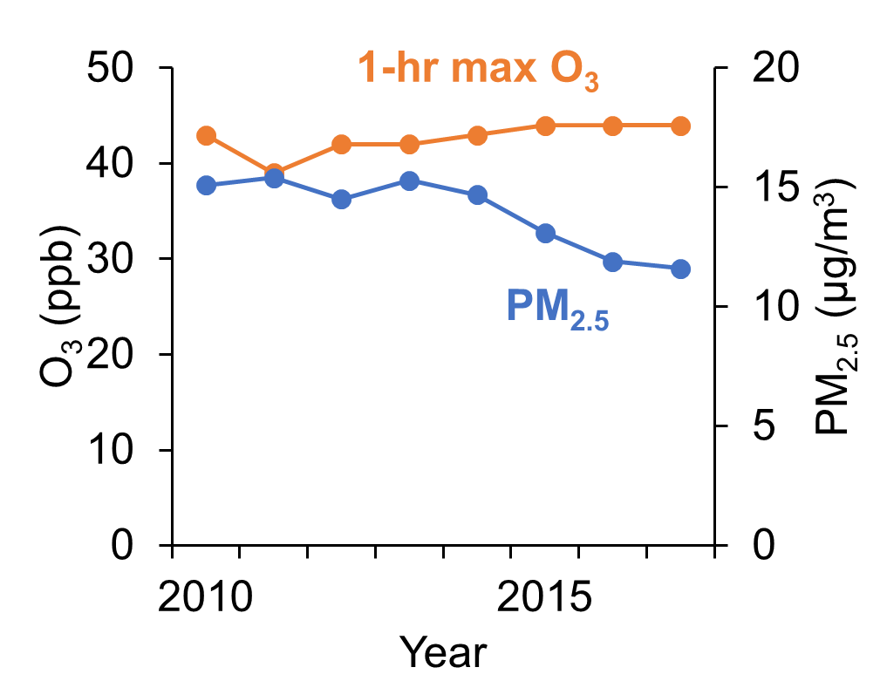
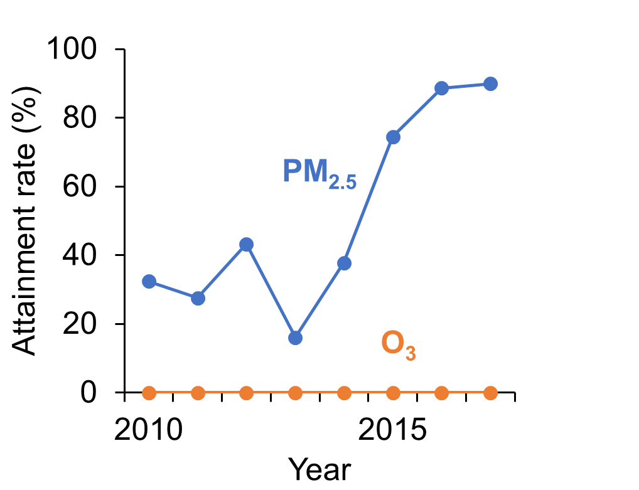
Background
Ozone
  Little change
  0% attainment
PM_{2.5}
  Gradually declining
  Non-attainment in some areas
  Mainly secondary components
Need effective strategies to reduce precursors

Slide 3

J-STREAM
Japan's Study for Reference Air Quality Modeling
  (J-STREAM)
Regional model inter-comparison
  Evaluate ranges of results simulated by participating models
  Seek optimal model configurations for better model performance

Slide 4
Influence of emission sources
Essential information to consider effective strategies
Source sensitivity
  Brute Force Method (BFM)
  High-order Decoupled Direct Method (HDDM)
Source apportionment
  Integrated Source Apportionment Method (ISAM)
Mutual comparison
  To appropriately understand implications

Slide 5
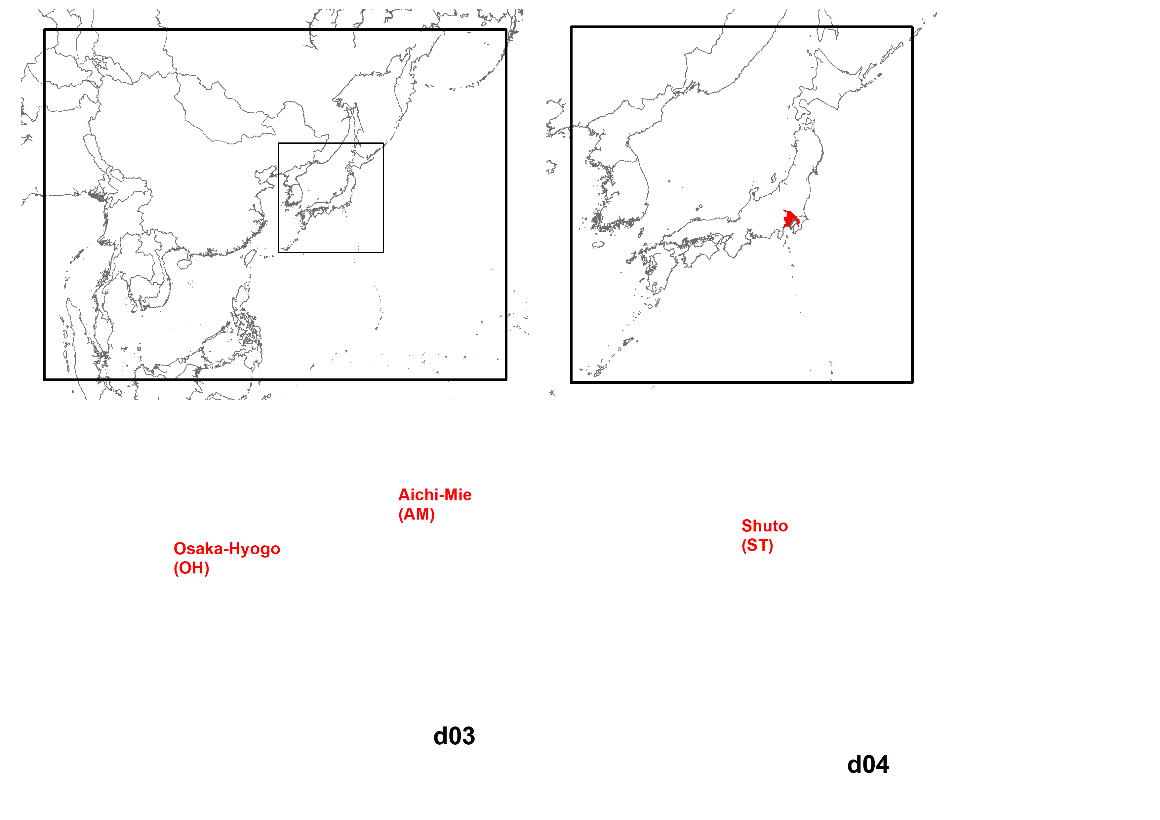
Methodology
Regional meteorological model
  WRF-ARW version 3.7.1
Regional chemical transport model
  CMAQ version 5.0.2
Target period
  2 weeks in 4 seasons in FY2016
Target domains
BCON
Tokyo
d01 (45 x 45 km)
d02 (15 x 15 km)

Slide 6
Input datasets
Boundary concentration
  CHASER (Sudo et al., 2001)
cb05tucl_ae6_aq
Emissions:
Area | Source | Data
Asia | Anthropogenic Ship | HTAP version 2.2 (Janssens-Maenhout et al. 2015) + Recent changes (Zheng et al., 2018)
 | Biogenic | MEGAN version 2.1 (Guenther et al., 2012)
 | Volcano | AeroCom (Diehl et al., 2012)
 | Biomass burning | GFED version 4.1s (van der Werf et al. 2017)
Japan | Transportation | MOEJ PM2.5EI
 | Ship | OPRF
 | Other anthropogenic | J-STREAM (Chatani et al., 2018)
 | Biogenic | MEGAN version 2.1 + Japanese vegetation (Chatani et al., 2017)
 | Volcano | JMA

Slide 7
Target sectors
-20% perturbations in BFM (x 5 to show results)
Group | Sector
s01 | On-road vehicles
s02 | Ships
s03 | Non-road transport (machineries, railways, and airplanes)
s04 | Stationary combustion (power plants, industries, and commercial)
s05 | Biomass combustion (smoking, cooking, and agricultural residue burning)
s06 | Residential
s07 | Fugitive volatile organic compounds
s08 | Agriculture (except for residue burning) and fugitive ammonia
s09 | Natural (volcanoes, and biogenic)
s10 | Other countries in d02
s11 | Transport through boundaries of d02
s12 | Sea salt

Slide 8
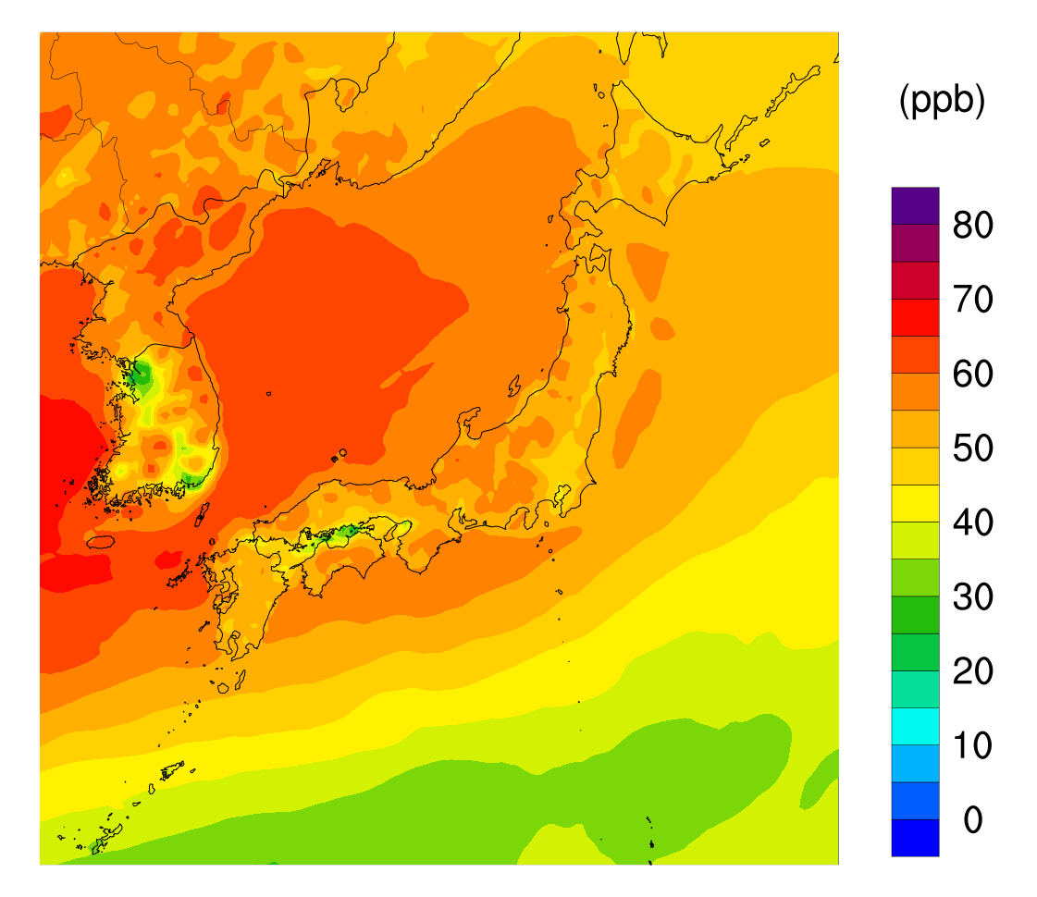
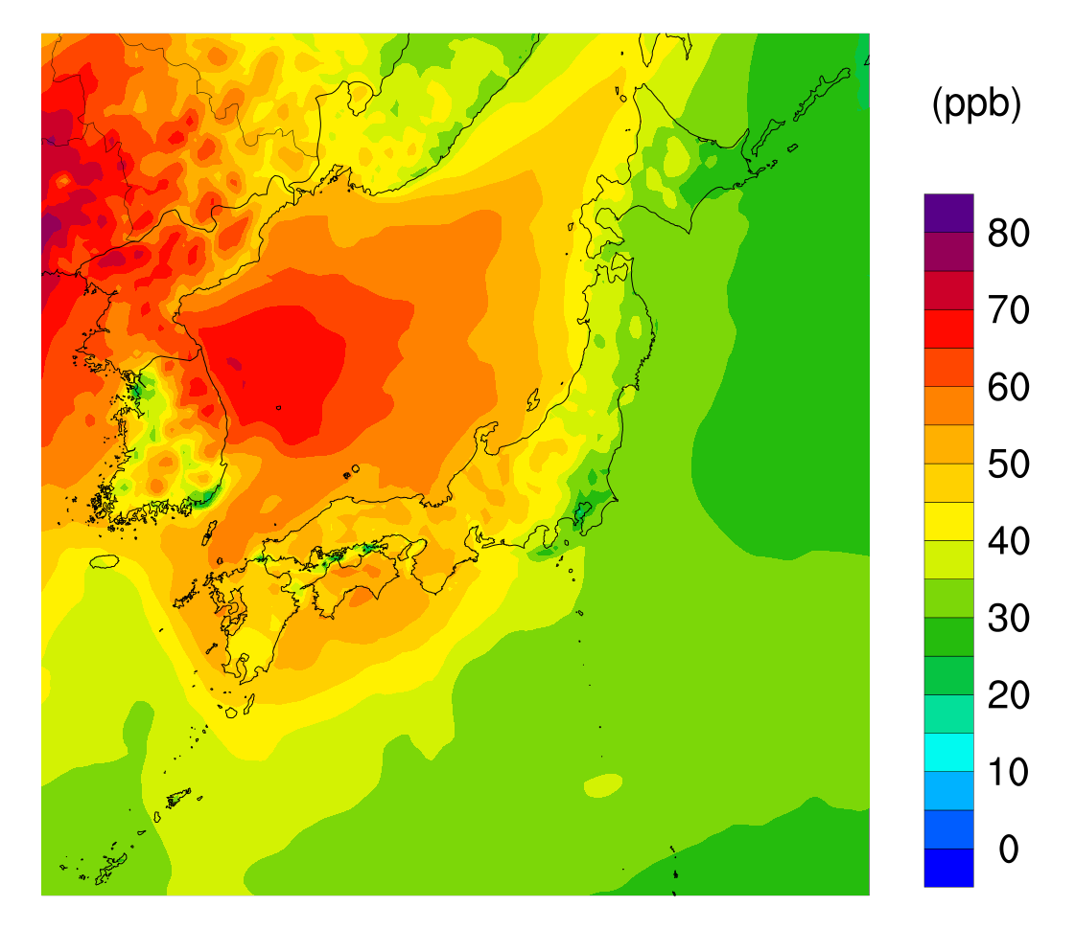
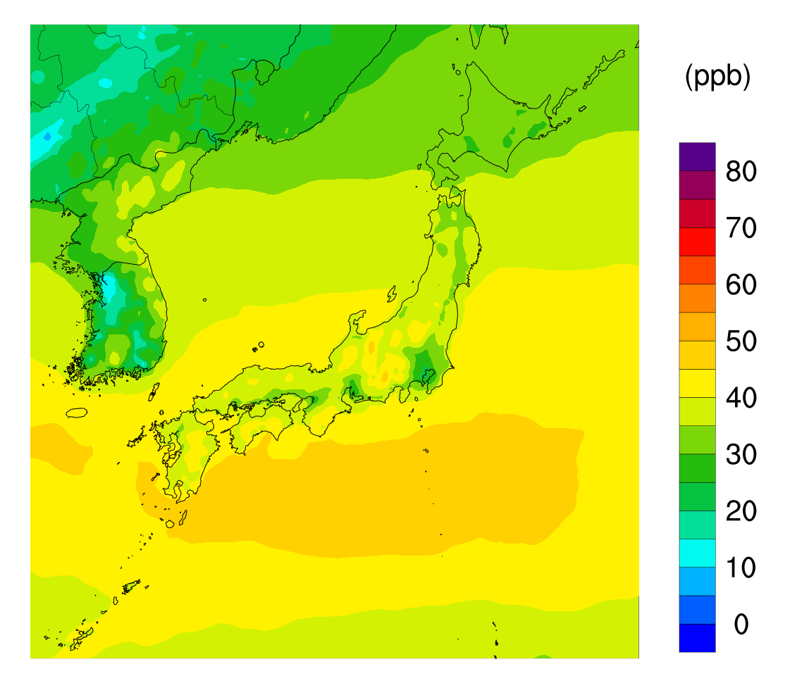
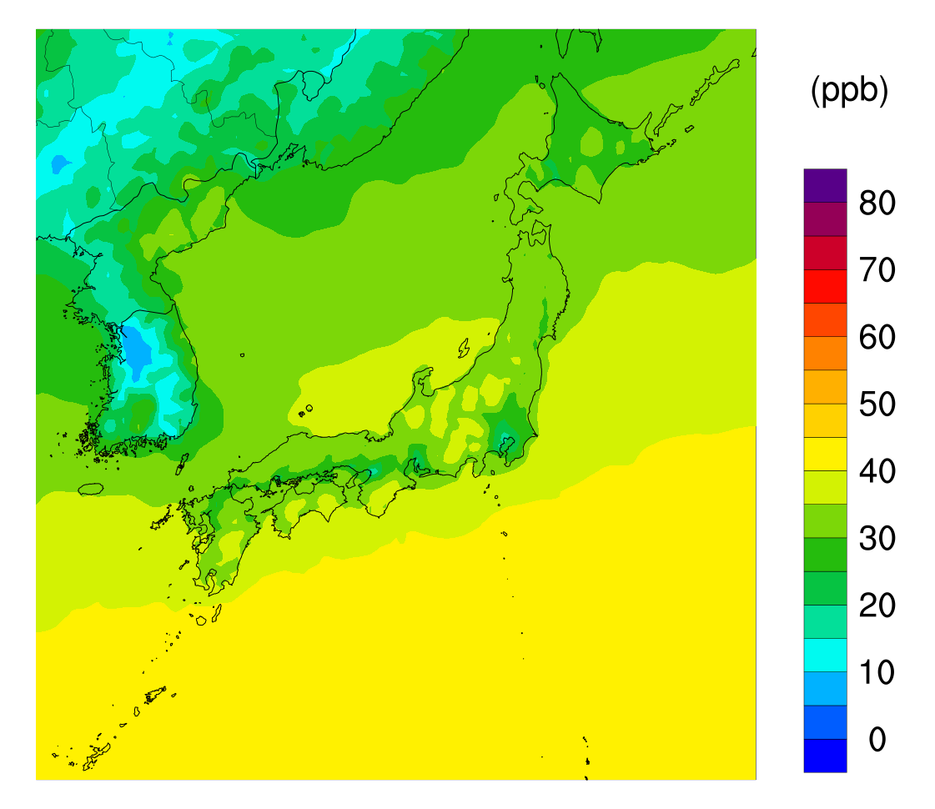
Mean O₃ distributions
Spring
Summer
Autumn
Winter

Slide 9
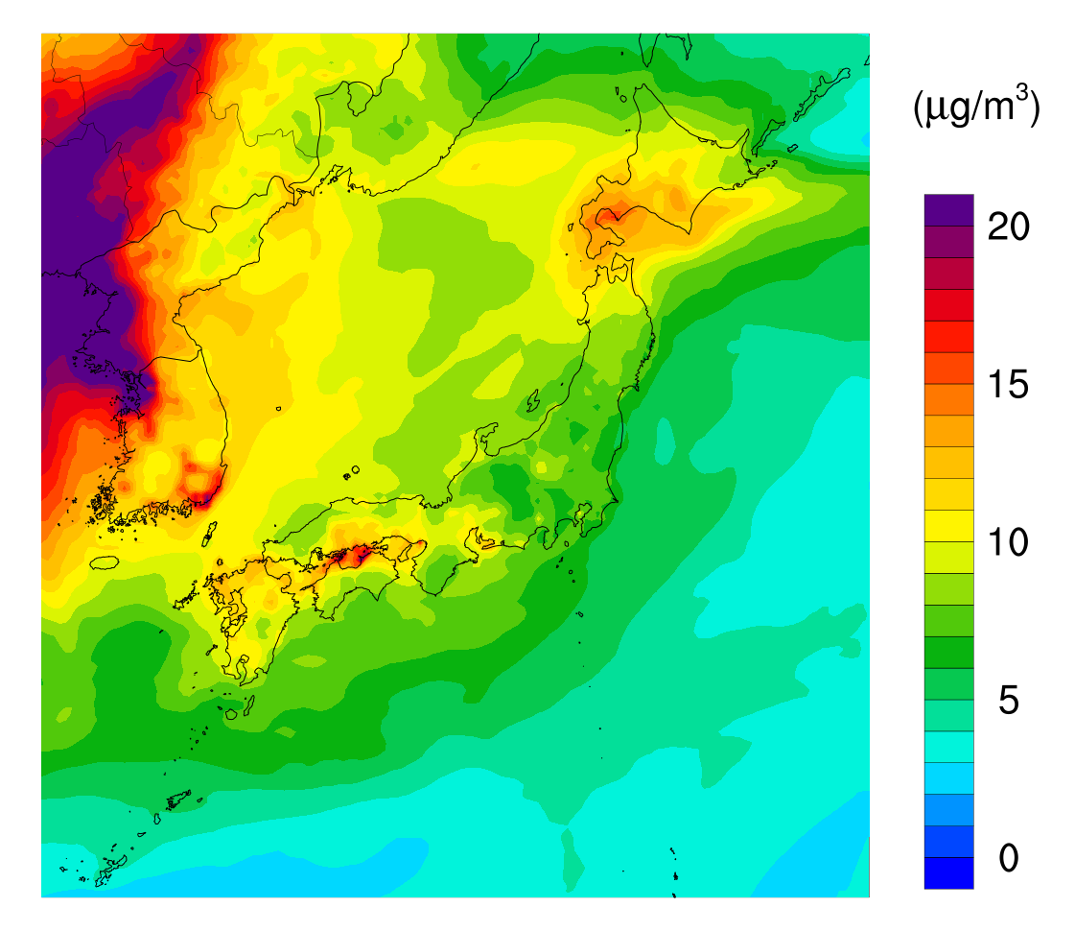
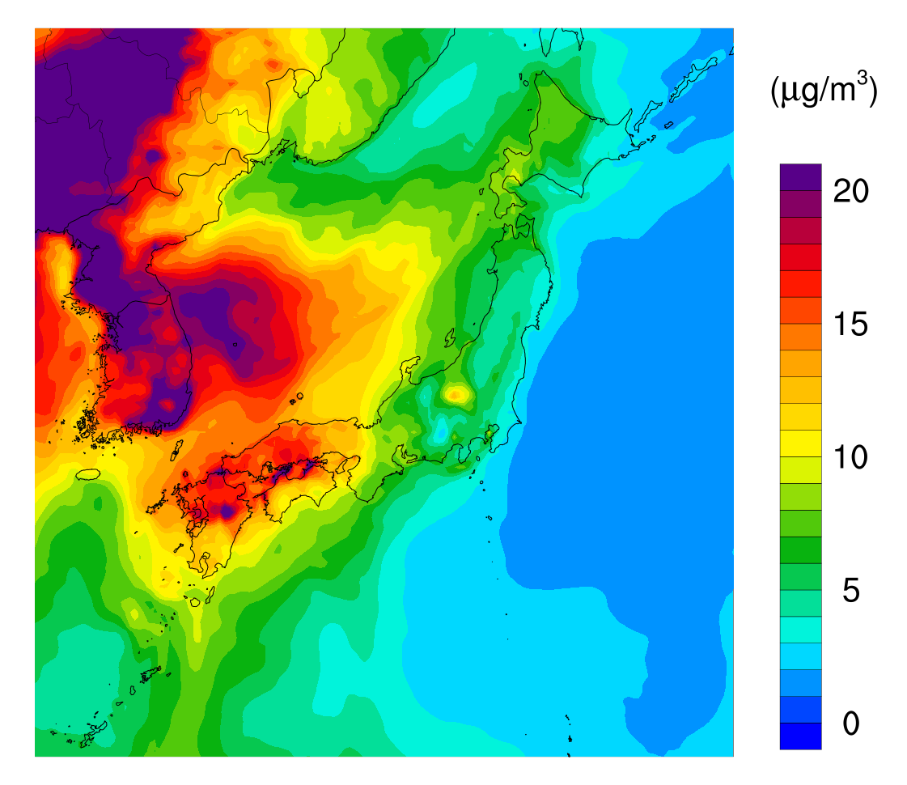
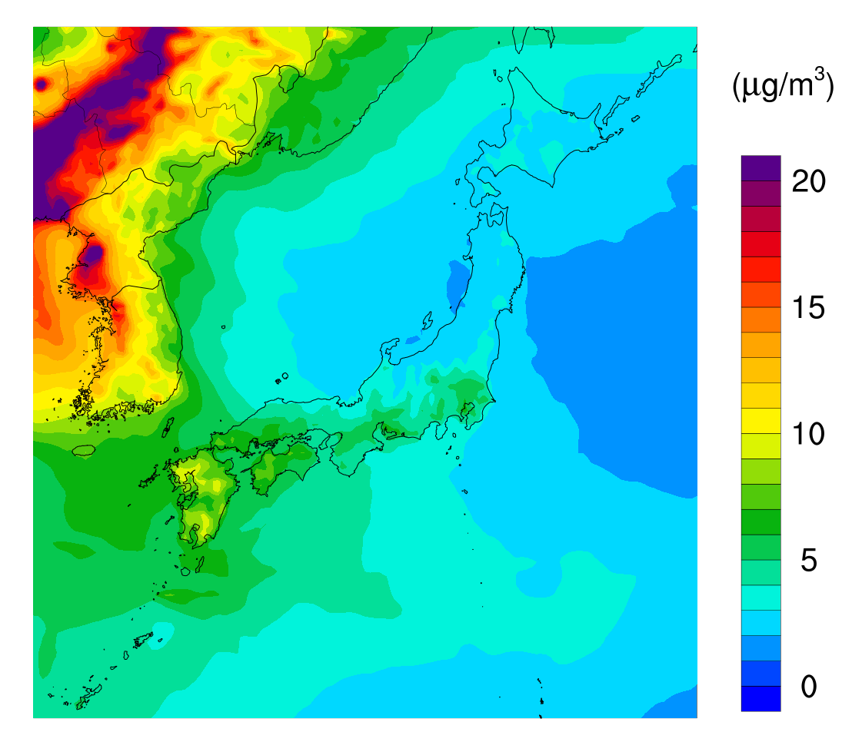
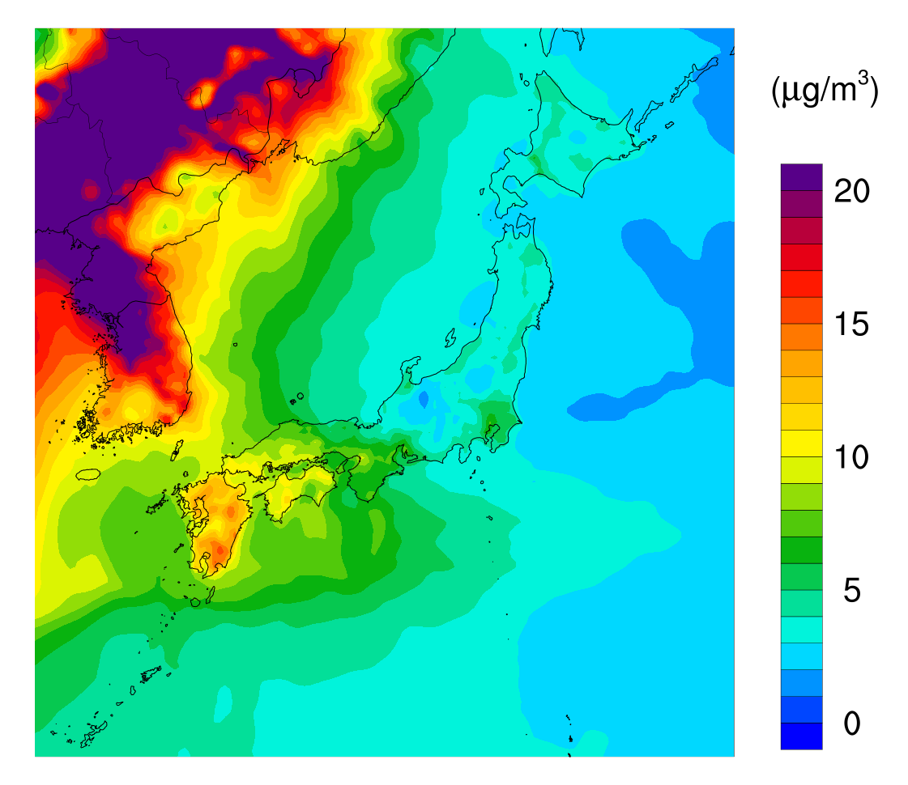
Mean PM_{2.5} distributions
Spring
Summer
Autumn
Winter

Slide 10
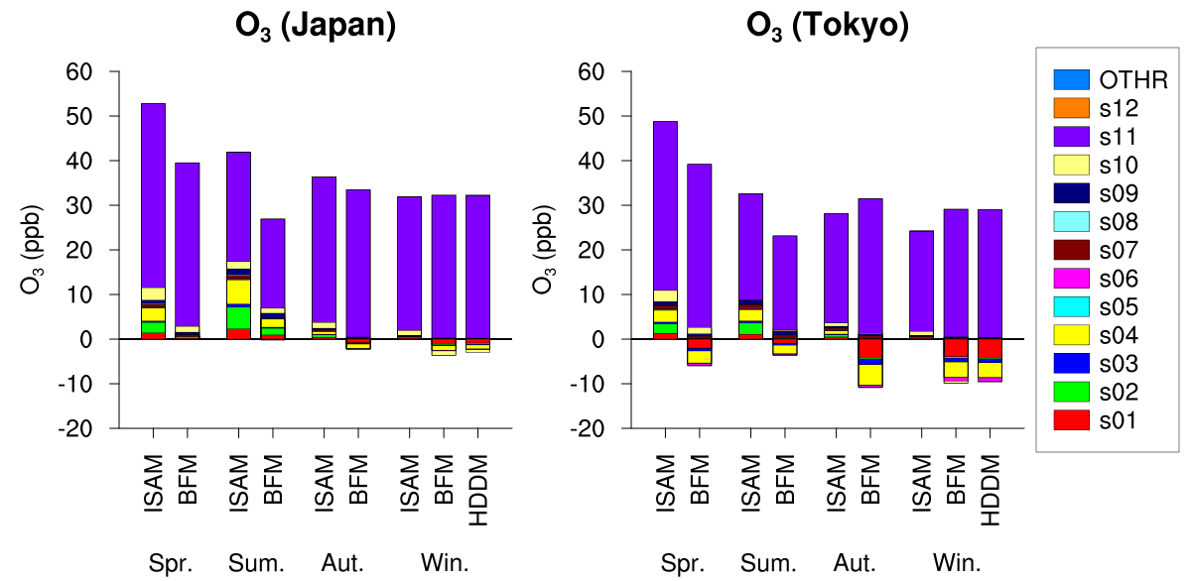
Sensitivity and apportionment for O₃
Overwhelming influence of transport through boundaries
Smaller or negative sensitivities of domestic sources
Similar sensitivities by BFM and HDDM
HDDM results obtained only for winter

Slide 11
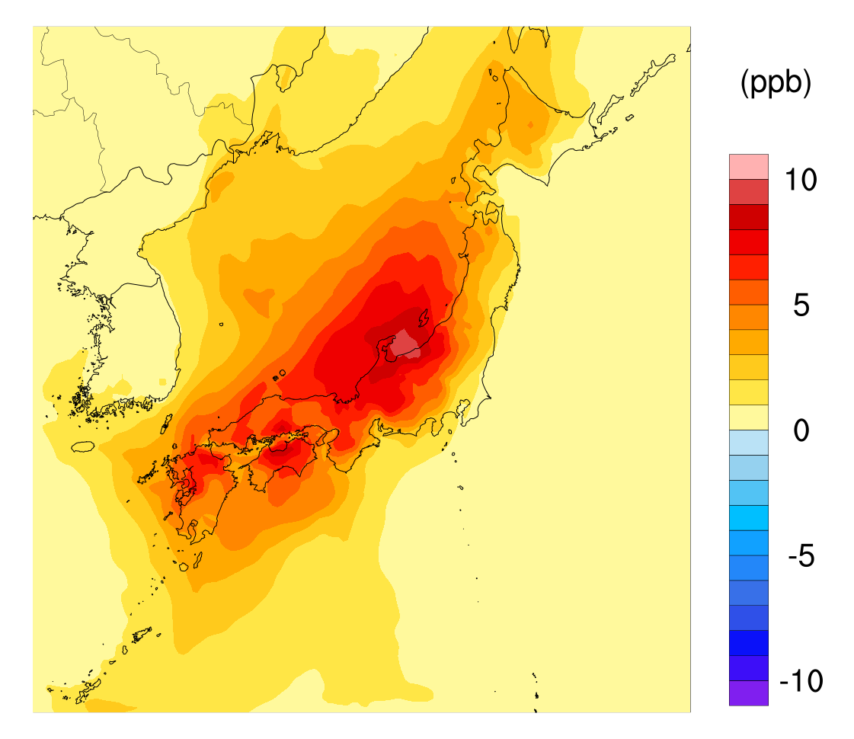
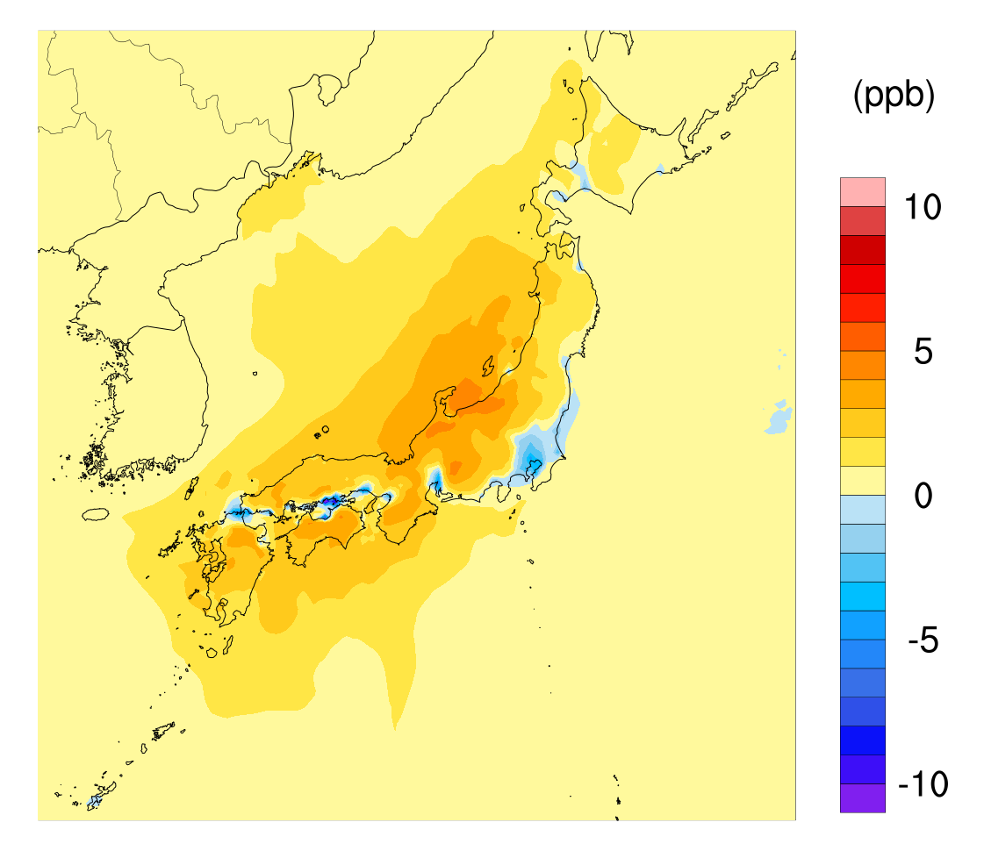
Maps of sensitivities and apportionments
O₃ s04 ISAM Sum.
O₃ s04 BFM Sum.

Slide 12
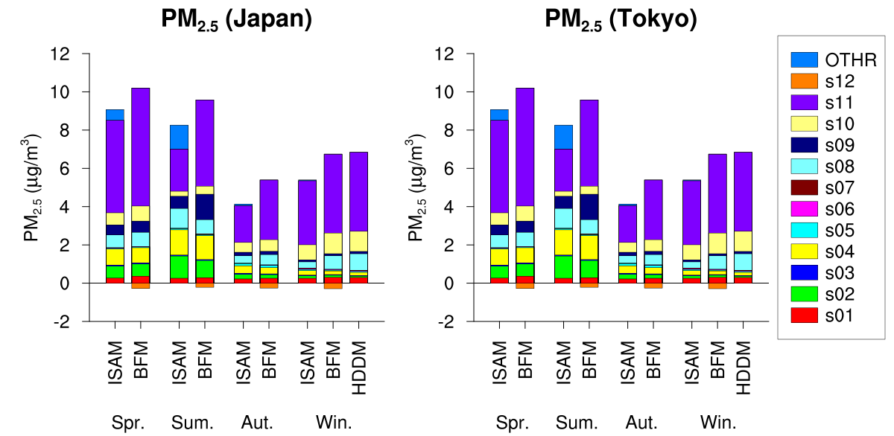
Sensitivity and apportionment for PM_{2.5}
Large influence of transport through boundaries
Higher sensitivities than apportionments

Slide 13
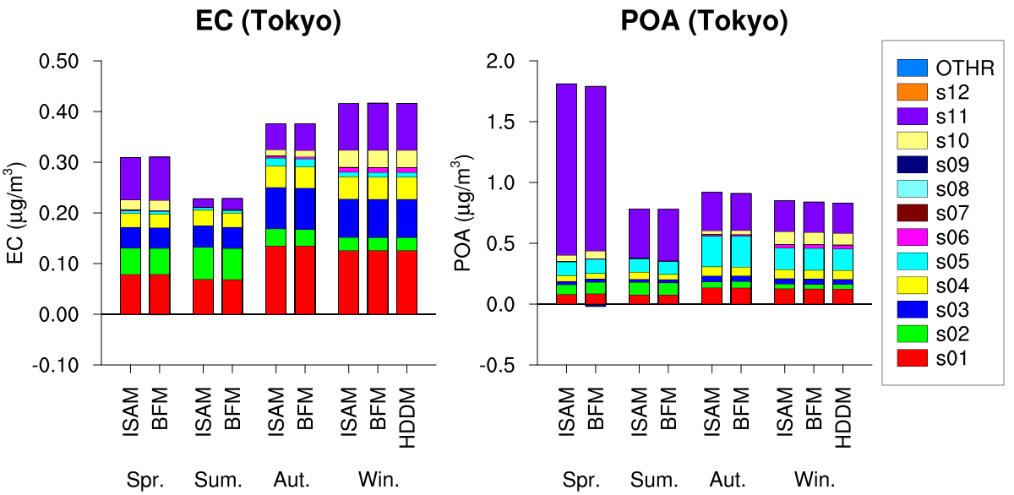
Sensitivity and apportionment for EC and POA
Consistent sensitivities and apportionments for inert components

Slide 14
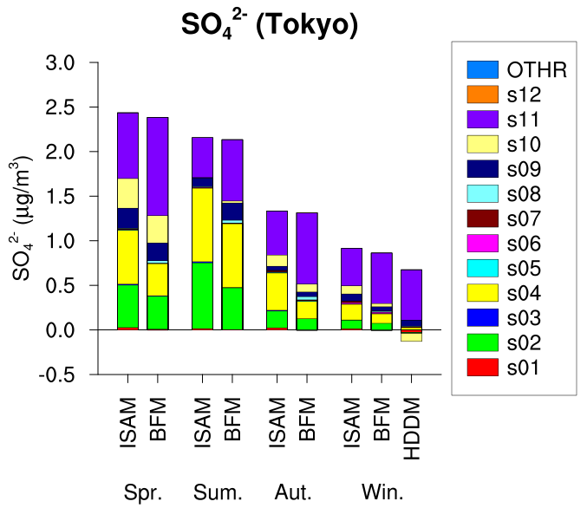
Sensitivity and apportionment for SO₄²⁻
Different sectoral contributions to sensitivities and apportionments
  Origins of S obtained by ISAM
  Larger sensitivity of transport through boundaries

Slide 15
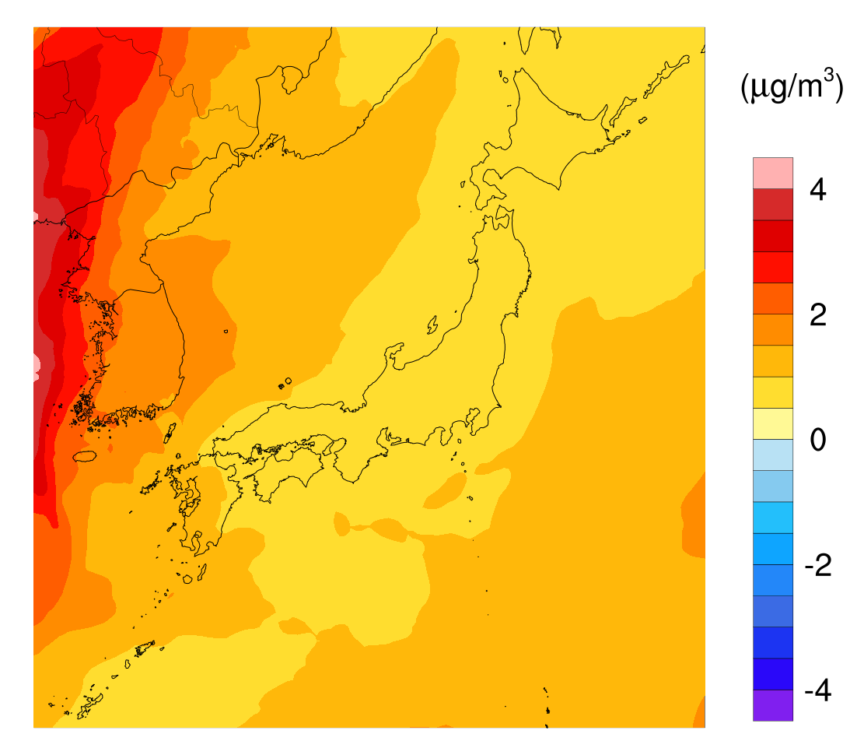
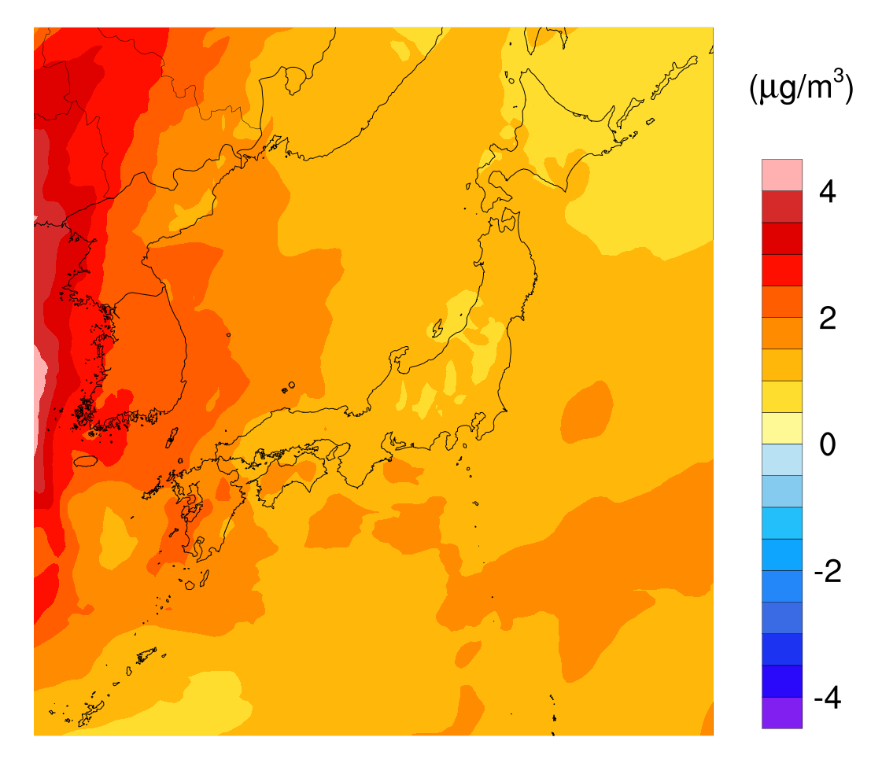
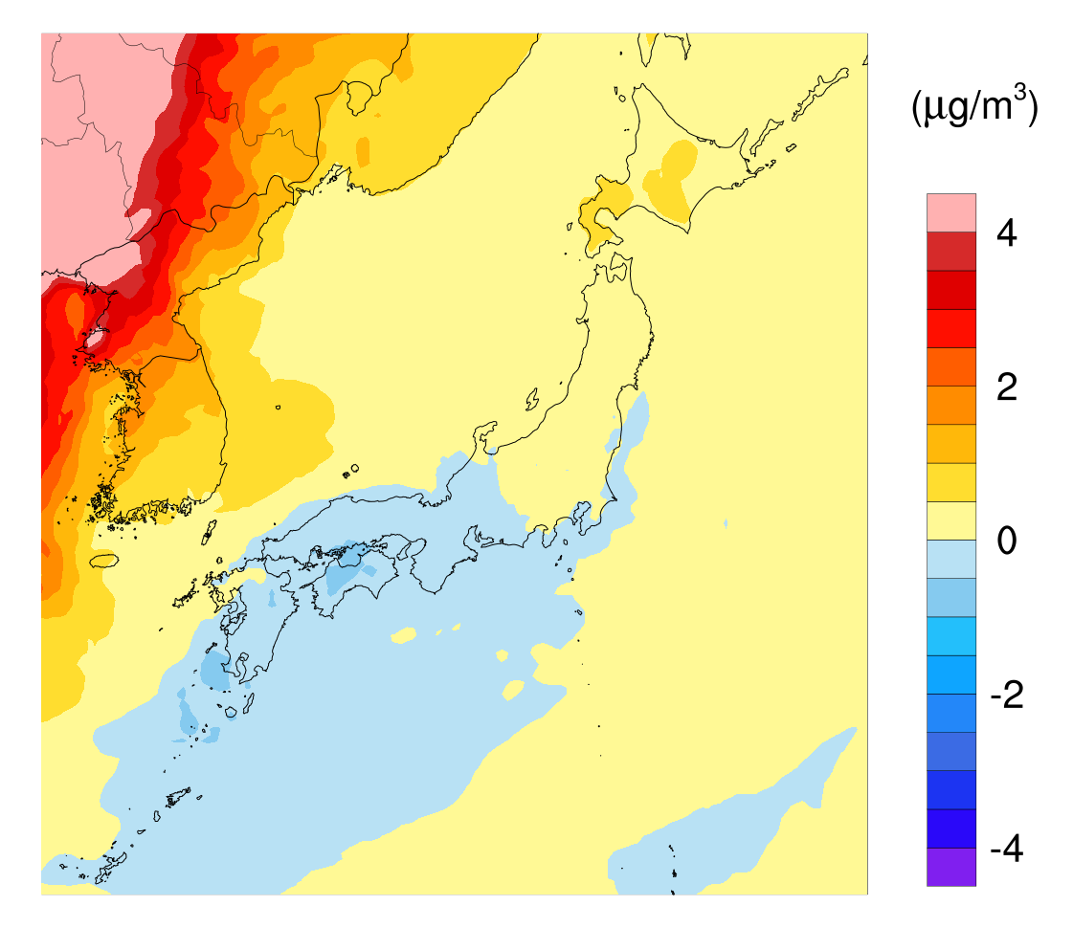
Maps of sensitivities and apportionments
SO₄²⁻ s11 ISAM Spr.
SO₄²⁻ s11 BFM Spr.
(equivalent to SO₄²⁻)
SO₂ s11 BFM Spr.

Slide 16
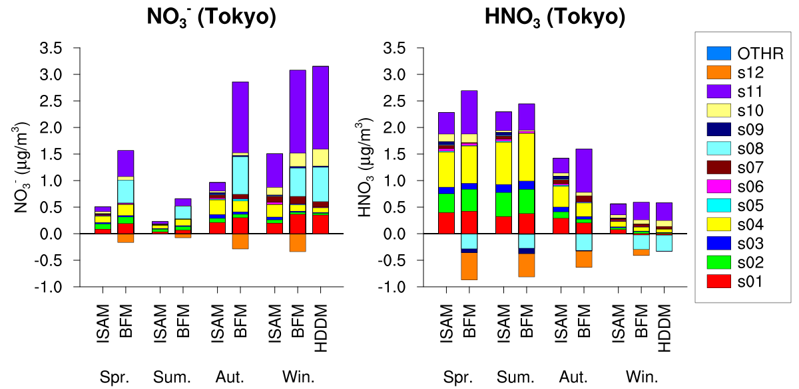
Sensitivity and apportionment for NO₃⁻
Significant nonlinearities in sensitivities
Large sensitivity of NH₃ sources on NO₃⁻
Large sensitivity of transport through boundaries due to oxidation and partitioning

Slide 17
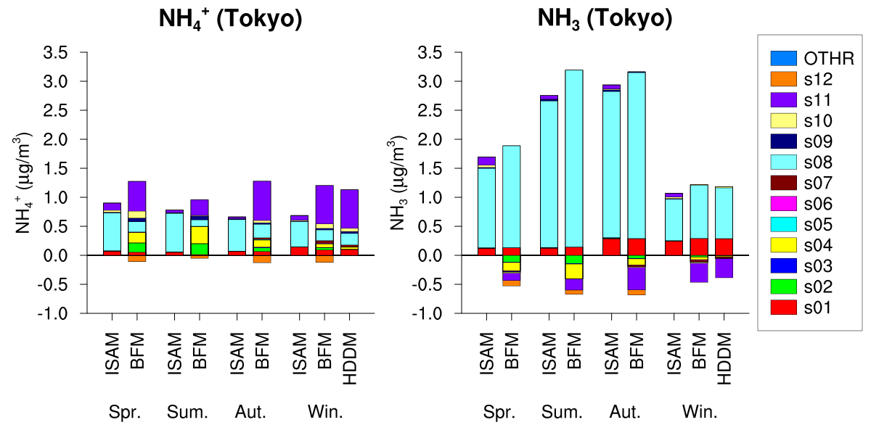
Sensitivity and apportionment for NH₄⁺
Features similar to NO₃⁻
Large sensitivity of NO_{X} sources on NH₄⁺

Slide 18
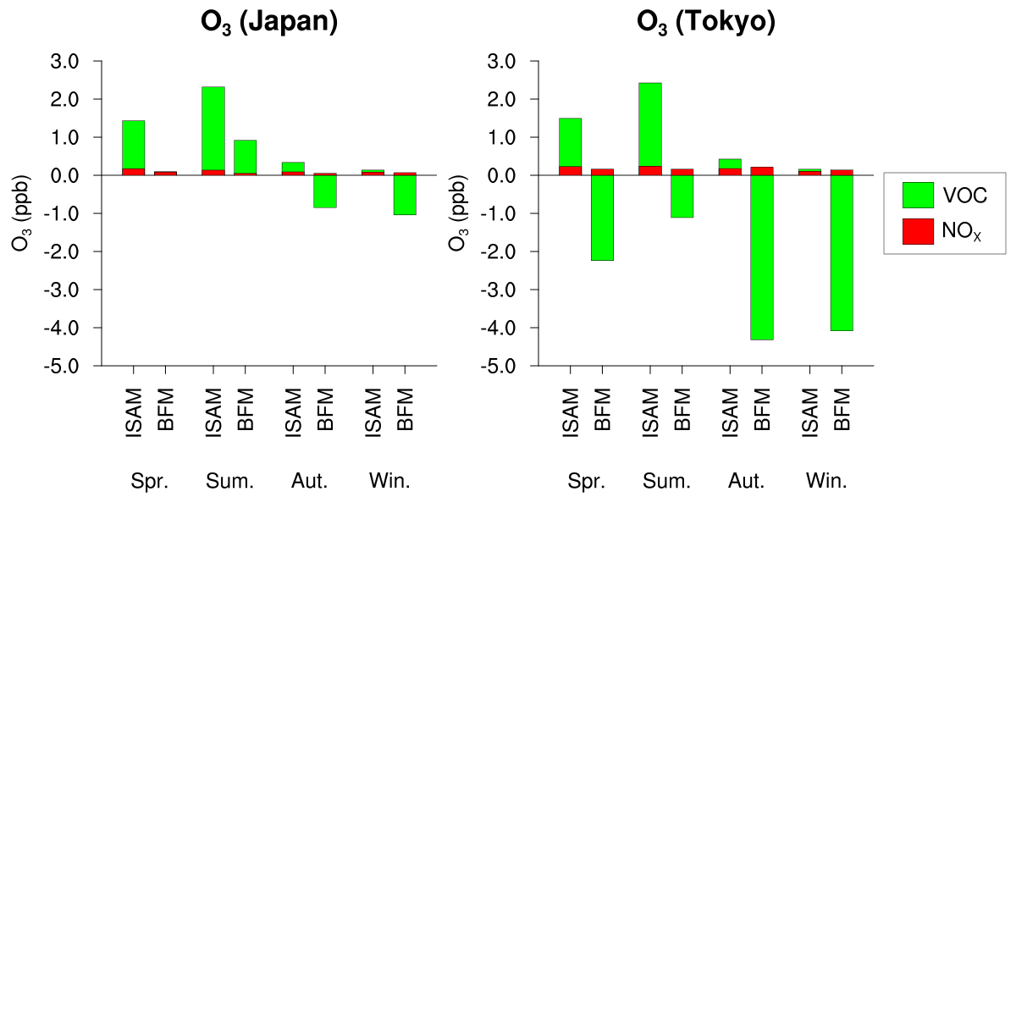
Dependence of O₃ on NO_{X} and VOC
Similar dependences on VOC in apportionments by ISAM and sensitivities by BFM
Large differences of dependences on NO_{X}
(for s01)

Slide 19
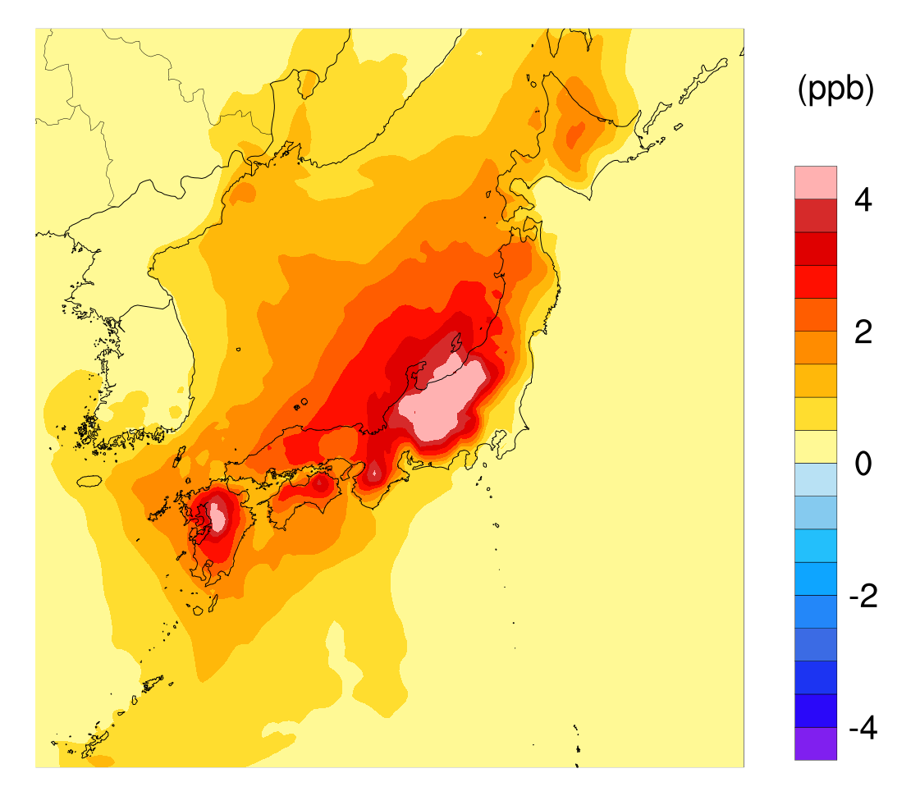
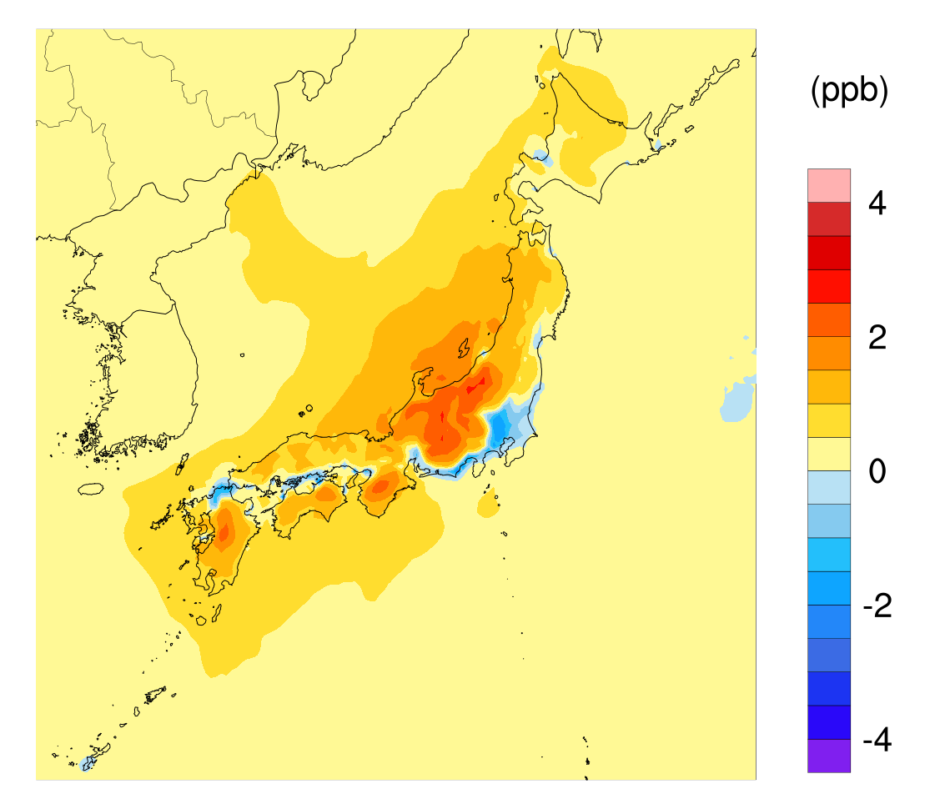
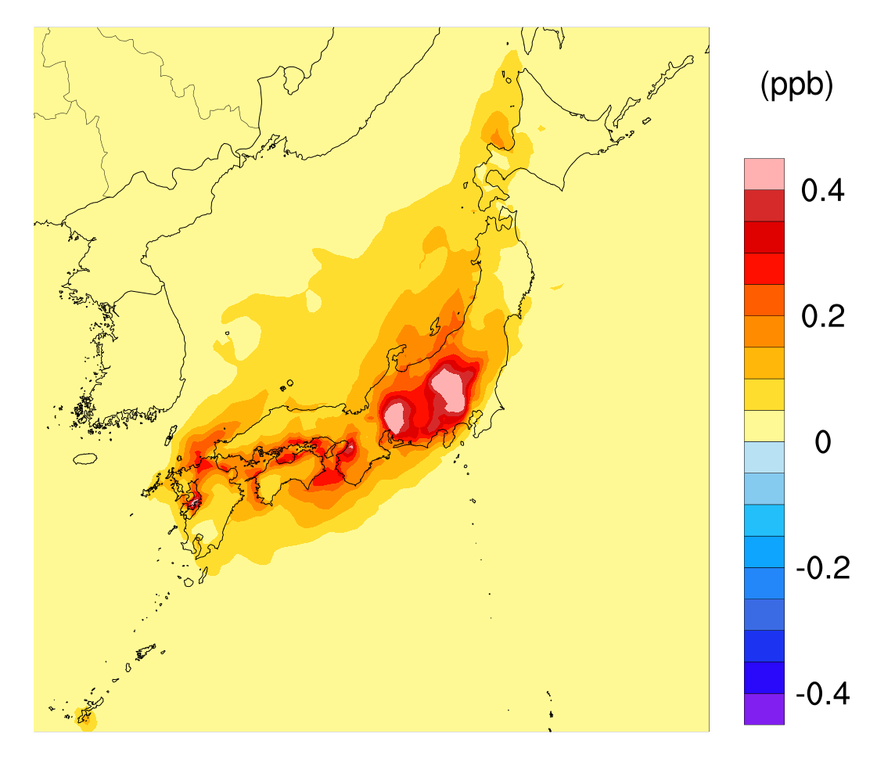
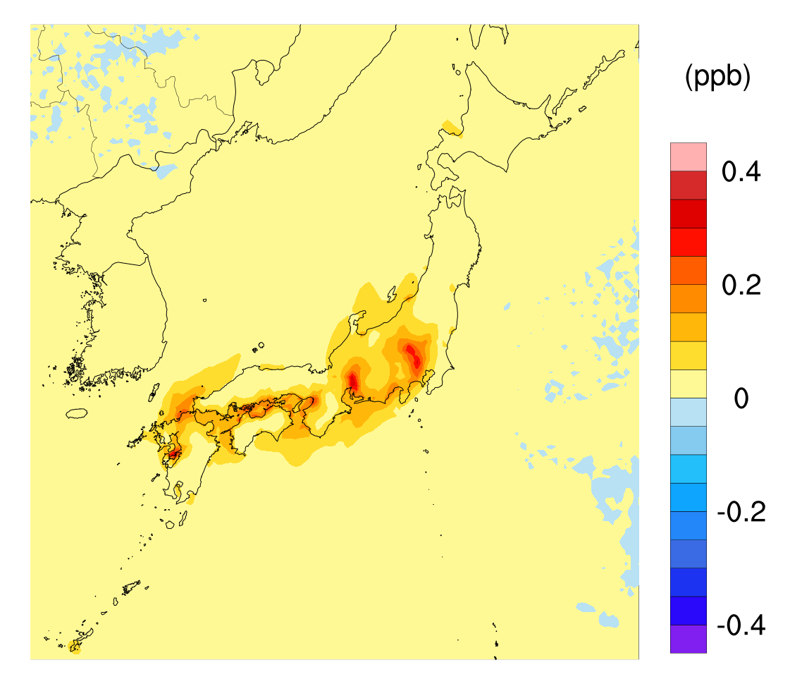
Maps of dependences on NO_{X} and VOC
O₃ s01-NOx ISAM Sum.
O₃ s01-NOx BFM Sum.
O₃ s01-VOC ISAM Sum.
O₃ s01-VOC BFM Sum.

Slide 20
Summary
Sensitivities and apportionments are consistent for inert species.
Significant nonlinearities appear in sensitivities of secondary species.
  Smaller or negative sensitivities of domestic NO_{X} sources on O₃.
  Different attributions of SO₄²⁻ in apportionments and sensitivities.
  Mutual dependences of NO_{X} and NH₃ sources in sensitivities on NO₃⁻ and NH₄⁺.
It is important to evaluate sensitivities for considering effective strategies taking nonlinear changes in concentrations into account.

Slide 21
Acknowledgement
The study was supported by the Environment Research and Technology Development Fund (5-1601) of the Environmental Restoration and Conservation Agency.
Thank you
for your attention

Slide 23
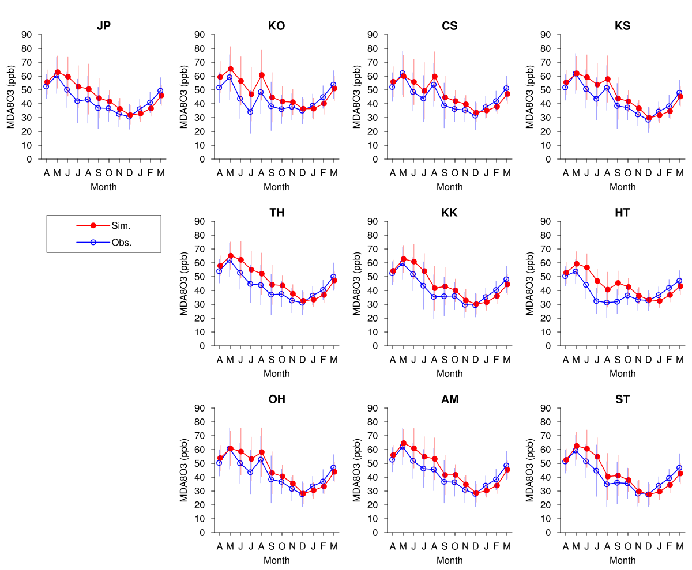
Model performance on O₃

Slide 24
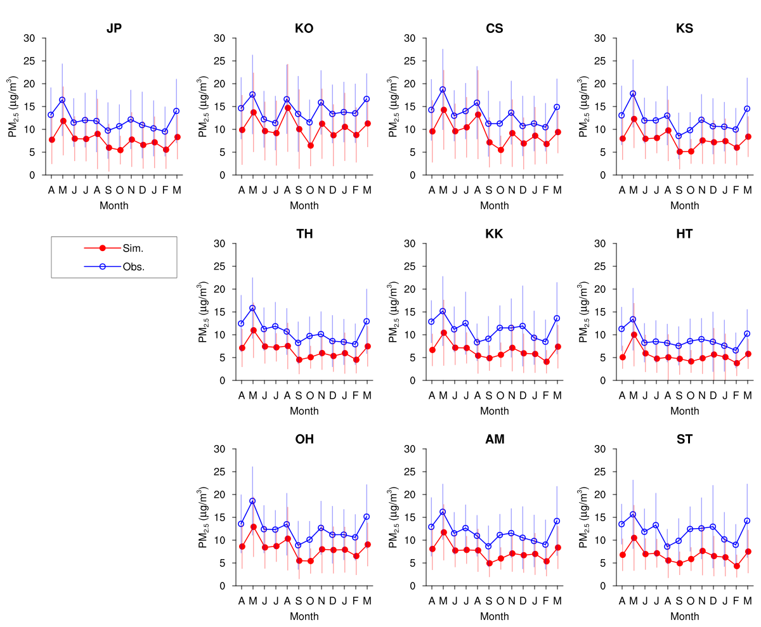
Model performance on PM_{2.5}

