Slide 1
Air pollutant emission impacts of electric vehicle market penetration scenarios
Dan Loughlin, Samaneh Babaee*, Yang Ou*, Carol Lenox, Chris Nolte, and Tai Wu
U.S. EPA Office of Research and Development
* Research participants through the Oak Ridge Institute for Science and Education
Susan Burke, Meredith Cleveland, Chris Ramig, Michael Shell, Ryan Sims, and Aaron Sobel
U.S. EPA Office of Air and Radiation
Steven J. Smith
Joint Global Change Research Institute

Slide 2
Foreword
Intended audience
  Air quality researchers and managers interested in assessing the multi-decadal and environmental implications of emerging technologies and future scenarios.
Caveats
  All results are intended to be illustrative. Assumptions are not fully described here. Please do not cite the results.
Acknowledgements
  Others who have contributed substantially to the work presented here include Wenjing Shi, a grantee through the Oak Ridge Institute for Science and Education (ORISE), and Gokul Iyer of Pacific Northwest National Laboratory (PNNL).
Disclaimer
  The views expressed in this presentation are those of the authors and do not necessarily represent the views or policies of the U.S. EPA or other author institutions.

Slide 3
Abbreviations
Models
  GCAM – Global Change Assessment Model
  GCAM-USA – GCAM version with state-level resolution for the United States
Emissions
  BC – Black carbon
  CFCs - Chlorofluorocarbons
  CH₄ – Methane
  CO – Carbon monoxide
  CO₂ – Carbon dioxide
  GHG – Greenhouse gases
  N₂O – Nitrous Oxide
  NOx – Nitrogen oxides
  OC – Organic carbon
  PM – Particulate Matter
  PM_{2.5} – PM of diameter less than 2.5 microns
  SO₂ – Sulfur dioxide
  VOC – Volatile Organic Compounds
Units
  EJ – Exajoules
  MTC – Megatonnes Carbon
  kT – Kilotonnes
Technologies and fuels
  CCS – Carbon Capture and Sequestration
  CHP – Combined Heat and Power
  EV – Electric Vehicle
  CNG – Compressed Natural Gas
Organizations
  JGCRI – Joint Global Change Research Institute
  NREL – National Renewable Energy Laboratory
  ORISE – Oak Ridge Institute for Science and Education
  PNNL – Pacific Northwest National Laboratory
  RGGI – Regional Greenhouse Gas Initiative
  U.S. EPA – United States Environmental Protection Agency
Other
  AEO18 – Annual Energy Outlook 2018
  PC – Personal Computer
  IPM – Integrated Planning Model
  GDP – Gross Domestic Product

Slide 4
Outline
Background
  Human-earth system models
  Global Change Assessment Model (GCAM)
  GCAM Long-term Interactive Multi-Pollutant Scenario Evaluator (GLIMPSE)
Illustrative application: Electric vehicles
  U.S. national impacts
  U.S. regional impacts
Summary
Next steps

Slide 5
Background:
Human-earth system models
Scenario
assumptions
End points
Population
growth
Energy
Technology penetrations
Economic growth
Fuel use and prices
Economic
Resource
availability
Policy cost
Energy prices
Climate change
Land and food prices
Climate
Technology development
GHG emissions
Global mean temperature
Behavior and preferences
Environmental
Air pollutant emissions
Policies
Water use
Health impacts

Slide 6
Background:
Human-earth system models
Scenario
assumptions
End points
Simulation model
Population
growth
Energy
Human systems
Technology penetrations
Economic growth
Energy
system
Buildings
Industry
Fuel use and prices
Economic
Resource
availability
Policy cost
Transport
Agriculture
Land use
Energy prices
Climate change
Land and food prices
Climate
Technology development
Earth systems
GHG emissions
Water resources
Land resources
Atmosphere
Carbon cycle
Global mean temperature
Behavior and preferences
Environmental
Air pollutant emissions
Policies
Simulate each system and their interactions
Water use
Health impacts
Human-earth system models differ in their components, level of detail, and outputs.

Slide 7
Background:
Global Change Assessment Model with state resolution
Scenario
assumptions
End points
GCAM-USA
Population
growth
Energy
Time horizon: 2010 – 2100 (typically 2010-2050)
Time steps: 5 years
Spatial coverage:
Global, 32 energy-economic regions
U.S. energy system at 50-state resolution
Sectors:
Electric, industrial, buildings, transportation, ag
Emissions:
GHG: CO₂, CH₄, N₂O, CFCs
Air pollutant: NOx, SO₂, PM, CO, VOC, BC, OC
Platform: PC, Mac, or Linux
Availability: Open source, free
Technology penetrations
Economic growth
Fuel use and prices
Economic
Resource
availability
Policy cost
Energy prices
Climate change
Land and food prices
Climate
Technology development
GHG emissions
Global mean temperature
Behavior and preferences
Environmental
Air pollutant emissions
Policies
Water use
GCAM development is organized by the Joint Global Change Research Institute
U.S. EPA modifications to GCAM-USA include refined emission factors, emissions controls, air quality and energy policies, and a graphical interface
Health impacts

Slide 8
Background:
Topics that can be explored with GCAM-USA
Estimate future air pollutant and greenhouse gas emissions
Evaluate outputs over alternative scenarios or assumptions
  Population, GDP, technologies, etc.
Evaluate the impacts of various policies and regulations
  Pollutant taxes or caps
  Renewable portfolio standards
  Vehicle efficiency standards
  Subsidies on specific technologies
  Emission standards on new sources
For various technological or policy scenarios
  Characterize cross-sector interactions
  Identify unintended consequences
Develop low-cost management strategies
  Simultaneously considering measures such as controls, energy efficiency, renewable electricity, and fuel switching

Slide 9
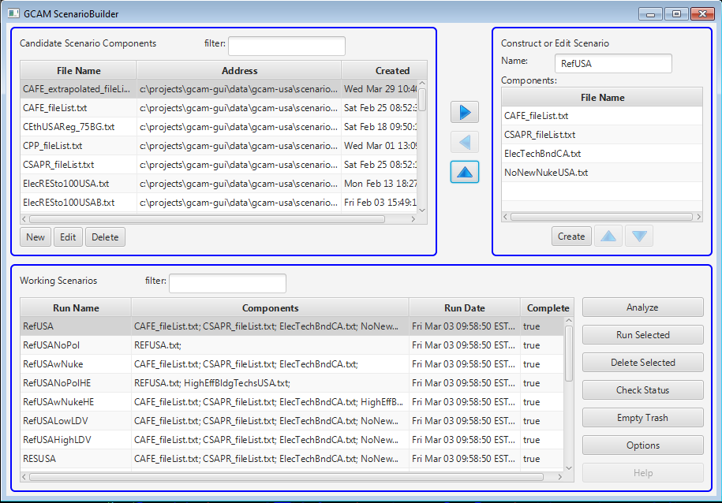
Background:
GLIMPSE multi-pollutant scenario evaluator
Scenario
assumptions
GLIMPSE
End points
Population
growth
Energy
Time horizon: 2010 – 2100 (typically 2010-2050)
Time steps: 5 years
Spatial coverage:
Global, 32 energy-economic regions
U.S. energy system at 50-state resolution
Sectors:
Electric, industrial, buildings, transportation
Emissions:
GHG: CO₂, CH₄, N₂O, CFCs
Air pollutant: NOx, SO₂, PM, CO, VOC, BC, OC
Platform: PC, Mac, or Linux
Availability: Open source, free
Technology penetrations
Economic growth
Fuel use and prices
Economic
Resource
availability
Policy cost
Energy prices
Climate change
Land and food prices
Climate
Technology development
GHG emissions
Global mean temperature
Behavior and preferences
Environmental
Air pollutant emissions
Policies
Water use
The GLIMPSE graphical interface simplifies setting up and executing modeling runs, visualizing results
Health impacts

Slide 10
Illustrative application:
Energy and emission impacts of electric vehicles
Context
  AEO18 passenger vehicle EV market share in 2050: ~11%
  However, recent EV cost projections are much lower than in AEO18
Research questions
  What EV penetration is projected by GCAM-USA using updated EV costs?
  What are the energy and emission impacts of greater EV penetration?
  How do these impacts differ by U.S. region?
  What drives regional differences?
Methodology
  Compare two scenarios with GCAM-USA:
    Low-EV: calibrated to approximate AEO18
    Higher-EV: projected using GCAM-USA using updated EV costs

Slide 11
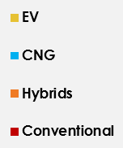
Results:
Light duty market penetration
How does EV market penetration differ between the Low-EV and Higher-EV scenarios?
What technologies are being displaced by higher EV penetration?
Low-EV
Higher-EV
Higher-EV minus Low-EV
CNG
EV
Hybrid
Conventional
Light duty travel met by EVS, 2050: 11%
Light duty travel met by EVs, 2050: 31%
About 60% of offset travel demand is
from hybrid cars and trucks.

Slide 12
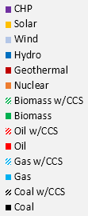
Results:
Electricity production
How much additional electricity must be produced in the Higher-EV scenario?
What mix of technologies are used to meet the additional electricity demands?
Low-EV
Higher-EV
Higher-EV minus Low-EV
Solar
Low-EV total
Wind
Hydro
Nuclear
Gas
Coal
After 2020, wind and solar make
up a large portion of new generation
By 2050, electricity production has
increased by 7% relative to Low-EV
Some coal that would retire under the Low-EV scenario instead stays in use.
Natural gas, wind, and solar comprise most of the additional generation.

Slide 13

Results:
System-wide emissions response at the national level
Categories:
(1) Primary:
Avoided tailpipe emissions (purple)
(2) Secondary:
Avoided refinery emissions (red)
Electricity production emissions (blue)
(3) Tertiary:
Price-induced fuel-switching (light purple,
green, and orange)
There is a net reduction in CO₂, NOx, and SO₂. PM_{2.5} increases, driven by the electric sector.
Electric sector
Fuel extraction, refining
and transport
Net
Transportation
CO₂ (MTC) NOx (kT) SO₂ (kT) PM_{2.5} (kT)

Slide 14
Results:
System-wide emissions response at the national level
Categories:
(1) Primary:
Avoided tailpipe emissions (purple)
(2) Secondary:
Avoided refinery emissions (red)
Electricity production emissions (blue)
(3) Tertiary:
Price-induced fuel-switching (light purple,
green, and orange)
There is a net reduction in CO₂, NOx, and SO₂. PM_{2.5} increases, driven by the electric sector.
Electric sector
Fuel extraction, refining
and transport
Transportation
Net
CO₂ (MTC) NOx (kT) SO₂ (kT) PM_{2.5} (kT)

Slide 15
Results:
System-wide emissions response at the national level
Categories:
(1) Primary:
Avoided tailpipe emissions (purple)
(2) Secondary:
Avoided refinery emissions (red)
Electricity production emissions (blue)
(3) Tertiary:
Price-induced fuel-switching (light purple,
green, and orange)
There is a net reduction in CO₂, NOx, and SO₂. PM_{2.5} increases, driven by the electric sector.
CO₂ (MTC) NOx (kT) SO₂ (kT) PM_{2.5} (kT)

Slide 16
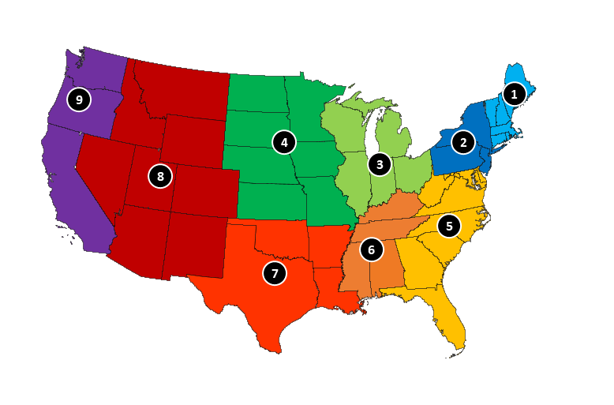
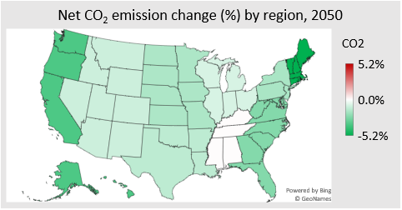
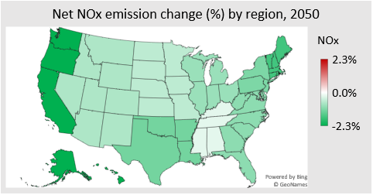
Results:
Comparison of regional emission responses
How do the regional net emission changes compare?
9
1
8
4
3
2
5
6
7
6
4
8
National
3
Greater reductions
7
New England
Pacific
9
Hawaii and Alaska are not included in Region 9 values shown

Slide 17
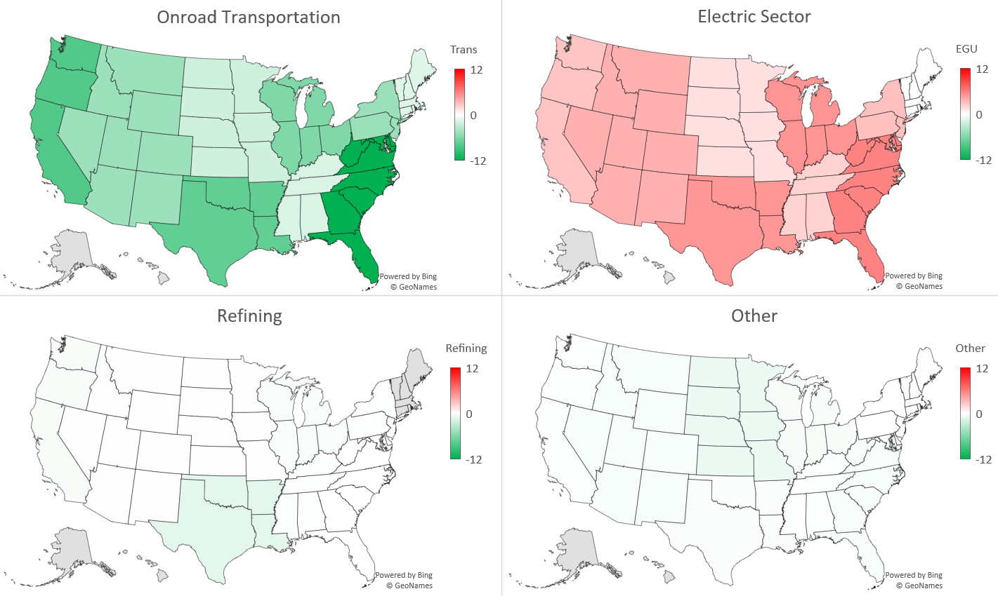
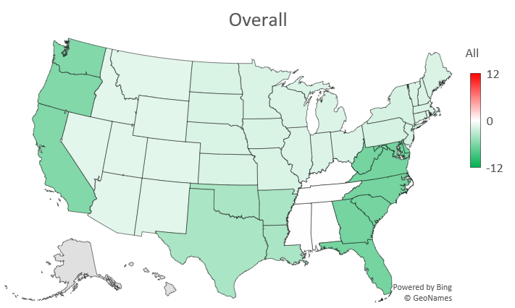
Results:
Differences in regional CO₂ emissions
Differences in 2050 CO₂ by Census Division and sector, Higher-EV minus Low-EV
Sectoral
Net
(MTC)
(MTC)
Net change across all sectors
(MTC)
(MTC)
(MTC)
Largest decrease: Region 5, Southeast, -6.5 MTC
Net change in CO₂ emissions by Census Division

Slide 18
Results:
Factors driving regional differences
Regions
9
1
8
4
3
2
6
5
7
The technologies used to meet additional electricity demands differ by region
Emission intensity of additional electricity in 2050:
CO₂: 24 MTC/EJ
NOx: 21 kT/EJ
Emission intensity of additional electricity in 2050:
CO₂: 19 MTC/EJ
NOx: 7.8 kT/EJ
Emission intensity of additional electricity in 2050:
CO₂: -1.9 MTC/EJ
NOx: -0.004 kT/EJ
The Region 1 response to EVs
reflects RGGI
Intensity calculation: Change in regional electric sector emissions (Higher-EV minus Low-EV)
Change in regional electricity production

Slide 19
Observations
GCAM-USA suggests that increased EV market share will generally lead to net CO₂ and NOx reduction benefits
  Changes in transportation, electric, and refinery sector emissions drive these trends
There is geographic heterogeneity in benefits due to factors such as:
  How additional electricity is produced
  How state and regional policies affect the
  production mix and use of controls
  How electricity is traded among regions
  Refineries activity is concentrated in several states

Slide 20
Summary
GCAM-USA can be applied to examine the long-term energy and emission impacts of EVs
  Categories of impacts:
    Primary (transportation sector)
    Secondary (electricity production and refining)
    Tertiary (price-induced fuel switching within and across sectors)
  State-level insights informed by:
    Existing technology stock
    Fuel prices and renewable resources
    State, regional, and national policies and regulations

Slide 21
Next Steps
Re-evaluate EV scenarios with the forthcoming version of GCAM-USA, which has an improved electric sector representation
Explore higher EV penetration scenarios
Link GCAM-USA with IPM to provide a more detailed exploration of electric sector response to EVs, including under alternative charging scenarios

Slide 22
Questions?
For more information, please contact:
Loughlin.Dan@epa.gov
https://www.epa.gov/air-research/glimpse-computational-framework-supporting-state-level-environmental-and-energy

