Slide 1
Updates and Improvements to 2023 and 2028 Emission Inventory Projections
Caroline Farkas, Alison Eyth, Jeff Vukovich
October 22, 2019
Notes:
Projections are created from the emissions modeling platform base year to support policy and regulation research and evaluation

Slide 2
Disclaimer
The views expressed in this presentation are those of the author(s) and do not necessarily represent the views or policies of the Agency.

Slide 3
Outline
Why develop projected emission inventories?
How do we project emissions?
2016 Collaborative Emissions Modeling Platform
Pollutant-Sector Comparison
Projections for Various Sectors

Slide 4
Why develop projected emission inventories?
To evaluate policy options and impacts of changing emissions and use the results in a relative sense
EPA develops Regulatory Impact Analyses (RIAs) for regulations
Describe the potential social benefits and social costs
Interstate transport: The Clean Air Act’s "good neighbor" provision requires EPA and states to address interstate transport of air pollution that affects downwind states' ability to attain and maintain National Ambient Air Quality Standards (NAAQS)
Other types of analyses: regional haze, etc.

Slide 5
How do we project emissions?
Models are used to project some sectors (e.g., electric generating units (EGUs), nonroad, onroad)
Projection factors are developed for many sectors based on the U.S. Energy Information Administration’s (EIA) Annual Energy Outlook (AEO)
AEO is a rich data source with 30 year forecasts of U.S. energy markets
Sectors: non-EGU point, nonpoint, onroad activity, oil and gas
Known federal, state, and local regulations and control technology requirements are implemented as “control factors”
Meteorology is kept the same as the base year
Base year fire and biogenic emissions are used in future years

Slide 6
2016v1 Platform Projections
The projection of 2016v1 emissions was a collaborative process with heavy involvement from sector workgroups
Includes data provided by Federal, State, and Local agencies and Regional Organizations
Updated data were due by May 31, 2019
Projected inventories released early October
https://www.epa.gov/air-emissions-modeling/2016v1-platform
Future year scripts and air quality model-ready files coming soon
First public projections since 2011 platform

Slide 7
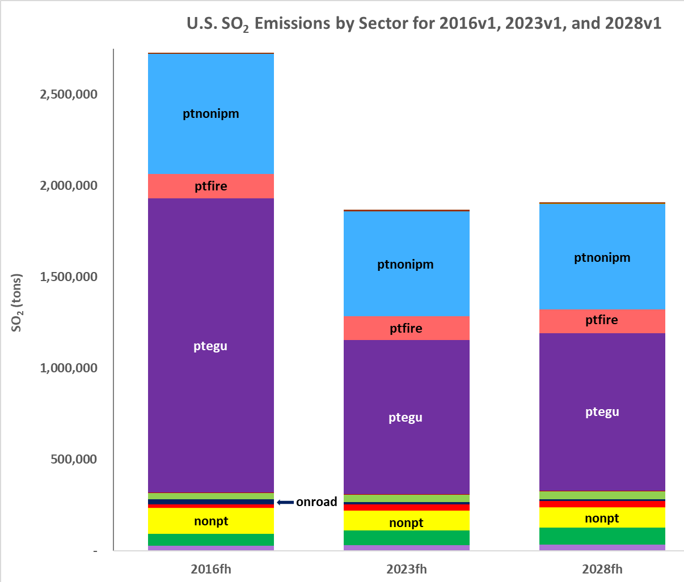
Notes:
Emissions of SO2 are predicted to decrease – especially from EGUs

Slide 8
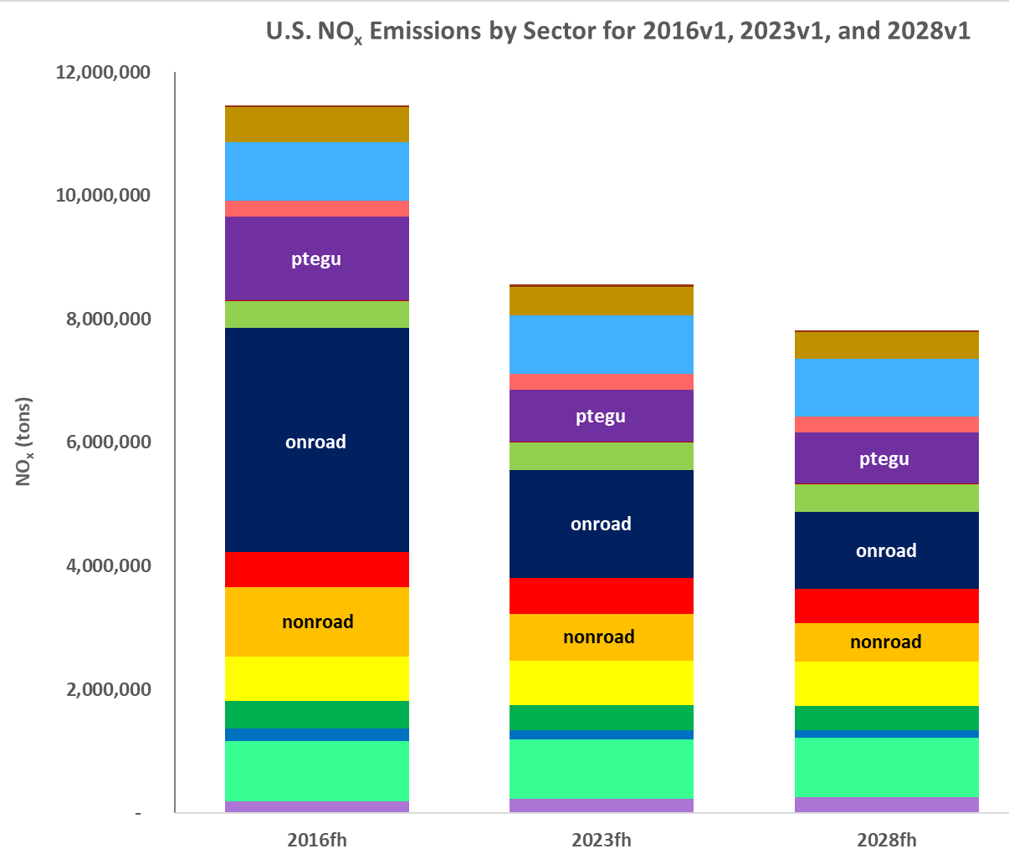
Notes:
Emissions of NOx are predicted to decrease – especially for EGUs, onroad, and nonroad

Slide 9
Notes:
Emissions of VOCs are dominated by biogenic processes, but onroad VOC emissions are predicted to decrease

Slide 10
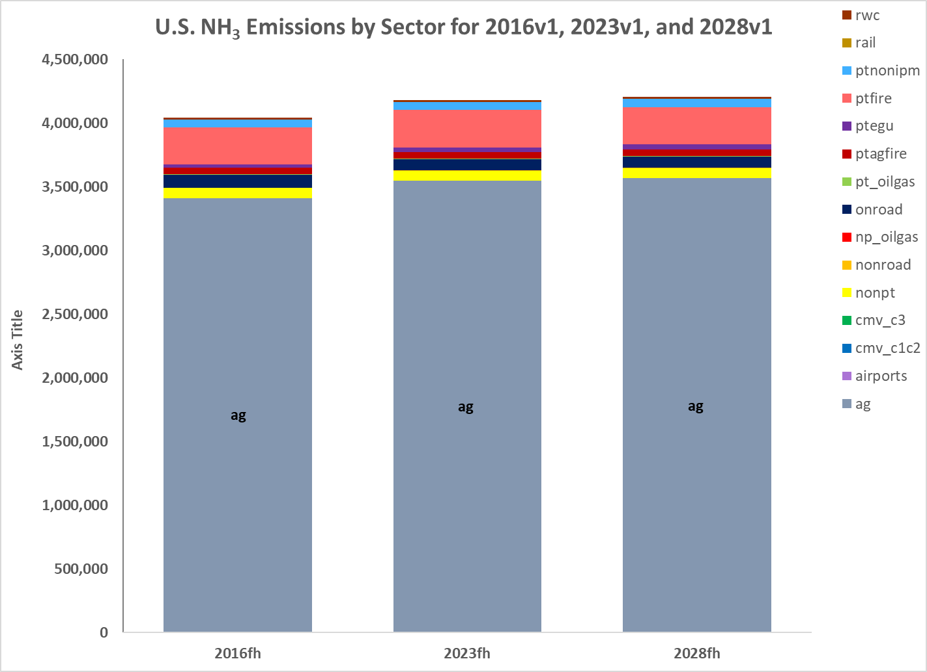
Notes:
Ammonia emissions are projected to increase – especially from agriculture

Slide 11
Electric Generating Units (EGUs)
Two options are available for future year EGUs:
Eastern Regional Technical Advisory Committee (ERTAC) EGU model v16.0
EPA’s Integrated Planning Model (IPM) version 6, May 2019 case
New for 2016v1 platform projections
Recent closures and committed units have been incorporated
ERTAC
New CAMD data
IPM
Adjustments to SO2 emission factors for coal units
Updated methodology for PM post-processing that makes base and future year PM more consistent for units operating similarly

Slide 12
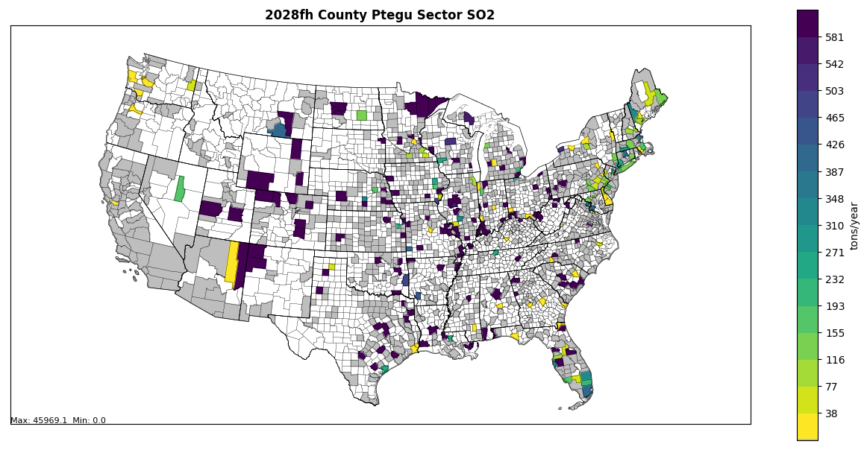
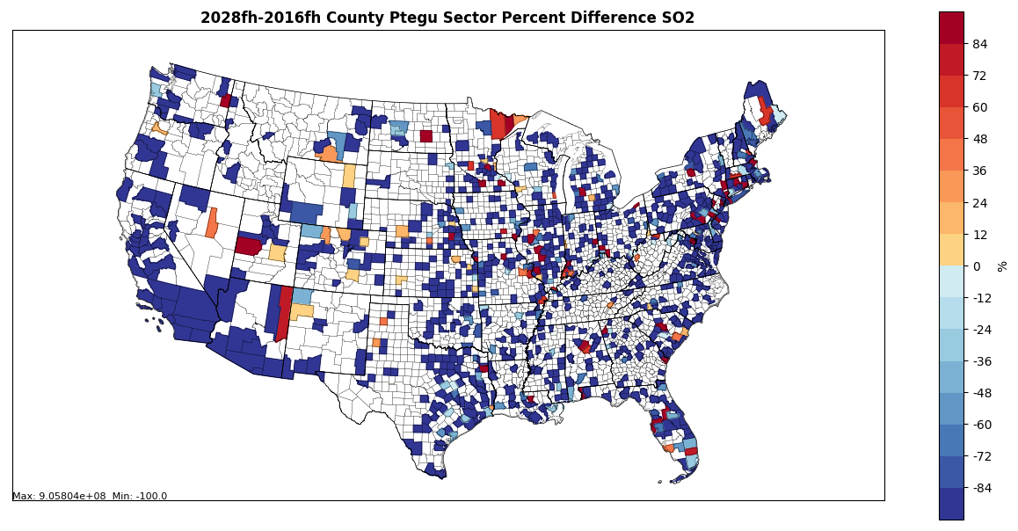
2028 EGU SO₂ Emissions and Changes from 2016
Notes:
EGU county projection map

Slide 13
Onroad Emissions
Projected by combining emission factors from the Motor Vehicle Emissions Simulator (MOVES) with year-specific activity data
New for 2016v1 platform projections
Projections of vehicle age distributions now reflect the dip in vehicle counts that resulted from reduced car sales during the economic recession
AEO 2019 to project vehicle miles traveled (VMT)
Hoteling hours reduced based on new factors for combination long haul truck VMT on restricted highways
State/local agencies provided updated inputs
California provided emissions for base and future years

Slide 14
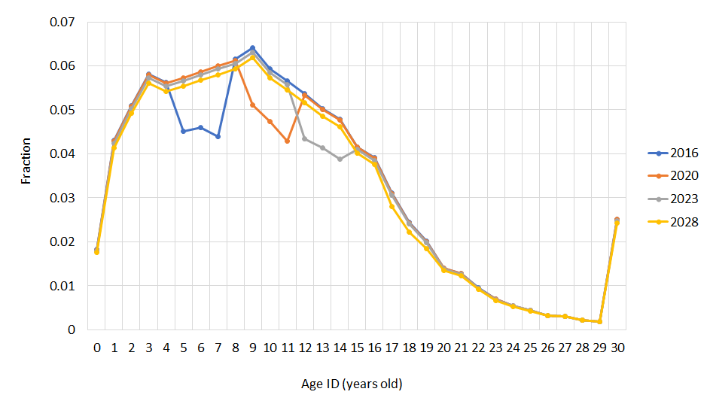
Example Base and Future Year Age Distributions for Passenger Cars
Notes:
Notice the dip for the recession moving back in time as the year modeled is later

Slide 15
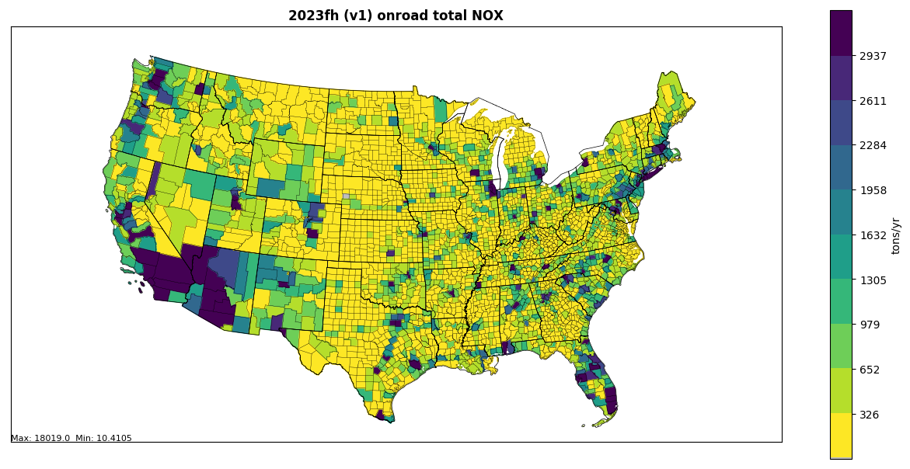
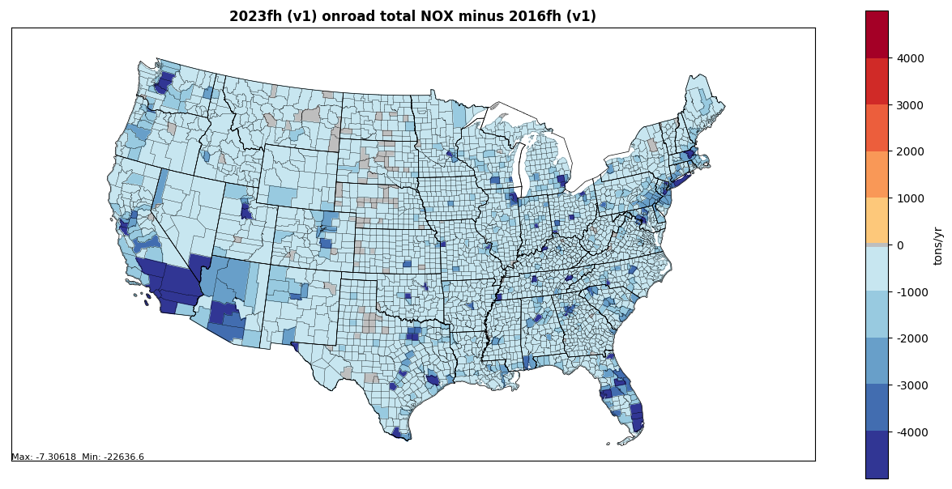
Total Onroad NOx 202x-2016
2023 v1 Onroad total NOx
2028 v1 Onroad total NOx
2023 minus 2016 v1 NOx
2028 minus 2016 v1 NOx

Slide 16
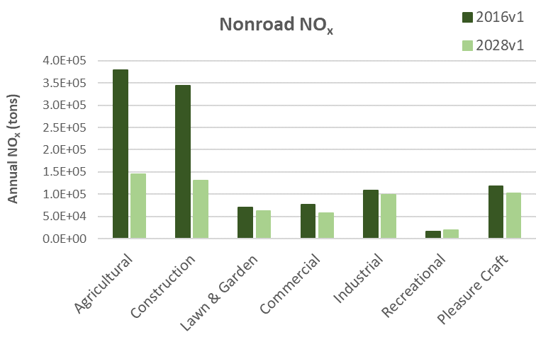
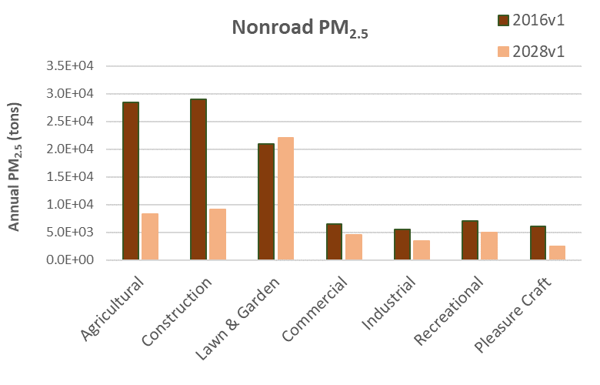
Nonroad Projections: 2016v1
Declines in emissions from 2016 to 2028 are the result of equipment turnover → newer, cleaner engines are projected to dominate the market in future years
-61.6%
-61.9%
-9.2%
-13.6%
-10.5%
-25.8%
+21.5%
Nonroad engine regulations driving emissions reductions include:
Tier 4 standards for nonroad diesel engines (starting in 2008)
Emission standards for new nonroad spark-ignition engines, equipment, and vessels (starting in 2010)
-70.6%
-68.8%
+5.0%
-30.2%
-37.9%
-30.4%
-59.2%

Slide 17
Oil and Gas Projections
Point Oil and Gas sources
Production-related sources: used State historical data and AEO 2019
Exploration-related sources: used a four year average of 2014-2017 exploration activity (instead of 2 year average in beta version)
Transmission-related sources: used factors based on AEO 2019
Nonpoint Oil and Gas sources
Exploration-related sources: used 4-year average emission dataset
Production-related sources: used State historical data and AEO 2019
Federal and state-level controls
New source performance standards (NSPS) for oil and gas, reciprocating internal combustion engines (RICE), natural gas turbines, and process heaters
Reasonably Available Control Technology (RACT) in Pennsylvania, and updates to natural gas transmission compressors in New Jersey
Western Regional Air Partnership (WRAP) Oil and Gas inventory has been provided and is being reviewed

Slide 18
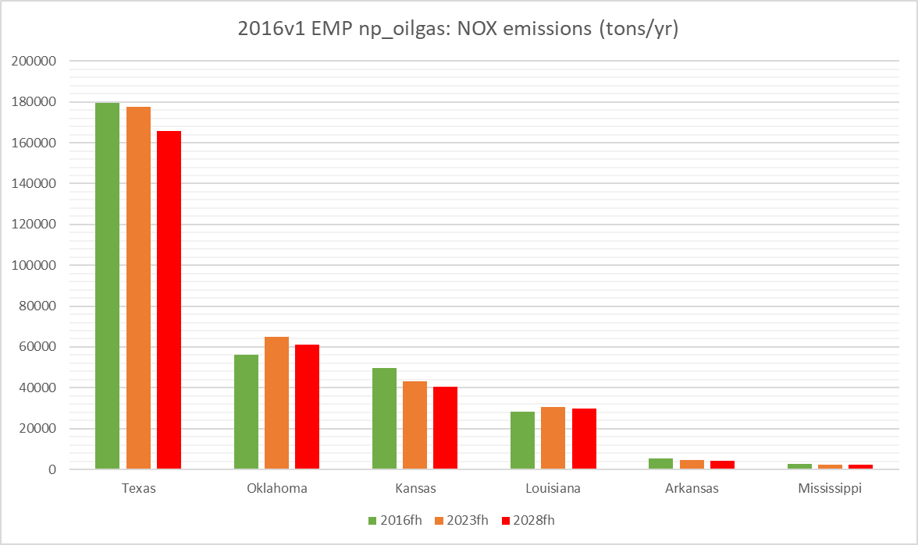
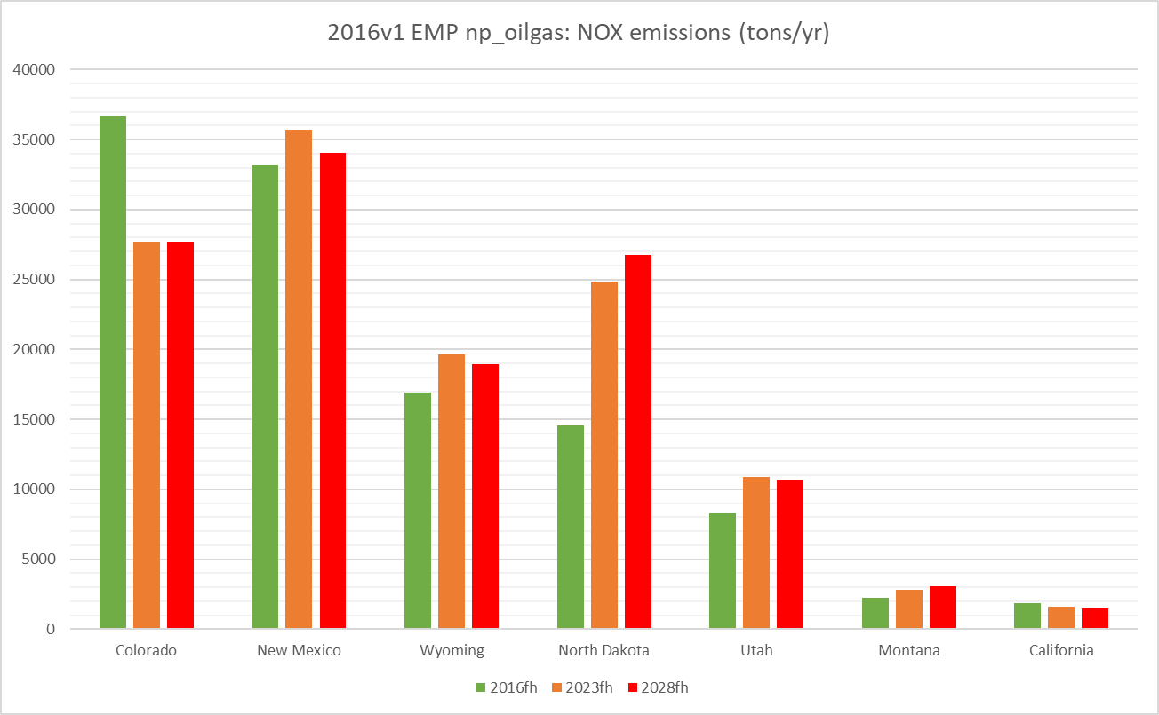
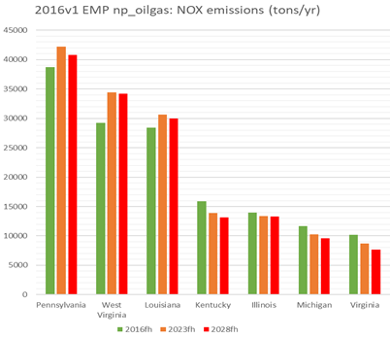
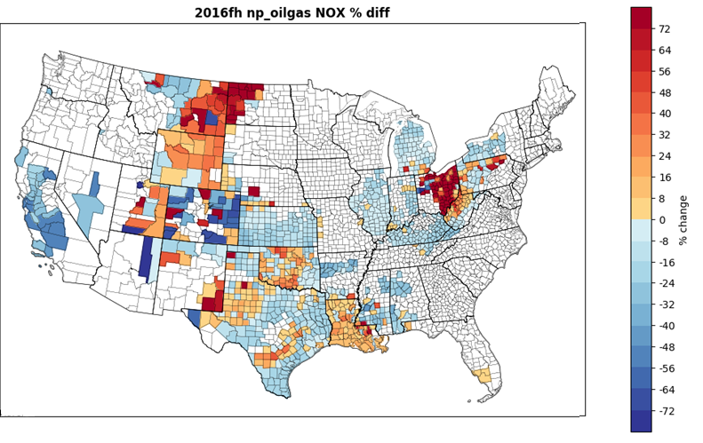
Nonpoint Oil & Gas NO_{x} emissions comparison
Green: 2016v1
Orange: 2023v1
Red: 2028v1
Texas Oklahoma Kansas Louisiana Arkansas Mississippi
Colorado New Mex. Wyoming N.Dakota Utah Montana California
2028-2016 NO_{x} nonpoint Oil and Gas percent difference
Penn. W.Virginia Louisiana Kentucky Illinois Michigan Virginia
Notes:
O&G plot?

Slide 19
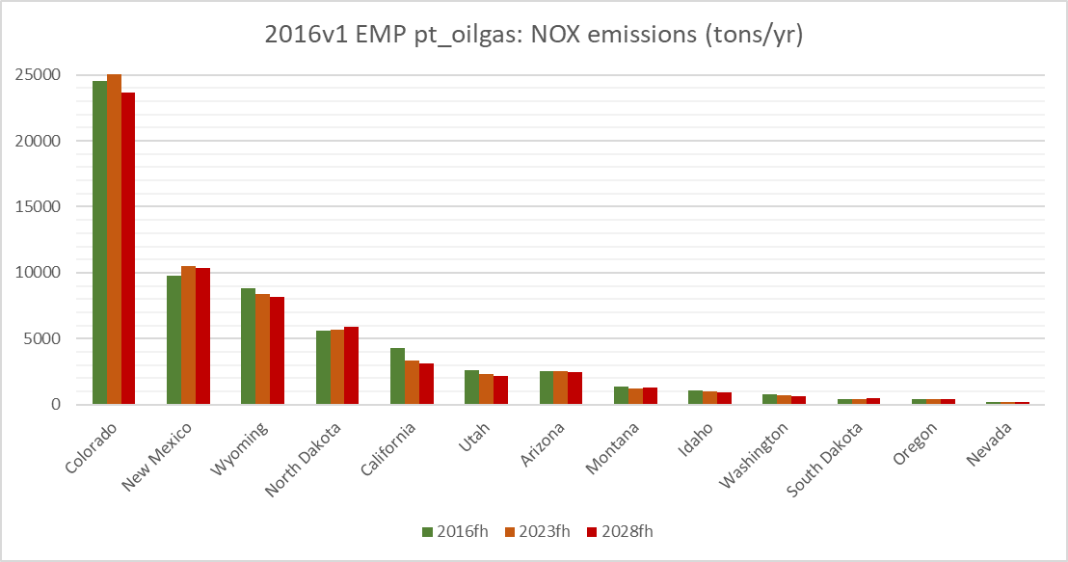
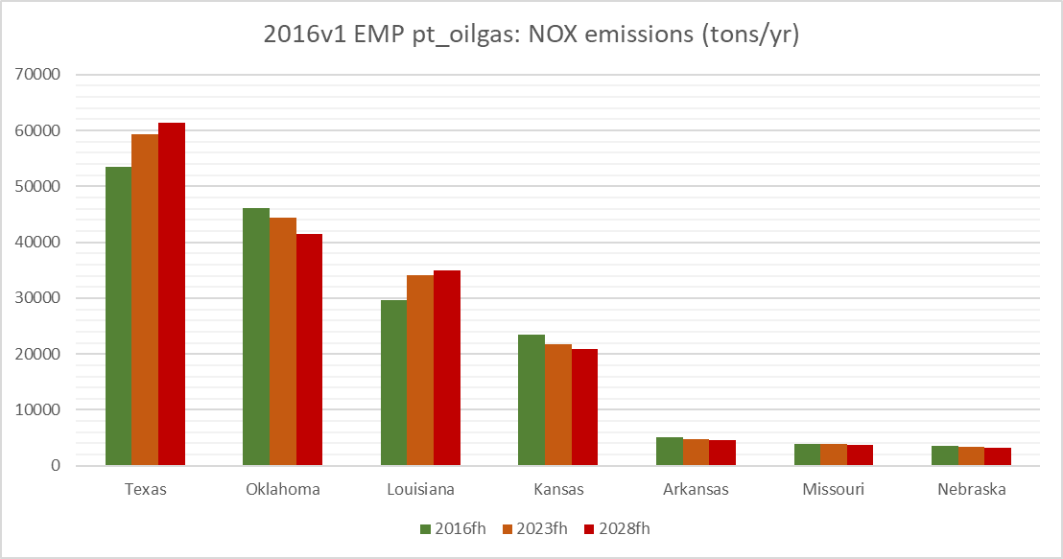
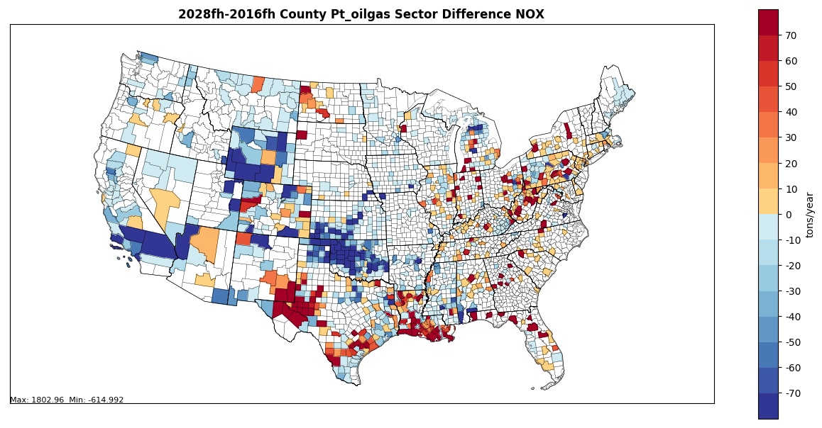
Point Oil & Gas NO_{x} emissions
Green: 2016v1
Orange: 2023v1
Red: 2028v1
Texas Oklahoma Louis. Kansas Arkansas Miss. Nebraska
CO NM WY ND CA UT AZ MT ID WA SD OR NV
Notes:
O&G plot?

Slide 20
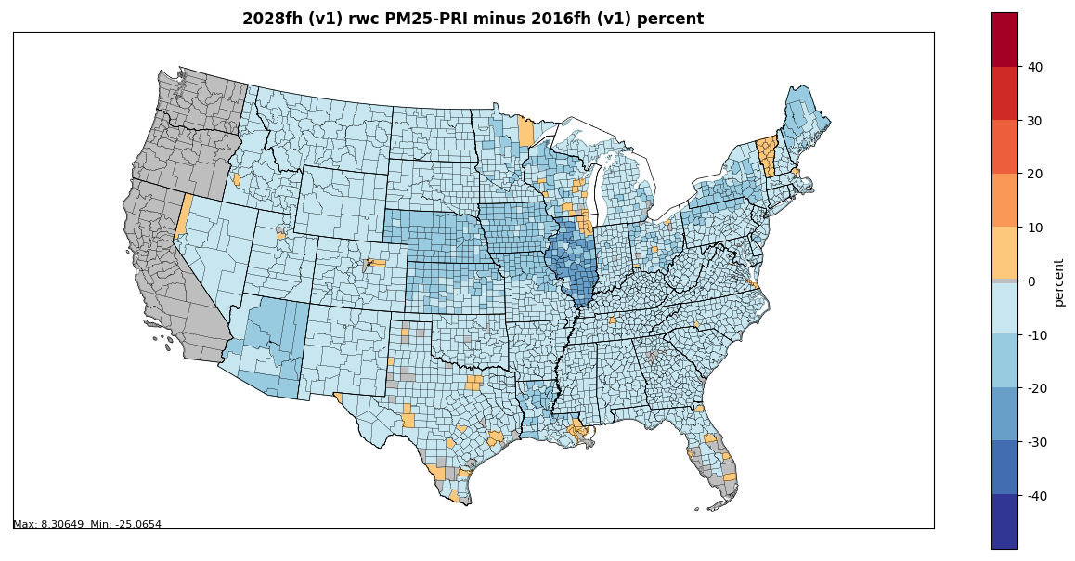
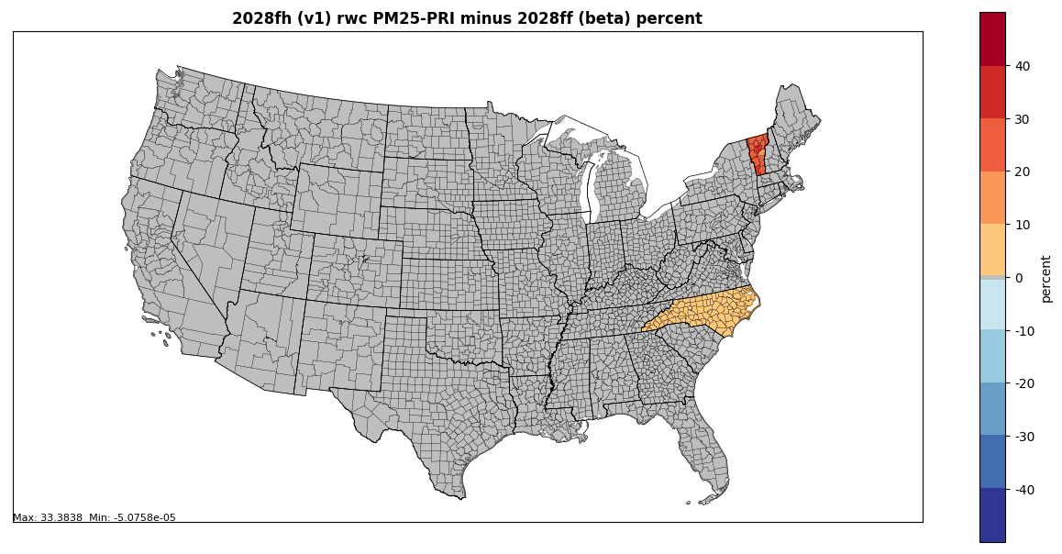
Residential
Wood
Combustion difference maps
VT and NC submitted edits for v1
CA, OR, WA have no growth for future year scenarios
Largest decreases in projections are from indoor wood non-EPA certified furnaces

Slide 21
Projections for Other Sectors
Area fugitive dust (afdust) projections
Unpaved road dust emissions are held constant (instead of growing them in future years)
Nonroad emission projections
Texas provided future-year nonroad emissions for v1
Rail projections updated
2016v1 method uses emission factor trend derived from recent rail inventory efforts

Slide 22
Questions?
Access 2016, 2023, and 2028 modeling platform and emission inventories: https://www.epa.gov/air-emissions-modeling/2016v1-platform
Thank you to our collaborators!

Slide 23
Changes in future year emissions carried over from work on 2017NEI
Ag Livestock Waste Emissions
2017 National Emissions Inventory (NEI) data used in 2016v1 corrected a past underprediction of animal counts for dairy cows, poultry
Airport Emissions
2017 NEI estimates emissions using Aviation Environmental Design Tool (AEDT), but projections are still based on the Terminal Area Forecast (TAF)
Onroad Age Distributions
CRCA-115 VIN decode project
Nonroad MOVES setup
Month and spatial allocations of snowmobiles in UT
Recreational marine allocations in WA
Updated equipment pops. in AZ, UT, CT
Commercial Marine Vessel (CMV) Inventory

Slide 24
2016
2023
2028
2016
2023
2028
2016
2023
2028
2016
2023
2028

