Slide 1
Source Apportionment Modeling to Investigate Local and Non-Local Contributions to Ground-Level Ozone in Albuquerque, New Mexico
By Kenneth Craig, Garnet Erdakos, Shih Ying Chang, and Lynn Baringer
For the 18th Annual CMAS Conference
October 23, 2019
STI-7145

Slide 2
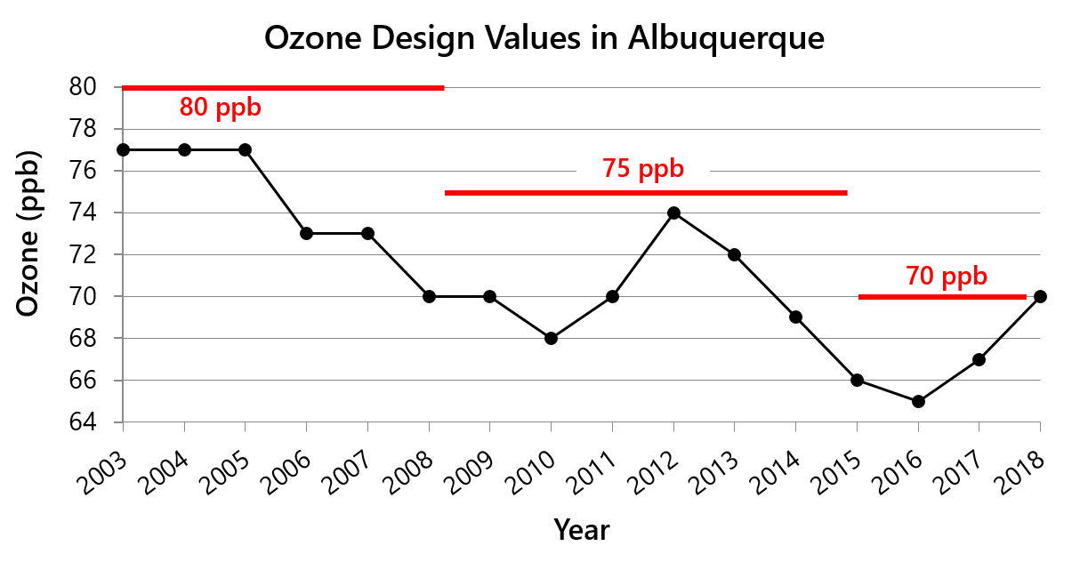
Ozone design values in the Albuquerque area have been decreasing over the last 15 years, but have increased in recent years. In 2018, the design value was 70 ppb, which is on the cusp of violating the current federal standard.
2

Slide 3
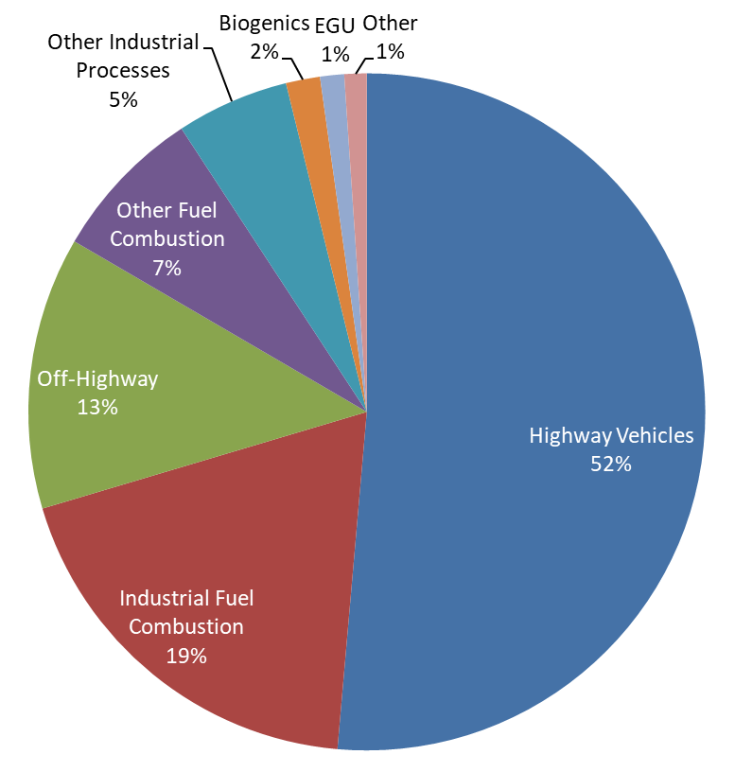
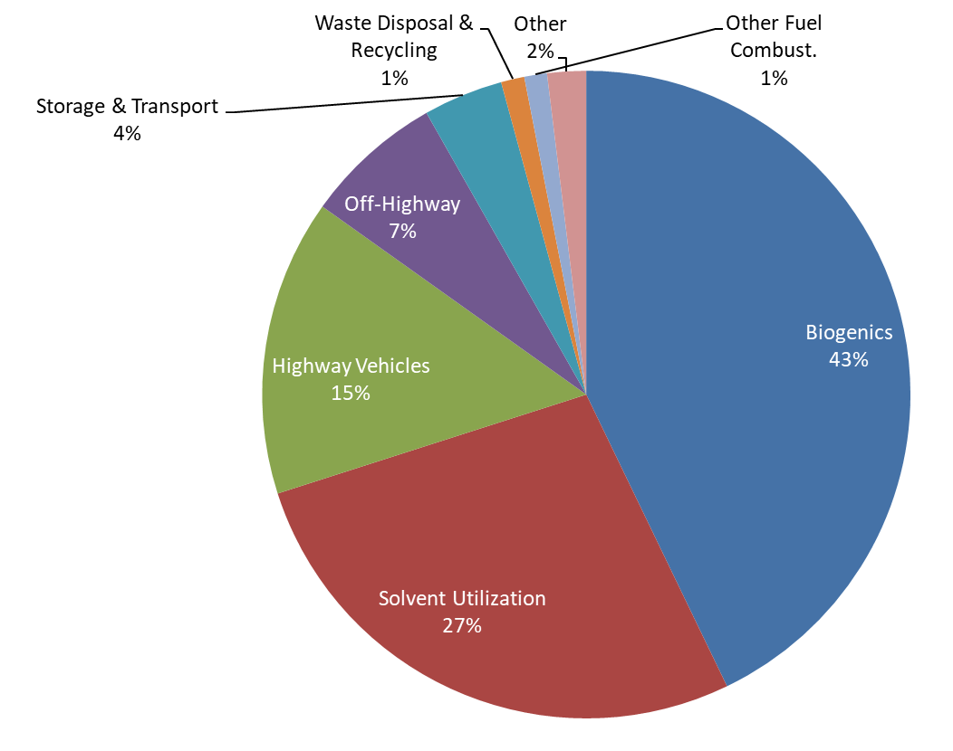
Bernalillo County 2014 Emissions
NOx Emissions
VOC Emissions

Slide 4
Bernalillo County Emissions Summary
Sector | NO_{x} [tons/day] | VOC [tons/day]
Onroad Mobile | 22.5 | 11.1
Nonpoint | 7.8 | 28.1
Point (major industry) | 4.7 | 1.7
Non-road | 4.6 | 6.8
Biogenic and Soil (BEIS) | 1.3 | 101.8
Total | 40.9 | 145.3
These numbers are representative of summer weekday emissions.
Nonpoint include sources too numerous to account for individually, such as small-scale fuel combustion, solvent utilization, mining and quarrying, gas distribution, commercial cooking, treatment works, and other miscellaneous sources.

Slide 5
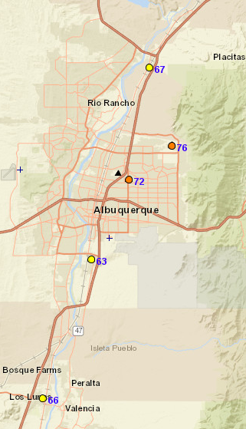
Modeling Episodes
Two Episodes
June 12–16, 2017
July 3–14, 2017
Ozone was in the Unhealthy for Sensitive Groups category in Albuquerque on four days during these episodes.
These episodes include most of the high ozone days that occurred in 2017.
Ozone on July 10, 2017

Slide 6
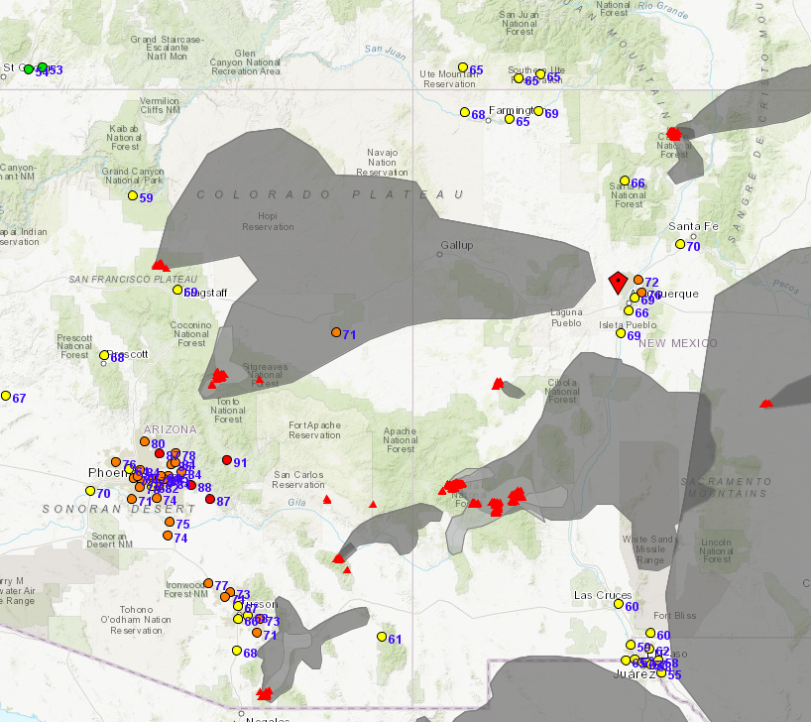
High Ozone Conditions on June 14, 2017
500 mb weather map on June 14, 2017 from NCEP Daily Weather Map archive
Hazard Mapping System (HMS) satellite detections (red triangles) and HMS-analyzed smoke (gray shading) on June 14, 2017 (from AirNow-Tech)

Slide 7
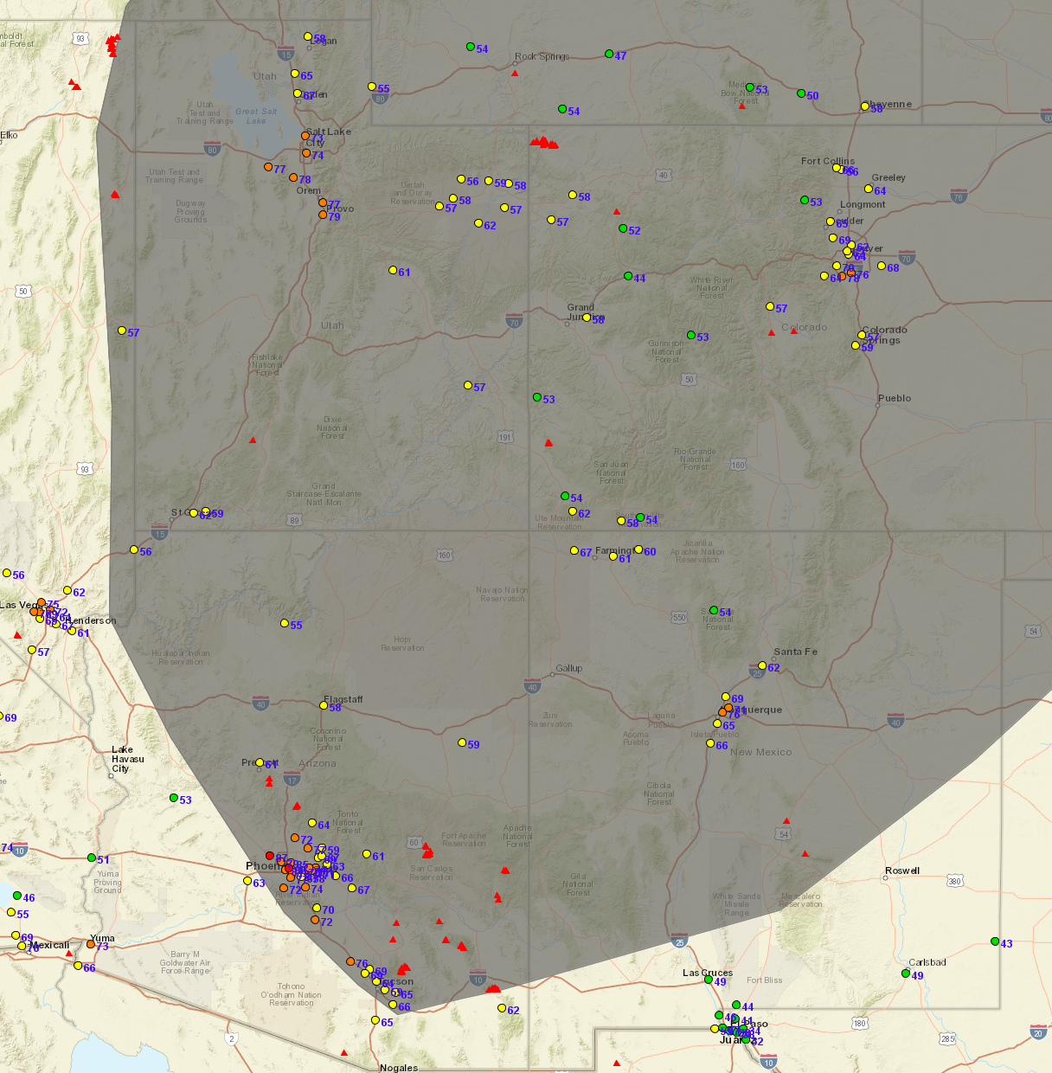
High Ozone Conditions on July 7, 2017
500 mb weather map on July 7, 2017 from NCEP Daily Weather Map archive
HMS satellite detections (red triangles) and HMS-analyzed smoke (gray shading) on July 7, 2017 (from AirNow-Tech)

Slide 8
CAMx Input Data
Emissions
Primarily based on NEI 2014v7.2 platform
2017 CEMS for EGUs
Adjustments to onroad mobile emissions from 2014 to 2017
BEIS for 2017 biogenics
Day-specific wildfire and prescribed fire emissions
Meteorology
WRF version 3.9.1
Model performance was good and within established benchmarks
Boundary Conditions
Based on output data (every 6 hours) from the Model for Ozone and Related chemical Tracers (MOZART) from NCAR

Slide 9
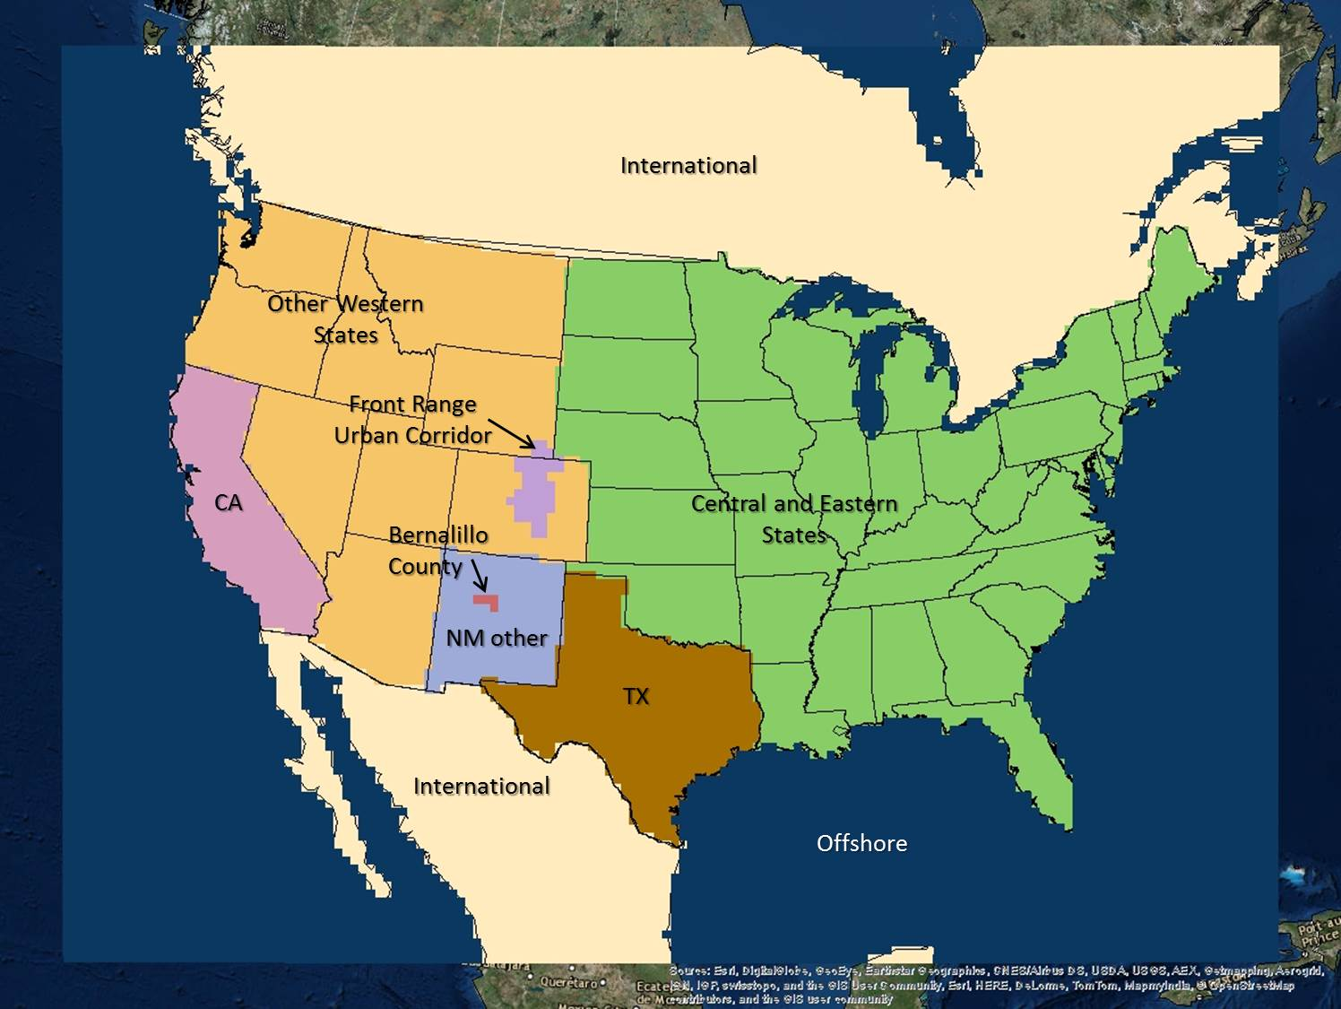
CAMx Modeling
CAMx Version 6.4
OSAT3
APCA
36-km, 12-km, and 4-km modeling domains
Nine source regions
Four source sectors
Biogenic
Onroad mobile
Wildland fire
Other anthropogenic
Three EGUs and one refinery in New Mexico, tagged individually
36-km Domain

Slide 10
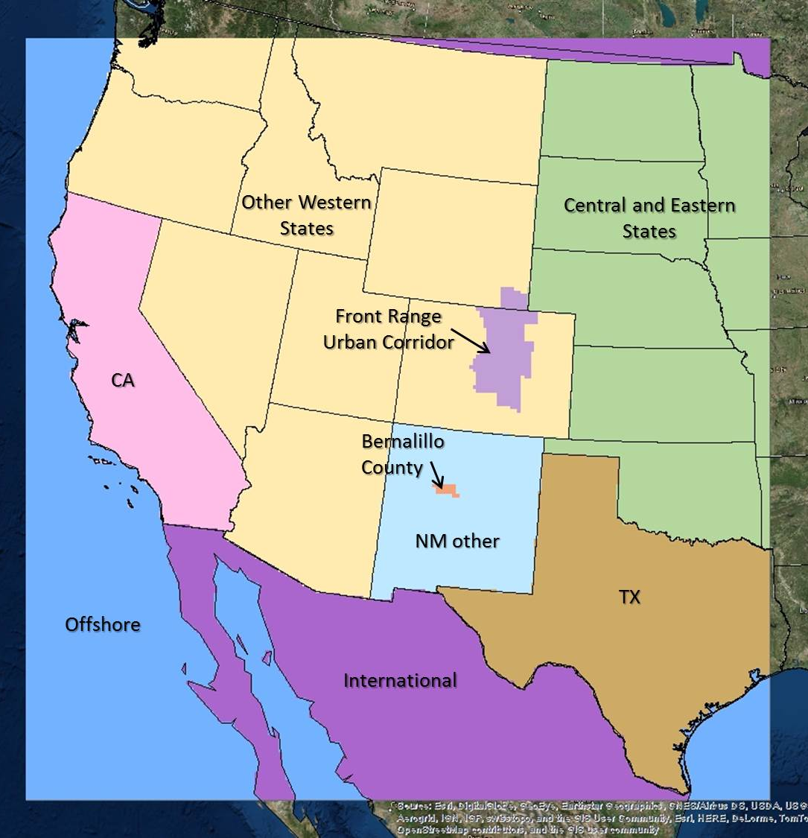
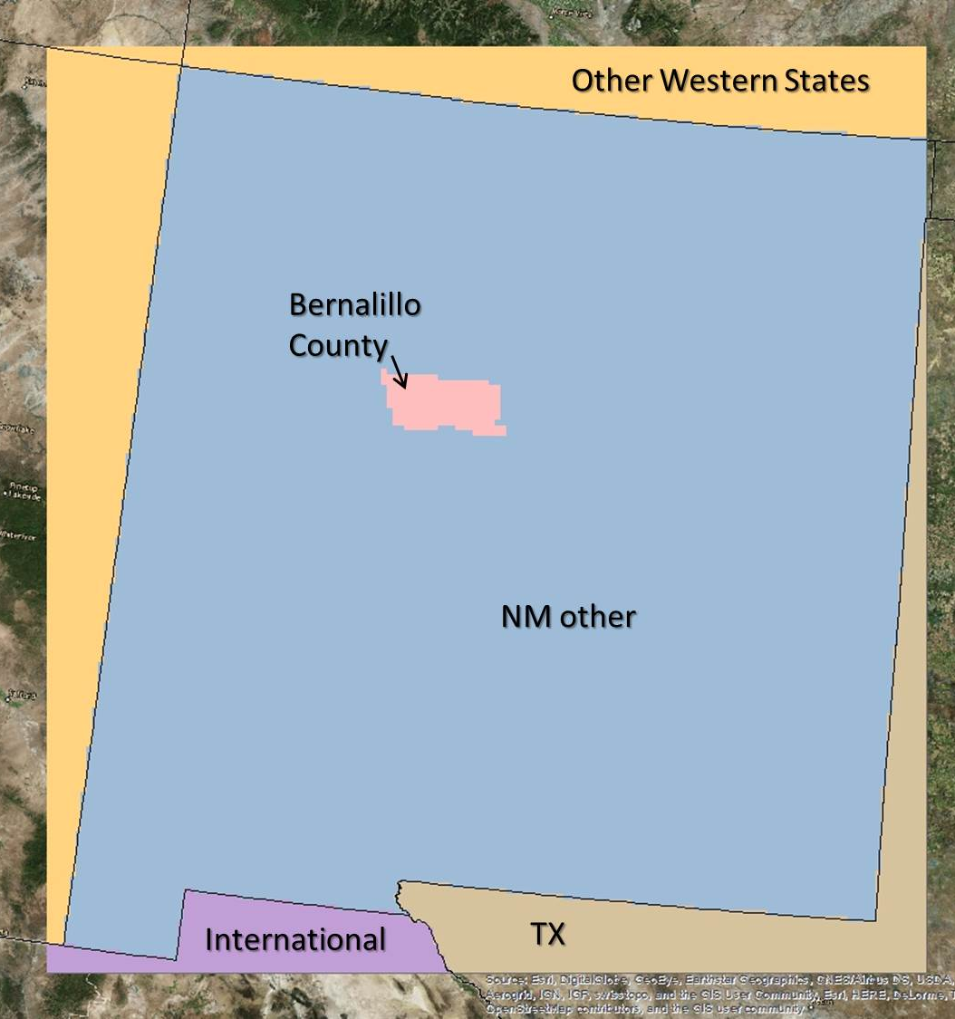
CAMx Modeling
CAMx Version 6.4
OSAT3
APCA
36-km, 12-km, and 4-km modeling domains
Nine source regions
Four source sectors
Biogenic
Onroad mobile
Wildland fire
Other anthropogenic
Three EGUs and one refinery in New Mexico, tagged individually
12-km Nested Domain
4-km Nested Domain

Slide 11
Data Analysis Approach
Calculate the source contributions to the daily 8-hr average ozone concentration for time periods with the highest modeled daily 8-hr average ozone concentration
Select data for the grid cell with the highest daily 8-hr average concentration in Albuquerque/Bernalillo County
Average the contributions across days with 8-hr average ≥ 65 ppb
Analyze absolute and relative contributions

Slide 12
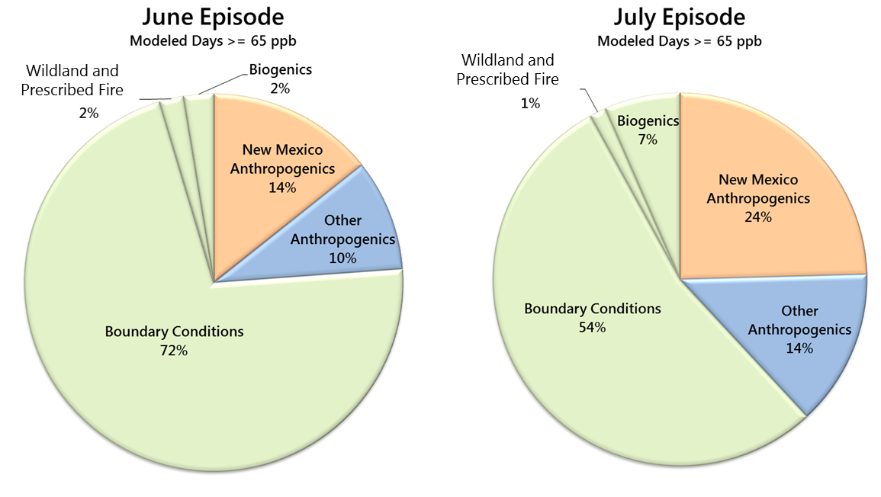
Source Apportionment Results
Non-local ozone is more prevalent in Albuquerque during the June episode.
Local ozone is more prevalent during the July episode.

Slide 13
Source Apportionment Results: New Mexico Contributions
June episode
July episode

Slide 14
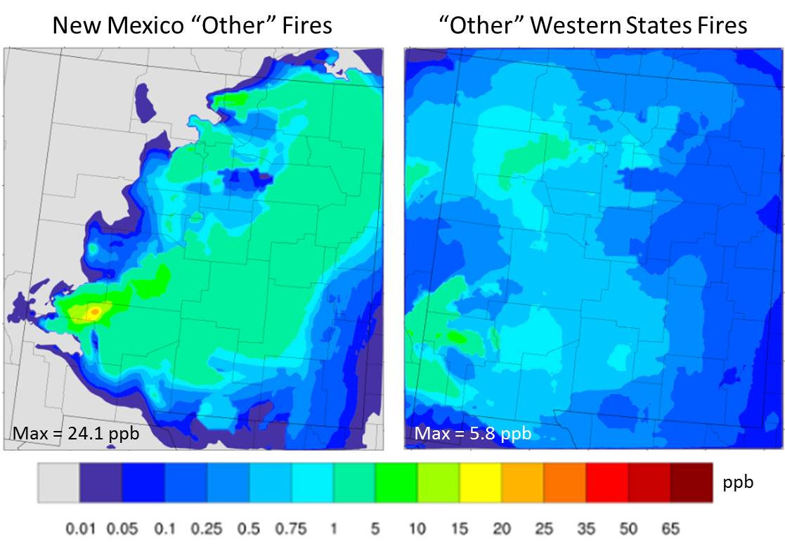
Fire Impacts on Ozone on June 15, 2017
Fires within New Mexico
Fires outside New Mexico
Albuquerque

Slide 15
Ozone Impacts from Major Power Plants on June 15, 2017
Albuquerque

Slide 16
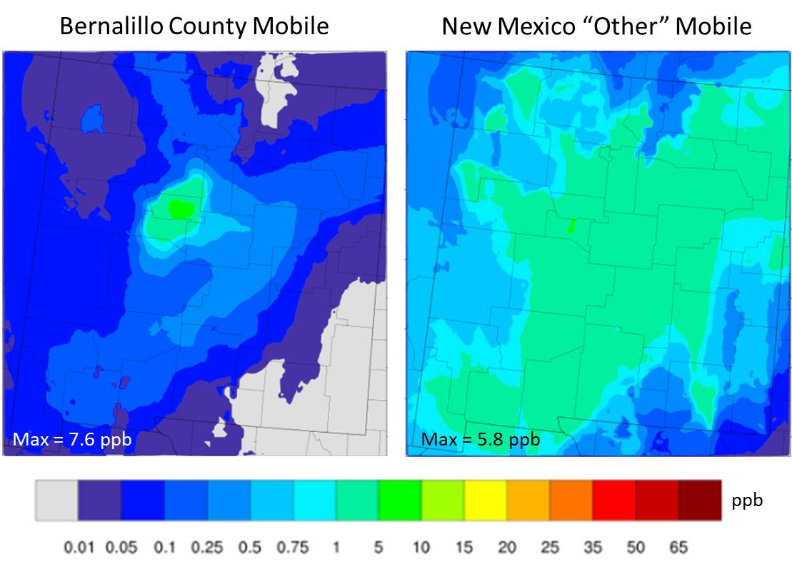
Mobile Source Impacts on Ozone on July 10, 2017
Albuquerque

Slide 17
Source Apportionment of 8-hr Ozone
Source | June Episode
Boundary Conditions | 48 ppb
Anthropogenic and non-anthropogenic from other western and eastern states | 6.3 ppb
Bernalillo County | 6.0 ppb
New Mexico (remainder) | 3.6 ppb
California | 1.5 ppb
Wildland Fire | 1.4 ppb
San Juan and Four Corners EGUs | 0.4 ppb
Mexico | 0.3 ppb
Texas | No Impact
Denver | No Impact
Total | 67.5 ppb
Source | July Episode
Boundary Conditions | 37 ppb
Bernalillo County | 12.3 ppb
Anthropogenic and non-anthropogenic from other western and eastern states | 7.9 ppb
New Mexico (remainder) | 5.3 ppb
Wildland Fire | 1.7 ppb
Texas | 1.4 ppb
Mexico | 1.2 ppb
California | 1.0 ppb
Denver | 0.8 ppb
San Juan and Four Corners EGUs | 0.3 ppb
Total | 68.9 ppb
Average modeled peak 8-hr ozone impact across high-ozone days.

Slide 18
Summary (1 of 2)
Transport from outside New Mexico is always important and accounts for over half of the ozone in Albuquerque.
Local emissions in Albuquerque and Bernalillo County are also important. Half of the locally generated ozone is due to onroad mobile source emissions.
Contributions from emissions in Albuquerque and Bernalillo County were less prevalent during the June ozone episode, which was driven largely by long-range transport.

Slide 19
Summary (2 of 2)
On high ozone days in the two modeled episodes, contributions from major power plants in northern New Mexico were small.
Impacts from man-made emissions in western states, including California, are non-negligible.
Ozone contributions from wildfire smoke were important during both episodes.
Emissions from nonroad and non-mobile source sectors are becoming increasingly important.

Slide 20
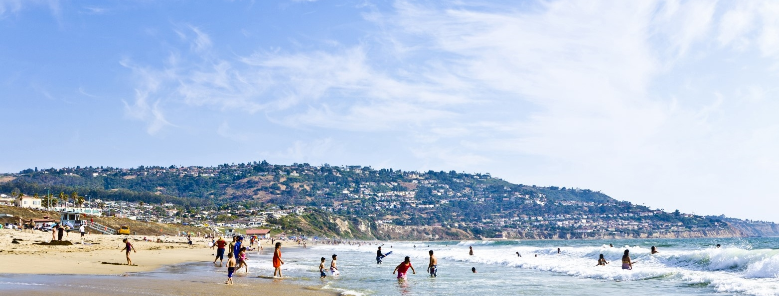
Acknowledgement
This work was supported by the City of Albuquerque Environmental Health Department.
20
Notes:
This slide is optional. If you want to keep it, feel free to modify it. If your client doesn’t care where our offices are, remove that information.
Replace content above with text from our website, www.sonomatech.com.
Remove business areas/services that don’t apply. Replace them with others that do (try not to list more than eight):
Air Quality
Capacity Building
Content and 508 Compliance
Data Science/Analysis
Data Management
Emissions
Exceptional Events
Expert Testimony
Fire and Fuels
Forecasting
Fuels Mapping
Kids Making Sense
Low-Cost Sensors
Modeling
Measurements
Meteorology
Monitoring
Public Outreach
Public Data Displays
Smoke Impact Analysis
Software Development
Training
Transportation

Slide 21
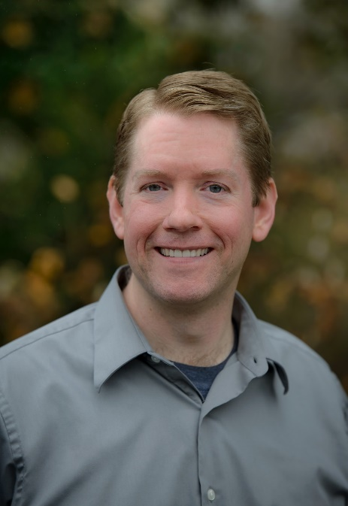
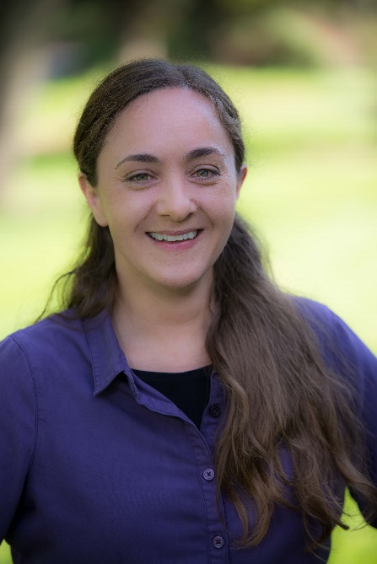
Kenneth Craig
Senior Atmospheric Scientist
Manager, Atmospheric and Emissions Modeling Group
kcraig@sonomatech.com
Garnet Erdakos
Atmospheric Scientist
Project Manager
gerdakos@sonomatech.com
SonomaTech.com 707-665-9900

Slide 22
Supplemental Slides

Slide 23
Smoke and Ozone on June 14, 2017

Slide 24
Smoke and Ozone on July 7, 2017

Slide 25
Source Apportionment Results: June Episode
Non-local ozone is more prevalent in Albuquerque during the June episode.

Slide 26
Source Apportionment Results: July Episode
Local ozone is more prevalent in Albuquerque during the July episode.

