Slide 1
State of the
Center for Community Modeling and Analyses System (CMAS)
– 18 Years Serving the Community
Sarav Arunachalam
Acting Director, CMAS Center
18th Annual CMAS Conference
October 21 – 23, 2019
Chapel Hill, NC

Slide 2
The CMAS Center at UNC https://www.cmascenter.org/
Established in 2001, the U.S. EPA’s CMAS Center has been hosted at UNC since 2003, which works with the agency to lead the international, open-source, community-based air quality modeling and analysis software used to develop policies and analyze air quality impacts
Objectives
  Serve as bridge between segments of the AQ modeling community
  Foster growth of developer and user communities
  Serve as hub for modeling education and training
Functions
  Model Research and Development
  User Support
  Applications and Training
  Outreach

Slide 3
Illustrative News Alerts
“The new [Transport] rules would bring $120 billion in annual health benefits. These include preventing 14,000 to 36,000 premature deaths, 23,000 nonfatal heart attacks, 21,000 cases of acute bronchitis, 240,000 cases of aggravated asthma and 1.9 million missed school and work days.”
- New York Times (July 2010)
“The new [Ozone] standard will result in health benefits valued at $2 billion to $19 billion and cost an estimated $7.6 billion to $8.5 billion, the agency [EPA] said in an e-mailed release.”
- Bloomberg.com (March 2008)

Slide 4
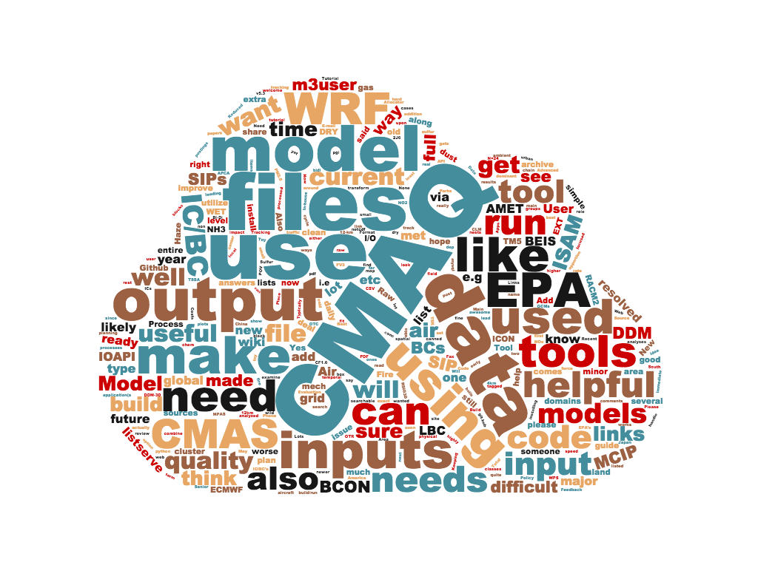
CMAS Modeling and Analysis Tools (1 of 2)
MODEL RESEARCH AND DEVELOPMENT
Modeling (Regional)
CMAQ, Community Multiscale Air Quality modeling System
SMOKE, Sparse Matrix Operator Kernel Emission modeling System
Modeling (Dispersion of Near Source Releases)
R-LINE, Research LINE source dispersion Model
C-LINE, Community-LINE Source Model
C-PORT, Community PORT Model
Modeling (Architecture, Design and Coupling)
I/O API, Input/Output Applications Programming Interface
MCIP, Meteorology Chemistry Interface Processor
Spatial Allocator
Speciation Tool
FEST-C, Fertilizer Emission Scenario Tool

Slide 5
CMAS Modeling and Analysis Tools (2 of 2)
MODEL RESEARCH AND DEVELOPMENT
Analysis and Visualization
VERDI, Visualization Environment for Rich Data Interpretation
PAVE, Package for Analysis and Visualization of Environmental data (deprecated)
Model Evaluation
AMET, Atmospheric Model Evaluation Tool
Policy and Planning
CoST, Control Strategy Tool
EMF, Emissions Modeling Framework
BenMAP, Benefits Mapping and Analysis Program
ABaCAS, Air Benefit and Cost and Assessment System

Slide 6
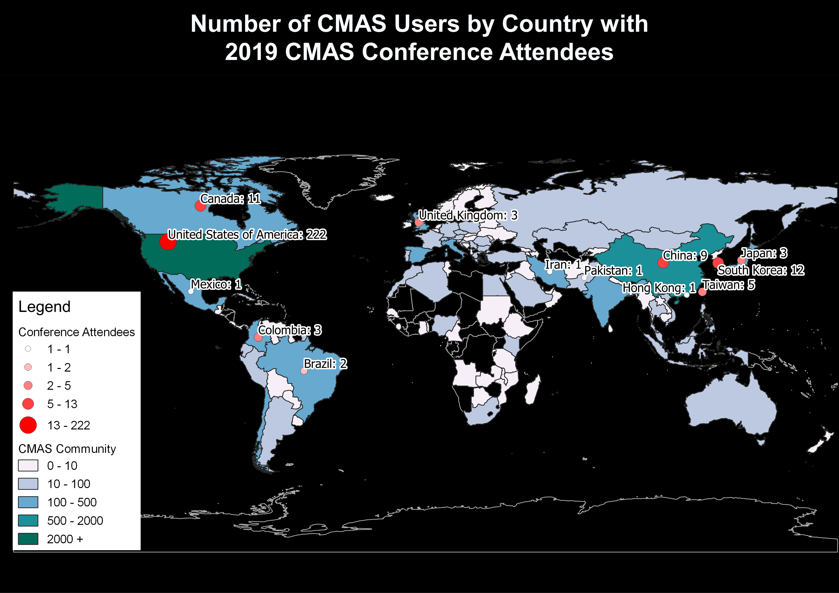
CMAS Global Footprint
USER SUPPORT

Slide 7

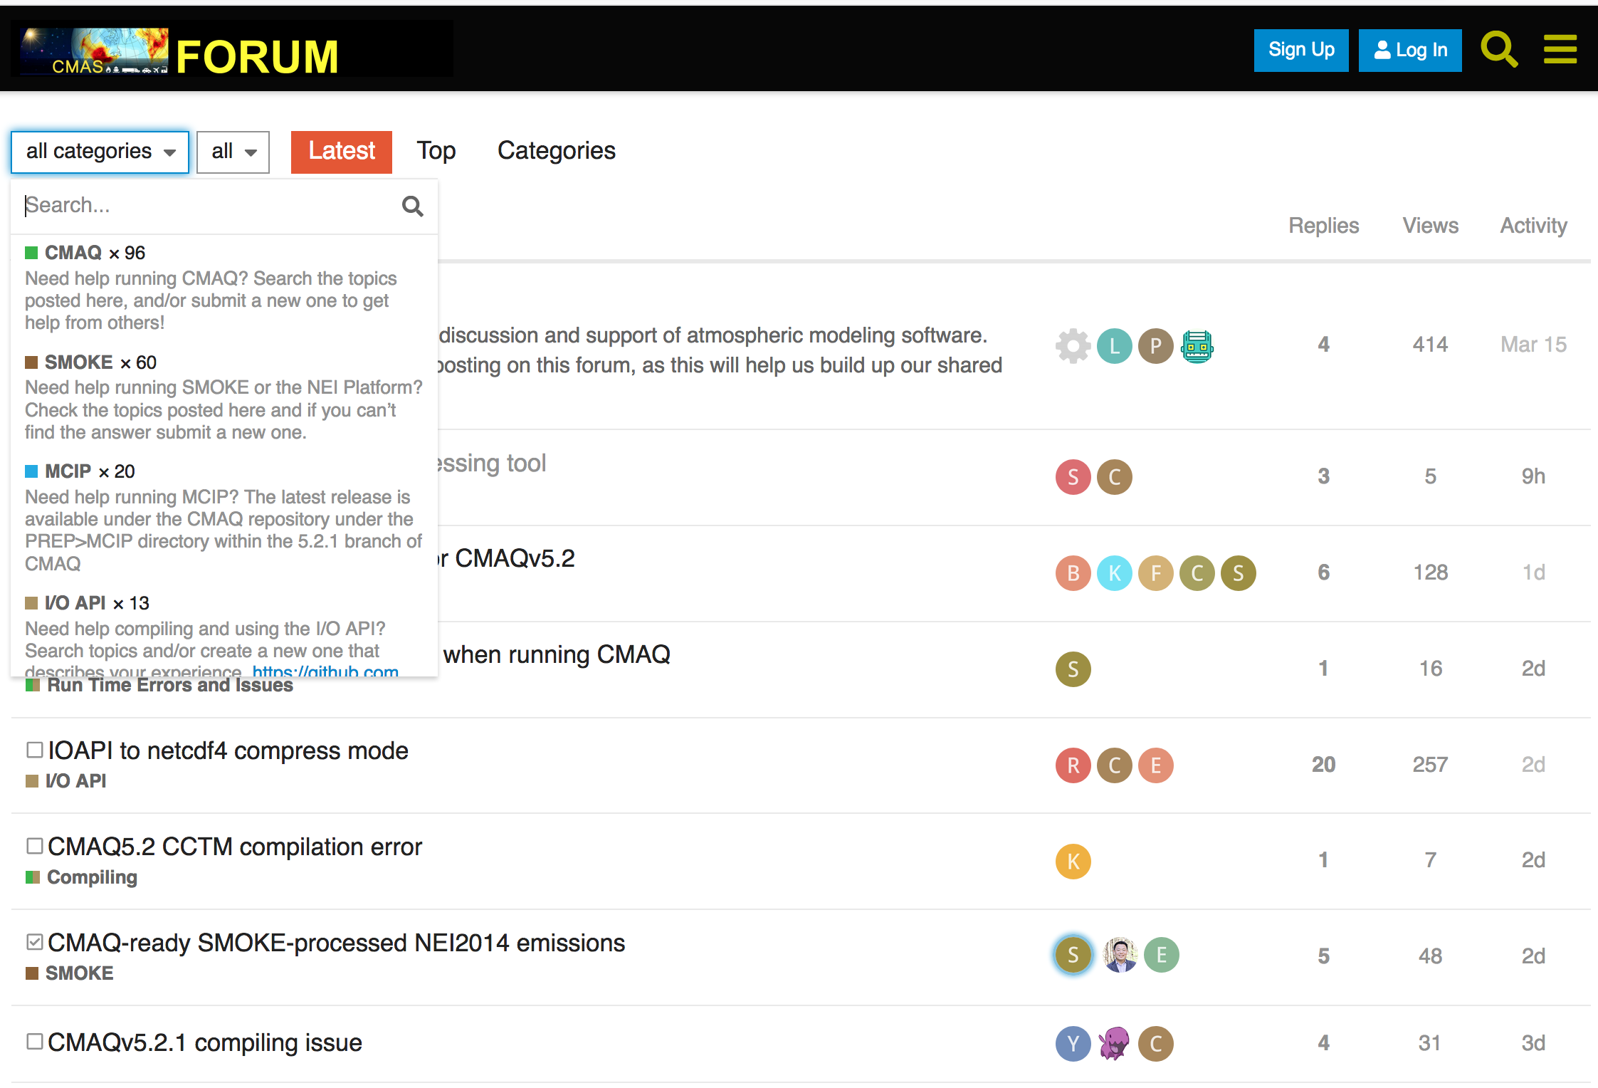
CMAS Discourse Forum http://forum.cmascenter.org
USER SUPPORT

Slide 8

CMAS Data Warehouse https://dataverse.unc.edu/dataverse.xhtml?alias=cmascenter
USER SUPPORT
Uses DataVerse
  An open source web application to share, preserve, cite, explore, analyze data
  Facilitates data access, and allows to replicate others' work more easily
  Researchers, journals, data authors, publishers, data distributors, and affiliated institutions all receive academic credit and web visibility
  Each Dataverse entry linked to a unique DOI, enabling easy citation, discovery
Open-access database for collecting and disseminating model data
  Includes meteorology, emissions and air quality model inputs and outputs
  DataVerse does not contain data files; however, each dataset description includes instructions on how to obtain the downloadable data
  All data stored on UNC’s portal to the Google cloud
Maintained as a public service by the CMAS Center
  In collaboration with the U.S. EPA’s ORD and OAR

Slide 9



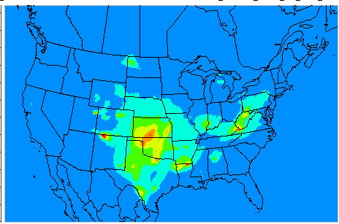

CMAS Data Warehouse
USER SUPPORT
Emissions (NEI)
Reporting
Met (WRF/MCIP)
AQ (CMAQ)
Modeling
Data Warehouse on Google Cloud
Observations
Visualization
25 TB and Growing

Slide 10
CMAS Data Warehouse
- both for and from the community
USER SUPPORT
Current datasets available for CMAS community
  CMAQ outputs – hourly and daily
    2002 – 2016 @ 12x12-km for Continental U.S.
  NEI Emissions Inventories
    2014 V7.1 and 2016 Beta, and V1
  MCIP
    2015, 2016 @ 12x12-km for Continental U.S.
  CMAQ Northern Hemispheric Outputs
    2016 @ 108x108-km for extracting custom IC/BCs
Interactive Forms interface to share datasets from researchers to others

Slide 11
Model Downloads
USER SUPPORT
Model Releases during 2018 – 2019
FEST-C v1.4
SMOKE v4.6
Spatial Allocator v4.4
VERDI v2.0β
CoST/EMF v3.2 and v3.3
C-LINE v5.1
CMAQ v5.3

Slide 12
Training – both Onsite and Offsite
APPLICATIONS AND TRAINING
Twice a year onsite at UNC
Recently started to transition to online training
Conducted international training sessions
  Brazil, Bulgaria, Canada, China, Colombia, Greece, Hong Kong, India, Mexico, S. Korea
Special trainings
  Python for Air Quality Research and Applications
  Model Interpretive Analyses

Slide 13
Collaboration and Information Sharing
OUTREACH
CMAS Conferences
  Annually at Chapel Hill, NC during October
    18th Annual Conference (October 21 – 23, 2019)
  Asia
    CMAS – Asia Pacific Conference (Beijing, China in May 2018)
    CMAS – Asia Pacific Conference (Japan in May 2022)*
  South America
    4th CMAS South America Conference (July 2019)
    5th CMAS South America Conference (July 2021) *
Webinars
  Webinar series on special topics or new releases
CMAS Visiting Scientist Program
  2018: Brazil, Hong Kong, Aveiro (Portugal)
  2019: Brazil, China
Peer-reviewed Journal Articles
  J. Air and Waste Mgmt Assoc (from CMAS 2019)

Slide 14
CMAS Center Team
@ UNC
External Advisory Committee (EAC)
Director and Outreach
  Sarav Arunachalam (Acting)
Research and Applications
  Sarav Arunachalam
Training and Conference
  B.H. Baek
User Support and Documentation
  Liz Adams
Communications and Events
  Brian Naess
  Emily Williams
Technical Editing
  Kurt Thurber
Arastoo Pour Biazar (Univ Alabama)
Tyler Fox (US EPA)
Amir Hakami (Carleton Univ)
Prakash Karamchandani (Ramboll)
Byeong-Uk Kim (GA EPD)
Naresh Kumar (EPRI)
Rebecca Matichuk (US EPA)
Mike Moran (Env Canada)
Talad Odman (Ga Tech)
Roger Timmis (Env Agency, UK)
Taciana Toledo (UFMG, Brazil)
Neil Wheeler (Science-One)
Yang Zhang (NCSU)

Slide 15
Acknowledgements
Adel Hanna, CMAS Director
  We wish him a speedy recovery
CMAS Community and EAC Members
U.S. EPA
Tom Pierce, U.S. EPA ORD
  CMAS Center Program Officer
Electric Power Research Institute
  Sponsoring the Student Poster awards

Slide 16


