Slide 1
Version 1.0 of the 2016 Collaborative Emissions Modeling Platform
Alison Eyth (U.S. EPA Office of Air Quality Planning & Standards)
Zac Adelman (Lake Michigan Air Director’s COnsortium)
Caroline Farkas, Jeff Vukovich (EPA OAQPS)
Serpil Kayin (EPA OAP), Sarah Roberts (EPA OTAQ)
Mark Janssen (LADCO), Julie McDill (MARAMA), Tom Moore (WESTAR)
Doug Boyer (TCEQ), Tammy Manning (NC DEQ)
Tom Richardson (OK DEQ), Eric Zalewsky (NYSDEC)
2019 CMAS Center Conference
October 22, 2019

Slide 2
Overview of the National Emissions Inventory Collaborative
Purpose
  Develop a new, multi-purpose emissions modeling platform to replace the 2011 and 2014 platforms
Motivation for Collaboration
  States and regional organizations wanted to be more involved in creating the national emissions modeling platform
  EPA thought a better and more accepted product would result through collaboration
Approach
  2016 base year was selected through a collaborative process
  2023 and 2028 future years selected for regulatory relevance
Notes:
A new multi-purpose emissions modeling platform based is needed to replace the 2011 platform
State Implementation Plans, federal analyses
An outgrowth of states and regional organizations wanting to be more involved
For the first time, EPA, states, and MJOs are engaging in collaborative emissions modeling platform development
The 2016 base year was selected via a collaborative process
Regional and state organizations led this process
2016 emissions are different than 2014, most recent NEI year
Future years selected due to regulatory relevance
2023 is relevant for Ozone NAAQS moderate non-attainment areas
2028 is a key year for regional haze

Slide 3
Organizational Structure
Coordination co-leads: Alison Eyth (EPA OAQPS) and
Zac Adelman (Lake Michigan Air Directors COnsortium)
  Develop process and communication structures, help resolve issues, documentation requirements, coordinate distribution of resulting data
Sector-specific workgroups (11): one regional/state staff and one EPA staff (where possible)
  Included over 240 participants from states/locals/regions/federal land managers and EPA
  Prepared emissions estimates for 2016 and future years
  Improved how the emissions sectors are modeled, where possible
  Workgroup meeting notes are available on the Collaborative Wiki: http://views.cira.colostate.edu/wiki/wiki/9169
Coordination committee: regional, state, and EPA leaders
  Includes coordination and workgroup co-leads plus regional multi-jurisditctional directors
  Define processes, raise and resolve issues, co-lead workgroups

Slide 4
Collaborative Timeline
Mar 2019
beta base year (2016) platform
release
Oct 2019
v1 platform release
Spring 2018
alpha
platform
release
Dec 2017
First Coordination committee call
Apr 2019
beta future years platform release
 | 2018 | 2019
Mar 2018
Jun 2018
Sep 2018
Dec 2018
Mar 2019
Jun 2019
Sep 2019
Oct-Dec 2017
MJOs, EPA, and states initiate the collaborative, recruitment of WG co-leads, infrastructure development
Quarterly National Report-Out Webinars
Register here for next quarterly call
on 1/23/2020 @ 12 noon Eastern

Slide 5
2016 Platform Availability
Alpha: preliminary version based on 2014NEIv2 for some and 2016 for other key sectors (released Spring, 2018)
  For initial testing of 2016 model runs
  Compatible versions of 2014 and 2015 were also released
  Data / documentation: https://www.epa.gov/air-emissions-modeling/2014-2016-version-7-air-emissions-modeling-platforms
Beta: improved and/or new version of actual 2016 emissions for most sectors (March 2019)
  Preliminary projected emissions for 2023 and 2028 sent to workgroups (April 2019) – workgroup comments on beta due by May 31, 2019
  Data/Documentation: http://views.cira.colostate.edu/wiki/wiki/10197
  2016 emissions inventories and AQM inputs + outputs hosted at the Intermountain West Data Warehouse (IWDW)
V1.0: fully updated 2016 emissions and complete projected emissions for 2023 and 2028 (October 2019)
  SMOKE inputs for 2016, 2023, 2028 available; outputs only for 2016
  Data/Documentation: http://views.cira.colostate.edu/wiki/wiki/10202
  Emissions data soon to be available from the IWDW
  LADCO Data Viewer hosts an archive of static plots

Slide 6
Developing 2016v1 from beta
Workgroups reviewed and incorporated comments on beta version
  Most sectors had comments (EGUs, non-EGUs, oil and gas, nonpoint, nonroad, rail, …)
  New mobile source emissions from California + Nonroad emissions from Texas
  New oil and gas inventory for Western states (not yet incorporated into 2016v1)
Planned substantive improvements implemented for many sectors
  Onroad: activity data, age distributions, SMOKE-MOVES updates
  Nonroad: spatial distribution for agriculture and construction
  Commercial Marine Vessels: new hourly “gridded point” inventories
  Airports: from new Aviation Environmental Design Tool (AEDT)
  Agricultural: improved animal counts and fertilizer
  Biogenic: land use updates for Canada
  Canada: Dust emissions reduced
  Improved projections for various sectors (see Farkas @ 8:50)
  Fires: improved representation and additional datasets (see Vukovich @ 9:10)

Slide 7

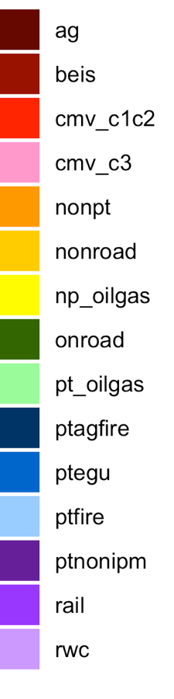
2016beta Emissions Summaries
Airports
Agriculture
Biogenic
Commercial Marine Vehicles, C1&2
Commercial Marine Vessels, C3
Area/Nonpoint
Off-road Mobile
Nonpoint Oil & Gas
On-road Mobile
Point Oil & Gas
Agricultural Fires
Electric Generating Units
Wild and Prescribed Fires
Non-EGU Point
Rail
Residential Wood Combustion
Comparisons across recent inventory platforms (2011, 2014, 2016)
Beta case names end in ff,
v1 case names end in fh
Summaries of key ”Criteria” pollutants: NOx, VOC (O₃ precursors); PM_{2.5}, SO₂, NH₃ (PM & haze precursors) are available
Note that annual totals do not show temporal variability in the data
More detailed results are available from the LADCO and IWDW websites

Slide 8
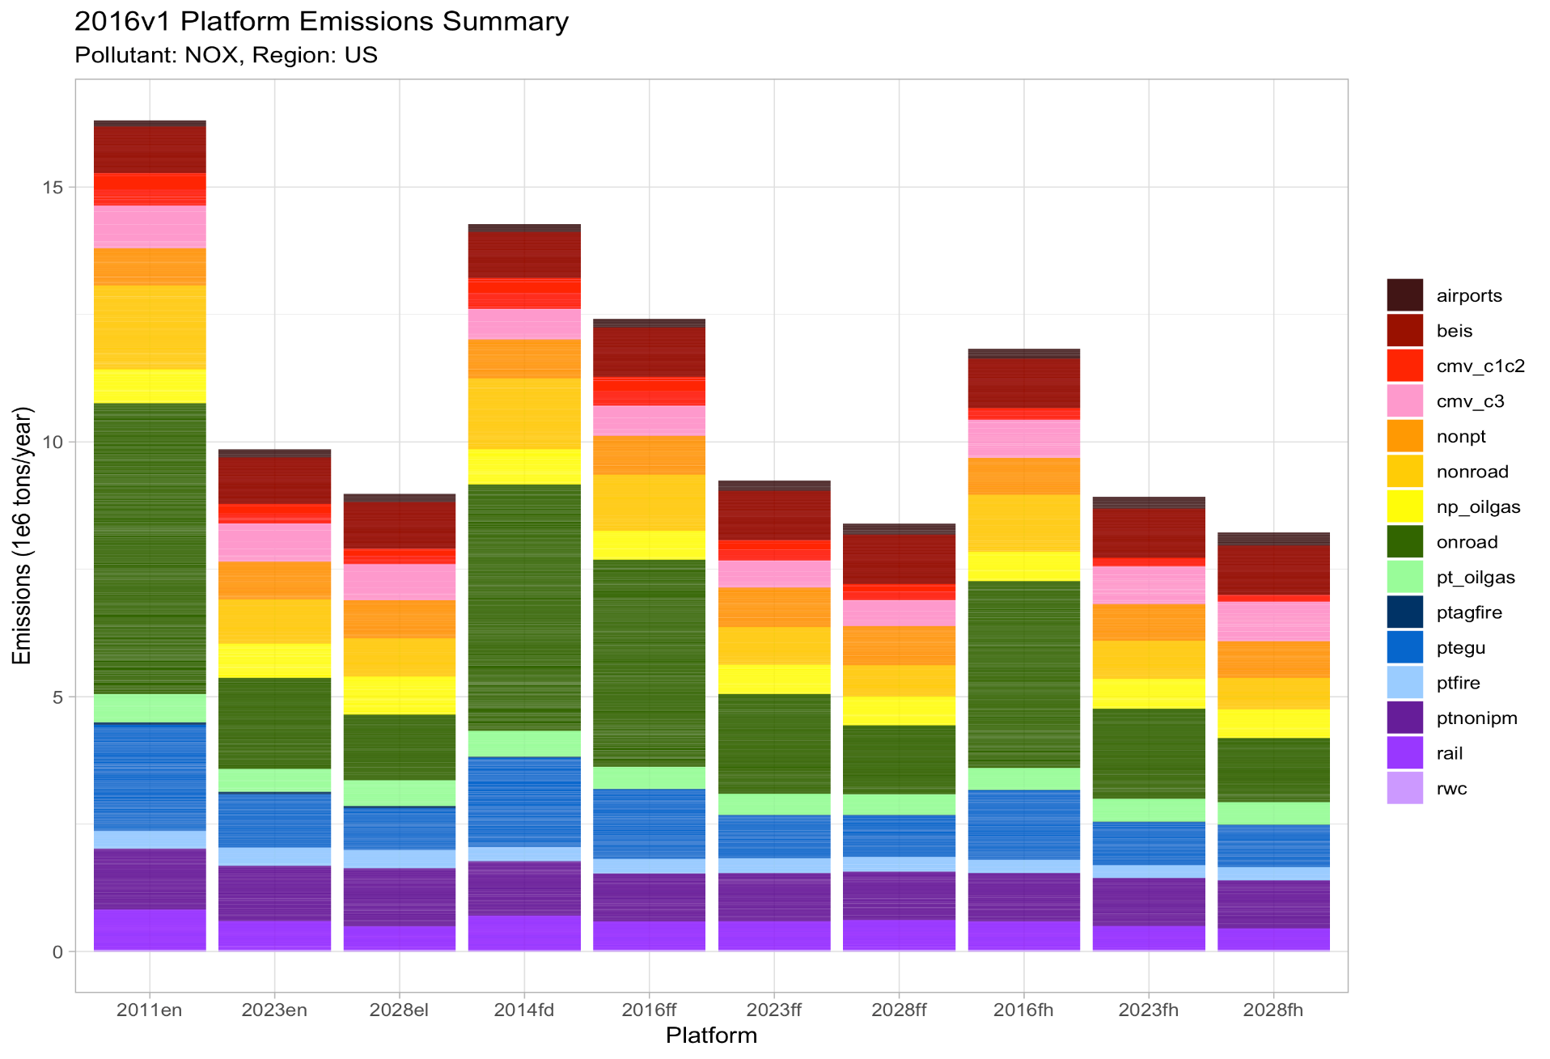
National NOx Emissions totals 2011 through 2028
2011en 2023en 2028el 2014 2016b 2023b 2028b 2016v1 2023v1 2028v1
Notes:
Onroad NOx emissions are lower in the v1 platform than in beta.
Ptegu emissions decreased from 2014 to 2016. Bright purple at the bottom is rail with ptnonipm above it.
Overall 2016v1 NOx emissions are slightly lower than beta.

Slide 9
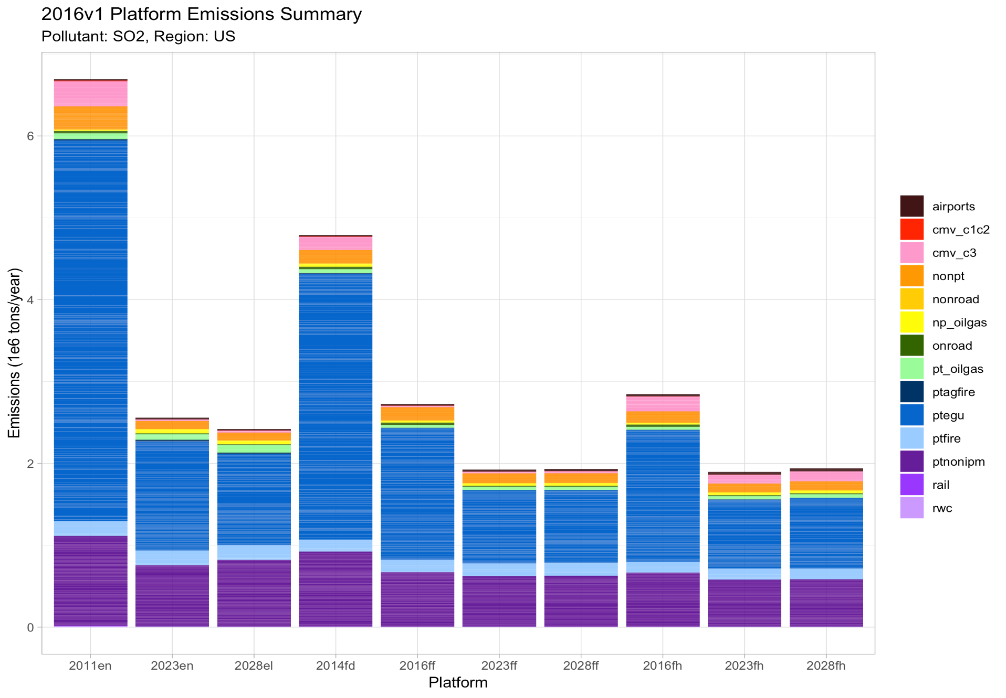
National SO₂ Emissions totals
2011 through 2028
2011en 2023en 2028el 2014 2016b 2023b 2028b 2016v12023v1 2028v1
Notes:
SO2 is lower in 2016 than 2014. The dark purple at the bottom is ptnonipm.

Slide 10
Sector-specific Updates

Slide 11
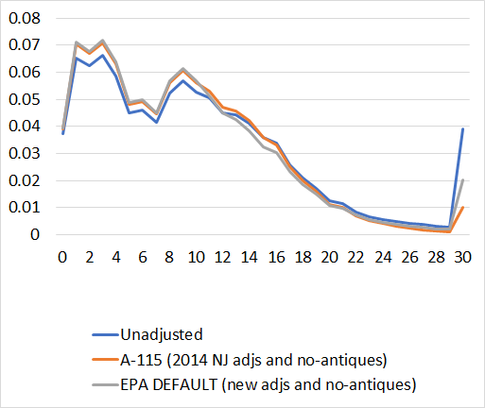
Onroad Emissions Updates
Key onroad mobile input data sets were updated
  Vehicle age distributions, representative counties, Vehicle miles traveled,
  Vehicle populations, hoteling hours
  Improved representation of speed distribution and gridded hourly NOx humidity adjustments within SMOKE (see Baek from 2019 US EPA Inventory conference)
Updated Passenger Car
Age Distribution for 2016
Use of speed distributions
instead of interpolation
Vehicle age (years)

Slide 12
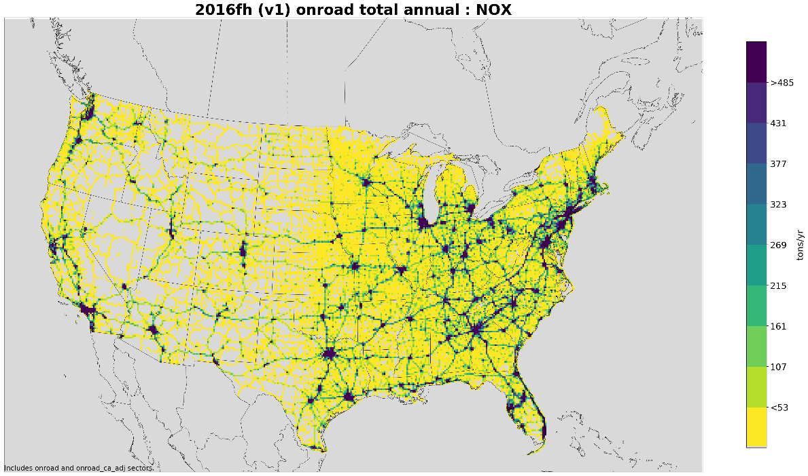
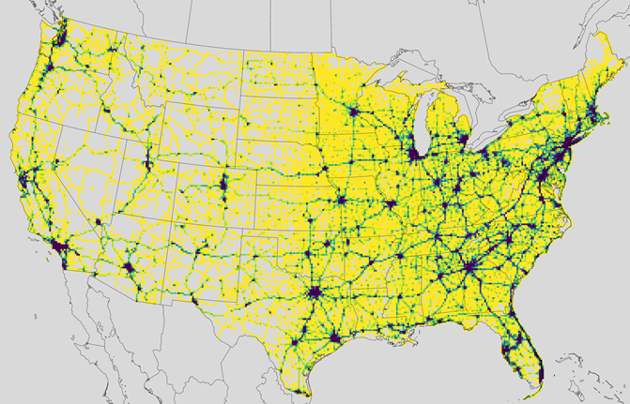
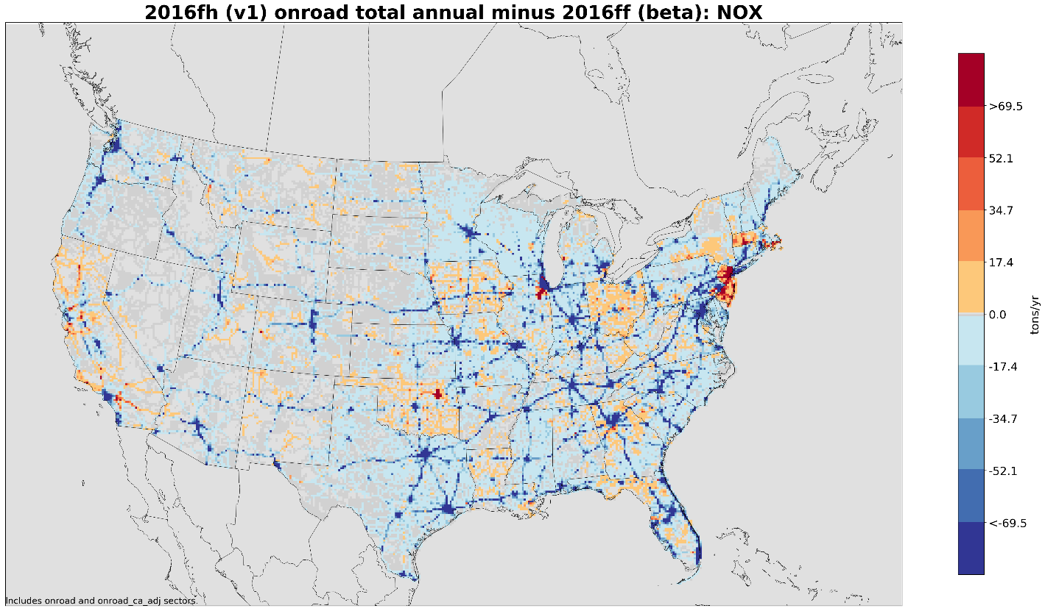
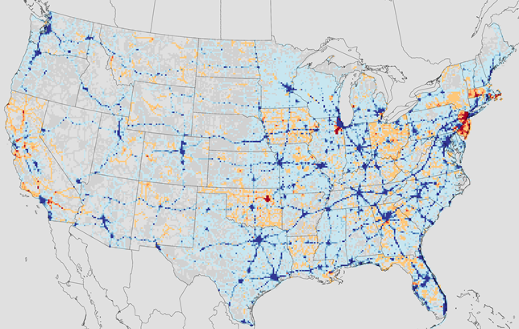
12km Gridded 2016v1 Onroad NOx Emissions (tons/yr)
The various input and processing updates had an impact on emissions compared to beta
About 10% less NOx and 7% less VOC
Emissions along highways reduced due to new hoteling hours multiplier
Representative county and other input updates caused increases in some areas
> 485
> 69.5
Pollutant | 2016v1 | 2016v1/ 2016beta
CO | 19,889,617 | 0.98
NH3 | 100,318 | 0.99
NOX | 3,630,548 | 0.89
PM10-PRI | 239,997 | 0.88
PM25-PRI | 117,758 | 0.90
SO2 | 27,559 | 1.00
VOC | 1,852,260 | 0.93
< 69.5

Slide 13
Commercial Marine Vessel Updates
New CMV inventory was developed in conjunction with 2017 NEI
Automated Identification System (AIS) data were obtained for the year 2017
  AIS transponder signals are used to help prevent ship collisions
  Data retrieved cover waters around the continental U.S., Canada, Mexico, Alaska, Hawaii, and Puerto Rico
Ship ID information was matched with ship databases to derive vessel and engine characteristics
Emissions were computed for each ship at 5 minute intervals for criteria air pollutants
  Emis = Time (hr) * Power (kW) * Emis. Factor (g/kWh) * LLAF
    where LLAF is a low load adjustment factor that increases emissions at low loads
The 5 minute emissions were adjusted to 2016 values based on entrance & clearance data
Emissions were aggregated to hourly values in each model grid cell and
represented as point sources at the center of each grid cell
  Grids include U.S. (12km), US/Can/Mex (36km), Alaska (9km), Hawaii (3km),
  Puerto Rico (3km), Lake Michigan (4km, 1km), Long Island Sound (4km, 1.33km)
  Hourly data also used in Canada although some areas and also the lower part of 36km domain had to be gapfilled

Slide 14
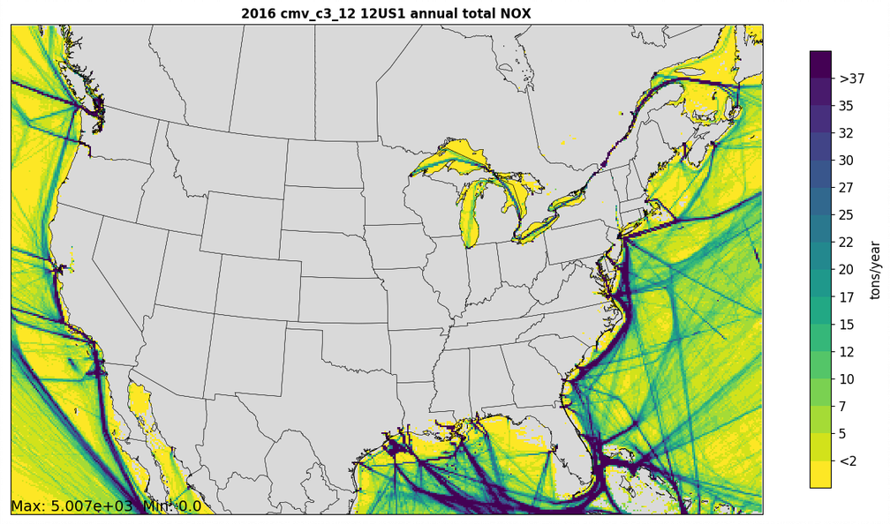
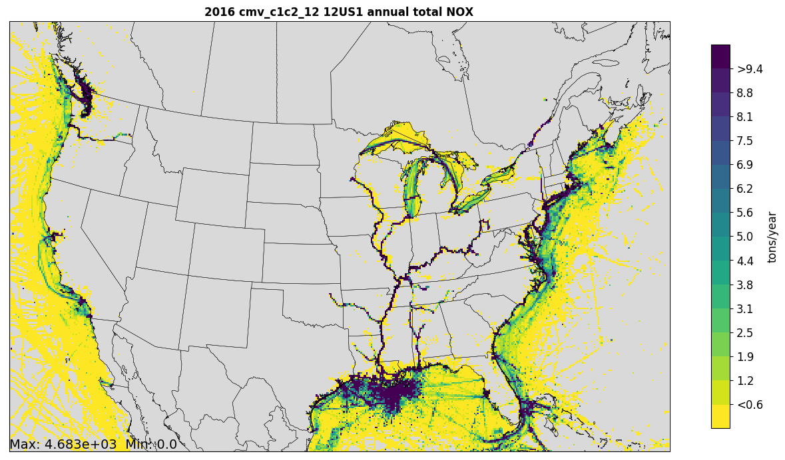
Annual CMV NOx Emissions
C3: > 30L displacement / cylinder
- Bulk carriers, cruise ships, container ships,
tankers, etc.
C1 & C2: < 30L displacement
Fishing boats, tugboats, supply vessels, etc.
Note lower scale on plot
C3 ships are given stack heights of 66ft (layer 2-4 depending on met.), and C1/C2 assigned 1ft to force them into layer 1
For C3, interpolation of missing data was implemented, requiring methods to mask out some stray emissions over land

Slide 15
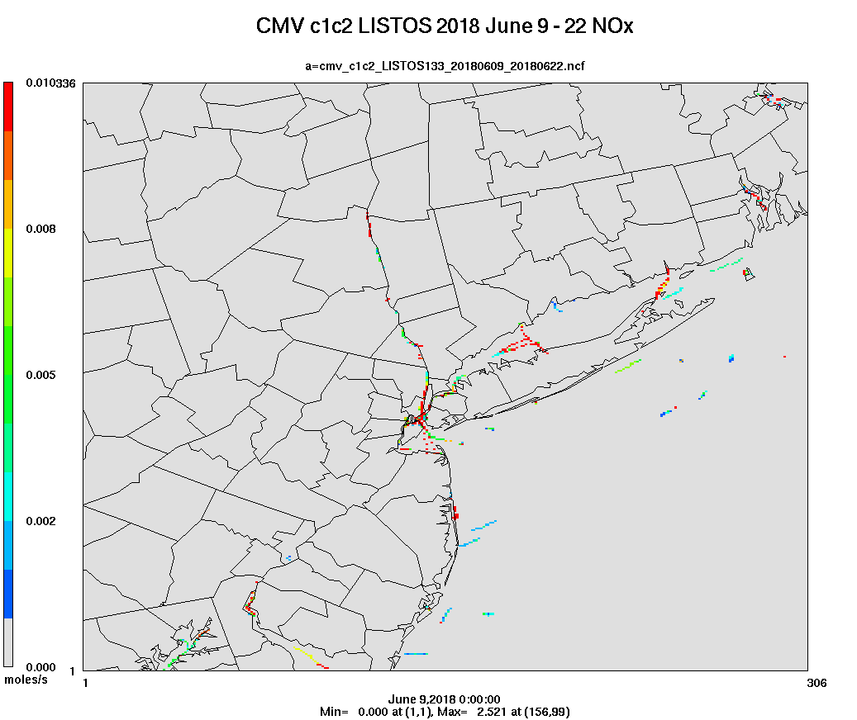
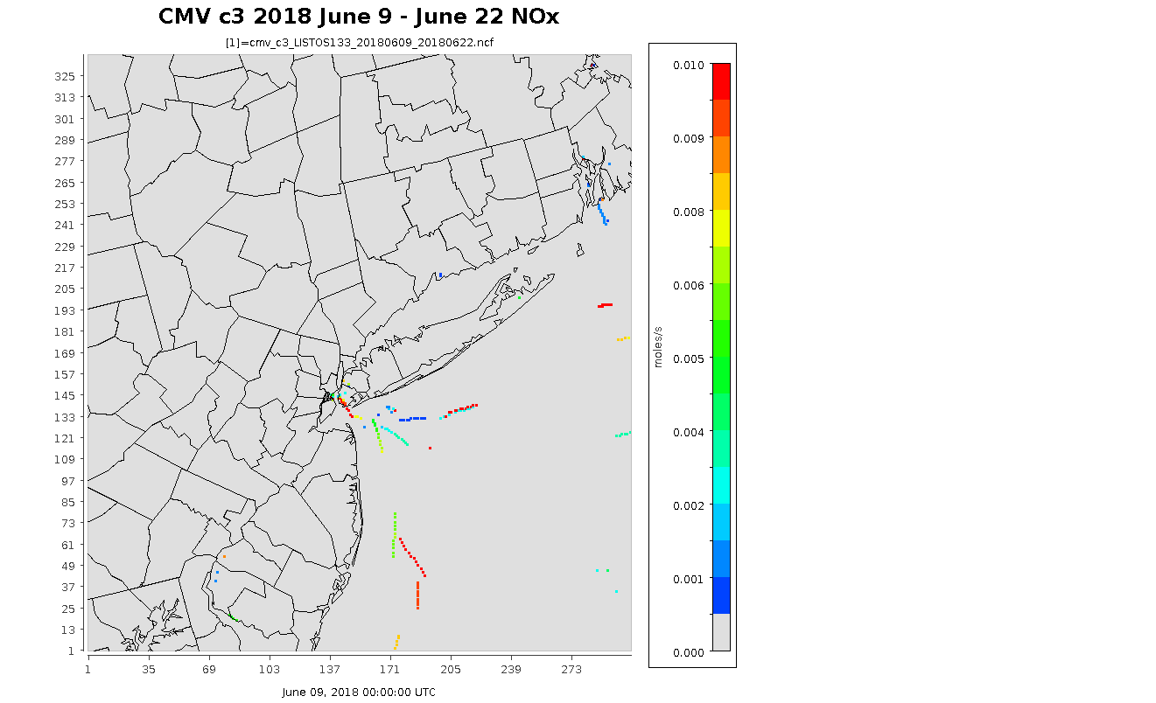
Hourly CMV Animations
Area shown is New York, New Jersey, Connecticut

Slide 16
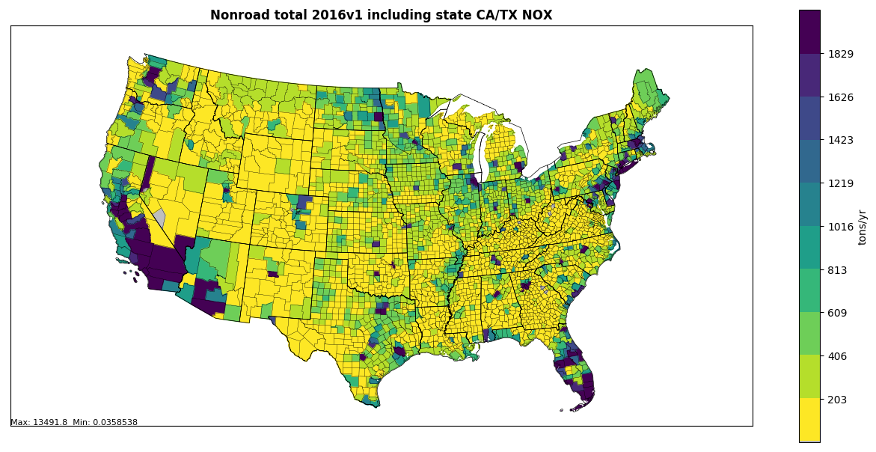
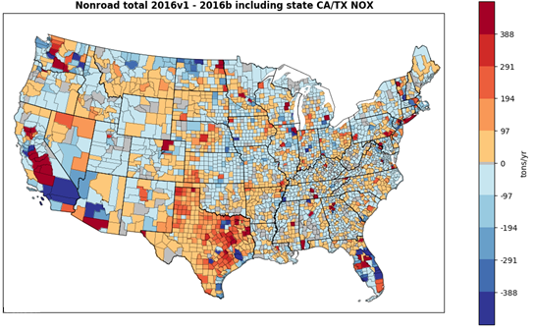
2016v1 Nonroad total NOx vs. beta (tons/yr)
MOVES2014b was run with:
updated spatial allocation factors for Agricultural and Construction equipment
various input data from 2017 NEI submissions
LADCO agricultural temporal profiles
- GA fuel supply data
state-supplied emissions (CA, TX)

Slide 17
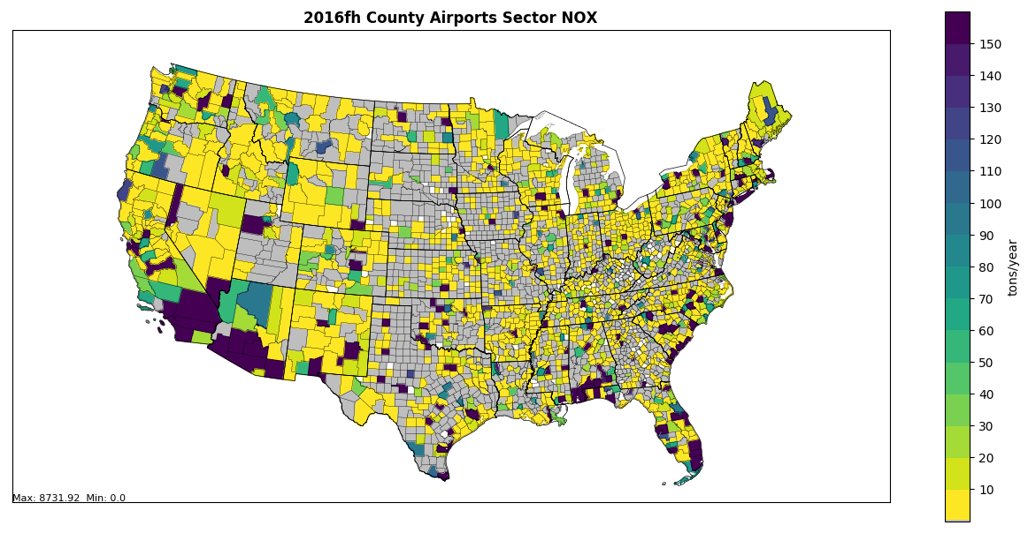
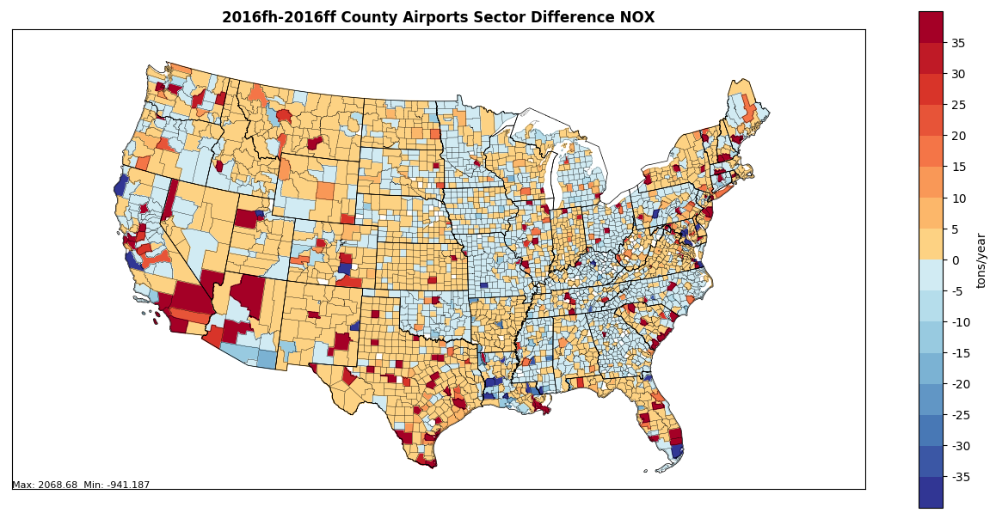
Airports
A new aircraft emissions model Aviation Environmental Design Tool (AEDT) was used for 2016v1 and is based on 2017 NEI airport emissions adjusted back to 2016 levels
- Airports are now a separate sector in 2016v1

Slide 18
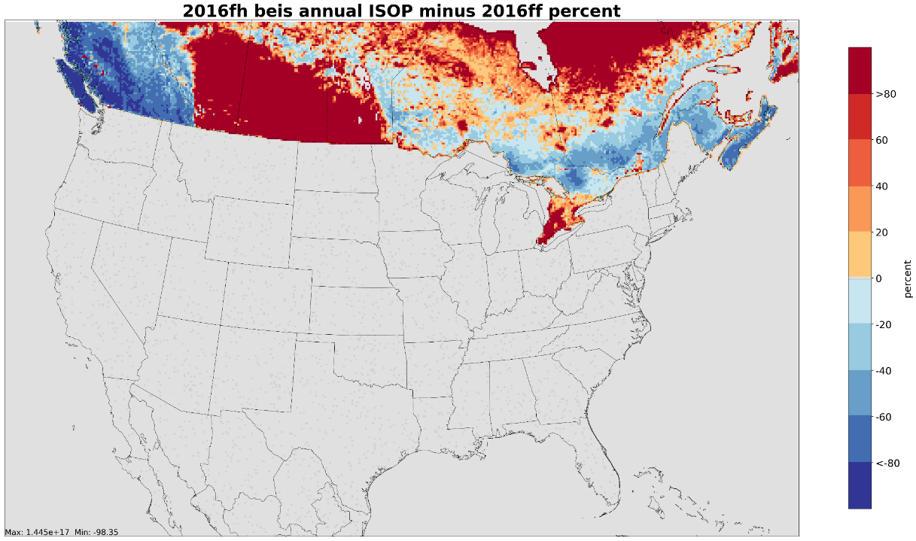
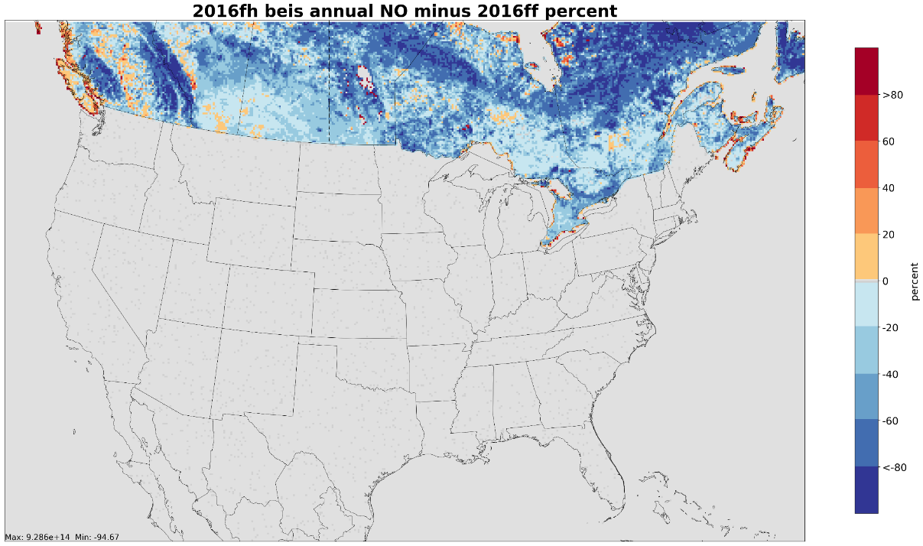
Improved Biogenic Land Use in Canada
Environment Canada and Climate Change Canada (ECCC) provided a Biogenic Emissions Landcover Database version 4 (BELD4) compatible1km resolution dataset to update landuse for their country
In Canada for v1, the 17 MODIS landuse types in beta were replaced by 92 different BELD4 landuse types specified by ECCC
Canadian landuse changes resulted in significant changes in VOC emissions and some impact on biogenic NOx emissions
Isoprene differences
NOx differences

Slide 19
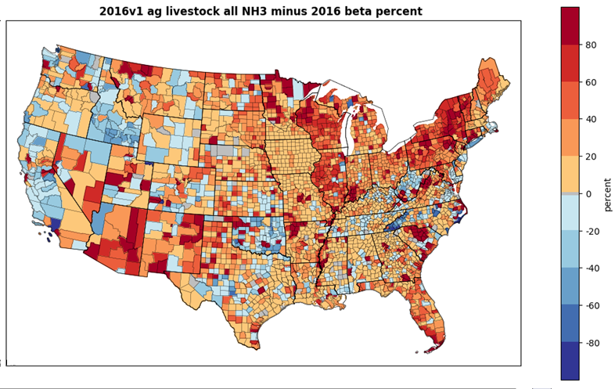
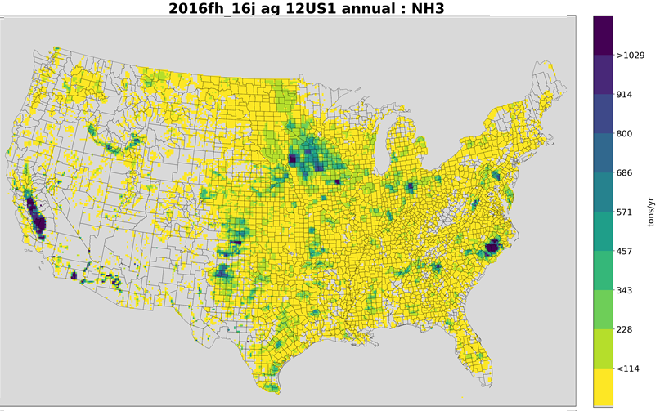
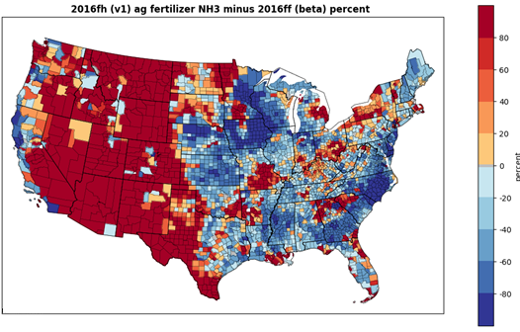
Agricultural Ammonia
Updated livestock counts compatible with 2017 NEI were included
- Correct an underprediction for cows, poultry
Updated 2016 fertilizer emissions were based on reported fertilizer rates coupled with an iterative calculation (J. Bash)

Slide 20
Inventory Collaborative Next Steps
Release future year SMOKE outputs and future scripts (merged AQM-ready emissions to follow)
Review new WRAP oil and gas inventory
Confirm future of workgroups (e.g., continue, meet quarterly, disband)
  MOVES and EGU to continue (they predate the Collaborative)
  2016 oil and gas to disband and merge with National Oil and Gas Workgroup
  Emissions modeling workgroup will continue
    Apply, test, and improve ancillary data used in emissions models
    Review air quality model results from the various versions of the modeling platform
Air quality modeling of 2016v1platform cases by EPA and others
  Applications include state implementation plans, research projects, regulatory work
Model evaluation forum is reviewing performance – over 90 members
  States, locals, federal agencies, Canadians (Led by Heather Simon)
Inventories will continue to be improved, e.g.:
  New Future year EGU inventories being developed (both IPM and ERTAC)
  2017 NEI is coming soon (point data is already available)
  Other inventory and emissions modeling improvements
  Not yet sure if there will be a “2016v2” (i.e., another full inventory release)

Slide 21
Thank You to All who Participated!
Coordination Committee:
  Regional (Multijurisdictional) Organization Leaders: Zac Adelman (LADCO), Jim Boylan (SESARM), Dave Foerter (OTC), John Hornback (SESARM), Michael Vince (CENSARA), Mary Uhl (WESTAR)
  Past and present Workgroup leaders: Doug Boyer (TCEQ), Alison Eyth (EPA), Caroline Farkas (EPA), Mark Janssen (LADCO), Serpil Kayin (EPA), Tammy Manning (NC DENR), Julie McDill (MARAMA), Susan McCusker (MARAMA),
  Tom Moore (WESTAR), Tom Richardson (OK DEQ), Sarah Roberts (EPA), Rebecca Simpson (CO DPHE), Jennifer Snyder (EPA), Jeff Vukovich (EPA), Debbie Wilson (MARAMA), Eric Zalewsky (NY DEC)
Workgroup members: Over 240 state, local, and regional staff are actively participating, plus additional EPA staff working on the inventories
Goal of developing a better, more accepted, inventory was achieved – and a lot was learned along the way by all

