Slide 1
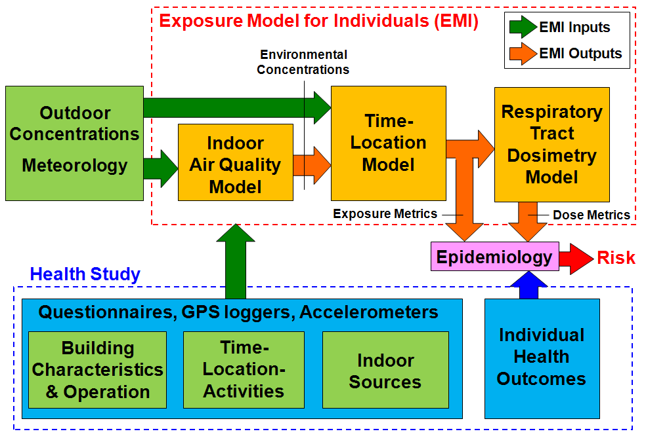
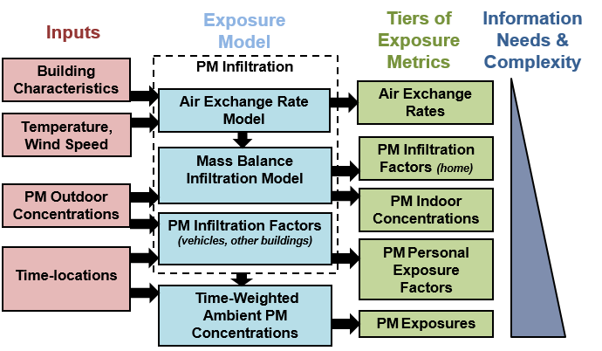
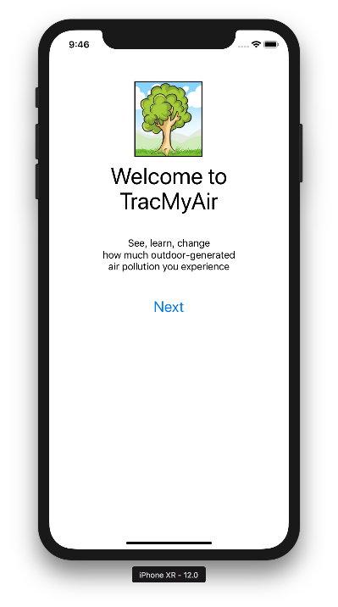
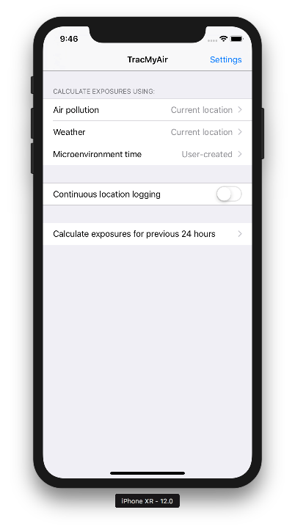
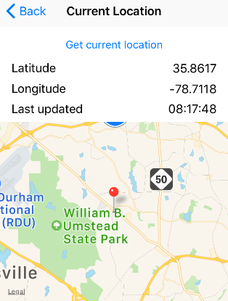
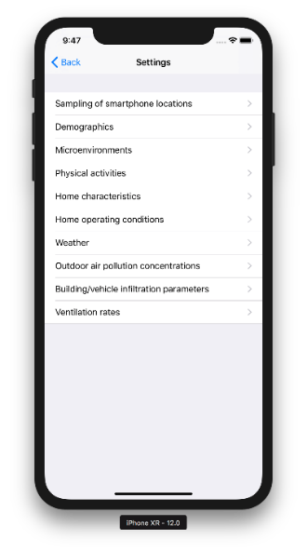
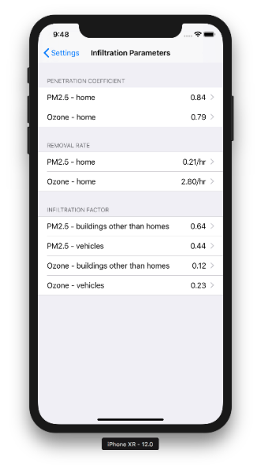
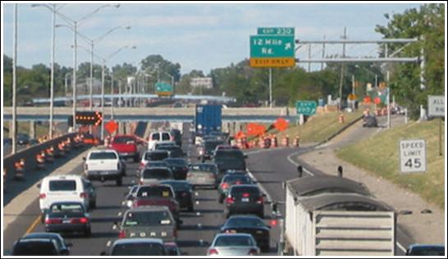
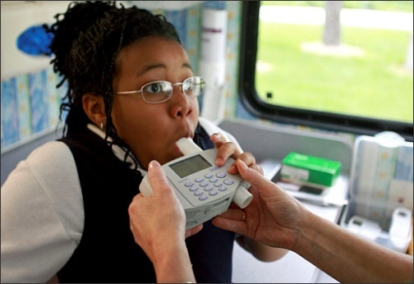
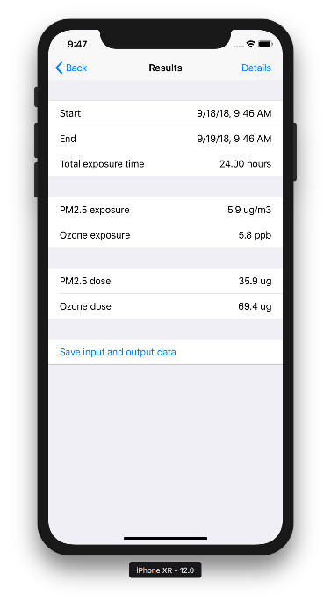
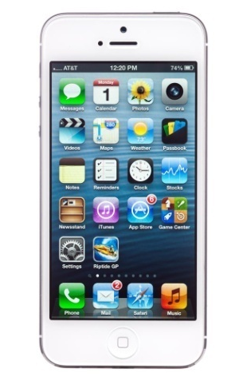
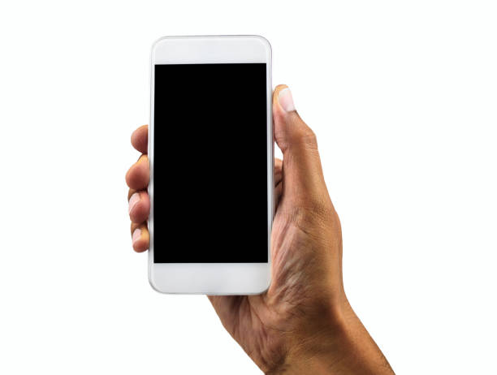
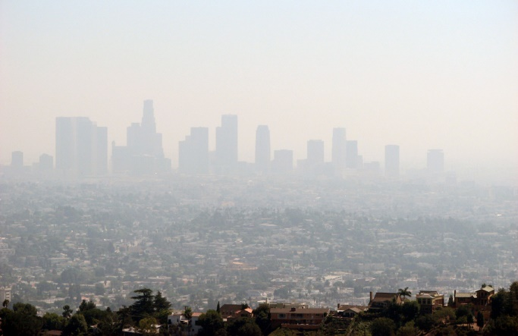
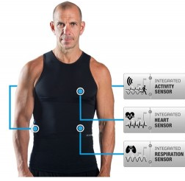
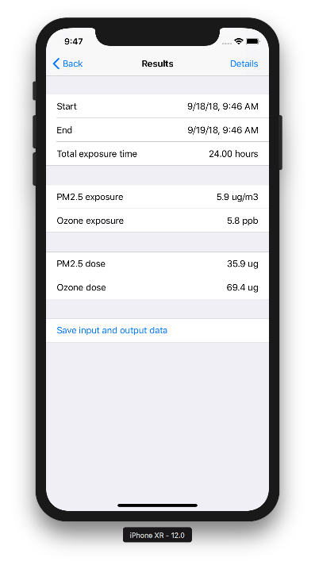
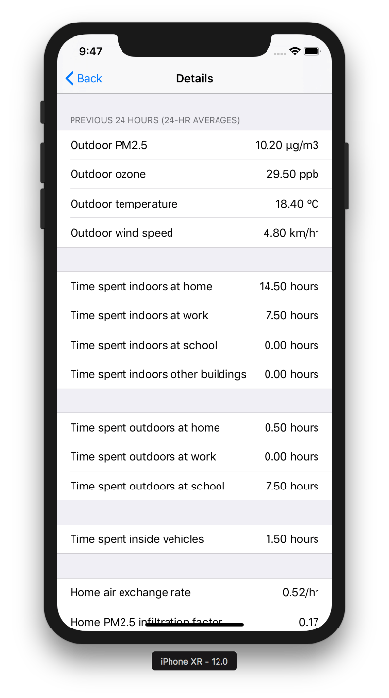
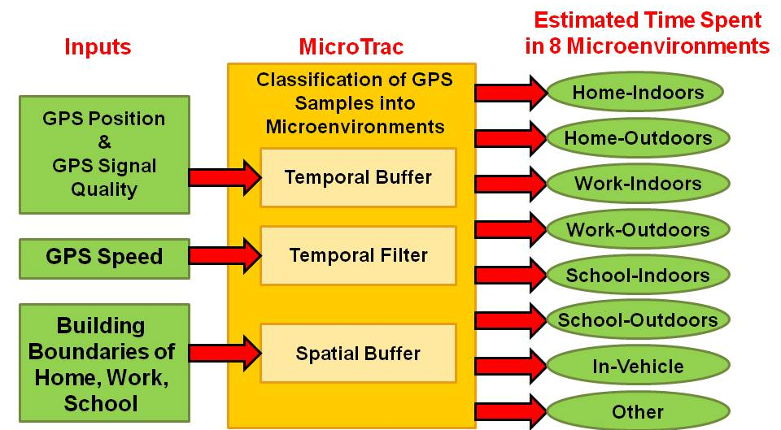
Development of TracMyAir Smartphone App for Predicting Exposures to Ambient PM_{2.5} and Ozone
Michael Breen,¹ Yadong Xu,¹ Catherine Seppanen,² Sarav Arunachalam,² Timothy Barzyk,¹ Janet Burke,¹ David Diaz-Sanchez,¹ Peter Egeghy,¹ Stephen Graham,¹
Vito Ilacqua,¹ Vlad Isakov,¹ Vasu Kilaru,¹ Laura Kolb,¹ John Langstaff,¹ Thomas Long,¹ Steven Prince,¹Jennifer Richmond-Bryant,¹ Ronald Williams¹
¹US EPA, Research Triangle Park, North Carolina, United States
²University of North Carolina at Chapel Hill, Chapel Hill, North Carolina, United States
Michael Breen l breen.michael@epa.gov l 919-541-9409
Abstract
Exposure Model for Individuals (EMI)
TracMyAir App - Method
To better understand human exposure to air pollutants and their potential for adverse health effects, it is important to account for time spent in different indoor and outdoor locations, and the air pollutant concentrations in those locations. Currently available exposure models have several limitations, including need for substantial technical exposure modeling expertise. Near real-time predictions are not possible since large and diverse input data must be collected, organized, and processed by complex exposure models. To address these limitations, we are developing TracMyAir, a smartphone application that automatically estimates exposures to ambient PM_{2.5} and ozone based on several sources of input data available from smartphones, including: near real-time ambient air pollution measurements from local monitors, local weather, user’s locations, and building characteristics of user’s home. TracMyAir uses an exposure model that accounts for time spent in different indoor and outdoor locations, and building-specific attenuation of ambient PM_{2.5} and ozone when indoors. The app will be an efficient and cost-effective tool for researchers to apply exposure predictions for epidemiology studies and other situations where direct air quality monitoring cannot be performed. TracMyAir can also be used for developing public health strategies to help susceptible people (e.g., those with asthma) reduce their exposure to air pollution. Future versions of TracMyAir can be integrated with air quality models when nearby monitoring data is not available.
TracMyAir
Smartphone location used to determine nearest ambient air pollution monitor, nearest weather station, time spent in microenvironments
Smartphone-based Exposures for Epidemiology Studies
Microenvironment Tracker (MicroTrac) Model
TracMyAir Features
Home-specific air exchange model accounts for daily variability of air infiltration (indoor-outdoor temp, wind speed), natural ventilation (open windows), and mechanical ventilation (window fans)
Infiltration model accounts for pollutant-specific mass balance parameters
Home indoor air quality model accounts for removal of PM2.5 from daily operation air cleaners
Inhaled dose model accounts for daily physical activities to determine ventilation rates
Clinical
Visits
Automated classification model for GPS data to estimate time spent in various microenvironments (e.g., in-vehicle, home, school, work)
Addresses critical need for accurate, cost-effective, and less burdensome time-location data to improve air pollution exposure assessments
Supports recommendations of NRC report (Exposure Science in 21st Century) for linking GPS data with models to:
  Improve exposure assessments
  Process large data from ubiquitous smartphones
Embedded GPS in smartphones
TracMyAir App – Results
Wearable
Sensors
Estimates PM2.5 and ozone exposure metrics for epidemiology studies (daily 24-h average):
TracMyAir App
Exposures
Cohort Health Data
Personal exposure
Inhaled dose
Home infiltration factor
Home indoor concentration
Personal exposure factor
Time spent in each microenvironment
Challenges of Air Pollution Epidemiology Studies
  Possible exposure misclassifications from using surrogates (e.g., central-site ambient monitors)
  Cost, participant burden of personal exposure monitoring
Benefits of Modeling Exposures for Epidemiology Studies
  Account for building-specific infiltration (i.e., attenuation) of ambient air pollutants
  Account for time spent in different microenvironments with different air pollutant concentrations
References
Disclaimer
Advantages of TracMyAir App for Epidemiology Studies
  Automated, real-time predictions of individual exposures
  Facilitate and expand use of modeled exposure metrics for epidemiology studies
Breen et al., Sci Total Environ 2018.
Breen et al., Environ Sci Technol 2015.
Breen et al., J Expo Sci Environ Epidemiol 2014.
Although this presentation was reviewed by the U.S. EPA and approved, it may not necessarily reflect official Agency policy. Mention of trade names or commercial products does not constitute endorsement or recommendation for use.

