Slide 1

Estimating smoke emission using GOES satellite observations and HYSPLIT model
Tianfeng Chai^{1,2,3}, Hyuncheol Kim^{1,2,3}, and Ariel Stein¹
1: NOAA/OAR/Air Resources Laboratory (ARL)
2: Cooperative Institute for Climate & Satellites-Maryland (CICS-MD)
3: University of Maryland, College Park, MD

Slide 2
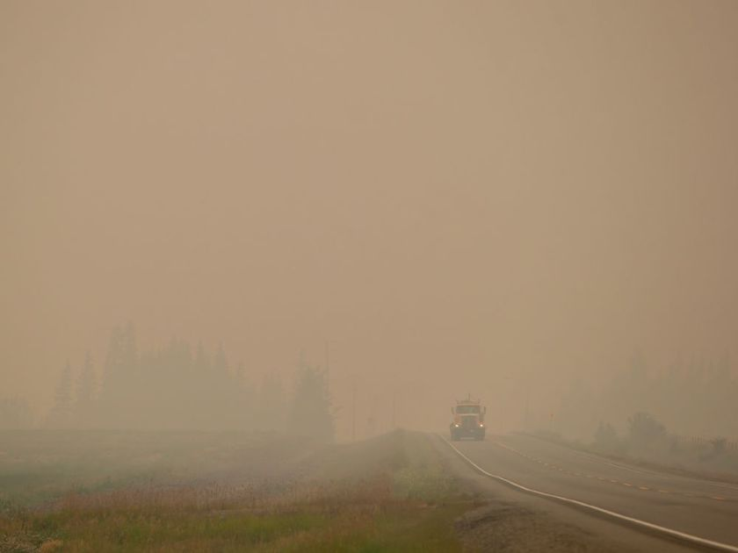
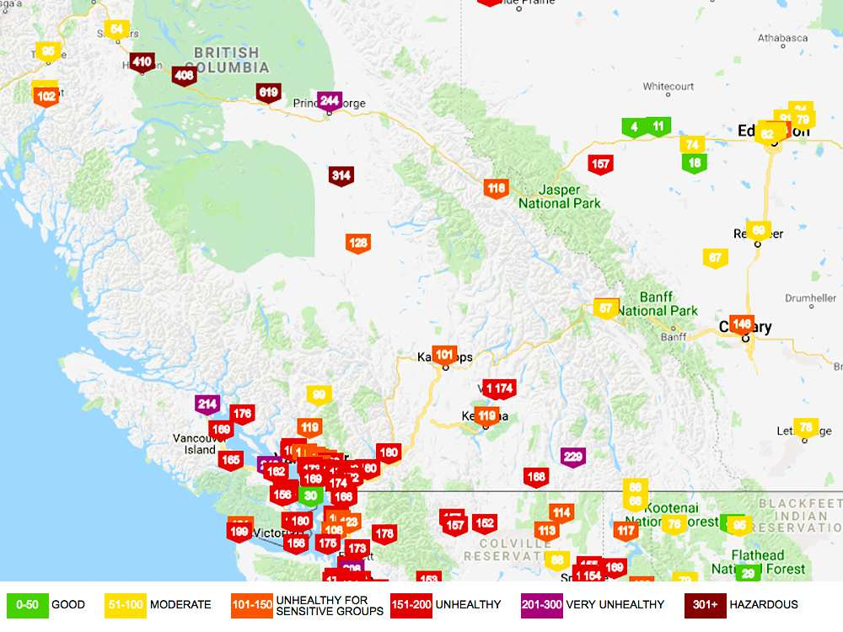
Motivation
Smoke from wildfires has significant negative impacts on public health;
The air quality forecast quality is greatly hindered by the large uncertainties of the wildfire emission estimates;
We aim to objectively and optimally estimate the fire sources based on the satellite observations of the fire plumes and HYSPLIT model.
Thick smoke from wildfires fills the air as a motorist travels on Hwy. 27 between Vanderhoof and Fort St. James, B.C., on Wednesday, August 15, 2018. DARRYL DYCK / CP
Air quality in several B.C. communities is listed as ‘hazardous’ due to wildfire smoke. AirVisuals
https://vancouversun.com/news/local-news/b-c-wildfires-2018-air-quality-in-vanderhoof-double-hazardous-levels

Slide 3
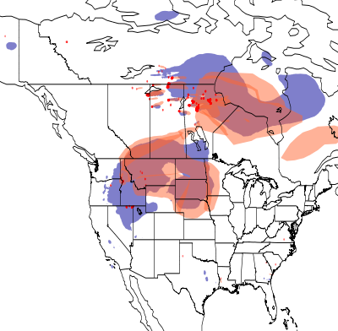
Smoke forecasts with HYSPLIT: Current status
NOAA NESDIS HMS Smoke and fire detection
Smoke column from the HYSPLIT model (blue) and NESDIS Hazardous Mapping System (orange)
Incorporates imagery from NOAA and NASA satellites (GOES-West, GOES-East, Terra/Aqua MODIS, AVHRR on NOAA-15/-18/-19)
Provides fire locations, starting time, durations
USFS’s BlueSky: Estimate PM_{2.5} emissions and plume rise
Emission aggregated and assumptions are made to for the forecasting period
Operational since March, 2007

Slide 4
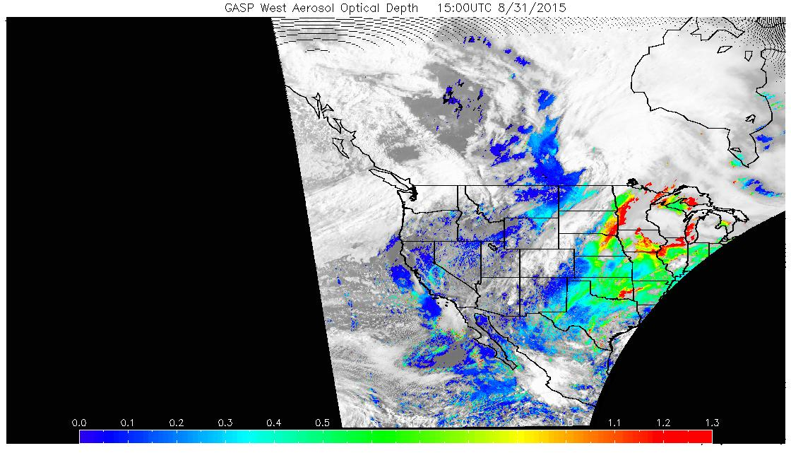
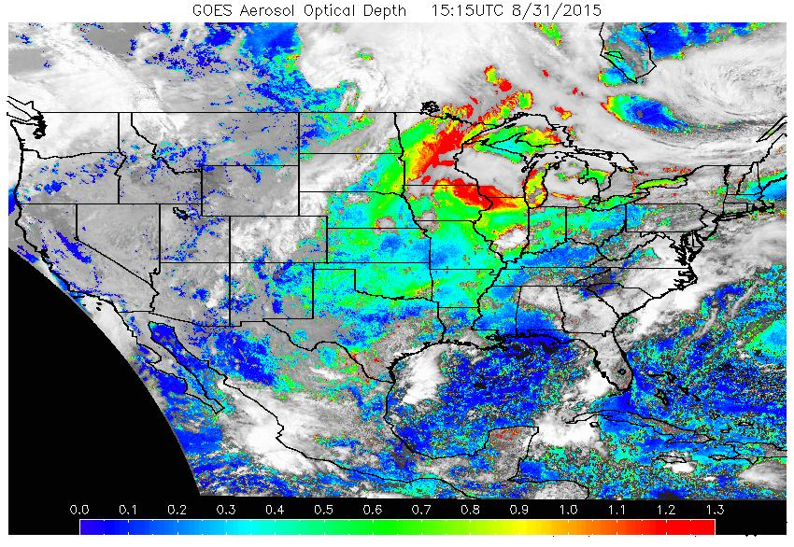
NOAA NESDIS GOES Aerosol/Smoke products (GASP)
The GASP product is a retrieval of the Aerosol Optical Depth (AOD) made from the current GOES West/East visible imagery. Satellite measured aerosol optical depth (AOD) is available at a 30-minute interval and 4 km X 4 km spatial resolution during the sunlit portion of the day. (http://www.ssd.noaa.gov/PS/FIRE/GASP/gasp.html)
Can we objectively and optimally estimate the fire sources based on the satellite observations of the fire plumes, instead of using BlueSky to estimate the emissions?

Slide 5
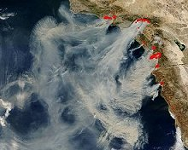
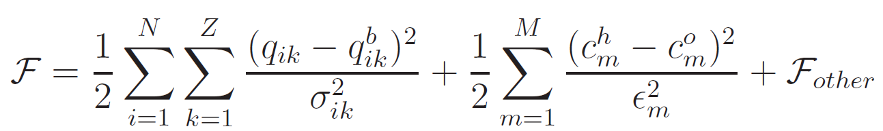
Methodology
An independent HYSPLIT simulation starting at each HMS fire location with given starting time and duration is run with unit source, at several possible release height to generate a Transfer Coefficient Matrix (TCM).
Source terms are solved by minimizing a cost function built to mostly measure the differences between model predictions and observations, following a general data assimilation approach.
Hourly gridded GASP

Slide 6
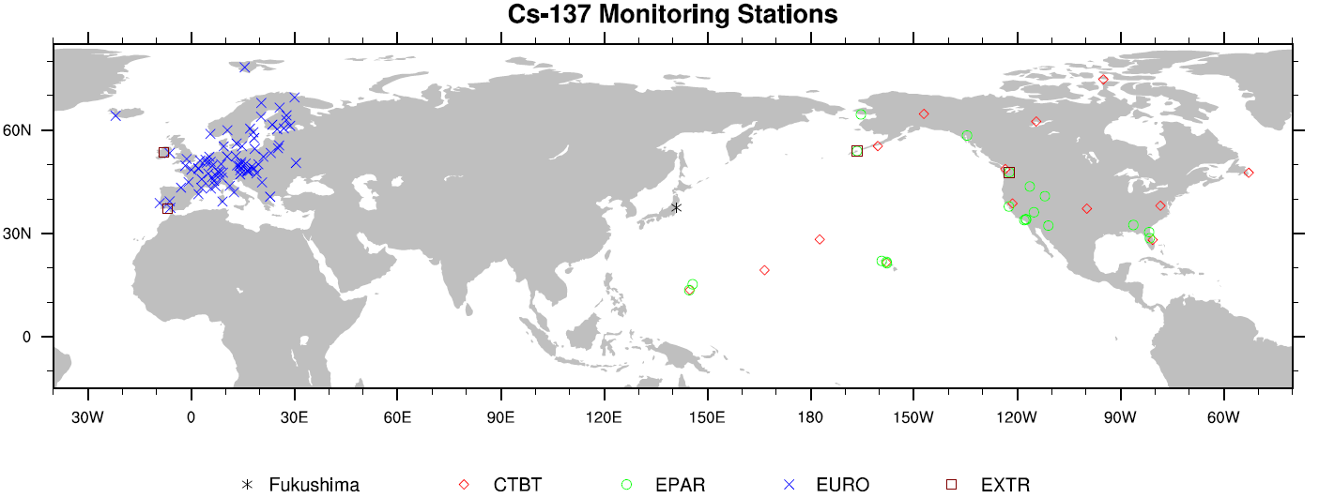
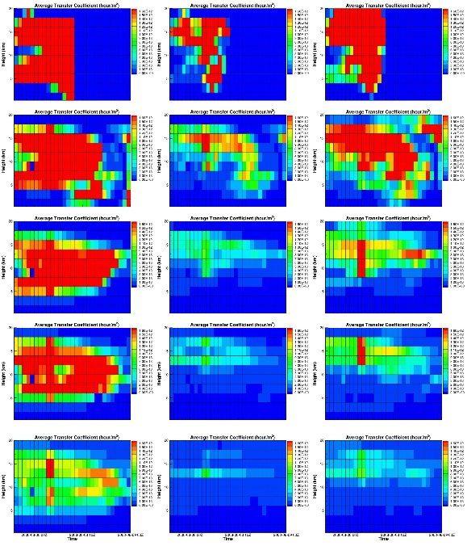
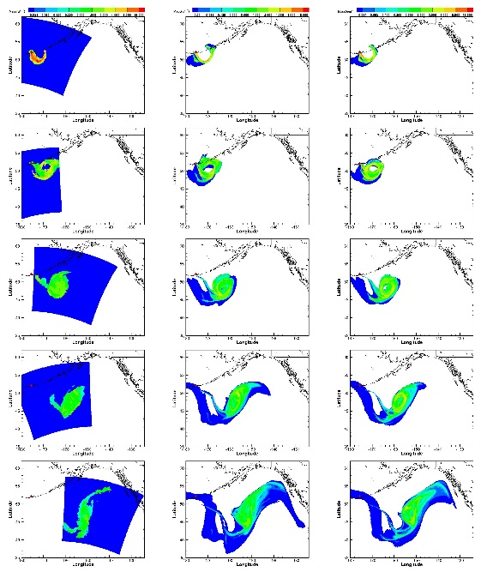
HYSPLIT inverse modeling
1. Fukushima source term estimation
Ref: Source term estimation using air concentration measurements and a Lagrangian dispersion model–Experiments with pseudo and real cesium-137, T Chai, R Draxler, A Stein – Atmos. Environ., 2015
2. Volcanic ash application-Kasatochi eruption
Ref: Imprvoving volcanic ash predictions with the HYSPLIT dispersion model by assimilating MODIS satellite retrievals
Chai, T., A Crawford, B Stunder, MJ Pavolonis, R Draxler, A Stein
Atmos. Chem. Phys. 17, 2865-2879

Slide 7
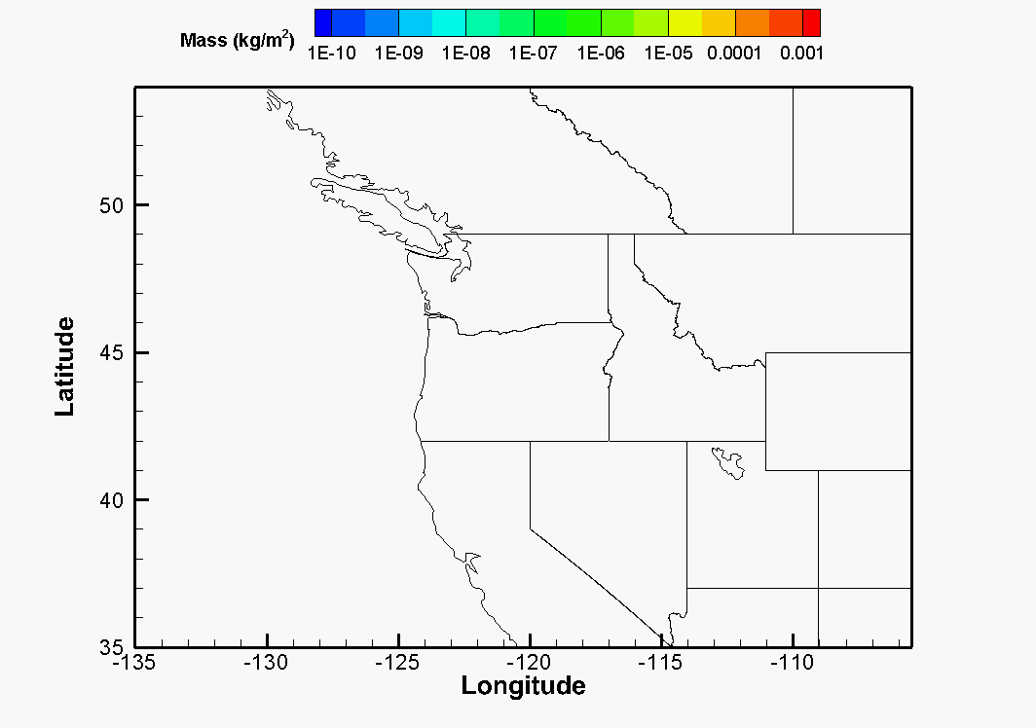
Twin experiments
In twin experiments, known wildfire sources are released to generate smoke plumes. Then pseudo-observations (satellite mass loadings) are generated based on the HYSPLIT simulation results ;
With exact solutions available, the inverse algorithm can be fully evaluated.
Hourly, at 0.5ºx0.5º resolution
9 fire locations, constant releases each day for 2 days from 6Z on 8/17/15, at 1500m or 2000m, MET: gdas1

Slide 8
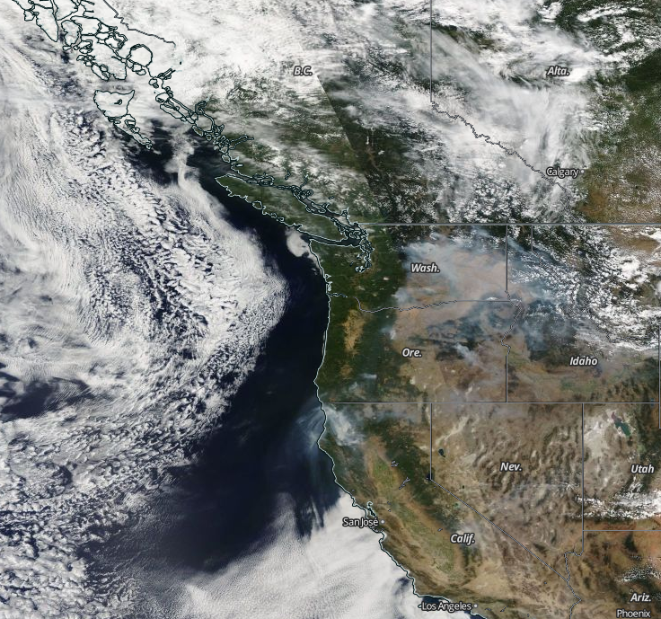
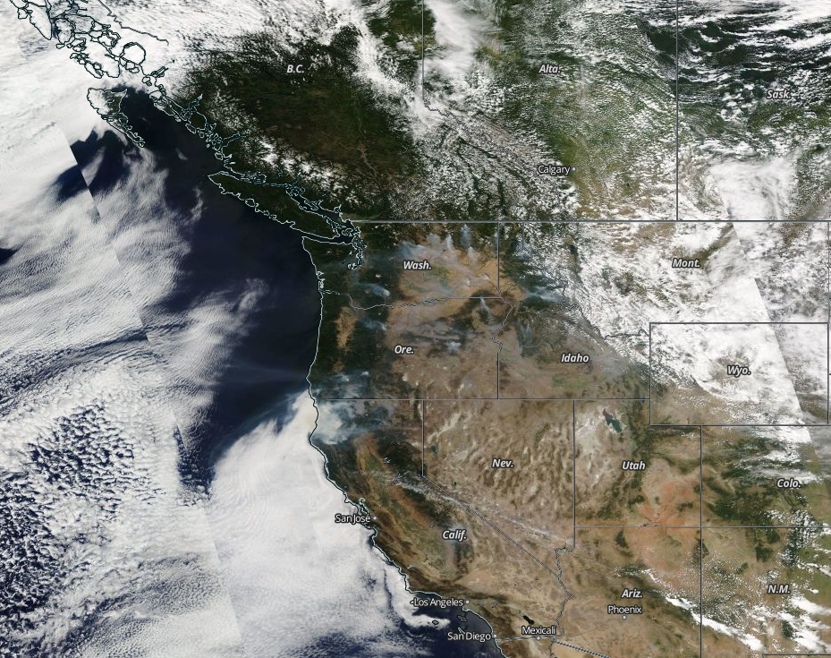
NASA WORLDVIEW – Corrected reflectance (true color) Aqua & Terra MODIS
8/17/2015
8/18/2015

Slide 9
Case 1:
All 48 hourly non-zero mass loadings are assumed retrieved accurately;
ln(q_{ik}) as control variables to avoid negative emission results;
First guess is 10⁵kg/hr at all location/height;
Background term effect is minimized with extremely large uncertainty given ;
Observations uncertainties at 10% M + 0.003kg/m²;
Minimization stops after cost function reduced to be 10⁻⁶F_{init}.
Case 1 result
Actual sources

Slide 10
Source term error statistics
48 hr observations 24 hr observations
Case 2: Remove 1st day observations from Case 1
 | Source term | MAE (kg/hr) | Normalized MAE | RMSE (kg/hr) | Normalized RMSE
Case 1 | Day 1 | 534.9 | 0.77% | 841.4 | 1.21%
 | Day 2 | 1760.5 | 2.53% | 3332.5 | 4.78%
Case 2 | Day 1 | 1985.8 | 2.85% | 3310.2 | 4.75%
 | Day 2 | 1393.0 | 2.00% | 2943.2 | 4.22%

Slide 11
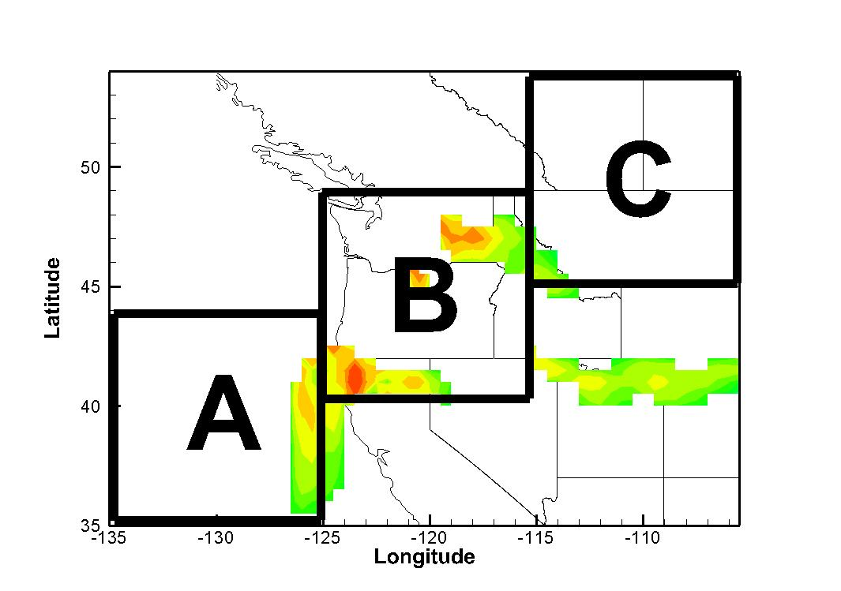
Spatial coverage
Case 3 | Day 2 observations, w/o Region A
Case 4 | Day 2 observations, w/o Region B
Case 5 | Day 2 observations, w/o Region C
Source term error statistics
 | Source term | MAE (kg/hr) | Normalized MAE | RMSE (kg/hr) | Normalized RMSE
Case 3 | Day 1 | 606.4 | 0.87% | 1156.3 | 1.66%
 | Day 2 | 301.2 | 0.43% | 573.4 | 0.82%
Case 4 | Day 1 | 23834.6 | 34.21% | 32157.9 | 46.16%
 | Day 2 | 66177.5 | 94.99% | 78653.3 | 112.90%
Case 5 | Day 1 | 3974.9 | 5.71% | 8803.3 | 12.64%
 | Day 2 | 3400.6 | 4.88% | 10663.2 | 15.31%

Slide 12
Observation errors
2nd day observations only;
without spatial blocking;
Gaussian-distributed errors are added to pseudo observations.
Source term error statistics
 | Source term | MAE (kg/hr) | Normalized MAE | RMSE (kg/hr) | Normalized RMSE
Case 6 10% | Day 1 | 1448.6 | 2.08% | 2259.7 | 3.24%
 | Day 2 | 4418.7 | 6.34% | 11121.8 | 15.96%
Case 7 | Day 1 | 2105.8 | 3.02% | 3954.7 | 5.68%
20% | Day 2 | 8567.9 | 12.30% | 22884.4 | 32.84%
Case 8 | Day 1 | 6227.6 | 8.94% | 12047.1 | 17.29%
50% | Day 2 | 22034.5 | 31.63% | 67298.2 | 96.60%
Case 9 | Day 1 | 10104.2 | 14.50% | 19759.9 | 28.36%
100% | Day 2 | 34560.9 | 49.61% | 131203.9 | 188.33%

Slide 13
HYSPLIT-based Emission Inverse Modeling System
NOAA NESDIS
NOAA ARL
USDA Forest Service
GASP
ASDTA
HMS
HYSPLIT
BlueSky
Fuel-loading based fire emissions system
AOD
Fire detection
(Location/Time)
TCM
Cost Function
Minimization
Constrain
First guess
Adjusted
Fire Emissions

Slide 14
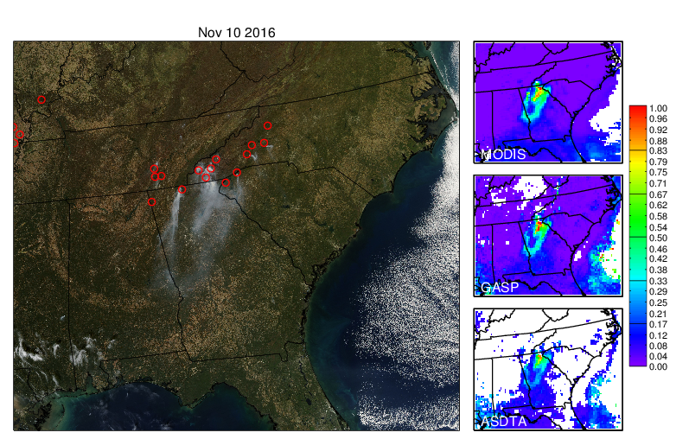
Observed fire events in southeastern US on November 10, 2016. MODIS truecolor image is shown in left panel, and MODIS, GASP, ASDTA aerosol optical depths are shown in right panel. Red circles indicate locations of wildfires detected by HMS.
GASP: GOES Aerosol/Smoke Product
ASDTA: Automated Smoke Detection and Tracking Algorithm

Slide 15
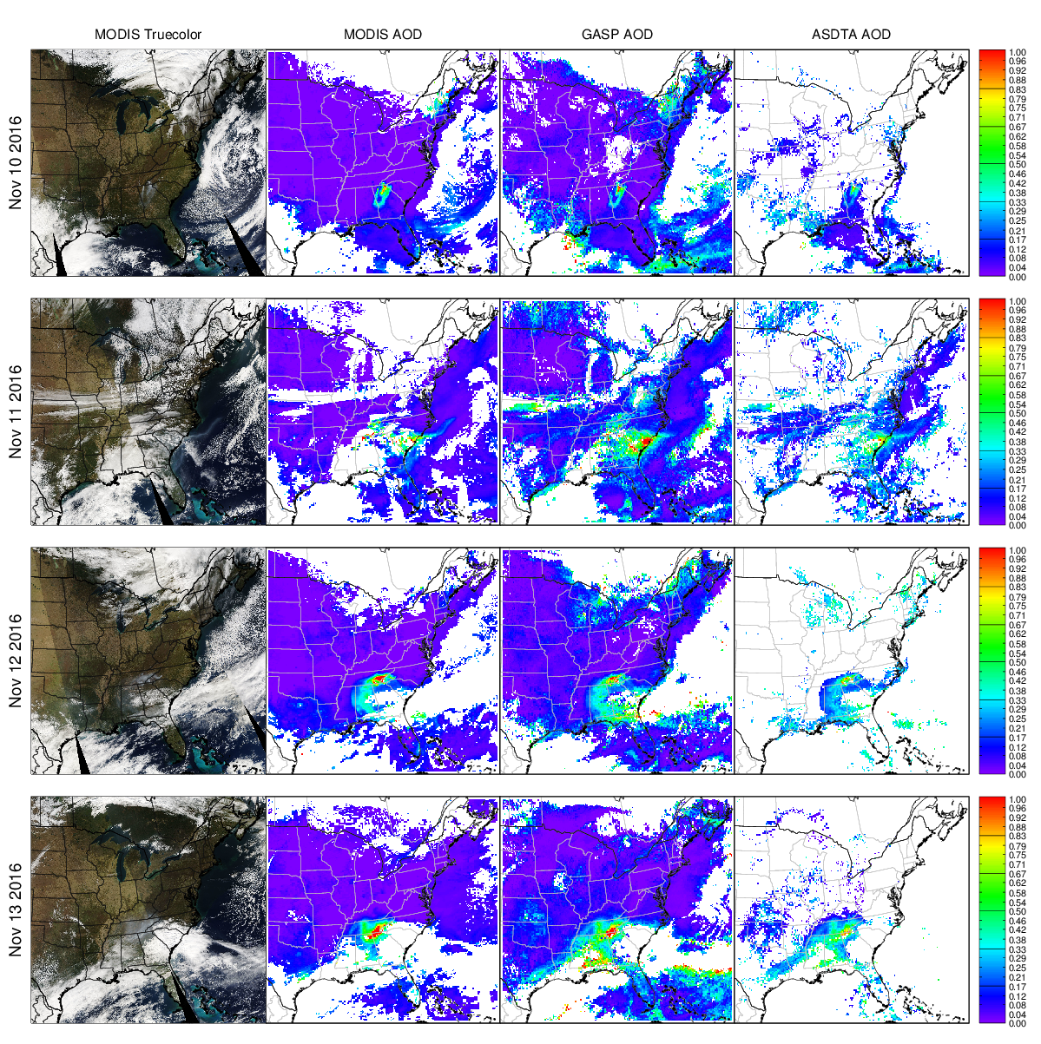
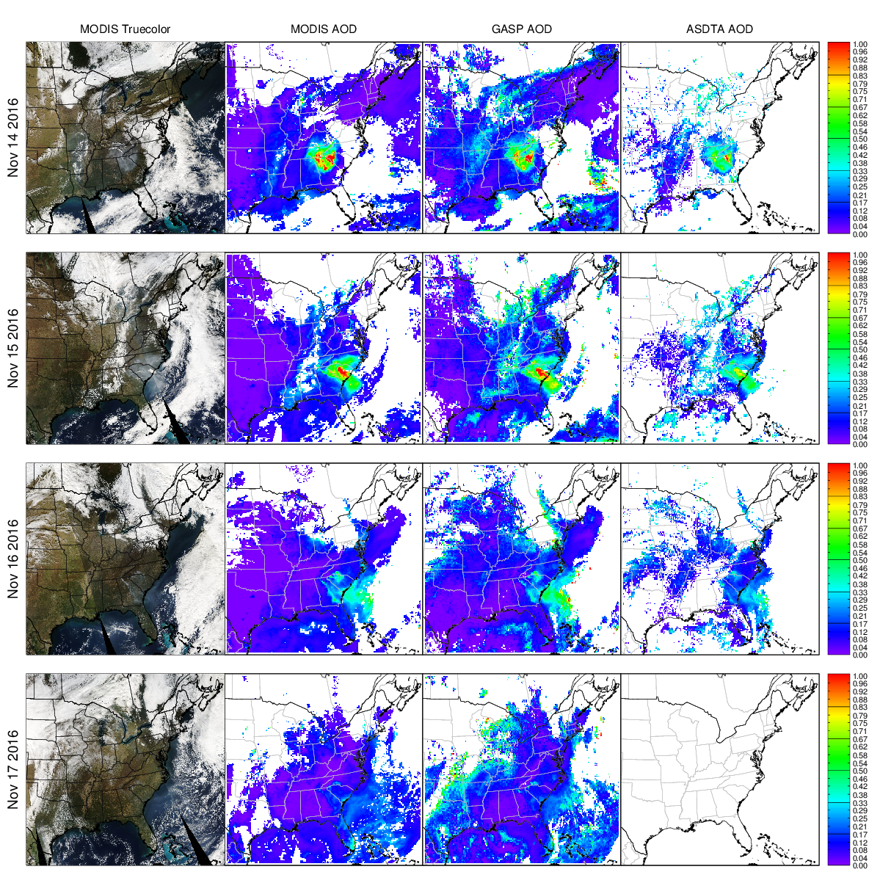
Observed wildfire events for the study during November 10-17, 2016. MODIS truecolor images, MODIS AOD, GASP AOD, and ASDTA AOD are shown.

Slide 16
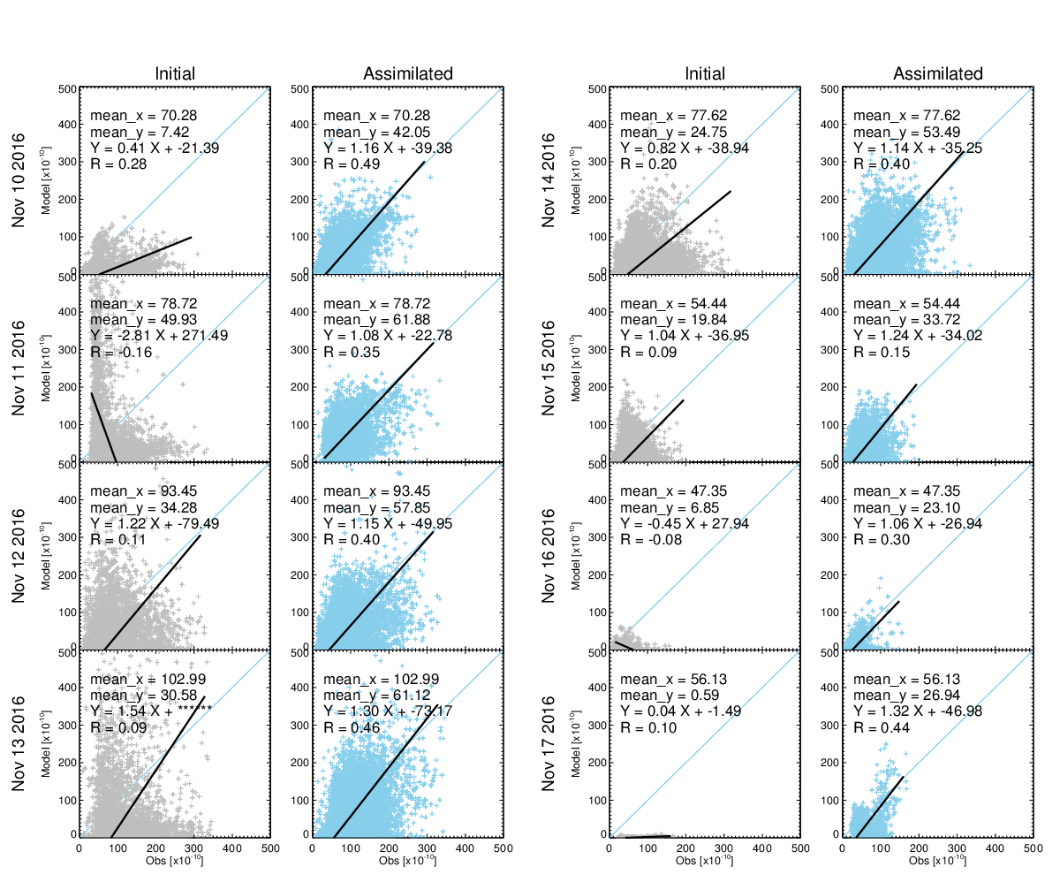
Scatter plot comparison between initial and assimilated particulate matter concentrations (10⁻¹⁰ kg/m³ ) using adjusted fire emissions during November 10-17, 2016

Slide 17
Performance evaluation - Statistics of modeled smoke particulate concentration (10⁻¹⁰ kg/m³) using initial and top-down fire emissions
 |  | Nov. 10 | Nov. 11 | Nov. 12 | Nov. 13 | Nov. 14 | Nov. 15 | Nov. 16 | Nov. 17
 | Observation | 70.28 | 78.72 | 93.45 | 102.99 | 77.62 | 54.44 | 47.35 | 56.13
mean | Initial | 7.42 | 49.93 | 34.28 | 30.58 | 24.75 | 19.84 | 6.85 | 0.59
 | Top-down | 42.05 | 61.88 | 57.85 | 61.12 | 53.49 | 33.72 | 23.10 | 26.94
RMSE | Initial | 73.34 | 118.20 | 93.68 | 11.53 | 69.63 | 46.56 | 50.49 | 61.22
 | Top-down | 51.43 | 46.50 | 68.14 | 72.44 | 51.87 | 39.28 | 40.61 | 43.69
Slope | Initial | 0.41 | -2.81 | 1.22 | 1.54 | 0.82 | 1.04 | -0.45 | 0.04
 | Top-down | 1.16 | 1.08 | 1.15 | 1.30 | 1.14 | 1.24 | 1.06 | 1.32
R | Initial | 0.28 | -0.16 | 0.11 | 0.09 | 0.2 | 0.09 | -0.08 | 0.1
 | Top-down | 0.49 | 0.35 | 0.40 | 0.46 | 0.4 | 0.15 | 0.3 | 0.44

Slide 18
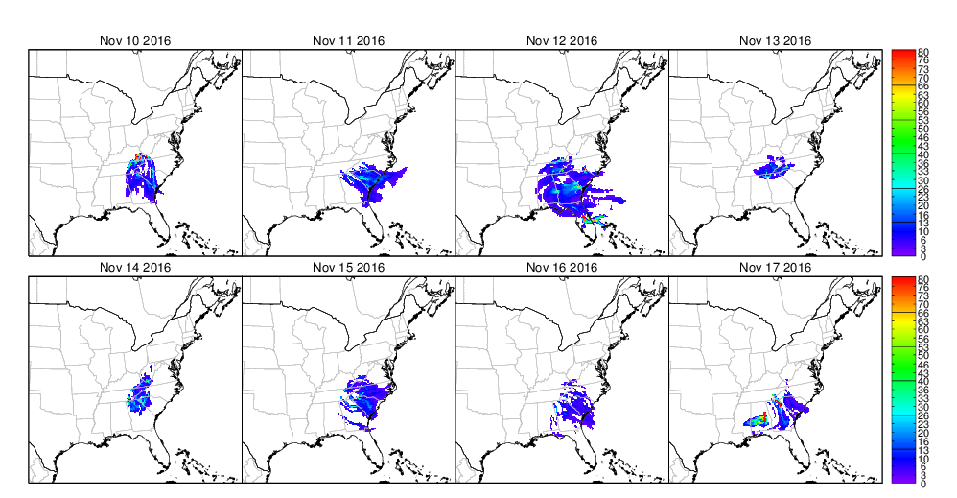
Spatial distributions of reconstructed fire particulate matter column concentrations (10⁻¹⁰ kg/m³ ) using top-down estimated wildfire emissions.

Slide 19
Summary and future direction
  Wildfire emission inversion has been built based on HYSPLIT model, its TCM, and a cost function;
  With pseudo observations generated using HYSPIT model simulations (twin experiments), true emissions (release height and emission rate) can be recovered;
  A case study using real GOES data has been performed;
  High resolution GOES-16 data will be tested;
  More evaluation will be performed using VIIRS AOD and surface PM2.5 observations;
  Model uncertainty will be included in the HYSPLIT inversion system.

Slide 20
Thank you!
This work is funded by NOAA Award NA16OAR4590121

Slide 21
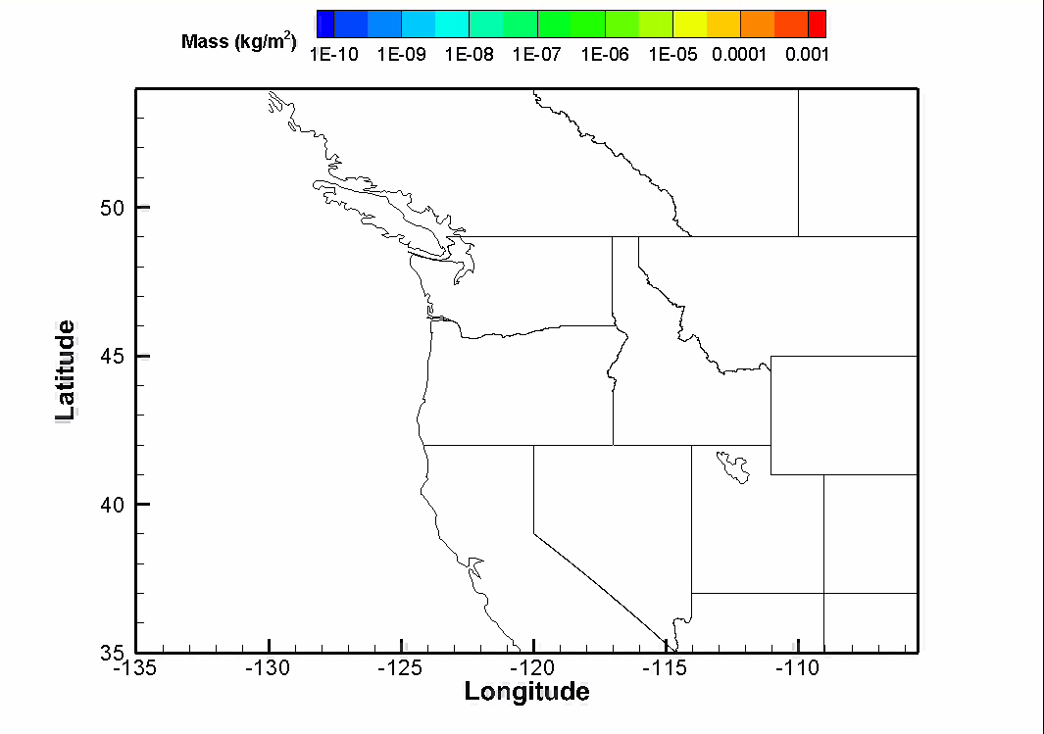
Twin experiments

