Slide 1
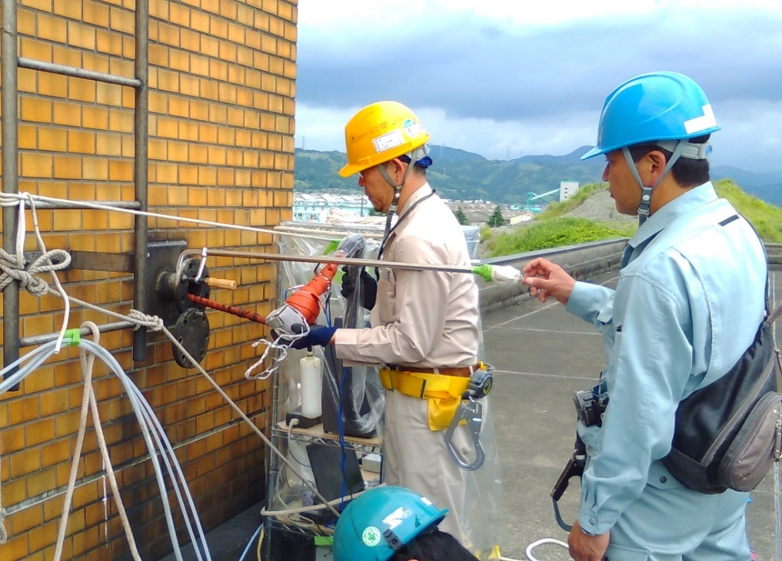
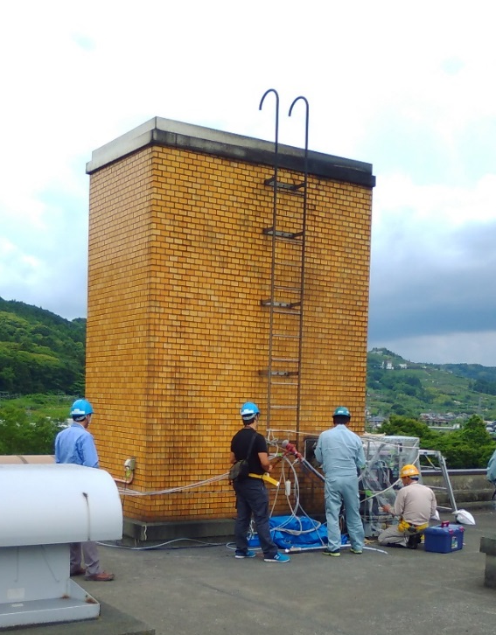



Contributions of Condensable Particulate Matter
to Atmospheric Organic Aerosol over Japan
Yu Morino,^{*1} Satoru Chatani,¹ Kiyoshi Tanabe,¹ Yuji Fujitani,¹ Tazuko Morikawa,²
Katsuyuki Takahashi,³ Kei Sato,¹ and Seiji Sugata¹
(¹National Institute for Environmental Studies, Japan, ²Japan Automobile Research Institute, Japan,
³Japan Environmental Sanitation Center, Japan)
Environ. Sci. Technol. 2018, 52, 8456−8466
17th Annual CMAS Conference
Friday Center, UNC-Chapel Hill, October 22-24, 2018
Acknowledgements: This research was partly supported by the Environment Research and Technology
Development Fund (5-1408, 5-1506, S-12-1, and 5-1801) of the Ministry of the Environment, Japan.

Slide 2
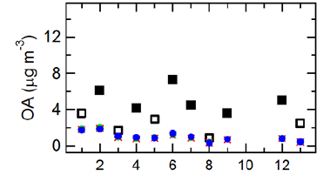

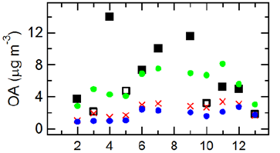
Problems of organic aerosol modeling
Model representation of OA
Simulation of OA in Japan
Winter
Molar mass
Summer
~ vapor pressure
Shiraiwa et al., 2014;
Obs
VBS model
Two-product model
#1: two-product model
POA
SOA1
SOA2
VOC
#2: VBS model
←west east→
Morino et al., AAQR, 2015;
Primary-OA/SVOC
Obs. sites
SOA1
– SOA4
VOC
1,Tsushima; 2,Fukuoka; 3,Oki; 4,Matsue; 5,Kyotango; 6,Osaka; 7,Shiga; 8,Tateyama; 9,Toyama; 10,Sado; 11,Niigata; 12,Sapporo; 13,Rishiri;
VBS model better reproduced observed OA than the traditional model, though several problems remained.
Simulation models treat OA in a very simple manner.

Slide 3
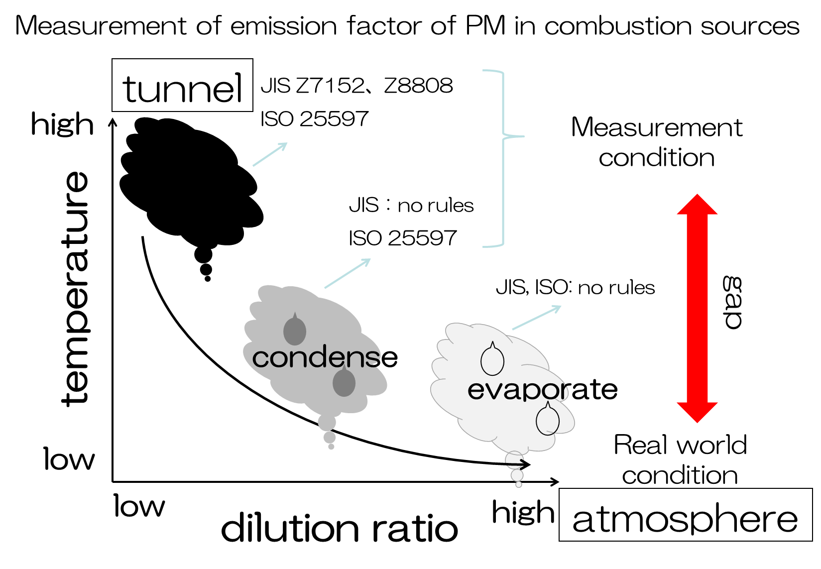
Condensable particulate matter
In the gas phase under stack conditions
Condense into PM immediately after discharge from the stack
Japanese industrial standards
Filterable PM
Condensable PM

Slide 4
Methodology – measurement of condensable PM
Dilution sampling method
(e.g., ISO, CTM-039, Tokyo metropolis)
Impinger method
(e.g., EPA 201A/202)
Sampling of CPM after isothermal dilution.
Possibility of negative artifacts by SVOC wall loss.
CPM is sampled with a condenser, dry impingers, and a filter.
Positive artifacts by gas adsorption.
Richards et al., 2005
PEC/MOE, 2014

Slide 5
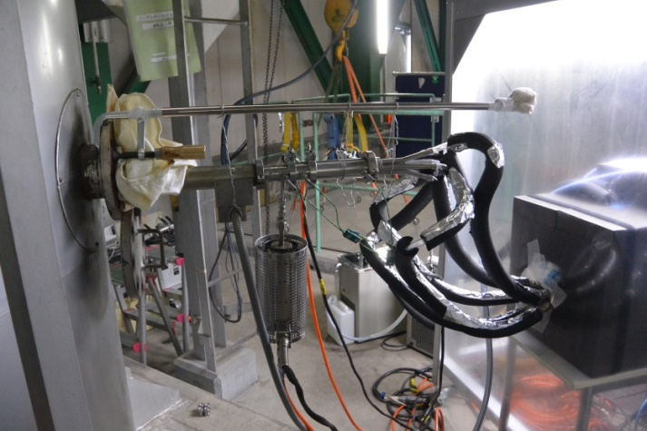
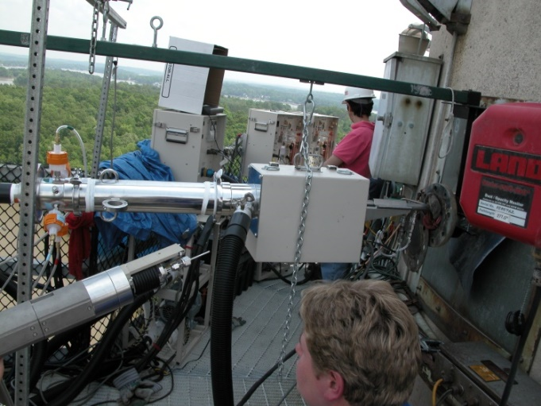
Emission surveys of filterable and condensable PM
In the conventional emission survey of PM_{2.5}, condensable PM was not measured.
→ Exhaust should be sampled after dilution and cooling.
Emission survey of PM_{2.5}
(stationary combustion sources)
PM_{2.5} measurement by NIES (dilution sampling)
Diluter
Residence chamber
Stacks
Conventional (w/o dilution)
Measurement of filterable PM
Particle sampler
Particle sampler
PM_{2.5} cyclone
Diluter
(DR=20)
Residence chamber
Emission survey in the US
Measurement of condensable + filterable PM (with dilution)
Residence chamber
Flow of
exhaust
Diluter

Slide 6
Emission surveys of filterable and condensable PM
In the conventional emission survey of PM_{2.5}, condensable PM was not measured.
→ Exhaust should be sampled after dilution and cooling.
Emission survey of PM_{2.5}
(stationary combustion sources)
PM_{2.5} at combustion sources (μg m⁻³)
②
Stacks
filterable + condensable PM
②
Conventional (w/o dilution)
Measurement of filterable PM
other
Particle sampler
①
SO₄²⁻
Particle sampler
organics
filterable PM
PM_{2.5} cyclone
①
organics
Diluter
(DR=20)
Residence chamber
w/o dilution w. dilution w/o dilution w. dilution
Flow of
exhaust
Measurement of condensable + filterable PM (with dilution)
Gas combustion Waste burning
Tokyo metropolis, 2011
Condensable PM had critical contributions to PM_{2.5} (particularly, organic aerosol) from stationary combustion sources.

Slide 7
Previous studies – modeling of condensable PM
Semivolatile organics from vehicle exhaust
Condensable PM from RWC
(residential wood burning)
SVOC aging and emission profiles
RWC
Emissions in Europe
EC
OC
w/o CPM with CPM
Contributions of SVOC to ambient OA
OC conc. from biomass burning
In Vavihill
(southern Sweden)
SVOC emissions and its aging reactions have important contributions to ambient OA.
OC emissions and concentrations significantly increased by considering condensable PM from RWC.
Robinson et al., Science, 2007;
Denier van der Gon, ACP, 2015

Slide 8
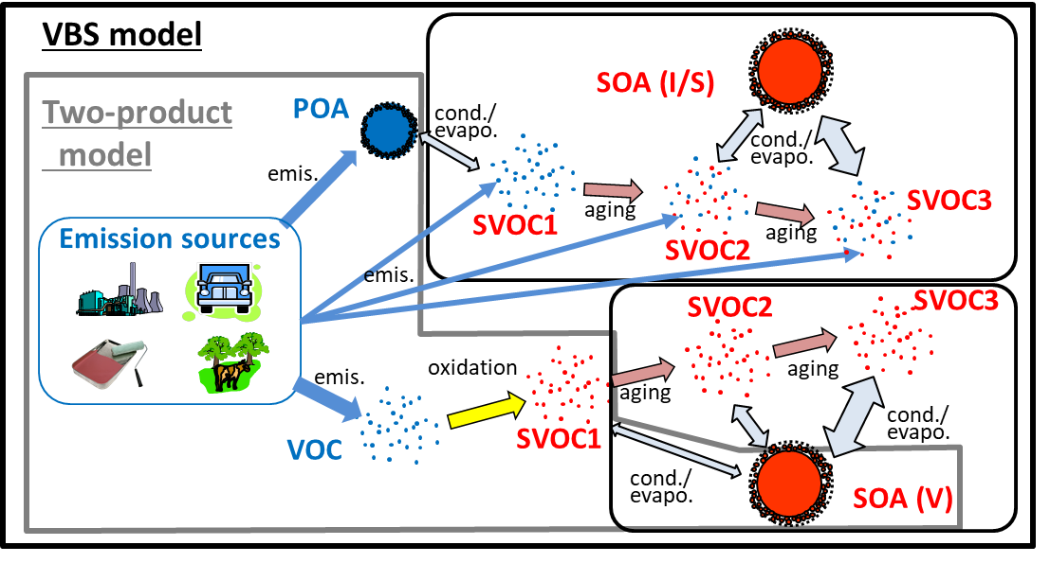
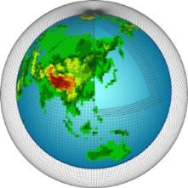
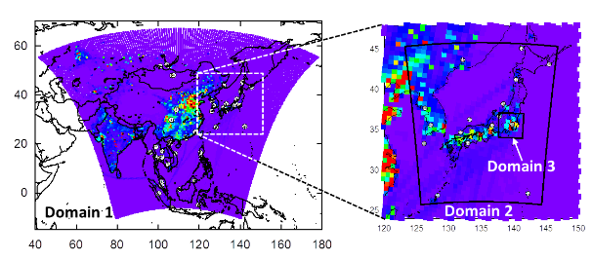
Objectives of this study
To estimate contributions of condensable PM from stationary combustion sources to atmospheric OA
  Emission inventory of condensable PM was preliminary estimated from data of Japanese emission surveys.
  Contributions of condensable PM to atmospheric organic aerosol were estimated using a chemical transport model.
  Model setups
  ■Meteo. model：WRF v3.3
  ■CTM：CMAQ v5.0.2
  ■Chem./aerosol module:
  CB05/AERO6VBS
  ■Period：Jan-Feb, Apr-May and Jul-Aug, 2012
■Emission data
Anthropogenic (Japan) | JATOP
Anthropogenic (East Asia) | REAS v2.1
Biomass burning | GFED v3.1
Volcano | AEROCOM/JMA
Biogenic VOC | MEGAN v2.10
Global-scale CTM
MIROC-ESM-CHEM
Regional-scale CTM
WRF/CMAQ
Morino et al., AAQR, 2015; Morino et al., ES&T, 2017;
Δx = 300 km
Δx = 60km
Δx = 15km

Slide 9
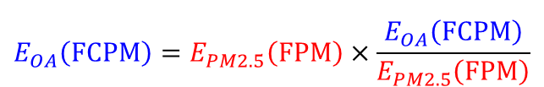
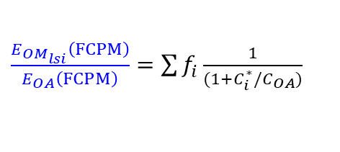
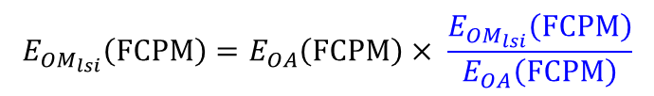
Emissions of condensable PM - Methods
  Emissions of organic aerosol
filterable + condensable PM
  Emissions of organic aerosol + S/IVOC
$$E_{OA}\left(FCPM\right)=E_{PM2.5}\left(FPM\right)×\frac{E_{OA}\left(FCPM\right)}{E_{PM2.5}\left(FPM\right)}$$
$$E_{{OM}_{lsi}}\left(FCPM\right)=E_{OA}\left(FCPM\right)× \frac{E_{{OM}_{lsi}}\left(FCPM\right)}{E_{OA}\left(FCPM\right)}$$
filterable + condensable PM
filterable PM
filterable PM
LVOC+ SVOC
+ IVOC
Organic aerosol
PM_{2.5} emission rates
from emission inventory
From emission surveys of condensable PM
Emissions of S/IVOC were estimated based on the assumed volatility distributions.
Shrivastava et al., 2011; Grieshop et al., 2009;
Stacks
$\frac{E_{{OM}_{lsi}}\left(FCPM\right)}{E_{OA}\left(FCPM\right)}=\sum{f_{i}\frac{1}{(1+C_{i}^{∗}/C_{OA})}}$
Conventional (w/o dilution)
Measurement of filterable PM
Particle sampler
①
Particle sampler
w/o dilution
PM_{2.5} cyclone
②
With dilution
Diluter
(DR=20)
Residence chamber
C_{OA+SVOC}
Flow of
exhaust
Measurement of condensable + filterable PM (with dilution)
C_{OA}
Tokyo Metropolis, 2011; 2016; Ministry of Env., 2015;
Notes:
C:\Users\my\Documents\WORK\Present\Seminar\Projects_所外\PM_菅田推進費_H26-\151221_SPECIATE\160301_揮発性分布

Slide 10
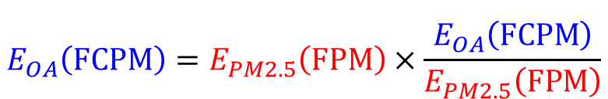
Emissions of condensable PM - Profiles
$$E_{OA}\left(FCPM\right)=E_{PM2.5}\left(FPM\right)×\frac{E_{OA}\left(FCPM\right)}{E_{PM2.5}\left(FPM\right)}$$
filterable + condensable PM
filterable + condensable PM
filterable PM
filterable PM
Original speciation (filterable PM)
For the estimate of condensable PM

Slide 11
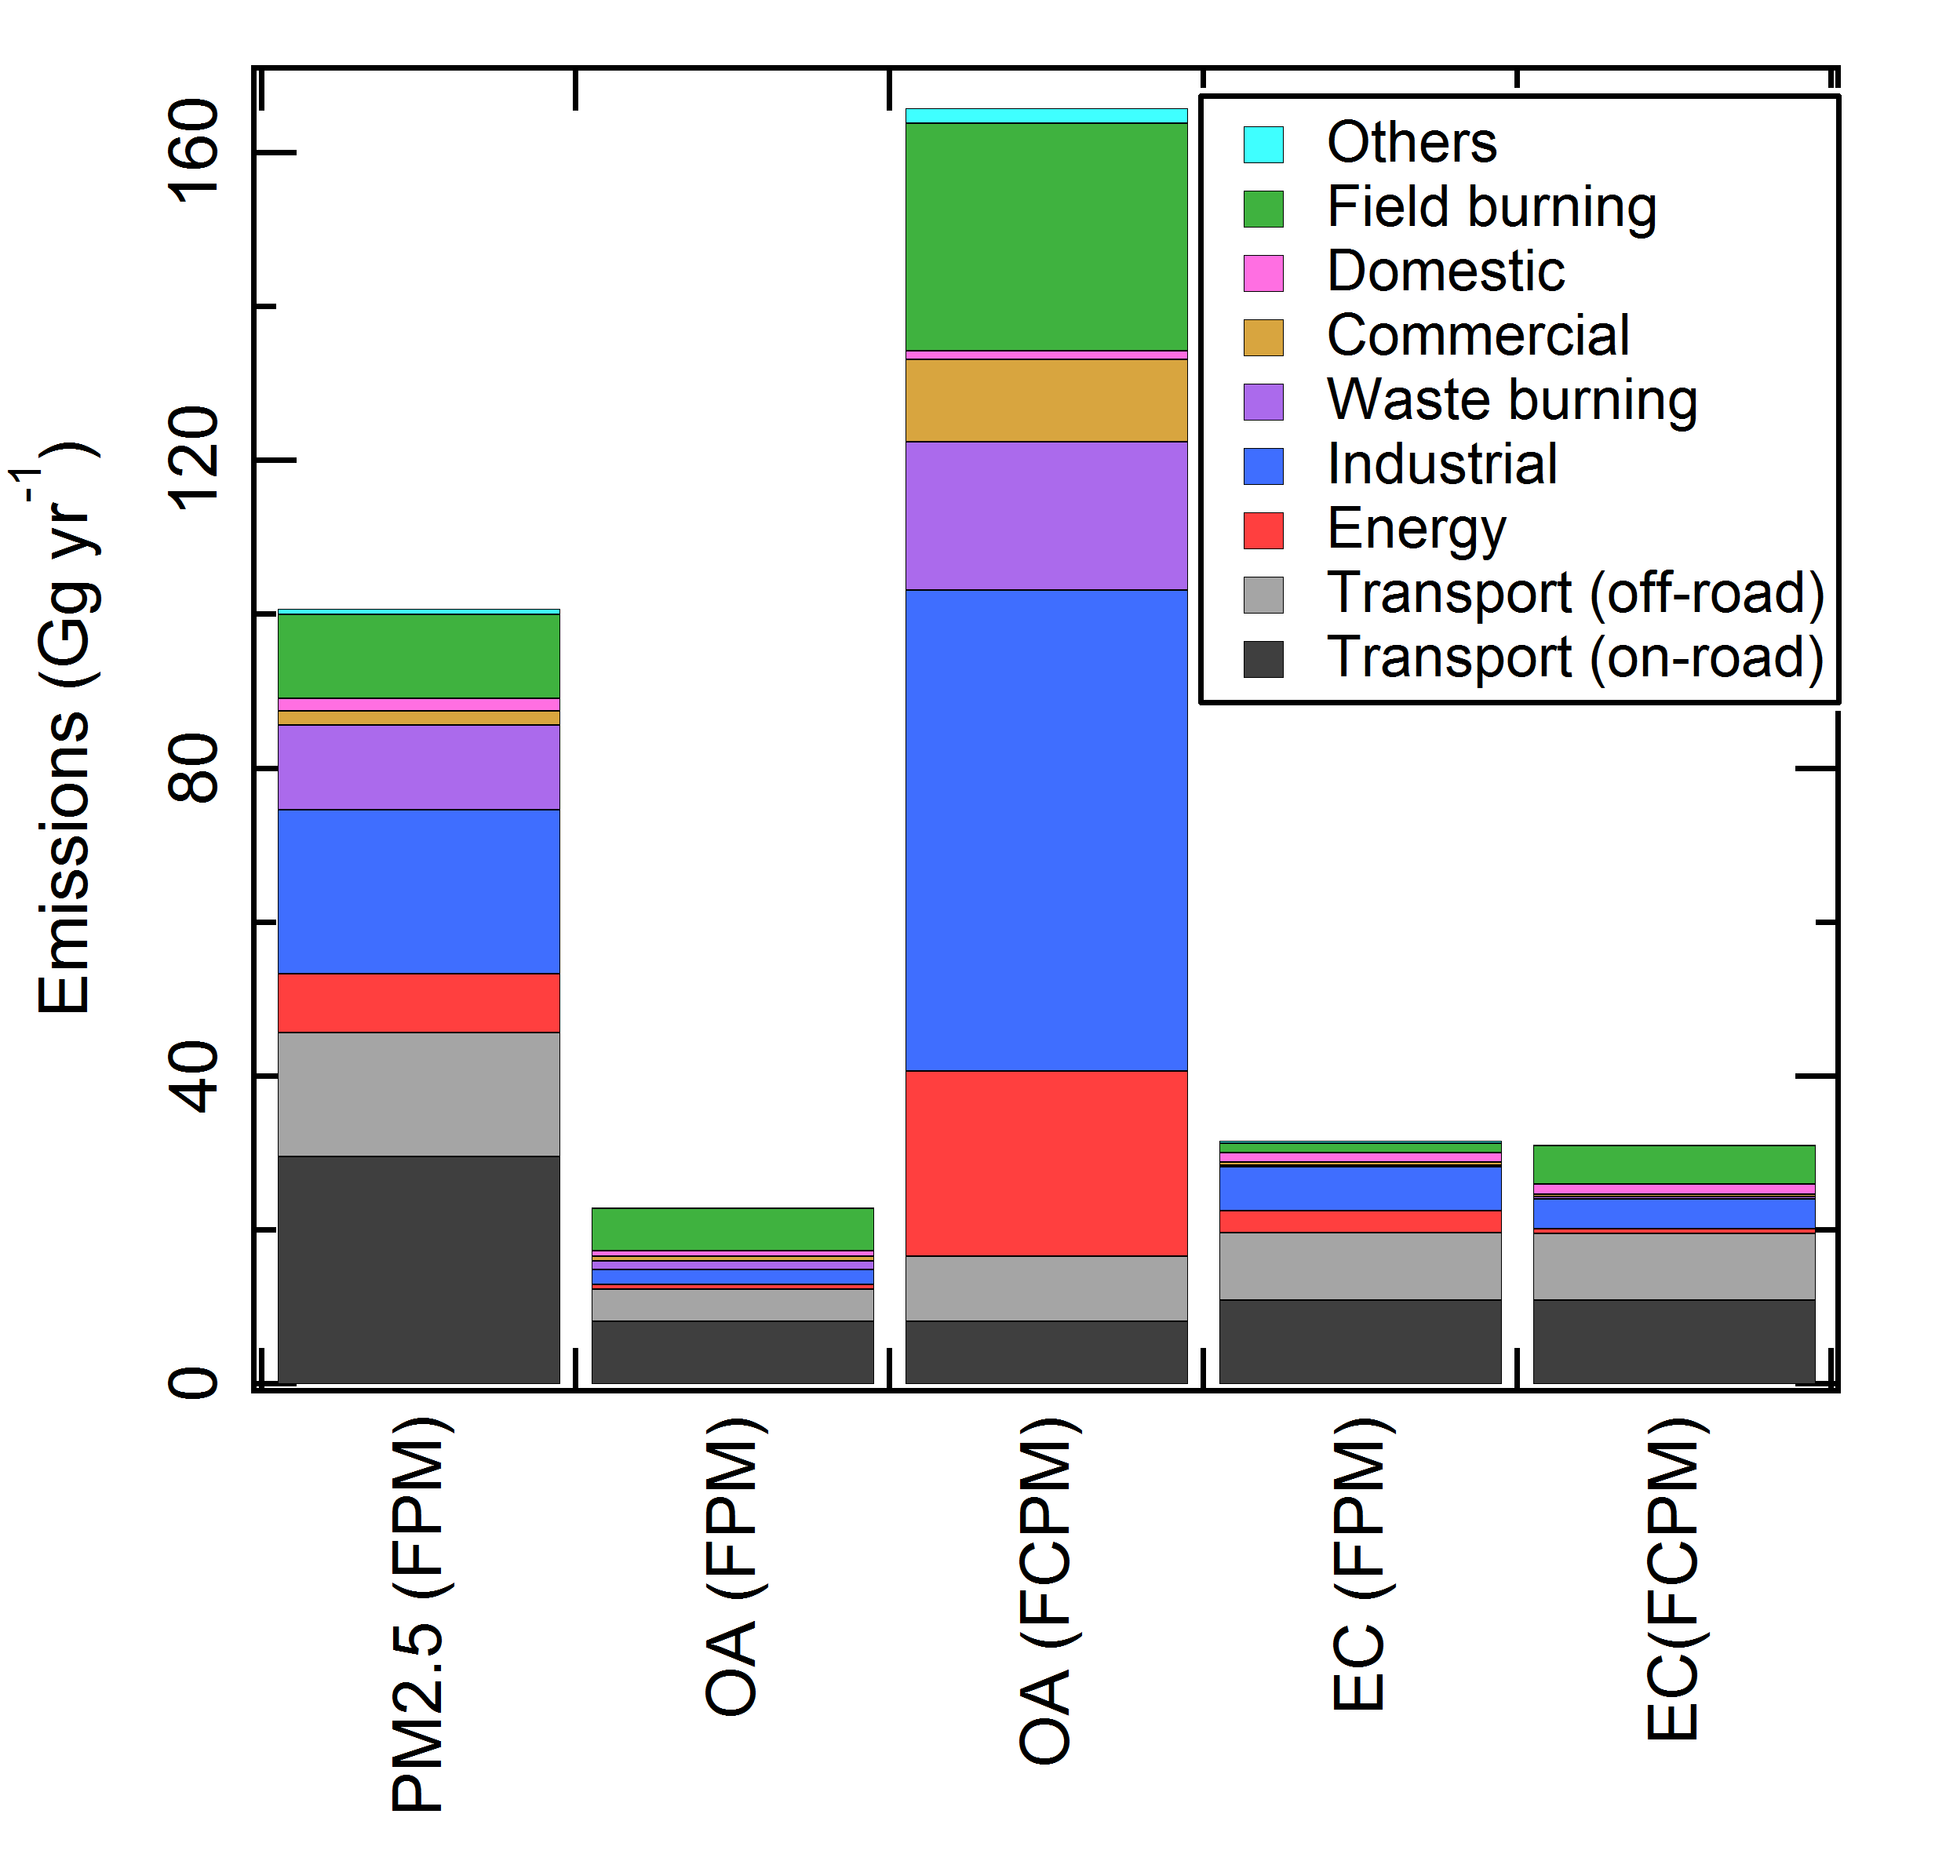
Emissions of condensable PM - Results
$$E_{OA}\left(FCPM\right)=E_{PM2.5}\left(FPM\right)×\frac{E_{OA}\left(FCPM\right)}{E_{PM2.5}\left(FPM\right)}$$
filterable + condensable PM
filterable PM
Emissions of PM_{2.5}, OA, and EC over Japan(Gg/yr)
OA emission rates increased by a factor of seven after correction for condensable PM (even higher than total PM_{2.5} emissions in filterable PM)
EC emission rates did not largely change even after correction,
FPM：Filterable PM
FCPM：filterable + Condensable PM

Slide 12
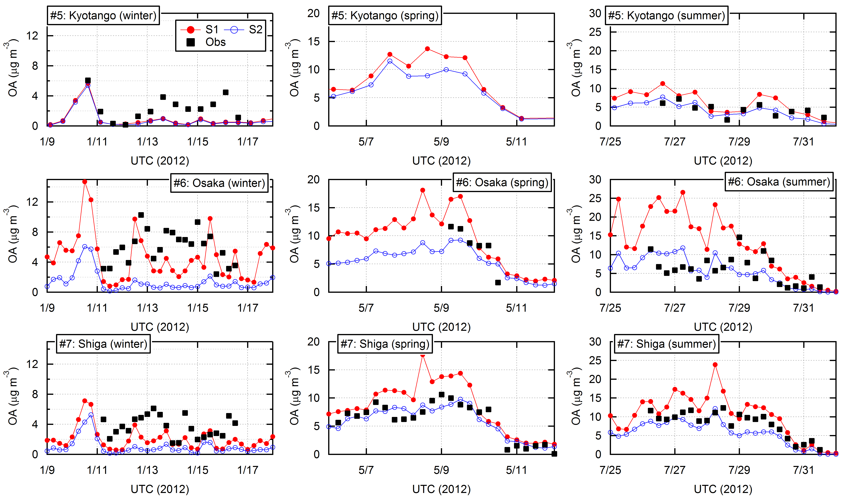
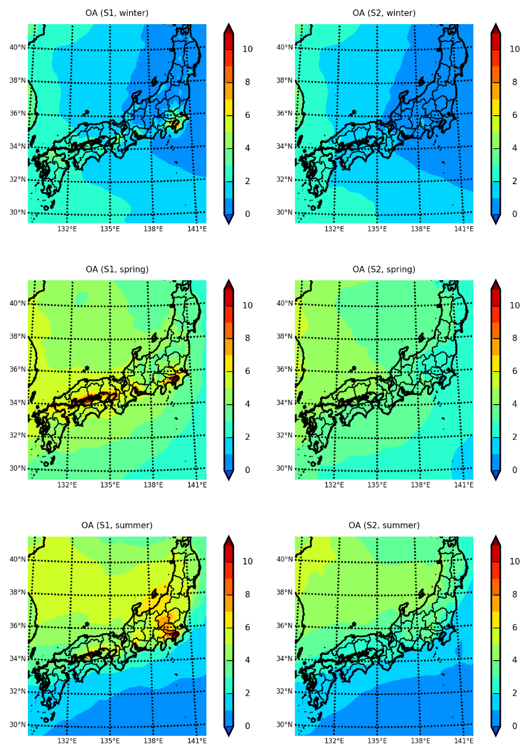
Contributions of condensable PM to atmospheric OA
Winter
Summer
S1：with FPM+CPM
S2：with FPM
Remote
Winter
S1：with FPM+CPM
S2：with FPM
Urban
Spring
Rural
Summer
Model performance of OA was improved in winter but overestimated in summer.
Simulated OA drastically increased around urban and industrial areas.

Slide 13
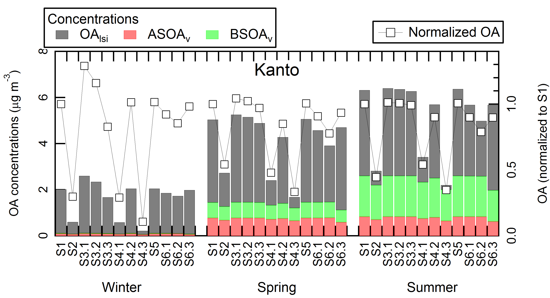
Sensitivity analysis of uncertain parameters
Simulated OA is highly sensitive to C* distributions.
Less sensitive to vaporization enthalpy (ΔH_{vap}) and aging rates (k_{OH+SVOC})
FPM+CPM
FPM
FPM+CPM
FPM
FPM+CPM
FPM

Slide 14
Measurement of volatility distributions
10 μm-cut cyclone
Electrical Low Pres. Impactor
Teflon filter
Quartz filter
Impactor
stack
Virtual impactor
1. Filterable PM
Quartz filter
Impactor
2. Condensable PM
Teflon filter
Canister
Residence
chamber
Impactor
incinerator
Dilution air
Diesel vehicle
Incinerator of general waste
Incinerator of sewage sludge (+ Bunker A)
 | 2014 Diesel vehicle | 2015 Incinerator (general waste) | 2016 Incinerator (sewage sludge)
Fuel | Diesel fuel | General waste | sewage sludge + Bunker A
Temperature (ºC, furnace) | 2000 | 1000 | 700-800
Aftertreatment | Oxidation catalyst | Bug filter | Cyclone
Flow rate (stacks, m/s) | 1.8 | 13.0 | 16.0
Water content (stacks, %) | - | 19.8 | 8.4
Gas temperature (ºC, stacks) | 25 | 200 | 160
PM10 | 213.9 | 38 | 19507
Gas temperature (ºC, after dilution) | 25 | 25 | 25

Slide 15
Summary
Preliminary estimate of condensable PM emissions
By considering condensable PM, OA emissions increased by a factor of seven, and stationary combustion sources in industrial or energy sector became the largest contributors to OA emissions over Japan.
Simulation of CMAQ (with VBS)
By considering condensable PM, simulated OA increased by factors of 2.5–6.1 in the Kanto regions.
Model performance of OA was improved in winter, but observed OA was overestimated in summer.
Future works
Improvement of emission estimates by collecting emission survey data.
Evaluation of contributions of primary and secondary OA by comparing with organic tracer measurements.

