Slide 1
COMMUNITY MODELING AND ANALYSIS SYSTEM: 2018 Conference, UNC Chapel Hill, USA
Simulation of the Meteorological Conditions by Introducing the Urban Physics within the PX-LSM and ACM2-PBL Scheme in the WRF Model over the PRD Region in Southern China
Utkarsh Prakash BHAUTMAGEª, Chun Yin DYª, Jimmy Chi-Hung FUNGª,
Jonathan PLEIM^{b}, Alexis LAUª, Adel HANNA^{c}
ªDivision of Environment, HKUST, Hong Kong
^{b}Environmental Protection Agency, Research Triangle Park, NC, USA
^{c}Institute for the Environment, UNC Chapel Hill, USA
Date – 24.OCT.2018

Slide 2
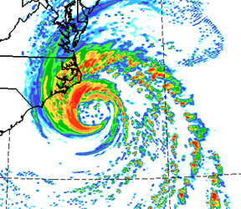
WRF (Weather Research Forecast) Model V4.0
It is a non-hydrostatic, compressible model with a mass coordinate system developed by NCAR.
It was designed as a numerical weather prediction model, but can also be used as a regional climate model.
The model has a capability to resolve large scale motions explicitly, whereas the small scale motions are parameterized by subgrid scale modelling.
It serves a wide range of meteorological applications across scales from tens of meters to thousands of kilometres.
It is designed for both Research and Operational needs.

Slide 3
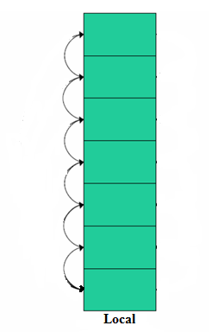
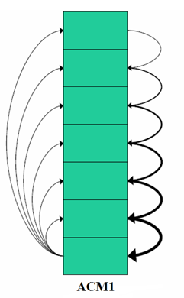
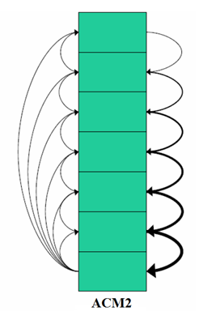
Planetary Boundary Layer (PBL) Modeling Options in WRF V4.0
The WRF Model V4.0 provides 13 Nos. of planetary boundary layer physics schemes
Most commonly used PBL schemes include:
1. Yonsei University (YSU) non-local scheme (Hong et al. 2006)
2. Asymmetric Convective Model version2 (ACM2) non-local scheme (Pleim, 2007a, 2007b)
3. Mellor-Yamada-Janjic (MYJ) local scheme (Janjic, 1990, 1996, 2002)
4. Bougeault-Lacarrere (Boulac) local scheme (Bougeault and Lacarrere, 1989)
TKE closure schemes
Nonlocal upward flux transport from the surface AND asymmetrical layer by layer downward transport from the adjacent upper layer
Local vs. Nonlocal schemes:
Local
ACM1
ACM2
The fluxes are diffused locally
Local upward diffusion

Slide 4
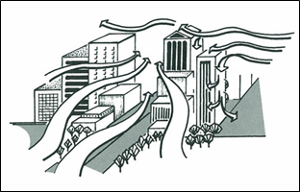
Urban Effect on the Airflow
Intense Shear Layer
At the top of the Urban canopy
Wake Development
Turbulent wakes are generated by roughness elements
Drag
Drag occurs due to the presence of buildings
Mean kinetic energy is converted into turbulent kinetic energy
Wakes efficiently mix and diffuse momentum, heat, moisture and scalers like pollutants
Size of eddies are related to the dimensions of roughness elements
It includes momentum and thermal drag
Radiations
Differential heating/cooling of sunlit/shaded surfaces
Radiation trappings in the street canyon
Heat storage in the buildings including anthropogenic sources

Slide 5
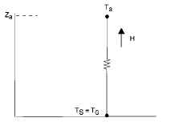
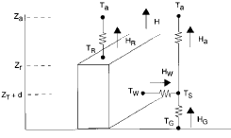
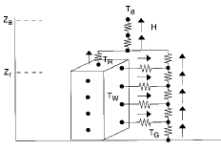
URBAN Modeling Options Used in the WRF Model
Slab Model
It treats the urban geometry as a flat surface
Parameters such as soil heat capacity, thermal conductivity, surface albedo, roughness length, moisture availability are varied at the surface
UCM (Urban Canopy Model)
Single layer approach can calculate canyon drag coefficient, friction velocity etc.
Surface skin temp. at roof, walls, road and temp. profiles, radiations also
BEP (Building Effect Parameterization)
+
BEM (Building Energy Model)
Most sophisticated Multi layer approach
Building effects are parameterized on the grid averaged variables
Sensible heat flux, momentum flux is passed to the WRF-Noah land surface model
Accounts roof, walls, road effects on momentum, TKE and potential temp.
BEM accounts for the anthropogenic fluxes e.g. air conditioning
Shadowing, trapping and reflections of radiations are considered
Reflection of radiations from the surfaces and shadowing effects of buildings in 3D
Slab Model
UCM
BEP + BEM

Slide 6
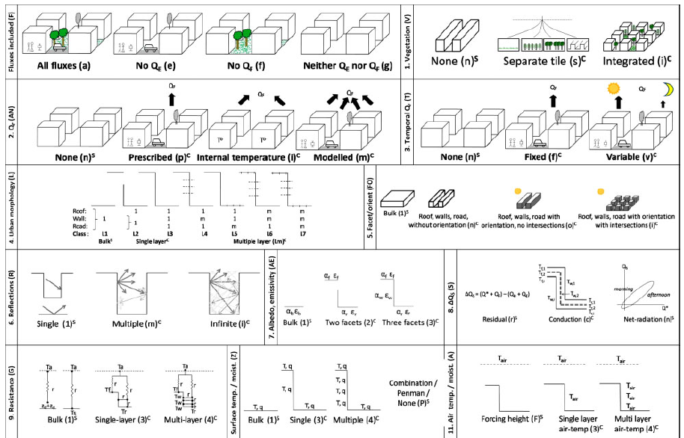
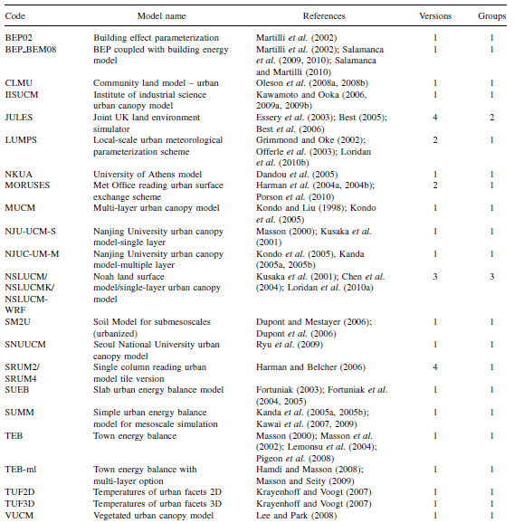
Grimmond, C. S. B., Blackett, M., Best, M. J., Barlow, J., Baik, J. J., Belcher, S. E., ... & Fortuniak, K. (2010). The international urban energy balance models comparison project: first results from phase 1. Journal of applied meteorology and climatology, 49(6), 1268-1292.
Grimmond, C. S. B., Blackett, M., Best, M. J., Baik, J. J., Belcher, S. E., Beringer, J., ... & Dandou, A. (2011). Initial results from Phase 2 of the international urban energy balance model comparison. International Journal of Climatology, 31(2), 244-272.
No individual model does best for every flux modelled.
Using an ensemble of models rather than one model is generally better than any individual model for an individual flux.
In general, the medium complexity ensemble performs least well and the simple performs best.

Slide 7
Objectives
To develop an Urban integrated PX-LSM and ACM2 PBL scheme module to incorporate the governing urban physics in the WRF model
To check the newly developed Urban-PBL scheme’s performance mainly over the PRD region in Southern China along with the real time observation comparison

Slide 8
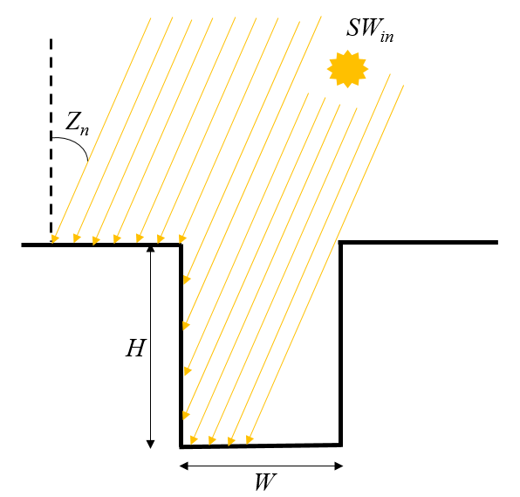
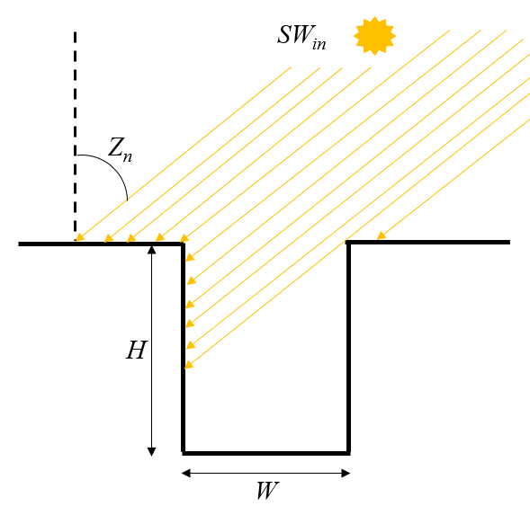
[I] Correction to the Shortwave Radiation ${SW}_{street}^{↓}$ reaching the urban surface in PX-LSM
Solar Zenith Angle keeps on changing during the daytime
Presence of Urban structure obstructs the solar radiation from reaching the ground
Urban morphological parameters will play a major role in the
distribution of
radiation on surface
$$\tan{Z_{n}}<\frac{W}{H}$$
$${SW}_{street}={SW}_{in(Dir)}↓ ∙\left[1− \left\{ \frac{H∙\tan{Z_{n}}}{W}\left|\sin\left(\frac{π}{2}−θ\right)\right| \right\} \right]$$
$${SW}_{street}=0$$
${SW}_{street}^{FNL}=\left(1−α_{r}\right) {SW}_{street}+\left(1−α_{r}\right) {SW}_{in(Dif)}$ $↓ + \left(1−α_{r}\right) \left(1−ψ_{r}\right)∙M_{w}$
$${GSW}_{urban}↓ =(U_{f}∙{SW}_{street}^{FNL})+(1−U_{f}) (1 − α)∙SOLDN$$

Slide 9
$$ψ_{r}={\left[{\left(\frac{H}{W}\right)}^{2}+1\right]}^{1/2}−\left(\frac{H}{W}\right)$$
$$ψ_{w}=\frac{\frac{1}{2}∙\left\{\left(\frac{H}{W}\right)+1 −{\left[{\left(\frac{H}{W}\right)}^{2}+1\right]}^{1/2}\right\}}{\left(\frac{H}{W}\right)}$$
$$M_{w}=\frac{ψ_{w}∙α_{w}∙R_{r}\left(0\right)}{1−\left(1−2ψ_{w}\right)α_{w}+(1−ψ_{r})ψ_{w}α_{r}α_{w}}$$
$$R_{r}\left(0\right)=α_{r}∙{SW}_{street}+α_{r}∙{SW}_{in(Dif)}↓$$

Slide 10
[II] Estimation of Urban Ground and Roof Temperatures in PX-LSM
The new model includes the prognostic equations for estimating the Urban ground (Street + Veg) and Roof temperatures based on two layer force-restore algorithm.
Latent heat fluxes from the urban street and roof are accounted for the precipitation events and from evapotranspiration from vegetation at street level
Urban Ground
Urban Roof
$$\frac{∂T_{UG}}{∂t}=C_{T}\left(R_{n}−{HF}_{UG}−{LE}_{veg}−{LE}_{street}\right)−\frac{2π}{τ}\left(T_{UG}−T_{2UG}\right)$$
$$\frac{∂T_{RF}}{∂t}=C_{T_RF}\left(R_{n}−{HF}_{RF}−{LE}_{roof}\right)−\frac{2π}{τ}\left(T_{RF}−T_{2RF}\right)$$
$$\frac{∂T_{2UG}}{∂t}=\frac{1}{τ}\left(T_{UG}−T_{2UG}\right)$$
$$\frac{∂T_{2RF}}{∂t}=\frac{1}{τ}\left(T_{RF}−T_{2RF}\right)$$
where:
$R_{n}={GSW}_{urban}↓− ϵσT_{UG}^{4}+ϵ$ $L↓$
$R_{n}=GSW↓− ϵσT_{RF}^{4}+ϵ$ $L↓$

Slide 11
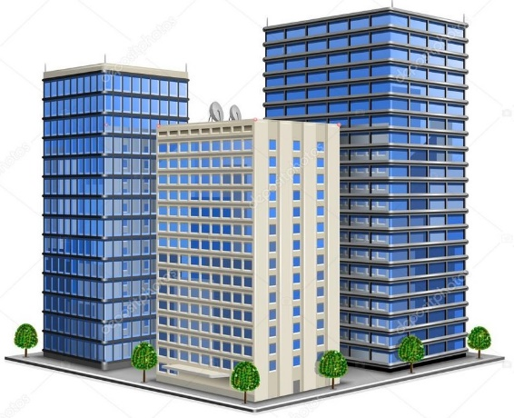
[III] Estimation of Urban Momentum and Thermal Fluxes
Momentum Flux
Sensible Heat Flux
$F_{m_Horz}=−ρu_{∗}^{2}\hat{U}=−ρ\frac{k^{2}}{{\left[\ln\left(\frac{∆z/2}{z_{0}}\right)\right]}^{2}}f_{m}\left|\overline{U}\right|\overline{U}$
$${HF}_{UG}=−ρ_{1}\left(\frac{C_{P_air} }{r_{aH}}\right) (θ_{1}−θ_{UG})$$
${HF}_{RF}=−ρ_{RF}\frac{k^{2}}{{\left[\ln\left(\frac{∆z/2}{z_{0}}\right)\right]}^{2}}\left(f_{h}\right)∙R_{F}\left|\overline{U}\right|(T_{air_RF}−T_{RF})$ $C_{P_air_RF}$
$F_{m_Vert}=−ρC_{D}\left|{\overline{U}}_{ort}\right|{\overline{U}}_{ort}$
$C_{D}$ is the drag coefficient
${\overline{U}}_{ort}$ is the wind speed vector orthogonal to the street direction
$r_{aH}$ is the aerodynamic resistance for Heat
$f_{m}$ and $f_{h}$ are scalar functions based on the atmospheric stability (taken from Louis, 1979)
$R_{F}$ is the roof fraction

Slide 12
Model Setup Configuration over the PRD Region

Slide 13
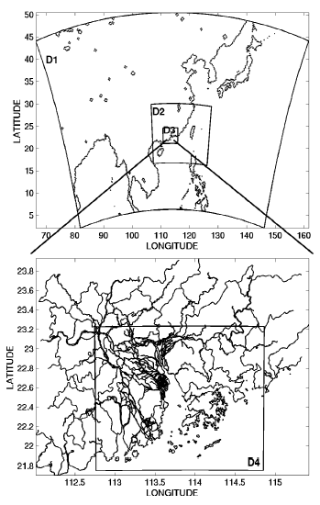
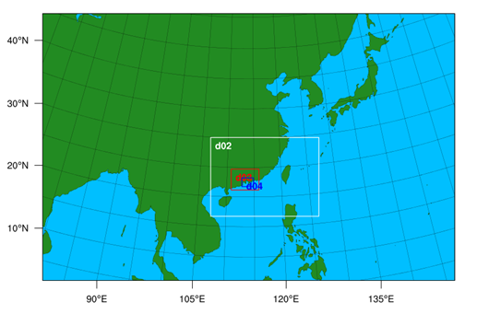
Details of Configuration Setting Used in WRF V4.0 Model
WRF V4.0 schemes and other options | Selected configuration
Sigma levels | 50 (0 m, 8 m, 17.5 m, 26.5 m, 36.5 m, 46.5 m, 57 m, ....)
Model top pressure | 50 hPa (about 20 km AGL)
Met. data (initial condition) | NCEP FNL (Final Operational Global Analysis data) with spatial resolution of 1⁰ in lat & long and temporal resolution of 6-hrs
Nested domain resolution | D1(27 km), D2(9 km), D3(3 km), D4(1 km)
Surface layer physics | Pleim-Xiu (D1-D4)
Surface physics | Pleim-Xiu scheme (D1-D3) New Urban Pleim-Xiu (uPX) scheme only at D4
PBL physics | ACM2 (Pleim) scheme (D1-D3), New Urban-ACM (uACM) scheme only at D4
No. of soil layers | 2 (for Pleim-Xiu)
No. of land categories | 24 (USGS)
Coarse domain time step | 60 sec (1:3 Parent time step ratio for nested domains)
Surface urban physics | Off (D1-D4)
Domains Setup

Slide 14
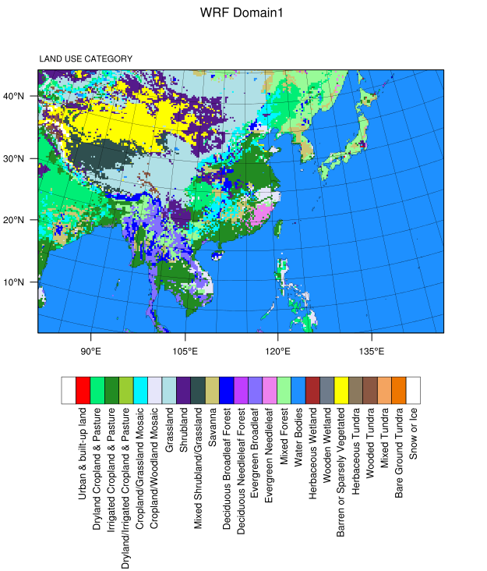
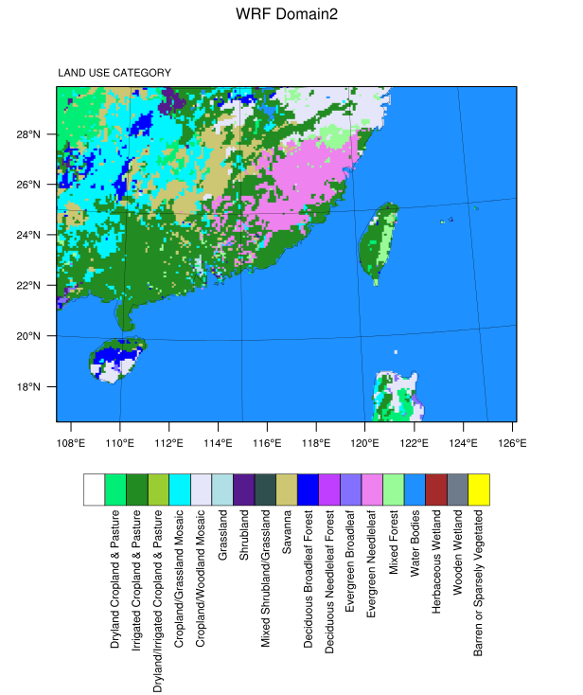
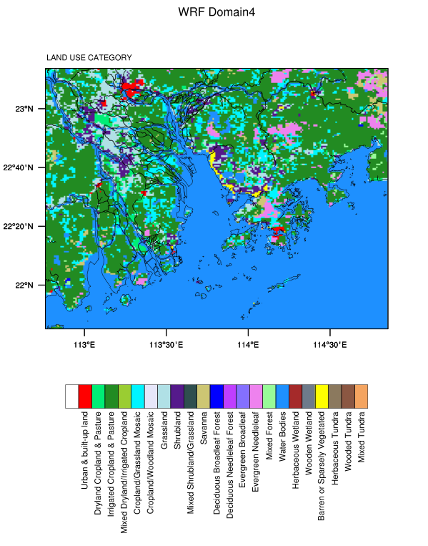
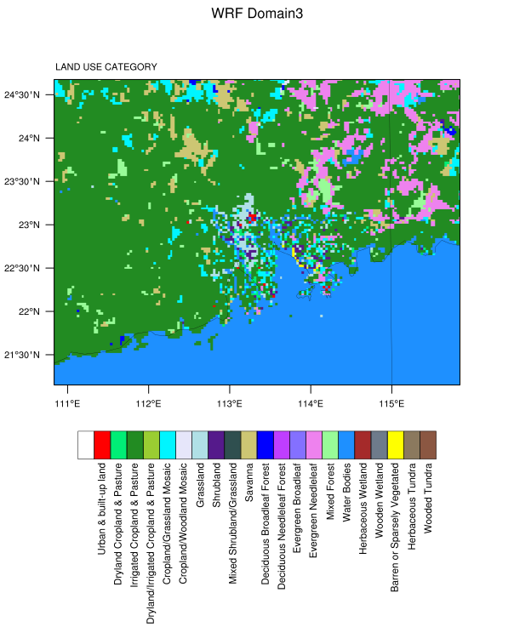
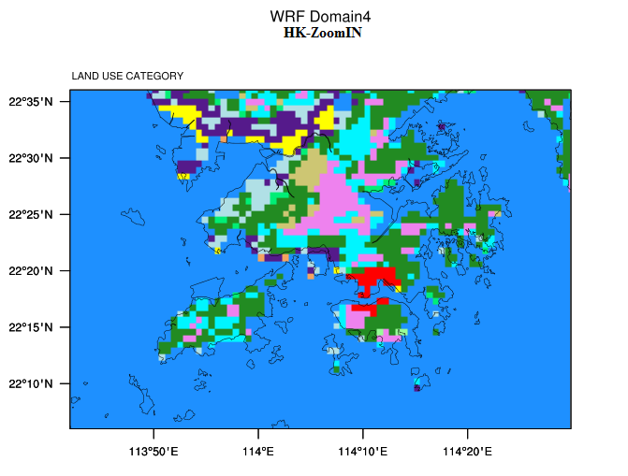
Default USGS-24 Landuse Category Plots Used for Basic-ACM Run
Domain1
Domain2
Domain4
The Default Landuse has only few Urban in the Domain4
Domain3
Hong Kong in Domain4

Slide 15
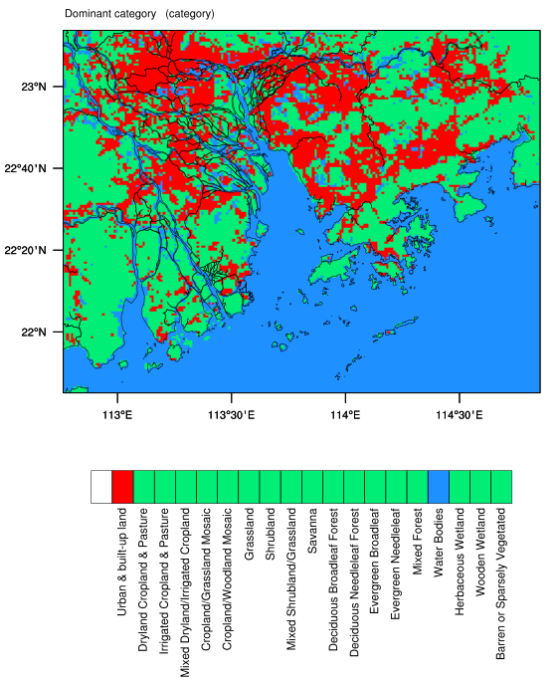
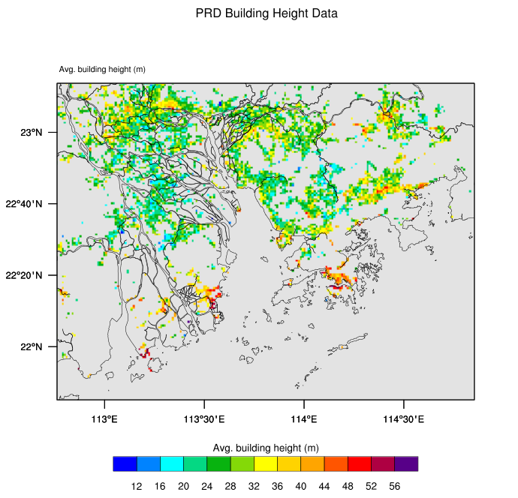
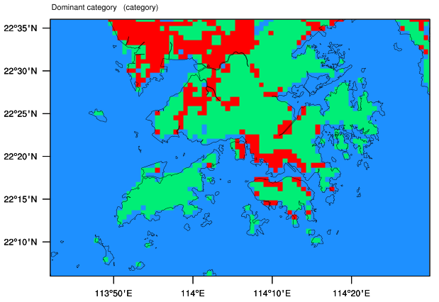
WUDAPT Landuse Category Domain4 Plot Used for Urban-ACM Run
Landuse Showing Urban Areas
Landuse Based upon 2010 WUDAPT Data
Avg. Building Height (m)
Dominant Urban in HK

Slide 16
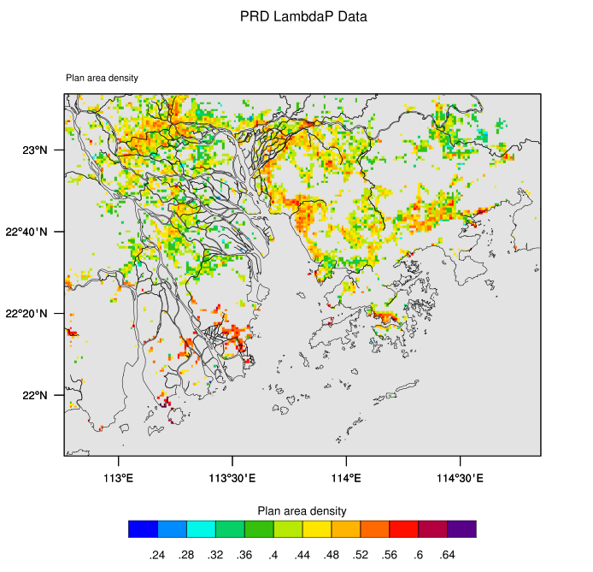
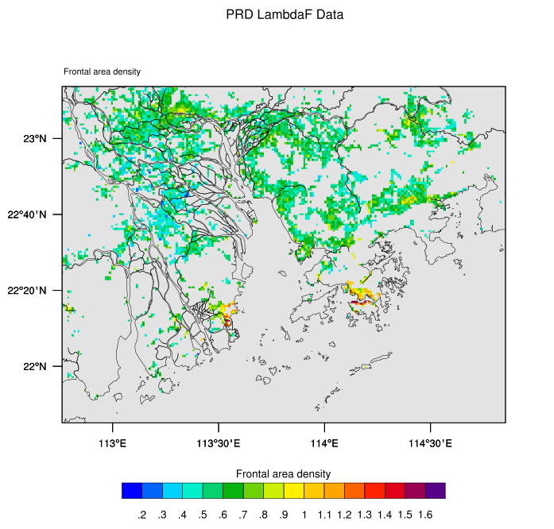
Urban Morphological Parameters Dataset for the PRD Region
Based upon 2010 WUDAPT Data
Avg. Building Height (m) Plan Area Density Frontal Area Density

Slide 17
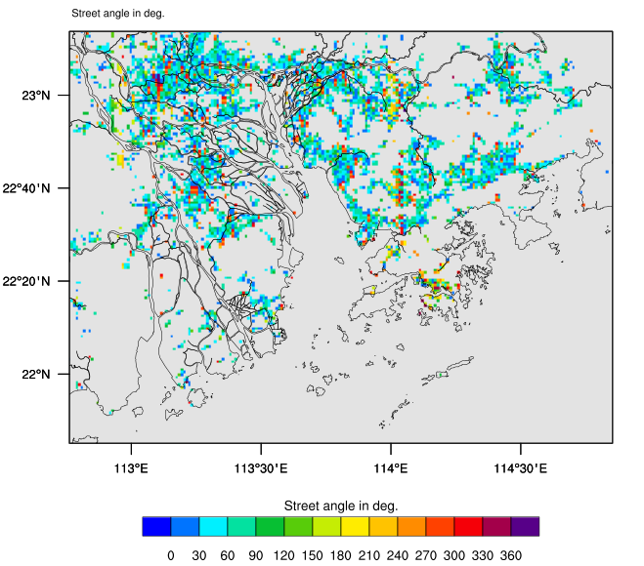
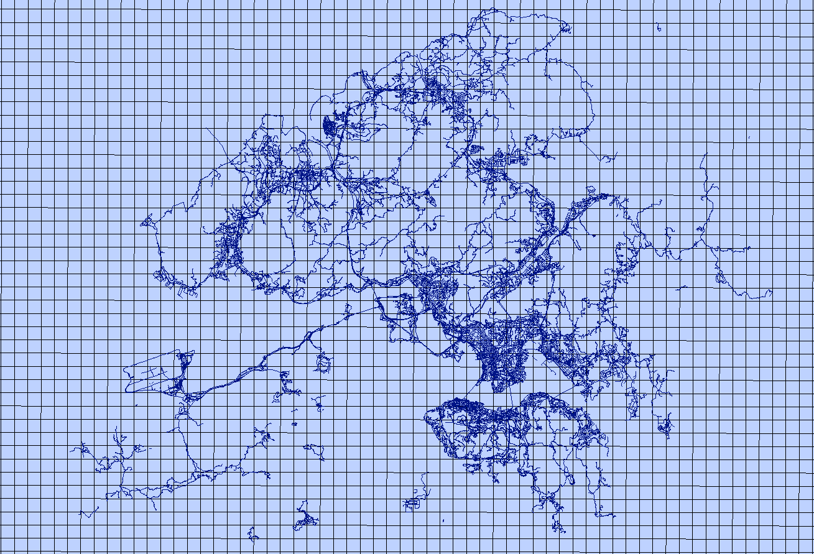
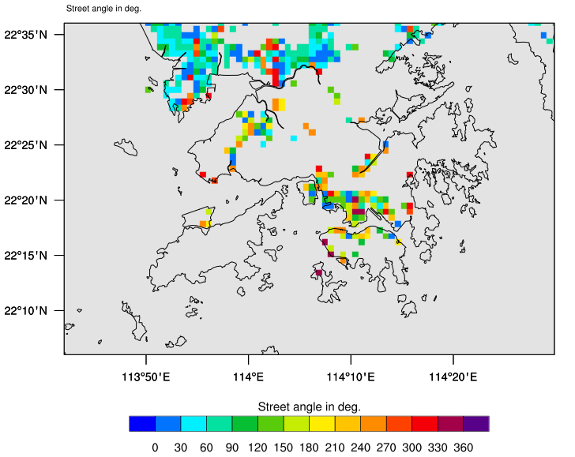
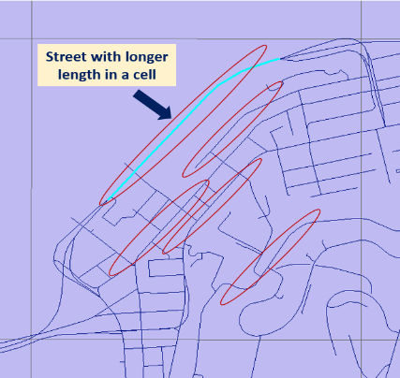
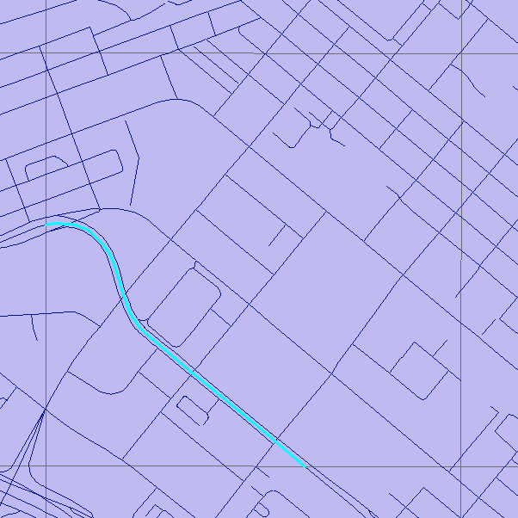
Obtaining Dominant Street Angle Information at each 1km x 1km grid cell
Street Distribution in Hong Kong
Street canyons with longer length

Slide 18
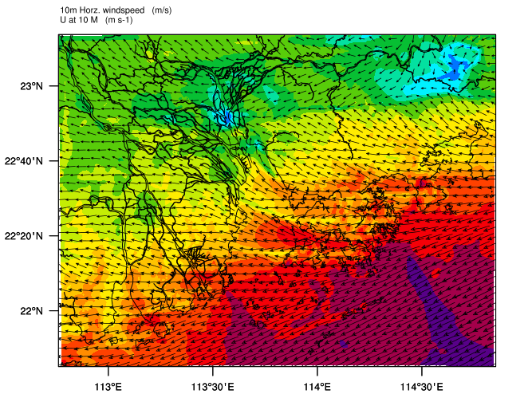
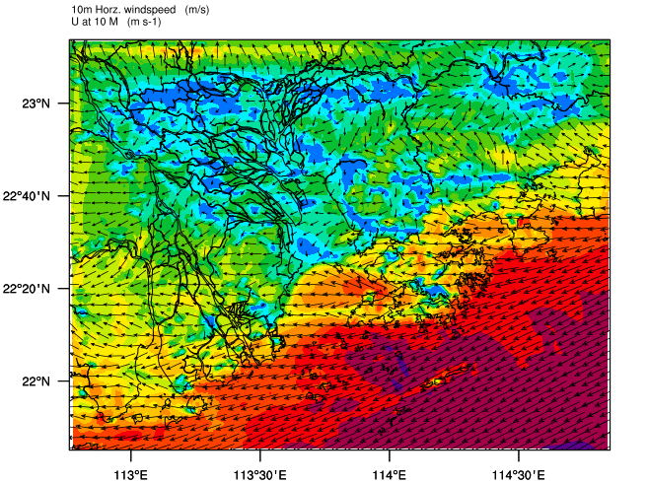
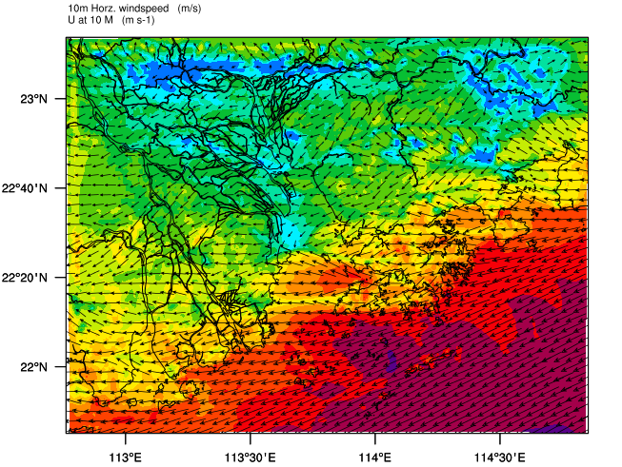
[I] 10m-WSP (m/s) Basic-ACM and Urban-ACM Plots over PRD on 29th March 2010
06 UTC (14 LT)
Basic-ACM Urban-ACM [0° st. angle] Urban-ACM [45° st. angle]
Change of street angle affects the wind speed magnitude and direction both

Slide 19
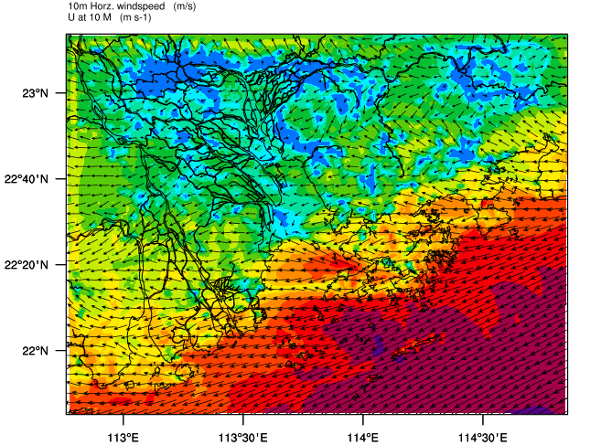
[II] 10m-WSP (m/s) Basic-ACM and Urban-ACM Plots over PRD on 29th March 2010
06 UTC (14 LT)
Basic-ACM Urban-ACM [0° st. angle] Urban-ACM [RNDM st. angle]
Change of street angle affects the wind speed magnitude and direction both

Slide 20
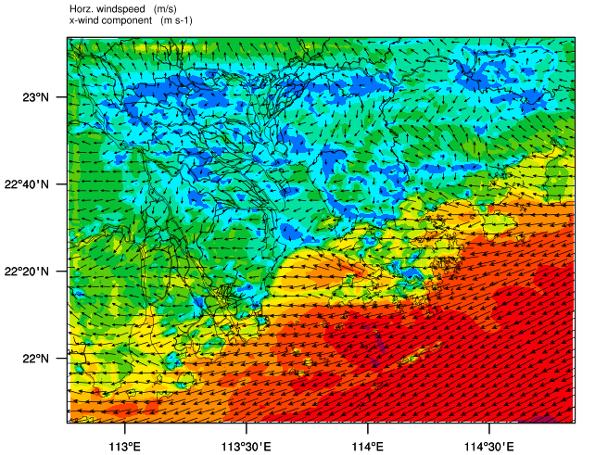
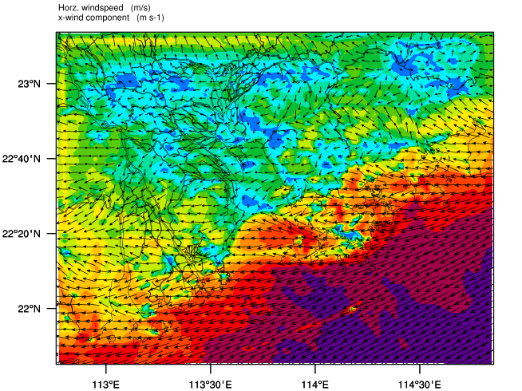
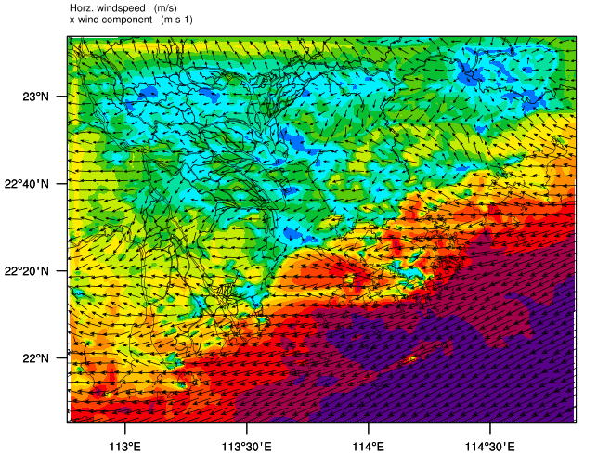
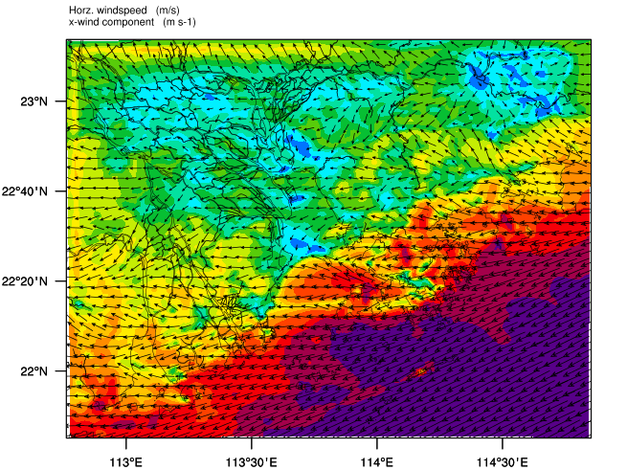
[III] 10m-WSP (m/s) Urban-ACM Plots [0°] st. angle vertical height comparison over PRD
on 29th March 2010
4 m 22 m
06 UTC (14 LT)
Wind speed increases with the increase of height above ground
Wind direction changes too with the height
31.5 m 51.5 m

Slide 21
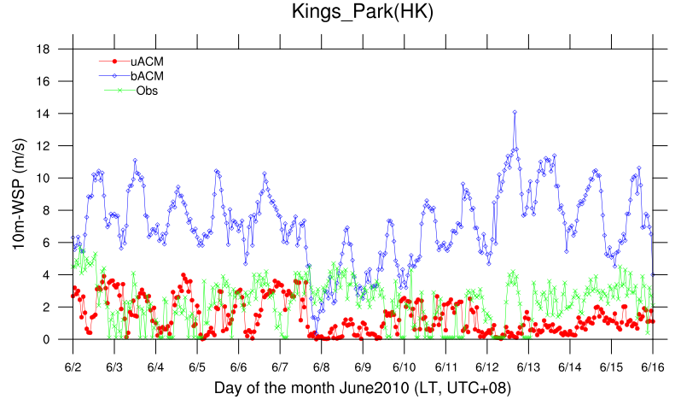
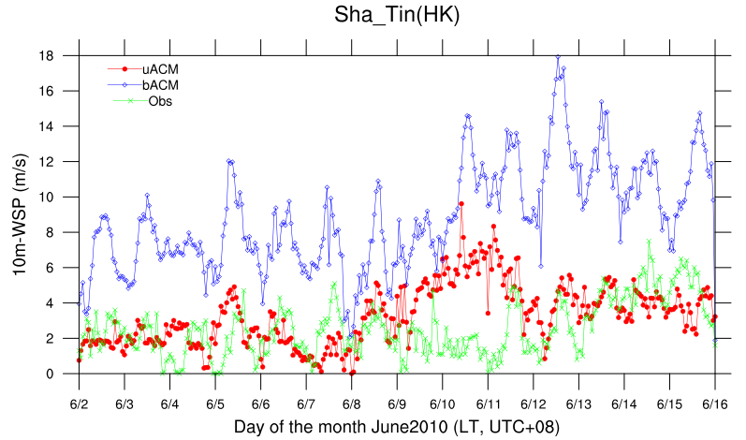
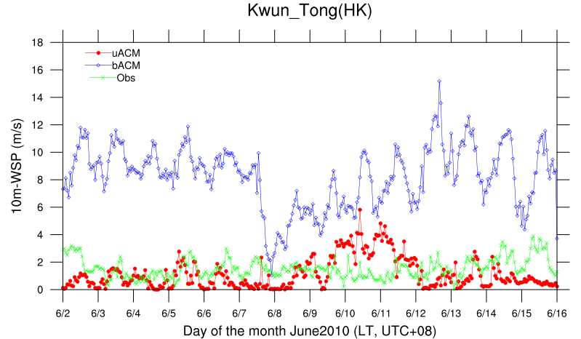
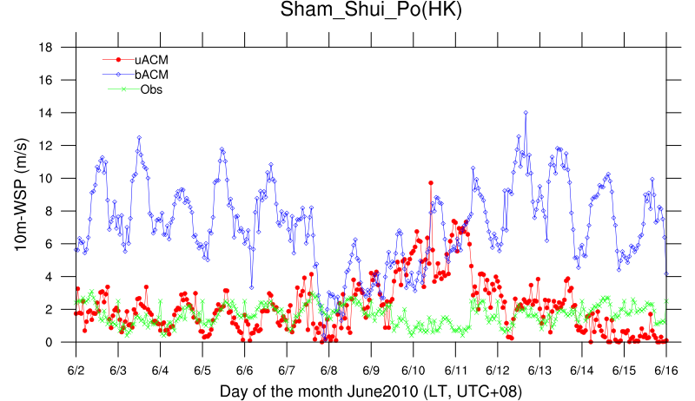
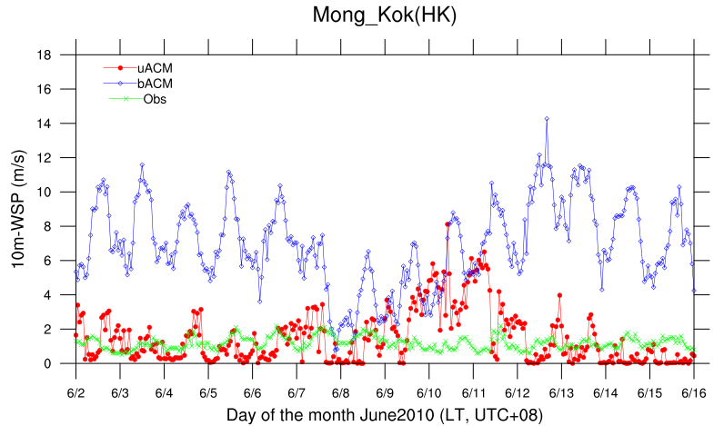
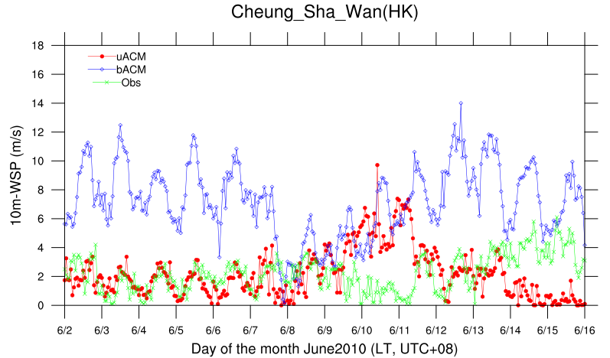
10m-WSPD

Slide 22
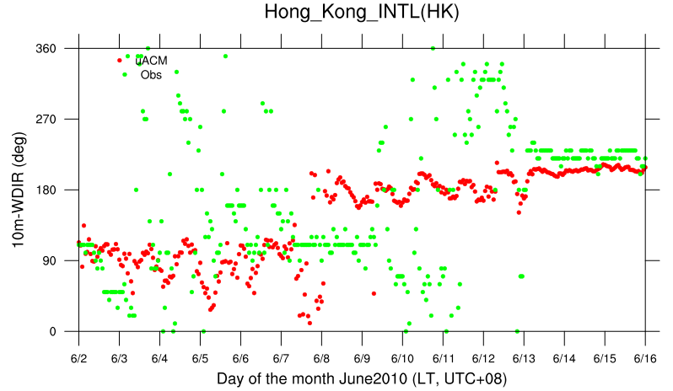
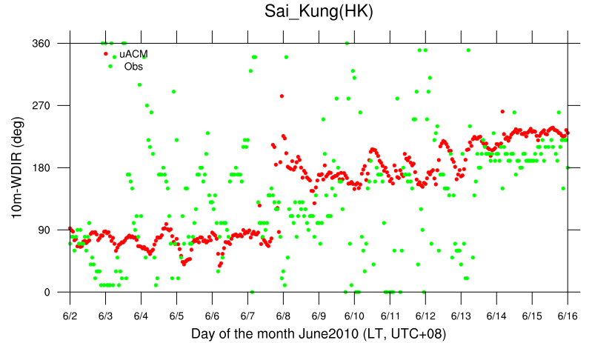
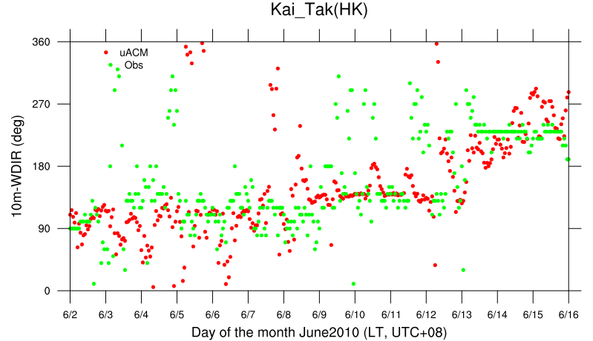
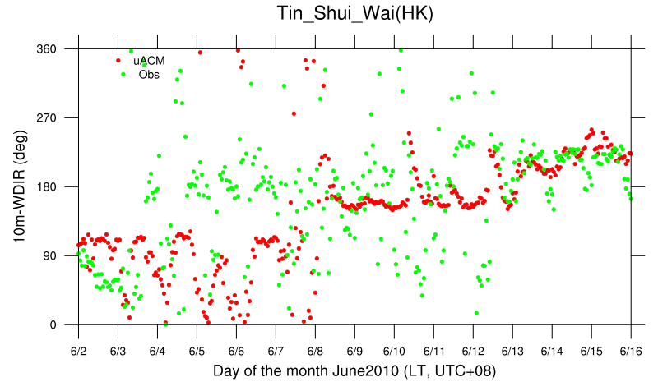
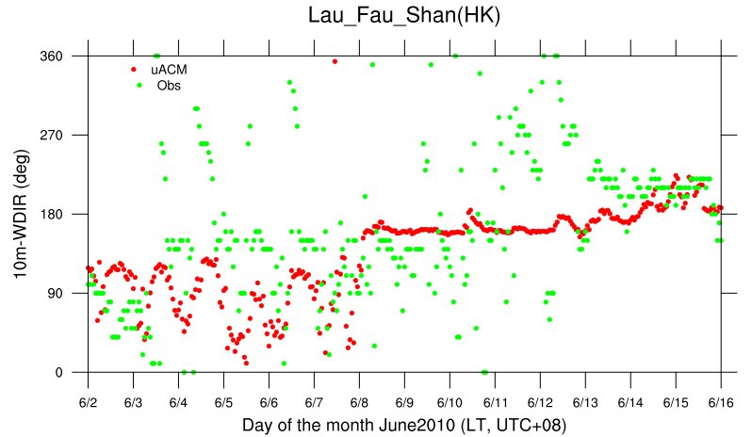
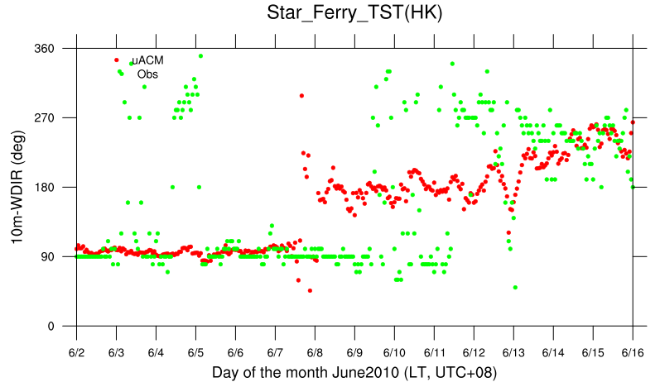
10m-WDIR

Slide 23
WITH ONLY DENSE URBAN IN HONG KONG
Hong Kong Dense Urban Region was considered as shown with the Purple transparent rectangle in the plot (Black dots represents HK Meteorology Stations)
Vertical Plots of Horizontal wind-speed are plotted averaged at 87 urban cells at time 06 UTC.

Slide 24
[IV] Vertical Profiles Averaged over 87 Urban Grid Cells in Hong Kong
29th Mar 2010, 02PM
The horizontal windspeed was reduced by greater extent near to the surface
Inflection point is observed in the curve at Urban Rooftop height
Horizontal Windspeed

Slide 25
[V] Time-Series of Urban Rooftop and Ground heat fluxes in June 2010 in PRD Region
Urban Rooftop
Urban Ground
Non-Urban Ground
Urban Rooftop Heat Fluxes are larger than the Ground

Slide 26
[VI] Time-Series of Urban Rooftop and Ground Temperature in June 2010 in PRD Region
Urban Rooftop
Urban Ground
Non-Urban Ground
Urban Rooftop Temperatures are higher than the Urban Ground

Slide 27
[VII] Vertical Profiles of Potential Temperature at Urban Location on 1st June 2010
10 AM
02 PM
04 PM
09 PM
03 AM
Urban Ground is cooler in the morning with stable profile
At Nighttime the ground is slightly warmer with profiles remaining isothermal

Slide 28
Conclusions
The newly developed Urban-PX and Urban-ACM2 scheme is able to represent the urban phenomenon with less number of Urban parameters and within less computational time.
The meteorological field variables such as Wind speed and Potential temperature are sensitive to the urban parameters such as Avg. building height, Plan area density, Frontal area density and Street angle data etc.
The vertical profiles of the Horizontal wind speed and Potential Temperature were obtained as expected when compared with the theoretical basis.
The Urban ground temperature and the Rooftop Temperature profiles have shown a diurnal variation along with the heat fluxes.

Slide 29
Objectives
To develop Urban Rooftop convection in the Urban-ACM model
To incorporate the anthropogenic fluxes in the model
To compare the modelled 2m-Temperature time series with the meteorological station observation data in Hong Kong for different seasons along with statistical model evaluation
To compare the modelled Planetary Boundary Layer (PBL) height with the observation data at Hong Kong
To check the newly developed model’s performance for determining the air pollutant dispersion in the city areas

