Slide 1
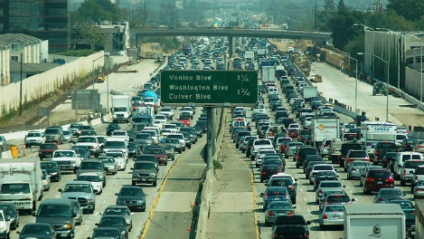
Hybrid Modeling to Estimate Near-Road Pollutant Concentrations and Exposures
Fatema Parvez, KRISTINA WAGSTROM
University of Connecticut
ACKNOWLEDGEMENTS: Computing Resources: UConn Booth Engineering Center for Advanced Technology
Funding: NSF CAREER Award #1752231, Eversource Energy Assistant Professorship for Environmental Engineering Education

Slide 2
Objective
Provide improved estimates of ambient air pollutant concentrations for use in exposure estimation.
regional + local = total
CAMx
RLINE
double counting
spatiotemporal resolution
computational and data expense
chemistry

Slide 3
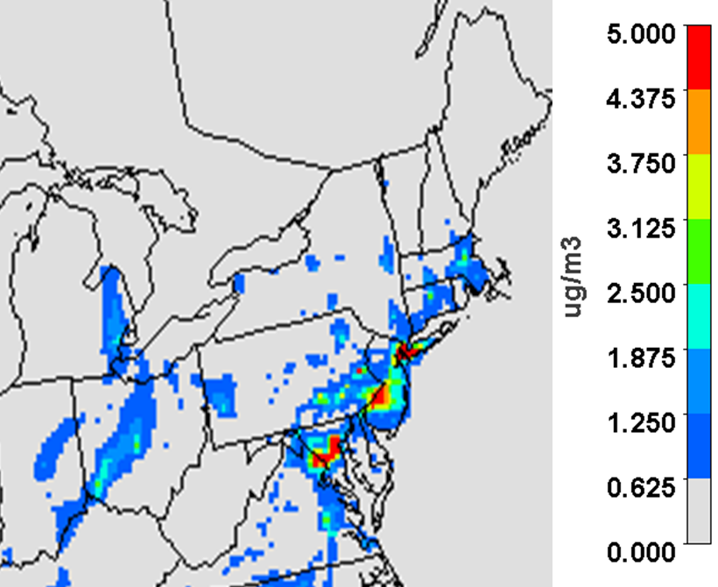
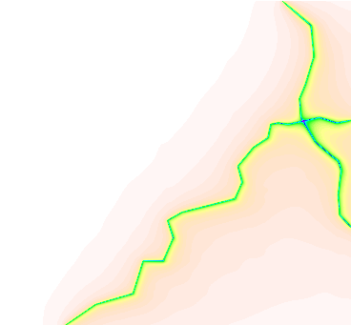
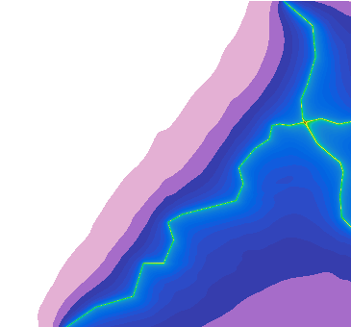
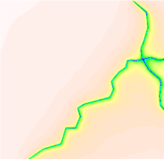
CAMx
Local Onroad Contribution
Regional Concentration
RLINE
Hybrid
TRAP Concentrations
Normalized TRAP Proxy
Updated TRAP
Spatiotemporal Concentration
Final
Population and Activity Data
Exposure
TRAP = Traffic-Related Air Pollution

Slide 4
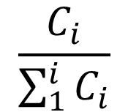
Simplified, Illustrative Example
3 µg/m³
2 µg/m³
1 µg/m³
CAMx PSAT
Local Onroad Contribution
Regional Concentration
Regional
Hybrid
RLINE
Hybrid
TRAP Concentrations
Normalized TRAP Proxy
Updated TRAP
Spatiotemporal Concentration
2 µg/m³
3 µg/m³
20%
30%
1.6
µg/m³
2.4
µg/m³
2.6
µg/m³
3.4
µg/m³
$$\frac{C_{i}}{\sum_{1}^{i}{C_{i}}}$$
2.4
µg/m³
1.6
µg/m³
3.4
µg/m³
2.6
µg/m³
3 µg/m³
2 µg/m³
30%
20%

Slide 5
CAMx
Local Onroad Contribution
Regional Concentration
RLINE
Hybrid
TRAP Concentrations
Normalized TRAP Proxy
Updated TRAP
Spatiotemporal Concentration
Final
Population and Activity Data
Exposure
TRAP = Traffic-Related Air Pollution

Slide 6
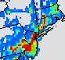
Regional Contribution
CAMx with PSAT
Local Onroad Contribution
Regional Concentration
CAMx: Chemical transport model
PSAT: Particulate Matter Source Apportionment Technology
Spatial Domain: Northeastern US
Spatial Resolution: 12 x 12 km
Temporal Domain: 2011
Temporal Resolution: Hourly
Result: Hourly regional and local onroad concentrations at 12km for all species

Slide 7
CAMx
Local Onroad Contribution
Regional Concentration
RLINE
Hybrid
TRAP Concentrations
Normalized TRAP Proxy
Updated TRAP
Spatiotemporal Concentration
Final
Population and Activity Data
Exposure
TRAP = Traffic-Related Air Pollution

Slide 8
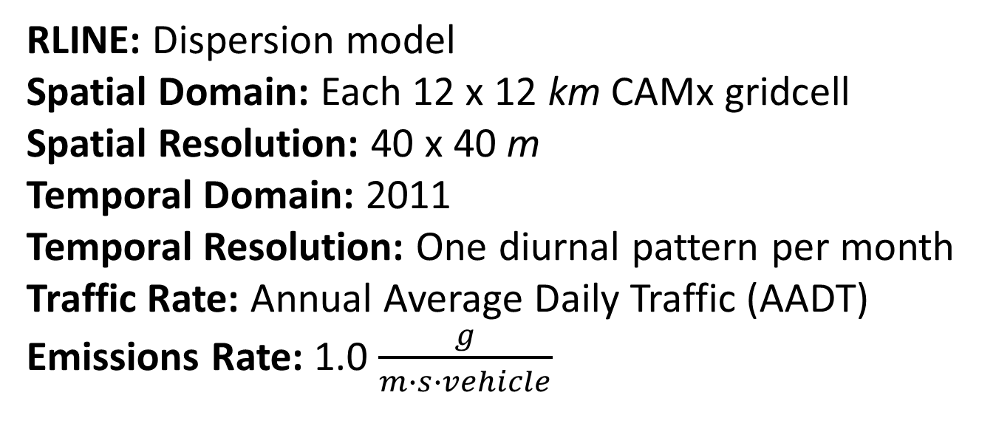
Local Contribution
TRAP Concentrations
Normalized TRAP Proxy
RLINE
RLINE: Dispersion model
Spatial Domain: Each 12 x 12 km CAMx gridcell
Spatial Resolution: 40 x 40 m
Temporal Domain: 2011
Temporal Resolution: One diurnal pattern per month
Traffic Rate: Annual Average Daily Traffic (AADT)
Emissions Rate: 1.0 $\frac{g}{m∙s∙vehicle}$
Result: 288 hourly spatial proxies at 40m for a generic species
TRAP = Traffic-Related Air Pollution

Slide 9
CAMx
Local Onroad Contribution
Regional Concentration
RLINE
Hybrid
TRAP Concentrations
Normalized TRAP Proxy
Updated TRAP
Spatiotemporal Concentration
Final
Population and Activity Data
Exposure
TRAP = Traffic-Related Air Pollution

Slide 10
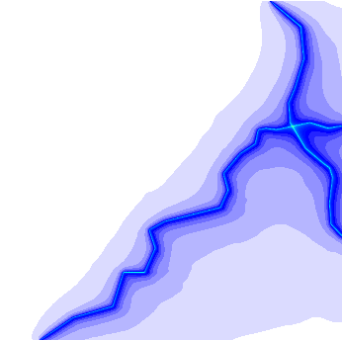
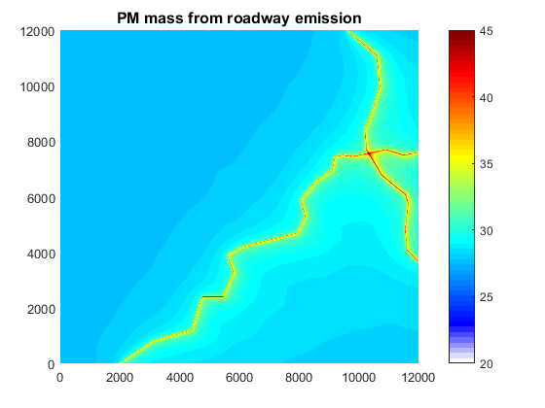
Combined Contribution
CAMx
Local Onroad Contribution
Regional Concentration
Hourly, 12000m
Hourly, 12000m
Hybrid
Normalized TRAP Proxy
Updated TRAP
Spatiotemporal Concentration
Hourly proxies, 40m
Hourly TRAP, 40m
Hourly total, 40m
Result: Hourly total concentrations at 40m for all species.
TRAP = Traffic-Related Air Pollution

Slide 11
New Haven, CT

Slide 12

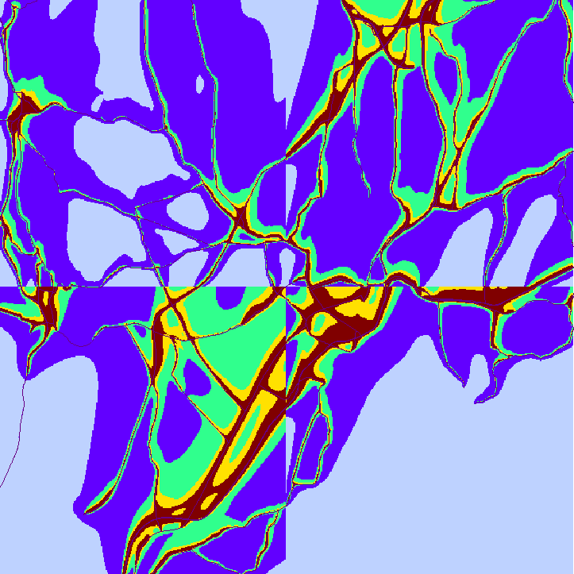
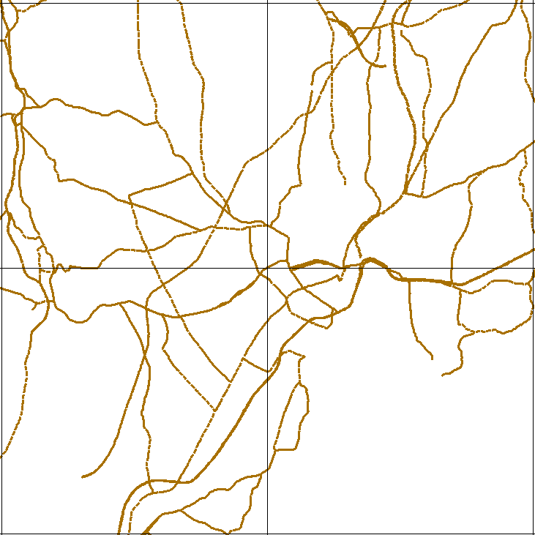
CAMx Only
24 km
ppb
>50
40
30
20
10
Summer - New Haven, CT

Slide 13
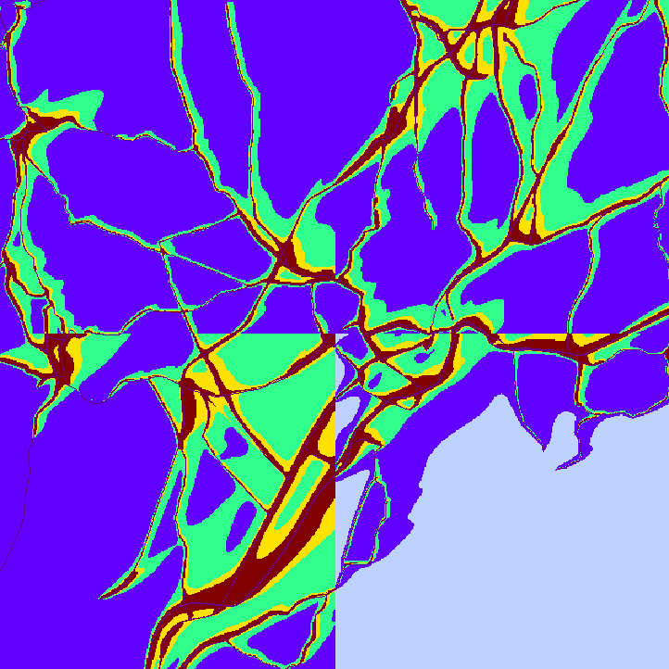
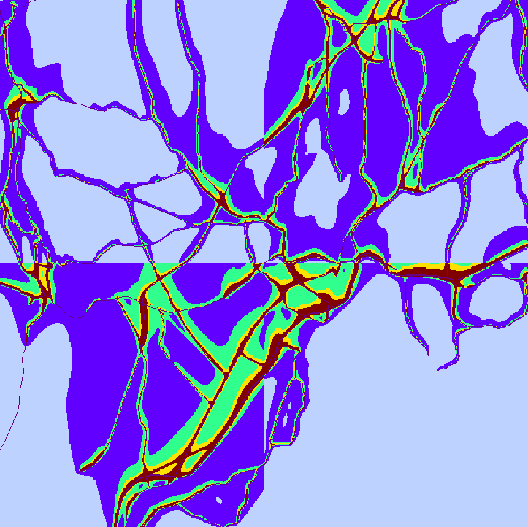
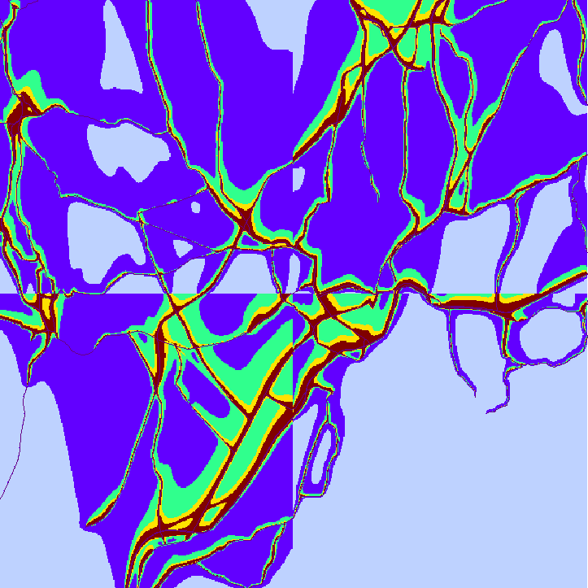
NOx Concentrations
Winter
Spring
Significant seasonal variation:
Winter highest
Fall and Spring lowest
ppb
>50
40
30
Summer
Fall
20
10
New Haven, CT

Slide 14
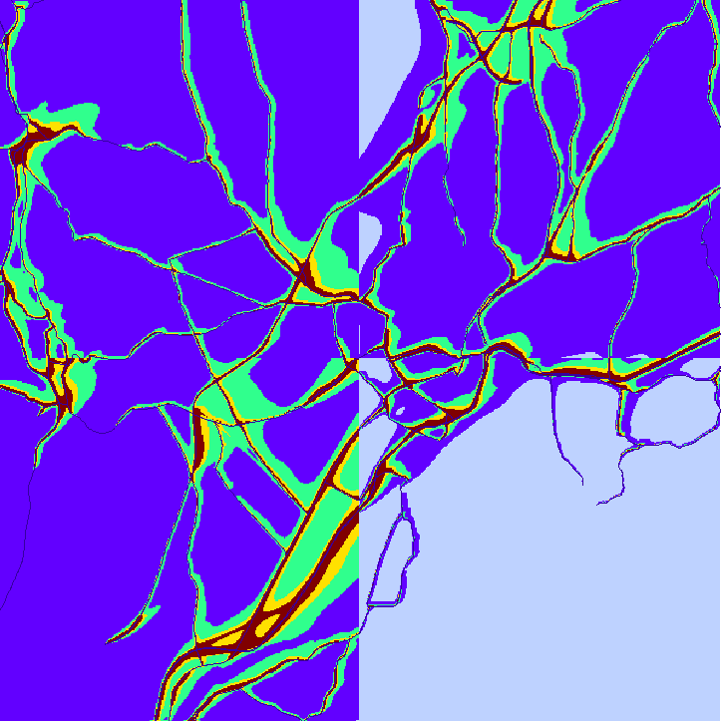
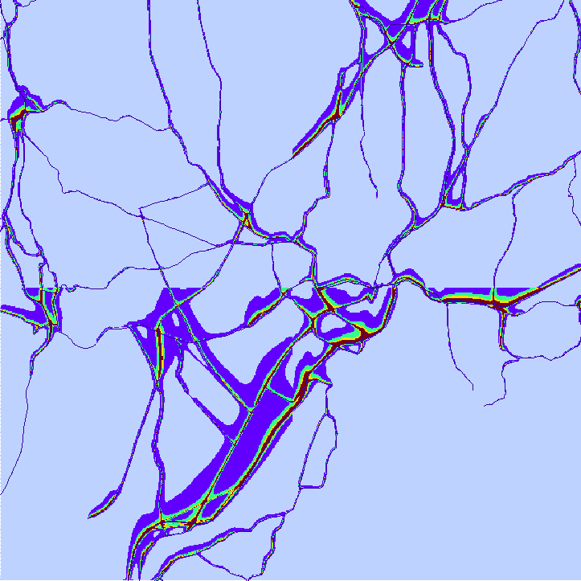
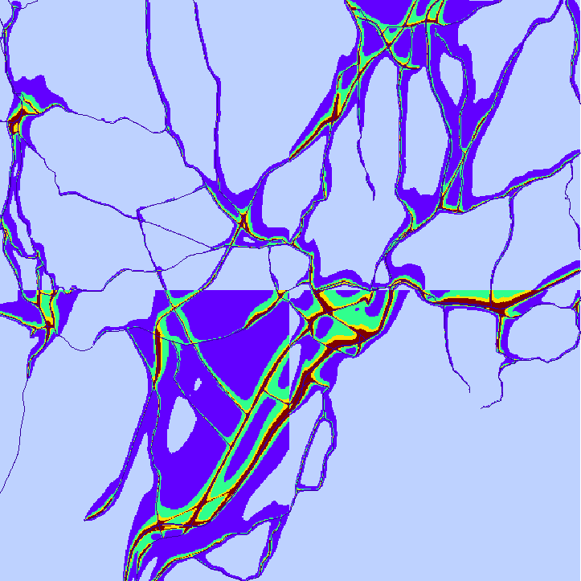
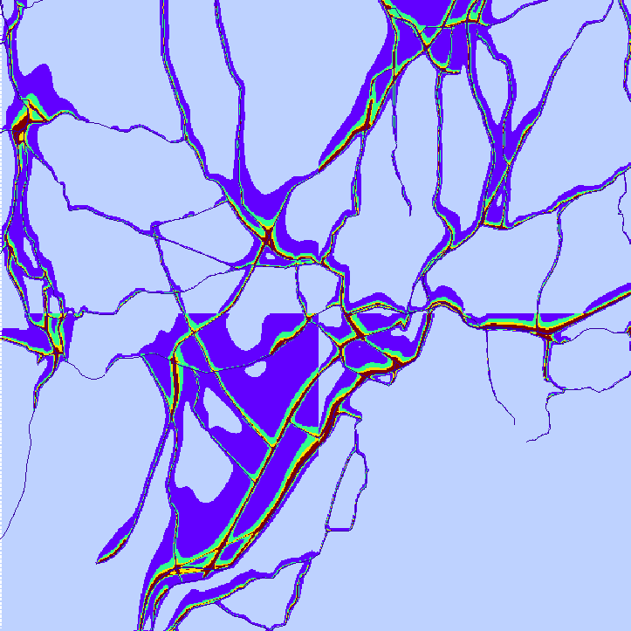
Elemental Carbon (EC) Concentrations
Winter
Spring
Seasonal variation is even more substantial for particulate matter
µg/m³
>3.0
2.5
2.0
Summer
Fall
1.5
1.0
New Haven, CT

Slide 15
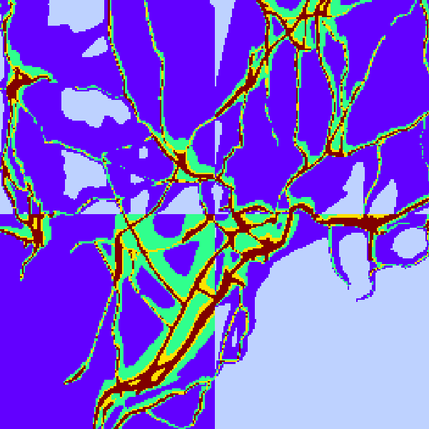
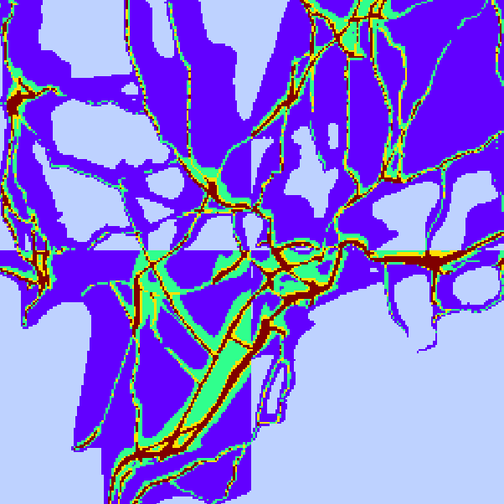
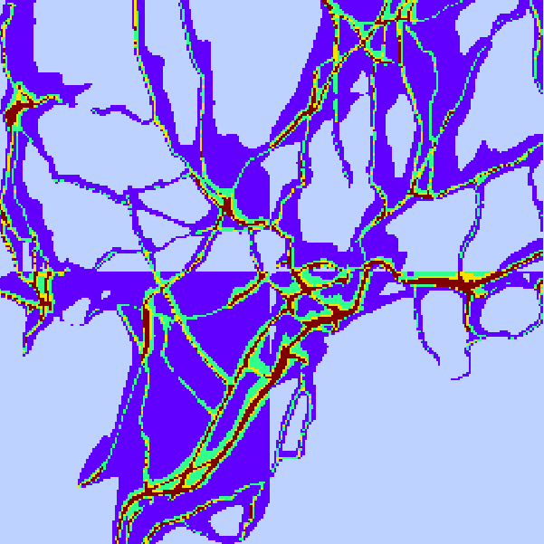
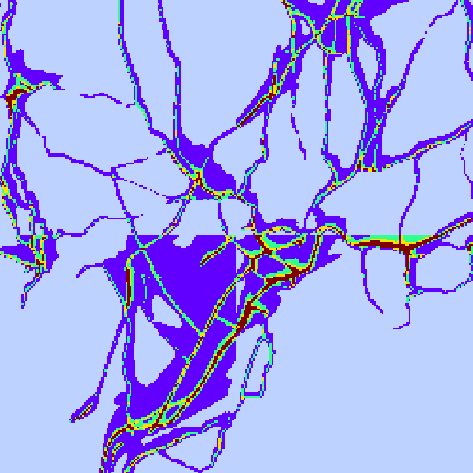
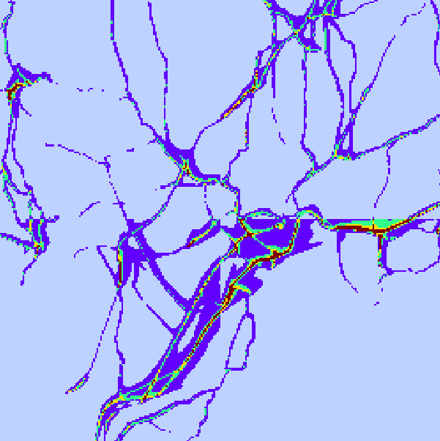
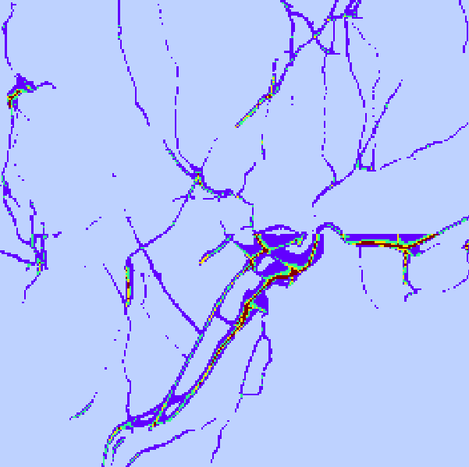
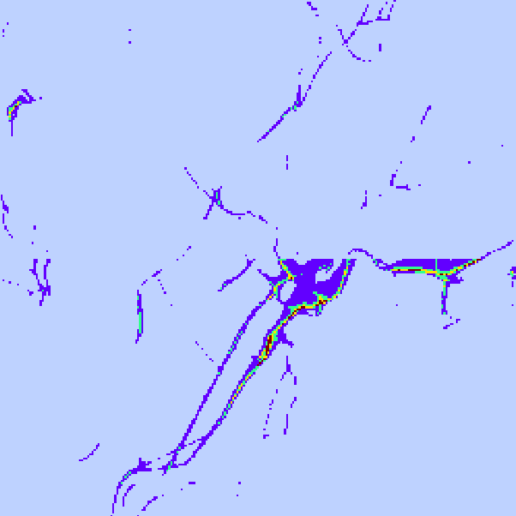
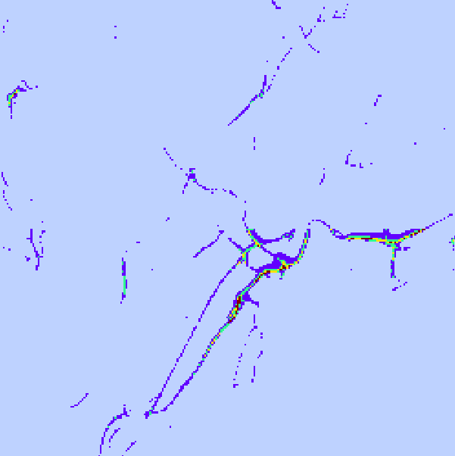
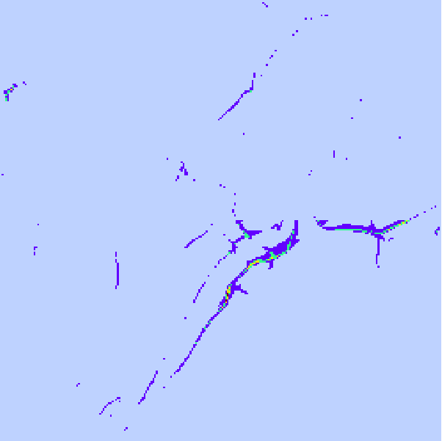
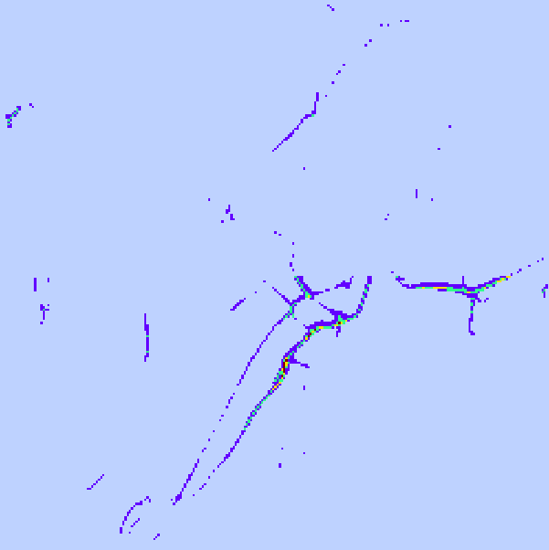
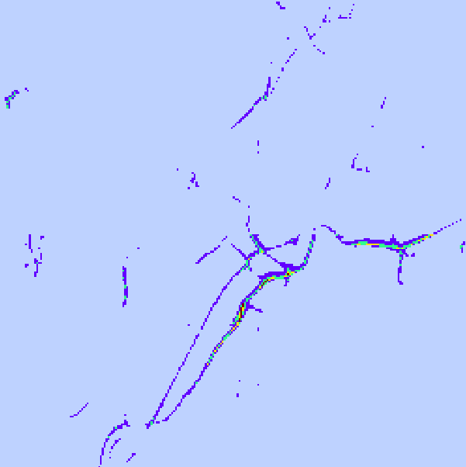

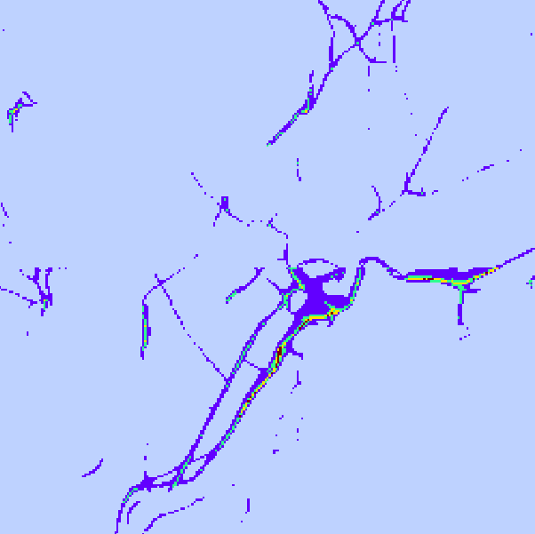
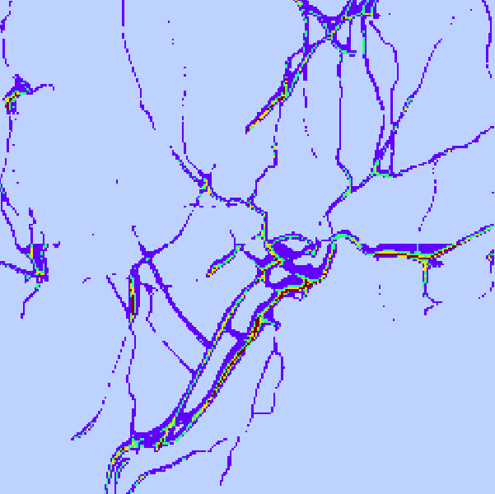
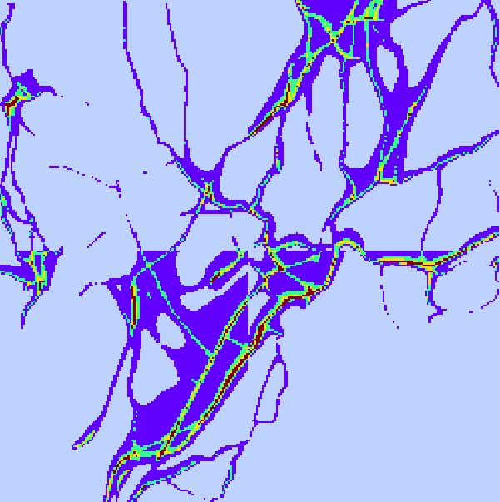
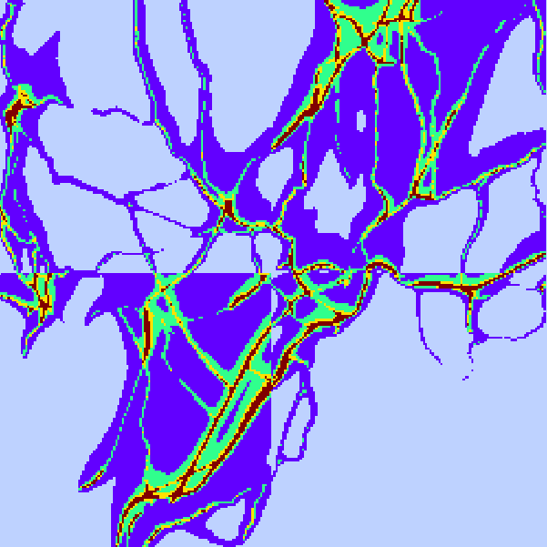
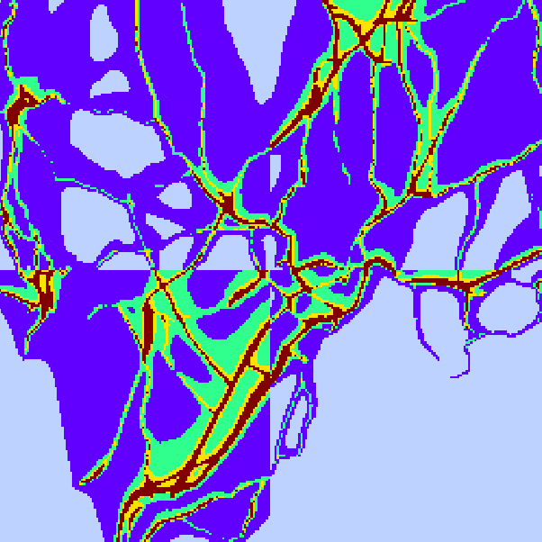
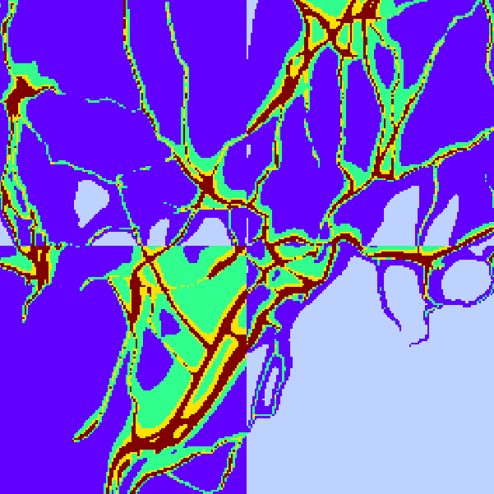
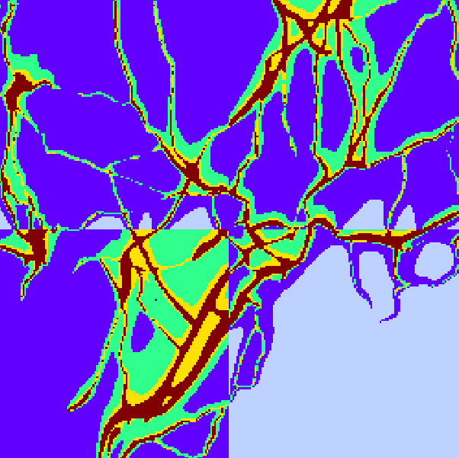
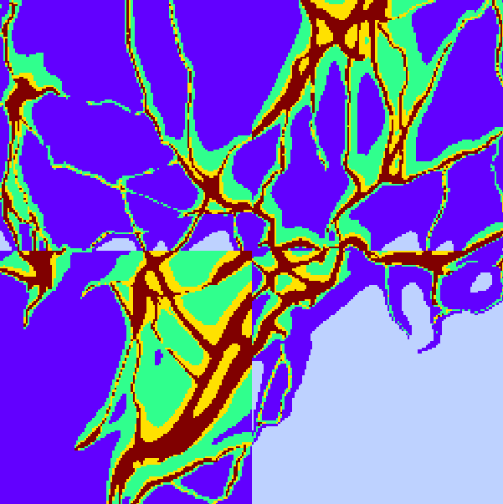
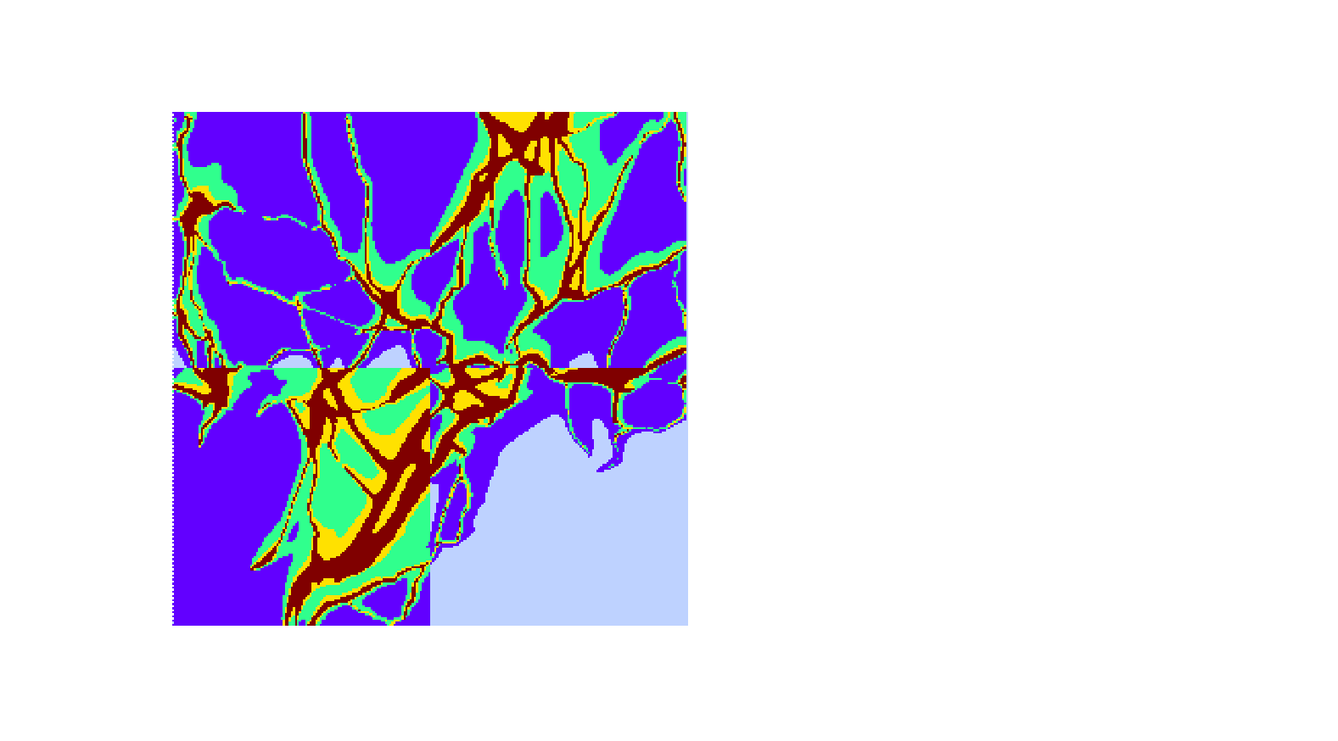

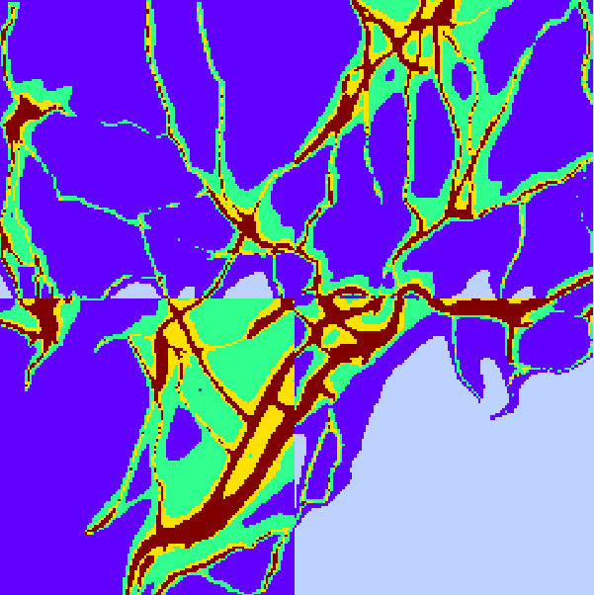
NOx Temporal Variability
1:00
2:00
3:00
4:00
5:00
6:00
7:00
8:00
9:00
10:00
11:00
12:00
ppb
Strong diurnal variability
>75
60
45
13:00
14:00
15:00
16:00
17:00
18:00
30
15
19:00
20:00
21:00
22:00
23:00
24:00
New Haven, CT
January

Slide 16
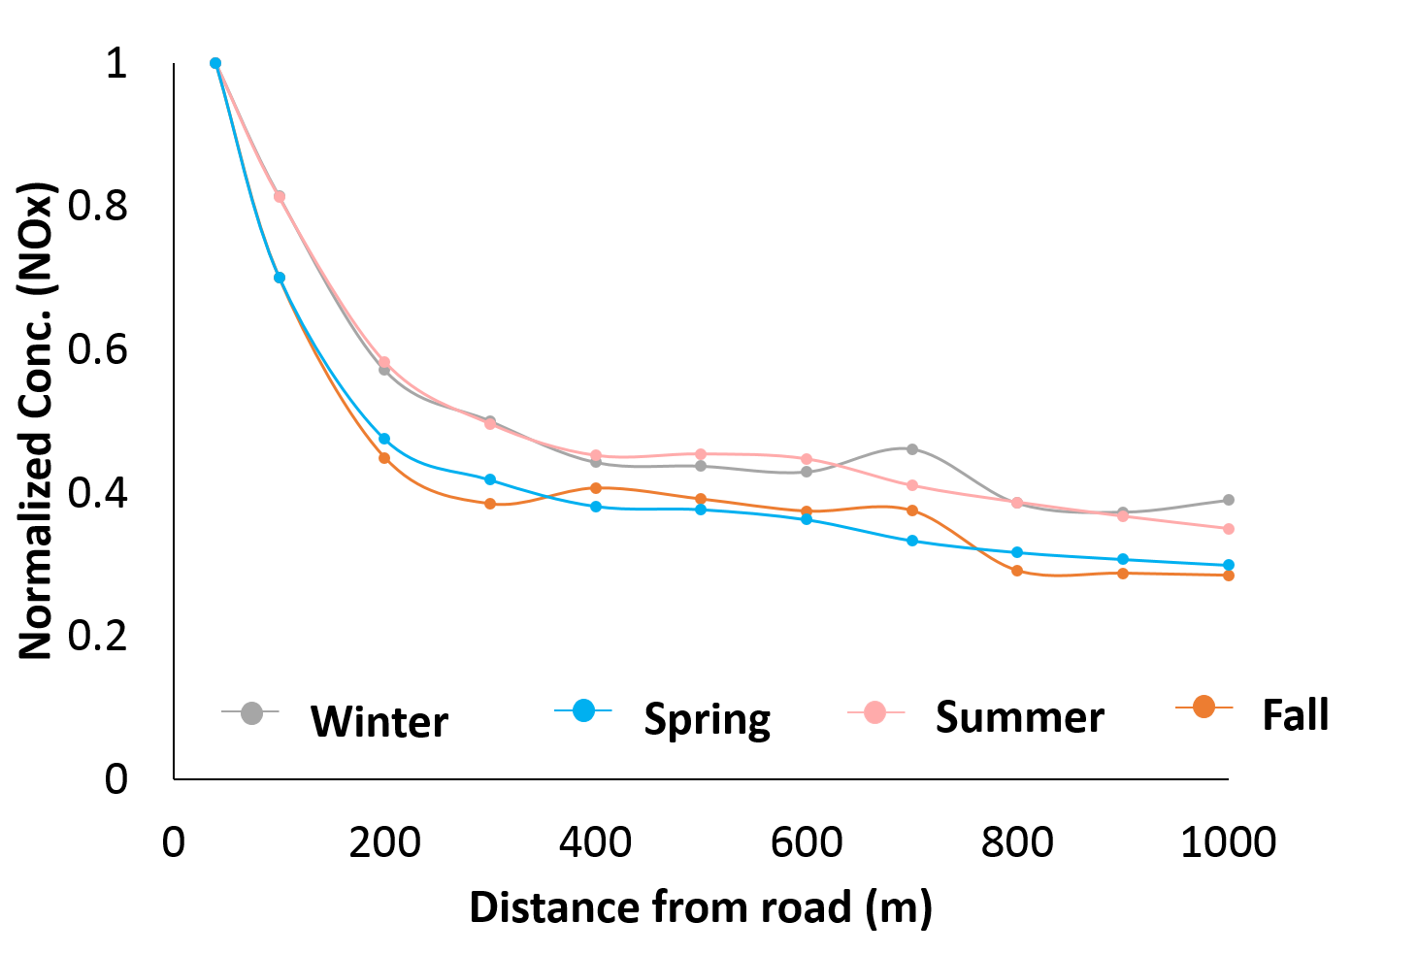
NOx Near Road Concentration Gradient
Reaches background by 400m
New Haven, CT

Slide 17
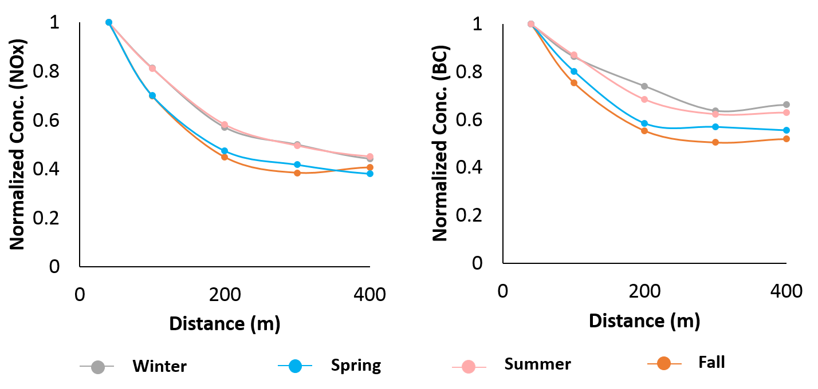
Near Road Concentration Gradients
Still represents the differences between species
New Haven, CT

Slide 18
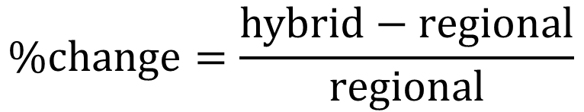
Change in Population-Weighted Concentration
$$\%change=\frac{hybrid−regional}{regional}$$
New Haven
Hartford
Potential for increased exposure estimates to PM_{2.5}

Slide 19
Model Evaluation for NO₂ – New Haven
Satellite-Based Estimates:
Berkeley High-Resolution (BEHR v3.0A) OMI NO₂: Russel et al. (2011) ACP
Land Use Regression Estimates:
Census Block Level: Bechle et al. (2015) ES&T
Reasonable alignment with other estimates

Slide 20
Exposure
CAMx
Local Onroad Contribution
Regional Concentration
RLINE
Hybrid
TRAP Concentrations
Normalized TRAP Proxy
Updated TRAP
Spatiotemporal Concentration
Final
Population and Activity Data
Exposure
TRAP = Traffic-Related Air Pollution

Slide 21
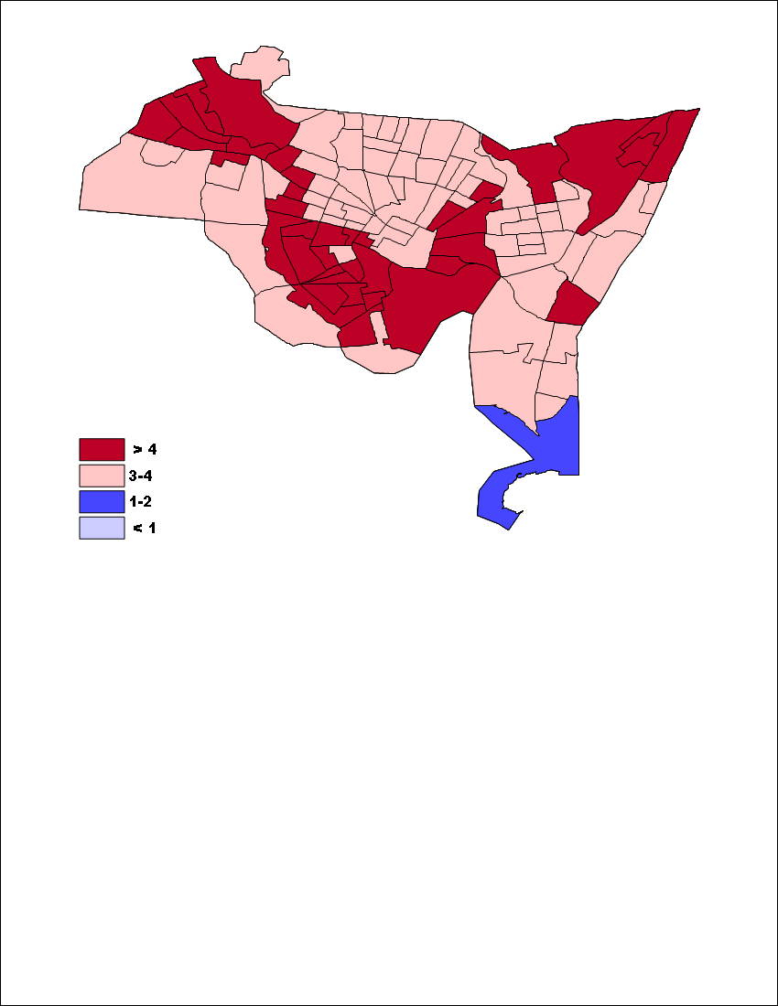
Change in estimate of All Cause Mortality (25-99)
Change = Hybrid - Regional
Increased spatial variability leads to increases in the estimated all cause mortality throughout the city.
Total Increase: 40 deaths
BenMAP-CE: Laden et al. (2006)
Similar results using Pope et al. (2002)
per 10,000

Slide 22
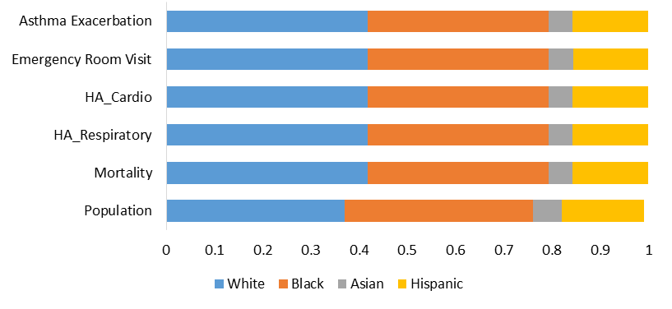
Demographic Specific Impacts (New Haven)

Slide 23
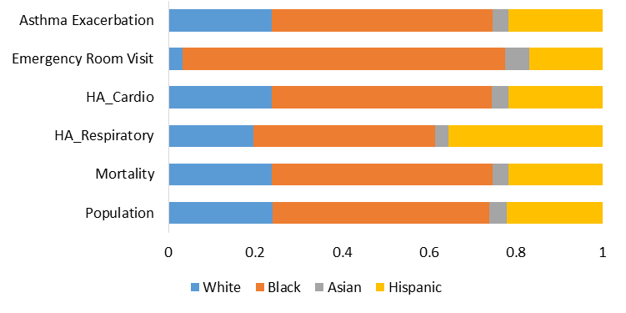
Demographic Specific Impacts (Hartford)

Slide 24
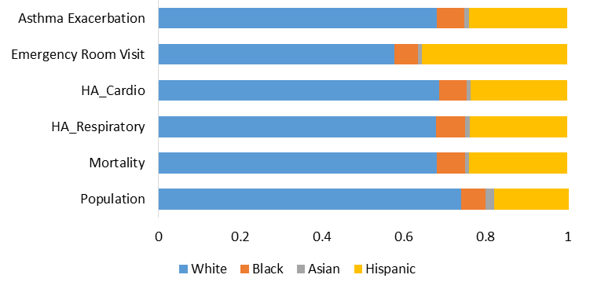
Demographic Specific Impacts (Willimantic)

Slide 25
Take Home Points
This approach provides spatiotemporal estimates of a wide number of pollutants accounting for some chemistry without double counting or undue computational and data burden.
Winter exhibits the highest concentrations for PM_{2.5}.
Fall and Spring exhibit the highest spread.
Concentrations reach background by ~400m.
Estimates align well with existing estimates.
Accounting for the increased spatial variability resulted in overall higher estimates of negative health impacts.
Parvez, F., Wagstrom, K. A hybrid modeling framework to estimate pollutant concentrations and exposure in near road environments. Submitted.

Slide 26
Acknowledgements
Co-author: Fatema Parvez
Computing Resources:
University of Connecticut Booth Engineering Center for Advanced Technology
Funding:
National Science Foundation CAREER Award #1752231
Eversource Assistant Professor for Environmental Engineering Education Endowment

Slide 27
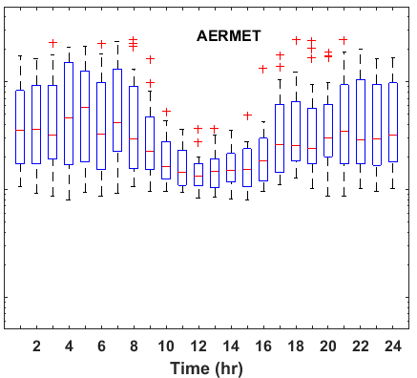
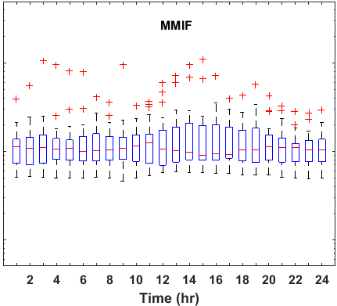
Note about RLINE Meteorology
New Haven, CT
Caution is important when using model-derived meteorology – particularly in coastal areas.
Observation-Based
Model-Based
Parvez and Wagstrom. 2018. Comparing Estimates from the R-LINE Near Road Dispersion Model Using Model-derived and Observation-derived Meteorology. Atmospheric Pollution Research. 9(3). 483-493.

Slide 28
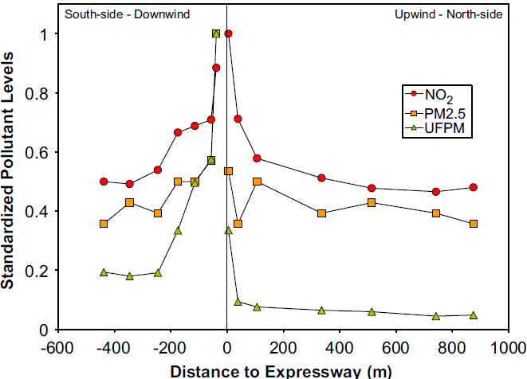
wind direction
Beckerman et al. (2008) AE
Notes:
As if dealing with the noise from these roads was not enough, there is also substantial evidence of elevated levels of many pollutant concentrations in the areas within a couple 100m of major roads. To make things even more complicated, the dispersion pattern of these species differs both spatially and temporally.

Slide 29

New Haven Asthma Levels:
New Haven and Hartford both have asthma levels ~4x the CT state average.
CT Department of Public Health Asthma Program (2010)
Notes:
For our study, we are investigating spatiotemporal near road pollutant levels in several major cities in Connecticut. For those who are not particularly familiar with Connecticut, while it is often thought of as a wealthier state, the story in the urban areas if quite the opposite.
Hartford and New Haven are two of five medium-sized cities (population 100,000-150,000) in Connecticut.
The median household income in Hartford is less than half the state average with over 30% of the population living below the poverty line.
Hartford has the highest unemployment rate in the state (almost three times the state average).
Most relevant to this project, Hartford residents, particularly children, suffer from elevated rates of asthma, with rate of children’s Emergency Department visits for asthma approximately four times the state average.
Finally, approximately one third of the households in Hartford do not have access to a car meaning they spend more time exposed to TRAP while walking, biking, and waiting for buses.

Slide 30
~19% of the US population lives near major roadways
Rowangould (2013) Transp. Res. Part Transp. Environ.
Notes:
As I am sure many of you are aware, traffic-related air pollution is an important problem impacting a large fraction of the population. In the US, over 1/5 of the population lives within a couple of 100m major roadways and this is even higher in other areas of the world.

Slide 31




Hartford EC Concentrations
Winter
Spring
Seasonal variation is similar for Hartford, CT.
µg/m³
3.0
2.5
2.0
Summer
Fall
1.5
1.0
Hartford, CT

Slide 32


Population Weighted Average Concentrations
Higher concentrations in New Haven than Hartford.
New Haven
Hartford

